Slide 1
2025 ACC/AHA/HRS/ISACHD/SCAI Guideline for the Management of Adults With Congenital Heart Disease
A Report of the American College of Cardiology/American Heart Association Joint Committee on Clinical Practice Guidelines
Developed in Collaboration With and Endorsed by the Heart Rhythm Society, International Society for Adult Congenital Heart Disease, and Society for Cardiovascular Angiography and Interventions

Slide 2
Citation
This slide set is adapted from the 2025 ACC/AHA/HRS/ISACHD/SCAI Guideline for the Management of Adults With Congenital Heart Disease. Published online ahead of print December 18, 2025, available at: Circulation. https://www.ahajournals.org/doi/10.1161/CIR.0000000000001402 and Journal of the American College of Cardiology, published online ahead of print December 18, 2025. J Am Coll Cardiol. https://doi.org/10.1016/j.jacc.2025.09.006
© 2025 the American Heart Association, Inc. and the American College of Cardiology Foundation. All rights reserved. This article has been published in Circulation and the Journal of the American College of Cardiology.

Slide 3
2025 Writing Committee Members*
Michelle Gurvitz, MD, MS, FACC, Chair
Eric V. Krieger, MD, FACC, Co-Vice-Chair
Stephanie Fuller, MD, MS, FACC, FAHA, Co-Vice-Chair
Leslie L. Davis, PhD, ANP-BC, FAHA, FACC, JC Liaison†
Michelle M. Kittleson, MD, PhD, FACC, JC Liaison†‡
Jamil A. Aboulhosn, MD, FACC, FSCAI§
Elisa A. Bradley, MD, FACC
Jonathan Buber, MD, FACC
Curt J. Daniels, MD, FACC
Konstantinos Dimopoulos, MD, MSc, PhD
Alexander Egbe, MBBS, MPH, FACC
Tracy R. Geoffrion, MD, MPH
Anitha John, MD, PhD, FACC, FAHA
Paul Khairy, MDCM, PhD║
Yuli Y. Kim, MD, FACC¶
Jacqueline Kreutzer, MD, FAHA, FACC, FSCAI
Matthew J. Lewis, MD, MPH
Jonathan N. Menachem, MD
Jeremy P. Moore, MD, MS, FACC, FHRS, CCDS, CEPS-P
Kathryn A. Osteen, PhD, RN, CMSRN, CNE#
Puja B. Parikh, MD, MPH, FACC, FSCAI**,††
Arwa Saidi, MBBCh, MEd, FACC
Katherine B. Salciccioli, MD, FACC
Rachel L. Schunder, MA‡‡
Anne Marie Valente, MD, FAHA, FACC
Rachel M. Wald, MD
*Writing committee members are required to recuse themselves from voting on sections to which their specific relationships with industry and other entities may apply; see Appendix 1 for recusal information. †ACC/AHA Joint Committee on Clinical Practice Guidelines liaison. ‡Former Joint Committee on Clinical Practice Guidelines member; current member during the writing effort. §Society for Cardiovascular Angiography and Interventions representative. ║Heart Rhythm Society representative. ¶International Society for Adult Congenital Heart Disease representative. #Patient representative. **ACC/AHA Joint Committee on Performance Measures liaison. ††Former Joint Committee on Performance Measures member; current member during the writing effort. ‡‡Joint AHA/ACC staff representative.

Slide 4
Table 1. What Is New
New or Revised | Section Title | 2018 Recommendation | 2025 Recommendation
New | 3.1.2. The ACHD Program and Cardiologists | N/A | COR 1: Patients in adult congenital heart disease (ACHD) anatomic–physiological (AP) class IA should have at least 1 evaluation by an ACHD cardiologist to develop a plan of care.
New | 3.2. Expertise for Noncardiac Surgery | N/A | COR 1: In patients with ACHD AP classifications IC–D, IIB–D, and IIIA–D who undergo noncardiac procedures, postprocedural care should involve collaboration with an ACHD cardiologist to incorporate expert opinion, provide guideline-based medical therapy (GDMT), and improve outcomes.
New | 3.2. Expertise for Noncardiac Surgery | N/A | COR 1: In patients with ACHD AP classifications IC–D, IIC–D, and IIIA–D, anesthesia for noncardiac procedures should be administered by, or in collaboration or consultation with, an anesthesiologist with ACHD expertise to reduce the likelihood of perioperative complications.
COR indicates Class of Recommendation.

Slide 5
Table 1. What Is New (con’t.)
New | 3.4. Expertise for Cardiac Surgery and Invasive Cardiac Procedures | N/A | COR 1: In patients with ACHD who undergo invasive cardiac procedures, preprocedural involvement of an ACHD cardiologist is recommended to risk-stratify the patient, determine appropriate procedure location, guide periprocedural planning and support, and assist in preprocedural clinical optimization to improve outcomes.
New | 3.4. Expertise for Cardiac Surgery and Invasive Cardiac Procedures | N/A | COR 1: In patients with ACHD undergoing invasive cardiac procedures, postprocedural care should involve collaboration with an ACHD cardiologist to incorporate expert opinion, provide guideline-based therapy, and improve outcomes.
New | 3.4. Expertise for Cardiac Surgery and Invasive Cardiac Procedures | N/A | COR 1: In patients with ACHD AP classifications IC–D, IIA–D, and IIIA–D, anesthesia for invasive cardiac procedures should be administered by, or in collaboration or consultation with, an anesthesiologist who has congenital heart disease expertise to reduce the likelihood of perioperative complications.

Slide 6
Table 1. What Is New (con’t.)
New | 3.4. Expertise for Cardiac Surgery and Invasive Cardiac Procedures | N/A | COR 2a: In patients with ACHD who undergo invasive cardiac procedures for acquired cardiovascular disease, it can be beneficial for operators with expertise in procedural treatment of acquired disease to collaborate with ACHD experts.
New | Section 3.5. Management of Cyanosis is new.
New | Section 3.6.1. Heart Failure contains all new recommendations.
New | Section 3.6.2. Heart Transplantation and MCS contains all new recommendations.
New | 3.7. Genetic Syndromes Screening | N/A | COR 2a: In adults with congenital heart disease and a family history of congenital heart disease or clinical features associated with a genetic syndrome, referral for genetic evaluation is reasonable to guide management.
New | 3.8. Reproductive Health, Pregnancy, and Contraception | N/A | COR 2a: For patients with ACHD who are considering assisted reproductive technology, discussions involving an ACHD cardiologist can be beneficial to increase patients’ knowledge about their options and the associated risks.

Slide 7
Table 1. What Is New (con’t.)
New | 3.8. Reproductive Health, Pregnancy, and Contraception | N/A | COR 3 No Benefit: Routine cesarean delivery has no benefit and may cause harm in pregnant patients with ACHD in the absence of an obstetric indication or high-risk cardiac condition.
New | 3.10.2. Physical Activity, Exercise, and Sports Participation | N/A | COR 2a: In patients with ACHD, participation in competitive sports is reasonable following a comprehensive evaluation by an ACHD specialist that incorporates functional status and individualized assessment of risks and benefits.
Revised | The 2018 guideline had a section dedicated to severe pulmonary hypertension and Eisenmenger syndrome. In the 2025 guideline, these pulmonary hypertension recommendations are within the different shunt lesion sections, and Eisenmenger syndrome is a stand-alone section.
New | 4.1.1. Atrial Septal Defect | N/A | COR 1: Adults with an unrepaired atrial septal defect (ASD) and pulmonary arterial hypertension (PAH) should undergo risk assessment and management in consultation with pulmonary hypertension specialists to improve outcomes.

Slide 8
Table 1. What Is New (con’t.)
Revised | 4.1.1. Atrial Septal Defect | COR 2b: Percutaneous or surgical closure may be considered for adults with ASD when net left-to-right shunt (Qp:Qs) is ≥1.5:1, pulmonary artery (PA) systolic pressure is ≥50% of systemic arterial systolic pressure, and/or pulmonary vascular resistance (PVR) is greater than one-third of the systemic resistance. | COR 1: In adults with an isolated unrepaired secundum ASD, transcatheter closure is usually preferred to surgical repair to reduce length of stay and recovery time.
New | 4.1.1. Atrial Septal Defect | N/A | COR 1: In adults with an unrepaired ASD and evidence of (or strong suspicion for) paradoxical embolism, ASD closure is recommended to prevent recurrent embolism.
New | 4.1.1. Atrial Septal Defect | N/A | COR 2a: In adults with an unrepaired ASD, significant left-to-right shunt (Qp:Qs ≥1.5), right ventricular (RV) dilation, PAH (PVR 5-8 Wood units), and without significant left ventricular (LV) disease, closure can be beneficial if PVR <5 Wood units can be achieved with targeted PAH therapy, to improve medium-term functional status.

Slide 9
Table 1. What Is New (con’t.)
New | 4.1.2. Ventricular Septal Defect | N/A | COR 1: Patients with an unrepaired ventricular septal defect (VSD) should be assessed for the presence of PAH to guide decisions about medical therapy and repair.
New | 4.1.2. Ventricular Septal Defect | N/A | COR 1: In adults with a perimembranous VSD being considered for repair, evaluation to exclude RV outflow tract (RVOT) obstruction or double-chambered RV (DCRV) is recommended to improve management planning.
New | 4.1.2. Ventricular Septal Defect | N/A | COR 1: Adults with a VSD (repaired or unrepaired) and PAH should be followed by specialists with expertise in ACHD and pulmonary hypertension to reduce morbidity and mortality.

Slide 10
Table 1. What Is New (con’t.)
New | 4.1.2. Ventricular Septal Defect | N/A | COR 3 No Benefit: In adults with a VSD, Qp:Qs <1.5, and no other indications, closure should not be performed to avoid unnecessary perioperative risks.
Revised | 4.1.3. Atrioventricular Septal Defect | COR 2a: Cardiac catheterization can be useful in adults with atrioventricular septal defect (AVSD) when pulmonary hypertension is suspected. | COR 1: Adults with an unrepaired AVSD or those with residual shunts after prior repair should be assessed for the presence of PAH to guide medical therapy and assess suitability for repair.
New | 4.1.3. Atrioventricular Septal Defect | N/A | COR 1: Adults with an AVSD (repaired or unrepaired) and PAH should be managed by pulmonary hypertension specialists and by clinicians with pulmonary hypertension expertise to improve outcomes.

Slide 11
Table 1. What Is New (con’t.)
Revised | 4.1.3. Atrioventricular Septal Defect | COR 2a: Operation for discrete LV outflow tract (LVOT) obstruction in adults with ASVD is reasonable with a maximum gradient of ≥50 mm Hg, a lesser gradient if heart failure (HF) symptoms are present, or if concomitant moderate-to-severe mitral or atrial regurgitation are present. | COR 1: In adults with repaired AVSD and LVOT obstruction with symptoms attributable to the obstruction, or LV systolic dysfunction (LV ejection fraction <50%), surgical repair is recommended to improve functional status and preserve ventricular function.
Revised | 4.1.3. Atrioventricular Septal Defect | COR 1: Surgery for primary repair of ASVD or closure of residual shunts in adults with repaired ASVD is recommended when there is a net left-to-right shunt (Qp:Qs ≥1.5:1), PA systolic pressure <50% systemic, and PVR less than one-third systemic. | COR 1: In adults with an unrepaired AVSD or those with residual shunts after previous repair, significant left-to-right shunt (Qp:Qs ≥1.5), and/or significant or progressive atrial/ventricular dilatation with no PAH (PVR ≤2 Wood units), closure of the AVSD or residual shunt is recommended to improve functional class and clinical outcomes.
New | 4.1.4. Anomalous Pulmonary Venous Connections | N/A | COR 1: For adults with anomalous pulmonary venous connections (APVCs) who do not have an indication for repair, routine cardiac imaging is recommended for serial evaluation of RV size and function and for assessment of pulmonary hypertension.

Slide 12
Table 1. What Is New (con’t.)
New | 4.1.4. Anomalous Pulmonary Venous Connections | N/A | COR 1: For adults with repaired APVCs and dyspnea on exertion and/or reduced functional capacity, cardiac magnetic resonance (CMR) or computed tomography (CT) angiography is recommended to evaluate for venous obstruction or residual shunt.
New | 4.1.4. Anomalous Pulmonary Venous Connections | N/A | COR 3 No Benefit: For adults with APVCs who have a normal to mildly enlarged right ventricle and whose Qp:Qs is <1.5, surgical repair is not indicated, given the absence of data to support benefit.
New | Section 4.1.5. Patent Ductus Arteriosus contains all new recommendations.
Revised | 4.2.1. Cor Triatriatum Sinister | COR 1: Adults presenting with cor triatriatum sinister should be evaluated for other congenital abnormalities, particularly ASD, VSD, and APVC. | COR 2a: In adults with unrepaired cor triatriatum sinister, transesophageal echocardiography and/or cross-sectional imaging can be useful to identify the size and location of the membrane orifice and to assess for the presence of associated congenital cardiac defects.

Slide 13
Table 1. What Is New (con’t.)
Revised | 4.2.1. Cor Triatriatum Sinister | COR 1: Surgical repair is indicated for adults with cor triatriatum sinister for symptoms attributable to the obstruction or substantial gradient across the membrane. | COR 2a: In asymptomatic adults with unrepaired cor triatriatum sinister and severe membrane obstruction, surgical resection can be useful to prevent the sequelae of left atrial hypertension.
New | 4.2.1. Cor Triatriatum Sinister | N/A | COR 1: In adults with unrepaired cor triatriatum sinister and atrial fibrillation or atrial flutter, prior stroke, or left atrial thrombus, chronic anticoagulation is recommended to prevent embolic stroke, whether or not conventional thromboembolic risk factors are present.
New | 4.2.1. Cor Triatriatum Sinister | N/A | COR 2a: In adults with unrepaired cor triatriatum sinister and atrial fibrillation or atrial flutter, a rhythm control strategy can be beneficial to avoid clinical decompensation.
New | 4.2.2. Congenital Mitral Stenosis, Including Shone Complex | N/A | COR 1: Adults with multiple left-sided obstructive lesions (Shone complex) and suspected pulmonary hypertension should undergo invasive hemodynamic assessment to identify and classify pulmonary hypertension.

Slide 14
Table 1. What Is New (con’t.)
New | 4.2.4. Congenital Diseases of the Aortic Valve | N/A | COR 1: Adults with a bicuspid aortic valve who have an aortic diameter >4 cm at the level of the sinuses or the ascending aorta, or who have risk factors for aortic dissection, should undergo lifelong surveillance for progression of thoracic aortic disease to improve early detection of aortic growth.
New | 4.2.4. Congenital Diseases of the Aortic Valve | N/A | COR 1: In adults with a congenitally abnormal aortic valve who meet indications for valve replacement, surgical and transcatheter options should be reviewed by heart valve and ACHD expert teams in a shared decision-making process to determine a management plan.
New | 4.2.6. Coarctation of the Aorta | N/A | COR 2a: In adults with coarctation of the aorta who present with exertional symptoms, evaluation for coronary artery disease is reasonable to guide management.

Slide 15
Table 1. What Is New (con’t.)
Revised | 4.3.1. Ebstein Anomaly | COR 2a: Electrophysiological study with or without catheter ablation can be useful in the diagnostic evaluation of adults with Ebstein anomaly and ventricular preexcitation but without supraventricular tachycardia. | COR 1: In adults with Ebstein anomaly, an electrophysiological study is recommended for patients with symptomatic arrhythmia or asymptomatic ventricular preexcitation to assess for substrates for ablation, including multiple or high-risk accessory pathways.
New | 4.3.2. Valvular Pulmonary Stenosis | N/A | COR 1: In asymptomatic adults with moderate or severe valvular pulmonary stenosis and at least moderate tricuspid regurgitation or any RV dysfunction, pulmonary valve intervention is recommended to reduce pressure overload and improve valvular function.
New | 4.3.2.1. Isolated Pulmonary Regurgitation After Repair of Pulmonary Stenosis | N/A | COR 1: In adults with moderate or greater pulmonary regurgitation resulting from treated isolated valvular pulmonary stenosis, CMR imaging is recommended to establish anatomy, quantify the degree of regurgitation, and measure RV volumes and systolic function.
New | 4.3.3. Management of DCRV | N/A | COR 2a: In adults with RV dysfunction or symptoms attributed to DCRV, cardiac catheterization is reasonable to characterize anatomy and severity.

Slide 16
Table 1. What Is New (con’t.)
New | 4.3.3. Management of DCRV | N/A | COR 2a: In adults with DCRV and moderate or greater RVOT obstruction, diagnostic assessment with CMR (or, if contraindicated, cardiac CT) can be beneficial to characterize the anatomy.
Revised | 4.3.4. Isolated Branch Pulmonary Artery Stenosis | COR 2a: In adults with peripheral or branch PA stenosis, PA dilation and stenting can be useful. | COR 1: In adults with symptoms related to peripheral or branch PA stenosis, pulmonary branch balloon angioplasty and/or stent implantation is recommended to improve hemodynamics and symptoms.
New | 4.3.5 Tetralogy of Fallot | N/A | COR 1: In adults with repaired tetralogy of Fallot (TOF), echocardiography is recommended for assessment of pulmonary and tricuspid valve dysfunction, right atrial size, ventricular size and function, residual VSDs, and estimation of RV systolic pressure to characterize residual hemodynamic sequelae.
New | 4.3.5 Tetralogy of Fallot | N/A | COR 1: In adults with repaired TOF and native RVOT anatomy being considered for transcatheter pulmonary valve replacement, cardiac CT is recommended to determine anatomic suitability.

Slide 17
Table 1. What Is New (con’t.)
New | 4.3.5. Tetralogy of Fallot | N/A | COR 2a: In adults with repaired TOF and appropriate ICD therapies for monomorphic ventricular tachycardia, adjunctive catheter ablation is reasonable to reduce ventricular tachyarrhythmia burden.
New | 4.3.5. Tetralogy of Fallot | N/A | COR 2a: In adults with repaired TOF with moderate or greater pulmonary valve dysfunction and progressive ventricular systolic dysfunction, pulmonary valve replacement (surgical or transcatheter) is reasonable to preserve ventricular function.
New | 4.3.7. Management of Right Ventricle-to-Pulmonary Artery Conduits | N/A | COR 2a: In adults with an RV-to-PA conduit being considered for transcatheter intervention, preprocedural coronary CT is reasonable to assess conduit calcification, anatomic characteristics, and coronary artery proximity to guide procedural planning.
Revised | 4.3.7. Management of Right Ventricle-to-Pulmonary Artery Conduits | COR 2a: RV-to-PA conduit intervention is reasonable for adults with an RV-to-PA conduit and moderate or greater PR or moderate or greater stenosis with reduced functional capacity or arrhythmia. | COR 1: For adults with an RV-to-PA conduit, severe stenosis and/or severe regurgitation, and symptoms or worsening functional capacity or a sustained arrhythmia, conduit intervention should be performed to improve cardiovascular status.

Slide 18
Table 1. What Is New (con’t.)
New | 4.4.1.1. Patients With dextro-Transposition of the Great Arteries and Atrial Switch | N/A | COR 1: Adults with dextro-transposition of the great arteries (d-TGA) and atrial switch who present with progressive exercise intolerance or HF should undergo cardiopulmonary exercise testing to assess for potential intervention targets, including arrhythmia and desaturation.
Revised | 4.4.1.1. Patients With dextro-Transposition of the Great Arteries and Atrial Switch | COR 2a: Assessment for a communication through the interatrial baffle or venous stenosis is reasonable for adults with d-TGA with atrial switch, particularly if transvenous pacemaker/ICD implantation is considered or leads are already present. | COR 1: Adults with d-TGA and atrial switch with progressive exercise intolerance, HF, pulmonary hypertension, worsening atrial or ventricular tachyarrhythmia, pathway obstruction, or baffle leak should undergo invasive hemodynamic assessment to identify targets for medical, percutaneous, or surgical intervention.
New | 4.4.1.1. Patients With dextro-Transposition of the Great Arteries and Atrial Switch | N/A | COR 1: Adults with d-TGA and atrial switch who require permanent pacemaker or an ICD should undergo preprocedural imaging, in addition to intraprocedural contrast venography, to detect baffle stenosis and residual baffle leaks.

Slide 19
Table 1. What Is New (con’t.)
New | 4.4.1.1. Patients With dextro-Transposition of the Great Arteries and Atrial Switch | N/A | COR 2a: For adults with d-TGA and atrial switch, biomarkers and validated disease-specific risk scores can be useful to identify patients at high risk for adverse cardiac events, prompting closer follow-up and referral to specialized HF transplant centers.
Revised | 4.4.1.1. Patients With dextro-Transposition of the Great Arteries and Atrial Switch | COR 1: Ambulatory monitoring for bradycardia or sinus node dysfunction is recommended for adults with d-TGA with atrial switch, especially if treated with beta blockers or other rate-slowing agents. | COR 2a: In adults with d-TGA and atrial switch with new or progressive symptoms of heart failure, it is reasonable to obtain a resting electrocardiogram and outpatient ambulatory rhythm monitoring, to ensure timely diagnosis and treatment of tachyarrhythmia or bradyarrhythmia.
New | 4.4.1.1. Patients With dextro-Transposition of the Great Arteries and Atrial Switch | N/A | COR 1: Adults with d-TGA and atrial switch who have symptoms attributable to a baffle leak should undergo closure of the leak to improve symptoms and quality of life.
New | 4.4.1.1. Patients With dextro-Transposition of the Great Arteries and Atrial Switch | N/A | COR 1: In adults with d-TGA and atrial switch who have symptoms attributable to systemic or pulmonary venous pathway stenosis or liver congestion, intervention to relieve the stenosis is indicated to improve symptoms and prognosis.

Slide 20
Table 1. What Is New (con’t.)
New | 4.4.1.1. Patients With dextro-Transposition of the Great Arteries and Atrial Switch | N/A | COR 1: Adults with d-TGA and atrial switch who have worsening symptoms of exercise intolerance, HF, or arrhythmia refractory to treatment should be referred to a HF program for assessment for mechanical support and transplantation in consultation with an ACHD cardiologist, to improve quality of life and prolong survival.
Revised | 4.4.1.1. Patients With dextro-Transposition of the Great Arteries and Atrial Switch | COR 1: GDMT with appropriate attention to the need for anticoagulation is recommended to promptly restore sinus rhythm for adults with d-TGA with atrial switch repair presenting with atrial arrhythmia. | COR 2a: In adults with d-TGA and atrial switch who have sustained intra-atrial reentrant arrhythmias or atrial fibrillation, oral anticoagulation can be useful to prevent embolic events.
New | 4.4.1.1. Patients With dextro-Transposition of the Great Arteries and Atrial Switch | N/A | COR 2a: Adults with d-TGA and atrial switch who require transvenous lead placement can benefit from catheter-based interventions to address residual baffle leaks or obstruction before lead placement, to reduce the risk for systemic thromboembolism and/or future baffle occlusion.

Slide 21
Table 1. What Is New (con’t.)
Revised | 4.4.1.2. Arterial Switch Operation | COR 2a: Physiological tests of myocardial perfusion for adults with d-TGA after arterial switch can be beneficial for assessing symptoms suggestive of myocardial ischemia. | COR 1: In adults with an arterial switch operation and symptoms concerning for myocardial ischemia, coronary evaluation with coronary angiography, cross-sectional imaging, and/or functional coronary assessment for an anatomic etiology should be performed.
New | 4.4.1.2. Arterial Switch Operation | N/A | COR 1: In adults with an arterial switch operation and evidence of myocardial ischemia, coronary revascularization should be performed to reduce symptoms and improve outcomes.
New | 4.4.1.2. Arterial Switch Operation | N/A | COR 2a: In asymptomatic adults with an arterial switch operation who have moderate or greater supravalvar or branch PA stenosis—in addition to RV hypertension, RV dysfunction, progressive tricuspid regurgitation, and/or objective decline in exercise capacity—intervention can be useful to relieve obstruction.
New | Section 4.4.1.3. Patients With d-TGA and Rastelli Repair contains all new recommendations.

Slide 22
Table 1. What Is New (con’t.)
New | 4.4.2. Management of CCTGA | N/A | COR 1: In adults with congenitally corrected transposition of the great arteries (CCTGA), periodic transthoracic echocardiography is recommended to assess chamber function, systemic tricuspid valve function, and associated anatomic lesions such as septal defects and LVOT stenosis.
New | 4.4.2. Management of CCTGA | N/A | COR 2a: In adults with CCTGA without symptoms, periodic ambulatory rhythm monitoring is reasonable to screen for high-grade atrioventricular block.
New | 4.4.2. Management of CCTGA | N/A | COR 2a: In symptomatic adults with CCTGA and high-grade atrioventricular block, physiological pacing (CRT or conduction system pacing) is reasonable to relieve symptoms.
New | 4.4.5. Fontan Palliation of Single-Ventricle Physiology | N/A | COR 1: In adults with Fontan circulation and evidence of progressive Fontan circulatory failure, formal evaluation by a HF/transplant cardiologist with experience in heart transplantation in the adult Fontan population is recommended.

Slide 23
Table 1. What Is New (con’t.)
New | 4.4.5. Fontan Palliation of Single-Ventricle Physiology | N/A | COR 1: In adults with Fontan circulation, imaging and laboratory evaluation of the liver should be performed at least annually to screen for hepatocellular carcinoma and for evidence of progressive Fontan-associated liver disease.
New | 4.4.5. Fontan Palliation of Single-Ventricle Physiology | N/A | COR 1: In adults with Fontan circulation and new or progressive symptoms, hypoxemia, declining functional status, or evidence of progressive or new-onset noncardiac organ dysfunction, hemodynamic evaluation with cardiac catheterization is recommended to guide therapy.
New | 4.4.5. Fontan Palliation of Single-Ventricle Physiology | N/A | COR 1: In adults with Fontan circulation and newly progressive or severe hypoxemia or hypotension, evaluation with advanced cardiac imaging (CMR, CT, transesophageal echocardiography) is recommended to rule out thrombus or emboli in the Fontan or pulmonary vasculature.
New | 4.4.5. Fontan Palliation of Single-Ventricle Physiology | N/A | COR 1: In adults with Fontan circulation undergoing CT angiography to rule out thrombus or emboli in the Fontan or pulmonary vasculature, imaging should be performed using protocols to avoid false-negative or false-positive results.

Slide 24
Table 1. What Is New (con’t.)
New | 4.4.5. Fontan Palliation of Single-Ventricle Physiology | N/A | COR 2a: In adults with Fontan circulation, consultation by a hepatologist, in collaboration with an ACHD cardiologist, is reasonable to facilitate interpretation of hepatic testing, diagnose and treat complications related to portal hypertension, and participate in timing and management decisions specific to organ transplantation.
New | 4.4.5. Fontan Palliation of Single-Ventricle Physiology | N/A | COR 2a: In adults with Fontan circulation, liver biopsy can be helpful to delineate the degree of hepatic fibrosis or cirrhosis before consideration of transplantation.
New | 4.4.5. Fontan Palliation of Single-Ventricle Physiology | N/A | COR 1: In adults with Fontan circulation and sinus node dysfunction requiring pacemaker placement, atrial-based pacing with programming to minimize ventricular pacing is recommended to improve patient symptoms and to avoid pacing-induced cardiomyopathy.
New | 4.4.5. Fontan Palliation of Single-Ventricle Physiology | N/A | COR 1: In adults with Fontan circulation with new-onset atrial flutter or atrial fibrillation, timely cardioversion (pharmacological or electrical) is recommended to prevent clinical decompensation.

Slide 25
Table 1. What Is New (con’t.)
New | 4.4.5. Fontan Palliation of Single-Ventricle Physiology | N/A | COR 1: Adults with Fontan circulation referred for cardiac transplantation should undergo pretransplantation review by a committee with broad multidisciplinary representation to improve patient selection and posttransplant outcomes.
New | 4.4.5. Fontan Palliation of Single-Ventricle Physiology | N/A | COR 2a: In adults with Fontan circulation and atrioventricular block whose burden of ventricular pacing is likely to be high (ie, >40%), apical site pacing is preferred over nonapical sites to improve transplant-free survival.
New | 4.4.5. Fontan Palliation of Single-Ventricle Physiology | N/A | COR 2a: In adults with Fontan circulation, formal exercise programs and/or cardiac rehabilitation (appropriate to the patient’s ability) can be beneficial in improving functional capacity.
New | 4.4.5. Fontan Palliation of Single-Ventricle Physiology | N/A | COR 2a: In adults with Fontan circulation and hemodynamically significant stenosis of the Fontan or PAs, catheter-based stenting of the stenosis to reduce Fontan pressure and improve flow is reasonable to improve hemodynamics.

Slide 26
Table 1. What Is New (con’t.)
New | 4.4.5. Fontan Palliation of Single-Ventricle Physiology | N/A | COR 2a: In symptomatic adults with Fontan circulation, or those with evidence of systemic ventricular volume overload, closure of aortopulmonary collaterals to improve symptoms and reduce the likelihood of pathologic ventricular remodeling can be useful.
Revised | 4.4.5. Fontan Palliation of Single-Ventricle Physiology | COR 2a: In adults after Fontan palliation, it is reasonable to perform biochemical and hematological testing on an annual basis, especially for liver and renal function. | COR 1: In adults with Fontan circulation, annual laboratory evaluation is recommended to assess for evidence of organ-system dysfunction or hematologic abnormality.
Revised | 4.4.5. Fontan Palliation of Single-Ventricle Physiology | COR 2b: Antiplatelet therapy or anticoagulation with a vitamin K antagonist may be considered in adults after Fontan palliation without known or suspected thrombus, thromboembolic events, or prior arrhythmia. | COR 1: In adults with Fontan circulation and the absence of high-risk features (history of thromboembolism, sustained atrial flutter/fibrillation, or atriopulmonary Fontan) or bleeding contraindications, treatment with either aspirin or anticoagulation is recommended to reduce the probability of thromboembolic disease.
New | Section 4.4.5.1. HLHS/Norwood Repair is new.
New | 4.4.6. Eisenmenger Syndrome | N/A | COR 3 Harm: Adults with Eisenmenger syndrome should be advised against pregnancy to decrease the risk associated with excess maternal morbidity and mortality.

Slide 27
Table 1. What Is New (con’t.)
Revised | 4.4.6. Eisenmenger Syndrome | COR 2a: Bosentan is a reasonable therapy to treat symptomatic adults with Eisenmenger syndrome with 1 of the following: shunts other than ASD/VSD (eg, PDA, aortopulmonary window), or complex congenital heart lesions or Down syndrome. | COR 1: In adults with Eisenmenger syndrome and an LV ejection fraction >40% who are symptomatic or have reduced exercise capacity, initial monotherapy with PAH-directed therapy is recommended to improve symptoms, hemodynamics and overall survival.
Revised | 4.4.6. Eisenmenger Syndrome | COR 2a: It is reasonable to use phosphodiesterase type 5 (PDE-5) inhibitors (eg, sildenafil, tadalafil) to treat symptomatic adults with Eisenmenger syndrome with ASD, VSD, or great artery shunt. | COR 1: In adults with Eisenmenger syndrome and an LV ejection fraction >40% who are symptomatic or have reduced exercise capacity, initial monotherapy with PAH-directed therapy is recommended to improve symptoms, hemodynamics, and overall survival.
Revised | 4.4.6. Eisenmenger Syndrome | COR 2a: In symptomatic adults with Eisenmenger syndrome, bosentan and PDE-5 inhibitors are reasonable in combination if symptomatic improvement does not occur with either medication alone. | COR 1: In adults with Eisenmenger syndrome and an LV ejection fraction >40% who remain symptomatic or have worsening exercise capacity on a single PAH therapy, dual combination therapy with an endothelin receptor antagonist and a PDE-5 inhibitor is recommended to improve symptoms, hemodynamics, and overall survival.

Slide 28
Table 1. What Is New (con’t.)
New | 4.4.6. Eisenmenger Syndrome | N/A | COR 1: In adults with Eisenmenger syndrome who present with atrial arrhythmias, prompt restoration and maintenance of sinus rhythm is recommended to avoid hemodynamic deterioration.
New | 4.4.6. Eisenmenger Syndrome | N/A | COR 2a: In adults with Eisenmenger syndrome, a regular exercise program in combination with directed PAH therapy can be effective in improving exercise capacity.
New | 4.4.6. Eisenmenger Syndrome | N/A | COR 3 No Benefit: Adults with Eisenmenger syndrome should not be routinely prescribed oral anticoagulation given the high bleeding risk and lack of long-term survival benefit.
New | 4.4.6. Eisenmenger Syndrome | N/A | COR 3 Harm: In adults with Eisenmenger syndrome, closure of any intracardiac or vascular shunt should not be performed given the increased perioperative risks and risks for short- and long-term morbidity and mortality.

Slide 29
Table 1. What Is New (con’t.)
New | 4.4.6. Eisenmenger Syndrome | N/A | COR 3 Harm: In adults with Eisenmenger syndrome and intracardiac shunts who meet indications for permanent pacing or an ICD, endocardial leads may be potentially harmful given the increased risk for systemic thromboembolism.
New | 4.5.1. Anomalous Aortic Origin of a Coronary Artery | COR 2a: Surgery is reasonable for anomalous aortic origin of the left coronary artery from the right sinus in the absence of symptoms or ischemia. COR 2a: Surgery for anomalous aortic origin of a coronary artery is reasonable in the setting of ventricular arrhythmias. | COR 2a: In adults with asymptomatic anomalous origin of the left coronary artery, surgery is reasonable in the presence of high-risk anatomy.
New | Section 4.6. Vascular Rings and Pulmonary Artery Slings is new.

Slide 30
Top Take-Home Messages

Slide 31
Top Take-Home Messages
1. Adults with congenital heart disease benefit from routine care at adult congenital heart disease (ACHD) centers and in collaboration with ACHD cardiologists. Multidisciplinary teams are useful for complex-care decision-making.

Slide 32
Top Take-Home Messages
2. Patients with anatomic or physiologically moderate or complex ACHD who undergo cardiac or noncardiac procedures are recommended to have an ACHD cardiologist involved in their care to offer expert guidance on procedures, anesthesia, and postprocedural management.

Slide 33
Top Take-Home Messages
3. The possibility of endocarditis is important to evaluate in acute or subacute malfunction of bioprosthetic pulmonary valves, and endocarditis has been added to the physiological classification system (subacute bacterial endocarditis in the past year is stage D).

Slide 34
Top Take-Home Messages
4. Most pregnant patients with ACHD can undergo vaginal delivery safely, with appropriate risk stratification and monitoring.

Slide 35
Top Take-Home Messages
5. Updated recommendations for tetralogy of Fallot include (a) referral for pulmonary valve replacement in patients with repaired tetralogy of Fallot, according to right ventricular end-systolic volume criteria (>80 mL/m²) and other metrics rather than end-diastolic volume; and (b) new approaches to arrhythmia management, including ablation of ventricular tachycardia.

Slide 36
Top Take-Home Messages
6. Strategies for patients with secundum atrial septal defect and pulmonary arterial hypertension now include recommendations for closure for many patients with a significant left-to-right shunt and pulmonary vascular resistance ≤2 Wood units or >2 to <5 Wood units.

Slide 37
Top Take-Home Messages
7. Rhythm control is typically preferred over rate control for atrial arrhythmias in complex patients, such as those with a systemic right ventricle or Fontan circulation.

Slide 38
Top Take-Home Messages
8. New recommendations on guideline-directed medical therapy for heart failure in patients with ACHD include people with a systemic right or left ventricle and discussions of pacing strategies for a systemic right ventricle and Fontan circulation.

Slide 39
Top Take-Home Messages
9. Patients with Eisenmenger syndrome can be treated with pulmonary vasodilators, using either phosphodiesterase-5 inhibitors or endothelin receptor antagonists as initial therapy.

Slide 40
Top Take-Home Messages
10. Fontan screening for liver disease includes recommendations for at least annual imaging and laboratory evaluation, including alpha-fetoprotein, and at least 1 consultation with a hepatologist.

Slide 41
Table 4. ACHD AP Classification (CHD Anatomy + Physiological Stage = ACHD AP Classification)
CONGENITAL HEART DISEASE ANATOMY
I: Simple
Ostium secundum ASD
Patent ductus arteriosus
Ventricular septal defect
Pulmonic stenosis
II: Moderate Complexity
Anomalous aortic origin of a coronary artery from the opposite sinus
Anomalous coronary artery arising from the pulmonary artery
Anomalous pulmonary venous connection, partial or total
Atrioventricular septal defect (partial or complete)
Congenital aortic valve disease
Congenital mitral valve disease

Slide 42
Table 4. ACHD AP Classification (CHD Anatomy + Physiological Stage = ACHD AP Classification) (con’t.)
Coarctation of the aorta
Cor triatriatum sinister
Dextro-TGA after arterial switch operation
Ebstein anomaly
Infundibular right ventricular outflow obstruction/double-chamber right ventricle
Peripheral pulmonary artery stenosis
Sinus venosus defect
Subvalvular aortic stenosis (excluding hypertrophic cardiomyopathy, which these guidelines do not address)
Supravalvar aortic stenosis
Tetralogy of Fallot
Vascular ring or sling

Slide 43
Table 4. ACHD AP Classification (CHD Anatomy + Physiological Stage = ACHD AP Classification) (con’t.)
III: Great Complexity (or Complex)
Double-outlet ventricle
Fontan physiology
Interrupted aortic arch
Pulmonary atresia (all forms, including tetralogy of Fallot with pulmonary atresia)
Single-ventricle anatomy (including double-inlet left ventricle, tricuspid/mitral atresia, hypoplastic left heart, any other anatomic abnormality with a functionally single ventricle)
Congenitally corrected TGA (CCTGA, levo-TGA)
Dextro-TGA after atrial switch (Mustard/Senning) operation
Dextro-TGA after Rastelli operation
Truncus arteriosus
Unrepaired or partially palliated cyanotic congenital heart defect

Slide 44
Table 4. ACHD AP Classification (CHD Anatomy + Physiological Stage = ACHD AP Classification) (con’t.)
PHYSIOLOGICAL STAGE
Stage A
No cardiac symptoms
No hemodynamic or anatomic sequelae
No sustained arrhythmias*
Normal exercise capacity*
Normal pulmonary pressure
*See Table 5.

Slide 45
Table 4. ACHD AP Classification (CHD Anatomy + Physiological Stage = ACHD AP Classification) (con’t.)
Stage B
Arrhythmia* not requiring new treatment or a change in therapy in the past 12 months
Mild native valve dysfunction* or prosthetic valve with normal function
Mild ventricular dysfunction
Mild ventricular enlargement
Presence of a permanent pacemaker or ICD, without need for ICD therapy in the past 12 months
Trivial or small shunt* (not hemodynamically significant)
Stage C
BNP or NT-proBNP level ≥2 times the upper limit of normal
Hemodynamically significant shunt*
Mild or moderate chronic hypoxemia* (baseline resting oxygen saturation 86–92%)
Moderate or greater valvular dysfunction*
Moderate or severe ventricular dysfunction (systemic, pulmonic, or both)
Pulmonary arterial hypertension (low-risk)*
Sustained or high-burden tachyarrhythmia in the past 12 months requiring treatment with antiarrhythmic drugs, ablation, cardioversion, or ICD therapy
*See Table 5.

Slide 46
Table 4. ACHD AP Classification (CHD Anatomy + Physiological Stage = ACHD AP Classification) (con’t.)
Stage D
Hospitalization for heart failure in the past 12 months
Endocarditis in the prior 1 year
Eisenmenger syndrome
NYHA functional class* III or IV symptoms
Recurrent arrhythmias* that are hemodynamically significant and/or refractory to treatment
Severe hypoxemia* (baseline oxygen saturation ≤85%)
Pulmonary arterial hypertension* (intermediate- or high-risk)
Modified with permission from Stout et al. Copyright 2018 American Heart Association, Inc. and American College of Cardiology Foundation.
*See Table 5.
ACHD indicates adult congenital heart disease; AP, anatomic and physiological; ASD, atrial septal defect; BNP, B-type natriuretic peptide; ICD, implantable cardioverter-defibrillator; NT-proBNP, N-terminal prohormone of B-type natriuretic peptide; NYHA, New York Heart Association; PDA, patent ductus arteriosus; TGA, transposition of the great arteries; and VSD, ventricular septal defect.

Slide 47
Table 5. Physiological Variables as Used in ACHD AP Classiﬁcation
Variable | Description
Arrhythmia | Arrhythmias are very common in patients with ACHD and may be both the cause and the consequence of deteriorating hemodynamics, valvular dysfunction, or ventricular dysfunction. Given that arrhythmias are associated with symptoms, outcomes, and prognosis, they are categorized based on their presence and their response to treatment. No sustained arrhythmia: No documented clinically relevant atrial or ventricular tachyarrhythmias Arrhythmia not requiring new treatment or a change in therapy in the past 12 months: Bradyarrhythmia, atrial or ventricular tachyarrhythmia not requiring new antiarrhythmic therapy, cardioversion, ablation, or pacemaker/ICD placement Recurrent arrhythmias that are hemodynamically significant and/or refractory to treatment
Concomitant valvular heart disease (VHD) | Severity deﬁned according to the 2020 VHD guideline. Mild VHD Moderate VHD Severe VHD

Slide 48
Table 5. Physiological Variables as Used in ACHD AP Classiﬁcation (con’t.)
Exercise capacity | Patients with ACHD are often asymptomatic despite exercise limitations that manifest as diminished exercise capacity upon objective evaluation; accordingly, assessing both subjective and objective exercise capacity is important (see NYHA classiﬁcation system below). Exercise capacity is associated with prognosis. Abnormal objective cardiac limitation to exercise is deﬁned as an exercise maximum ventilatory equivalent of oxygen below the range expected for the speciﬁc congenital heart disease anatomic diagnosis.
Hypoxemia/hypoxia/cyanosis | See Section 3.5 for a detailed deﬁnition of cyanosis. Hypoxemia is deﬁned as baseline oxygen saturation measured by pulse oximetry at rest ≤92%. Severe hypoxemia is deﬁned as oxygen saturation at rest ≤85%. Hypoxia refers to inadequate tissue oxygenation that may or may not be present in the setting of chronic hypoxemia. Cyanosis is blue or purple discoloration of the skin, lips, and nailbeds caused by levels ≥5 g/dL of desaturated hemoglobin; it is visible in patients with chronic hypoxemia and normal or high hemoglobin levels but may be absent in patients with anemia.

Slide 49
Table 5. Physiological Variables as Used in ACHD AP Classiﬁcation (con’t.)
NYHA functional classiﬁcation system | Functional Capacity Patients with cardiac disease but resulting in no limitation of physical activity: Ordinary physical activity does not cause undue fatigue, palpitation, dyspnea, or anginal pain. Patients with cardiac disease resulting in slight limitation of physical activity: They are comfortable at rest. Ordinary physical activity results in fatigue, palpitations, dyspnea, or anginal pain. Patients with cardiac disease resulting in marked limitation of physical activity: They are comfortable at rest. Less than ordinary activity causes fatigue, palpitations, dyspnea, or anginal pain. Patients with cardiac disease resulting in inability to carry on any physical activity without discomfort: Symptoms of heart failure or the anginal syndrome may be present even at rest. If any physical activity is undertaken, discomfort increases.

Slide 50
Table 5. Physiological Variables as Used in ACHD AP Classiﬁcation (con’t.)
Pulmonary arterial hypertension | Pulmonary arterial hypertension is deﬁned as: Mean pulmonary artery pressure by right heart catheterization ≥20 mm Hg and a pulmonary capillary wedge pressure ≤15 mm Hg; and pulmonary vascular resistance ≥2 Wood units. Pulmonary arterial hypertension risk categories are measured using the 3-strata risk score calculator.
Shunt (hemodynamically signiﬁcant shunt) | An intracardiac shunt is considered hemodynamically signiﬁcant if there is evidence of chamber enlargement distal to the shunt and/or evidence of sustained Qp:Qs ≥1.5. An intracardiac shunt not meeting these criteria would be described as small or trivial.
Modified with permission from Stout et al. Copyright 2018 American Heart Association, Inc. and American College of Cardiology Foundation.
ACHD indicates adult congenital heart disease; AP, anatomic and physiological; ICD, implantable cardioverter-deﬁbrillator; NYHA, New York Heart Association; and Qp:Qs, pulmonary-to-systemic blood ﬂow ratio.

Slide 51
General Principles

Slide 52
Care Access and Delivery in the ACHD Population
 | Recommendation for Care Access and Delivery in the ACHD Population Referenced studies that support recommendation are summarized in the Evidence Table.
COR | LOE | Recommendation
1 | B-NR | ACHD programs and clinicians who care for adults with congenital heart disease should follow policies and procedures that reduce barriers, reduce attrition, and improve access to lifelong ACHD care.

Slide 53
Table 6. The Lifelong Trajectory of Improving Access to ACHD Care
Key Issues at Each Life Stage | Potentially Involved Stakeholders | Possible Solutions
Early childhood (0 to 12 years) Patient/family education Loss to care | Children’s hospitals Pediatric cardiology/heart centers Social workers Patients and families Payors Congenital heart disease advocacy organizations | Empower patients to stay in congenital heart disease care, by offering well-structured patient and family education. Identify patient barriers for loss to care; and add resources. Use electronic health records and databases to track patients who are lost to care—and to help them navigate back to care.
Adolescence to young adulthood (13 to 18 years) Transition education Loss to care | Children’s hospitals Pediatric cardiology/heart centers Social workers Patients and families Payors Congenital heart disease advocacy organizations | Procure and deploy resources to identify patients who are eligible for pediatric-to-adult transition education. Develop and implement transition education. Use electronic health records and databases to track patients who are lost to care—and to help them navigate back to care. Identify barriers to care to navigate back to care.
ACHD indicates adult congenital heart disease; and CHD, congenital heart disease.

Slide 54
Table 6. The Lifelong Trajectory of Improving Access to ACHD Care (con’t.)
Young adulthood (18 to 26 years) Loss to care Transfer to ACHD care | Children’s hospitals Pediatric cardiology/heart centers Adult care hospitals ACHD providers and programs Social workers Patients and families Payors ACHD advocacy organizations | Develop and implement processes, policies, and resources for successful transfer from pediatric to adult care. Identify barriers to care. Use electronic health records and databases to track patients who are lost to care—and to help them navigate back to care.
Adulthood (18 to 80+ years) Loss during transfer to ACHD care Loss to care during adulthood Insufficient number of ACHD cardiologists and programs | ACHD programs Adult care hospitals Social work professionals Patients Governmental agencies Medical education and medical board organizations ACHD advocacy organizations | Use electronic health records and databases to track patients who are lost to care and help navigate back to CHD care. Engage resources to track patients and identify barriers to care. Consider innovative care options such as telehealth. Partner with advance practice providers and general cardiologists, to provide local care. Increase the number and geographic availability of ACHD cardiologists.
ACHD indicates adult congenital heart disease; and CHD, congenital heart disease.

Slide 55
Transition Education and Transfer of Care
 | Recommendations for Transition Education and Transfer of Care Referenced studies that support recommendations are summarized in the Evidence Table.
COR | LOE | Recommendations
1 | A | All patients with congenital heart disease should receive structured, patient-centered transition education that is age-, sex-, gender-, and developmentally appropriate to improve knowledge* and reduce loss to care.†
 | B-NR
1 | B-NR | Congenital heart disease programs and clinicians should have transfer-of-care policies and procedures to ensure effective handoffs of patients from a pediatric to an ACHD cardiologist.

Slide 56
The ACHD Program and Cardiologists
 | Recommendations for the ACHD Program and Cardiologists Referenced studies that support recommendations are summarized in the Evidence Table.
COR | LOE | Recommendations
1 | B-NR | Patients in ACHD AP classes IB–D, IIA–D, and IIIA–D should be evaluated and managed by or in collaboration with an ACHD cardiologist and, when indicated and accessible, an ACHD program to improve outcomes.
1 | B-NR | Patients in ACHD AP class IA should have at least 1 evaluation by an ACHD cardiologist to develop a plan of care.

Slide 57
Table 7. ACHD Program Components
ACHD board-eligible/-certified cardiologists
Congenital cardiac surgeons
Advanced practice providers
Registered nurses
Advanced imagers: echocardiography/CT/CMR*
Cardiac intensivist*
Advanced heart failure and transplant cardiologist*
Cardiac catheterization interventionalist*
Electrophysiologist*
Cardiac anesthesiologist*
Multidisciplinary specialists
Maternal fetal medicine
Hepatology
Pulmonary hypertension
Cardiovascular genetics
Palliative medicine
Social work
Psychology
Modified with permission from Stout et al. Copyright 2018 American Heart Association, Inc. and American College of Cardiology Foundation.
*Personnel and service lines supervised, performed, and interpreted by clinicians with expertise and/or training in congenital heart disease.
ACHD indicates adult congenital heart disease; CMR, cardiovascular magnetic resonance; and CT, computed tomography.

Slide 58
Expertise for Noncardiac Surgery
 | Recommendations for Expertise for Noncardiac Surgery Referenced studies that support recommendations are summarized in the Evidence Table.
COR | LOE | Recommendations
1 | B-NR | In patients with ACHD being considered for noncardiac procedures, preprocedural involvement of an ACHD cardiologist is recommended to risk-stratify the patient, determine appropriate procedure location, guide periprocedural planning and support, and assist in preprocedural clinical optimization to improve outcomes.
1 | B-NR | In patients with ACHD AP classifications IC–D, IIB–D, and IIIA–D who undergo noncardiac procedures, postprocedural care should involve collaboration with an ACHD cardiologist to incorporate expert opinion, provide guideline-based therapy, and improve outcomes.
1 | C-LD | In patients with ACHD AP classifications IC–D, IIC–D, and IIIA–D, anesthesia for noncardiac procedures should be administered by, or in collaboration or consultation with, an anesthesiologist with ACHD expertise to reduce the likelihood of perioperative complications.

Slide 59
Table 8. Preoperative Checklist for Noncardiac Surgery in Patients With ACHD
Clarify clinical information related to congenital heart disease
Clarify prior procedures, residua, sequelae, and current status, including ACHD anatomic–physiological classiﬁcation.
Develop management strategies for preoperative optimization to minimize risk and improve postprocedural outcome.
Factors associated with increased risk for perioperative morbidity and mortality: Cyanosis Complex congenital heart disease Frailty Heart failure Operations on the respiratory and nervous systems Pulmonary hypertension Urgent/emergency procedures
Modified with permission from Stout et al. Copyright 2018 American Heart Association, Inc. and American College of Cardiology Foundation.
ACHD indicates adult congenital heart disease.

Slide 60
Table 8. Preoperative Checklist for Noncardiac Surgery in Patients With ACHD (con’t.)
Issues to consider: Arrhythmias, including bradyarrhythmias Abnormal venous and/or arterial anatomy affecting venous and arterial access and blood pressure monitoring Adjustment of anticoagulant volume in tubes for some blood work in patients with cyanosis Developmental disability Differential dependence on preload/afterload and impacts on ventilation and/or insufflation strategies Endocarditis prophylaxis Erythrocytosis Monitoring of renal and liver function Need for meticulous line care (consider air ﬁlters for intravenous lines) to reduce risk for paradoxical embolism in patients with reduced oxygen saturations because of right-to-left shunts Periprocedural anticoagulation Persistent shunts Prevention of venous thrombosis Pulmonary vascular disease Valvular disease Ventricular function (systemic and/or subpulmonary)
Modified with permission from Stout et al. Copyright 2018 American Heart Association, Inc. and American College of Cardiology Foundation.
ACHD indicates adult congenital heart disease.

Slide 61
Mental Health and Neurocognitive Assessment
 | Recommendations for Mental Health and Neurocognitive Assessment Referenced studies that support recommendations are summarized in the Evidence Table.
COR | LOE | Recommendations
1 | C-LD | Adults with congenital heart disease should be assessed for mental health conditions, including depression, anxiety, and post-traumatic stress disorder, to identify those who may benefit from mental health services.
2a | C-LD | For adults with congenital heart disease who have mental health concerns, referral to a mental health clinician can be beneficial to improve psychological symptoms and quality of life.
2b | B-NR | For adults with congenital heart disease, neuropsychological testing may be considered to guide therapies that enhance academic, behavioral, psychosocial, and adaptive functioning.
2b | C-LD | For adults with congenital heart disease, evaluation for cognitive decline and frailty may be considered to identify patients who can benefit from additional support.

Slide 62
Expertise for Cardiac Surgery and Invasive Cardiac Procedures
 | Recommendations for Expertise for Cardiac Surgery and Invasive Cardiac Procedures Referenced studies that support recommendations are summarized in the Evidence Table.
COR | LOE | Recommendations
1 | B-NR | In patients with ACHD who undergo invasive cardiac procedures, preprocedural involvement of an ACHD cardiologist is recommended to risk-stratify the patient, determine appropriate procedure location, guide periprocedural planning and support, and assist in preprocedural clinical optimization to improve outcomes.
1 | B-NR | In patients with ACHD, invasive cardiac procedures involving congenital lesions should be performed by operators with expertise in congenital heart disease procedures to ensure appropriate periprocedural care.

Slide 63
Expertise for Cardiac Surgery and Invasive Cardiac Procedures (con’t.)
1 | C-LD | In patients with ACHD undergoing invasive cardiac procedures, postprocedural care should involve collaboration with an ACHD cardiologist to incorporate expert opinion, provide guideline-based therapy, and improve outcomes.
1 | C-LD | In patients with ACHD AP classifications IC–D, IIA–D, and IIIA–D, anesthesia for invasive cardiac procedures should be administered by, or in collaboration or consultation with, an anesthesiologist who has congenital heart disease expertise to reduce the likelihood of perioperative complications.
2a | B-NR | In patients with ACHD who undergo invasive cardiac procedures for acquired cardiovascular disease, it can be beneficial for operators with expertise in procedural treatment of acquired disease to collaborate with ACHD experts.

Slide 64
Management of Cyanosis
 | Recommendations for Management of Cyanosis Referenced studies that support recommendations are summarized in the Evidence Table.
COR | LOE | Recommendations
1 | B-NR | Patients with ACHD and cyanosis should receive annual screening for and treatment of iron deficiency to improve exercise capacity and functional status.
1 | B-NR | In patients with ACHD and cyanosis who present with persistent, new, or worsening neurologic deficits, urgent brain imaging to exclude cerebral abscess or stroke should be performed.
1 | B-NR | In patients with ACHD and cyanosis who present with symptoms of hyperviscosity, rehydration with oral or intravenous fluids should be performed to improve symptoms and reduce the risk for vascular complications.
1 | B-NR | Pregnant patients with ACHD and cyanosis should be closely followed for the entire duration of the pregnancy by a multidisciplinary cardio-obstetrics team of experts in maternal-fetal medicine, ACHD, and obstetric anesthesia to reduce the risk for pregnancy-related cardiovascular and obstetric complications.

Slide 65
Management of Cyanosis (con’t.)
1 | C-EO | Patients with ACHD and cyanosis who are of childbearing age should receive comprehensive family planning consultation, including recommendations on safe and reliable contraceptive methods, from a multidisciplinary team of experts in family planning and ACHD.
2a | B-NR | In patients with ACHD and cyanosis who experience recurrent unexplained hypertension or tachycardia, evaluation to detect pheochromocytomas and paragangliomas is reasonable.
2a | B-NR | In patients with ACHD, cyanosis, and recurrent episodes of joint pain, it is reasonable to check serum uric acid levels and evaluate for gout.
2b | B-R | In patients with ACHD and cyanosis, the use of supplemental oxygen during exercise may be considered to improve exercise capacity.
2b | C-EO | In patients with ACHD, hematocrit >65%, and hyperviscosity symptoms that persist despite adequate rehydration and treatment of iron deficiency, phlebotomy may be considered.
3: No Benefit | B-NR | In patients with ACHD and cyanosis, prophylactic phlebotomy is not recommended.

Slide 66
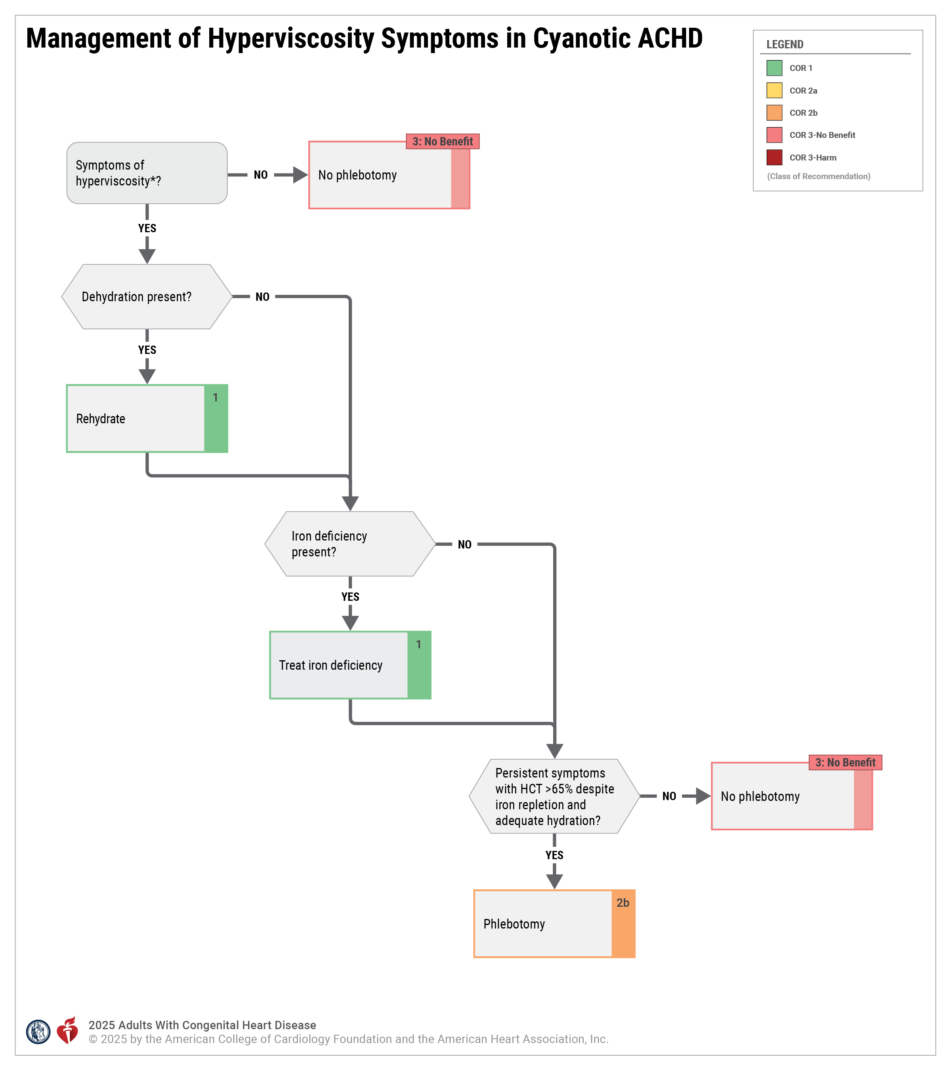
Figure 1. Management of Hyperviscosity Symptoms in Cyanotic ACHD
*All patients should have at least annual screening for iron deficiency.
ACHD indicates adult congenital heart disease; and HCT, hematocrit.

Slide 67
Heart Failure
 | Recommendations for Heart Failure Referenced studies that support recommendations are summarized in the Evidence Table.
COR | LOE | Recommendations
2a | B-NR | In patients with ACHD and heart failure symptoms who have systemic left ventricular (LV) dysfunction and biventricular circulation, and who otherwise meet accepted criteria for cardiac resynchronization therapy (CRT), use of CRT is reasonable to improve heart failure symptoms.
2a | C-LD | In patients with ACHD and heart failure symptoms who have systemic LV systolic dysfunction and biventricular circulation, use of GDMT for heart failure is reasonable to improve heart failure symptoms.
2a | C-LD | In patients with ACHD and heart failure symptoms who have systemic LV dysfunction and biventricular circulation, who otherwise meet accepted criteria, use of a primary-prevention implantable cardioverter-defibrillator (ICD) is reasonable to prevent sudden cardiac death (SCD).

Slide 68
Heart Transplantation and MCS
 | Recommendations for Heart Transplantation and MCS Referenced studies that support recommendations are summarized in the Evidence Table.
COR | LOE | Recommendations
1 | B-NR | In patients with ACHD and heart failure, evaluation by specialists with medical and surgical experience in ACHD, as well as by specialists with expertise in advanced heart failure, is recommended to assess appropriateness for advanced heart failure therapies, such as heart transplantation or MCS.
2a | B-NR | In patients with ACHD who are considered for heart transplantation, multiorgan transplantation (heart–lung, heart–kidney, or heart–liver) is reasonable based on center-specific assessment of the degree of respective lung, kidney, or liver dysfunction.
2a | B-NR | In patients with ACHD and advanced heart failure that is refractory to optimal medical and device-based therapy, the use of durable MCS devices is reasonable to improve quality of life or as a bridge to transplantation.

Slide 69
Genetic Syndromes Screening
 | Recommendations for Genetic Syndromes Screening Referenced studies that support recommendations are summarized in the Evidence Table.
COR | LOE | Recommendations
2a | B-NR | For adults with conotruncal defects, screening for 22q11.2 deletion syndrome is reasonable to assess the risk of transmission to offspring and to screen for associated comorbidities.
2a | C-EO | In adults with congenital heart disease and a family history of congenital heart disease or clinical features associated with a genetic syndrome, referral for genetic evaluation is reasonable to guide management.

Slide 70
Table 9. Genetic Syndromes and Their Associations With Congenital Heart Disease
Syndrome | Genetic Abnormality | Clinical Features | Percentage of Affected Patients With Congenital Heart Disease | Common Cardiac Findings
22q11.2 deletion syndrome (DiGeorge syndrome, velocardiofacial syndrome) | 22q11.2 deletion | Facial dysmorphia, palate and speech abnormalities, thymic and parathyroid hypoplasia, hypocalcemia, immunodeficiency, neurodevelopmental and psychiatric disorders | 60%-80% | Interrupted aortic arch type B, other aortic arch abnormalities, truncus arteriosus, tetralogy of Fallot, ventricular septal defect/pulmonary atresia
Down syndrome | Trisomy 21 | Facial dysmorphia, developmental disability, atlantoaxial instability, obstructive sleep apnea, craniofacial abnormalities | 40%-50% | Atrial septal defect, ventricular septal defect, atrioventricular septal defect, tetralogy of Fallot
Modified with permission from Stout et al. Copyright 2018 American Heart Association, Inc. and American College of Cardiology Foundation.

Slide 71
Table 9. Genetic Syndromes and Their Associations With Congenital Heart Disease (con’t.)
Syndrome | Genetic Abnormality | Clinical Features | Percentage of Affected Patients With Congenital Heart Disease | Common Cardiac Findings
Holt–Oram syndrome | TBX5 | Upper-limb skeletal abnormalities, conduction abnormalities | 75% | Atrial septal defect, ventricular septal defect, valvular disease (mitral valve prolapse, pulmonary stenosis)
Klinefelter syndrome | 47,XXY | Tall stature, hypoplastic testes, delayed puberty and developmental disability | 50% | Patent ductus arteriosus, atrial septal defect, mitral valve prolapse
Noonan syndrome | PTPN11, KRAS, SOS1, RAF1, NRAS, BRAF, MAP2K1 | Facial anomalies, webbed neck, chest deformity, lymphatic abnormalities, bleeding abnormalities | 80% | Pulmonary stenosis, atrial septal defect, hypertrophic cardiomyopathy, atrioventricular septal defect
Modified with permission from Stout et al. Copyright 2018 American Heart Association, Inc. and American College of Cardiology Foundation.

Slide 72
Table 9. Genetic Syndromes and Their Associations With Congenital Heart Disease (con’t.)
Syndrome | Genetic Abnormality | Clinical Features | Percentage of Affected Patients With Congenital Heart Disease | Common Cardiac Findings
Turner syndrome | 45,X | Short stature, webbed neck, lymphedema, primary amenorrhea | 30% | Bicuspid aortic valve, coarctation of the aorta, aortopathies, partial anomalous pulmonary venous connection, atherosclerosis risk
Williams syndrome | 7q11.23 deletion | “Elfin” facial features, social personality, hearing loss, developmental delay, infantile hypercalcemia | 50%-80% | Supravalvar aortic stenosis, branch pulmonary artery stenosis, supravalvar pulmonary stenosis, coronary ostial stenosis, QTc prolongation, mid-aortic narrowing syndrome
Modified with permission from Stout et al. Copyright 2018 American Heart Association, Inc. and American College of Cardiology Foundation.

Slide 73
Table 9. Genetic Syndromes and Their Associations With Congenital Heart Disease (con’t.)
Syndrome | Genetic Abnormality | Clinical Features | Percentage of Affected Patients With Congenital Heart Disease | Common Cardiac Findings
Alagille syndrome | JAG1 | Facial dysmorphism, hepatic dysfunction (chronic cholestasis, elevated liver enzymes, biliary atresia, hypercholesterolemia, or liver failure), neurovascular accidents, renal anomalies (renal artery stenosis, hypertension, renal tubular acidosis, uteropelvic obstruction, small, hyperechoic kidneys) | 70%-75% | Two-thirds with peripheral or branch pulmonary artery stenosis or other arterial narrowing (coarctation of the aorta, renal artery stenosis, middle cerebral artery, Moyamoya); also can have tetralogy of Fallot, aortic stenosis, septal defects, mid-aortic narrowing syndrome
Heterotaxy syndrome | ZIC3, SHROOM3, GRK 5, ANKS3, NODAL, CFC1, LEFTY2, GDF1, SMAD2, ACVR2B | Situs abnormalities, ciliary dysfunction, functional asplenia, conduction abnormalities, biliary atresia | 50%-95% | Atrioventricular septal defect (balanced, unbalanced), malposed great vessels, interrupted inferior vena cava, bilateral superior vena cava, atrial isomerism
Modified with permission from Stout et al. Copyright 2018 American Heart Association, Inc. and American College of Cardiology Foundation.

Slide 74
Reproductive Health, Pregnancy, and Contraception
 | Recommendations for Reproductive Health, Pregnancy, and Contraception Referenced studies that support recommendations are summarized in the Evidence Table.
COR | LOE | Recommendations
1 | B-NR | In adults with congenital heart disease of childbearing age, counseling on contraceptive options is recommended to inform pregnancy-related shared decision-making.
1 | B-NR | Adults with congenital heart disease interested in pregnancy should receive preconception counseling, in collaboration with an ACHD cardiologist, about the maternal cardiac, obstetric, and fetal risks associated with pregnancy and the potential long-term risks to the pregnant individual.
1 | C-LD | Screening fetal echocardiography is indicated to detect congenital heart disease if either parent has ACHD to optimize delivery planning and access to care.

Slide 75
Reproductive Health, Pregnancy, and Contraception (con’t.)
1 | C-LD | In pregnant patients with ACHD AP classifications IB–D, IIA–D, and IIIA–D, an individualized care plan, including mode of delivery, need for cardiac monitoring, and anesthetic support, should be documented in the medical record and communicated to the patient and care team, to reduce maternal risks for morbidity and mortality.
1 | C-LD | In pregnant patients with ACHD AP classifications IB–D, IIA–D, and IIIA–D, management should be provided by, or in collaboration with, a cardio-obstetrics team with expertise in ACHD and maternal-fetal medicine, to improve clinical outcomes.
1 | C-LD | Patients with ACHD who have high risk for maternal morbidity and mortality should be counseled to avoid pregnancy and given guidance on effective contraception to improve outcomes.

Slide 76
Reproductive Health, Pregnancy, and Contraception (con’t.)
1 | C-LD | For pregnant patients with ACHD who have high risk for morbidity and mortality, the option of terminating pregnancy should be discussed to reduce that risk.
2a | C-LD | In patients with ACHD who are of childbearing age, referral to a genetic counselor for preconception planning is reasonable to facilitate understanding of the risks for congenital heart disease in their offspring.
2a | C-EO | For patients with ACHD who are considering assisted reproductive technology, discussions involving an ACHD cardiologist can be beneficial to increase patients’ knowledge about their options and the associated risks.
3: No Benefit | C-LD | Routine cesarean delivery has no benefit and may cause harm in pregnant patients with ACHD in the absence of an obstetric indication or high-risk cardiac condition.
3: Harm | B-NR | In patients with ACHD who are at high risk for thromboembolic events, contraceptive agents that contain estrogen are potentially harmful.

Slide 77
Table 10. Congenital Heart Conditions Considered Significantly High Risk for Maternal Complications in Pregnancy*
Congenital Heart Lesions
Severe, symptomatic, left-sided obstructive lesions (mitral stenosis, subaortic and aortic stenosis)
Severe native coarctation or recoarctation
Cyanotic congenital heart disease or Eisenmenger syndrome
Fontan physiology
Systemic right ventricle with at least moderately depressed ventricular function
Other Factors/Conditions
Advanced New York Heart Association class (III or IV)
Prior adverse cardiac event during pregnancy
Pulmonary arterial hypertension
Significantly decreased systemic ventricular dysfunction (ejection fraction <30%)
Aortopathy (diameter >5 cm or associated with connective tissue disorders)
Mechanical heart valves
Refractory ventricular arrhythmias
*Information adapted from the modified World Health Organization classification system.
Adapted from Regitz-Zagrosek et al. by permission of Oxford University Press. Copyright 2018 The European Society of Cardiology and The European Society of Hypertension.

Slide 78
Ionizing Radiation Exposure
 | Recommendation for Ionizing Radiation Exposure Referenced studies that support recommendation are summarized in the Evidence Table.
COR | LOE | Recommendation
1 | B-NR | In adults with congenital heart disease, processes to limit radiation exposure during imaging and cardiovascular procedures are recommended to reduce the lifetime risk for cancer.

Slide 79
Exercise Testing
 | Recommendations for Exercise Testing Referenced studies that support recommendations are summarized in the Evidence Table.
COR | LOE | Recommendations
2a | B-NR | In patients with ACHD, CPET can be useful for establishing a baseline functional assessment, guiding clinical care, stratifying risk for major adverse cardiovascular events, and ongoing surveillance.
2a | B-NR | In patients with ACHD and established PAH, or in those unable to perform CPET yielding reliable diagnostic information, a 6-minute walk test can be useful to objectively assess symptom severity, functional capacity, and response to therapy.

Slide 80
Physical Activity, Exercise, and Sports Participation
 | Recommendations for Physical Activity, Exercise, and Sports Participation Referenced studies that support recommendations are summarized in the Evidence Table.
COR | LOE | Recommendations
1 | B-R | Patients with ACHD should have their activity levels assessed at regular intervals to receive counseling about the types and intensity of exercise appropriate to their clinical status.
2a | B-R | In patients with ACHD, exercise training and cardiac rehabilitation can be useful to increase exercise capacity.
2a | C-LD | In patients with ACHD, CPET can be useful to guide physical activity recommendations.
2a | C-EO | In patients with ACHD, participation in competitive sports is reasonable following a comprehensive evaluation by an ACHD specialist that incorporates functional status and individualized assessment of risks and benefits.

Slide 81
Specific Conditions

Slide 82
Table 11. Isolated Shunt Lesions and Pulmonary Arterial Hypertension
PAH–ACHD Subtype | Patient Characteristics |  | Evidence for Use of Risk Assessment Factors/Tools | Evidence for Use of PAH-Specific Therapy
 | Resting hypoxemia/cyanosis | Typical defect size
Eisenmenger syndrome | Usually | Large | Patient age, pretricuspid shunt, resting oxygen saturation, loss of sinus rhythm, pericardial effusion, BNP, C-reactive protein, 6MWD, echocardiography, renal dysfunction, or other clinical stratification tools.* | Endothelin-receptor antagonists, phosphodiesterase-5 inhibitors, prostacylin analogs†
Prevalent systemic to pulmonary shunts (left-to-right shunts with elevated PVR, yet not meeting criteria for Eisenmenger syndrome) | No | Moderate to large | Review using the 3-strata risk-prediction model for newly diagnosed patients, the 4-strata risk-prediction model for patients with established PAH, and/or any of the Eisenmenger syndrome tools.‡ | No direct studies on this isolated cohort; treatment has typically followed recommendations for idiopathic PAH

Slide 83
Table 11. Isolated Shunt Lesions and Pulmonary Arterial Hypertension (con’t.)
PAH–ACHD Subtype | Patient Characteristics |  | Evidence for Use of Risk Assessment Factors/Tools | Evidence for Use of PAH-Specific Therapy
 | Resting hypoxemia/cyanosis | Typical defect size
Coincidental defects with elevated PVR | Rare | Small | Review using the 3-strata risk-prediction model for newly diagnosed patients, the 4-strata risk-prediction model for patients with established PAH, and/or any of the Eisenmenger syndrome tools.‡ | No direct studies on this isolated cohort; treatment has typically followed recommendations for idiopathic PAH
Postcorrection defects with elevated PVR | Rare (with small residual shunts and severe pulmonary vascular disease) | Corrected | Review using the 3-strata risk-prediction model for newly diagnosed patients, the 4-strata risk-prediction model for patients with established PAH, and/or any of the Eisenmenger syndrome tools.‡ | Phosphodiesterase-5 inhibitors, endothelin receptor antagonists, oral prostacyclin receptor analog, activin signaling inhibitors§

Slide 84
Table 11. Isolated Shunt Lesions and Pulmonary Arterial Hypertension (con’t.)
*No validated score available.
†See Section 4.4.6 for details on the order of PAH-directed drug initiation.
‡For patients in groups B, C, and D, the 3- and 4-strata models have been applied, and evidence for use has included enrollment of patients in this category; however, validation for this specific population in isolation from other forms of PAH has not been directly studied.
§Trials that included patients with PAH after congenital defect correction.
6MWD indicates 6-minute walk distance; ACHD, adult congenital heart disease; BNP, B-type natriuretic peptide; N/A, not applicable; PAH, pulmonary arterial hypertension; and PVR, pulmonary vascular resistance.

Slide 85
Atrial Septal Defect
 | Recommendations for Atrial Septal Defect Referenced studies that support recommendations are summarized in the Evidence Table.
COR | LOE | Recommendations
Diagnostic
1 | B-NR | In adults with an unrepaired ASD, CMR imaging, transesophageal echocardiography, or cardiac CT is recommended to define defect size, morphology, rim anatomy, and pulmonary venous connections.
1 | B-NR | Adults with an unrepaired ASD and PAH should undergo risk assessment and management in consultation with pulmonary hypertension specialists to improve outcomes.
1 | C-EO | Adults with an unrepaired ASD should be assessed for the presence of PAH to guide medical therapy and determine suitability for repair.
2b | C-LD | In adults with an unrepaired ASD, balloon test occlusion before closure may be reasonable to assess hemodynamic changes.

Slide 86
Atrial Septal Defect (con’t.)
Therapeutic
1 | B-R | In adults with an unrepaired ASD, significant left-to-right shunt (Qp:Qs ≥ 1.5) and right ventricular (RV) dilation, in the absence of PAH (PVR ≤2 Wood units) or significant LV disease*, ASD closure is recommended to improve functional class and clinical outcomes.
1 | B-NR | In adults with an isolated unrepaired secundum ASD, transcatheter closure is usually preferred to surgical repair to reduce length of stay and recovery time.
1 | C-EO | In adults with an unrepaired ASD and evidence of (or strong suspicion for) paradoxical embolism, ASD closure is recommended to prevent recurrent embolism.
2a | B-R | In adults with an unrepaired ASD, significant left-to-right shunt (Qp:Qs ≥ 1.5) and RV dilation, with a PVR >2 to <5 Wood units, and without significant LV disease,* ASD closure is reasonable to improve functional status.
*Significant LV disease: any condition resulting in chronically elevated left atrial pressure ≥15 mm Hg.

Slide 87
Atrial Septal Defect (con’t.)
2a | B-NR | In adults with an unrepaired ASD, significant left-to-right shunt (Qp:Qs ≥ 1.5), RV dilation, PAH (PVR 5 to 8 Wood units), and without significant LV disease, closure can be beneficial if PVR <5 Wood units can be achieved with targeted PAH therapy, to improve medium-term functional status.
2b | B-NR | In adults with an unrepaired ASD and PAH for whom closure is indicated, fenestrated repair can be considered to improve functional class and clinical outcomes.
2b | B-NR | In adults with unrepaired superior sinus venosus ASD (SVASD), transcatheter closure (when technically feasible) may be a reasonable alternative to surgery to reduce operative morbidity.
2b | B-NR | In adults with an unrepaired ASD, significant left-to-right shunt (Qp:Qs ≥1.5), and PAH with PVR of 5 to 8 Wood units while receiving targeted PAH therapy, the usefulness of fenestrated ASD closure to improve functional class and clinical outcomes is uncertain.
3: Harm | C-LD | In adults with an unrepaired ASD and Eisenmenger physiology, ASD closure should not be performed to avoid increasing morbidity and mortality.

Slide 88
Table 12. Atrial Septal Defect: Routine Follow-Up and Testing Intervals
Type of Follow-Up or Testing | Physiological Stage A* (mo) | Physiological Stage B* (mo) | Physiological Stage C* (mo) | Physiological Stage D* (mo)
Outpatient ACHD cardiologist | 36–60 | 12–24 | 6–12 | 3–6
Electrocardiogram | 36–60 | 12–24 | 12 | 12
Transthoracic echocardiogram | 36–60 | 12–24 | 12 | 12
For recommendations about CMR imaging intervals, see Section 4.1.1 supportive text for recommendation #1.
Modified with permission from Stout et al. Copyright 2018 American Heart Association, Inc. and American College of Cardiology Foundation.
*See Section 2.2 for details on the ACHD anatomic and physiological classification system.
ACHD indicates adult congenital heart disease; and CMR, cardiovascular magnetic resonance.

Slide 89
Assessment Type | Findings
Clinical history, examination | Reduced functional capacity Symptoms: Functional: dyspnea, fatigue Right heart failure: congestion, abdominal distention, early satiety History of near-syncope Desaturation at rest Cyanosis Clubbing Accentuated S2 heart sound Jugular venous distention, distended abdomen, peripheral edema
Exercise capacity | Reduced 6-minute walk distance Possibly reduced resting or exercising oxygen saturation Abnormal lung function, at rest and during exercise
Imaging | Electrocardiogram: right ventricular enlargement Transthoracic echocardiography: RVE, flattened IVS, RAE, peak TR jet >2.9 m/s, RVOT acceleration time <105 ms, TAPSE <18 mm
Biomarkers | Elevated BNP or NT-proBNP
Hemodynamics | mPAP >20 mm Hg and PVR >2 Wood units and PCWP ≤15 mm Hg
Table 13. Assessment for Pulmonary Arterial Hypertension in Adults With Congenital Heart Disease
BNP indicates B-type natriuretic peptide; CT, computed tomography; IVS, interventricular septum; JVD, jugular venous distention; mPAP, mean pulmonary artery pressure; NT-proBNP, N-terminal prohormone of B-type natriuretic peptide; PAH, pulmonary arterial hypertension; PCWP, pulmonary capillary wedge pressure; PVR, pulmonary vascular resistance; RAE, right atrial enlargement; RVE, right ventricular enlargement; RVOT, right ventricular outflow tract; TAPSE, tricuspid annular plane systolic excursion; and TR, tricuspid regurgitation.

Slide 90
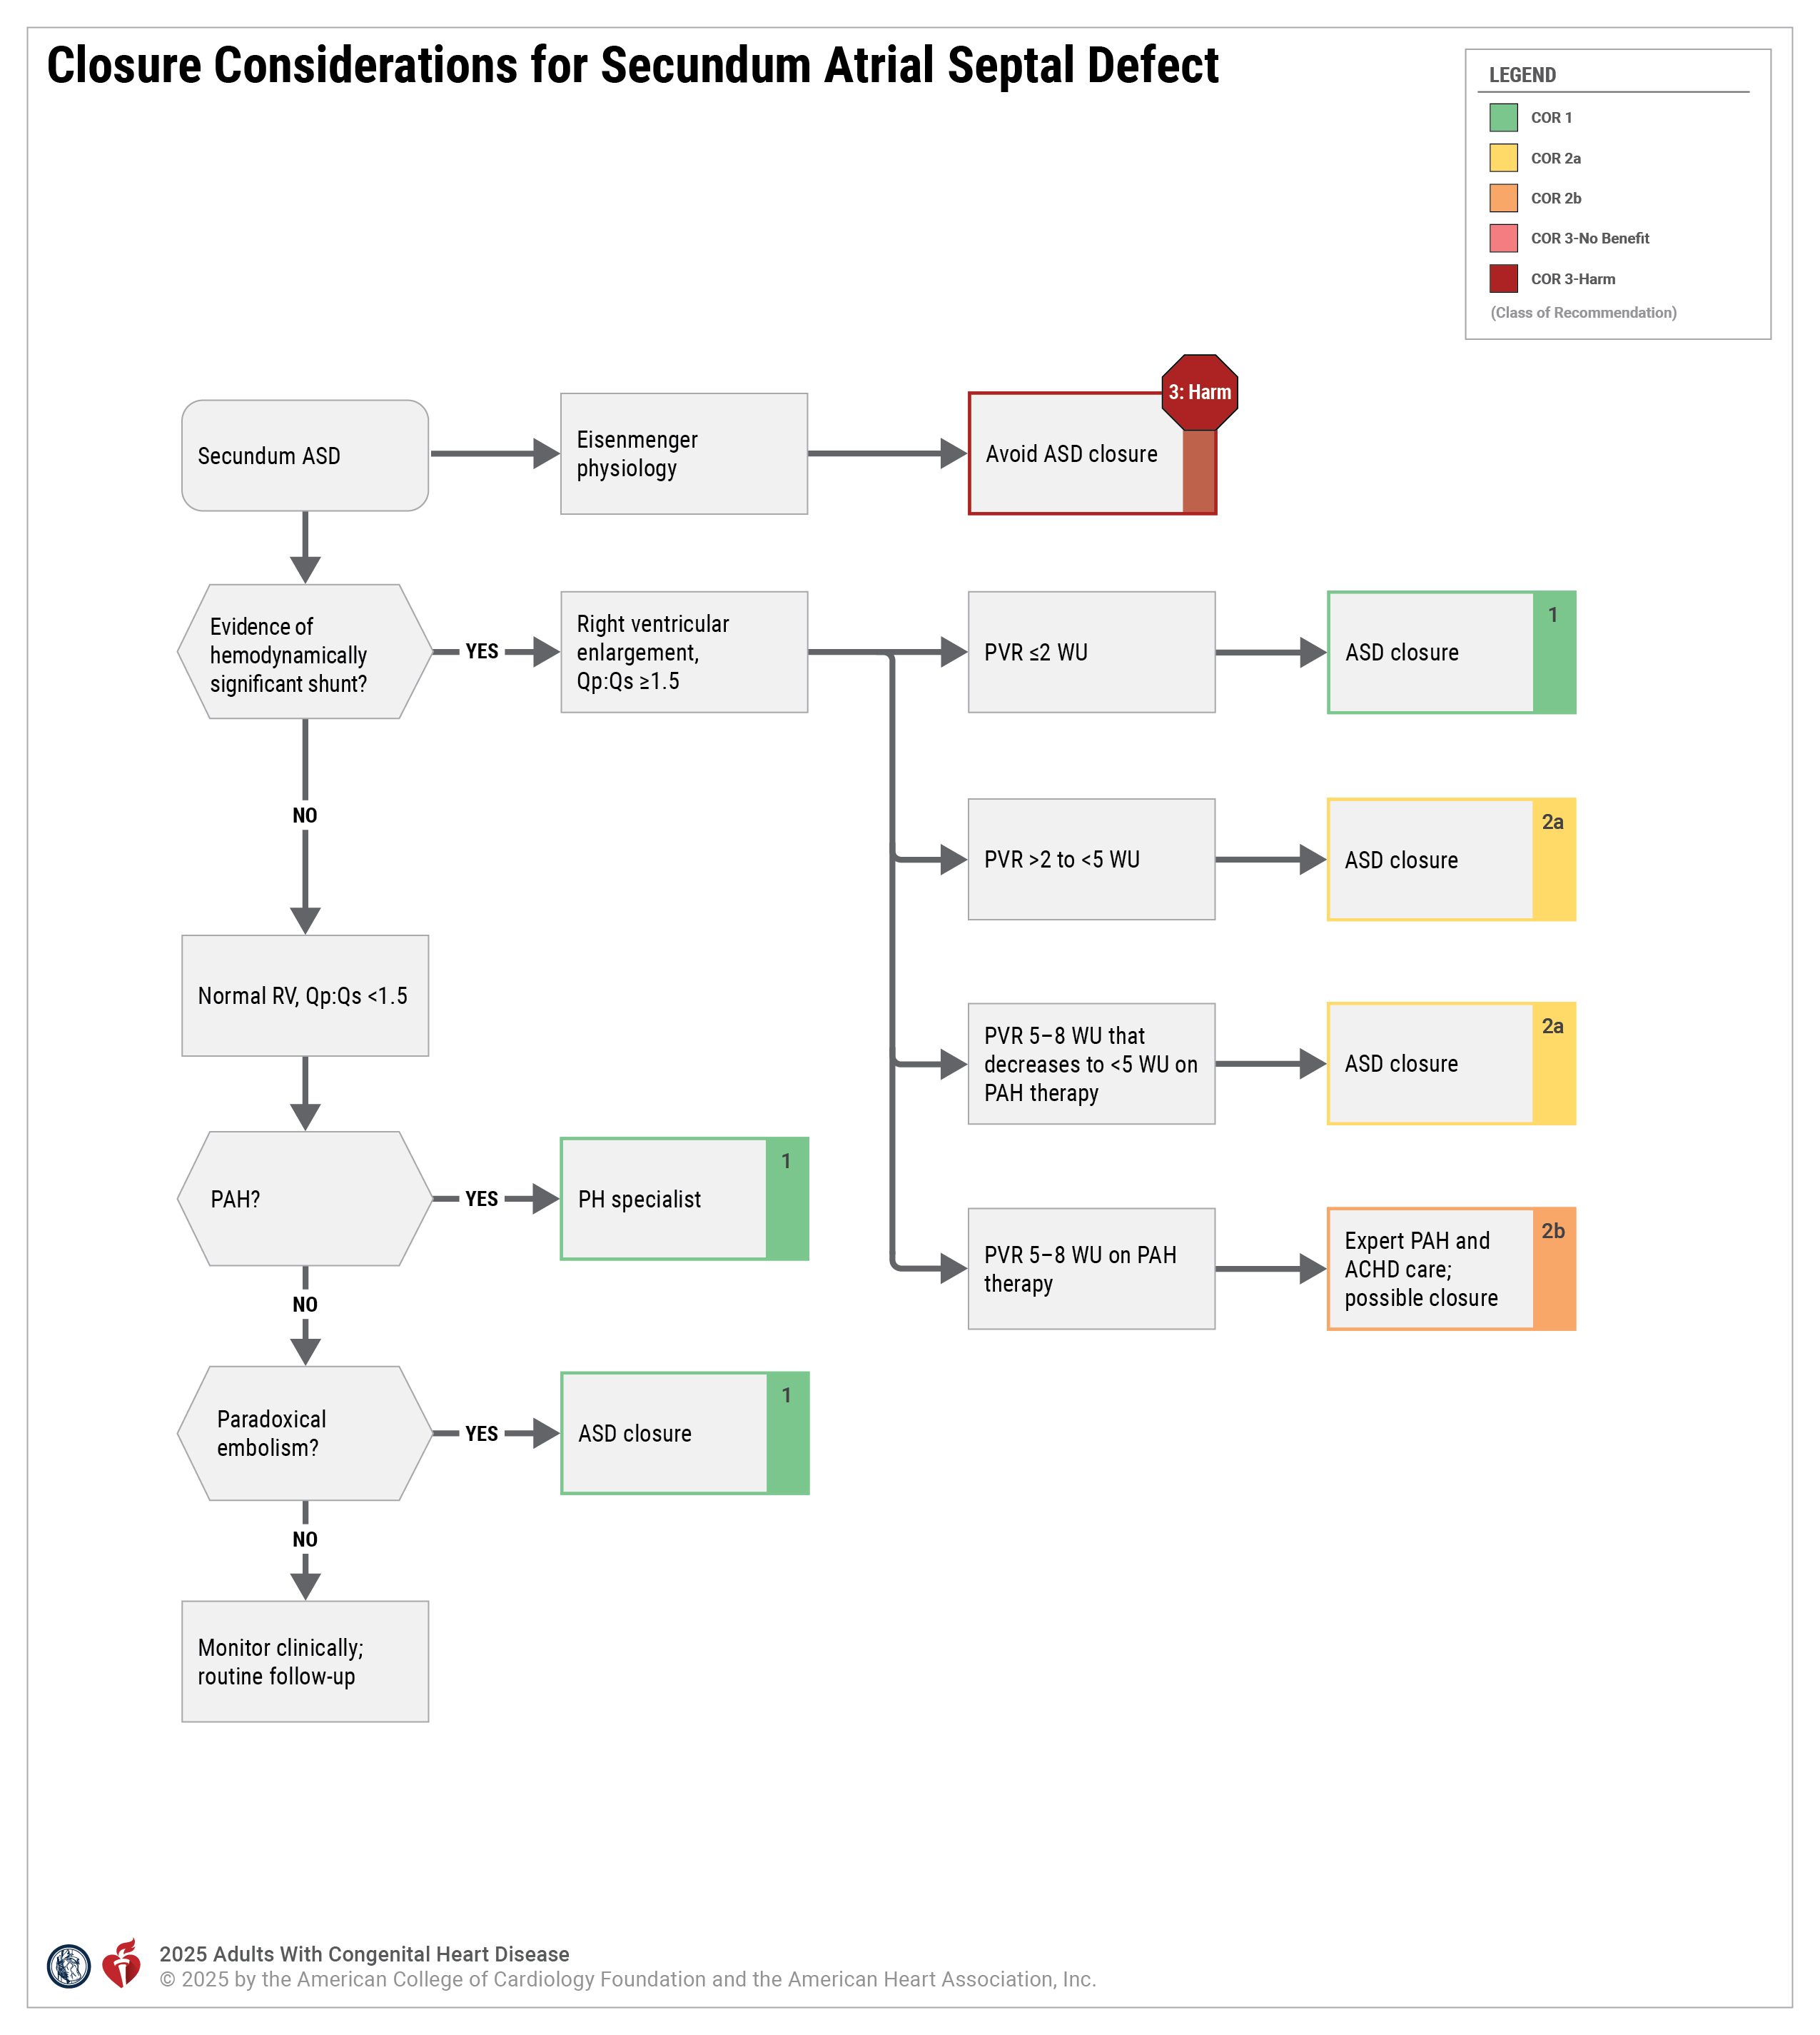
Figure 2. Closure Considerations for Secundum Atrial Septal Defect.
All ASD closure recommendations assume the patient has no evidence of significant left heart disease.
*Therapy, PAH-directed medical therapy.
ACHD indicates adult congenital heart disease; ASD, atrial septal defect; PAH, pulmonary arterial hypertension; PH, pulmonary hypertension; PVR, pulmonary vascular resistance; Qp:Qs, pulmonary-to-systemic blood flow ratio; RV, right ventricle; and WU, Wood units.

Slide 91
Ventricular Septal Defect
 | Recommendations for Ventricular Septal Defect Referenced studies that support recommendations are summarized in the Evidence Table.
COR | LOE | Recommendations
Diagnostic
1 | B-NR | Patients with an unrepaired VSD should be assessed for the presence of PAH to guide decisions about medical therapy and repair.
1 | B-NR | In adults with a perimembranous VSD being considered for repair, evaluation to exclude RV outflow tract (RVOT) obstruction or double-chambered right ventricle (DCRV) is recommended to improve management planning.
1 | C-LD | Adults with a VSD (repaired or unrepaired) and PAH should be followed by specialists with expertise in ACHD and pulmonary hypertension to reduce morbidity and mortality.

Slide 92
Ventricular Septal Defect (con’t.)
Therapeutic
1 | B-NR | In adults with a VSD, a significant left-to-right shunt (Qp:Qs ≥1.5), and significant or progressive LV dilatation with no evidence of PAH (PVR ≤2 Wood units), closure of the defect is recommended to eliminate the shunt and preserve ventricular function.
2a | C-LD | In adults with a VSD, LV volume overload, Qp:Qs ≥1.5:1, and mild PAH (PVR >2 but <5 Wood units), closure of the VSD is reasonable to eliminate the shunt, in order to reduce the risk for progressive PAH and the burden of chronic volume overload on the LV.
2a | C-LD | In adults with an outlet or perimembranous VSD causing progressive moderate or greater aortic regurgitation, closure of the VSD is reasonable to preserve aortic valve function.
2b | C-LD | In adults with a recent history of infective endocarditis involving a VSD, closure of the VSD may be reasonable to reduce the risk for recurrent endocarditis.

Slide 93
Ventricular Septal Defect (con’t.)
2b | C-LD | In adults with a VSD, Qp:Qs ≥1.5, and PAH (PVR 5 to 8 Wood units) without hypoxemia, if PVR drops to <5 Wood units with PAH therapies, usefulness of closure of the VSD is uncertain to reduce the risk for progressive PAH and the burden of chronic volume overload on the left ventricle.
3: No Benefit | B-NR | In adults with a VSD, Qp:Qs <1.5, and no other indications, closure should not be performed to avoid unnecessary perioperative risks.
3: Harm | B-NR | In adults with a VSD and Eisenmenger physiology, VSD closure should not be performed to avoid escalating morbidity and mortality.

Slide 94
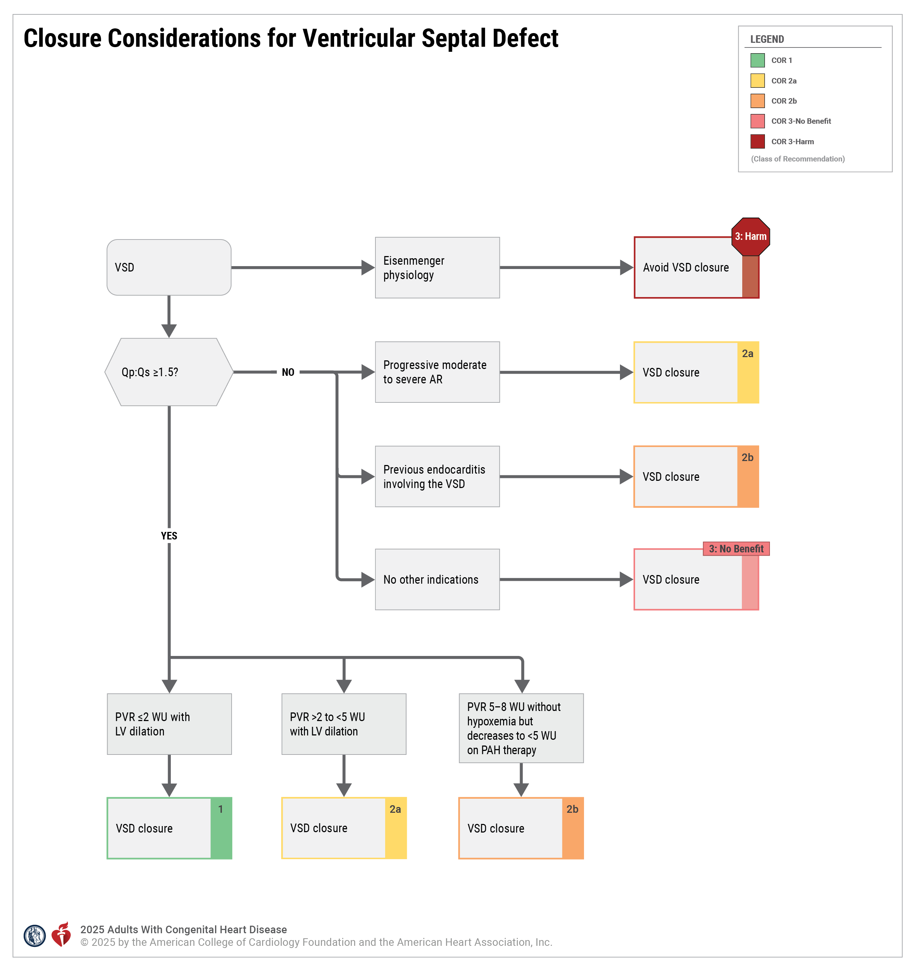
Figure 3. Closure Considerations for Ventricular Septal Defect.
*See Section 4.4.6, “Eisenmenger Syndrome.”
AR indicates aortic regurgitation; LV, left ventricular; PVR, pulmonary vascular resistance; Qp:Qs, pulmonary-to-systemic blood flow ratio; VSD, ventricular septal defect; and WU, Wood units.

Slide 95
Table 14. Ventricular Septal Defect: Routine Follow-Up and Testing Intervals
Type of Follow-Up or Testing | Physiological Stage A*† (mo) | Physiological Stage B*‡ (mo) | Physiological Stage C* (mo) | Physiological Stage D* (mo)
Outpatient ACHD cardiologist | 36–60 | 12–60 | 6–12 | 3–6
Electrocardiogram | 36–60 | 12–60 | 12 | 12
Transthoracic echocardiogram | 36–60 | 12–60 | 12 | 12
Modified with permission from Stout et al. Copyright 2018 American Heart Association, Inc. and American College of Cardiology Foundation.
*See Section 2.2 for details on the ACHD anatomic and physiological classification system.
†Some physiological stage A patients with spontaneously closed muscular ventricular septal defects without residual anatomic or hemodynamic sequelae can be discharged from routine cardiology follow-up and be seen on an as-needed basis.
‡Stage B patients with a ventricular septal defect and a hemodynamically insignificant shunt who have normal chamber size without pulmonary hypertension can be seen every 36 to 60 months. Patients with ventricular dilation, dysfunction, or arrhythmia should be seen more frequently.
ACHD indicates adult congenital heart disease.

Slide 96
Atrioventricular Septal Defect
 | Recommendations for Atrioventricular Septal Defect Referenced studies that support recommendations are summarized in the Evidence Table.
COR | LOE | Recommendations
Diagnostic
1 | C-LD | Adults with an unrepaired AVSD or those with residual shunts after prior repair should be assessed for the presence of PAH to guide medical therapy and assess suitability for repair.
1 | C-LD | Adults with an AVSD (repaired or unrepaired) and PAH should be managed by clinicians with pulmonary hypertension expertise to improve outcomes.

Slide 97
Atrioventricular Septal Defect (con’t.)
Therapeutic
1 | B-NR | In adults with repaired AVSD and LV outflow tract (LVOT) obstruction with symptoms attributable to the obstruction, or LV systolic dysfunction (LV ejection fraction <50%), surgical repair is recommended to improve functional status and preserve ventricular function.
1 | B-NR | In adults with repaired AVSD with a) symptomatic severe left atrioventricular valve regurgitation or b) asymptomatic severe left atrioventricular valve regurgitation with LV dilation (LV end-systolic diameter ≥40 mm) or LV systolic dysfunction (LV ejection fraction <60%), valve surgery is recommended to improve functional status and prevent worsening ventricular function.

Slide 98
Atrioventricular Septal Defect (con’t.)
1 | C-LD | In adults with an unrepaired AVSD or those with residual shunts after previous repair, significant left-to-right shunt (Qp:Qs ≥1.5), and/or significant or progressive atrial/ventricular dilatation with no PAH (PVR ≤2 Wood units), closure of the AVSD or residual shunt is recommended to improve functional class and clinical outcomes.
2a | C-EO | In adults with an unrepaired AVSD or those with residual shunts after previous repair, significant left-to-right shunt (Qp:Qs ≥1.5), and/or significant or progressive atrial/ventricular dilatation with mild PAH (PVR >2 to <5 Wood units), closure is reasonable to improve functional class and clinical outcomes.
2b | C-LD | In asymptomatic adults with AVSD, LVOT obstruction, and progressive greater than mild aortic regurgitation, surgical repair may be reasonable to prevent worsening ventricular function and progressive aortic valve disease.
3: Harm | C-LD | In adults with an unrepaired AVSD or those with residual shunts after previous repair demonstrating Eisenmenger physiology or PVR >10 Wood units, shunt closure should not be performed to avoid additional morbidity and mortality.

Slide 99
Table 15. Atrioventricular Septal Defect: Routine Follow-Up and Testing Intervals
Type of Follow-Up or Testing | Physiological Stage A* (mo) | Physiological Stage B* (mo) | Physiological Stage C* (mo) | Physiological Stage D* (mo)
Outpatient ACHD cardiologist | 24–36 | 12–24 | 6–12 | 3–6
Electrocardiogram | 24–36 | 12–24 | 12 | 12
Transthoracic echocardiogram | 24–36 | 12–24 | 12 | 12
Modified with permission from Stout et al. Copyright 2018 American Heart Association, Inc. and American College of Cardiology Foundation.
*See Section 2.2 for details on the ACHD anatomic and physiological classification system.
ACHD indicates adult congenital heart disease.

Slide 100
Anomalous Pulmonary Venous Connections
 | Recommendations for Anomalous Pulmonary Venous Connections Referenced studies that support recommendations are summarized in the Evidence Table.
COR | LOE | Recommendations
Diagnostic
1 | B-NR | For adults with APVCs, cardiovascular magnetic resonance (CMR) imaging is recommended to assess pulmonary venous anatomy, to evaluate RV size and function, and to determine shunt fraction (Qp:Qs).
1 | B-NR | For adults with APVCs who do not have an indication for repair, routine cardiac imaging is recommended for serial evaluation of RV size and function and for assessment of pulmonary hypertension.
1 | B-NR | For adults with repaired APVCs and dyspnea on exertion and/or reduced functional capacity, CMR or computed tomography (CT) angiography is recommended to evaluate for venous obstruction or residual shunt.
2a | B-NR | For adults with unrepaired APVCs and noninvasive evidence of, and/or risk factors for, PAH, cardiac catheterization can be useful to evaluate hemodynamics and aid in determining indication for repair.

Slide 101
Anomalous Pulmonary Venous Connections (con’t.)
Therapeutic
1 | B-NR | For adults with APVCs who have cardiac symptoms and/or reduced functional capacity with RV volume overload, and whose Qp:Qs is ≥1.5, surgical repair is recommended to improve symptoms and clinical outcomes.
1 | B-NR | For adults with APVCs undergoing surgical repair for an ASD, repair of the APVC(s) is recommended, when technically feasible, to reduce left-to-right shunting and RV volume overload.
2a | B-NR | For adults with APVCs who are asymptomatic; whose Qp:Qs is ≥1.5; and who have severe or progressive RV volume overload, reduced RV systolic function, PAH by invasive measurement, or objective exercise intolerance, surgical repair* is reasonable in order to improve hemodynamics and/or stabilize RV size and function.
3: No Benefit | B-NR | For adults with APVCs who have a normal to mildly enlarged right ventricle and whose Qp:Qs is <1.5, surgical repair is not indicated, given the absence of data to support benefit.

Slide 102
Table 16. Comparison of Anomalous Pulmonary Venous Connections With Atrial Septal Defect
 | Anomalous Pulmonary Venous Connections | Atrial Septal Defect
Shunt direction | Left-to-right only | Left-to-right, right-to-left, or bidirectional
Risk for paradoxical embolism | No | Yes
Risk for hypoxemia | No | Yes
Magnitude of shunt change over time | No | Yes
Right ventricular volume overload | Yes | Yes
Risk for pulmonary arterial hypertension | Yes | Yes

Slide 103
Table 17. Anomalous Pulmonary Venous Connections: Routine Follow-Up and Testing Intervals
Type of Follow-Up or Testing | Physiological Stage A* (mo) | Physiological Stage B* (mo) | Physiological Stage C* (mo) | Physiological Stage D* (mo)
Outpatient ACHD cardiologist | 36–60 | 24 | 6–12 | 3–6
Electrocardiogram | 36–60 | 24 | 12 | 12
Transthoracic echocardiogram | 36–60 | 24 | 12 | 12
For recommendations on CMR and CT angiography, see Section 4.1.4 supportive text for recommendations #1–3.
*See Section 2.2 for details on the ACHD anatomic and physiological classification system.
ACHD indicates adult congenital heart disease; CMR, cardiovascular magnetic resonance; and CT, computed tomography.

Slide 104
Patent Ductus Arteriosus
 | Recommendations for Patent Ductus Arteriosus Referenced studies that support recommendations are summarized in the Evidence Table.
COR | LOE | Recommendations
Diagnostic
1 | C-LD | Adults with a PDA and PAH should be managed by an ACHD specialist and clinicians with pulmonary hypertension expertise, to minimize morbidity and mortality.
1 | C-EO | Patients with an unrepaired PDA should be evaluated for PAH to guide recommendations for treatment.
1 | C-EO | Adults with a PDA should undergo assessment of LV function and left-sided chamber size with echocardiography and/or CMR imaging, to guide recommendations for treatment.
2a | C-LD | In adults with a PDA and PAH, balloon test occlusion of the PDA can be useful to facilitate accurate quantification of PVR and to identify patients who are candidates for closure.

Slide 105
Patent Ductus Arteriosus (con’t.)
Therapeutic
1 | C-LD | In adults with a PDA, left heart enlargement attributable to the PDA, a net left-to-right shunt, and no evidence of PAH (PVR ≤2 Wood units), closure to eliminate the shunt is recommended to improve clinical outcomes.
2a | C-LD | In adults with a PDA, left heart enlargement attributable to the PDA, a net left-to-right shunt, and PVR >2 but <5 Wood units, closure to eliminate the shunt is reasonable to improve clinical outcomes.
2b | C-EO | In adults with a PDA, left heart enlargement attributable to the PDA, a net left-to-right shunt, and moderate PAH (PVR 5 to 8 Wood units), closure may be considered if the PVR drops to <5 Wood units with initiation of PAH therapies.
3: No Benefit | C-EO | In asymptomatic adults with a PDA, no evidence of left atrial or LV enlargement, and no prior history of endarteritis, closure has no benefit.
3: Harm | C-LD | In adults with a PDA and Eisenmenger syndrome or PVR >10 Wood units, closure to eliminate the shunt should not be performed to avoid additional morbidity or mortality risk.

Slide 106
Table 18. Patent Ductus Arteriosus: Routine Follow-Up and Testing Intervals
Type of Follow-Up or Testing | Physiological Stage A*† (mo) | Physiological Stage B*‡ (mo) | Physiological Stage C* (mo) | Physiological Stage D* (mo)
Outpatient ACHD cardiologist | 36–60 | 12–60 | 6–12 | 3–6
Electrocardiogram | 36–60 | 12–60 | 12 | 12
Transthoracic echocardiogram | 36–60 | 12–60 | 12 | 12
Modified with permission from Stout et al. Copyright 2018 American Heart Association, Inc. and American College of Cardiology Foundation.
*See Section 2.2 for details on the ACHD anatomic and physiological classification system.
†Stage A patients who had closure of their PDA during infancy without residual shunt, chamber dilation, or complications can likely be discharged from cardiology care or be seen on an as-needed basis
‡Stage B patients with a PDA and a hemodynamically insignificant shunt who have normal chamber size without pulmonary hypertension can be seen every 36 to 60 months. Patients with ventricular dilation, dysfunction, or arrhythmia should be seen more frequently.
ACHD indicates adult congenital heart disease; and PDA, patent ductus arteriosus.

Slide 107
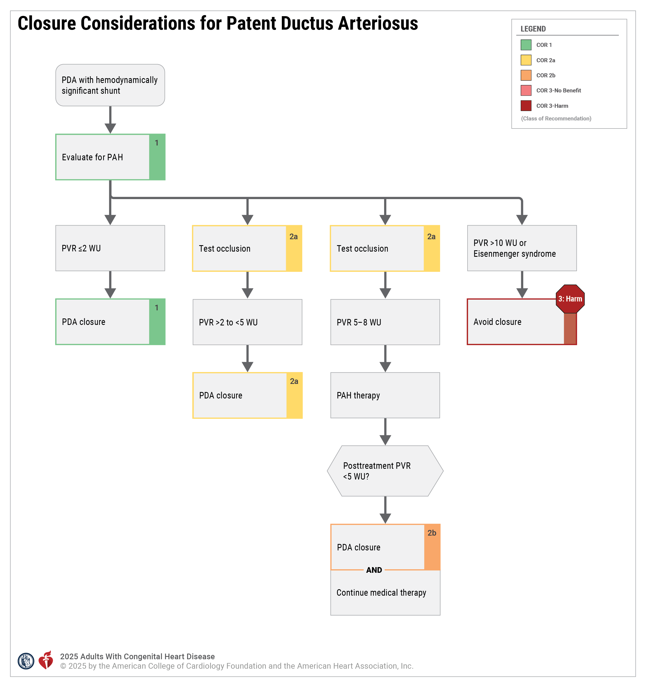
Figure 4. Closure Considerations for Patent Ductus Arteriosus.
PAH indicates pulmonary arterial hypertension; PDA, patent ductus arteriosus; PVR, pulmonary vascular resistance; and WU, Wood units.

Slide 108
Cor Triatriatum Sinister
 | Recommendations for Cor Triatriatum Sinister Referenced studies that support recommendations are summarized in the Evidence Table.
COR | LOE | Recommendations
Diagnostic
2a | B-NR | In adults with unrepaired cor triatriatum sinister, transesophageal echocardiography and/or cross-sectional imaging can be useful to identify the size and location of the membrane orifice and to assess for the presence of associated congenital cardiac defects.
2a | B-NR | In adults with repaired cor triatriatum sinister and symptoms compatible with recurrent membrane obstruction, it is reasonable to evaluate for the presence of residual congenital cardiac defects, including pulmonary vein stenosis.

Slide 109
Cor Triatriatum Sinister (con’t.)
Therapeutic
1 | B-NR | In adults with unrepaired cor triatriatum sinister and symptoms attributable to membrane obstruction, surgical resection is recommended to reduce the consequences of left atrial hypertension.
1 | C-LD | In adults with unrepaired cor triatriatum sinister and atrial fibrillation or atrial flutter, prior stroke, or left atrial thrombus, chronic anticoagulation is recommended to prevent embolic stroke, whether or not conventional thromboembolic risk factors are present.
2a | C-LD | In asymptomatic adults with unrepaired cor triatriatum sinister and severe membrane obstruction, surgical resection can be useful to prevent the sequelae of left atrial hypertension.
2a | C-LD | In adults with unrepaired cor triatriatum sinister and atrial fibrillation or atrial flutter, a rhythm control strategy can be beneficial to avoid clinical decompensation.
2b | C-LD | In highly symptomatic adults with unrepaired cor triatriatum sinister, significant membrane obstruction, and elevated operative risk,* catheter-based intervention may be considered as a bridge to surgical resection.
*For example, decompensated heart failure, severe pulmonary hypertension, or pregnancy (see supportive text for details).

Slide 110
Table 19. Cor Triatriatum Sinister: Routine Follow-Up and Testing Intervals
Type of Follow-Up or Testing | Physiological Stage A* (mo) | Physiological Stage B* (mo) | Physiological Stage C* (mo) | Physiological Stage D* (mo)
Outpatient ACHD cardiologist | 36–60 | 12–24 | 6–12 | 3–6
Electrocardiogram | 36–60 | 12–24 | 6–12 | 3–6
Transthoracic echocardiogram | 36–60 | 12–24 | 12 | 12
For recommendations about timing of CMR and CT angiography, see Section 4.2.1 supportive text for recommendations #1 and #2.
*See Section 2.2 for details on the ACHD anatomic and physiological classification system.
ACHD indicates adult congenital heart disease, CMR, cardiovascular magnetic resonance; and CT, computed tomography.

Slide 111
Congenital Mitral Stenosis, Including Shone Complex
 | Recommendations for Congenital Mitral Stenosis, Including Shone Complex Referenced studies that support recommendations are summarized in the Evidence Table.
COR | LOE | Recommendations
1 | B-NR | Adults with congenital mitral stenosis or a parachute mitral valve should be evaluated for additional left-sided obstructive lesions to guide management.
1 | C-LD | Adults with multiple left-sided obstructive lesions (Shone complex) and suspected pulmonary hypertension should undergo invasive hemodynamic assessment to identify and classify pulmonary hypertension.

Slide 112
Table 20. Congenital Mitral Stenosis: Routine Follow-Up and Testing Intervals
Type of Follow-Up or Testing | Physiological Stage A* (mo) | Physiological Stage B* (mo) | Physiological Stage C* (mo) | Physiological Stage D* (mo)
Outpatient ACHD cardiologist | 36–60 | 12–24 | 6–12 | 3–6
Electrocardiogram | 36–60 | 12–24 | 12 | 12
Transthoracic echocardiogram | 36–60 | 24 | 12 | 12
Modified with permission from Stout et al. Copyright 2018 American Heart Association, Inc. and American College of Cardiology Foundation.
*See Section 2.2 for details on the ACHD anatomic and physiological classification system.
ACHD indicates adult congenital heart disease.

Slide 113
Subaortic Stenosis
 | Recommendations for Subaortic Stenosis Referenced studies that support recommendations are summarized in the Evidence Table.
COR | LOE | Recommendations
Diagnostic
2b | C-EO | For patients with subaortic stenosis and equivocal symptoms, exercise stress testing may be considered to assess the physiological response to exercise and to determine whether symptoms are attributable to subaortic stenosis.
Therapeutic
1 | C-EO | For patients with symptoms attributable to subaortic stenosis, surgical repair is recommended to alleviate symptoms.
2b | C-LD | For asymptomatic patients with LV dysfunction or LV hypertrophy in the setting of subaortic stenosis, surgical repair may be considered to mitigate worsening LV function, hypertrophy, or both.
2b | C-LD | For asymptomatic patients with subaortic stenosis and at least mild aortic regurgitation, surgical repair may be considered to prevent progressive aortic regurgitation.

Slide 114
Table 21. Subaortic Stenosis: Routine Follow-Up and Testing Intervals
Type of Follow-Up or Testing | Physiological Stage A* (mo) | Physiological Stage B* (mo) | Physiological Stage C* (mo) | Physiological Stage D* (mo)
Outpatient ACHD cardiologist | 36 | 24 | 6–12 | 3–6
Electrocardiogram | 36 | 24 | 12 | 12
Transthoracic echocardiogram | 36 | 24 | 12 | 12
Modified with permission from Stout et al. Copyright 2018 American Heart Association, Inc. and American College of Cardiology Foundation.
*See Section 2.2 for details on the ACHD anatomic and physiological classification system.
ACHD indicates adult congenital heart disease.

Slide 115
Congenital Diseases of the Aortic Valve
 | Recommendations for Congenital Diseases of the Aortic Valve Referenced studies that support recommendations are summarized in the Evidence Table.
COR | LOE | Recommendations
Diagnostic
1 | B-NR | Adults with a BAV should be screened for the presence of COA and aortic aneurysm to obtain early diagnosis and determine a management plan.
1 | B-NR | Adults with a BAV who have an aortic diameter >4 cm at the level of the sinuses or the ascending aorta, or who have risk factors for aortic dissection,* should undergo lifelong surveillance for progression of thoracic aortic disease to improve early detection of aortic growth.†
2a | B-NR | In first-degree relatives of adults with a BAV, 1-time echocardiographic screening for the presence of a congenitally abnormal aortic valve or aortic aneurysm is reasonable to obtain early diagnosis.
*Risk factors: family history of aortic dissection, aortic growth rate ≥0.3 cm/year, COA, “root phenotype” aortopathy.
†Modified from the “2022 ACC/AHA Guideline for the
Diagnosis and Management of Aortic Disease.”

Slide 116
Congenital Diseases of the Aortic Valve (con’t.)
Therapeutic
1 | C-LD | In adults with a congenitally abnormal aortic valve who meet indication for valve replacement, surgical and transcatheter options should be reviewed by heart valve and ACHD expert teams in a shared decision-making process to determine a management plan.
2b | B-NR | In young adults with congenital aortic valve stenosis, a noncalcified valve with no more than mild aortic regurgitation, and an indication for intervention, balloon valvuloplasty may be reasonable to delay the need for aortic valve surgery.

Slide 117
Table 22. Congenital Diseases of the Aortic Valve: Imaging Testing Intervals for Asymptomatic Patients With Normal LV Function
 | Frequency of Echocardiography
Progressive (Stage B) | Aortic stenosis Every 3–5 years (mild severity, V_{max} 2.0–2.9 m/s or mean ΔP <20 mm Hg) Every 1–2 years (moderate severity, V_{max} 3.0–3.9 m/s or mean ΔP 20–39 mm Hg) Aortic regurgitation Every 3–5 years (mild severity) Every 1–2 years (moderate severity)
CMR indicates cardiovascular magnetic resonance; CT, computed tomography; LV, left ventricular; Vmax, maximum velocity; and ΔP, peak pressure gradient.
Modified with permission from Otto et al. Copyright 2020 American Heart Association, Inc. and American College of Cardiology Foundation.

Slide 118
Table 22. Congenital Diseases of the Aortic Valve: Imaging Testing Intervals for Asymptomatic Patients With Normal LV Function (con’t.)
 | Frequency of Echocardiography
Severe (Stage C) | Aortic stenosis Every 6–12 months (V_{max} ≥4.0 m/s or mean ΔP ≥40 mm Hg) Aortic regurgitation Every 6–12 months Dilating left ventricle: more frequently
Aortic dilation >4 cm at the level of the sinuses, the ascending aorta, or both | Periodic echocardiogram, CMR, or CT at intervals determined by: Degree and rate of progression of aortic dilatation Family history of aortic dissection History of coarctation
CMR indicates cardiovascular magnetic resonance; CT, computed tomography; LV, left ventricular; Vmax, maximum velocity; and ΔP, peak pressure gradient.
Modified with permission from Otto et al. Copyright 2020 American Heart Association, Inc. and American College of Cardiology Foundation.

Slide 119
Supravalvar Aortic Stenosis
 | Recommendations for Supravalvar Aortic Stenosis Referenced studies that support recommendations are summarized in the Evidence Table.
COR | LOE | Recommendations
Diagnostic
1 | C-LD | In adults with suspected supravalvar aortic stenosis or with Williams syndrome, baseline aortic imaging is recommended to define the anatomy and severity of supravalvar aortic stenosis. | In adults with suspected supravalvar aortic stenosis or with Williams syndrome, baseline aortic imaging is recommended to define the anatomy and severity of supravalvar aortic stenosis.
1 | C-LD | In adults with Williams syndrome and supravalvar aortic stenosis, baseline coronary imaging is recommended to evaluate for abnormalities such as coronary ostial stenosis. | In adults with Williams syndrome and supravalvar aortic stenosis, baseline coronary imaging is recommended to evaluate for abnormalities such as coronary ostial stenosis.

Slide 120
Supravalvar Aortic Stenosis (con’t.)
Therapeutic
1 | B-NR | In adults with supravalvar aortic stenosis who are symptomatic and/or have diminished LV systolic function due to stenosis, surgical repair is recommended to alleviate symptoms and preserve ventricular function.
1 | C-LD | Adults with supravalvar aortic stenosis and coronary ostial stenosis with symptoms of ischemia should undergo coronary artery revascularization to alleviate symptoms and preserve ventricular function.
2b | C-EO | In adults with asymptomatic severe supravalvar aortic stenosis, normal ventricular size and function, and a normal exercise stress test, surgical repair may be considered to avoid worsening of cardiac function and symptoms.

Slide 121
Table 23. Supravalvar Aortic Stenosis: Routine Follow-Up and Testing Intervals
Type of Follow-Up or Testing | Physiological Stage A* (mo) | Physiological Stage B* (mo) | Physiological Stage C* (mo) | Physiological Stage D* (mo)
Outpatient ACHD cardiologist | 24 | 24 | 6–12 | 3–6
Electrocardiogram | 24 | 24 | 12 | 12
Transthoracic echocardiogram† | 24 | 24 | 12 | 12
Modified with permission from Stout et al. Copyright 2018 American Heart Association, Inc. and American College of Cardiology Foundation.
*See Section 2.2 for details for ACHD anatomic and physiological classification system.
†Routine transthoracic echocardiography may be unnecessary if CMR imaging is performed to assess aortic anatomy.
ACHD indicates adult congenital heart disease; and CMR, cardiovascular magnetic resonance.

Slide 122
Coarctation of the Aorta
 | Recommendations for Coarctation of the Aorta Referenced studies that support recommendations are summarized in the Evidence Table.
COR | LOE | Recommendations
Diagnostic
1 | B-NR | In adults with unrepaired COA, cross-sectional imaging is recommended to determine COA severity and delineate anatomy of the thoracic aorta.
1 | B-NR | In adults with repaired COA, periodic cross-sectional imaging is recommended to screen for recurrent COA, aortic root/ascending aorta aneurysms, and vascular complications related to COA repair (focal aortic aneurysm/pseudoaneurysms/dissection, and stent fracture).*
1 | B-NR | In adults with COA, blood pressure measurement at rest in the upper and lower extremities is recommended as part of routine clinical assessment to screen for hypertension and residual/recurrent COA.
*See Table 24.

Slide 123
Coarctation of the Aorta (con’t.)
2a | B-NR | In adults with COA, ambulatory blood pressure measurement is reasonable to diagnose hypertension and monitor response to antihypertensive therapy.
2a | B-NR | In adults with COA, exercise testing is reasonable to screen for exercise-induced hypertension.
2a | B-NR | In adults with COA who present with exertional symptoms, evaluation for coronary artery disease is reasonable to guide management.
2b | B-NR | In adults with COA, screening for intracranial aneurysms by brain MR or CT angiography may be considered to guide management.
Therapeutic
1 | B-NR | In adults with native or repaired COA, surgical or transcatheter stent therapy is recommended for anatomically and hemodynamically significant COA to prevent irreversible LV dysfunction from chronic pressure overload.†
1 | B-NR | In adults with native or repaired COA and hypertension without hemodynamically significant COA, GDMT for hypertension is recommended to maintain controlled resting and ambulatory blood pressure.
†See Table 25.

Slide 124
Table 24. Coarctation of the Aorta: Routine Follow-Up and Testing Intervals
Type of Follow-Up or Testing | Physiological Stage A* (mo) | Physiological Stage B* (mo) | Physiological Stage C* (mo) | Physiological Stage D* (mo)
Outpatient ACHD cardiologist | 24 | 24 | 12 | 6
Electrocardiogram | 24 | 24 | 12 | 6
Transthoracic echocardiogram | 24 | 24 | 12 | 12
For recommendations on exercise testing, see Section 4.2.6 recommendation #5. For recommendations about timing of CMR and CT angiography, see Section 4.2.6 supportive text for recommendations #1 and #2.
Modified with permission from Stout et al. Copyright 2018 American Heart Association, Inc. and American College of Cardiology Foundation.
*See Section 2.2 for details on the ACHD anatomic and physiological classification system.
ACHD indicates adult congenital heart disease; CMR, cardiovascular magnetic resonance; and CT, computed tomography.

Slide 125
Table 25. Features Suggestive of Hemodynamic Significance in Coarctation of the Aorta
Diagnostic Test | Index | Findings
Upper-to-lower extremity systolic blood pressure gradient | Systolic blood pressure | >20 mm Hg
Transthoracic echocardiography | Doppler mean gradient Corrected COA MIG gradient Doppler profile | >20 mm Hg*† >20 mm Hg*† Diastolic tail in the descending aorta and diastolic forward flow in abdominal aorta
Cardiac catheterization | COA peak-to-peak gradient | >20 mm Hg*
MRA/CTA | Aortic isthmus ratio Angiogram | <0.5–0.7 Collateral arteries
*Gradients may be lower in the context of LV dysfunction, severe aortic stenosis, or extensive collateral arteries. Of the Doppler-derived COA gradients, COA mean gradient provides the best approximation for catheterization-derived peak-to-peak gradient. Although corrected and uncorrected maximum instantaneous gradient both have similar correlations with catheterization-derived peak-to-peak gradient, the threshold to detect peak-to-peak gradient >20 mm Hg is different for both indices.
†In repaired aortic coarctation, Doppler gradients may be elevated, even without narrowing, because of poor arterial compliance and pressure recovery.
COA indicates coarctation of the aorta; CTA, computed tomography angiography; MIG, maximum instantaneous gradient; and MRA, magnetic resonance angiography.

Slide 126
Ebstein Anomaly
 | Recommendations for Ebstein Anomaly Referenced studies that support recommendations are summarized in the Evidence Table.
COR | LOE | Recommendations
Diagnostic
1 | B-NR | In adults with Ebstein anomaly, an electrophysiological study is recommended for patients with symptomatic arrhythmia or asymptomatic ventricular preexcitation to assess for substrates for ablation, including multiple or high-risk accessory pathways.
2a | B-NR | In adults with Ebstein anomaly, CMR imaging can be useful to determine anatomy, RV dimensions, and systolic function to guide surgical planning and management.
2a | B-NR | In adults with Ebstein anomaly, electrophysiological study (and catheter ablation, if needed) can be useful before tricuspid valve surgery to improve clinical outcomes.
2a | C-LD | In adults with Ebstein anomaly, if transthoracic echocardiography is inadequate to guide surgical planning, transesophageal echocardiography can be beneficial to characterize tricuspid valve morphology and function.

Slide 127
Ebstein Anomaly (con’t.)
2b | B-NR | In adults with Ebstein anomaly and severe RV dysfunction in whom there is concern that the RV will not support the entire stroke volume, preoperative diagnostic cardiac catheterization may be considered to assess candidacy for a bidirectional superior cardiopulmonary (Glenn) anastomosis.
Therapeutic
1 | B-NR | In adults with Ebstein anomaly and at least moderate tricuspid regurgitation in the presence of heart failure, worsening exercise capacity, or progressive RV systolic dysfunction, surgical intervention is recommended to restore valve function and augment cardiac output.
1 | B-NR | In adults with Ebstein anomaly and high-risk accessory pathway conduction or multiple accessory pathways, catheter ablation is recommended to reduce the risk for SCD.

Slide 128
Ebstein Anomaly (con’t.)
2a | B-NR | In asymptomatic adults with Ebstein anomaly and at least moderate tricuspid regurgitation in the presence of progressive RV enlargement, systemic desaturation from a right-to-left atrial shunt, recurrent arrhythmias, and/or paradoxical embolism, surgical intervention can be beneficial to improve clinical outcomes.
2b | B-NR | In adults with Ebstein anomaly and severe RV dysfunction in whom there is concern that the RV will not tolerate supporting the entire stroke volume, a bidirectional superior cavopulmonary (Glenn) anastomosis at the time of tricuspid valve surgery may be considered in carefully selected individuals to improve cardiac output through ventricular unloading.
2b | C-LD | In adults with Ebstein anomaly who have an ASD/patent foramen ovale, and cyanosis or paradoxical embolism, isolated closure may be considered after hemodynamic assessment to improve clinical outcomes.

Slide 129
Table 26. Ebstein Anomaly: Routine Follow-Up and Testing Intervals
Type of Follow-Up or Testing | Physiological Stage A* (mo) | Physiological Stage B* (mo) | Physiological Stage C* (mo) | Physiological Stage D* (mo)
Outpatient ACHD cardiologist | 12–24 | 12 | 6-12 | 3-6
Electrocardiogram | 12–24 | 12 | 12 | 12
Transthoracic echocardiogram† | 12–24 | 12–24 | 12 | 12
For recommendations about timing of CMR imaging, see Section 4.3.1 supportive text for recommendation #2.
Modified with permission from Stout et al. Copyright 2018 American Heart Association, Inc. and American College of Cardiology Foundation.
*See Section 2.2 for details on the ACHD anatomic and physiological classiﬁcation system.
†Routine transthoracic echocardiogram may be unnecessary in a year when CMR imaging is performed, unless clinical indications warrant otherwise.
ACHD indicates adult congenital heart disease; and CMR, cardiovascular magnetic resonance.

Slide 130
Valvular Pulmonary Stenosis
 | Recommendations for Valvular Pulmonary Stenosis Referenced studies that support recommendations are summarized in the Evidence Table.
COR | LOE | Recommendations
1 | B-NR | In symptomatic adults with moderate or severe valvular pulmonary stenosis who have favorable valve anatomy, balloon valvuloplasty is recommended to improve symptoms.
1 | B-NR | In symptomatic adults with moderate or severe valvular pulmonary stenosis who are ineligible for, or have had suboptimal results after balloon valvuloplasty, pulmonary valve replacement is recommended to improve symptoms.
1 | C-LD | In asymptomatic adults with moderate or severe valvular pulmonary stenosis and at least moderate tricuspid regurgitation or any RV dysfunction, pulmonary valve intervention is recommended to reduce pressure overload and improve valvular function.
2a | C-EO | In asymptomatic adults with severe valvular pulmonary stenosis, intervention is reasonable to reduce pressure overload and improve valvular function.

Slide 131
Table 27. Severity of Right Ventricular Outflow Tract Dysfunction
Pulmonic stenosis severity*
Degree of stenosis | Doppler velocity and gradient across the right ventricular outflow tract
Mild | Peak gradient, <36 mm Hg (peak velocity <3 m/s)
Moderate | Peak gradient, 36–64 mm Hg (peak velocity 3–4 m/s)
Severe | Peak gradient, >64 mm Hg (peak velocity >4 m/s); Mean gradient >35–40 mm Hg
Adapted with permission from Stout et al. Copyright 2018 American Heart Association,
Inc. and American College of Cardiology Foundation.
*Severity of pulmonary valve stenosis may be underestimated in the context of ventricular dysfunction.
CMR indicates cardiovascular magnetic resonance; and PR, pulmonary regurgitation.

Slide 132
Table 27. Severity of Right Ventricular Outflow Tract Dysfunction (con’t.)
Pulmonary regurgitation severity†
Degree of regurgitation | Regurgitation fraction and volume, as measured by CMR imaging | Echocardiographic features associated with pulmonic regurgitation
Mild | Regurgitant fraction <20%; regurgitant volume <30 mL | Diastolic flow reversal at the pulmonary valve level Narrow vena contracta Flat pressure half-time Faint density of spectral Doppler signal
Moderate | Regurgitant fraction 20%–40%; regurgitant volume 30–59 mL | Diastolic flow reversal at the main or branch pulmonary artery level‡ Steep pressure half-time§ Low PR index║ Denser signal of the spectral Doppler signal Broad vena contracta
Severe | Regurgitant fraction >40%; regurgitant volume 60 mL
Adapted with permission from Stout et al. Copyright 2018 American Heart Association,
Inc. and American College of Cardiology Foundation.
†CMR, the preferred imaging methodology for quantifying PR, is used to define the degree of PR. Echocardiographic features of mild and hemodynamically significant PR also are listed.
‡Assessment may be affected by pulmonary arterial compliance.
§Pressure half-time <100 ms, corresponding to significant PR (defined as regurgitant fraction ≥20% on CMR).
║PR index (defined as duration of PR signal/total diastolic period) <0.77, corresponding to PR fraction >24.5%.
CMR indicates cardiovascular magnetic resonance; and PR, pulmonary regurgitation.

Slide 133
Table 28. Valvular Pulmonary Stenosis: Routine Follow-Up and Testing Intervals
Type of Follow-Up or Testing | Physiological Stage A* (mo) | Physiological Stage B* (mo) | Physiological Stage C* (mo) | Physiological Stage D* (mo)
Outpatient ACHD cardiologist | 36–60 | 24 | 6–12 | 3–6
Electrocardiogram | 36–60 | 24 | 12 | 12
Transthoracic echocardiogram | 36–60 | 24 | 12 | 12
Adapted with permission from Stout et al. Copyright 2018 American Heart Association, Inc. and American College of Cardiology Foundation.
*See Section 2.2 for details on the ACHD anatomic and physiological classiﬁcation system.
ACHD indicates adult congenital heart disease.

Slide 134
Isolated Pulmonary Regurgitation After Repair of Pulmonary Stenosis
 | Recommendations for Isolated Pulmonary Regurgitation After Repair of Pulmonary Stenosis Referenced studies that support recommendations are summarized in the Evidence Table.
COR | LOE | Recommendations
 |  | Diagnostic
1 | B-NR | In adults with moderate or greater pulmonary regurgitation resulting from treated isolated valvular pulmonary stenosis, CMR imaging is recommended to establish anatomy, quantify the degree of regurgitation, and measure RV volumes and systolic function.

Slide 135
Isolated Pulmonary Regurgitation After Repair of Pulmonary Stenosis (con’t.)
 |  | Therapeutic
1 | B-NR | In patients with symptomatic moderate or greater pulmonary regurgitation resulting from treated isolated valvular pulmonary stenosis, pulmonary valve replacement is recommended to improve symptoms.
2a | C-LD | In asymptomatic patients with moderate or greater pulmonary regurgitation resulting from treatment of isolated pulmonary stenosis with RV systolic dysfunction, pulmonary valve replacement is reasonable to restore valve function and preserve RV systolic function.
2b | C-LD | In asymptomatic patients who have moderate or greater pulmonary regurgitation resulting from treatment of isolated pulmonary stenosis and at least moderate tricuspid regurgitation and/or progressive RV dilation or progressive decline in exercise capacity,* pulmonary valve replacement may be reasonable to restore valve function, ameliorate RV size, and preserve RV systolic function.
*See Figure 5.

Slide 136
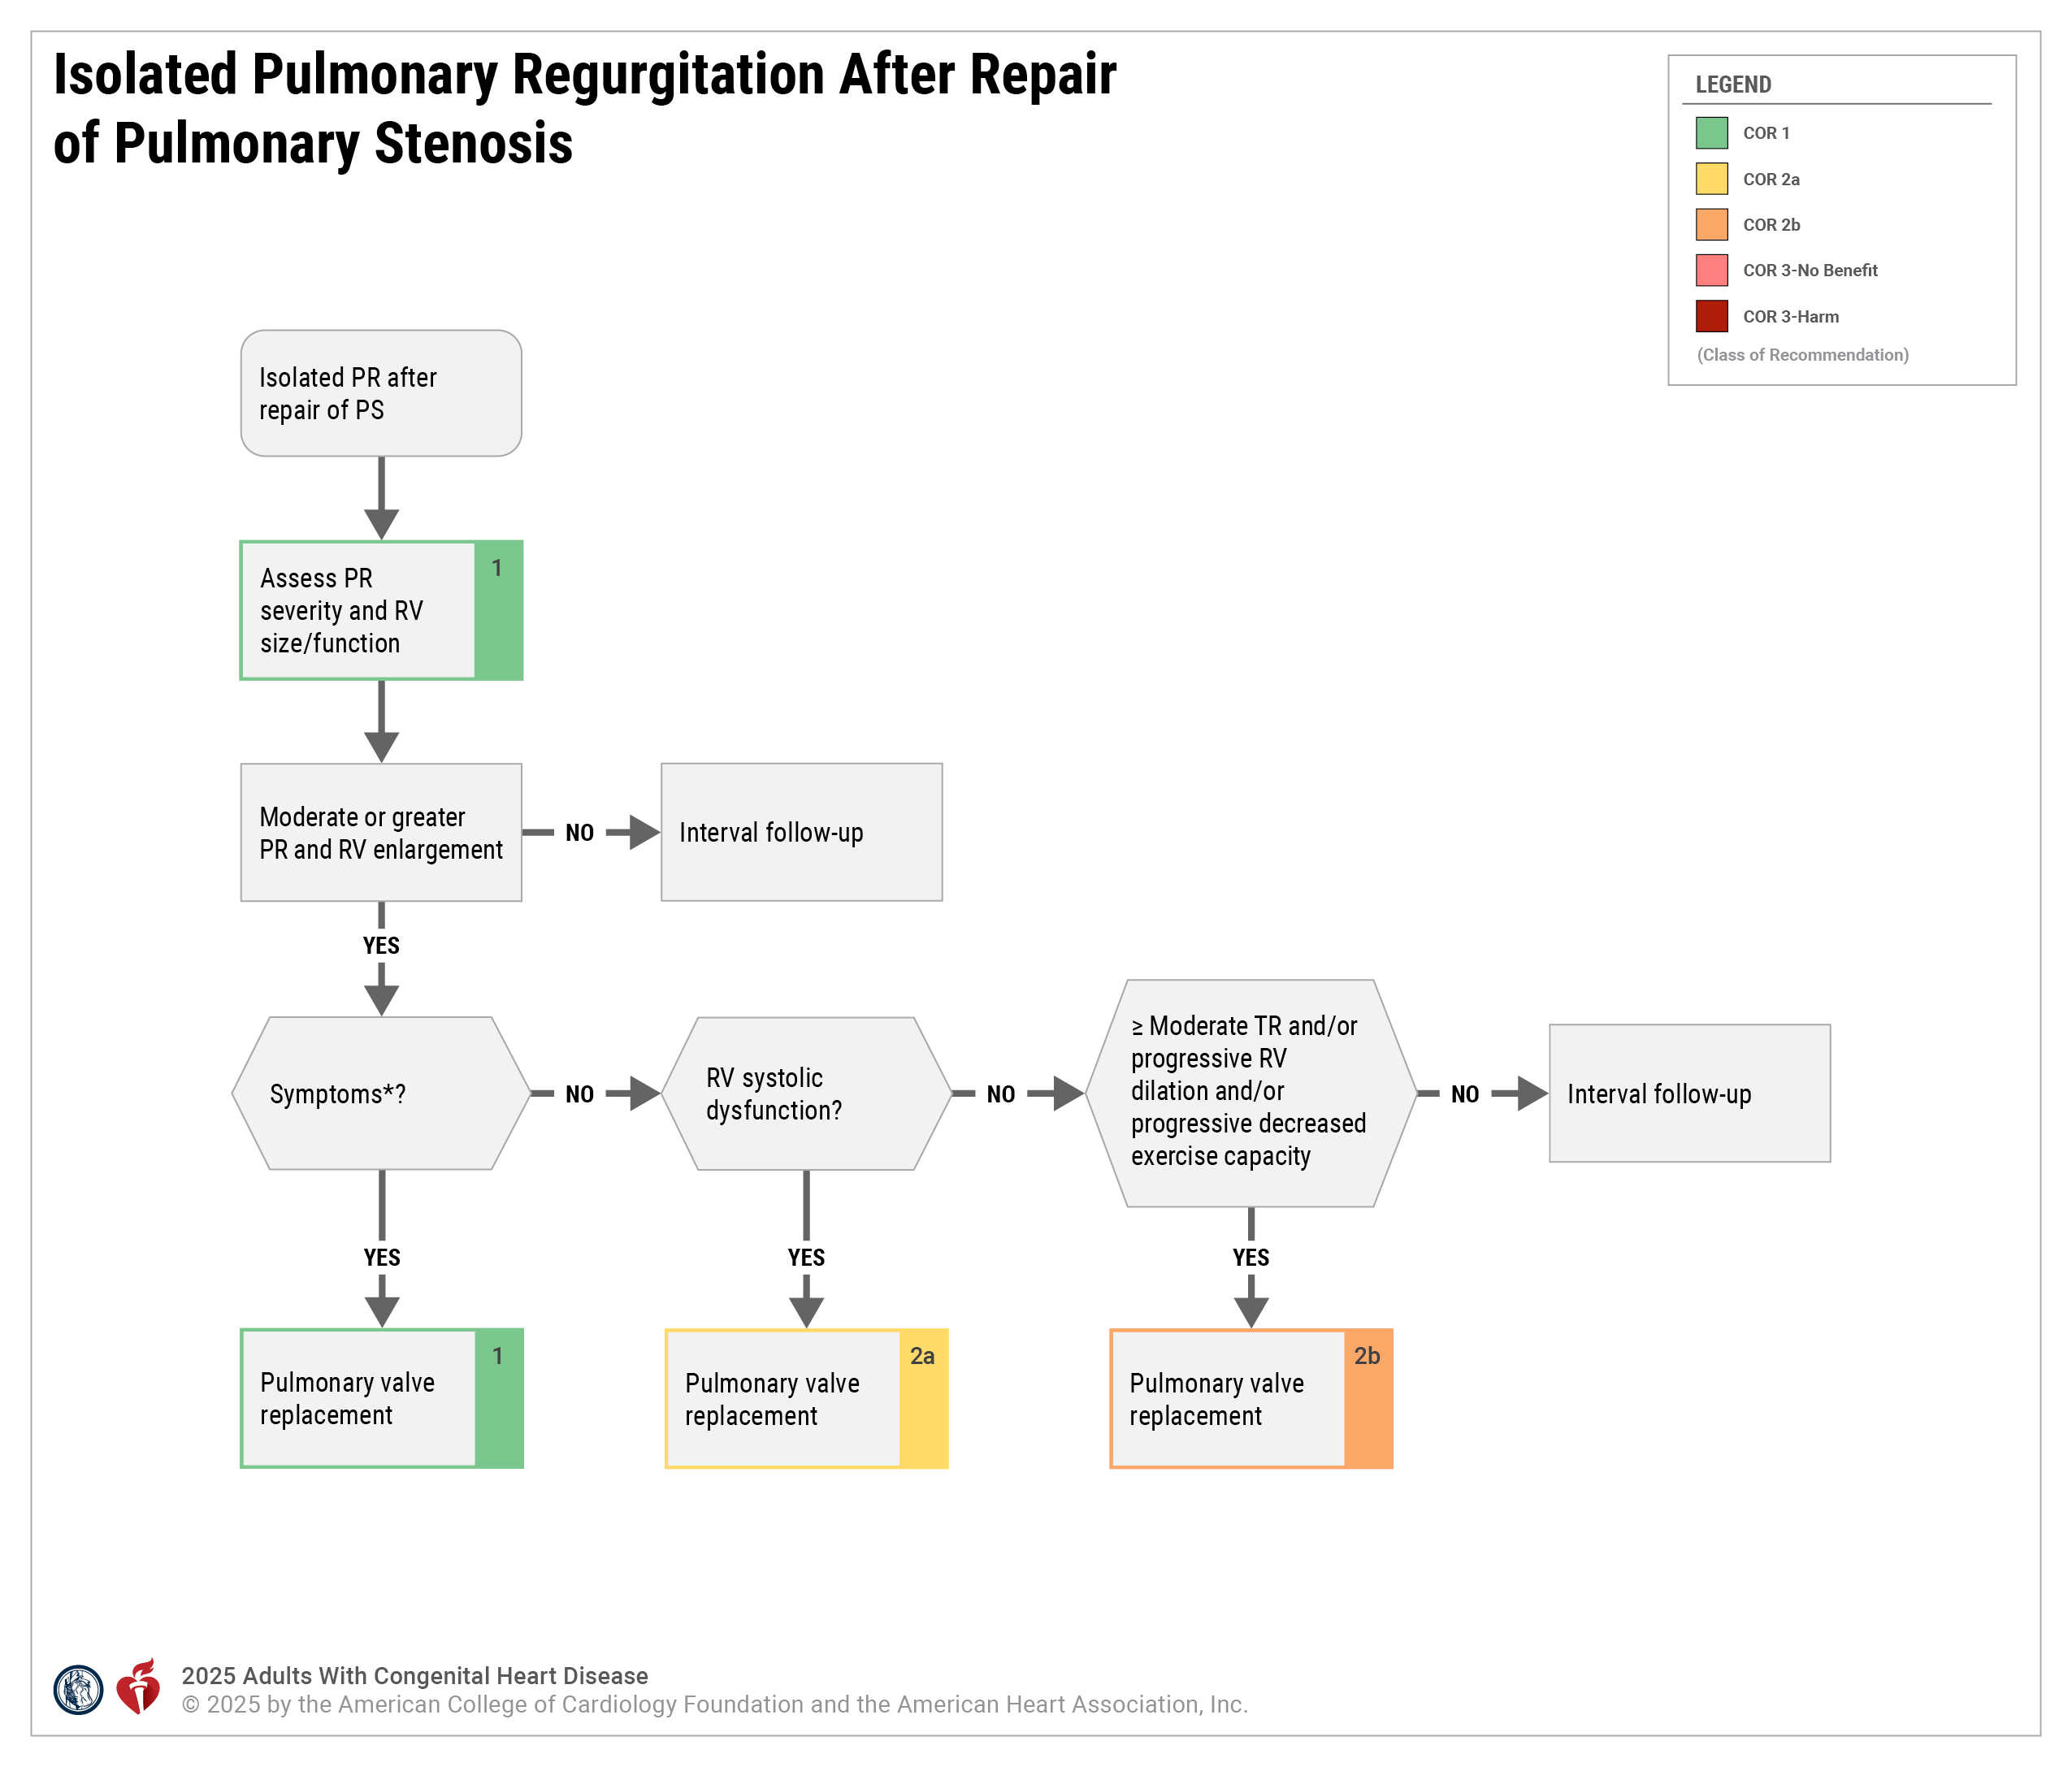
Figure 5. Isolated Pulmonary Regurgitation After Repair of Pulmonary Stenosis.
For routine follow-up and testing intervals, see Table 29.
*Symptoms may include dyspnea, chest pain, and/or exercise intolerance attributable to PR or otherwise unexplained.
PR indicates pulmonary regurgitation; PS, pulmonary stenosis; RV, right ventricular; and TR, tricuspid regurgitation.
Modified with permission from Stout et al. Copyright 2018 American Heart Association, Inc. and American College of Cardiology Foundation.

Slide 137
Table 29. Isolated Pulmonary Regurgitation After Repair of Pulmonary Stenosis
Type of Follow-Up or Testing | Physiological Stage A* (mo) | Physiological Stage B* (mo) | Physiological Stage C* (mo) | Physiological Stage D* (mo)
Outpatient ACHD cardiologist | 36–60 | 24 | 6–12 | 3–6
Electrocardiogram | 36–60 | 24 | 12 | 12
Transthoracic echocardiogram | 36–60 | 24 | 12 | 12
For recommendations about timing of CMR imaging, see Section 4.3.2.1 supportive text for recommendation #1.
Modified with permission from Stout et al. Copyright 2018 American Heart Association, Inc. and American College of Cardiology Foundation.
*See Section 2.2 for details on the ACHD anatomic and physiological classiﬁcation system.
ACHD indicates adult congenital heart disease; and CMR, cardiovascular magnetic resonance.

Slide 138
Management of Double-Chambered Right Ventricle
 |  | Recommendations for the Management of Double-Chambered Right Ventricle Referenced studies that support recommendations are summarized in the Evidence Table.
COR | LOE | Recommendations
Diagnostic
2a | C-LD | In adults with RV dysfunction or symptoms attributed to DCRV, cardiac catheterization is reasonable to characterize anatomy and severity.
2a | C-EO | In adults with DCRV and moderate or greater RVOT obstruction, diagnostic assessment with CMR (or, if contraindicated, cardiac CT) can be beneficial to characterize the anatomy.*
Therapeutic
1 | C-LD | In adults with DCRV, moderate or greater RVOT obstruction, and otherwise unexplained symptoms of heart failure, cyanosis, or exercise limitation, surgical repair is recommended to improve symptoms.
2a | C-LD | In asymptomatic adults with DCRV and severe RVOT obstruction, surgical repair is reasonable to prevent symptoms and adverse RV remodeling.
*Table 27 delineates levels of severity of RVOT obstruction and their related echocardiographic parameters.

Slide 139
Table 30. Double-Chambered Right Ventricle: Routine Follow-Up and Testing Intervals
Type of Follow-Up or Testing | Physiological Stage A* (mo) | Physiological Stage B* (mo) | Physiological Stage C* (mo) | Physiological Stage D* (mo)
Outpatient ACHD cardiologist | 24–36 | 24 | 6–12 | 3–6
Electrocardiogram | 24–36 | 24 | 12 | 12
Transthoracic echocardiogram | 24–36 | 24 | 12 | 6–12
For recommendations about timing of CMR and CT imaging, see Section 4.3.3 supportive text for recommendation #2.
Modified with permission from Stout et al. Copyright 2018 American Heart Association, Inc. and American College of Cardiology Foundation.
*See Section 2.2 for details on the ACHD anatomic and physiological classiﬁcation system.
ACHD indicates adult congenital heart disease; CMR, cardiovascular magnetic resonance; and CT, computed tomography.

Slide 140
Isolated Branch Pulmonary Artery Stenosis
 | Recommendations for Isolated Branch Pulmonary Artery Stenosis Referenced studies that support recommendations are summarized in the Evidence Table.
COR | LOE | Recommendations
 |  | Diagnostic
1 | B-NR | In adults with peripheral or branch PA stenosis, echocardiography and cross-sectional imaging (cardiac CT or CMR) are recommended to evaluate RV pressure and systolic function, degree of tricuspid regurgitation, and degree and location of stenosis.

Slide 141
Isolated Branch Pulmonary Artery Stenosis (con’t.)
 |  | Therapeutic
1 | B-NR | In adults with symptoms related to peripheral or branch PA stenosis, pulmonary branch balloon angioplasty and/or stent implantation is recommended to improve hemodynamics and symptoms.
2a | B-NR | In asymptomatic adults with isolated peripheral PA stenosis* and any of the following—RV hypertension that is more than half the systemic pressure, RV dysfunction, moderate or greater degree of tricuspid regurgitation, or worsening exercise performance—pulmonary branch balloon angioplasty and stent implantation can be useful to improve hemodynamics, reduce tricuspid regurgitation, and improve pulmonary blood flow.
*Angiographic narrowing and/or asymmetric pulmonary blood flow with a reduction >10% in expected perfusion to the affected lung.

Slide 142
Table 31. Isolated Branch Pulmonary Artery Stenosis: Routine Follow-Up and Testing Intervals
Type of Follow-Up or Testing | Physiological Stage A* (mo) | Physiological Stage B* (mo) | Physiological Stage C* (mo) | Physiological Stage D* (mo)
Outpatient ACHD cardiologist | 24–36 | 24 | 6–12 | 3–6
Electrocardiogram | 24–36 | 24 | 12 | 12
Transthoracic echocardiogram | 24–36 | 24 | 12 | 12
For recommendations about timing of CT and MR angiography, see Section 4.3.4 supportive text for recommendation #1.
Modified with permission from Stout et al. Copyright 2018 American Heart Association, Inc. and American College of Cardiology Foundation.
*See Section 2.2 for details on the ACHD anatomic and physiological classification system.
ACHD indicates adult congenital heart disease; CT, computed tomography; and MR, magnetic resonance.

Slide 143
Tetralogy of Fallot
 | Recommendations for Tetralogy of Fallot Referenced studies that support recommendations are summarized in the Evidence Table.
COR | LOE | Recommendations
Diagnostic
1 | B-NR | In adults with repaired TOF, echocardiography is recommended for assessment of pulmonary and tricuspid valve dysfunction, right atrial size, ventricular size and function, residual VSDs, and estimation of RV systolic pressure to characterize residual hemodynamic sequelae.
1 | B-NR | In adults with repaired TOF and residual hemodynamic sequelae, CMR imaging is recommended for quantifying pulmonary valve function, ventricular size and function, and branch PA size and flow; characterizing the right and LVOT anatomy; quantifying residual shunts or aortopulmonary collateral flow; and assessing fibrosis and viability of the ventricular myocardium.
1 | B-NR | In adults with repaired TOF undergoing right ventricle-to-pulmonary artery (RV-to-PA) conduit stenting or transcatheter pulmonary valve placement with a balloon-expandable platform, assessment of coronary artery compression risk is indicated to ensure absence of coronary artery compression from stent/valve placement.

Slide 144
Tetralogy of Fallot (con’t.)
1 | B- NR | In adults with repaired TOF and native RVOT anatomy being considered for transcatheter pulmonary valve replacement, cardiac CT is recommended to determine anatomic suitability.
2a | B-NR | In adults with repaired TOF and moderate risk for future sustained ventricular tachycardia and/or SCD, invasive electrophysiology evaluation is reasonable to inform clinical management.
2a | C- EO | In adults with repaired TOF in whom adequate data cannot be obtained noninvasively in the setting of an arrhythmia, heart failure, unexplained ventricular dysfunction, suspected pulmonary hypertension, residual hemodynamic lesions, or cyanosis, cardiac catheterization with angiography is reasonable for assessing hemodynamics to direct management and therapies.
2b | C-LD | In adults with repaired TOF undergoing pulmonary valve placement (surgical or transcatheter), preprocedural invasive electrophysiology evaluation with programmed ventricular stimulation and 3-dimensional mapping may be considered to identify and treat latent monomorphic ventricular tachycardia substrates.

Slide 145
Tetralogy of Fallot (con’t.)
2b | C-LD | In adults with repaired TOF, noninvasive evaluation (12-lead electrocardiography, contrast-enhanced MR imaging, and/or CT angiography) may be considered to characterize ventricular tachycardia substrates.
Therapeutic
1 | B-NR | In symptomatic adults with repaired TOF and moderate or greater pulmonary valve dysfunction,* pulmonary valve replacement (surgical or transcatheter) is recommended for relief of symptoms.
2a | B- NR | In asymptomatic adults with repaired TOF, moderate or greater pulmonary valve dysfunction,* and at least 2 of the following—RV end-systolic volume index >80 mL/m², RV end-diastolic volume ≥2x LV end-diastolic volume, RV ejection fraction ≤46%, LV ejection fraction ≤50%, or progressive decline in exercise capacity—pulmonary valve replacement (surgical or transcatheter) is reasonable for improving outcomes, including lowering risks for ventricular arrhythmias and death.
2a | B-NR | In adults with repaired TOF and high risk (by clinical markers and/or multivariable score†) for SCD, placement of an ICD is reasonable to prevent SCD.

Slide 146
Tetralogy of Fallot (con’t.)
2a | B-NR | In adults with repaired TOF and appropriate ICD therapies for monomorphic ventricular tachycardia, adjunctive catheter ablation is reasonable to reduce ventricular tachyarrhythmia burden.
2a | C-LD | In adults with repaired TOF with moderate or greater pulmonary valve dysfunction* and progressive ventricular systolic dysfunction, pulmonary valve replacement (surgical or transcatheter) is reasonable to preserve ventricular function.
2b | C-LD | In adults with repaired TOF with at least moderate pulmonary valve dysfunction* and progressive functional tricuspid regurgitation of a moderate or greater severity associated with RV dilation, pulmonary valve intervention may be reasonable to prevent worsening tricuspid valve dysfunction and RV dilation.
2b | C-LD | For carefully selected patients with repaired TOF and hemodynamically tolerated monomorphic ventricular tachycardia related to a well-defined anatomical isthmus, ablation monotherapy may be considered in lieu of ICD placement at centers with ACHD electrophysiology expertise.
2b | C-LD | In adults with repaired TOF and moderate or greater pulmonary regurgitation and ventricular tachyarrhythmia requiring treatment,‡ pulmonary valve replacement (surgical or percutaneous), in addition to electrophysiological intervention, may be considered.

Slide 147
Tetralogy of Fallot (con’t.)
*Pulmonary valve dysfunction defined as moderate PR (CMR-derived RF ≥25%) or RVSP >2/3 systemic pressure due to RVOT obstruction.
†Refer to Table 32 and Table 33 for individual risk scores.
‡Antiarrhythmic classes I/III or amiodarone, catheter ablation, electrical cardioversion, defibrillation, pace-termination, or ICD shock for sustained ventricular arrhythmia.

Slide 148
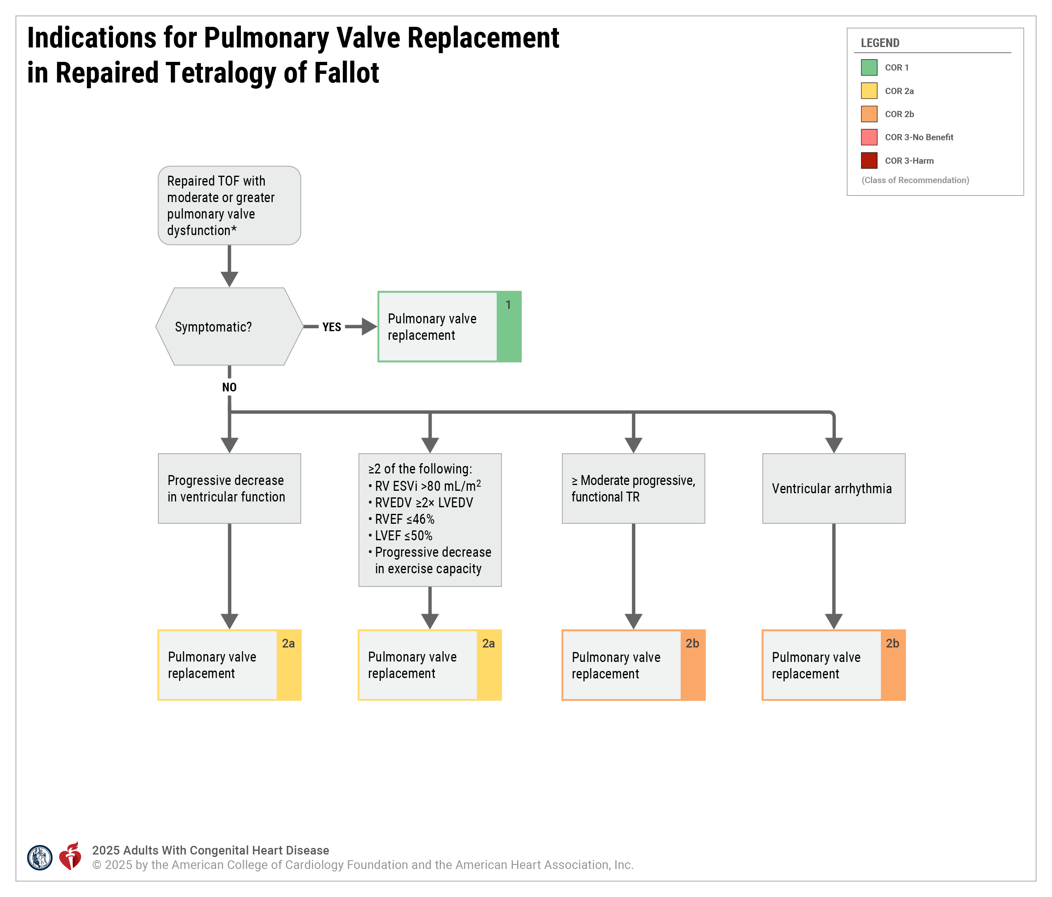
Figure 6. Indications for Pulmonary Valve Replacement in Repaired Tetralogy of Fallot.
*Pulmonary valve dysfunction defined as moderate PR (CMR-derived RF ≥25%) or RVSP >2/3 systemic pressure due to RVOTO.
CMR indicates cardiovascular magnetic resonance; ESVi, end-systolic volume index; LVEDV, left ventricular end-diastolic volume; LVEF, left ventricular ejection fraction; PR, pulmonary regurgitation; RF, regurgitant fraction; RV, right ventricular; RVEDV, right ventricular end-diastolic volume; RVEF, right ventricular ejection fraction; RVOTO, right ventricular outflow tract obstruction; RVSP, right ventricular systolic pressure; TOF, tetralogy of Fallot; and TR, tricuspid regurgitation.
Modified with permission from Stout et al. Copyright 2018 American Heart Association, Inc. and American College of Cardiology Foundation.

Slide 149
Table 32. Established Risk Factors for Sustained Monomorphic Ventricular Tachycardia/Sudden Cardiac Death in Repaired Tetralogy of Fallot
QRS duration ≥180 ms
Moderate or greater LV or RV dysfunction
Prior ventriculotomy
Late age at definitive repair
Symptomatic nonsustained ventricular tachycardia/arrhythmic symptoms
QRS fragmentation
Inducible sustained ventricular arrhythmia at invasive electrophysiology study
LV indicates left ventricular; and RV, right ventricular.

Slide 150
Table 33. Published Risk Scores for Calculating Risk for Sustained Ventricular Tachycardia/Sudden Cardiac Death in Repaired Tetralogy of Fallot
PREVENTION-ACHD | Brompton, UK | PACES
Case-control design | Observational design | Case-control design
Outcome: SCD | Outcome: SCD, sustained VT, resuscitated VF | Outcome: SCD, sustained VT, appropriate ICD shock
783 patients | 550 patients | 286 patients
8 events | 29 events | 70 events

Slide 151
Table 33. Published Risk Scores for Calculating Risk for Sustained Ventricular Tachycardia/Sudden Cardiac Death in Repaired Tetralogy of Fallot (con’t.)
Risk factor* | Points | Risk factor† |  | Points | Risk factor* or † | Points
 |  |  |  |  | Surgical era | <1980 | ≥1980
Coronary artery disease | 1 | RV LGE extent |  |  | Arrhythmic symptoms | 3 | 3
NYHA II-III symptoms | 1 |  | Moderate | 22 | ≥ Moderate LV dysfunction | 3 | 3
Supraventricular tachycardia | 1 |  | Severe | 24 | ≥ Moderate RV dysfunction | 2 | 1
Systemic EF<40% | 1 | LV LGE present |  | 11 | ≥ Moderate RV pressure | 1 | 1
Subpulmonary EF<40% | 1 | RVEF |  |  | ≥ Moderate RV volume | 1 | 1
QRS duration ≥120 ms | 1 |  | 36-47% | 8 | Age at repair <6.5 | 2 | 0
QT dispersion ≥70 ms | 1 |  | ≤35% | 16 | Shunt pre-repair | 2 | 1
 |  | LVEF |  |  | Complex repair | 1 | 2
 |  |  | 36-55% | 5 | QRS duration ≥180 ms | 1 | 1
 |  |  | ≤35% | 17 | Sustained/nonsustained VT | 1 | 1

Slide 152
Table 33. Published Risk Scores for Calculating Risk for Sustained Ventricular Tachycardia/Sudden Cardiac Death in Repaired Tetralogy of Fallot (con’t.)
 |  | Peak VO₂ ≤17 mL/kg/m² | 9
 |  | BNP ≥127 ng/L | 9
 |  | Akinetic RVOT length ≥55 mm | 9
 |  | RV pressure ≥47 mm Hg | 5
Total score | Annual event rate | Total score | Annual event rate | Total score | Risk category
0-2 | <1% | 0-20 | 0.20% | <3 | Low
3 | 1%-2% | 21-39 | 0.90% | 3-6 | Moderate
4 | 3%-4% | ≥40 | 3.70% | 7-9 | High
5 | 5%-10% |  |  | >9 | Very high
6 | 11%-25%
7 | >25%

Slide 153
Table 33. Published Risk Scores for Calculating Risk for Sustained Ventricular Tachycardia/Sudden Cardiac Death in Repaired Tetralogy of Fallot (con’t.)
* Echocardiographic values
† CMR values
ACHD indicates adult congenital heart disease; BNP, B-type natriuretic peptide; CMR, cardiovascular magnetic resonance; EF, ejection fraction; ICD, implantable cardioverter-defibrillator; LGE, late gadolinium enhancement; LV, left ventricular; NYHA, New York Heart Association; RV, right ventricular, RVOT, RV outflow tract; SCD, sudden cardiac death; VF, ventricular fibrillation; and VT, ventricular tachycardia.

Slide 154
Table 34. Repaired Tetralogy of Fallot: Routine Follow-Up and Testing Intervals
Type of Follow-Up or Testing | Physiological Stage A* (mo) | Physiological Stage B* (mo) | Physiological Stage C* (mo) | Physiological Stage D* (mo)
Outpatient ACHD cardiologist | 12–24 | 12–24 | 12 | 3–6
Electrocardiogram | 24 | 12–24 | 12 | 12
Transthoracic echocardiogram | 24 | 12–24 | 12 | 6–12
For timing of routine CMR and cardiac CT, see Section 4.3.5 supportive text for recommendations #2–5.
Modified with permission from Stout et al. Copyright 2018 American Heart Association, Inc. and American College of Cardiology Foundation.
*See Section 2.2 for details on the ACHD anatomic and physiological classiﬁcation system.
ACHD indicates adult congenial heart disease; CMR, cardiovascular magnetic resonance; and CT, computed tomography.

Slide 155
Management of RV-to-PA Conduits
 | Recommendations for Management of RV-to-PA Conduits Referenced studies that support recommendations are summarized in the Evidence Table.
COR | LOE | Recommendations
Diagnostic
1 | B-NR | In patients undergoing RV-to-PA conduit stent implantation and/or transcatheter pulmonary valve implantation, preprocedural assessment of the risk for coronary artery compression should be performed to prevent coronary artery obstruction.
1 | B-NR | In patients with a stent implanted within an RV-to-PA conduit who have unanticipated progression in conduit dysfunction, imaging should be performed to rule out conduit stent fracture.
1 | B-NR | In patients with an RV-to-PA conduit, with or without transcatheter pulmonary valve implantation, unexpected conduit dysfunction with worsening pulmonary stenosis or pulmonary regurgitation should prompt an evaluation to rule out infective endocarditis and/or thrombus.

Slide 156
Management of Right Ventricle-to-Pulmonary Artery Conduits (con’t)
2a | C-LD | In adults with an RV-to-PA conduit and unexplained sustained arrhythmia, heart failure symptoms, ventricular dysfunction, or cyanosis, cardiac catheterization is reasonable to assess the hemodynamics to guide further management.
2a | C-LD | In adults with an RV-to-PA conduit being considered for transcatheter intervention, preprocedural coronary CT is reasonable to assess conduit calcification, anatomic characteristics, and coronary artery proximity to guide procedural planning.
Therapeutic
1 | B-NR | For adults with an RV-to-PA conduit, severe stenosis and/or severe regurgitation, and symptoms or worsening functional capacity or a sustained arrhythmia, conduit intervention should be performed to improve cardiovascular status.*¹¹⁻¹³
2a | B-NR | For adults with an RV-to-PA conduit, moderate stenosis and/or moderate regurgitation, and symptoms or worsening functional capacity or a sustained arrhythmia, conduit intervention is reasonable to improve cardiovascular status.*
2a | B-NR | For asymptomatic adults with an RV-to-PA conduit and severe stenosis and/or severe regurgitation, and reduced RV ejection fraction, RV dilation, or progressive tricuspid valve regurgitation to at least moderate, conduit intervention is reasonable to improve cardiovascular status.*
*For criteria for interventions in patients with repaired TOF and an RV-to-PA conduit, refer to Section 4.3.5, “TOF.”

Slide 157
Table 35. Right Ventricle to Pulmonary Artery Conduit: Routine Follow-Up and Testing Intervals
Type of Follow-Up or Testing | Physiological Stage A* (mo) | Physiological Stage B* (mo) | Physiological Stage C* (mo) | Physiological Stage D* (mo)
Outpatient ACHD cardiologist | N/A | 12 | 6–12 | 3–6
Electrocardiogram | N/A | 12 | 12 | 12
Transthoracic echocardiogram† | N/A | 12 | 12 | 6–12
Modified with permission from Stout et al. Copyright 2018 American Heart Association, Inc. and American College of Cardiology Foundation.
*See Section 2.2 for details on the ACHD anatomic and physiological classiﬁcation system.
ACHD indicates adult congenital heart disease; and N/A, not applicable.

Slide 158
Patients With dextro-Transposition of the Great Arteries and Atrial Switch
 | Recommendations for Patients With dextro-Transposition of the Great Arteries and Atrial Switch Referenced studies that support recommendations are summarized in the Evidence Table.
COR | LOE | Recommendations
Diagnostic
1 | B-NR | Adults with dextro-transposition of the great arteries (d-TGA) and atrial switch who have progressive exercise intolerance or heart failure should undergo imaging with transthoracic echocardiogram and CMR imaging to assess ventricular, valve, baffle, and pathway function to detect and identify treatable hemodynamic lesions.
1 | B-NR | Adults with d-TGA and atrial switch who present with progressive exercise intolerance or heart failure should undergo CPET to assess for potential intervention targets, including arrhythmia and desaturation.
1 | B-NR | Adults with d-TGA and atrial switch with progressive exercise intolerance, heart failure, pulmonary hypertension, worsening atrial or ventricular tachyarrhythmia, pathway obstruction, or baffle leak should undergo invasive hemodynamic assessment to identify targets for medical, percutaneous, or surgical intervention.

Slide 159
Patients With dextro-Transposition of the Great Arteries and Atrial Switch (con’t)
1 | C-LD | Adults with d-TGA and atrial switch who require permanent pacemaker or an ICD should undergo preprocedural imaging, in addition to intraprocedural contrast venography, to detect baffle stenosis and residual baffle leaks.
2a | B-NR | For adults with d-TGA and atrial switch, biomarkers and validated disease-specific risk scores can be useful to identify patients at high risk for adverse cardiac events, prompting closer follow-up and referral to specialized heart failure transplant centers.
2a | B-NR | In adults with d-TGA and atrial switch with new or progressive symptoms of heart failure, it is reasonable to obtain a resting electrocardiogram and outpatient ambulatory rhythm monitoring, to ensure timely diagnosis and treatment of tachyarrhythmia or bradyarrhythmia.
2b | B-NR | In adults with d-TGA and atrial switch, it may be reasonable to apply disease-specific scores to identify patients at increased risk for sustained ventricular tachyarrhythmia and/or SCD, in order to determine eligibility for a primary-prevention ICD.

Slide 160
Patients With dextro-Transposition of the Great Arteries and Atrial Switch (con’t)
Therapeutic
1 | B-NR | In adults with d-TGA and atrial switch who have atrial arrhythmias, rhythm control strategies are preferable to rate control strategies to reduce symptoms and prevent heart failure.
1 | C-LD | Adults with d-TGA and atrial switch who have symptoms attributable to a baffle leak should undergo closure of the leak to improve symptoms and quality of life.
1 | C-LD | In adults with d-TGA and atrial switch who have symptoms attributable to systemic or pulmonary venous pathway stenosis or liver congestion, intervention to relieve the stenosis is indicated to improve symptoms and prognosis.
1 | C-LD | Adults with d-TGA and atrial switch who have worsening symptoms of exercise intolerance, heart failure, or arrhythmia refractory to treatment should be referred to a heart failure program for assessment for mechanical support and transplantation in consultation with an ACHD cardiologist, to improve quality of life and prolong survival.

Slide 161
Patients With dextro-Transposition of the Great Arteries and Atrial Switch (con’t)
2a | C-LD | In adults with d-TGA and atrial switch who have sustained intra-atrial reentrant arrhythmias or atrial fibrillation, oral anticoagulation can be useful to prevent embolic events.
2a | C-EO | Adults with d-TGA and atrial switch who require transvenous lead placement can benefit from catheter-based interventions to address residual baffle leaks or obstruction before lead placement, to reduce the risk for systemic thromboembolism and/or future baffle occlusion.
2b | B-NR | Symptomatic adults with d-TGA and atrial switch who have a failing systemic right ventricle and a QRS duration >150 ms related to chronic ventricular pacing may be considered for CRT to improve symptoms.
2b | B-R | In adults with d-TGA and atrial switch who have heart failure with reduced RV function, it may be reasonable to use GDMT for heart failure with reduced ejection fraction in order to treat the heart failure and improve symptoms, ventricular function, and outcomes.

Slide 162
Table 36. Patients With d-TGA and Atrial Switch: Routine Testing and Follow-Up Intervals
Type of Follow-Up or Testing | Physiological Stage A* | Physiological Stage B* (mo) | Physiological Stage C* (mo) | Physiological Stage D* (mo)
Outpatient ACHD cardiologist | N/A | 12–24 | 12 | 3–6
Electrocardiogram | N/A | 12–24 | 12 | 12
Transthoracic echocardiogram | N/A | 12–24 | 12 | 12
For recommendations on routine Holter monitoring, see supportive text for recommendation #6. For recommendations about timing of CMR, see supportive text for recommendation #1.
Modified with permission from Stout et al. Copyright 2018 American Heart Association Inc. and American College of Cardiology Foundation.
*See Section 2.2 for details on the ACHD anatomic and physiological classiﬁcation system.
ACHD indicates adult congenital heart disease; CMR, cardiovascular magnetic resonance; d-TGA, dextro-transposition of the great arteries; and N/A, not applicable.

Slide 163
Arterial Switch Operation
 | Recommendations for Arterial Switch Operation Referenced studies that support recommendations are summarized in the Evidence Table.
COR | LOE | Recommendations
Diagnostic
1 | B-NR | In adults with an arterial switch operation, baseline and serial imaging with both echocardiography and CMR imaging should be performed periodically to assess neoaortic size, valve function, PA or branch PA morphology, and ventricular function.
1 | C-LD | In adults with an arterial switch operation and symptoms concerning for myocardial ischemia, coronary evaluation with coronary angiography, cross-sectional imaging, and/or functional coronary assessment for an anatomic etiology should be performed.
2a | B-NR | In asymptomatic adults with an arterial switch operation, baseline anatomic assessment of coronary artery anatomy and patency with gated cardiac CT is reasonable to evaluate for postoperative complications and/or high-risk features.

Slide 164
Arterial Switch Operation (con’t.)
Therapeutic
1 | C-EO | In adults with an arterial switch operation and evidence of myocardial ischemia, coronary revascularization should be performed to reduce symptoms and improve outcomes.
2a | C-EO | In adults with an arterial switch operation and symptoms attributable to moderate or greater supravalvar or branch PA stenosis, intervention is reasonable to improve symptoms and functional class.
2a | C-EO | In asymptomatic adults with an arterial switch operation who have moderate or greater supravalvar or branch PA stenosis—in addition to RV hypertension, RV dysfunction, progressive tricuspid regurgitation, and/or objective decline in exercise capacity—intervention can be useful to relieve obstruction.
2b | B-NR | In adults with an arterial switch operation and severe neoaortic root dilation who have progressive neoaortic valve insufficiency and/or rapid root growth or for whom a neoaortic valve intervention is planned, neoaortic root replacement may be considered to prevent worsening neoaortic regurgitation.

Slide 165
Table 37. Patients With d-TGA and Arterial Switch: Routine Follow-Up and Testing Intervals
Type of Follow-Up or Testing | Physiological Stage A* (mo) | Physiological Stage B* (mo) | Physiological Stage C* (mo) | Physiological Stage D* (mo)
Outpatient ACHD cardiologist | 12–24 | 12 | 6–12 | 3–6
Electrocardiogram | 12–24 | 12–24 | 12 | 6
Transthoracic echocardiogram† | 12–24 | 12–24 | 12 | 12
For recommendations about timing of cardiac CT and CMR imaging, see supportive text for recommendations #1–3. For suggested frequency of CMR imaging,‡ see supportive text for recommendation #1.
Modified with permission from Stout et al. Copyright 2018 American Heart Association, Inc. and American College of Cardiology Foundation.
*See Section 2.2 for details on the ACHD anatomic and physiological classiﬁcation system.
†Routine transthoracic echocardiography may be further deferred during an interval when CMR is performed.
‡CMR should include assessment of neoaortic size, the origin and proximal course of the coronary arteries, branch pulmonary arteries, ventricular function, and valvular function.
ACHD indicates adult congenital heart disease; CMR, cardiovascular magnetic resonance; and CT, computed tomography.

Slide 166
Patients With d-TGA and Rastelli Repair
 | Recommendation for Patients With d-TGA and Rastelli Repair Referenced studies that support recommendation are summarized in the Evidence Table.
COR | LOE | Recommendation
Diagnostic
1 | B-NR | In adults with d-TGA and Rastelli repair, imaging is recommended to ensure timely identification of complications, including stenosis and/or regurgitation of the RV-to-PA conduit, residual VSDs, LVOT obstruction, and RV dysfunction.

Slide 167
Table 38. Patients With d-TGA and Rastelli Operation: Routine Follow-Up and Testing Intervals
Type of Follow-Up or Testing | Physiological Stage A* (mo) | Physiological Stage B* (mo) | Physiological Stage C* (mo) | Physiological Stage D* (mo)
Outpatient ACHD cardiologist | N/A | 12–24 | 12 | 3–6
Electrocardiogram | N/A | 12–24 | 12 | 12
Transthoracic echocardiogram | N/A | 12–24 | 12 | 12
For recommendations about timing of cardiac CT and CMR imaging, see supportive text for recommendation #1.
*See Section 2.2 for details on the ACHD anatomic and physiological classiﬁcation system.
ACHD indicates adult congenital heart disease; d-TGA, dextro-transposition of the great arteries; and N/A, not applicable.

Slide 168
Management of CCTGA
 | Recommendations for Management of CCTGA Referenced studies that support recommendations are summarized in the Evidence Table.
COR | LOE | Recommendations
Diagnostic
1 | B-NR | In adults with congenital CCTGA, periodic* transthoracic echocardiography is recommended to assess chamber function, systemic tricuspid valve function, and associated anatomic lesions such as septal defects and LVOT stenosis.
2a | B-NR | In adults with CCTGA, periodic cross-sectional imaging (preferably, CMR) is reasonable to assess systemic ventricular volumes and function, quantify the severity of systemic tricuspid regurgitation, and assess the severity of associated anatomic lesions.
2a | B-NR | In adults with CCTGA without symptoms, periodic ambulatory rhythm monitoring is reasonable to screen for high-grade atrioventricular block.
*See Table 39 for details on the periodicity of testing.

Slide 169
Management of CCTGA (con’t.)
Therapeutic
1 | B-NR | In symptomatic adults with CCTGA, severe systemic tricuspid regurgitation, and normal or mildly impaired RV systolic function, surgical tricuspid valve replacement is recommended to relieve symptoms and preserve RV function.
2a | B-NR | In asymptomatic adults with CCTGA, severe systemic tricuspid regurgitation, and normal or mildly impaired RV systolic function, surgical tricuspid valve replacement is reasonable to preserve RV systolic function.
2a | B-NR | In symptomatic adults with CCTGA and high-grade atrioventricular block, physiological pacing (CRT or conduction system pacing) is reasonable to relieve symptoms.
2b | B-NR | In adults with CCTGA and heart failure with RV dysfunction, the use of GDMT may be reasonable to improve ventricular function and functional capacity.
2b | B-NR | In symptomatic adults with CCTGA and severe LVOT stenosis, surgical or transcatheter therapy to relieve LVOT obstruction may be considered to improve symptoms and preserve LV systolic function while accounting for the potential risk of worsening the severity of tricuspid regurgitation.

Slide 170
Table 39. Congenitally Corrected Transposition of the Great Arteries: Routine Follow-Up and Testing Intervals
Type of Follow-Up or Testing | Physiological Stage A* | Physiological Stage B* (mo) | Physiological Stage C* (mo) | Physiological Stage D* (mo)
Outpatient ACHD cardiologist | N/A | 12 | 12 | 6
Electrocardiogram | N/A | 12 | 12 | 12
Transthoracic echocardiogram | N/A | 12 | 12 | 12
For recommendations regarding CMR and cardiac CT, see supportive text for recommendation #2.
For recommendations regarding ambulatory rhythm monitoring, see supportive text for recommendation #3.
Modified with permission from Stout et al. Copyright 2018 American Heart Association, Inc. and American College of Cardiology Foundation.
*See Section 2.2 for details on the ACHD anatomic and physiological classification system.
ACHD indicates adult congenital heart disease; CMR, cardiovascular magnetic resonance; CT, computed tomography; and N/A, not applicable.

Slide 171
Table 40. Truncus Arteriosus: Routine Follow-Up and Testing Intervals
Type of Follow-Up or Testing | Physiological Stage A* (mo) | Physiological Stage B* (mo) | Physiological Stages C* (mo) | Physiological Stage D* (mo)
Outpatient ACHD cardiologist | N/A | 12 | 3–6 | 3–6
Electrocardiogram | N/A | 12 | 6–12 | 6–12
Transthoracic echocardiogram | N/A | 12 | 6–12 | 6–12
*See Section 2.2 for details on the ACHD anatomic and physiological classification system.
ACHD indicates adult congenital heart disease; and N/A, not applicable.

Slide 172
Table 41. Surgical Management Options for Types of Double-Outlet Right Ventricle
Type of Double-Outlet Right Ventricle Physiology | Surgical Management Options
Ventricular septal defect type with double-outlet right ventricle | Left ventricle to aorta intracardiac baffle
Tetralogy of Fallot type with pulmonary stenosis or atresia | Left ventricle to aorta intracardiac baffle with right ventricular outflow tract reconstruction or right ventricle to pulmonary artery conduit
dextro-transposition of the great arteries type | Arterial switch operation with closure of ventricular septal defect; Rastelli-type repair; aortic translocation
Hypoplastic ventricle with single-ventricle type physiology | Fontan operation

Slide 173
Fontan Palliation of Single-Ventricle Physiology
 | Recommendations for Fontan Palliation of Single-Ventricle Physiology Referenced studies that support recommendations are summarized in the Evidence Table.
COR | LOE | Recommendations
Diagnostic
1 | B-NR | In adults with Fontan circulation and evidence of progressive Fontan circulatory failure, formal evaluation by a heart failure/transplant cardiologist with experience in heart transplantation in the adult Fontan population is recommended.
1 | C-LD | In adults with Fontan circulation, imaging and laboratory evaluation of the liver should be performed at least annually to screen for hepatocellular carcinoma and for evidence of progressive Fontan-associated liver disease (FALD).
1 | C-EO | In adults being considered for Fontan palliation or Fontan conversion, cardiac catheterization should be performed to ensure the presence of acceptable hemodynamics.
1 | C-EO | In adults with Fontan circulation and new-onset or worsening atrial tachyarrhythmias, evaluation with imaging and follow-up cardiac catheterization as indicated is recommended to assess for potential contributory anatomic or hemodynamic abnormalities and Fontan-pathway thrombosis.

Slide 174
Fontan Palliation of Single-Ventricle Physiology (con’t.)
1 | C-EO | In adults with Fontan circulation and new or progressive symptoms, hypoxemia, declining functional status, or evidence of progressive or new-onset noncardiac organ dysfunction, hemodynamic evaluation with cardiac catheterization is recommended to guide therapy.
1 | C-EO | In adults with Fontan circulation and newly progressive or severe hypoxemia or hypotension, evaluation with advanced cardiac imaging (MR, CT, transesophageal echocardiography) is recommended to rule out thrombus or emboli in the Fontan or pulmonary vasculature.
1 | C-EO | In adults with Fontan circulation undergoing CT angiography to rule out thrombus or emboli in the Fontan or pulmonary vasculature, imaging should be performed using protocols to avoid false-negative or false-positive results.
1 | C-EO | In adults with Fontan circulation, annual laboratory evaluation is recommended to assess for evidence of organ-system dysfunction or hematologic abnormality.
2a | C-EO | In adults with Fontan circulation, consultation by a hepatologist, in collaboration with an ACHD cardiologist, is reasonable to facilitate interpretation of hepatic testing, diagnose and treat complications related to portal hypertension, and participate in timing and management decisions specific to organ transplantation.

Slide 175
Fontan Palliation of Single-Ventricle Physiology (con’t.)
2a | C-LD | In adults with Fontan circulation, liver biopsy can be helpful to delineate the degree of hepatic fibrosis or cirrhosis before consideration of transplantation.
2b | C-LD | In adults with Fontan circulation undergoing cardiac catheterization (diagnostic, interventional, or electrophysiological), it may be reasonable to exclude Fontan-related thrombus before catheter placement to avoid pulmonary or systemic thromboembolism.
Therapeutic
1 | B-NR | In adults with Fontan circulation and a known or suspected thrombus, atriopulmonary Fontan, a history of thromboembolism, or a history of sustained atrial flutter or fibrillation, anticoagulation is recommended to reduce the likelihood of thromboembolic disease.
1 | B-NR | In adults with Fontan circulation and the absence of high-risk features (history of thromboembolism, sustained atrial flutter/fibrillation, or atriopulmonary Fontan) or bleeding contraindications, treatment with either aspirin or anticoagulation is recommended to reduce the probability of thromboembolic disease.
1 | B-NR | In adults with Fontan circulation and sinus node dysfunction requiring pacemaker placement, atrial-based pacing with programming to minimize ventricular pacing is recommended to improve patient symptoms and to avoid pacing-induced cardiomyopathy.

Slide 176
Fontan Palliation of Single-Ventricle Physiology (con’t.)
1 | C-LD | In adults with Fontan circulation with new-onset atrial flutter or atrial fibrillation, timely cardioversion (pharmacological or electrical) is recommended to prevent clinical decompensation.
1 | C-EO | Adults with Fontan circulation referred for cardiac transplantation should undergo pretransplantation review by a committee with broad multidisciplinary representation to improve patient selection and posttransplant outcomes.
2a | B-NR | In adults with Fontan circulation and atrioventricular block whose burden of ventricular pacing is likely to be high (ie, >40%), apical site pacing is preferred over nonapical sites to improve transplant-free survival.
2a | B-NR | In adults with Fontan circulation, formal exercise programs and/or cardiac rehabilitation (appropriate to the patient’s ability) can be beneficial in improving functional capacity.
2a | C-LD | In adults with Fontan circulation and recurrent supraventricular tachycardia, catheter ablation performed by an electrophysiologist with experience in ACHD is reasonable to reduce arrhythmia recurrence and associated morbidity.

Slide 177
Fontan Palliation of Single-Ventricle Physiology (con’t.)
2a | C-EO | In adults with Fontan circulation and hemodynamically significant stenosis of the Fontan or PAs, catheter-based stenting of the stenosis to reduce Fontan pressure and improve flow is reasonable to improve hemodynamics.
2a | C-EO | In symptomatic adults with Fontan circulation, or those with evidence of systemic ventricular volume overload, closure of aortopulmonary collaterals to improve symptoms and reduce the likelihood of pathologic ventricular remodeling can be useful.
2b | B-R | In adults with Fontan circulation, treatment with pulmonary vasodilators may be considered to improve exercise capacity.
2b | C-LD | In adults with an atriopulmonary Fontan, preserved ventricular function, and acceptable surgical risk with atrial arrhythmias refractory to medical and catheter-based therapies, Fontan conversion surgery may be considered to reduce arrhythmia recurrence.
2b | C-EO | In adults with Fontan circulation and symptoms or Fontan circulatory failure attributable to significant intracardiac structural or anatomic abnormalities, reoperation may be considered to improve symptoms or reduce the likelihood of progressive Fontan circulatory failure.

Slide 178
Table 42. Fontan Palliation: Routine Follow-Up and Testing Intervals
Type of Follow-Up or Testing | Physiological Stage A* (mo) | Physiological Stage B* (mo) | Physiological Stage C* (mo) | Physiological Stage D* (mo)
Outpatient ACHD cardiologist | N/A | 12 | 6–12 | 3–6
Electrocardiogram | N/A | 12 | 6–12 | 6–12
Transthoracic echocardiogram | N/A | 12 | 12 | 6–12
For recommendations about timing of CMR imaging, see Section 4.4.5 supportive text for recommendations #6 and #7. For recommendations about timing of liver imaging, see Section 4.4.5 supportive text for recommendation #2.
Modified with permission from Stout et al. Copyright 2018 American Heart Association, Inc. and American College of Cardiology Foundation.
*See Section 2.2 for details on the ACHD anatomic and physiological classification system.
ACHD indicates adult congenital heart disease; CMR, cardiovascular magnetic resonance; and N/A, not applicable.

Slide 179
HLHS/Norwood Repair
 | Recommendation for HLHS/Norwood Repair Referenced studies that support recommendation are summarized in the Evidence Table.
COR | LOE | Recommendation
Diagnostic
2a | C-EO | In patients with HLHS, routine 3-dimensional imaging of the neoaorta to assess for dilation and obstruction is reasonable.

Slide 180
Eisenmenger Syndrome
 | Recommendations for Eisenmenger Syndrome Referenced studies that support recommendations are summarized in the Evidence Table.
COR | LOE | Recommendations
Diagnostic
1 | B-NR | In adults with suspected Eisenmenger syndrome, invasive hemodynamic assessment should be performed to confirm the diagnosis and to exclude concomitant disease that contributes to right-to-left shunting or PAH.
1 | B-NR | Adults with Eisenmenger syndrome should be managed by specialists with expertise in both congenital cardiology and PAH to improve outcomes.
3: Harm | B-NR | Adults with Eisenmenger syndrome should be advised against pregnancy to decrease the risk associated with excess maternal morbidity and mortality.

Slide 181
Eisenmenger Syndrome (con’t.)
Therapeutic
1 | B-R | In adults with Eisenmenger syndrome and an LV ejection fraction >40% who are symptomatic or have reduced exercise capacity, initial monotherapy with PAH-directed therapy* is recommended to improve symptoms, hemodynamics, and overall survival.
1 | B-NR | In adults with Eisenmenger syndrome and an LV ejection fraction >40% who remain symptomatic or have worsening exercise capacity on a single PAH therapy, dual combination therapy with an endothelin receptor antagonist and a phosphodiesterase-5 inhibitor is recommended to improve symptoms, hemodynamics, and overall survival.
1 | C-LD | In adults with Eisenmenger syndrome who present with atrial arrhythmias, prompt restoration and maintenance of sinus rhythm is recommended to avoid hemodynamic deterioration.
2a | C-LD | In adults with Eisenmenger syndrome, a regular exercise program in combination with directed PAH therapy can be effective in improving exercise capacity.

Slide 182
Eisenmenger Syndrome (con’t.)
2b | C-LD | In adults with Eisenmenger syndrome and LV ejection fraction >40% who are deemed to be at high risk for adverse outcomes† or who have rapidly progressive disease, inhaled or subcutaneous prostacyclin therapy may be considered as initial therapy or as an addition to other PAH therapy to improve symptoms, exercise capacity, and hemodynamics.
2b | C-EO | In adults with Eisenmenger syndrome, anticoagulation therapy may be considered for patients with high-risk features (atrial arrhythmia, new or enlarging pulmonary arterial thrombosis, or prior thromboembolic event) and low bleeding risk to prevent thromboembolic complications.
3: No Benefit | B-NR | Adults with Eisenmenger syndrome should not be routinely prescribed oral anticoagulation given the high bleeding risk and lack of long-term survival benefit.
3: Harm | B-NR | In adults with Eisenmenger syndrome, closure of any intracardiac or vascular shunt should not be performed given the increased perioperative risks and risks for short- and long-term morbidity and mortality.
3: Harm | B-NR | In adults with Eisenmenger syndrome and intracardiac shunts who meet indications for permanent pacing or an ICD, endocardial leads may be potentially harmful given the increased risk for systemic thromboembolism.

Slide 183
Eisenmenger Syndrome (con’t.)
Recommendations on managing chronic cyanosis—including, but not limited to, management of iron supplementation, hyperviscosity, and risk and management of central nervous system infections—generally apply to patients with Eisenmenger syndrome and are provided in Section 3.5, “Management of Cyanosis.”
*See Table 43 for evidence and recommendations on specific PAH therapies.
†Patients at high risk include patients with World Health Organization functional class 3 or 4, a 6-minute walk distance <165 m, tricuspid annular plane systolic excursion <16 mm, and NT-proBNP level >1,400 pg/mL.³¹

Slide 184
Table 43. First-Line PAH-Directed Therapy in Patients With Eisenmenger Syndrome
Medication Class | Clinical Trial Evidence | 2022 ESC/ERS Guidelines for the Diagnosis and Treatment of Pulmonary Hypertension | 2025 ACC/AHA Guidelines for the Management of Adults with Congenital Heart Disease
Endothelin receptor antagonists | Two moderate-size randomized controlled trials of bosentan (BREATHE 5 trial, 54 patients) and macitentan (MAESTRO trial, 226 patients) evaluated the effects of endothelin receptor antagonists in Eisenmenger syndrome. BREATHE 5 showed improvement in hemodynamics and functional class after 16 weeks of treatment. The MAESTRO trial design was different and included a more heterogeneous patient population, including wider age range, wider spectrum of functional classes, patients on background therapy with PDE5 inhibitors, and patients with Down syndrome. The primary endpoint, which consisted of 6MWD, was neutral. Secondary endpoints of functional class and NT-proBNP levels favored macitentan therapy. In a subgroup of patients aged ≥18 years who had a follow-up invasive hemodynamic assessment and did not have Down syndrome, those in the macitentan group had hemodynamic improvement, which was also associated with an improvement in 6MWD. | Bosentan is a class 1 recommendation; other endothelin receptor antagonists “should be considered” in patients with Eisenmenger syndrome (class 2a recommendations). | All endothelin receptor antagonists are recommended as initial treatment in patients with Eisenmenger syndrome (class 1 recommendation).

Slide 185
Table 43. First-Line PAH-Directed Therapy in Patients With Eisenmenger Syndrome (con’t.)
Medication Class | Clinical Trial Evidence | 2022 ESC/ERS Guidelines for the Diagnosis and Treatment of Pulmonary Hypertension | 2025 ACC/AHA Guidelines for the Management of Adults with Congenital Heart Disease
Phosphodiesterase-5 inhibitors | A small randomized controlled trial (28 patients) and a retrospective observational study showed improvements in 6MWD, functional status, and hemodynamics without a significant reduction in SVR. | Phosphodiesterase-5 inhibitors “should be considered” in patients with Eisenmenger syndrome (class 2a recommendation). | All phosphodiesterase-5 inhibitors are recommended as initial treatment in patients with Eisenmenger syndrome (class 1 recommendation).
Soluble guanylate cyclase stimulator (riociguat) | Data on Eisenmenger syndrome are currently lacking. A subgroup analysis of the trials that had shown benefit in PAH (PATENT 1+2) demonstrated that in patients with persistent or recurrent PAH after congenital heart defect correction, riociguat use was associated with sustained improvement in 6MWD, PVR, NT-proBNP level, and WHO functional class at 2 years. | Riociguat “should be considered” in patients with Eisenmenger syndrome (class 2a recommendation). | No specific recommendation due to lack of data.

Slide 186
Table 43. First-Line PAH-Directed Therapy in Patients With Eisenmenger Syndrome (con’t.)
Medication Class | Clinical Trial Evidence | 2022 ESC/ERS Guidelines for the Diagnosis and Treatment of Pulmonary Hypertension | 2025 ACC/AHA Guidelines for the Management of Adults with Congenital Heart Disease
Prostacyclin analogs and receptor agonists | Data on the effects of inhaled iloprost are conflicting, with 1 small randomized controlled trial (16 patients) showing no effect on 6MWD, BNP levels, or quality of life, whereas 1 small single-arm study (11 patients) showed an increase in 6MWD, subjective quality of life, and RV function. There are no data on subcutaneous/intravenous prostacyclin or oral prostacyclin receptor agonist therapy (selexipag) as a stand-alone initial treatment. | Initial prostacyclin therapy “should be considered” in patients with Eisenmenger syndrome (class 2a recommendation). | Initial inhaled prostacyclin therapy may be considered in patients with Eisenmenger syndrome (class 2b recommendation).
Activin signaling inhibitors | No data are currently available on the activin signaling inhibitor sotatercept in patients with Eisenmenger syndrome. | No recommendation | No recommendation

Slide 187
Table 43. First-Line PAH-Directed Therapy in Patients With Eisenmenger Syndrome (con’t.)
6MWD indicates 6-minute walk distance; ACC, American College of Cardiology; AHA, American Heart Association; BNP, B-type natriuretic peptide; BREATHE-5, Bosentan Randomized Trial of Endothelin Antagonist Therapy-5; ERS, European Respiratory Society; ESC, European Society of Cardiology; MAESTRO, Macitentan in Eisenmenger Syndrome to Restore Exercise Capacity; NT-proBNP, N-terminal prohormone of B-type natriuretic peptide; PAH, pulmonary arterial hypertension; PATENT 1+2, Pulmonary Arterial hypertension sGC-stimulator Trial; PVR, pulmonary vascular resistance; SVR, systemic vascular resistance; and WHO, World Health Organization.

Slide 188
Table 44. Eisenmenger Syndrome: Routine Follow-Up and Testing Intervals
Type of Follow-Up or Testing | Physiological Stage A* (mo) | Physiological Stage B* (mo) | Physiological Stage C* (mo) | Physiological Stage D* (mo)
Outpatient ACHD cardiologist | N/A | N/A | 6–12 | 3–6
Electrocardiogram | N/A | N/A | 6–12 | 6–12
Transthoracic echocardiogram | N/A | N/A | 12 | 6–12
*See Section 2.2 for details on the ACHD anatomic and physiological classification system.
ACHD indicates adult congenital heart disease; and N/A, not applicable.

Slide 189
Anomalous Aortic Origin of a Coronary Artery
 | Recommendations for Anomalous Aortic Origin of a Coronary Artery Referenced studies that support recommendations are summarized in the Evidence Table.
COR | LOE | Recommendations
Diagnostic
1 | B-NR | In adults with suspected anomalous origin of a coronary artery (AAOCA), coronary CT angiography or MR angiography (if CT angiography is contraindicated) is recommended to confirm the anatomic diagnosis and guide management.
1 | B-NR | In adults with an AAOCA from the opposite sinus, risk stratification with evaluation for physiological and/or ischemic changes should be performed to guide management.

Slide 190
Anomalous Aortic Origin of a Coronary Artery (con’t.)
Therapeutic
1 | B-NR | In adults with symptomatic AAOCA or diagnostic evidence consistent with myocardial ischemia attributable to the anomalous artery, surgery is recommended.
2a | C-EO | In adults with asymptomatic anomalous origin of the left coronary artery, surgery is reasonable in the presence of high-risk anatomy.*
2b | B-NR | In asymptomatic adults with an AAOCA from the opposite sinus and without evidence of ischemia or evidence of compromised coronary perfusion, the benefit of surgery is not well established, and continued observation or surgery may be reasonable.
*High-risk findings such as ostial or proximal stenosis, slit-like orifice, acute angle of takeoff, or intramural course.

Slide 191
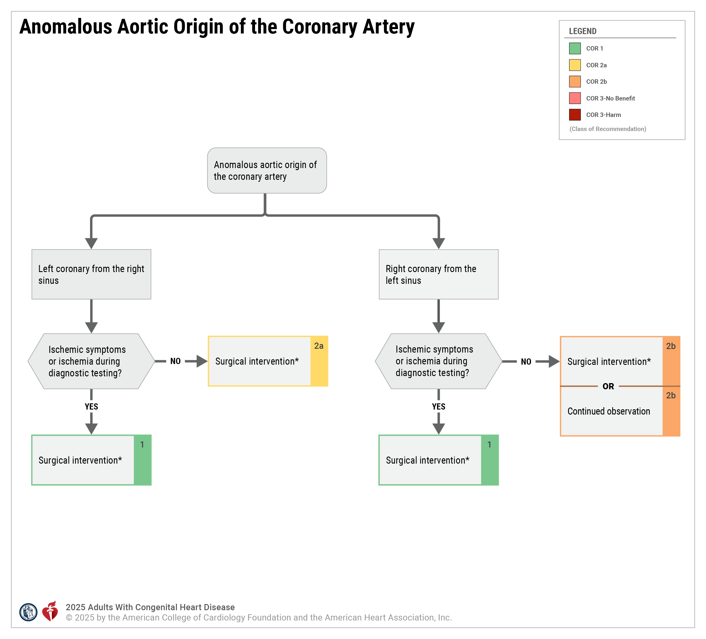
Figure 7. Anomalous Aortic Origin of the Coronary Artery.
*Surgical approaches include coronary unroofing with or without osteoplasty, coronary reimplantation, and pulmonary translocation. Coronary artery bypass graft is reserved for patients with coexisting coronary artery disease.
Modified with permission from Stout et al. Copyright 2018 American Heart Association, Inc. and American College of Cardiology Foundation.

Slide 192
Table 45. Anomalous Aortic Origin of a Coronary Artery: Routine Follow-Up and Testing Intervals
Type of Follow-Up or Testing | Physiological Stage A* (mo) | Physiological Stage B* (mo) | Physiological Stage C* (mo) | Physiological Stage D* (mo)
Outpatient ACHD cardiologist | 24–36 | 12 | 12 | 12
Electrocardiogram | 24–36 | 12 | 12 | 12
Transthoracic echocardiogram | 24–36 | 24 | 12 | 12
For recommendations on routine CT and MR angiography, see supportive text for recommendations #1 and #2.
*See Section 2.2 for details on the ACHD anatomic and physiological classification system.
ACHD indicates adult congenital heart disease; CT, computed tomography; and MR, magnetic resonance.

Slide 193
Anomalous Coronary Artery Arising From the Pulmonary Artery
 | Recommendations for Anomalous Coronary Artery Arising From the Pulmonary Artery Referenced studies that support recommendations are summarized in the Evidence Table.
COR | LOE | Recommendations
1 | B-NR | In adults with an anomalous left coronary artery arising from the PA, surgery is recommended to improve cardiac function and reduce the risk for myocardial ischemia.
1 | B-NR | In symptomatic adults with an anomalous right coronary artery arising from the PA and with evidence of ischemia, surgery is recommended to reduce ischemia, to reduce the risk for SCD, and to improve cardiac function.
2b | B-NR | In asymptomatic adults with an anomalous right coronary artery arising from the PA and without evidence of cardiac dysfunction or ischemia, surgery may be considered to avoid the development of cardiac dysfunction.

Slide 194
Vascular Rings and Pulmonary Artery Slings
 | Recommendations for Vascular Rings and Pulmonary Artery Slings Referenced studies that support recommendations are summarized in the Evidence Table.
COR | LOE | Recommendations
Diagnostic
1 | B-NR | For adults with unexplained symptoms of airway or esophageal compression that raise concern for vascular ring or PA sling, anatomic assessment with cross-sectional imaging of the aortic arch and PAs is recommended.
1 | B-NR | For adults with persistent symptoms of airway or esophageal compression after repair of vascular ring or PA sling, cross-sectional advanced imaging is recommended to evaluate postoperative anatomy and indications for additional intervention.
Therapeutic
2a | B-NR | For adults with symptoms of airway or esophageal compression and a vascular ring or PA sling, surgical repair* is reasonable to improve symptoms.
3: No Benefit | B-NR | For asymptomatic adults with a vascular ring or PA sling, surgical repair is not indicated.
*A cardiothoracic surgeon with expertise in ACHD should perform the repair.

Slide 195
Table 46. Anatomy of Vascular Rings
Complete ring Right aortic arch with aberrant left subclavian artery and left ligamentum arteriosum Right aortic arch with mirror image branching and left ligamentum arteriosum extending from descending aorta to main pulmonary artery Left aortic arch with aberrant right subclavian artery and right ligamentum arteriosum Double aortic arch Circumflex aorta
Incomplete ring Left aortic arch with aberrant right subclavian artery Right aortic arch with aberrant left subclavian artery and right ligamentum arteriosum
Other Innominate artery compression syndrome Left pulmonary artery sling
Modified with permission from Porcaro et al via a Creative Commons Attribution 4.0 International License (http://creativecommons.org/licenses/by/4.0/). Copyright 2023 Springer Nature.

Slide 196
Abbreviations
Abbreviation | Meaning/Phrase
AAOCA | anomalous aortic origin of a coronary artery
ACHD | adult congenital heart disease
AP | anatomic and physiological
APVC | anomalous pulmonary venous connection
ASD | atrial septal defect
AVSD | atrioventricular septal defect
BAV | bicuspid aortic valve
BNP | B-type natriuretic peptide
CCTGA | congenitally corrected transposition of the great arteries
CMR | cardiovascular magnetic resonance
COA | coarctation of the aorta
CPET | cardiopulmonary exercise testing
CRT | cardiac resynchronization therapy

Slide 197
Abbreviations (con’t.)
Abbreviation | Meaning/Phrase
DCRV | double-chambered right ventricle
d-TGA | dextro-transposition of the great arteries
FALD | Fontan-associated liver disease
GDMT | guideline-directed medical therapy
HLHS | hypoplastic left heart syndrome
ICD | implantable cardioverter-defibrillator
LV | left ventricular
LVOT | left ventricular outflow tract
MCS | mechanical circulatory support
MR | magnetic resonance
NT-proBNP | N-terminal prohormone of B-type natriuretic peptide
PA | pulmonary artery
PAH | pulmonary arterial hypertension
PA-IVS | pulmonary atresia with intact ventricular septum

Slide 198
Abbreviations (con’t.)
Abbreviation | Meaning/Phrase
PDA | patent ductus arteriosus
PVR | pulmonary vascular resistance
Qp:Qs | pulmonary-to-systemic blood flow ratio
RV | right ventricular
RVEDV | right ventricular end diastolic volume
RVOT | right ventricular outflow tract
RV-to-PA | right ventricle-to-pulmonary artery
SCD | sudden cardiac death
SVASD | sinus venosus atrial septal defect
TOF | tetralogy of Fallot
VSD | ventricular septal defect

