Slide 1
Palliative and End-of-life care in stroke:
A Scientific Statement from the American Heart Association
Claire J. Creutzfeldt, MD, Chair; Julia Bu, MD; Amber Comer, PhD; Susan Enguidanos, PhD; Barbara Lutz, PhD, RN, FAHA; Marisha T. Robinson, MS, MD; Darin B. Zahuranec, MD, FAHA; Robert G. Holloway, MD, MPH, Vice Chair; on behalf of the American Heart Association Stroke Council; Council on Cardiovascular and Stroke Nursing; and Council on Clinical Cardiology

Slide 2
Stroke Council Professional Education Committee
Slide presentation developed by:
Natalie T. Cheng, MD

Slide 3
Palliative and End-of-Life Care in Stroke
Link:
https://www.ahajournals.org/doi/10.1161/STR.0000000000000479
Key words included in the article:
palliative care; stroke; terminal care
Citation:
Creutzfeldt CJ, Bu J, Comer A, Enguidanos S, Lutz B, Robinson MT, Zahuranec DB, Holloway RG; on behalf of the American Heart Association Stroke Council; Council on Cardiovascular and Stroke Nursing; and Council on Clinical Cardiology. Palliative and end-of-life care in stroke: a scientific statement from the American Heart Association. Stroke. Published online December 16, 2024. doi: 10.1161/STR.0000000000000479

Slide 4
Overview & Goal

Slide 5
Overview and goal
overview
Recent advances in acute stroke treatment have led to reduced morbidity and mortality rates, leading to an increased number of survivors who face long-term challenges, ranging from cognitive and physical disabilities to psychosocial and existential distress
Goal
To provide an update on palliative care needs and holistic assessment specific to stroke
To discuss health care disparities specific to stroke and palliative care
To provide key points for clinicians and healthcare systems caring for patients with stroke and their families in the postacute care period and at the end of life

Slide 6
Racial or ethnic health care inequities

Slide 7
Racial or ethnic health care inequities
In Black and Hispanic populations, there is an established trend of higher stroke incidence, worse functional outcomes, and less frequent receipt of acute stroke treatments
Racial and ethnic disparities persist in advance care planning and patterns of serious illness treatment after stroke
In the general population, Black or Hispanic individuals had 77% and 70%, respectively, lower odds of completing an advance directive compared with White individuals
Historically underrepresented racial or ethnic groups are less like than White individuals to have DNR orders or to transition to comfort measures only and more likely to use long-term life-sustaining treatments, such as tracheostomy or percutaneous gastrostomy
In a study of severe acute brain injury, including stroke, Black, Hispanic, and Asian individuals were less frequently discharged to hospice compared to White individuals
Systems-level factors likely contribute to these inequities
Systemic tailored interventions may help mitigate these historical inequities, such as goals-of-care conversation priming guides, use of bilingual and bicultural lay patient navigators, and community-developed culturally based palliative care consultations programs

Slide 8
Palliative care needs and holistic assessment

Slide 9
Total pain of illness
Health care professionals need to focus on sources of distress (physical, emotional, psychosocial, spiritual/existential) and to acknowledge the effect on patients and their family care partners

Slide 10
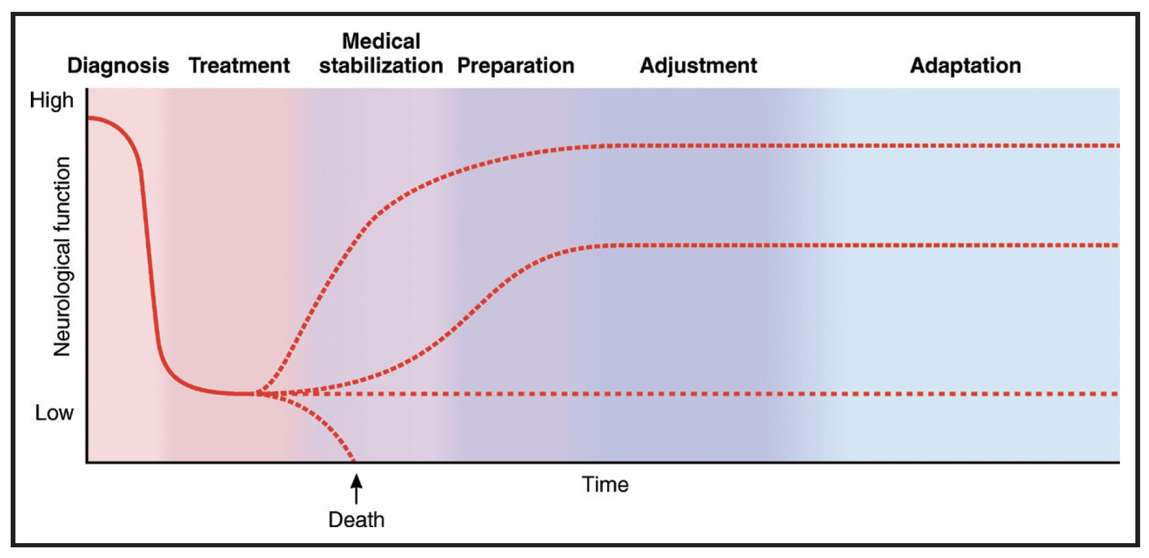
Palliative care Needs
Palliative care needs of patients and their care partners fluctuates over the course of the illness and should be reassessed based on events, symptoms, changes in function, and stage of illness

Slide 11
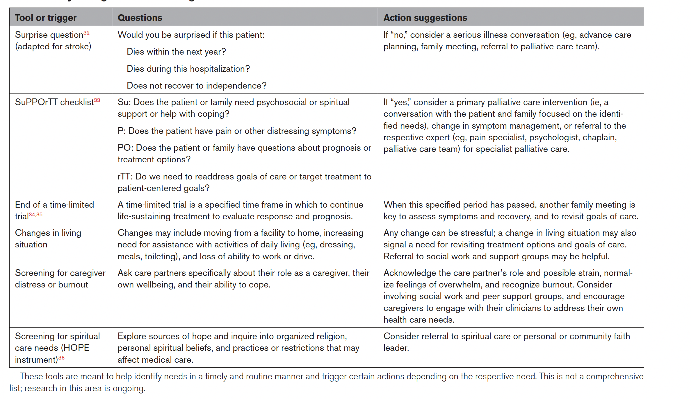
Palliative care NEEDS assessment
Several palliative care needs checklists and screening tools exist to assist health care professionals in helping to recognize and manage palliative care needs

Slide 12
Palliative Care for Stroke in the Postacute SEtting
There is limited evidence to guide how to integrate palliative care into routine stroke care
Community-based palliative care models developed for other serious noncancer illnesses could be adapted for stroke
Interdisciplinary models of specially trained nurses and social workers may be the most effective approach to address the multidimensional needs of patients with stroke and their family care partners

Slide 13
Postacute Care of Family Members
The AHA/American Stroke Association provides support resources for patient with stroke and their family care partners, including caregiver support, financial ramifications of stroke, recipe ideas for patients with dysphagia, and links to local support groups:
https://www.stroke.org/en/help-and-support
Guidance on support resources should be tailored to patients’ individual situations and where they are in the stroke trajectory

Slide 14
End-of-Life Care After STroke
Most patients who die after stroke do so in the hospital or nursing facilities, but the proportion who die at home is increasing
The most commonly documented symptoms after stroke at the end of life are pain and dyspnea. Pain assessments should be done using both verbal and nonverbal indicators of discomfort due to many patients having altered consciousness or difficulty communicating.
Clinicians should counsel families to anticipate reduced food and fluid intake, decreased ability to cough, breathing noises and changes in breathing, reduced circulatory and renal function, reduced levels of consciousness, agitation
Hospice should be considered when oral intake is limited and artificial nutrition is not pursued, complications of stroke occur, imaging indicates a poor prognosis, or coma has persisted for 3 days and is associated with the absence of a verbal response, brainstem reflexes, and withdrawal response to pain

Slide 15
Future directions
Key focus of future research should be how to reliably deliver high-quality goal-concordant care for culturally diverse patients with stroke and their families as well as how to measure the success of this delivery
The concept of palliative pharmacotherapy specific to stroke requires further research
Palliative care teams should be consulted when symptoms are refractory to first-line treatment, care partners are experiencing distress or burnout, or a goals-of-care or prognosis conversation requires more in-depth clinical training

Slide 16
Thank you!

