Slide 1
AHA ScienCe AdvisorY Vascular Neurology Considerations for Anti-amyloid Immunotherapy
Steven M. Greenberg, MD, PhD, FAHA, Vice Chair; Hugo J. Aparicio, MD, MPH, FAHA; Karen L. Furie, MD, MPH; Manu S. Goyal, MD, MSc; Jason D. Hinman, MD, PhD; Mariel Kozberg, MD, PhD; Anne Leonard, MPH, BSN, RN, FAHA; Mark J. Fisher, MD, Chair; on behalf of the American Heart Association Stroke Council; Council on Cardiovascular and Stroke Nursing; and Council on Clinical Cardiology.

Slide 2
Stroke council professional education & SCILL committee
Slide presentation developed by:
Phillip Gorelick MD, FAHA

Slide 3
Vascular Neurology Considerations for Antiamyloid Immunotherapy Link: https://www.ahajournals.org/doi/10.1161/STR.0000000000000480 Note: The URL in this message will be live when the advisory publishes online. Key words included in the article: Alzheimer disease; amyloid; antibodies; cerebral amyloid angiopathy; immunotherapy Citation: Greenberg SM, Aparicio HJ, Furie KL, Goyal MS, Hinman JD, Kozberg M, Leonard A, Fisher MJ; on behalf of the American Heart Association Stroke Council; Council on Cardiovascular and Stroke Nursing; and Council on Clinical Cardiology. Vascular neurology considerations for antiamyloid immunotherapy: a science advisory from the American Heart Association. Stroke. Published online December 11, 2024. doi: 10.1161/STR.0000000000000480

Slide 4
Purpose of this AHA Science Advisory

Slide 5
Purpose of AHA science advisory
Anti–amyloid-βeta (aβ) monoclonal antibody infusion for mild cognitive impairment or mild dementia attributable to Alzheimer disease (AD) is the first food and drug administration (FDA)–approved disease modifying therapy for AD.
Amyloid-related imaging abnormalities (aria), vasogenic edema (ARIA-E) and intracranial micro- or macro-hemorrhages (ARIA-H), are the only major adverse events commonly associated with this class of immunotherapies.
This science advisory provides a set of practical considerations for clinicians consulting on cerebrovascular aspects of anti-aβ monoclonal antibody infusion.
It is not a comprehensive review of aria or a guideline.
Rather, because ARIA-E and ARIA-H are fundamentally cerebrovascular in origin, stroke specialists and clinicians need to be informed whether:
Patients who have indications for antithrombotic therapy are candidates for anti-aβ immunotherapy;
Patients receiving immunotherapy could be treated with thrombolytics or thrombectomy; and
How to treat aria when it occurs.

Slide 6
Background

Slide 7
Background: anti-Aβ monoclonal antibodies
There are 3 FDA-approved anti-AB monoclonal antibodies for treatment of mild cognitive impairment or mild dementia attributable to AD.
Aducanumab, a monoclonal antibody selected for reactivity with AB
aggregates, was granted accelerated approval based on 1 of 2 phase 3 trials; however, its commercialization has been discontinued by its manufacturer.
Lecanemab, a monoclonal antibody reactive to AB protofibrils, was initially granted accelerated approval.
Donanemab, a monoclonal antibody directed against a pyroglutamate
containing form of AB present in AD plaques, slowed decline in a phase 3 trial, and received full FDA approval.

Slide 8
Background: Frequency of ARIA-e and ARIA-H
ARIA-E and ARIA-H are common neuroradiological imaging findings associated with
anti-AB therapies based on its incidence in phase 3 studies:
AB Monoclonal Antibody ARIA-E ARIA-H
Aducanumab (high dose) 35% 28%
Lecanemab 12.6% 17.3%
Donanemab 24% 31.4%
Most of ARIA-E and ARIA-H is detected by radiological imaging as it is usually asymptomatic
or mildly symptomatic with transient reversible clinical manifestations.
Clinical symptoms may include headache, nausea, or altered mental status, however,
focal neurologic findings may be present.
A subset of ≈1% to 2% of treated individuals have ARIA-E, classified as a severe adverse
event, and ≈0.5% have intracranial hemorrhage (ICH) >1 cm in diameter.

Slide 9
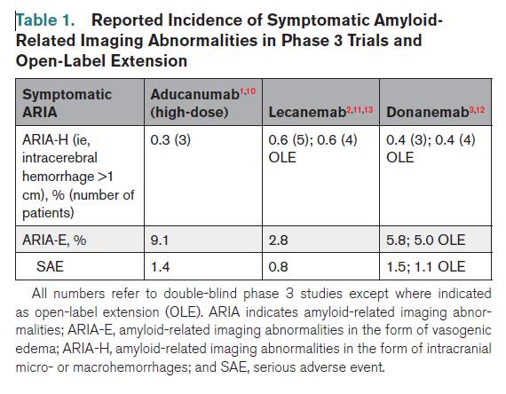
Background: Incidence of Symptomatic ARIA in Phase 3 Trials and Open-label Extension studies
*
*Reference numbers in this slide set refer to references in the AHA Science Advisory by
Greenberg S et al. Stroke 2024; 55:e00–e00. DOI: 10.1161/STR.0000000000000480 TBD 2024.

Slide 10
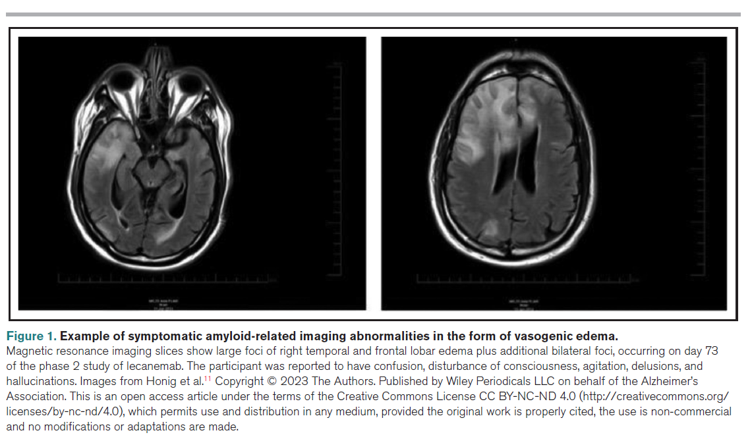
Background: MRI Example of ARIA-E

Slide 11
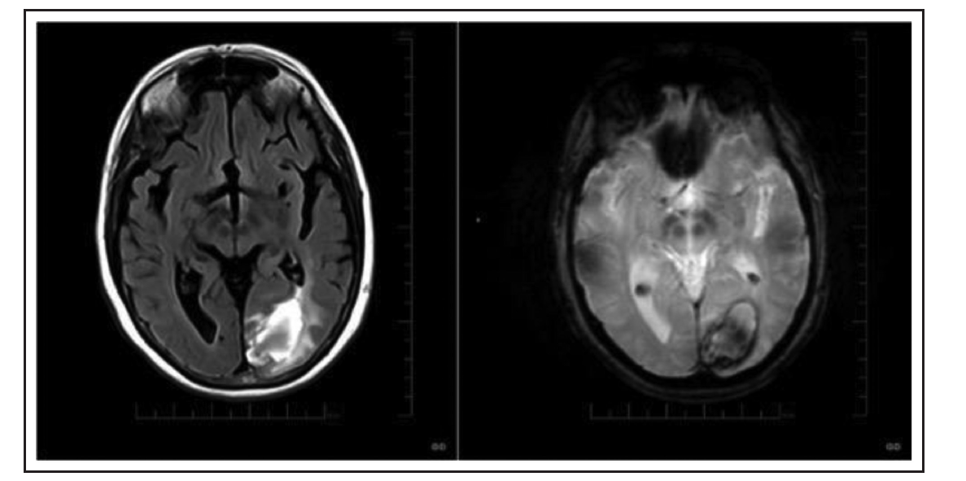
Background: MRI Example of ARIA-H
Figure 2. Example of symptomatic amyloid-related imaging abnormalities in the form intracerebral hemorrhage.

Slide 12
BackgrounD: Mechanisms and Risks For ARIA-E and ARIA-H
The appearance of vasogenic edema and hemorrhagic lesions in ARIA resembles that of cerebral amyloid angiopathy (CAA)–related inflammation (CAA-ri), suggesting a close relationship between the 2 syndromes.
Patients with CAA-ri have been reported to have elevated cerebrospinal fluid
concentrations of AB autoantibodies, suggesting that it may represent a spontaneous
version of the iatrogenic ARIA syndrome.
The observation that markers of CAA such as lobar cerebral microbleeds or cortical
superficial siderosis on baseline magnetic resonance imaging (MRI) predict increased future risk of developing ARIA-E (Table 2), supports a model for ARIA based on binding of the administered antibodies to the vascular AB deposits that make up CAA.
AB immunologically cleared from plaques may relocate into vessels exacerbating
severity of the syndrome.

Slide 13
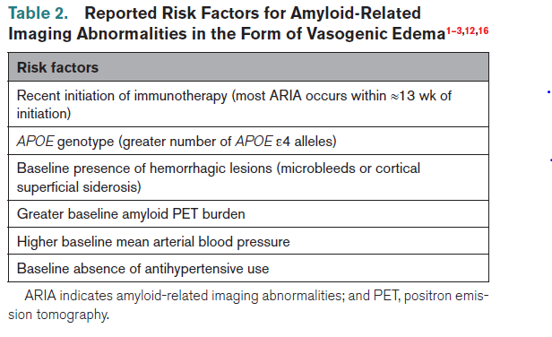
Background: Reported Risks for ARIA-E

Slide 14
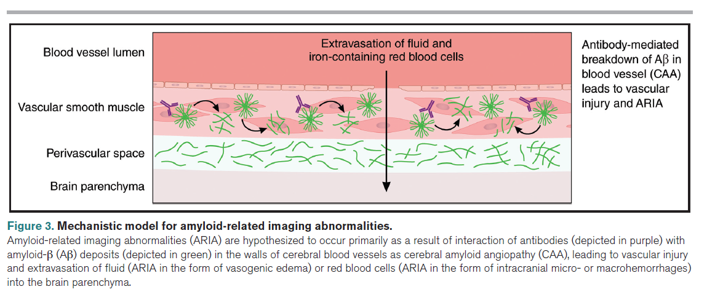
Background: Mechanisms for Amyloid-related imaging abnormalities

Slide 15
CONSIDERATIONS FOR IMMUNOTHERAPY CANDIDATES WITH EVIDENCE OF PREEXISTING CEREBROVASCULAR DISEASE

Slide 16
When there is Evidence of Cerebral Amyloid Angiopathy (CAA)
Should individuals with evidence of CAA be excluded from AB immunotherapy
treatment?
Clinical trials of anti-amyloid therapy excluded persons with:
>4 cerebral microbleeds;
Past ICH; or
At least 1 (aducanumab and lecanemab) or >1 (donanemab) foci of cortical
superficial siderosis.
Hemorrhagic lesions, when restricted to cortical or lobar locations, suggest
advanced CAA pathology.
The FDA labels for aducanumab and lecanemab recommend caution in
treating individuals outside the parameters used for trial enrollment.
Appropriate Use Recommendations indicate that such individuals with the
above trial exclusions be excluded from immunotherapy treatment.

Slide 17
Which Individuals with CAA Should be Considered for Exclusion from anti-ab immunotherapy?
There may be a progressively increasing risk of ARIA-E across categories of 0, 1, and 2 to 4 cerebral microbleeds (donanemab study).
2. APOE genotypes containing the APOE ε4 allele confer increased ARIA risk.
3. Individuals with past ischemic stroke or severe white matter hyperintensities
were excluded from AD immunotherapy trials based on concern that anti-AB
monoclonal therapies might not work in persons with a strong vascular
component to the cognitive syndrome, rather than over concern for ARIA risk.

Slide 18
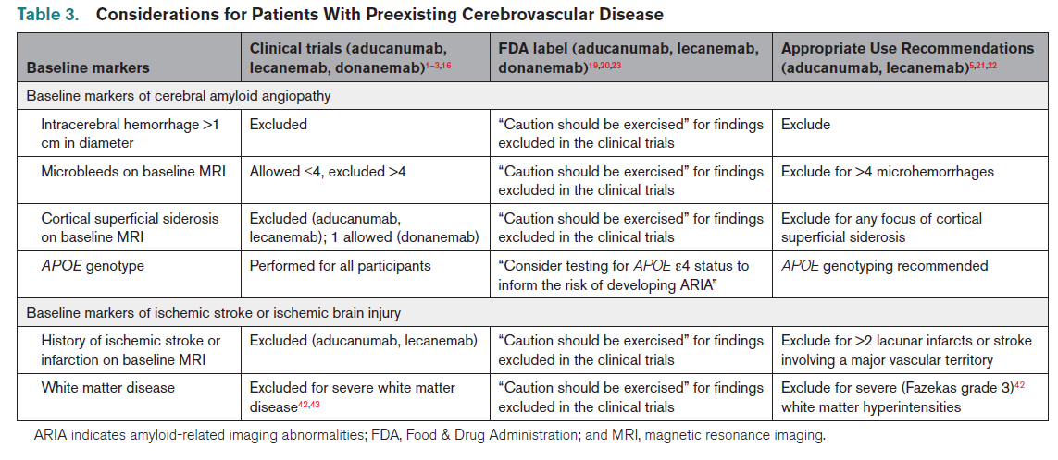
Summary of Considerations for Patients with Pre-Existing Cerebrovascular Disease

Slide 19
CONSIDERATIONS FOR IMMUNOTHERAPY IN CANDIDATES WITH INDICATIONS FOR ANTICOAGULANt, ANTIPLATELET, & THROMBOLYTIC AGENTS

Slide 20
Considerations for Antithrombotic & thrombolytic agents
Prior to administration of antithrombotic or thrombolytic agents, careful consideration must be given as there may be an increase of risk of ICH with use of anti-amyloid agents.
Based on data from randomized and open label extension studies, the risk of symptomatic ICH is in the 2-3% range with concomitant administration of anticoagulation.
Antiplatelet and Anticoagulant Agents:
Antiplatelet monotherapy is thought to be reasonably well tolerated, however, dual
antiplatelet therapy has greater potential to increase the risk of ICH.
Overall, FDA labels have advised “additional caution” in use of concomitant
antithrombotic agents.
Appropriate Use Recommendations have recommended against concomitant use of anticoagulants until more data demonstrating safety are available (Table 4).

Slide 21
Considerations for AntiThrombotic and Thrombolytic Agents
Thrombolytics:
Fatal multifocal ICHs in 1 lecanemab-treated patient and 1 donanemab-treated
patient have been reported after intravenous administration of alteplase or
tenecteplase, respectively.
The FDA labels for aducanumab and lecanemab advise ‘additional caution’ when
considering thrombolysis.
The FDA label for donanemab notes that ‘because ARIA-E can cause focal neurologic
deficits that can mimic an ischemic stroke, treating clinicians should consider whether
such symptoms could be due to ARIA-E before giving thrombolytic therapy.
The Appropriate Use Recommendation for lecanemab recommends against use of
thrombolytics until further data demonstrate safety (Table 4).

Slide 22
Summary of Considerations for Antithrombotic & thrombolytic agents

Slide 23
CONSIDERATIONS FOR TREATING AND PREVENTING INCIDENT ARIA

Slide 24
CONSIDERATIONS FOR TREATING AND PREVENTING INCIDENT ARIA
FDA Recommendations for Management of ARIA:
Suspend dosing for:
Moderate to severe ARIA-E or ARIA-H MRI findings (defined as appearance of a
hyperintense lesion at least 5 cm in greatest dimension or multiple hyperintense foci, at least 5 new cerebral microbleeds, or at least 2 new foci of cortical superficial siderosis);
Moderate to severe ARIA-E clinical symptoms (defined as sufficient to affect daily activities); or
Any symptomatic ARIA-H (including all ICHs).
2. Base the decision to resume dosing on resolution of imaging findings and symptoms and on clinical judgement.
Appropriate Use Recommendations:
In addition, consider anti-inflammatory treatment, such as corticosteroids for ARIA-E.
High-dose Steroid Anti-inflammatory Regiment to Consider for ARIA-E: intravenous methylprednisolone 1 g daily for 3 to 5 days; then, oral prednisone 60 mg daily tapered to discontinuation over several months.

Slide 25
CONSIDERATIONS FOR TREATING AND PREVENTING INCIDENT ARIA-H
For patients with ARIA-H presenting with symptomatic ICH,
follow existent AHA ICH guidance.
2. Evacuation of the types of lobar ICHs that are often related to
CAA does not seem to carry increased risk of surgical
complication.
3. Antihypertensive blood pressure medication when indicated
has the potential to reduce ICH risk and possibly the risk of
ARIA-E.

Slide 26
Future Steps

Slide 27
Future Steps
To better optimize the trade-off between benefit of AB immunotherapy in AD and the risks, further exploration of the following related areas could prove beneficial:
1. Development of better predictor equations of severe or
life-threatening ARIA;
2. Elucidation and testing of mechanism-based prevention and
treatment strategies;
3. Better definition of the decision tipping point for determining
when benefit of therapy outweighs risk.
4. Collection of real-world data to determine efficacy and safety of anti-AB therapy in AD.

Slide 28
Summary

Slide 29
Summary
ARIA is a common and often asymptomatic effect of anti-amyloid
Immunotherapy diagnosed on MRI of the brain.
2. Symptomatic presenting features may include headache, altered mental
status, partial or generalized seizures, and focal neurologic deficits.
3. ARIA risk can be stratified by the presence of CAA markers: cerebral
microbleeds, cortical superficial siderosis, and APOE genotype (e4).
4. Blood pressure control may reduce the risk of ARIA-E.

Slide 30
Summary
5. Anticoagulation may increase the risk of severe ARIA-H. A careful
risk-benefit assessment should be considered before administering
concomitant anti-amyloid immune therapy and anticoagulation.
6. Pending further data demonstrating the safety of thrombolysis in this
setting, clinicians might reasonably consider a high level of caution or
avoidance of thrombolytic therapy in patients receiving anti-amyloid
immunotherapy.
7. Mechanical thrombectomy without thrombolytics for patients with
established clinical indications is likely safe and should be considered.

Slide 31
Thank you

