Slide 1
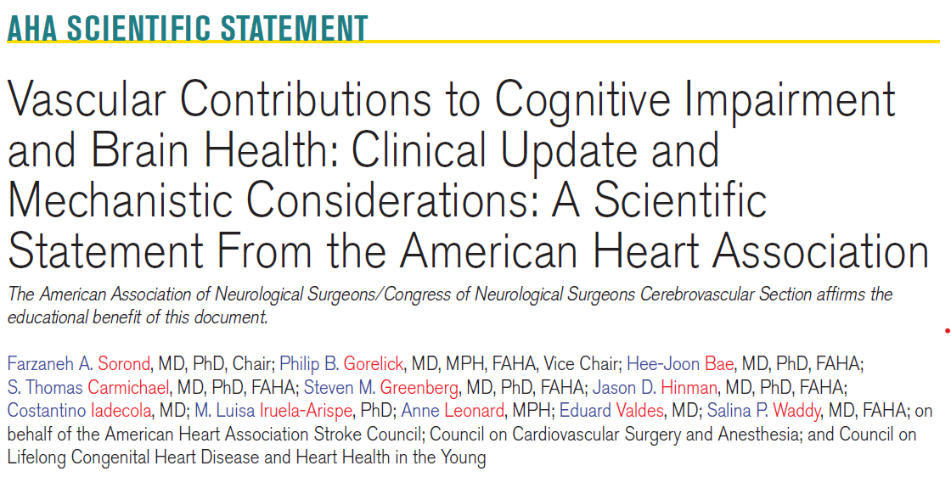

Slide 2
Link: https://www.ahajournals.org/doi/10.1161/STR.0000000000000524
Key words included in the article:
Brain; cerebral circulation ;cognition; dementia; neurodegeneration diseases; vascular health
Citation:
Sorond FA, Gorelick PB, Bae H-J, Carmichael ST, Greenberg SM, Hinman JD, Iadecola C, Iruela-Arispe ML, Leonard A, Valdes E, Waddy SP; on behalf of the American Heart Association Stroke Council; Council on Cardiovascular Surgery and Anesthesia; and Council on Lifelong Congenital Heart Disease and Heart Health in the Young. Vascular contributions to cognitive impairment and brain health: clinical update and mechanistic considerations: a scientific statement from the American Heart Association. Stroke. Published online May 26, 2026. doi: 10.1161/STR.0000000000000524

Slide 3
This slide set was developed by Philip B. Gorelick, MD MPH, under the Auspices of the AHA stroke council
Scientific & Clinical Education Lifelong Learning (SCILL)/professional education Committee

Slide 4
Purpose of this AHA Scientific Statement:
Provides an Update oN Vascular Contributions to Cognitive Impairment and Brain Health

Slide 5
Background

Slide 6
Background
This 2026 AHA statement updates information since the AHA 2011 scientific statement on vascular contributions to cognitive impairment and dementia (VCID) & is mechanistically focused.
The following topical areas are discussed:
  Clinical Update: the role of vascular risk factors (VRFs) and their modification; and
  Mechanisms: an overview of mechanisms whereby VRFs and vascular disease contribute to accelerated cognitive decline and worsening brain health.
Mechanistic features that are emphasized:
  Circulating factors rendering the brain vulnerable to vascular injury.
  Opportunities for repair, recovery, resilience and resistance to
vascular-mediated injury as potential avenues for prevention and treatment for
preservation of brain health across the lifespan.

Slide 7
Since the Last AHA Guidance Statement in 2011 on this topic, there have been a number of Clinically-focused statements published on the prevention of cognitive impairment and dementia the next few slides gives a summary of the literature

Slide 8
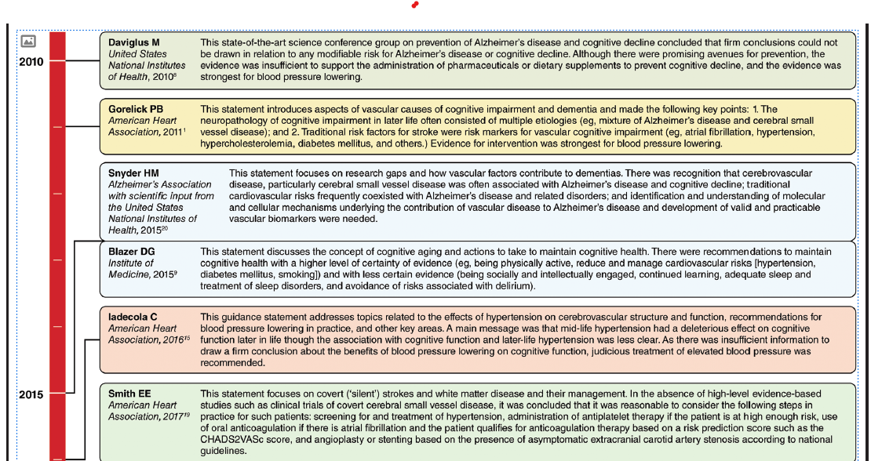
Figure 1. Evolution of select U.S. Consensus or guidance statements for the prevention of cognitive impairment and dementia (2010–2025).

Slide 9
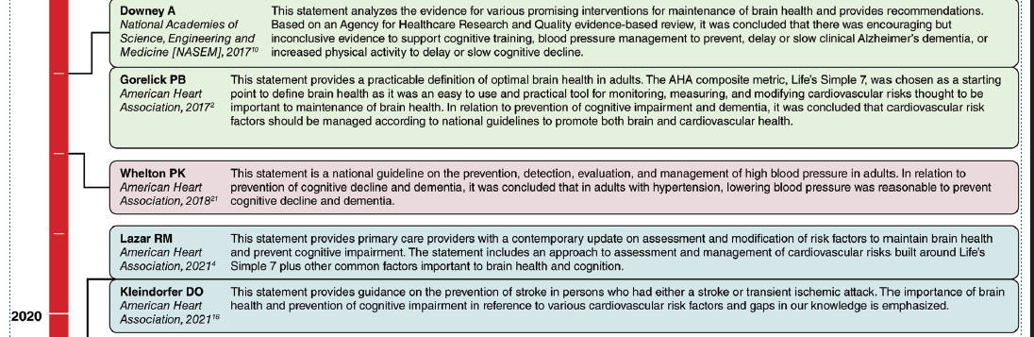
Figure 1 (continued)

Slide 10
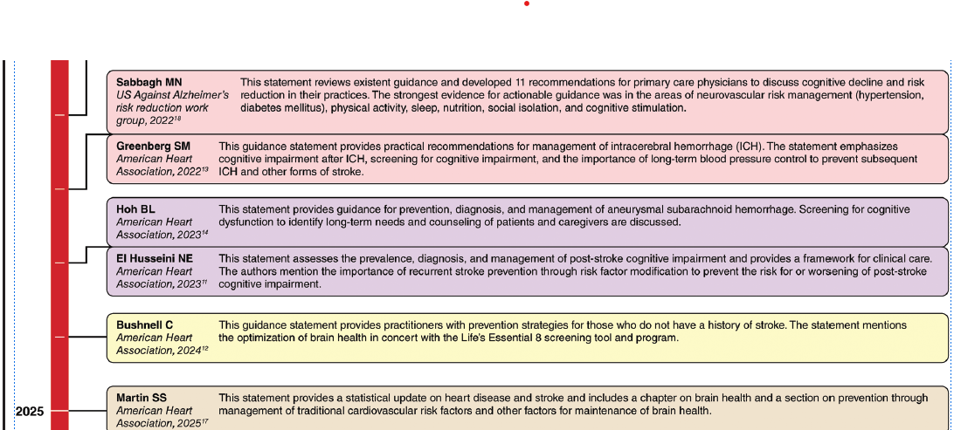
Figure 1 (Continued)

Slide 11
Definitions of Core Concepts & Themes in 2026 AHA Scientific Statement on Vascular Contributions to Cognitive Impairment & Brain Health

Slide 12
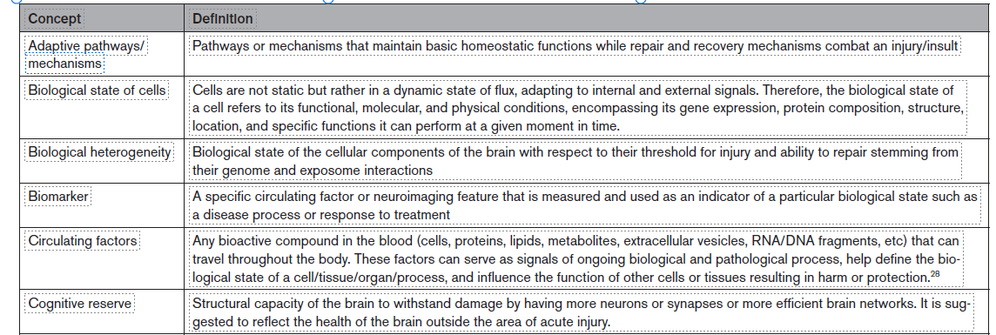
Definitions of Core Concepts & Themes

Slide 13
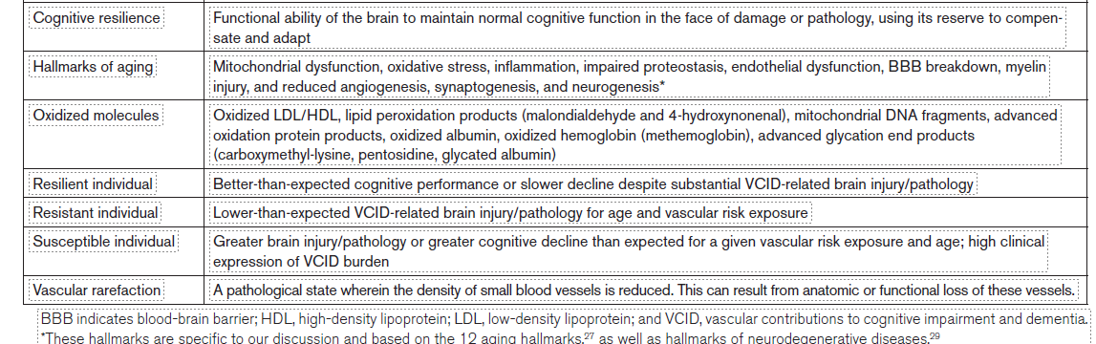
Definitions of Core Concepts & Themes (continued)

Slide 14
Clinical Update

Slide 15
Clinical Update Highlights: Vascular Risk Factors (VRFs)
VRFs are well accepted to adversely affect brain health.
AHA’s Life’s Essential 8 (LE8) is an easy-to-use clinical tool for assessing &
Improving brain health.
LE8 includes:
  5 ideal health behaviors (non-smoking, physical activity at goal levels, healthy diet, body mass index <25 kg/m2, and 7–9 hours of sleep); and
  3 ideal health factors (untreated blood pressure <120/<80 mm Hg,
total cholesterol <200 mg/dL, and fasting blood glucose <100 mg/dL).
Though not formally incorporated into LE8, the LE8 literature recognizes the roles of social determinants of health and psychological well-being in relation to brain health.
In 2024, the Lancet Commission on dementia prevention, intervention, and care expanded its list of modifiable risk factors for dementia to 14 (see next slide).

Slide 16
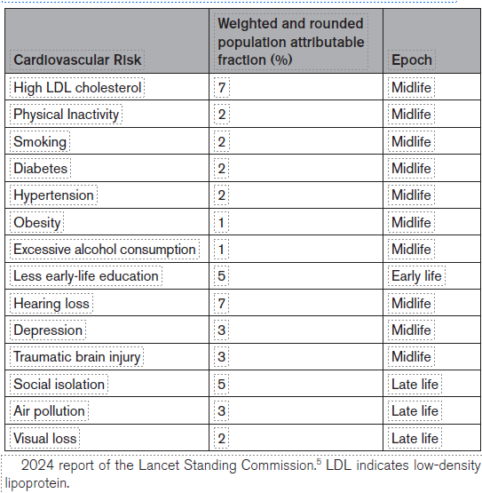
Clinical Update Highlights: Vascular Risk Factors (Continued)
Table: Modifiable Traditional Cardiovascular and
Other Risks for Dementia by Epoch and Population
Attributable Fraction According to the
2024 Lancet Commission.
The 14 factors represent 45% of the population
attributable fraction of dementia risk and 7
of the factors are traditional cardiovascular
risks.
Source: Livingston G, Huntley J, Liu KY, et al.
Dementia prevention, intervention, and care: 2024
report of the Lancet Standing Commission. Lancet.
2024;404:572–628. doi: 10.1016/S0140-6736(24)01296-0.

Slide 17
Clinical Update Highlights: Vascular Risk Factors (continued)
Studies of trajectories of vascular risks in childhood, adolescence, and young adulthood (e.g., Young Finns Study, Bogalusa Heart Study, CARDIA) point to their adverse influence on brain structure and function by late-early life and midlife.
Cognitive changes may be observed in early adulthood and suggest possible new time windows to consider for VRF detection & management for maintenance of brain health.
Understanding how the trajectories of VRFs and variabilities of these factors affect brain health across life stages will be important in future prevention strategies for maintenance of brain health.

Slide 18
Clinical Update Highlights: Multi-domain Interventions
SPRINT MIND study - (Systolic Blood Pressure Intervention Trial–Memory and Cognition in Decreased Hypertension), a sub-study of SPRINT: A Turning Point
A single factor intervention: intensive blood pressure control (target: systolic blood pressure <120 mmHg) led to significant reduction of clinically relevant non-primary outcomes, mild cognitive impairment and the composite of mild cognitive impairment and probable dementia.*
Before SPRINT: recommendations for lowering blood pressure for maintenance of brain health were based largely on observational data.
*Primary outcome in SPRINT MIND: probable dementia

Slide 19
Clinical Update Highlights: Multidomain Interventions (continued)
The success of SPRINT MIND led to or supported the development of multi-domain intervention studies such as FINGER (Finnish Geriatric Intervention Study to Prevent Cognitive Impairment and Disability).
Prior single- or multi-factor intervention studies had largely failed in relation to prevention or slowing of cognitive endpoints.
FINGER trial used a multidomain intervention (diet, exercise, cognitive training, and vascular risk monitoring) in older adults with elevated cardiovascular risk.
Over a 2-year period, the FINGER intervention showed improvements in overall cognitive performance.
These promising results led to the development of the World-Wide FINGERS Network, a global initiative aimed at adapting and harmonizing
multidomain dementia prevention strategies across regions.

Slide 20
Clinical Update Highlights: Multidomain Interventions (continued)
US POINTER trial (US Study to Protect Brain Health Through Lifestyle Intervention to Reduce Risk)
Designed to assess whether FINGER results generalized to a larger, more diverse population at risk of dementia in the United States.
Main Question Addressed by US POINTER Trial: Does a structured moderate- to high-intensity multidomain lifestyle intervention result in a statistically significant greater improvement in global cognition over 2 years relative to a lower-intensity self-guided intervention?
Answer: Yes! This proved to be the result.

Slide 21
Select Clinical Update References
1.Gorelick PB, Scuteri A, Black SE, et al. Vascular contributions to cognitive impairment and dementia: a statement for healthcare professionals from the American Heart Association/American Stroke Association. Stroke. 2011;42:2672–2713. doi: 10.1161/STR.0b013e3182299496
2.Gorelick PB, Furie KL, Iadecola C, et al. Defining optimal brain health in adults: a presidential advisory from the American Heart Association/American Stroke Association. Stroke. 2017;48:e284–e303. doi: 10.1161/STR.0000000000000148
3.Iadecola C, Duering M, Hachinski V, et al. Vascular cognitive impairment and dementia: JACC scientific expert panel. J Am Coll Cardiol. 2019;73:3326–3344. doi: 10.1016/j.jacc.2019.04.034
4.Lazar RM, Howard VJ, Kernan WN,et al. A primary care agenda for brain health: a scientific statement from the American Heart Association. Stroke. 2021;52:e295–e308. doi: 10.1161/STR.0000000000000367

Slide 22
Clinical Update Highlights: Select Clinical Update References (continued)
5. Lloyd-Jones DM, Ning H, Labarthe D, et al. Status of cardiovascular health in US adults and children using the American Heart Association's new "Life's Essential 8" metrics: prevalence estimates from the National Health and Nutrition Examination Survey (NHANES), 2013 Through 2018. Circulation. 2022;146:822–835.doi:10.1161/CIRCULATIONAHA.122.060911.
6. Williamson JD, Pajewski NM, Auchus AP, et al. SPRINT MIND Investigators for the SPRINT Research Group. Effect of intensive vs standard blood pressure control on probable dementia: a randomized clinical trial. JAMA. 2019;321:553–561. doi: 10.1001/jama.2018.21442.
7. Ngandu T, Lehtisalo J, Solomon A, et al. A 2-year multidomain intervention of diet, exercise, cognitive training, and vascular risk monitoring versus control to prevent cognitive decline in at-risk elderly people (FIN-GER): a randomised controlled trial. Lancet. 2015;385:2255–2263. doi: 10.1016/S0140-6736(15)60461-5.
8. Baker LD, Espeland MA, Whitmer RA, et al. Structured vs self-guided multidomain lifestyle interventions for global cognitive function: the US POINTER randomized clinical trial. JAMA. 2025;334:681–691. doi: 10.1001/jama.2025.12923.

Slide 23
Mechanisms

Slide 24
Mechanistic Landscape: Introduction
Role of LE8: of note, poorly controlled components of LE8 converge on similar final common mechanistic pathways: oxidative stress, chronic inflammation, endothelial dysfunction, cellular senescence, & maladaptive remodeling.
Although there is a synergism between LE8, brain health, and cardiovascular health, optimizing treatment or control of the component factors of LE8 may not fully restore brain health.
There is a need to discover other mechanisms which may mediate brain health. By unmasking these mechanisms, we may better understand how to maintain brain resilience & reserve. Why is it that some persons are more resistant or resilient to vascular brain injury? (see next slides).
Biological age: a critical time-dependent variable & central regulator of cellular and molecular responses to injury
.
In this section, we review molecular signals, cellular processes, and brain functions linked to vascular brain injury & prospects for prevention or treatment.

Slide 25
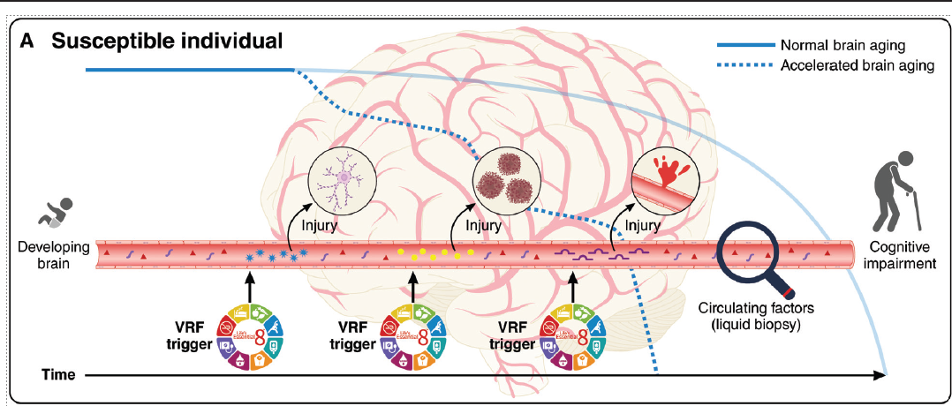
Mechanistic Landscape:
Conceptual diagram of vascular contributions to age-related cognitive decline and worsening brain health

Slide 26
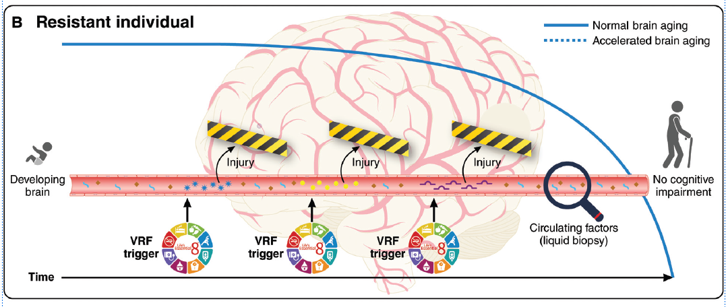
Mechanistic Landscape: Conceptual diagram of vascular contributions to age-related cognitive decline and worsening brain health (Continued).

Slide 27
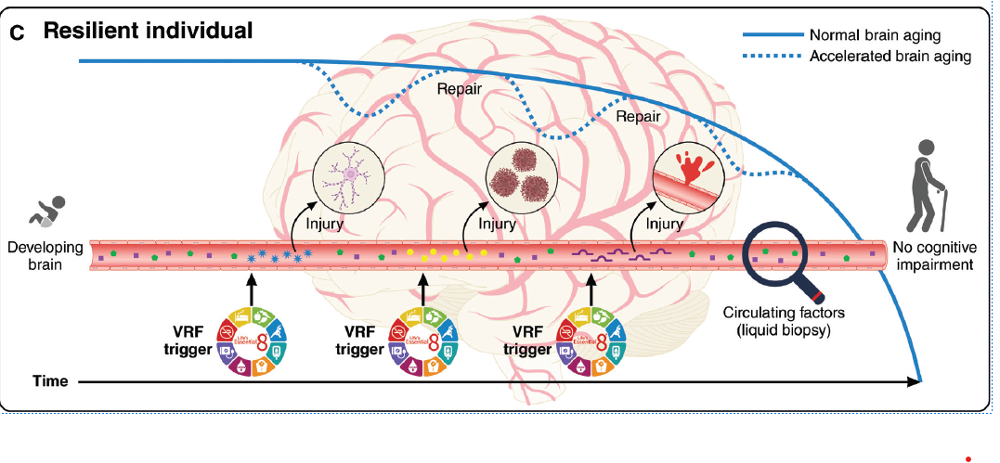
Mechanistic Landscape: Conceptual diagram of vascular contributions to age-related cognitive decline and worsening brain health (Continued).

Slide 28
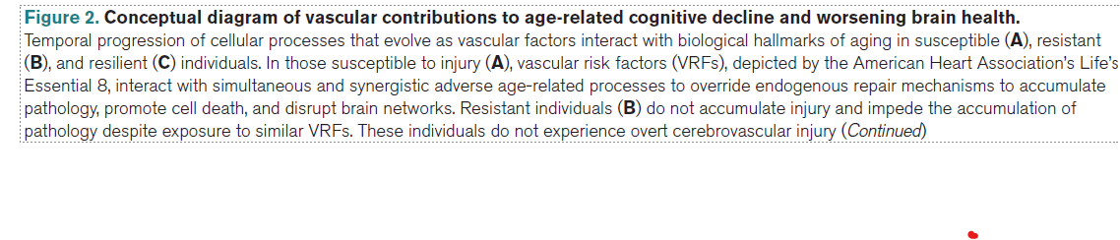
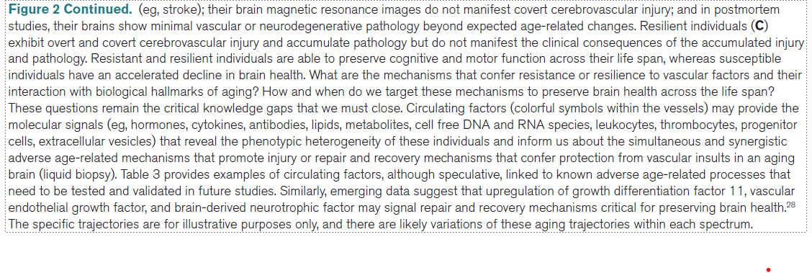
Mechanistic Landscape: Conceptual diagram of vascular contributions to age-related cognitive decline and worsening brain health: Legend

Slide 29
Mechanistic Landscape: Major Mechanisms of Injury
Overarching Mechanisms:
  Hypoperfusion & circulating factors.
  Cell type and susceptibility to injury.
  Brain injury & potential repair mechanisms.
Central Nervous System Mechanisms:
  Cellular processes: mitochondrial & metabolic function, proteostasis, endothelial nitric oxide bioavailability.
  Organ specific brain processes: blood brain barrier function & regulation, & white matter connectivity.
Table 1- (biological processes & molecular signals/pathways),
Table 2 - (circulating factors by age-related processes) & Table 3 (age-related
biological processes overriding adaptive mechanisms in brain health) further
define these processes (see next slides).

Slide 30
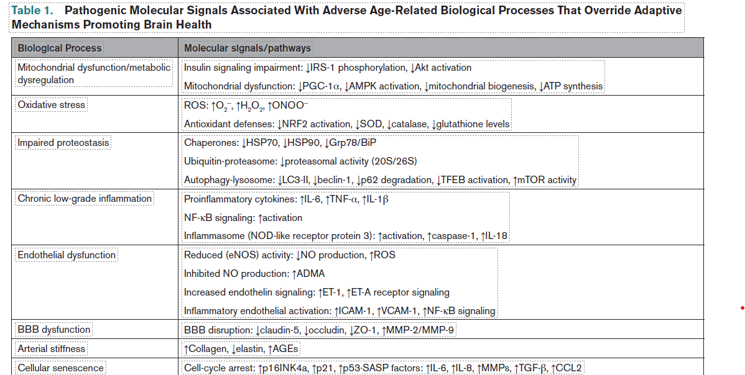

Slide 31
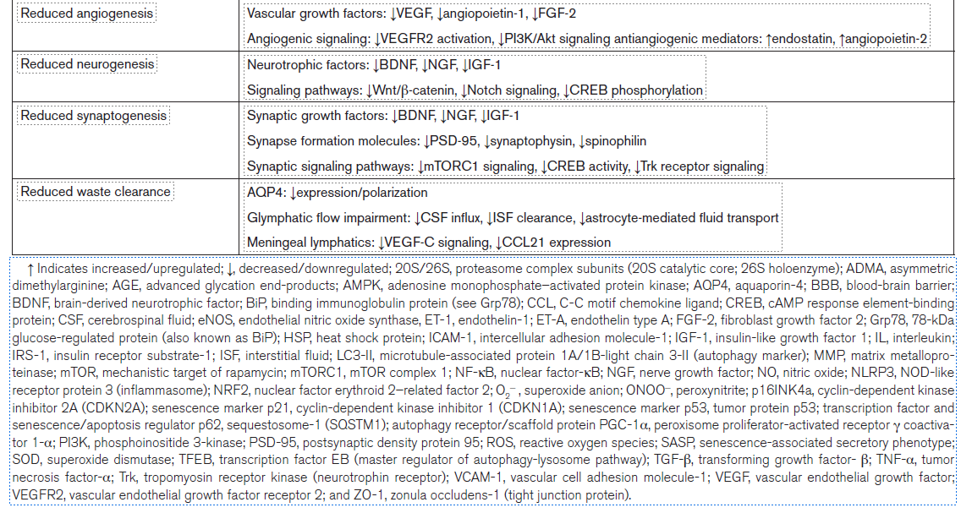
Table 1 (continued)

Slide 32
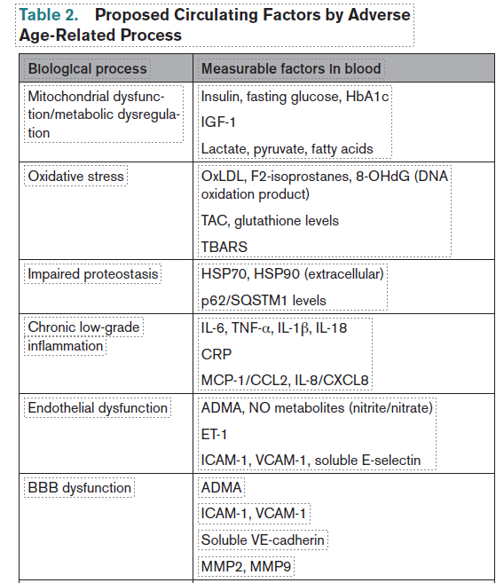
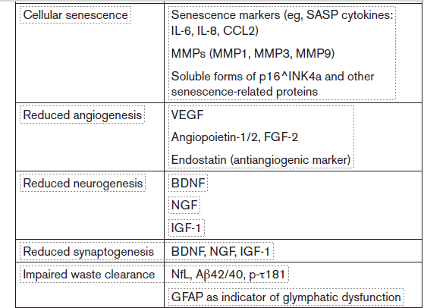
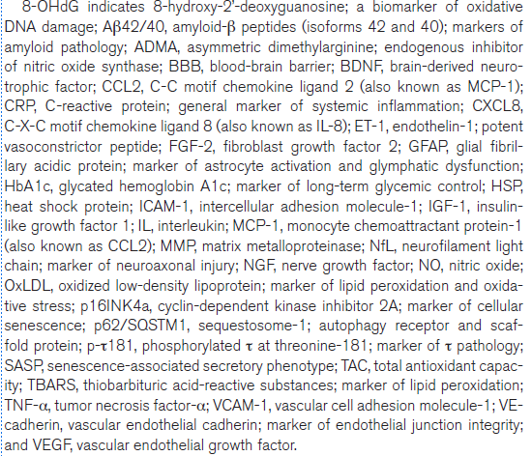

Slide 33
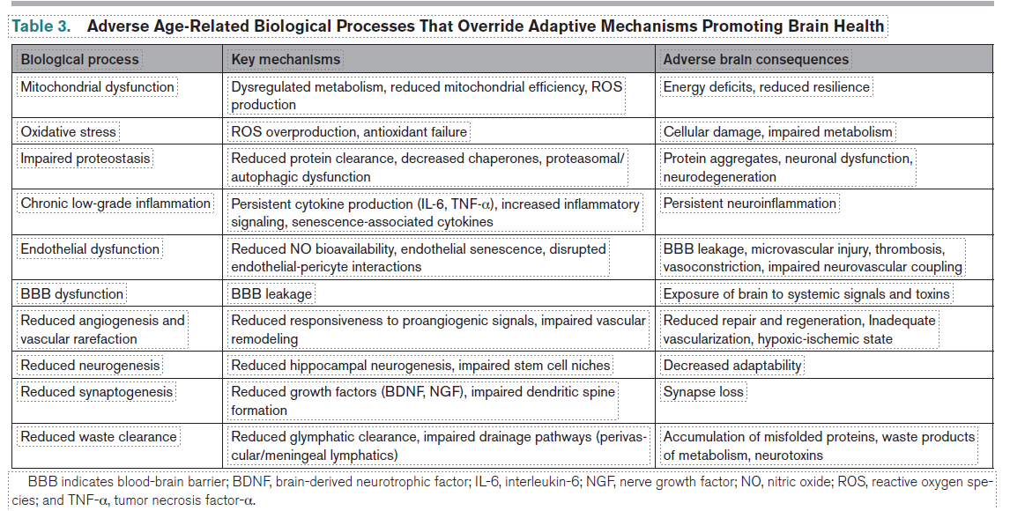

Slide 34
Mechanistic Landscape: Impaired Developmental Repair and Recovery Processes with Aging
Angiogenesis: restores perfusion, supports neurogenesis & synaptic remodeling, repairs
the BBB, facilitates waste clearance, regulates immune traffic, and helps restore tissue
function; aging undermines these processes: e.g., proangiogenic signals (Table 1) decline.
Myelination: remyelination is expected to occur in response to myelin injury, however,
age-related alterations in remyelination and imbalances in proinflammatory and anti-
inflammatory signals hinder myelin repair & disrupt brain connectivity; oligodendrocyte
precursor cells become fewer and less able to differentiate, leading to incomplete repair
resulting in thinner, disorganized myelin sheaths
.
Central Nervous System Clearance: stiffened arteries reduce pulsatility & impair
glymphatic system function & thus waste removal, setting the stage for toxins such
amyloid-beta & others to accumulate in the interstitial fluid of the brain.
Neurogenesis & Synaptogenesis: brain plasticity declines with age (e.g., adversely
affected by mitochondrial dysfunction, oxidative stress).

Slide 35
Select Clinical Mechanistic References
Lopez-Otin C, Blasco MA, Partridge L, Serrano M, Kroemer G. Hallmarks of aging: an expanding universe. Cell. 2023;186:243–278. doi: 10.1016/j.cell.2022.11.001.
2. Mitroi DN, Tian M, Kawaguchi R, Lowry WE, Carmichael ST. Single-nucleus transcriptome analysis reveals disease- and regeneration-associated endothelial cells in white matter vascular dementia. J Cell Mol Med.2022;26:3183–3195. doi: 10.1111/jcmm.17315.
3. Wilcock D, Jicha G, Blacker D, et al. MarkVCID Consortium. MarkVCID Cerebral Small Vessel Consortium, I: enrollment, clinical, fluid protocols. Alzheimers Dement. 2021;17:704–715. doi: 10.1002/alz.12215.
4. Iadecola C, Anrather J. The immunology of stroke and dementia. Immunity. 2025;58:18–39. doi: 10.1016/j.immuni.2024.12.008.
5. Snyder HM, Corriveau RA, Craft S, et al. Vascular contributions to cognitive impairment and dementia including Alzheimer's disease. Alzheimers Dement. 2015;11:710–717. doi: 10.1016/j.jalz.2014.10.008.

Slide 36
Role of Biomarkers

Slide 37
Role of Biomarkers in VCID
Blood and CSF circulating factors: offer a pathway to detect time-dependent
mechanisms underpinning current and future brain injury.
2. Promising CSF and Plasma Biomarkers Under Study: neurofilament light and
glial fibrillary acidic protein, plasma placental growth factor, and CSF soluble platelet-derived growth factor receptor-β, MMP9, interleukin-6, vascular endothelial growth factor, albumin quotient, fibrinogen, von Willebrand factor, & blood-based BBB- and inflammation-linked microRNAs.
3. Promising Neuroimaging Biomarkers Under Study: white matter hyperintensities,
microinfarcts, diffusion tensor imaging measures of tissue ultrastructure, free-water mapping, peak skeletonized mean diffusivity, cerebrovascular reactivity, and arteriolosclerosis scores.
4. Longitudinal profiling of circulating factors: will be important to map age-related
trajectories to determine windows of opportunity for early prevention/treatment opportunities.

Slide 38
PREVENTION OF COGNITIVE IMPAIRMENT
AND MAINTENANCE OF BRAIN HEALTH

Slide 39
PREVENTION OF COGNITIVE IMPAIRMENT & MAINTENANCE OF BRAIN HEALTH
VRFs significantly accelerate age-related cognitive impairment & contribute
to loss of brain health.
Modifying VRFs is important to reduce the impact of ongoing injury but is
not sufficient to preserve or restore brain health for everyone.
We must also target: resilience, repair, and recovery mechanisms to modify
the active cascade of vascular and brain injury.
Age-related injury mechanisms are amplified by VRFs: e.g., mitochondrial
dysfunction, oxidative stress, inflammation, impaired proteostasis, endothelial
dysfunction, BBB breakdown, myelin injury, reduced angiogenesis, synaptogenesis, & neurogenesis.
As injury accelerates: adaptive responses switch from repair to cell death,
leading to loss of plasticity, decreased resilience, and increased vulnerability.
Key gaps: availability of biomarkers that capture the dynamic biological
heterogeneity of VCID and enable identification of targetable mechanisms.

Slide 40
Opportunities to Preserve Brain Health Based on Mechanistic Considerations

Slide 41
Opportunities to Preserve Brain Health
Assessing Capacity and Early Intervention: study functional
capacity & circulating factors to map normative trajectories
across the lifespan (e.g., early elevation of circulating oxidized molecules may
warrant targeting oxidative stress alongside hypertension; later
changes in inflammatory or proteostasis markers might signal
the need for additional interventions).
Timing Repair Mechanisms: mapping the temporal course of
failure in angiogenesis, myelination, neurogenesis, & synaptogenesis
could lead to well-timed intervention(s) to upregulate these functions.
Insights From Resilient Individuals: identify adaptive mechanisms
that mitigate VRFs & preserve cognition while exposing biological
heterogeneity of repair capacity or resistance to injury.
Precision Prevention: precision approaches guided by circulating
factor profiles to enhance cellular health and resist or repair injury at
appropriate time windows.

Slide 42
Conclusion

Slide 43
Conclusions
VRFs are involved not only in VCID but also Alzheimer’s disease.
Recognition of this observation has led to the realization that
age-related cognitive impairment is a multi-mechanistic process (i.e.,
mixed or coexisting brain processes/pathologies) & thus must be
considered multi-mechanistic in origin.
Further elucidation of these mechanisms by study of circulating
biomarkers will unmask new avenues for interventions to prevent or
slow brain injury cascades across the lifespan
Until such mechanistic therapies are available, intensification of
control of modifiable VRFs, such as increasing physical activity,
remains the most effective strategy to preserve brain health.

Slide 44
Thank you!

