Slide 1
2026 AHA/ACC/ACCP/ACEP/CHEST/SCAI/SHM/SIR/SVM/SVN Guideline for the Evaluation and Management of Acute Pulmonary Embolism in Adults
A Report of the American College of Cardiology/American Heart Association Joint Committee on Clinical Practice Guidelines
Developed in Collaboration With and Endorsed by the American College of Clinical Pharmacy, American College of Emergency Physicians, American College of Chest Physicians, Society for Cardiovascular Angiography & Interventions, Society of Hospital Medicine, Society of Interventional Radiology, Society for Vascular Medicine, and the Society of Vascular Nursing

Slide 2
Citation
This slide set is adapted from the Year Guideline. Published online ahead of print Thursday, February 19, 2026, available at: Circulation. https://www.ahajournals.org/doi/10.1161/CIR.0000000000001415 And Journal of the American College of Cardiology, published online ahead of print Thursday, February 19, 2026. J Am Coll Cardiol. https://doi.org/10.1016/j.jacc.2025.11.005
© 2026 the American Heart Association, Inc. and the American College of Cardiology Foundation. All rights reserved. This article has been published in Circulation and the Journal of the American College of Cardiology.

Slide 3
2026 Writing Committee Members*
Mark A. Creager, MD, FACC, FAHA, MSVM, Chair
Geoffrey D. Barnes, MD, MSc, FACC, FAHA, FSVM, Co-Vice-Chair
Jay Giri, MD, MPH, FACC, FAHA, FSCAI, Co-Vice-Chair
Debabrata Mukherjee, MD, MS, FACC, FAHA, FSVM, MSCAI, JC Liaison†
William Schuyler Jones, MD, FACC, JC Liaison†
Allison E. Burnett, PharmD, PhC, CACP‡
Teresa Carman, MD, RPVI, MSVM
Ana I. Casanegra, MD, MS, FAHA, FSVM
Lana A. Castellucci, MD, MSc
Sherrell M. Clark§
Mary Cushman, MD, MSc, FAHA
Kerstin de Wit, MBChB, MSc, MD, MRCP, FRCEM, FRCPC
Jennifer M. Eaves, DNP, MSN, RN
Margaret C. Fang, MD, MPH║
Joshua B. Goldberg, MD
Stanislav Henkin, MD, FACC, FAHA
Hillary Johnston-Cox, MD, FACC
Sabeeda Kadavath, MD, FACC ¶
Daniella Kadian-Dodov, MD, FACC, FAHA, FSVM
William Brent Keeling, MD, FACC
Andrew J.P. Klein, MD, FACC, FSCAI#
Jun Li, MD
Michael C. McDaniel, MD, FACC, FSCAI
Lisa K Moores, MD, FCCP, FRCP**
Gregory Piazza, MD, MS, FACC, FAHA
Karen S Prenger, MS, APRN-CNS, CV-BC, CPHQ, CCNS††
Steven C. Pugliese, MD
Mona Ranade, MD‡‡
Rachel P. Rosovsky, MD, MPH
Farla Russo§
Eric A. Secemsky, MD, MSc, RPVI, FACC, FAHA, FSCAI, FSVM
Akhilesh K. Sista, MD, FAHA, FSIR
Leben Tefera, MD, FACC
Ido Weinberg, MD, FACC, FSVM§§
Lauren M. Westafer, DO, MPH, MS║║
Michael N. Young, MD, RPVI, FACC, FSCAI
*Writing committee members are required to recuse themselves from voting on sections to which their specific relationships with industry and other entities may apply; see Appendix 1 for recusal information. †ACC/AHA Joint Committee on Clinical Practice Guidelines liaison. ‡American College of Clinical Pharmacy representative. §AHA Patient representative. ║ Society of Hospital Medicine representative. ¶AHA/ACC Joint Committee on Performance Measures liaison. #Society for Cardiovascular Angiography and Interventions representative. **American College of Chest Physicians representative. ††Society of Vascular Nursing representative. ‡‡Society of Interventional Radiology representative. §§Society of Vascular Medicine representative. ║║American College of Emergency Physicians representative. ¶¶Former ACC/AHA Joint Committee on Clinical Practice Guidelines member; current member during the writing effort.

Slide 4
Top Take-Home Messages

Slide 5
Top Take Home Messages
1. A new clinical classification scheme is presented, entitled “Acute Pulmonary Embolism Clinical Categories,” with 5 categories (A-E) and subcategories, ranging from low to high risk for adverse outcomes, in order to enhance the precision of severity classification, prognosis assessment, and evidence-based therapeutic decision-making for patients presenting with acute PE.

Slide 6
Top Take Home Messages
2. Patients with acute PE who are asymptomatic (AHA/ACC PE Category A) can safely be discharged home from the emergency room and do not need to be hospitalized.

Slide 7
Top Take Home Messages
3. Early hospital discharge is generally recommended for patients with acute PE who are symptomatic but have a low clinical severity score (AHA/ACC PE Category B).

Slide 8
Top Take Home Messages
4. Symptomatic patients with acute PE and an elevated clinical severity score, including those with elevated biomarkers and/or right ventricular dysfunction (AHA/ACC PE Category C), incipient cardiopulmonary failure (AHA/ACC PE Category D), and those with cardiopulmonary failure characterized by persistent hypotension (AHA/ACC PE Category E) should be hospitalized to optimize treatment strategies.

Slide 9
Top Take Home Messages
5. Advanced therapies, including systemic thrombolysis, catheter-based thrombolysis, mechanical thrombectomy, and surgical embolectomy are reasonable for patients with acute PE in AHA/ACC PE Category E1 and can be considered for patients with acute PE in AHA/ACC PE Category D1-2.

Slide 10
Top Take Home Messages
6. PE response teams (PERTs) are recommended to improve timeliness of care.

Slide 11
Top Take Home Messages
7. In patients with acute PE who require initial parenteral anticoagulant therapy, low-molecular-weight heparin (LMWH) is recommended over unfractionated heparin (UFH).

Slide 12
Top Take Home Messages
8. In patients with acute PE who are eligible for oral anticoagulation, direct oral anticoagulants (DOACs) are recommended over vitamin K antagonists (VKAs), unless contraindicated, to prevent recurrent venous thromboembolism (VTE) and reduce major bleeding.

Slide 13
Top Take Home Messages
9. In patients with a first acute PE without a major reversible risk factor and in those with a persistent risk factor, continuing anticoagulation beyond the initial treatment phase (3-6 months) into the extended phase is recommended.

Slide 14
Top Take Home Messages
10. Patients who have had acute PE should be asked about PE-related symptoms and functional limitations at every visit for at least 1 year to screen for chronic thromboembolic pulmonary disease (CTEPD) or other causes of dyspnea and functional limitation.

Slide 15
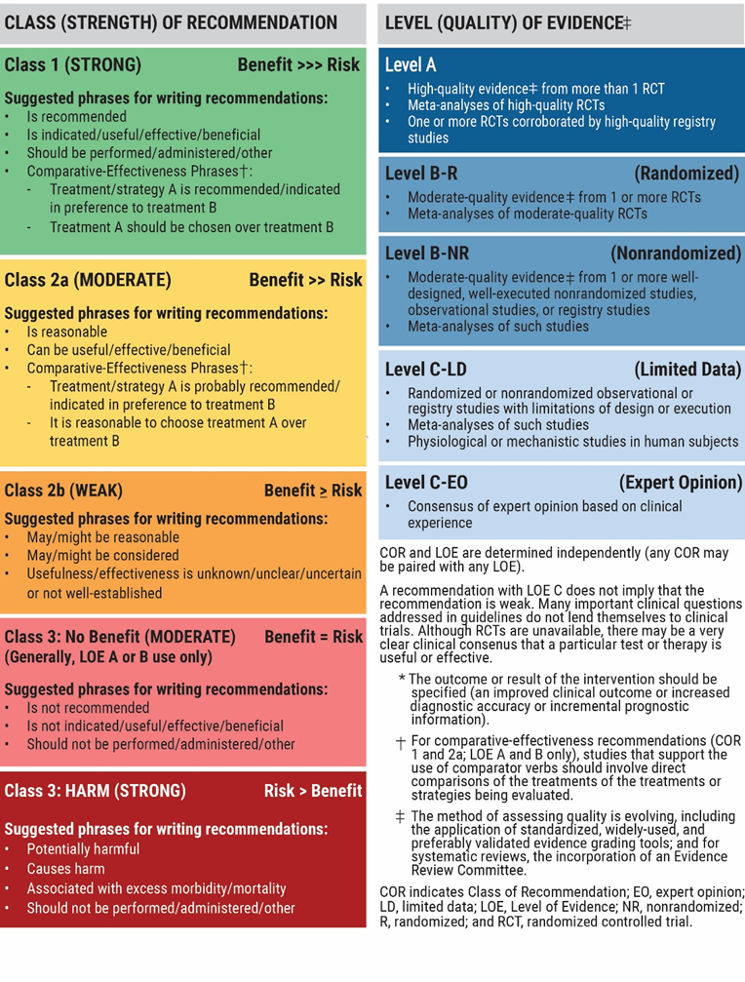
Table 2. Applying the American College of Cardiology/American Heart Association Class of Recommendation and Level of Evidence to Clinical Strategies, Interventions, Treatments, or Diagnostic Testing in Patient Care* (Updated December 2024)

Slide 16
Evaluation and Diagnosis

Slide 17
Clinical Assessment
 | Recommendations for Clinical Assessment Referenced studies that support recommendations are summarized in the Evidence Table.
COR | LOE | Recommendations
1 | A | In patients presenting with symptoms suggestive of acute PE, a targeted history and comprehensive physical examination is recommended to assist in determining the clinical pretest probability of acute PE.
2a | B-R | In adult patients undergoing evaluation for PE and who have a low or intermediate clinical probability of PE (<50%) by risk assessment, an age-adjusted D-dimer value below the threshold (age × 10 μg/L for fibrinogen equivalent units [FEU] assays) effectively excludes PE and the need for imaging.
2a | B-R | In adult patients with suspected PE, the YEARS algorithm* can be useful to identify which patients do not need imaging to rule out a PE.
2b | B-NR | In pregnant adults, it may be reasonable to use pregnancy-adapted YEARS criteria to identify patients who do not need imaging for PE.
*YEARS algorithm: A threshold D-dimer of 500 μg/L in patients who have ≥1 of the following: 1) clinical signs of DVT, 2) hemoptysis, and/or 3) PE as the most likely diagnosis. A D-dimer threshold of 1000 μg/L is used for patients who have no YEARS criteria.

Slide 18
Table 3. Clinical Decision Rules
Clinical Pretest Probability Score | Components | Points |  | Clinical Pretest Probability Grouping and Utilization
Wells Score for PE | Clinical symptoms of DVT (leg swelling, pain with palpitation) | 3 |  | Low: <2 Moderate: 2-6 High: >6 Modified Wells Scoring: PE likely: >4 PE unlikely: ≤4
 | PE more likely than other diagnoses | 3
 | Heart rate >100 bpm | 1.5
 | Immobilization (≥3 days) or surgery in the previous 4 weeks | 1.5
 | Previous DVT or PE | 1.5
 | Hemoptysis | 1
 | Cancer | 1
DVT indicates deep vein thrombosis; and PE, pulmonary embolism.

Slide 19
Table 3. Clinical Decision Rules (con’t.)
Clinical Pretest Probability Score | Components | Points |  | Clinical Pretest Probability Grouping and Utilization
PE Rule Out Criteria | Age <50 years |  |  | Assess if clinical pretest probability (gestalt) of PE is <15% (eg, Wells <2) When all criteria are met, the likelihood of PE is low and no further testing is required.
 | Heart rate <100 bpm
 | Oxyhemoglobin saturation ≥95%
 | No hemoptysis
 | No estrogen use
 | No prior DVT or PE
 | No unilateral leg swelling
 | No surgery/trauma requiring hospitalization within the prior 4 weeks
DVT indicates deep vein thrombosis; and PE, pulmonary embolism.

Slide 20
Table 3. Clinical Decision Rules (con’t.)
 |  | Revised Geneva Score | Simplified Revised Geneva Score
Revised Geneva Score | Age >65 | 1 | 1 | Revised Geneva Low: 0-3 Intermediate: 4-10 High: ≥11 Simplified Revised Geneva Low: 0-1 Intermediate: 2-4 High: 5-7 Unlikely: 0-2 Likely: 3-7
 | Previous DVT or PE | 3 | 1
 | Surgery under general anesthesia or fracture of the lower limbs within 1 months | 2 | 1
 | Active cancers | 2 | 1
 | Unilateral lower-limb pain | 3 | 1
 | Hemoptysis | 2 | 1
 | Heart rate 75-94 bpm | 3 | 1
 | Heart rate ≥95 bpm | 5 | 1
 | Pain on lower limb deep vein palpation and unilateral edema | 4 | 1
DVT indicates deep vein thrombosis; and PE, pulmonary embolism.

Slide 21
Table 3. Clinical Decision Rules (con’t.)
Adapted with permission from Klok et al. Copyright 2008 American Medical Association. All rights reserved, including those for text and data mining, AI training, and similar technologies. Additional material adapted with permission from Le Gal et al. and from Annals of Internal medicine. Copyright 2006 American College of Physicians. All Rights Reserved. Reprinted with the permission of American College of Physicians, Inc.

Slide 22
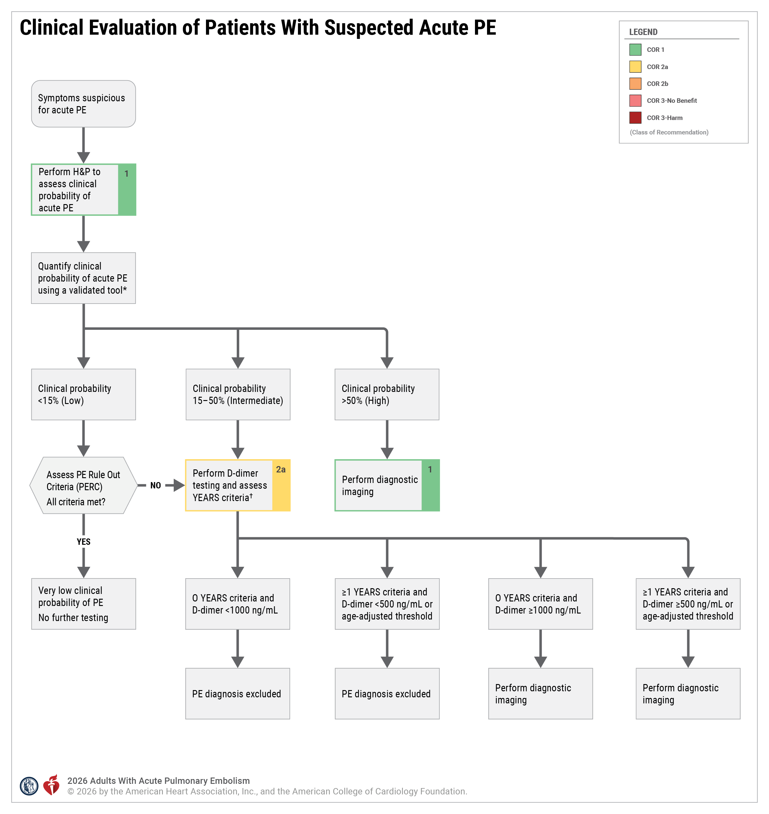
Figure 1. Clinical Evaluation of Patients With Suspected Acute PE
*Indicates validated tools such as the Wells score, revised Geneva score, or clinical gestalt.
†YEARS criteria include clinical signs of DVT, hemoptysis, or PE is the most likely diagnosis. Use of an age-adjusted D-dimer is an alternative to the use of the YEARS criteria. For pregnant patients, the pregnancy adapted YEARS criteria should be used.
DVT indicates deep vein thrombosis; and PE, pulmonary embolism.

Slide 23
Diagnostic Testing
 | Recommendations for Diagnostic Testing Referenced studies that support recommendations are summarized in the Evidence Table.
COR | LOE | Recommendations
1 | A | In patients presenting with symptoms and signs suggestive of acute PE, imaging is recommended for those who are deemed high probability (>50% probability of PE) by a validated clinic risk prediction score or an elevated D-dimer level in order to confirm or exclude PE.
1 | A | In patients undergoing imaging evaluation for suspected PE, a positive CTPA or high probability ventilation/perfusion (V/Q) scan is sufficient to diagnose PE.
1 | B-R | In patients undergoing imaging evaluation, a CTPA is recommended in preference to a V/Q scan to confirm the diagnosis of acute PE.

Slide 24
Diagnostic Testing (con’t.)
2a | B-NR | In pregnant patients presenting with symptoms, YEARS criteria suggestive of acute PE, and a normal chest x-ray, imaging evaluation with low-radiation dose CTPA is reasonable over low-dose perfusion scintigraphy.
2a | B-R | In patients undergoing evaluation for PE, V/Q single-photon emission CT (SPECT) is reasonable in preference to a planar V/Q scan as a diagnostic study.
2a | B-R | In patients with suspected acute PE who cannot undergo a CTPA, it is reasonable to perform a V/Q scan in preference to contrast-enhanced magnetic resonance angiography (MRA) to improve the diagnostic yield.
2b | B-NR | In patients with confirmed acute PE, obtaining lower extremity venous duplex ultrasound examination may be reasonable in patients with clinical findings suggestive of DVT or if the presence of DVT will change management or inform prognosis.

Slide 25
Diagnostic Testing (con’t.)
3: No Benefit | B-NR | In patients with suspected PE and a negative CTPA or normal V/Q SPECT, venous duplex ultrasonography is not useful for further PE diagnostic evaluation.
3: No Benefit | B-NR | In patients with suspected acute PE, an echocardiogram is not recommended to confirm or refute the diagnosis of PE.
3: No Benefit | B-R | In patients with suspected acute PE, computed tomographic venography of the inferior vena cava (IVC) and lower extremity veins is not recommended as a routine adjunct to CTPA to diagnose venous thrombosis.

Slide 26
Diagnostic Testing (con’t.)
Reporting Findings on Diagnostic Imaging
1 | B-R | In patients presenting with an acute PE who undergo CTPA, reporting the numerical right ventricle (RV)/left ventricle (LV) ratio (measured by internal diameter assessed on axial or reformatted 4D-chamber view) is recommended over subjective quantification for risk stratification.
1 | B-NR | In patients with acute PE who undergo transthoracic echocardiography, RV dysfunction should be assessed and reported by the following parameters: RV/LV end-diastolic ratio; RV end-diastolic diameter; tricuspid annular plane systolic excursion (TAPSE), estimated right ventricular systolic pressure; RV free wall hypokinesis with sparing of the apex (McConnell’s sign); tricuspid systolic velocity; paradoxical septal motion; and IVC respirophasic collapse to assist with risk stratification.
2b | B-NR | In patients with acute PE, reporting of chronic features* on CTPA may be useful to identify patients at risk for chronic clinical sequelae of PE, including post-PE CTEPD.
*Examples include intravascular webs, pulmonary artery retraction or dilation, bronchial artery dilation, RV hypertrophy, and intraventricular septal flattening.

Slide 27
Table 4. Optimal Methods of RV Dysfunction Assessment on Echocardiogram
 | Recommended Technique for Assessment | Definition of Parameter
RV dimension | End-diastole from a right ventricle-focused apical 4-chamber view Apical 4-chamber view | EDD >30 mm RV basal EDD >42 mm
RV/LV | End-diastolic ratio (apical or subcostal view) | RV/LV >0.9
TAPSE ⁴² | Measures the distance of systolic excursion of the RV annular segment in cm, on M-mode, along a longitudinal plane, from a standard apical 4-chamber view from end-diastole to end-systole | TAPSE <1.6 cm is abnormal
Doppler evidence of pulmonary hypertension | Tissue Doppler imaging | Pulmonary acceleration time <90 ms, or the presence of an RV/atrial gradient >30 mm Hg
Tricuspid systolic velocity | Apical or subcostal 4-chamber view | Tricuspid systolic velocity >2.6 m/sec
EDD indicates end-diastolic diameter; LV, left ventricle; RV, right ventricle; and TAPSE, tricuspid annular plane systolic excursion.

Slide 28
Table 5. Progression of Acute PE Risk Categorization Schemas
Year | Organization | Risk Category | Clinical Criteria
2011 | AHA Scientific Statement | Low risk | Normotensive; no right ventricular dysfunction or myocardial necrosis (elevated troponin)
 |  | Submassive | Systolic BP ≥90 mm Hg and either right ventricular dysfunction or myocardial necrosis
 |  | Massive | Systolic blood pressure <90 mm Hg for >15 minutes or requiring inotropic support
2019 | ESC Acute Pulmonary Embolism Risk Scheme | Low risk | Nonelevated risk score (eg, PESI class I-II or sPESI=0) Normal right ventricle on imaging
 |  | Intermediate-low risk | Elevated risk score (eg, PESI class III-IV or sPESI ≥1) None or 1 positive of either troponin or right ventricular dysfunction on imaging
 |  | Intermediate-high risk | Elevated risk score (eg, PESI class III-IV or sPESI ≥1) Both positive troponin and right ventricular dysfunction on imaging
 |  | High risk | Hemodynamic instability
ACC indicates American College of Cardiology; AHA, American Heart Association; BP, blood pressure; ESC, European Society of Cardiology; PESI, Pulmonary Embolism Severity Index; and sPESI, simplified Pulmonary Embolism Severity Index.

Slide 29
Table 5. Progression of Acute PE Risk Categorization Schemas (con’t.)
2026 | AHA/ACC Acute PE Clinical Categories | A | Subclinical – incidental and asymptomatic PE
 |  | B | Symptomatic PE with low clinical severity score (eg, PESI class I-II, sPESI=0, Hestia=0)
 |  | C | Symptomatic PE with elevated clinical severity score (eg, PESI class III-V, sPESI ≥1, Hestia ≥1)
 |  | D | Incipient cardiopulmonary failure (eg, normotensive shock)
 |  | E | Cardiopulmonary failure
ACC indicates American College of Cardiology; AHA, American Heart Association; BP, blood pressure; ESC, European Society of Cardiology; PESI, Pulmonary Embolism Severity Index; and sPESI, simplified Pulmonary Embolism Severity Index.

Slide 30
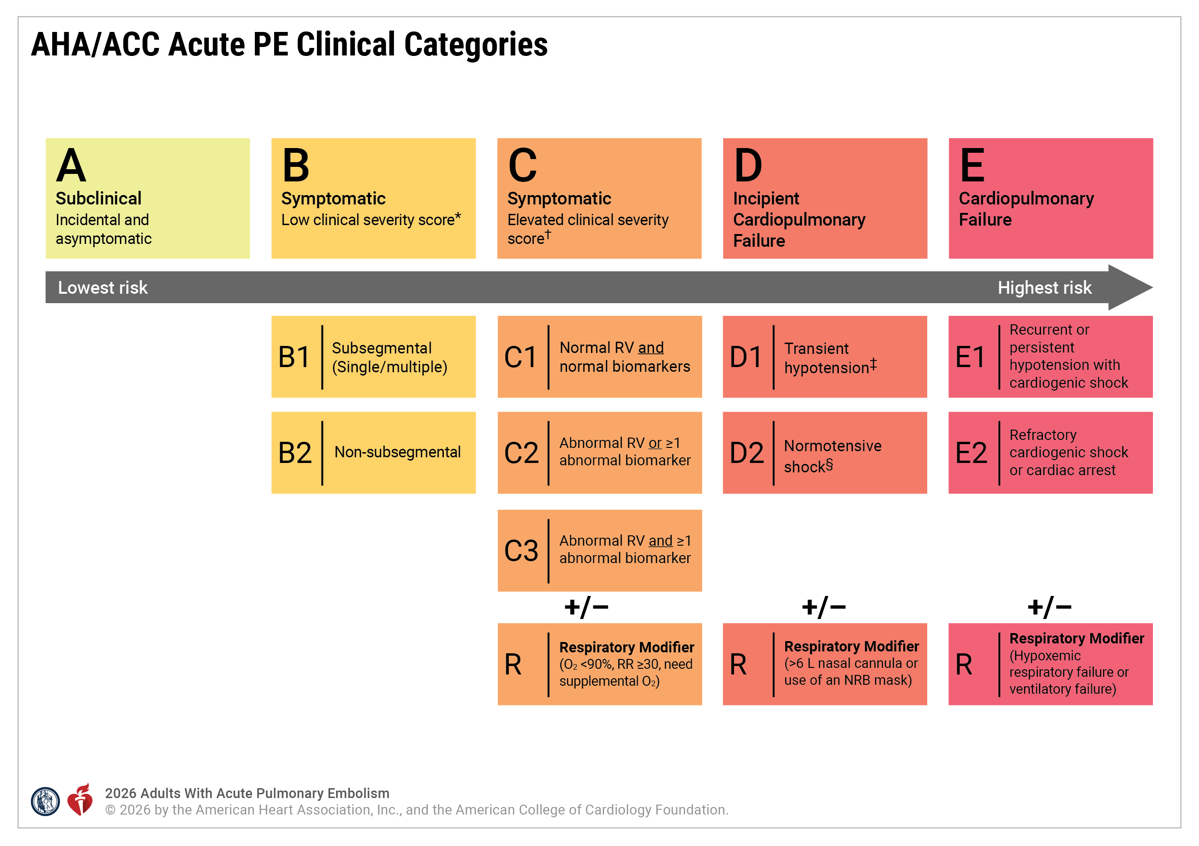
Figure 2. AHA/ACC Acute PE Clinical Categories

Slide 31
Figure 2. AHA/ACC Acute PE Clinical Categories (con’t.)
When patients meet the respiratory modifier status criteria, then add “R” to the category description (eg, C3R, D2R).
*Low Clinical Severity Score includes PESI ≤85 or sPESI =0 or Bova ≤ 4.
†Elevated Clinical Severity Score includes PESI >85 or sPESI ≥1 or Bova > 4.
‡Systolic blood pressure <90 or decrease >40 mm Hg lasting <15 min or responding to IV fluids.
§Any: Lactate >2 mmol/L, acute kidney injury, urine output <0.5 mL/kg/hr, mental status change, cardiac index <2.2 L/min/m², mean arterial pressure <60 mm Hg, increased shock score/stage (SCAI stage, CPES score).
ACC indicates American College of Cardiology; AHA, American Heart Association; CPES, Composite Pulmonary Embolism Shock; IV, intravenous; NC, nasal cannula; NRB, nonrebreather; O₂, oxygen; PE, pulmonary embolism; PESI, Pulmonary Embolism Severity Index; RR, respiratory rate; RV, right ventricle; and sPESI, simplified PESI.

Slide 32
Risk Assessment Using Clinical Risk Scores
 | Recommendations for Risk Assessment Using Clinical Risk Scores Referenced studies that support recommendations are summarized in the Evidence Table.
COR | LOE | Recommendations
1 | B-R | In patients diagnosed with acute PE in AHA/ACC PE Categories A and B, use of the Hestia, PESI, and/or sPESI risk scores is recommended to identify patients with a low risk for short-term adverse outcomes.
2a | B-NR | In hemodynamically stable patients diagnosed with acute PE in AHA/ACC PE Categories C and D, using a validated PE-specific risk score is reasonable to identify patients with a higher risk for short-term adverse outcomes.
2b | B-NR | In hemodynamically stable patients diagnosed with acute PE in AHA/ACC PE Categories C and D, the National Early Warning Score (NEWS) and its updated version, NEWS2, scores may be reasonable alternatives to a PE-specific risk score to identify patients with a higher risk for short-term adverse outcomes who may require monitoring for clinical deterioration.

Slide 33
Table 6. Acute PE Clinical Risk Prediction Scores Used in the Acute Care Setting
Risk Score Name | Risk Score Components | Range of Risk Score | Risk Categories and Definitions
PESI | Age Male (10 pts) History of cancer (30 pts) History of heart failure (10 pts) Chronic lung disease, (10 pts) Heart rate ≥110 bpm (20 pts) Systolic blood pressure <100 mm Hg (30 pts) Respiratory rate ≥30 bpm (20 pts) Temperature <36°C (20 pts) Altered mental status (60 pts) Oxygen saturation <90% (20 pts) Calculate score by adding age (in years) and points by risk factor | Class I to V | Class I (lowest risk): ≤65 pts Class II: 66-85 pts Class III: 86-105 pts Class IV: 106-125 pts Class V: (highest risk) ≥126 pts

Slide 34
Table 6. Acute PE Clinical Risk Prediction Scores Used in the Acute Care Setting (con’t.)
Risk Score Name | Risk Score Components | Range of Risk Score | Risk Categories and Definitions
sPESI | Age >80 yrs History of cancer Chronic cardiopulmonary disease Systolic blood pressure <100 mm Hg Heart rate ≥110 bpm Arterial oxygen saturation <90% Calculate score by adding 1 pt for each of the risk factors | Low or High | 0 points: Low risk of 30-day mortality ≥1 point: High risk of 30-day mortality
Bova Score | Systolic blood pressure 90-100 mm Hg (2 pts) Cardiac troponin elevation (2 pts) Right ventricular dysfunction (2 pts) Heart rate ≥110 bpm (1 pt) Calculate score by adding pts for each of the risk factors | 0 to 7 | Stage I (lowest risk): 0-2 pts Stage II: 3-4 pts Stage III (highest risk): >4 pts

Slide 35
Table 6. Acute PE Clinical Risk Prediction Scores Used in the Acute Care Setting (con’t.)
Risk Score Name | Risk Score Components | Range of Risk Score | Risk Categories and Definitions
Hestia Criteria | Is the patient hemodynamically unstable? Is thrombolysis or embolectomy necessary? Active bleeding or high risk of bleeding? More than 24 h of oxygen supply to maintain oxygen saturation >90%? Is pulmonary embolism diagnosed during anticoagulant treatment? Severe pain needing intravenous pain medication for more than 24 h? Medical or social reasons for treatment in the hospital for more than 24 h (infection, cancer, no support system)? Does the patient have a creatinine clearance of <30 mL/min? Does the patient have severe liver impairment? Is the patient pregnant? Does the patient have a documented history of heparin-induced thrombocytopenia? | Negative versus Positive | If answer to all criteria is no, then Hestia rule is negative and consider outpatient management If answer to at least 1 of the criteria is yes, then Hestia rule is positive and consider hospitalization

Slide 36
Table 6. Acute PE Clinical Risk Prediction Scores Used in the Acute Care Setting (con’t.)
Risk Score Name | Risk Score Components | Range of Risk Score | Risk Categories and Definitions
CPES Score | Elevated cardiac troponin Elevated B-type natriuretic peptide Moderately or severely reduced RV function Central thrombus burden (saddle PE) Concomitant deep vein thrombosis Heart rate ≥100 bpm Calculate score by assigning 1 pt for each of the factors | 0 to 6 | 0-5 pts: Lower risk for normotensive shock (cardiac index ≤2.2 L/min/m²) 6 pts: Higher risk for normotensive shock
Shock Index | Heart rate divided by systolic blood pressure | Continuous | Lower scores associated with lower risk Lack of consensus on which cut-points to use for PE risk stratification
NEWS and NEWS2 | Respiratory rate, oxygen saturation, temperature, systolic blood pressure, heart rate, level of consciousness, and need for supplemental oxygen Points are assigned based on individual measurements in each category | 0 to 20 | NEWS2 ≥9: High risk

Slide 37
Table 6. Acute PE Clinical Risk Prediction Scores Used in the Acute Care Setting (con’t.)
CPES indicates Composite Pulmonary Embolism Shock; NEWS, National Early Warning Score; PE, pulmonary embolism; PESI, Pulmonary Embolism Severity Index; RV, right ventricle; and sPESI, simplified PESI.

Slide 38
Hemodynamic Assessment
 | Recommendations for Hemodynamic Assessment Referenced studies that support recommendations are summarized in the Evidence Table.
COR | LOE | Recommendations
2a | B-NR | In patients with acute PE in AHA/ACC PE Category D2, evaluating for the presence of normotensive shock* can be useful to identify patients at increased risk for clinical deterioration and in-hospital death.
2a | B-NR | In patients with acute PE in AHA/ACC PE Category C3, a MAP <80 mm Hg may be useful to identify patients who may require escalation of therapy.
*Normotensive shock is defined as isolated hypoperfusion without hypotension identified with any of the following markers: serum lactate >2 mmol/L, urine output <720 mL in 24 hours, creatinine increase ≥0.3 mg/mL in 24 hours, cardiac index ≤2.2 L/min/m2 from peripheral arterial and mixed venous oxygenation saturation values.

Slide 39
Biomarkers for Risk Stratification
 | Recommendations for Risk Stratification of PE Using Biomarkers Referenced studies that support recommendations are summarized in the Evidence Table.
COR | LOE | Recommendations
1 | B-NR | In patients with acute PE and an elevated clinical severity score without features of hypotension or shock (ie, AHA/ACC PE Category C), measurement of at least 1 cardiac biomarker (ie, troponin, brain natriuretic peptide [BNP]) is recommended to assist with risk stratification for short-term complications and/or mortality.
1 | B-NR | In patients with acute PE AHA/ACC PE Categories C to E who are undergoing evaluation at an acute care facility, measurement of lactate (either venous or arterial) is recommended to assist with risk stratification for short-term complications and/or mortality.¹²⁻¹⁸

Slide 40
Right Ventricular Imaging for Risk Stratification
 | Recommendations for Right Ventricular Imaging for Risk Stratification Referenced studies that support recommendations are summarized in the Evidence Table.
COR | LOE | Recommendations
1 | A | In patients with acute PE and an elevated clinical severity score but without evidence of shock (ie, AHA/ACC PE Categories C-D), RV imaging is recommended for short-term risk stratification.
2a | B-NR | In patients with acute PE and an elevated clinical severity score but without evidence of persistent hypotension or shock (ie, AHA/ACC PE Categories C-D), use of echocardiography over CT is preferred for short-term risk stratification.

Slide 41
Quantification of Thrombus Burden for Short-Term Risk Stratification
 | Recommendation for Quantification of Thrombus Burden for Short-Term Risk Stratification Referenced studies that support the recommendation are summarized in the Evidence Table.
COR | LOE | Recommendation
3: No Benefit | B-NR | In patients with acute PE in AHA/ACC PE Categories A-C, quantification of angiographic thrombus burden for short-term risk stratification is not recommended.

Slide 42
Acute Management

Slide 43
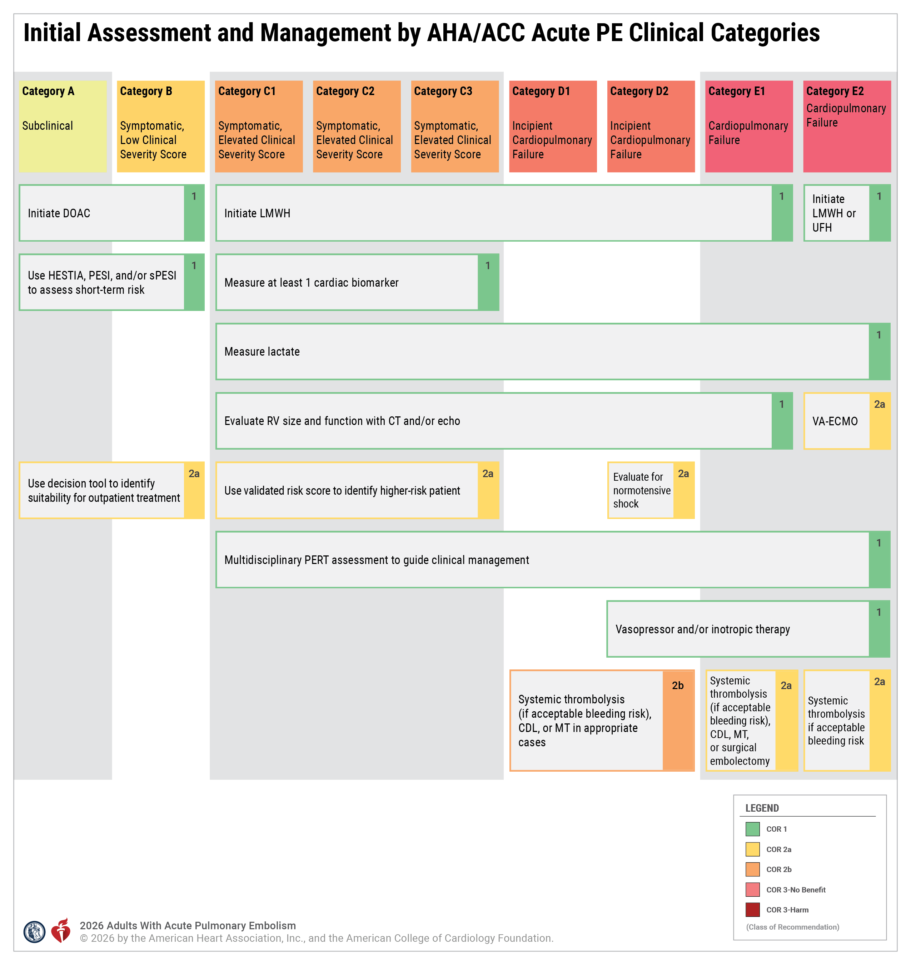
Figure 3. Initial Assessment and Management by AHA/ACC Acute PE Clinical Categories
ACC indicates American College of Cardiology; AHA, American Heart Association; CDL, catheter-directed thrombolysis; COR, class of recommendation; CT, computed tomography; DOAC, direct oral anticoagulant; ECMO, extracorporeal membrane oxygenation; LMWH, low-molecular-weight heparin; MT, mechanical thrombectomy; PE, pulmonary embolism; PERT, PE response team; PESI, Pulmonary Embolism Severity Index; RV, right ventricle; sPESI, simplified PESI; UFH, unfractionated heparin; and VA, venoarterial.
Initial assessment and management of acute PE by category with associated COR 1 and 2a recommendations along with select COR 2b recommendations. Additional COR 2b recommendations that are not included in this figure may be appropriate in select clinical cases.

Slide 44
Suitability for Outpatient Management of PE
 | Recommendations for Suitability for Outpatient Management of PE Referenced studies that support recommendations are summarized in the Evidence Table.
COR | LOE | Recommendations
2a | B-R | In patients diagnosed with acute PE in a clinic or an ED, it is reasonable to use a decision tool* to identify suitability for outpatient treatment.
2a | B-R | In select patients diagnosed with acute PE in AHA ACC PE Categories A and B in a clinic or ED, outpatient treatment† is a reasonable option compared with hospitalization, when the rate of 90-day adverse outcomes is low and it aligns with patient goals.
*Decision tool options include the Hestia rule, the PESI, and the sPESI.
†Patients suitable for discharge from the outpatient or emergency setting must have immediate access to anticoagulant medication and rapid, reliable, expert follow-up in place.

Slide 45
Placement in the Hospital
 | Recommendations for Triage and Placement in the Hospital Referenced studies that support recommendations are summarized in the Evidence Table.
COR | LOE | Recommendations
1 | C-EO | In patients with acute PE who are receiving thrombolytic therapy (systemic or CDL), placement in a unit that can provide close monitoring, such as an intensive care unit (ICU) or intermediate level of care unit, is recommended to monitor for adverse events.
2a | B-R | In patients admitted to the hospital with acute PE who undergo mechanical thrombectomy (MT) and are hemodynamically stable, admission to a level of care that can provide continuous telemetry and nursing care familiar with the postprocedural complications of the device used is reasonable.

Slide 46
Interhospital Transfers
 | Recommendations for Interhospital Transfers Referenced studies that support recommendations are summarized in the Evidence Table.
COR | LOE | Recommendations
2b | C-LD | For patients with acute PE who exhibit high-risk features* but are hemodynamically stable (AHA/ACC PE Categories C3-D), transferring to a center that can provide advanced therapies† may be considered to ensure access to appropriate interventions.
3: Harm | C-EO | Unstable patients with acute PE (AHA/ACC PE Category E) should not be transferred to another medical center before stabilizing their condition.
*High-risk features include RV dysfunction and elevated cardiac biomarkers.
†Advanced therapy examples: surgical embolectomy, CDL, MT, ECMO, and placement of an IVC filter.

Slide 47
Pulmonary Embolism Response Team
 | Recommendation for PERT Referenced studies that support the recommendation are summarized in the Evidence Table.
COR | LOE | Recommendation
1 | B-NR | In patients with acute PE who are at increased risk of adverse outcomes (ie, AHA/ACC PE Categories C-E)*, a multidisciplinary PERT assessment is recommended to improve in-hospital clinical care delivery.
*AHA/ACC PE Categories A or B with multiple comorbidities may also benefit from a PERT (eg, Category B with intracranial hemorrhage).

Slide 48
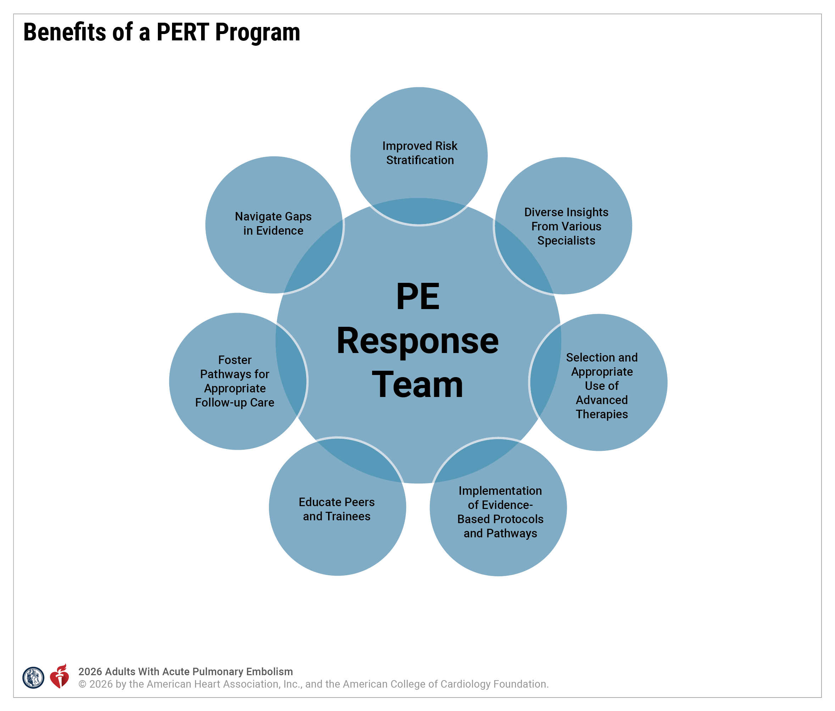
Figure 4. Benefits of a PERT Program
PERT teams can make a significant impact on the clinical care delivery model by improving risk stratification, expediting initiation of treatments, such as anticoagulation therapy, and aiding the clinician in selecting the most appropriate advanced interventions when deemed appropriate.
PERT indicates pulmonary embolism response team.
Modified with permission from Bejjani et al.3 Copyright 2022 MDPI.

Slide 49
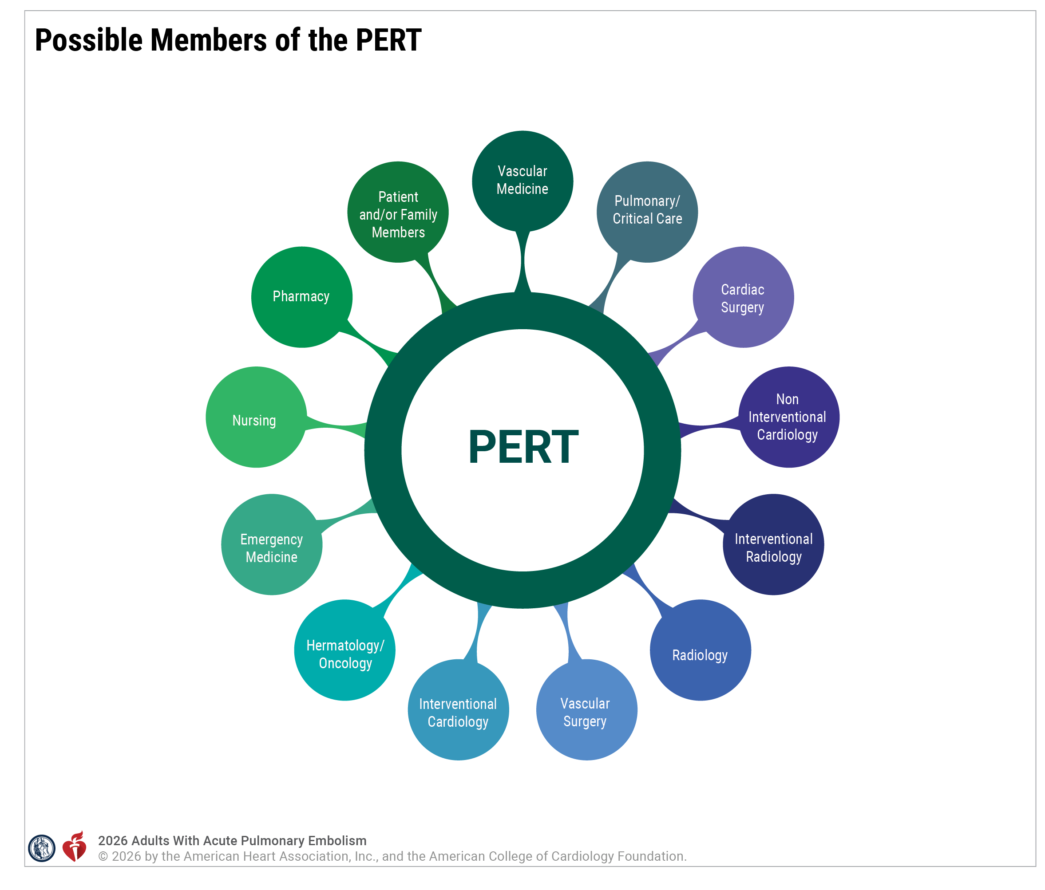
Figure 5. Possible Members of the PERT
Not all PERT programs will include all of these specialties.
PERT indicates pulmonary embolism response team.
Modified from Rosovsky et al. Copyright 2018, with permission from Elsevier.

Slide 50
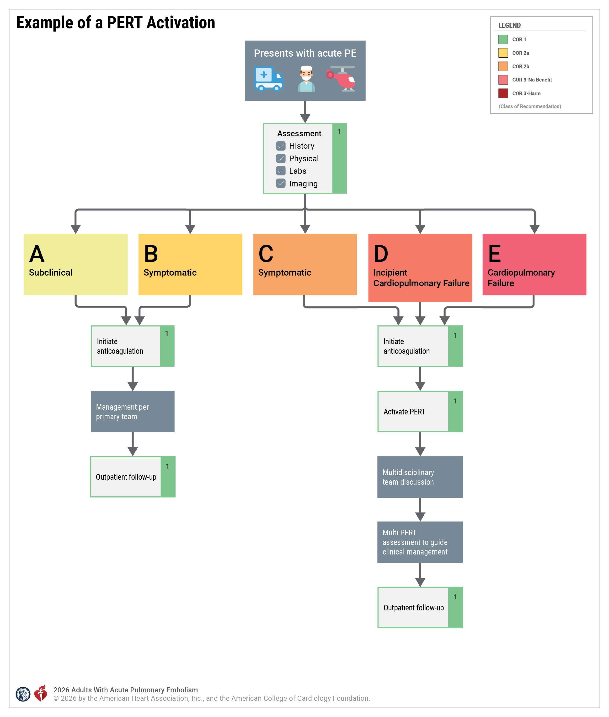
Figure 6. Example of a PERT Activation
The model and process of PERT activation. When a PE is diagnosed, the designated in-house PERT physician is paged, pertinent clinical information is gathered, and the severity of the case is assessed. If necessary, members of a multidisciplinary team discuss the case via phone, virtual meeting, or in person. Diagnostic and treatment options are discussed, recommendations are generated, and appropriate resources are mobilized. Upon discharge, patients follow up in a multidisciplinary clinic.
COR indicates class of recommendation; PE, pulmonary embolism; PERT, pulmonary embolism response team.
Modified from Rosovsky. Copyright 2018, with permission from Elsevier.

Slide 51
Anticoagulation Therapy
 | Recommendations for Anticoagulation Therapy Referenced studies that support recommendations are summarized in the Evidence Table.
COR | LOE | General Recommendations
1 | B-R | In patients with acute PE who do not have an absolute contraindication to anticoagulation therapy, anticoagulation therapy should be initiated to reduce the risk of recurrent VTE and death.
1 | B-R | In patients with acute PE in AHA/ACC Categories C1-E1 who require parenteral anticoagulant therapy initially, LMWH is recommended over UFH to reduce recurrent VTE and major bleeding.
1 | B-R | In patients with acute PE who are eligible for oral anticoagulation, DOACs are recommended over vitamin K antagonists (VKAs), unless contraindicated, to prevent recurrent VTE and reduce major bleeding.
2a | C-EO | In patients with suspected acute PE in AHA/ACC PE Category C2 or higher and in whom the bleeding risk is low, it may be beneficial to administer therapeutic anticoagulation when imaging is delayed or not immediately accessible.

Slide 52
Anticoagulation Therapy (con’t.)
Anticoagulation Therapy and Special Considerations
Obesity
2a | B-NR | In patients with obesity (body mass index [BMI] >30 kg/m²) and acute PE who are receiving oral anticoagulant therapy, treatment with a DOAC (unless contraindicated) over a VKA is reasonable to prevent recurrent PE and reduce major bleeding.
2b | B-NR | In patients with class III obesity (BMI >40 kg/m²) and acute PE who are receiving LMWH therapy, reducing the dose of LMWH may be reasonable to reduce the risk of bleeding.
Thrombotic Antiphospholipid Antibody Syndrome
1 | A | In patients with acute PE and established thrombotic antiphospholipid antibody syndrome, a VKA is recommended in preference to a DOAC for the prevention of venous and arterial thrombosis.
2b | B-R | In patients with acute PE determined to have only a single anticardiolipin antibody or a β2-glycoprotein antibody, a DOAC might be a reasonable alternative to a VKA to prevent recurrent PE.

Slide 53
Anticoagulation Therapy (con’t.)
Primary or Metastatic Brain Tumor
2b | C-LD | In patients with primary or metastatic brain tumors and acute PE who are otherwise eligible for oral anticoagulation, a DOAC may be considered over LMWH to reduce the risk of ICH.
Chronic Kidney Disease
1 | A | In patients with mild-to-moderate (stage 2-3) chronic kidney disease (CKD) and acute PE who require oral anticoagulant therapy, a DOAC is recommended over a VKA to reduce major bleeding.
2b | B-NR | In patients with severe kidney disease (stage 4-5) or endstage kidney disease on hemodialysis and confirmed PE who require oral anticoagulant therapy, it is uncertain whether apixaban is better than VKA to reduce major bleeding.

Slide 54
Anticoagulation Therapy (con’t.)
Pregnancy
1 | C-LD | In patients who are pregnant, have acute PE, and can receive anticoagulation, either LMWH or UFH are recommended to prevent recurrent VTE.
3: Harm | C-LD | In patients who are pregnant and have acute PE, DOACs and warfarin are potentially harmful and may result in miscarriages or fetal anomalies.
Breastfeeding
1 | C-LD | In patients with acute PE who are breastfeeding and require anticoagulation, LMWH, UFH, or warfarin are recommended over a DOAC, to prevent potential bleeding in the infant.

Slide 55
Anticoagulation Therapy (con’t.)
Chronic Liver Disease
2a | C-LD | In patients with Child-Pugh class A chronic liver disease and acute PE, treatment with a DOAC instead of a VKA is reasonable to reduce bleeding.
2b | C-LD | In patients with Child-Pugh class B chronic liver disease and acute PE, treatment with a DOAC instead of a VKA may be reasonable to reduce bleeding risk.
3: Harm | C-LD | In patients with Child-Pugh class C chronic liver disease and acute PE, treatment with a DOAC instead of a VKA is not recommended due to potential for increased bleeding.

Slide 56
Anticoagulation Therapy (con’t.)
Anticoagulation Therapy and Endovascular Procedures
1 | C-LD | In patients with acute PE undergoing CDL, concurrent therapeutic anticoagulation (LMWH or UFH) or subtherapeutic anticoagulation (UFH) is recommended over no anticoagulation to prevent recurrent PE.
1 | B-NR | In patients with acute PE who have undergone an endovascular procedure or received thrombolytic therapy, initial parenteral anticoagulation with LMWH is preferred over UFH to provide reliable therapeutic anticoagulation and reduce the risk of recurrent VTE.
2a | C-LD | In patients with acute PE likely to undergo endovascular procedures for PE management, LMWH is reasonable over UFH to provide more effective anticoagulation.

Slide 57
Anticoagulation Therapy (con’t.)
Anticoagulation Monitoring and Special Considerations
1 | C-LD | In patients with acute PE in whom LMWH is monitored, measuring a peak anti-Xa level 3 to 5 hours after an LMWH dose once a steady state is reached (≥3 doses) is recommended in preference to checking trough or random levels in order to most accurately identify if the patient is within the expected therapeutic range.
2a | C-LD | In patients with acute PE who have severe CKD (CrCl of <30 mL/min) and are being treated with LMWH, it is reasonable to monitor anti-Xa levels to guide dose adjustment in order to reduce bleeding risk.
2b | C-LD | In pregnant patients treated with LMWH for acute PE, the usefulness of monitoring the peak anti-Xa level at least once per trimester is not well established to guide dose adjustment and reduce bleeding and/or thromboembolic risk.

Slide 58
Anticoagulation Therapy (con’t.)
2b | C-LD | In patients who weigh >150 kg or have a BMI of >40 kg/m² and are receiving LMWH for treatment of acute PE, the benefit of monitoring anti-Xa levels is not established to avoid supratherapeutic levels of LMWH after initial therapy.
2b | C-LD | In patients with acute PE treated with LMWH in the ICU, the benefit of monitoring anti-Xa levels is not established to avoid supratherapeutic and/or subtherapeutic levels.
3: No Benefit | A | In most patients with acute PE treated with weight-based LMWH, laboratory monitoring of anti-Xa level and dose adjustment is not indicated to reduce recurrent VTE or bleeding.

Slide 59
Hemodynamic Pharmacotherapy
 | Recommendations for Hemodynamic Pharmacotherapy Referenced studies that support recommendations are summarized in the Evidence Table.
COR | LOE | Recommendations
1 | C-LD | For patients with cardiogenic shock due to acute PE (AHA/ACC PE Categories D2-E2), the use of vasopressors and/or inotropes is recommended to improve cardiac output and systemic perfusion.
2b | C-LD | In patients with acute PE in AHA/ACC PE Categories D1-2 in whom there are concerns for reduced preload based on clinical assessment, the use of volume management with normal saline or other volume expanders may be considered to improve cardiac output and blood pressure.
2b | B-R | For patients with acute PE in AHA/ACC PE Categories C2-E, the use of inhaled pulmonary vasodilators may be considered to reduce RV afterload.

Slide 60
Sedation and Ventilatory Strategies
 | Recommendations for Sedation and Ventilatory Strategies Referenced studies that support recommendations are summarized in the Evidence Table.
COR | LOE | Recommendations
1 | C-LD | In patients with acute PE in AHA/ACC PE Categories C-E who require sedation for intubation, hemodynamic supportive therapies (vasopressors, inotropes, and/or venoarterial [VA]-ECMO) should be available to support the patient in the event the patient becomes unstable.
2a | C-LD | For patients with acute PE and moderate-severe hypoxia, use of heated high-flow nasal cannula (HFNC) oxygenation rather than standard nasal cannula oxygenation can be beneficial to improve oxygenation.
3: Harm | C-LD | In patients with acute PE in AHA/ACC PE Categories C-E, deep sedation and mechanical ventilation should not be performed, unless clinically indicated, in order to avoid hemodynamic collapse.

Slide 61
Mechanical Circulatory Support
 | Recommendations for Mechanical Circulatory Support Referenced studies that support recommendations are summarized in the Evidence Table.
COR | LOE | Recommendations
1 | B-NR | In patients with known or suspected acute PE on VA-ECMO, continuation of parenteral systemic anticoagulation is recommended in the absence of bleeding to prevent further thrombotic or embolic complications.
2a | B-NR | In patients with acute, refractory cardiogenic shock as a result of known or suspected acute PE (AHA/ACC PE Category E2), it is reasonable to institute VA-ECMO, provided appropriate resources are available, to stabilize hemodynamics and improve oxygenation.
2b | C-LD | In patients with acute PE in AHA/ACC PE Category E2 who are placed on VA-ECMO support, the usefulness of additional advanced therapies is not well established.

Slide 62
Role of the Inferior Vena Cava Filter
 | Recommendations for Inferior Vena Cava Filters Referenced studies that support recommendations are summarized in the Evidence Table.
COR | LOE | Recommendations
1 | B-R | In patients with acute PE who cannot tolerate anticoagulation but in whom an IVC filter is deemed necessary, retrievable IVC filters are recommended over permanent filters to reduce the short-term incidence of recurrent PE while minimizing long-term adverse outcomes.
1 | C-LD | In patients with retrievable IVC filters, retrieval should be attempted as soon as the risk of PE has sufficiently decreased and anticoagulation tolerated in order to minimize the risk of long-term filter-related complications.
2a | B-R | In patients with acute PE who cannot tolerate anticoagulation, IVC filters can be useful to reduce the short-term incidence of recurrent PE.

Slide 63
Role of the Inferior Vena Cava Filter con’t.
2a | C-LD | In patients with indwelling IVC filters, the use of a structured follow-up program is reasonable to increase retrieval rates and detect complications.
2b | C-LD | In patients with acute PE in AHA/ACC PE Categories D-E, and who are undergoing advanced interventions such as systemic thrombolysis, CDL, MT, or surgical embolectomy, the benefit of IVC filter placement is uncertain to reduce the short-term incidence of recurrent PE and mortality.
2b | C-LD | In patients with recurrent PE despite optimal therapeutic anticoagulation who are in AHA/ACC PE Categories B-E, IVC filter placement may be considered to reduce the short-term incidence of additional recurrent PE.
3: Harm | A | In patients with acute PE who are therapeutically anticoagulated, routine IVC filter placement should not be performed.

Slide 64
Advanced Management
 | Recommendations for Interventional Advanced Management Referenced studies that support recommendations are summarized in the Evidence Table.
COR | LOE | Recommendations
2a | C-LD | In patients with acute PE in AHA/ACC PE Categories C3-E2 who have evidence of free-floating right atrial and/or RV clot-in-transit, the utilization of advanced therapies over anticoagulation alone is reasonable to reduce the risk of clinical deterioration.
2b | B-R | In patients with acute PE in AHA/ACC PE Categories C2-D2 and without contraindications to thrombolysis, and in whom advanced therapy is being considered, the usefulness of either CDL or MT over the other is uncertain for reduction in mortality or major bleeding.

Slide 65
Table 7. Summary of Advanced Therapy Recommendations
AHA/ACC PE Risk Outcomes Category | Systemic Lysis | CDL | MT | Surgery
A-C1 | 3-Harm A | 3-NB C-EO | 3-NB C-EO | 3-NB C-EO
C2 | 3-Harm B-R | 2B C-LD (unclear) | 2B C-LD (unclear) | 3-NB C-EO
C3 | 2B C-LD (unclear) | 2B C-LD (unclear) | 2B C-LD (unclear) | 3-NB C-EO
D1-2 | 2B C-LD (may be considered) | 2B B-NR (may be considered) | 2B B-NR (may be considered) | 2B C-LD (unclear)
E1 | 2A C-LD | 2A C-LD | 2A B-NR | 2A B-NR
E2 | 2A C-LD | N/A | N/A | 3-NB B-NR
ACC indicates American College of Cardiology; AHA, American Heart Association; CDL, catheter-directed thrombolysis; and MT, mechanical thrombectomy.

Slide 66
Systemic Thrombolysis
 | Recommendations for Systemic Thrombolysis Referenced studies that support recommendations are summarized in the Evidence Table.
COR | LOE | Recommendations
2a | C-LD | In patients with acute PE in AHA/ACC PE Categories E1-2 and acceptable bleeding risk, in whom advanced therapy is being considered, systemic thrombolysis and anticoagulation is reasonable over anticoagulation alone to reduce mortality and recurrent PE.
2b | C-LD | In patients with acute PE in AHA/ACC PE Categories D1-2 and an acceptable bleeding risk, in whom advanced therapy is being considered, systemic thrombolysis and anticoagulation may be considered over anticoagulation alone to prevent further clinical deterioration.
2b | C-LD | In patients with acute PE in AHA/ACC PE Category C3 and acceptable bleeding risk, in whom advanced therapy is being considered, the use of systemic thrombolysis and anticoagulation over anticoagulation alone to prevent further clinical deterioration is uncertain.
2b | C-LD | In patients with acute PE being treated with systemic thrombolysis, lower dose systemic thrombolytics may be considered to reduce the risk of bleeding.⁶⁻¹⁰
3: Harm | B-R | In patients with acute PE in AHA/ACC PE Categories A1-C2, systemic thrombolysis should not be used over anticoagulation alone due to increased risk of major bleeding and ICH.

Slide 67
Catheter-Directed Thrombolysis
 | Recommendations for Catheter-Directed Thrombolysis Referenced studies that support recommendations are summarized in the Evidence Table.
COR | LOE | Recommendations
2a | C-LD | In patients with acute PE in AHA/ACC PE Category E1, CDL plus anticoagulation is reasonable to prevent further clinical deterioration and early mortality.
2b | B-NR | In patients with acute PE in AHA/ACC PE Categories D1-2 in whom advanced therapy is being considered, CDL plus anticoagulation may be considered to prevent further clinical deterioration.
2b | C-LD | In patients with acute PE in AHA/ACC PE Categories C2-3, the benefit of CDL plus anticoagulation compared with anticoagulation alone to prevent short-term fatal/nonfatal clinical deterioration, and improve long-term mortality, functional capacity, and quality of life is unclear.

Slide 68
Catheter-Directed Thrombolysis (con’t.)
2b | C-LD | In patients with acute PE in AHA/ACC PE Categories D1-E1 in whom thrombolysis is being considered, the efficacy of CDL over systemic thrombolysis to reduce short-term fatal/nonfatal clinical deterioration, and improve long-term survival, functional capacity, and quality of life is unclear, but CDL may be considered over systemic thrombolysis to reduce major bleeding risks.
3: No Benefit | B-NR | In patients with acute PE who are undergoing CDL, a reduced thrombolytic dose of <5 mg of alteplase per PA is not recommended over a standard dose of 5 to 10 mg of alteplase per PA to reduce the risk of bleeding and/or reduce the rate of fatal or nonfatal clinical deterioration.
3: No Benefit | C-EO | In patients with acute PE in AHA/ACC PE Categories A-C1, CDL is not recommended over anticoagulation alone for improving clinical outcomes or symptoms.

Slide 69
Mechanical Thrombectomy
 | Recommendations for Mechanical Thrombectomy Referenced studies that support recommendations are summarized in the Evidence Table.
COR | LOE | Recommendations
2a | B-NR | In patients with acute PE in AHA/ACC PE Category E1, it is reasonable to choose MT plus anticoagulation over anticoagulation alone to prevent further clinical decompensation and acute mortality.
2b | B-NR | In patients with acute PE in AHA/ACC PE Categories D1-2 in whom advanced therapy is being considered, MT plus anticoagulation may be considered over anticoagulation alone to prevent further clinical deterioration.
2b | C-LD | In patients with acute PE in AHA/ACC PE Categories C2-3, the benefit of MT plus anticoagulation compared with anticoagulation alone is unclear in preventing short-term fatal/nonfatal clinical deterioration and improving long-term survival and functional capacity.

Slide 70
Mechanical Thrombectomy (con’t.)
2b | B-NR | In patients with acute PE in AHA/ACC PE Categories D1-E1 in whom advanced therapy is being considered, the efficacy of MT to reduce short-term fatal/nonfatal clinical deterioration and improve long-term survival, functional capacity, and quality of life over systemic thrombolysis is unclear, but MT mechanical thrombectomy may be considered over systemic thrombolysis to reduce major bleeding risks.
3: No Benefit | C-EO | In patients with acute PE in AHA/ACC PE Categories A-C1, MT is not recommended over anticoagulation alone for improving clinical outcomes or symptoms.

Slide 71
Surgical Embolectomy
 | Recommendations for Surgical Embolectomy Referenced studies that support recommendations are summarized in the Evidence Table.
COR | LOE | Recommendations
2a | B-NR | In patients with acute PE in AHA/ACC PE Category E1, surgical embolectomy compared with anticoagulation alone is reasonable to prevent further clinical decompensation and acute mortality.
2b | C-LD | In patients with acute PE in AHA/ACC PE Categories D1-2 and D2 in whom advanced treatment is being considered, surgical embolectomy plus anticoagulation may be considered over anticoagulation alone to prevent further clinical deterioration.

Slide 72
Surgical Embolectomy (con’t.)
2b | B-NR | In patients with acute PE in AHA/ACC PE Categories D1-E1 who are surgical candidates and in whom advanced therapy is being considered, the benefits of surgical embolectomy to reduce short-term fatal/nonfatal clinical deterioration and improve long-term survival, functional capacity, and quality of life over systemic thrombolysis is unclear, but surgical embolectomy may be considered over systemic thrombolysis to reduce the risk of ICH.
3: No Benefit | C-EO | In patients with acute PE in AHA/ACC PE Categories A-C3, surgical embolectomy is not recommended over anticoagulation alone for improving clinical outcomes or symptoms.
3: No Benefit | B-NR | In patients with acute PE in AHA/ACC PE Category E2 not on mechanical circulatory support, surgical embolectomy is not recommended over other advanced therapies for preventing short-term mortality.

Slide 73
Monitoring and Follow-Up

Slide 74
Follow-Up Care for Acute PE
 | Recommendations for Follow-Up Care Post-Acute PE Referenced studies that support recommendations are summarized in the Evidence Table.
COR | LOE | Recommendations
1 | C-LD | In patients with acute PE, it is beneficial to have clinical follow-up within the first week of discharge to provide patient education, address barriers to anticoagulation therapy, ensure adherence to prescribed medications, and detect bleeding complications.
1 | C-EO | Patients with acute PE should have a clinical visit at or before 3 months after diagnosis to discuss duration of anticoagulation, review the need for further testing, and assess for persistent PE-related symptoms.
1 | C-LD | Patients who have had acute PE should be asked about PE-related symptoms and functional limitations at every visit for at least 1 year to screen for CTEPD or other causes of dyspnea and functional limitation.

Slide 75
Follow-Up Care for Acute PE (con’t.)
1 | B-NR | In patients with a history of acute PE who remain on anticoagulation into the extended phase (beyond 3-6 months from diagnosis), periodic reassessment of the risk and benefits of continued anticoagulation is recommended to ensure the safety and efficacy of continuing anticoagulation.
2a | B-NR | In patients with acute PE, the use of general or disease-specific questionnaires is reasonable to screen for anxiety and depression at follow-up visits.
2a | B-NR | In select complex patients⁺ with acute PE, it is reasonable to have follow-up care occur in a specialized PE clinic†, if available, to optimize care.
2b | B-NR | In patients who remain symptomatic 3 to 6 months after acute PE, it may be reasonable to obtain a performance test (SMWT, ISWT, ESWT*) to quantify physical limitations and identify which patients require more extensive evaluation.
*SMWT, Six-minute walk test; ISWT, incremental shuttle walking test; ESWT, endurance shuttle walking test.
+Complex patients likely to benefit from specialized care are referenced in Table 8.
†Specialty clinics are defined as those with expertise in PE management, such as pulmonology/critical care, hematology, cardiology, vascular medicine or, if available, a multidisciplinary PERT clinic.

Slide 76
Follow-Up Care for Acute PE (con’t.)
Cancer Screening and Thrombophilia Testing in the Absence of PE Risk Factors
1 | A | In patients with acute PE without associated identifiable risk factors, a thorough history, physical examination, and age-appropriate cancer screening should be obtained to diagnose undetected cancer.
2b | C-LD | In patients without a major reversible risk factor for acute PE who have a family history of thrombosis or are <55 years of age, it might be reasonable to perform testing for genetic and acquired thrombophilia if the thrombophilia tests results are anticipated to change management or better inform family risk discussions.
3: No Benefit | A | In patients with acute PE, routine imaging with CT or positron emission tomography-CT is not recommended to diagnose undetected cancer.

Slide 77
Follow-Up Care for Acute PE (con’t.)
Contraception, Pregnancy, and Hormonal Therapy
1 | C-EO | Patients of childbearing potential with acute PE should be counseled about contraception and anticoagulation options in the event that they become pregnant.
2a | C-EO | In patients who have experienced a PE and become pregnant, management by a team specializing in thrombotic complications can be useful to minimize pregnancy-related complications.
2a | C-LD | For patients using anticoagulant therapy for the treatment or prevention of PE who have experienced or are at risk of abnormal uterine bleeding, it is reasonable to discuss medical management (eg, hormonal therapies), alternate anticoagulant strategies, and gynecologic interventional strategies to mitigate abnormal uterine bleeding risk rather than considering anticoagulation cessation.
2b | C-LD | In patients with acute PE who require or are being considered for estrogen-containing hormone therapy, continuation or initiation of hormonal therapy might be considered if there is a favorable risk-benefit ratio and the patient remains on anticoagulation.

Slide 78
Table 8. Indications for Referral to a Specialized Clinic for Management
Indication | Description
Complex anticoagulation management | Patients requiring frequent adjustments or monitoring of anticoagulation therapy, including labile INRs, or fluctuating renal function, anticoagulation failure, allergies, high-risk/active bleeding
VTE history or recurrent PE | Patients with a history of recurrent VTE or those with an elevated risk of recurrence
Unresolved symptoms | Patients with ongoing symptoms such as dyspnea or exercise intolerance, potentially indicating CTEPD, may require specialty care
Pregnancy-related PE | Pregnant or postpartum patients with PE may require specialized management due to the associated complexities of anticoagulation during pregnancy and the postpartum period
Complicated clinical presentation | Patients with a PE in the setting of complex medical conditions (cancer, severe chronic illnesses), which may complicate standard treatment
Expert second opinion | Patients or referring physicians seeking a second opinion on management of complex patient care
CTEPD indicates chronic thromboembolic pulmonary disease; INR, international normalized ratio; PE, pulmonary embolism; and VTE, venous thromboembolism.

Slide 79
Patient Activity and Travel
 | Recommendations for Patient Activity and Travel Referenced studies that support recommendations are summarized in the Evidence Table.
COR | LOE | Recommendations
2a | A | In patients recovering from acute PE, it is reasonable to encourage early ambulation rather than bed rest in order to reduce the risk of complications.
2a | B-R | In patients with a history of acute PE, use of compression stockings during long-haul (≥5 h) travel can be useful to lower the risk of DVT.
2b | C-EO | In patients with a history of acute PE related to travel or immobility who are not currently receiving anticoagulation therapy, it may be reasonable to use a one-time prophylactic dose of an oral anticoagulant or a parenteral LMWH on the day of long-haul travel to reduce the risk of recurrent VTE.
2b | C-LD | For patients recovering from acute PE in AHA/ACC PE Categories C2-E, it may be reasonable to restrict long-haul travel for 4 weeks after initiation of treatment or when symptoms have resolved to reduce risk of adverse events.

Slide 80
Anticoagulation Therapy by Recurrence Risk
 | Recommendations for Anticoagulation Therapy by Recurrence Risk Referenced studies that support recommendations are summarized in the Evidence Table.
COR | LOE | Recommendations
1 | A | In patients with a first acute PE and no major reversible risk factor, continuing anticoagulation beyond the initial treatment phase (3-6 months) into the extended treatment phase* is beneficial to prevent recurrent VTE.
1 | B-NR | In patients with a first acute PE due to a major reversible risk factor, stopping anticoagulation at the end of the initial treatment phase (3-6 months) is recommended over continuing anticoagulation into the extended treatment phase in order to optimize the net clinical benefit of recurrent VTE versus bleeding.
*Anticoagulation beyond the initial 3 to 6 months without an anticipated stop date.

Slide 81
Anticoagulation Therapy by Recurrence Risk (con’t.)
1 | C-LD | In patients with a first PE due to a persistent risk factor, continuing anticoagulation at the initial treatment phase (3-6 months) into the extended treatment phase is reasonable in order to prevent recurrent VTE.
1 | A | For patients with a PE who are offered anticoagulation beyond the initial treatment phase (3-6 months) into the extended treatment phase, treatment with a DOAC, unless contraindicated, is recommended over a VKA to reduce the risk of bleeding.
1 | A | For patients with a PE and with cancer who are offered anticoagulation beyond the initial treatment phase (3-6 months) into the extended treatment phase, either a DOAC or LMWH is recommended over VKA to reduce the risk of recurrent VTE.
1 | B-R | For patients with a PE and without cancer offered anticoagulation beyond the initial treatment phase (3-6 months) into the extended treatment phase, but have a contraindication to DOAC, VKA is recommended over aspirin or no therapy to reduce the risk of recurrent VTE.

Slide 82
Anticoagulation Therapy by Recurrence Risk (con’t.)
1 | A | For patients with a PE who are offered anticoagulation beyond the initial treatment phase (3-6 months) into the extended treatment phase, treatment with half-dose apixaban or rivaroxaban is recommended to reduce the risk of bleeding.
2a | B-NR | In patients with a first acute PE due to a minor reversible risk factor, shared decision-making about stopping anticoagulation at the end of the initial treatment phase (3-6 months) versus continuing anticoagulation into the extended treatment phase is reasonable in order to optimize the net clinical benefit of recurrent VTE versus bleeding.
2a | B-R | For patients who would be offered anticoagulation beyond the initial treatment phase (3-6 months) into the extended treatment phase, but have a contraindication to or refuse anticoagulation, it is reasonable to choose low-dose aspirin over no therapy to reduce the risk of recurrent VTE.

Slide 83
Table 9. Risk Factors for Venous Thromboembolism
Major Reversible Risk Factor | Minor Reversible Risk Factor | Persistent Risk Factor
Surgery with general anesthesia ≥30 minutes Hospitalization for acute medical illness ≥72 hours while confined to hospital bed Cesarean section Lower limb fracture | Surgery with general anesthesia <30 minutes Hospitalization for acute medical illness <72 hours Out-of-hospital acute medical illness ≥72 hours while confined to bed Estrogen therapy (hormone replacement or contraceptive) Peripartum period Trauma with decreased mobility ≥72 hours | Active cancer with or without ongoing treatment Autoimmune disease (ie, rheumatoid arthritis, systemic lupus erythematous, etc) Inflammatory bowel disease Chronic immobility
Adapted from Kearon et al. Copyright 2016, with permission from Elsevier.

Slide 84
Recurrent Pulmonary Embolism
 | Recommendations for Recurrent Pulmonary Embolism Referenced studies that support recommendations are summarized in the Evidence Table.
COR | LOE | Recommendations
1 | C-EO | In patients with a history of PE and who present with new symptoms and signs suggestive of recurrent or breakthrough PE, radiographic imaging with a CTPA or V/Q scan is recommended to objectively confirm or exclude the diagnosis.
1 | C-LD | In patients with a history of PE who have a documented recurrent PE despite being treated with an anticoagulant, an evaluation is recommended to detect clinical and pharmacological factors that may contribute to recurrent PE.
2a | C-EO | In patients with recurrent PE who are adherent with prescribed therapeutic-intensity anticoagulation, changing therapy to an alternative drug class rather that continuing therapy with the same drug class is reasonable.

Slide 85
Recurrent Pulmonary Embolism (con’t.)
2a | C-EO | In patients who have documented recurrent acute PE while adherent to anticoagulation with a reduced-dose DOAC, it is reasonable to anticoagulate with a full-dose DOAC within the same class.
2a | B-NR | In patients with cancer and a recurrent PE despite being therapeutically anticoagulated with LMWH, dose escalation of LMWH by 20% to 25% is reasonable to prevent future recurrent PE.

Slide 86
Complications and Sequelae

Slide 87
Persistently Symptomatic Patients After Acute PE
 | Recommendations for Persistently Symptomatic Patients After Acute PE Referenced studies that support recommendations are summarized in the Evidence Table.
COR | LOE | Recommendations
Evaluation
1 | B-NR | In patients with ongoing dyspnea and/or functional impairment after ≥3 months of therapeutic anticoagulation after an acute PE, a diagnostic evaluation is recommended to assess for CTEPD.
2a | B-NR | For patients undergoing a diagnostic evaluation for CTEPD, it is reasonable to obtain both a transthoracic echocardiogram (TTE)* and a lung perfusion scan (planar V/Q, or V/Q single-photon emission CT [SPECT], SPECT/CT) over an echocardiogram alone to exclude CTEPD or determine if additional diagnostic testing is needed.
2a | B-NR | For patients undergoing a diagnostic evaluation for CTEPD, cardiopulmonary exercise testing (CPET) is reasonable to exclude CTEPD.
3: No Benefit | B-NR | In patients with a history of acute PE, who have resolution of symptoms and low suspicion for CTEPD, a follow-up CTPA or lung perfusion scan (planar V/Q, V/Q SPECT, SPECT/CT) is not beneficial to assess for the degree of thrombosis resolution.
*In a patient with normal echocardiogram at the time of acute PE, a repeated echocardiogram at 3 to 6 months is low yield and may be omitted.

Slide 88
Persistently Symptomatic Patients After Acute PE (con’t.)
Management
1 | B-NR | Patients being evaluated for CTEPD should continue anticoagulation until the evaluation is completed to prevent recurrent VTE and/or CTEPD progression unless contraindicated due to high bleeding risk.
1 | B-R | For patients in whom CTEPD has been excluded but who have ongoing dyspnea and/or functional impairment despite ≥3 months of therapeutic anticoagulation an acute PE, a pulmonary rehabilitation program is reasonable to improve symptoms and exercise tolerance.
1 | C-LD | For patients with a diagnosis of CTEPD with PH, referral to a center with expertise in managing CTEPD is recommended to optimize evaluation and management.
2a | C-LD | For select patients with a diagnosis of CTEPD without PH, referral to a center with expertise can be beneficial in managing CTEPD.

Slide 89
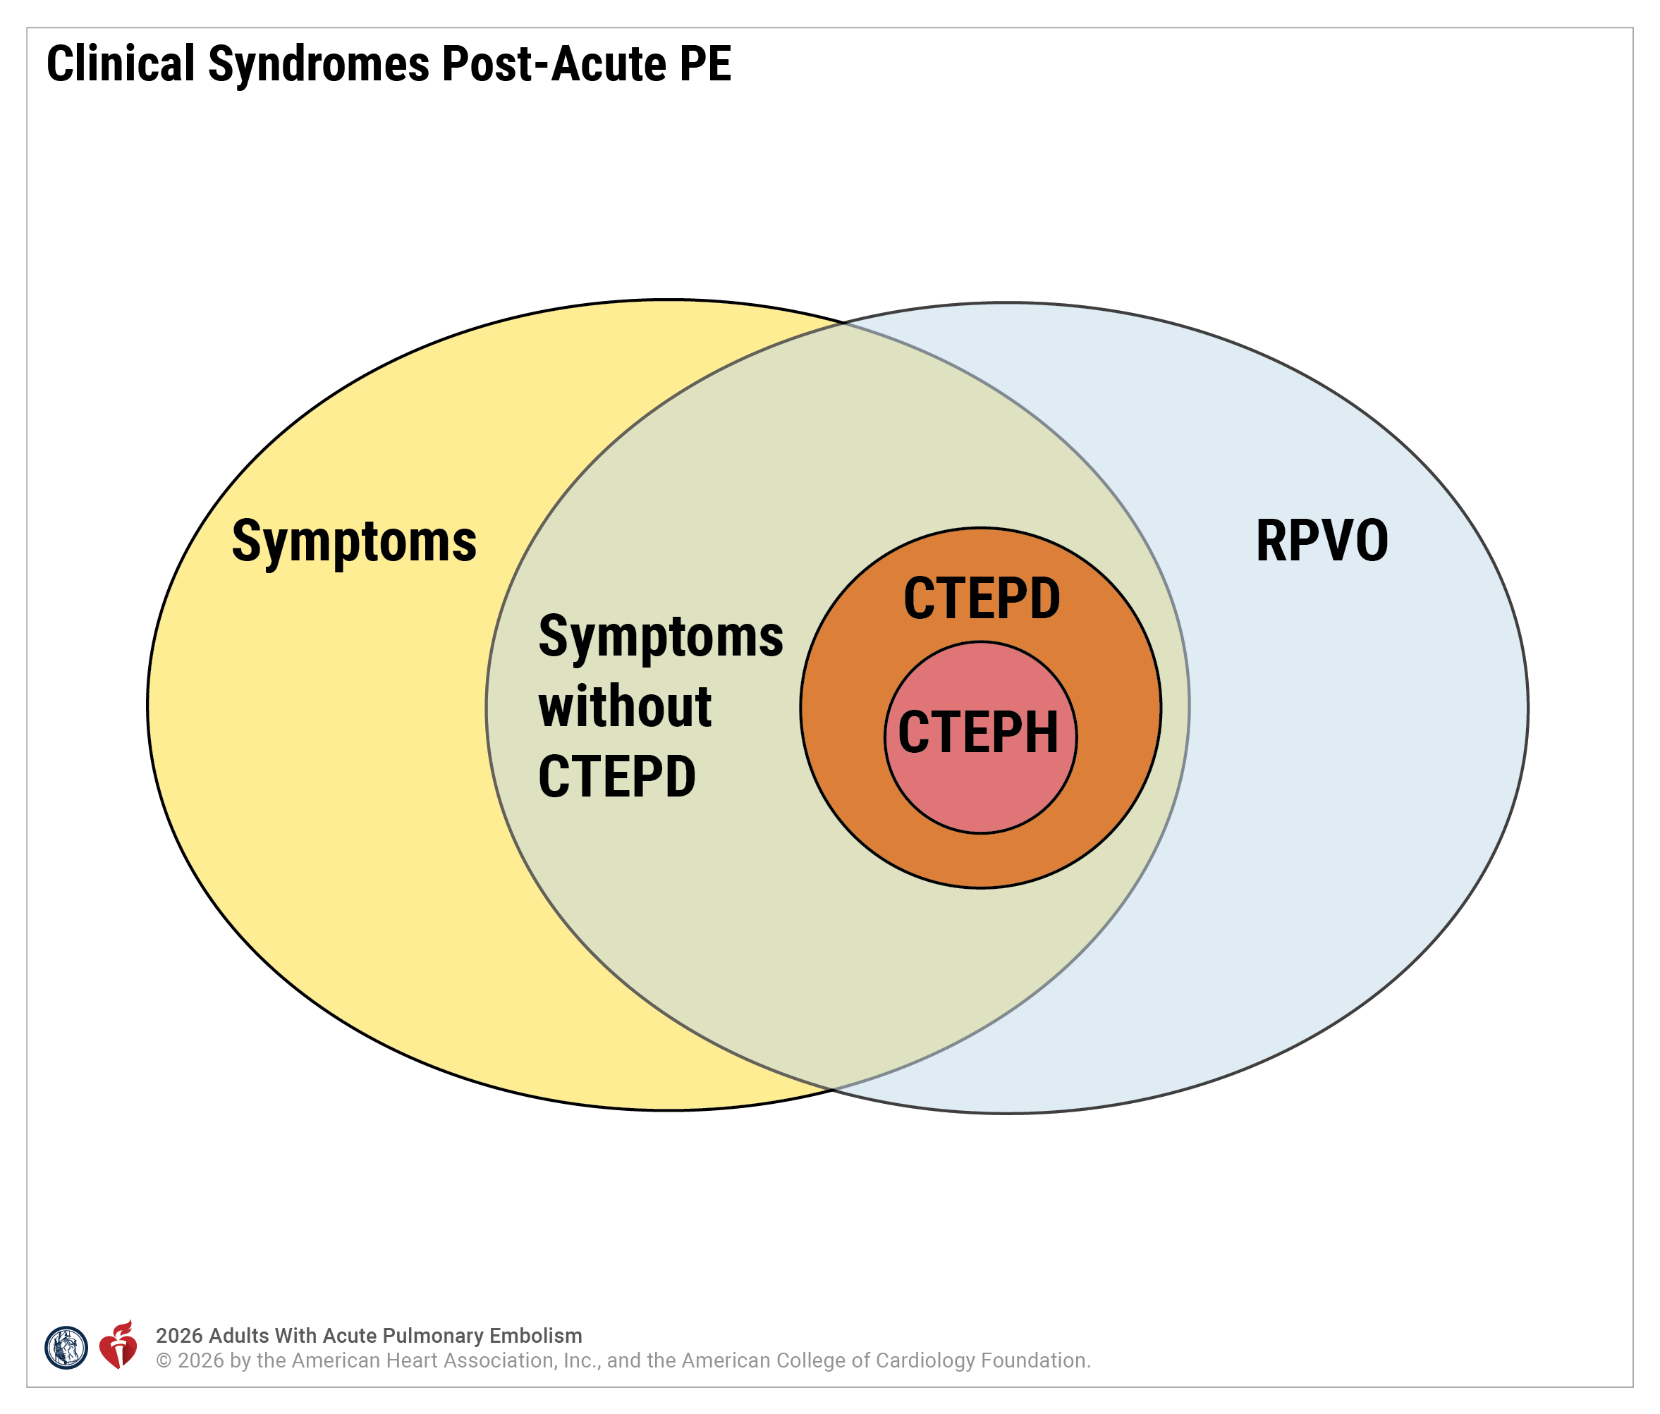
Figure 7. Clinical Syndromes Post-Acute Pulmonary Embolism
CTEPD indicates chronic thromboembolic pulmonary disease; CTEPH, chronic thromboembolic pulmonary hypertension; and RPVO, residual pulmonary vascular obstruction.

Slide 90
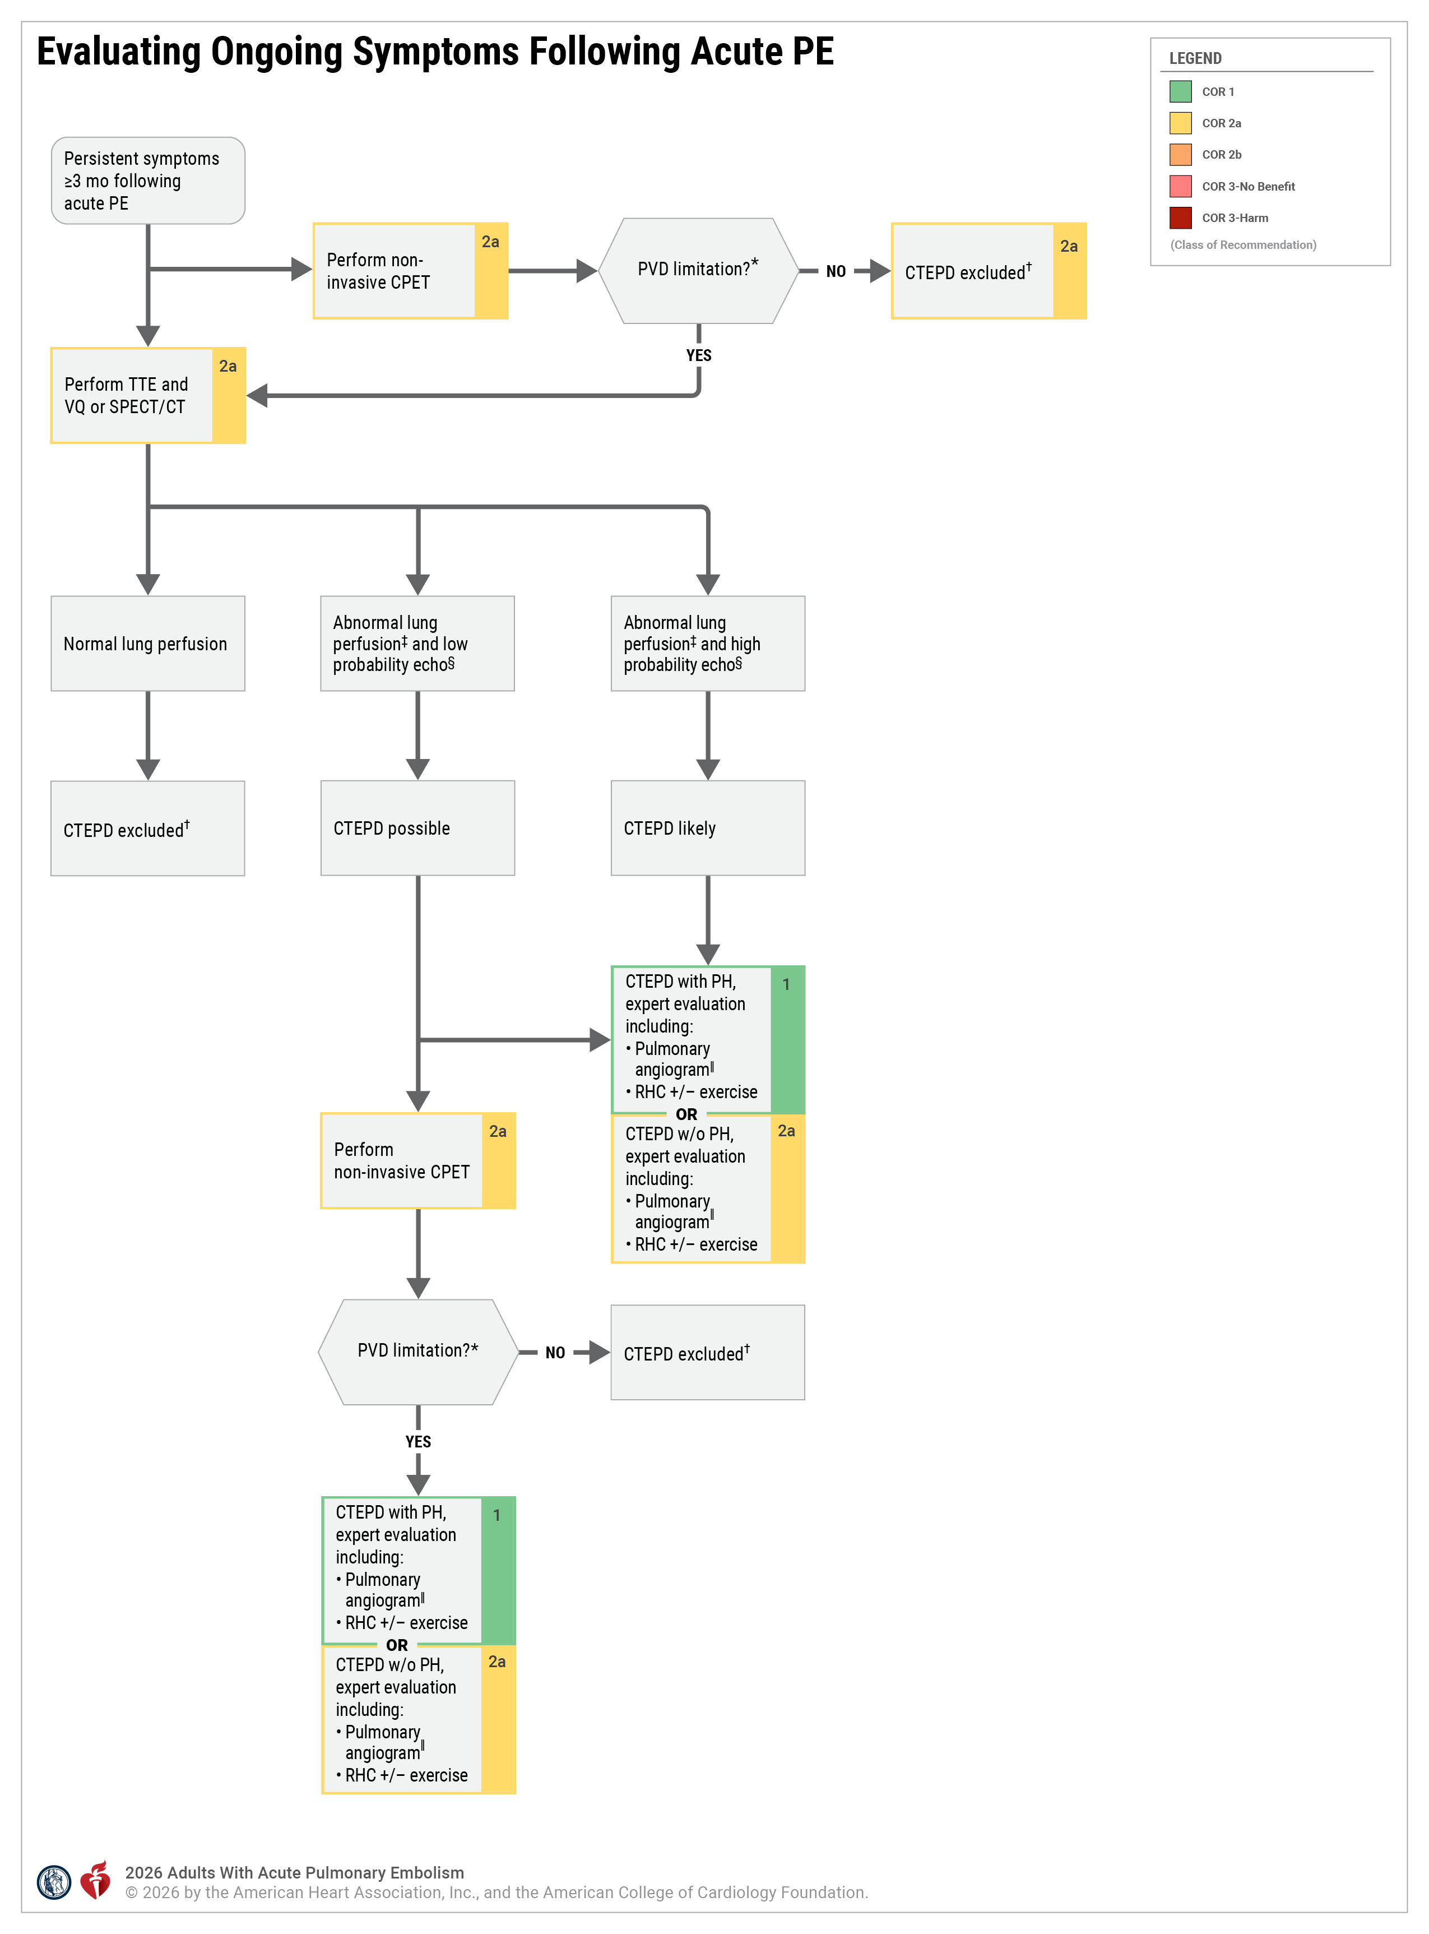
Figure 8. Evaluating Ongoing Symptoms Following Acute PE
*PVD limitation defined by circulatory impairment with abnormalities in stroke volume (oxygen pulse) and VD/VT and/or VE/VCO2.
†While CTEPD is excluded, evaluation for other etiologies of symptoms is warranted.
‡Positive V/Q or SPECT/CT scan refers to any mismatched perfusion defects.
§Low-probability echocardiogram is defined as a TRV ≤2.8 m/s and absence of echocardiographic PH signs (Table 10).
Higher- probability echocardiogram is defined as a TRV ≥2.8 m/s and presence of echocardiographic PH signs (Table 10). High-risk echocardiogram refers to intermediate- or high-probability echocardiography criteria per 2022 European Respiratory Society guidelines, while low-risk echocardiogram refers to low-probability echocardiography criteria.
║Pulmonary angiography may be CT or invasive pulmonary angiogram depending on clinician choice as evaluation will differ based on center experience.
CPET indicates cardiopulmonary exercise testing; CT, computed tomography; CTPED, chronic thromboembolic pulmonary disease; PH, pulmonary hypertension; PVD, pulmonary vascular disease; RPVO, residual pulmonary vascular obstruction; RHC, right heart catheterization; SPECT, single-photon emission computed tomography; TRV, tricuspid regurgitation velocity; TTE, transthoracic echocardiography; VE/VCO2, ventilatory inefficiency; and V/Q, ventilation-perfusion.
Adapted from Pugliese, et al and from the American Thoracic Society. Copyright © 2019 American Thoracic Society. All rights reserved. Annals of the American Thoracic Society is an official journal of the American Thoracic Society

Slide 91
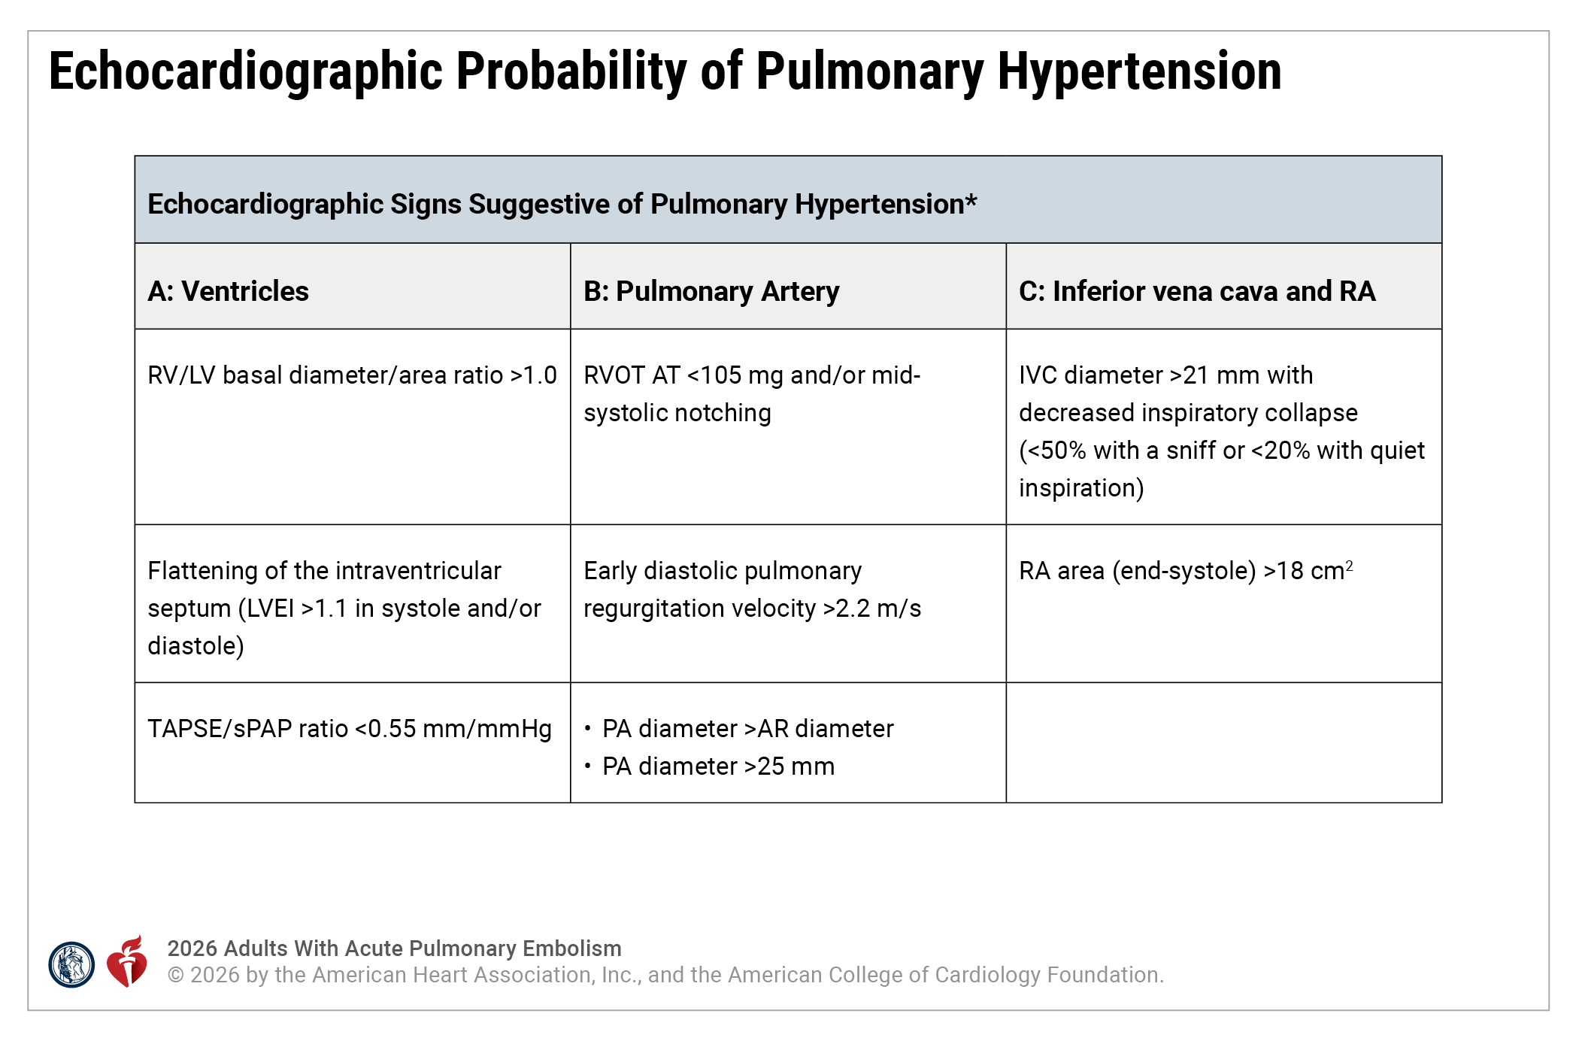
Table 10. Echocardiographic Signs Suggestive of Pulmonary Hypertension
AR indicates aortic root; IVC, inferior vena cava; LV, left ventricle; LVEI, left ventricle eccentricity index; m, meters; PA, pulmonary artery; PH, pulmonary hypertension; RA, right atrium; RV, right ventricle; RVOT AT, right ventricular outflow tract acceleration time; sPAP, systolic pulmonary arterial pressure; TAPSE, tricuspid annular plane systolic excursion; TRV, tricuspid regurgitation velocity, and s, second.
*Signs from at least 2 categories (A/B/C) must be present to alter the level of echocardiographic probability of PH.
Adapted with permission from Humbert et al. and from © European Society of Cardiology & European Respiratory Society 2025.

Slide 92
Evidence Gaps and Future Directions

Slide 93
Table 11. Evidence Gaps and Future Direction in the Management of Acute PE
Category | Evidence Gaps and Future Directions
Risk Stratification and Scoring Systems | Validation of the AHA/ACC Acute PE Clinical Categories Determination of the utility of generic risk scores (like NEWS2) in predicting outcomes Better characterization of the impact of genetic and acquired thrombophilia testing on patient-relevant outcomes in acute PE Determination of whether the degree of RV enlargement relative to the LV may be more predictive than a binary normal/abnormal assessment Development of risk scores that can identify patients who will have better outcomes with advanced therapies Assess the role of thrombus burden in key subpopulations and the impact of acute intervention to reduce thrombus burden on patient-relevant outcomes
Anticoagulation/Thrombolytic Therapy | Development of new anticoagulants with lower bleeding risk Evaluation of how D-dimer–based strategies perform in patients on therapeutic anticoagulation Assessment of the impact of compression therapy and anticoagulation to reduce PE risk for short-and long-haul travel Safety and efficacy of short-term LMWH versus DOAC following acute PE intervention

Slide 94
Table 11. Evidence Gaps and Future Direction in the Management of Acute PE (con’t.)
Category | Evidence Gaps and Future Directions
Advanced Therapies | Creation of algorithms for when to use each interventional tool for advanced therapy of PE Assessment of efficacy and safety of various dosing regimens of thrombolytic agents to treat acute PE Assessment of the efficacy and safety of interventional and postinterventional procedure anticoagulant therapy Evaluation of the efficacy and safety of catheter-based interventions versus anticoagulation alone among AHA/ACC PE Categories C-D patients for acute and long-term outcomes Evaluation of the efficacy and safety of surgical embolectomy in a randomized trial Determination of the role for isolated RV support devices in AHA/ACC PE Category E patients Evaluation of the efficacy and safety of catheter-based interventions versus systemic thrombolysis among AHA/ACC PE Category E patients for acute and long-term outcomes
Chronic Conditions and Long-Term Outcomes | Better characterization of subtypes of CTEPD and their clinical consequences Assessment of novel biomarkers, clinical characteristics, and imaging findings for risks of developing chronic thromboembolism

Slide 95
Table 11. Evidence Gaps and Future Direction in the Management of Acute PE (con’t.)
Category | Evidence Gaps and Future Directions
Special Populations and Personalized Medicine | Evaluation of diagnostic and treatment strategies in rural populations with limited access to care Determination the efficacy of anticoagulation therapy on patients with a history of PE who require long-term estrogen-containing hormone therapy Determination of the safety of direct oral anticoagulants in patients who are pregnant or breastfeeding
Technology and Innovation | Use of AI in the diagnosis and risk stratification of patients with acute PE Radiomics for aging of thrombus PE and risk stratification

Slide 96
Abbreviations
Abbreviation | Meaning/Phrase
APS | antiphospholipid syndrome
AUB | abnormal uterine bleeding
BMI | body mass index
BNP | brain natriuretic protein
BPA | balloon pulmonary angioplasty
CDL | catheter-directed thrombolysis
CKD | chronic kidney disease
CPET | cardiopulmonary exercise testing
CPR | cardiopulmonary resuscitation
CT | computed tomography
CTEPD | chronic thromboembolic pulmonary disease
CTEPH | chronic thromboembolic pulmonary hypertension
CTPA | computed tomography pulmonary angiography
CTV | computed tomography venography
CVD | cardiovascular disease
DOAC | direct oral anticoagulant
DVT | deep vein thrombosis
ECMO | extracorporeal membrane oxygenation
ED | emergency department
eGFR | estimated glomerular filtration rate
ESWT | endurance shuttle walking test

Slide 97
Abbreviations (con’t.)
Abbreviation | Meaning/Phrase
FDA | US Food and Drug Administration
FEU | fibrinogen equivalent units
GDMT | guideline-directed management therapy
HFNC | high-flow nasal cannula
ICH | intracranial hemorrhage
ICU | intensive care unit
IMV | invasive mechanical ventilation
ISWT | incremental shuttle walking test
IVC | inferior vena cava
LMWH | low molecular weight heparin
LV | left ventricle
MAP | mean arterial pressure
MRA | magnetic resonance angiography
MRI | magnetic resonance imaging
MT | mechanical thrombectomy
MV | mitral valve
NE | norepinephrine
NEWS | national early warning score
NIV | noninvasive mechanical ventilation
PA | pulmonary artery
PE | pulmonary embolism

Slide 98
Abbreviations (con’t.)
Abbreviation | Meaning/Phrase
PESI | pulmonary embolism severity index
PH | pulmonary hypertension
PTE | pulmonary thromboendarterectomy
PVFR | pulmonary venous flow reduction
PVR | pulmonary vascular resistance
RCT | randomized controlled trial
RPVO | residual pulmonary vascular obstruction
RV | right ventricle
SMWT | six-minute walk test
SPECT | single-photon emission computed tomography
SR | systematic review
SVR | systemic vascular resistance
TAPSE | tricuspid annular plane systolic excursion
TS | thrombolysis
TTE | transthoracic echocardiogram
UFH | unfractionated heparin
VD/VT | alveolar dead space
VE/VCO₂ | ventilatory efficiency
VKA | vitamin K antagonist
VO2 | peak oxygen consumption
V/Q | ventilation/perfusion
VTE | venous thromboembolism

