Slide 1
Impact of sleep disorders and disturbed sleep on brain health
A Scientific Statement from The American Heart Association
Rebecca F. Gottesman (Chair); Pamela L. Lutsey (Vice-chair); Helene Benveniste; Devin L. Brown; Kelsie M. Full; Jin-Moo Lee; Ricardo S. Osorio; Matthew P. Pase; Nancy S. Redeker; Susan Redline; Adam P. Spira; on behalf of the American Heart Association Stroke Council, Council on Cardiovascular and Stroke Nursing, and Council on Hypertension

Slide 2
Stroke council professional education committee
Slide presentation developed by:
Amanda Jagolino-Cole, MD

Slide 3
SLEEP and Sleep disturbances

Slide 4
What is sleep?
Sleep is a biobehavioral state characterized by changes in brain electrical activity that manifest as altered consciousness, reduced sensory responsiveness, and decreased muscle tone.
Notes:
Image: https://www.heart.org/en/healthy-living/go-red-get-fit/sleep-women-and-heart-disease

Slide 5
SLEEP ARCHITECTURE: STAGES
 | EEG Pattern | Typical Duration | Interpretation
Stage N1 (NREM) | Low voltage amplitude, mixed‐frequency activity, presence of theta activity, slow rolling eye movements and vertex waves. | < 5% of total sleep time. | Transition from wake, lightest sleep stage. Increased duration in disorders associated with poor sleep quality.
Stage N2 (NREM) | Presence of sleep spindles (bursts of 11–15 Hz frequency band activity, 0.5 and 2 sec in duration) and K complexes (sharp, biphasic delta waves, > 5 sec). | 45% of total sleep time. | Spindles implicated in synaptic plasticity and memory consolidation. K‐complexes maintain sleep and memory consolidation.
Stage N3 (NREM) (also: Slow Save Sleep) | High amplitude, slow (delta) waves. | 25% of total sleep time. | “Deepest” sleep; high arousal threshold, making it harder to awake from. Reflects global synchronous neural activity. Linked to hormone and cellular energy regulation, metabolic waste product clearance, immune and autonomic nervous system, cardiovascular and brain health. Declines with aging and in disorders that fragment sleep.
Stage R (REM) | Low amplitude, mixed frequency EEG with low muscle activity and rapid eye movements. Saw tooth waves present. | 25% of total sleep time. | High brain metabolic activity and pulse and blood pressure variability. Sleep-disordered breathing may be most severe in REM. Reduced REM associated with reduced declarative memory and emotional regulation and higher mortality, depression. REM duration and timing can be altered by some medications.
Abbreviations: EEG - electroencephalogram, NREM - non-rapid eye-movement, REM - rapid eye movement

Slide 6
SLEEP DURATION
 | Thresholds for Adults | Comments
Sufficient Sleep | 7‐9 hours of sleep per night for adults aged 18‐64, and 7‐8 hour per night for older adults. | Associated with optimal health for most adults.
Short Sleep Duration | Less than 7 hours of self‐reported sleep per Night. | Associated with weight gain, diabetes, hypertension, cardiovascular disease, poorer acute cognitive function.
Long Sleep Duration | More than 9 hours of self‐reported sleep per night. | Associated with depression, polypharmacy, numerous morbidities and mortality.
Recommendations listed here are based on the Centers for Disease Control and Prevention. However, some other organizations and publications define short and long duration using different durations.

Slide 7
COMMON SLEEP DISTURBANCES
 | Definitions | Thresholds for Abnormality | Comments
Insomnia | A perceived difficulty with sleep initiation, consolidation, duration (staying asleep), or quality, despite an adequate opportunity to sleep, coupled with subsequent daytime impairment. | Based primarily on perceived sleep quality, though some diagnostic criteria specify a minimum length of sleep onset duration (≥ 30 min) or periods of waking after sleep onset (≥ 30 min at least three times per week). | Associated with elevated sympathetic CNS activity, systemic inflammation and hypothalamic‐pituitary-adrenal axis dysregulation, as well as increased risk of mood and anxiety disorders, weight gain, diabetes, hypertension, stroke, and dementia.
Sleep Fragmentation | Repetitive interruptions of sleep by arousal or periods of wakefulness. | Defined using EEG, autonomic or behavioral markers. On EEG tracing, arousals are identified by “an abrupt shift in EEG frequency lasting ≥ 3 sec. | Fragmented sleep is less restorative, may reduce memory consolidation. Associated with adverse values of numerous brain health markers.
Circadian Rhythm Disorders | Problems with regularity or timing of the sleep/wake cycle in relation to the external environment (light/dark cycle). | Numerous specific disorders exist, each with its own specific clinical criteria and thresholds. Can be due to intrinsic (e.g., genetic), extrinsic (e.g., light exposure, travel, shift work) factors, and associated with development (delayed phase) and aging (advanced phase). | Misalignment of the body’s internal clock with the light/dark cycle can result in cardiovascular disease and may contribute to or result from neurological disease.
This table does not include all sleep disorders and disturbances. The focus is on disorders that have been most directly linked to brain health. Abbreviations: EEG - electroencephalography

Slide 8
SLEEP-DISORDERED BREATHING (sleep disorders)
 | Definitions | Thresholds for Abnormality | Comments
Obstructive Sleep Apnea (OSA) | AHI 5-15 with nocturnal symptoms (snoring, snorting, gasping, breathing pauses) or excessive daytime symptoms (sleepiness, fatigue) despite sufficient opportunity to sleep, unexplained by other medical problems; or AHI >15 regardless of symptoms. | Normal: AHI <5 Mild: AHI 5-15 Moderate: AHI 15-30 Severe: AHI >30 | Severe OSA often associated with sleep fragmentation, reduced N3 and REM sleep, and hypoxemia. Alternative metrics, such as sleep-apnea related hypoxic burden, arousal intensity, sleep apnea related heart rate changes are emergent predictors of heart disease and/or mortality.
Central Sleep Apnea | Polysomnography showing a predominance of central apneas or hypopneas (>50%) with a central apnea hypopnea index ≥ 5. Central events are identified as an absence of airflow for ≥ 10 s with no or limited respiratory effort (apneas) or reduction in airflow without airflow limitation and little respiratory effort (hypopneas). | Central Apnea Index (CAI) ≥ 5. Clear cutoffs for severity not established. | Often associated with cardiac disease (heart failure, atrial fibrillation), stroke, or opioid use. Often occurs with Cheyne Stokes Respiration (> 3 consecutive central apneas/central hypopneas separated by crescendo and decrescendo change in breathing amplitude). Patients with an elevated CAI often also experience obstructive events.
Sleep-Related Hypoventilation | Polysomnography shows elevated carbon dioxide levels during sleep (e.g., end‐tidal carbon dioxide tension or Transcutaneous carbon dioxide) >55 mmHg for >10 min) or an increase in >10 mmHg compared to an awake supine value to a value >50 mmHg for >10 min. | Severity tracks magnitude of sleep‐related hypercapnia and hypoxia | Includes several disorders such as: Obesity hypoventilation syndrome; Congenital central alveolar hypoventilation syndrome; Idiopathic central alveolar hypoventilation; Sleep‐related hypoventilation due to a medication or substance; Sleep‐related hypoventilation due to a medical disorder
Abbreviations: AHI – Apnea-hypopnea index (defined as the number of obstructive apneas, or episodes of complete upper airway obstruction, and/or hypopneas, or partial airway obstruction, per hour of sleep, CAI – Central Apnea Index

Slide 9
Brain health

Slide 10
What is brain health?
Alterations in “Brain health” encompass the spectrum of subclinical to clinical disease.
These can include:
Cerebrovascular imaging changes
Clinically apparent stroke
Cognitive decline
dementia
Notes:
Image: https://www.heart.org/en/health-topics/sleep-disorders/sleep-apnea-and-heart-disease-stroke

Slide 11
Longstanding vascular disease can adversely impact brain health in many ways
Clinically apparent ischemic stroke and intracerebral hemorrhage
“Subclinical” silent infarcts, white matter hyperintensities (leukoaraiosis), cerebral microbleeds, enlarged perivascular spaces, cerebral atrophy
These are associated with long-term sequelae including cognitive decline and dementia, impaired gait, and increased stroke risk
Comorbid Alzheimer’s Disease (AD) and AD-related dementias: AD and the vascular contributions to cognitive impairment and dementia are common dementia subtypes

Slide 12
Assessing BrAIN health
Clinical assessments
Clinical signs for stroke
Cognitive measures
Psychiatric evaluation
Additional testing
Neuroimaging
Blood testing, including neurofilament light chain, a marker of axonal injury
Cerebrospinal fluid biomarkers
Indictors for underlying Alzheimer’s Disease pathology, specifically:
Amyloid-β (Aβ) or tau positron emission tomography
Blood or cerebrospinal fluid phosphorylated tau or Aβ levels

Slide 13
Normal physiology of sleep and brain health

Slide 14
Sleep and memory consolidation
sleep plays a central role in optimization of cognitive performance
Important for attention, executive function, and short-term memory (particularly cognitive processes that rely heavily on the prefrontal cortex)
Strengthening and promoting preserved recent learning, including episodic and procedural memory
Integrating REM (rapid eye movement) and NREM (non-REM) for memory consolidation – relocating new, unstable memories from the hippocampus to the neocortex where they are more durable
Older adults may experience deficits in the consolidation of episodic memories due to aging-related deterioration of brain structure, sleep quality, and concomitant comorbidity.

Slide 15
“Synaptic homeostasis”
A leading hypothesis for mechanisms involved in sleep-dependent memory consolidation:
In wakefulness, learning is associated with selective changes in synapse number and strength in relevant circuits
With cumulative learning throughout wakefulness, net increases in synaptic density and strengths increase throughout the brain – a process not sustainable long-term
“Synaptic homeostasis” holds that slow-wave activity during NREM (non-rapid eye movement) sleep downregulates synaptic strengths proportionately across all synapses, effectively normalizing synaptic strengths throughout the brain
The advantage of such daily recurrent homeostatic downregulation of synaptic strengths is retention of energetic efficiency without compromising fidelity of synaptic neurotransmission

Slide 16
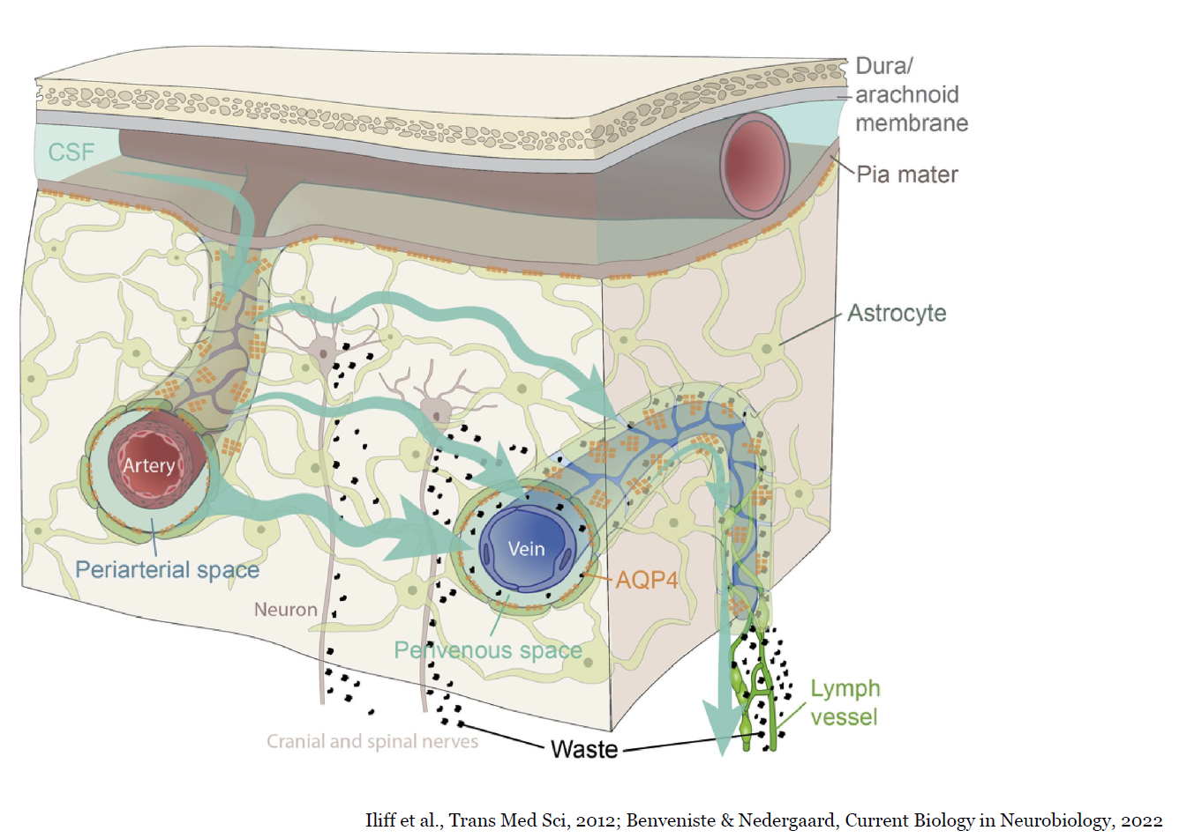
Glymphatic system
An alternate pathway implicated in brain health
A perivascular transit passageway for cerebral spinal fluid (CSF) to exchange with interstitial fluid, facilitating waste removal including Aβ and tau protein.
CSF enters into the peri-arterial channels via vascular pulsatility/vasomotion
Aquaporin-4 channels on the glia end-feet facilitate efficient perivascular CSF exchange for waste clearance
Glymphatic waste egresses via peri-venous channels, and ‘hot spots’ along dural venous sinuses serve as bridges between the glymphatic system and lymphatic vasculature in the dura
Glymphatic waste disposal depends on sleep state, with enhanced glymphatic activity during N3 sleep and under certain anesthetic regimens

Slide 17
Epidemiology: associations of sleep with brain health

Slide 18
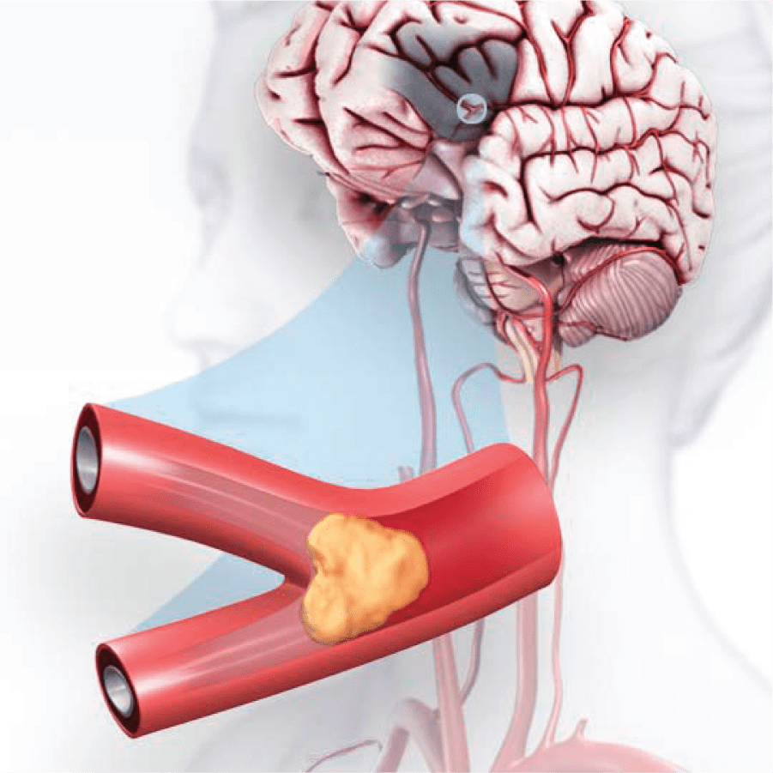
Sleep and stroke
sleep disturbances and disorders are associated with increased stroke risk
Obstructive Sleep Apnea
Stronger association in men
Stronger association with higher Apnea-Hypopnea Index in both men and women
Long sleep duration
Short sleep duration
Insomnia
Notes:
Image: https://www.stroke.org/en/about-stroke/types-of-stroke/ischemic-stroke-clots

Slide 19
Sleep and silent cerebrovascular disease
sleep disturbances and disorders are associated with subclinical markers of vascular brain injury
Obstructive Sleep Apnea
Associated with higher odds of white matter hyperintensities (in addition to lacunar infarcts) on MRI
Associated with decreases in cerebral blood flow in medial temporal regions, reversible with CPAP treatment
Insomnia
Linked to lower integrity of white matter fibers connecting subcortical nuclei and the prefrontal cortex
Short sleep duration
Predicted white matter hyperintensities in the parietal region
Less N3/Slow Wave Sleep was associated with higher white matter
hyperintensity volumes and lower cortical gray matter volumes
Image: Moroni et al., Circulation: Cardiovascular Imaging. 2020.
Notes:
Image: https://www.ahajournals.org/doi/10.1161/CIRCIMAGING.120.010460

Slide 20
Sleep and Alzheimer’s disease (AD) AND AD-related dementias (ADRDs)
sleep disturbances and disorders are associated AD and ADrDs
Obstructive Sleep Apnea
Dementia, including specifically AD
Mild cognitive impairment
Cerebral spinal fluid and blood-based biomarkers of Aβ and tau
Heightened inflammation
Hippocampal volume loss
Insomnia
Dementia
Short sleep duration/Long sleep duration
Dementia
Aβ deposition
Smaller brain volumes
Impaired circadian rest/activity rhythms
Mild cognitive impairment
Dementia
Aβ deposition
Medial temporal lobe atrophy

Slide 21
Methodological considerations
Study design, measurement, AND confounding complicate evaluation of literature on sleep and brain health
Study design considerations
Accounting for reverse causation – disease pathology may be present for years before clinical symptoms manifest
Accounting for simultaneous assessment of sleep and dementia in older adults – sleep and circadian disorders may be a manifestation of underlying pathology
Diverse patient populations to increase generalizability
Measurement considerations
Accounting for more multiple sleep phenotypes
Accounting for varying assessment methods, cut points, and definitions
Incorporating repeated measures of sleep throughout adulthood
Confounding considerations
Accounting for common factors among dementia and sleep disorders including genetics and vascular risk factors
Accounting for important covariates
Adequate power, sample-size estimates

Slide 22
Mechanisms for the impact of sleep disorders and disturbances on brain health

Slide 23
Traditional vascular risk factors as mediators
Vascular risk factors may confound sleep/brain health associations
Sleep disorders can contribute to the development of cardiovascular risk factors
Including obesity, hypertension, diabetes, dyslipidemia, ischemic heart disease, and atrial fibrillation
Mechanisms include pro-inflammatory pathways, autonomic nervous system dysfunction, alterations in 24-hour blood pressure profiles, carotid and coronary atherosclerosis, reduced Stage N3 sleep
Sleep disorders can lead to alterations in cerebral autoregulation, hypercoagulability, increased shunting through a patent foramen ovale, endothelial dysfunction, sympathetic hyperarousal and sleep fragmentation
Timing of sleep in relation to stroke risk, possible circadian rhythmicity of stroke

Slide 24
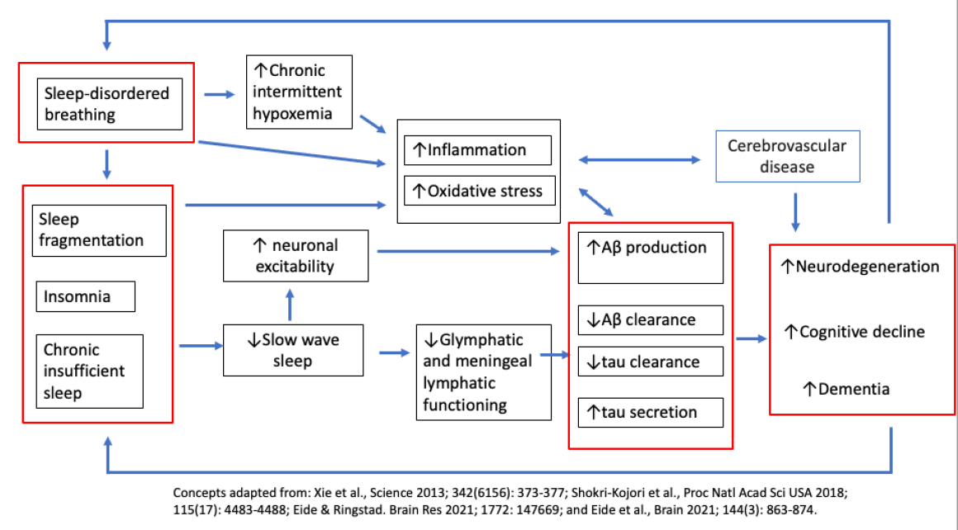
Disturbances in synaptic homeostasis
Stage N3 sleep may protect against neurodegenerative disease and support brain recovery after stroke
Excessive neuronal activity can increase Aβ production and tau release
Sleep deprivation in experimental rat models impairs axonal sprouting, synaptogenesis, and motor recovery after stroke
Mechanisms through which sleep disorders may lead to dementia.

Slide 25
Glymphatic dysfunction
Sleep disturbances or disorders may reduce efficiency of glymphatic clearance of neurotoxic metabolites
Glymphatic clearance efficiency is optimized in deeper stages of sleep
Stage N3 sleep is associated with reduced central noradrenergic tone and increased interstitial fluid volume fraction
Glymphatic transport function is dependent on body posture and under circadian control
Glymphatic dysfunction is associated with aging, sleep deprivation, in neurodegenerative disease states including Alzheimer’s Dementia, cerebral small vessel disease, cerebral amyloid angiopathy, Parkinson’s Disease, and normal pressure hydrocephalus.

Slide 26
Molecular mechanisms of Alzheimer’s disease (AD)
Lower cerebral spinal fluid Aβ is found in the morning, however this is attenuated by prolonged wakefulness.
Endothelial cells mediating blood-brain barrier dysfunction, important for Aβ clearance, are under circadian control.
Truncated forms of tau, leading to increased tau peptides, are found in cerebrospinal fluid in sleep-deprived humans.
Overnight sleep deprivation may promote tau phosphorylation isoforms found in early stages of AD.
Other factors increasing Aβ and tau include intermittent hypoxia, sleep fragmentation, intrathoracic pressure swings, stress, depression, disrupted circadian rhythms, or increased oxidative stress and inflammation
Sleep deprivation and obstructive sleep apnea may also increase release of other proteins associated with non-AD neurogenerative pathways

Slide 27
IMPORTANCE OF SLEEP IN PEOPLE WITH IMPAIRED BRAIN HEALTH

Slide 28
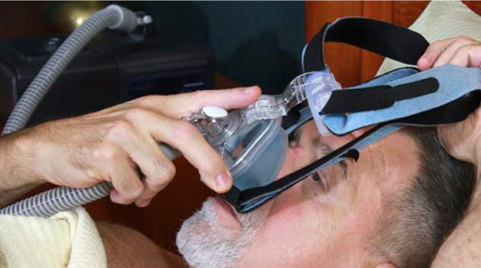
Post-stroke recovery
Insomnia, sleepiness, and long-duration of sleep are common among stroke patients
Stroke patients have poorer sleep efficiency, shorter total sleep time, and different sleep architecture (including lower percentage of slow wave sleep), compared to control patients
Lower sleep efficiency, less total sleep time, less Stage N3 sleep, longer rapid eye movement (REM) sleep latency, and lower REM percentages are associated with worse post-stroke clinical outcomes including functional status and memory
In the inpatient rehabilitation setting, greater sleep time, sleep efficiency, Stage N2 percentage, and REM percentage are associated with improvement in ability to perform activities of daily living
Obstructive Sleep Apnea identified after stroke is associated with worse functional and cognitive outcomes, and increased stroke recurrence and mortality
Pilot trials of CPAP suggest benefit in neurologic and cognitive outcome
Sleep SMART (NCT03812653) and RISEUP (NCT04130503) are ongoing trials
Notes:
Image: https://www.heart.org/en/news/2018/07/12/cpap-machines-for-sleep-apnea-could-decrease-heart-failure-risk

Slide 29
Sleep disorders in individuals with dementias
Patients with Alzheimer’s Disease (AD) commonly experience difficulty falling asleep, nighttime awakenings, and daytime sleepiness
Patients with AD and AD-Related Dementias (ADRD) experience circadian rhythm disorders
Sleep disorders in AD/ADRD patients portend more severe cognitive and neuropsychiatric symptoms, poorer quality of life, higher caregiver burden, earlier institutionalization, and increased mortality
Sleep-focused clinical trials have largely excluded patients with dementia
Uncertainty remains regarding the risks associated with sleep therapies
The clinical relevance and impact of Obstructive Sleep Apnea treatment is unknown in this patient population
Notes:
Image: https://www.stroke.org/en/about-stroke/types-of-stroke/ischemic-stroke-clots

Slide 30
PREVENTION AND TREATMENT

Slide 31
Optimizing sleep to preserve brain health
The “Life’s Essential 8” 2022 AHA Presidential Advisory highlights the potential role of sleep duration in preventing cardiovascular health
Reducing prevalence of Obstructive Sleep Apnea may also prevent adverse brain outcomes
Novel approaches are needed to preserve brain health through non-vascular pathways, including optimizing memory consolidation and synaptic homeostasis, reducing sleep fragmentation, regulating daily rhythmicity, and identifying means to enhance Stage N3 sleep and/or glymphatic waste clearance
Modifiable risk factors for poor brain health seem most impactful at earlier stages in life
Notes:
Image: https://www.heart.org/en/healthy-living/healthy-lifestyle/lifes-essential-8#.WxloOu4vyUl

Slide 32
Treatment of sleep disorders to protect brain health
CPAP to treat Obstructive Sleep Apnea may improve neurologic function, quality of life, depression, language, and cognition
Study results are mixed, and follow-up durations have been short
Adherence to CPAP is difficult for stroke survivors but may predict greater improvements in brain health outcomes
More rigorously conducted, long-term clinical trials are needed to investigate treatment of Obstructive Sleep Apnea and dementia
Insufficient evidence also remains to determine the effect of treatments for other sleep disorders and cognitive decline
There is a need to understand in which situations sleepiness acts as a risk factor for a treatable sleep disorder rather than a marker of neuropathology

Slide 33
REDUCING DISPARITIES in sleep AND brain health
Social determinants of health provide an essential context for optimizing and preserving brain health
Individuals of low socioeconomic status, who identify from within a racial/ethnic minority group, or who experience specific neighborhood-level factors, have higher likelihood of poor sleep quality, quantity, and sleep disorders
Individuals from racial/ethnic minority group backgrounds are more likely to have sleep-related chronic illness and disproportionate sleep loss
There are considerable health equity concerns regarding diagnosis, and access and adherence to treatment of sleep disorders involving multi-level social determinants of health

Slide 34
REDUCING DISPARITIES in sleep AND brain health
Multi-level interventions are needed to reduce sleep disparities
Individual and family levels
Neighborhood and broader sociocultural context
Access to care
Advocacy
Interdisciplinary efforts among sleep specialists, non-sleep specialist physicians, advanced practitioners, nurses, public health practitioners, educators, the media, payors, public interest groups, and others

Slide 35
Future directions

Slide 36
FUTURE DIRECTIONS FOR SLEEP AND BRAIN HEALTH
Interventional
Identify scalable interventions to enhance aspects of sleep (e.g., duration, slow‐wave activity) that may benefit brain health
Identify populations (e.g., based on age, sex, race, ethnicity, socio‐economic status, biomarkers, comorbidity, genetics) who are most at risk of adverse brain outcomes in the face of poor sleep so that future RCTs can be targeted
Conduct RCTs (including the very old as well as patients with dementia) to determine whether the treatment of prevalent sleep disorders, such as insomnia and obstructive sleep apnea, as well as short, fragmented, and irregular sleep improve brain health outcomes
Consider novel trial designs or causal modeling frameworks such as target trial emulation from existing observational data to study sleep interventions
Observational
Conduct studies that include deep phenotyping of markers of both sleep and brain health to allow for a deeper understanding of underlying mechanisms.
Develop better parameters, including possibly incorporation of wearables, to comprehensively evaluate sleep characteristics and brain health in large samples, and over time
Use longitudinal studies and causal frameworks to establish the extent to which changes in sleep across the lifespan drive neurodegeneration and cognitive decline in later life, as well as the precise mechanism by which neurodegeneration disrupts sleep characteristics.
Examine how sleep disorders interacts with circadian rhythm alterations to affect brain health.
Mechanistic/Basic and Translational
Understand the role of sleep and circadian rhythms on the mechanisms of action of neurodegenerative proteinopathies
Use neuropathological studies to better establish the regulation of sleep and sleep breathing and how they are disrupted by neurodegenerations
Understand the relationship between age‐related sleep disorders and impaired learning/ memory consolidation
Understand how sleep disorders alter synaptic homeostasis
Learn how hypoxemia interacts with non‐respiratory sleep parameters to affect the pathways of interest
Define drivers of increased glymphatic transport and waste clearance during sleep
Define anatomical pathways, and driving forces of solute clearance from the brain
Understand the anatomical and functional coupling between the glymphatic and lymphatic systems in health and disease
Evaluate brain biomarkers or other surrogate measures of sleep measures as well as neurodegeneration
Increase the use of sleep‐dependent tasks instead of traditional cognitive testing during wakefulness

