Slide 1
Vascular Contributions to Cognitive Impairment and Dementia in the United States: Prevalence and Incidence
American Heart Association Scientific Statement
Authors:
Eric E. Smith, MD, MPH, FAHA, Chair;
Hugo J. Aparicio, MD, MPH, FAHA,
Vice Chair; Rebecca F. Gottesman,
MD, PhD, FAHA; Manu S. Goyal, MD, MSc;
Steven M. Greenberg, MD, PhD, FAHA;
Julie A. Schneider, MD, MS;
Farzaneh A. Sorond, MD, PhD;
Clinton B. Wright, MD, MS, FAHA
Citation:Vascular Contributions to Cognitive Impairment and Dementia in the
United States: Prevalence and Incidence: A Scientific Statement From the American Heart Association

Slide 2
Stroke SCILL/Professional Educational committee
Slide presentation developed by:
Philip Gorelick MD

Slide 3
Overview

Slide 4
Overview: Why Is THIS American Heart Association Scientific Statement Important?
In the US, vascular contributions to cognitive impairment and dementia (VCID) are common & may be the most preventable cause of clinically significant cognitive decline.
In older persons, VCID often co-exists with neurodegenerative disease to form mixed causes of cognitive impairment (e.g., Alzheimer disease + VCID).
In persons over age 65 years in the us, there are up to 2.7 million people living with vascular dementia or mixed dementia .
>800,000 persons may be diagnosed with vascular dementia yearly.
Types of vascular disease contributing to cognitive impairment detectable by mri include:
    Covert brain infarcts (11.3 million people).
    High volumes of white matter hyperintensity (11.1 million persons).
    Cerebral microbleeds (19.9 million persons).
5. Cerebrovascular disease is preventable & successful prevention could reduce the total number of dementia cases by 27-33%.

Slide 5
Background

Slide 6
Background
After Alzheimer’s Disease (AD), vascular dementia (VaD) is the 2nd most common cause of dementia.
The combination of AD and cerebrovascular disease is the most frequent pathological finding in dementia
(30-40% of cases).
Terms (Table 1):
    “Vascular cognitive impairment:” refers to all forms of cognitive impairment of any severity to which vascular disease contributes.
B. “Vascular contributions to cognitive impairment and dementia:” refers to how vascular disease may contribute to cognitive impairment whether there is vascular or other disease (e.g.,neurodegenerative disease).
Neuroimaging biomarkers of cerebral small vessel disease are common & typically include:
    Lacunar or other small subcortical infarcts.
    White matter hyperintensities.
    Cerebral microbleeds & cortical superficial siderosis.
    Enlarged perivascular spaces.

Slide 7
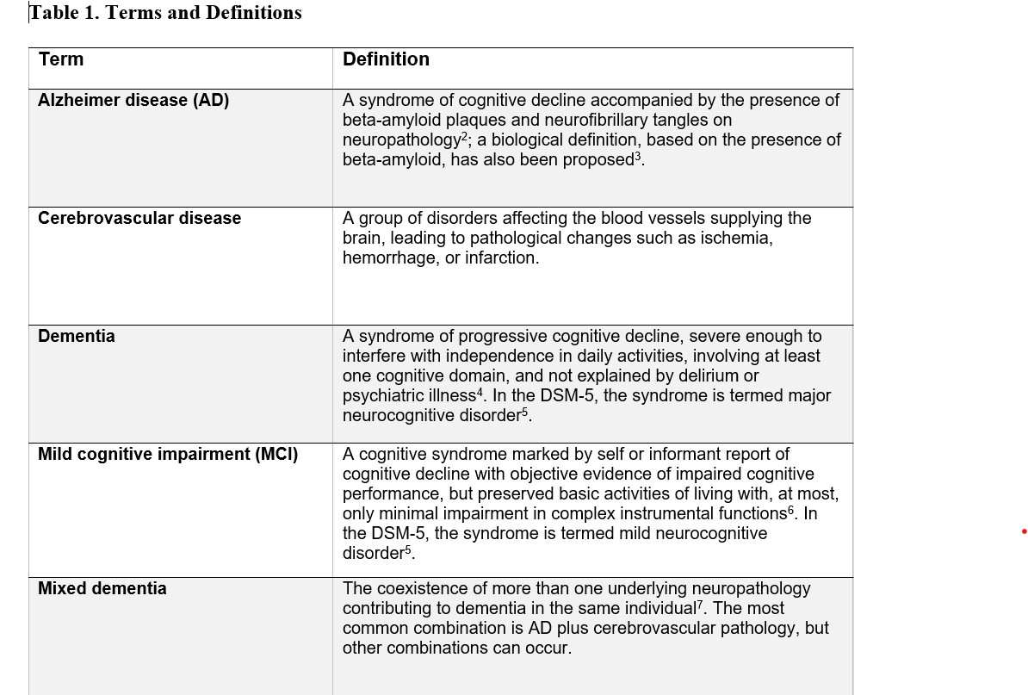
Section Header

Slide 8
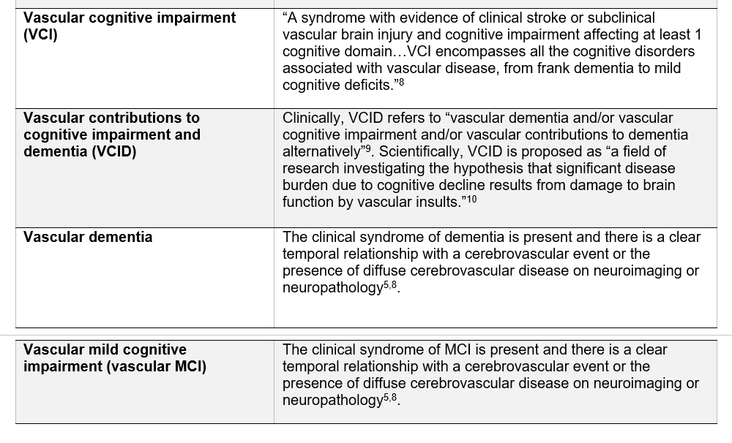

Slide 9
Three Questions Answered in this Statement
How many Americans develop VCID annually?
How many Americans have subclinical VCID?
How many Americans have VCID?

Slide 10
Methodology

Slide 11
Methods
  Scoping review to identify sources of information on the prevalence and incidence of VCID in the US.
  Keywords and medical subject heading terms:
    vascular dementia, leukoaraiosis, brain infarcts, lacunes, white matter hyperintensities of presumed vascular origin, microbleeds, prevalence, and incidence.
  Preference given to U.S. data, but where lacking international studies were reviewed.
  Types of data:
    diagnoses made by clinicians, population-based cohort studies, & prospective studies followed by brain donation & autopsy.
  Population attributable fraction (PAF) to assign causation of multiple neuropathologies within the same brain.
  PAF: estimates proportion of risk for a condition that can be assigned to each single factor, simultaneously adjusting for the effects of all other factors (e.g., influence of vascular and neurodegenerative changes in the same brain).
  At risk for cognitive impairment: estimated based on presence of covert or subclinical neuroimaging findings (e.g., white matter hyperintensities, brain infarcts, cerebral microbleeds).

Slide 12
Prevalance & InCidence of VCID According to Physician Diagnosis

Slide 13
Prevalence of VCID According to Physician Diagnosis
  Source of Data:
      Centers for Medicare & Medicaid (CMS) fee-for-service claims data from 2011 to 2013.
  ICD 9 Codes Searched:
      codes 290.40, 290.41, 290.42, and 290.43.
  Age: ≥68 years in 2013.
  Prevalence of Vascular Dementia 2011-2013:
    1. 2.1 per 100 (450,162 diagnoses per 21,624,228 beneficiaries).
  2. Corresponding to 14.5% of the 3,110,654 individuals with dementia
  from all causes.
  Incidence of Vascular Dementia: Not reported in claim’s data (Table 2).

Slide 14
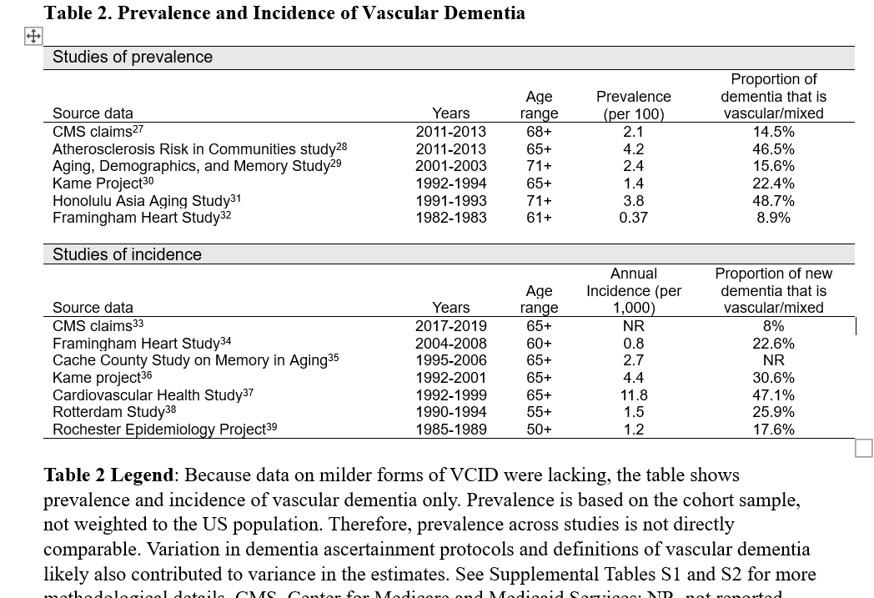
Section Header

Slide 15
Limitations to Claim’s Data
  Absence of standardized diagnostic testing or criteria for physicians to use when submitting vascular dementia codes.
  Non-systematic capture of mixed vascular plus neurodegenerative cognitive impairment.
  Variability introduced by different methods for ascertaining dementia from claims codes.

Slide 16
Prevalence & Incidence of vCID According to epidemiological Studies

Slide 17
Overview & Results
  Studies describing the epidemiology of vascular dementia often use varying criteria & the results are heterogeneous (Table 2).
  Cache County Study on Memory in Aging:
      <2% of individuals were diagnosed with incident vascular dementia over 7.1 years.
  Kame Project (possible AD and vascular dementia were not mutually exclusive):
      incidence rate for vascular dementia was 4.4 per 1000; prevalence estimated at 6.3% across multiple age groups.
  Atherosclerosis Risk in Communities (ARIC) study:
      pure cerebrovascular disease as an etiology for dementia was rare: 2%, but AD with a secondary cerebrovascular etiology was more common: 22% of dementia cases.
  Rotterdam Study:
      incidence of vascular dementia cases, without separating out those with an AD secondary etiology: 1.5 per 1000 person-years and found in 14% of dementia cases.

Slide 18
Influence of Biomarkers
  Lack of highly specific and definitive biomarkers for VCID has complicated estimation of incidence and prevalence rates.
  Estimates of the occurrence of vascular dementia may vary by as much as 4-fold.
  Addition of magnetic resonance imaging (MRI) to evaluate for VCID: increases the number of cases attributed to vascular dementia.
  Incident vascular dementia cases maybe temporally related to a symptomatic stroke or related to bilateral infarcts seen on imaging.

Slide 19
PREVALENCE AND INCIDENCE OF VCID ACCORDING TO BRAIN AUTOPSY DATA

Slide 20
Neuropathology-Based Studies Offer Advantages
  Measure the presence of various types of cerebrovascular pathologies & accounts for the broadest range of concomitant neurodegenerative pathologies.
  Least biased data come from larger scale community-based studies with prospective assessment of cognitive status before death.
  High participant brain donation and autopsy rates.
  Comprehensive assessment of dementia neuropathology.
  Statistical modeling of the association of neuropathological features with dementia, simultaneously adjusting for each other.

Slide 21
Examples of Neuropathological-Based Studies
Figure 1.
  Religious Orders Study and the Rush Memory and Aging Project:
      high rate of brain autopsy (87%); Mean age at death was 89.6 years; In an analysis of 1,161, vascular pathologies accounted for 27% of the PAF for dementia (Figure 1): macroscopic infarcts 9%, cerebral amyloid angiopathy 8%, atherosclerosis 6%, and arteriolosclerosis 5%.
  Adult Changes in Thought Study:
    autopsy sub study with 221 participants; mean age at death was 86.5 years; vascular pathology, represented by microinfarcts, accounted for 33% of the PAF for dementia (Figure 1).

Slide 22
Examples of Neuropathological-Based Studies (continued)
  Medical Research Council Cognitive Function in Ageing Study (MRC-CFAS): 456 participants; median age at death was 81 years; vascular pathologies accounted for 33% of the PAF for dementia (Figure 1): cerebral amyloid angiopathy 12%, white matter lesion or lacunes 12%, and infarcts or hemorrhages plus white matter lesions or lacunes 9%.
  Vascular pathology is the 2nd most common cause of dementia, accounting for 27% to 33% of the risk after controlling for all other pathologies.

Slide 23
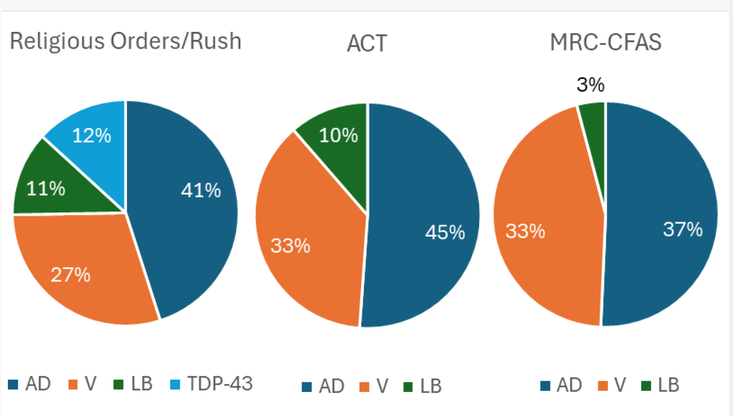
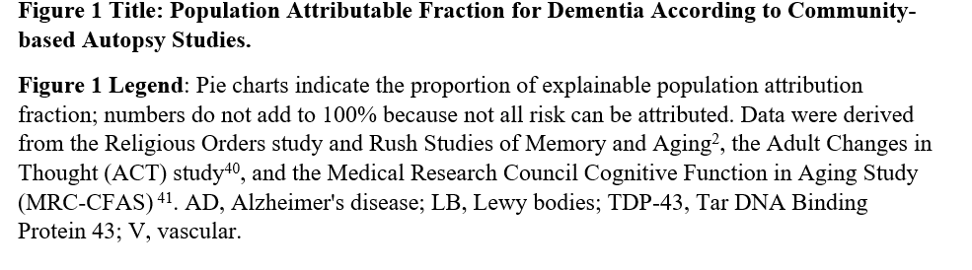
Fig. 1: Population Attributable Fraction for Dementia According to Community Autopsy Studies

Slide 24
Limitations of Neuropathology Studies
Rely on sampling a limited number of brain regions, often with preference to regions affected by neurodegenerative disease & under sampling of regions, such as the white matter, that are more affected by cerebrovascular disease.
Persons who agree to autopsy may not be representative of the general population.
Autopsy participation rates may not be clear, raising the possibility of selection bias.
The high ages at death suggests volunteers may have been healthier than average study participants.
Even though all known neuropathologies were included in models, there may still be unrecognized pathologies that could affect the estimates.
Even with a comprehensive neuropathological assessment, a significant proportion of dementia risk cannot be explained.
Fewer data on the neuropathology of MCI.

Slide 25
PREVALENCE OF SUBCLINICAL NEUROIMAGING MARKERS OF VCID

Slide 26
Neuroimaging Markers of VCID
  Markers of VCID are detectable on brain MRI:
  A. Routine Practice:
      White matter hyperintensities (WMHs).
      “Subclinical”, “covert”, or “silent” brain infarcts (SBI).
      Cerebral microbleeds (CMB).
  B. Other neuroimaging biomarkers:
      White matter microarchitecture.
      Blood-brain barrier permeability.
      Vascular reactivity.
  C. Prevalence:
      “Significant” WMH: ~10-30% of older individuals (increases with age).
      SBI: similar and increases with age.
      CMB: ~10% if <70 and up to 37% if >70 years of age.

Slide 27
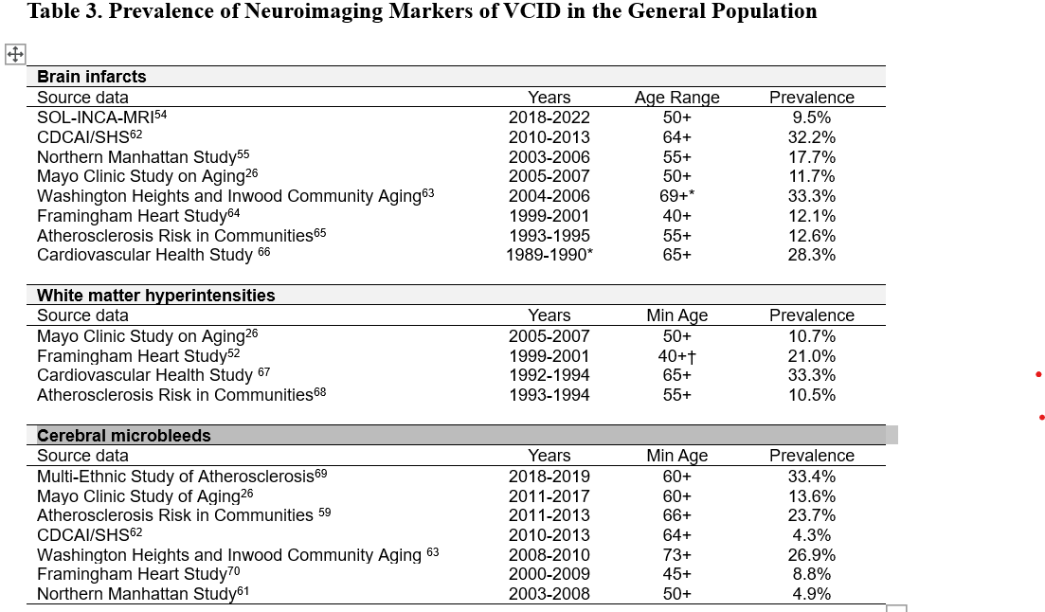

Slide 28
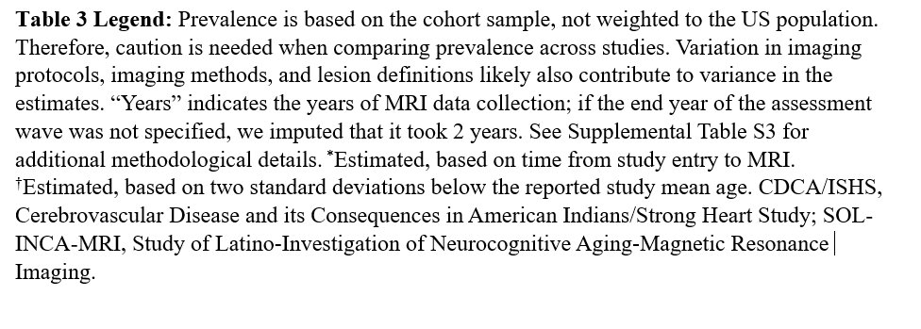

Slide 29
Limitations of Biomarker Studies
Estimates of MRI-based biomarker findings vary considerably (table 3).
2. Findings may be explained at least in part by:
  Variations in co-morbidities (e.g., age, risk factors such as smoking & hypertension).
  Differences in age, race, & sex.
  Selection bias in relation to participant selection, recruitment & retention.
  Differences in MRI scanning equipment, imaging techniques, methods for identifying lesions, and definitions of when a marker should be considered clinically significant.
  Suggestions to achieve greater harmony across studies:
(1). Use common terms from strive (standards for reporting vascular changes on neuroimaging criteria.
(2). Robustly identify & validate biomarkers (e.g., Mark VCID consortium study)

Slide 30
PREVALENCE AND INCIDENCE OF VCID ACCORDING TO RACE, ETHNICITY, AND SEX

Slide 31
dementia prevalence and incidence by race, ethnicity and sex
Race/Ethnicity
Medicare Beneficiary Data (age ≥68 years in 2013):
19.2% Of dementia cases in non-hispanic black persons were vascular, compared with only 14.1% of dementia cases in non- Hispanic White persons.
Cardiovascular Health Study:
Non-white race (the majority [97%], being black) was a strong risk factor for incident vascular dementia (hazard ratio [HR] 2.5, 95% confidence interval [CI] 1.16-5.41) or mixed vascular and AD (HR 1.9, 95% ci 1.06-3.27).

Slide 32
dementia prevalence and incidence by race, ethnicity and sex (Continued)
Sex
Medicare Data:
Women: greater age-adjusted dementia prevalence and incidence than men.
Prospective Population cohort:
Men: greater age-adjusted risk of dementia compared with women, although the difference was not statistically significant
(rate ratio 1.6, 95 % CI 0.6-3.8).
Rotterdam Study:
Incidence rate of vascular dementia greater in men (1.7%, 95% ci 1.1–2.4) than in women (1.3%, 95% ci 0.9–1.9); rate ratio for women to men after adjustment: 0.57 (95% ci: 0.34–0.97).
Some studies report a greater incidence of vascular dementia in women or no difference.

Slide 33
dementia prevalence and incidence by race, ethnicity and sex (Continued)
Population attributable fraction (PAF) for modifiable risk factors in dementia (table 4):
Lower in white and Asian groups,
Higher in black, Hispanic, and American Indian/Alaska Native groups.
Vascular dementia may be more preventable than AD:
Joint PAF for vascular dementia (40.9%) and dementia not otherwise specified (37.1%) was higher than for AD only (17.9%) or mixed dementia with AD (17.0%)

Slide 34
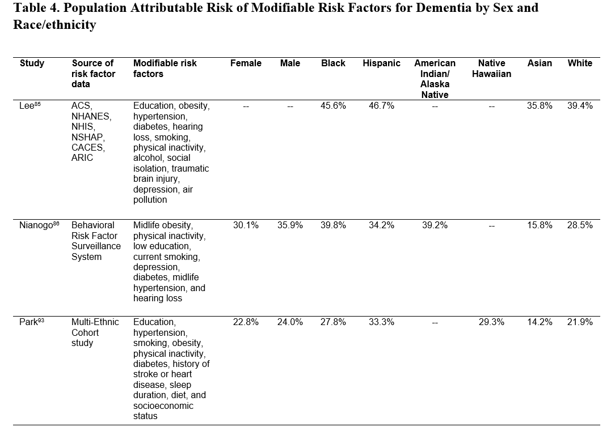
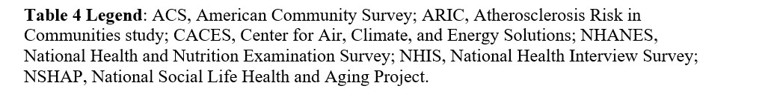

Slide 35
Conclusions

Slide 36
Conclusions:
Estimates of VCID incidence and prevalence vary widely & may be
explained by disparate study methods & populations.
2. The best available evidence suggests the following vascular dementia
incidence & prevalence rates:
  2.7 million persons living with vascular dementia or mixed dementia.
  Up to 809,000 persons have vascular dementia.
  Annually, as many as 603,000 new persons develop vascular dementia or
mixed vascular dementia.
3. If cerebrovascular pathology could be eliminated from the population,
1.5 to 1.8 million fewer people would be living with dementia.
4. By comparison, 5.8 million persons living with dementia due to AD and
a neuropathology study attributes 41% of the risk of dementia to AD.

Slide 37
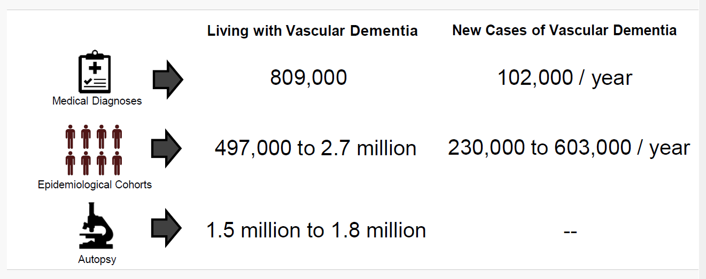
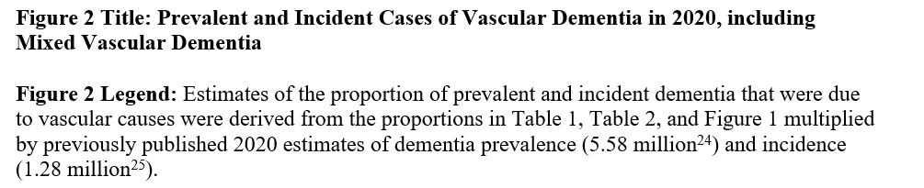
Fig. 2: Prevalent & Incident Cases of Vascular Dementia, 2020

Slide 38
Conclusions (continued):
5. Compared with White and Asian groups, VCID is higher in Black, Hispanic (any race), American Indian, Alaska Native, and native Hawaiian groups.
6. Proportion of dementia explained by risk factors, particularly vascular risk factors, greater for Black, Hispanic (any race), American Indian, Alaska Native, and Native Hawaiian populations.
7. Population-wide interventions to address hypertension, diabetes, smoking, and other risk factors may reduce race- and ethnicity-based disparities in dementia incidence.
8. Achieving better estimates of VCID incidence & prevalence: by
harmonizing VCID definitions, validation of new biomarkers of cerebrovascular processes, and their association with clinically significant cognitive impairment.

Slide 39
The End

