Slide 1
Identifying best practices for improving the evaluation & management of stroke in rural lower-resourced settings
A Scientific Statement From the American Heart Association
Kori S. Zachrison, Kaiz S. Asif, Sherita Chapman, Enrique C. Leira, Karen E. Joynt Maddox, Susan Maynard, Christa O’Hana S. Nobleza, Charles R. Wira
On behalf of the American Heart Association Emergency Neurovascular Care & Telestroke Committee of the Stroke Council; Council on Cardiovascular & Stroke Nursing; & Council on Cardiovascular Radiology & Intervention

Slide 2
Identifying Best Practices for Improving the Evaluation and Management of Stroke in Rural Lower-Resourced Settings
Citation:
Zachrison KS, Asif KS, Chapman S, Leira EC, Joynt Maddox KE, Maynard S, Nobleza COS, Wira CR; on behalf of the American Heart Association Emergency Neurovascular Care and Telestroke Committee of the Stroke Council; Council on Cardiovascular and Stroke Nursing; and Council on Cardiovascular Radiology and Intervention. Identifying best practices for improving the evaluation and management of stroke in rural lower-resourced settings: a scientific statement from the American Heart Association. Stroke. Published online December 12, 2024. doi: 10.1161/STR.0000000000000478
Link:
https://www.ahajournals.org/doi/10.1161/STR.0000000000000478
Key words included in the article:
delivery of health care; health resources; rural hospitals; rural population; stroke

Slide 3
Stroke council professional education committee
Slide presentation developed by:
Amanda Jagolino-Cole, MD

Slide 4
rural patients & stroke

Slide 5
Rural Patients with stroke…
Have higher mortality rates relative to urban patients
Have reduced access to treatment
Have worse functional outcomes after time-sensitive thrombolysis & thrombectomy
Are more socially vulnerable at baseline
More enrolled in Medicare, higher levels of disability, more prevalent & less controlled risk factors
Disparities are more pronounced for Black patients residing in rural areas.

Slide 6
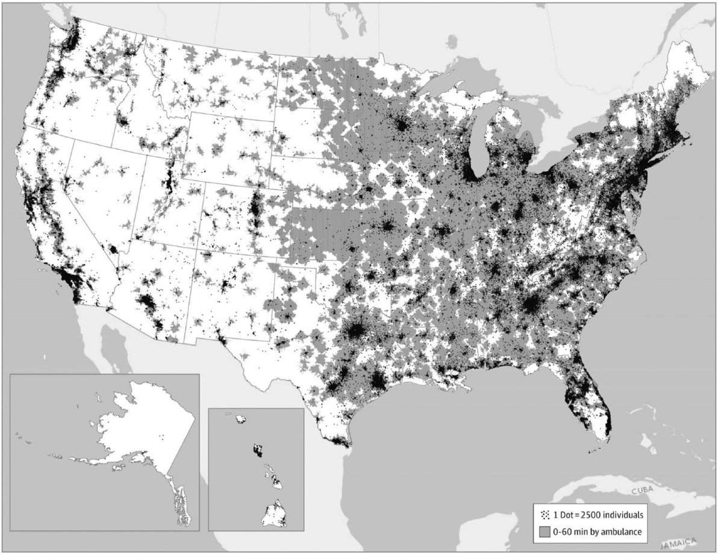
Estimated population access to acute stroke & telestroke centers in the United States in 2019. US population access to emergency departments with acute stroke expertise, defined as confirmation of a hospital as an Acute Stroke Ready Hospital, a Primary Stroke Center, a Thrombectomy-Capable Stroke Center, or a Comprehensive Stroke Center, or an.
geography
>28 million people in US live >60 miles from a Primary Stroke Center or an Acute Stroke Ready Hospital
Varied stroke resources & capabilities occur across sites of care
Stroke center certification is largely based on self-initiation more so than needs-based assessment
Conversion to stroke center status is more likely in urban hospitals

Slide 7
Rural Patients with stroke…
Less likely receive care at stroke centers
More often present to uncertified community EDs with less robust staffing, fewer resources, & lack of major quality improvement efforts & interventions
More likely travel outside of local healthcare markets to receive postacute care
Experience persistent challenges across the continuum of stroke care including thrombectomy access, inpatient care, postacute care transitions

Slide 8
Strategies to improve stroke care & reduce variability across geographic regions for rural patients
Improve rural representation in stroke quality improvement programs
Investment in rural healthcare sites as anchors for their respective communities
Expanded, accessible, & collaborative quality improvement efforts
Improved & monitored performance in stroke care
Enhance delivery of care
Informed future clinical engagement, research, & system-level
improvements across stakeholders (clinicians, healthcare system leaders, public health leaders, policymakers, research funding organizations) are essential.

Slide 9
The coordinated stroke system of care: challenges in the remote setting & potential strategies

Slide 10
Coordinated systems of care require early incorporation & collaboration among all stakeholders
Hospital Administrators
Direct Care Providers
Regulatory Agencies
Payers
Patients
Caregivers
Advocacy Organizations
Policymakers
Coordinated regional stroke systems of care are pivotal in optimizing patient outcomes but can be challenging to implement in underresourced rural settings with geographic limitations.

Slide 11
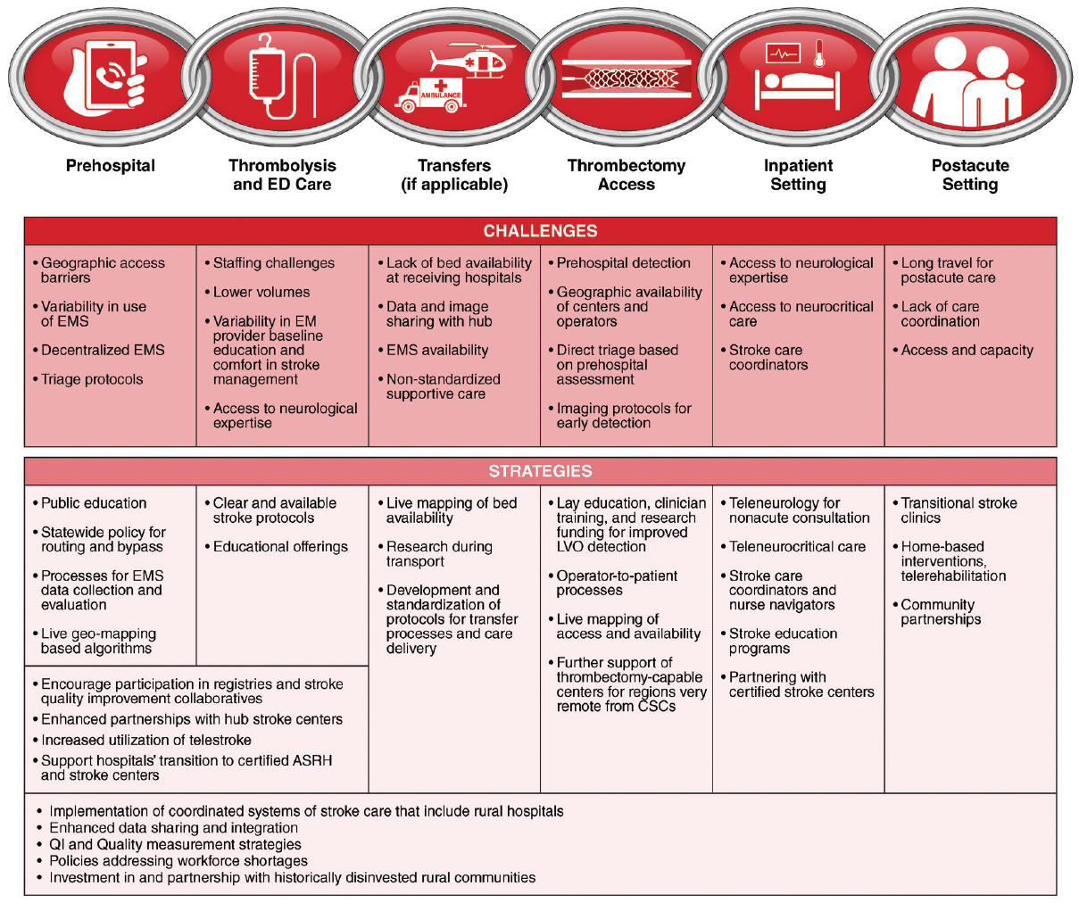
Potential strategies to address challenges in caring for patients with stroke in rural settings across the continuum of care.

Slide 12
Distance from expert care & increased travel times to stroke-capable hospitals
Supporting hospitals’ transition to certified Acute Stroke Ready Hospitals or stroke centers
Championing from Foundations (eg, the AHA/ASA, state departments of public health)
Using air transport
Individual EDs, hospitals, EMS agencies
Challenges Encountered
Potential Strategies
Level of Intervention/Target Audience
Implementing telestroke for remote specialist access
PREHOSPITAL
Distance from health care & increased travel times to stroke-capable hospitals may delay reperfusion & definitive care.
Individual EDs & hospitals,
policymakers, regulators

Slide 13
Lower use of EMS for prehospital transport
Creating behavior theory-informed, user-centered public campaigns
State departments of public health, CSCs & transfer-receiving hospitals, foundations (eg, the AHA/ASA)
Improving ambulance availability in rural settings
Investment in EMS pipeline, education, & infrastructure regionally by receiving hospital CSCs, state departments of public health, policymakers
Challenges Encountered
Potential Strategies
Level of Intervention/Target Audience
PREHOSPITAL
People living in rural communities have lower odds of arrival by EMS for stroke, despite its the association with improved care & outcomes.

Slide 14
Decentralized EMS systems with variation in care delivery (eg, use of stroke assessment tools)
Creating a statewide policy for stroke assessment tool implementation & routing & bypass decisions, adapted for rural locations
Foundations (eg, AHA/ASA) for ongoing advocacy, policymakers to guide change, state departments of public health for implementation of change
Providing a standardized methodology for collecting EMS data to facilitate evaluation processes & operational improvements
National EMS leadership organizations, foundations (eg, AHA/ASA) for ongoing advocacy
Challenges Encountered
Potential Strategies
Level of Intervention/Target Audience
PREHOSPITAL
Decentralized organization has contributed to variations in training, quality, & accessibility of EMS.

Slide 15
PREHOSPITAL INNOVATION WARRANTING FURTHER RESEARCH IN RURAL SETTINGS
TechnologIES to improve stroke detection & identification of stroke from large vessel occlusion
Prehospital telemedicine
Smartphone applications
Artificial intelligence
Live geomapping-based algorithms
Optimizing prehospital routing decisions
Mobile stroke units in collaboration with another ambulance or transferring ED’s
Success & priorities
Success dependent on recognizing varying regional resources & adapting efforts to local environments
Priorities
Establishing & standardizing prehospital protocols & regulation
Developing effective behavioral theory-informed training strategies
Evolving methods of funding EMS in low-resource settings

Slide 16
Variation in educational experience & qualifications of clinicians staffing EDs
Ensuring written & readily accessible site protocols for stroke care
Quality measure development by certifying organizations, investment in satellite sites by transfer-receiving hospitals, ongoing advocacy by foundations
Challenges Encountered
Potential Strategies
Level of Intervention/Target Audience
Increasing educational offerings
Participating in no- or low-cost quality improvement initiatives
Supporting hospitals’ transition to certified Acute Stroke Ready Hospitals or stroke centers
Enhancing partnerships with hub stroke centers
Increasing use of telestroke
THROMBOLYSIS/ED CARE
Variability in neurologic training in emergency medicine residencies may contribute to decreased use of thrombolysis without institutional structure & support of established stroke protocols & processes.
Support of regional CSCs or sites’ frequent transfer-receiving hospitals
Individual EDs & hospitals
Policymakers, state departments of
public health
Individual EDs & hospitals with support of regional CSCs or frequent transfer-receiving centers
Research funding related to implementation, payment policy changes for better incentivization

Slide 17
Real or relative staffing shortages (eg, dependence on an on-call CT technologist or travelers rather than full-time staff)
Ensuring written & readily accessible site protocols for stroke care & rapid imaging transfer
Individual EDs & hospitals
Considering the scope of practice laws, cross-state licensure policy
Foundations such as AHA/ASA for ongoing advocacy, policymakers to guide change
Challenges Encountered
Potential Strategies
Level of Intervention/Target Audience
THROMBOLYSIS/ED CARE
Staffing shortages & reliance on per diem or traveler staffing with less familiarity with local systems of care can accentuate challenges in hyperacute stroke care delivery in the rural setting.

Slide 18
Low annual stroke volumes
Performing mock stroke codes & computer-based simulation exercises
Support of regional CSCs or sites’ frequent transfer-receiving hospitals
Challenges Encountered
Potential Strategies
Level of Intervention/Target Audience
THROMBOLYSIS/ED CARE
Mock stroke codes or simulation exercises may be useful for sites with low annual stroke volumes.

Slide 19
Strategies with potential to enhance resource-limited stroke systems
Support Growth in the number of acute stroke ready hospitals, stroke centers, & get with the guidelines-stroke participating sites
Increase registry participation through the American Heart Association Rural Health Initiative
implement Local, regional, & statewide stroke system policy changes & legislation to increase the number of stroke certified centers
Leverage professional society qi resources (eg, e-qual network) to provide educational opportunities, toolkits, data collection/feedback, & merit-based incentive payment system credits with centers for medicare & Medicaid services

Slide 20
enhanced partnership between rural centers & hub hospitals via telestroke
Engagement opportunities for receiving hospitals to improve research at satellite sites
Perform education through research activities to disseminate data from existing trials & benefits of stroke research among spoke clinicians
Promote tools from electronic medical records to identify patients for clinical trials
Facilitate inclusion of small hospitals in rural settings into existing research networks
Coordinate with tertiary-based IRB to support hospitals that lack IRB for research
Use electronic consent platforms or telestroke video communications to consent & enroll patients in trials of interventions that can be delivered locally or upon arrival
Use tertiary-based air medical crews as coinvestigators to enroll patients in clinical trials of interventions that can be delivered during helicopter interhospital transfer or upon arrival
Engagement opportunities for receiving hospitals to improve care at satellite sites
Education & communication
Perform general multidisciplinary educational activities
Provide specialized training of community clinicians to improve skills
Streamline transfers by immediately linking not only the sending/receiving physicians but also bed navigators & aerial & ground transport coordinators
Share electronic medical record & radiology images through a smartphone application
Provide timely feedback to the transferring facility by various methods
Direct local interventions
Organize transition of care of patients with stroke to their community to ensure adherence with secondary prevention interventions, including adequate blood pressure management & recognition of changes that would require rehospitalization
Identify a local champion to advance & support initiatives, including stroke certification
Subsidize the cost of stroke certification & a stroke coordinator & help with regulatory & organizational support
Establish teleneurology systems of care that include local telestroke support
Engage spokes as active participants in any decisions that affect the local system of care
Notes:
Image from: https://store.education.heart.org/basics-of-telestroke-course-package

Slide 21
No-bed syndrome & diversion status
Creating an active national bed availability board in collaboration with AHA or national stroke systems to be available for EMS
Foundations such as AHA/ASA or the CDC nationally, state departments of public health for regional work
Challenges Encountered
Potential Strategies
Level of Intervention/Target Audience
TRANSFERS
Transfer processes do not optimally counteract geographic disparities in stroke care access.
Variation in transfer patterns & care delivered during transfer
Developing & sharing standardized protocols, taking into account longer transport distances, transfer decision-making, & care delivery during transport
Foundations such as AHA/ASA or CDC nationally, local leadership from CSCs or sites’ frequent transfer-receiving hospitals

Slide 22
VARIATION & AVAILABILITY IN TRANSFERS FOR RURAL PATIENTS
Basis of transfer decisions
Distance, shared affiliation, competition, hospital reputation, patient insurance
Varying benefit of transfer by patient race & insurance
Differential acceptance
Cost concerns
Social/family support
Availability of ambulances for transport
Capacity & bed-availability
Inconsistent data & imaging sharing among transferring/accepting sites
Non-standardized care during transfer

Slide 23
ADDITIONAL STRATEGIES TO IMPROVE TRANSFERS FOR RURAL PATIENTS
Improved coordination & configuration of the stroke system
Addressing policies that reinforce legacies of segregation & inequitable access
Use of 9-1-1 service for interfacility transfer
Further research on interfacility transfer

Slide 24
Potential Strategies
Level of Intervention/Target Audience
Challenges Encountered
State departments of public health, CSCs & transfer-receiving hospitals, foundations such as the AHA/ASA
Providing more robust outreach in underrepresented & underserved regions to increase education on recognition of stroke & LVO & its effects, & increasing education & developing processes to decrease biases in stroke treatment for LVO
Patient-level sociocultural & educational disparity & its effects on LVO recognition & the activation of LVO process
THROMBECTOMY ACCESS
Mechanical thrombectomy is a standard of are yet rural and under-resourced settings experience several challenges limiting timely access.
Geographic availability of
accredited thrombectomy-capable centers
Creating a live map available for EMS & hospitals of the available TCCs, factoring in traffic & weather data, to facilitate appropriate & immediate transfer
State departments of public health
MT operator availability
Creating processes to bring a CSC neurointerventionalist team to meet a patient in the nearest TCC if the CSC is far
Research funding organizations to
support future research in stroke
system of care organization
Lack of standardized training for
LVO detection for prehospital EMS
& in-patient staff
Leveraging available online & in-person training programs through AHA & making it widely available & affordable for hospitals & EMS
Foundations such as AHA/ASA,
state departments of public health
Lack of research incorporating
prehospital device & AI radiologic
software recognition for LVO
Increasing funding for or subsidizing prehospital device & AI
software research integration
Research funding organizations
to support future research in
prehospital device & AI software
Transfer-related delays in access
Improving door-in-door-out time protocols
Individual EDs & hospitals with
support of regional CSCs or
frequent transfer-receiving centers

Slide 25
Access to inpatient neurologic expertise
Using teleneurology beyond the hyperacute phase of care
Individual EDs & hospitals
Challenges Encountered
Potential Strategies
Level of Intervention/Target Audience
INPATIENT SETTING
Patients with stroke in rural hospitals have higher mortality; potentially contributing factors include hyperacute stroke care received pre-admission, & differences in available resources.

Slide 26
ADDITIONAL STRATEGIES TO IMPROVE INPATIENT STROKE CARE FOR RURAL PATIENTS
Addressing gaps in stroke quality measures & education
Attention to secondary stroke prevention measure standards
Investing in annual comprehensive stroke center education programs
Partnering with certified stroke centers
Implementation of stroke care coordinators & nurse navigators

Slide 27
Long travel distances for access to postacute care
Developing transitional stroke clinics
Regional CSCs or sites’ frequent transfer-receiving hospitals
Growing use of home-based interventions (eg, telerehabilitation)
Regional CSCs or sites’ frequent transfer-receiving hospitals
Challenges Encountered
Potential Strategies
Level of Intervention/Target Audience
Building community partnerships for developing informal support groups
POSTACUTE SETTING
Rural patients with stroke experience fewer home health & intermediate rehabilitation discharges, & more skilled nursing discharges. Post acute follow-up workup for stroke of undetermined cause may also be inadequate.
Regional CSCs or sites’ frequent transfer-receiving hospitals,
individual EDs & hospitals

Slide 28
Cross-cutting system issues, policy implications, & key strategies for consideration

Slide 29
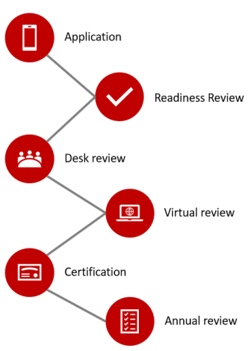
Strategies related to designation & improving delivery of stroke care in rural areas
Promotion of stroke center designation may improve stroke care delivery – barriers include low stroke volumes, lack of neurologist coverage, & financial resources for telemedicine
National stroke center certifications are preferable to state-based certifications due to heterogenous processes, lower performance, & worse outcomes
Expansion of stroke center certification should be geographically efficient to optimize population coverage
Equitable distribution of certified thrombectomy centers should ensure coverage of rural populations
Stroke center designation has implications for EMS transport of stroke patients
Increased access to designated stroke centers should reduce pre-hospital transport time & time to thrombolysis
Notes:
Image from page 7: https://www.heart.org/-/media/Files/Professional/Quality-Improvement/International-Stroke-Center-Certification/Stroke_Certification_Eligibility_Guide.pdf

Slide 30
Data integration
Many strategies to improve access, quality, & outcomes are dependent on interoperable or fully integrated data systems
Streamlined, efficacious, safe, & quality care can be enhanced with real-time, complete data integration in various settings including
Interhospital transfers
Inpatient hospitalization
Artificial intelligence
Postacute care transitions & follow-up care
Barriers include
Fragmented data collections systems
Lack of standardization
Inadequate processes for securing & anonymizing data
Inadequate processes for ensuring good data quality
Solutions include
A shared electronic medical record platform
Greater use of stroke registries – while challenging, registry data collection is essential for understanding the quality of care provided
Notes:
Image from:
https://www.heart.org/en/professional/datascience

Slide 31
Qi & quality measurement
Successful approaches to QI strategies in rural, lower-resourced settings recognize the needs, challenges, & limited resources of rural sites.
QI programs that account for limitations in personnel & budget may be more accessible for rural sites
A network-oriented approach may be useful in collaboration with regional referral centers
Quality measurement is used for internal QI, benchmarking, accountability, & reimbursement
Smaller-volume centers may find quality measurement challenging but still of value for identifying areas of improvement
Structural measures may be more suitable for broad use provided they take into account variation in resources
Transferred patients are often excluded from measure denominators
High-performing rural or low-resourced centers may be valuable
sources of data to better understand approaches to best
practice implementation
Notes:
Image from: https://www.heart.org/en/professional/quality-improvement

Slide 32
Policy solutions
Patients in rural areas are an underserved population vulnerable to inefficient care & poor outcomes until policies address specific workforce & resource shortages
Potential policy changes to support stroke care for rural patients include:
Supporting training programs for rural clinicians & aligning scope of practice laws with the realities of staffing rural vs urban facilities
Supporting telehealth delivery via
Updated cross-state licensure systems
Assistance for broadband access programs or satellite technology, dedicated infrastructure & equipment
Reimbursement of phone consultation & imaging assessment for settings & scenarios without video-capability
Facilitating data sharing & integration
Requirements for hospitals to participate in consistent, systematic, real-time data sharing
Support for small rural facility infrastructure to modernize & harmonize systems
Increasing attention to investment & partnership of historically divested communities in rural settings
Particularly those with a high proportion of individuals with marginalized or disenfranchised populations
Integrating rural systems of care across other disciplines, potentially
more effectively advocating for systematic investments in shared resources
Notes:
Image from: https://www.heart.org/en/get-involved/advocate/policy-research/our-policy-positions

Slide 33
conclusions

Slide 34
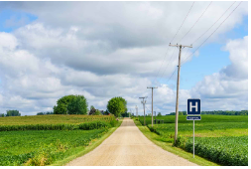
SUMMARY & CONCLUSIONS
Disparities in stroke care for patients residing in rural, low-resource settings post challenges & affect many individuals.
Interventions & investments need to support the entire spectrum of prehospital, acute, & post acute care for rural EMS, EDs, & hospitals.
Strategies include increasing stroke certification, engaging in mentorship from stroke centers accepting transfers, multistakeholder collaboration, & policy interventions addressing awareness, education, infrastructure, data management, & QI programs, taking into account the challenges & needs of the rural setting.

