Slide 1
Ejection Fraction as the Sixth Vital Sign for Patients with COVID
Improved triage using point-of-care echocardiography
Cincinnati Children’s Hospital Medical Center
David Watkins (UW), Ross Keller (UW), Sara Nikravan (UW), Nick Johnson (UW), Sachita Shah (UW), James Town (UW), Randy Martin (Caption Health), Kilian Kepsell (Caption Health), Craig Sable (CNMC), Federico Asch (MedStar), Nicholas Ollberding (CCHMC), Roberto Lang (Chicago)

Slide 2


Background
Myocardial Injury
Arrythmia
Cardiac Dysfunction
Early identification of patients with myocardial dysfunction may improve management.

Slide 3
Background
Limited provider-to-patient contact
PPE conservation
Lack of skilled human resources (LMICs)
Access to echocardiography is limited in many settings.

Slide 4
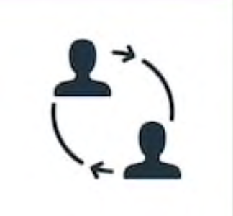
Background
Conserve resources
Improve access to diagnosis
Change outcomes
Task sharing echocardiography with frontline healthcare providers may serve as a “6th vital sign” that can be integrated with POC testing
.

Slide 5
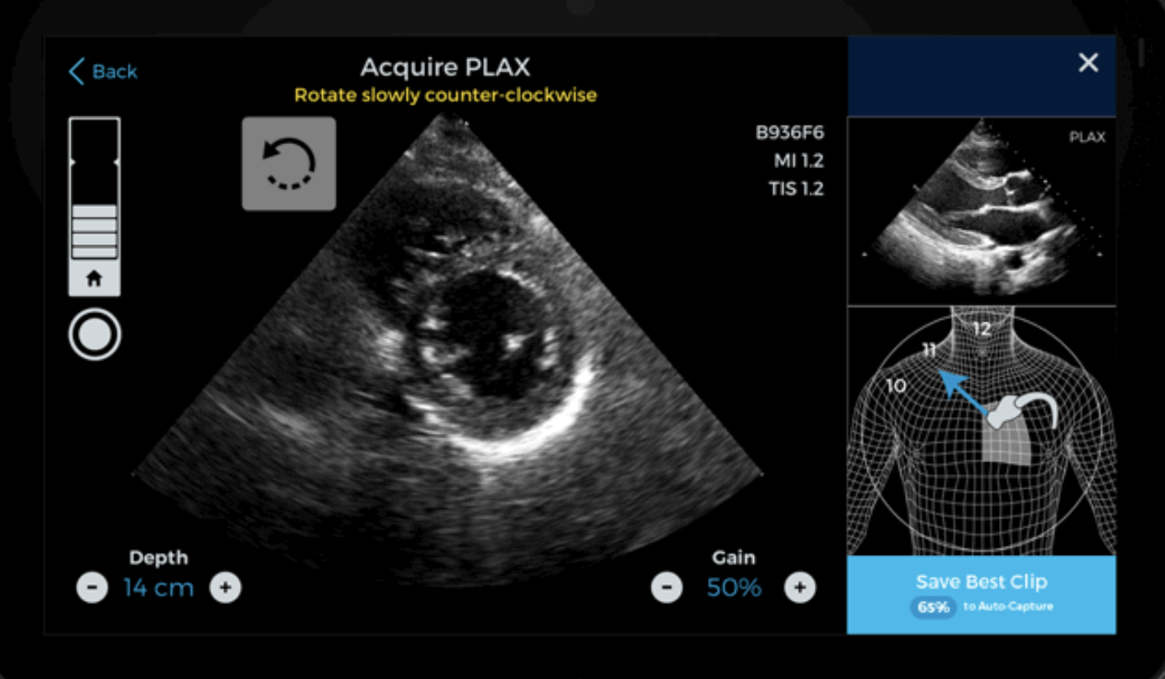
Quality Meter
Background
Prescriptive Guidance
Reference Image
Rapid scale up of non-expert echo has challenges
Navigational guidance provides a technology solution
Probe
Positioning Diagram
AutoCapture
Save Best Clip
Caption Guidance™ provides real time feedback on probe
position and diagnostic quality

Slide 6
Specific Aims
Compare the efficiency and quality of FoCUS with and without AI-assistance in the COVID ED
Describe the longitudinal pattern of EF in critically ill patients with COVID in the ICU
Evaluate frontline provider experience with AI-guided FoCUS in the ED and ICU
Develop a simple risk prediction score that integrates EF to improve triage of patients with COVID infection.

Slide 7
ED Cohort
ICU Cohort
Clinical Prediction Cohort
ED Cohort
Non-intubated, >18 years, suspected or confirmed COVID-19
Randomized to NG + Auto EF or non-assisted FoCUS first
Outcomes at 30-60 days
Comparison of image acquisition time and image quality
Provider survey – Technology Acceptability Model (TAM) + survey on ease of workflow integration
n=100
n=25
n > 300

Slide 8
ED Cohort
ICU Cohort
Clinical Prediction Cohort
ICU Cohort
>18 years, confirmed COVID-19, admitted to the ICU
NG Echo and lung u/s integrated into clinical workflow daily
Provider survey – Technology Acceptability Model (TAM) + survey on ease of workflow integration
Linear mixed-effects regression (LMER) change in EF during ICU stay, differences in outcome modeled
ICU Cohort
>18 years, confirmed COVID-19, admitted to the ICU
NG Echo and lung u/s integrated into clinical workflow daily
Provider survey – Technology Acceptability Model (TAM) + survey on ease of workflow integration
Linear mixed-effects regression (LMER) change in EF during ICU stay
n=100
n=25
n > 300

Slide 9
Clinical Prediction Cohort
>300 patients recruited across centers
Demographic and clinical data, echo within 24 hours of presentation, outcomes data
Echo images uploaded (when approved) to Cloud-based storage
Multivariate regression – predict probability for critical illness
ED Cohort
ICU Cohort
Clinical Prediction Cohort
n=100
n=25
n > 300
*FOCUS on POC findings that would be available in a low-resource environment

Slide 10



Overall Timeline
 | May | June | July | Aug | Sept | Oct | Nov | Dec | Jan | Feb | Mar | April
COVID Research Committee
IRB
DUA
Trice Cloud Platform | Agreement
Aim 1 Recruitment
Aim 2 Recruitment
Aim 3 Recruitment

Slide 11
Ejection Fraction as the Sixth Vital Sign for Patients with COVID
Improved triage using point-of-care echocardiography

