Slide 1






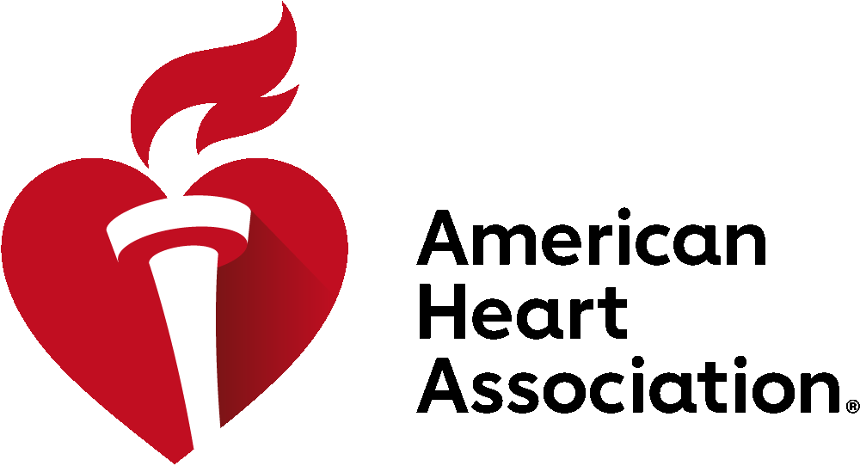

Four Days. Global Experts. Limitless Discovery.
November 6-9, 2026
Chicago, IL
Join us at #ScientificSessions26, the global stage for breakthrough cardiovascular science and medicine!
Four Full Days of Programming across 21 basic, clinical and population sciences programming communities.
Attend Moderated Digital Posters and reimagined Poster Sessions, Guideline-focused sessions and visit the Learning Studios.
Can’t Miss Sessions
2026 Nobel Laureate Address with Joshua D. Angrist, PhD.
Late-Breaking Science Sessions
Hypertrophic Cardiomyopathy Medical Society at Sessions
Guideline-focused sessions
Cardiovascular Kidney Metabolic Certificate Program
Innovation Forum
Obesity Summit
Bioengineering in Cardiovascular Health BCVS Symposium
From Discovery to Delivery: Translating Cardiovascular Innovation into Scalable Global Impact
and more!
Inclusive, career-spanning access
Designed for early-career professionals, senior leaders and everyone in between with opportunities to engage with leaders in the field within your specialty.
More value through American Heart Association Professional Membership
With Scientific Sessions OnDemand included when registering ($499 value), members unlock real, lasting value that extends well beyond the event.
ScientificSessions.org
Professional Members save on Registration rates.

Slide 2
Four Days. Global Experts. Limitless Discovery.
November 6-9, 2026
Chicago, IL
NEW at Scientific Sessions 2026!
21 education communities providing cohesive content
More professional development opportunities for all career stages, women and underrepresented communities
More educational content offering deeper insights and broader learning opportunities
Innovation additions like AI/tech, an expanded Simulation Zone with hands-on experiences, and a new offering of dynamic, fast-paced talks designed to inspire and drive innovative discussion
New collaboration with Hypertrophic Cardiomyopathy Medical Society (HCMS)
Increased Moderated Digital Poster presentations
New Innovation Forum
High-energy experience designed to help clinicians, scientists, and innovators turn ideas into impact.
More expertise from clinicians, American Heart Association award winners, Pls, editors and leaders in the field
ScientificSessions.org

