Slide 1
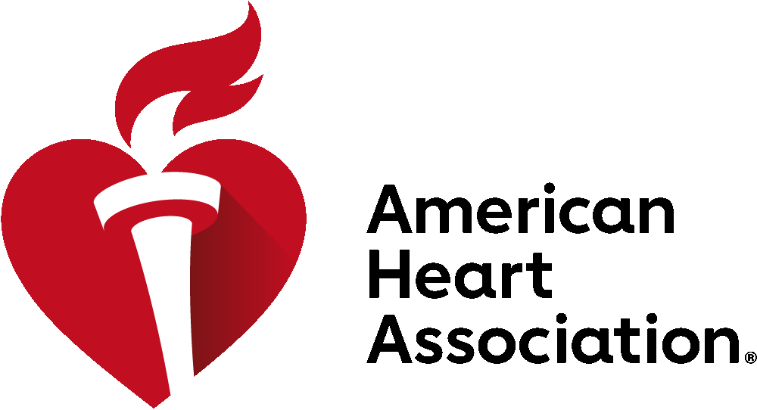
Four Days. Global Experts. Limitless Discovery.
November 7-10, 2025
New Orleans, LA
Join us at #AHA25, the global stage for breakthrough cardiovascular science and medicine!
Four Full Days of Programming across 21 basic, clinical and population sciences programming communities.
Attend Moderated Digital Posters and reimagined Poster Sessions, Guideline-focused sessions and visit the Learning Studios.
New this year: Expanded clinical content in Learning Studios!
Can’t Miss Sessions
2025 Nobel Laureate Address with Ardem Patapoutian, Ph.D.
Late-Breaking Science Sessions
HCMS* at Sessions
QCOR* at Sessions
Genomic and Precision Medicine Symposium
Core Cardiology Programming
Guideline-focused sessions
Cardiovascular Kidney Metabolic Certificate Program and more!
*Hypertrophic Cardiomyopathy Medical Society
*Quality of Care and Outcomes Research
Inclusive, career-spanning access
Designed for early-career professionals, senior leaders and everyone in between with opportunities to engage with leaders in the field within your specialty.
More value through AHA Professional Membership
With Scientific Sessions OnDemand included when registering ($499 value), members unlock real, lasting value that extends well beyond the event.
ScientificSessions.org
AHA Professional Members save on Registration rates.

Slide 2
Four Days. Global Experts. Limitless Discovery.
November 7-10, 2025
New Orleans, LA
NEW at Scientific Sessions 2025!
21 education communities providing cohesive content
More professional development opportunities for all career stages, women and underrepresented communities
More educational content offering deeper insights and broader learning opportunities
Innovation additions like AI/tech, an expanded Simulation Zone with hands-on experiences, and a new offering of dynamic, fast-paced talks designed to inspire and drive innovative discussion
New collaboration with Hypertrophic Cardiomyopathy Medical Society (HCMS)
Increased Moderated Digital Poster presentations
New Core Cardiology content providing practical guidance for both cardiologists and the broader community of healthcare providers.
More expertise from clinicians, AHA award winners, Pls, editors and leaders in the field
ScientificSessions.org

