Slide 1

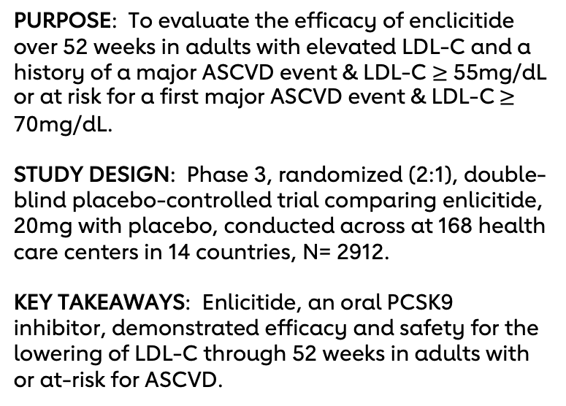
CORALreef Lipids
Efficacy and Safety of Enlicitide, an Oral PCSK9 Inhibitor, for Lowering
LDL Cholesterol in Adults with or At-Risk for ASCVD: The Phase 3 CORALreef Lipids Trial
PURPOSE: To evaluate the efficacy of enclicitide over 52 weeks in adults with elevated LDL-C and a history of a major ASCVD event & LDL-C $≥$ 55mg/dL or at risk for a first major ASCVD event & LDL-C $≥$ 70mg/dL.
STUDY DESIGN: Phase 3, randomized (2:1), double-blind placebo-controlled trial comparing enlicitide, 20mg with placebo, conducted across at 168 health care centers in 14 countries, N= 2912.
KEY TAKEAWAYS: Enlicitide, an oral PCSK9 inhibitor, demonstrated efficacy and safety for the lowering of LDL-C through 52 weeks in adults with or at-risk for ASCVD.
 | Enlicitide N= 1935 | Placebo N= 969 | LS Mean Group Difference (95% CI) | P value
Primary Outcome
LDL-C reduction from baseline to Week 24 | -57.1% | +3.0% | -55.8% ​ (-60.9, -50.7%) | p<0.001
Secondary Outcome
LDL-C reduction from baseline to Week 52 | -50.4% | +4.0% | -47.6% ​ (-52.7, -42.5%) | p<0.001
Safety Outcome
Serious adverse events | 191 (9.9%) | 116 (12.0%) | NA | NA
RESULTS: In a diverse population, once daily oral enlicitide achieved significant reductions in LDL-C at 24 weeks and sustained through 52 weeks. Enlicitide was relatively safe compared to placebo.
Presented by: Ann Marie Navar, MD, PhD, UT Southwestern Medical Center, Dallas, TX.
© 2025, American Heart Association. All rights reserved. Results reflect the data available at the time of presentation.
Professional Heart Daily @AHAScience | #AHA25
Notes:
I think we need to take out tolerability no data
1

