Slide 1
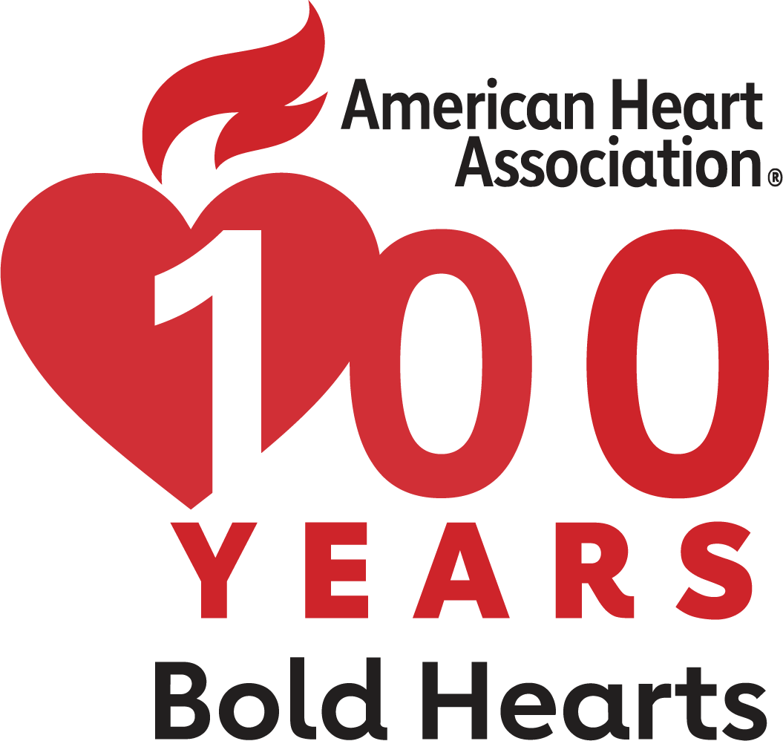
Celebrating 100 Years of AHA
Pre-Sessions Symposia & Early Career Day: November 15, 2024
Scientific Sessions: November 16-18, 2024
Chicago, IL
What to Expect
4 days of presentations that emphasize advances in basic, clinical and population sciences
Attend Moderated Digital Posters and Reimagined Poster Sessions
Can’t Miss Sessions
Late-Breaking Science Sessions
Heart/Kidney Symposium
QCOR* at Sessions
Novel Technologies in Arrhythmia Therapy
Identifying and Practicing Emerging Genomic-Based Therapies in Cardiovascular Disease
Hot Debates in Heart Failure Diagnosis and Management
And more
Engagement opportunities to keep you connected with colleagues and industry leaders
Register Today!
#AHA24
Members receive discounts on registration
*Quality of Care and Outcomes Research
ScientificSessions.org

Slide 2
Celebrating 100 Years of AHA
Pre-Sessions Symposia & Early Career Day: November 15, 2024
Scientific Sessions: November 16-18, 2024
Chicago, IL
Highlights
Pre-Sessions Symposia & Early Career Day on Friday - An all-encompassing and engaging agenda, showcasing exceptional symposia events, specialized programs for early career development, QCOR* at Sessions, and numerous opportunities for networking and mentorship.
Access Cutting-Edge Programming – Attend the meeting in Chicago and prioritize programming as it relates to your specialty. If you can't join us in Chicago, catch up on what you missed with Scientific Sessions OnDemand™!
Set ablaze your Sessions experience – Uncover the wonders of the Science & Technology Hall, where the Heart Hub awaits as a distinctive learning and networking destination.
Connect with your community – Identify your peers and network with colleagues.
Register Today!
#AHA24
Members receive discounts on registration
*Quality of Care and Outcomes Research
ScientificSessions.org

