Slide 1
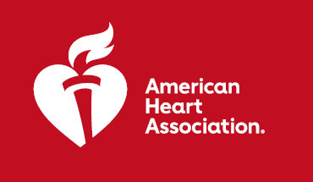


SELECT:
Semaglutide Effects on Heart Disease and Stroke in People with
Overweight or Obesity without Diabetes
RESULTS: In adults with overweight or obesity who do not have diabetes, semaglutide reduced the risk of major adverse cardiovascular events by 20%.
PURPOSE: To investigate if semaglutide may reduce the risk of having cardiovascular events in patients with overweight or obesity and with prior cardiovascular disease.
TRIAL DESIGN: Event-driven superiority trial (N=17,604), multicenter, randomized, placebo-controlled (semaglutide 2.4mg vs placebo), double-blind.
 | Semaglutide N=8803 | Placebo N=8801 | HR or Difference (95% CI) | P Value
Primary Endpoints:
CV death, nonfatal, or nonfatal stroke | 6.5% 569 events | 8.0% 701 events | HR 0.80 (0.72 to 0.90) | P<0.001
Secondary Endpoints:
% body weight change from baseline | -9.39±0.09% | -0.88±0.08% | -8.5% (-8.8 to -8.3) | NA
Time to first event: HbA_{1c} ≥ 6.5% | 3.5% | 12.0% | HR 0.27 (0.24 to 0.31) | NA
Adverse events leading to drug D/C | 16.6% | 8.2% | NA | P<0.001
Key Takeaways: Weekly addition of subcutaneous semaglutide to standard of care improved cardiovascular outcomes in patients with pre-exiting cardiovascular disease and overweight or obese, but without diabetes.
Presented by: A. Michael Lincoff, MD, Cleveland Clinic, USA. Scientific Sessions 2023. 2023, American Heart Association.
All rights reserved. Results reflect the data available at the time of presentation.
#AHA2
#AHA23

