Slide 1
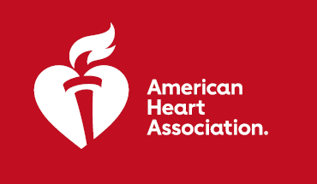
CARDIA-SSBP: Effects of Dietary Sodium on Systolic Blood Pressure in Middle-Aged Individuals: A Randomized Order Cross-Over Trial
RESULTS: In normotensive and hypertensive adults, a low sodium diet significantly lowered SBP. The decline in BP was independent of HTN status and anti-hypertensive medication use, consistent across subgroups, and did not result in excess adverse events.
PURPOSE: Dietary sodium recommendations are debated in part due to variable blood pressure (BP) response to sodium consumption. Further, the BP effect of dietary sodium among individuals on antihypertensive medications is understudied, particularly in randomized trials.
TRIAL DESIGN: N=213, randomized crossover trial in Coronary Artery Risk Development in Young Adults (CARDIA) study and non-CARDIA participants. Participants attended a baseline visit on usual diet, then completed one-week high- (~2,200 mg sodium added to usual daily diet) and low-sodium (~500 mg daily total) diets in random order.
 | Change in 24-Hour Ambulatory BP | Median Reduction | P-value
Primary Endpoints:
Change in Systolic Blood Pressure | 74.4%, -21.6% | 7 (IQR, 0 to 14) mm Hg | < .001
Change in Diastolic Blood Pressure | 63.3%, -29.7% | 2 (IQR, -1 to 6) mm Hg | < .001
Change in Mean Arterial Blood Pressure | 73.4%, -25.6% | 4 (IQR, 0 to 8) mm Hg | < .001
Change in Pulse Pressure | 81.9%, -13.1% | 5 (IQR, 1 to 8) mm Hg | < .001
Key Takeaways: The decline in SBP with a low-sodium diet was independent of hypertension status and anti-hypertensive medication use, consistent across subgroups, and did not result in excess adverse events.
Presented by: Deepak K. Gupta. Nashville, TN. Scientific Sessions 2023. © 2023, American Heart Association.
All rights reserved. Results reflect the data available at the time of presentation.
#AHA2
#AHA23

