Slide 1
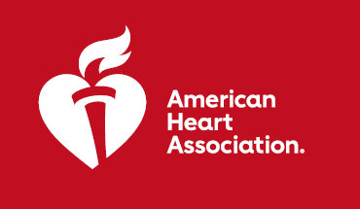

ARTESIA: Apixaban For The Prevention Of Stroke In Patients
With Subclinical Atrial Fibrillation (SCAF)
RESULTS: Patients with subclinical atrial fibrillation (SCAF) taking apixaban were 49% less likely to have stroke or a blood clot compared to patients who were taking aspirin daily but had an increased risk of bleeding.
PURPOSE: The purpose of this study was to compare apixaban with aspirin to reduce the risk of stroke in patients with device detected subclinical AF and additional risk factors for stroke.
TRIAL DESIGN: Multicenter randomized controlled trial enrolled 4012 individuals with SCAF lasting 6 minutes to 24 hours, detected by an implanted pacemaker, defibrillator or cardiac monitor, and who had additional stroke risk factors. Patients randomized in a double-blind, double-dummy fashion to apixaban at 5 mg twice daily (2.5 mg twice daily if meeting criteria for dose reduction) or aspirin 81 mg once daily.
 | Apixaban N=2015 | Aspirin N=1997 | HR or OR (95%CI) | P value
Primary efficacy outcome of stroke or systemic embolism (Intention to Treat Analysis/ITT) | 55 (0.78%) | 86 (1.24%) | 0.63 (0.45-0.88) | <0.007
Safety Endpoints all major bleeding on treatment | 86 (1.71) | 47 (0.94) | 1.60 (1.26-2.57) | 0.001
Key Takeaways: Patients with subclinical atrial fibrillation can benefit from apixaban to reduce the risk of stroke and systemic thromboembolism.
Presented by: Professor Jeff S. Healey, McMaster University, Canada. Scientific Sessions 2023. © 2023, American Heart Association.
All rights reserved. Results reflect the data available at the time of presentation.
#AHA2
#AHA23

