Slide 1
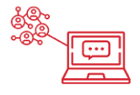
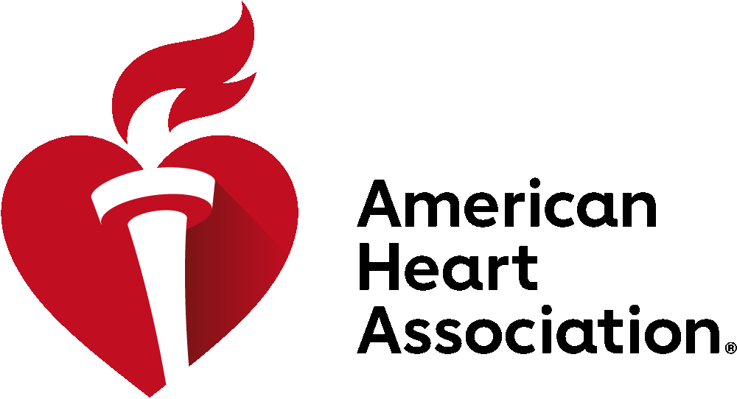
Pre-Cons and Stroke Nursing Symposia: February 4, 2025
ISC Sessions: February 5-7, 2025
Los Angeles Convention Center | Los Angeles, California
What to Expect
3 days of presentations intended to maximize thought-provoking discussions among scientists and clinicians.
CE credits available
4 exciting specialized Pre-Con Symposia
Attend Daily Main Events, Late-Breaking Science Oral and Poster Abstracts , NEW Digital Posters, Meet the Expert online sessions and more!
Can’t Miss Sessions:
Late-Breaking Science Sessions
Hot Debates in blood pressure management, unruptured aneurysm treatment, stenting, CTP and more
From Bench to Bedside and Beyond sessions
And more!
Engagement opportunities including the new Neuro Talk Theater, Poster Sessions, networking and early career events.
Register today at International Stroke Conference Registration - Professional Heart Daily | American Heart Association
#ISC25

