Slide 1
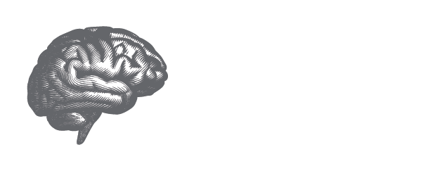
Primary Results of the Stroke Preclinical Assessment Network (SPAN)
Purpose: The Stroke Preclinical Assessment Network (SPAN) was developed to establish a rigorous preclinical assessment of highly promising cerebroprotectant treatment candidates across six independent laboratories, a central coordinating center, and a partnership with NINDS for possible further study of successful agents in future human clinical trials.
Trial Design: An NINDS randomized, controlled, blinded, multi-laboratory trial that applied clinical trial methods to preclinical research. Based on clinically meaningful treatment effect sizes, efficacy and futility boundaries were defined in a Multi-Arm Multi-Stage statistical approach designed to drop futile interventions after each of four sequential stages. Standard transient MCA occlusion was performed in equal numbers of males and females of young mice, young rats, aging mice, mice with diet-induced obesity, and spontaneously hypertensive rats. Treatment interventions included uric acid, tocilizumab, fingolimod, veliparib, Fasudil, remote ischemic conditioning (RIC), saline, or RIC sham.
Primary Outcome: Corner test for asymmetric turning at day 28, rated by three certified investigators blinded to the recorded videos of animal behavior. N=2437 in the mITT analysis.
Secondary Outcomes: MRI lesion volumes, grid walk.
Key Takeaways: Of 6 possible cerebroprotectant treatment candidates, uric acid 16 mg/kg given intravenously at the time of reperfusion was shown to be the most promising, exceeding the specified boundary criterion for efficacy. The SPAN design and infrastructure provides an effective model that could be used in similar preclinical, multi-laboratory studies in other disease areas, and should help improve reproducibility in translational science.
Presented by: Lauren Sansing on behalf of the SPAN Investigators. International Stroke Conference 2023. © 2023, American Heart | American Stroke Association. All rights reserved.
Results reflect the data available at the time of presentation.
#ISC23
Notes:
One liner: Of the 6 possible cerebroprotectant candidates, uric acid 16 mg/kg given IV at the time of reperfusion was shown to be the most promising, exceeding the specified boundary criterion for efficacy, and demonstrates how the SPAN design and infrastructure provides an effective model that could be used in similar preclinical, multi-laboratory studies in other disease areas, and can help improve reproducibility in translational science.

