Slide 1






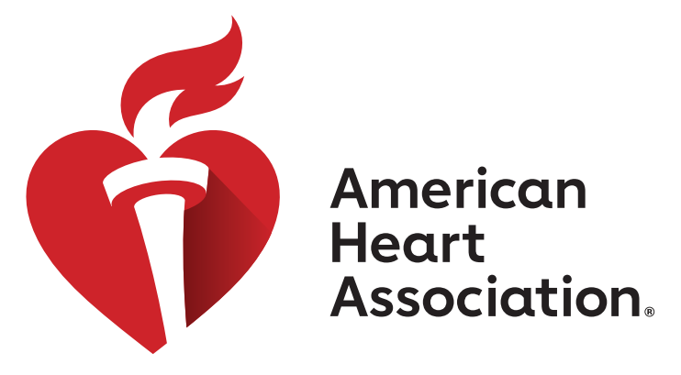
Shaping the Future of Cardiovascular Medicine:
Integrating Basic Science Breakthroughs to Clinical Impact
Boston, MA | July 13-16, 2026
Submit your Abstracts to #BCVS26
Participate in and experience interactive oral abstract presentations
26 abstract categories tailored to your field of study
Get published in AHA’s online Scientific Journal, Circulation Research
Opportunity to present your accepted abstracts and be considered for early career abstract awards.
Grow your professional network and reconnect with colleagues in person
Follow for live updates March 17-19!
Abstracts Close Wednesday, March 11
professional.heart.org/bcvssessions
#BCVS26

