Slide 1
Brain health across the lifespan:
A framework for future studies
American Heart Association
Writing Group members
Chair: Elisabeth Breese Marsh, MD
Vice Chair: Helen Lavretsky, MD, MS
Nadine A. Kasparian, PhD
Nancy A. Pike PhD, RN
Kristian P. Doyle, PhD
Neelum T. Aggarwal
Heather J. Fullerton, MD, MAS
Autumn S. Ivy, MD, PhD
Nomazulu Dlamini, MBBS, MSc, PhD
on behalf of the American Heart Association Stroke Council Science Committee on Psychological Health and Wellbeing

Slide 2
Slide set prepared by
Andrew Slusher MD a member of the Stroke Council SCILL and Professional Education Committee
:
Citation:
Marsh EB, Lavretsky H, Kasparian NA, Pike NA, Doyle KP, Aggarwal NT, Fullerton HJ, Ivy AS, Dlamini N; on behalf of the American Heart Association Stroke Council; Council on Cardiovascular and Stroke Nursing; Council on Cardiovascular Surgery and Anesthesia; and Council on Clinical Cardiology. Brain health across the life span: a framework for future studies: a scientific statement from the American Heart Association. Stroke. Published online April 28, 2026. doi: 10.1161/STR.0000000000000518
Link: https://www.ahajournals.org/doi/10.1161/STR.0000000000000518
Key words included in the article: aging, premature; brain; cognition; mental health; resilience, psychological

Slide 3
The Concepts of Brain Health…
Refer to the optimal functioning of the brain across cognitive, emotional, and behavioral domains throughout life
Also refers to cognitive resilience, defined as the ability for the brain to recover following an insult
Prior research has identified certain vascular risk factors that increase the risk of cerebrovascular disease, premature, aging, and cognitive dysfunction

Slide 4
This Scientific Statement is focused on the role of nonvascular physical and psychological variables impacting brain health across the lifespan
Provides an initial framework for future studies by highlighting the varying degrees of existing evidence for biological contributions and potential mitigating strategies to promote brain health across the life span

Slide 5
Non-Vascular physical and psychologic variables that affect brain health across the lifespan

Slide 6
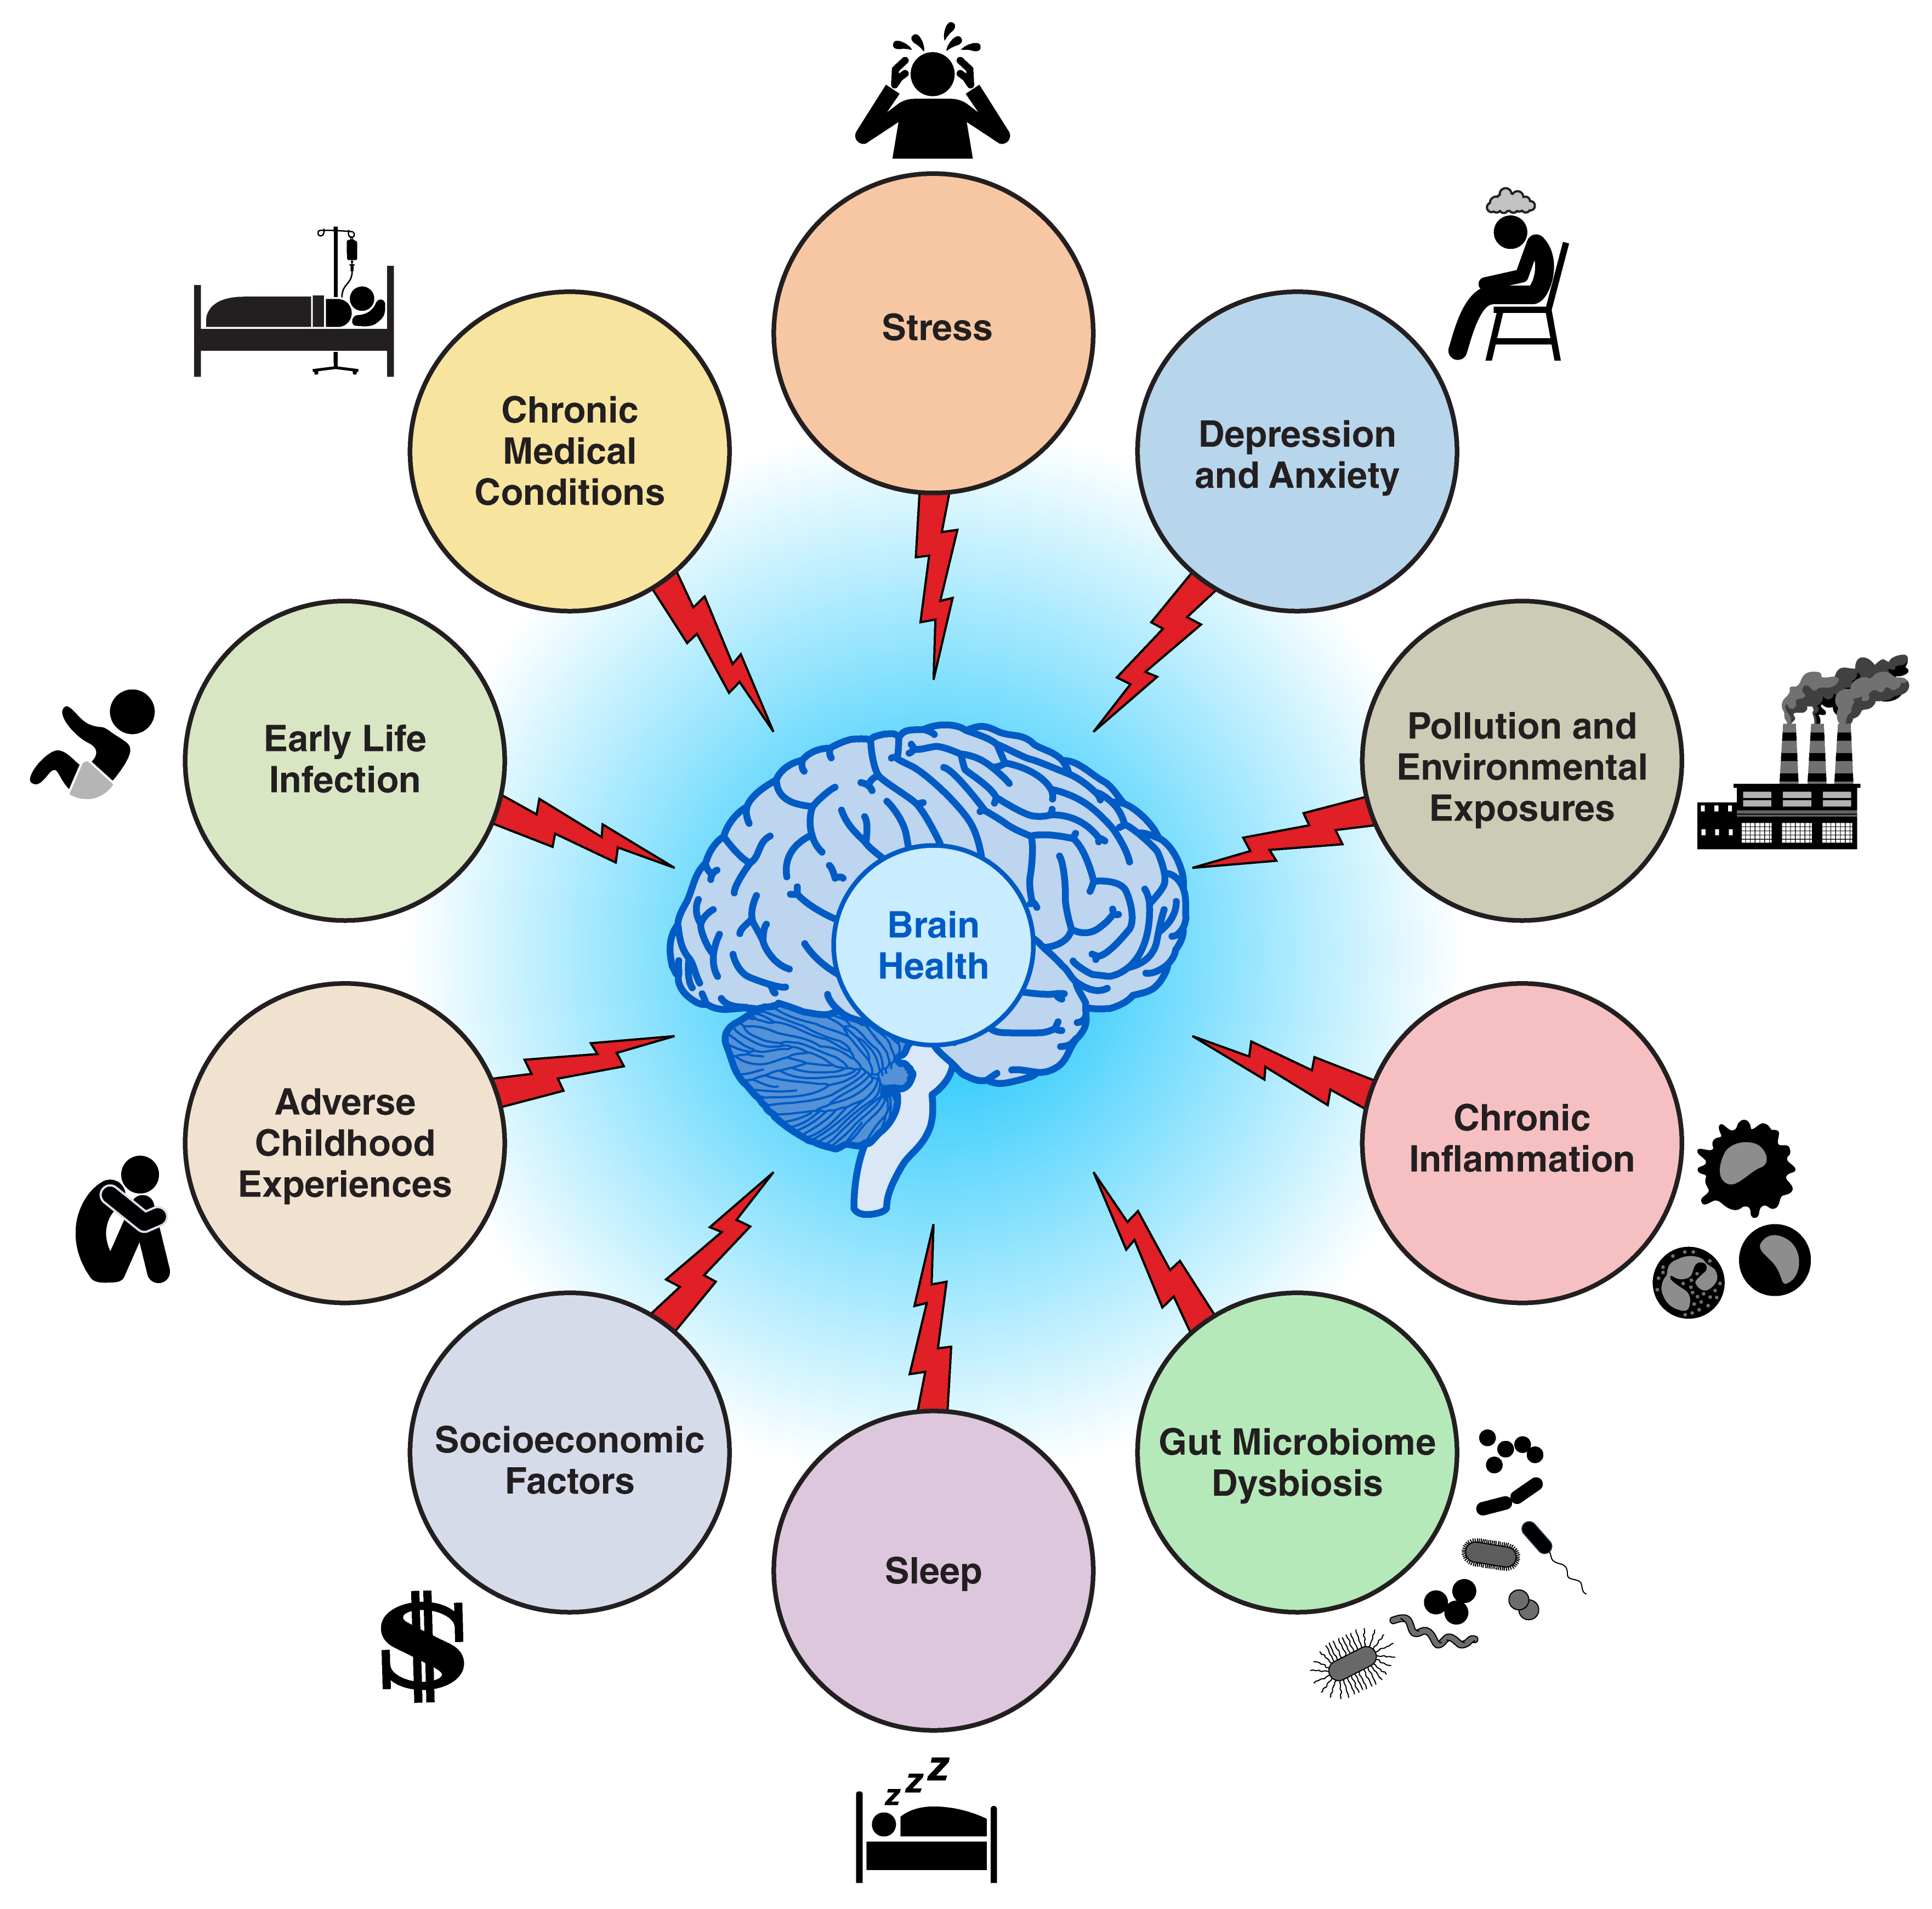

Slide 7
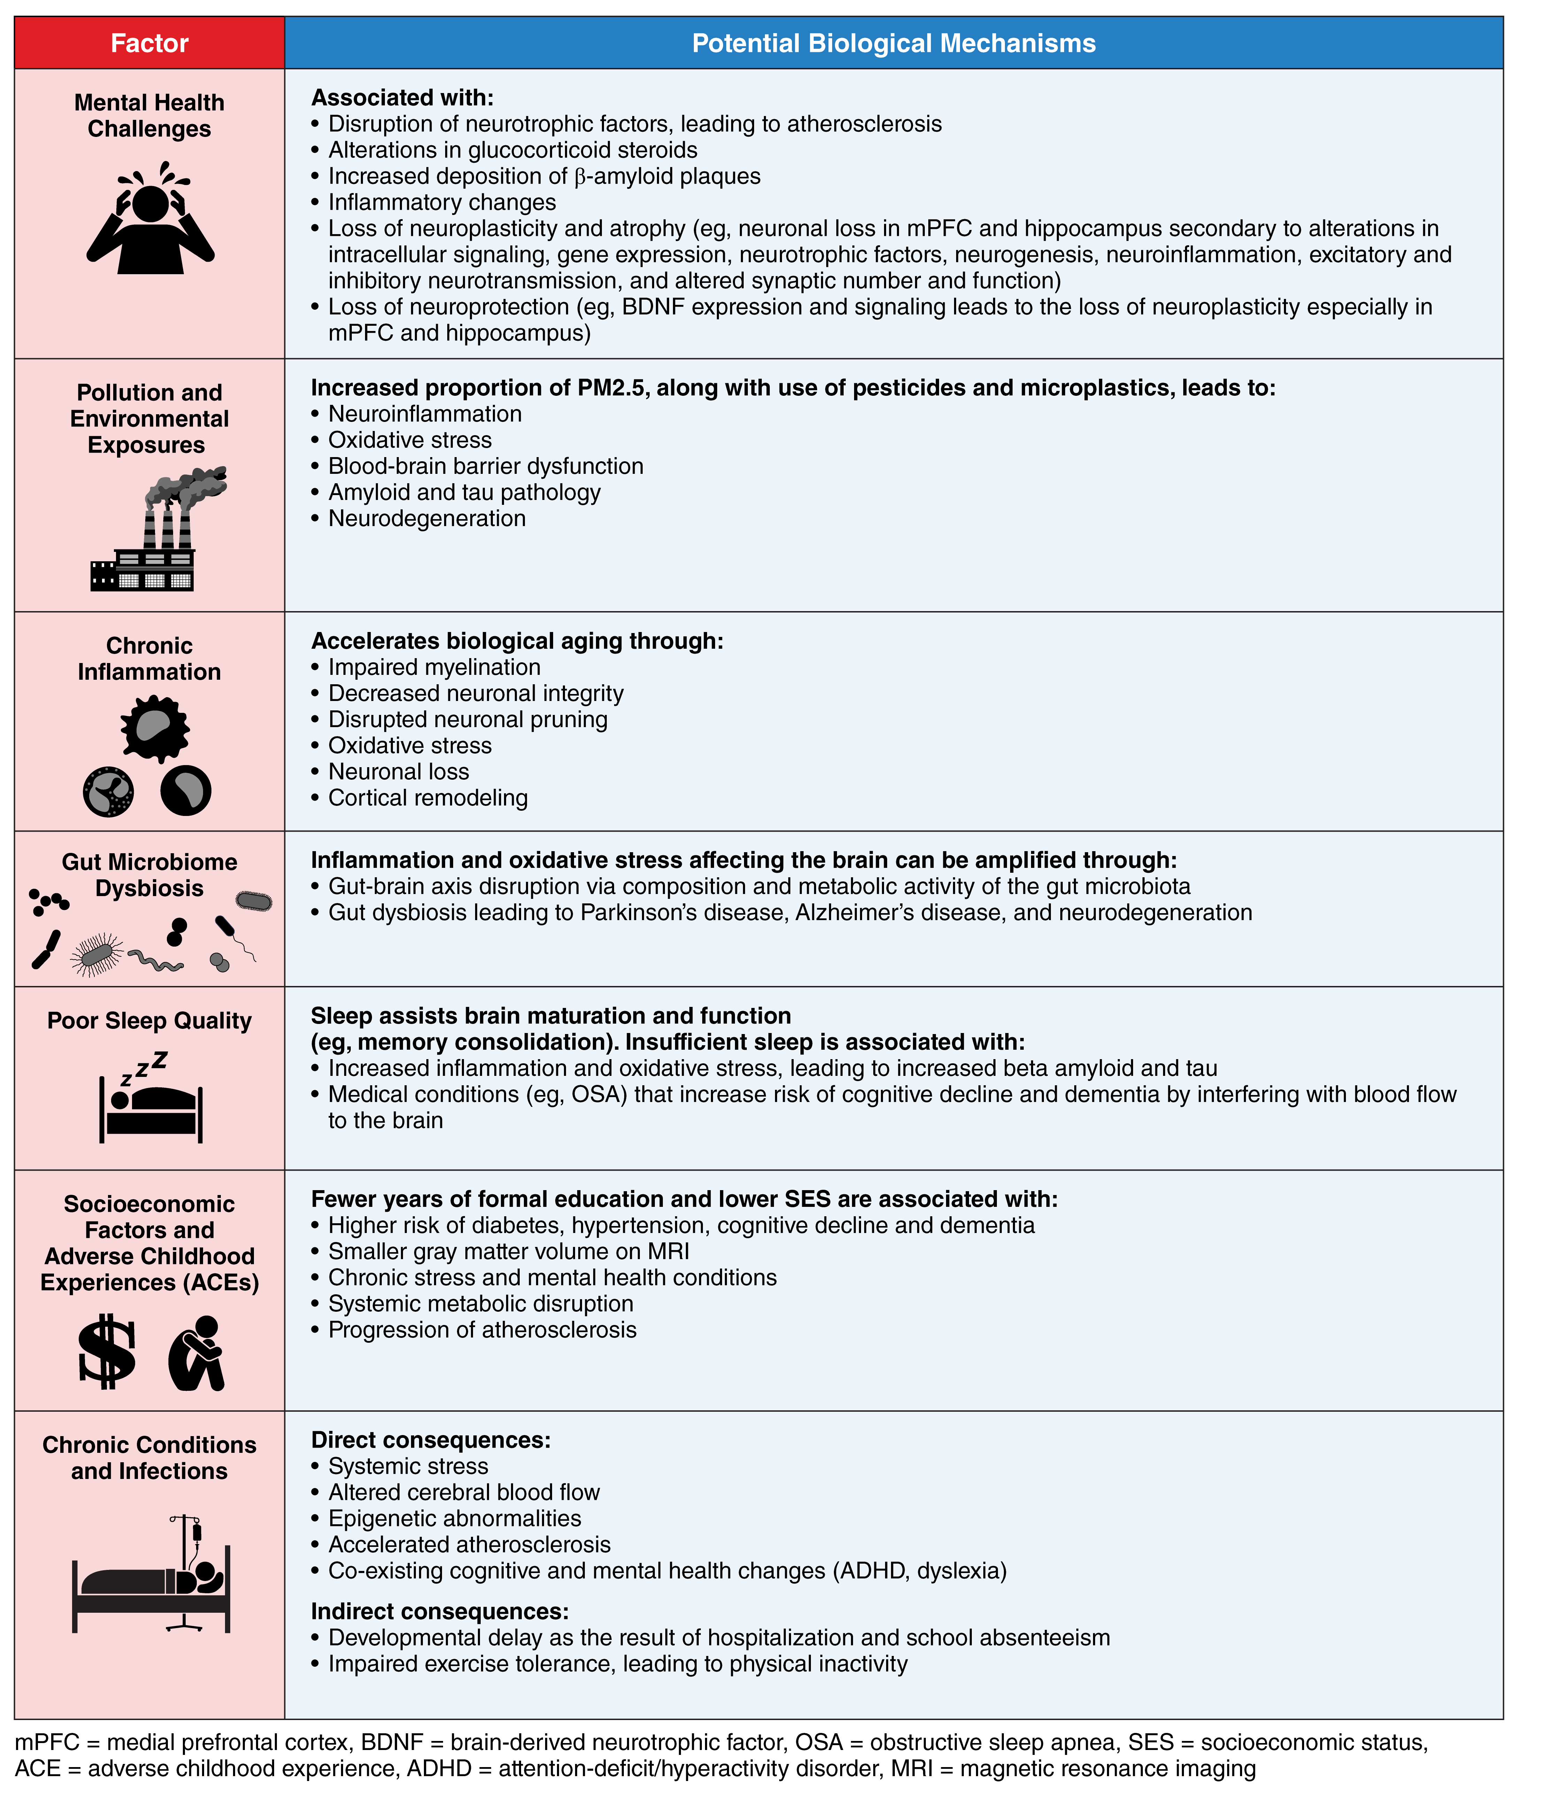

Slide 8
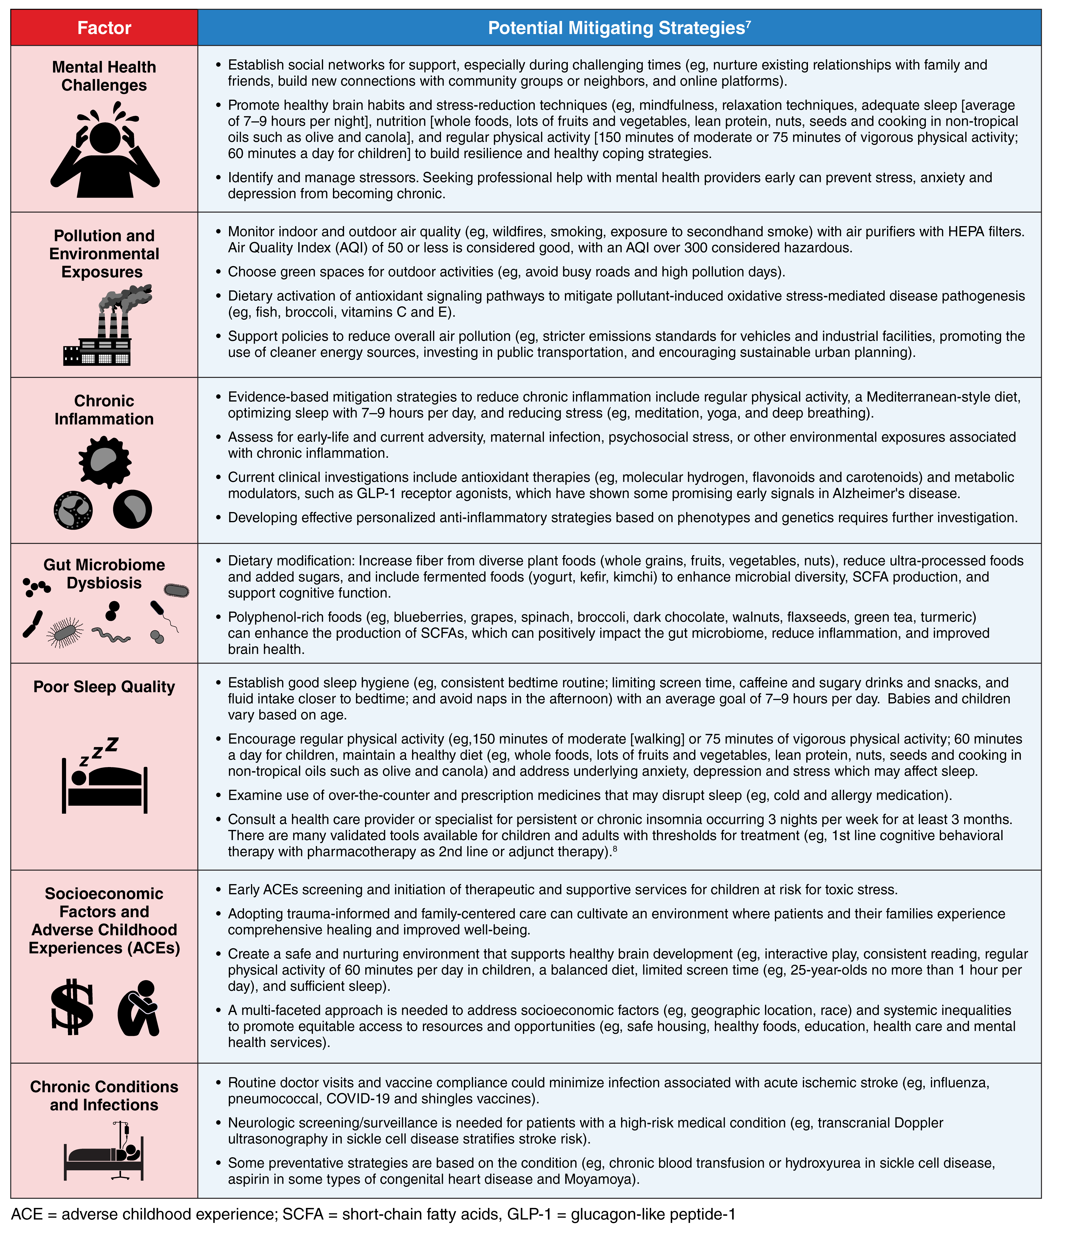

Slide 9
Stress, depression, and anxiety
  Role of mental health in neurologic disorders underappreciated
  Chronic stress-related neuro-biologic changes underlying depression and anxiety lead to higher stroke risk and progression of cognitive decline and dementia
  Negative emotional states have been shown to predispose to higher risk of cardiovascular or stroke-related morbidity and mortality
  Literature has suggested an association between depression and dementia, particularly the timing of depression
    Depression or depressive symptoms early in life associated with 2-fold or greater increased risk of dementia
    Studies have shown reduced gray matter volume in children who have experienced depression
  Given the current mental health crisis, it is imperative to develop more accessible and effective treatments for depression and anxiety

Slide 10
Stress, depression, and anxiety
Potential biologic mechanisms linking depression and dementia
    Vascular disease
    Alterations in glucocorticoid steroids
    Hippocampal atrophy
    Increased deposition of beta-amyloid plaques
    Inflammatory changes
    Deficits of nerve growth factors

Slide 11
Stress, depression, and anxiety
Potential biologic mechanisms
  Depression and anxiety have been shown to disrupt neurotrophic factors and synaptic connectivity, which affects neuroplasticity mechanisms involving the prefrontal cortex and hippocampus→neurodegenerative and vascular brain changes later in life
  Chronic stress has been shown to reduce neuroprotective factors such as BDNF (Brain-Derived Neurotrophic Factor), thereby hindering neuroplasticity, particularly in the prefrontal cortex and hippocampus
  Chronic stress and negative emotions have also been shown to promote a proinflammatory state, which contributes to neurodegenerative and cerebrovascular changes accelerating biologic aging

Slide 12
Pollution and environmental exposures
  Air pollution, heavy metals, pesticides, and other toxicants shown to affect brain health
  Particulate matter with a diameter of <2.5 micrometers (PM<2.5) is associated with increased risk of mild cognitive impairment and Alzheimer dementia
    Potential sources: Agriculture, road traffic, burning coal, wildfires
    PM<2.5 from agriculture and wildfires specifically associated with increased risk of dementia
  Prenatal and early-life exposures have been shown to disrupt brain development, influence neurobehavioral trajectories and cognitive outcomes
  Maternal exposure to particulate matter is associated with adverse birth outcomes, including brain development
  Analysis of 6 European population-based birth cohorts showed that air pollution (particularly exposure to NO₂ from motorized traffic sources) was associated with reduced psychomotor development
  Prenatal exposure to polycyclic aromatic hydrocarbons and heavy metals (lead and mercury) linked to lower IQ scores and increased risk of neurodevelopment delay

Slide 13
Pollution and environmental exposures
Potential biologic mechanisms
  Air pollutants accelerate neurodegeneration through microglial activation, systemic inflammation, and direct neuronal toxicity
  Particulate matter with a diameter of <2.5 micrometers (PM<2.5) has been shown to trigger:
    Neuroinflammation
    Oxidative stress
    Blood brain barrier dysfunction
    Vascular changes
    Accumulation of amyloid and tau pathology
  Elevated markers of neuroinflammation and Alzheimer pathology have been observed in residents of highly polluted urban regions, even among children and young adults
  Certain pesticides and microplastics both linked to neurodegenerative disorders through the following mechanisms:
    Accumulation of misfolded proteins
    Mitochondrial dysfunction
    Blood brain barrier dysfunction

Slide 14
Pollution and environmental exposures
Potential mitigating strategies
  Environmental injustice exacerbates risks
  People from underrepresented racial or ethnic groups face disproportionate exposures to pollutants:
    Pollution needs to be addressed as a modifiable risk factor for neurodegenerative and cerebrovascular disease
    Policies to reduce disproportionate exposures in vulnerable populations needs to be prioritized.
    Potential strategies to reduce pollution exposure:
    Regulatory policies to lower emissions
    Urban planning to mitigate traffic-related pollution
    Public health interventions

Slide 15
Chronic inflammation
  As opposed to acute/protective inflammation, chronic inflammation involves sustained immune activation that drives long term neurologic harm when resolution mechanisms fail
  Excessive exposure to chronic inflammation in early development increases risk for neurodevelopmental disorders including autism spectrum disorder and schizophrenia
  Elevated inflammatory markers during adolescent stage associated with increased vulnerability to mood disorders and cognitive deficits
  Adolescent exposure to chronic low-grade inflammation negatively impacts brain maturation and mental health:
    Early-life adversity
    Infection
    Psychosocial stress
    Other environmental exposures

Slide 16
Chronic inflammation
Potential biologic mechanisms
  Excessive exposure to chronic inflammation in early development can disrupt multiple neurodevelopmental processes including:
    Synapse formation
    Myelination
    Neuronal migration
  Adolescent exposure to chronic low-grade inflammation can disrupt synaptic pruning and cortical remodeling
  Proinflammatory states lead to prolonged microglia activation and subsequent release of inflammatory cytokines:
    Cytokines disrupt synaptic plasticity, promote oxidative stress, and contribute to neuronal loss
    The failure of specialized pro-resolving mechanisms (resolvins) and effererocytosis (cellular clearance of debris) appears to be a key transition point from beneficial to harmful neuroinflammation

Slide 17
Chronic inflammation
Potential biologic mechanisms
  Chronic inflammation also leads to vascular damage via endothelial dysfunction and acceleration of atherosclerosis
    Increased risk of MI, stroke, and impaired brain circulation
  Vascular damage promotes further inflammation, creating a feed—forward loop that contributes to accelerated brain aging
  Psychological stress has been shown to amplify chronic inflammation through its effects on the HPA axis and sustained cortisol production
  Sex differences: Women at increased risk of neuroinflammatory conditions due to stronger immune responses
    Declining estrogen levels during menopause may exacerbate inflammation-related cognitive decline in women

Slide 18
Chronic inflammation
Potential mitigating strategies
  Lifestyle interventions:
    Regular physical activity
    Mediterranean-style diet
    Optimization of sleep
    Reduction of psychologic stress
  Pharmacologic strategies debated
    Anti-inflammatory and anti-oxidant therapies have shown little benefit in human trials
    Studies using antioxidant therapies and metabolic modulators such glucagon-like peptide-1 receptor agonists have shown some promise in Alzheimer Disease but require confirmatory studies

Slide 19
Gut microbiome dysbiosis
  Gut-Brain Axis: A bidirectional communication network between the gastrointestinal tract and the central nervous system, influencing brain health and disease pathogenesis
  Alterations in gut microbiota can affect cognitive performance, emotional regulation, and susceptibility to neurodegenerative diseases
  Key microbial metabolites (notably short chain fatty acids) have been shown to directly modulate blood brain barrier integrity, microglial activation, and neuroinflammatory signaling
    Diets rich in fiber support production of short chain fatty acids
    Western-style diets promote intestinal permeability, systemic inflammation, and adverse cognitive outcomes
  Sex-based differences in gut microbiota may also contribute to sex-specific cognitive vulnerabilities

Slide 20
Gut-Brain influences across various life stages
Potential biologic mechanisms
  Establishment of the microbiome during the prenatal and early postnatal period has significant influence on neuro-development
    Early-stage disruptions may be linked to neurodevelopmental disorders such as autism spectrum disorder
    Heightened neuro-plasticity during this phase make it very susceptible to microbiome influences on neurogenesis, myelination, and synaptic development
  Adolescence is also a critical period
    Stress, infections, poor diet, and antibiotic exposure can alter microbiota composition, increasing neuroinflammation and future neurodegenerative risk
    May affect mental health and cognitive function
  In older populations, age related shifts in microbiome composition are strongly correlated with the manifestations of neurodegenerative diseases
    Aging leads to a reduction in microbial diversity, increases gut barrier dysfunction and low-grade inflammation, potentially exacerbating neuroinflammatory processes

Slide 21
Gut-Brain influences across various life stages
Potential biologic mechanisms
  Alzheimer disease shows robust associations with gut dysbiosis, in which altered microbiota promote neuroinflammation and cognitive decline through multiple pathways
  Parkinson disease also shows gut-brain axis involvement, with microbiome changes potentially contributing to motor and nonmotor symptoms
  Relationship between gut dysbiosis and neurodegenerative conditions appears to be bi-directional
    Disease progression further alters microbiome composition in a self-perpetuating cycle

Slide 22
Gut microbiome dysbiosis
Potential mitigating strategies
  Dietary modification, probiotic and prebiotic supplementation, and fecal microbiota transplantation can help to restore microbial balance and support cognitive function
  PROMOTe (Protein and Skeletal Muscle in Older Twins: Role of the Gut Microbiome) trial
    Prebiotics can modestly improve cognition in older adults
  Some meta-analyses have supported probiotics for cognitive impairment while others have shown mixed results
    Continued investigation needed
  Current evidence supports increasing dietary fiber through various plant-based foods, reducing ultra-processed foods and added sugars, and including fermented foods such as yogurt, kefir, or kimchi
  Strain and dose specific guidelines for probiotics, prebiotics, and fecal microbiota transplantation not yet sufficiently standardized to support universal recommendations

Slide 23
Poor sleep quality
  Sleep appears to evolve with the brain across the lifespan
    Important in development, memory, and disease prevention
  Frequent naps in early childhood and slow wave brain activity support hippocampal maturation and long-term memory consolidation
  Duration of sleep in adulthood is thought to preserve gray matter volume in key areas serving cognition
    Hippocampus
    Frontal cortex

Slide 24
Poor sleep quality
Potential biologic mechanisms
  Sleep supports memory consolidation, synaptic downscaling, and clearing of proteins from the glymphatic system
  Inadequate or poor sleep quality associated with cognitive decline and dementia
    Impaired removal of toxic beta amyloid and other substances from the brain
  Accumulation of beta amyloid and tau also may in turn disrupt the sleep-wake cycle, leading to further sleep fragmentation
  Obstructive sleep apnea increases the risk of cognitive decline and dementia
    Interferes with blood flow to the brain and patterns of brain activity that promote memory and attention

Slide 25
Poor sleep quality
Potential mitigating strategies
  Sleep and sleep patterns support brain homeostasis
  “Sleep capital” can be conceptualized as the cumulative social, economic, and health gains derived from maintaining adequate sleep and light exposure across the life span
  Policy level perspectives have emphasized sleep capital as a key investment in brain health, cognitive resilience, and economic productivity throughout life

Slide 26
Socioeconomic factors and adverse childhood experiences
  Adverse childhood experiences (ACEs): Abuse, neglect, and exposure to household challenges
    ACEs increase risk for learning and attention difficulties in childhood, mental health conditions, neurovascular events, and Alzheimer and other dementias
  The negative association between years of formal education and risk for cognitive decline and dementia historically attributed to higher cognitive reserve among more educated individuals
    More recent research suggests that lower socioeconomic status is more specifically linked to a greater risk of diabetes and hypertension, which serve as risk factors for subsequent cognitive decline and dementia
  Racial inequities are broadly linked to the global burden of stroke and cardiovascular disease, as well as to disparities in overall brain health

Slide 27
Socioeconomic factors and adverse childhood experiences
Potential biologic mechanisms
  Accumulation of ACEs causes prolonged and excessive activation of the HPA axis, leading to elevated cortisol levels and excessive glucocorticoid receptor activation
  Dysregulation of the HPA axis has implications for multiple biologic systems and may result in hyper-elevated cortisol levels and allostatic overload, often referred to as “toxic stress syndrome”
  Alterations in catecholamine signaling and autonomic nervous systemic dysregulation in response to early life stress may also influence brain development

Slide 28
Other Biologic mechanisms linked to ace accumulation
Accumulation of ACEs→disruption of systemic inflammatory, endocrine, and metabolic functions→ implications for neuro-biologic health
Elevated cortisol can contribute to progression of atherosclerosis and impaired glucose metabolism→cumulative damaging effects on brain health over time
Epigenetics (molecular mechanisms governing gene expression and cellular functions) also shown to mediate the body’s toxic stress response

Slide 29
Socioeconomic factors and adverse childhood experiences
Potential mitigating strategies
  Evidence based interventions focus of ensuring a safe, healing, and cognitively stimulating environment to support brain health development
    Interactive play
    Consistent reading
    Regular physical activity
    Balanced diet
    Sufficient sleep
    Limiting screen time
    Facilitating time outside in natural outdoor settings
    Managing stress
  Social determinants of health can greatly impede functional outcomes
    Low SES, geographic constraints, exposure to systemic racism, historical underrepresentation of racial or ethnic groups, and discrimination

Slide 30
Socioeconomic factors and adverse childhood experiences
Potential mitigating strategies
  Early identification of those at risk allows for the introduction of strategies to prevent or mitigate risk
  Identifying those who may be at risk of a toxic stress response
    Considering the type, timing, and duration of adversity
    Exacerbating factors
    Presence of supports and protective factors within the environment
  Psychotherapy

Slide 31
Early life infection and chronic medical conditions
  Mounting evidence showing that non-atherosclerotic cardiovascular and cerebrovascular diseases of childhood affect brain development, cognitive function, and mental health
    Congenital heart disease
    Hematologic diseases such as sickle cell anemia
    Cerebral arteriopathies such as moyamoya
  Chronic pediatric diseases may also have indirect implications for brain health
    Physiologic stress of frequent hospitalizations and procedures
    Limited access to exercise
    School absenteeism
    Family psychologic stress
    Genetic and epigenetic factors
  Obesity also a risk factor for vascular brain health, impairing cognition and brain structure at all stages of life
  Atherosclerotic factors do not emerge as risk factors for overt stroke until young adulthood

Slide 32
Early life infection and chronic medical conditions
Potential biologic mechanisms
  Non-atherosclerotic cardiovascular and cerebrovascular diseases of childhood
    Cause impairment of cerebral perfusion→disruption of normal formation of neural networks in the brain→leading to cognitive impairment
    Cranial radiation:
      Injures cerebral arteries and result in direct neurotoxic effects
  Obesity linked to:
    Insulin resistance
    Inflammation
    Vascular injury
    Hormonal imbalances

Slide 33
Early life infection and chronic medical conditions
Potential mitigation strategies
  Hydroxyurea shown to protect against silent brain infarcts in children with sickle cell disease, helping to maintain cognitive function
  Environmental and lifestyle factors, many of which linked to social determinants of health, have been shown to affect cerebrovascular health and cognitive function in childhood
  Diet and exercise
  Major and minor infections associated with increased risk of stroke in childhood
  Poor vaccination status an independent predictor of childhood stroke

Slide 34
conclusion
  Physical and psychologic risk factors beginning prenatally have a considerable impact on brain maturation and overall cognitive health
  This scientific statement underscores the significance of early detection, prevention, and intervention initiatives in promoting optimal brain health
  Factors such as epigenetics likely influence why individuals with similar exposures can experience varying outcomes
  Important to emphasize the intrinsic link between mental health and neurologic health in aging
  Essential to urge health care professionals, policymakers, and the general public to prioritize comprehensive strategies that safeguard and promote brain health across the life span

Slide 35
conclusion
  Action must be taken to understand and address the needs of communities that have had unequal access to preventive health information and services
  We advocate for a holistic approach that integrates the biopsychosocial framework within traditional medical practice to ensure development, testing, and implementation of interventions across the life span to promote brain health and mental well-being
  By implementing personalized, culturally responsive, evidence-based practices and advancing research in medicine, neuropsychiatry, behavioral neurology, psychology, and geroscience, we can extend health, longevity, and independence in aging adults

Slide 36
The end

