Slide 1

Guideline Essentials:
American Heart Association
Clinical Slide Series
ADAPTED FROM:
2026 ACC/AHA/ACCP/ACEP
CHEST/SCAI/SHM/SIR/SVM/SVN
Guideline for Evaluation and Management of Acute Pulmonary Embolism in Adults
AHA Clinical Update PPTX

Slide 2
Table 1.
Applying Class of Recommendation and Level of Evidence to Clinical Strategies, Interventions, Treatments, or Diagnostic Testing in Patient Care
CLASS (STRENGTH) OF RECOMMENDATION
CLASS 1 (STRONG) Benefit >>> Risk
Suggested phrases for writing recommendations: Is recommended Is indicated/useful/effective/beneficial Should be performed/administered/other Comparative-Effectiveness Phrases†: Treatment/strategy A is recommended/indicated in preference to treatment B Treatment A should be chosen over treatment B
CLASS 2a (MODERATE) Benefit >> Risk
Suggested phrases for writing recommendations: Is reasonable Can be useful/effective/beneficial Comparative-Effectiveness Phrases†: Treatment/strategy A is probably recommended/indicated in preference to treatment B It is reasonable to choose treatment A over treatment B
CLASS 2b (Weak) Benefit ≥ Risk
Suggested phrases for writing recommendations: May/might be reasonable May/might be considered Usefulness/effectiveness is unknown/unclear/uncertain or not well-established
CLASS 3: No Benefit (MODERATE) Benefit = Risk
Suggested phrases for writing recommendations: Is not recommended Is not indicated/useful/effective/beneficial Should not be performed/administered/other
CLASS 3: Harm (STRONG) Risk > Benefit
Suggested phrases for writing recommendations: Potentially harmful Causes harm Associated with excess morbidity/mortality Should not be performed/administered/other
LEVEL (QUALITY) OF EVIDENCE‡
LEVEL A
High-quality evidence‡ from more than 1 RCT Meta-analyses of high-quality RCTs One or more RCTs corroborated by high-quality registry studies
LEVEL B-R (Randomized)
Moderate-quality evidence‡ from 1 or more RCTs Meta-analyses of moderate-quality RCTs
LEVEL B-NR (Nonrandomized)
Moderate-quality evidence‡ from 1 or more well-designed, well-executed nonrandomized studies, observational studies, or registry studies Meta-analyses of such studies
LEVEL C-LD (Limited Data)
Randomized or nonrandomized observational or registry studies with limitations of design or execution Meta-analyses of such studies Physiological or mechanistic studies in human subjects
LEVEL C-EO (Expert Opinion)
Consensus of expert opinion based on clinical experience.
COR and LOE are determined independently (any COR may be paired with any LOE).
A recommendation with LOE C does not imply that the recommendation is weak. Many important clinical questions addressed in guidelines do not lend themselves to clinical trials. Although RCTs are unavailable, there may be a very clear clinical consensus that a particular test or therapy is useful or effective.
* The outcome or result of the intervention should be specified (an improved clinical outcome or increased diagnostic accuracy or incremental prognostic information).
† For comparative-effectiveness recommendation (COR 1 and 2a; LOE A and B only), studies that support the use of comparator verbs should involve direct comparisons of the treatments or strategies being evaluated.
‡ The method of assessing quality is evolving, including the application of standardized, widely-used, and preferably validated evidence grading tools; and for systematic reviews, the incorporation of an Evidence Review Committee.
COR indicates Class of Recommendation; EO, expert opinion; LD, limited data; LOE, Level of Evidence; NR, nonrandomized; R, randomized; and RCT, randomized controlled trial.
Creager, M.A., et al. 2026 AHA/ACC/ACEP/CHEST/SCAI/SHM/SIR/SVM/SVN Guideline for Evaluation and Management of Acute Pulmonary Embolism in Adults. Circulation.

Slide 3
Clinical Evaluation of Patients with Suspected Acute PE
Symptoms suspicious for acute PE
Perform H&P to assess clinical probability of acute PE (Class 1)
Quantify clinical probability of acute PE using a validated tool*
Clinical probability
<15% (Low)
Clinical probability
15-50% (Intermediate)
Clinical probability
>50% (High)
Assess PE Rule Out Criteria (PERC) All criteria met?
No
Perform D-dimer testing and assess YEARS criteria† (Class 2a)
Perform diagnostic testing (Class 1)
Yes
Very low clinical probability of PE
No further testing
0 YEARS criteria and
D-dimmer <1000 ng/mL
≥1 YEARS criteria and
D-dimmer <500 ng/mL or age-adjusted threshold
0 YEARS criteria and
D-dimmer ≥ 1000 ng/mL
≥1 YEARS criteria and
D-dimmer ≥500 ng/mL or age-adjusted threshold
PE Diagnosis excluded
PE Diagnosis excluded
Perform diagnostic imaging
Perform diagnostic imaging
Abbreviations: DVT indicates deep vein thrombosis; and PE, pulmonary embolism.

Slide 4
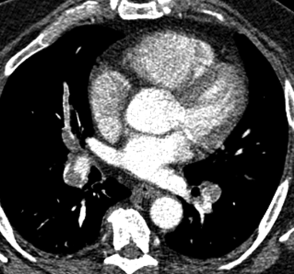
Diagnostic Testing
COR | RECOMMENDATIONS
1 | In patients presenting with symptoms and signs suggestive of acute PE, imaging is recommended for those who are deemed high probability (>50% probability of PE) by a validated clinic risk prediction score or an elevated D-dimer level in order to confirm or exclude PE.
1 | In patients undergoing imaging evaluation for suspected PE, a positive CTPA or high probability ventilation/perfusion (V/Q) scan is sufficient to diagnose PE.
1 | In patients undergoing imaging evaluation, a CTPA is recommended in preference to a V/Q scan to confirm the diagnosis of acute PE.
Abbreviations: CTPA indicates Computed Tomography Pulmonary Angiogram; PE, Pulmonary embolism; and V/Q, ventilation/perfusion.
Notes:
Hunsaker, Andetta R et al. “Imaging in acute pulmonary embolism with special clinical scenarios.” Circulation. Cardiovascular imaging vol. 3,4 (2010): 491-500. doi:10.1161/CIRCIMAGING.109.855981

Slide 5

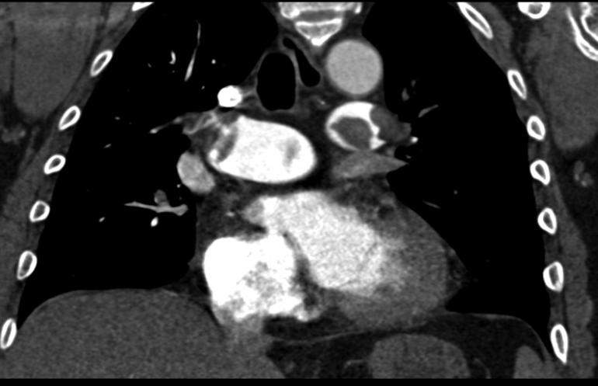
Diagnostic Testing – Reporting Findings
CTPA
TTE
COR | RECOMMENDATIONS
1 | In patients presenting with an acute PE who undergo CTPA, reporting Numerical RV/LV ratio (measured by internal diameter assessed on axial or reformatted 4D-chamber view) is recommended over subjective quantification for risk stratification
2b | In patients with acute PE, reporting of chronic features† on CTPA may be useful to identify patients at risk for chronic clinical sequelae of PE, including post-PE CTEPD Examples include: intravascular webs pulmonary artery retraction or dilation bronchial artery dilation RV hypertrophy intraventricular septal flattening
COR | RECOMMENDATIONS
1 | In patients with acute PE who undergo transthoracic echocardiography, RV dysfunction should be assessed and reported by the following parameters: RV/LV end-diastolic ratio RV end-diastolic diameter tricuspid annular plane systolic excursion (TAPSE) Estimated right ventricular systolic pressure RV free wall hypokinesis with sparing of the apex (McConnell’s sign) Tricuspid systolic velocity Paradoxical septal motion IVC respirophasic collapse
Abbreviations: CTEPD indicates Chronic Thromboembolic Pulmonary Disease; CTPA, Computed Tomography Pulmonary Angiography;
IVC, inferior vena cava; LV, Left ventricle; PE, pulmonary embolism; RV, Right ventricle; and TTE, Transthoracic echocardiogram.
Notes:
Hunsaker, Andetta R et al. “Imaging in acute pulmonary embolism with special clinical scenarios.” Circulation. Cardiovascular imaging vol. 3,4 (2010): 491-500. doi:10.1161/CIRCIMAGING.109.855981

Slide 6
AHA/ACC Acute PE Clinical Categories
A
Subclinical
Incidental and asymptomatic
B
Symptomatic
Low clinical severity score*
C
Symptomatic
Elevated clinical severity score†
D
Incipient Cardiopulmonary Failure
E
Cardiopulmonary Failure
Lowest risk
Highest risk
B1
C1
D1
E1
Subsegmental (Single/multiple)
Normal RV
and normal biomarkers
Transient hypotension‡
Recurrent of persistent hypotension with cardiogenic shock
B2
C2
D2
E2
Abnormal RV or ≥1 abnormal biomarkers
Normotensive shock§
Refractory cardiogenic shock or cardiac arrest
Non-Subsegmental
C3
Abnormal RV and ≥1 abnormal biomarkers
+/-
+/-
+/-
R
R
R
Abbreviations: ACC indicates American College of Cardiology; AHA, American Heart Association; CPES, Composite Pulmonary Embolism Shock; IV, intravenous; NC, nasal cannula; NRB, nonrebreather; O2, oxygen; PE, pulmonary embolism; PESI, Pulmonary Embolism Severity Index; RR, respiratory rate; RV, right ventricle; and sPESI, simplified PESI.
Respiratory Modifier
(O₂<90%, RR≥30, need supplemental O₂)
Respiratory Modifier
(>6 L nasal cannula or use of NRB mask)
Respiratory Modifier
(Hypoxemic respiratory failure or ventilatory failure)

Slide 7
Initial Assessment and Management by AHA/ACC Acute PE Clinical Categories
Category A
Subclinical
Category B
Symptomatic,
Low Clinical Severity Score
Category C1
Symptomatic,
Elevated Clinical Severity Score
Category C2
Symptomatic,
Elevated Clinical Severity Score
Category C3
Symptomatic,
Elevated Clinical Severity Score
Category D1
Incipient Cardiopulmonary Failure
Category D2
Incipient Cardiopulmonary Failure
Category E1
Cardiopulmonary Failure
Category E2
Cardiopulmonary Failure
Initiate DOAC (1)
Initiate LMWH (1)
Initiate LMWH or UFH (1)
Use HESTIA, PESI and/or sPESI
to assess short-term risk (1)
Measure at least 1 cardiac biomarker (1)
Measure lactate (1)
Evaluate RV size and function with CT and/or echo (1)
VA-ECMO (2a)
Use decision tool to identify suitability for outpatient treatment (2a)
Use validated risk score to identify higher-risk patient (2a)
Evaluate for normotensive shock (2a)
Multidisciplinary PERT assessment to guide clinical management (1)
Vasopressor and/or inotropic therapy (1)
Abbreviations: ACC indicates American College of Cardiology; AHA, American Heart Association; CDL, catheter-directed thrombolysis; COR, class of recommendation; CT, computed tomography; DOAC, direct oral anticoagulant; ECMO, extracorporeal membrane oxygenation; LMWH, low-molecular-weight heparin; MT, mechanical thrombectomy; PE, pulmonary embolism; PERT, PE response team; PESI, Pulmonary Embolism Severity Index; RV, right ventricle; sPESI, simplified PESI; UFH, unfractionated heparin; and VA, venoarterial.
Systemic Thrombolysis (if acceptable bleeding risk), CDL, MT in appropriate cases. (2b)
Systemic Thrombolysis (if acceptable bleeding risk), CDL, MT, or surgical embolectomy. (2a)
Systemic Thrombolysis (if acceptable bleeding risk). (2a)

Slide 8

Placement in the Hospital
COR | RECOMMENDATIONS
1 | In patients with acute PE who are receiving thrombolytic therapy (systemic or CDL), placement in a unit that can provide close monitoring, such as an intensive care unit (ICU) or intermediate level of care unit, is recommended to monitor for adverse events.
2a | In patients admitted to the hospital with acute PE who undergo mechanical thrombectomy (MT) and are hemodynamically stable, admission to a level of care that can provide continuous telemetry and nursing care familiar with the postprocedural complications of the device used is reasonable.
Abbreviations: CDL indicates catheter directed thrombolysis; ICU, intensive care unit; MT, mechanical thrombectomy; and PE, pulmonary embolism.

Slide 9

Pulmonary Embolism Response Team (PERT)
COR | RECOMMENDATIONS
1 | In patients with acute PE who are at increased risk of adverse outcomes (ie, AHA/ACC PE Categories C-E)*, a multidisciplinary PERT assessment is recommended to improve in-hospital clinical care delivery.
*AHA/ACC PE Categories A or B with multiple comorbidities may also benefit from a PERT (eg, Category B with intracranial hemorrhage).

Slide 10
Benefits of a
PERT Program
Improved Risk Stratification
Diverse Insights From Various Specialists
Navigate Gaps in Evidence
PE Response Team
Foster Pathways for Appropriate Follow-up Care
Selection and Appropriate Use of Advanced Therapies
Implementation of Evidence-Based Protocols and Pathways
Educate Peers and Trainees
Abbreviations: PE indicates pulmonary embolism; and PERT, Pulmonary Embolism Response Team.

Slide 11
Possible Member of the PERT
Vascular Medicine
Patient and/or Family Members
Pulmonary/ Critical Care
Pharmacy
Cardiac Surgery
Nursing
Non Interventional Cardiology
PERT
Emergency Medicine
Interventional Radiology
Hermatology/
Oncology
Radiology
Interventional Cardiology
Vascular Surgery
Abbreviations: PERT indicates Pulmonary Embolism Response Team.

Slide 12
PERT Activation Example
Symptoms suspicious for acute PE
Assessment: History, Physical, Labs, Imaging (1)
A
Subclinical
B
Symptomatic
C
Symptomatic
D
Incipient Cardiopulmonary Failure
E
Cardiopulmonary Failure
Initiate anticoagulation (1)
Initiate anticoagulation (1)
Activate PERT (1)
Management per primary team
Multidisciplinary team discussion
Outpatient follow-up (1)
Multi PERT assessment to guide clinical management*
Outpatient follow-up (1)
Abbreviations: PE indicates pulmonary embolism; PERT, Pulmonary Embolism Response Team.

Slide 13
Anticoagulation Therapy – General Recommendations
COR | RECOMMENDATIONS
1 | In patients with acute PE who do not have an absolute contraindication to anticoagulation therapy, anticoagulation therapy should be initiated to reduce the risk of recurrent VTE and death.
1 | In patients with acute PE in AHA/ACC Categories C1-E1 who require parenteral anticoagulant therapy initially, LMWH is recommended over UFH to reduce recurrent VTE and major bleeding.
1 | In patients with acute PE who are eligible for oral anticoagulation, direct oral anticoagulants (DOACs) are recommended over Vitamin K antagonists (VKAs), unless contraindicated, to prevent recurrent VTE and reduce major bleeding
2a | In patients with suspected acute PE in AHA/ACC PE Category C2 or higher and in whom the bleeding risk is low, it may be beneficial to administer therapeutic anticoagulation when imaging is delayed or not immediately accessible
Abbreviations: ACC indicates American College of Cardiology; AHA, American Heart Association; COR, class of recommendation; DOAC, direct oral anticoagulant; LMWH, low-molecular-weight heparin; PE, pulmonary embolism; UFH, unfractionated heparin; and VKA, Vitamin K antagonists; and VTE, venous thromboembolism.

Slide 14
Hemodynamic Pharmacotherapy
Cardiogenic shock
due to PE
AHA/ACC PE Categories D2-E2
Concerns for reduced preload based on clinical assessment
AHA/ACC PE Categories D1-2
In patients with PE
AHA/ACC PE Categories C2-E
COR | RECOMMENDATIONS
1 | The use of vasopressors and/or inotropes is recommended to improve cardiac output and systemic perfusion.
COR | RECOMMENDATIONS
2b | The use of volume management with normal saline or other volume expanders may be considered to improve cardiac output and blood pressure.
COR | RECOMMENDATIONS
2b | The use of inhaled pulmonary vasodilators may be considered to reduce RV afterload.
Abbreviations: ACC indicates American College of Cardiology; AHA, American Heart Association; COR, class of recommendation; DOAC, direct oral anticoagulant; LMWH, low-molecular-weight heparin; PE, pulmonary embolism; UFH, unfractionated heparin; and VKA, Vitamin K antagonists; and VTE, venous thromboembolism.

Slide 15


Sedation and Ventilatory Strategies
COR | RECOMMENDATIONS
1 | In patients with acute PE in AHA/ACC PE Categories C-E who require sedation for intubation, hemodynamic supportive therapies should be available to support the patient in the event the patient becomes unstable.
2a | For patients with acute PE and moderate-severe hypoxia, use of heated high-flow nasal cannula (HFNC) oxygenation rather than standard nasal cannula oxygenation can be beneficial to improve oxygenation.
3 HARM | In patients with acute PE in AHA/ACC PE Categories C-E, deep sedation and mechanical ventilation should not be performed, unless clinically indicated, in order to avoid hemodynamic collapse.
During acute PE:
Heart rate and systemic vascular resistance both increase to maintain systemic and myocardial perfusion due to RV dysfunction
Anxiolytic and analgesic medications can potentially eliminate the compensatory mechanism resulting in hemodynamic collapse
Abbreviations: ACC indicates American College of Cardiology; AHA, American Heart Association; HFNC, high-flow nasal cannula; and PE, pulmonary embolism.

Slide 16
Mechanical Circulatory Support
COR | RECOMMENDATIONS
1 | In patients with known or suspected acute PE on VA-ECMO, continuation of parenteral systemic anticoagulation is recommended in the absence of bleeding to prevent further thrombotic or embolic complications.
2a | In patients with acute, refractory cardiogenic shock as a result of known or suspected acute PE (AHA/ACC PE Category E2), it is reasonable to institute VA-ECMO, provided appropriate resources are available, to stabilize hemodynamics and improve oxygenation.
2b | In patients with acute PE in AHA/ACC PE Category E2 who are placed on VA-ECMO support, the usefulness of additional advanced therapies is not well established.
Abbreviations: ACC indicates American College of Cardiology; AHA, American Heart Association; PE, pulmonary embolism; and ECMO, extracorporeal membrane oxygenation..

Slide 17
The Role of Inferior Vena Cava Filters
COR | RECOMMENDATIONS
2a | In patients with acute PE who cannot tolerate anticoagulation, IVC filters can be useful to reduce the short-term incidence of recurrent PE.
1 | In patients with acute PE who cannot tolerate anticoagulation but in whom an IVC filter is deemed necessary, retrievable IVC filters are recommended over permanent filters to reduce the short-term incidence of recurrent PE while minimizing long-term adverse outcomes.
1 | In patients with retrievable IVC filters, retrieval should be attempted as soon as the risk of PE has sufficiently decreased and anticoagulation tolerated in order to minimize the risk of long-term filter-related complications.
2a | In patients with indwelling IVC filters, the use of a structured follow-up program is reasonable to increase retrieval rates and detect complications.
COR | RECOMMENDATIONS
2b | In patients with recurrent PE despite optimal therapeutic anticoagulation who are in AHA/ACC PE Categories B-E, IVC filter placement may be considered to reduce the short-term incidence of additional recurrent PE.
2b | In patients with acute PE in AHA/ACC PE Categories D-E, and who are undergoing advanced interventions such as systemic thrombolysis, CDL, MT, or surgical embolectomy, the benefit of IVC filter placement is uncertain to reduce the short-term incidence of recurrent PE and mortality.
3 Harm | In patients with acute PE who are therapeutically anticoagulated, routine IVC filter placement should not be performed.
Abbreviations: ACC indicates American College of Cardiology; AHA, American Heart Association; CDL, catheter-directed thrombolysis; IVC, inferior vena cava; MT, mechanical thrombectomy; and PE, pulmonary embolism.

Slide 18

Systemic Thrombolysis in Acute PE
In patients with acute PE and an acceptable bleeding risk,
in whom advanced therapy is being considered…
COR | AHA/ACC PE CATEGORY | RECOMMENDATIONS
2a | E1-E2 | Systemic thrombolysis and anticoagulation is reasonable over anticoagulation alone to reduce mortality and recurrent PE.
2b | D1-D2 | Systemic thrombolysis and anticoagulation may be considered over anticoagulation alone to prevent further clinical deterioration
2b | C3 | Systemic thrombolysis and anticoagulation over anticoagulation alone to prevent further clinical deterioration is uncertain.
2b |  | In patients with acute PE being treated with systemic thrombolysis, lower dose systemic thrombolytics may be considered to reduce the risk of bleeding
3 Harm | A1-C2 | Systemic thrombolysis should not be used over anticoagulation alone due to increased risk of major bleeding and intracranial hemorrhage.
Abbreviations: ACC indicates American College of Cardiology; AHA, American Heart Association’; COR, class of recommendation; and PE, pulmonary embolism;

Slide 19
Comparing Catheter-Directed Thrombolysis and Mechanical Thrombectomy
COR | AHA/ACC PE CATEGORY | Catheter-Directed Thrombolysis RECOMMENDATIONS | Mechanical Thrombectomy RECOMMENDATIONS
2a | E1 | CDL plus anticoagulation is reasonable to prevent further clinical deterioration and early mortality. | It is reasonable to choose MT plus anticoagulation over anticoagulation alone to prevent further clinical decompensation and acute mortality.
2b | D1-E1 | The efficacy of CDL over systemic thrombolysis is unclear | The efficacy of MT over systemic thrombolysis is unclear, but MT may be considered over systemic thrombolysis to reduce major bleeding risks.
2b | D1-D2 | CDL plus anticoagulation may be considered to prevent further clinical deterioration. | MT plus anticoagulation may be considered to prevent further clinical deterioration.
2b | C2-C3 | The benefit of CDL plus anticoagulation as compared to anticoagulation alone is unclear. | The benefit of MT plus anticoagulation as compared to anticoagulation alone is unclear.
3 No Benefit | A-C1 | CDL is not recommended over anticoagulation alone for improving clinical outcomes or symptoms. | MT is not recommended over anticoagulation alone for improving clinical outcomes or symptoms.
Abbreviations: ACC indicates American College of Cardiology; AHA, American Heart Association’; COR, class of recommendation CDL , catheter-directed thrombolysis; PA, pulmonary artery; PE, pulmonary embolism.

Slide 20
Surgical Embolectomy
COR | AHA/ACC PE CATEGORY | RECOMMENDATIONS
2a | E1 | SE as compared to anticoagulation alone is reasonable to prevent further clinical decompensation and acute mortality.
2b | D1-D2 | SE plus anticoagulation may be considered over anticoagulation alone to prevent further clinical deterioration.
2b | D1-E1 | Benefits of SE to reduce short-term fatal/nonfatal clinical deterioration and improve long-term survival, functional, capacity, and quality of life over systemic thrombolysis is unclear, but embolectomy may be considered over systemic thrombolysis to reduce the risk of ICH.
3 No Benefit | A-C3 | SE is not recommended over anticoagulation alone for improving clinical outcomes or symptoms.
3 No Benefit | E2 | For those not on mechanical circulatory support, SE is not recommended over other advanced therapies for preventing short-term mortality.
Abbreviations: ACC indicates American College of Cardiology; AHA, American Heart Association’; COR, class of recommendation; SE, surgical embolectomy; and PE, pulmonary embolism.

Slide 21
Summary of Advanced Therapy Recommendations
AHA/ACC PE Risk Outcomes Category | Systemic Lysis | CDL | MT | Surgery
A-C1 | 3-Harm A | 3-NB C-EO | 3-NB C-EO | 3-NB C-EO
C2 | 3-Harm B-R | 2B C-LD (unclear) | 2B C-LD (unclear) | 3-NB C-EO
C3 | 2B C-LD (unclear) | 2B C-LD (unclear) | 2B C-LD (unclear) | 3-NB C-EO
D1-2 | 2B C-LD (may be considered) | 2B B-NR (may be considered) | 2B B-NR (may be considered) | 2B C-LD (unclear)
E1 | 2A C-LD | 2A C-LD | 2A B-NR | 2A B-NR
E2 | 2A C-LD | N/A | N/A | 3-NB B-NR
Abbreviations: ACC indicates American College of Cardiology; AHA, American Heart Association; CDL, catheter-directed thrombolysis; and MT, mechanical thrombectomy.

Slide 22
Recommendations for Follow-up Care After an Acute PE
COR | RECOMMENDATIONS
1 | In those with a history of acute PE who remain on anticoagulation into the extended phase (beyond 3-6 months from diagnosis), periodic reassessment of the risk and benefits of continued anticoagulation is recommended to ensure the safety and efficacy of continuing anticoagulation.
2a | In patients with acute PE, the use of general or disease-specific questionnaires is reasonable to screen for anxiety and depression at follow-up visits.
2a | In select complex patients⁺ with acute PE, it is reasonable to have follow-up care occur in a specialized PE clinic†, if available, to optimize care.
2b | In patients who remain symptomatic 3 to 6 months after acute PE, it may be reasonable to obtain a performance test (SMWT, ISWT, ESWT) to quantify physical limitations and identify which patients require more extensive evaluation.
COR | RECOMMENDATIONS
1 | Follow-up within 1st Week after discharge to provide patient education, address barriers to anticoagulation therapy, ensure adherence to medications, and detect bleeding complications.
1 | Follow-up at or before 3 Months after diagnosis to discuss duration of anticoagulation, review the need for further testing, and assess for persistent PE-related symptoms.
1 | Asked about PE-related symptoms and functional limitations at every visit for at least 1 year to screen for CTEPD or other causes of dyspnea and functional limitation.
Abbreviations: CTEPD indicates chronic thromboembolic pulmonary disease; ESWT, endurance shuttle walking test ; ISWT, incremental shuttle walking test; PE, pulmonary embolism; SMWT, Six-minute walk test; and VTE, venous thromboembolism.

Slide 23



Patient Activity and Travel
COR | RECOMMENDATIONS
2a | In patients recovering from acute PE, it is reasonable to encourage early ambulation rather than bed rest in order to reduce the risk of complications.
2a | In patients with a history of acute PE, use of compression stockings during long-haul (≥5 h) travel can be useful to lower the risk of DVT.
2b | In patients with a history of acute PE related to travel or immobility who are not currently receiving anticoagulation therapy, it may be reasonable to use a one-time prophylactic dose of an oral anticoagulant or a parenteral LMWH on the day of long-haul travel to reduce the risk of recurrent VTE.
2b | For patients recovering from acute PE in AHA/ACC PE Categories C2-E, it may be reasonable to restrict long-haul travel for 4 weeks after initiation of treatment or when symptoms have resolved to reduce risk of adverse events.
Abbreviations: LMWH indicates low molecular weight heparin; and PE, pulmonary embolism.

Slide 24
Recommendations for Anticoagulation Therapy by Recurrence Risk
Anticoagulation beyond initial phase (3-6 months)
COR | RECOMMENDATIONS
1 | First acute PE and no major reversible risk factor, continuing anticoagulation beyond the initial treatment phase (3-6 months) into the extended treatment phase is beneficial to prevent recurrent VTE.
1 | First acute PE due to a major reversible risk factor, stopping anticoagulation at the end of the initial treatment phase (3-6 months) is recommended over continuing anticoagulation into the extended treatment phase in order to optimize the net clinical benefit of recurrent VTE versus bleeding.
1 | In patients with a first PE due to a persistent risk factor, continuing anticoagulation at the initial treatment phase (3-6 months) into the extended treatment phase is reasonable in order to prevent recurrent VTE.
1 | For patients with a PE who are offered anticoagulation beyond the initial treatment phase (3-6 months) into the extended treatment phase, treatment with a DOAC, unless contraindicated, is recommended over a VKA to reduce the risk of bleeding.
Abbreviations: PE indicates pulmonary embolism, and VTE, venous thromboembolism.

Slide 25
Recommendations for Anticoagulation Therapy by Recurrence Risk-continued
Anticoagulation beyond initial phase (3-6 months)
COR | RECOMMENDATIONS
1 | For patients with a PE and with cancer who are offered anticoagulation beyond the initial treatment phase (3-6 months) into the extended treatment phase, either a DOAC or LMWH is recommended over VKA to reduce the risk of recurrent VTE.
1 | For patients with a PE and without cancer offered anticoagulation beyond the initial treatment phase (3-6 months) into the extended treatment phase, but have a contraindication to DOAC, VKA is recommended over aspirin or no therapy to reduce the risk of recurrent VTE.
1 | For patients with a PE who are offered anticoagulation beyond the initial treatment phase (3-6 months) into the extended treatment phase, treatment with half-dose apixaban or rivaroxaban is recommended to reduce the risk of bleeding.
Abbreviations: ASA indicates aspirin; DOAC, direct oral anticoagulant; LMWH, low-molecular-weight heparin; VKA, vitamin K antagonist; and VTE, venous thromboembolism.

Slide 26
Recurrent Pulmonary Embolism
Symptoms suggestive of PE
Documented Recurrent PE
COR | RECOMMENDATIONS
1 | In patients with a history of PE and who present with new symptoms and signs suggestive of recurrent or breakthrough PE, radiographic imaging with a CTPA or V/Q scan is recommended to objectively confirm or exclude the diagnosis.
COR | RECOMMENDATIONS
1 | In patients with a history of PE who have a documented recurrent PE despite being treated with an anticoagulant, an evaluation is recommended to detect clinical and pharmacological factors that may contribute to recurrent PE.
Recurrent PE
Adherent to therapy
Documented Recurrent
Acute PE
Adherent with reduced dose of DOAC
Cancer and Recurrent PE
Adherent to Therapeutic LMWH
COR | RECOMMENDATIONS
2a | Change to alternative drug class rather than continuing therapy with the same drug is reasonable.
COR | RECOMMENDATIONS
2a | It is reasonable to increase to full dose of DOAC in the same class.
COR | RECOMMENDATIONS
2a | Escalattion dose of LMWH by 20-25% is reasonable to prevent future recurrent PE.
Abbreviations: CTPA indicates computed tomography pulmonary angiography; DOAC, direct oral anticoagulant; LMWH, low-molecular-weight heparin; and V/Q, ventilation/perfusion.

Slide 27
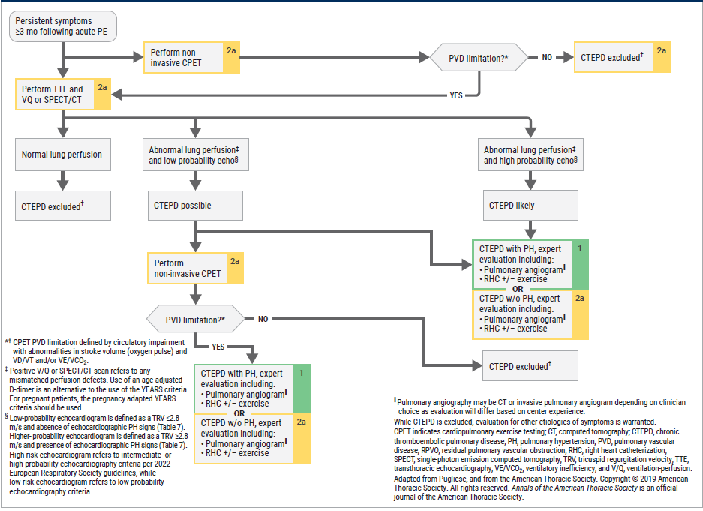
Revaluating Ongoing Symptoms Following Acute PE

Slide 28
Acknowledgments
Many thanks to our Guideline Ambassadors who were guided by Dr. Elliott Antman in developing this translational learning product in support of the
2026 ACC/AHA/ACCP/ACEP/CHEST/SCAI/SHM/SIR/SVM/SVN Guideline for Evaluation and Management of Acute Pulmonary Embolism in Adults
.
Christian Akem Dimala, MD MPH
Matthew Anderson, MD
Alexander Dang, MD
Sarah Godfrey, MD MPH
Manaquibb Khan, MBBS
The American Heart Association requests this electronic slide deck be cited as follows:
Akem Dimala, C., Anderson, M., Dang, A., Godfrey, S., Khan, M., Reyna, G.G., & Antman, E. M. (2026). AHA Clinical Slides [PowerPoint slides]; Adapted from the 2026 ACC/AHA/ACCP/ACEP/CHEST/SCAI/SHM/SIR/SVM/SVN Guideline for Evaluation and Management of Acute Pulmonary Embolism in Adults. Circulation. Guideline Essentials: AHA Clinical Slide Series - Professional Heart Daily | American Heart Association

Slide 29
Copyright and Permissions Notice
© Copyright 2026. American Heart Association. All rights reserved.
This material is the copyrighted property of the American Heart Association and is provided for reference purposes only. It may not be copied, reproduced, stored in a retrieval system, transmitted, altered in any way or used as a derivative work, or distributed in any form or by any means—electronic, mechanical, photocopying, recording, or otherwise—without prior written permission from the publisher.
This content may be used for limited educational and personal use.
Further distribution or dissemination requires a licensing agreement. Unauthorized use or distribution in any media is strictly prohibited.
For permissions inquiries and licensing fee information,
please see the information/Request Form at this link:
https://www.heart.org/en/about-us/statements-and-policies/copyright-request-form

