Slide 1

Guideline Essentials:
American Heart Association
Clinical Slide Series Update
ADAPTED FROM:
2026 AHA/ASA Guideline for the
Early Management of Patients with
Acute Ischemic Stroke
AHA Clinical Update PPTX

Slide 2
Figure 1. Journey of a patient with AIS
Abbreviations: AIS indicates acute ischemic stroke; EMS, emergency medical services; EVT, endovascular thrombectomy; MSU, mobile stroke unit; and TNK, tenecteplase.
Prabhakaran, S., et al. 2026 AHA/ASA Guideline for the Early Management of Patients with AIS. Stroke.

Slide 3
Table 1.
Applying Class of Recommendation and Level of Evidence to Clinical Strategies, Interventions, Treatments, or Diagnostic Testing in Patient Care
CLASS (STRENGTH) OF RECOMMENDATION
CLASS 1 (STRONG) Benefit >>> Risk
Suggested phrases for writing recommendations: Is recommended Is indicated/useful/effective/beneficial Should be performed/administered/other Comparative-Effectiveness Phrases†: Treatment/strategy A is recommended/indicated in preference to treatment B Treatment A should be chosen over treatment B
CLASS 2a (MODERATE) Benefit >> Risk
Suggested phrases for writing recommendations: Is reasonable Can be useful/effective/beneficial Comparative-Effectiveness Phrases†: Treatment/strategy A is probably recommended/indicated in preference to treatment B It is reasonable to choose treatment A over treatment B
CLASS 2b (Weak) Benefit ≥ Risk
Suggested phrases for writing recommendations: May/might be reasonable May/might be considered Usefulness/effectiveness is unknown/unclear/uncertain or not well-established
CLASS 3: No Benefit (MODERATE) Benefit = Risk
Suggested phrases for writing recommendations: Is not recommended Is not indicated/useful/effective/beneficial Should not be performed/administered/other
CLASS 3: Harm (STRONG) Risk > Benefit
Suggested phrases for writing recommendations: Potentially harmful Causes harm Associated with excess morbidity/mortality Should not be performed/administered/other
LEVEL (QUALITY) OF EVIDENCE‡
LEVEL A
High-quality evidence‡ from more than 1 RCT Meta-analyses of high-quality RCTs One or more RCTs corroborated by high-quality registry studies
LEVEL B-R (Randomized)
Moderate-quality evidence‡ from 1 or more RCTs Meta-analyses of moderate-quality RCTs
LEVEL B-NR (Nonrandomized)
Moderate-quality evidence‡ from 1 or more well-designed, well-executed nonrandomized studies, observational studies, or registry studies Meta-analyses of such studies
LEVEL C-LD (Limited Data)
Randomized or nonrandomized observational or registry studies with limitations of design or execution Meta-analyses of such studies Physiological or mechanistic studies in human subjects
LEVEL C-EO (Expert Opinion)
Consensus of expert opinion based on clinical experience.
COR and LOE are determined independently (any COR may be paired with any LOE).
A recommendation with LOE C does not imply that the recommendation is weak. Many important clinical questions addressed in guidelines do not lend themselves to clinical trials. Although RCTs are unavailable, there may be a very clear clinical consensus that a particular test or therapy is useful or effective.
* The outcome or result of the intervention should be specified (an improved clinical outcome or increased diagnostic accuracy or incremental prognostic information).
† For comparative-effectiveness recommendation (COR 1 and 2a; LOE A and B only), studies that support the use of comparator verbs should involve direct comparisons of the treatments or strategies being evaluated.
‡ The method of assessing quality is evolving, including the application of standardized, widely-used, and preferably validated evidence grading tools; and for systematic reviews, the incorporation of an Evidence Review Committee.
COR indicates Class of Recommendation; EO, expert opinion; LD, limited data; LOE, Level of Evidence; NR, nonrandomized; R, randomized; and RCT, randomized controlled trial.
Prabhakaran, S., et al. 2026 AHA/ASA Guideline for the Early Management of Patients with AIS. Stroke.

Slide 4

Stroke Awareness-Population Level
COR | RECOMMENDATIONS
1 | For the general public, implementation of educational programs on stroke recognition in patients of all ages and the need to seek emergency care (calling 9-1-1) is recommended and should be implemented by public health and community leaders and medical professionals to reduce gaps in knowledge about stroke warning signs and to improve stroke preparedness.
COR | RECOMMENDATIONS
1 | In addition to the general public, emergency medical services (EMS) professionals, physicians (including primary care professionals), and other health care personnel should receive targeted stroke educational programs to reduce prehospital delays and maximize eligibility for acute treatment of ischemic stroke (e.g. thrombolysis).

Slide 5
EMS Systems
Prehospital coordination and identification of hospital capabilities of stroke care involving EMS is crucial for time-sensitive treatment of patients with acute stroke.
COR | RECOMMENDATIONS
1 | Health care policy makers should establish regional systems of stroke care to increase access to time-sensitive therapies that include the determination of: a) health care facilities that provide initial emergency care, including administration of IVT, and b) centers capable of performing endovascular stroke treatment with comprehensive periprocedural care to which rapid transport must be arranged when appropriate.
COR | RECOMMENDATIONS
1 | EMS leaders, together with local experts, regional or state agencies, and medical authorities, should develop prehospital triage protocols to ensure that patients with suspected stroke are rapidly identified, assessed with a validated tool for stroke screening, and preferentially transported to the most appropriate stroke centers.
Abbreviations: EMS indicates emergency medical services; and IVT, intravenous thrombolytics.

Slide 6

Prehospital Assessment and Management
Dispatch Recommendation
Ambulance Transport - Recommendations
COR | RECOMMENDATIONS
2a | In callers to 9-1-1, EMS dispatch use of a telephone stroke assessment tool is reasonable and can be beneficial in early identification of stroke, reduced on-scene time, and/or prioritization of transport.
COR | RECOMMENDATIONS
1 | In patients with suspected stroke transported by ambulance, use of a brief stroke assessment tool by prehospital personnel is recommended to improve early stroke identification, including large vessel occlusion (LVO) stroke.
2b | In pediatric patients with suspected stroke transported by ambulance, the usefulness of common adult stroke screening tools is uncertain because they perform poorly for identification of stroke. Newer pediatric stroke screening tools demonstrate good interrater reliability; however, their sensitivity, specificity, and predictive value in the prehospital setting remain to be determined, and their usefulness is unknown.
Abbreviations: EMS indicates emergency medical services.

Slide 7

EMS Destination Management
Areas without local access to TSCs
COR | RECOMMENDATIONS
3 No Benefit | In areas with well-coordinated SSOC and local hospital(s) proficient in thrombolysis delivery and secondary interhospital transfer, direct transport of patients with suspected LVO to a distant (eg, 45–60 min) TSC compared with transport to a local stroke center does not improve 3-month clinical outcomes.
Interhospital Transfer
COR | RECOMMENDATIONS
1 | Hospitals and EMS professionals should establish agreements and protocols to prioritize interhospital transfer of patients with acute stroke needing a higher level of care to reduce door-indoor-out (DIDO) times.
Abbreviations: EMS indicates emergency medical services; LVO, large vessel occlusion; and TSC, thrombectomy-capable stroke center

Slide 8
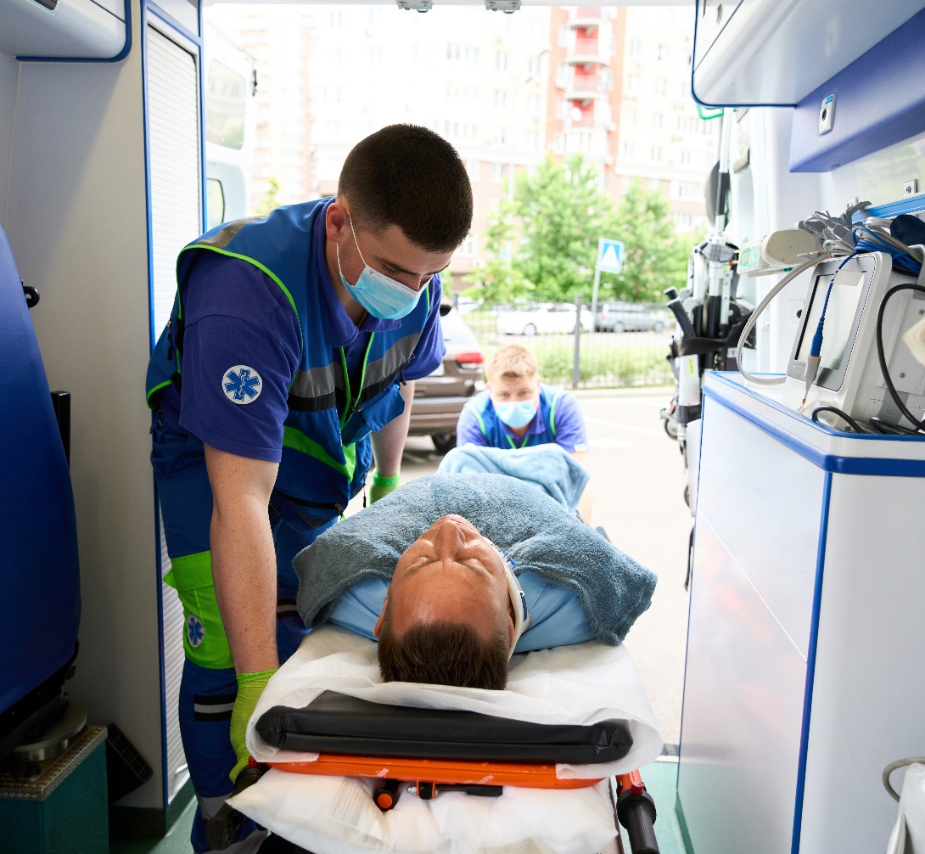
Role of Mobile Stroke Units
COR | RECOMMENDATIONS
1 | In patients with suspected AIS, the use of MSUs over conventional EMS where available is recommended for the transport and management of thrombolytic-eligible patients to ensure the fastest achievable onset-to-treatment time and improve functional outcomes.
Abbreviations: AIS indicates acute ischemic stroke; and MSU, mobile stroke unit(s)

Slide 9

Telemedicine
COR | RECOMMENDATIONS
1 | For patients with suspected stroke, telemedicine in the ambulance should be considered, when feasible, to complement paramedic assessment to identify candidates for reperfusion interventions.
1 | For patients with AIS presenting in EDs without in-house imaging interpretation expertise, teleradiology systems are recommended for timely review of brain imaging, identification of contraindications to thrombolysis, and facilitation of IVT decision-making.
1 | For patients with AIS presenting to EDs without acute neurological expertise, telestroke systems are effective over usual care by the ED team for IVT decision-making and optimal thrombolytic delivery including increased thrombolytic administration and shorter time to delivery.
Abbreviations: AIS indicates acute ischemic stroke; ED, emergency department; and IVT, intravenous thrombolysis

Slide 10

Organization and Integration of Components
COR | RECOMMENDATIONS
1 | Hospitals caring for patients with acute stroke that provide EVT (ie, TSC, CSC hospitals) should develop a system to comprehensively track key time metrics and other care processes relevant to thrombectomy (eg, door-to-puncture time, successful reperfusion), as well as long-term patient outcomes.
1 | Hospitals caring for patients with acute stroke that provide EVT (ie, TSC, CSC hospitals) should credential neurointerventionalists using established and agreed upon training and certification standards.
Abbreviations: AIS indicates acute ischemic stroke; CSC, comprehensive stroke center; EVT, endovascular thrombectomy;
and TSC, Thrombectomy-capable stroke center.

Slide 11












Stroke Severity Assessment
Why NIHSS?
Rapid, reproducible assessment
Quantifies neurological deficit
Facilitates communication across teams
Identifies candidates for IV thrombolysis & thrombectomy
Tracks change over time
Predicts complication risk (e.g. ICH)
COR | RECOMMENDATIONS
1 | In patients with suspected AIS, the use of a stroke severity rating scale, preferably the NIHSS, is recommended for measuring clinical deficits at baseline and after reperfusion therapies.
Score | Stroke Severity
0 | No stroke symptoms
1-4 | Minor stroke
5-15 | Moderate stroke
16-20 | Moderate to severe stroke
21-42 | Severe stroke
NIHSS Components
Consciousness
Orientation
Commands
Gaze
Visual Fields
Facial Movements
Motor Arm/Leg
Limb Ataxia
Sensory
Language
Articulation
Extinction/
Inattention
Abbreviations: ICH indicates intracerebral hemorrhage; and NIHSS, National Institutes of Health Stroke Scale.
Notes:
3.1 Stroke Scales

Slide 12
Figure 2. ASPECTS: Alberta Stroke Program Early CT Score
Abbreviations: CT indicates computed tomography; and MCA, middle cerebral artery.
Prabhakaran, S., et al. 2026 AHA/ASA Guideline for the Early Management of Patients with AIS. Stroke.

Slide 13


Imaging Approaches- IVT Evaluation
Do NOT Delay
Pediatric Imaging
Pediatric Imaging Alternative
COR | RECOMMENDATIONS
1 | In hospital systems that care for patients with suspected AIS, protocols based on process improvement initiatives should be established so that emergent brain imaging can be performed as rapidly as possible (eg, within 25 minutes) to facilitate timely reperfusion interventions.
COR | RECOMMENDATIONS
2a | In pediatric patients with suspected AIS, emergent brain and vascular imaging with MRI/MRA of the cervical and intracranial vessels is reasonable to identify patients with large vessel occlusion and to differentiate arterial ischemic stroke from hemorrhagic stroke or stroke mimics.
COR | RECOMMENDATIONS
2a | In pediatric patients with suspected AIS, emergent brain and vascular imaging with CT/CTA of the cervical and intracranial vessels is reasonable if MRI/MRA imaging is not available immediately (within 25 minutes) to identify patients with large vessel occlusion.
Abbreviations: AIS indicates acute ischemic stroke; CT, computed tomography; CTA, computed tomographic angiography;
IVT, intravenous thrombolysis; MRA, magnetic resonance angiography; and MRI, magnetic resonance imaging.
Notes:
3.1 IVT Evaluation

Slide 14


Blood Pressure Management - IVT/EVT
After IVT
After EVT
COR | RECOMMENDATIONS
3 No Benefit | In patients with mild to moderate severity AIS who have been treated with IVT, intensive SBP reduction (target of <140 mm Hg compared with <180 mm Hg) is not recommended because it is not associated with an improvement in functional outcome.
COR | RECOMMENDATIONS
3 Harm | In patients with AIS with LVO of the anterior circulation who have been successfully recanalized by endovascular therapy (mTICI 2b, 2c, or 3) and without other indication for blood pressure management target, intensive SBP reduction target of <140 mm Hg for the first 72 hours is harmful and not recommended.
Abbreviations: AIS indicates acute ischemic stroke; EVT, endovascular thrombectomy; IVT, intravenous thrombolytics;
LVO, large vessel occlusion; and SBP, systolic blood pressure.
Notes:
4.3 BP Management-Before Reperfusion Treatment-After IVT-After Endovascular Thrombectomy (only)

Slide 15
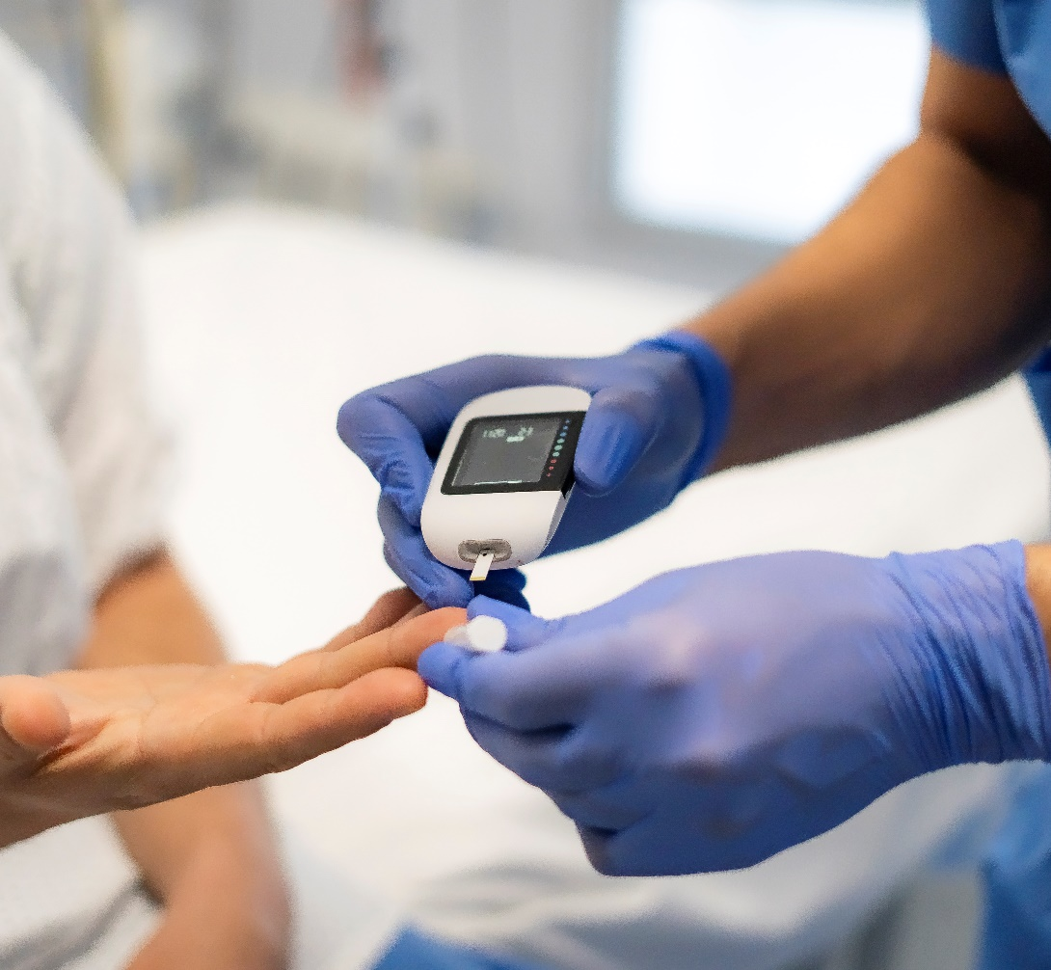
Blood Glucose Management in AIS
COR | RECOMMENDATIONS
1 | In patients with AIS, hypoglycemia (bloodglucose <60 mg/dL) should be treated to avoid complications.
3 No Benefit | In hospitalized patients with AIS with hyperglycemia, treatment with IV insulin to achieve blood glucose levels in the range of 80 to 130 mg/dL is not recommended to improve 3-month functional outcomes.
Abbreviations: AIS indicates acute ischemic stroke; and IV, intravenous.
Notes:
4.4 Temperature Management

Slide 16
Thrombolysis Decision-Making-General and Pediatric
Treat Fast
Discuss Risks & Benefits
COR | RECOMMENDATIONS
1 | In adult patients with AIS who are eligible for IVT within 4.5 hours of symptom onset, treatment should be initiated as quickly as possible, assuring safe administration and avoiding potential delays associated with additional multimodal neuroimaging, such as CTA/MRA, and CT/MR perfusion imaging.
COR | RECOMMENDATIONS
1 | In patients with AIS eligible for IVT, health care professionals should discuss its potential risks and benefits with competent patients and/or available patient representatives, when feasible, to ensure shared decision-making.
Rule Out Mimics
Pediatric Patients
COR | RECOMMENDATIONS
3 No Benefit | In eligible adult patients with AIS presenting with mild non-disabling stroke deficits (eg, isolated sensory syndrome in many cases) within 4.5 hours of symptom onset or last known well, IVT is not recommended as it has not shown superiority in improving functional outcomes compared to double antiplatelet treatment.
COR | RECOMMENDATIONS
2b | In pediatric patients aged 28 days to 18 years with confirmed AIS presenting within 4.5 hours of symptom onset and disabling deficits, IVT with alteplase may be considered as it is safe, but efficacy is uncertain.
Abbreviations: AIS indicates acute ischemic stroke; CT, computed tomography; CTA, computed tomographic angiography;
IVT, intravenous thrombolytics; MRA, magnetic resonance angiography; and MR, magnetic resonance..
Notes:
4.6.1 Thrombolysis Decision-Making-General Principles (only)

Slide 17
Choice of Thrombolytic Agent and Extended Time Windows for IVT
COR | RECOMMENDATIONS
1 | In adult patients with AIS presenting within 4.5 hours of symptom onset or last known well and eligible for IVT, tenecteplase at a dose of 0.25 mg/kg body weight (max 25 mg) or alteplase at a dose of 0.9 mg/kg body weight is recommended to improve functional outcomes.
3 No Benefit | In adult patients with AIS presenting within 4.5 hours of symptom onset or last known well and eligible for IVT, tenecteplase at a dose of 0.4 mg/kg body weight is not recommended
COR | RECOMMENDATIONS
2a | In patients with AIS who have salvageable ischemic penumbra detected on automated perfusion imaging and who (a) awake with stroke symptoms within 9 hours from the midpoint of sleep or (b) are 4.5–9 hours from last known well, IV thrombolysis may be reasonable to improve functional outcomes.
Abbreviations: AIS indicates acute ischemic stroke; and IVT, intravenous thrombolytics

Slide 18
Summary of Table 8. Other Situations Wherein Thrombolysis is Deemed to Be Considered
Benefits > Risk (Treat) | Benefits = Risk (Individualized DM) | Benefits < Risk (Avoid)
Extracranial dissections | Pre-existing disability/frailty | CT with extensive hypodensity
Extra-axial neoplasms | DOAC exposure <48h | CT with hemorrhage
Post-angiography | Ischemic stroke <3mos (size, HT) | Mod-severe TBI <14d
Unruptured aneurysm | Prior ICH (deep/lobar, mechanism) | Neurosurgery <14d
History of GI/GU bleed | Body trauma or mod-severe TBI 14d-3mos | Spinal cord injury <3mos
History of MI | Surgery <10d or neurosurgery 14d-3mos | Intra-axial neoplasm
Moya-moya disease | Recent GI/GU bleed <21d | Infective endocarditis
Stroke mimics | Unruptured intracranial dissections/AVMs | Coagulopathy/thrombocytopenia
 | Recent MI <3mos | Aortic arch dissection
 | Cardiac thrombus or pericarditis | ARIA
 | Active malignancy, pregnancy, post-partum
 | Dural or non-compressive arterial stick <7d
Abbreviations: ARIA indicates Amyloid-related imaging abnormalities; AVM, arteriovenous malformation; CT, computed tomography; DOAC, direct oral anticoagulant; GI, gastrointestinal; GU, genitourinary; ICH, intracerebral hemorrhage; MI, myocardial infarction; and TBI, traumatic brain injury.
Prabhakaran, S., et al. 2026 AHA/ASA Guideline for the Early Management of Patients with AIS. Stroke.

Slide 19
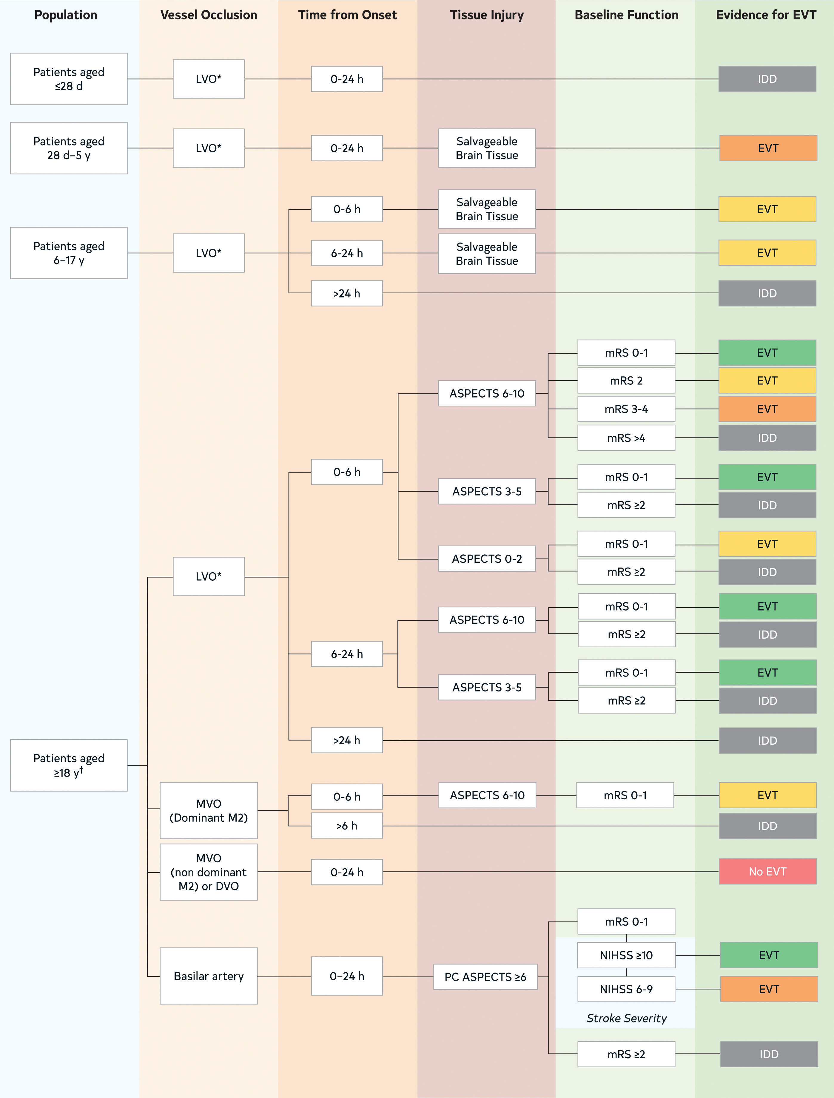
Figure 3. Algorithm for management of AIS eligibility for EVT
Abbreviations: DVO indicates distal vessel occlusion; EVT, endovascular thrombectomy; IDD, insufficient data to determine; LVO, large vessel occlusion; mRS, modified Rankin scale; MVO, medium vessel occlusion; and NIHSS, National Institutes of Health Stroke Scale.
Prabhakaran, S., et al. 2026 AHA/ASA Guideline for the Early Management of Patients with AIS. Stroke.

Slide 20
Endovascular Thrombectomy for Adults
COR | RECOMMENDATIONS
1 | In patients with AIS from anterior circulation proximal LVO of the ICA or M1, presenting within 6 hours from onset of symptoms, with NIHSS score ≥6, prestroke mRS score of 0 to 1, and ASPECTS 3 to 10, EVT is recommended to improve functional clinical outcomes and reduce mortality
Thrombectomy
0 to 6 Hours
After Onset of Symptoms, ASPECTS 3 to 10
COR | RECOMMENDATIONS
1 | In patients with AIS from anterior circulation proximal LVO of the ICA or M1 presenting between 6 and 24 hours from onset of symptoms, with NIHSS score ≥6, prestroke mRS score 0 to 1 and ASPECTS ≥6, EVT is recommended to improve functional clinical outcomes and reduce mortality.
Thrombectomy
6 to 24 Hours
After Onset of Symptoms, ASPECTS 6 to 10
COR | RECOMMENDATIONS
1 | In selected patients with AIS from anterior circulation proximal LVO of the ICA or M1, presenting between 6 and 24 hours from onset of symptoms, with age <80 years, NIHSS score ≥6, prestroke mRS score 0 to 1, ASPECTS 3 to 5, and without significant mass effect on imaging, EVT is recommended to improve functional clinical outcomes and reduce mortality.
Thrombectomy
6 to 24 Hours
After Onset of Symptoms, ASPECTS 3 to 5
Abbreviations: AIS indicates acute ischemic stroke; EVT, endovascular thrombectomy; ICA, internal carotid artery;
LVO, large vessel occlusion; mRS – modified Rankin scale; and NIHSS, National Institutes of Health Stroke Scale.

Slide 21
Endovascular Thrombectomy for Adults continued
COR | RECOMMENDATIONS
2a | In selected patients† with AIS from anterior circulation proximal LVO of the ICA or M1 presenting within 6 hours from onset of symptoms, with age <80 years, NIHSS score ≥6, prestroke mRS 0 to 1, ASPECTS 0 to 2, and without significant mass effect on imaging, EVT is reasonable to improve functional clinical outcomes and reduce mortality.
Thrombectomy
0 to 6 Hours
After Onset of Symptoms, ASPECTS 0 to 2
COR | RECOMMENDATIONS
2a | In patients with AIS from anterior circulation proximal LVO of the ICA or M1 presenting within 6 hours from onset of symptoms, with NIHSS score ≥6, and ASPECTS ≥6, who have a prestroke mRS score of 2, EVT is reasonable to improve functional clinical outcomes and reduce accumulated disability.
Thrombectomy
6 to 24 Hours
After Onset of Symptoms, ASPECTS 3 to 5
Abbreviations: AIS indicates acute ischemic stroke; EVT, endovascular thrombectomy; ICA, internal carotid artery;
LVO, large vessel occlusion; mRS – modified Rankin scale; and NIHSS, National Institutes of Health Stroke Scale.

Slide 22
Posterior Circulation Stroke
COR | RECOMMENDATIONS
1 | In patients with AIS, with basilar artery occlusion, a baseline mRS score of 0 to 1, NIHSS score ≥10 at presentation, and PC-ASPECTS ≥6 (mild ischemic damage), EVT within 24 hours from onset of symptoms is recommended to achieve better functional outcome and reduce mortality.
2b | In patients with AIS, with basilar artery occlusion, a baseline mRS score of 0 to 1, NIHSS score 6 to 9 at presentation, and PC-ASPECTS ≥6 (mild ischemic damage) the effectiveness of EVT within 24 hours to improve functional outcomes and reduce mortality is not well established.
Abbreviations: AIS indicates acute ischemic stroke; EVT, endovascular thrombectomy; LVO, large vessel occlusion;
mRS – modified Rankin scale; and NIHSS, National Institutes of Health Stroke Scale.

Slide 23
Endovascular Techniques
COR | RECOMMENDATIONS
1 | In patients with AIS due to an LVO, EVT with contact aspiration, stent retrievers, or combination techniques is recommended to achieve rapid and adequate reperfusion
1 | In patients with AIS undergoing EVT, reperfusion to an extended TICI grade 2b/2c/3 is recommended as early as possible within the therapeutic window to achieve maximum functional benefit at 90 days.
1 | In patients with AIS undergoing EVT, either general anesthesia or procedural sedation are recommended to facilitate EVT.
3 No Benefit | In patients with AIS from occlusion of medium or distal vessels of the anterior, middle (nondominant or codominant M2, M3), or posterior cerebral arteries, EVT with stent retrievers is of no benefit for improving functional outcomes.
3 No Benefit | In the management of patients with AIS in the setting of LVO, preoperative administration of tirofiban before EVT is not useful to improve 90-day functional outcome.
Abbreviations: AIS indicates acute ischemic stroke; EVT, endovascular thrombectomy; and LVO, large vessel occlusion.

Slide 24
Endovascular Thrombectomy in Pediatrics
COR | RECOMMENDATIONS
2a | In pediatric patients ≥6 years with acute neurological symptoms and ischemic stroke due to LVO and within 6 hours from symptom onset, EVT can be effective if performed by experienced neurointerventionalists to improve functional outcomes.
2a | In pediatric patients ≥6 years with acute neurological symptoms and ischemic stroke due to LVO, 6 to 24 hours from symptom onset, and with potentially salvageable brain tissue, EVT can be effective to improve functional outcomes.
2b | In pediatric patients aged 28 days to 6 years with acute neurological symptoms, including first-time seizure and AIS due to LVO, within 24 hours from symptom onset, and with potentially salvageable brain tissue, EVT performed by neurointerventionalists with pediatric experience may be reasonable to improve functional outcomes.
Abbreviations: AIS indicates acute ischemic stroke; ; EVT, endovascular thrombectomy; and LVO, large vessel occlusion.

Slide 25
Antiplatelet Treatment
COR | RECOMMENDATIONS
2a | In patients with minor (NIHSS score ≤5) noncardioembolic AIS or high-risk TIA (ABCD² score ≥4) within 24 to 72 hours from stroke onset, or NIHSS score of 4 to 5 within 24 hours from onset, who did not receive IVT, with presumed atherosclerotic cause (≥50% stenosis of intracranial or extracranial stenosis that was likely to have accounted for clinical presentation or acute new infarctions on imaging of presumed large artery atherosclerosis origin), DAPT (clopidogrel and aspirin) for 21 days followed by SAPT is reasonable to reduce the 90-day risk of recurrent stroke.
3: No Benefit | In patients with AIS treated with IVT within 3 hours after symptom onset, adjunctive treatment with IV eptifibatide is not recommended to reduce disability at 3 months.
Abbreviations: AIS indicates acute ischemic stroke; DAPT, dual antiplatelet therapy; IVT, intravenous thrombolytics;
NIHSS, National Institutes of Health Stroke Scale; SAPT, single antiplatelet therapy; and TIA, transient ischemic attack.

Slide 26
Figure 4. DAPT for minor noncardioembolic AIS and TIA
Abbreviations: ABCD2 indicates Age, Blood Pressure, Clinical Features, Duration, and Diabetes (TIA risk score); AIS, acute ischemic stroke; Asa, aspirin; Athero, atherosclerosis; CHANCE, Clopidogrel in High-risk patients with Acute Nondisabling Cerebrovascular Events; CHANCE 2, Clopidogrel versus Ticagrelor in High-risk Patients with Acute Nondisabling Cerebrovascular Events; DAPT, Dual Antiplatelet Therapy; INSPIRES, Innovative Stroke Prevention and Intervention Research Study; LKN, last known normal; MT, mechanical thrombectomy; NIHSS, National Institutes of Health Stroke Scale; POINT, Platelet-Oriented Inhibition in New TIA and Minor Ischemic Stroke; SAPT, Single Antiplatelet Therapy; THALES, Acute Stroke or Transient Ischemic Attack Treated with Ticagrelor and ASA for Prevention of Stroke and Death; and TIA, transient ischemic attack.
Prabhakaran, S., et al. 2026 AHA/ASA Guideline for the Early Management of Patients with AIS. Stroke.

Slide 27
Anticoagulants
COR | RECOMMENDATIONS
2a | In carefully selected (eg, milder severity) patients with AIS with atrial fibrillation, a strategy of early oral anticoagulation poststroke is low risk and is reasonable compared with a strategy of delayed anticoagulation, although the efficacy of early anticoagulation for prevention of early recurrent stroke is not established.
2b | In patients with an AIS and ipsilateral, high-grade ICA stenosis, the benefit of urgent anticoagulation is not well established
2b | In patients with AIS with an ipsilateral, nonocclusive, extracranial intraluminal thrombus, the safety and efficacy of short-term anticoagulation are not well established.
2b | In patients with AIS who experience HT, initiation or continuation of anticoagulation may be considered depending on the specific clinical scenario and underlying indication.
3 No Benefit | In patients with AIS, the use of argatroban is not effective as an adjunctive therapy with IVT to improve long-term functional outcomes.
3 No Benefit | In patients with AIS, early anticoagulation (within 48 hours of stroke onset) does not reduce the likelihood of early neurological worsening or increase the likelihood of a favorable functional outcome and is not recommended.
Abbreviations: AIS indicates acute ischemic stroke; HT, hemorrhagic transformation; ICA, internal carotid artery; and IVT, intravenous thrombolytics.

Slide 28




Stroke Units
COR | RECOMMENDATIONS
1 | In patients with AIS of all ages, treatment within an organized inpatient stroke care unit supported by a specialty trained, interdisciplinary care team (ie, acute stroke units, rehabilitation stroke units, comprehensive stroke units, and mixed rehabilitation units) that incorporates standardized stroke care order sets and protocols is recommended to reduce the odds of poor outcomes and death.
Characteristics of an organized specialized inpatient care unit:
Assessment
& Monitoring
Clinical Management
(first 5 days)
Discharge
Planning
Rehabilitation
Assessment of stroke/diagnosis mechanism by specialized stroke provider
Assessment and monitoring by nurses with continuous specialized training in stroke
Stroke mechanism treatment planning
Standardized acute stroke care order sets utilization
Physical and medical complications management guided by clinical practice guidelines/protocols
Early rehabilitation assessment and mobilization by the stroke team
Multidisciplinary team care to include nursing and caregivers with weekly meetings
Early goal setting and onset of rehabilitation by physical, occupational, and speech therapy
Integration with specialized rehabilitation nursing care and caregivers
Collaborative planning with interdisciplinary clinical team
Early assessment of discharge needs
Integration of patient and care givers with a focus on continued education support
Coordination of follow-up care
Abbreviations: AIS indicates Acute Ischemic Stroke

Slide 29
Dysphagia in patients with Acute Ischemic Stroke
COR | RECOMMENDATIONS
1 | In patients with AIS, performing a bedside swallow screening prior to initiation of liquid or food intake is recommended to screen for patients at increased risk for aspiration.
2a | In patients with AIS, it is reasonable for dysphagia screening to be performed by speech pathologists or other trained health care professionals.
2a | In patients with AIS who have failed or are unable to participate in a bedside swallow screening due to neurological disabilities, it is reasonable to perform an endoscopic examination of swallowing function to aid in determination of dysphagia severity and aspiration risk.
2b | An oral hygiene protocol may be reasonable to reduce the risk for pneumonia.
2a | In patients with stroke with dysphagia, treatment with pharyngeal electrical stimulation (PES), can be beneficial to reduce dysphagia severity and decrease the risk of aspiration.
2a | In patients with severe stroke with dysphagia requiring tracheotomy and mechanical ventilation, treatment with PES, after ventilator weaning can be beneficial to decrease dysphagia severity, reduce the risk of aspiration, and expedite decannulation.
Abbreviations: AIS indicates Acute Ischemic Stroke; and PES, pharyngeal electrical stimulation.

Slide 30
Deep Vein Thrombosis Prophylaxis
COR | RECOMMENDATIONS
1 | In patients with AIS who have impaired mobility and do not have contraindications to intermittent pneumatic compression (IPC), IPC in addition to routine care is recommended over routine care alone to reduce the risk of deep vein thrombosis (DVT).
2a | In patients with AIS who have impaired mobility, either prophylactic-dose subcutaneous heparin (UFH or LMWH) is reasonable to reduce the risk of VTE.
2b | In patients with AIS who have impaired mobility, the benefit of prophylactic-dose subcutaneous heparin (UFH or LMWH) over no prophylactic-dose heparin is not well established to increase overall survival.
2b | In patients with AIS who have impaired mobility and who are selected for prophylactic anticoagulation, the benefit of prophylactic-dose LMWH over prophylactic-dose UFH to prevent DVT is uncertain.
3 Harm | In patients with AIS who have impaired mobility, elastic compression stockings cause harm, including skin breakdown, ulceration, and tissue necrosis, compared with usual care.
Abbreviations: AIS indicates acute ischemic stroke; DVT, deep venous thrombosis; IPC, intermittent pneumatic compression;
LMWH, low –molecular-weight heparin; UFH, unfractionated heparin; and VTE, venous thromboembolism

Slide 31

Depression
In patients with AIS
COR | RECOMMENDATIONS
1 | Administration of a structured depression inventory is recommended to routinely screen for poststroke depression (PSD), although the optimal timing of screening is uncertain.
In patients diagnosed with PSD
COR | RECOMMENDATIONS
1 | Treatment with antidepressants and/or nonpharmacological interventions (ie, psychotherapy, noninvasive brain stimulation, acupuncture) is recommended to improve depressive symptoms.
Abbreviations: AIS indicates acute ischemic stroke; and PSD, poststroke depression.
Notes:
2187671214

Slide 32

Other In-Hospital Management Considerations
COR | RECOMMENDATIONS
2a | For select patients with AIS and their families, referral to palliative care resources is reasonable as appropriate.
3 No Benefit | In patients with AIS, routine use of prophylactic antibiotics has not been shown to be beneficial in improving functional outcomes.
3 Harm | In patients with AIS, routine placement of indwelling bladder catheters should not be performed because of the associated risk of catheter-associated urinary tract infections (UTIs).
Abbreviations: AIS indicates acute ischemic stroke; and UTI, urinary tract infection.

Slide 33





Rehabilitation in patients with Acute Ischemic Stroke
Road to Recovery
In-hospital
SSRIs
High–dose mobilization
COR | RECOMMENDATIONS
1 | In-hospital, formal, interdisciplinary assessment and provision of rehabilitation at a level appropriate for the individual patient is recommended to improve functional recovery.
COR | RECOMMENDATIONS
3 No Benefit | SSRIs are not effective for improving motor recovery or functional status.
COR | RECOMMENDATIONS
3 Harm | High-dose, very early mobilization within 24 hours of stroke onset is not recommended to improve the odds of a favorable outcome at 3 months and may be harmful.
Abbreviations: SSRIs indicates selective serotonin reuptake inhibitors.
Prabhakaran, S., et al. 2026 AHA/ASA Guideline for the Early Management of Patients with AIS. Stroke.
Notes:
1172231683
532048382
1385865242

Slide 34



Brain Swelling - General Recommendations
COR | RECOMMENDATIONS
1 | In patients with large cerebral or cerebellar infarctions at high risk for developing brain swelling and herniation, an early discussion of care options and possible outcomes should take place with patients (if feasible) and family or next of kin to ascertain patient-centered preferences in shared decision-making, especially during prognosis formation and when considering interventions or limitations in care.
COR | RECOMMENDATIONS
1 | In patients with large cerebral or cerebellar infarctions, close monitoring of the patient for signs of neurological worsening during the first days after stroke is recommended to rapidly evaluate the need for potential interventions.
COR | RECOMMENDATIONS
1 | In patients with large cerebral or cerebellar infarctions who are at increased risk for malignant brain swelling, early transfer to an institution with appropriate neurosurgical and critical care expertise is recommended to ensure timely treatment.

Slide 35
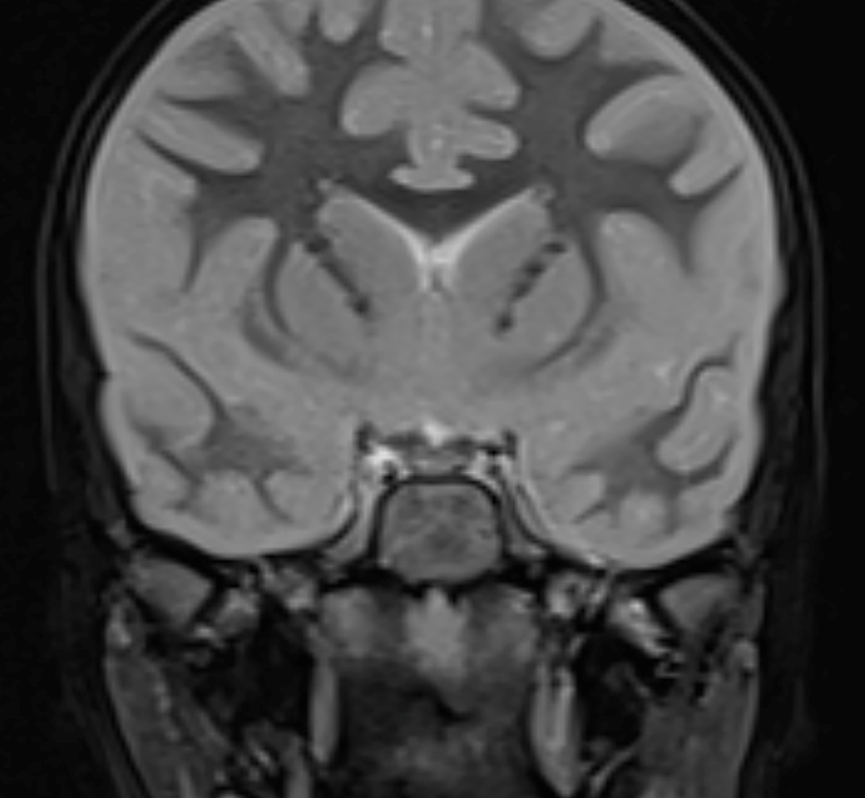
Brain Swelling - Medical Management
COR | RECOMMENDATIONS
2a | In patients with large cerebral or cerebellar infarctions and neurological decline from brain swelling, the use of osmotic therapy as a bridge to a surgical intervention is reasonable to improve functional outcome and reduce mortality.
3 No Benefit | In patients with large hemispheric infarction 18 to 70 years of age, the use of IV glibenclamide does not result in improved functional outcome and is not recommended.
3 Harm | In patients with large cerebral or cerebellar infarctions and brain swelling, hypothermia, barbiturates, or corticosteroids should not be administered to treat brain swelling due to the lack of evidence of efficacy and potential of increased adverse effects.
Abbreviations: IV indicates intravenous.
Notes:
1395851975

Slide 36
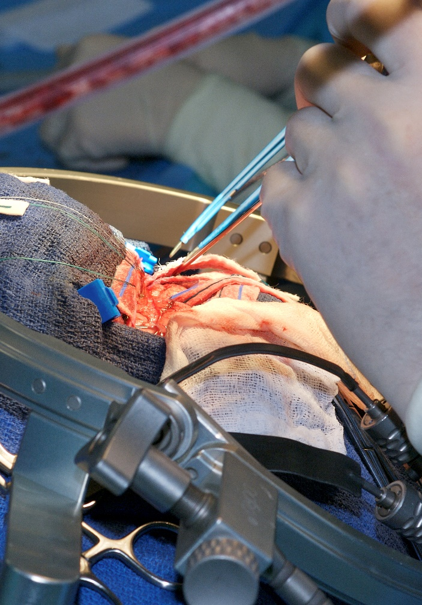
Supratentorial Infarction - Surgical Management
COR | RECOMMENDATIONS
1 | In patients ≤ 60 years of age with unilateral MCA infarctions who deteriorate neurologically within 48 hours from brain swelling despite medical therapy, Decompressive craniectomy with dural expansion is beneficial to Reduce mortality AND Improve functional outcome.
COR | RECOMMENDATIONS
2b | In patients > 60 years of age with unilateral MCA infarctions who deteriorate neurologically within 48 hours from brain swelling despite medical therapy, Decompressive craniectomy with dural expansion may be considered to: Reduce mortality
Abbreviations: MCA indicates middle cerebral artery.

Slide 37
Cerebellar Infarction - Surgical Management
COR | RECOMMENDATIONS
1 | In patients with cerebellar infarction and obstructive hydrocephalus, ventriculostomy is recommended to: Improve neurological function Decrease mortality Concomitant or subsequent decompressive craniectomy may or may not be necessary on the basis of factors such as: The size of the infarction Neurological condition Degree of brainstem compression Effectiveness of medical management
COR | RECOMMENDATIONS
1 | In patients with cerebellar infarction causing neurological deterioration from brainstem compression or volumes ≥35 mL Decompressive suboccipital craniectomy with dural expansion should be performed to: Improve outcomes AND Decrease mortality

Slide 38
Seizures
In adult patients with an
unprovoked seizure after AIS:
In adult patients with AIS:
COR | RECOMMENDATIONS
1 | Management that includes antiseizure medication is recommended on the basis of specific patient characteristics to reduce the risk of seizure recurrence.
COR | RECOMMENDATIONS
3 No Benefit | Prophylactic treatment with antiseizure medication is not recommended to prevent seizures or improve functional outcome.
Abbreviations: AIS indicates acute ischemic stroke

Slide 39
Acknowledgments
Many thanks to our Guideline Ambassadors who were guided by Dr. Elliott Antman in developing this translational learning product in support of the
2026 AHA/ASA Guideline for the Early Management of Patients with AIS.
Abdelrhman Abumoawad, MD
Ayeeshik Kole, MD
Girish Pathangey, MD
Aparna Sajja, MD
Shavonne Williams, MN, APRN, ACNS-BC, CCRN, SCRN, ANVP-BC, CHC
The American Heart Association requests this electronic slide deck be cited as follows:
Abumoawad, A., Kole, A., Pathangey, G., Sajja, S., Williams, S., Reyna, G.G., & Antman, E. M. (2026). AHA Clinical Slides [PowerPoint slides]; Adapted from the 2026 AHA/ASA Guideline for the Early Management of Patients with AIS. Stroke. Guideline Essentials: AHA Clinical Slide Series - Professional Heart Daily | American Heart Association

Slide 40
Copyright and Permissions Notice
© Copyright 2026. American Heart Association. All rights reserved.
This material is the copyrighted property of the American Heart Association and is provided for reference purposes only. It may not be copied, reproduced, stored in a retrieval system, transmitted, altered in any way or used as a derivative work, or distributed in any form or by any means—electronic, mechanical, photocopying, recording, or otherwise—without prior written permission from the publisher.
This content may be used for limited educational and personal use.
Further distribution or dissemination requires a licensing agreement. Unauthorized use or distribution in any media is strictly prohibited.
For permissions inquiries and licensing fee information,
please see the information/Request Form at this link:
https://www.heart.org/en/about-us/statements-and-policies/copyright-request-form

