Slide 1

Guideline Essentials:
AHA Clinical Slide Series
ADAPTED FROM:
2025 AHA/ACC/HRS/ISACHD/SCAI
Guideline for the Management of Adults with Congenital Heart Disease
AHA Clinical Update PPTX

Slide 2
Table 1.
Applying Class of Recommendation and Level of Evidence to Clinical Strategies, Interventions, Treatments, or Diagnostic Testing in Patient Care
CLASS (STRENGTH) OF RECOMMENDATION
CLASS 1 (STRONG) Benefit >>> Risk
Suggested phrases for writing recommendations: Is recommended Is indicated/useful/effective/beneficial Should be performed/administered/other Comparative-Effectiveness Phrases†: Treatment/strategy A is recommended/indicated in preference to treatment B Treatment A should be chosen over treatment B
CLASS 2a (MODERATE) Benefit >> Risk
Suggested phrases for writing recommendations: Is reasonable Can be useful/effective/beneficial Comparative-Effectiveness Phrases†: Treatment/strategy A is probably recommended/indicated in preference to treatment B It is reasonable to choose treatment A over treatment B
CLASS 2b (Weak) Benefit ≥ Risk
Suggested phrases for writing recommendations: May/might be reasonable May/might be considered Usefulness/effectiveness is unknown/unclear/uncertain or not well-established
CLASS 3: No Benefit (MODERATE) Benefit = Risk
Suggested phrases for writing recommendations: Is not recommended Is not indicated/useful/effective/beneficial Should not be performed/administered/other
CLASS 3: Harm (STRONG) Risk > Benefit
Suggested phrases for writing recommendations: Potentially harmful Causes harm Associated with excess morbidity/mortality Should not be performed/administered/other
LEVEL (QUALITY) OF EVIDENCE‡
LEVEL A
High-quality evidence‡ from more than 1 RCT Meta-analyses of high-quality RCTs One or more RCTs corroborated by high-quality registry studies
LEVEL B-R (Randomized)
Moderate-quality evidence‡ from 1 or more RCTs Meta-analyses of moderate-quality RCTs
LEVEL B-NR (Nonrandomized)
Moderate-quality evidence‡ from 1 or more well-designed, well-executed nonrandomized studies, observational studies, or registry studies Meta-analyses of such studies
LEVEL C-LD (Limited Data)
Randomized or nonrandomized observational or registry studies with limitations of design or execution Meta-analyses of such studies Physiological or mechanistic studies in human subjects
LEVEL C-EO (Expert Opinion)
Consensus of expert opinion based on clinical experience.
COR and LOE are determined independently (any COR may be paired with any LOE).
A recommendation with LOE C does not imply that the recommendation is weak. Many important clinical questions addressed in guidelines do not lend themselves to clinical trials. Although RCTs are unavailable, there may be a very clear clinical consensus that a particular test or therapy is useful or effective.
* The outcome or result of the intervention should be specified (an improved clinical outcome or increased diagnostic accuracy or incremental prognostic information).
† For comparative-effectiveness recommendation (COR 1 and 2a; LOE A and B only), studies that support the use of comparator verbs should involve direct comparisons of the treatments or strategies being evaluated.
‡ The method of assessing quality is evolving, including the application of standardized, widely-used, and preferably validated evidence grading tools; and for systematic reviews, the incorporation of an Evidence Review Committee.
COR indicates Class of Recommendation; EO, expert opinion; LD, limited data; LOE, Level of Evidence; NR, nonrandomized; R, randomized; and RCT, randomized controlled trial.
Gurvitz, M., et al. (2025). 2025 AHA/ACC/HRS/ISACHD/SCAI Guideline for the Management of Adults With Congenital Heart Disease.Circulation.

Slide 3
Care Access and Delivery in the ACHD Population
Care Access and Delivery in the ACHD Population
COR | RECOMMENDATIONS
1 | ACHD programs and clinicians who care for adults with congenital heart disease should follow policies and procedures that reduce barriers, reduce attrition, and improve access to lifelong ACHD care.
COR | RECOMMENDATIONS
1 | All patients with congenital heart disease should receive structured, patient-centered transition education that is age-, sex-, gender-, and developmentally appropriate to improve knowledge and reduce loss to care.
1 | Congenital heart disease programs and clinicians should have transfer-of-care policies and procedures to ensure effective handoffs of patients from a pediatric to an ACHD cardiologist.
Abbreviations: ACHD indicates adult congenital heart disease.
Notes:
Science: verified

Slide 4
The ACHD Program and Cardiologists
COR | RECOMMENDATIONS
1 | Patients in ACHD anatomic–physiological classes IB–D, IIA–D, and IIIA–D should be evaluated and managed by or in collaboration with an ACHD cardiologist and, when indicated and accessible, an ACHD program to improve outcomes.
1 | Patients in ACHD anatomic–physiological class IA should have at least one evaluation by an ACHD cardiologist to develop a plan of care.
ACHD Program Components:
ACHD board-eligible/-certified cardiologists
Congenital cardiac surgeons
Advanced practice providers
Registered nurses
Advanced imagers: echocardiography/CT/CMR*
Cardiac intensivist*
Advanced heart failure and transplant cardiologist*
Cardiac catheterization interventionalist*
Electrophysiologist*
Cardiac anesthesiologist*
Multidisciplinary specialists
  Maternal fetal medicine
  Hepatology
  Pulmonary hypertension
  Cardiovascular genetics
  Palliative medicine
  Social work
  Psychology
*Personnel and service lines supervised, performed, and interpreted by clinicians with expertise and/or training in congenital heart disease.
Abbreviations: ACHD indicates adult congenital heart disease; CMR, cardiovascular magnetic resonance; and CT, computed tomography.
Notes:
Science: verified

Slide 5

Mental Health and Neurocognitive Assessment
COR | RECOMMENDATIONS
1 | Adults with congenital heart disease should be assessed for mental health conditions, including depression, anxiety, and post-traumatic stress disorder, to identify those who may benefit from mental health services.
2a | For adults with congenital heart disease who have mental health concerns, referral to a mental health clinician can be beneficial to improve psychological symptoms and quality of life.
2b | For adults with congenital heart disease, neuropsychological testing may be considered to guide therapies that enhance academic, behavioral, psychosocial, and adaptive functioning.
2b | For adults with congenital heart disease, evaluation for cognitive decline and frailty may be considered to identify patients who can benefit from additional support.
Notes:
Science: verified

Slide 6
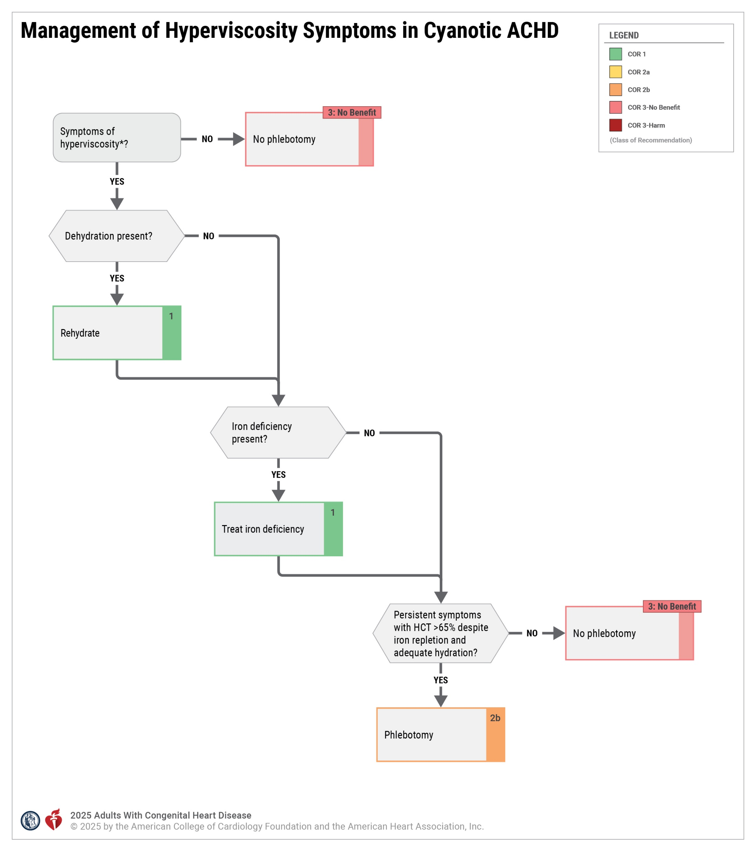
Abbreviations: ACHD indicates adults with congenital heart disease; and HCT, hematocrit.
Notes:
Science: verified

Slide 7

Heart Failure & Transplantation
COR | RECOMMENDATIONS
2a | CRT is reasonable in ACHD pts with HF, systemic LV dysfunction, biventricular circulation, and standard CRT criteria
2a | GDMT is reasonable for ACHD pts with HF and systemic LV systolic dysfunction with biventricular circulation
2a | Primary prevention ICD is reasonable in ACHD pts with HF and systemic LV dysfunction and biventricular circulation meeting standard ICD criteria
Abbreviations: ACHD indicates adult congenital heart disease; CRT, cardiac resynchronization therapy; GDMT, guideline-directed medical therapy; HF, heart failure; ICD, implantable cardioverter-defibrillator; LV = left ventricle; MCS, mechanical circulatory support; and QoL, quality of life.

Slide 8

Genetic Screening & Testing
COR | RECOMMENDATIONS
2a | Adults with conotruncal defects: screening for 22q11.2 deletion is reasonable to assess transmission risk and associated comorbidities.
2a | Adults with CHD + FHx of CHD or syndromic features: referral for genetic evaluation is reasonable to guide management.
Abbreviations: CHD indicates congenital heart disease; and FHx, family history.
Notes:
Science: verified

Slide 9
Reproductive Health, Pregnancy, & Contraception
COR | RECOMMENDATIONS
1 | In high maternal‑risk patients, counsel to avoid pregnancy and provide guidance on effective contraception.
1 | For pregnant pts with ACHD who have high risk for morbidity and mortality, the option of terminating pregnancy should be discussed to reduce that risk.
2a | Referral of ACHD pts of childbearing age to a genetic counselor for preconception planning is reasonable to understand offspring CHD risk.
2a | When considering assisted reproductive technology, including an ACHD cardiologist can be beneficial to discuss risks/options.
3: No Benefit | Routine cesarean delivery has no benefit and may cause harm without obstetric indication or high‑risk cardiac condition.
3: Harm | In patients with ACHD who are at high risk for thromboembolic events, contraceptive agents that contain estrogen are potentially harmful
COR | RECOMMENDATIONS
1 | Counsel on contraceptive options to inform pregnancy-related shared decision-making in adults with CHD of childbearing age.
1 | Provide preconception counseling in collaboration with an ACHD cardiologist about maternal cardiac, obstetric, and fetal risk and long-term risk to the pregnant person.
1 | If either parent has ACHD, perform screening fetal echocardiography to detect CHD and optimize delivery planning.
1 | For pregnant pts with AP classes IB–D, IIA–D, IIIA–D, document an individualized delivery plan (monitoring, anesthesia, mode).
1 | In pregnant pts with AP classes IB–D, IIA–D, IIIA–D, manage by/with a cardio‑obstetrics team with ACHD & MFM expertise.
Abbreviations: ACHD indicates adult congenital heart disease; CHD, congenital heart disease; and MFM, maternal fetal medicine.

Slide 10



ASD: Diagnostic Recommendations
COR | RECOMMENDATIONS
1 | Unrepaired ASD: Use CMR, TEE, or CT to define size, rims, and pulmonary venous connections.
1 | Unrepaired ASD + PAH: Assess/manage with pulmonary hypertension specialists.
1 | All unrepaired ASD: Assess for PAH to guide therapy and repair suitability.
2b | In adults with an unrepaired ASD, balloon test occlusion before closure may be reasonable to assess hemodynamic changes.
Abbreviations: ASD indicates atrial septal defect; CMR, cardiac magnetic resonance; CT, computed tomography; PAH, pulmonary artery hypertension; and TEE, transesophageal echocardiography.
Notes:
Science: verified

Slide 11
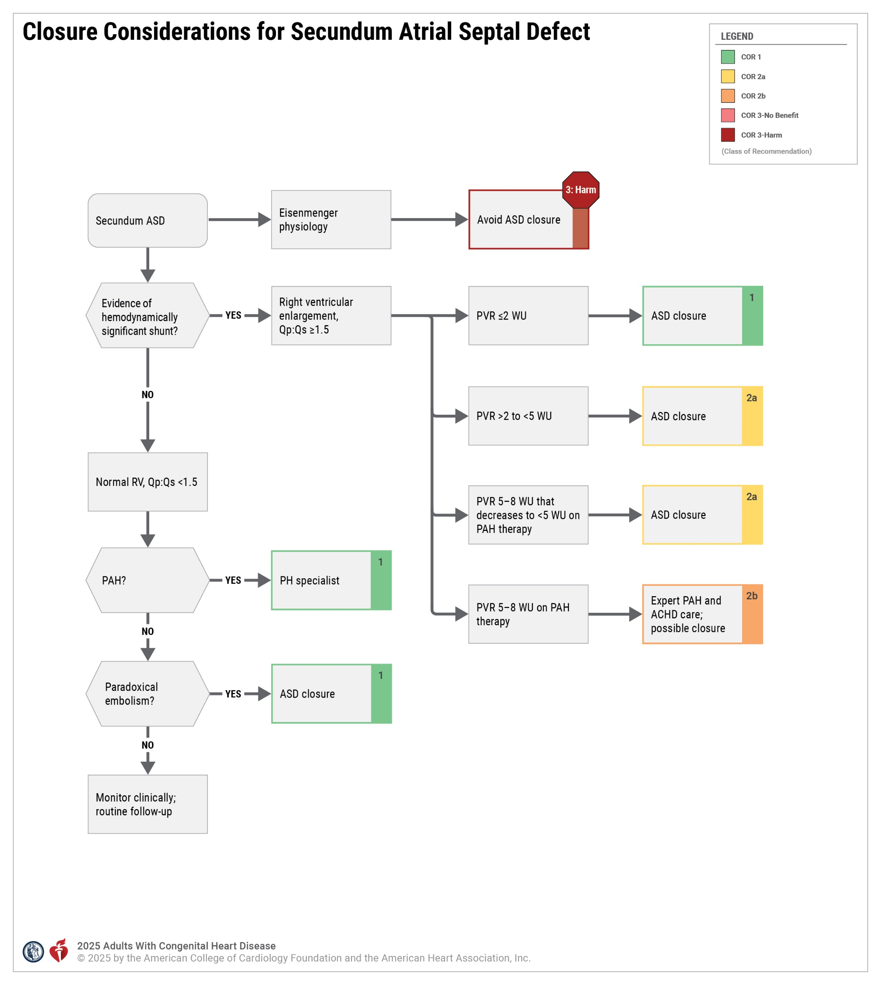
Abbreviations: ACHD indicates adult congenital heart disease; ASD, atrial septal defect; PAH, pulmonary arterial hypertension; PH, pulmonary hypertension; PVR, pulmonary vascular resistance; Qp:Qs, pulmonary-to-systemic blood flow ratio; RV, right ventricle; and WU, Wood units.

Slide 12
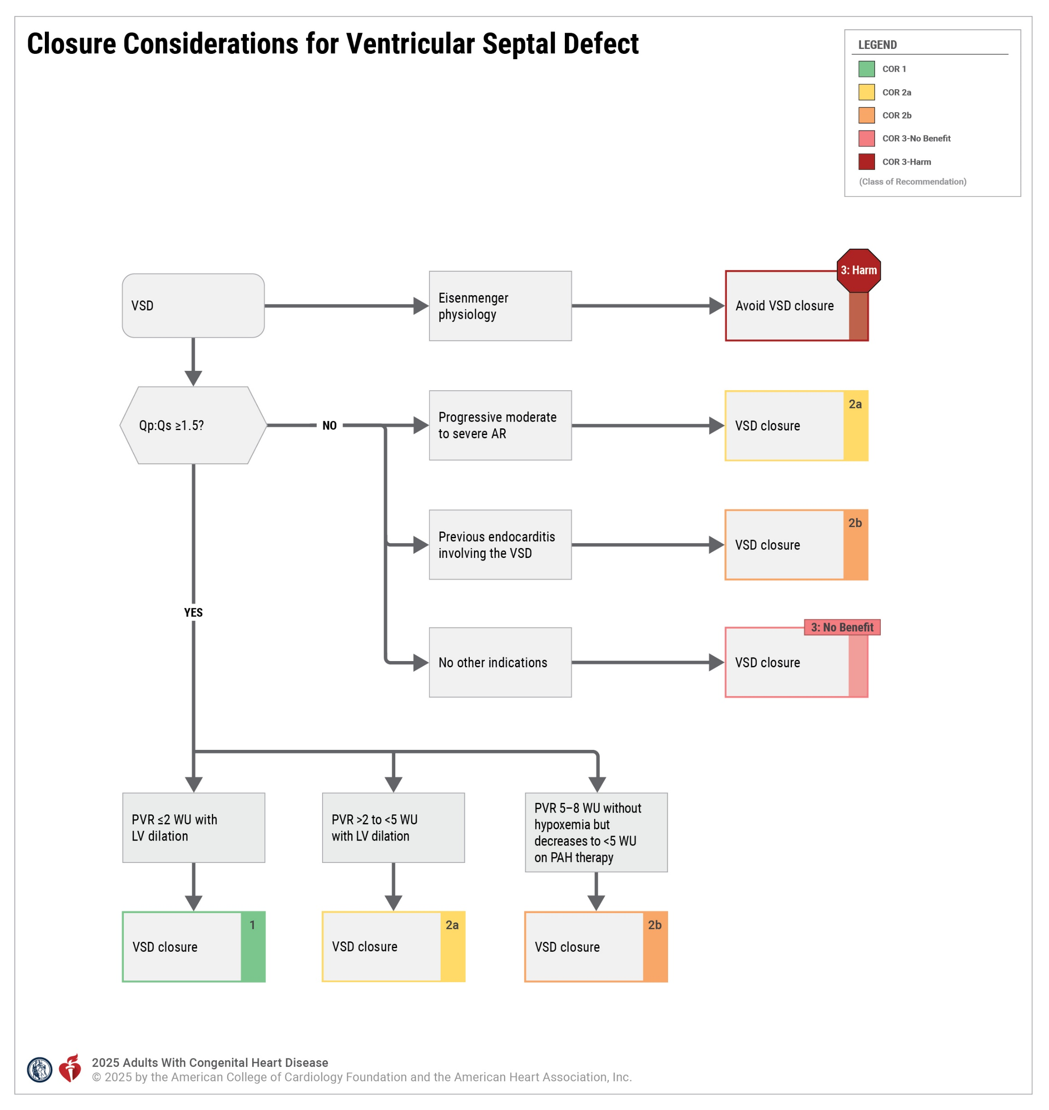
Abbreviations: AR indicates aortic regurgitation; LV, left ventricular; PVR, pulmonary vascular resistance; Qp:Qs, pulmonary-to-systemic blood flow ratio; VSD, ventricular septal defect; and WU, Wood units.

Slide 13
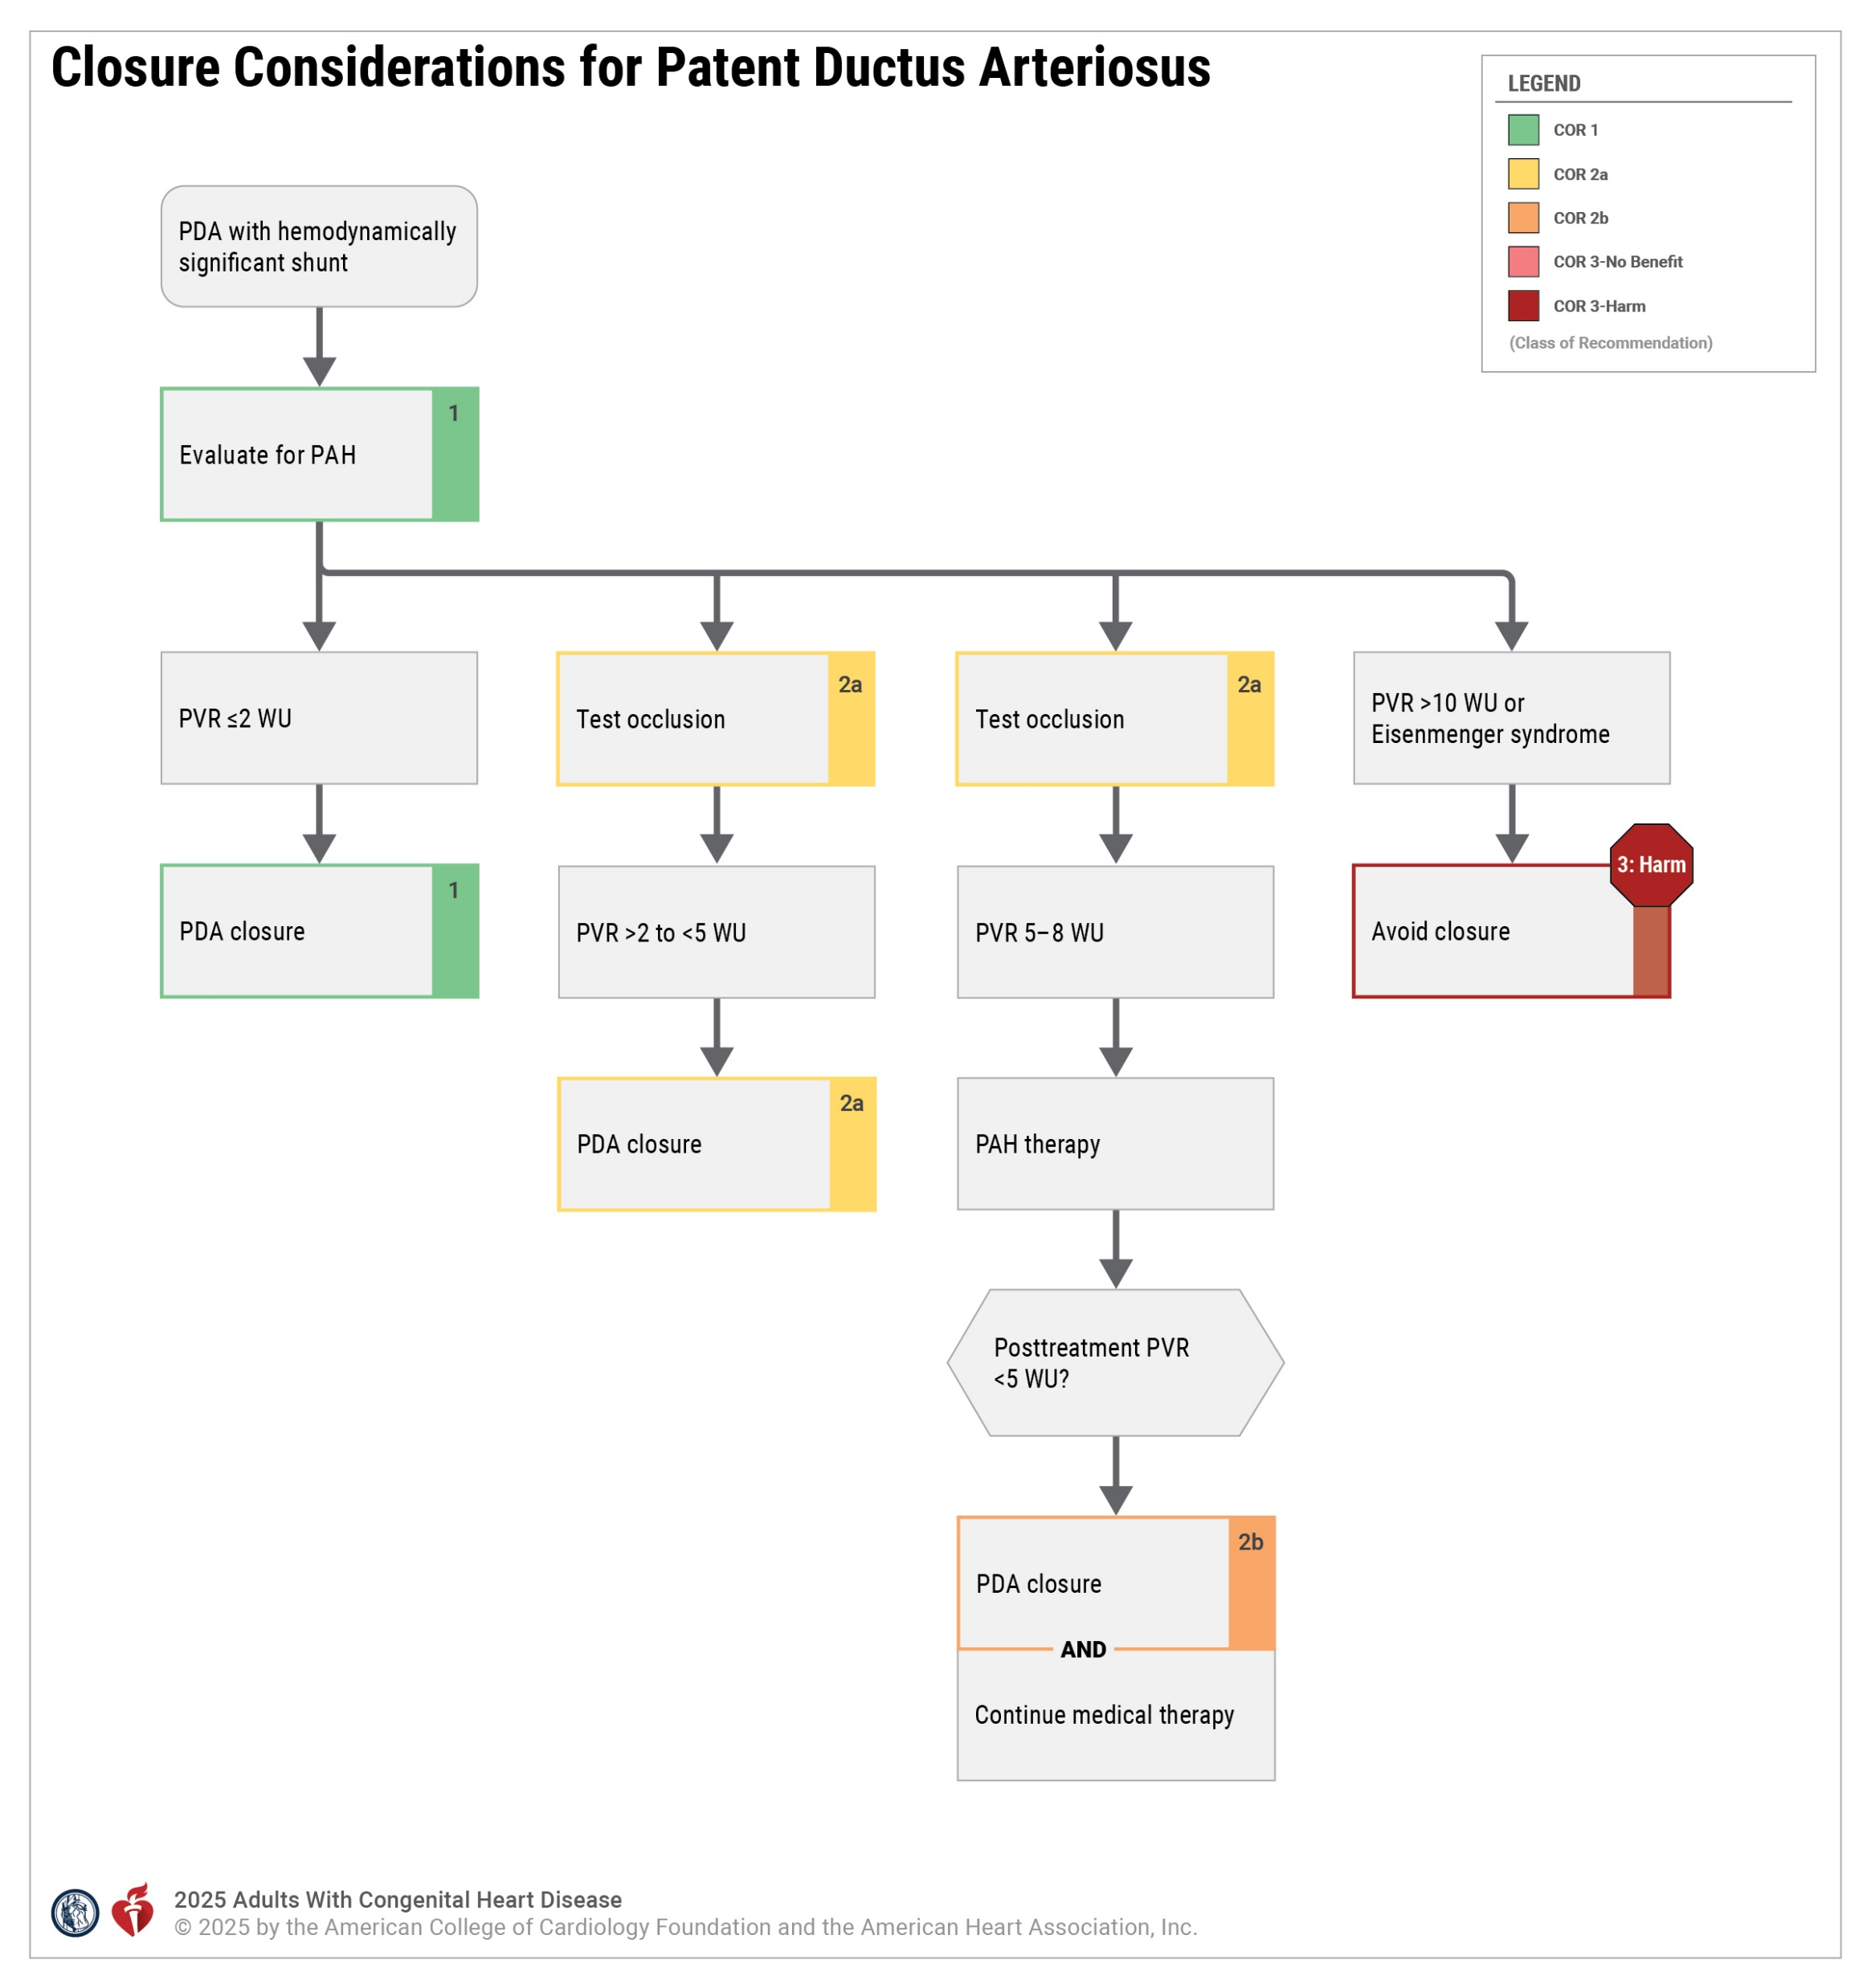
Abbreviations: PAH indicates pulmonary arterial hypertension; PDA, patent ductus arteriosus; PVR, pulmonary vascular resistance; and WU, Wood units.

Slide 14
Congenital Diseases of the Aortic Valve
BAV: The Most Common Congenital Cardiac Abnormality
4.6/1000 live births
2-3x more common in males
Diagnostic Recommendations
Adults with a BAV should be screened for the presence of COA and aortic aneurysm to obtain early diagnosis and determine a management plan.
Adults with a BAV who have an aortic diameter >4 cm at the level of the sinuses or the ascending aorta, or who have risk factors for aortic dissection, should undergo lifelong surveillance for progression of thoracic aortic disease.
In first-degree relatives of adults with a BAV, 1-time echocardiographic screening for the presence of a congenitally abnormal aortic valve or aortic aneurysm is reasonable.
Therapeutic Recommendations
Class 1
Class 1
Class 2a
In young adults with aortic valve stenosis, a noncalcified valve with mild aortic regurgitation, and an indication for intervention, balloon valvuloplasty may be reasonable to delay the need for aortic valve surgery. Class 2b
In those who meet indication for valve replacement, surgical and transcatheter options should be reviewed by expert teams with shared decision-making to determine a plan. Class 1
Abbreviations: BAV indicates bicuspid aortic valve; COA, coarctation of the aorta; and TAVR, transcatheter aortic valve replacement
Notes:
4.2.4 Congenital Diseases of the Aortic Valve
Science: Thank you, verified

Slide 15
Coarctation of the Aorta
COR | Diagnostic RECOMMENDATIONS
1 | In adults with unrepaired COA, cross-sectional imaging is recommended to determine COA severity and delineate anatomy of the thoracic aorta
1 | In those with a repaired COA, periodic cross-sectional imaging is recommended to screen for recurrent COA, aortic root/ascending aorta aneurysms, and vascular complications related to COA repair.
1 | In adults with COA, blood pressure measurement at rest in the upper and lower extremities is recommended as part of routine clinical assessment.
2a | In adults with COA, ambulatory blood pressure measurement is reasonable to diagnose hypertension and monitor response to antihypertensive therapy.
2a | In adults with COA, exercise testing is reasonable to screen for exercise-induced hypertension
2a | In adults with COA who present with exertional symptoms, evaluation for coronary artery disease is reasonable to guide management.
2b | In adults with COA, screening for intracranial aneurysms by brain MR or CT angiography may be considered to guide management.
COR | Therapeutic RECOMMENDATIONS
1 | In adults with native or repaired COA, surgical or transcatheter stent therapy is recommended for anatomically and hemodynamically significant COA.
1 | In adults with native or repaired COA and hypertension without hemodynamically significant COA, GDMT for hypertension is recommended.
Abbreviations: ACHD indicates adult congenital heart disease; CHD, congenital heart disease; and MFM, maternal fetal medicine.
Notes:
Science: verified

Slide 16
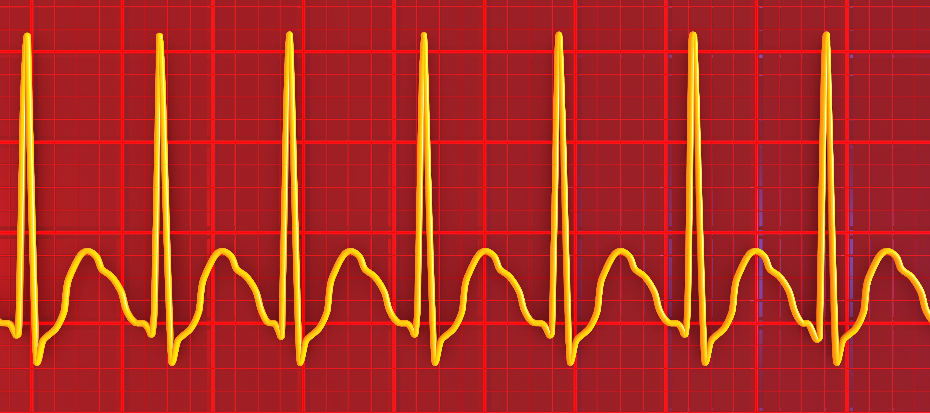
Ebstein Anomaly Diagnostic Recommendations
Electrophysiological study is recommended with symptomatic arrhythmia or asymptomatic ventricular preexcitation.(1)
CMR imaging can be useful to determine anatomy, RV dimensions, and systolic function. (2a)
Supraventricular
Tachycardia
If TTE is inadequate to guide surgical planning, TEE can be beneficial. (2a)
Ebstein Anomaly
In adults with Ebstein anomaly and severe RV dysfunction in whom there is concern that the RV will not support the entire stroke volume, preoperative diagnostic cardiac catheterization may be considered to assess candidacy for a bidirectional superior cavopulmonary (Glenn) anastomosis. (2b)
Electrophysiological study (and catheter ablation, if needed) can be useful before tricuspid valve surgery. (2a)
Abbreviations: ASD indicates atrial septal defect; cMRI, cardiac magnetic resonance imaging;
CPET, cardiopulmonary exercise test; RV, right ventricle; SCD, sudden cardiac death; and VSD, ventricular septal defect.
Notes:
4.3.1 Ebstein Anomaly
SCIENCE: Verified

Slide 17

Ebstein Anomaly Therapeutic Recommendations
COR | RECOMMENDATIONS
1 | Ebstein anomaly and at least moderate tricuspid regurgitation in the presence of heart failure, worsening exercise capacity, or progressive RV systolic dysfunction, surgical intervention is recommended.
1 | Ebstein anomaly and high-risk accessory pathway conduction or multiple accessory pathways, catheter ablation is recommended.
2a | Asymptomatic Ebstein anomaly and at least moderate tricuspid regurgitation in the presence of progressive RV enlargement, systemic desaturation from a right-to-left atrial shunt, recurrent arrhythmias, and/or paradoxical embolism, surgical intervention can be beneficial.
2b | Ebstein anomaly and severe RV dysfunction in whom there is concern that the RV will not tolerate supporting the entire stroke volume, a bidirectional superior cavopulmonary (Glenn) anastomosis at the time of tricuspid valve surgery may be considered.
2b | Ebstein anomaly with an ASD/ patent foramen ovale, and cyanosis or paradoxical embolism, isolated closure may be considered after hemodynamic assessment.
Tricuspid Valve Replacement
in a Patient with Ebstein Anomaly
Abbreviations: ACHD indicates adult congenital heart disease; CHD, congenital heart disease; and MFM, maternal fetal medicine.
Notes:
https://www.gettyimages.com/detail/photo/tricuspid-valve-replacement-royalty-free-image/542334817
SCIENCE: verified

Slide 18
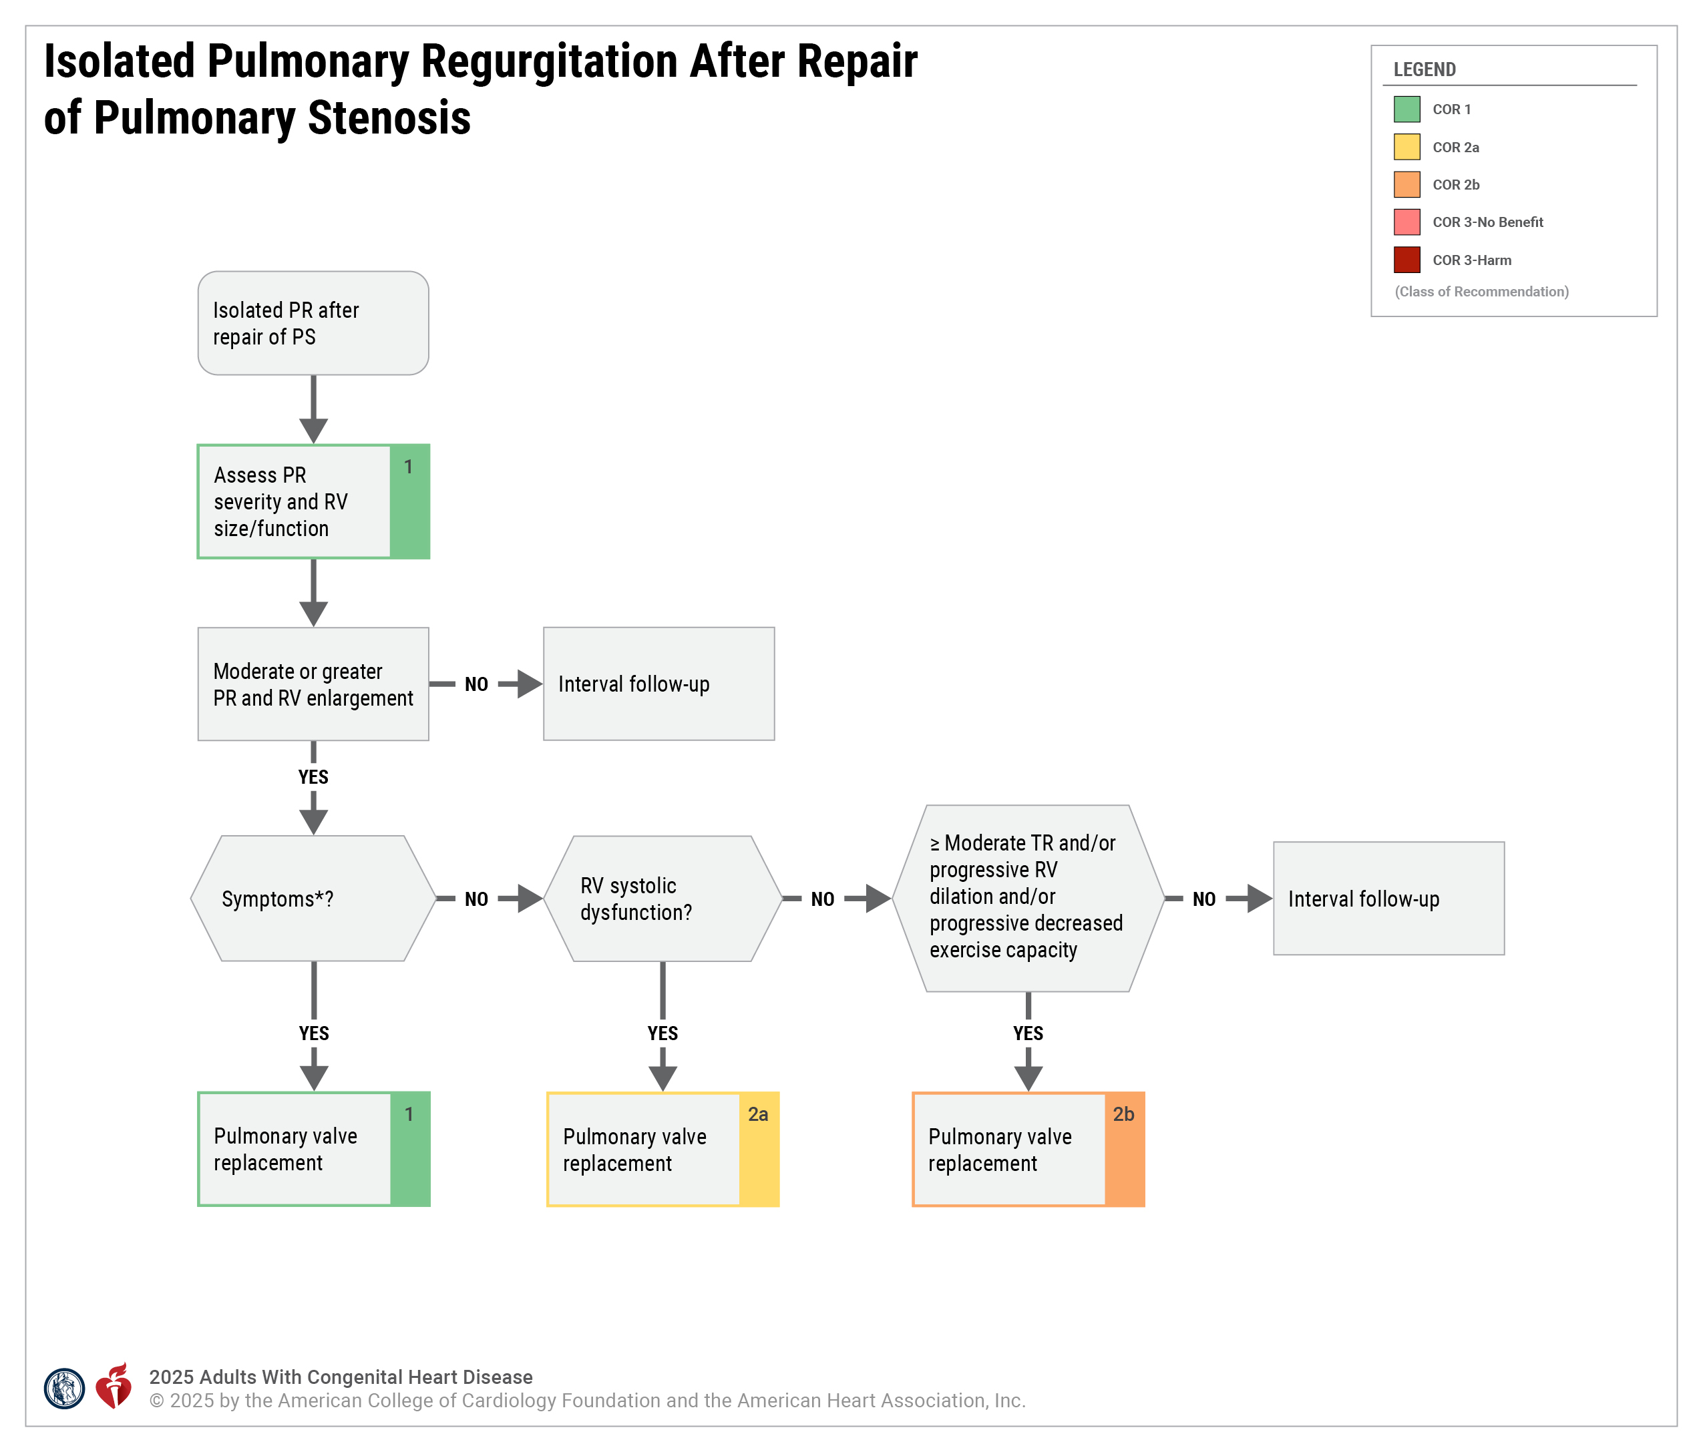
Abbreviations: PR indicates pulmonary regurgitation; PS, pulmonary stenosis; RV, right ventricular; and TR, tricuspid regurgitation.

Slide 19
Isolated Branch Pulmonary Artery Stenosis
Diagnostic
Therapeutic
Peripheral or branch PA stenosis
Asymptomatic isolated peripheral pulmonary artery stenosis*
Symptomatic peripheral or branch pulmonary artery stenosis
Echo and cardiac CT or CMR for cross-sectional imaging is recommended. (1)
RV > ½ systemic pressure, RV dysfunction, ≥ moderate TR, or worsening exercise capacity
Balloon Angioplasty and/or stent implantation is recommended. (1)
Balloon Angioplasty
and/or stent (2a)
Abbreviations: CT indicates computerized tomograph; CMR, cardiac magnetic resonance; RV, right ventricle; TR, tricuspid regurgitation
* Angiographic narrowing and/or reduction >10% in expected perfusion to the affected lung
Notes:
SCIENCE: verified

Slide 20
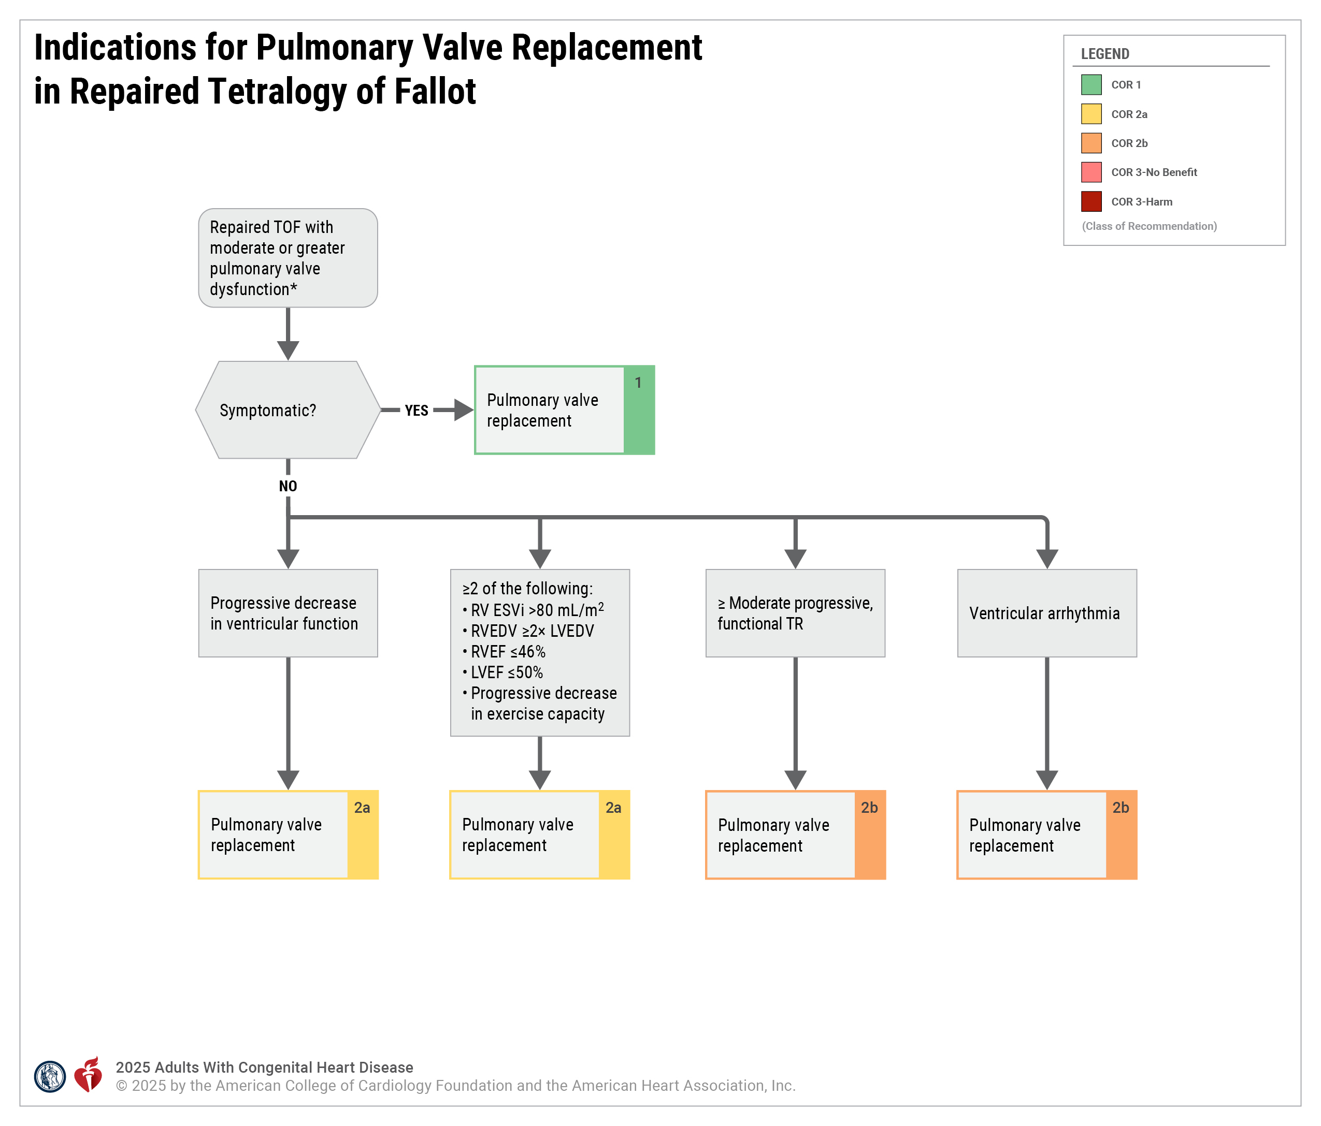
Abbreviations: CMR indicates cardiovascular magnetic resonance; ESVi, end-systolic volume index; LVEDV, left ventricular end-diastolic volume; LVEF, left ventricular ejection fraction; PR, pulmonary regurgitation; RF, regurgitant fraction; RV, right ventricular; RVEDV, right ventricular end-diastolic volume; RVEF, right ventricular ejection fraction; RVOTO, right ventricular outflow tract obstruction; RVSP, right ventricular systolic pressure; TOF, tetralogy of Fallot; and TR, tricuspid regurgitation.

Slide 21


Dextro-Transposition of the Great Arteries and Rastelli Operation
COR | RECOMMENDATIONS
1 | In adults with d-TGA and Rastelli repair, imaging is recommended to ensure timely identification of complications, including stenosis and/or regurgitation of the right ventricle –to pulmonary artery conduit, residual VSDs, LVOT obstruction, and RV dysfunction.
CMR
Provide valuable information on the RVOT and LVOT
Use limited by conduit calcification
Should be repeated every 3 to 5 years in asymptomatic patients with no significant stenosis or regurgitation of the conduit, and otherwise every 1 to 3 years.
Long-term risks increased for:
Arrhythmia (38% within a median 24 years)
Heart failure (RV systolic and diastolic dysfunction)
Infective endocarditis
Cardiac CT angiography
Provides anatomic information on the conduit
Detailed position of the coronary arteries
Should be performed when planning intervention or when echocardiography and CMR have not provided adequate anatomic information
Abbreviations: CMR indicates cardiac magnetic resonance; CT, computed tomography; LVOT, left ventricular outflow tract; RV, right ventricle; RVOT, right ventricular outflow tract; TR, tricuspid regurgitation; and VSD, ventricular septal defect.
Notes:
4.4.2 Management of CCTGA
SCIENCE: verified, section 4.4.1.3., pp 83-84

Slide 22
Fontan Palliation of Single-Ventricle Physiology
Diagnostic Recommendations
COR | RECOMMENDATIONS
1 | In adults with Fontan circulation and new or progressive symptoms, hypoxemia, declining functional status, or evidence of progressive or new-onset noncardiac organ dysfunction, hemodynamic evaluation with cardiac catheterization is recommended.
1 | In adults with Fontan circulation and newly progressive or severe hypoxemia or hypotension, evaluation with advanced cardiac imaging (MR, CT, transesophageal echocardiography) is recommended.
1 | In adults with Fontan circulation undergoing CT angiography to rule out thrombus or emboli in the Fontan or pulmonary vasculature, imaging should be performed using protocols to avoid false-negative or false-positive results.
1 | In adults with Fontan circulation, annual laboratory evaluation is recommended.
COR | RECOMMENDATIONS
1 | In adults with Fontan circulation and evidence of progressive Fontan circulatory failure, formal evaluation by a heart failure/transplant cardiologist with experience in heart transplantation in the adult Fontan population is recommended.
1 | In adults with Fontan circulation, imaging and laboratory evaluation of the liver should be performed at least annually.
1 | In adults being considered for Fontan palliation or Fontan conversion, cardiac catheterization should be performed.
1 | In adults with Fontan circulation and new-onset or worsening atrial tachyarrhythmias, evaluation with imaging and follow-up cardiac catheterization as indicated is recommended.
Abbreviations: CT indicates computed tomography.

Slide 23
Fontan Palliation of Single-Ventricle Physiology
Therapeutic Recommendations
COR | RECOMMENDATIONS
1 | In adults with Fontan circulation and a known or suspected thrombus, atriopulmonary Fontan, a history of thromboembolism, or a history of sustained atrial flutter or fibrillation, anticoagulation is recommended.
1 | In adults with Fontan circulation and the absence of high-risk features or bleeding contraindications, treatment with either aspirin or anticoagulation is recommended.
1 | In adults with Fontan circulation and sinus node dysfunction requiring pacemaker placement, atrial-based pacing with programming to minimize ventricular pacing is recommended.
1 | In adults with Fontan circulation with new-onset atrial flutter or atrial fibrillation, timely cardioversion (pharmacological or electrical) is recommended.
1 | Adults with Fontan circulation referred for cardiac transplantation should undergo pretransplantation review by a committee with broad multidisciplinary representation.
Abbreviations: ACHD indicates adult congenital heart disease; And AV atrioventricular.
Notes:
SCIENCE: verified

Slide 24








Eisenmenger syndrome in adults
In adults with Eisenmenger syndrome and an LV ejection fraction >40% who are symptomatic or have reduced exercise capacity, initial monotherapy with PAH-directed therapy∗ is recommended. (1)
In adults with Eisenmenger syndrome who present with atrial arrhythmias, prompt restoration and maintenance of sinus rhythm is recommended. (1)
In adults with Eisenmenger syndrome, a regular exercise program in combination with directed PAH therapy can be effective in improving exercise capacity. (2a)
In adults with Eisenmenger syndrome, anticoagulation therapy may be considered for patients with high-risk features. (2b)
Advised against pregnancy (3: Harm)
Closure of any intracardiac
or vascular shunts should not be performed (3: Harm)
Endocardial leads may be potentially harmful (3: HARM)
*atrial arrhythmia, new or enlarging pulmonary arterial thrombus, or prior thrombotic event
Abbreviations: PAH indicates pulmonary arterial hypertension.
Notes:
SCIENCE: verified

Slide 25
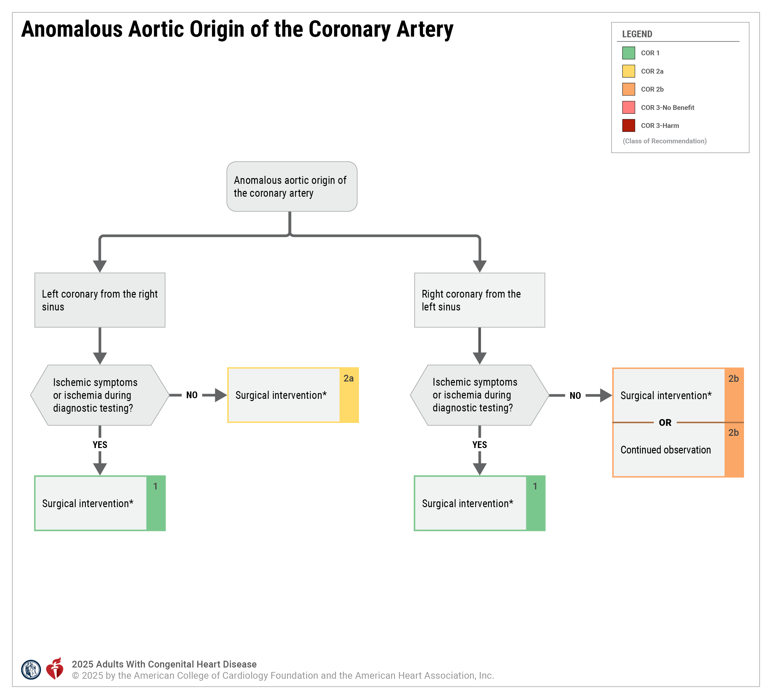

Slide 26
Acknowledgments
Many thanks to our Guideline Ambassadors who were guided by Dr. Elliott Antman in developing this translational learning product in support of the
2025 AHA/ACC/HRS/ISACHD/SCAI Guideline for the Management of Adults With Congenital Heart Disease.
Ibrahim Ahmed, MD
Zaki Al-Yafeai, MD
Anthony Angueira, MD PhD
Lauren East, MD
Arsalan Hamid, MBBS
Charlie ‘Joe’ Sang, MD
Charles Sherrod, MD
Crystal Yan, MD
The American Heart Association requests this electronic slide deck be cited as follows:
Ahmed, I., Al-Yafeai, Z., Angueira, A., East, L., Hamid, A., Sang, C., Sherrod, C., Yan, C., Reyna, G.G., & Antman, E. M. (2025). AHA Guideline Essentials; Adapted from: [PowerPoint slides]. Retrieved from the 2025 AHA/ACC/HRS/ISACHD/SCAI Guideline for the Management of Adults With Congenital Heart Disease.
Guideline Essentials: AHA Clinical Slide Series - Professional Heart Daily | American Heart Association

Slide 27
Copyright and Permissions Notice
© Copyright 2025. American Heart Association. All rights reserved.
This material is the copyrighted property of the American Heart Association and is provided for reference purposes only. It may not be copied, reproduced, stored in a retrieval system, transmitted, altered in any way or used as a derivative work, or distributed in any form or by any means—electronic, mechanical, photocopying, recording, or otherwise—without prior written permission from the publisher.
This content may be used for limited educational and personal use.
Further distribution or dissemination requires a licensing agreement. Unauthorized use or distribution in any media is strictly prohibited.
For permissions inquiries and licensing fee information,
please see the information/Request Form at this link:
https://www.heart.org/en/about-us/statements-and-policies/copyright-request-form

