Slide 1
AHA Clinical Update
ADAPTED FROM:
2022 Guideline for the Management of Patients With Spontaneous Intracerebral Hemorrhage: A Guideline From the American Heart Association/ American Stroke Association

Slide 2
TABLE OF CONTENTS
Population Health Implications
Mechanisms of ICH Injury
ICH Etiology Determines Hemorrhage Location
Diagnosis & Assessment
Medical and Neurointensive Tx for ICH
Hemostasis & Coagulopathy
General Inpatient Care
Seizures & Antiseizure Drugs
Neuroinvasive Monitoring, Intracranial Pressure & Edema Treatment
Surgical Interventions
Outcome Prediction & Goals of Care
Decisions to Limit Life-Sustaining Treatment
Rehabilitation & Recovery
Neurobehavioral Complications
Secondary Prevention
Primary ICH Prevention in Individuals with High-Risk Imaging Findings
2

Slide 3

Table 1.
Applying Class of Recommendation and Level of Evidence to Clinical Strategies, Interventions, Treatments, or Diagnostic Testing in Patient Care
CLASS (STRENGTH) OF RECOMMENDATION
CLASS 1 (STRONG) Benefit >>> Risk
Suggested phrases for writing recommendations: Is recommended Is indicated/useful/effective/beneficial Should be performed/administered/other Comparative-Effectiveness Phrases†: Treatment/strategy A is recommended/indicated in preference to treatment B Treatment A should be chosen over treatment B
CLASS 2a (MODERATE) Benefit >> Risk
Suggested phrases for writing recommendations: Is reasonable Can be useful/effective/beneficial Comparative-Effectiveness Phrases†: Treatment/strategy A is probably recommended/indicated in preference to treatment B It is reasonable to choose treatment A over treatment B
CLASS 2b (Weak) Benefit ≥ Risk
Suggested phrases for writing recommendations: May/might be reasonable May/might be considered Usefulness/effectiveness is unknown/unclear/uncertain or not well-established
CLASS 3: No Benefit (MODERATE) Benefit = Risk
Suggested phrases for writing recommendations: Is not recommended Is not indicated/useful/effective/beneficial Should not be performed/administered/other
CLASS 3: Harm (STRONG) Risk > Benefit
Suggested phrases for writing recommendations: Potentially harmful Causes harm Associated with excess morbidity/mortality Should not be performed/administered/other
LEVEL (QUALITY) OF EVIDENCE‡
LEVEL A
High-quality evidence‡ from more than 1 RCT Meta-analyses of high-quality RCTs One or more RCTs corroborated by high-quality registry studies
LEVEL B-R (Randomized)
Moderate-quality evidence‡ from 1 or more RCTs Meta-analyses of moderate-quality RCTs
LEVEL B-NR (Nonrandomized)
Moderate-quality evidence‡ from 1 or more well-designed, well-executed nonrandomized studies, observational studies, or registry studies Meta-analyses of such studies
LEVEL C-LD (Limited Data)
Randomized or nonrandomized observational or registry studies with limitations of design or execution Meta-analyses of such studies Physiological or mechanistic studies in human subjects
LEVEL C-EO (Expert Opinion)
Consensus of expert opinion based on clinical experience.
COR and LOE are determined independently (any COR may be paired with any LOE).
A recommendation with LOE C does not imply that the recommendation is weak. Many important clinical questions addressed in guidelines do not lend themselves to clinical trials. Although RCTs are unavailable, there may be a very clear clinical consensus that a particular test or therapy is useful or effective.
*The outcome or result of the intervention should be specified (an improved clinical outcome or increased diagnostic accuracy or incremental prognostic information).
†For comparative-effectiveness recommendation (COR 1 and 2a; LOE A and B only), studies that support the use of comparator verbs should involve direct comparisons of the treatments or strategies being evaluated.
‡The method of assessing quality is evolving, including the application of standardized, widely-used, and preferably validated evidence grading tools; and for systematic reviews, the incorporation of an Evidence Review Committee.
COR indicates Class of Recommendation; EO, expert opinion; LD, limited data; LOE, Level of Evidence; NR, nonrandomized; R, randomized; and RCT, randomized controlled trial.

Slide 4



Population Health Implications
Annual Ischemic Stroke & ICH Incidence
Total Strokes: ~795K
Incidence of ICH by Race
Early-term ICH Mortality is 30-40%
≈1.6-fold greater among Black than White people
≈1.6-fold greater among Mexican American than non-Hispanic White people
Abbreviations: ICH indicates intracerebral hemorrhage; and SAH, subarachnoid hemorrhage.

Slide 5
Mechanisms of ICH Injury
0 - 6 hours
>6 hours
Primary Injury
Secondary Injury
↑ ICP
Hydrocephalus
Herniation
Cerebral Edema
Inflammation
Toxicity from Blood Products
Hematoma
Expansion
General Principle: Acute ICH management targets these mechanisms.
Abbreviations: ICH indicates intracerebral hemorrhage; and ICP, intracranial pressure.

Slide 6
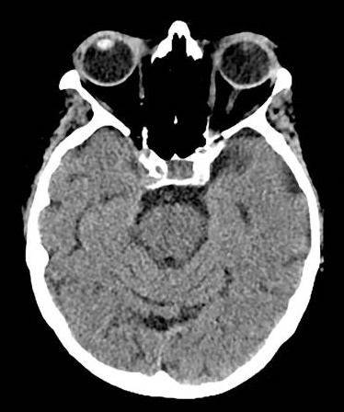
ICH Etiology Determines Hemorrhage Location
Deep/Posterior Fossa ICH Etiologies
Arteriolosclerosis
Penetrating arteriole lipohyalinosis due to HTN, DM, Age
Macrovascular
AVM
Aneurysm
Dural AVF
Cavernous Malformation/Cavernoma
Cerebral Venous Thrombosis
Lobar ICH Etiologies
Cerebral Amyloid Angiopathy
Amyloid deposition in vessel walls
Arteriolosclerosis
Macrovascular
Diagnostic Reasoning: CAA typically causes only lobar (or superficial cerebellar) hemorrhages. Arteriolosclerosis may cause both deep and lobar hemorrhages. Coexistent pathology is possible.
Abbreviations: AVF indicates arteriovenous fistula; AVM, arteriovenous malformation; CAA, cerebral amyloid angiopathy; DM, diabetes mellitus; HTN, hypertension; and ICH, intracerebral hemorrhage.

Slide 7







Diagnosis & Assessment | Work-Up for Acute ICH Course
History
Time
Symptoms
Vascular
Risk Factors
Medications
Cognitive Impairment or Dementia
Substance Use
Liver disease, Uremia, Malignancy and Hematologic disorders
Time of
symptom onset
Headache
Focal neurologic deficits
Seizures
Decreased level of consciousness
Ischemic Stroke
Prior ICH
Hypertension
Hyperlipidemia
Diabetes mellitus
Metabolic syndrome
Imaging biomarkers
Cerebral microbleeds
Antithrombotics:
Anticoagulants, thrombolytics, antiplatelet agents, NSAIDS
Vasoconstrictive Agents:
Triptans, SSRIs, decongestants, stimulants, phentermine, sympathomimetic drugs
Antihypertensives:
Estrogen-containing oral contraceptives
Smoking
Alcohol use
Marijuana
Sympathomimetic drugs
Amphetamines, methamphetamines, cocaine
Associated with (but not specific for) amyloid angiopathy
May be associated with coagulopathy
Abbreviations: ICH indicates intracerebral hemorrhage; NSAIDS, non-steroidal anti-inflammatory drugs, and SSRI, selective serotonin reuptake inhibitors.

Slide 8
Diagnosis & Assessment | Work-Up in Acute ICH
Physical Examination
Serum
Urine
Airway, Breathing & Circulation
Vital signs
General: Focused on the head, heart, lungs, abdomen, and extremities
Focused Neurological Exam (NIHSS, GCS)
CBC
BUN and Creatinine
LFTs
Glucose
Inflammatory markers
(ESR and/or CRP)
PT (with INR)
aPTT
Specific tests for DOACs
Urine toxicology screen
Pregnancy test
Cardiac-specific
Troponin
ECG
Abbreviations: aPTT indicates activated partial thromboplastin time; BUN, blood urea nitrogen; CRP, C-reactive protein; DOAC, direct oral anticoagulant; ECG, electrocardiogram; ESR, erythrocyte sedimentation rate; GCS, Glasgow coma scale; ICH, intracerebral hemorrhage; INR, international normalized ratio; LFTs, liver function tests; NIHSS, National Institutes of Health Stroke Scale; and PT, prothrombin time.

Slide 9
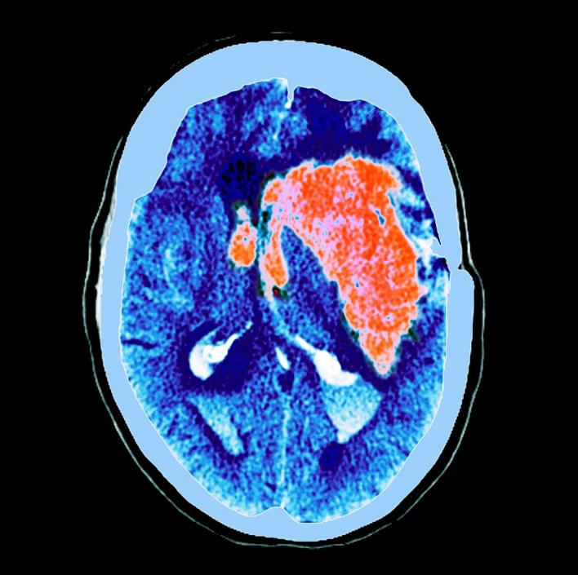
Diagnosis & Assessment | Work-Up in Acute ICH
Indicators of Increased Morbidity & Mortality:
Thrombocytopenia
Acute Kidney Injury
Hyperglycemia
Elevated troponin
Indicators of Increased HE:
Anemia
Anticoagulant-related hemorrhages
Identification of a spot sign on CTA or contrast-enhanced OR certain imaging features on NCCT such as heterogeneous densities within the hematoma or irregularities at its margins.
Abbreviations: CTA indicates computed tomography angiography; HE, hematoma expansion; ICH, intracerebral hemorrhage; and NCCT, noncontrast computed tomography .

Slide 10
Diagnosis & Assessment | Neuroimaging to Diagnose ICH
Time of presentation with
stroke-like symptoms:
Obtain rapid CT or MRI to confirm the diagnosis of spontaneous ICH (1)
CT angiography within the first few hours of ICH onset:
May be reasonable to detect some structural causes of secondary ICH (2b)
Beyond first 24 hours: Serial imaging is generally guided by clinical picture of the patient
TIME COURSE
Serial head CT scans can be useful for:
Patients with spontaneous intracerebral and/or intraventricular hemorrhage within the first 24 hours after symptom onset to evaluate for HE
Patients with low GCS score or neurological deterioration to evaluate for HE, hydrocephalus, perihematomal edema or herniation
(2a)
Utilizing CT markers of HE to identify patients at risk for HE may be reasonable.
Imaging findings:
Non contrast CT:
Heterogeneous densities within the hematoma
Irregularities at the hematoma margins
CT angiography/ Contrast enhanced CT:
Spot sign
(2b)
Abbreviations: CT indicates computed tomography; HE, hematoma expansion; ICH, intracerebral hemorrhage; and MRI, magnetic resonance imaging.

Slide 11
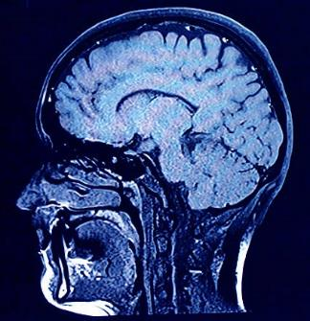
Diagnosis & Assessment | Strategy to Determine ICH Etiology
For Patients With…
Utilize This Diagnostic Strategy…
Lobar ICH
Age <70 yrs
CT Angiogram/Venogram Recommended (1)
- AND -
- OR -
MRI + MR Angiogram Reasonable (2a)
Deep/Posterior Fossa ICH
Age <45
Age 45-70 yrs, NO HTN
- AND -
Cerebral Angiogram Reasonable (2a)
Spontaneous IVH with NO parenchymal hemorrhage (any age)
- OR -
Cerebral Angiogram Recommended (1)
CTA/MRA suggestive of macrovascular ICH etiology (any age)
Abbreviations: CT indicates computed tomography; CTA, computed tomography angiogram; HTN, hypertension; ICH, intracerebral hemorrhage; IVH, intraventricular hemorrhage; MRA, magnetic resonance angiogram; and MRI, magnetic resonance imaging.

Slide 12

Medical and Neurointensive Treatment for ICH
Acute Blood Pressure Lowering in Spontaneous ICH
To improve functional outcomes.
Medication titration to ensure continuous smooth & sustained control of BP, avoiding peaks and large variability in SBP, can be beneficial. (2a)
Initiating tx within 2 hrs of ICH onset and reaching target within 1-hr can be beneficial to reduce the risk of HE. (2a)
In ICH of mild to moderate severity presenting with SBP between 150 and 220 mmHg, acute lowering of SBP to a target of 140 mmHg with the goal of maintaining in the range of 130 to 150 mmHg is safe and may be reasonable. (2b)
If presenting with large or severe ICH or those requiring surgical decompression, the safety and efficacy of intensive BP lowering are not well established. (2b)
If ICH is mild to moderate severity presenting with SBP >150 mmHg, acute lowering of SBP to hrs. <130 mmHg is potentially harmful. (3:Harm)
Abbreviations: HE indicates hematoma expansion; ICH, intracerebral hemorrhage; mmHg, millimeters of mercury; SBP, systolic blood pressure; and tx, treatment.

Slide 13
Hemostasis & Coagulopathy
Management of Anticoagulant-Related Hemorrhage
Patients with ICH on anticoagulation
Discontinue anticoagulation therapy immediately. Rapid reversal should be performed as soon as possible (1)
VITAMIN K ANTAGONISTS
DABIGATRAN
FACTOR Xa-INHIBITORS
HEPARINS
INR 1.3 –1.9
INR >2.0
History: When last dose taken
Unfractionated Heparin
Low Molecular Weight Heparin
4-F PCC
10-20 IU/kg (2b)
4-F PCC
25-50 IU/kg
(1)
Activated charcoal if DOAC < 2 hrs (potential efficacy up to 8 hrs) (2b)
Protamine
(2a)
Protamine
(2b)
Is
Idarucizumab available?
Is
Andexanet alfa available?
IV Vitamin K
(1)
YES
NO
YES
NO
Idarucizumab (2a)
PCCs or aPCC and/or
renal replacement therapy
(2b)
Andexanet
alfa
(2a)
4 Factor PCCs or aPCC (2b)
Abbreviations: 4-F PCC indicates four-factor prothrombin complex concentrate; aPCC, activated prothrombin complex concentrate; DOAC, direct oral anticoagulant;
ICH, intracerebral hemorrhage; and INR, international normalized ratio.

Slide 14
Hemostasis & Coagulopathy
Antiplatelet-Related Hemorrhage in Spontaneous ICH
Patients with Spontaneous ICH
If the patient is being treated with aspirin, platelet transfusion might be considered to reduce postoperative bleeding and mortality.
(2b)
Does the
patient require
emergent
neurosurgery?
YES
NO
If the patient is being treated with antiplatelet agents, the effectiveness of desmopressin with or without platelet transfusions to reduce the expansion of the hematoma is uncertain.
(2b)
If the patient is being treated with ASA, platelet transfusions are potentially harmful and should not be administered. (3:Harm)
Abbreviations: ASA indicates aspirin; and ICH, intracerebral hemorrhage.

Slide 15
Hemostasis & Coagulopathy
General Hemostatic Treatments
Synopsis of the Evidence
HE occurs in up to a third of patients after ICH and is associated with poor outcome.
Hemostatic therapy for the prevention of HE remains an attractive therapeutic target after ICH.
In patients with spontaneous ICH (with or without the spot sign), the effectiveness of recombinant factor VIIa to improve functional outcome is unclear. (2b)
In patients with spontaneous ICH (with or without the spot sign, black hole sign, or blend sign), the effectiveness of TXA to improve functional outcome is not well established. (2b)
ICH expansion most commonly occurs very early after onset, and future studies need to target earlier treatment
Abbreviations: CTA indicates computed tomography angiography; HE, hematoma expansion; and ICH, intracerebral hemorrhage.

Slide 16

General Inpatient Care
Considerations for Inpatient Care Setting
Initiation of Appropriate
Life Sustaining Therapies
(1)
Provision of care in a specialized inpatient unit with a multidisciplinary team (1)
If specialized unit is not available, then transfer to centers with full range of high-acuity care and expertise
(1)
In patients with spontaneous ICH and clinical hydrocephalus, transfer to centers with Neurosurgical capabilities for hydrocephalus management (e.g. EVD placement and monitoring)
(1)
Abbreviations: EVD indicates external ventricular drain; and ICH, intracerebral hemorrhage.

Slide 17

Inpatient Care Checklist
In Non-Ambulatory Spontaneous ICH…
Prevention & Management of Acute Medical Complications | Use of standardized protocols/order sets is recommended to reduce disability and mortality. (1) Formal dysphagia screening protocol should be implemented prior to initiation of oral intake to reduce disability and the risk of pneumonia. (1)
 | Continuous cardiac monitoring for first 24 to 72 hrs is reasonable to monitor for cardiac arrhythmias & new cardiac ischemia. (2a) Laboratory and radiographic testing for infection on admission and throughout the hospital course is reasonable to improve outcomes. (2a)
Priorities for Nursing Care | Frequent neurological assessments (including GCS) should be performed by ED nurses in the early hyperacute phase of care to assess change in status, neurological examination, or LOC. (1)
 | Frequent neuro assessments in ICU/Stroke unit up are reasonable up to 72 hrs from admission to detect early ND. (2a) Nursing staff with specialized stroke competency education can be effective in improving outcome & mortality. (2a)
Abbreviations: DVT indicates deep vein thrombosis; ED, emergency department; HE, hematoma expansion; hrs, hours; GCS, Glasgow Coma Scale; ICH, intracerebral hemorrhage; ICU, intensive care unit; LMWH, low molecular weight heparin; LOC, level of consciousness; ND, neurological deterioration; PE, pulmonary embolism; Tx, treatment; UFH, unfractionated heparin; and VTE, venous thromboembolism.

Slide 18

Inpatient Care Checklist
In Non-Ambulatory Spontaneous ICH…
Thromboprophylaxis & Tx of Thrombosis
Prophylaxis | … , intermittent pneumatic compression starting on the day of diagnosis is recommended for VTE (DVT and PE) prophylaxis. (1)
 | … low-dose UFH or LMWH can be useful to reduce risk of PE (2a) … temporary use of retrievable filter as bridge until anticoagulation initiated. (2a)
 | … low-dose UFH or LMWH prophylaxis at 24 to 48 hrs from ICH onset may be reasonable to optimize the benefits of preventing thrombosis relative to the risk of HE. 2b)
 | … graduated compression stockings of knee-high or thigh-high length alone are not beneficial for VTE prophylaxis. (3: No Benefit)
Treatment | … and proximal DVT who are not yet candidates for anticoagulation, temporary use of retrievable filter is reasonable as a bridge until anticoagulation initiated. (2a)
 | … and proximal DVT or PE, delaying treatment with UFH or LMWH 1 to 2 weeks after onset of ICH might be considered. (2b)
Abbreviations: DVT indicates deep vein thrombosis; HE, hematoma expansion; hrs, hours; ICH, intracerebral hemorrhage; LMWH, low molecular weight heparin;
PE, pulmonary embolism; Tx, treatment; UFH, unfractionated heparin; and VTE, venous thromboembolism.

Slide 19


General Inpatient Care
Glucose and Temperature Management
Glucose Management
Temperature Management
Monitor serum glucose to reduce both hyper/hypoglycemia. (1)
Treat serum glucose
<40-60 mg/dL
to reduce mortality. (1)
In patients with spontaneous ICH, pharmacologically treating an elevated temperature may be reasonable to improve functional outcomes. (2b)
NICE-SUGAR trial findings:
In critically ill, target of <180 mg/dL associated with lower mortality than target of 81-108 mg/dL.
Intensive glucose control (target 81-108 mg/dL) more likely to result in severe hypoglycemic events compared to control.
The usefulness of therapeutic hypothermia
(<35°C/95°F) to decrease peri-ICH edema is
unclear. (2b)
Temperature abnormalities can occur in over 30% of acute ICH patients, with fever associated with higher clinical severity and worse outcomes.
In patients with spontaneous ICH, treating
moderate to severe hyperglycemia (>180–
200 mg/dL, >10.0–11.1 mmol/L) is reasonable to improve outcomes. (2a)
Abbreviations: dL indicates deciliter; ICH, intracerebral hemorrhage; mg/dL, milligram per deciliter; mmol/L, millimoles per liter; and NICE-SUGAR,
Normoglycemia in Intensive Care Evaluation and Surviving Using Glucose Algorithm Regulation.

Slide 20
Seizures and Antiseizure Drugs
New onset seizures in sICH are relatively common (2.8-28%) and occur within the first 24 hrs of hemorrhage
Unexplained abnormal or fluctuating mental status, or suspicious of seizures, cEEG is reasonable to
diagnose electrographic seizures and epileptiform discharges
(24 hours or longer)
(2a)
sICH patients without suspicion of seizure
Avoid ASD
(3: No Benefit)
Confirmed clinical or electrographic seizures
Administer ASD
(1)
Abbreviation: ASD indicates antiseizure drugs; cEEG, continuous electroencephalography; hrs, hours; and sICH, spontaneous intracerebral hemorrhage.

Slide 21
Neuroinvasive Monitoring, Intracranial Pressure & Edema Treatment
sICH or IVH and hydrocephalus which is contributing to decreased level of consciousness:
Ventricular drainage should be performed to reduce mortality (1)
ICP monitoring and treatment to reduce mortality and improve outcomes (2b)
Corticosteroids should not be administered for treatment of elevated ICP (3: No Benefit)
Early prophylactic hyperosmolar therapy for improving outcomes is not well established (2b)
Bolus hyperosmolar therapy may be considered for
transiently reducing ICP (2b)
Abbreviation: ICP indicates intracranial pressure; IVH, intraventricular hemorrhage; and sICH, spontaneous intracerebral hemorrhage.

Slide 22
Surgical Interventions
Minimally Invasive Surgical Evacuation of ICH
Patient Selection
MIS for ICH
Supratentorial ICH, hematoma volume >20-30 mL, GCS 5-12
Supratentorial ICH, hematoma volume >20-30 mL, GCS 5-12
Intervention
MIS ± hematoma thrombolysis to improve mortality can be useful (2a)
MIS ± hematoma thrombolysis to improve functional outcome is of uncertain effectiveness (2b)
Choosing MIS rather than craniotomy to improve functional outcomes may be reasonable
(2b)
Abbreviations: GCS indicates Glasgow Coma Scale; ICH, intracerebral hemorrhage; and MIS, minimally invasive surgery.

Slide 23
Surgical Interventions
Minimally Invasive Surgical Evacuation of Intraventricular Hemorrhage
IVH
Surgical Management
Spontaneous IVH + Obstructive Hydrocephalus
Spontaneous ICH <30 mL
IVH requiring EVD
Spontaneous ICH < 30 mL
GCS >3
IVH requiring EVD
EVD
EVD + thrombolytic
Neuroendoscopy
+ EVD
+/- thrombolytic
Mortality Reduction
(I)
Functional Outcome Benefit
(2b*)
Mortality Reduction
(2a)
Functional Outcome Benefit
(2b†)
Functional Outcome Benefit
(2b†)
Reduced Permanent Shunt Dependence (2b†)
Note: *Not well established. †Uncertain
Abbreviations: EVD indicates external ventricular drain; GCS, Glasgow coma scale; ICH, Intracerebral hemorrhage, and IVH, intraventricular hemorrhage.

Slide 24
Surgical Interventions
Craniotomy for Supratentorial Hemorrhage
Supratentorial ICH of moderate or greater severity*
Note: * >10 cc with a significant neurologic deficit
Craniotomy for hemorrhage evacuation to improve mortality or functional outcomes is of uncertain usefulness
(2b)
Craniotomy for hemorrhage evacuation may be considered as a life-saving measure in patients who are deteriorating
(2b)
Abbreviations: ICH indicates intracerebral hemorrhage.

Slide 25
Surgical Interventions
Craniotomy for Posterior Fossa Hemorrhage
Cerebellar ICH
If any of the following present
Neurologic deterioration
Brainstem compression
Obstructive hydrocephalus
ICH volume ≥ 15cc
Immediate surgical removal of hemorrhage ± EVD is recommended to reduce mortality (1)
Abbreviations: EVD indicates external ventricular drain; and ICH, intracerebral hemorrhage.

Slide 26
Surgical Interventions
Craniectomy for ICH
In patients with supratentorial ICH who are in a coma, have large hematomas with significant midline shift, or have elevated ICP refractory to medical management:
….decompressive craniectomy with or without hematoma evacuation may be considered to reduce mortality. (2b)
….effectiveness of decompressive craniectomy with or without hematoma evacuation to improve functional outcomes is uncertain. (2b)
Abbreviation: ICH indicates intracerebral hemorrhage; and ICP, intracranial pressure.

Slide 27
Outcome Prediction and Goals of Care
In patients with spontaneous ICH
… administering a baseline measure of overall hemorrhage severity is recommended as part of the initial evaluation to provide an overall measure of clinical severity. (1)
Examples:
ICH-score
Max-ICH
… a baseline
severity score might be reasonable to provide
a general framework for communication with
the patient and their caregivers. (2b)
… a baseline
severity score should
NOT be used as the sole
basis for forecasting individual prognosis or
limiting life-sustaining treatment. (3:Harm)
Click to view Measures for Evaluating Overall Hemorrhage Severity
Abbreviations: ICH indicates intracerebral hemorrhage.

Slide 28
Decisions to Limit Life-Sustaining Treatment
In patients with spontaneous ICH
Can not fully participate in medical decision-making
No pre-existing
life-sustaining therapy limitations
For patients who have DNAR Status
Shared decision-making between surrogates and physicians is reasonable
(2a)
Aggressive care including postponement of new DNAR orders or withdrawal of medical support until at least the 2nd full day of hospitalization is reasonable (2b)
Limiting other medical and surgical interventions unless explicitly specified is associated with increased patient mortality
(3: Harm)
Abbreviations: DNAR indicates do not attempt resuscitation; and ICH, intracerebral hemorrhage.

Slide 29
Rehabilitation and Recovery
In patients with spontaneous ICH
Multidisciplinary rehabilitation with regular team meetings and discharge planning is recommended (1)
Mild-moderate ICH severity: Early supported discharge is beneficial (1)
Moderate ICH severity:
Early rehabilitation
(24-48 hours after onset) may be considered (2b)
ICH without
depression, fluoxetine
therapy is not effective
to enhance poststroke functional status.
(3: No Benefit)
Very early and intense mobilization < 24 hours: potentially harmful
(3: Harm)
Abbreviations: ICH indicates intracerebral hemorrhage; and SSRIs, selective serotonin reuptake inhibitors.

Slide 30
Neurobehavioral Complications
In patients with spontaneous ICH
In the Post-acute Period
Moderate to Severe Depression
Cognitive Impairment
Pre-existing or New Mood Disorders
Administration
of depression & anxiety screening tools.
(1)
Administration of a cognitive screening tool.
(1)
Appropriate evidence-based treatments including psychotherapy & pharmacotherapy.
(1)
Referral for cognitive therapy.
(2a)
Might consider cholinesterase inhibitors or memantine.
(2b)
Continuation or initiation of SSRIs
after ICH.
(2a)
Abbreviations: ICH, intracerebral hemorrhage; and SSRIs, selective serotonin reuptake inhibitors.

Slide 31
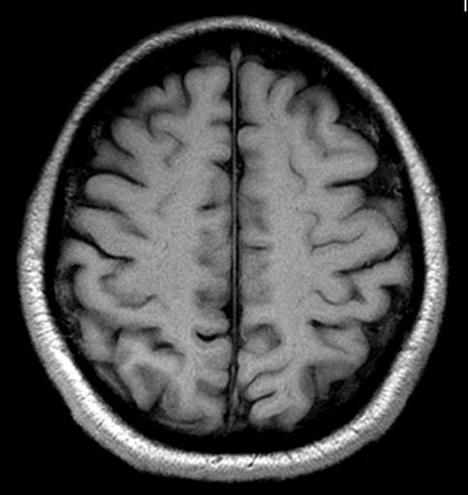








Secondary Prevention
Prognostication of Future ICH Risk
2
In patients with spontaneous ICH in whom the risk for recurrent ICH may facilitate prognostication or management decisions, it is reasonable to incorporate the following risk factors for ICH recurrence into decision-making:
Lobar location of the initial ICH;
older age;
presence, number, and lobar location of microbleeds on MRI;
presence of disseminated cortical superficial siderosis on MRI;
poorly controlled hypertension;
Asian or Black race;
and presence of apolipoprotein E ε2 or ε4 alleles. (2a)
1
3
MRI imaging characteristics:
Lobar location of initial ICH
Number and lobar location of microbleeds
Presence of cortical superficial siderosis
Abbreviation: ICH indicates intracerebral hemorrhage; and MRI, magnetic resonance imaging.

Slide 32


Secondary Prevention
Blood Pressure Management
Uncontrolled HTN accounts for 74% of global population-attributable risk for ICH.
Guiding Principle
In patients with spontaneous ICH, it is reasonable to lower BP to 130/80 mmHg for long-term management to prevent hemorrhage recurrence (2a).
Abbreviations: BP indicates blood pressure; HTN, hypertension; ICH, intracerebral hemorrhage; and mmHg, millimeters of mercury.

Slide 33
Secondary Prevention
Management of Antithrombotic Agents and Other Medications
HIGH RISK of thrombotic events
ex. Patient with mechanical valve, LVAD
Nonvalvular AF
WEIGH RISKS vs BENEFITS of restarting anticoagulation
Statins
Risks and benefits of statins on ICH outcomes and recurrence are
uncertain (2b)
risk>benefit
benefit<risk
Early resumption of anticoagulation is
reasonable (2a)
Resumption of anticoagulation
may be reasonable (2b)
LAA closure may be considered ( 2b)
NSAIDs
Consider initiation of anticoagulation 7-8 weeks after ICH ( 2b)
Regular long-term use of NSAIDs is potentially harmful because of the increased risk of ICH (3: Harm)
Resumption of antiplatelet therapy may be reasonable based on consideration of benefit and risk (2b)
Abbreviations: AF indicates atrial fibrillation; ICH, intracerebral hemorrhage; LAA, left atrial appendage; LVAD, left ventricular assist device; and NSAID, non-steroidal anti-inflammatory drugs.

Slide 34





Secondary Prevention
Lifestyle Modifications / Patient and Caregiver Education
LIFESTYLE MODIFICATIONS
Blood pressure control
Avoiding heavy alcohol use
Supervised training and counseling
PATIENT & CAREGIVER EDUCATION
Psychosocial education
Caregiver support & training

Slide 35
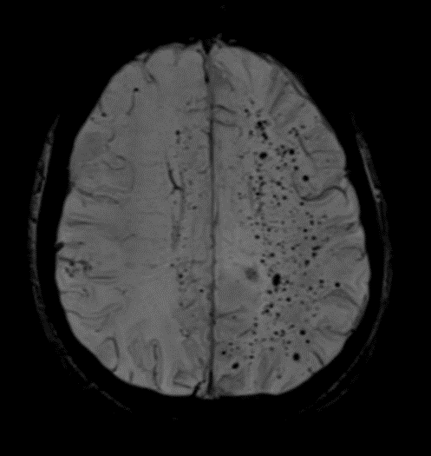
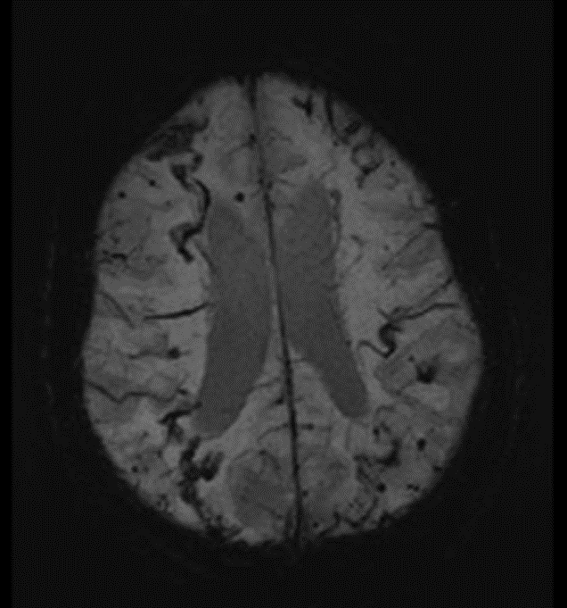
Primary ICH Prevention in Individuals with High-Risk Imaging Findings
Cerebral microbleed
Cortical superficial siderosis
Incorporate available MRI information on cerebral microbleed burden or cortical superficial siderosis to inform decision-making for primary prevention (2b)
Abbreviation: ICH indicates intracerebral hemorrhage.

Slide 36
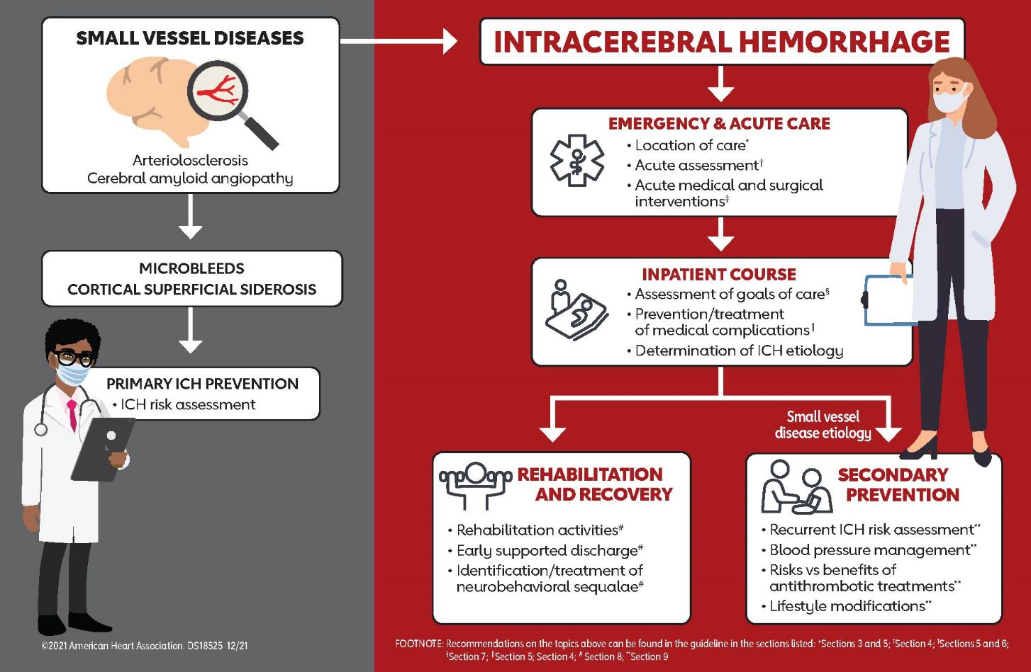
Small Vessel Diseases figure

Slide 37
Acknowledgments
Many thanks to our Guideline Ambassadors who were guided by Dr. Elliott Antman in developing this translational learning product in support of the 2022 Guideline for the Management of Patients With Spontaneous Intracerebral Hemorrhage: A Guideline From the American Heart Association/ American Stroke Association
Matthew Gusler, DO
Nycole Joseph, MD
Shuo Qian, MD
Karan Ravishankar, MD
Meghana Srinivas, MD
Michael Teitcher, MD
Robin Ulep, MD
The American Heart Association requests this electronic slide deck be cited as follows:
Gusler, M., Joseph, N., Quin, S., Ravishankar, K., Srinivas, M., Teitcher, M., Ulep, R., Bezanson, J. L., & Antman, E. M. (2022). Clinical Update; Adapted from: 2022 Guideline for the Management of Patients
With Spontaneous Intracerebral Hemorrhage: A Guideline From the American Heart Association/
American Stroke Association [PowerPoint slides]. Retrieved from https://professional.heart.org/en/science-news.

Slide 38
Appendix
Measures for evaluating overall hemorrhage severity
 Return to previous slide
Gregório T, Pipa S, Cavaleiro P, Atanásio G, Albuquerque I, Castro Chaves P, Azevedo L. Original intracerebral hemorrhage score for the prediction of short-term mortality in cerebral hemorrhage: systematic review and meta-analysis. Crit Care Med. 2019;47:857–864. doi: 10.1097/CCM.0000000000003744
Gregório T, Pipa S, Cavaleiro P, Atanásio G, Albuquerque I, Chaves PC, Azevedo L. Assessment and comparison of the four most extensively validated prognostic scales for intracerebral hemorrhage: systematic review with meta-analysis. Neurocrit Care. 2019;30:449–466. doi: 10.1007/s12028-018-0633-6
Gregório T, Pipa S, Cavaleiro P, Atanásio G, Albuquerque I, Chaves PC, Azevedo L. Prognostic models for intracerebral hemorrhage: systematic review and meta-analysis. BMC Med Res Methodol. 2018;18:145. doi: 10.1186/s12874-018-0613-8
Sembill JA, Gerner ST, Volbers B, Bobinger T, Lücking H, Kloska SP, Schwab S, Huttner HB, Kuramatsu JB. Severity assessment in maximally treated ICH patients: the max-ICH score. Neurology. 2017;89:423–431. doi: 10.1212/WNL.0000000000004174
Sembill JA, Castello JP, Sprügel MI, Gerner ST, Hoelter P, Lücking H, Doerfler A, Schwab S, Huttner HB, Biffi A, et al. Multicenter validation of the max-ICH score in intracerebral hemorrhage. Ann Neurol. 2021;89:474– 484. doi: 10.1002/ana.25969
Abbreviation: ICH indicates intracerebral hemorrhage.

