Slide 1
Clinical Update
ADAPTED FROM:
2022 ACC/AHA Guideline
for the Diagnosis and
Management of Aortic Disease

Slide 2
Table
Applying Class of Recommendation and Level of Evidence to Clinical Strategies, Interventions, Treatments, or Diagnostic Testing in Patient Care
CLASS (STRENGTH) OF RECOMMENDATION
CLASS 1 (STRONG) Benefit >>> Risk
Suggested phrases for writing recommendations: Is recommended Is indicated/useful/effective/beneficial Should be performed/administered/other Comparative-Effectiveness Phrases†: Treatment/strategy A is recommended/indicated in preference to treatment B Treatment A should be chosen over treatment B
CLASS 2a (MODERATE) Benefit >> Risk
Suggested phrases for writing recommendations: Is reasonable Can be useful/effective/beneficial Comparative-Effectiveness Phrases†: Treatment/strategy A is probably recommended/indicated in preference to treatment B It is reasonable to choose treatment A over treatment B
CLASS 2b (Weak) Benefit ≥ Risk
Suggested phrases for writing recommendations: May/might be reasonable May/might be considered Usefulness/effectiveness is unknown/unclear/uncertain or not well-established
CLASS 3: No Benefit (MODERATE) Benefit = Risk
Suggested phrases for writing recommendations: Is not recommended Is not indicated/useful/effective/beneficial Should not be performed/administered/other
CLASS 3: Harm (STRONG) Risk > Benefit
Suggested phrases for writing recommendations: Potentially harmful Causes harm Associated with excess morbidity/mortality Should not be performed/administered/other
LEVEL (QUALITY) OF EVIDENCE‡
LEVEL A
High-quality evidence‡ from more than 1 RCT Meta-analyses of high-quality RCTs One or more RCTs corroborated by high-quality registry studies
LEVEL B-R (Randomized)
Moderate-quality evidence‡ from 1 or more RCTs Meta-analyses of moderate-quality RCTs
LEVEL B-NR (Nonrandomized)
Moderate-quality evidence‡ from 1 or more well-designed, well-executed nonrandomized studies, observational studies, or registry studies Meta-analyses of such studies
LEVEL C-LD (Limited Data)
Randomized or nonrandomized observational or registry studies with limitations of design or execution Meta-analyses of such studies Physiological or mechanistic studies in human subjects
LEVEL C-EO (Expert Opinion)
Consensus of expert opinion based on clinical experience.
COR and LOE are determined independently (any COR may be paired with any LOE).
A recommendation with LOE C does not imply that the recommendation is weak. Many important clinical questions addressed in guidelines do not lend themselves to clinical trials. Although RCTs are unavailable, there may be a very clear clinical consensus that a particular test or therapy is useful or effective.
*The outcome or result of the intervention should be specified (an improved clinical outcome or increased diagnostic accuracy or incremental prognostic information).
†For comparative-effectiveness recommendation (COR 1 and 2a; LOE A and B only), studies that support the use of comparator verbs should involve direct comparisons of the treatments or strategies being evaluated.
‡The method of assessing quality is evolving, including the application of standardized, widely-used, and preferably validated evidence grading tools; and for systematic reviews, the incorporation of an Evidence Review Committee.
COR indicates Class of Recommendation; EO, expert opinion; LD, limited data; LOE, Level of Evidence; NR, nonrandomized; R, randomized; and RCT, randomized controlled trial.

Slide 3
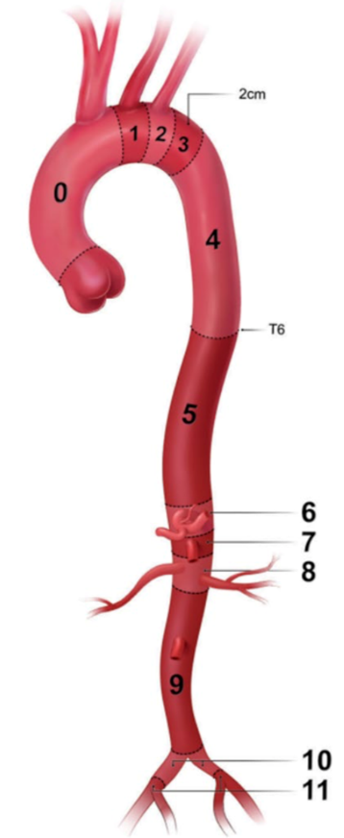
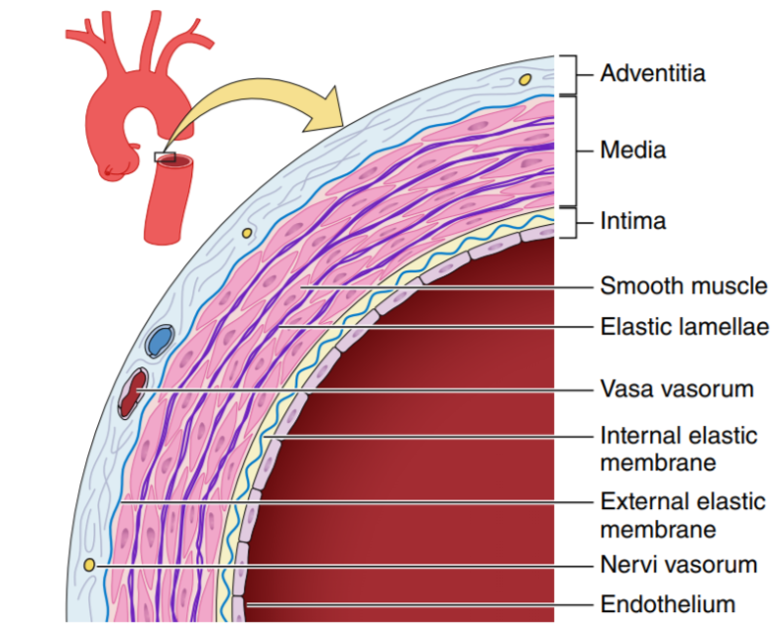
Aortic Anatomy
Layers of the Aortic Wall
Zones of the Aorta
Aortic Aneurysm
The standard definition of 1.5x expected diameter is not applicable to the root and ascending aorta, use > 4.5 cm for these segments
For patients with height or BSA outside of 1-2 SD of the mean, use:
Aortic size index [aortic diameter (cm) / BSA (m²)]
Aortic height index [aortic diameter (cm)/ patient height (m)]
Cross sectional area to height
Abbreviations: BSA indicates body surface area; cm, centimeter; m, meter; and SD, standard deviation.

Slide 4
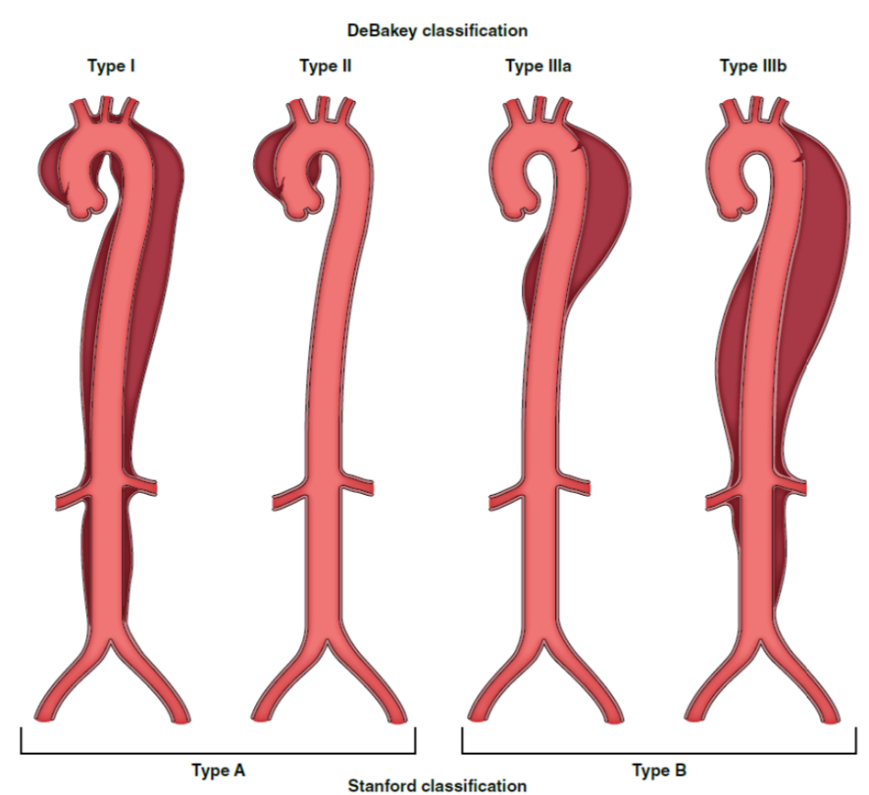
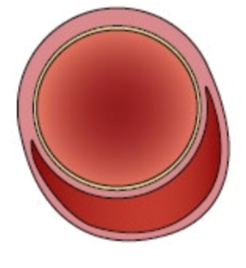
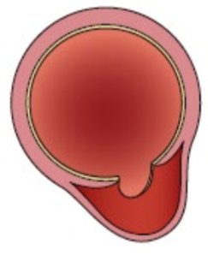
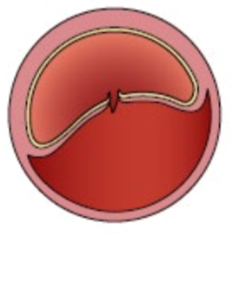



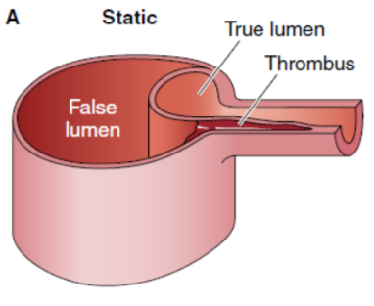
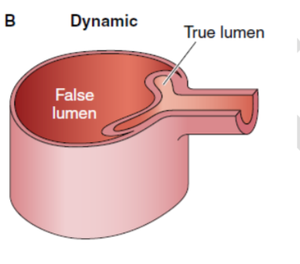
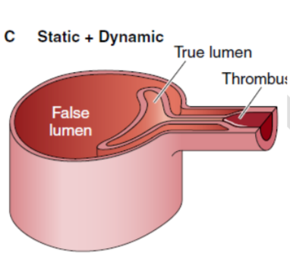
Aortic Dissection Classification
Classification
Types of acute aortic syndromes
Malperfusion

Slide 5
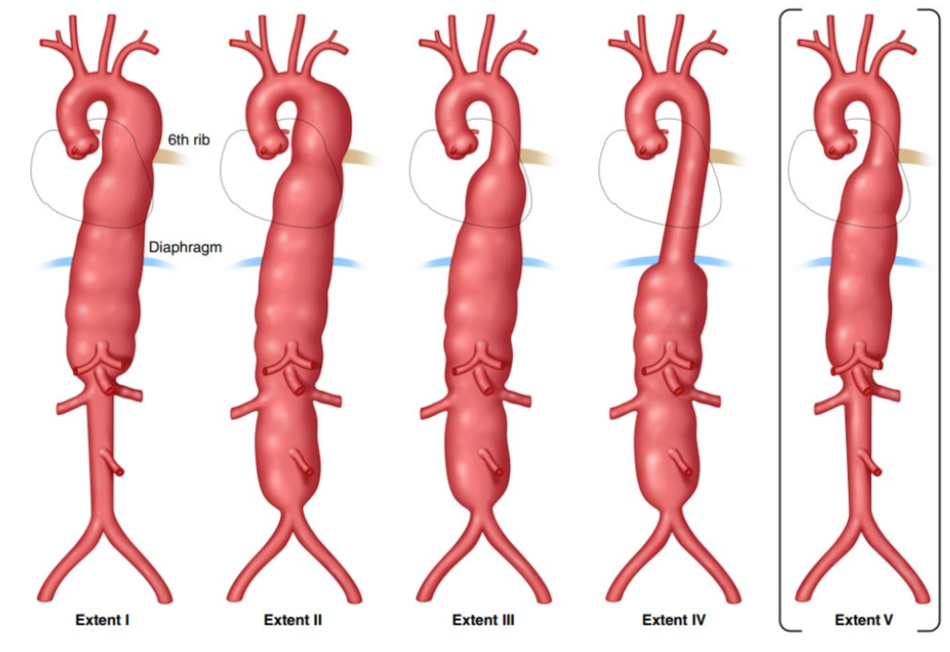
Thoracoabdominal Aortic Aneurysm Classification
Crawford Classification
Extent | Description
I | Below left subclavian to above celiac axis OR opposite superior mesenteric and above renal arteries
II | Below left subclavian to above iliac bifurcation
III | Below T6 to above the infrarenal abdominal aorta to the iliac bifurcation
IV | Below T12, tapering to above the iliac bifurcation
V | Below T6, tapering to just above the renal arteries
Predicts morbidity and mortality associated with aneurysm repair

Slide 6
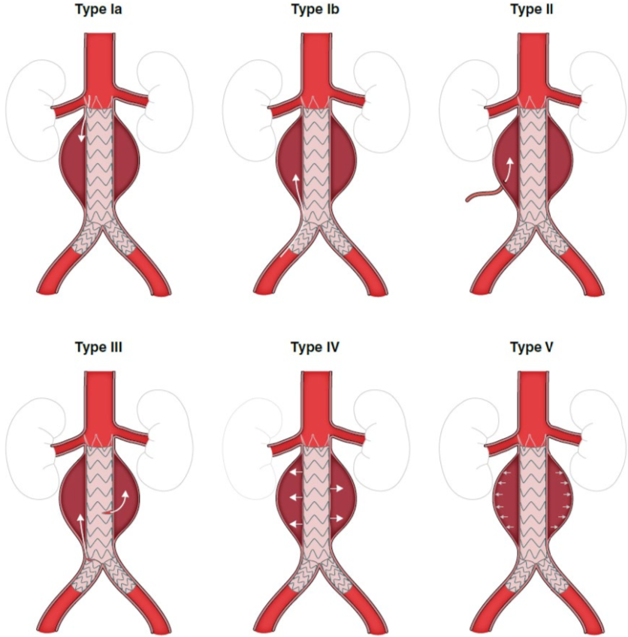
Thoracoabdominal Aortic Aneurysm Classification
Endoleak Classification
Extent | Description
I | 1a = proximal attachment endoleak 1b = distal attachment endoleak
II | Backfilling of aneurysm sac through branch vessels of the aorta
III | Graft defect or component misalignment
IV | Leakage through graft wall from endograft porosity
V | Endotension from aortic pressure through graft to aneurysm sac
Endoleak = persistence of blood flow outside graft and within the aneurysm sac, preventing its complete thrombosis

Slide 7
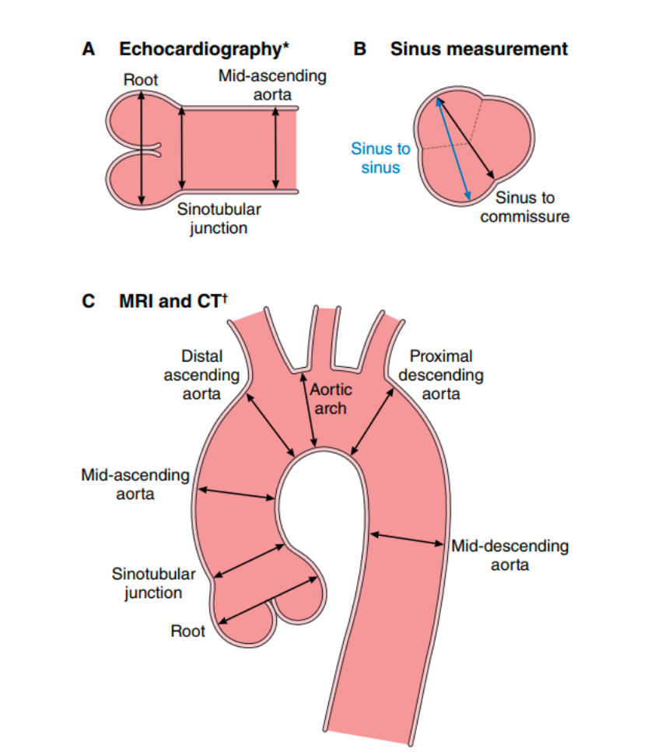
Imaging and Measurement for the Presence and Progression of Aortic Disease
COR | RECOMMENDATIONS
1 | Aortic diameters should be measured at reproducible anatomic landmarks perpendicular to axis of blood flow. In cases of asymmetric or oval contour, the longest diameter and its perpendicular diameter should be reported.
1 | Episodic and cumulative ionizing radiation doses should be kept as low as feasible while maintaining diagnostic image quality.
1 | When performing CT or MR imaging, it is recommended that the root and ascending aortic diameters be measured from inner-edge to inner-edge, using an ECG-synchronized technique. If there are aortic wall abnormalities, such as atherosclerosis or discrete wall thickening (more common in the distal aorta), the outer-edge to outer-edge diameter should be reported.
1 | The aortic root diameter should be recorded as maximum sinus to sinus measurement. In the setting of known asymmetry, multiple measurements should be reported, and both short- and long-axis images of the root should be obtained to avoid underestimation of the diameter.
2a | It is reasonable that a dilated root or ascending aorta be indexed to patient height or body surface area in the report, to aid in clinical risk assessment.
2a | In patients with known or suspected aortic disease, when performing echocardiography, it is reasonable to measure the aorta from leading- edge to leading-edge, perpendicular to the axis of blood flow.
2b | Using inner-edge to inner-edge measurements may also be considered, particularly on short-axis imaging.
Abbreviations: CT, computed tomography; ECG, electrocardiogram; and MR, magnetic resonance.

Slide 8
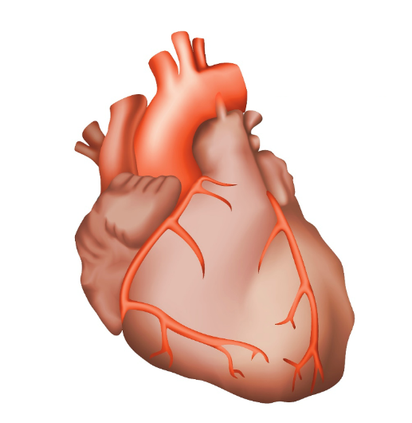
Diagnostic Performance of
Aortic Imaging Modalities
 | CT | MRI | TTE | TEE | US
Availability | +++ | ++ | +++ | ++ | +++
Portability | - | - | +++ | +++ | +++
Speed of acquisition | +++ | + | ++ | ++ | ++
Spatial resolution | +++ | ++ | ++ | +++ | ++
Temporal resolution | + | ++ | +++ | +++ | +++
Three-dimensional data set | +++ | ++ | + | + | +
Arch branch vessel evaluation | +++ | +++ | ++ | + | N/A
Evaluation of valve and ventricular function | + | ++ | +++ | +++ | N/A
Legend
+++ = excellent results
++ = good results
+ = fair results
- = not available
n/a = not applicable
Abbreviations: CT indicates computed tomography; MRI, magnetic resonance imaging; TEE, transesophageal echocardiography; TTE, transthoracic echocardiography; and US, abdominal aortic ultrasound.

Slide 9
Essential Elements of CT and MRI Aortic Imaging Reports
🔑 Essential Elements of CT and MRI Aortic Imaging Reports
Maximum aortic diameter at each level
Abnormalities of aortic wall (e.g. atherosclerosis, diffuse thickening or mural thrombus)
Describe areas of luminal stenosis/occlusion
If acute aortic syndrome → proximal/distal extension, entry tear site, and complications
Branch vessel involvement, evidence of malperfusion or end-organ injury
Disease classification (e.g., acute aortic syndrome, aneurysm/pseudoaneurysm, atherosclerotic disease)
Relevant details regarding method of image acquisition (e.g. ECG-gating, phase of acquisition)
Abbreviations: ECG indicates electrocardiogram.

Slide 10
Frequency of Surveillance Imaging of Abdominal Aortic Aneurysms Based on Current Aortic Diameter
Abdominal Aortic Aneurysm
3.0 – 3.9 cm
4.0 – 4.9 cm in men
4.0 – 4.4 cm in women
> 5.0 cm in men
> 4.5 cm in women
Imaging every 3y
(Class 1)
Imaging every 12 mo
(Class 1)
Imaging every 6 mo
(Class 1)
Abbreviations: cm indicates centimeter; mo, month; and y, year.

Slide 11
Recommendations for Surgery for Sporadic Aneurysms of the Aortic Root and Ascending Aorta
Aneurysms of the aortic root or ascending aorta
Symptomatic
Asymptomatic
Diameter ≥5.5 cm
Diameter <5.5 cm
Maximum diameter of ≥5.0 cm
Pt. height >1 SD above or below the mean and max. cross-sectional aortic area/height ratio of ≥10 cm2/m
Aortic size index of ≥3.08 cm/m2 or aortic height index of ≥3.21 cm/m
Proceed to surgical repair (Class 1)
Confirmed rapid growth rate (≥0.3 cm/y over 2y OR ≥0.5 cm in 1y)
Surgery is reasonable by experienced surgeons in a MAT (Class 2a)
Surgery may be reasonable when performed by experienced surgeons in a MAT (Class 2b)
Pt. undergoing repair or replacement of tricuspid AV with a concomitant aneurysm of the ascending aorta with max. diameter of ≥4.5 cm
Ascending aortic replacement is reasonable by experienced surgeons in MAT (Class 2a)
Pt. undergoing cardiac surgery for other than AV repair or replacement with aneurysm of the aortic root or ascending aorta and max. diameter of ≥5.0 cm
Ascending aortic replacement may be reasonable (Class 2b)
Abbreviations: AV indicates aortic valve; cm, centimeter; CT, computed tomography; y, year; MAT, multidisciplinary aortic team; max, maximal; pt, patient; SD, standard deviation; and y, year.

Slide 12
Surgical Approach in Sporadic Aneurysms of the Aortic Root and AAA for Patients Meeting Surgery Criteria
COR | RECOMMENDATIONS
1 | 1. In patients with an aneurysm isolated to the ascending aorta who meet criteria for surgery, aneurysm resection and replacement with an interposition graft should be performed.
1 | 2. In patients undergoing aortic valve repair or replacement with a concomitant ascending aortic aneurysm, a separate aortic valve intervention and ascending aortic graft is recommended.
1 | 3. In patients undergoing aortic root replacement with an aortic valve that is not suitable for sparing or repair, a mechanical or biological valved conduit aortic root replacement is indicated.
2a | 4. In patients undergoing aortic root replacement, valve-sparing aortic root replacement is reasonable if the aortic valve is suitable for sparing or repair and when performed by experienced surgeons in a Multidisciplinary Aortic Team.
Key Take-Away
The goal of prophylactic repair of aneurysms of the aortic root and ascending aorta is to prevent life threatening complications from acute aortic events such as AoD, aortic rupture, or sudden death. This goal is best achieved when the risk of future adverse aortic events is greater than the expected surgical mortality (considering both the surgeon’s and institutional experience).
Abbreviations: AoD indicates aortic dissection; and MAT, Multidisciplinary Aortic Team.

Slide 13
Recommendations for Aortic Arch Aneurysms
Considerations for Surgical Approach
Aortic arch aneurysm
In patients undergoing
open surgical repair for …..
Symptomatic
Asymptomatic
an ascending aortic aneurysm
an aortic arch aneurysm
Low or intermediate operative risk
Low
operative risk
High
surgical risk
if the aneurysmal disease extends into the proximal aortic arch, it is reasonable to extend the repair with a hemiarch
replacement
(Class 2a)
if the aneurysmal disease extends into the proximal descending thoracic aorta, an elephant trunk procedure may be considered
(Class 2b)
Open surgical replacement is recommended
(Class 1)
Open surgical replacement at an arch diameter of >5.5 cm is reasonable
(Class 2a)
Hybrid or endovascular approach may be reasonable (Class 2b)
Abbreviations: cm indicates centimeter; and DTA, descending thoracic aneurysm.

Slide 14
Guidance for Repair of Intact Descending Thoracic Aortic Aneurysms
Descending thoracic aortic aneurysm repair thresholds
Risk factors for increased aneurysm rupture
Growth ≥0.5cm/y
Symptomatic
Marfan or Loeys-Dietz syndrome
HTAD
Saccular aneurysm
Female sex
Mycotic aneurysm
Risk factors for increased operative morbidity
Advanced age, particularly ≥75 y
CKD3 or greater
COPD and FEV1 <50% predicted
Prior stroke
Functional dependence
Unfavorable anatomy for TEVAR
<5.5cm
>5.5cm
>>5.5cm
Patients with average
operative risk and elevated risk of rupture
Patients with average
operative risk and average risk of rupture
Patients with elevated operative risk and average risk of rupture
Abbreviations: cm indicates centimeter; CKD, chronic kidney disease; COPD, chronic obstructive pulmonary disease; CT, computed tomography; FEV, forced expiratory volume; HTAD, heritable thoracic aortic disease; TEVAR, thoracic endovascular aortic repair; and y, year.

Slide 15
Guidance for Repair of Thoracoabdominal
Aortic Aneurysms
Thoracoabdominal aortic aneurysm
Ruptured requiring intervention
Intact requiring intervention
Hemodynamically stable
Repair is recommended when the diameter is
> 6.0 cm
(Class 1)
Repair is reasonable when the diameter is >5.5 cm and the repair is performed by experienced surgeons in a MAT (Class 2a)
Features associated with an increased risk of rupture,* repair is reasonable when the diameter is <5.5 cm
(Class 2a)
In patients with Marfan syndrome, Loeys-Dietz syndrome, or vascular Ehlers-Danlos syndrome open repair is recommended over endovascular repair (Class 1)
And suitable anatomy, endovascular repair with fenestrated stent grafts, branched stent grafts, or both may be considered in centers with endovascular expertise and access to appropriate endovascular stent grafts (Class 2b)
Open repair is recommended (Class 1)
Endovascular repair may be reasonable in centers with endovascular expertise and access to appropriate endovascular stent grafts (Class 2b)
*Features Associated With Increased Risk of TAAA Rupture
Rapid growth (confirmed increase in diameter of >0.5 cm/y)
Symptomatic aneurysm
Significant change in aneurysm appearance
Saccular aneurysm or presence of penetrating atherosclerotic ulcers
Abbreviations: cm indicates centimeter; CT, computed tomography; PAU, penetrating aortic ulcer; TAAA, thoracoabdominal aortic aneurysm; and y, year.

Slide 16
Guidance for Repair of Abdominal Aortic Aneurysms
Abdominal aortic aneurysm
Ruptured
Unruptured
In the hemodynamic stable pt., CT imaging is recommended to evaluate whether the AAA is amenable to endovascular repair (Class 1)
In the pt. with suitable anatomy, endovascular repair is recommended over open repair to reduce the risk of morbidity and mortality
(Class 1)
Local anesthesia is preferred to general anesthesia to reduce risk of perioperative mortality
(Class 2a)
Permissive hypotension can be beneficial to decrease the rate of bleeding (Class 2a)
Repair is recommended in those with a maximal aneurysm diameter of >5.5 cm in men or >5.0 cm in women (Class 1)
Symptoms that are attributable to the aneurysm, repair is recommended to reduce the risk of rupture (Class 1)
And saccular AAA, intervention to reduce the risk of rupture may be reasonable (Class 2b)
And aneurysm growth of >0.5 cm in 6 months, repair to reduce the risk of rupture may be reasonable
(Class 2b)
Abbreviations: AAA indicates abdominal aortic aneurysm; cm, centimeter; CT, computed tomography; and pt., patient.

Slide 17
Surveillance Protocols Following Aneurysm Repair
 | Thoracic aorta |  | Abdominal aorta
 | Open repair | TEVAR | Open repair | EVAR | Complex EVAR
1 month | - | CT | - | CT | CT
12 months | CT | CT | CT | Duplex US* | CT
Annually | CT/MRI every 5 years | CT/MRI | CT/MRI every 5 years | Duplex US* | CT/MRI vs US
*Duplex US findings that should prompt additional axial imaging
Aneurysm sac enlargement
Any endoleak
Stent graft fracture
Stent graft migration
Stent graft separation
Abbreviations: CT indicates computed tomographic; EVAR, endovascular aortic repair; MRI, magnetic resonance imaging;
TEVAR, thoracic endovascular aortic repair; and US, ultrasound.

Slide 18
Acute Aortic Dissection:
Malperfusion Treatment Options
Acute Aortic Dissection
Type A AoD
Type B AoD
Rupture Tamponade
Stroke
Mesenteric or Renal Malperfusion
Lower Extremity Ischemia
Rupture Tamponade
Mesenteric or Renal Malperfusion
Lower Extremity Ischemia
Immediate Ascending Aortic/Arch Surgery
Endovascular Fenestration
Ascending Aortic Arch Surgery +/- antegrade TEVAR
TEVAR +/-
false lumen embolization
Endovascular fenestration
TEVAR
Ascending Aortic/Arch Surgery
Ischemia persists
Extra-anatomic Bypass
Target Vessel Stenting
Abbreviations: AoD indicates aortic dissection; and TEVAR, thoracic endovascular aortic repair.

Slide 19
Recommendations for Surgical Repair Strategies in Acute Type A Aortic Dissection
Acute Type A Dissection
Partially dissected root but no significant aortic
valve leaflet pathology
Extensive destruction of the aortic root, a root aneurysm, or a known genetic aortic disorder
In selected patients who are stable
Without an intimal tear in the arch or a significant arch aneurysm
Dissection flap extending through arch into descending thoracic aorta
Aortic valve resuspension is recommended over valve replacement
(Class 1)
Aortic root replacement is recommended with a mechanical or biological valved conduit
(Class 1)
Valve-sparing root repair may be reasonable, when performed by experienced surgeons in a MAT
(Class 2b)
Hemiarch repair is recommended over more extensive arch replacement (Class 1)
An extended aortic repair with antegrade stenting of the proximal descending thoracic aorta may be considered to treat malperfusion and reduce late distal aortic complications
(Class 2b)
In patients with acute type A aortic dissection undergoing aortic repair, an open distal anastomosis
is recommended to improve survival and increase false-lumen thrombosis rates. (Class 1)
Abbreviations: MAT indicates Multidisciplinary Aortic Team.

Slide 20
Recommendations for the
Management of Acute Type B Aortic Dissection
Acute Type B Dissection
Uncomplicated
Complicated
High-risk anatomic features
Medical therapy as initial management (Class 1)
If rupture or other complications, intervention recommended
(Class 1)
Endovascular management may be considered
(Class 2b)
Other complications
Rupture
In the presence of suitable anatomy, the use of endovascular approaches, rather than open surgical repair, is reasonable (Class 2a)
In the presence of suitable anatomy, endovascular stent grafting, rather than open surgical repair, is recommended
(Class 1)

Slide 21
Recommendations for Management of Intramural Hematoma
*High-Risk Imaging Features of IMH
 | Type A IMH | Type B IMH | Both Type A and Type B IMH
Max. aortic diameter | >45–50 mm | >47–50 mm | Increasing
Hematoma thickness | >10 mm | >13 mm | Increasing
Focal intimal disruption with ulcer-like projection involving: | ascending aorta or arch | descending thoracic aorta if it develops in acute phase
Pericardial effusion | On admission | Increasing or recurrent pleural effusion
Progression to aortic dissection |  |  | ‎‎ ✓
Intramural hematoma
Complicated
Uncomplicated
Acute type A
or type B
Type A
Type B
Urgent repair is
recommended
(Class 1)
Prompt open repair
recommended
(Class 1)
Selected patients who are at increased operative risk and do not have high-risk imaging features, initial or expectant medical management
may be considered
(Class 2b)
Medical therapy
as the initial
management strategy
recommended (Class 1)
Patients who require repair of the distal arch or descending aorta
If high risk imaging
features,* intervention
may be reasonable
(Class 2b)
Favorable
anatomy
Unfavorable
anatomy
Endovascular repair is
reasonable
(Class 2a)
Open surgery
reasonable
(Class 2a)
Abbreviations: IMH indicates intramural hematoma.

Slide 22
Recommendations for Penetrating Atherosclerotic Ulcer and Type of Repair
Penetrating atherosclerotic ulcer
W/Rupture
Isolated
W/IMH
Urgent repair recommended
(Class 1)
Symptomatic
Asymptomatic
Ascending Aorta
Aortic Arch/descending Aorta
Abdominal Aorta
Repair recommended if pain clinically correlated with radiological findings
(Class 1)
Urgent elective repair may be considered
if high risk imaging features*
(Class 2b)
Urgent repair recommended
(Class 1)
Urgent repair reasonable (Class 2a)
Urgent repair may be considered (Class 2b)
Proximal arch
Distal arch or descending aorta
*High-Risk Imaging Features of PAUs
Maximum PAU diameter >13–20 mm
Maximum PAU depth >10 mm
Significant growth of PAU diameter or depth
PAU associated with a saccular aneurysm
PAU with an increasing pleural effusion
**Medical Comorbidities
Extensive and diffuse ASCVD in aorta and coronary arteries
HTN
Tobacco use
COPD
Renal insufficiency
Connective tissue disorder
Either open surgical repair or endovascular repair is reasonable, based on anatomy and medical comorbidities**
(Class 2a)
Open surgical repair recommended
(Class 1)
Abbreviations: ASCVD indicates atherosclerotic cardiovascular disease; COPD, chronic obstructive pulmonary disease;
HTN, hypertension; IMH, intramural hematoma; mm, millimeter; and PAU, penetrating atherosclerotic ulcer.

Slide 23
Approach to the Initial Management of
Blunt Traumatic Thoracic Aortic Injury
COR | RECOMMENDATIONS
1 | Management and treatment at a trauma center with the facilities to treat aortic pathology is recommended.
1 | Anti-impulse therapy to reduce the risk of injury extension and rupture should be implemented, except in patients with hypotension or hypovolemic shock.
Medical management
COR | RECOMMENDATIONS
2a | With high-risk imaging features* aortic intervention is reasonable.
2b | Without high-risk imaging features, nonoperative management and follow-up surveillance imaging may be reasonable.
Operative repair
*High-Risk Imaging Features of BTTAI
Posterior mediastinal hematoma >10 mm
Lesion to normal aortic diameter ratio >1.4
Mediastinal hematoma causing mass effect
Pseudocoarctation of the aorta
Large left hemothorax
Ascending aortic, aortic arch, or great vessel involvement
Aortic arch hematoma
COR | RECOMMENDATIONS
1 | Nonoperative management and f/u imaging are recommended.
COR | RECOMMENDATIONS
1 | With nonprohibitive comorbidities or injuries, aortic intervention is recommended
Abbreviations: BTTAI indicates blunt traumatic thoracic aortic injury f/u, follow-up; and mm, millimeter.

Slide 24
Approach to the Initial Management of
Blunt Traumatic Abdominal Aortic Injury
Treatment with either endovascular or open repair is reasonable and depends on degree of injury, aortic anatomy, and the patient’s overall clinical status (Class 2a)
Grade 1
Intimal tear, defect, or thrombus < 10mm
Anti-impulse therapy if tolerated and repeat imaging in 24-48 hours (Class 1)
Grade 2
Intimal tear, defect, or thrombus ≥10mm
if associated with malperfusion, it is reasonable to consider repair (Class 2a)
Grade 3
Pseudoaneurysm
it may be reasonable to consider repair to reduce risk of progression to life-threatening injury (Class 2b)
Grade 3
Aortic rupture
Repair should be performed to address
life-threatening aortic injury (Class 1)
The usefulness of routine application of REBOA for hemorrhage control is unclear and in some cases may cause harm. (Class 3:Harm)
Aortic Injury Zones. Some Zone 1 and 3 injuries are typically amenable to endovascular approaches, while Zone 2 injuries are not.
Abbreviations: REBOA indicates resuscitative endovascular balloon occlusion of the aorta.

Slide 25
Long Term Surveillance and Management following Acute Aortic Syndrome
Aortic Dissection or
Intramural Hematoma
Penetrating Aortic Ulcer (PAU)*
Open or Endovascular Repair
Medical Therapy
Repair
Medical Therapy
CT or MRI at 1 month, 6 months, 12 months, and if stable then annually thereafter (Class 1)
Surveillance imaging at appropriate intervals for repair is reasonable
(Class 2a)
CT is reasonable at 1 month and if stable, every 6 months for 2 years then at appropriate intervals thereafter
(Class 2a)
Surveillance imaging at appropriate intervals for repair; if residual aortic disease remains unrepaired then CT or MRI at 1 month, 6 months, 12 months, and if stable then annually thereafter
(Class 1)
Whether initially treated medically or with intervention, who have chronic residual TAD and an aneurysm with a total aortic diameter of >5.5 cm, elective thoracic aortic repair is recommended
(Class 1)
* 46% of PAUs progress to dissection or intramural hematoma after mean 12 months
Abbreviations: cm indicates centimeter; CT, computed tomography; MRI, magnetic resonance imaging;
PAU, penetrating atherosclerotic ulcer; and TAD, thoracic aortic disease.

Slide 26



Counseling and Management of Aortic Disease in Pregnancy and Postpartum
Prepregnancy
During Pregnancy
Delivery
COR | RECOMMENDATIONS
1 | MFS, LDS, vEDS, and nonsyndromic HTAD Genetic counseling before pregnancy: Heritable nature of aortic condition (Class 1)
1 | MFS, LDS, vEDS, nonsyndromic HTAD, TS and BAV with aortic dilation Aortic imaging: TTE and or MRI or CT (Class 1)
1 | MFS, LDS, vEDS, nonsyndromic HTAD, TS and BAV with aortic dilation Counseling before pregnancy: Risk of AoD (Class 1)
COR | RECOMMENDATIONS
2b | Multidisciplinary team management Maternal fetal medicine Cardiology Cardiac Surgery (Class 2b)
1 | Guideline treatment of hypertension (Class 1)
1 | Beta-blocker therapy during pregnancy and postpartum (Class 1)
1 | TTE aortic root and ascending aorta surveillance each trimester and postpartum (Class 1)
1 | Non-contrast MRI surveillance of aortic arch, descending or abdominal aorta (Class 1)
COR | RECOMMENDATIONS
1 | Cesarean delivery if history of chronic AoD (Class 1)
1 | Vaginal delivery if aortic diameter <4.0 cm (Class 1)
2a | Cesarean delivery if aortic diameter >4.5 cm (Class 2a)
2b | Vaginal delivery with regional anesthesia, expedited second stage and assisted delivery if aortic diameter 4.0-4.5 cm (Class 2b)
2b | Cesarean delivery for syndromic or nonsyndromic HTAD with aortic diameter 4.0-4.5 cm (Class 2b)
Abbreviations: AoD indicates aortic dissection; BAV, bicuspid aortic valve; cm, centimeter; CT, computed tomography;
HTAD, heritable thoracic aortic diseases; LDS, Loeys-Dietz Syndrome; MFS, Marfan Syndrome; MRI, magnetic resonance imaging; TTE, transthoracic echocardiography; TS, Turner Syndrome; and vEDS, Vascular Ehlers-Danlos Syndrome.

Slide 27




Diagnosis and Management of
Inflammatory Aortitis
Diagnostic Criteria
Systemic Therapy
TAK (≥3) criteria present
Age <40Y
Claudication
↓Brachial Pulse
SCA/aortic bruit
SBP variation ≥10mmHg in arms
Aortic or aortic branch stenosis
GCA (≥3) criteria present
Age >50y
New localize headache
Temporal artery tenderness
or ↓ pulse
ESR >50mm/h
(+) Necrotizing vasculitis
on arterial bx
Initial therapy for active GCA/TAK:
High-dose glucocorticoid (Class 1)
(prednisone 40-60mg/day or equivalent)
GCA + active aortitis:
Tocilizumab is recommended as adjunctive therapy to glucocorticoids, with methotrexate as an alternative (Class 1)
TAK: non-biological disease-modifying anti-rheumatic drugs (e.g., methotrexate, hydroxychloroquine, azathioprine, sulfamethoxazole, and leflunomide) should be given in combination with glucocorticoids
(Class 1)
Imaging / Monitoring
TAK or GCA Patients: Initial MRI or CT +/- PET
entire aorta and branches ( Class 1)
Surgery
Monitor treatment efficacy with periodic serum inflammatory markers (CRP/ESR) and repeat imaging (Class 1)
Elective (open or endovascular) surgical intervention to treat aortic and/or branch vessel complications is reasonable for GCA/TAK patients in remission (Class 2a)
Annual surveillance imaging for GCA/TAK patients
in remission (MRI/CT/PET) (Class 2a)
Abbreviations: CT indicates computed tomography; ESR, erythrocyte sedimentation rate; GCA, giant cell arteritis; h, hour; mg, milligram; MRI, magnetic resonance imaging; PET, positron emission tomography; SCA, subclavian artery; TAK, Takayasu arteritis and y, year.

Slide 28

Diagnosis and Management of Infection of the Native Aorta
Individualized approach for each patient
based on location, clinical status, surgical risk
COR | RECOMMENDATIONS
1 | Thoracic or abdominal aneurysm/dissection associated with infectious aortitis: Open surgical repair is recommended (Class 1)
2b | In select patients, treatment with endovascular repair may be considered. (Class 2b)
2a | Infectious aortitis complicated by rupture, either open or endovascular repair is reasonable, based on the patient’s status at presentation and institutional expertise. (Class 2a)
2b | Intravenous antimicrobial therapy of at least 6 weeks’ duration may be considered, with lifelong suppressive therapy in select cases not amenable to interventional repair or who have recurrent infection (Class 2b)

Slide 29
Diagnosis and Management of
Prosthetic Aortic Graft Infection
Suspected aortic graft infection
Imaging (preferably with CTA) is reasonable to evaluate suspected prosthetic aortic graft infection (Class 2a)
Confirmed aortic graft infection
Initial Treatment
Late Management
Hemodynamically
Stable
Hemodynamically
Unstable
Unsuitable for
open surgery
Following operative treatment, ID consultation and at least 6 weeks of targeted intravenous antimicrobial+/- prolonged oral suppressive therapy is recommended (Class 1)
Reasonable to perform open surgery* with either in situ reconstruction or extra-anatomic bypass (Class 2a)
Reasonable to perform emergent open surgery* with either explant or native repair and in situ reconstruction (Class 2a)
Endovascular therapy is reasonable as bridge for hemodynamic instability or as long-term therapy for unsuitable surgical candidates (Class 2a)
Lifelong suppressive antimicrobials may be considered for cases with extensive abscess, MRSA, Pseudomonas aeruginosa, MDROs, or in situ reconstruction (Class 2b)
*No clear superiority of cryopreserved allografts, rifampin- or silver-impregnated grafts
Abbreviations: CTA indicates computed tomography angiography; ID, infectious diseases;
MRSA, methicillin-resistant Staphylococcus aureus; and MDROs, multidrug-resistant organisms.

Slide 30
Aortic Atherosclerotic Disease
Associated with coronary artery disease, peripheral arterial disease and all-cause mortality.
Associated with embolic complications such as stroke
Medical Management of Aortic Atheroma
COR | RECOMMENDATIONS
1 | In patients with atherosclerosis affecting the aorta and coronary arteries and/or peripheral arteries, it is recommended to prescribe antiplatelet and/or anticoagulant therapy (Class 1)
2a | In patients with aortic atherosclerosis and coronary artery disease and/or PAD, it is reasonable to prescribe a moderate- or high-intensity statin (Class 2a)
2b | In patients with aortic atheroma of >4 mm thickness, statin therapy may be reasonable (Class 2b)
Abbreviations: mm indicates millimeter; and PAD, peripheral arterial disease.

Slide 31

Aortic Thrombus and Occlusion
,
Aortic Mural Thrombus
Aortic Occlusion
Most asymptomatic but may embolize
Secondary to extensive atherosclerosis
Typically, below renal arteries
Clinical spectrum from acute to chronic occlusion
May be asymptomatic if extensive collaterals, commonly presents with claudication symptoms
Primary:
Normal or minimally atherosclerotic aorta
May be idiopathic or associated with hypercoagulability
Often pedunculated and extend into lumen
Secondary:
Associated with aortic pathology (aneurysm, atheroma, aortitis)
Often in descending thoracic and abdominal aorta
Treatment: Embolectomy for acute embolus
OR
Revascularization options: endovascular, open aortic, extra-anatomic bypass
No RCT evidence for any specific revascularization strategy
Diagnosis: CTA or TEE
Treatment: Primary thrombus or embolic events managed with anticoagulation, endovascular intervention, and/or open surgery
Abbreviations: CTA indicates computed tomography angiography; RCT, randomized controlled trial; and TEE, transesophageal echocardiography.

Slide 32


Shared-Decision Making
Determining appropriate threshold for intervention
Deciding on the type of surgical repair
Surgical vs endovascular approach
Medical management and surveillance
Pregnancy
(e.g. mode of delivery, threshold for prophylactic surgery)

Slide 33
Coarctation of the Aorta: Recommendations for Diagnosis and Management
Criteria for Significant
Coarctation
COR | RECOMMENDATIONS
1 | In patients with CoA, including those who have undergone surgical or endovascular intervention, an MRI or CT is recommended for initial, surveillance, and follow-up aortic imaging
1 | BP should be measured in both arms and one of the lower extremities
1 | In patients with significant native or recurrent CoA and HTN, endovascular stenting or open surgical repair of the coarctation is recommended
1 | Guideline-directed medical therapy is recommended for the treatment of HTN
2b | In adult patients, screening for intracranial aneurysms by MRI or CT may be reasonable
Upper extremity hypertension (at rest, on ambulatory BP monitor or with pathologic BP response to exercise) or LVH
✚ any 1 of the following:
Non-invasive BP difference >20 mmHg between upper and lower extremities
Peak-to-peak gradient >20 mmHg by catheterization (or >10 mmHg if decreased LV systolic function or significant collaterals)
Mean gradient >20 mmHg by echocardiography (or >10 mmHg if decreased LV systolic function or significant collaterals)
Abbreviations: BP indicates blood pressure; CoA, coarctation of the aorta; CT, computed tomography;
HTN, hypertension; LVH, left ventricular hypertrophy; and MRI, magnetic resonance imaging.

Slide 34


Physical Activity and Quality of Life
COR | RECOMMENDATIONS
1 | For patients with significant aortic disease, education and guidance should be provided about avoiding intense isometric exercises, burst exertion/activities, and collision sports (Class 1)
1 | For patients who have undergone surgery for aortic aneurysm or dissection, postoperative cardiac rehabilitation is recommended (Class 1)
2a | In patients with thoracic or abdominal aortic aneurysms whose BP is adequately controlled, it is reasonable to encourage 30 to 60 minutes of mild-to-moderate intensity aerobic activity at least 3 to 4 days per week (Class 2a)
2a | For patients with clinically significant aortic disease, it is reasonable to screen for anxiety, depression, and post-traumatic stress disorder and, when indicated, provide resources for support (Class 2a)
Abbreviations: AAA indicates abdominal aortic aneurysms; and BP, blood pressure.

Slide 35
Cost and Value Considerations for Aortic Aneurysm Repair
Aortic Aneurysm
Open vs. Endovascular Repair Cost-Effectiveness
Endovascular repair associated with … compared to open repair:
BENEFITS
Lower initial costs for endovascular repair with
shorter hospital stay
DRAWBACKS
Higher long-term costs due to ongoing surveillance and reinterventions
Areas for Improvement in Cost-Effectiveness
Minimize duplication of diagnostic imaging by using common protocols, imaging platforms, and reduction in redundant clinician visits through coordinated care
Abbreviations: AoD indicates aortic dissection.

Slide 36



Evidence Gaps and Future Directions
Biomarker Studies
Genetic and
Nongenetic Factors
Genetic and
Nongenetic Factors
Biomarker expression has not been clearly associated with relevant clinical aortic events.
Biomarkers can help identify new treatment options for patients with aortic disease.
Image based cardiac and aortic markers with machine learning might provide a wealth of information for guiding the optimal care.
Genetic testing can identify pathogenic mutations in specific genes that increase a patient’s risk of aneurysm and/or dissection aiding in optimal timing of aortic repair.
Environmental factors and lifestyle habits may contribute to aortic aneurysm formation.
Aortic diameter alone is an insufficient predictor of AoD risk.
Understanding the distribution of biomechanical wall stress and hemodynamic flow disturbances may improve risk stratification and patient outcomes.
Abbreviations: AAA indicates abdominal aortic aneurysm; EVAR, endovascular aneurysm repair;
TEVAR, thoracic endovascular aneurysm repair; and TAA, thoracic aortic aneurysm.

Slide 37






Evidence Gaps and Future Directions
 | Male versus female patients have different rates of aortic aneurysm growth and dissection risk
 | Need improved baseline HRQOL assessment in patients with aortic disease
 | Improved stent-graft design to improve flexibility and durability, higher resolution imaging technology, and advances in simulation training
 | Unmet need for patient-centric rehabilitation protocols and individualized exercise programs
 | Sociodemographic disparities pose challenges to patients and providers who seek and offer cardiovascular and aortic care.
Abbreviations: HRQOL indicates health-related quality of life.

Slide 38
Acknowledgments
Many thanks to our Guideline Ambassadors who were guided by Dr. Elliott Antman in developing this translational learning product in support of the 2022 ACC/AHA Guideline for the Diagnosis and Management of Aortic Disease.
Sean Patrick Thomas Murphy, MD
Alex Dalal, MD
Courtenay Holscher, MD, PhD
Clauden Louis, MD, MS, MPH
Jessica G.Y. Luc, MD
Rebecca Sorber, MD
Albert Pedroza, MD
The American Heart Association requests this electronic slide deck be cited as follows:
Murphy, S. P., Dalal, A. R., Holscher, C., Louis, C., Luc, J. G. Y., Sorber, R., Pedroza, A., Bezanson, J. L., & Antman, E. M. (2022). AHA Clinical Update; Adapted from: 2022 ACC/AHA Guideline for the Diagnosis and Management of Aortic Disease: A Guideline From the American Heart Association [PowerPoint slides]. Retrieved from https://professional.heart.org/en/science-news.

