Slide 1
Clinical Update
Adapted from: 2020 ACC/AHA Guideline for the Diagnosis and Treatment of Patients with Hypertrophic Cardiomyopathy

Slide 2
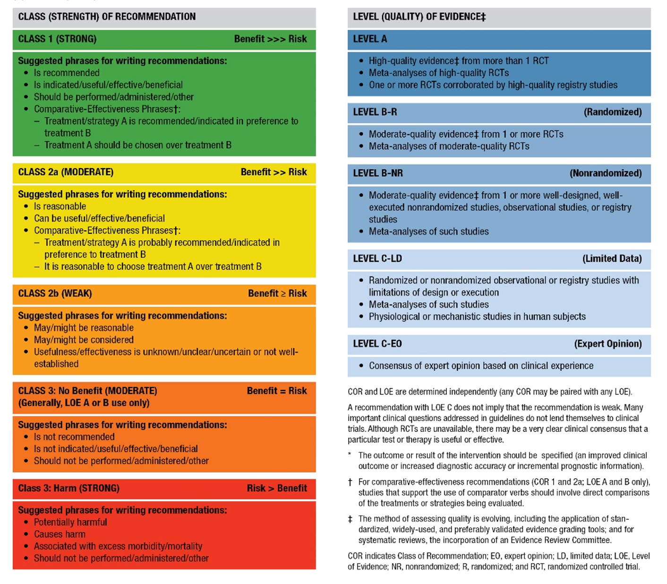
ACC/AHA Applying Class of Recommendation and Level of Evidence to Clinical Strategies, Interventions, Treatments, or Diagnostic Testing in Patient Care (Updated May 2019)*

Slide 3





Hypertrophic Cardiomyopathy (HCM) is a Globally Prevalent & Common Genetic Heart Disease
Inheritance Pattern
Sex Distribution
Disease Prevalence
Triggers for Evaluation
+/-
+/+
Symptoms
Cardiac Event
Heart Murmur
Abnormal EKG
Cardiac Imaging
Family Studies
50%
50%
+/-
Women diagnosed less commonly
Estimated
1:200 – 1:500
Autosomal Dominant
Other non-HCM Causes of LV Hypertrophy
⅔ have LVOTO
Metabolic & Multi-organ Syndromes
RASopathies
Mitochondrial myopathies
Glycogen / Lysosomal storage diseases
Amyloidosis
Sarcoidosis
Hemochromatosis
Danon disease
LV Outflow Tract
Obstruction (LVOTO)
Secondary Causes
Athlete’s heart
Hypertension
Valvular & subvalvular stenosis
HCM
⅓ do not have LVOTO
Abbreviations: EKG, indicates electrocardiogram; RAS, reticular activating system.

Slide 4
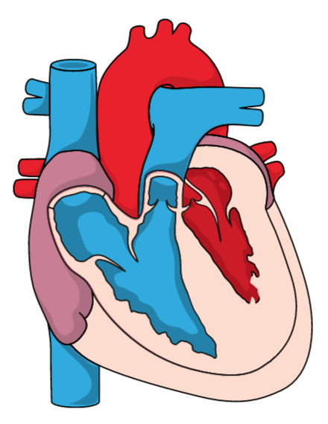

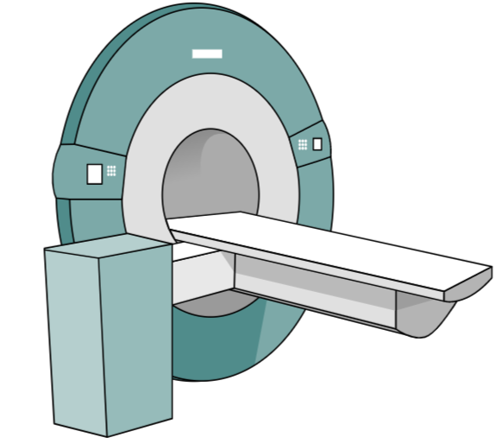
Defining Hypertrophic Cardiomyopathy in 2020
Morphologic expression confined solely to the heart
Characterized by left ventricular (LV) hypertrophy
Basal anterior septum in continuity with the anterior free wall = most common
No other cardiac, systemic or metabolic disease capable of producing the magnitude of hypertrophy present
Disease-causing sarcomere (or sarcomere-related) variant identified or genetic etiology unresolved
Diagnostic Criteria in Adults
Other Nondiagnostic Morphologic Abnormalities Associated with HCM
Systolic anterior motion (SAM) of the mitral valve
Hyperdynamic LV function
Hypertrophied & apically displaced papillary muscles
Myocardial crypts
Anomalous papillary muscle insertion in anterior MV leaflet
Elongated mitral valve leaflets
Myocardial bridging
Right ventricular hypertrophy
2D echocardiography or cardiac MRI
Maximal end-diastolic LV wall thickness > 15 mm
Maximal end-diastolic LV wall thickness 13-14 mm in family member of HCM pt. or in conjunction with positive genetic test
Abbreviations:2D, indicates two dimentional; MRI, magnetic resonance imaging; mm, millimeter; pt, patient.

Slide 5


Genetic Etiology of Hypertrophic Cardiomyopathy (HCM)
~30-60% of HCM patients have an identifiable pathogenic or
likely-pathogenic genetic variant
Many others have no genetic evidence of disease
and / or
no other affected family members
Sarcomere Genes Implicated in HCM
MYH7
MYBPC3
TNNI3
TNNT2
TPM1
MYL2
MYL3
ACTC1
Two most common genes that harbor
pathogenic variants in HCM (70%)

Slide 6



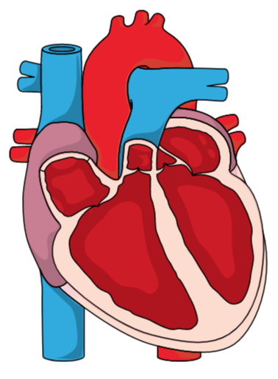
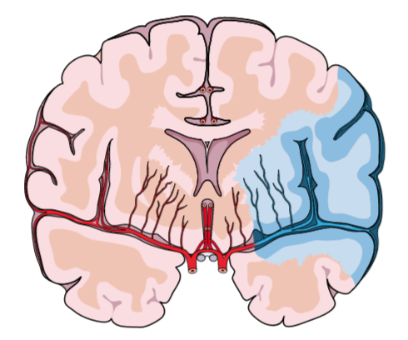

Adverse Event Associated Hypertrophic Cardiomyopathy
Majority of patients with HCM have a normal life expectancy without limiting symptoms or the need for major treatments
Sudden Death
Progressive Functional Limitation
Atrial Fibrillation
Thromboembolism
Heart Failure

Slide 7
Hypertrophic Cardiomyopathy Mortality Rates Now < 1% per Year
Improvements in Risk Stratification
ICD Implantation
Sudden Death
Now the greatest unmet treatment need in adults
Heart Failure
Abbreviations: ICD indicates implantable cardioverter-defibrillator.

Slide 8


Pathophysiologic Myocardial Changes in Hypertrophic Cardiomyopathy
LVOT Obstruction
Mitral Regurgitation
Myocardial Ischemia
Autonomic Dysfunction
Diastolic Dysfunction
Abbreviations: LVOT indicates left ventricular outflow tract.

Slide 9










Left Ventricular Outflow Tract Obstruction (LVOTO)
LVOTO, either at rest or with provocation, is present in approximately 75% (2/3) of patients with HCM
Septal Hypertrophy
Long Leaflets
Anterior displacement of the papillary muscles & mitral valve apparatus
Peak gradient of ≥30 mm Hg is considered to be indicative of obstruction
Narrow Left Ventricular Outflow Tract
Stroke Volume
Heart Failure
Survival
Abnormal Flow Vectors
Left Ventricular Hypertrophy
Systolic Anterior Motion
of the Mitral Valve
Left Ventricular Systolic Pressure
Dynamic LVOT
Contractility
Preload
Afterload
Myocardial Ischemia
LVOTO
Variable Location
Combined
Prolonged ventricular
relaxation
Resting or provoked gradients ≥50 mm Hg generally considered to be the threshold for septal reduction therapy (SRT) in those patients with drug refractory symptoms.
Mid-cavitary
Mitral Regurgitation
hypertrophied papillary muscles
compensatory mid-ventricular hyperkinesis
after apical infarction
anomalous
papillary muscle insertion

Slide 10




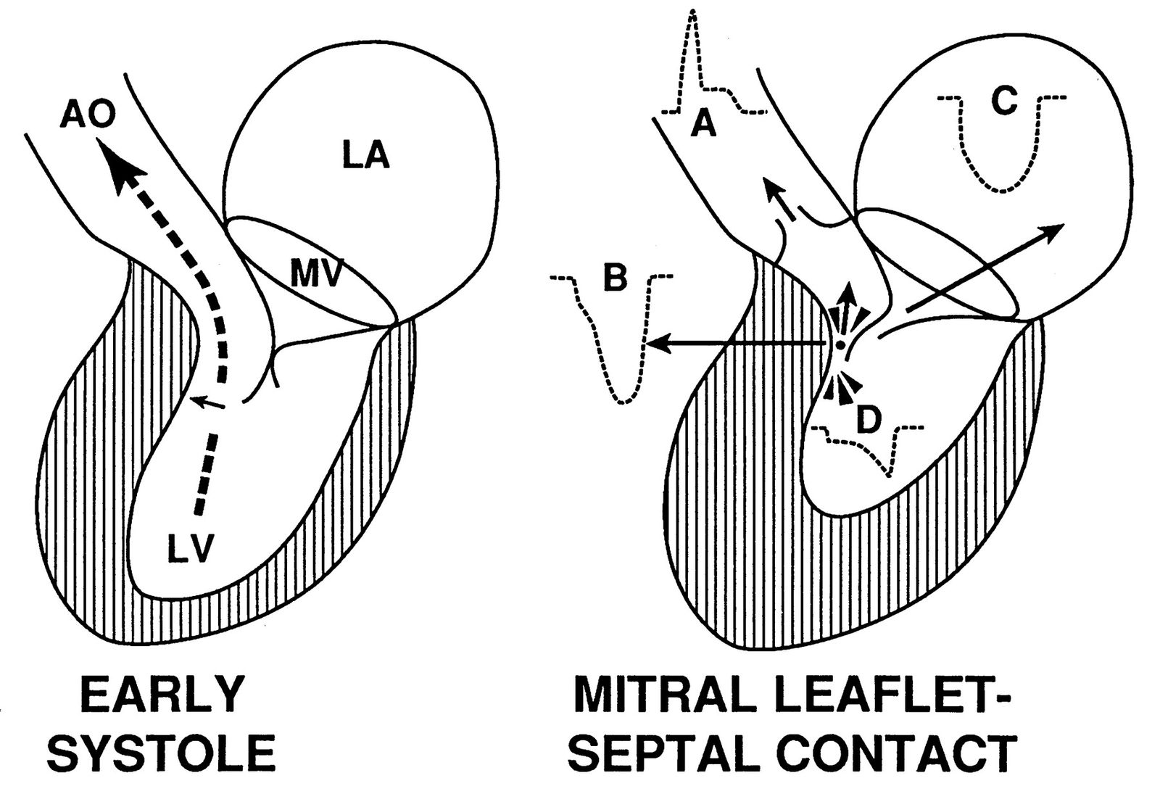
A Closer Look at Left Ventricular Outflow Tract Obstruction (LVOTO)
Primary leaflet abnormalities
Left Ventricular Outflow
Tract Obstruction (LVOT)
Mitral Regurgitation (MR)
Excessive leaflet length, anomalous papillary muscle insertion, & anteriorly displaced papillary muscles
Systolic Anterior Motion (SAM) of the Mitral Valve
Symptoms
In MR caused by LVOTO, SAM of the mitral valve leads to loss of leaflet coaptation, and the jet is predominantly mid-to-late systolic and posterior or lateral in orientation. However, central and anterior jets may also result from SAM of the mitral valve
Factors that affect the severity of LVOTO also may affect the degree of MR. Thus, significant MR may not be evident without provocation for LVOTO and SAM of the mitral valve.

Slide 11







Pathophysiology of Diastolic Dysfunction in HCM
Impaired Cellular Mechanisms
Altered Ventricular Load
Abnormal intracellular Ca reuptake
Altered systolic-diastolic coupling
Impaired cardiac cellular energetics
Diastolic Dysfunction
High Intracavitary Pressures
Non Uniformity in Contraction & Relaxation
Chamber Stiffness
Chamber Stiffness
Atrial Fibrillation
Left Atrial Fibrosis
Myocardial Hypertrophy
Ischemia
Interstitial Fibrosis
Stroke Volume
Left Ventricular Cavity Size

Slide 12
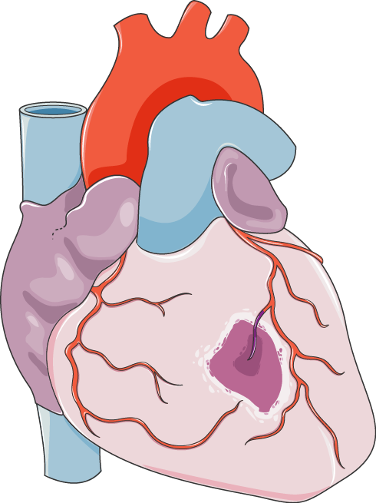




Pathophysiologic Mechanisms of Myocardial Ischemia in HCM
Microvascular Dysfunction
Medial Hypertrophy & Reduced Density of Arteries
Impaired Coronary
Flow Reserve
Myocardial
Hypertrophy
Increased Myocardial O₂ Demand
High Intracavitary Pressures
Oxygen Demand-Supply Mismatch
Left Ventricular Outflow Obstruction
Epicardial Coronary Artery Disease
Myocardial Bridging
Myocardial
Ischemia
Angina and/or Dyspnea
Heart Failure
Ventricular Arrhythmias
Left Ventricular Aneurysm
Diastolic Dysfunction

Slide 13
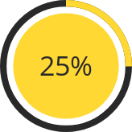
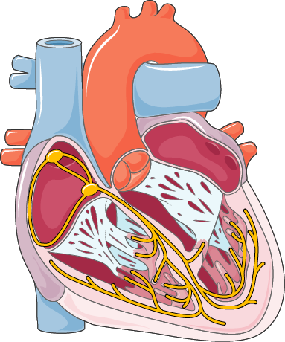




Autonomic Dysfunction in Hypertrophic Cardiomyopathy
Impaired Heart
Rate Response
Inappropriate Vasodilation
The prevalence of autonomic dysfunction in HCM is uncertain, although studies have described an abnormal blood pressure response to exercise in 25% of patients (1-3)
Impaired Response to Exercise*
* Failure to increase systolic blood
pressure by at least 20 mm Hg, or a drop in systolic blood
pressure during exercise of >20 mm Hg from the peak
value obtained
Diastolic Filling Abnormalities
Left Ventricular Outflow Tract Obstruction
Poor Prognosis
1. Maron BJ, Wolfson JK, Epstein SE, et al. Intramural (“small vessel”) coronary artery disease in hypertrophic cardiomyopathy. J Am Coll Cardiol. 1986;8:545– 57.
2. Karamitsos TD, Dass S, Suttie J, et al. Blunted myocardial oxygenation response during vasodilator stress in patients with hypertrophic cardiomyopathy. J Am Coll Cardiol. 2013;61:1169–76.
3. Raphael CE, Cooper R, Parker KH, et al. Mechanisms of myocardial ischemia in hypertrophic cardiomyopathy: insights from wave intensity analysis and magnetic resonance. J Am Coll Cardiol. 2016 Oct 11;68(15):1651-1660.

Slide 14










Recommendations for Shared Decision-Making in HCM
Discussions should involve:
-- Disclosure of risk and benefits
-- Anticipated outcomes of all options
--Goals, concerns and preferences of the patient (and family if the patient is a minor)
Shared decision discussions should be applied to:
--Genetic testing
--Sudden death risk assessment and ICD implantation
--Participation in high-intensity exercise and competitive sports
--Medical and invasive therapies for LVOT obstruction

Slide 15

Teams Based Approach to Hypertrophic Cardiomyopathy Care
Cardiologists Working Outside of HCM Centers:
Initial and Surveillance Testing
Initial Treatment Recommendations
Rapid Assessment for Change in Disease Course
HCM Centers:
Confirmation of Diagnosis
Genetic Counseling and Testing
Advanced Treatment Decisions and Procedures
Comprehensive HCM Centers:
Complex Invasive Septal Reduction Therapies
Catheter Ablation for Ventricular and Complex Atrial Tachyarrhythmias
Advanced Heart Failure Therapies

Slide 16

Role of the Cardiologist
Comprehensive HCM Centers:
Complex Invasive Septal Reduction Therapies
Catheter Ablation for Ventricular and Complex Atrial Tachyarrhythmias
Advanced Heart Failure Therapies
Cardiologists Outside of HCM Centers:
Initial and Surveillance Testing
Initial Treatment Recommendations
Rapid Assessment for Change in Disease Course
HCM Centers:
Confirmation of Diagnosis
Genetic Counseling and Testing
Advanced Treatment Decisions

Slide 17
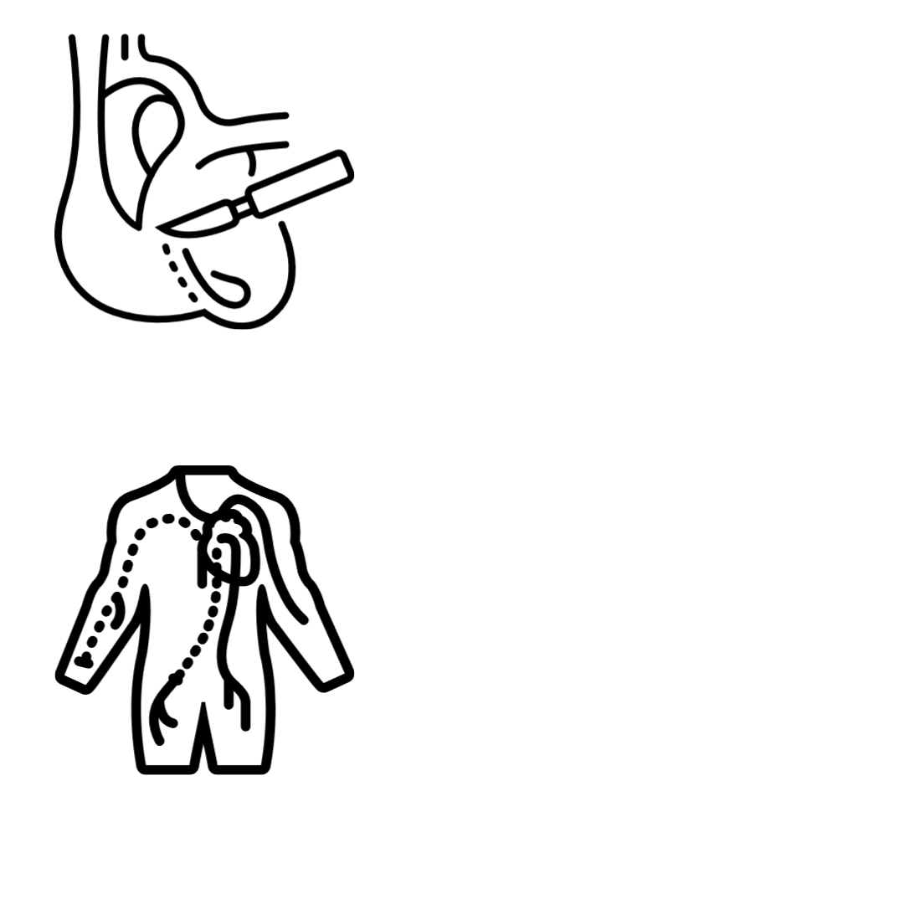
Recommendations for Septal Reduction Therapy
Invasive septal reduction therapy is associated with increased morbidity and mortality at low volume centers defined as centers with the lowest tertiles of hospital volumes
Referral to a high volume HCM Center should be strongly considered for invasive septal reduction therapy
Centers performing invasive septal reduction therapies should aim for outcomes similiar to comprehensive HCM Centers

Slide 18
Clinical Features in Patients with “HCM Mimics”
Life Stage | Systemic Features | Possible Etiology | Diagnostic Approach
Infants (0-12 months) and toddlers | Dysmorphic features, failure to thrive, metabolic acidosis | RASopathies Glycogen storage diseases, other metabolic or mitochondrial diseases Infant of a mother with diabetes | Geneticist assessment Newborn metabolic screening Specific metabolic assays Genetic testing
Early childhood | Delayed or abnormal cognitive development, visual or hearing impairment | RASopathies Mitochondrial diseases | Biochemical screening Genetic testing
School age and adolescence | Skeletal muscle weakness or movement disorder | Friedrich ataxia, Danon disease Mitochondrial disease | Biochemical screening Neuromuscular assessment Genetic testing
Adulthood | Movement disorder, peripheral neuropathy, renal dysfunction | Anderson-Fabry disease, Friedrich ataxia, infiltrative disorders (e.g., amyloidosis), glycogen storage diseases | Biochemical screening, Neuromuscular assessment Genetic testing
Abbreviations: RAS indicates reticular activating system.

Slide 19
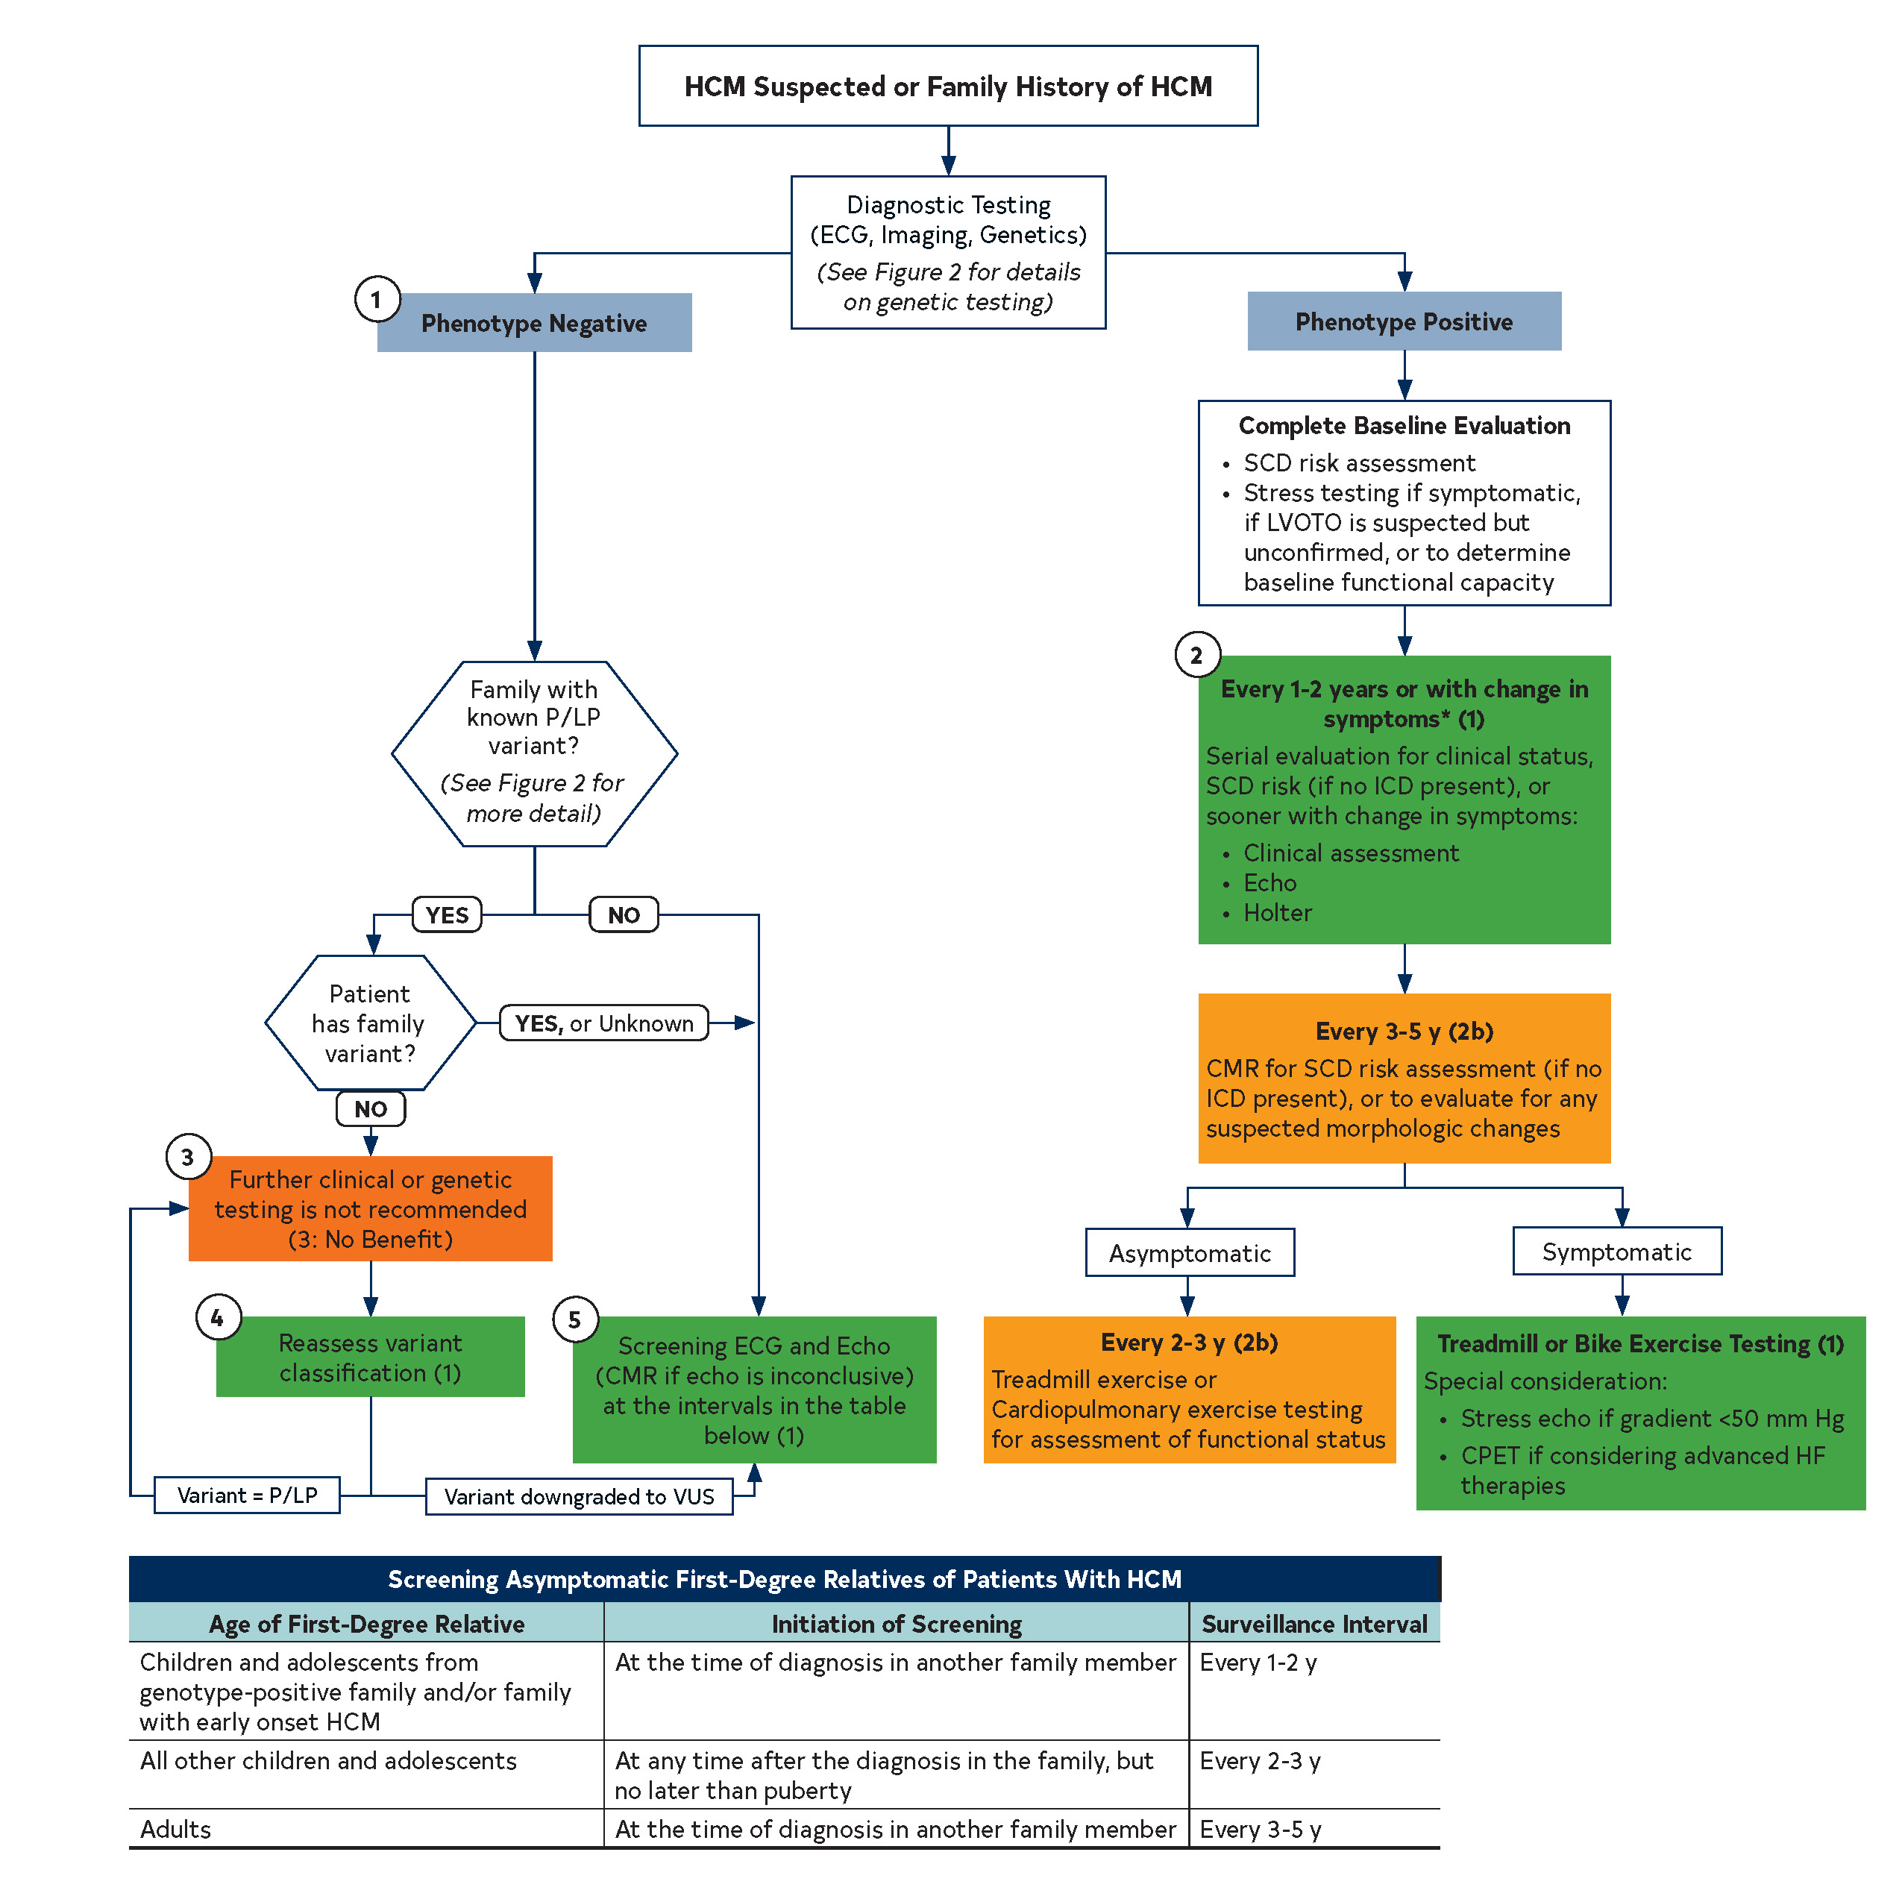
Recommended Evaluation and Testing for Suspected HCM or Family History of HCM
Phenotype Negative
(Slide 19)
Abbreviations: CMR indicates cardiovascular magnetic resonance; CPET, cardiopulmonary exercise test; ECG, electrocardiography/electrocardiogram; HCM, hypertrophic cardiomyopathy; HF, heart failure; ICD, implantable cardioverter-defibrillator; LVOTO, left ventricular outflow tract obstruction; P/LP, pathogenic or likely pathogenic variant; SCD, sudden cardiac death; and VUS, variant of unknown significance.

Slide 20
(1) Slide 19 - Screening with Electrocardiography and 2D Echocardiography Recommendations in Asymptomatic Family Members*
Age of First-Degree Relative | Initiation of Screening | Repeat ECG, Echo
Pediatric
Children and adolescents from genotype-positive families, and families with early onset disease | At the time HCM is diagnosed in another family member | Every 1-2 y
All other pediatric | At any time after HCM is diagnosed in a family member but no later than puberty | Every 2-3 y
Adults | At the time HCM is diagnosed in another family member | Every 3-5 y
*Includes all asymptomatic, phenotype-negative first-degree relatives deemed to be at-risk for developing HCM based on family history or genotype status and may sometimes include more distant relatives based on clinical judgment. Screening interval may be modified (e.g., at onset of new symptoms or in families with a malignant clinical course or late-onset HCM).
Abbreviations: ECG indicates electrocardiogram; Echo, echocardiogram; and HCM, hypertrophic cardiomyopathy.

Slide 21
Recommended Evaluation and Testing of Phenotype Positive HCM
Phenotype Positive
Abbreviations: CMR indicates cardiovascular magnetic resonance; CPET, cardiopulmonary exercise test; ECG, electrocardiography/electrocardiogram; HCM, hypertrophic cardiomyopathy; HF, heart failure; ICD, implantable cardioverter-defibrillator; LVOTO, left ventricular outflow tract obstruction; P/LP, pathogenic or likely pathogenic variant; SCD, sudden cardiac death; and VUS, variant of unknown significance.

Slide 22
Echocardiography Recommendations in Hypertrophic Cardiomyopathy
COR | LOE | Recommendations
1 | B-NR | 1. In patients with suspected HCM, a TTE is recommended in the initial evaluation.
1 | B-NR children | 2. In patients with HCM with no change in clinical status or events, repeat TTE is recommended every 1 to 2 years to assess the degree of myocardial hypertrophy, dynamic LVOTO, MR, and myocardial function.
1 | C-LD adults | 2. In patients with HCM with no change in clinical status or events, repeat TTE is recommended every 1 to 2 years to assess the degree of myocardial hypertrophy, dynamic LVOTO, MR, and myocardial function.
1 | B-NR | 3. For patients with HCM who experience a change in clinical status or a new clinical event, repeat TTE is recommended.
1 | B-NR | 4. For patients with HCM and resting LVOT gradient <50 mm Hg, a TTE with provocative maneuvers is recommended.
Abbreviations: COR indicates classification of recommendation; LOE, level of evidence; B-NR, Level B nonrandomized: C-LD, Level C, limited data; TTE, transthoracic echocardiogram; LVOTO, left ventricular outflow tract obstruction; MR, mitral regurgitation; LVOT, left ventricular outflow tract.

Slide 23
Cardiovascular Magnetic Resonance (CMR) Imaging Recommendations in HCM
COR | LOE | Recommendations
1 | B-NR | For patients suspected to have HCM in whom echocardiography is inconclusive, CMR imaging is indicated for diagnostic clarification
1 | B-NR | 2. For patients with LVH in whom there is a suspicion of alternative diagnoses, including infiltrative or storage disease as well as athlete’s heart, CMR imaging is useful.
1 | B-NR | 3. For patients with HCM who are not otherwise identified as high risk for SCD, or in whom a decision to proceed with ICD remains uncertain after clinical assessment that includes personal/family history, echocardiography, and ambulatory electrocardiographic monitoring, CMR imaging is beneficial to assess for maximum LV wall thickness, ejection fraction (EF), LV apical aneurysm, and extent of myocardial fibrosis with LGE.
1 | B-NR | 4. For patients with obstructive HCM in whom the anatomic mechanism of obstruction is inconclusive on echocardiography, CMR imaging is indicated to inform the selection and planning of SRT.
Abbreviations: SCD indicates sudden cardiac death; ICD, implanted cardioverter-defibrillator; LV, left ventricular; LGE, late gadolinium enhancement; SRT, septal reduction therapy; COR, classification of recommendation; LOE, level of evidence; B-NR, Level B nonrandomized.

Slide 24




Risk Assessment of Sudden Cardiac Death (SCD) in HCM
At initial evaluation and every 1-2 years (Class I)
Assess the following (Class I):
Personal history of cardiac arrest, sustained ventricular arrhythmia,
OR unexplained syncope suspected to be arrhythmic
Family history of premature SCD in a close relative
Maximal LV wall thickness, EF<=50%, apical aneurysm
NSVT episodes on continuous ambulatory electrocardiographic
monitoring; In select adult patients without major SCD risk factors, ICD may be considered in NSVT present on ambulatory monitoring (Class IIb).
IF none of the above:
CMR to help decision regarding ICD (Class I)
Reasonable to obtain echocardiographic LA diameter and LVOT gradient (Class IIa)
Abbreviations: EF indicates ejection fraction; NSVT, non-sustained ventricular tachycardia; CMR, cardiovascular magnetic resonance; ICD, implantable cardioverter defibrillator; LA, left atrium; LVOT, left ventricular outflow tract.

Slide 25






Indications for ICD in HCM Patients
Risk Factors
Recommendations
SCD, VF or sustained VT
If Yes
An ICD is recommended (Class I)
At least one of the following:
Massive LVH
FH of SCD
Unexplained syncope
Apical aneurysm
EF<=50%
An ICD is reasonable (Class IIa)
An ICD is reasonable (Class IIa)
If Yes
Consider using 5-year risk estimator tool for SCD to aid in decision making.
If Yes in Children
NSVT
If Yes in Adults
An ICD may be considered (Class IIb)
An ICD may be considered (Class IIb)
Significant LGE on CMR
If Yes
If No Risk Factors
An ICD is not indicated (Class III)
Abbreviations: ICD indicates implantable cardioverter defibrillator; SCD, sudden cardiac death; VF, ventricular fibrillation; VT, ventricular tachycardia; LVH, left ventricular hypertrophy; FH, family history; EF, ejection fraction; NSVT, non-sustained ventricular tachycardia; LGE, late gadolinium enhancement; CMR, cardiac magnetic resonance imaging.

Slide 26
Pharmacologic Management Based on Type of HCM
Obstructive
Discontinue
Vasodilators
Digoxin
High dose diuretics
Nonobstructive/Preserved EF
(symptoms of exertional angina or dyspnea)
Symptoms r/t LVOTO
Persistent dyspnea with volume overload
non-vasodilating
β blockers
ARBs/ACEi in symptomatic patients is not well established.
Acute Hypotension
Cautious use of low-dose oral diuretics
Therefore treatment includes:
If not effective:
IV Fluids
β blockers or CCBs*
CCBs *
If no response:
If dyspnea continues:
Verapamil is potentially harmful in severe dyspnea at rest, very high gradients and in children < 6 weeks
Diuresis
Phenylephrine ±
β blockers
If persistent severe symptoms:
In persistent NYHA class III/VI + apical HCM
Treat with GDMT for HFpEF
OR
Add Disopyramide
Septal reduction therapy in eligible patients
Apical myectomyⱡ
Nonobstructive/Preserved EF
(asymptomatic)
The following is not well established:
β blockers or CCBs if asymptomatic
*non-dihydropyridine calcium channel blockers (CCBs)
ⱡLV end-diastolic volume <50 mL/m2 and LV stroke volume <30 mL/m2
Abbreviations: CCBs indicates calcium channel blockers; LVOTO, left ventricular outflow tract obstruction; IV, intravenous; EF, ejection fraction; ACEi, angiotensin-converting enzyme inhibitors; ARBs, angiotensin receptor blockers: GDMT: goal-directed medical therapy; HFpEF: heart failure with preserved ejection fraction

Slide 27
Invasive Management of Obstructive HCM
Obstructive HCM with NYHA class III/IV despite GDMT
Alcohol septal ablation is recommended for eligible patients if surgery is contraindicated or the risk is considered unacceptable because of serious comorbidities or advanced age
Myectomy is recommended if associated conditions exist where surgical treatment is necessary (such as: associated anomalous papillary muscle, markedly elongated anterior mitral leaflet, intrinsic mitral valve disease, multivessel CAD, valvular aortic stenosis)
SRT at an experienced center
SRT at an experienced center
For severely symptomatic patients, SRT in eligible patients, performed at experienced centers, may be considered as an alternative to escalation of medical therapy after shared decision-making including risks and benefits of all treatment options
Myectomy is reasonable in patients with NYHA class II if:
a) Severe and progressive pulmonary hypertension thought to be attributable to LVOTO or associated MR
b) Left atrial enlargement with >1 episodes of symptomatic AF
c) Poor functional capacity attributable to LVOTO as documented on treadmill exercise testing
d) Children and young adults with very high resting LVOT gradients (>100 mm Hg)
For symptomatic patients in whom SRT is an option, mitral valve replacement should not be performed for the sole purpose of relief of LVOTO
Abbreviations: GDMT indicates guideline directed medical therapy; NYHA, New York Heart Association; SRT, septal reduction therapy; CAD, coronary artery disease; MR, mitral regurgitation; LVOTO, left ventricular outflow tract obstruction; AF, atrial fibrillation.

Slide 28

Atrial Fibrillation (AF) in Hypertrophic Cardiomyopathy
In patients with clinical AF or subclinical AF (duration ≥ 24 hours) DOACs are first line
Vitamin K antagonists are second line Independent of CHA₂DS₂-VASc score
For rate control strategy use either beta blockers, verapamil or diltiazem.
In patients with poorly tolerated AF, a rhythm control strategy with cardioversion or anti-arrhythmic drugs can be beneficial
AF catheter ablation can be effective when drug therapy is ineffective, contraindicated or not patient’s preference
In patients with AF undergoing myectomy , surgical AF ablation can be beneficial
Abbreviations: DOACs indicates direct-acting oral anticoagulants.

Slide 29
Management of HCM and Ventricular Arrhythmias
Anti tachycardia pacing to minimize shocks
Despite AAD and ablation
Recurrent ICD shocks despite
β-blockers
Recurrent VT
If ineffective, not tolerated or not preferred
AAD
Amiodarone
Dofetilide*
Mexiletine
Sotalol
Heart transplant
Catheter ablation
* Not in children
Abbreviations: AAD indicates antiarrhythmic drug therapy; VT, ventricular tachycardia; ICD, implantable cardioverter-defibrillator.

Slide 30
Hypertrophic Cardiomyopathy with Advanced Heart Failure
LVAD is reasonable bridge to transplant
LVEF
≤50%
LBBB
If NYHA class II-IV and LVEF ≤50%, consider CRT
Consider discontinuing negative inotropic agents
NYHA ≥ III
ICD maybe beneficial
LVEF
≤50%
If recurrent ventricular arrhythmias, refer for transplant
Despite medical therapy, consider CPET evaluation
NYHA
≥ III
NYHA ≥ III
Rule out
Other cause of LV systolic dysfunction
LVEF≤50%
Guideline-directed medical therapy similar to HFrEF
Abbreviations: LVEF indicates left ventricular ejection fraction; LV, left ventricular; HFrEF, heart failure reduced ventricular function; CPET, cardiopulmonary exercise testing; NYHA, New York
Heart Association; LVAD, left ventricular assist device; ICD, implantable cardioverter defibrillator; LBBB, left bundle branch block; CRT, cardiac resynchronization therapy.

Slide 31





Lifestyle Considerations in HCM
Mild to moderate intensity exercise if beneficial (Class I)
Comprehensive evaluation and shared discussion regarding sports participation
are recommended (Class I)
Patients with other comorbidities, prevention and management of atherosclerotic cardiovascular disease are recommended (Class I)
It is reasonable to follow the Federal Motor Carrier Safety Guidelines that permit driving commercial vehicles for those who do not have ICD or any major risk for
SCD (Class IIa)
For pilots with HCM, it is reasonable to permit multi-crew flying duties if they are asymptomatic, low risk for SCD and complete a treadmill stress test (Class IIa)
Moderate to high intensity exercise maybe considered after comprehensive evaluation and shared discussion (Class IIb)
ICD placement for the sole purpose of participation in competitive athletics should
not be performed (Class III)
Abbreviations: HCM indicates hypertrophic cardiomyopathy; ICD, implantable cardioverter defibrillator; SCD, sudden cardiac death.

Slide 32







Recommendations for HCM in Pregnancy
In high risk HCM, consultation with a maternal-fetal medicine expert is recommended (Class I).
In patients with HCM and atrial fibrillation or other indications for anti-coagulation, low-molecular weight heparin or low dose warfarin are recommended (Class I).
Selected beta-blocker should be administered for symptoms of LVOT obstruction or arrhythmia, with continued fetal monitoring (Class I).
Vaginal delivery is the first-choice delivery option in HCM (Class I).
In clinically stable HCM, it is reasonable to advise pregnancy is generally safe as part
of shared discussion (Class IIa).
Reasonable to cardiovert new or recurrent atrial fibrillation, especially if symptomatic
(Class IIa).
Reasonable to perform serial echocardiography in the second or third trimester, or if
symptoms develop (Class IIa).
Abbreviations: HCM indicates hypertrophic cardiomyopathy; LVOT, left ventricular outflow tract.

Slide 33





Unmet Needs
Randomized clinical trials are needed to prevent or attenuate disease progression, explore new therapies and gender-specific outcomes in HCM.
New risk factors to enhance the power of risk stratification algorithms, especially in children.
Pharmacological and catheter-based ablation for arrhythmia management, especially in young patients.
Greater access to genetic counseling and testing.
More data needed regarding potential risks of exercise and sports in patients with HCM.
Abbreviations: HCM indicates hypertrophic cardiomyopathy.

Slide 34
Many thanks to our Guideline Ambassadors who were guided by
Dr. Elliott Antman in developing this translational learning product adapted from the ACC/AHA 2020 Hypertrophic Cardiomyopathy Guideline.
HCM
Yuvraj Chowdhury, MD
Marat Fudim, MD, MHS
Ahmad Masri, MD, MS
Nosheen Reza, MD
Jainy Savla, MD
Lina Ya'qoub, MD
Ommen, SR et al. 2020 ACC/AHA Guideline for the Diagnosis and Treatment of Patients with Hypertrophic Cardiomyopathy. Circulation. XXX:XX-XX.

