Slide 1
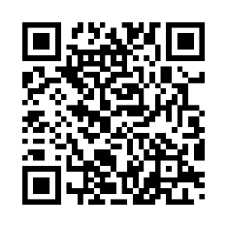
Guideline Essentials:
American Heart Association
Clinical Slide Series
ADAPTED FROM:
2026 AHA/ASA Guideline for
Adult Stroke Rehabilitation
and Recovery
AHA Clinical (PPTX)

Slide 2
Table 1.
Applying Class of Recommendation and Level of Evidence to Clinical Strategies, Interventions, Treatments, or Diagnostic Testing in Patient Care
CLASS (STRENGTH) OF RECOMMENDATION
CLASS 1 (STRONG) Benefit >>> Risk
Suggested phrases for writing recommendations: Is recommended Is indicated/useful/effective/beneficial Should be performed/administered/other Comparative-Effectiveness Phrases†: Treatment/strategy A is recommended/indicated in preference to treatment B Treatment A should be chosen over treatment B
CLASS 2a (MODERATE) Benefit >> Risk
Suggested phrases for writing recommendations: Is reasonable Can be useful/effective/beneficial Comparative-Effectiveness Phrases†: Treatment/strategy A is probably recommended/indicated in preference to treatment B It is reasonable to choose treatment A over treatment B
CLASS 2b (Weak) Benefit ≥ Risk
Suggested phrases for writing recommendations: May/might be reasonable May/might be considered Usefulness/effectiveness is unknown/unclear/uncertain or not well-established
CLASS 3: No Benefit (MODERATE) Benefit = Risk
Suggested phrases for writing recommendations: Is not recommended Is not indicated/useful/effective/beneficial Should not be performed/administered/other
CLASS 3: Harm (STRONG) Risk > Benefit
Suggested phrases for writing recommendations: Potentially harmful Causes harm Associated with excess morbidity/mortality Should not be performed/administered/other
LEVEL (QUALITY) OF EVIDENCE‡
LEVEL A
High-quality evidence‡ from more than 1 RCT Meta-analyses of high-quality RCTs One or more RCTs corroborated by high-quality registry studies
LEVEL B-R (Randomized)
Moderate-quality evidence‡ from 1 or more RCTs Meta-analyses of moderate-quality RCTs
LEVEL B-NR (Nonrandomized)
Moderate-quality evidence‡ from 1 or more well-designed, well-executed nonrandomized studies, observational studies, or registry studies Meta-analyses of such studies
LEVEL C-LD (Limited Data)
Randomized or nonrandomized observational or registry studies with limitations of design or execution Meta-analyses of such studies Physiological or mechanistic studies in human subjects
LEVEL C-EO (Expert Opinion)
Consensus of expert opinion based on clinical experience.
Abbreviations:
SNF indicates skilled nursing facility; IRF, inpatient rehabilitation facility; and LTCH, long-term care hospital.
COR and LOE are determined independently (any COR may be paired with any LOE).
A recommendation with LOE C does not imply that the recommendation is weak. Many important clinical questions addressed in guidelines do not lend themselves to clinical trials. Although RCTs are unavailable, there may be a very clear clinical consensus that a particular test or therapy is useful or effective.
* The outcome or result of the intervention should be specified (an improved clinical outcome or increased diagnostic accuracy or incremental prognostic information).
† For comparative-effectiveness recommendation (COR 1 and 2a; LOE A and B only), studies that support the use of comparator verbs should involve direct comparisons of the treatments or strategies being evaluated.
‡ The method of assessing quality is evolving, including the application of standardized, widely-used, and preferably validated evidence grading tools; and for systematic reviews, the incorporation of an Evidence Review Committee.
COR indicates Class of Recommendation; EO, expert opinion; LD, limited data; LOE, Level of Evidence; NR, nonrandomized; R, randomized; and RCT, randomized controlled trial.
Richards, L.G., et al. 2026 AHA/ASA Guideline for the Adult Stroke Rehabilitation and Recovery. Stroke.

Slide 3
The Path from Acute Stroke through
Rehabilitation and Recovery
Abbreviations: SNF indicates skilled nursing facility; IRF, inpatient rehabilitation facility; and LTCH, long-term care hospital.

Slide 4
Emotional Responses and Pathway During Stroke Recovery

Slide 5
Overview: 11 Top Take-Home Messages
2026 AHA/ASA Guideline for Adult Stroke Rehabilitation and Recovery
1. Multidisciplinary Therapeutics
7. Care Partner Well-Being Requirements
2. Longitudinal Communication for Care Team
8. Mental Health Post-Stroke
3. Acute and Long-Term Rehabilitation
9. Telehealth's Role
4. Restore Structure and Function with Targeted Therapies
10. Clinical Trials of Rehabilitation Interventions are Needed
5. Reduce Functional Impairments with Task Practice
11. Standardized Outcome Measures for Behavioral Interventions
6. Rehabilitation Therapy Reassessment and Re-engagement

Slide 6

1. Multidisciplinary Therapeutics
TAKE-HOME MESSAGE
Goals of rehabilitation:
Reduce neurological impairment
Improve function via restorative and compensatory interventions
For successful outcomes, it is critical to:
Participate in coordinated therapeutics
Use a multidisciplinary approach
GUIDELINE RECOMMENDATION
In persons with stroke who are candidates for post-acute rehabilitation, organized, coordinated, interprofessional care is recommended to achieve maximal functional independence.
MDT
Multidisciplinary team approach
Class 1
Abbreviations: MDT indicates multidisciplinary team. Recommendation: 2.1.1

Slide 7

2. Longitudinal Communication for Care Team
TAKE-HOME MESSAGE
Stroke rehabilitation requires:
Close communication among interprofessional team
Integration of care among the interprofessional team
Longitudinal communication among providers is
critical to delivering:
Efficient, effective and high-value rehabilitation
Care across the continuum
GUIDELINE RECOMMENDATION
In persons with stroke seeking outpatient or home-based rehabilitation, organized community-based and coordinated interprofessional rehabilitation care is recommended to achieve more functional improvement.
COMM
Ongoing
care team communication
Class 1
Recommendation: 2.1.3

Slide 8
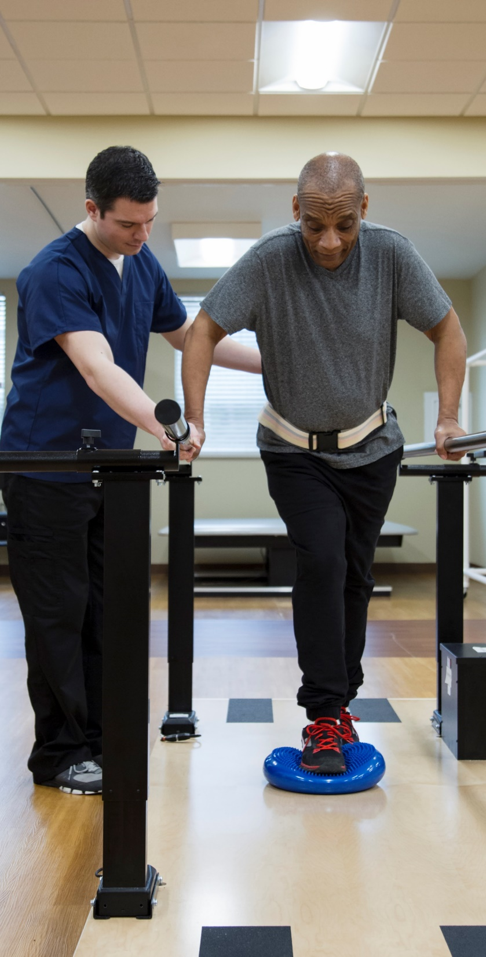
3. Acute and Long-Term Rehabilitation
TAKE-HOME MESSAGE
Rehabilitation:
Begins in the acute phase
Continues long-term
No expiration date on rehabilitation potential
Initiation in the acute phase is associated with better outcomes
REHAB
Acute through long-term recovery

Slide 9
3. Acute and Long-Term Rehabilitation
GUIDELINE RECOMMENDATIONS
In persons with stroke in the acute phase, early mobilization should be undertaken using a graduated mobilization protocol that commences 24-48 hours after stroke onset to improve functional outcomes and quality of life.
In persons with acute stroke, high-dose mobilization
within the first 24 hours after stroke
onset should not be performed to avoid risk of
neurological worsening and worsened functional
outcomes.
Class 1
REHAB
Acute through long-term recovery
Class 3: Harm
Recommendation: 2.2.1, 2.2.2

Slide 10

4. Restore Structure and Function with Targeted Therapies
TAKE-HOME MESSAGE
Rehabilitation combines interventions for:
Restitution of body structure and function
Learning compensatory strategies
Better methods are needed to select:
Treatment approaches
Timing of interventions
Dosing of various interventions
TARGET
Targeted neurological therapies

Slide 11
4. Restore Structure and Function with Targeted Therapies
GUIDELINE RECOMMENDATIONS
In persons with stroke, an individually tailored exercise program is indicated to optimize physical health, including cardiorespiratory fitness, mobility and to reduce the risk of future vascular events.
For persons with stroke, an evidence-based, goal-oriented, multidisciplinary physical rehabilitation program is recommended to improve gait and mobility.
TARGET
Targeted neurological therapies
Class 1
Recommendation: 5.1.1, 5.5.1

Slide 12
4. Restore Structure and Function with Targeted Therapies
GUIDELINE RECOMMENDATIONS
In persons with stroke with cognitive impairments, supervised moderate- to high-intensity technology-supported cognitive training programs that are tailored and adaptive to performance are recommended to improve global cognition, attention, and working memory.
In persons with stroke and aphasia, a variety of speech and language treatment approaches should be administered to facilitate restorative or compensatory communication.
TARGET
Targeted neurological therapies
Class 1
Recommendation: 6.1.1, 6.2.2

Slide 13
4. Restore Structure and Function with Targeted Therapies
GUIDELINE RECOMMENDATIONS
In persons with post-stroke hemiparesis, ADL training tailored to individual needs and eventual discharge setting is useful to achieve an optimal level of independence.
Persons with stroke should receive IADL training tailored to individual needs and eventual discharge setting for optimal function.
TARGET
Targeted neurological therapies
Class 1
Recommendation: 5.6.1, 5.6.2

Slide 14

5. Reduce Upper Limb Functional Impairments with Task Practice
TAKE-HOME MESSAGE
Interventions to reduce upper limb impairments and implementing compensatory strategies depend on a learning process driven by:
Continuous repetition
Diverse forms of task practice, including constraint-induced movement therapy
GUIDELINE RECOMMENDATION
In persons with stroke, participation in a program of task-specific upper limb activities commencing in rehabilitation and continuing at home or in the community is recommended to optimize upper limb function and performing activities of daily living.
TASK
Task-specific practice improves upper limb function
Class 1
Recommendations: 5.6.3

Slide 15
5. Reduce Gait and Mobility Impairments with Task Practice
TAKE-HOME MESSAGE
Interventions to reduce gait and mobility impairments and implementing compensatory strategies depend on a learning process driven by:
Task-specific training focused on overground walking, stepping and balance
GUIDELINE RECOMMENDATION
In persons with stroke, participation in a program of task-specific activities commencing in rehabilitation and continuing at home or in the community is recommended to optimize gait and mobility.
TASK
Task-specific practice improves gait and mobility
Class 1
Recommendations: 5.5.2

Slide 16
5. Improve Cognition through Exercise and Physical Activity
TAKE-HOME MESSAGE
Exercise and physical activity have beneficial effects on cognition after stroke.
GUIDELINE RECOMMENDATION
In persons with stroke, participation in a regular program of exercise or physical activity commencing in rehabilitation and continuing at home or in the community is recommended to optimize cognitive health.
TASK
Exercise and Physical Activity improves cognition
Class 1
Recommendation: 5.1.2

Slide 17
5. Using Behavioral Swallowing treatments for Dysphagia
GUIDELINE RECOMMENDATION
For patients with stroke-associated dysphagia, behavioral swallowing treatment is effective for improving swallowing function, increasing tolerance of food textures, reducing the risk of negative health outcomes, and improving quality of life.
TASK
Behavioral swallowing treatments improves health and quality of life
Class 1
Recommendation: 5.10.10

Slide 18

6. Rehabilitation Therapy Reassessment and Re-engagement
TAKE-HOME MESSAGE
Ongoing rehabilitation may require:
Periodic reassessment
Re-engagement in therapy at various time points
GUIDELINE RECOMMENDATION
In persons with stroke, a formal assessment of body structures and functions, activity limitations and participation restrictions, and personal and environmental factors is recommended to inform treatment planning, care transitions, and discharge planning.
RE-ASSESS
Ongoing therapy reassessment
Class 1
Recommendation: 4.1.1

Slide 19

7. Care Partner Well-Being Requirements
TAKE-HOME MESSAGE
Care partners need comprehensive education and training to effectively support:
Their own health and well-being
The stroke survivor's rehabilitation and recovery
CARE
Support for care partners

Slide 20
7. Care Partner Well-Being Requirements continued
GUIDELINE RECOMMENDATIONS
Active and intentional engagement of caregivers of persons with stroke as early as possible and throughout rehabilitation can be beneficial to improve knowledge about stroke, mental health and caregiver burden.
For persons with stroke, involving caregivers in education and training using teach-back about care and rehabilitation activities can be beneficial to improve patient and caregiver outcomes such as experience of care, activities of daily living and mobility.
CARE
Support for care partners
Class 2a
Recommendations: 7.2.1 and 7.2.2

Slide 21

8. Mental Health Post-Stroke
TAKE-HOME MESSAGE
Mental health:
Key component of successful recovery after stroke
Post-stroke depression:
Common
Treatable
Can interfere with successful rehabilitation
Screening for this condition is advised
GUIDELINE RECOMMENDATION
In persons with stroke, early screening using a valid screening instrument for post-stroke depression (from 3 days to 3 months post-stroke) is recommended to identify individuals in need of further evaluation and treatment.
MH
Mental health screening & support
Class 1
Abbreviations: MH indicates mental health. Recommendation: 3.7.1

Slide 22

9. Telehealth's Role
TAKE-HOME MESSAGE
Telehealth:
Growing role in supporting care transitions
Growing role in rehabilitation across the continuum after stroke
Provides opportunities to improve access to care
Provides opportunities to improve the cost-effectiveness of care
GUIDELINE RECOMMENDATION
For persons living at home after mild to moderate stroke, telerehabilitation therapies are reasonable alternatives to in-person therapies when access to these in-person therapies is limited or absent.
TELE
Telehealth in stroke rehabilitation
Class 2a
Recommendation: 7.4.3

Slide 23

10. Clinical Trials of Stroke Rehabilitation Interventions are Needed
TAKE-HOME MESSAGE
To advance mechanism-based, personalized approaches to stroke rehabilitation, the field requires:
Larger, well-designed clinical trials: Essential for filling current evidence gaps regarding rehabilitation interventions.
Continued basic and translational research: Necessary to deepen our understanding of nervous system injury and recovery
RCT
Evidence from clinical trials needed
Abbreviations: RCT indicates randomized controlled trial.

Slide 24

11. Standardized Outcome Measures for Behavioral Interventions
TAKE-HOME MESSAGE
The successful identification and implementation of future stroke interventions depend on utilizing outcome measures that are both:
Standardized: Uniformly applied to ensure reliable data.
Behavior-specific: Directly relevant to behavioral intervention strategies
OUTCOMES
Standardized measurement frameworks

Slide 25
Overview: 11 Top Take-Home Messages
2026 AHA/ASA Guideline for Adult Stroke Rehabilitation and Recovery
1. Multidisciplinary Therapeutics - Multidisciplinary team approach for successful rehabilitation outcomes
7. Care Partner Well-Being Requirements –
Care giver education and training to support self-care and stroke survivor’s recovery
2. Longitudinal Communication for Care Team – Critical to delivering effective care across the continuum
8. Mental Health Post-Stroke – Screening advised for depression, which is common and treatable
3. Acute and Long-Term Rehabilitation –
No expiration date on recovery potential
9. Telehealth’s Role – Supports care transitions
and rehabilitation, improves care access and
cost-effectiveness
4. Restore Structure and Function with Targeted Therapies – Better methods are needed to select treatment approaches, timing, and dosing
10. Clinical Trials of Stroke Rehabilitation Interventions are Needed – To advance nervous system understanding and personalized strategy development
5. Reduce Functional Impairments with Task Practice – Continuous repetition and diverse forms of task practice support learning processes
11. Standardized Outcome Measures for Behavioral Interventions are Needed – For identification and implementation of future strategies.
6. Therapy Reassessment and Re-engagement – Required for ongoing rehabilitation

Slide 26
Reference & Attribution
CITATION
The American Heart Association requests this electronic slide deck be cited as follows:
Reyna, G.G. (2026). Guideline Essentials: Clinical Slide Series [PowerPoint slides]; Adapted from 2026 AHA/ASA Guideline for Adult Stroke Rehabilitation and Recovery. Stroke. Guideline Essentials: AHA Clinical Slide Series - Professional Heart Daily | American Heart Association
EDUCATIONAL USE NOTICE
This slide set was prepared by the American Heart Association Lifelong Learning Science and Health Advisor team as a guideline derivative product for educational purposes. Content is adapted from the published guideline; clinicians should refer to the full guideline document for complete recommendations, evidence tables, and COR/LOE ratings.

Slide 27
Copyright and Permissions Notice
© Copyright 2026. American Heart Association. All rights reserved.
This material is the copyrighted property of the American Heart Association and is provided for reference purposes only. It may not be copied, reproduced, stored in a retrieval system, transmitted, altered in any way or used as a derivative work, or distributed in any form or by any means—electronic, mechanical, photocopying, recording, or otherwise—without prior written permission from the publisher.
This content may be used for limited educational and personal use.
Further distribution or dissemination requires a licensing agreement. Unauthorized use or distribution in any media is strictly prohibited.
For permissions inquiries and licensing fee information,
please see the information/Request Form at this link:
https://www.heart.org/en/about-us/statements-and-policies/copyright-request-form

