Slide 1
2025 AHA/ACC/AANP/AAPA/ABC/ACCP/ACPM/AGS/AMA/ASPC/
NMA/PCNA/SGIM
Guideline for the Prevention, Detection, Evaluation, and Management of High Blood Pressure in Adults
A Report of the American Heart Association/American College of Cardiology Joint Committee on Clinical Practice Guidelines
Developed in Collaboration With and Endorsed by American Academy of Physician Associates; American Association of Nurse Practitioners; American College of Clinical Pharmacy; American College of Preventive Medicine; American Geriatrics Society; American Medical Association; American Society of Preventive Cardiology; Association of Black Cardiologists; National Medical Association; Preventive Cardiovascular Nurses Association; and the Society of General Internal Medicine.

Slide 2
Citation
This slide set is adapted from the 2025 AHA/ACC/AANP/AAPA/ABC/ACCP/ACPM/AGS/AMA/ASPC/NMA/PCNA/SGIM Guideline for the Prevention, Detection, Evaluation, and Management of High Blood Pressure in Adults. Published ahead of print August 14, 2025, available at: Circulation. https://www.ahajournals.org/doi/10.1161/CIR.0000000000001356 And Journal of the American College of Cardiology, published online ahead of print August 14, 2025. J Am Coll Cardiol. https://www.jacc.org/doi/10.1016/j.jacc.2025.05.007
© 2025 the American Heart Association, Inc. and the American College of Cardiology Foundation. All rights reserved. This article has been published in Circulation and the Journal of the American College of Cardiology.

Slide 3
2025 Writing Committee Members*
Daniel W. Jones, MD, FAHA, Chair
Keith C. Ferdinand, MD, FACC, FAHA, FASPC, Vice Chair
Sandra J. Taler, MD, FAHA, Vice Chair
Heather M. Johnson, MD, MS, FAHA, FACC, FASPC, JC Liaison†
Daichi Shimbo, MD, JC Liaison†
Marwah Abdalla, MD, MPH, FAHA, FACC‡
M. Martine Altieri, PA-C, MHSc§
Nisha Bansal, MD, MAS, FAHA
Natalie A. Bello, MD, MPH, FACC
Adam P. Bress, PharmD, MS║
Jocelyn Carter, MD, MPH¶
Jordana B. Cohen, MD, MSCE, FAHA
Karen J. Collins, MBA
Yvonne Commodore-Mensah, PhD, MHS, BSN, RN, FAHA, FPCNA#
Leslie L. Davis, PhD, ANP-BC, FACC, FAHA
Brent Egan, MD, FAHA**
Sadiya S. Khan, MD, MSc, FACC, FAHA
Donald M. Lloyd-Jones, MD, ScM, FAHA, FACC
Bernadette Mazurek Melnyk, PhD, APRN-CNP, FAANP††
Eva A. Mistry, MBBS, MSCI, FAHA
Modele O. Ogunniyi, MD, MPH, FACC, FAHA‡‡
Stacey L. Schott, MD, MPH§§
Sidney C. Smith Jr., MD, FAHA, MACC
Amy W. Talbot, MPH
Wanpen Vongpatanasin, MD, FAHA, FACC
Karol E. Watson, MD, PhD, FACC, FAHA, FASPC║║
Paul K. Whelton, MB, MD, MSc, FAHA
Jeff D. Williamson, MD, MHS, FAGS¶¶
*Writing committee members are required to recuse themselves from voting on sections to which their specific relationships with industry may apply; see Appendix 1 for detailed information. †ACC/AHA Joint Committee on Clinical Practice Guidelines. ‡Association of Black Cardiologists Representative. §American Academy of Physician Associates Representative. ║American College of Clinical Pharmacy Representative. ¶Society of General Internal Medicine Representative. #Preventive Cardiovascular Nurses Association Representative.
**American Medical Association Representative. ††American Association of Nurse Practitioners Representative. ‡‡National Medical Association Representative. §§American College of Preventive Medicine Representative. ║║American Society of Preventive Cardiology Representative. ¶¶American Geriatrics Society Representative. ##Former AHA/ACC Joint Committee on Clinical Practice Guidelines member; current member during the writing effort.

Slide 4
What Is New
New or Revised | Section Title | 2017 Recommendation | 2025 Recommendation
New terminology | N/A | Hypertensive urgency | Severe hypertension
New recommendation | 3.2.3. Secondary Forms of Hypertension | N/A | COR 1: In adults with resistant hypertension, screening for primary aldosteronism is recommended regardless of whether hypokalemia is present to increase rates of detection, diagnosis, and specific targeted therapy.
New recommendation | 3.2.3.1. Primary Aldosteronism | N/A | COR 1: In adults with an indication for screening for primary aldosteronism, it is recommended to continue most antihypertensive medications (other than MRA) prior to initial screening to minimize barriers to or delays in screening.

Slide 5
What Is New (con’t.)
New recommendation | 5.1. Lifestyle and Psychosocial Approaches | N/A | COR 2a: In adults with or without hypertension, potassium-based salt substitutes can be useful to prevent or treat elevated BP and hypertension, particularly for patients in whom salt intake is related mostly to food preparation or flavoring at home, except in the presence of CKD or use of drugs that reduce potassium excretion where additional monitoring is probably indicated.

Slide 6
What Is New (con’t.)
Revised recommendation | 5.2.2. BP Treatment Threshold and the Use of CVD Risk Estimation to Guide Drug Treatment of Hypertension (utilizing PREVENT instead of PCE) | COR 1: Use of BP-lowering medications is recommended for secondary prevention of recurrent CVD events in patients with clinical CVD and an average of SBP ≥130 mm Hg or an average DBP ≥80 mm Hg and for primary prevention in adults with an estimated 10-year ASCVD risk of ≥10% and an average SBP ≥130 mm Hg or an average DBP ≥80 mm Hg | COR 1: In adults with hypertension without clinical CVD but with diabetes or CKD or at increased 10-year CVD risk (ie, ≥7.5% based on PREVENT), initiation of medications to lower BP is recommended when average SBP is ≥130 mm Hg and average DBP is ≥80 mm Hg to reduce the risk of CVD events and total mortality.

Slide 7
What Is New (con’t.)
Revised recommendation | 5.2.2. BP Treatment Threshold and the Use of CVD Risk Estimation to Guide Drug Treatment of Hypertension (utilizing PREVENT instead of PCE) | COR 1: Use of BP-lowering medication is recommended for primary prevention of CVD in adults with no history of CVD and with an estimated 10-year ASCVD risk <10% and an SBP ≥140 mm Hg or a DBP ≥90 mm Hg | COR 1: In adults with hypertension without clinical CVD and with estimated 10-year CVD risk <7.5% based on PREVENT, initiation of medications to lower BP is recommended if average SBP remains ≥130 mm Hg or average DBP remains ≥80 mm Hg after a 3- to 6-month trial of lifestyle intervention to prevent target organ damage and mitigate further increases in BP.
Revised recommendation | 5.3.1. Diabetes | COR 2b: In adults with diabetes and hypertension, ACEi or ARB may be considered in the presence of albuminuria. | COR 1: In adults with diabetes and hypertension, ACEi or ARB are recommended in the presence of CKD as identified by eGFR <60 mL/min/1.73m2 or albuminuria ≥30 mg/g and should be considered when mild albuminuria (<30 mg/g) is present to delay progression of diabetic kidney disease.

Slide 8
What Is New (con’t.)
Revised recommendation | 5.3.8. Chronic Kidney Disease | COR 2a: In adults with hypertension and CKD (stage 3 or higher or stage 1 and 2 with albuminuria ≥300 mg/d, or ≥300 mg/g albumin-to-creatinine ratio or the equivalent in the first morning void), treatment with an ACEi is reasonable to slow kidney disease progression. AND COR 2b: In adults with hypertension and CKD (stage 3 or higher or stage 1 and 2 with albuminuria ≥300 mg/d, or ≥300 mg/g albumin-to-creatinine ratio or the equivalent in the first morning void), treatment with an ARB may be reasonable if an ACEi is not tolerated. | COR 1: For adults with hypertension and CKD as identified by eGFR <60 mL/min/1.73m2 with albuminuria of ≥30 mg/g, RAASi (either with ACEi or ARB but not both) is recommended to decrease CVD and delay progression of kidney disease.

Slide 9
What Is New (con’t.)
New recommendation | 5.3.9.1. Acute Intracerebral Hemorrhage | N/A | COR 2a: For adult patients with acute spontaneous ICH who present with SBP between 150 and 220 mm Hg, it can be beneficial to immediately lower SBP to 130 to <140 mm Hg for at least 7 days after ICH to improve functional outcomes, but stop antihypertensive medications if SBP <130 mm Hg.
Revised recommendation | 5.3.9.2. Acute Ischemic Stroke | COR 2a: In adults with ICH who present with SBP >220 mm Hg, it is reasonable to use continuous intravenous drug infusion and close BP monitoring to lower SBP. | COR 2a: In adults with acute spontaneous ICH requiring acute BP lowering, careful titration to ensure smooth, nonlabile, and sustained control of BP, avoiding peaks and large variability in SBP, can be beneficial for improving functional outcomes.

Slide 10
What Is New (con’t.)
Revised recommendation |  | COR 3 Harm: Immediate lowering of SBP to <140 mm Hg in adults with spontaneous ICH who present within 6 hours of the acute event and have an SBP between 150 and 220 mm Hg is not of benefit to reduce death or severe disability and can potentially be harmful. | COR 3 Harm: In patients undergoing successful brain reperfusion with endovascular treatment for a large vessel occlusion, lowering SBP <140 mm Hg within the first 24 to 72 hours after reperfusion can worsen long-term functional outcome.
Revised recommendation | 5.3.9.4. Mild Cognitive Impairment and Dementia | COR 2a: In adults with hypertension, BP lowering is reasonable to prevent cognitive decline and dementia. | COR 1: In adults with hypertension, a goal of <130 mm Hg SBP is recommended to prevent mild cognitive impairment and dementia.

Slide 11
What Is New (con’t.)
New recommendation | 5.5. Hypertension and Pregnancy | N/A | COR 1: Pregnant individuals with SBP ≥160 mm Hg or DBP ≥110 mm Hg confirmed on repeat measurement within 15 minutes should receive antihypertensive medication to lower BP to <160/<110 mm Hg within 30 to 60 minutes to prevent adverse events.

Slide 12
What Is New (con’t.)
New recommendation | 5.5. Hypertension and Pregnancy | N/A | COR 1: Pregnant individuals with chronic hypertension (defined as prepregnancy hypertension or SBP 140 to 159 mm Hg and/or DBP 90 to 109 mm Hg prior to 20 weeks gestation) should receive antihypertensive therapy to achieve BP <140/90 mm Hg to prevent maternal and perinatal morbidity and mortality.
New recommendation | 5.5. Hypertension and Pregnancy | N/A | COR 1: Individuals with hypertension who are planning a pregnancy or who become pregnant should be counseled about the benefits of low-dose aspirin to reduce the risk of preeclampsia and its sequelae.

Slide 13
What Is New (con’t.)
Revised recommendation | 5.5. Hypertension and Pregnancy | COR 3 Harm: Women with hypertension who become pregnant should not be treated with ACEi or direct renin inhibitors. | COR 3 Harm: Individuals with hypertension who are planning a pregnancy or who become pregnant should not be treated with atenolol, ACEi, ARB, direct renin inhibitors, nitroprusside, or MRA to avoid fetal harm.
New recommendation | 5.6. Resistant Hypertension and Renal Denervation | N/A | COR 1: In adults with resistant hypertension, a more detailed evaluation for secondary causes, to include careful review of all medications and removal of those with interfering effects on BP, is beneficial for lowering BP and simplifying treatment.

Slide 14
What Is New (con’t.)
New recommendation | 5.6. Resistant Hypertension and Renal Denervation | N/A | COR 1: All patients with hypertension who are being considered for RDN should be evaluated by a multidisciplinary team with expertise in resistant hypertension and RDN.
New recommendation | 5.6. Resistant Hypertension and Renal Denervation | N/A | COR 1: For patients with hypertension for whom RDN is contemplated, the benefits of lowering BP and potential procedural risks compared with continuing medical therapy should be discussed as part of a shared decision-making process to ensure patients choose the therapy that meets their expectations.

Slide 15
What Is New (con’t.)
New recommendation | 6.2. Hypertensive Emergencies and Severe Hypertension for Non-Pregnant and Non-Stroke Patients | N/A | COR 3 Harm: For adults with severe hypertension (>180/120 mm Hg) who are hospitalized for noncardiac conditions without evidence of acute target organ damage, intermittent use of additional intravenous or oral antihypertensive medications are not recommended to acutely reduce BP.

Slide 16
Top Take-Home Messages

Slide 17
Top Take-Home Messages
1. High blood pressure is the most prevalent and modifiable risk factor for the development of cardiovascular diseases, including coronary artery disease, heart failure, atrial fibrillation, stroke, dementia, chronic kidney disease, and all-cause mortality. The overarching blood pressure treatment goal is <130/80 mm Hg for all adults, with additional considerations for those who require institutional care, have a limited predicted lifespan, or are pregnant.

Slide 18
Top Take-Home Messages
2. Clinicians should collaborate with community leaders, health systems, and practices to implement screening of all adults in their communities and implement guideline-based recommendations regarding prevention and management of high blood pressure to improve rates of blood pressure control.

Slide 19
Top Take-Home Messages
3. Multidisciplinary team-based care is effective in assessing and addressing patient access to medications and other structural barriers to support individual patient needs and thereby reduce barriers to achieving hypertension control. Team members may include physicians, pharmacists, nurse practitioners, nurses, physician assistants/associates, dieticians, community health workers, and other health care professionals.

Slide 20
Top Take-Home Messages
4. Blood pressure is classified by the following framework: normal blood pressure is defined as <120 mm Hg systolic and <80 mm Hg diastolic; elevated blood pressure as 120 to 129 mm Hg systolic and <80 mm Hg diastolic; stage 1 hypertension as 130 to 139 mm Hg systolic or 80 to 89 mm Hg diastolic; and stage 2 hypertension as ≥140 mm Hg systolic or ≥90 mm Hg diastolic.

Slide 21
Top Take-Home Messages
5. For all adults, lifestyle changes, including maintaining or achieving a healthy weight, following a heart-healthy eating pattern (such as DASH), reducing sodium intake, increasing dietary potassium intake, adopting a moderate physical activity program, managing stress, and reducing or eliminating alcohol intake are strongly recommended to prevent or treat elevated blood pressure and hypertension.

Slide 22
Top Take-Home Messages
6. Initiation of medication therapy to lower blood pressure in addition to lifestyle interventions is recommended for all adults with average blood pressure ≥140/90 mm Hg and/or for selected adults with average blood pressure ≥130/80 mm Hg who have clinical cardiovascular disease, previous stroke, diabetes, chronic kidney disease, or increased 10-year predicted cardiovascular risk of ≥7.5% defined by PREVENT™.

Slide 23
Top Take-Home Messages
7. In adults with average blood pressure ≥130/80 mm Hg and at lower 10-year cardiovascular disease risk defined by PREVENT of <7.5%, initiation of medication therapy to lower blood pressure is recommended if average blood pressure remains ≥130/80 mm Hg after an initial 3- to 6-month trial of lifestyle modification.

Slide 24
Top Take-Home Messages
8. For all adults with stage 2 hypertension, the initiation of antihypertensive drug therapy with 2 first-line agents of different classes in a single-pill, fixed-dose combination is preferred over 2 separate pills to improve adherence and reduce time to achieve blood pressure control.

Slide 25
Top Take-Home Messages
9. Home blood pressure monitoring combined with frequent interactions with multidisciplinary team members using standardized measurement and treatment protocols is an important integrated tool to improve rates of blood pressure control. Reliance on cuffless devices, including smartwatches, for accurate blood pressure measurements should be avoided until these devices demonstrate greater precision and reliability.

Slide 26
Top Take-Home Messages
10. Severe hypertension in nonpregnant individuals, defined as blood pressure >180/120 mm Hg, without evidence of acute target organ damage, should be evaluated and treated in the outpatient setting with initiation, reinstitution or intensification of oral antihypertensive medications in a timely manner.

Slide 27
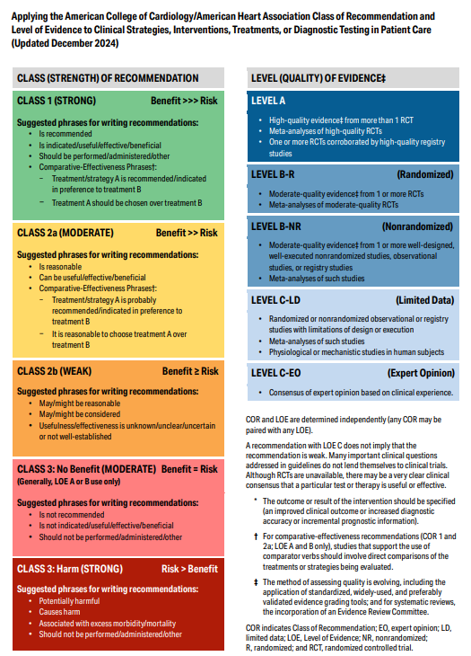
Table 3. Applying the American College of Cardiology/American Heart Association Class of Recommendation and Level of Evidence to Clinical Strategies, Interventions, Treatments, or Diagnostic Testing in Patient Care* (Updated December 2024)

Slide 28
Definitions and Classification of Blood Pressure

Slide 29
Definition of High Blood Pressure
Recommendation for Definition of High Blood Pressure References that support the recommendation are summarized in the evidence table.
COR | LOE | Recommendation
1 | B-NR | In adults, BP should be categorized as normal, elevated, or stage 1 or 2 hypertension to prevent and treat high BP (Table 4).

Slide 30
Table 4. Categories of Blood Pressure in Adults*
BP Category | SBP |  | DBP
Normal | <120 mm Hg | and | <80 mm Hg
Elevated | 120 to 129 mm Hg | and | <80 mm Hg
Hypertension
Stage 1 | 130 to 139 mm Hg | or | 80 to 89 mm Hg
Stage 2 | ≥140 mm Hg | or | ≥90 mm Hg
*Adults with SBP and DBP in 2 categories should be designated to the higher BP category. This table excludes individuals who are pregnant (see Section 5.5, “Hypertension and Pregnancy”).
BP indicates blood pressure (based on an average of ≥2 careful readings obtained on ≥2 occasions, as detailed in Section 3 (“Evaluation and Diagnosis”); DBP, diastolic blood pressure; and SBP, systolic blood pressure.
Adapted with permission from Whelton et al. Copyright 2018 American College of Cardiology Foundation and American Heart Association, Inc.

Slide 31
Evaluation and Diagnosis

Slide 32
Table 5. Prevalence of Hypertension* Among U.S. Adults Aged 18 to 80 Years, 2017 to 2020
 | Prevalence
Demographic group | Men | Women
Overall | 49.5% (59.0 million) | 43.9% (56.3 million)
Age groups, years
18-29 | 20.3% | 9.0%
30-44 | 39.6% | 23.7%
45-59 | 57.4% | 52.5%
60-74 | 70.7% | 71.4%
75-80 | 83.7% | 84.8%
Racial and ethnic groups (age-adjusted)
NH White | 47.0% | 39.0%
NH Black | 56.8% | 56.7%
NH Asian | 49.8% | 39.1%
Hispanic | 50.4% | 36.3%
Other | 50.7% | 47.9%
*Hypertension defined as diagnosed hypertension, BP ≥130/80 mm Hg, or receiving antihypertensive therapy.
BP indicates blood pressure; and NH, non-Hispanic. Derived from NHANES.

Slide 33
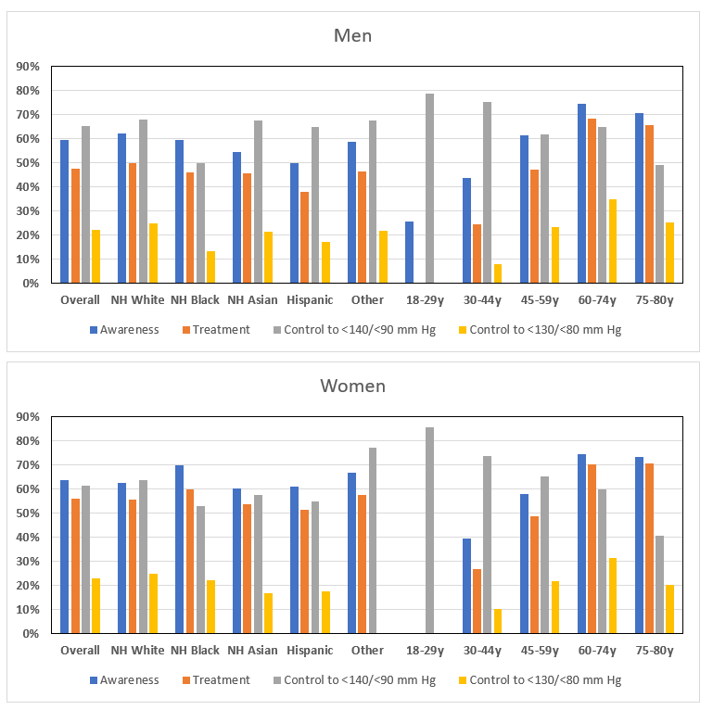
Figure 1. Rates of Awareness, Treatment, and Control of Hypertension Among U.S. Adults Aged 18 to 80 Years, 2017 to 2020*
*Missing data points indicate uncertain estimates due to small sample sizes for that subgroup.
NH indicates non-Hispanic. Derived from NHANES.

Slide 34
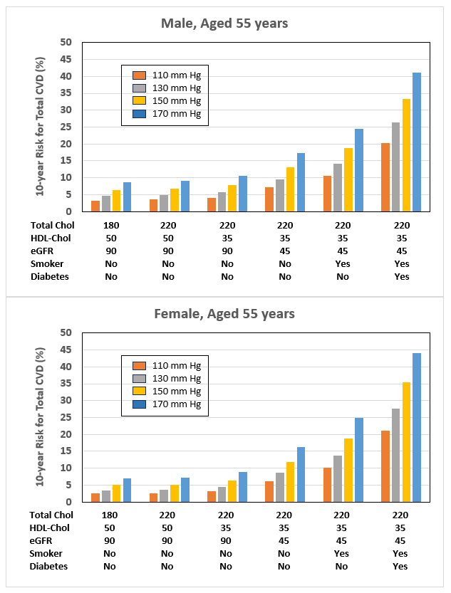
Figure 2. Estimated 10-Year Risks for Total Cardiovascular Disease Using the PREVENTTM CVD Risk Equations, Stratified by Blood Pressure Levels With Selected Combinations of Risk Factors
CVD indicates cardiovascular disease; eGFR, estimated glomerular filtration rate; and HDL, high-density lipoprotein. Derived from via PREVENT.

Slide 35
Accurate Measurement of In-Office Blood Pressure
Recommendations for Accurate Measurement of In-Office Blood Pressure
COR | LOE | Recommendations
1 | C-LD | When diagnosing and managing high BP in adults, standardized methods are recommended for the accurate measurement and documentation of in-office BP (Figure 3).
2a | C-EO | When measuring in-office BP in adults, it is reasonable to use the oscillometric method with an automated device over the auscultatory method.

Slide 36
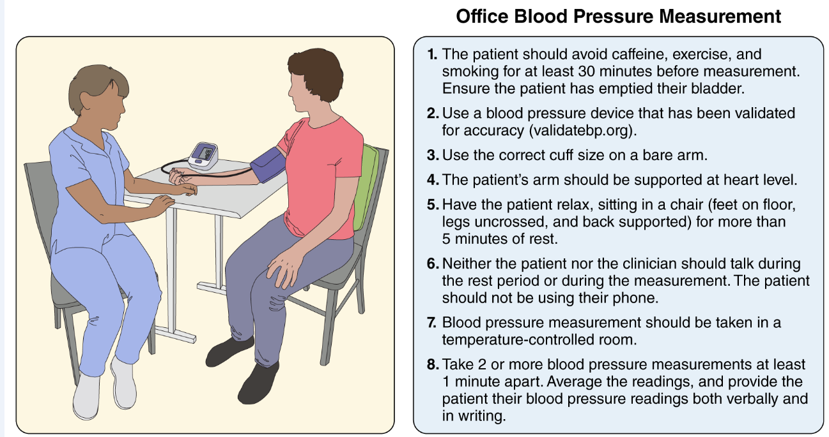
Figure 3. Checklist for Accurate Office Blood Pressure Measurement
BP indicates blood pressure; DBP, diastolic blood pressure; and SBP, systolic blood pressure.
Sourced from Pickering et al. Adapted with permission from Whelton et al. Copyright 2018 American College of Cardiology Foundation and American Heart Association, Inc. Adapted from Mancia et al by permission of Oxford University Press. Copyright 2013 Oxford University Press. Adapted with permission from Weir et al from Annals of Internal Medicine. Copyright 2014 American College of Physicians. All Rights Reserved. Adapted with permission of American College of Physicians. Created by Sceyence Studios.

Slide 37
Patient Evaluation, Including Laboratory Tests and Other Diagnostic Procedures
Recommendation for Laboratory Tests and Other Diagnostic Procedures
COR | LOE | Recommendation
1 | C-EO | For adults who are diagnosed with hypertension, laboratory tests (ie, complete blood count, serum electrolytes, serum creatinine, lipid profile, glucose or hemoglobin A1c [HbA1c], thyroid-stimulating hormone, urinalysis, and urine albumin-to-creatinine ratio) and diagnostic procedures (12-lead ECG) should be performed to optimize management.

Slide 38
Table 6. Routine Laboratory Testing for New Diagnosis of Hypertension
Diagnostic Tests
Complete blood count
Serum sodium, potassium, calcium
Serum creatinine with estimation of glomerular filtration rate (based on the 2021 CKD-EPI Creatinine Equation)
Lipid profile
Fasting blood glucose or Hemoglobin A1c
Thyroid-stimulating hormone
Urinalysis
Urine albumin-to-creatinine ratio; urine protein-to-creatinine ratio
ECG
ECG indicates electrocardiogram.
Modified with permission from Whelton et al. Copyright 2018 American College of Cardiology Foundation and American Heart Association, Inc.

Slide 39
Ambulatory Blood Pressure Monitoring and Home Blood Pressure Monitoring
Recommendations for Ambulatory Blood Pressure Monitoring and Home Blood Pressure Monitoring Referenced studies that support the recommendations are summarized in the evidence table.
COR | LOE | Recommendations
1 | A | In adults with suspected hypertension, out-of-office BP measurements by either ABPM or HBPM are recommended to confirm the diagnosis of hypertension.
1 | A | In adults who are taking antihypertensive medication, HBPM is recommended for monitoring the titration of BP-lowering medication, along with cointerventions such as patient education, telehealth counseling, and clinical interventions.

Slide 40
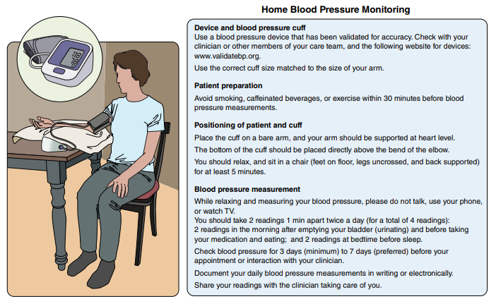
Figure 4. Home Blood Pressure Monitoring.
See Table 7 for HBPM targets. BP indicates blood pressure; and HBPM, home blood pressure monitoring.
Adapted with permission from Whelton et al. Copyright 2019 American College of Cardiology Foundation and American Heart Association, Inc. Created by Sceyence Studios.

Slide 41
Table 7. Values of Systolic/Diastolic Blood Pressure for Ambulatory and Home Blood Pressure Monitoring Corresponding to Office Systolic/Diastolic Blood Pressure Levels
Office, mm Hg | HBPM, mm Hg | Daytime ABPM, mm Hg | Nighttime ABPM, mm Hg | 24-Hour ABPM, mm Hg
120/80 | 120/80 | 120/80 | 100/65 | 115/75
130/80 | 130/80 | 130/80 | 110/65 | 125/75
140/90 | 135/85 | 135/85 | 120/70 | 130/80
160/100 | 145/90 | 145/90 | 140/85 | 145/90
ABPM indicates ambulatory blood pressure monitoring; BP, blood pressure; DBP, diastolic blood pressure; HBPM, home blood pressure monitoring; and SBP, systolic blood pressure.
Modified with permission from Whelton et al.. Copyright 2018 American College of Cardiology Foundation and American Heart Association, Inc.

Slide 42
Cuffless Blood Pressure Devices
Recommendation for Cuffless Blood Pressure Devices
COR | LOE | Recommendation
3: No Benefit | C-LD | In adults, the use of cuffless BP devices is not recommended for the diagnosis or management of high BP.

Slide 43
Table 8. Environmental, Behavioral, and Genetic Causes of Hypertension
Dietary intake factors | Nondietary factors
Higher sodium intake | Genetic variants
Lower potassium intake | Overweight/obesity
Lower calcium/magnesium intake | Lower physical activity/fitness
Lower diet quality (lower intake of fruits/vegetables, plant proteins, fiber) | Sleep disturbances (related to duration, quality, regularity, and/or disordered breathing)
Alcohol intake | Psychosocial stressors
 | Air pollution

Slide 44
White-Coat Hypertension and Masked Hypertension, and White-Coat Effect and Masked Uncontrolled Hypertension
Recommendations for White-Coat Hypertension and Masked Hypertension, and White-Coat Effect and Masked Uncontrolled Hypertension Referenced studies that support the recommendations are summarized in the evidence table.
COR | LOE | Recommendations
2a | B-NR | In adults with untreated office SBP ≥130 mm Hg or DBP ≥80 mm Hg, and without office SBP ≥160 mm Hg or DBP ≥100 mm Hg, it is reasonable to exclude white-coat hypertension using out-of-office BP monitoring before a diagnosis of hypertension is made.
2a | B-NR | In adults with white-coat hypertension or masked hypertension, out-of-office BP monitoring is reasonable to exclude transition to a diagnosis of sustained hypertension.

Slide 45
White-Coat Hypertension and Masked Hypertension and White-Coat Effect and Masked Uncontrolled Hypertension (con’t.)
2a | C-LD | In adults with apparent treatment-resistant hypertension on office BP, it is reasonable to exclude white-coat effect, a form of pseudoresistance, using out-of-office BP monitoring.
2a | B-NR | In adults who are taking antihypertensive medication and have elevated office BP (office SBP ≥130 mm Hg or DBP ≥80 mm Hg) but do not have resistant hypertension or office SBP ≥160 mm Hg or DBP ≥100 mm Hg, it is reasonable to exclude white-coat effect using out-of-office BP monitoring.
2b | B-NR | In adults with untreated office SBP <130 mm Hg and DBP <80 mm Hg, it may be reasonable to exclude masked hypertension using out-of-office BP monitoring.
2b | B-NR | In adults who are taking antihypertensive medication and have office SBP <130 mm Hg and DBP <80 mm Hg, it may be reasonable to exclude masked uncontrolled hypertension using out-of-office BP monitoring.

Slide 46
Table 9. Blood Pressure Categories Based on Office and Out-of-Office Blood Pressure Measurements
BP Category | High BP in the office setting? | High BP outside of the office setting?*
Among individuals not taking antihypertensive medication
Sustained normotension | No | No
Sustained hypertension | Yes | Yes
Masked hypertension | No | Yes
White-coat hypertension | Yes | No
Among individuals taking antihypertensive medication
Controlled hypertension | No | No
Uncontrolled hypertension | Yes | Yes
Masked uncontrolled hypertension | No | Yes
White-coat effect | Yes | No
Modified with permission from Whelton et al. Copyright 2018 American College of Cardiology Foundation and American Heart Association, Inc.

Slide 47
Table 9. Blood Pressure Categories Based on Office and Out-of-Office Blood Pressure Measurements (con’t.)
*Please refer to Table 7 for office BP and out-of-office BP thresholds used to define high BP. High out-of-office BP is defined as SBP ≥130 mm Hg or DBP ≥80 mm Hg when using awake BP and SBP ≥125 mm Hg or DBP ≥75 mm Hg when using 24-hour BP. These BP thresholds correspond to an office SBP ≥130 mm Hg or DBP ≥80 mm Hg. Out-of-office BP is primarily based on mean awake BP or mean 24-hour BP. It remains unclear whether asleep BP should be used to determine high out-of-office BP as the prevalence and reproducibility of isolated nocturnal hypertension (high asleep BP without high awake BP) are both low. Further, there is no high-quality RCT evidence to indicate that lowering asleep BP reduces CVD risk.
BP indicates blood pressure.

Slide 48
Secondary Forms of Hypertension
Recommendations for Secondary Forms of Hypertension References that support recommendations are summarized in the evidence table.
COR | LOE | Recommendations
1 | C-EO | In adults with hypertension, screening for speciﬁc forms of secondary hypertension is recommended when clinical suspicion is present (Table 10 and Figure 5) to increase rates of detection, diagnosis, and specific targeted therapy.
1 | B-NR | In adults with resistant hypertension, screening for primary aldosteronism is recommended regardless of whether hypokalemia is present to increase rates of detection, diagnosis, and specific targeted therapy.
2a | C-EO | In adults who have a positive screening test for a form of secondary hypertension, referral to a clinician who has expertise in that form of hypertension is reasonable for diagnostic confirmation and treatment.

Slide 49
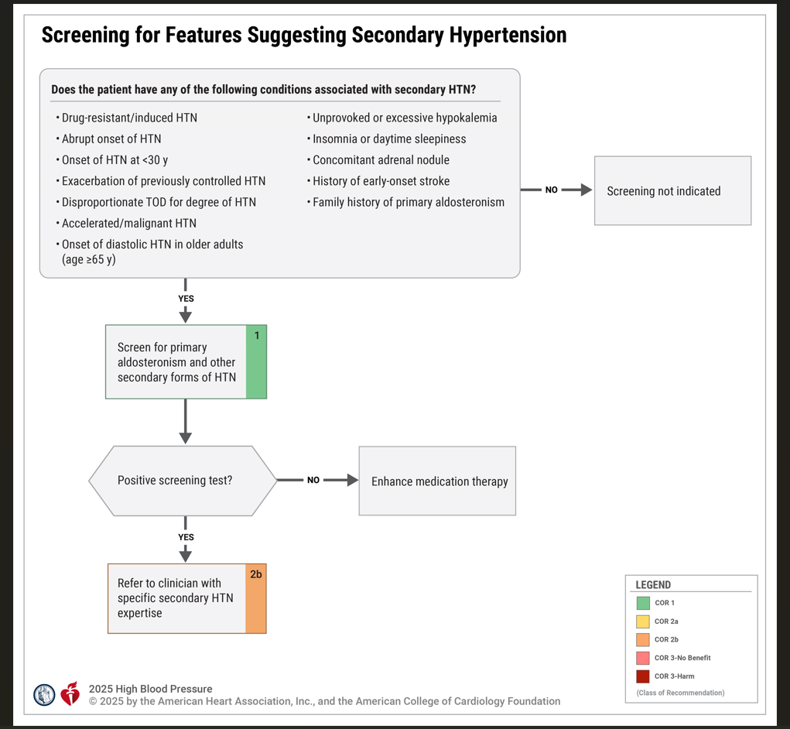
Figure 5. Screening for Features Suggesting Secondary Hypertension
HTN indicates hypertension; and TOD, target organ damage (eg, cerebrovascular disease, hypertensive
retinopathy, left ventricular hypertrophy, left ventricular dysfunction, heart failure, coronary artery disease, chronic kidney disease, albuminuria, peripheral
artery disease).
Modified with permission from Whelton et al. Copyright 2018 American College of Cardiology Foundation and American Heart Association, Inc.

Slide 50
Table 10. Causes of Secondary Hypertension With Indications for Additional Testing and Diagnostic Screening Tests
 | Prevalence | Indications for Additional Testing | Physical Examination Findings | Screening Tests | Confirmatory Tests
Common causes
OSA | 25%–50% | Snoring, choking, gasping during sleep; daytime sleepiness; resistant hypertension | Obesity, large neck size (eg, >17 inches [men]; >16 inches [women], Mallampati class 3-4; loss of normal nocturnal BP fall | STOP-Bang Questionnaire; Berlin Questionnaire; overnight oximetry | Referral for polysomnography or home sleep apnea testing if no suspicion of nonrespiratory sleep disorders (eg, narcolepsy)
CKD | 14% | Diabetes, obstruction, hematuria; urinary frequency and nocturia; urinary incontinence, analgesic abuse; family history of polycystic kidney disease; elevated serum creatinine; abnormal urinalysis | Abdominal mass or large palpable kidneys (polycystic kidney disease); skin pallor | Electrolytes, including sodium, potassium, chloride, and bicarbonate, serum creatinine, urinalysis, urine microalbumin, serum cystatin C, renal ultrasound | Tests to evaluate cause of CKD

Slide 51
Table 10. Causes of Secondary Hypertension With Indications for Additional Testing and Diagnostic Screening Tests (con’t.)
Primary aldosteronism | 5%–25% | Resistant hypertension; hypertension with hypokalemia (spontaneous or diuretic induced); hypertension and muscle cramps or weakness; hypertension and incidentally discovered adrenal mass; hypertension and obstructive sleep apnea; hypertension and family history of early-onset hypertension or stroke | Arrhythmias (with hypokalemia); especially AF | Electrolytes, including sodium and potassium, plasma aldosterone/ renin activity ratio (correction of hypokalemia and withdrawal of MRA for 4-6 wk) | Oral sodium loading test (with 24-h urine aldosterone) or IV saline infusion test with plasma aldosterone at 4 h of infusion or captopril suppression test (in patients not on ACEi or ARB treatment), adrenal CT scan, adrenal vein sampling

Slide 52
Table 10. Causes of Secondary Hypertension With Indications for Additional Testing and Diagnostic Screening Tests (con’t.)
Drug or alcohol induced¹¹ | 2%–20% | Sodium-containing antacids; antidepressants; nicotine (smoking); alcohol; NSAIDs; oral contraceptives; cyclosporine or tacrolimus; sympathomimetics (decongestants, anorectics); cocaine, amphetamines and other illicit drugs; neuropsychiatric agents; erythropoiesis-stimulating agents; cancer treatment (VEGF inhibitors, Bruton tyrosine kinase inhibitors and others), clonidine withdrawal; herbal agents (Ma Huang, ephedra) | Fine tremor, tachycardia, sweating (cocaine, ephedrine, MAO inhibitors); acute abdominal pain (cocaine) | Urinary drug screen (illicit drugs) | Response to withdrawal of suspected agent

Slide 53
Table 10. Causes of Secondary Hypertension With Indications for Additional Testing and Diagnostic Screening Tests (con’t.)
Renovascular hypertension | 0.1%-5% | Resistant hypertension; hypertension of abrupt onset or worsening or increasingly difficult to control; ﬂash pulmonary edema (atherosclerotic); early-onset hypertension, especially in women (ﬁbromuscular hyperplasia) | Abdominal systolic-diastolic bruit; bruits over other arteries (carotid, femoral) | Electrolytes, including sodium, potassium, chloride, and bicarbonate, renal duplex Doppler ultrasound; magnetic resonance arteriography; abdominal CT arteriography | Bilateral selective renal intra-arterial angiography

Slide 54
Table 10. Causes of Secondary Hypertension With Indications for Additional Testing and Diagnostic Screening Tests (con’t.)
Uncommon causes
Hypothyroidism | <1% | Dry skin; cold intolerance; constipation; hoarseness; weight gain | Delayed ankle reﬂex; periorbital edema; coarse skin; cold skin; slow movement; goiter | Thyroid- stimulating hormone; free thyroxine | None
Hyperthyroidism | <1% | Warm, moist skin; heat intolerance; nervousness; tremulousness; palpitations, insomnia; weight loss; diarrhea; proximal muscle weakness | Lid lag; ﬁne tremor of the outstretched hands; warm, moist skin, goiter, thyroid nodule | Thyroid- stimulating hormone; free thyroxine | Radioactive iodine uptake and scan

Slide 55
Table 10. Causes of Secondary Hypertension With Indications for Additional Testing and Diagnostic Screening Tests (con’t.)
Pheochromocytoma/ paraganglioma | <0.6% | Resistant hypertension; paroxysmal hypertension or crisis superimposed on sustained hypertension; “spells,” BP lability, headache, sweating, palpitations, piloerection; positive family history of pheochromocytoma/ paraganglioma; adrenal incidentaloma | Skin stigmata of neuroﬁbromatosis (café-au-lait spots; neuroﬁbromas); orthostatic hypotension | 24-h urinary fractionated metanephrines or plasma metanephrines under standard conditions (supine position with indwelling IV cannula) | CT or MRI scan of abdomen/pelvis, Ga-DOTATATE PET/CT scan
Aortic coarctation (undiagnosed or repaired) | 0.1% | Young adult with hypertension (<30 y) | BP higher in upper extremities than in lower extremities; absent femoral pulses; continuous murmur over patient’s back, chest, or abdominal bruit; left thoracotomy scar (postoperative) | Echocardiogram | Thoracic and abdominal CT angiogram or magnetic resonance arteriography

Slide 56
Table 10. Causes of Secondary Hypertension With Indications for Additional Testing and Diagnostic Screening Tests (con’t.)
Cushing syndrome | <0.1% | Rapid weight gain, especially with central distribution; proximal muscle weakness; depression; hyperglycemia | Central obesity, “moon” face, dorsal and supraclavicular fat pads, wide (1 cm) violaceous striae, hirsutism | Overnight 1-mg dexamethasone suppression test | 24-h urinary free cortisol excretion (preferably multiple); midnight salivary cortisol
Primary hyperparathyroidism | Rare | Hypercalcemia | Usually none | Serum calcium | Serum parathyroid hormone
Congenital adrenal hyperplasia | Rare | Hypertension and hypokalemia; virilization (11-beta-hydroxylase deﬁciency [11-beta-OH]); incomplete masculinization in men and primary amenorrhea in women (17-alpha-hydroxylase deﬁciency [17-alpha-OH]) | Signs of virilization (11-beta-OH) or incomplete masculinization (17-alpha-OH) | Hypertension and hypokalemia with low or normal aldosterone and renin | 11-beta-OH: elevated DOC, 11-deoxycortisol, and androgens; 17-alpha-OH; decreased androgens and estrogen but elevated DOC and corticosterone

Slide 57
57
Table 10. Causes of Secondary Hypertension With Indications for Additional Testing and Diagnostic Screening Tests (con’t.)
Mineralocorticoid excess syndromes other than primary aldosteronism | Rare | Early-onset hypertension; resistant hypertension; hypokalemia or hyperkalemia | Arrhythmias (with hypokalemia) | Low aldosterone and renin | Urinary cortisol metabolites; genetic testing
Acromegaly | Rare | Acral features, enlarging shoe, glove, or hat size; headache, visual disturbances; diabetes | Acral features; large hands and feet; frontal bossing | Serum growth hormone ≥1 ng/mL during oral glucose load | Elevated age- and sex-matched IGF-1 level; MRI scan of the pituitary

Slide 58
Table 10. Causes of Secondary Hypertension With Indications for Additional Testing and Diagnostic Screening Tests (con’t.)
ACEi indicates angiotensin-converting enzyme inhibitors; ARB, angiotensin receptor blockers; BP, blood pressure; AF, atrial fibrillation; CKD, chronic kidney disease; CT, computed tomography; DOC, 11-deoxycorticosterone; h, hour; IGF-1, insulin-like growth factor-1; IV, intravenous; MAO, monoamine oxidase; mg, milligrams; MRI, magnetic resonance imaging; NSAIDs, nonsteroidal anti-inﬂammatory drugs; OH, hydroxylase; OSA, obstructive sleep apnea; RCT, randomized clinical trial; VEGF, vascular endothelial growth factor; wk, week; and y, years.
Modified with permission from Whelon et al. Copyright 2018 American College of Cardiology Foundation and American Heart Association, Inc.

Slide 59
Table 11. Selected List of Frequently Used Medications and Other Substances That May Cause Elevated Blood Pressure With Recommendations for Management*
Agent | Possible Management Strategy
Nonprescription drugs/substance
Alcohol | Options include abstinence or limit alcohol to ≤1 drink daily for women and ≤2 drinks daily for men
Caffeine | Limit caffeine intake to <300 mg/d Avoid more than 1 cup daily in patients with severe uncontrolled hypertension
Decongestants (eg, phenylephrine, pseudoephedrine) | Use for shortest duration possible and avoid in severe or uncontrolled hypertension Consider alternative therapies (eg, nasal saline, intranasal corticosteroids, antihistamines) as appropriate

Slide 60
Table 11. Selected List of Frequently Used Medications and Other Substances That May Cause Elevated Blood Pressure With Recommendations for Management* (con’t.)
Agent | Possible Management Strategy
Nonprescription drugs/substance
Herbal supplements (eg, Ma Huang, ephedra, St. John’s wort [with MAO inhibitors, yohimbine]) | Avoid use
Black licorice | Avoid use
NSAIDs; acetaminophen | Avoid systemic NSAIDs when possible Limit acetaminophen to less than 4 g/day12 Consider alternative analgesics (eg, topical NSAIDs), depending on indication and risk
Recreational drugs (eg, “bath salts” [MDPV], cocaine, methamphetamine, etc) | Discontinue or avoid use

Slide 61
Table 11. Selected List of Frequently Used Medications and Other Substances That May Cause Elevated Blood Pressure With Recommendations for Management* (con’t.)
Agent | Possible Management Strategy
Prescription drugs
Sudden withdrawal of central-acting sympatholytic drugs such as clonidine and tizanidine | Recommend avoiding oral clonidine for treatment of hypertension whenever possible and tapering upon discontinuation; use cyclobenzaprine or other muscle relaxants instead of tizanidine
Amphetamines† (eg, amphetamine, methylphenidate dexmethylphenidate, dexamfetamine, lisdexamfetamine, dextroamphetamine) | Discontinue or decrease dose Consider behavioral therapies or nonstimulants (such as guanfacine) for ADHD
Antidepressants† (eg, MAOIs, SNRIs, TCAs) | Consider alternative agents (eg, SSRIs) depending on indication Avoid tyramine-containing foods with MAOIs

Slide 62
Table 11. Selected List of Frequently Used Medications and Other Substances That May Cause Elevated Blood Pressure With Recommendations for Management* (con’t.)
Agent | Possible Management Strategy
Prescription drugs
Atypical antipsychotics† (eg, risperidone, olanzapine) | Discontinue or limit use when possible Consider behavior therapy where appropriate Recommend lifestyle modiﬁcation (Section 5.1) Consider alternative agents associated with lower risk of weight gain, diabetes, and dyslipidemia
Immunosuppressants† (eg, cyclosporine) | Consider converting to tacrolimus, which may be associated with fewer effects on BP
Oral contraceptives† | Use low-dose (eg, 20–30 mcg ethinyl estradiol) agents or a progestin-only form of contraception, or consider alternative forms of birth control where appropriate (eg, barrier, abstinence, nonhormonal IUD) Avoid use in women with uncontrolled hypertension

Slide 63
Table 11. Selected List of Frequently Used Medications and Other Substances That May Cause Elevated Blood Pressure With Recommendations for Management* (con’t.)
Agent | Possible Management Strategy
Prescription drugs
Systemic corticosteroids† (eg, dexamethasone, ﬂudrocortisone, methylprednisolone, prednisone, prednisolone) | Avoid or limit use when possible Consider alternative modes of administration (eg, inhaled, topical) when feasible
Angiogenesis inhibitor† (eg, bevacizumab) and tyrosine kinase inhibitors (eg, sunitinib, sorafenib) | Avoid or limit use when possible
Androgen deprivation therapy† such as CYP 17 inhibitors (eg, abiraterone, orteronel) or androgen receptor antagonist (eg, enzalutamide) | Avoid or limit use when possible Consider alternative chemotherapy

Slide 64
Table 11. Selected List of Frequently Used Medications and Other Substances That May Cause Elevated Blood Pressure With Recommendations for Management* (con’t.)
*List is not all inclusive.
†In specific cases when a specific therapy is needed or the best option for the patient, it is reasonable to continue the medication and initiate or intensify antihypertensive therapy.
ADHD indicates attention-deﬁcit/hyperactivity disorder; BP, blood pressure; CVD, cardiovascular disease; IUD, intrauterine device; MAOI, monoamine-oxidase inhibitors; MDPV, methylenedioxy pyrovalerone; NSAIDs, nonsteroidal anti-inﬂammatory drugs; SNRI, serotonin norepinephrine-reuptake inhibitor; SSRI, selective serotonin-reuptake inhibitor; and TCA, tricyclic antidepressant.
Modified with permission from Whelton et al. Copyright 2018 American College of Cardiology Foundation and American Heart Association, Inc.

Slide 65
Primary Aldosteronism
Recommendations for Primary Aldosteronism
COR | LOE | Recommendations
1 | C-EO | In adults with hypertension, screening for primary aldosteronism is recommended in the presence of any of the following conditions to increase rates of detection, diagnosis, and specific targeted therapy: resistant hypertension (regardless of whether hypokalemia is present), hypokalemia (spontaneous or diuretic induced), OSA, incidentally discovered adrenal mass, family history of early-onset hypertension, or stroke at a young age (<40 years).
2b | C-EO | In adults with stage 2 hypertension, screening for primary aldosteronism may be considered to increase rates of detection, diagnosis, and specific targeted therapy.

Slide 66
Primary Aldosteronism(con’t.)
1 | C-LD | In adults with an indication for screening for primary aldosteronism, use of plasma aldosterone, renin activity, and the plasma aldosterone:renin activity ratio is recommended for initial screening to assess if there is biochemical evidence of primary aldosteronism.
1 | C-EO | In adults with an indication for screening for primary aldosteronism, it is recommended to continue most antihypertensive medications (other than mineralocorticoid receptor antagonists [MRA]) prior to initial screening to minimize barriers to or delays in screening.
1 | C-EO | In adults with hypertension and a positive screening test for primary aldosteronism or continued suspicion for primary aldosteronism based on suppressed plasma renin or disproportionate target organ damage, referral to a hypertension specialist or endocrinologist is recommended for further evaluation and treatment.

Slide 67
Renal Artery Stenosis
Recommendations for Renal Artery Stenosis References that support recommendations are summarized in the evidence table.
COR | LOE | Recommendations
1 | A | In adults with hypertension and atherosclerotic renal artery stenosis, medical therapy is recommended to reduce kidney and CVD morbidity and mortality.
2a | C-EO | In adults with hypertension and atherosclerotic renal artery stenosis for whom medical management has failed (eg, resistant hypertension, worsening kidney function, and/or acute HF), it is reasonable to refer patients for revascularization by percutaneous renal artery angioplasty and/or stent placement.
2b | C-LD | In adults with hypertension and nonatherosclerotic renal artery stenosis, including fibromuscular dysplasia, it may be reasonable to refer patients for revascularization by percutaneous renal artery angioplasty.

Slide 68
Obstructive Sleep Apnea
Recommendations for Obstructive Sleep Apnea Referenced studies that support the recommendations are summarized in the evidence table.
COR | LOE | Recommendations
2a | B-R | In adults with hypertension and OSA who have overweight or obesity, weight loss interventions when combined with continuous positive airway pressure (CPAP) treatment can be effective in reducing SBP.
2a | B-R | In adults with resistant hypertension and moderate-to-severe OSA, CPAP treatment can be useful in reducing BP.

Slide 69
Blood Pressure Management

Slide 70
70
Lifestyle and Psychosocial Approaches
Recommendations for Lifestyle and Psychosocial Approaches Referenced studies that support the recommendations are summarized in the evidence table.
COR | LOE | Recommendations
 |  | Weight
1 | A | In adults who have overweight or obesity, weight loss is recommended with a goal of at least 5% of body weight reduction to prevent or treat elevated BP and hypertension.

Slide 71
Lifestyle and Psychosocial Approaches (con’t.)
Diet and Nutrients
1 | A | In adults with or without hypertension, a heart-healthy eating pattern, such as the DASH eating plan, is recommended to prevent or treat elevated BP and hypertension.
1 | A | In adults with or without hypertension, reduction of dietary sodium intake* is recommended to <2,300 mg/day, moving toward an ideal limit of <1,500 mg/day to prevent or treat elevated BP and hypertension.
*Dietary sodium reduction may be contraindicated in patients with severe, symptomatic orthostatic hypotension.

Slide 72
†This recommendation refers to potassium-based salt substitutes, which typically contain 25% to 30% potassium chloride, 65% to 75% sodium chloride, and 0% to 10% flavoring agents. Products that refer to themselves as “salt substitutes” that do not contain potassium chloride as a substitute for sodium chloride have unknown effects on BP.
‡Drugs that reduce potassium excretion include: potassium-sparing diuretics (eg, amiloride, triamterene), mineralocorticoid receptor antagonists (eg, spironolactone, eplerenone, finerenone), angiotensin-converting enzyme inhibitors (eg, captopril, enalapril, lisinopril, benazepril, and others), angiotensin receptor blockers (eg, losartan, valsartan, candesartan, telmisartan, and others), and some immunosuppressive agents (eg, cyclosporine, tacrolimus).
§Moderate potassium supplementation is <80 mmol/day (<80 mEq/day).
Lifestyle and Psychosocial Approaches (con’t.)
2a | A | In adults with or without hypertension, potassium-based salt substitutes† can be useful to prevent or treat elevated BP and hypertension, particularly for patients in whom salt intake is related mostly to food preparation or flavoring at home, except in the presence of CKD or use of drugs that reduce potassium excretion where monitoring of serum potassium levels is indicated‡.
1 | A | In adults with elevated BP or hypertension, moderate potassium supplementation§, ideally from dietary sources, is recommended to prevent or treat elevated BP and hypertension, except in the presence of CKD or use of drugs that reduce potassium excretion where monitoring of serum potassium levels is indicated.‡

Slide 73
Lifestyle and Psychosocial Approaches (con’t.)
Alcohol
1 | A | Adults with or without hypertension who currently consume alcohol should be advised to pursue a recommended goal of abstinence, or at least to reduce alcohol intake to ≤1 drink/day for women and ≤2 drinks/day for men to prevent or treat elevated BP and hypertension║.
Physical Activity
1 | A | In adults with or without hypertension, increasing physical activity, through a structured exercise program that includes aerobic exercise and/or resistance training, is recommended to prevent or treat elevated BP and hypertension.
║One standard drink (12 to 14 g alcohol) is equivalent to 12 oz of beer (5% alcohol by volume), 5 oz of wine (12% alcohol by volume), or 1.5 oz of distilled spirits (40% alcohol by volume).

Slide 74
Lifestyle and Psychosocial Approaches (con’t.)
Stress Reduction
2b | B-R | In adults with or without hypertension, stress reduction through transcendental meditation may be reasonable to prevent or treat elevated BP and hypertension, as an adjunct to lifestyle or medication interventions.
2b | B-R | In adults with or without hypertension, other forms of stress management, such as breathing control techniques or yoga, may be reasonable to prevent or treat elevated BP and hypertension, as an adjunct to lifestyle or medication interventions.

Slide 75
Table 12. Lifestyle and Stress Reduction Interventions to Lower Blood Pressure
Intervention | Target/Biomarker | Evidence-Based Goals | Approximate Mean Change in SBP (mm Hg)*
 |  |  | With Hypertension | Without Hypertension
Weight loss | Body weight or BMI | Aim for sustained ≥5% reduction in body weight or ≥3 kg/m² reduction in BMI; expect about 1 mm Hg reduction for every 1-kg reduction in body weight | -6 to -8 | -3 to -5
Heart-healthy diet | DASH eating pattern | Consume a diet rich in fruits, vegetables, whole grains, and low-fat dairy products, with reduced content of saturated and total fat | -5 to -8 | -3 to -7
Reduced intake of sodium | Dietary sodium intake; 24-hour urinary sodium | Optimal goal is <2,300 mg/day, but aim for an ideal limit of <1,500 mg/day | -6 to -8 | -1 to -4
*Because inclusion/exclusion criteria and comparator groups vary across interventions, these values should not be compared directly to indicate comparative effectiveness.
BMI indicates body mass index; DASH, Dietary Approaches to Stop Hypertension; and SBP, systolic blood pressure.
Modified with permission from Whelton et al. Copyright 2018 American College of Cardiology Foundation and American Heart Association, Inc.

Slide 76
Table 12. Lifestyle and Stress Reduction Interventions to Lower Blood Pressure (con’t.)
Use of salt substitute | Replace cooking/table salt (100% sodium chloride) with salt substitute (25%-30% potassium chloride, 65%-75% sodium chloride, and 0%-10% flavoring agents); 24-hour urinary sodium and potassium | Reduce dietary sodium intake as above | -5 to -7 | -5
Enhanced intake of potassium | Dietary potassium intake; 24-hour urinary potassium | Aim for 3,500-5,000 mg/day, ideally by consumption of a diet rich in potassium; or alternative use of moderate-dose pharmacological potassium supplementation (<80 mmol) | -6 | -3 to -6
Reduced alcohol intake | Alcohol consumption | Optimal goal is abstinence for all adults for best health outcomes; in patients who consume alcohol, aim for >50% reduction in daily intake to no more than 2 drinks/day in men or 1 drink/day in women | -4 to -6 | -3
Modified with permission from Whelton et al. Copyright 2018 American College of Cardiology Foundation.

Slide 77
Table 12. Lifestyle and Stress Reduction Interventions to Lower Blood Pressure (con’t.)
Exercise | Aerobic exercise | 90-150 minutes/week 65%-75% heart rate reserve | -4 to -8 | -2 to -7
 | Dynamic resistance | 90-150 minutes/week 50%-80% 1 rep maximum 6 exercises, 3 sets/exercise, 10 repetitions/set | -2 to -7 | -2 to -5
 | Isometric resistance | 4 × 2 minutes (hand grip), 1 minute rest between exercises, 30%-40% maximum voluntary contraction, 3 sessions/week | -5 to -10 | -4 to -6
Modified with permission from Whelton et al. Copyright 2018 American College of Cardiology Foundation.

Slide 78
Table 12. Lifestyle and Stress Reduction Interventions to Lower Blood Pressure (con’t.)
Meditation | Transcendental meditation | Training by a professional, followed by 2 x 20 minute sessions/day while seated comfortably with eyes closed | -5 to -7 | -5
Breathing control | Slowing respiration | Device-guided session to decrease respiration to <10 breaths/minute for 15 minutes/day | -5 | -5
Modified with permission from Whelton et al. Copyright 2018 American College of Cardiology Foundation.

Slide 79
Blood Pressure Treatment Threshold and the Use of CVD Risk Estimation to Guide Drug Treatment of Hypertension
Recommendations for Blood Pressure Treatment Threshold and the Use of CVD Risk Estimation to Guide Drug Treatment of Hypertension Referenced studies that support the recommendations are summarized in the evidence table.
COR | LOE | Recommendations
1 | A | In all adults with hypertension, initiation of medications to lower BP is recommended when average SBP is ≥140 mm Hg to reduce the risk of cardiovascular events and total mortality.
1 | A | In all adults with hypertension, initiation of medications to lower BP is recommended when average DBP is ≥90 mm Hg to reduce the risk of cardiovascular events and total mortality.
1 | A | In adults with hypertension and clinical CVD, initiation of medications to lower BP is recommended when average SBP is ≥130 mm Hg to reduce the risk of cardiovascular events and total mortality.

Slide 80
Blood Pressure Treatment Threshold and the Use of CVD Risk Estimation to Guide Drug Treatment of Hypertension (con’t.)
1 | C-LD | In adults with hypertension and clinical CVD, initiation of medications to lower BP is recommended when average DBP is ≥80 mm Hg to reduce the risk of cardiovascular events and total mortality.
1 | A | In adults with hypertension without clinical CVD but with diabetes or CKD or at increased short-term CVD risk (ie, estimated 10-year CVD risk ≥7.5% based on PREVENT*), initiation of medications to lower BP is recommended when average SBP is ≥130 mm Hg to reduce the risk of CVD events and total mortality.
1 | C-LD | In adults with hypertension without clinical CVD but with diabetes or CKD or at increased 10-year CVD risk (ie, ≥7.5% based on PREVENT*), initiation of medications to lower BP is recommended when average DBP is ≥80 mm Hg to reduce the risk of CVD events and total mortality.
*Increased short-term or 10-year risk is defined as a 10-year predicted risk for CVD events of ≥7.5% based on PREVENT (Predicting Risk of cardiovascular disease EVENTs).

Slide 81
Blood Pressure Treatment Threshold and the Use of CVD Risk Estimation to Guide Drug Treatment of Hypertension (con’t.)
1 | B-R | In adults with hypertension without clinical CVD and with estimated 10-year CVD risk <7.5% based on PREVENT*, initiation of medications to lower BP is recommended if average SBP remains ≥130 mm Hg after a 3- to 6-month trial of lifestyle intervention to prevent target organ damage and mitigate further rise in BP.
1 | B-R | In adults with hypertension without clinical CVD and with estimated 10-year CVD risk <7.5% based on PREVENT*, initiation of medications to lower BP is recommended if average DBP ≥80 mm Hg after a 3- to 6-month trial of lifestyle intervention to prevent target organ damage and mitigate further rise in BP.
*Increased short-term or 10-year risk is defined as a 10-year predicted risk for CVD events of ≥7.5% based on PREVENT (Predicting Risk of cardiovascular disease EVENTs).

Slide 82
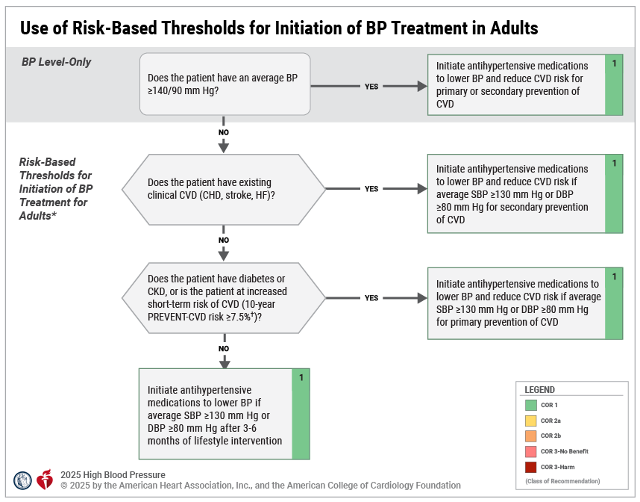
Figure 6. Use of Risk-Based Thresholds for Initiation of BP Treatment in Adults
BP indicates blood pressure; CHD, coronary heart disease; CKD, chronic kidney disease; CVD, cardiovascular disease; DBP, diastolic blood pressure; HF, heart failure; PREVENT, Predicting Risk of cardiovascular EVENTs; and SBP, systolic blood pressure.
*In older adults who may be frail or have a limited life expectancy, a clinician-patient assessment of potential benefits and harms of BP lowering should be pursued to align care with patient goals.
†Increased short-term or 10-year risk is defined as a 10-year predicted risk for CVD events of ≥7.5% using PREVENT.

Slide 83
Initial Medication Selection for Treatment of Primary Hypertension
Recommendation for Initial Medication Selection for Treatment of Primary Hypertension Referenced studies that support the recommendation are summarized in the evidence table.
COR | LOE | Recommendation
1 | A | For adults initiating antihypertensive drug therapy, thiazide-type diuretics, long-acting dihydropyridine CCB, and ACEi or ARB are recommended as first-line therapy to prevent CVD.

Slide 84
Table 13. FDA-Approved Drugs for Treatment of Hypertension
Class | Drug | Usual Dose, Range (mg/d)* | Daily Frequency | Comments
Agents recommended for initial therapy
Thiazide-type diuretics | Chlorthalidone | 12.5–25 | 1 | Chlorthalidone has a longer half-life and is more potent than hydrochlorothiazide on a mg-to-mg basis. Monitor for hyponatremia and hypokalemia, increased glucose, uric acid, and calcium levels. Monitor patients with history of acute gout unless patient is on uric acid–lowering therapy.
 | Hydrochlorothiazide | 25–50 | 1
 | Indapamide | 1.25–2.5 | 1

Slide 85
Table 13. FDA-Approved Drugs for Treatment of Hypertension (con’t.)
ACEi | Benazepril | 10–40 | 1 or 2 | Do not use in combination with ARB or direct renin inhibitor. There is an increased risk of hyperkalemia, especially in patients with CKD or in those on K+ supplements or K+-sparing drugs. There is a risk of acute renal failure in patients with severe bilateral renal artery stenosis. Do not use if patient has history of angioedema with ACEi. Avoid use in pregnancy.
 | Captopril | 12.5–150 | 2 or 3
 | Enalapril | 5–40 | 1 or 2
 | Fosinopril | 10–40 | 1
 | Lisinopril | 10–40 | 1
 | Moexipril | 7.5–30 | 1 or 2
 | Perindopril | 4–16 | 1
 | Quinapril | 10–80 | 1 or 2
 | Ramipril | 2.5–20 | 1 or 2
 | Trandolapril | 1–4 | 1

Slide 86
Table 13. FDA-Approved Drugs for Treatment of Hypertension (con’t.)
ARBs | Azilsartan | 40–80 | 1 | Do not use in combination with ACEi or direct renin inhibitor. There is an increased risk of hyperkalemia in CKD or in those on K+ supplements or K+-sparing drugs. There is a risk of acute renal failure in patients with severe bilateral renal artery stenosis. Do not use if patient has history of angioedema with ARBs. Patients with a history of angioedema with an ACE inhibitor can receive an ARB beginning 6 weeks after ACE inhibitor is discontinued. Avoid use in pregnancy.
 | Candesartan | 8–32 | 1
 | Eprosartan | 600–800 | 1 or 2
 | Irbesartan | 150–300 | 1
 | Losartan | 50–100 | 1 or 2
 | Olmesartan | 20–40 | 1
 | Telmisartan | 20–80 | 1
 | Valsartan | 80–320 | 1

Slide 87
Table 13. FDA-Approved Drugs for Treatment of Hypertension (con’t.)
CCB— dihydropyridines | Amlodipine | 2.5–10 | 1 | Associated with dose-related lower extremity edema, which is more common in women than men.
 | Felodipine | 2.5–10 | 1
 | Isradipine | 5–10 | 2
 | Nicardipine SR | 60–120 | 2
 | Nifedipine LA | 30–90 | 1
 | Nisoldipine | 17–34 | 1

Slide 88
Table 13. FDA-Approved Drugs for Treatment of Hypertension (con’t.)
Alternative agents
CCB— nondihydropyridines | Diltiazem ER | 120–360 | 1 | Avoid routine use with beta blockers because of increased risk of bradycardia and heart block. Do not use in patients with HFrEF. There are drug interactions with diltiazem and verapamil (CYP3A4 major substrate and moderate inhibitor).
 | Verapamil IR | 120–360 | 3
 | Verapamil SR | 120–360 | 1 or 2
 | Verapamil-delayed onset ER | 100–300 | 1 (in the evening)
Diuretics—loop | Bumetanide | 0.5–2 | 2 | These are preferred diuretics in patients with symptomatic HF. They are preferred over thiazide-type diuretics in patients with moderate-to-severe CKD (eg, GFR <30 mL/min). The longer-acting choice of torsemide is preferred for treatment of hypertension. A loop diuretic is an option for patients who develop thiazide-type diuretic associated hyponatremia.
 | Furosemide | 20–80 | 2
 | Torsemide | 5–10 | 1

Slide 89
Table 13. FDA-Approved Drugs for Treatment of Hypertension (con’t.)
Diuretics—potassium-sparing | Amiloride | 5–10 | 1 or 2 | As monotherapy, these agents are minimally effective antihypertensive agents. Combination therapy of a potassium-sparing diuretic with a thiazide-type diuretic can be considered in patients with hypokalemia on thiazide-type diuretic monotherapy. Avoid use in patients with significant CKD (eg, GFR <45 mL/min).
 | Triamterene | 50–100 | 1 or 2

Slide 90
Table 13. FDA-Approved Drugs for Treatment of Hypertension (con’t.)
Diuretics— aldosterone antagonists | Eplerenone | 50–100 | 1 or 2 | These are preferred agents in primary aldosteronism and resistant hypertension. Spironolactone is associated with greater risk of gynecomastia and impotence compared with eplerenone. Demonstrated efficacy as fourth-agent add-on therapy for resistant hypertension. Avoid use with K+ supplements, other K+-sparing diuretics, or significant renal dysfunction (eg, GFR <45 mL/min). Eplerenone often requires twice-daily dosing for adequate BP lowering. Avoid use in pregnancy.
 | Spironolactone | 25–100 | 1

Slide 91
Table 13. FDA-Approved Drugs for Treatment of Hypertension (con’t.)
Beta blockers— cardioselective | Atenolol | 25–100 | 2 | Beta blockers are not recommended as first-line agents unless the patient has CHD or HF. These are preferred in patients with bronchospastic airway disease requiring a beta blocker. Bisoprolol and metoprolol succinate are preferred in patients with HFrEF. Avoid abrupt cessation.
 | Betaxolol | 5–20 | 1
 | Bisoprolol | 2.5–10 | 1
 | Metoprolol tartrate | 100–200 | 2
 | Metoprolol succinate | 50–200 | 1
Beta blockers— cardioselective and vasodilatory | Nebivolol | 5–40 | 1 | Nebivolol induces nitric oxide–induced vasodilation. Avoid abrupt cessation.
Beta blockers— noncardioselective | Nadolol | 40–120 | 1 | Avoid use in patients with reactive airways disease. Avoid abrupt cessation.
 | Propranolol IR | 80–160 | 2
 | Propranolol LA | 80–160 | 1

Slide 92
92
Table 13. FDA-Approved Drugs for Treatment of Hypertension (con’t.)
Beta blockers— intrinsic sympathomimetic activity | Acebutolol | 200–800 | 2 | Generally avoid, especially in patients with CHD or HF. Avoid abrupt cessation.
 | Penbutolol | 10–40 | 1
 | Pindolol | 10–60 | 2
Combined alpha and beta blockers | Carvedilol | 12.5–50 | 2 | Use of carvedilol is preferred in patients with HFrEF. Avoid abrupt cessation.
 | Carvedilol phosphate | 20–80 | 1
 | Labetalol | 200–1200 | 2
Direct renin inhibitor | Aliskiren | 150–300 | 1 | Do not use in combination with ACEi or ARB. Aliskiren is very long acting. There is an increased risk of hyperkalemia in CKD or in those on K+ supplements or K+-sparing drugs. Aliskiren may cause acute renal failure in patients with severe bilateral renal artery stenosis. Avoid use in pregnancy.

Slide 93
Table 13. FDA-Approved Drugs for Treatment of Hypertension (con’t.)
Alpha-1 blockers | Doxazosin | 1–16 | 1 | These are associated with orthostatic hypotension, especially in older adults with a greater BP drop with first dose effect. These may be considered a second-line agent in patients with symptomatic benign prostatic hypertrophy.
 | Prazosin | 2–20 | 2 or 3
 | Terazosin | 1–20 | 1 or 2
Central alpha-2- agonist and other centrally acting drugs | Clonidine oral | 0.1–0.8 | 2 | These are generally reserved as last-line choices because of significant CNS adverse effects, especially in older adults. Avoid abrupt discontinuation of clonidine, which may induce hypertensive crisis. Clonidine must be tapered to avoid rebound hypertension.
 | Clonidine patch | 0.1–0.3 | 1 weekly
 | Methyldopa | 250–1000 | 2
 | Guanfacine | 0.5–2 | 1

Slide 94
Table 13. FDA-Approved Drugs for Treatment of Hypertension (con’t.)
Direct vasodilators | Hydralazine | 100–200 | 2 or 3 | These are associated with sodium and water retention and reflex tachycardia and should be used with a diuretic and beta blocker. Hydralazine is associated with a drug-induced lupus-like syndrome at higher doses. Minoxidil is associated with hirsutism and requires a loop diuretic. Minoxidil can induce pericardial effusion.
 | Minoxidil | 5 - 40 | 1-2
Dual endothelin receptor antagonist | Aprocitentan | 12.5 | 1 | Associated with mild-to-moderate fluid retention usually occurring within the first 4 to 6 weeks of therapy. Indicated as add-on therapy for patients whose BP is not adequately controlled on other antihypertensive medications. Avoid use in pregnancy.

Slide 95
Table 13. FDA-Approved Drugs for Treatment of Hypertension (con’t.)
Modified with permission from Whelton et al. Copyright 2018 American College of Cardiology Foundation and American Heart Association, Inc, and with permission from Chobanian et al. Copyright 2003 American Heart Association, Inc.
ACEi indicates angiotensin-converting-enzyme inhibitors; ARB, angiotensin receptor blockers, BP, blood pressure; CCB, calcium channel blocker; CNS, central nervous system; CKD, chronic kidney disease; CHD, coronary heart disease; GFR, glomerular filtration rate; HF, heart failure; HFrEF, HF with reduced rejection fraction; and K+, potassium.

Slide 96
Choice of Initial Monotherapy Versus Initial Combination Drug Therapy
Recommendations for Choice of Initial Monotherapy Versus Combination Drug Therapy Referenced studies that support the recommendations are summarized in the evidence table.
COR | LOE | Recommendations
1 | B-R | In adults with stage 2 hypertension (SBP ≥140 mm Hg and DBP ≥90 mm Hg), initiation of antihypertensive drug therapy with 2 first-line agents of different classes, ideally in a single-pill combination (SPC), is recommended to improve BP control and adherence.
2a | C-EO | In adults with stage 1 hypertension (SBP 130 to 139 mm Hg and DBP 80 to 89 mm Hg), initiation of antihypertensive drug therapy with a single first-line antihypertensive drug is reasonable, with dosage titration and sequential addition of other agents as needed to achieve BP control.
3: Harm | A | In adults with hypertension, simultaneous use of an ACEi, ARB, and/or renin inhibitor in combination is not recommended due to the potential for harm.

Slide 97
Table 14. Commercially Available Antihypertensive Medication Single-Pill Combinations
Antihypertensive Medication Class Combination | Medication Combination | Generic Available | Doses Available (in order of medication combination listed)
ACEi or ARB + Thiazide-type diuretic | Benazepril + HCTZ | Yes | 10 mg / 12.5 mg 20 mg / 12.5 mg 20 mg / 25 mg
 | Captopril + HCTZ | Yes | 25 mg / 15 mg 25 mg / 25 mg 50 mg / 15 mg 50 mg / 25 mg
 | Enalapril + HCTZ | Yes | 5 mg / 12.5 mg 10 mg / 25 mg
 | Fosinopril + HCTZ | Yes | 10 mg / 12.5 mg 20 mg / 12.5 mg
 | Lisinopril + HCTZ | Yes | 10 mg / 12.5 mg 20 mg / 12.5 mg 20 mg / 25 mg
 | Moexipril + HCTZ | Yes | 7.5 mg / 12.5 mg 15 mg / 12.5 mg 15 mg / 25 mg
 | Quinapril + HCTZ | Yes | 10 mg / 12.5 mg 20 mg / 12.5 mg 20 mg / 25 mg

Slide 98
Table 14. Commercially Available Antihypertensive Medication Single-Pill Combinations (con’t.)
Antihypertensive Medication Class Combination |  | Medication Combination | Generic Available | Doses Available (in order of medication combination listed)
ACEi or ARB + Thiazide-type diuretic | Azilsartan + chlorthalidone |  | No (est. patent expiration 2030) | 40 mg / 12.5 mg 40 mg / 25 mg
 | Candesartan + HCTZ |  | Yes | 16 mg / 12.5 mg 32 mg / 12.5 mg 32 mg / 25 mg
 | Irbesartan + HCTZ |  | Yes | 150 mg / 12.5 mg 300 mg / 12.5 mg 300 mg / 25 mg
 | Losartan + HCTZ |  | Yes | 50 mg / 12.5 mg 100 mg / 12.5 mg 100 mg / 25 mg
 | Olmesartan + HCTZ |  | Yes | 20 mg / 12.5 mg 40 mg / 12.5 mg 40 mg / 25 mg
 | Telmisartan + HCTZ |  | Yes | 40 mg / 12.5 mg 80 mg / 12.5 mg 80 mg / 25 mg
 | Valsartan + HCTZ |  | Yes | 80 mg / 12.5 mg 160 mg / 12.5 mg 160 mg / 25 mg 320 mg / 12.5 mg 320 mg / 25 mg

Slide 99
Table 14. Commercially Available Antihypertensive Medication Single-Pill Combinations (con’t.)
Antihypertensive Medication Class Combination | Medication Combination | Generic Available | Doses Available (in order of medication combination listed)
ACEi or ARB + Calcium channel blocker | Benazepril + amlodipine | Yes | 10 mg / 2.5 mg 10 mg / 5 mg 20 mg / 5 mg 20 mg / 10 mg 40 mg / 5 mg 40 mg / 10 mg
 | Perindopril + amlodipine | No (est. patent expiration 2029) | 3.5 mg / 2.5 mg 7 mg / 5 mg 14 mg / 10 mg
 | Trandolapril + verapamil | Yes | 1 mg / 240 mg 2 mg / 180 mg 2 mg / 240 mg 4 mg / 240 mg

Slide 100
Table 14. Commercially Available Antihypertensive Medication Single-Pill Combinations (con’t.)
Antihypertensive Medication Class Combination | Medication Combination | Generic Available | Doses Available (in order of medication combination listed)
ACEi or ARB + Calcium channel blocker | Olmesartan + amlodipine | Yes | 20 mg / 5 mg 20 mg / 10 mg 40 mg / 5 mg 40 mg / 10 mg
 | Telmisartan + amlodipine | Yes | 40 mg / 5 mg 40 mg / 10 mg 80 mg / 5 mg 80 mg / 10 mg
 | Valsartan + amlodipine | Yes | 160 mg / 5 mg 160 mg / 10 mg 320 mg / 5 mg 320 mg / 10 mg

Slide 101
Table 14. Commercially Available Antihypertensive Medication Single-Pill Combinations (con’t.)
Antihypertensive Medication Class Combination | Medication Combination | Generic Available | Doses Available (in order of medication combination listed)
ARB + Beta blocker | Valsartan + nebivolol | Yes | 80 mg / 5 mg
Beta blocker + Thiazide-type diuretics | Atenolol + chlorthalidone | Yes | 50 mg / 25 mg 100 mg / 25 mg
 | Bisoprolol + HCTZ | Yes | 2.5 mg / 6.25 mg 4 mg / 6.25 mg 10 mg / 6.25 mg
 | Metoprolol tartrate + HCTZ | Yes | 50 mg / 25 mg 100 mg / 25 mg 100 mg / 50 mg
Potassium-sparing diuretic + thiazide-type diuretics | Amiloride + HCTZ | Yes | 5 mg / 50 mg
 | Triamterene + HCTZ | Yes | 37.5 mg / 25 mg 75 mg / 50 mg
MRA + thiazide-type diuretics | Spironolactone + HCTZ | Yes | 25 mg / 25 mg

Slide 102
Table 14. Commercially Available Antihypertensive Medication Single-Pill Combinations (con’t.)
Antihypertensive Medication Class Combination | Medication Combination | Generic Available | Doses Available (in order of medication combination listed)
ARB + CCB + thiazide-type diuretics | Olmesartan + amlodipine + HCTZ | Yes | 20 mg / 5 mg / 12.5 mg 40 mg / 5 mg / 12.5 mg 40 mg / 5 mg / 25 mg 40 mg / 10 mg / 12.5 mg 40 mg/ 10 mg / 25 mg
 | Valsartan + amlodipine + HCTZ | Yes | 160 mg / 5 mg / 12.5 mg 160 mg / 5 mg / 25 mg 160 mg / 10 mg / 12.5 mg 160 mg / 10 mg / 25 mg 320 mg / 10 mg / 25 mg

Slide 103
Table 14. Commercially Available Antihypertensive Medication Single-Pill Combinations (con’t.)
ACEi indicates angiotensin-converting enzyme inhibitor; ARB, angiotensin receptor blocker; ARNi, angiotensin receptor-neprilysin inhibitor; CCB, calcium channel blocker; FDA, Food and Drug Administration; HCTZ, hydrochlorothiazide; and MRA, mineralocorticoid receptor antagonist.
Data are derived from the FDA Orange Book databases.

Slide 104
Antihypertensive Medication Adherence Strategies
Recommendations for Antihypertensive Medication Adherence Strategies Referenced studies that support the recommendations are summarized in the evidence table.
COR | LOE | Recommendations
1 | B-R | In adults with hypertension, antihypertensive medication dosing once daily rather than multiple times daily is beneficial to improve medication adherence.
1 | B-R | In adults with hypertension, the use of a SPC to reduce pill burden rather than taking separate pills is effective to improve medication adherence.
2a | B-R | In adults with hypertension, use of medication reminder aids and educational or self-management interventions can be useful to improve medication adherence.

Slide 105
Table 15. Evidence-Based Strategies for Improving Antihypertensive Medication Adherence
Evidence-Based Strategies for Improving Antihypertensive Medication Adherence
Dose consolidation
Single pill combination rather than separate pills
Education/coaching by pharmacists and other health professionals
Electronic/home blood pressure monitoring and feedback
Integration of patient preferences and values/shared decision-making into management plan
Medication synchronization and reminder aids
Mindfulness-based stress reduction or counseling for high stress, anxiety, and/or depression
Self-management interventions
Modified with permission from Choudhry et al. Copyright 2022 American Heart Association Inc.

Slide 106
Table 16. Pharmacokinetic Drug-Drug Interactions With Antihypertensive Medications
Blood Pressure Drug | Potential Interacting Drug | Clinical Effect
Absorption
Thiazide-type diuretics | Cholestyramine | Decreased absorption leading to reduced BP lowering
Amlodipine, furosemide, metoprolol, carvedilol, bisoprolol, nebivolol, telmisartan | Potassium binder (patiromer) | Decreased absorption of antihypertensives leading to reduced BP-lowering effects. To mitigate this, administer the antihypertensives at least 3 h before or after taking the potassium binder
Furosemide | Potassium binder (sodium zirconium cyclosilicate) | Increased absorption of furosemide due to increased gastric pH leading to increased clinical effects (eg, diuresis or risk of hypokalemia); effect diminished with separation of administration by 2 h
Methyldopa | Iron salts | Decreased absorption of methyldopa leading to reduced BP lowering
BB indicates beta blocker; BP, blood pressure; CCB, calcium channel blocker; h, hour; and P-gp, P-glycoprotein.
Modified with permission from Fravel et al. Copyright 2021 Springer Nature.

Slide 107
Table 16. Pharmacokinetic Drug-Drug Interactions With Antihypertensive Medications (con’t.)
Metabolism
Bisoprolol, carvedilol, metoprolol | CYP2D6 inhibitors (eg, amiodarone, cimetidine, diphenhydramine, fluoxetine, paroxetine, terbinafine) | Increased BB concentration leading to enhanced clinical effects (eg, hypotension and bradycardia)
Diltiazem, verapamil | CYP3A4 inhibitors (eg, clarithromycin, erythromycin itraconazole, ketoconazole) | Increased nondihydropyridine concentration leading to enhanced clinical effects (eg, hypotension and bradycardia)
Diltiazem, verapamil | CYP3A4 inducers (eg, carbamazepine, phenobarbital, phenytoin, St. John’s Wort, rifampin) | Decreased nondihydropyridine CCB concentration leading to reduced clinical effects (eg, minimization of blood pressure and pulse lowering)
CYP3A4 inhibition via amlodipine, verapamil, or diltiazem or other CYP3A4 inhibitors | Tacrolimus, cyclosporine | Increased calcineurin inhibitor concentration leading to increased risk for side effects (eg, renal impairment)
 | Dabigatran, rivaroxaban | Increased concentration leading to increased risk for bleeding
BB indicates beta blocker; BP, blood pressure; CCB, calcium channel blocker; h, hour; and P-gp, P-glycoprotein.
Modified with permission from Fravel et al. Copyright 2021 Springer Nature.

Slide 108
Table 16. Pharmacokinetic Drug-Drug Interactions With Antihypertensive Medications (con’t.)
CYP3A4 inhibition via amlodipine, verapamil, or diltiazem or other CYP3A4 inhibitors | Atorvastatin, simvastatin | Increased statin concentration leading to increased risk for side effects (eg, myopathy)
 | Colchicine | Increased colchicine concentration leading to increased risk for adverse effects (eg, neuromuscular toxicity)
 | Eplerenone | Increased risk of hypotension and hyperkalemia Using a lower dose of eplerenone when combined with diltiazem could be considered a productive interaction, as the inhibition of eplerenone’s metabolism might allow for lower doses to be effective, reducing the risk of adverse effects while maintaining efficacy
BB indicates beta blocker; BP, blood pressure; CCB, calcium channel blocker; h, hour; and P-gp, P-glycoprotein.
Modified with permission from Fravel et al. Copyright 2021 Springer Nature.

Slide 109
Table 16. Pharmacokinetic Drug-Drug Interactions With Antihypertensive Medications (con’t.)
Elimination
Lithium | Thiazide-type diuretics, RAS blockers | Reduced lithium clearance leading to increased lithium toxicity risk
P-glycoprotein (P-gp)
Verapamil via P-gp inhibition | Dabigatran | Reduced P-gp efflux of dabigatran leading to increased dabigatran levels, which results in a higher risk of bleeding
Verapamil and carvedilol via P-gp inhibition | Digoxin | Reduced P-gp efflux of digoxin leading to increased digoxin levels, resulting in a higher risk of digoxin toxicity
BB indicates beta blocker; BP, blood pressure; CCB, calcium channel blocker; h, hour; and P-gp, P-glycoprotein.
Modified with permission from Fravel et al. Copyright 2021 Springer Nature.

Slide 110
Table 17. Pharmacodynamic Drug-Drug Interactions With Antihypertensive Medications
Drug Combinations |  | Clinical Effect
Cautionary interactions
Any antihypertensive medication | NSAIDs | Reduced BP lowering via sodium retention
 | Sympathomimetic (eg, pseudoephedrine, dextroamphetamine) | Reduced BP lowering
 | Venlafaxine | Reduced BP lowering
nondihydropyridine CCB | Beta blockers | Bradycardia or atrioventricular block
ACEi | ARBs | AKI, hyperkalemia
 | Potassium-sparing diuretics Spironolactone, eplerenone, triamterene, amiloride | Hyperkalemia
 | Sulfamethoxazole/trimethoprim | Hyperkalemia
 | Potassium supplements | Hyperkalemia
 | NSAIDs (eg, ibuprofen, naproxen) | AKI
Clonidine, methyldopa, guanfacine | CNS depressants (eg, zolpidem, alprazolam) | Sedation
Clonidine | Noncardioselective BB (eg, nadalol or propranolol) | Unopposed alpha agonism upon BB withdrawal leading to hypertensive crisis
ACEi indicates angiotensin-converting enzyme inhibitors; AKI, acute kidney injury; ARB, angiotensin receptor blockers; BB, beta blocker; BP, blood pressure; CCB, calcium channel blocker; CNS, central nervous system; NSAIDs, nonsteroidal anti-inflammatory drugs; RAASi, renin-angiotensin aldosterone inhibitor; and RAS, renin-angiotensin system.
Modified with permission from Fravel et al. Copyright 2021 Springer Nature.

Slide 111
Table 17. Pharmacodynamic Drug-Drug Interactions With Antihypertensive Medications (con’t.)
Advantageous interactions
Dihydropyridine CCB | RAS inhibitor | Reduced risk of dihydropyridine CCB-induced lower leg swelling
RAS inhibitors | Diuretics | Balanced effects on serum potassium levels with diminished possibility for hypokalemia (with diuretic) or hyperkalemia (with RAASi)
RAS inhibitors | Potassium binder | Lowers risk of hyperkalemia from the RAS inhibitor
Diuretic | Potassium supplement | Lowers risk of hypokalemia from the diuretic
ACEi indicates angiotensin-converting enzyme inhibitors; AKI, acute kidney injury; ARB, angiotensin receptor blockers; BB, beta blocker; BP, blood pressure; CCB, calcium channel blocker; CNS, central nervous system; NSAIDs, nonsteroidal anti-inflammatory drugs; RAASi, renin-angiotensin aldosterone inhibitor; and RAS, renin-angiotensin system.
Modified with permission from Fravel et al. Copyright 2021 Springer Nature.

Slide 112
Blood Pressure Goal for Patients With Hypertension
Recommendations for Blood Pressure Goal for Patients With Hypertension Referenced studies that support recommendations are summarized in the evidence table.
COR | LOE | Recommendations
1 | A | In adults with confirmed hypertension who are at increased risk* for CVD, an SBP goal of at least <130 mm Hg, with encouragement to achieve SBP <120 mm Hg, is recommended to reduce the risk of cardiovascular events and total mortality.
2b | B-NR | In adults with confirmed hypertension who are not at increased risk* for CVD, an SBP goal of <130 mm Hg, with encouragement to achieve SBP <120 mm Hg, may be reasonable to reduce risk of further elevation of BP.
1 | B-R | In adults with confirmed hypertension who are at increased risk* for CVD, a DBP target of <80 mm Hg is recommended to reduce the risk of cardiovascular events and total mortality.
2b | B-NR | In adults with confirmed hypertension who are not at increased risk* for CVD, a DBP target of <80 mm Hg may be reasonable to reduce the risk of cardiovascular events.
*Increased risk is defined as a 10-year predicted risk for CVD events of ≥7.5% using

Slide 113
Diabetes
Recommendations for Diabetes Referenced studies that support the recommendations are summarized in the evidence table.
COR | LOE | Recommendations
1 | A | In adults with T2D and hypertension, antihypertensive drug treatment should be initiated at an SBP of ≥130 mm Hg with a treatment goal of <130 mm Hg, with encouragement to achieve an SBP <120 mm Hg to reduce CVD morbidity and mortality.
1 | C-LD | In adults with T2D and hypertension, antihypertensive drug treatment should be initiated at a DBP of ≥80 mm Hg with a treatment goal of <80 mm Hg to reduce CVD morbidity and mortality.
1 | A | In adults with T2D and hypertension, all first-line classes of antihypertensive agents (ie, thiazide-type diuretics, long-acting CCB, ACEi, and ARB) are useful and effective for BP lowering.
1 | A | In adults with diabetes and hypertension, ACEi or ARB are recommended in the presence of CKD as identified by eGFR <60 mL/min/1.73 m² or albuminuria ≥30 mg/g and should be considered when mild albuminuria (<30 mg/g) is present to delay progression of diabetes-related kidney disease.

Slide 114
Obesity and Metabolic Syndrome
Recommendations for Obesity and Metabolic Syndrome Referenced studies that support the recommendations are summarized in the evidence table.
COR | LOE | Recommendations
2b | B-R | In adults with hypertension who also have overweight or obesity with a BMI ≥27 kg/m², incretin mimetics (eg, GLP-1RA) when used for weight management may be effective as an adjunct to lower BP.
2b | B-R | In adults with hypertension who have obesity with a BMI ≥35.0 kg/m², bariatric surgery (when considered for weight loss) in combination with behavioral interventions and antihypertensive therapies may be effective at lowering BP.

Slide 115
Prevention of Heart Failure in Adults With Hypertension
Recommendations for the Prevention of HF in Adults With Hypertension References that support the recommendations are summarized in the evidence table.
COR | LOE | Recommendations
1 | B-R | In adults with hypertension, treating SBP to <130 mm Hg is recommended to lower the risk of developing HF.
1 | B-NR | In adults with hypertension, treating DBP to <80 mm Hg is recommended to lower the risk of developing HF.

Slide 116
Table 18. GDMT for Patients With Hypertension and Heart Failure With Reduced Ejection Fraction
Drug Class | Notes on Use
BB | In patients with HFrEF, even if asymptomatic, use 1 of the 3 BBs proven to reduce mortality and hospitalizations (bisoprolol, carvedilol, metoprolol succinate).
MRA | In patients with symptomatic HFrEF, spironolactone or eplerenone is recommended to reduce morbidity and mortality if eGFR is >30 mL/min/1.73 m² and potassium is <5.0 mEq/L.
RAASi with ACEi or ARB or ARNi | In patients with HFrEF and NYHA class II to III symptoms, ARNi is recommended to reduce morbidity and mortality. When the use of ARNi is not feasible, ACEi or ARB is recommended to reduce morbidity and mortality.
SGLT2i | SGLT2i are recommended in patients with symptomatic HFrEF to reduce hospitalization and cardiovascular mortality irrespective of the presence of type 2 diabetes.
ACEi indicates angiotensin-converting enzyme inhibitors; ARB, angiotensin receptor blockers; ARNi, angiotensin receptor-neprilysin inhibitors; BB, beta blocker; eGFR, estimated glomerular filtration rate; GDMT, guideline-directed medical therapy; HFrEF, heart failure with reduced ejection fraction; MRA, mineralocorticoid receptor antagonist; NYHA, New York Heart Association; RAASi, renin-angiotensin system inhibitors; and SGLT2i, sodium-glucose cotransporter inhibitors.
Modified with permission from Heidenreich et al. Copyright 2022 American College of Cardiology Foundation.

Slide 117
Table 18. GDMT for Patients With Hypertension and Heart Failure With Reduced Ejection Fraction (con’t.)
Additional GDMT to be added as indicated
Hydralazine and isosorbide dinitrate | For patients self-identified as Black with NYHA class III to IV HFrEF who are receiving optimal medical therapy, the combination of hydralazine and isosorbide dinitrate is recommended to improve symptoms and reduce morbidity and mortality. In patients with current or previous symptomatic HFrEF who cannot be given first-line agents, such as ARNi, ACEi, or ARB, because of drug intolerance or renal insufficiency, a combination of hydralazine and isosorbide dinitrate might be considered to reduce morbidity and mortality.
ACEi indicates angiotensin-converting enzyme inhibitors; ARB, angiotensin receptor blockers; ARNi, angiotensin receptor-neprilysin inhibitors; BB, beta blocker; eGFR, estimated glomerular filtration rate; GDMT, guideline-directed medical therapy; HFrEF, heart failure with reduced ejection fraction; MRA, mineralocorticoid receptor antagonist; NYHA, New York Heart Association; RAASi, renin-angiotensin-aldosterone system inhibitors; and SGLT2i, sodium-glucose cotransporter inhibitors.
Modified with permission from Heidenreich et al. Copyright 2022 American Heart Association, Inc, and American College of Cardiology Foundation.

Slide 118
Hypertension Treatment in Patients With Chronic Kidney Disease
Recommendations for Hypertension Treatment in Patients With Chronic Kidney Disease References that support recommendations are summarized in the evidence table.
COR | LOE | Recommendations
1 | A | For adults with hypertension and CKD as identified by eGFR <60 mL/min/1.73m² or albuminuria ≥30 mg albumin/g creatinine, treatment should target an SBP goal of <130 mm Hg to decrease all-cause mortality.
1 | B-R | For adults with hypertension and CKD as identified by eGFR <60 mL/min/1.73m² with albuminuria of ≥30 mg/g, RAASi (either with ACEi or ARB but not both) is recommended to decrease CVD and delay progression of kidney disease.

Slide 119
Acute Intracerebral Hemorrhage
Recommendations for Acute Intracerebral Hemorrhage References that support recommendations are summarized in the evidence table.
COR | LOE | Recommendations
2a | A | For adult patients with acute spontaneous intracerebral hemorrhage (ICH) who present with SBP between 150 and 220 mm Hg, it can be beneficial to immediately lower SBP to 130 to <140 mm Hg for at least 7 days after ICH to improve functional outcomes but stop antihypertensive medications if SBP <130 mm Hg.
2a | B-NR | In adults with acute spontaneous ICH requiring acute BP lowering, careful titration to ensure smooth, nonlabile, and sustained control of BP, avoiding peaks and large variability in SBP, can be beneficial for improving functional outcomes.
3: Harm | B-NR | For adult patients with acute spontaneous ICH who present with SBP >220 mm Hg, SBP should not be lowered below 130 mm Hg to reduce adverse events.

Slide 120
Acute Ischemic Stroke
Recommendations for Acute Ischemic Stroke References that support recommendations are summarized in the evidence table.
COR | LOE | Recommendations
1 | C-LD | In patients with acute ischemic stroke, hypotension and hypovolemia should be corrected to maintain systemic perfusion levels necessary to support organ function.
1 | B-NR | Patients who have elevated BP and are otherwise eligible for treatment with IV thrombolytics should have their BP lowered to SBP <185 mm Hg and DBP <110 mm Hg before IV thrombolytic therapy is initiated and should be maintained below 180/105 mm Hg for at least the first 24 hours after initiating thrombolytic therapy to avoid complications.
2a | B-NR | In patients who undergo endovascular treatment, it is reasonable to maintain the BP at ≤180/105 mm Hg during and for 24 hours after the procedure to improve long-term functional outcomes and prevent death.

Slide 121
Acute Ischemic Stroke (con’t.)
2b | C-LD | In patients with BP of ≥220/120 mm Hg who did not receive IV thrombolytic or endovascular treatment and have no comorbid conditions requiring acute antihypertensive treatment, it might be reasonable to lower BP by 15% during the first 24 hours after onset of stroke to improve outcomes.
3: No Benefit | A | In patients with BP <220/120 mm Hg who do not receive IV thrombolysis or endovascular treatment and do not have a comorbid condition requiring urgent antihypertensive treatment, initiating or reinitiating treatment of hypertension within the first 48 to 72 hours after an acute ischemic stroke is not effective to prevent death or disability.
3:Harm | A | In patients undergoing successful brain reperfusion with endovascular treatment for a large vessel occlusion, lowering SBP <140 mm Hg within the first 24 to 72 hours after reperfusion can worsen long-term functional outcome.

Slide 122
Secondary Stroke Prevention
Recommendations for Secondary Stroke Prevention References that support recommendations are summarized in the evidence table.
COR | LOE | Recommendations
1 | A | In patients with hypertension who have experienced an ischemic stroke, transient ischemic attack (TIA), or ICH, treatment with a thiazide-type diuretic, ACEi, or ARB is recommended for lowering BP and reducing recurrent stroke and ICH risk.
1 | B-R | In patients with hypertension who have experienced an ischemic stroke, TIA, or ICH, an office SBP/DBP goal of <130/80 mm Hg is recommended to reduce the risk of recurrent stroke, ICH, and other vascular events.
2a | B-R | In patients with no history of hypertension who have experienced an ischemic stroke, TIA, or ICH and have an average office SBP/DBP of ≥130/80 mm Hg, antihypertensive medication treatment can be beneficial to reduce the risk of recurrent stroke, ICH, and other vascular events.

Slide 123
Mild Cognitive Impairment and Dementia
Recommendation for Prevention of Mild Cognitive Impairment and Dementia Referenced studies that support the recommendation are summarized in the evidence table.
COR | LOE | Recommendation
1 | A | In adults with hypertension, a goal of <130 mm Hg SBP is recommended to prevent mild cognitive impairment and dementia.

Slide 124
Plan of Care for Hypertension
Recommendations for Plan of Care for Hypertension Referenced studies that support the recommendations are summarized in the evidence table.
COR | LOE | Recommendations
Team-Based Care
1 | A | For adults with uncontrolled hypertension, a team-based care approach is recommended to achieve and maintain BP control.
1 | C-LD | For adults with uncontrolled hypertension, an evidence-based care plan utilizing HBPM, and team-based care that is responsive to addressing adverse SDOH, is recommended to achieve and maintain BP control.
Framework in Clinical Practice to Improve Hypertension Control
1 | B-NR | For adults with uncontrolled hypertension, an integrated treatment model that includes accurate BP measurement, prompt treatment, patient engagement, and ongoing review of HBPM is recommended to improve BP control.

Slide 125
Plan of Care for Hypertension (con’t.)
Follow-Up After Initial BP Evaluation and Initiation of Antihypertensive Therapy
1 | B-R | Adults with uncontrolled hypertension placed on new or intensified medical therapy should have follow-up evaluations for medication adherence and response to treatment at monthly intervals until control is achieved.
Health Information Technology
1 | B-R | For adults with uncontrolled hypertension, health information technology (HIT) by synchronous (eg, phone, video call) or asynchronous (eg, text, email) communication is beneficial in improving BP control, access to care, and adherence to standards of care and should be incorporated in the management of hypertension, including the titration of BP medications.
1 | B-NR | In adults with undiagnosed or uncontrolled hypertension, use of the electronic health record (EHR) and patient registries is beneficial for screening and identification of hypertension to focus on those who need additional care.
2a | B-R | In adults with uncontrolled hypertension, telehealth interventions can be useful to reduce BP and improve office BP control.

Slide 126
Table 19. Responsibilities and Roles of the Hypertension Team
Hypertension Team Responsibilities
Communication, shared decision-making, and care coordination among various clinical team members, the patient, and patient caregivers Effective use of evidence-based diagnosis and management guidelines Regular, structured follow-up mechanisms and reminder systems to monitor patient progress Medication adherence support and patient education about hypertension medication Medication initiation, addition, and titration using evidence-based treatment algorithms Use of evidence-based tools and resources designed to maximize self-management (including health behavior change, lifestyle modification, etc)

Slide 127
Table 19. Responsibilities and Roles of the Hypertension Team (con’t.)
Individual Hypertension Team Members | Roles (examples)
Primary Care Physician/Cardiologist, Physician Assistant or Associate/Nurse Practitioner/ Advanced Practice Nurse | Routine and complex hypertension care, managing primary care issues
Cardiologist/Physician Assistant or Associate/Nurse Practitioner/ Advanced Practice Nurse | Routine and complex hypertension care, especially for patients with cardiac disease or high risk for major cardiovascular events
Nephrologist, Endocrinologist, Hypertension Specialist | Management of complex hypertension care, especially due to secondary causes, and/or resistant hypertension
Nurse (including in-office, home care, internal and external population health personnel) | Accurate assessment of BP, medication reconciliation, patient education, self-management, lifestyle modification, and adherence
Clinical Pharmacist | Comprehensive medication management, identification of medication-related interactions, and educating patients on their medication regimen
Dietician | Ongoing patient-centered counseling to assess dietary habits and preferences and set and monitor goals for healthy lifestyle
Social Worker | Assess for psychosocial, cultural, and financial barriers and find solutions to overcome these barriers
Community Health Worker | Assess and address social determinants of health and identify and promote acceptable community-based resources to overcome these barriers

Slide 128
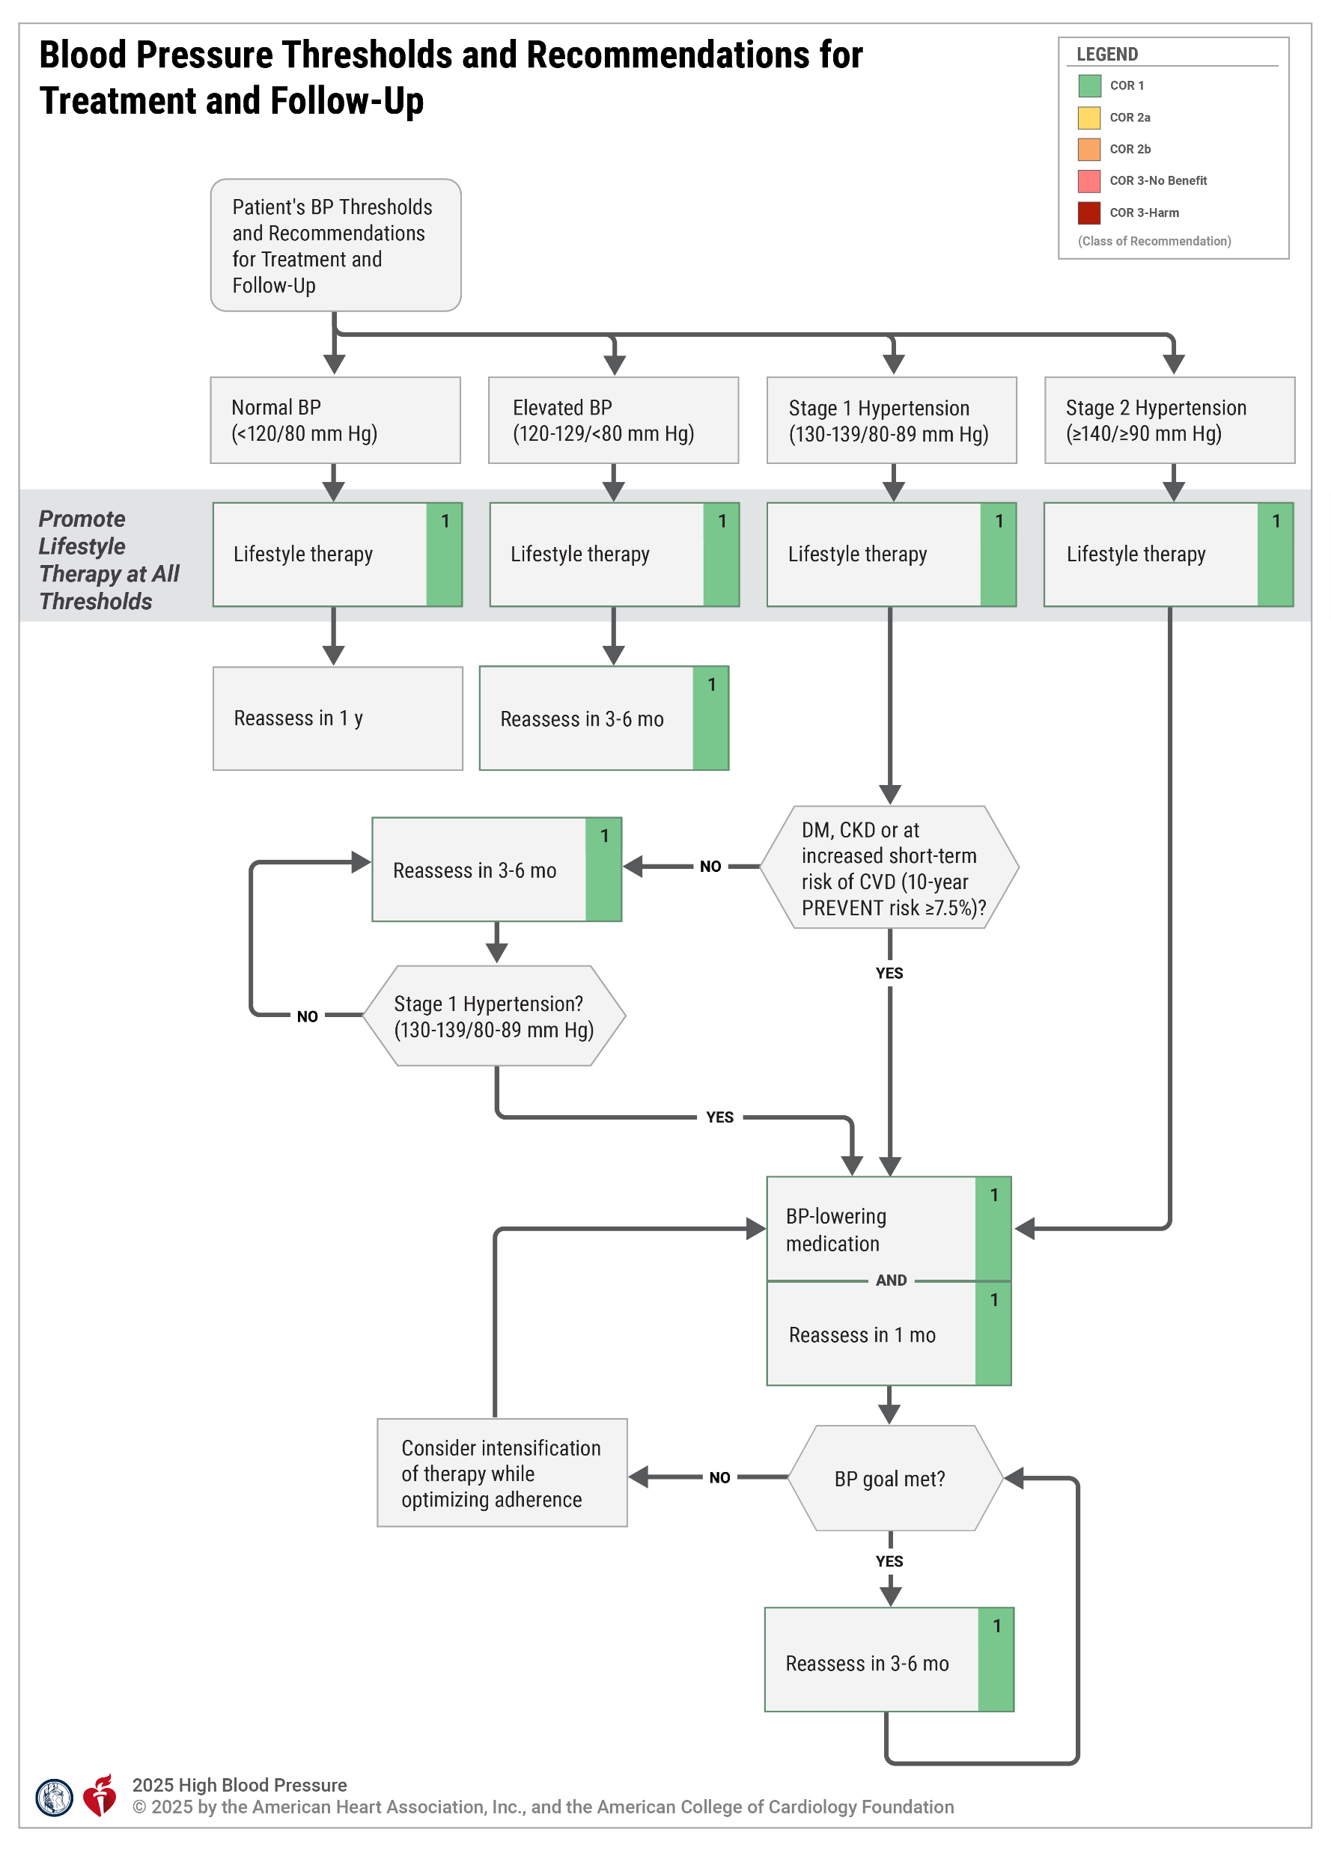
Figure 7. Blood Pressure Thresholds and Recommendations for Treatment and Follow-Up
BP indicates blood pressure; CVD, cardiovascular disease; DM, diabetes mellitus.
*Based on the PREVENT calculator.
Modified with permission from Whelton et al. Copyright 2018 American College of Cardiology Foundation.

Slide 129
Hypertension and Pregnancy
Recommendations for Individuals With Hypertension and Pregnancy* Referenced studies that support the recommendations are summarized in the evidence table.
COR | LOE | Recommendations
1 | A | For individuals with hypertension who are planning a pregnancy or who become pregnant, labetalol and extended-release nifedipine are preferred agents to treat hypertension and minimize fetal risk.
1 | B-R | Individuals with hypertension who are planning a pregnancy or who become pregnant should be counseled about the benefits of low-dose (81 mg/day) aspirin to reduce the risk of preeclampsia and its sequelae.
1 | B-R | Pregnant individuals with SBP ≥160 mm Hg or DBP ≥110 mm Hg confirmed on repeat measurement within 15 minutes should receive antihypertensive medication (Table 23) to lower BP to <160/<110 mm Hg within 30 to 60 minutes to prevent adverse events.
*ACOG diagnostic criteria and classification of hypertensive disorders of pregnancy are found in Tables 22 and 23.

Slide 130
Hypertension and Pregnancy (con’t.)
1 | B-R | Pregnant individuals with chronic† hypertension (defined as prepregnancy hypertension or SBP 140 to 159 mm Hg and/or DBP 90 to 109 mm Hg prior to 20 weeks’ gestation) should receive antihypertensive therapy to achieve BP <140/90 mm Hg to prevent maternal and perinatal morbidity and mortality.
3: Harm | C-LD | Individuals with hypertension who are planning a pregnancy or who become pregnant should not be treated with atenolol, ACEi, ARB, direct renin inhibitors, nitroprusside, or MRA to avoid fetal harm.
†Chronic hypertension in pregnancy is defined as a preexisting diagnosis of hypertension or SBP ≥140 mm Hg and/or DBP ≥90 mm Hg on 2 occasions at least 4 hours apart before 20 weeks’ gestation.

Slide 131
Table 20. Classification of Hypertensive Disorders of Pregnancy
Condition | Definition
Chronic hypertension | Diagnosis prior to pregnancy or at <20 weeks’ gestation
Gestational hypertension | De novo hypertension at ≥20 weeks’ gestation in the absence of proteinuria or other signs of preeclampsia
Preeclampsia | Gestational hypertension with proteinuria or other maternal end-organ dysfunction including neurologic findings, pulmonary edema, hematologic findings, acute kidney injury, hepatic dysfunction (Section 5.5.2)
Preeclampsia superimposed on chronic hypertension | Preeclampsia in a woman with a history of hypertension before pregnancy or before 20 weeks’ gestation
Derived from American College of Obstetricians and Gynecologists.

Slide 132
Table 21. ACOG Diagnostic Criteria for Hypertension in Pregnancy
Condition | Definition
Hypertension in pregnancy | SBP ≥140 mm Hg and/or DBP ≥90 mm Hg
Severe-range hypertension | SBP ≥160 mm Hg and/or DBP ≥110 mm Hg
ACOG indicates American College of Obstetricians and Gynecologists; DBP, diastolic blood pressure; and SBP, systolic blood pressure. Derived from American College of Obstetricians and Gynecologists.

Slide 133
Table 22. Common Oral Antihypertensive Agents in Pregnancy
Drug | Dosage | Comments
Labetalol | 200-2400 mg/d orally in two to three divided doses. Commonly initiated at 100-200mg twice daily. | Potential bronchoconstrictive effects. Avoid in women with asthma, preexisting myocardial disease, decompensated cardiac function, and heart block and bradycardia.
Nifedipine | 30-120 mg/d orally of an extended-release preparation. Commonly initiated at 30-60 mg once daily (extended release). | Do not use sublingual form. Immediate-release formulation should generally be reserved for control of severe, acutely elevated blood pressures in hospitalized patients. Should be avoided in tachycardia.
Reproduced with permission from American College of Obstetricians and Gynecologists.
Copyright 2019 American College of Obstetricians and Gynecologists.

Slide 134
Table 22. Common Oral Antihypertensive Agents in Pregnancy (con’t.)
Methyldopa | 500-3000 mg/d orally in two to four divided doses. Commonly initiated at 250 mg twice or three times daily. | Safety data up to 7 years of age in offspring. May not be as effective as other medications, especially in control of severe hypertension. Use limited by side effect profile (sedation, depression, dizziness).
Hydrochlorothiazide | 12.5-50 mg daily | Second-line or third-line agent.
Reproduced with permission from American College of Obstetricians and Gynecologists.
Copyright 2019 American College of Obstetricians and Gynecologists.

Slide 135
Table 23. Antihypertensive Agents Used for Urgent Blood Pressure Control in Pregnancy
Drug | Dose | Comments | Onset of Action
Labetalol | 10-20 mg IV, then 20-80 mg every 10-30 min to a maximum cumulative dosage of 300 mg; or constant infusion 1-3 mg/min IV | Tachycardia is less common with fewer adverse effects. Avoid in women with asthma, preexisting myocardial disease, decompensated cardiac function, and heart block and bradycardia. | 1-2 min
Hydralazine | 5 mg IV or IM, then 5-10 mg IV every 20-40 min to a maximum cumulative dosage of 20 mg; or constant infusion of 0.5-10 mg/h | Higher or frequent dosage associated with maternal hypotension, headaches, and abnormal fetal heart rate tracings; may be more common than other agents. | 10-20 min
Nifedipine (immediate release) | 10-20 mg orally, repeat in 20 min if needed; then 10-20 mg every 2-6 h; maximum daily dose is 180 mg | May observe reflex tachycardia and headaches. | 5-10 min
h indicates hour; IM, intramuscular; IV, intravenous; and min, minutes.
Reprinted with permission from American College of Obstetricians and Gynecologists. Copyright 2020 American College of Obstetricians and Gynecologists.

Slide 136
Table 24. Diagnostic Criteria for Preeclampsia.
Blood pressure | SBP ≥140 mm Hg or DBP ≥90 mm Hg on two occasions at least 4 hours apart after 20 weeks of gestation in a woman with previously normal BP or SBP ≥160 mm Hg or DBP ≥110 mm Hg (severe hypertension can be confirmed within a short interval [minutes] to facilitate timely antihypertensive therapy).
AND
Proteinuria | ≥300 mg per 24-hour urine collection (or this amount extrapolated from a timed collection) or Protein/creatinine ratio ≥0.3 or Dipstick reading of 2+ (used only if other quantitative methods are not available)
Reprinted with permission from American College of Obstetricians and Gynecologists.
Copyright 2020 American College of Obstetricians and Gynecologists.
BP indicates blood pressure; DBP, diastolic blood pressure; and SBP, systolic blood pressure.

Slide 137
Table 24. Diagnostic Criteria for Preeclampsia. (con’t.)
OR in the absence of proteinuria, new onset hypertension with the new onset of any of the following:
Thrombocytopenia: Platelet count <100 x 10⁹/L
Renal insufficiency: Serum creatinine concentrations >1.1 mg/dL or a doubling of serum creatinine concentration in the absence of other renal disease
Impaired liver function: Elevated blood concentration of liver transaminases to twice normal concentration
Pulmonary edema
New-onset headache unresponsive to medication and not accounted for by the alternative diagnoses or visual symptoms
BP indicates blood pressure; DBP, diastolic blood pressure; and SBP, systolic blood pressure.
Reprinted with permission from American College of Obstetricians and Gyencologists.10 Copyright 2020 American College of Obstetricians and Gynecologists.

Slide 138
Resistant Hypertension and Renal Denervation
Recommendations for Resistant Hypertension and Renal Denervation Referenced studies that support the recommendations are summarized in the evidence table.
COR | LOE | Recommendations
 |  | Resistant Hypertension
1 | B-NR | In adults with resistant hypertension, a more detailed evaluation for secondary causes, to include careful review of all medications and removal of those with interfering effects on BP, is beneficial for lowering BP and simplifying treatment.
1 | B-R | In adults with uncontrolled resistant hypertension despite optimal treatment with first-line antihypertensive therapy (ie, a combination of ACEi or ARB plus CCB and thiazide-like diuretic [chlorthalidone or indapamide] and with an eGFR of ≥45 ml/min/1.73 m²), addition of a MRA is recommended to control BP.
2a | B-NR | In adults with uncontrolled resistant hypertension who cannot tolerate or have contraindications for MRA, the addition of one of the following agent or classes — amiloride, BBs, alpha blockers, central sympatholytic drugs, dual endothelin receptor antagonists or direct vasodilators — is reasonable to control BP.

Slide 139
Resistant Hypertension and Renal Denervation (con’t.)
 |  | Renal Denervation
2b | B-R | In carefully selected patients with systolic and diastolic hypertension (office SBP 140 to 180 mm Hg and DBP ≥90 mm Hg) and eGFR ≥40 mL/min/1.73 m² who have resistant hypertension despite optimal treatment, or intolerable side effects to additional antihypertensive drug therapy, renal denervation (RDN) may be reasonable as an adjunct treatment to BP medications and lifestyle modification to reduce BP.
1 | B-NR | All patients with hypertension who are being considered for RDN should be evaluated by a multidisciplinary team with expertise in resistant hypertension and RDN.
1 | C-EO | For patients with hypertension for whom RDN is contemplated, the benefits of lowering BP and potential procedural risks compared with continuing medical therapy should be discussed as part of a shared decision-making process to ensure patients choose the therapy that meets their expectations.

Slide 140
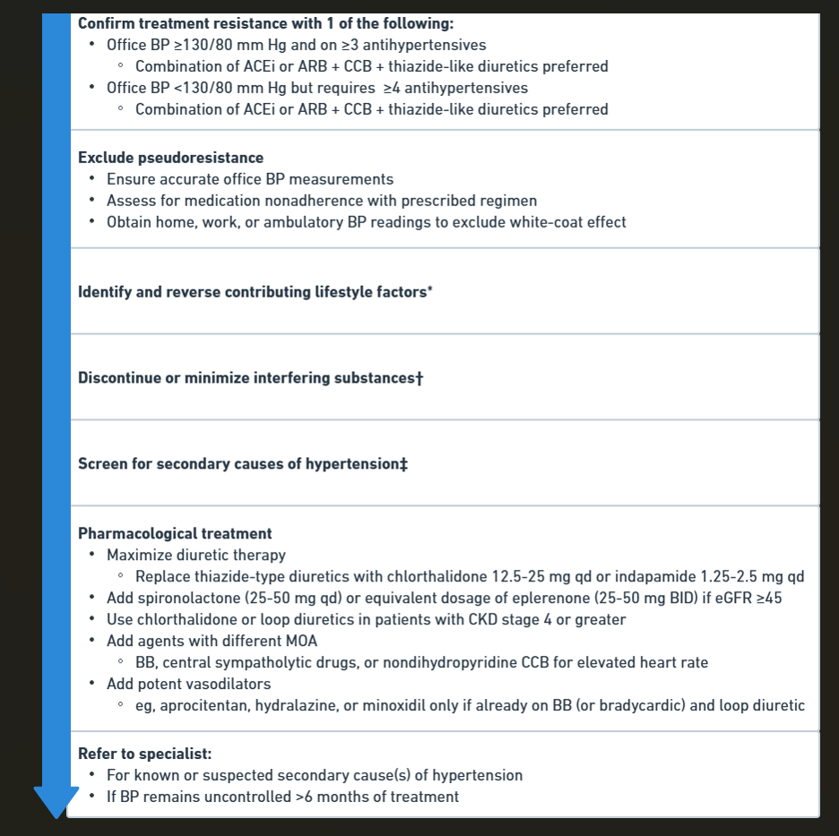
Figure 8. Resistant Hypertension: Diagnosis, Evaluation, and Treatment
*Please refer to Section 5.2, on lifestyle factors.
†Please refer to Table 11 for a complete list of drugs that elevate BP.
‡Please refer to Section 3.2.3, on secondary hypertension, and Subsections 3.2.3.1., 3.2.3.2, and 3.2.3.3.
ARB indicates angiotensin receptor blocker; BB, beta blocker; BP, blood pressure; BID, 2 times daily; CCB, calcium channel blocker; CKD, chronic kidney disease; DBP, diastolic blood pressure; eGFR, estimated glomerular filtration rate; mo, month; MOA, mechanisms of action; NSAIDs, nonsteroidal anti-inflammatory drugs; OSA, obstructive sleep apnea; qd, daily; and SBP, systolic blood pressure.
Copyright 2018 American College of Cardiology Foundation and American Heart Association, Inc.
Adapted with permission from Calhoun et al.
Copyright 2008 American Heart Association Inc.

Slide 141
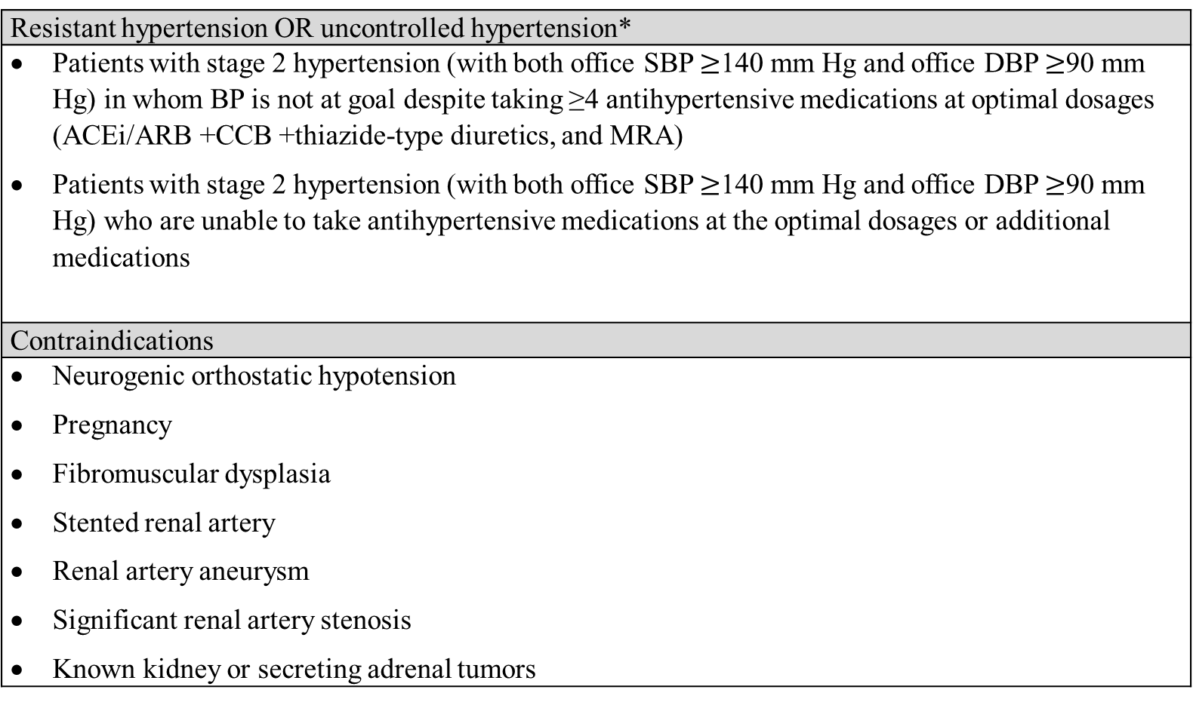
Table 25. Patient Selection for Renal Denervation
Resistant hypertension OR uncontrolled hypertension*
Patients with stage 2 hypertension (with both office SBP $≥$140 mm Hg and office DBP $≥$90 mm Hg) in whom BP is not at goal despite taking ≥4 antihypertensive medications at optimal dosages (ACEi/ARB +CCB +thiazide-type diuretics, and MRA) Patients with stage 2 hypertension (with both office SBP $≥$140 mm Hg and office DBP $≥$90 mm Hg) who are unable to take antihypertensive medications at the optimal dosages or additional medications
Contraindications
Neurogenic orthostatic hypotension Pregnancy Fibromuscular dysplasia Stented renal artery Renal artery aneurysm Significant renal artery stenosis Known kidney or secreting adrenal tumors
*After evaluation by a multidisciplinary team to screen for secondary hypertension and contraindications and following a shared decision-making process.
ACEi indicates angiotensin-converting enzyme inhibitor; ARB, angiotensin receptor blocker; CCB, calcium channel blocker; DBP, diastolic blood pressure; MRA, mineralocorticoid receptor antagonist; and SBP, systolic blood pressure.

Slide 142
Complications of Management

Slide 143
Management of Orthostatic Hypotension
Recommendations for Management of Orthostatic Hypotension Referenced studies that support the recommendations are summarized in the evidence table.
COR | LOE | Recommendations
1 | A | In adults with hypertension, improved BP control is recommended to reduce the risk for OH.
2a | A | In adults receiving intensive BP-lowering therapy with asymptomatic OH, treatment with a goal of SBP <130 mm Hg is reasonable due to increased CVD and mortality benefit.
2a | B-R | In adults with hypertension initiating treatment or adding medication with a goal of SBP <130 mm Hg, assessment for symptomatic OH is reasonable to detect other chronic conditions.

Slide 144
Hypertensive Emergencies and Severe Hypertension in Nonpregnant and Nonstroke Patients
Recommendations for Hypertensive Emergencies and Severe Hypertension for Non-Pregnant and Non-Stroke Patients* References that support recommendations are summarized in the evidence table.
COR | LOE | Recommendations
1 | B-NR | In adults with a hypertensive emergency (BP >180 and/or >120 mm Hg and evidence of acute target organ damage), admission to an intensive care unit is recommended for continuous monitoring of BP and target organ damage and for consideration of parenteral administration of appropriate therapy (Tables 26 and27 and Figure 9).
*Hypertensive emergencies in patients with acute ICH and acute ischemic stroke are discussed in Section 5.3.9 (“Cerebrovascular Disease”) and in pregnant adults in Section 5.5 (“Hypertension and Pregnancy”).

Slide 145
Hypertensive Emergencies and Severe Hypertension in Non-Pregnant and Non-Stroke Patients (con’t.)
1 | C-LD | For adults with a hypertensive emergency related to a compelling condition (eg, acute aortic syndrome or acute aortic dissection), SBP should be reduced to <140 mm Hg for most conditions and to <120 mm Hg in aortic dissection during the first hour, while monitoring for other target organ dysfunction.
1 | C-LD | For adults with a hypertensive emergency but without a compelling condition, SBP should be reduced with oral or parenteral therapy by no more than 25% within the first hour; then, if stable, to <160/100 mm Hg within the next 2 to 6 hours; and then cautiously to 130 to 140 mm Hg during the next 24 to 48 hours to limit target organ injury.
3: Harm | B-NR | For adults with severe hypertension (>180/120 mm Hg) who are hospitalized for noncardiac conditions without evidence of acute target organ damage, intermittent use of additional IV or oral antihypertensive medications are not recommended to acutely reduce BP.

Slide 146
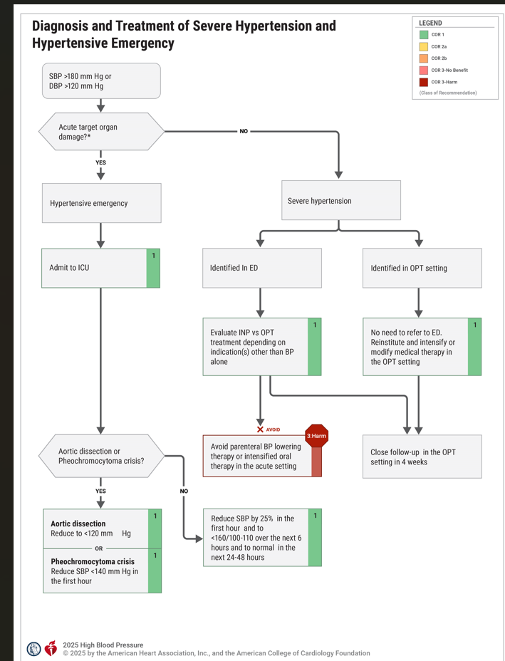
Figure 9. Diagnosis and Treatment of Severe Hypertension and Hypertensive Emergency
*Defined as acute heart failure/pulmonary edema, neurologic disorders (posterior reversible encephalopathy syndrome, encephalopathy, retinal hemorrhage, papilledema, intracranial hemorrhage, acute ischemic stroke), acute decompensated heart failure, acute coronary syndrome, acute kidney injury, acute aortic syndrome (penetrating aortic ulcer, aortic dissection).
DBP indicates diastolic blood pressure; ED, emergency department; ICU, intensive care unit; INP, inpatient; OPT, outpatient; and SBP, systolic blood pressure. For reinstitution, modification or intensification of medical therapy, refer to sections 5.2.2. through 5.2.4.
Modified with permission from Whelton et al. Copyright 2018 American College of Cardiology Foundation and American Heart Association, Inc.

Slide 147
Table 26. Intravenous Antihypertensive Drugs for Treatment of Hypertensive Emergencies
Class | Drug(s) | Usual Dose Range | Comments
CCB—dihydropyridines | Nicardipine | Initial 5 mg/h, increasing every 5 min by 2.5 mg/h to maximum 15 mg/h | Contraindicated in advanced aortic stenosis; no dose adjustment needed for persons aged ≥65 y. No negative inotropic or chronotropic effects.
 | Clevidipine | Initial 1–2 mg/h, doubling every 90 s until BP approaches target, then increasing by less than double every 5–10 min; maximum dose 21 mg/h; maximum duration 72 h | Contraindicated in patients with soybean, soy product, egg, and egg product allergy and in patients with defective lipid metabolism (eg, pathological hyperlipidemia, lipoid nephrosis [minimal change disease] or acute pancreatitis). No negative inotropic or chronotropic effects. Decreased risk of reflex tachycardia.

Slide 148
Table 26. Intravenous Antihypertensive Drugs for Treatment of Hypertensive Emergencies (con’t.)
Vasodilators—nitric-oxide dependent | Sodium nitroprusside | Initial 0.3–0.5 mcg/kg/min; increase in increments of 0.5 mcg/kg/min q 5 min to achieve BP target; maximum dose 10 mcg/kg/min; duration of treatment as short as possible | Due to potency, intra-arterial BP monitoring is recommended to prevent “overshoot.” Lower dose required for older adults. Tachyphylaxis is common with extended use. No negative inotropic or chronotropic effects. Due to increased mortality risk, should be avoided in acute cerebrovascular disease unless other agents are not available. Use cautiously in pregnancy or older adults. Cyanide toxicity (increased risk in liver dysfunction and chronic kidney disease) and thiocyanate toxicity (increased risk in kidney dysfunction, sCr >3) may occur for infusion rates ≥3 mcg/kg/min and/or duration ≥3 days. Cyanide toxicity and thiocyanate toxicity may present similarly with metabolic acidosis, altered mental status, and cardiac arrhythmia. For either toxicity state, nitroprusside should be discontinued and sodium thiosulfate or cyanocobalamin should be administered.
 | Nitroglycerin | Initial 5 mcg/min; increase in increments of 5 mcg/min every 3–5 min to a maximum rate of 200 mcg/min | Use only in patients with acute coronary syndrome and/or acute pulmonary edema. Do not use in volume-depleted patients. Tachyphylaxis is common with extended use.

Slide 149
149
Table 26. Intravenous Antihypertensive Drugs for Treatment of Hypertensive Emergencies (con’t.)
Vasodilators—direct | Hydralazine | Initial 10 mg via slow IV infusion (maximum initial dose 20 mg); repeat every 4–6 h as needed. Adjust rate up to total cumulative dose of 200 mg/24 hours | BP begins to decrease within 10–30 min, and the fall lasts 2–4 h. Hydralazine is an undesirable first-line agent for acute treatment in most patients due to unpredictability of response and prolonged duration of action.
Adrenergic blockers—beta-1 receptor selective antagonist | Esmolol | Loading dose 500–1000 mcg/kg/min over 1 min followed by a 50-mcg/kg/min infusion. For additional dosing, the bolus dose is repeated, and the infusion increased in 50-mcg/kg/min increments as needed to a maximum of 300 mcg/kg/min | Contraindicated in patients with concurrent beta-blocker therapy, bradycardia, or decompensated HF. Monitor for bradycardia. Higher doses may block beta-2 receptors and impact lung function in reactive airway and obstructive pulmonary disease.
Adrenergic blockers—combined alpha-1 and nonselective beta receptor antagonist | Labetalol | Initial 0.3–1.0-mg/kg dose (maximum 20 mg) slow IV injection every 2 min or 0.4–1.0-mg/kg/h IV infusion up to 3 mg/kg/h. Adjust rate up to total cumulative dose of 300 mg/24 hours | Contraindicated in reactive airway or obstructive pulmonary disease. Especially useful in hyperadrenergic syndromes. May worsen HF and should not be given in patients with second- or third-degree heart block or bradycardia.

Slide 150
Table 26. Intravenous Antihypertensive Drugs for Treatment of Hypertensive Emergencies (con’t.)
Adrenergic blockers— nonselective alpha receptor antagonist | Phentolamine | IV bolus dose 5 mg. Additional bolus doses every 10 min as needed to lower BP to target. Adjust rate up to total cumulative dose of 50 mg/24 h | Used in hypertensive emergencies induced by catecholamine excess (pheochromocytoma, interactions between monamine oxidase inhibitors and other drugs or food, cocaine toxicity, amphetamine overdose, or clonidine withdrawal).
Dopamine-1-receptor selective agonist | Fenoldopam | Initial 0.1–0.3 mcg/kg/min; may be increased in increments of 0.05–0.1 mcg/kg/min every 15 min until target BP is reached. Maximum infusion rate 1.6 mcg/kg/min | Contraindicated in patients at risk of increased intraocular pressure (glaucoma) or intracranial pressure and those with sulfite allergy.
ACE inhibitor | Enalaprilat | Initial 1.25 mg over a 5-min period. Doses can be increased up to 5 mg every 6 h as needed to achieve BP target. Adjust rate up to total cumulative dose of 50 mg/24 h | Contraindicated in pregnancy and should not be used in acute MI or bilateral renal artery stenosis. Mainly useful in hypertensive emergencies associated with high plasma renin activity. Poorly defined dose adjustments for kidney failure and may worsen kidney injury in those with CKD. Relatively slow onset of action (15 min) and unpredictability of BP response.

Slide 151
Table 26. Intravenous Antihypertensive Drugs for Treatment of Hypertensive Emergencies (con’t.)
BP indicates blood pressure; CCB, calcium channel blocker; CKD, chronic kidney disease; HF, heart failure; IV, intravenous; and MI, myocardial infarction.
Modified with permission from Whelton et al. Copyright 2018 American College of Cardiology Foundation and American Heart Association, Inc.

Slide 152
Table 27. Intravenous Antihypertensive Drugs for Treatment of Hypertensive Emergencies in Patients With Selected Comorbidities
Comorbidity | Preferred Drug(s)* | Comments
Acute aortic dissection | Esmolol, labetalol | Requires rapid lowering of SBP to ≤120 mm Hg. Beta blockade should precede vasodilator (eg, nicardipine or nitroprusside) administration, if needed for BP control or to prevent reflex tachycardia or inotropic effect; SBP ≤120 mm Hg should be achieved within 20 min.
Acute pulmonary edema | Clevidipine, nitroglycerin, nitroprusside | Beta blockers contraindicated.
Acute coronary syndromes | Esmolol†, labetalol, nicardipine, nitroglycerin† | Nitrates given in the presence of PDE-5 inhibitors may induce profound hypotension. Contraindications to beta blockers include moderate-to-severe LV failure with pulmonary edema, bradycardia (<60 bpm), hypotension (SBP <100 mm Hg), poor peripheral perfusion, second- or third-degree heart block, and reactive airways disease.
*Agents are listed in alphabetical order, not in order of preference.
†Agent of choice for acute coronary syndromes.
ACE indicates angiotensin-converting enzyme; ARB, angiotensin receptor blocker; BP, blood pressure; bpm, beats per minute; ICH, intracerebral hemorrhage; LV, left ventricular; PDE-5, phosphodiesterase type-5; and SBP, systolic blood pressure.
Modified with permission from Whelton et al. Copyright 2018 American College of Cardiology Foundation and American Heart Association, Inc.

Slide 153
Table 27. Intravenous Antihypertensive Drugs for Treatment of Hypertensive Emergencies in Patients With Selected Comorbidities (con’t.)
Comorbidity | Preferred Drug(s)* | Comments
Acute kidney injury | Clevidipine, fenoldopam, nicardipine | N/A
Eclampsia or preeclampsia | Hydralazine, labetalol, nicardipine, nifedipine | Requires rapid BP lowering. ACE inhibitors, ARB, renin inhibitors, and nitroprusside contraindicated.
Perioperative hypertension (BP ≥160/90 mm Hg or SBP elevation ≥20% of the preoperative value that persists for >15 min) | Clevidipine, esmolol, nicardipine, nitroglycerin | Intraoperative hypertension is most frequently seen during anesthesia induction and airway manipulation.
*Agents are listed in alphabetical order, not in order of preference.
ACE indicates angiotensin-converting enzyme; ARB, angiotensin receptor blocker; BP, blood pressure; bpm, beats per minute; ICH, intracerebral hemorrhage; LV, left ventricular; PDE-5, phosphodiesterase type-5; and SBP, systolic blood pressure.
Modified with permission from Whelton et al. Copyright 2018 American College of Cardiology Foundation and American Heart Association, Inc.

Slide 154
Table 27. Intravenous Antihypertensive Drugs for Treatment of Hypertensive Emergencies in Patients With Selected Comorbidities (con’t.)
Comorbidity | Preferred Drug(s)* | Comments
Acute sympathetic discharge or catecholamine excess states (eg, pheochromocytoma, postcarotid endarterectomy status) | Clevidipine, nicardipine, phentolamine | Requires rapid lowering of BP.
Acute ICH | Clevidipine, nicardipine, esmolol, labetalol, hydralazine | Section 5.3.9.1
Acute ischemic stroke | Clevidipine, nicardipine, esmolol, labetalol, hydralazine | Section 5.3.9.2
*Agents are listed in alphabetical order, not in order of preference.
ACE indicates angiotensin-converting enzyme; ARB, angiotensin receptor blocker; BP, blood pressure; bpm, beats per minute; ICH, intracerebral hemorrhage; LV, left ventricular; PDE-5, phosphodiesterase type-5; and SBP, systolic blood pressure.
Modified with permission from Whelton et al. Copyright 2018 American College of Cardiology Foundation.

Slide 155
Patients Scheduled for Surgical Procedures
Recommendations for Patients Scheduled for Surgical Procedures Referenced studies that support the recommendations are summarized in the evidence table.
COR | LOE | Recommendations
1 | B-NR | In patients with hypertension scheduled for major surgery who have been on BB chronically, BB should be continued throughout the perioperative period to assist with BP control.
2a | C-EO | In patients with hypertension scheduled for elective major surgery, it is reasonable to continue most medications for hypertension throughout the perioperative period.

Slide 156
Patients Scheduled for Surgical Procedures (con’t.)
2b | B-R | In patients with hypertension scheduled for major surgery, discontinuation of ACEi or ARB preoperatively may be considered to prevent hypotension during surgery.
2b | C-LD | In patients scheduled for elective major surgery with SBP ≥180 mm Hg or DBP ≥110 mm Hg, deferring surgery may be considered especially in high-risk patients to minimize perioperative complications.
3:Harm | B-NR | In patients with hypertension scheduled for surgery, abrupt preoperative discontinuation of BB or clonidine may result in rebound hypertension and is potentially harmful.
3:Harm | B-R | For patients with hypertension scheduled for surgery, BB should not be started on the day of surgery in BB-naïve patients because of increased risk of postoperative mortality.

Slide 157
Abbreviations
Abbreviations | Meaning/Phrase
ABPM | ambulatory blood pressure monitoring
ACEi | angiotensin-converting enzyme inhibitor
AD | aortic disease
AF | atrial fibrillation
AKI | acute kidney injury
AOBP | automated office blood pressure
ARB | angiotensin receptor blocker
ASCVD | atherosclerotic cardiovascular disease
BB | beta blocker
BMI | body mass index
BP | blood pressure
CCB | calcium channel blocker
CCD | chronic coronary disease
CKD | chronic kidney disease
CKM | cardiovascular-kidney-metabolic
COR | class of recommendation

Slide 158
Abbreviations (con’t.)
Abbreviations | Meaning/Phrase
CPAP | continuous positive airway pressure
CVD | cardiovascular disease
DASH | Dietary Approaches to Stop Hypertension
DBP | diastolic blood pressure
eGFR | estimated glomerular filtration rate
EHR | electronic health record
FDA | Food and Drug Administration, US
GDMT | guideline-directed medical therapy
GLP-1 | glucagon-like peptide-1
HBPM | home blood pressure monitoring
HCTZ | hydrochlorothiazide
HDP | hypertensive disorders of pregnancy
HF | heart failure
HFpEF | heart failure with preserved ejection fraction
HFrEF | heart failure with reduced ejection fraction
HbA1c | hemoglobin A1c

Slide 159
Abbreviations (con’t.)
Abbreviations | Meaning/Phrase
HIT | health information technology
HR | hazard ratio
ICH | intracerebral hemorrhage
IV | intravenous
LOE | level of evidence
MACE | major adverse cardiovascular event
MI | myocardial infarction
MRA | mineralocorticoid receptor antagonist
OH | orthostatic hypotension
OR | odds ratio
OSA | obstructive sleep apnea
PAD | peripheral artery disease
PCE | pooled cohort equation
QOL | quality of life
RAS | renin-angiotensin-system
RAASi | renin-angiotensin-aldosterone system inhibitor

Slide 160
Abbreviations (con’t.)
Abbreviations | Meaning/Phrase
RCT | randomized controlled trial
RDN | renal denervation
SBP | systolic blood pressure
SDOH | social drivers of health
SGLT2i | sodium-glucose cotransporter-2 inhibitor
SPC | single-pill combination
T2D | type 2 diabetes
TIA | transient ischemic attack
U.S. | United States

