Slide 1

Lay Stakeholders
in
Science and Research
Notes:
The American Heart Association depends on the time and talent of many volunteers to keep research and science moving forward towards the goal of creating a healthier world.
Because of your passion, capabilities, and interests you are about to volunteer your time and energy within AHA’s Science and Research Enterprise.
Let us tell you about the Lay Stakeholder in Science and Research initiative.

Slide 2
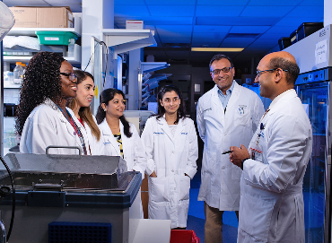

the AHA has invested more than
$4.5 billion in research
Invested More than $5 Billion in Research
Since 1949, the AHA has invested $5 billion in cardiovascular, cerebrovascular, and brain health research
Nation’s oldest and largest voluntary organization uniting more than 33 million volunteers and supporters.
Largest source of funding for cardiovascular disease and stroke research next to the federal government.
Global health impact
Notes:
So let’s begin with a few very important facts about the AHA.
Funding research is a cornerstone of the American Heart Association’s lifesaving mission -- a pillar upon which the AHA was founded and a key to our future. The AHA is the largest not-for-profit funding source for cardiovascular and cerebrovascular disease research next to the federal government. New knowledge resulting from AHA funding benefits millions of lives in every corner of the U.S. and around the world:
Translation into medical advancements
Updated guidelines for healthcare providers to most effectively treat patients and improve people's well-being
Building careers in science and research
Our bold research vision is guided by 12 Essential Elements to ensure AHA is at the forefront of global changes, emphasizes collaborative and team research, accelerates discovery, and drives groundbreaking research outcomes.
The AHA Research Committee and Subcommittees are composed of science and medicine volunteers. They establish and direct the organization's research policies and programs.

Slide 3
2024 Impact Goal
Every person deserves the opportunity for a full, healthy life. As champions for health equity, by 2024, the American Heart Association will advance cardiovascular health for all, including identifying and removing barriers to health care access and quality.
Every person deserves the opportunity for a full, healthy life.
As champions for health equity*, by 2024, the American Heart Association will advance cardiovascular health for all, including identifying and removing barriers to health care access and quality.
Notes:
And all of our work is dedicated to achieving our 2024 Impact Goal, which was strategically developed and is based on the latest science and data:
Every person deserves the opportunity for a full, healthy life. As champions for health equity, by 2024, the American Heart Association will advance cardiovascular health for all, including identifying and removing barriers to health care access and quality.
You’ll see the 2024 goal has an even sharper focus on health equity… When we talk about health equity, here’s what we mean: Simply put, health equity is a state that would be achieved if all people had the just opportunity to be healthy.
Our official, more detailed statement on health equity is …
Everyone deserves an optimal and just opportunity to be healthy, giving special attention to the needs of those at greatest risk of poor health and no one is disadvantaged from achieving their potential because of social position or any other socially defined circumstance.

Slide 4
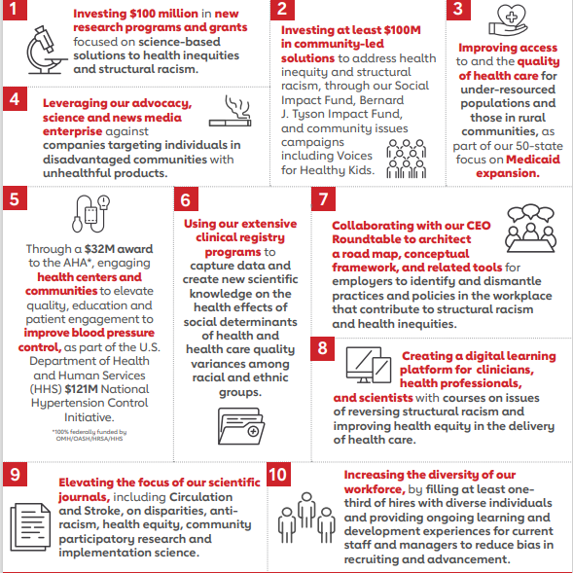
TEN COMITTMENTS
Addressing the drivers of health disparities, including the ​
social determinants of health, structural racism, and rural health inequities, is the only way to truly achieve equitable health and well-being for all.
Notes:
Addressing the drivers of health disparities, including the social determinants of health, structural racism, and rural health inequities, is the only way to truly achieve equitable health and well-being for all.
With a track record of helping to save and improve lives for nearly 100 years the American Heart Association is taking bold actions (we call them our ten commitments to remove the barriers to health and advanced cardiovascular health for all) . To the right of the screen you will see those ten commitments.
We are investing $100 million in new research programs in grants based on science to alleviate health inequities and structural racism.
we are also investing at least 100 million in community LED solutions for addressing health inequality and structural racism. we're improving the access to and the quality of healthcare for underrepresented populations in rural communities
through $32 million award we are engaging health centers and communities to elevate the quality and education to improve blood pressure control
We're using our extensive clinical registry programs to capture data so we have more scientific knowledge on the health effects of social determinants of health and health care and quality.
We're collaborating with our CEO roundtable to architecture a road map & conceptual framework and related tools for employers to identify and dismantle practices and policies in the workplace that contributed to this structural racism and health inequalities.
We're also creating a digital learning platform for clinicians and healthcare professionals and scientists to improve areas of health care.
We want to elevate the focus of our scientific journals.
And we want to increase the diversity of our workforce to reduce bias

Slide 5
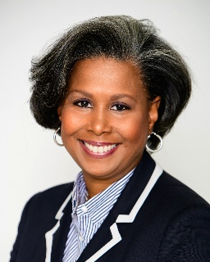
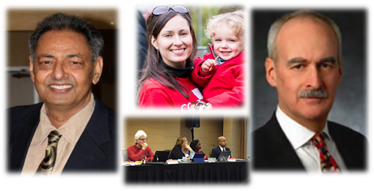
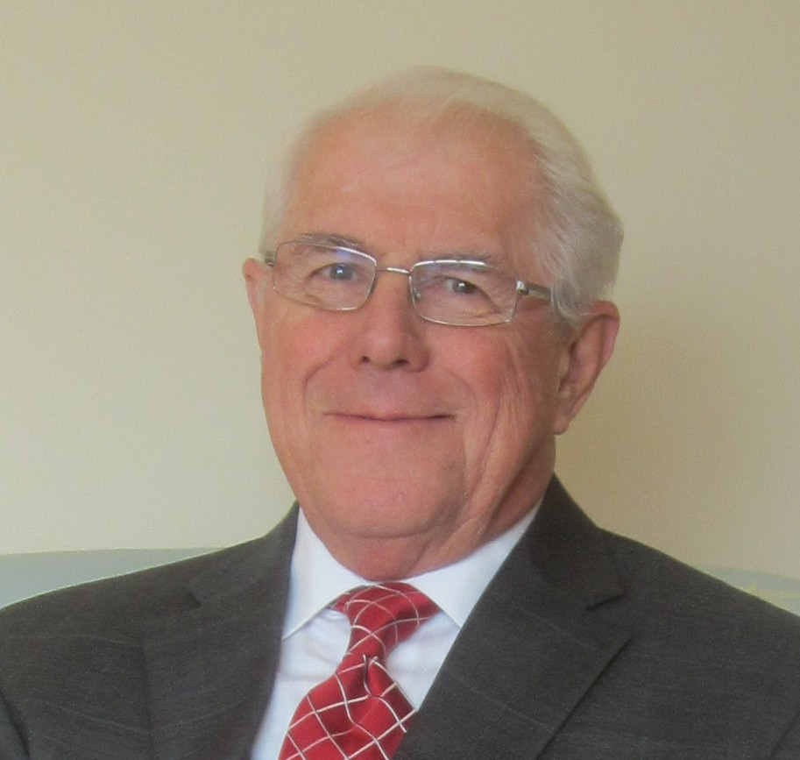
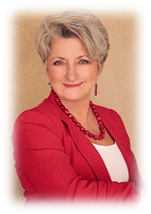
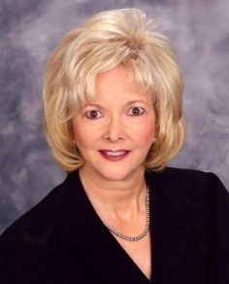
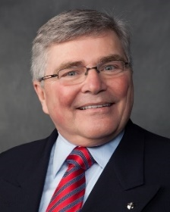
Lay Stakeholder Representatives
The Lay Stakeholder (non-scientist) volunteer is a patient, caregiver, advocate, survivor, family member, or thought leader with an intimate experience with cardiovascular and cerebrovascular disease. They are AHA volunteers without formal training as a scientist who possess a strong interest in advancing the AHA’s mission–to be a relentless force for a world of longer, healthier lives.
Notes:
Patients, caregivers and advocates are included in science and research committees and projects. Lay volunteers help shape the AHA research agenda and strengthen it’s impact on the mission of the organization.
….today we have dedicated staff and volunteers participating in many area.
Sometimes referred to as Lay Stakeholders/Lay Representatives/Lay Reviewers/lay writers
The Lay Stakeholder (non-scientist) volunteer are patients, caregivers, advocates, survivors, family members, or thought leaders with an intimate experience with cardiovascular and cerebrovascular disease. They are AHA volunteers without formal training as a scientist who possess a strong interest in advancing the AHA’s mission for longer, healthier lives.

Slide 6

Lay Stakeholder Engagement
Vital To The Mission
The role of the lay stakeholder is to add an outside perspective to research and science, a view which reflects the insights and concerns of patients, caregivers, the community, and funders. Lay Stakeholders bridge the communication gap between scientists and non-scientists prompting a sense of urgency for finding cures and more effective prevention, diagnosis, and treatments.
Notes:
The Lay Stakeholder volunteer is included in the mission of the AHA and is vital to the mission.
The role of the lay stakeholder is to add an outside perspective to research and science, a view which reflects the insights and concerns of patients, caregivers, the community, and funders. Lay Stakeholders bridge the communication gap between scientists and non-scientists prompting a sense of urgency for finding cures and more effective prevention, diagnosis, and treatments.
Including non-scientists helps to increase credibility, accountability and transparency of the research peer review, scientific statements and other research and science processes. Ultimately, including both scientists/researchers/clinicians and patient representatives reminds all of the human dimension of research and science outcomes.

Slide 7
Why AHA Invests in Lay Representatives
Increases the accountability and transparency of the research process.
Provides real-world understanding of what most impacts those affected by heart disease and stroke.
Helps shape the research agenda and strengthen its impact on the mission.
Gives voice to the issues stakeholders think are most important.
Integrates a diverse range of views.
Improves understanding of the benefits and burdens of patients in research studies.
Helps to evaluate the relevance of research funding applications to the mission of the AHA.
Helps scientists tailor research design to include a real-world patient perspective.
Enhances credibility of research and the applicability of research results to the patient, caregiver, and or community as individuals.
Ensures that AHA/ACC scientific statements and clinical practice guidelines include a patient representative perspective.
Informs others of the human dimension of research and its outcome.
Notes:
Why does the AHA invest in patient representatives?
Because they influence the direction of ECE science and research process . They create a new awareness in areas of science and research, and represent the patient community.
Increases the accountability and transparency of the research process.
Provides real-world understanding of what most impacts those affected by heart and Brain disorders and disease.
Helps shape the research agenda and strengthen its impact on the mission.
Gives voice to the issues stakeholders think are most important.
Integrates a diverse range of views (researchers, health professionals AND service-user representatives so research becomes more effective).
Improves understanding of the benefits and burdens of patients in research studies.
Helps to evaluate the relevance of research funding applications to the mission of the AHA.
Helps scientists tailor research design to include a real-world patient perspective.
Enhances credibility of research and the applicability of research results to the patient, caregiver, and or community as individuals.
Ensures that AHA/ACC scientific statements and clinical practice guidelines include a patient representative perspective.

Slide 8
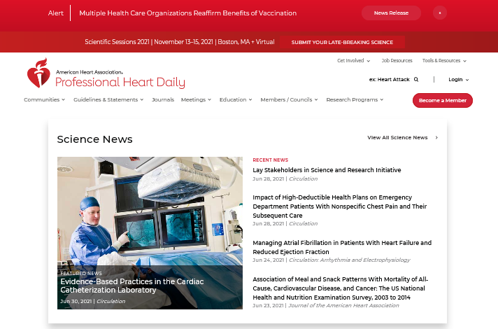
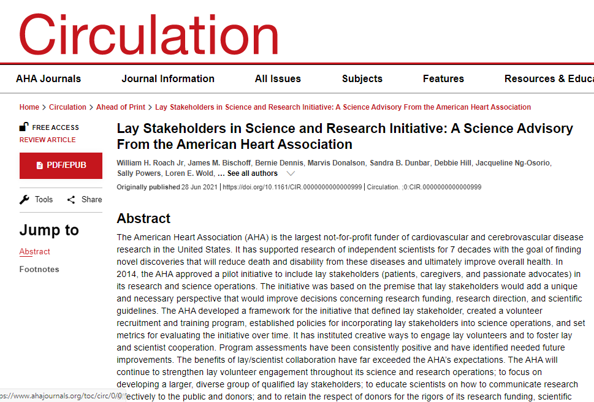
Lay Stakeholders in Science and Research Initiative:
A Science Advisory From the American Heart Association
Notes:
Lay Stakeholder in science and research in June of 2021 published best practices in the AHA Journal of Circulation. You can find this online under the LS link.

Slide 9
Participation is Growing
Notes:
The number of lay volunteers participating on AHA research and science committees and projects continues to grow.
The organization continues to support that lay stakeholders add a unique perspective to decisions about funding, research direction, and scientific guidelines written for the healthcare community.

Slide 10
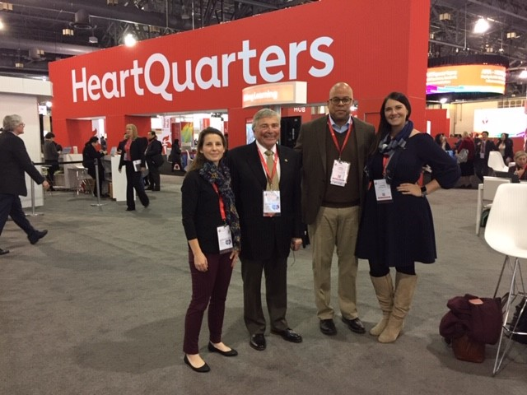
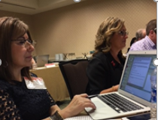
Science and Research Activities
Peer review
Research committees & subcommittees
Program oversight advisory committees
Writing guidelines groups and statements
Research seminars & scientific meetings
Lay volunteers are voting members on research committees
Notes:
Today at the American Heart Association (along side scientists & researchers) Lay Stakeholders are involved in many science and research activities;
Peer review
Research committees & subcommittees
Program oversight advisory committees
Writing guidelines groups and statements
Research seminars and scientific meetings
Lay volunteers are voting members on research committees.

Slide 11
Research Committee Reporting Structure
Board of Directors
*Lay Stakeholders in Science & Research
Task Force
Scientific Publishing Committee
Science Advisory Coordinating Committee (SACC)
*Bioethics Subcommittee
* Research
Committee
Open Science Committee
* Funding
Subcommittee
Strategic Outcomes
Subcommittee
* Peer Review &
Portfolio Management Subcommittee
Notes:
While there are many research committees, the lay stakeholders in science and research has its own task force who over sees reports directly to the Research Committee.
The AHA Lay Stakeholder Task Force on Science and Research has broad responsibility for engagement of lay stakeholders in all aspects of the AHA research enterprise.
Task Force Charge:
Assist with the development of strategies for recruitment of non-scientist volunteers, particularly those from under-represented groups
Aid in strategies and action plans for non-scientist engagement during and after involvement in science activities, including Scientific Sessions and other conferences
Explore strategies for consistent public acknowledgement of lay stakeholder volunteers
Review current training methods and explore new methods for improving quality
Broaden the inclusion of the Lay Voice by overseeing the continued integration between scientists and lay members on AHA science committees
Broaden the inclusion of the Lay Voice by building a more impactful role for AHA's lay champions as they become highly impactful Citizen Scientist partners

Slide 12
Research Committee Reporting Structure
Board of Directors
Enhancing Communications Task Force
Lay Stakeholders in Science & Research
Task Force
Scientific Publishing Committee
Science Advisory Coordinating Committee (SACC)
Bioethics Subcommittee
Research
Committee
Open Science Committee
Funding
Subcommittee
Peer Review Subcommittee
Portfolio Management
Subcommittee
Strategic Outcomes
Subcommittee
Working Group on Diversity & Inclusion
Peer Review Committees
Notes:
While there are many research committees, the lay stakeholders in science and research has its own task force who over sees reports directly to the Research Committee.
The AHA Lay Stakeholder Task Force on Science and Research has broad responsibility for engagement of lay stakeholders in all aspects of the AHA research enterprise.
Task Force Charge:
•Assist with the development of strategies for recruitment of non-scientist volunteers, particularly those from under-represented groups
•Aid in strategies and action plans for non-scientist engagement during and after involvement in science activities, including Scientific Sessions and other conferences
•Explore strategies for consistent public acknowledgement of lay stakeholder volunteers
•Review current training methods and explore new methods for improving quality
•Broaden the inclusion of the Lay Voice by overseeing the continued integration between scientists and lay members on AHA science committees
•Broaden the inclusion of the Lay Voice by building a more impactful role for AHA's lay champions as they become highly impactful Citizen Scientist partners
•Draft a manuscript describing AHA’s efforts and outcomes using lay reviewers on grant review study sections

Slide 13
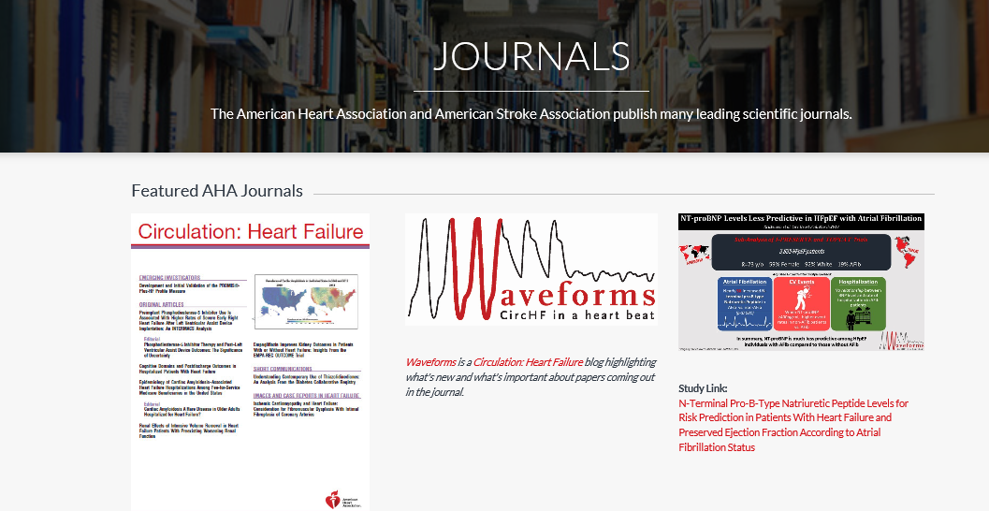
OFFICE OF
SCIENCE , MEDICINE AND HEALTH
Guidelines
Statements
Scientific Publishing
Notes:
Included in science operations is the office of Science, Medicine and Health.
The American Heart Association along with the American College of Cardiology publish medical guidelines and scientific statements on various cardiovascular and cerebrovascular topics. AHA \ACC volunteer scientists and healthcare professionals along with patient representatives write the statements. The statements are supported by scientific studies published in recognized journals and have a rigorous review and approval process.
Lay Stakeholders who serve on a manuscript writing group are helping to ensure that AHA’s scientific statements and clinical practice guidelines are developed with a patient perspective included.

Slide 14


Selection
AHA volunteer experience
Familiarity with heart (cardiovascular) or brain (cerebrovascular) disease or disorders.
A basic knowledge of scientific method and or general systematic approaches
The ability to examine research proposals and or scientific manuscripts / guidelines
Professional background
Willingness to abide by AHA conflict of interest policies
Excellent interpersonal relationship skills
Reliable
Ability to commit to the project
Notes:
When we receive a individual’s name who might be interested in serving on a Science and Research committee we compare the likely candidate to the criteria listed here.
I am a patient, caregiver or equal representative
I have AHA volunteer experience
I know the mission of AHA
I am familiar with heart disease, stroke, and/or the contributing risk factors
I have a basic knowledge of organized thought and processes
I believe I have an ability to examine research proposals objectively
I am mature in judgement
I believe I have the background/experience that provides a complementary perspective to those of clinical and scientific experts
I am able to work effectively in a group
I can speak, read, write and understand English
I will be able to voice comments, questions and opinion within a group of expert scientists
I have access to a PC or Apple laptop with wireless connection
I am proficient using email and other internet-based applications
Because you met the criteria a AHA staff member scheduled a 30-minute conference call. During the call we explained the initiative, learn more about you and introduced you to our team.
We ask questions to judge your communication skills, story and passion for inclusion in Science and Research projects.
You were given a score on suitability, research adaptability and general requirements.
Based on our findings we will match you to the most appropriate project/committee. Once you are “vetted” then training begins.

Slide 15
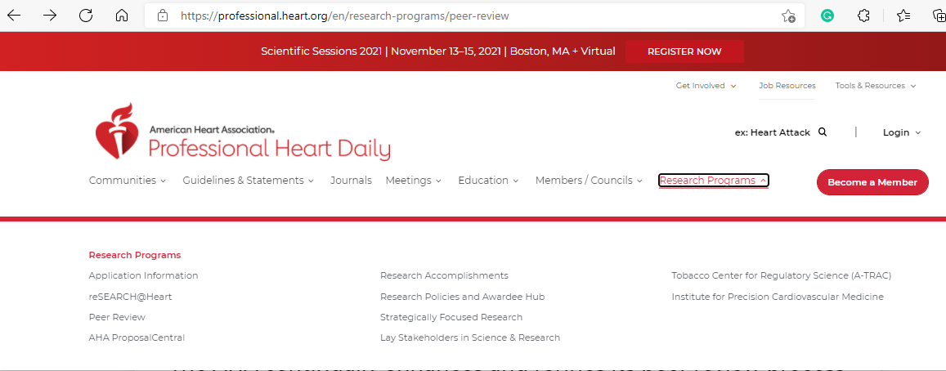

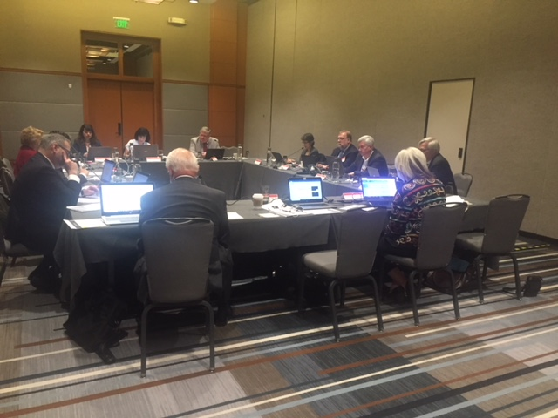

Next Steps
Visit webpage
Zoom Interview
Assignment
Notes:
A series of steps takes place before a volunteer can serve on a committee.
They are first recruited or referred by others. We encourage them to go to the website and to view the introductory presentation.
if still interested we would like you to contact us for a zoom interview . We want to learn more about you and your passion. We want to answer any questions you might have about the initiative. Once interviewed you will be placed in a database of volunteers.
Once a committee or project becomes available - A lay stakeholder(s) is matched or selected for a committee or project based on many factors – it might be their age, health diagnosis or volunteer experience. It could also be their professional background or close association with the scope of a project or committee. We look for a good fit for everyone in order to achieve the best outcome.
You are not obligated to accept our invitation. If you happen to decline you will remain on our master list of volunteers. If you accept we will tell you more about the project and training.

Slide 16
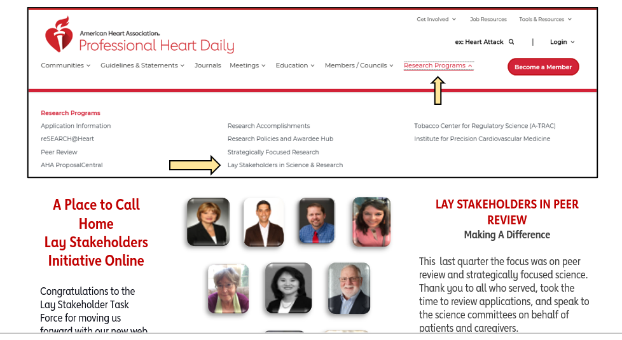
Website
Notes:
Let me introduce you to the lay stakeholder website and how to locate it.
Why does AHA Invests in Lay Representatives? For many reasons…let’s take a few minutes to hear from one of our long time very active volunteers…Debra Pitts.
Deborah Pitts (Lay Stakeholder Volunteer)
https://vimeo.com/432630406
3 minutes
password : AHA

Slide 17
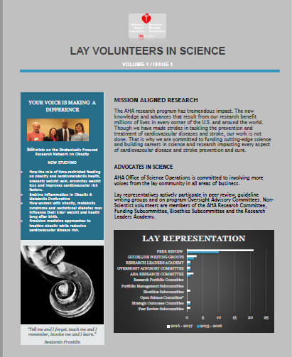
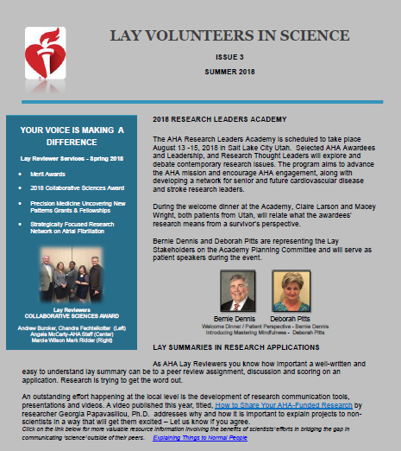
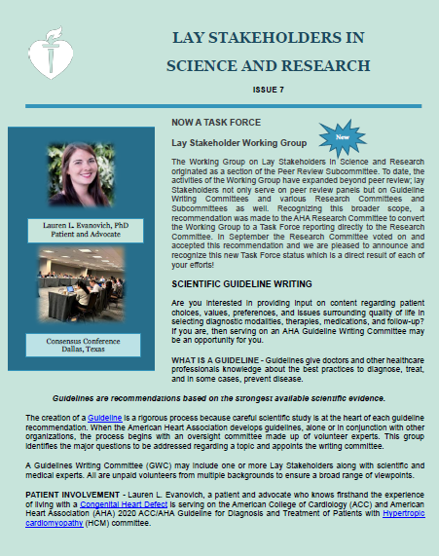
Thank You for Your Willingness to Serve

Slide 18
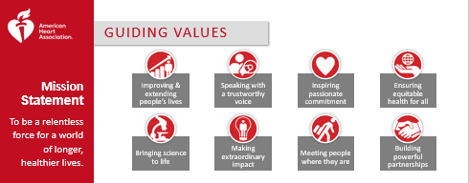

Code of Ethics
All the information that you are reviewing & hearing before and during meetings is confidential.
You are an important part of the committee.
If you accept an invitation to serve the committee is counting on you to be present.
Notes:
At the American Heart Association, our job can be easy to define: We save and improve lives. Our mission statement makes that clear. … But there’s a lot more to it. Everything we do is grounded in our guiding values.
Improving and extending peoples lives, speaking with a trustworthy voice, inspiring passionate commitment, ensuring equitable health for all, bringing science to
Improving and Extending People’s Lives
Bringing Science to Life
Speaking with a Trustworthy Voice
Building Powerful Partnerships
Inspiring Passionate Commitment
Meeting People Where They Are
Making an Extraordinary Impact
Ensuring Equitable Health for All
The American Heart Association is proud of our Code of Ethics which is built on AHA values.
We realize that what you are volunteering for is exciting and you will be eager tell others. But remember the information that you are reviewing & hearing before and during meetings is confidential. Please do not share this information with your family or friends or social network until you are allowed. In some cases you will need to remain silent on the information entrusted to you.
Maintaining the confidentiality of information entrusted to you is essential –others wellbeing may depend upon it. Be honest and ethical in your conduct, including ethical handling of actual or apparent conflicts of interest between personal and professional relationships.
Remember you will be an important part of the committee. If you accept an invitation to serve, the committee is counting on you to be present.

Slide 19

Our Mission & Next Steps
To be a relentless force for a world of longer, healthier lives
Notes:
Through our longstanding support of scientific research, the AHA has propelled breakthroughs that have saved and improved lives.
We’ve long supported scientific research in our fight against cardiovascular, cerebrovascular and brain health. And we’re making a difference. The research we’ve funded through the generosity of our donors is helping more and more people survive. Our core research programs have launched or furthered the work of many of this country’s brightest researchers. And we’ve added research awards that foster team science and accelerate discovery.
We believe that every person deserves to live longer & healthier.
Our mission assignment …is to be a relentless force for a world of longer, healthier lives.

