Slide 1

Myocardial Virus and Gene Expression in SARS- Co V- 2 Positive Patients with
Clinically Important Myocardial Dysfunction
Michael Bristow MD, PhD (CU AMC Cardiology and CVI, PI) Natasha Altman, MD (CU AMC Cardiology and CVI, Clinical PI) John Messenger, MD (CU AMC Cardiology, Co-PI)
Thomas Campbell, MD (CU AMC Infectious Disease, Co-I) Ed Gill, MD (CU AMC Cardiology and CVI, Co-I)
Amber Berning, MD (Pathology, Co-I) Bristow Laboratory (CU CVI, BSL-2+)
C U V _{I}
#AHA20

Slide 2
Disclosures
President & CEO of a biotech company (ARCA biopharma) developing a
drug for COVID-19 Coagulopathy (CAC)
− Drug (rNAPc2) and indication have no direct relationship to this
presentation or research program
C U V _{I}
#AHA20

Slide 3

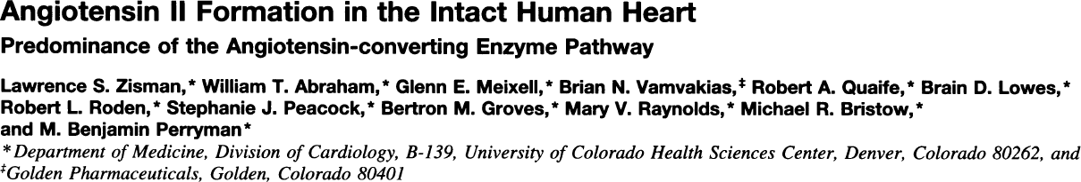
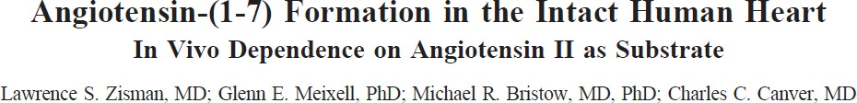
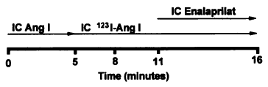
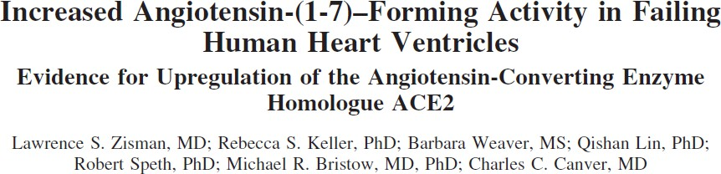
Larry Zisman
C.S. Sampling
HPLC peptide separation
C U V _{I}

Slide 4







The Renin-Angiotensin-Aldosterone System
Substrate or Effector
Enzyme
Receptor Inhibitor
angiotensinogen
β₁-AR blockers renin inhibitors
renin
sacubitril
angiotensin I
Angiotensin-(1-7)
ACE
ACE inhibitors
MLN-4760
angiotensin II
angiotensin I
MAS1 R
chymase
(Vasodilation,
anti-inflammatory, anti-hypertrophic)
AT₁ R
AT₂ R
ARBs
↑ aldosterone
Mineralocorticoid R
MRAs
C U V _{I}
Bristow MR et al, JBTS Sept 2020. DOI: 10.1016/j.jacbts.2020.06.007; Published online June 25, 2020

Slide 5


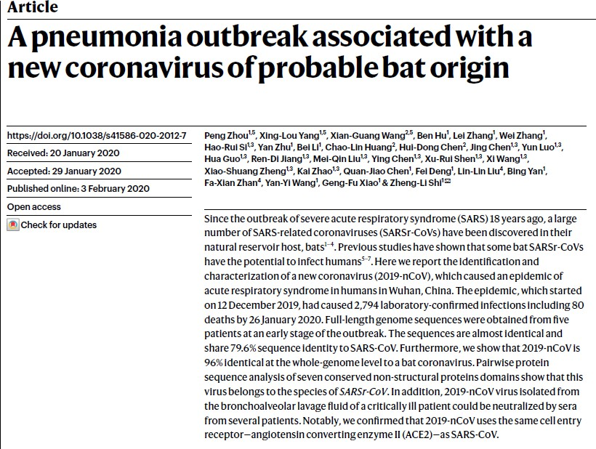
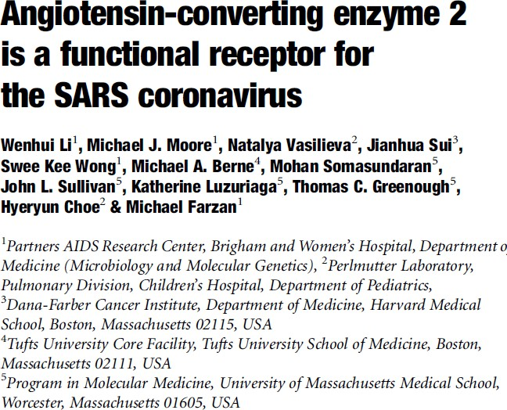
C U V _{I}

Slide 6
Myocardial Involvement in COVID-19: Published Information
As of 4/6/20 (AHA grant submission):
Myocardial injury & dysfunction minimal reports, mechanism uncertain
− Myopericarditis by CMR (1 report, no tissue)
− 1 heart autopsy biopsy, SCD in severe lung Dz, “no obvious histologic changes” in heart
Myocardial injury evidence by ↑ hs-cTn, associated with adverse
outcomes
ACE2 is CoV-2 receptor for cell entry, ↑ in failing/remodeled human LVs and in animal models Rxd with ARBs
C U V _{I}

Slide 7
Myocardial Virus and Gene Expression in SARS-CoV-2 Positive Patients with Clinically Important Myocardial Dysfunction: Aims
Aim 1. Detection of CoV-2 in cardiac myocytes.
N = 10, EMBx
Histopathology including EM, patients with evidence of CoV-2 myocardial involvement
RT-PCR for viral genome
Aim 2. Determine the degree of inflammatory reaction vs. direct myocardial injury.
Histopathology
Cytokine gene expression, circulating levels
Aim 3. Measure mRNA expression of the binding target (ACE2), proteases and integrins that have been shown to be key to cellular entry in non-cardiac cells.
mRNA abundance by RNA-Seq and microarray
ACE2, ACE, NPPB, α5 ITG, TF, mRNA abundance by RT-PCR rapid turnaround; circulating ACE2, ACE, ANG II, TF
Aim 4. Measure mRNA expression of candidate and global genes, and compare results to nonfailing controls and reduced LVEF nonischemic dilated cardiomyopathy (NDC) patients
mRNA abundance by RNA-Seq and microarray, n = 10 patients with CoV-2 myocardial involvement
12 NF, 12 F/NDC septal biopsies from explanted hearts; previous EmBx data (4 NF, 46 F/NDC)
C U V _{I}

Slide 8
Myocardial Virus and Gene Expression in SARS-CoV-2 Positive Patients with Clinically Important Myocardial Dysfunction: Revised Entry Criteria (10/1/20)
Inclusion, Hospitalized Patients
In or recently in ICU, PCR + for CoV-2, Age ≥18, COVID-19
myocardial involvement in the DDx, stable enough for cardiac catheterization
LVEF <50% OR
TnI ≥0.05 ng/ml OR
global longitudinal strain > -16 OR
ST-T changes suggesting STEMI, NSTEMI or myopericarditis with patent coronary arteries OR new onset sustained VT or VF
Patient or authorized representative able to give informed consent
Inclusion, Outpatients
In ICU in the past 3 mos, PCR + for CoV-2, Age ≥18, COVID-19
myocardial involvement in the DDx, stable enough for cardiac catheterization
LVEF, TnI, GLS, ST-T and VT/VF criteria same as for hospitalized patients
Patient able to give informed consent
C U V _{I}

Slide 9
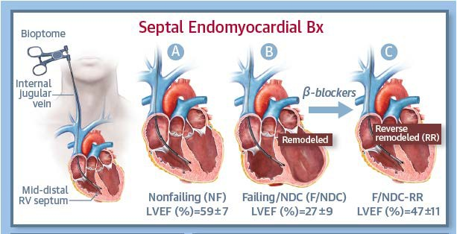
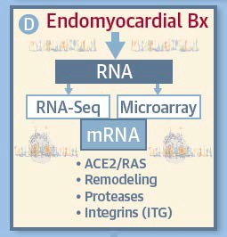
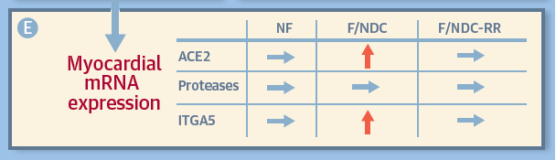
Dynamic Regulation of SARS-CoV-2 Binding and Cell Entry Mechanisms in Remodeled Human Ventricular Myocardium
Highlights:
Cellular receptor for CoV-2 (ACE2) and 5 proteases previously implicated in membrane fusion are expressed.
ACE2 upregulated ≈2 fold in remodeled LV, proteases NSC.
ACE2 normalizes on reverse remodeling independent of ACEIs or ARBs.
ITGA5, which encodes an integrin (α5 ITG) that binds to
ACE2 and to a motif (RGD) in the CoV-2 spike protein receptor receptor binding domain, is upregulated in remodeled LV
and normalizes on reverse remodeling, and is a candidate for facilitating or mediating CoV-2 cell binding and entry.
Thus upregulated CoV-2 cell binding mechanisms may explain heightened risk of COVID-19 in patients with underlying heart muscle disease.
C U V _{I}
Bristow MR et al, JBTS Sept 2020. DOI: 10.1016/j.jacbts.2020.06.007; Published online June 25, 2020

Slide 10
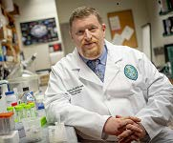
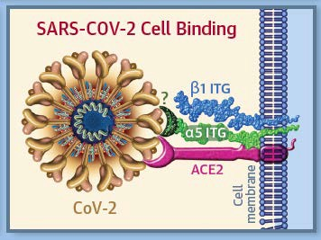

Integrin α5β1 facilitates CoV-2 binding and cell entry
Gregory Bix, MD, PhD, FAHA
gbix@tulane.edu
Director, Clinical Neuroscience Research Center, Tulane
The Integrin Binding Peptide, ATN-161, as a Novel Therapy for SARS-CoV-2 Infection (in review, Greg Bix Laboratory & BSL3 Core, Tulane SoM).
(non RGD peptide derived from fibronectin, binds to α5β1 at an α5 ITG binding site). In VeroE6 cells:
− CoV-2 binds to α5β1
− ATN-161 prevents CoV-2 binding to α5β1, (nM affinity), and α5 binding to ACE2 (μM)
− ATN-161 prevents CoV-2 cell infection (3.16 μM IC₅₀)
https://doi.org/10.1101/2020.06.15.153387doi:
bioRxiv preprint
C U V _{I}
Bristow MR et al, JBTS Sept 2020. DOI: 10.1016/j.jacbts.2020.06.007 Published online June 25, 2020

Slide 11
Myocardial Involvement in COVID-19: Summary so far
Clinically significant myocardial involvement in COVID-19 patients occurs with uncertain but not uncommon incidence, and is important to detect and monitor following the acute infection
Myocardial injury, most commonly detected by an elevation in hs-cTn, may be of
several types
− Inflammation (myocarditis); probably over Dx’d based on uncontrolled CMR studies
− Cytopathic effects in cardiac myocytes including myofibril disruption and loss, with no or little evidence of inflammation
− Vascular involvement, including microthrombi
ACE2 is upregulated in ventricular remodeling similar to NPPB, doesn’t appear to be modifiable by RASi therapy and may be a major reason for
worse outcomes in some patients
Integrin α5 or its α5β1 dimer is a co-receptor for CoV-2, and is a
C U
potential therapeutic target in COVID-19
V _{I}

