Slide 1

AHA Rapid Response COVID-19 Research – What’s Hot?
Mina Chung, MD
Cleveland Clinic Lerner College of Medicine of Case Western Reserve University
Director, AHA COVID-19 Coordinating Center
Disclosures: Research funding: AHA, NIH

Slide 2
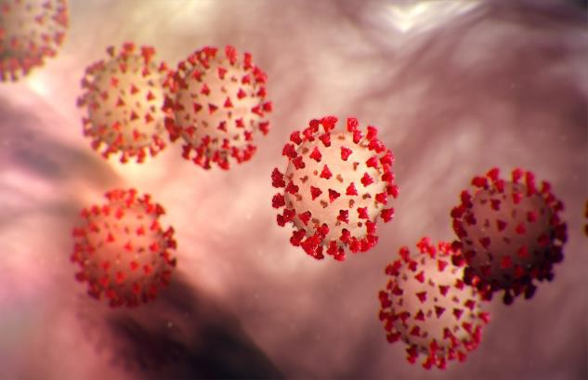
COVID-19
Funding for COVID-19 Initiatives
AHA responded rapidly to COVID-19
Over 750 Applications
Over 150 AHA volunteer reviewers
16 individual awards
4 Health Tech and Innovation SFRN supplemental awards
Coordinating Center
June 1-July 1 start dates
https://www.cdc.gov/media/dpk/diseases-and- conditions/coronavirus/images/outbreak-coronavirus-world- 1024x506px.jpg
2

Slide 3




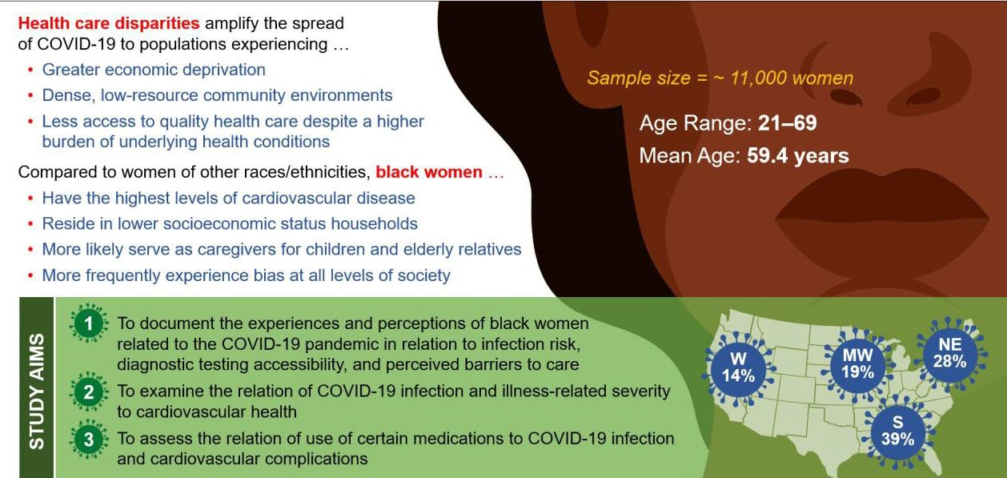
COVID-19 Infection, African American Women and Cardiovascular Health
Michelle A. Albert, MD, MPH; Co-PI, Yvette C. Cozier ScD University of California, San Francisco
3

Slide 4


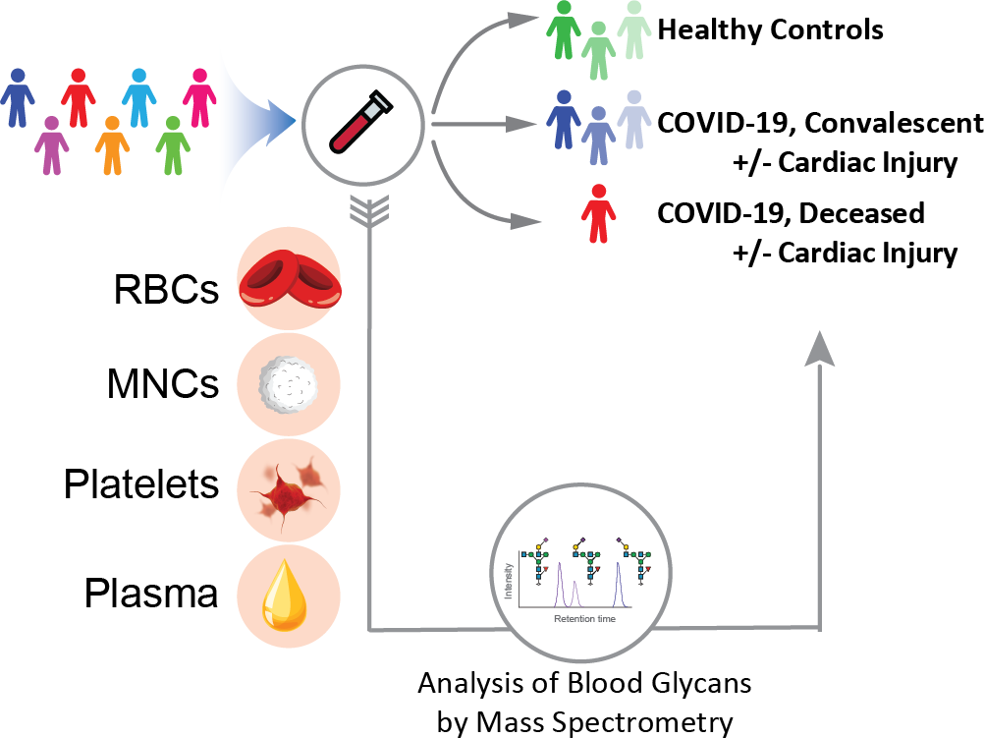
Harnessing Glycomics to Understand Myocardial Injury in COVID-19
Rebekah L. Gundry, PhD, FAHA
Identify the glycan signatures that predict patients with susceptibility versus those with protection to COVID-19 infection and post-viral myocardial injury.
Provide targets for precision medicine evaluation and new mechanistic understanding of how COVID-19 induces myocardial injury.

Slide 5
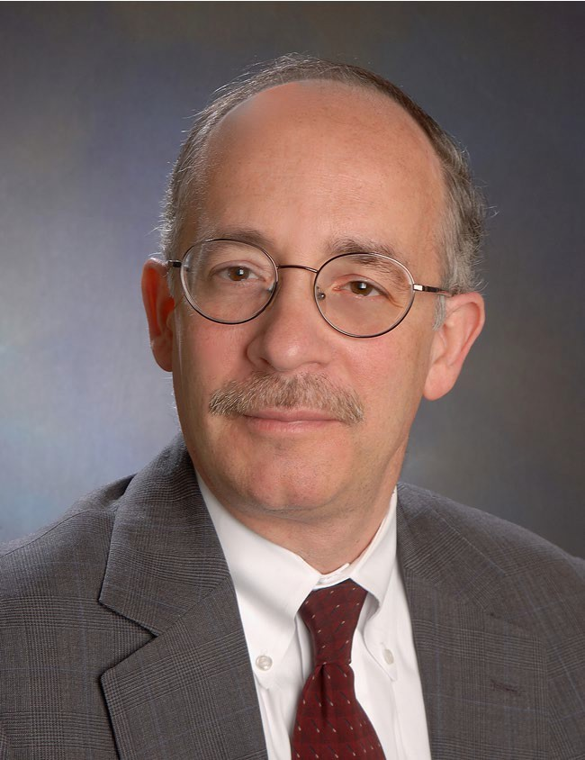
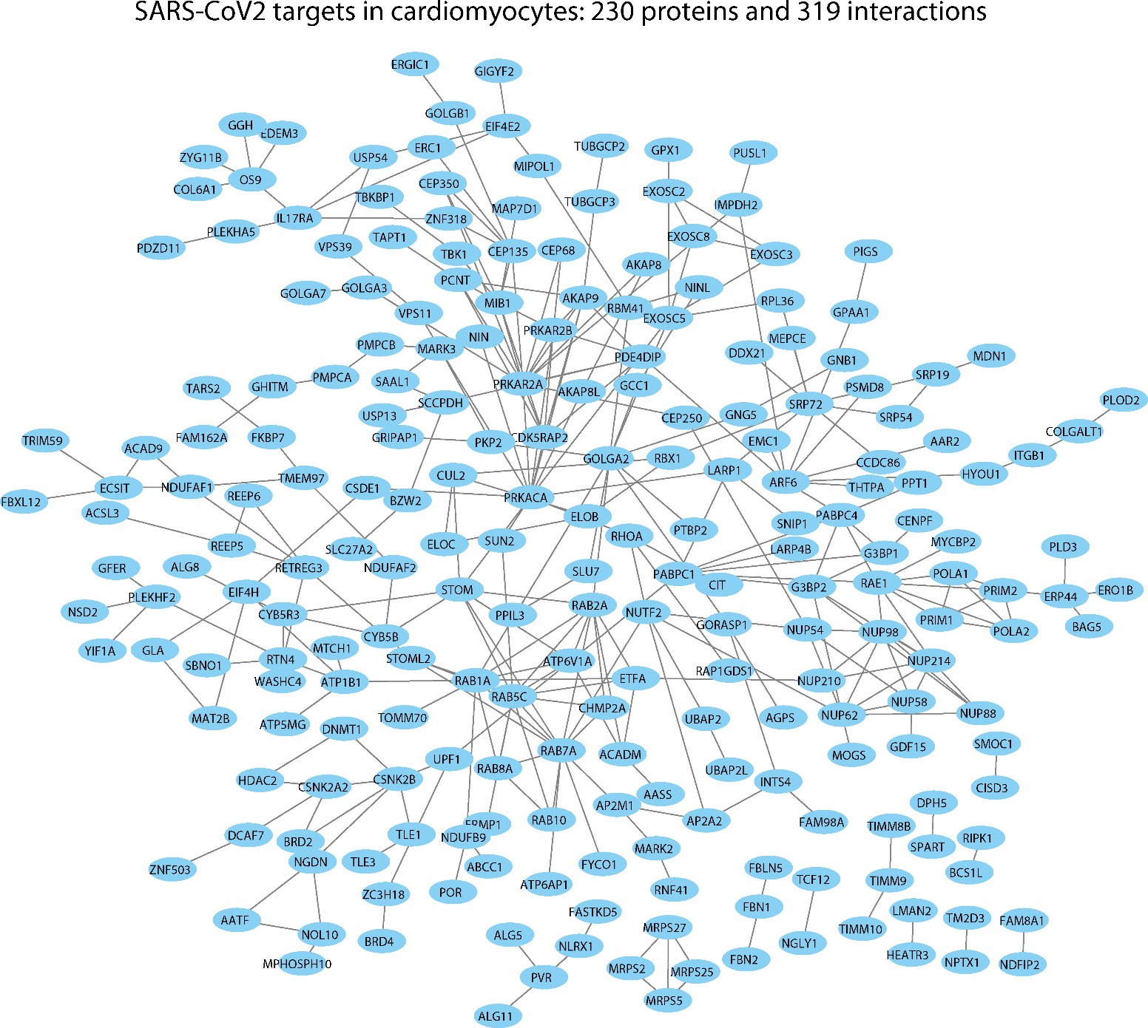
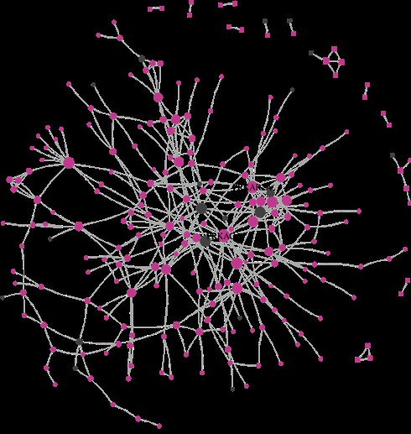
Repurposing Drugs for COVID-19
Joseph Loscalzo, MD, PhD Brigham and Women’s Hospital Harvard Medical School
The COVIDOME
5

Slide 6
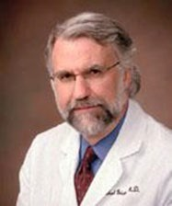
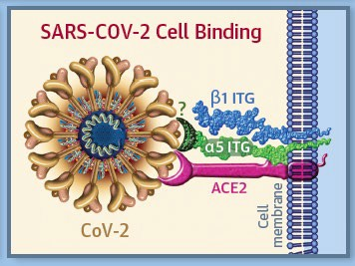
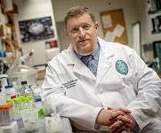

Myocardial Virus and Gene Expression in SARS CoV-2 Positive Patients with Clinically Important Myocardial Dysfunction Michael Bristow, University of Colorado AMC
The Integrin Binding Peptide, ATN-161, as a Novel Therapy for SARS-CoV-2
Infection (in review, Greg Bix laboratory & BSL3 Core, Tulane SoM)
Gregory Bix, MD, PhD, FAHA gbix@tulane.edu
Director, Clinical Neuroscience Research Center, Tulane
(non RGD peptide derived from fibronectin, binds to α5β1 at an α5 ITG binding site). In VeroE6 cells:
− CoV-2 binds to α5β1
− ATN-161 prevents CoV-2 binding to α5β1, (nM affinity), and α5 binding to ACE2 (μM)
− ATN-161 prevents CoV-2 cell infection (3.16 μM IC₅₀)
https://doi.org/10.1101/2020.06.15.153387doi: bioRxiv preprint
Integrin α5β1 facilitates CoV-2 binding and cell entry Bristow MR et al, JBTS Sept 2020. DOI: 10.1016/j.jacbts.2020.06.007 Published online June 25, 2020

Slide 7
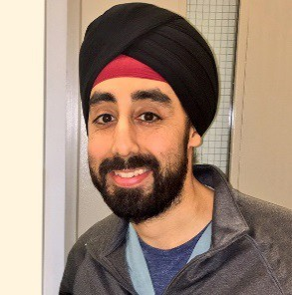

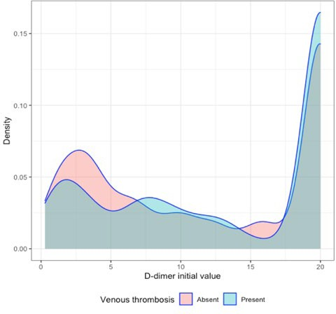
A Comprehensive Assessment of Arterial and Venous Thrombotic Complications in Patients with COVID-19
Sanjum Sethi, MD, MPH, Columbia University Irving Medical Center The Relationship of D-Dimer and Deep
Venous Thrombosis in COVID-19
Mahesh V. Madhavan, MD
Median peak D-Dimer levels were similar in patients with (N=186) and without (N=328) diagnosis of DVT (18.5 mg/dL [IQR: 6.4,
20.0] vs. 12.2 mg/dL
[IQR: 3.7, 20], p =
0.83)
Intermediate or Prophylactic-Dose Anticoagulation for Venous or Arterial Thromboembolism in Severe COVID-19:
A Cluster Based Randomized Selection Trial
NCT04367831
From the Frontlines of the Pandemic: Best of COVID-19 Clinical Research Friday, November 13, 2020, 9:00 am - 10:00 am
7

Slide 8


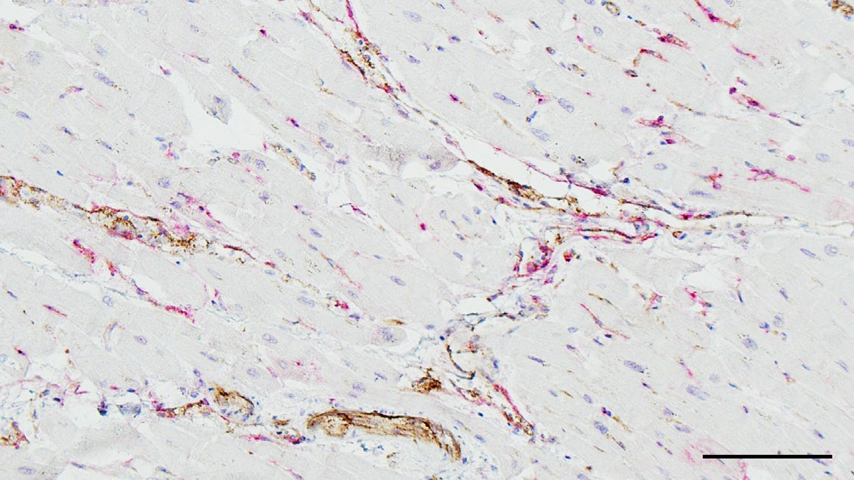
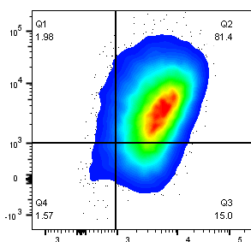

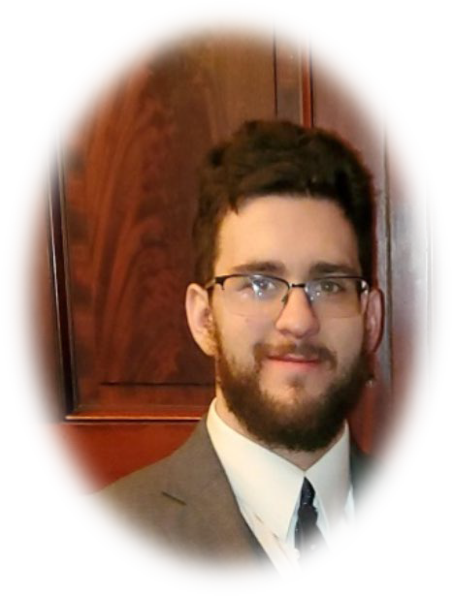
Pathogenesis of Cardiac Inflammation During COVID-19
Daniela Cihakova, Department of Pathology, Johns Hopkins University, Baltimore
Objective: We will determine changes of cardiac stroma cells and infiltrating immune cells phenotypes induced by COVID-19 infection by comparing heart autopsy samples of COVID-19 and non-CIVID-19 patients by immunohistochemistry, multiparameter flow cytometry, and scRNA sequencing.
Dr. Daniela Cihakova (PI)
Dr. Taejoon Won
Endothelial cells in SARS- CoV-2 infected heart
ACE2 expression in endothelial cells as seen via IHC
CD146
Monica Talor
Megan Wood
David Hughes
CD34
OPEN TO COLLABORATION!
Come see our website: http://labs.pathology.jhu.edu/cihakova/about/lab-members/

Slide 9
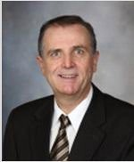

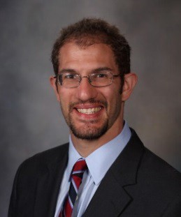
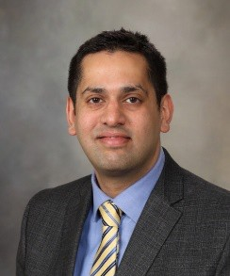
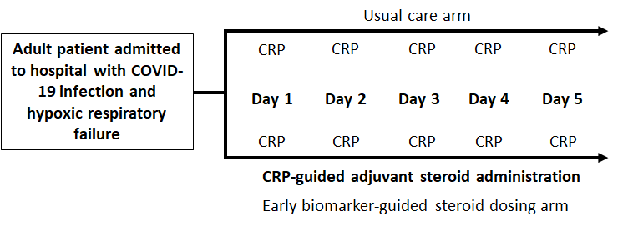
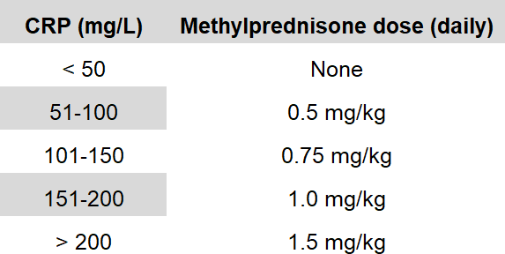
Cardiovascular Outcomes and Biomarker Titrated Corticosteroid Dosing for SARS COV-2 (COVID-19): A Randomized Controlled Trial
SMART-COVID Trial
Yewande Odeyemi, MD; Ognjen Gajic, MD, MS, Jacob C Jentzer, MD, Hemang Yadav, MD. Mayo Clinic
Feasibility of individualized-dosing (based on CRP) for adjuvant steroids
Comparison of individualized-dosing to:
  Fixed dose / one-size-fits-all (dexamethasone 6mg for 10 days)
  No steroids
Secondary CV Outcomes : arrhythmias, pressor requirement, evidence of myocardial injury (daily troponin)

Slide 10
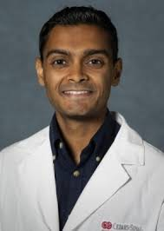
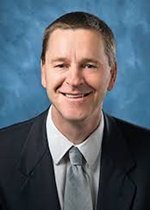
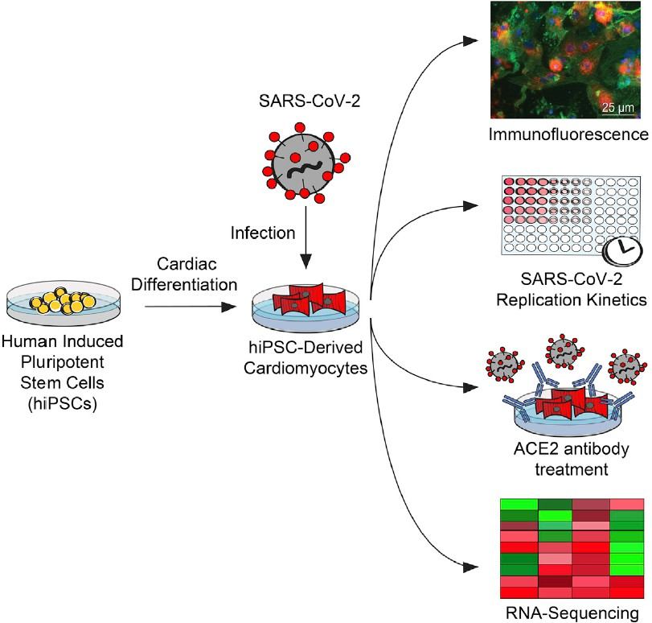


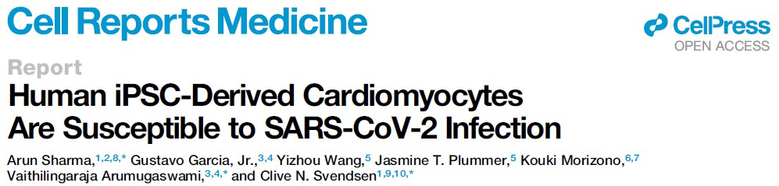
Human iPSCs and Organ Chips Model SARS- CoV-2-Induced Viral Myocarditis
Clive Svendsen and Arun Sharma, Cedars-Sinai Medical Center
Regenerative Medicine Institute
Cardiac Organ-Chip

Slide 11
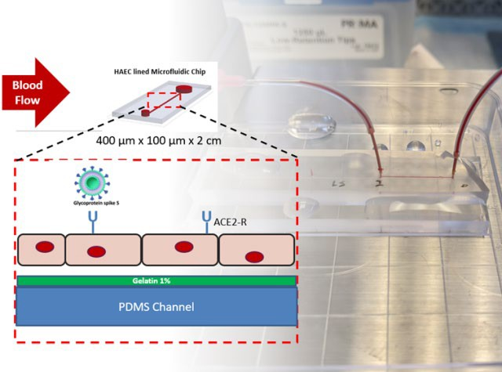

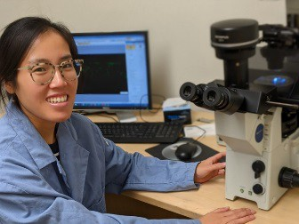
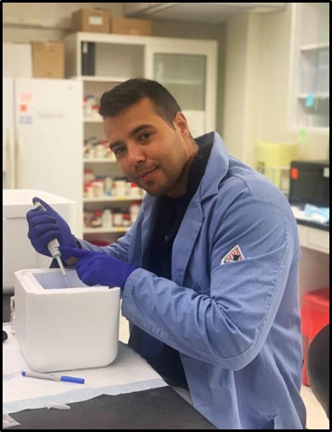
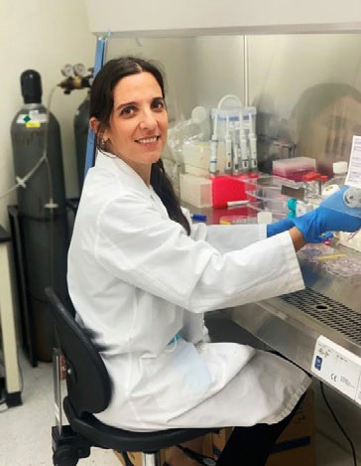
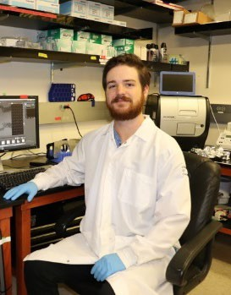
Rapid COVID-19-on-A-Chip to Screen Competitive Targets for SARS-CoV-2 Spike Binding Sites
Tzung Hsiai, MD, PhD, University of California, Los Angeles
Angela Lai, et al. Rapid Liposome Mimicking SARS-CoV-2 to Elucidate Thrombosis in Endothelialized Microfluidic Chip
Tzung Hsiai, MD, PhD
Angela Lai, PhD
Sandro Satta, PhD
Cayden Williamson, PhD student
Susana Cavallero, PhD

Slide 12
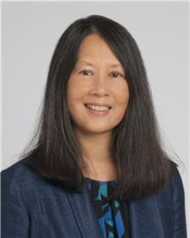
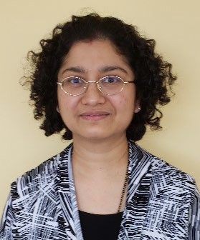
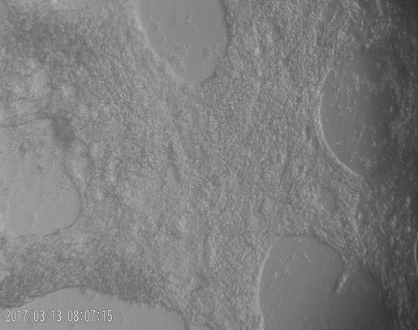
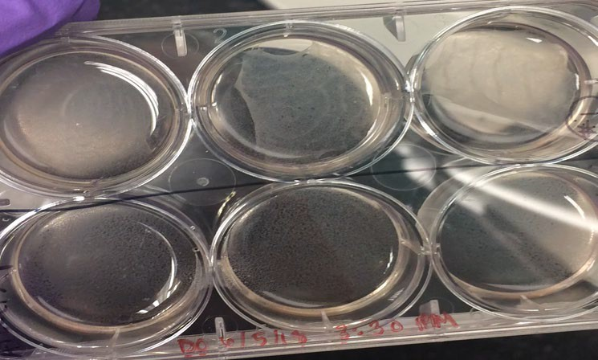
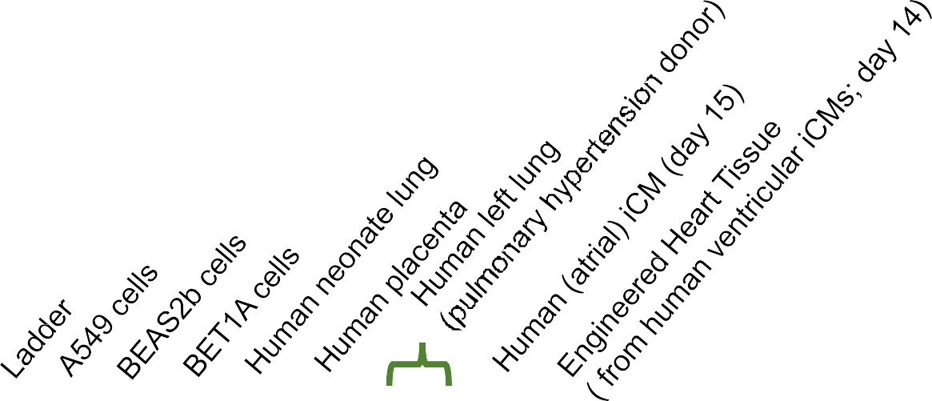
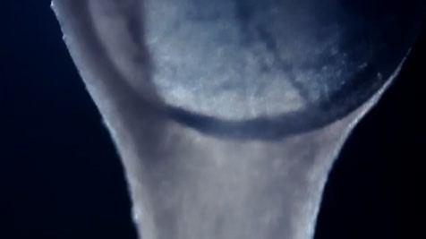
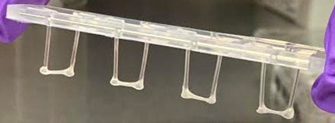
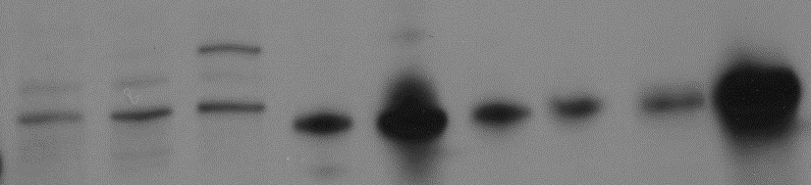

Testing of SARS-CoV-2 Infectivity and Antiviral Drug Effects in Engineered Heart Tissue, Microglial Cell Models, and COVID-19 Patient Registries Mina Chung, MD; Mitali Das, PhD, Cleveland Clinic
A new way to study COVID-19 and test drugs iPSCs⇒Cardiomyocytes⇒Engineered Heart Tissues
1 2 3 4 5 6 7 8 9 10
250
150
100

Slide 13
COVID-19 (C19)
Health Tech SFRN supplements
Andrea Beaton, Cincinnati Children's Hospital
Ejection Fraction as Sixth Vital Sign in C19 Patients: Improved triage using point-of-care echo
David Newman-Toker, Johns Hopkins University
In-Home Diagnostic Triage via Smartphone Video Virtual Check-In for Potential Stroke Symptoms During Pandemic: Novel Approach to Improving CV Health Equity & Long-Term Prevention
Paul Wang, Stanford University
Digital C19 Patient Tracking & Reporting Tool Kit Focused on CV Complications & Disease
Brahmajee Nallamothu, University of Michigan
C19 Health Eval & CV Complications Study: Using mHealth to Track Physiological & CV Consequences
https://www.cdc.gov/media/dpk/diseases-and- conditions/coronavirus/images/outbreak-coronavirus-world- 1024x506px.jpg
13

Slide 14
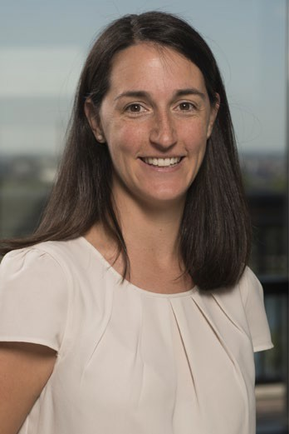
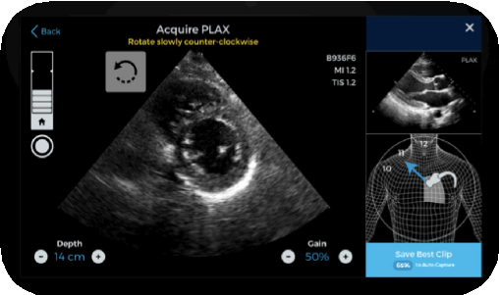
Ejection Fraction as the Sixth Vital Sign for Patients with COVID:
Improved triage using point-of-care echocardiography
Andrea Beaton, Cincinnati Children's Hospital
Access to echo is limited in many situations
Rapid scale up of non-expert echo has challenges
Navigational guidance provides a technology solution
Conserves resources, improves access to diagnosis, change outcomes
Prediction tool will be built to include LVEF
Quality Meter
Prescriptive Guidance
Reference Image
Probe Positioning Diagram
AutoCapture
Save Best
Clip
Real time feedback given on probe position and diagnostic quality

Slide 15


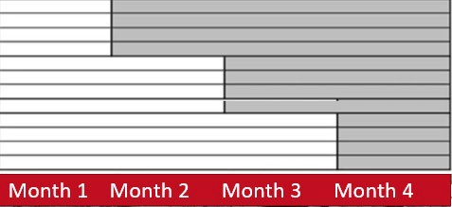
AHA COVID-19 GET WITH THE GUIDELINES® STEPPED WEDGE TRIAL
Paul J Wang, MD (Stanford); Mintu Turakhia, MD, MAS (Stanford); Ying Lu, PhD (Stanford); Ashish Sarraju , MD (Stanford); Fatima Rodriguez, MD, MPH (Stanford),
Connor O’Brien, MD (UCSF)
CAN DATA EXTRACTION FACILITATE DATA ENTRY?
WE WILL CONDUCT A STEPPED WEDGE CLUSTER RANDOMIZED TRIAL IN WHICH DATA EXTRACTION IS INTRODUCED
Possible Barriers to Data Entry:
Add to stress to providers and health care system
May prevent low resource centers from participating, undermining attempts to get data from diverse populations
May result in incomplete data entry
May result in selective non-consecutive entry of patients
The AHA Health Technologies and Innovation SFRN

Slide 16
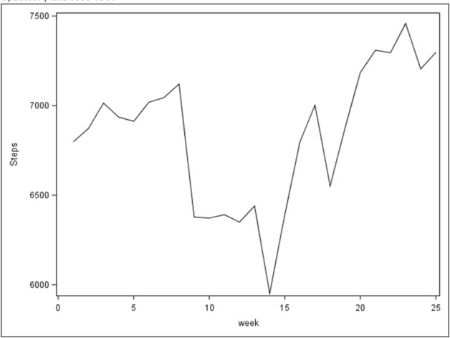
AHA COVID-19 Health Evaluation & Cardiovascular Complications (CHECC) Study:
Using mHealth to Track Physiological & CV Consequences
Brahmajee Nallamothu, University of Michigan
Hypothesis
COVID 19 pandemic has resulted in an adverse change of activity measures, such as step count and exercise; physiologic measures, such as blood pressure and heart rate; and other health measures, such as stress and mood levels
Vision
To develop interventions to maintain activity, control BP, and modulate stress and mood levels.
Our Approach
Next Steps
Complete analysis on step count, HR, mood, stress
Recruit small cohort of participants in UM community with documented COVID 19 to understand recovery trajectory using wearable device
Step counts of participants by week across COVID pandemic
Use Apple Watch to understand changes in activity as
well as heart rate
Use Omron blood pressure cuff to measure changes in blood pressure over time
Distribute COVID survey, with questions on COVID related symptoms, diagnosis, testing, exposures, and treatment
Baseline, weekly and quarterly distribution intervals

Slide 17

AHA COVID-19 Coordinating Center
Website
https://professional.heart.org/en
/research-programs/aha-rapid- response-grant-covid19
17

Slide 18

Thank You.
18

Slide 19

AHA Rapid Response Grants
COVID-19 and Its Cardiovascular Impact
Michelle Albert, University of California, San Francisco
COVID-19 Infection, African American Women and Cardiovascular Health
Anand Prasad, University of Texas Health Science Center at San Antonio
SARS-CoV-2 Infection and the Development of Cardiac Dysfunction
Jaejin An, Kaiser Permanente Southern California
Risk of Severe Morbidity and Mortality of Coronavirus Disease 2019 (COVID-19) Among Patients Taking Antihypertensive Medications
Paul Heidenreich, Stanford University
Outcomes for Patients with Hypertension, Diabetes and Heart Disease in the Coronavirus Pandemic: Impact of Angiotensin Converting Enzyme Inhibitors and Angiotensin Receptor Blockers Treatment
Michael Lu, Massachusetts General Hospital
Deep learning using chest radiographs to predict COVID-19 cardiopulmonary risk
19

Slide 20

AHA Rapid Response Grants
COVID-19 and Its Cardiovascular Impact
Rebekah Gundry, University of Nebraska Medical Center
Harnessing Glycomics to Understand Myocardial Injury in COVID-19
Michael Bristow, University of Colorado AMC
Myocardial Virus and Gene Expression in SARS CoV-2 Positive Patients with Clinically Important Myocardial Dysfunction
Joseph Loscalzo, Brigham and Women’s Hospital and Harvard Medical School
Repurposing Drugs for Treatment of Cardiomyopathy Caused by SARS-CoV-2
20

Slide 21
AHA Rapid Response Grants
COVID-19 and Its Cardiovascular Impact
Sanjum Sethi, Columbia University Irving Medical Center
A Comprehensive Assessment of Arterial and Venous Thrombotic Complications in Patients with COVID-19
Jane Freedman, University of Massachusetts Medical School
The Role of the Platelet in Mediating Cardiovascular Disease in SARS-CoV-2 Infection
Emily Tsai, Columbia University Vagelos College of Physicians & Surgeons
Elucidating the Pathogenesis of COVID-19 Cardiac Disease: Histopathological and snRNA-Seq Analyses of Human Myocardium
Daniela Cihakova, Johns Hopkins
Pathogenesis of Cardiac Inflammation During COVID-19
21

Slide 22
AHA Rapid Response Grants
COVID-19 and Its Cardiovascular Impact
Tzung Hsiai, University of California, Los Angeles
Rapid COVID-19-on-A-Chip to Screen Competitive Targets for SARS-CoV-2 Spike Binding Sites
Clive Svendsen and Arun Sharma, Cedars-Sinai Medical Center
Human iPSCs and Organ Chips Model SARS-CoV-2-Induced Viral Myocarditis
Mina Chung, Cleveland Clinic
Testing of SARS-CoV-2 Infectivity and Antiviral Drug Effects in Engineered Heart Tissue, Microglial Cell Models, and COVID-19 Patient Registries
Ognjen Gajic, Mayo Clinic
Cardiovascular Outcomes and Biomarker Titrated Corticosteroid Dosing for SARS COV-2 (COVID-19): A Randomized Controlled Trial
22

