Slide 1
American Heart Association
RESEARCH FUNDING OPPORTUNITIES
April 5, 2023
apply@heart.org
1
7/13/22

Slide 2
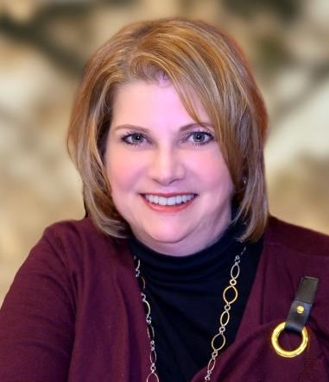
Learn about open funding opportunities from AHA, including eligibility and applicant instructions.
Gain an understanding of the direction and priorities of AHA’s research programs.
Elizabeth (Liz) Cooper-Reelhorn National Sr. Research Administrator
Office of Science Operations
American Heart Association
Lora Hillgartner Wong Sr. Content & Editorial Manager, Research Office of Science Operations American Heart Association

Slide 3
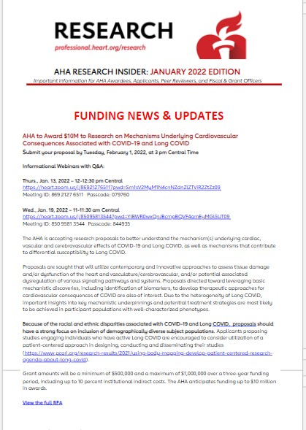
Professional.heart.org/research

Slide 4
MISSION & GOALS
AHA Mission
To be a relentless force for a world of longer, healthier lives.
2024 Impact Goal
Every person deserves the opportunity for a full, healthy life.
As champions for health equity, by 2024, the American Heart Association will advance
cardiovascular health for all, including identifying and removing barriers to health care access and quality.
3

Slide 5
RESEARCH IS THE FOUNDATION
Largest non-profit, non- governmental funder of cardiovascular & cerebrovascular research
$5 billion+ since 1949
Currently 1,440 active projects, totaling $461.7 million
4

Slide 6
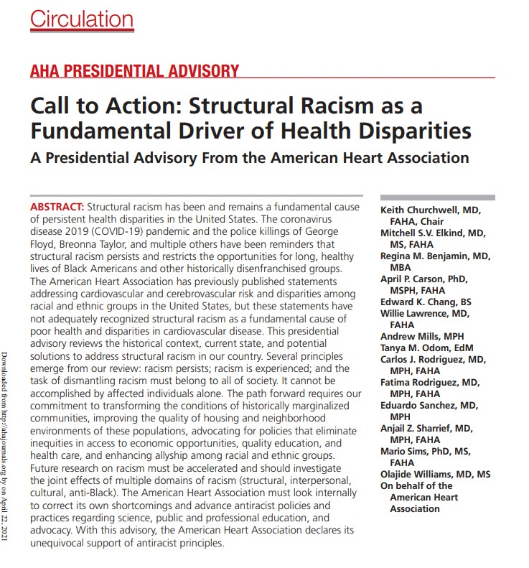
$100M TOWARD HEALTH EQUITY & STRUCTURAL RACISM RESEARCH
Drive systemic public health change focused on removing barriers to equitable health for everyone, everywhere
New research programs & grants focused on health inequities & structural racism
5
Expand investigator diversity: Research opportunities for underrepresented racial & ethnic groups
5

Slide 7
FOUNDATIONAL RESEARCH FUNDING
PROFESSIONAL.HEART.ORG/FUNDINGOPPORTUNITIES
In a typical year, the AHA offers research funding largely based on career stage:
Predoctoral Fellowship – Sept. 6
Postdoctoral Fellowship – Sept. 7
Institutional Award for Undergraduate Student Training – Sept. 13
AHA Institutional Research Enhancement Award (AIREA) – Sept. 14
Career Development Award – Dec. 6
Collaborative Sciences Award
Innovative Project Award
Transformational Project Award
Merit Award
10
This Photo by Unknown Author is licensed under CC BY-SA-NC

Slide 8
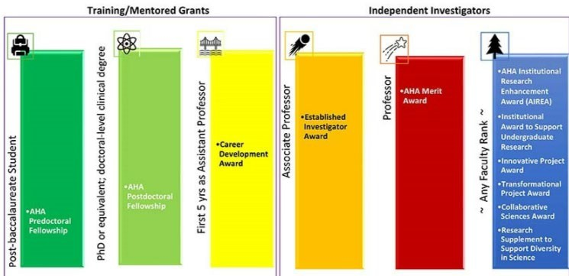
Career Levels Required for AHA Foundational Programs
11

Slide 9
STRATEGICALLY FOCUSED RESEARCH TOPICS
Board-directed – past examples:
COVID-related grants
Health Equity Research Networks
Prevention of Hypertension
Disparities in Maternal-Infant Health Outcomes
Rural Health Disparities
End Nicotine Addiction in Children and Teens
Watch application information page
Sign up for monthly Research newsletter from our main web page: professional.heart.org/research
6

Slide 10
FOCUSED RESEARCH TOPICS
Funding Partner Organizations – 2023
Research focused on congenital heart defects effects of walnut consumption on health-related outcomes Barth Syndrome | Early Career Researchers in clinical vascular science anesthesiology cerebrovascular research related to vascular neurology, stroke and neurocritical care
7
7

Slide 11
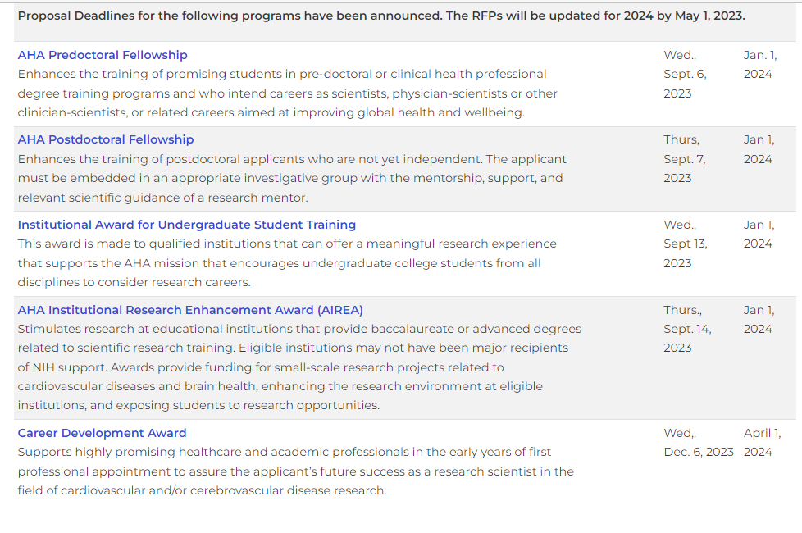
9

Slide 12
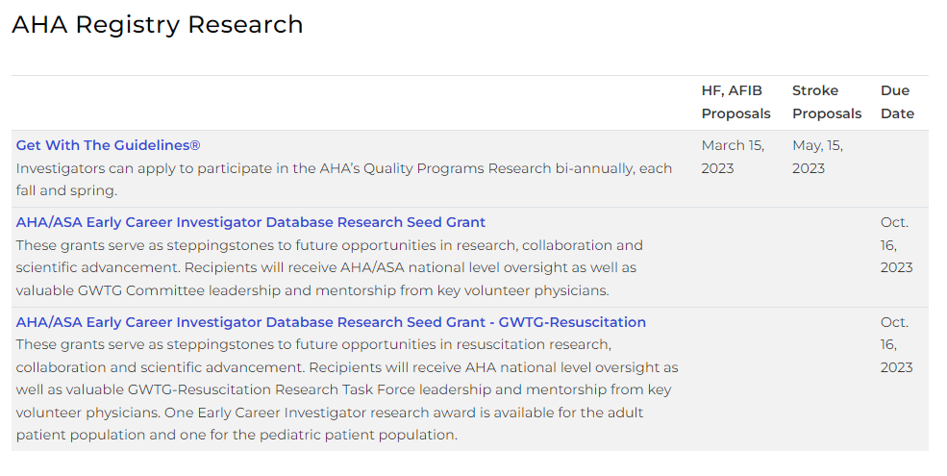

Slide 13
FEATURES OF ALL AHA AWARDS
All academic and health professionals
Clinical, translational, population, behavioral, basic science
Women, underrepresented groups in research, non-traditional career trajectories encouraged
Most require no minimum percent effort
Fully transferrable
Straightforward re-budgeting
https://professional.heart.org/en/research-programs/application-information
12

Slide 14
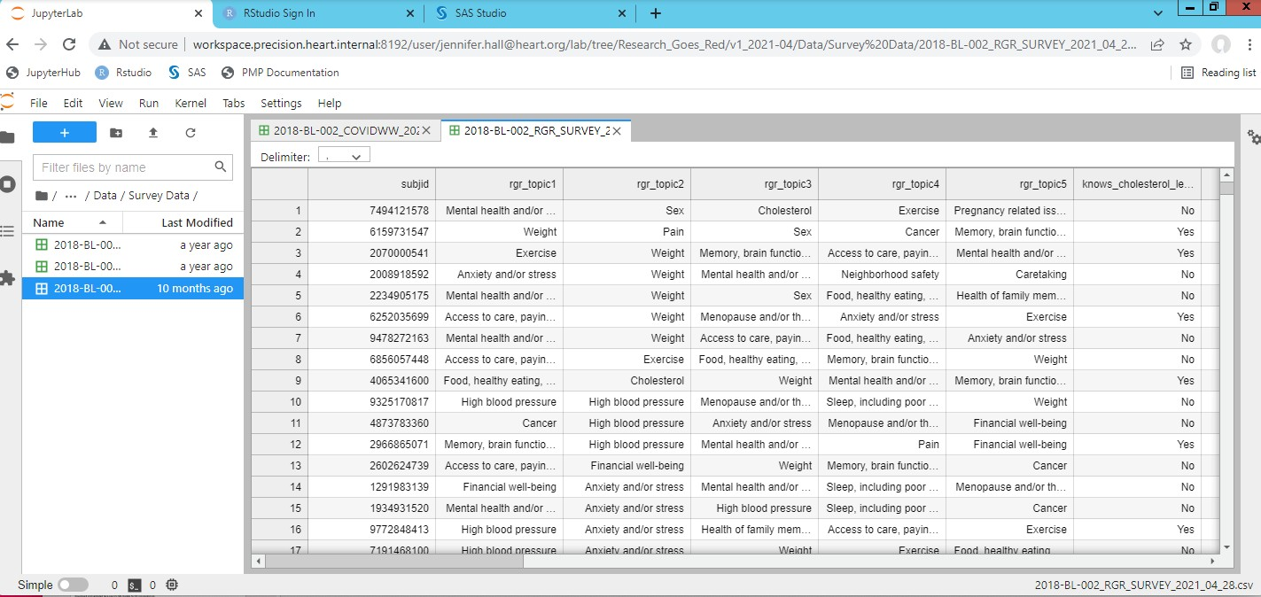
AHA Precision Medicine Platform
Highly secure cloud computing (AWS) workspaces equipped with analytical tools for research
Teams can easily collaborate; view the same data and code
Register for an account and workspace at precision.heart.org and include your Award ID
Please contact us with any questions – pmp@heart.org
Awardees are eligible for cloud credits!
13

Slide 15
AHA Open Science Policy Compliance
Data Plan
Submit with application
Update as needed
Preregistration
Deposit Data into AHA-Approved Repository
Due 12 months after Award ends
Any factual data needed for independent verification of research results
Data Deposit Confirmation
Due 12 months after Award ends
Add Publications to My NCBI
Add citations to My NCBI once publications are accepted
Link AHA award to citation
Submit Publications to PubMed Central
Available in Deliverables section of Proposal Central
Journal articles must be made freely available and linked to an AHA award within 12 months of publication
HRA Open
Email invitation sent at Award activation
Preprints
Encouraged, but not required
Allows for early communication of findings
Required for funded clinical trials
Encouraged for all studies making inferential claims
Set up HRA Open profile and link to My NCBI

Slide 16
IMPROVE YOUR CHANCE OF FUNDING
15

Slide 17
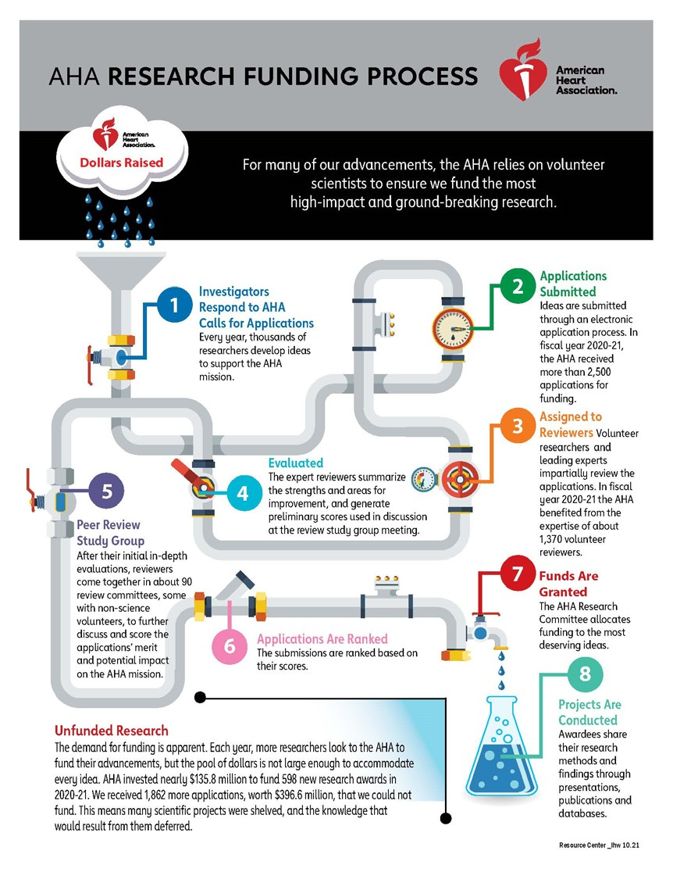
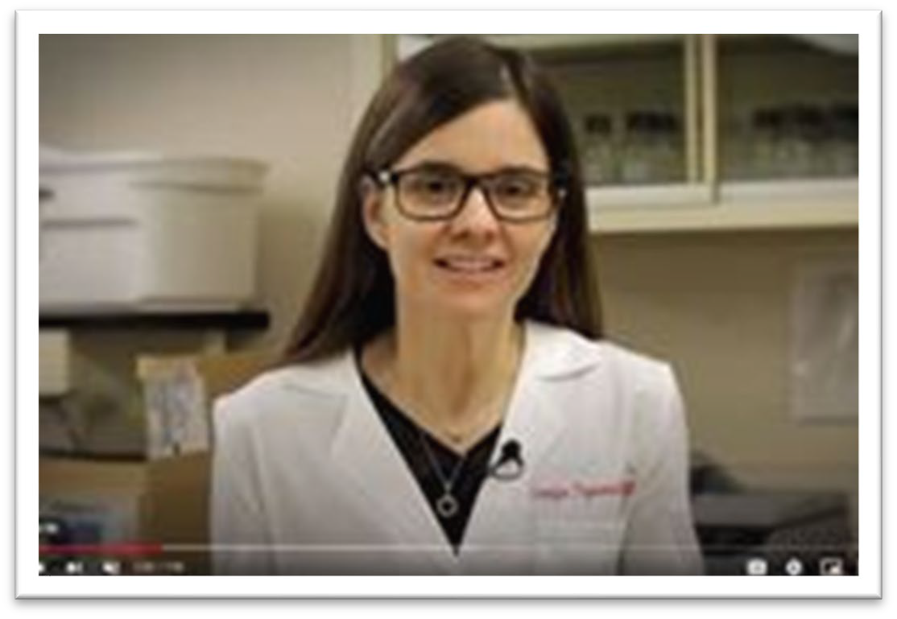
Application Resources
https://professional.heart.org/en/research-programs/application-resources
Internal & external tools: Fact sheets, articles, videos, online tools
AHA Research Application & Award Process
Step-by-step application instructions
Lay summary
Career development plan
Biosketch
Writing a proposal
Peer Review & scoring
16

Slide 18
APPLICATION TIPS
Some require pre-proposal (LOI)
Follow the instructions on ProposalCentral screens & AHA Application Instructions document
Apply@Heart.org
17

Slide 19
SUMMARY FOR NON-SCIENTISTS (LAY SUMMARY)
Describe your work to be understood by people who do not have science or medical backgrounds.
How to Share Your AHA-Funded Research by researcher Georgia Papavasiliou, Ph.D.
https://www.youtube.com/watch?v=04ZEyfM1T2s&list=PLtzTeR_CJ NHJBtkiHnTJ-uhYq3WGDYkP5&index=1
18

Slide 20
APPLICATION TIPS
Applicant must be AHA Professional Member Join early!!
https://professional.heart.org/en/partners
Application software is Proposal Central - -opens about 60 days prior to deadline
Work on your uploads in advance
https://professional.heart.org/en/research-programs/application- information/required-application-documents
19

Slide 21
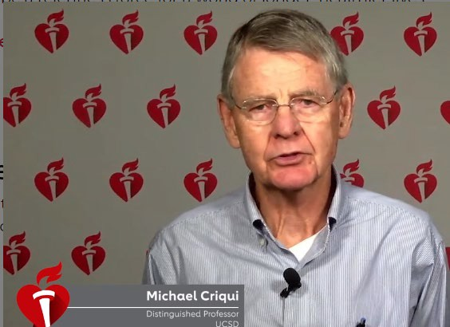
BECOME A PEER REVIEWER
professional.heart.org/PeerReview
Study sections by award type & topic
Virtual meeting via Zoom & ProposalCentral
Submit your CV to PeerReview@heart.org
Reviewer-in-Training program for
“You learn how to tailor your own grants to avoid the pitfalls you see in other people’s grants.” – Dr. Michael Criqui
AHA Postdoctoral Fellows
20
20

Slide 22
professional.heart.org/PeerReview
21

Slide 23
WEBINARS
Special Sessions For Most Programs
Listed on Application Resources page
Next General Session
To be announced
AHA Research award offerings
Application tips
Review process
Q & A session
All are invited
22

Slide 24
Questions/Inquiries
AHA Applications Team
Call 214.360.6107 (option 1)
E-mail apply@heart.org
American Heart Association American Stroke Association does not tolerate pervasive or severe harassment of any kind, including sexual harassment, whether it is within the agency, at research organizations that receive AHA funding, or anywhere else AHA-funded activities are conducted.
Only in safe and respectful work environments can individuals achieve their greatest potential and carry out the important work that supports the AHA mission.
23

