Slide 1
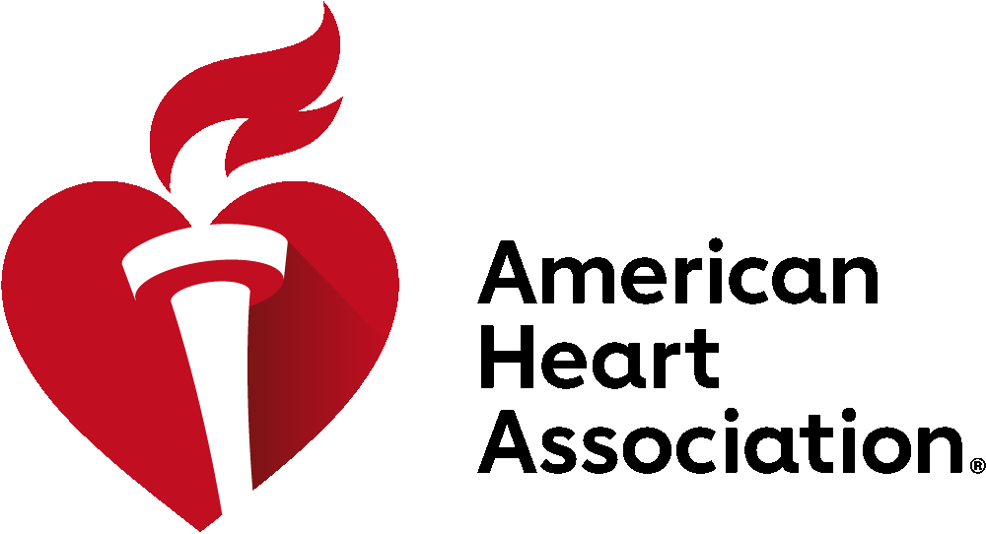
Showcase Your Science
Abstract Submissions Close: June 6 at 7pm EDT
Pre-Sessions Symposia & Early Career Day: November 15
Scientific Sessions: November 16-18
Chicago, IL
Join the centennial celebration & submit your abstract to #AHA24
Global Opportunity to present your accepted abstracts to an audience of your peers and thought leaders.
125 Abstract Categories across 26 basic, clinical and population programming communities
Accepted Abstracts published in Circulation, AHA’s premier scientific journal
Participate and Experience oral abstract and poster presentations
Grow your professional network and reconnect with colleagues in person
ScientificSessions.org
AHA Professional Members save over 50% on Abstract Submission Rates

