Slide 1
PAD Collaborative
Branding Guidelines

Slide 2
Table of Content
Synopsis
Statement of Relationship
Service Mark
Recognition
Promotions
Contact

Slide 3
Synopsis
Many adults in the U.S. are suffering from undetected or uncontrolled peripheral artery disease, PAD. Awareness of the risks of PAD, including reduced quality of life, amputation, heart disease, stroke and death, is low.
The PAD Collaborative unites organizations and experts with a goal to increase public awareness and understanding of PAD, prevent complications, address health barriers and improve quality of life for people living with the disease.

Slide 4
Statement of Relationship
The following statement of relationship is intended to explain the relationship of the parties to the public:
[Party Name] is a participating organization in the PAD Collaborative.
The [Party Name] is working alongside multiple organizations as a part of the PAD Collaborative.
The PAD Collaborative, founded by the American Heart Association, is supported in part by participating organizations and experts including [Party Name].
(On secondary copy): For a full list of participating organizations visit …
[Party Name] is a member of the PAD Collaborative founded by the American Heart Association to improve awareness and outcomes for PAD.
The Statement of Relationship must accompany the use of the Service Mark.
The Statement of Relationship must not:
Be placed next to an organization’s commercial message.
Be placed on or adjacent to an offer of savings.
Appear on materials that include superlative statements regarding a product or make comparisons to other 3rd party products.
Be altered in any way.

Slide 5
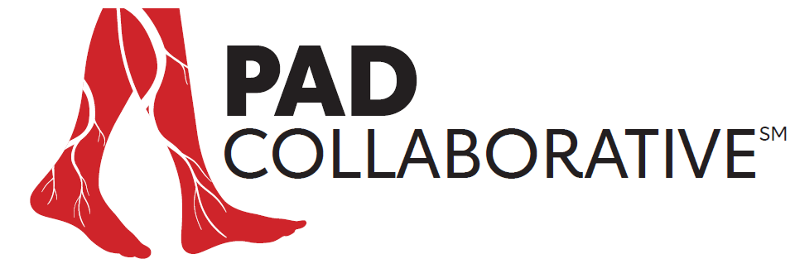
Service Mark
Type and Icon Relationship: The relationship between the type and the legs icon should never change.
Minimum Size: For clarity and legibility, the logo width should always exceed 1".
Color: The Alternate Mark may use in place of the Primary Mark.
Statement of Relationship must accompany the use of the PAD Collaborative Service Mark.
Primary Service Mark
Alternative Service Mark

Slide 6
Service Mark
The Service Mark must be used properly for a consistent brand presentation. The mark should not be altered in any way. Also, be careful to avoid these mistakes:
Do not stretch, distort or alter the mark in any way.
Never use any unapproved color variations of the mark.
Do not place over a complex image.
Do not use any part of the mark as part of another word, letter or as punctuation.
Do not enclose the mark in a shape or combine it with other design elements or effects.
Do not replace the approved typeface with any other typeface.
Do not rotate or render the mark three-dimensionally on 2-D media.
Do not add words, images or any other new elements to the marks.

Slide 7
Recognition
Organizations participating in the collaborative will receive logo recognition with hyperlinks to their site (required 2 click rule) for their part in the PAD Collaborative on the Collaborative’s homepage.
All organization logos will be weighted at the same percentage. When calculating logo sizes, it’s important to keep in mind the overall visual weight. All logos are not created equally when it comes to proportional sizing.
Participating organizations may add the PAD Collaborative Service Mark, Statement of Relationship and Synopsis to their website.
The Statement of Relationship must accompany the use of the Service Mark.

Slide 8
Future Collaborations
Promotions
Marketing assets approved by the PAD Collaborative will be available for member organizations to promote in their organization’s owned channels. These promotional materials may not be altered.
Educational Resources
Branded Patient resources created and science-approved by the PAD Collaborative will be available to member organizations for distribution through their organization’s channels.

Slide 9
Questions?
Contact:
Marla Hollander,
t-marla.hollander@heart.org

