Slide 1
Evidence update for minimally invasive surgical evacuation of supratentorial spontaneous intracerebral hemorrhage:
A science advisory from the American heart association

Slide 2
This slide set was developed by Andrew Slusher MD, member of the Stroke council SCILL and Professional Education committee
Evidence Update for Minimally Invasive Surgical Evacuation of Supratentorial Spontaneous Intracerebral Hemorrhage
Link:
https://www.ahajournals.org/doi/10.1161/STR.0000000000000529
Note: The URL in this message will be live when the advisory publishes online.
Key words included in the article:
cerebral hemorrhage; critical pathways; minimally invasive surgical procedures; patient selection
Citation:
Wolfe SQ, Amin-Hanjani S, Tschoe C, Simon SD, Kellner CP, Sheth KN; on behalf of the American Heart Association Stroke Council; and Council on Lifelong Congenital Heart Disease and Heart Health in the Young. Evidence update for minimally invasive surgical evacuation of supratentorial spontaneous intracerebral hemorrhage: a science advisory from the American Heart Association. Stroke. Published online August 24, 2026. doi: 10.1161/STR.0000000000000529

Slide 3
Historically, the surgical management of intracerebral hemorrhage has been limited due to concerns regarding procedural risks and lack of functional improvement
Recent advances in minimally invasive surgical techniques suggest potential improvements in functional recovery in select populations (i.e. lobar hemorrhage after spontaneous intracerebral hemorrhage)

Slide 4
Introduction
    2022 Guidelines for the management of patients with spontaneous intracerebral hemorrhage (sICH) provide:
      Class 2a (moderate) recommendation regarding the usefulness of minimally invasive surgical (MIS) evacuation of ICH to reduce mortality
      Class 2b (weak) recommendation regarding functional benefit, based on RCTs comparing MIS evacuation of ICH with medical management and several metanalyses exploring the safety and efficacy of different MIS techniques for ICH evacuation

Slide 5
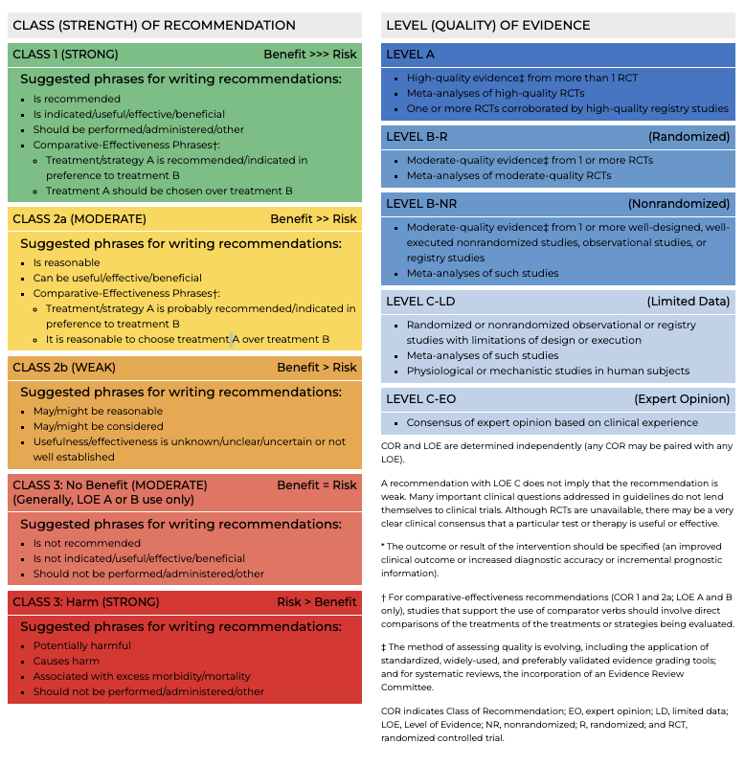

Slide 6
since the 2022 guidelines, two additional randomized controlled trials published
    ENRICH (Early Minimally Invasive Removal of Intracerebral Hemorrhage):
      2024
      Compared MIS tubular evacuation of ICH with modern medical management and found improved outcomes, primarily for lobar hemorrhages
    MIND (Artemis in the Removal of Intracerebral Hemorrhage):
      2025
      Compared endoscopic evacuation with guideline-based best medical management and found high rates of technical success and safety, despite neutral results
    Together, these studies suggest that select patients should be considered good candidates for surgical management

Slide 7
Evidence update: minimally invasive surgical evacuation of ich

Slide 8
Evidence update: minimally invasive surgical (MIS) evacuation of ich
  1989: Auer et al. reported good functional outcome and mortality benefit with endoscopic evacuation in patients <60 years old presenting with mild to moderate neurologic deficit and ICH volumes <50 mL
  2019: MISTIE III trial
  2024: ENRICH trial
  2025: MIND trial

Slide 9
MISTIE III trial (2019)
  MISTIE III (Minimally Invasive Surgery Plus rt-PA for ICH Evacuation III)
  Built on 3 RCTs evaluating stereotactic aspiration +/-thrombolytic and randomized 499 patients to stereotactic aspiration + alteplase
  Found clear mortality benefit at 365 days but no significant improvement in functional outcomes
  Subgroup analysis showed correlation between improved functional outcomes and residual ICH volume ≤15 mL, which was associated with site/surgeon experience

Slide 10
ENRICH (Early Minimally Invasive Removal of Intracerebral Hemorrhage) trial
  ENRICH (n=300) examined MIS tubular hematoma evacuation within 24 hours in patients with mild to severe neurological deficits (GCS score range 5-14) and hematoma volumes 30-80 cc
  Significant 6-month functional benefits of uW-mRS (Utility-Weighted Modified Rankin Scale) over medical management and improved 30-day mortality
  50.3% of patients undergoing MIS evacuation reached mRS 0-3 compared with 41.0% in the medical cohort
  30-day mortality was 9.3% vs. 18%
  180-day mortality was non-significant, with a lack of evidence of treatment effect on all-cause mortality
  Benefits driven by lobar ICH location, constituting 2/3 of the cohort
  After enrolling 48 patients with anterior basal ganglia hemorrhage in the MIS group (with 44 controls), basal ganglia enrollment was stopped as it fell below futility threshold

Slide 11
MIND trial
  Randomized 236 of planned 500 patients with hematoma volumes 20-80 cc to undergo endoscopic MIS within 72 hours
  In contrast to ENRICH, the MIND population consisted of 2/3 deep hemorrhages (including thalamic location)
  Stopped early following ENRICH trial results and subsequent independent feasibility analysis
  MIND achieved high technical efficacy (≈80% reduction, residual ≤15 mL in 79%), with fewer serious adverse events in the MIS group after an exploratory analysis
  Showed no significant reduction in mortality or improvement in functional outcomes at the 180- day endpoint
  Exploratory analysis did indicate improved clinical outcomes at 30-days with MIS (both lobar and deep)
  Generalizability is limited to the elderly population (Neither MIND nor ENRICH enrolled patients >80 years of age)

Slide 12
Summary of Evidence update: mis evacuation of ich
  New trial data provides preliminary evidence supporting the efficacy of tubular MIS for lobar ICH within 24 hours
  MIND trial highlights the feasibility and safety of endoscopic evacuation

Slide 13
Summary of evidence update (continued)
  Recent 2025 Cochrane Meta-Analysis:
    Analyzed 24 RCTs comparing surgery vs. medical management (n=4597) and found that in the 10 RCTs comparing MIS vs. medical management alone (n=2218), MIS probably increases the chances of a good functional outcome and reduces all-cause mortality
    Concerns exist about a high risk of bias and heterogeneity between the included studies that might prevent accurate interpretation
    Subsequent analysis revealed that the observed functional benefit is attenuated to non-significance when the analysis is restricted to low-risk-of-bias studies

Slide 14
Summary of evidence update (continued):
MIS techniques vs. open craniotomy
  Total of seven RCTs comparing MIS techniques for ICH with open craniotomy
  Large meta-analysis: Endoscopic surgery has generally demonstrated improved functional outcomes compared to craniotomy
  Better functional outcomes in supratentorial ICH observed with endoscopic evacuation over craniotomy
    Endoscopic ICH evacuation for basal ganglia and cerebellar ICH did not show significant benefits in mortality
  Endoscopic surgery vs. stereotactic aspiration
    Endoscopic surgery significantly improved functional outcomes and mortality in 2 large metanalyses, though only one RCT was represented

Slide 15
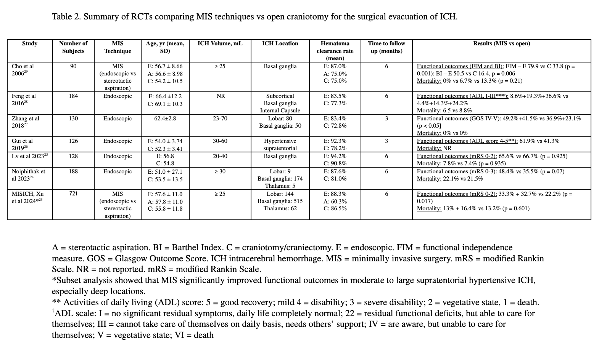

Slide 16
Techniques for minimally invasive surgical (MIS) ich evacuation

Slide 17
major Techniques for mis ich evacuation
Tubular (or Endoport)
Endoscopic
Stereotactic Aspiration (+/- intermittent thrombolytic adjuvant therapy for up to 72 hours)

Slide 18
Techniques for minimally invasive surgical (MIS) ich evacuation
  All three (tubular, endoscopic, and stereotactic aspiration) include the concept of using navigation to plan trajectories
    Helps to avoid eloquent cortex and account for subcortical tracts
  All three use intra-hematomal decompression, respecting adjacent tissue boundaries to optimize brain preservation
  Outcomes have been linked to site and surgeon experience
    All US-based RCTs require investigators to undergo standardized competency training in the technique with case reviews by the study Principal Investigators

Slide 19
Tubular (or endoport)
  Transsulcal parafascicular approach using a tubular retractor (used in ENRICH trial) carries the strongest evidence to date for MIS in ICH
      Tubular retractor placed using neuro-navigation through a sulcus of the brain to run parallel and avoid critical white matter tracts
      After retractor is placed into the clot, mechanical aspiration device is used to disrupt and aspirate the clot while minimizing trauma to surrounding tissue
      Control of bleeding achieved with direct bipolar cautery or hemostatic agents under direct exoscopic or microscopic visualization through the tubular device
  Other tubular devices include the Surgiscope, which consists of a tubular access system with an integrated light and video system
    Allows ICH evacuation through a smaller access port without the need for additional exoscopic or microscopic equipment

Slide 20
Endoscopic evacuation
  Represents the second major MIS strategy
  MIND trial evaluated MIS evacuation utilizing an endoscope and mechanical aspiration device for clot evacuation
  The endoscopic access device is typically smaller in caliber than tubular systems
  ICH evacuation is performed through a working port within the endoscope, with the hematoma evacuated under direct endoscopic visualization

Slide 21
Stereotactic catheter aspiration with thrombolysis
  Tested in MISTIE III
  Uses image-guided placement of a cannula with aspiration, followed by placement of a catheter with intermittent alteplase instillation to liquefy and drain the clot
  Thrombolytic administration is used as needed until the desired residual hematoma volume is reached
  Utilized neuro-navigation to optimize the trajectory along the long axis of the clot and tPA was instilled every 8 hours into the residual hematoma for subsequent drainage over 72 hours
  The approach of cranio-puncture aspiration with urokinase (used in China) has shown improved outcomes over medical therapy in basal ganglia ICH

Slide 22
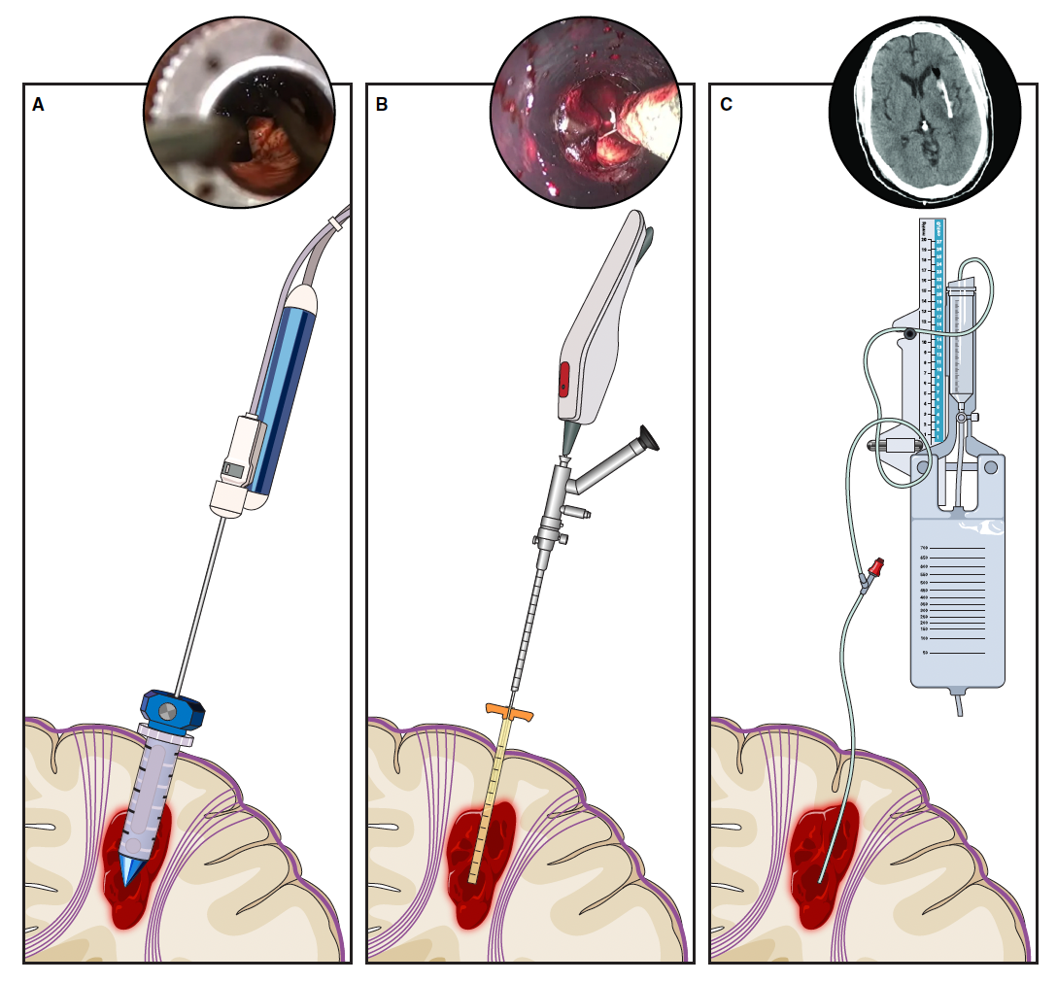
  A: Tubular (or Endoport)
  B: Endoscopic Evacuation
  C: Stereotactic Catheter Aspiration with Thrombolysis

Slide 23
Mis: Goals and optimal timing
  Many details regarding optimal volume reduction and timing still under investigation
  Across all techniques, a residual volume ≤15 mL appears to be the common surgical goal
  ENRICH: Achieved residual ICH volume of <15 mL in 73% of the surgical cohort
  MISTIE III: 60% of patients achieved ICH volumes ≤15 mL residual clot, which was associated with better functional outcome
  MIND: Achieved ICH volumes <15 mL in 79.2% of participants, although this did not result in statistically significant functional benefits

Slide 24
Mis: Goals and optimal timing
  Further investigation needed into the relationship between the 15 mL residual volume target and functional outcomes
  Optimal timing of surgery for ICH not yet resolved and further investigation is needed
      One meta-analysis suggests that evacuation up to 72 hours may improve clinical outcomes
      Smaller, non-randomized studies show that ultra-early craniotomy (<4 hrs.) may carry higher bleeding risk, but early MIS (<24 hours) appears safe

Slide 25
Minimally invasive surgical approaches in active trials
  Aurora Surgiscope:
    EVACUATE : NCT04434807
  Endoscopic evacuation:
    DIST : NCT05460793
    EMINENT : NCT05681988
    MINUTE
  Tubular endoport-mediated evacuation in deep hemorrhages:
    REACH : NCT06870812
    These ongoing trials will help determine optimal timing, technique, and patient selection

Slide 26
Acute medical management algorithm for medical therapy

Slide 27
Acute medical management algorithm
  Acute implementation of a multicomponent care bundle for ICH has been shown to significantly lower the likelihood of poor functional outcome
  INTERACT 3 (The Third Intensive Care Bundle With Blood Pressure Reduction in Acute Cerebral Hemorrhage) Trial:
    July 2023
    Enrolled 7036 patients with acute ICH arriving within 6 hours of symptoms
    Instituted care bundle (including rapid correction of coagulopathy, blood pressure reduction, normothermia, and normoglycemia)
    Resulted in improved functional outcomes and fewer serious adverse effects when care bundle instituted within 1 hour of presentation

Slide 28
Acute medical management algorithm for medical therapy
  INTERACT3 targeted glucose levels of 110-140 mg/dL for non-diabetics and 140-180 mg/dL for diabetics
  Rapid correction of coagulopathy is critical, within 90 minutes per the 2022 guidelines but with potential benefit achieved within 60 minutes as demonstrated by INTERACT3
  Systolic blood pressure goal of 130-140 mmHg was achieved within 1 hours and maintained for up to 7 days, balancing hematoma stability with cerebral perfusion without increased incidence of acute renal failure
  In line with 2022 ICH guidelines, platelet transfusion might be considered for patients on antiplatelet therapy undergoing MIS, although evidence is still limited and platelet transfusion carries potential harm and is not recommended in patients managed medically

Slide 29
Acute medical management algorithm for medical therapy
  Core medical principles: Close neurological monitoring, management of intracranial pressure, and avoidance of secondary brain injury through normoglycemia and normothermia
  Neuroimaging postoperatively to ensure successful evacuation, and at intervals to monitor for re-bleeding, development of hydrocephalus and edema based on clinical condition is advisable
  Coordination between neurosurgical, neurocritical care, and anesthesiology teams is essential for seamless transition from ICU stabilization to operative intervention and recovery
  These principles, guided by trial data and evolving clinical protocols, may support the safe application of MIS approaches to ICH in the modern stroke and critical care setting

Slide 30
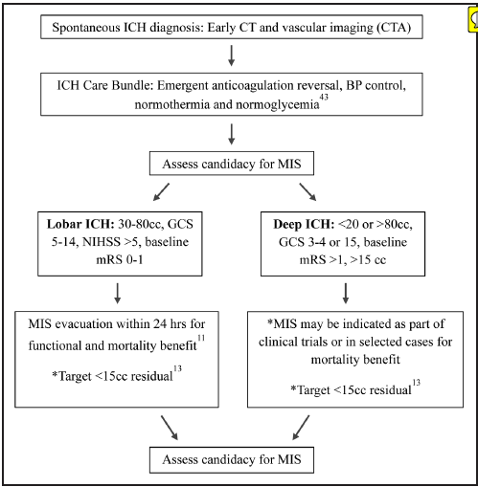

Slide 31
Surgical patient selection

Slide 32
Surgical patient selection
  Patient selection can be guided by the inclusion and exclusion criteria of the most recent RCTs (ENRICH, MIND, and MISTIE III)
  All three trials with similar patient populations:
    Hematoma volumes between 30-80 mL (MIND 20-80 mL) and moderate to severe neurologic deficit without clinical signs of herniation (NIHSS >5 and GCS >5)
    Modified Rankin Scale 0-1 at baseline
    Patients >80 years not routinely enrolled

Slide 33
Surgical patient selection (continued)
  ENRICH: Required evacuation within 24 hours of last known well
  MISTIE III and MIND: Required evacuation within 72 hours
  Exclusion criteria similar among all three trials:
    Clinical signs of herniation, uncorrectable coagulopathy, suspicion of an underlying lesion such as AVM or tumor, large or isolated intraventricular hemorrhage, and traumatic ICH
  Location of hemorrhage across studies:
    MISTIE III had 62% deep hematomas including thalamic location
    MIND had 70.8% deep location
    ENRICH excluded thalamic hemorrhages and showed no clear benefit in the treatment of basal ganglia lesions, while demonstrated significant functional benefit in lobar hemorrhages

Slide 34
Conclusion
  Overall, MIS may be considered for patients presenting with lobar ICH between 30-80 mL with good premorbid neurologic status, NIHSS>5, and GCS>5 undergoing surgery within the first 24 hours
  Mortality benefit from MIS in supratentorial ICH may be achieved with adequate clot evacuation within the first 72 hours
  Patients meeting the above criteria with reversible coagulopathies/anticoagulation, correctable antiplatelet use, or suspicion of amyloid angiopathy should not be summarily excluded from consideration for surgical MIS evacuation
  Despite the lack of demonstrated functional benefit with evacuation of basal ganglia ICH, MIS may still confer a mortality benefit, decreased rate of requiring a hemicraniectomy, and decreased ICU and hospital length of stay
  Patients with significant IVH and moderate baseline deficit (mRS 2-3) have not been studied in prior trials but may be considered on a case-by-case basis pending future data

Slide 35
Conclusion
  Based on current data, MIS appears to confer mortality benefit
  Functional outcome improvement is supported in MIS for lobar hemorrhages
  Surgeon training/performance important in achieving technical success and safety
  Optimal timing of MIS (and maximum threshold of timing) to achieve maximal benefit still under investigation
  Functional benefit of MIS in deep non-lobar hemorrhage remains to be demonstrated
  The superiority of any specific MIS technique has not been clearly established to date

Slide 36
future directions
  Choice and timing of outcomes including quality of life (QOL) measures, cognitive status, and cost-effectiveness will be needed, even for standard functional outcomes such as mRS
  Expanding eligibility criteria in trial setting to capture a broader population (e.g. ICH with prominent IVH) and to interrogate thresholds for minimum and maximum ICH volume will be needed
  At present, most ICH patients do not fall into criteria shown to benefit from MIS, leaving a major opportunity for further investigation

Slide 37
Thank you

