Slide 1

Guideline Essentials:
American Heart Association
Clinical Slide Series
ADAPTED FROM:
2026 AHA/ACC/ADA/ASN
Guideline for the Prevention, Detection, Evaluation, and Management of
Cardiovascular-Kidney-Metabolic Syndrome
AHA Clinical (PPTX)

Slide 2
Table 1.
Applying Class of Recommendation and Level of Evidence to Clinical Strategies, Interventions, Treatments, or Diagnostic Testing in Patient Care
CLASS (STRENGTH) OF RECOMMENDATION
CLASS 1 (STRONG) Benefit >>> Risk
Suggested phrases for writing recommendations: Is recommended Is indicated/useful/effective/beneficial Should be performed/administered/other Comparative-Effectiveness Phrases†: Treatment/strategy A is recommended/indicated in preference to treatment B Treatment A should be chosen over treatment B
CLASS 2a (MODERATE) Benefit >> Risk
Suggested phrases for writing recommendations: Is reasonable Can be useful/effective/beneficial Comparative-Effectiveness Phrases†: Treatment/strategy A is probably recommended/indicated in preference to treatment B It is reasonable to choose treatment A over treatment B
CLASS 2b (Weak) Benefit ≥ Risk
Suggested phrases for writing recommendations: May/might be reasonable May/might be considered Usefulness/effectiveness is unknown/unclear/uncertain or not well-established
CLASS 3: No Benefit (MODERATE) Benefit = Risk
Suggested phrases for writing recommendations: Is not recommended Is not indicated/useful/effective/beneficial Should not be performed/administered/other
CLASS 3: Harm (STRONG) Risk > Benefit
Suggested phrases for writing recommendations: Potentially harmful Causes harm Associated with excess morbidity/mortality Should not be performed/administered/other
LEVEL (QUALITY) OF EVIDENCE‡
LEVEL A
High-quality evidence‡ from more than 1 RCT Meta-analyses of high-quality RCTs One or more RCTs corroborated by high-quality registry studies
LEVEL B-R (Randomized)
Moderate-quality evidence‡ from 1 or more RCTs Meta-analyses of moderate-quality RCTs
LEVEL B-NR (Nonrandomized)
Moderate-quality evidence‡ from 1 or more well-designed, well-executed nonrandomized studies, observational studies, or registry studies Meta-analyses of such studies
LEVEL C-LD (Limited Data)
Randomized or nonrandomized observational or registry studies with limitations of design or execution Meta-analyses of such studies Physiological or mechanistic studies in human subjects
LEVEL C-EO (Expert Opinion)
Consensus of expert opinion based on clinical experience.
COR and LOE are determined independently (any COR may be paired with any LOE).
A recommendation with LOE C does not imply that the recommendation is weak. Many important clinical questions addressed in guidelines do not lend themselves to clinical trials. Although RCTs are unavailable, there may be a very clear clinical consensus that a particular test or therapy is useful or effective.
* The outcome or result of the intervention should be specified (an improved clinical outcome or increased diagnostic accuracy or incremental prognostic information).
† For comparative-effectiveness recommendation (COR 1 and 2a; LOE A and B only), studies that support the use of comparator verbs should involve direct comparisons of the treatments or strategies being evaluated.
‡ The method of assessing quality is evolving, including the application of standardized, widely-used, and preferably validated evidence grading tools; and for systematic reviews, the incorporation of an Evidence Review Committee.
COR indicates Class of Recommendation; EO, expert opinion; LD, limited data; LOE, Level of Evidence; NR, nonrandomized; R, randomized; and RCT, randomized controlled trial.
Ndumele, C.E., et al. 2026 AHA/ACC/ADA/ASN Guideline for the Prevention, Detection, Evaluation, and Management of CKM Syndrome. Circulation.

Slide 3
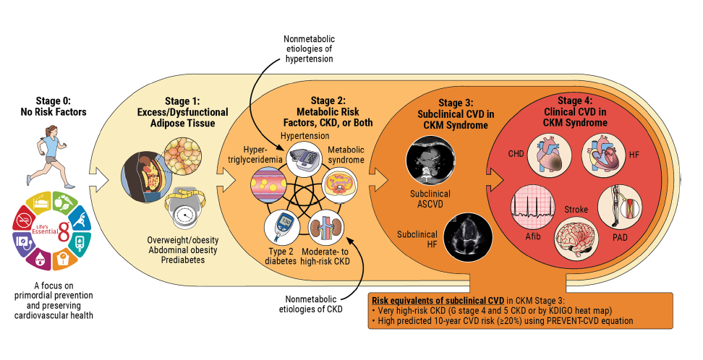
Stages of CKM Syndrome
Abbreviations: Afib indicates atrial fibrillation; ASCVD, atherosclerotic cardiovascular disease; CHD, coronary heart disease; CKD, chronic kidney disease; CKM, cardiovascular-kidney-metabolic; CVD, cardiovascular disease; HF, heart failure; KDIGO, Kidney Disease: Improving Global Outcomes; PAD, peripheral artery disease; and PREVENT, Predicting Risk of Cardiovascular Disease Events.

Slide 4
Longitudinal Assessments for
Adults According to Baseline CKM Syndrome Stage
Baseline CKM Stage
Stage 0
Stage 1
Stage 2-4
Longitudinal CKM Stage Assessments
Annual assessments of BMI, waist circumference and BP
Annual assessments of BMI, waist circumference and BP
Annual assessments of BMI, waist circumference and BP
Every year
Every 2-3 years
Every 5 years
Assessment of lipids,
glycemia, eGFR, and UACR
Assessment of lipids,
glycemia and eGFR
Assessment of lipids,
glycemia and eGFR
Abbreviations: BMI indicates body mass index; BP, blood pressure; CKM, cardiovascular kidney metabolic;
eGFR, estimated glomerular filtration rate; and UACR, urine albumin-to-creatinine ratio.

Slide 5
Conceptual Approach to CKM Risk Assessment and Refinement
Initial Assessment and CKM Staging
Assess for CKM risk factors* and adverse SDOH
Stage 1
Excess or dysfunctional adipose tissue
Stage 2 or 3
Metabolic risk factors and/or CKD
Stage 4
Clinical CVD
Reclassify CKM stage and assess
risk enhancers
Calculate PREVENT-CVD to quantify 10-y CVD risk
and to refine staging (30-79 years)
*CKM risk factors include adiposity, blood pressure, lipids, glycemia, and kidney function. Conceptual overview of the approach to staging that integrates baseline CKM assessments, risk estimation with the PREVENT-CVD equations, and personalization with risk-enhancing factors.
Stage 1
Stage 2
(<20% PREVENT-CVD)
Stage 3*
(≥20% PREVENT-CVD)
Assess for CKM risk enhancers to inform pt/clinician risk discussion and therapeutic pain
Assess for CKM risk enhancers to inform pt/clinician risk discussion and therapeutic plan
Abbreviations: CKM indicates cardiovascular kidney metabolic; CKD, chronic kidney disease; CV, cardiovascular; CVD, cardiovascular disease; pt, patient; and SDOH, social determinants of health.
Prevent
CKM syndrome progression
Lifestyle modification
and/or drug treatment as indicated for CVD primary prevention
Lifestyle modification and drug treatment as indicated for CVD primary prevention
Intensive lifestyle modification and drug treatment to prevent recurrent CVD events
and kidney failure

Slide 6
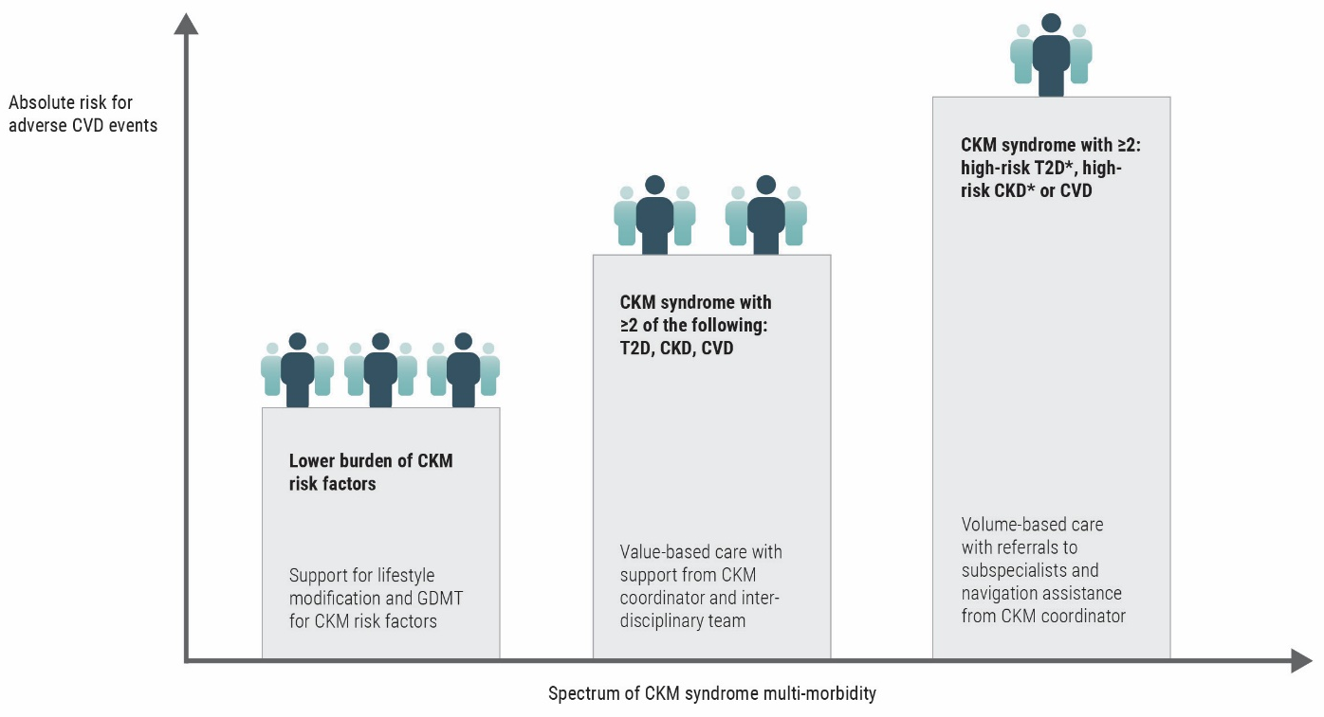
Use of Interdisciplinary Care Models in CKM Syndrome
Abbreviations: CKD indicates chronic kidney disease; CKM, cardiovascular kidney metabolic;
CVD, cardiovascular disease; and T2D, type 2 diabetes.

Slide 7
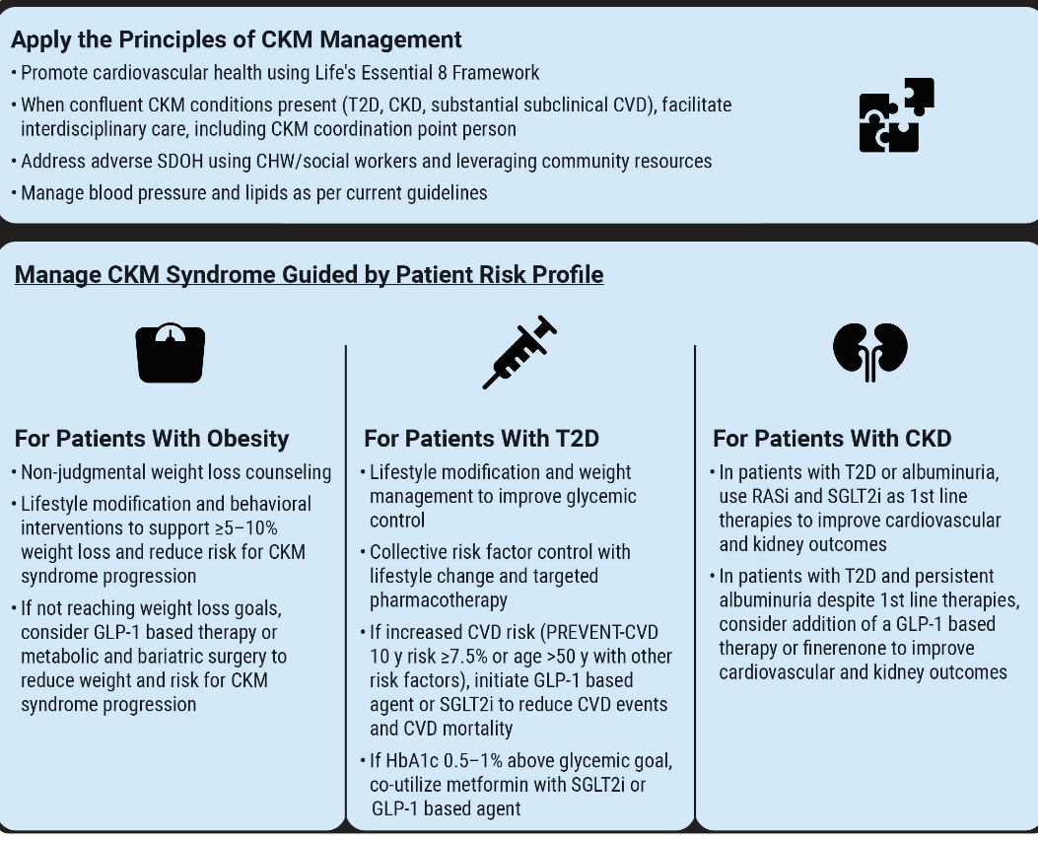
Overview of Management Principles for CKM Syndrome
Stages 1 to 3 for Patients With
Obesity, Type 2 Diabetes, or CKD
Abbreviations: CHW indicates community health worker; CKD, chronic kidney disease; CKM, cardiovascular kidney metabolic; CV, cardiovascular; CVD, cardiovascular disease; DM, diabetes; GLP-1, glucagon-like peptide-1; RASi; renin-angiotensin system inhibitors; SDOH, social determinants of health; SGLT2i ; sodium-glucose cotransporter-2 inhibitors; and T2D, type 2 diabetes.

Slide 8
Management of Obesity in
CKM Syndrome Stages 1-3
Patient with CKM and Obesity without CVD
Nonjudgmental weight loss counseling Class 1
Support behavioral change and lifestyle modification
Class 1
Adequate weight loss? (≥5-10% weight loss)
Yes
Provide ongoing support for lifestyle modification for long-term weight loss maintenance
Class 1
No
GLP-1-based therapy
Class 2a
Metabolic and bariatric surgery
Class 2a
Adequate weight loss? (≥5-10% weight loss)
Yes
Provide ongoing support for lifestyle modification for long-term weight loss maintenance
Class 1
No
Abbreviations: CKM indicates cardiovascular kidney metabolic; and GLP-1,glucagon-like peptide-1.
Ensure dose escalation, switch GLP-1-based therapy and/or refer to weight management specialist Class 1

Slide 9
Management of Type 2 Diabetes in CKM Syndrome
Stages 2-3
CKM with T2D without CVD
Recommend and support lifestyle modification Class 1
Achieve multi-modal risk factor control Class 1
At increased risk*?
No
Provide standard
glycemic pharmacotherapy
*Increased risk is defined as 10-year PREVENT-CVD of ≥7.5% or
age ≥50 years with T2D and additional CKM risk factors.
Yes
Add cardioprotective anti-hyperglycemic agent Class 1
GLP-1-based therapy
(Prioritize in severe obesity, MASLD or severe hyperglycemia) Class 1
SGLT2i
(Prioritize in CKD or pre-HF) Class 1
Abbreviations:
CKM indicates cardiovascular kidney metabolic; GLP-1, glucagon-like peptide-1; HbA1c, glycated hemoglobin A1C; HF, heart failure; MASLD, metabolic-dysfunction associated steatotic liver disease; SGLT2i ; sodium-glucose cotransporter-2 inhibitors; and T2D, type 2 diabetes.
AND
AND
Co-utilize Metformin (if not already initiated) if HbA1c >0.5-1% above glycemic goal Class 2a
Co-utilize Metformin (if not already initiated) if HbA1c >0.5-1% above glycemic goal Class 2a
Combined GLP-1-based therapy and SGLT2i if multiple CKM risk factors or very high predicted risk Class 2b

Slide 10
Management of CKD in
CKM Syndrome Stage 2-3
CKM syndrome with CKD (eGFR <60 and/or UACR ≥30 mg/g) without CVD
Albuminuria (UACR ≥30 mg/g)
present?
No kidney protective therapy needed
Type 2 diabetes?
No
No
Yes
Yes
RASi + SGLT2i
Class 1
UACR ≥200 mg/g
UACR
≥30-199 mg/g
RASi + SGLT2i
Class 1
RASi Class 1
SGLT2i Class 2a
Persistent albuminuria?
No
Continue current therapy and repeat UACR in 1 yr
Abbreviations: UACR indicates urine albumin-to-creatinine ratio; CKD, chronic kidney disease; eGFR, estimated glomerular filtration rate;
GLP-1, glucagon-like peptide 1; nsMRA, non-steroidal mineralocorticoid receptor antagonist; RASi, renin-angiotensin system inhibitors;
and SGLT2i; sodium glucose cotransporter 2 inhibitors.
Yes
Add additional
kidney-protective therapy
Class 1

Slide 11
Management of CKD in
CKM Syndrome Stages 2-3, continued
Add additional
kidney-protective therapy
Class 1
GLP-1 RA*
(Prioritize in uncontrolled hyperglycemia, obesity or MASLD) Class 1
nsMRA
Class 1
Check UACR every 3-6 mo
Class 2a
Persistent albuminuria?
No
Continue current therapy
Abbreviations: UACR indicates urine albumin-to-creatinine ratio; CKD, chronic kidney disease; eGFR, estimated glomerular filtration rate;
GLP-1, glucagon-like peptide 1; nsMRA, non-steroidal mineralocorticoid receptor antagonist; RASi, renin-angiotensin system inhibitors; and SGLT2i; sodium glucose cotransporter 2 inhibitors.
Yes
Consider combination
GLP-1 RA* + nsMRA
*Semaglutide is currently the only GLP-1 RA demonstrated to improve kidney
and CVD outcomes among patients with T2D and CKD with albuminuria.

Slide 12
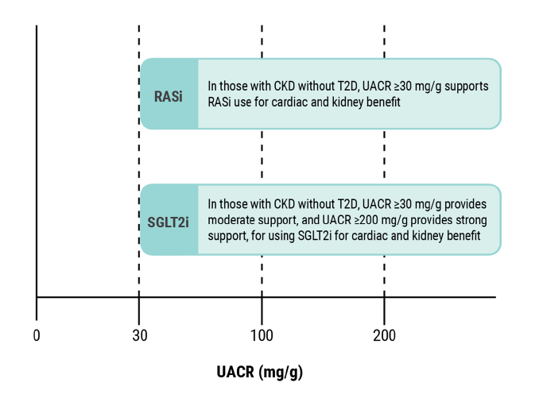
Cardiovascular and Kidney Protective Therapies in CKD Without T2D using UACR
Abbreviations: CKD indicates chronic kidney disease; T2D, type 2 diabetes; RASi; renin-angiotensin system inhibitors; SGLT2i ;
sodium-glucose cotransporter-2 inhibitors; and UACR, urine albumin-creatinine ratio.

Slide 13
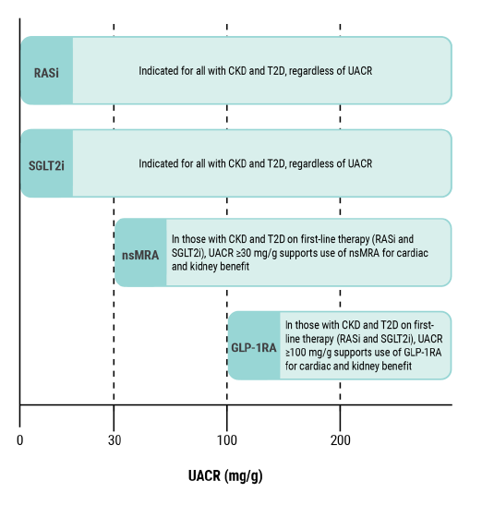
Cardiovascular and Kidney Protective Therapies in CKD With T2D using UACR
Abbreviations: CKD indicates chronic kidney disease; T2D, type 2 diabetes; GLP-1, glucagon-like peptide 1; nsMRA, non-steroidal mineralocorticoid receptor antagonist; RASi; renin-angiotensin system inhibitors; SGLT2i ; sodium-glucose cotransporter-2 inhibitors;
and UACR, urine albumin-creatinine ratio.

Slide 14
Evaluation and Management of Pre-HF in CKM Syndrome
Identify CKM syndrome without symptomatic clinical HF but with elevated short-term HF risk:
PREVENT-HF risk (≥5%)
Perform cardiac biomarker assessment (natriuretic peptides +/- high-sensitivity troponin*) to evaluate for pre-HF
If cardiac biomarkers elevated:
Optimize risk factor control
Consider cardiac imaging to refine risk estimation
Start prevention therapies for HF risk reduction
*High-sensitivity troponin can be considered for those with obesity, where natriuretic peptides may be low even in the setting of cardiac dysfunction and increased risk for developing HF. Evaluation of pre-HF in patients with CKM syndrome with increased predicted HF risk (PREVENT-HF risk ≥5%).
Abbreviations: CKM indicates cardiovascular kidney metabolic; and HF, heart failure.

Slide 15
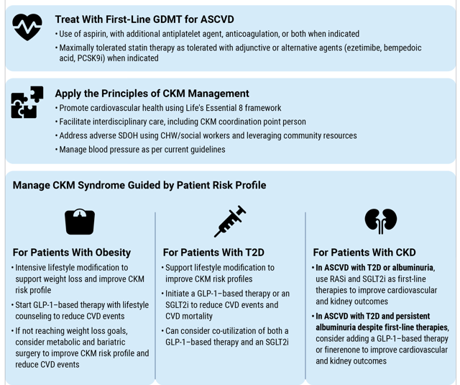
Overview of ASCVD Management in CKM Syndrome Stage 4
Abbreviations CHW indicates community health worker; CKM, cardiovascular kidney metabolic; CVD, cardiovascular disease; GDMT, guideline directed medical therapy; GLP-1, glucagon-like peptide-1; RASi; renin-angiotensin system inhibitors; SDOH, social determinants of health; SGLT2i ; sodium-glucose cotransporter-2 inhibitors; and T2D, type 2 diabetes.

Slide 16
Management of Comorbid Obesity and ASCVD in CKM
Obesity and ASCVD
Nonjudgmental weight loss counseling: lifestyle modification
Multi-component intensive
lifestyle intervention Class 1
AND
GLP-1-based therapy Class 1
Adequate weight loss (>5-10%)
Yes
Ongoing support of lifestyle modification and medication adherence for weight loss maintenance Class 1
No
Consider metabolic and bariatric surgery Class 2a
Ongoing support of lifestyle modification for weight loss maintenance Class 1
Abbreviations: ASCVD indicates atherosclerotic cardiovascular disease; and GLP-1, glucagon-like peptide 1.

Slide 17
Management of Comorbid T2D and ASCVD in CKM
T2D and ASCVD
Recommend and support
lifestyle modification Class 1
Achieve multi-modal risk factor control Class 1
Add cardioprotective antihyperglycemic agent to glycemic regimen Class 1
GLP-1-based therapy
(Prioritize in severe obesity, uncontrolled hyperglycemia, MASLD) Class 1
SGLT2i
(Prioritize in CKD or
pre-HF/HF) Class 1
Start combined GLP-1-based
and SGLT2i therapy Class 2a
Abbreviations: ASCVD indicates atherosclerotic cardiovascular disease; GLP-1, glucagon-like peptide-1; HbA1c, glycated hemoglobin A1C;
HF, heart failure; MASLD, metabolic-dysfunction associated steatotic liver disease; SGLT2i ; sodium-glucose cotransporter-2 inhibitors;
and T2D, type 2 diabetes.
Co-utilize other antiglycemia agents
(e.g. metformin) if HbA1c >0.5-1%
above individual goal

Slide 18
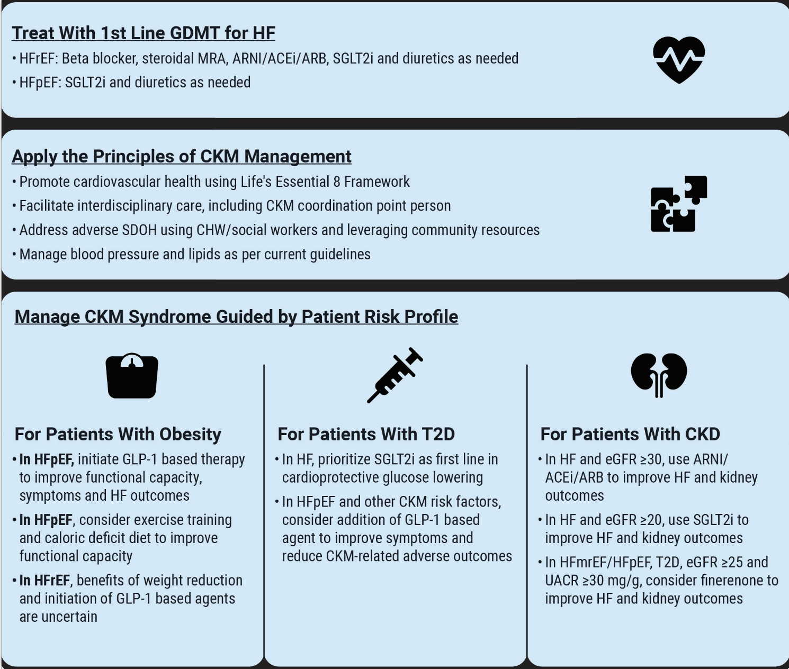
Overview of
HF Management in CKM Syndrome Stage 4
Abbreviations: CHW indicates community health worker; CKM, cardiovascular kidney metabolic; CVD, cardiovascular disease; eGFR, estimated glomerular filtration rate; GDMT, guideline directed medical therapy; GLP-1, glucagon-like peptide-1; HF, heart failure; HFpEF, heart failure with preserved ejection fraction; HFrEF, heart failure with reduced ejection fraction; SDOH, social determinants of health; SGLT2i ; sodium-glucose cotransporter-2 inhibitors; and T2D, type 2 diabetes.

Slide 19
Management of Obesity and HF According to
HF Subtype
Obesity and HF
HFrEF
HFpEF
HF GDMT
Beta Blockers
Class 1
Steroidal MRA
Class 1
ARNI/ACEi/
ARB
Class 1
SGLT2i
Class 1
SGLT2i
Class 1
GLP-1-based therapy
Class 1
Exercise training and caloric deficit diet
Class 2a
With the exception of the SGLT2i COR for HFpEF which is anticipated to be updated in the next 2022 HF guideline iteration, GDMT is concordant with the 2022 HF guideline per HF subtype which is highlighted in gray.
Abbreviations: GDMT indicates guideline directed medical therapy; GLP-1, glucagon-like peptide-1; HF, heart failure; HFpEF, heart failure with preserved ejection fraction; HFrEF, heart failure with reduced ejection fraction; and SGLT2i, sodium-glucose cotransporter-2 inhibitors.

Slide 20
Management of Type 2 Diabetes and HF According to HF Subtype
T2D and HF
HFrEF
HFpEF
HF GDMT
Beta Blockers
Class 1
Steroidal MRA
Class 1
ARNI/ACEi/
ARB
Class 1
SGLT2i
Class 1
SGLT2i
Class 1
Presence of obesity, uncontrolled hyperglycemia, MASLD, ASCVD,
CKD with albuminuria?
Continue current therapy
No
Yes
Management of patients with comorbid type 2 diabetes and HF according to HF subtype with HF GDMT as recommended by the 2022 Heart Failure Guidelines highlighted in gray.
Consider GLP-1-based therapy
Class 2a
Abbreviations: GDMT indicates guideline directed medical therapy; GLP-1, glucagon-like peptide-1; HF, heart failure; HFpEF, heart failure with
preserved ejection fraction; HFrEF, heart failure with reduced ejection fraction; and SGLT2i, sodium-glucose cotransporter-2 inhibitors.

Slide 21
Management of CKD and HF According to
HF Subtype
CKD and HF
HFrEF
HFmrEF/HFpEF
For improved HF outcomes
For improved HF and kidney outcomes
For improved HF and kidney outcomes
HF GDMT
Beta Blockers
Class 1
Steroidal MRA
Class 1
ARNI/ACEi/
ARB
(if eGFR >30 at initiation)
Class 1
SGLT2i
(if eGFR >20 at initiation)
Class 1
SGLT2i
(if eGFR >20 at initiation)
Class 1
T2D + CKD with
albuminuria present?
No
Continue current therapy
Yes
Management of patients with comorbid diabetes and HF according to HF subtype with HFGDMT as recommended by the 2022 Heart Failure Guidelines highlighted in gray.
Add nsMRA Class 2a
Abbreviations: CKD indicates chronic kidney disease; GDMT, guideline directed medical therapy; eGFR, estimated glomerular filtration rate; HF, heart failure; HFpEF, heart failure with preserved ejection fraction; HFrEF, heart failure with reduced ejection fraction; HFmrEF, heart failure with mildly reduced ejection fraction; SGLT2i, sodium-glucose cotransporter-2 inhibitors; and T2D, type 2 diabetes.

Slide 22
Citation
The American Heart Association requests this electronic slide deck be cited as follows:
Reyna, G.G. (2026). Guideline Essentials: Clinical Slide Series [PowerPoint slides]; Adapted from 2026 AHA/ACC/ADA/ASN Guideline for the Prevention, Detection, Evaluation and Management of Cardiovascular-Kidney-Metabolic Syndrome. Circulation. Guideline Essentials: AHA Clinical Slide Series - Professional Heart Daily | American Heart Association

Slide 23
Copyright and Permissions Notice
© Copyright 2026. American Heart Association. All rights reserved.
This material is the copyrighted property of the American Heart Association and is provided for reference purposes only. It may not be copied, reproduced, stored in a retrieval system, transmitted, altered in any way or used as a derivative work, or distributed in any form or by any means—electronic, mechanical, photocopying, recording, or otherwise—without prior written permission from the publisher.
This content may be used for limited educational and personal use.
Further distribution or dissemination requires a licensing agreement. Unauthorized use or distribution in any media is strictly prohibited.
For permissions inquiries and licensing fee information,
please see the information/Request Form at this link:
https://www.heart.org/en/about-us/statements-and-policies/copyright-request-form

