Slide 1
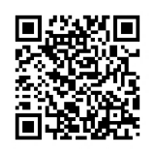
Guideline Essentials: AHA Clinical Slide Series
ADAPTED FROM:
2025 AHA/ACC/AANP/AAPA/ABC/ACCP/ACPM/
AGS/AMA/ASPC/NMA/PCNA/SGIM
Guideline for the Prevention, Detection, Evaluation and Management of High Blood Pressure in Adults
AHA Clinical Slides PPTX

Slide 2
Table 1.
Applying Class of Recommendation and Level of Evidence to Clinical Strategies, Interventions, Treatments, or Diagnostic Testing in Patient Care
CLASS (STRENGTH) OF RECOMMENDATION
CLASS 1 (STRONG) Benefit >>> Risk
Suggested phrases for writing recommendations: Is recommended Is indicated/useful/effective/beneficial Should be performed/administered/other Comparative-Effectiveness Phrases†: Treatment/strategy A is recommended/indicated in preference to treatment B Treatment A should be chosen over treatment B
CLASS 2a (MODERATE) Benefit >> Risk
Suggested phrases for writing recommendations: Is reasonable Can be useful/effective/beneficial Comparative-Effectiveness Phrases†: Treatment/strategy A is probably recommended/indicated in preference to treatment B It is reasonable to choose treatment A over treatment B
CLASS 2b (Weak) Benefit ≥ Risk
Suggested phrases for writing recommendations: May/might be reasonable May/might be considered Usefulness/effectiveness is unknown/unclear/uncertain or not well-established
CLASS 3: No Benefit (MODERATE) Benefit = Risk
Suggested phrases for writing recommendations: Is not recommended Is not indicated/useful/effective/beneficial Should not be performed/administered/other
CLASS 3: Harm (STRONG) Risk > Benefit
Suggested phrases for writing recommendations: Potentially harmful Causes harm Associated with excess morbidity/mortality Should not be performed/administered/other
LEVEL (QUALITY) OF EVIDENCE‡
LEVEL A
High-quality evidence‡ from more than 1 RCT Meta-analyses of high-quality RCTs One or more RCTs corroborated by high-quality registry studies
LEVEL B-R (Randomized)
Moderate-quality evidence‡ from 1 or more RCTs Meta-analyses of moderate-quality RCTs
LEVEL B-NR (Nonrandomized)
Moderate-quality evidence‡ from 1 or more well-designed, well-executed nonrandomized studies, observational studies, or registry studies Meta-analyses of such studies
LEVEL C-LD (Limited Data)
Randomized or nonrandomized observational or registry studies with limitations of design or execution Meta-analyses of such studies Physiological or mechanistic studies in human subjects
LEVEL C-EO (Expert Opinion)
Consensus of expert opinion based on clinical experience.
COR and LOE are determined independently (any COR may be paired with any LOE).
A recommendation with LOE C does not imply that the recommendation is weak. Many important clinical questions addressed in guidelines do not lend themselves to clinical trials. Although RCTs are unavailable, there may be a very clear clinical consensus that a particular test or therapy is useful or effective.
* The outcome or result of the intervention should be specified (an improved clinical outcome or increased diagnostic accuracy or incremental prognostic information).
† For comparative-effectiveness recommendation (COR 1 and 2a; LOE A and B only), studies that support the use of comparator verbs should involve direct comparisons of the treatments or strategies being evaluated.
‡ The method of assessing quality is evolving, including the application of standardized, widely-used, and preferably validated evidence grading tools; and for systematic reviews, the incorporation of an Evidence Review Committee.
COR indicates Class of Recommendation; EO, expert opinion; LD, limited data; LOE, Level of Evidence; NR, nonrandomized; R, randomized; and RCT, randomized controlled trial.
Jones, D.W., et al. (2025). 2025 AHA/ACC/AANP/AAPA/ABC/ACCP/ACPM/AGS/AMA/ASPC/NMA/PCNA/SGIM
Guideline for the Prevention, Detection, Evaluation and Management of High Blood Pressure in Adults.Circulation.

Slide 3
Definition and Classification of Blood Pressure
Blood Pressure Category | SBP |  | DBP
Normal | < 120 mmHg | and | < 80 mmHg
Elevated | 120 to 129 mmHg | and | < 80 mmHg
Stage 1 Hypertension | 130 to 139 mmHg | or | 80 to 89 mmHg
Stage 2 Hypertension | ≥ 140 mmHg | or | ≥ 90 mmHg
COR | RECOMMENDATIONS
1 | In adults, BP should be categorized as normal, elevated, or stage 1 or stage 2 hypertension to prevent and treat high BP.
Hypertension
Abbreviations: BP indicates blood pressure; DBP, diastolic blood pressure; and SBP, systolic blood pressure.

Slide 4
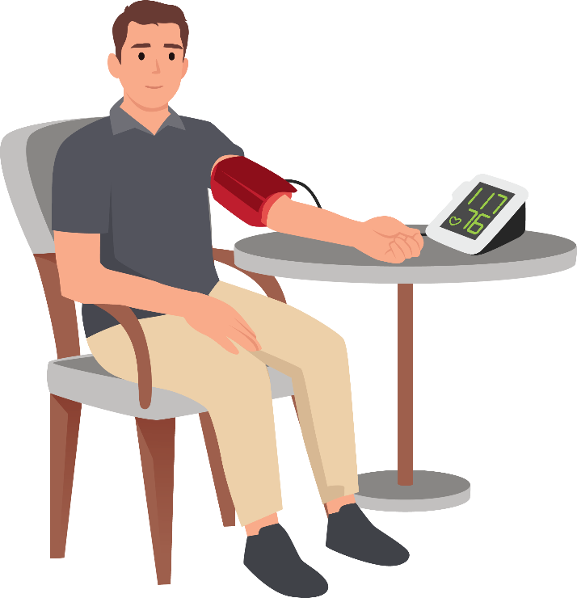
Best Practices for Accurate
In-Office Blood Pressure Measurement
Avoid caffeine, exercise, and smoking for at least 30 minutes before.
Use a BP device that has been validated for accuracy (validatebp.org).
COR | RECOMMENDATIONS
1 | When diagnosing and managing high BP in adults, standardized methods are recommended for the accurate measurement and documentation of in-office BP.
2a | When measuring in-office BP in adults, it is reasonable to use the oscillometric method with an automated device over the auscultatory method.
Use the correct cuff size on a bare arm.
The patient’s arm should be supported at heart level.
Take 2 or more BP measurements at least 1-minute apart.
Patient should be relaxed, sitting in a chair (feet flat, legs uncrossed, and back supported) for at least 5 minutes.
BP measurement should be done in a temperature-controlled room.
Neither patient nor clinician should talk during the rest or measurement. No use of phones.
Abbreviation: BP indicates blood pressure.

Slide 5
Essential Laboratory Tests and Diagnostic Procedures
When hypertension is suspected or confirmed, laboratory and diagnostic procedures are a standard part of the evaluation.
This information will provide a baseline and will inform management decisions including the need for additional testing.
These tests should be repeated at least annually to monitor for potential adverse effects of therapies including kidney disease progression and changes in predicted CVD risk.
Additional diagnostic evaluation should be considered when secondary causes of hypertension are suspected.
Routine Diagnostic Studies
Complete blood count
Serum sodium, potassium, calcium
Serum creatinine with estimation of GFR
Lipid profile
Fasting blood glucose or Hemoglobin A1c
Thyroid-stimulating hormone
Urinalysis
Urine albumin to creatinine ratio; urine protein to creatinine ratio
Electrocardiogram
COR | RECOMMENDATIONS
1 | For adults who are diagnosed with hypertension, laboratory tests (ie, complete blood count, serum electrolytes, serum creatinine, lipid profile, glucose or Hgb A1c, thyroid-stimulating hormone, urinalysis, and urine albumin to creatinine ratio) and diagnostic procedures (12-lead ECG) should be performed to optimize management.
Abbreviations: CVD indicates cardiovascular disease; ECG, electrocardiogram; and Hgb, hemoglobin.

Slide 6
From Clinic to Home: Blood Pressure Monitoring
COR | RECOMMENDATIONS
1 | In adults with suspected hypertension, out-of-office BP measurements by either ABPM or HBPM are recommended to confirm the diagnosis of hypertension.
1 | In adults who are taking antihypertensive medication, HBPM is recommended for monitoring the titration of BP-lowering medication, along with co-interventions such as patient education, telehealth counseling, and clinical interventions.
3: No Benefit | In adults, the use of cuffless BP devices is not recommended for the diagnosis or management of high BP.
Corresponding Ambulatory and Home Blood Values Measurement to Office Values
Office (mmHg) | HBPM (mmHg) | Daytime ABPM (mmHg) | Nightime ABPM (mmHg) | 24-Hour ABPM (mmHg)
120/80 | 120/80 | 120/80 | 100/65 | 115/75
130/80 | 130/80 | 130/80 | 110/65 | 125/75
140/90 | 135/85 | 135/85 | 120/70 | 130/80
160/100 | 145/90 | 145/90 | 140/85 | 145/90
Abbreviations: ABPM indicates ambulatory blood pressure monitoring; BP, blood pressure; and HBPM, home blood pressure monitoring.

Slide 7

Hypertension Causes, from Lifestyle to Genetics
Dietary Intake Factors
Non-Dietary Factors
Higher sodium intake
Lower potassium intake
Lower calcium/
magnesium intake
Lower diet quality (lower intake of fruits/ vegetables, plant proteins, fiber)
Alcohol intake
Genetics variants
Overweight/obesity
Lower physical activity/fitness
Sleep disturbances (related to duration, quality, regularity and/or disordered breathing)
Psychosocial stressors
Air pollution

Slide 8

White-coat and Masked Hypertension
White-coat hypertension: BP is high in the office setting and normal or elevated outside of the office setting
Masked hypertension: BP is high outside of the office setting and normal or elevated in the office setting
ABPM is preferred for excluding white-coat and masked hypertension among individuals not taking antihypertensives.
Adults with in-office BP ≥160/100 mmHg should be promptly started on antihypertensives
Studies have shown that individuals with white-coat and masked hypertension compared to those with sustained normotension are more likely to have sustained hypertension on follow-up.
Abbreviations: ABPM indicates ambulatory blood pressure monitoring; BP, blood pressure;
DBP, diastolic blood pressure; and SBP, systolic blood pressure.

Slide 9
White-coat and Masked Hypertension
COR | RECOMMENDATIONS
2a | In adults with untreated office SBP ≥130 mm Hg or DBP ≥80 mm Hg, and without office SBP ≥160 mm Hg or DBP ≥100 mm Hg, it is reasonable to exclude white-coat hypertension using out-of-office BP monitoring before a diagnosis of hypertension is made.
2a | In adults with white-coat hypertension, out-of-office BP monitoring is reasonable to exclude transition to a diagnosis of sustained hypertension.
2a | In adults with apparent treatment resistant hypertension on office BP, it is reasonable to exclude white-coat effect, a form of pseudoresistance, using out-of-office BP monitoring
2a | In adults who are taking antihypertensive medication and have elevated office BP (office SBP ≥130 mm Hg or DBP ≥80 mm Hg), but do not have resistant hypertension or office SBP ≥160 mm Hg or DBP ≥100 mm Hg, it is reasonable to exclude white-coat effect using out-of-office BP monitoring
2b | In adults with untreated office SBP <130 mm Hg and DBP <80 mm Hg, it may be reasonable to exclude masked hypertension using out-of-office BP monitoring
2b | In adults who are taking antihypertensive medication and have office SBP <130 mm Hg and DBP <80 mm Hg, it may be reasonable to exclude masked uncontrolled hypertension using out-of-office BP monitoring
Abbreviations: ABPM indicates ambulatory blood pressure monitoring; BP, blood pressure;
DBP, diastolic blood pressure; and SBP, systolic blood pressure.

Slide 10
Secondary Forms of Hypertension
Does the patient have any of the following conditions?
COR | RECOMMENDATIONS
1 | In adults with hypertension, screening for specific forms of secondary hypertension is recommended when clinical suspicion is present to increase rates of detection, diagnosis, and specific targeted therapy.
1 | In adults with resistant hypertension, screening for primary aldosteronism is recommended regardless of whether hypokalemia is present to increase rates of detection, diagnosis, and specific targeted therapy.
2a | In adults who a positive screening test for a form of secondary hypertension, referral to clinician who has expertise in that form of hypertension is reasonable for diagnostic confirmation and treatment.
Drug-resistant/induced HTN
Abrupt onset of HTN
Onset of HTN at <30 y
Exacerbation of previously controlled HTN
Disproportionate target organ damage
for degree of HTN
Accelerated/malignant HTN
Onset of diastolic HTN in older adults
(ages ≥65 y)
Unprovoked or excessive hypokalemia
Insomnia or daytime sleepiness
Concomitant adrenal nodule
History of early-onset stroke
Family history of primary aldosteronism
Yes
No
Screen for primary aldosteronism and other secondary forms of HTN
Screening not indicated
Positive screening test?
No
Yes
Refer to clinician with specific secondary HTN expertise
Abbreviation: HTN indicates hypertension.

Slide 11








Blood pressure management:
Lifestyle and psychosocial approaches
Weight
Diet
Alcohol
Exercise and Stress
OVERWEIGHT
OR OBESE
WITH OR WITHOUT HTN
WITH OR
WITHOUT HTN
WITH OR WITHOUT HTN
Class 1
Weight loss
goal ≥5%
Each ↓ 1Kg, BP ↓1/1 mmHg
Class 1
Heart-healthy eating pattern (i.e., DASH)
Class 1
Na+ intake
<2.3 g/d
Ideally, <1.5 g/d
Class 2a
Salt substitutes
K+ based
*
Class 1
Moderate dietary K+ intake
3.5-5 g/d
*
Class 1
Alcohol
Abstinence
or
≤1 drink/d ♀ ︎
≤2 drinks/d ♂ ︎
Class 1
Structured exercise
program
(Aerobics and/or Resistance)
Class 2b
Stress reduction
(i.e., meditation, yoga)
*Monitor potassium in those at risk for hyperkalemia
Abbreviations: BP indicates blook pressure; DASH, Dietary Approaches to Stop Hypertension diet Kg, kilograms; and HTN, hypertension.

Slide 12
Use of Risk Based Thresholds for Initiation of BP Treatment
Does the patient have an average BP ≥140/90 mm Hg?
Initiate anti-hypertensive medications to lower BP and reduce CVD risk for primary or secondary prevention of CVD
COR 1
BP Level-Only
Yes
No
Risk-Based Thresholds for Initiation of BP Treatment for Adults*
Does the patient have existing clinical CVD (CHD, stroke, HF)?
Initiate anti-hypertensive medications to lower BP and reduce CVD risk if average SBP≥130 mm Hg or DBP≥80 mm Hg for secondary prevention of CVD
COR 1
Yes
No
Does the patient have diabetes or CKD, or is the patient at increased short-term risk of CVD (10-year PREVENT-CVD risk≥7.5%)†
Initiate anti-hypertensive medications to lower BP and reduce CVD risk if average SBP≥130 mm Hg or DBP≥80 mm Hg for primary prevention of CVD
COR 1
Yes
No
Initiate anti-hypertensive medications to lower BP if average SBP≥130 mm Hg or DBP≥80 mm Hg after 3-6 months of lifestyle intervention attempts
COR 1
Abbreviations: BP indicates blood pressure; CHD, coronary heart disease; CKD, chronic kidney disease; CVD, cardiovascular disease;
DBP, diastolic blood pressure; HF, heart failure; PREVENT, Predicting Risk of CVD EVENTs; and SBP, systolic blood pressure.

Slide 13

Initial Medication Selection for Treatment of Primary HTN
COR | RECOMMENDATIONS
1 | For adults initiating antihypertensive drug therapy, thiazide-type diuretics, long-acting dihydropyridine CCBs, and ACEi or ARBs are recommended as first-line therapy to prevent CVD.
Thiazide type diuretic
Long acting DHP-CCB
ACEi
ARB
OR
Abbreviations: ACEi indicates Angiotensin Converting Enzyme inhibitors; ARB, Angiotensin Receptor Blocker; CVD, cardiovascular disease; and LA DHP-CCB, Dihydropyridine Calcium Channel Blocker.

Slide 14



Choice of initial monotherapy vs combination drug therapy
Stage 1 HTN*
Class 2a
Stage 2 HTN*
Class 1
Any stage HTN
Class 3: Harm
SBP 130-139 mmHg
DBP 80-89 mmHg
SBP ≥140 mmHg
DBP ≥90 mmHg
Some high-risk patients with stage 1 HTN.
Initiation of a single 1st line agent is reasonable.
Dosing titration and sequential addition
of other agents as needed.
Initiation of two 1st line agents
of different classes.
Ideally, in a single pill combination to improve adherence.
Don’t combine ACEi, ARBs
and/or renin inhibitors.
Abbreviations: ACEi indicates Angiotensin Converting Enzyme inhibitors; ARB, Angiotensin Receptor Blocker; and HTN, hypertension.

Slide 15
Antihypertension medication adherence strategies
Single pill
combination
(Class 1)
Education/Coaching
Medication sync
Other
interventions
(Class 2a)
To improve
adherence
Once daily
dosing
(Class 1)
Reminder Aids
Home BP Monitoring with feedback
Manage anxiety/
depression
Abbreviation: BP indicates blood pressure

Slide 16
Blood pressure goals for patients with HTN
Adults with confirmed HTN
10-year ASCVD risk ≥7.5% using PREVENT
Yes
No
SBP <130 mmHg,
ideally <120 mmHg
(Class 1)
SBP <130 mmHg,
ideally <120 mmHg
(Class 2b)
DBP <80 mmHg
(Class 1)
DBP <80 mmHg
(Class 2b)
Abbreviations: ASCVD indicates atherosclerotic cardiovascular disease; BP, blood pressure; DBP, diastolic blood pressure;
HTN, hypertension; PREVENT, Predicting Risk of CVD EVENTs; and SBP, systolic blood pressure.

Slide 17




Hypertension Management with DM
Take Home Point:
Greater than 80 % of adults with T2D have HTN.
Intensive BP goals are associated with improved CV outcomes.
BP Goal
Use antihypertensive medication(s) for
SBP >130 mmHg
or
DBP > 80 mmHg
(Class 1)
Initial Management
All first-line agents are effective.
(ie. Thiazide type diuretics, CCB, ACEi and ARBs, etc)
(Class 1)
Special considerations: CKD
If eGFR <60 ml/min/1.73m2 or moderate to severe albuminuria >30 mg/g; ACEi or ARB are recommended.
If mild albuminuria (<30,g/g), ACEi or ARBs can delay progression of DM-related kidney disease.
(Class 1)
Abbreviations: ACEi indicates Angiotensin Converting Enzyme inhibitors; ARB, Angiotensin Receptor Blocker; BP, blood pressure; CV, cardiovascular; CCB, Calcium Channel Blocker; DBP, diastolic blood pressure; DM, diabetes mellitus; T2D, type two diabetes mellitus; and SBP, systolic blood pressure.

Slide 18

Hypertension Management with
Obesity and Metabolic Syndrome
COR | RECOMMENDATIONS
2b | In adults with hypertension who also have overweight or obesity with a BMI ≥27 kg/m², incretin mimetics, like GLP-1 RAs, when used for weight management may be effective as an adjunct to lower BP
2b | In adults with hypertension who have obesity with a BMI≥35.0 kg/m², bariatric surgery for weight loss in combination with behavioral interventions and antihypertensive therapies may be effective at lowering BP.
Abbreviations: BMI indicates body mass index; BP, blood pressure; and GLP-1 RA, glucagon-like polypeptide-1 receptor agonist.

Slide 19

Prevention of Heart Failure in Adults with HTN
COR | RECOMMENDATIONS
1 | In adults with HTN, treat SBP to <130 mm Hg or DBP to <80 mm HG to prevent the progression of HF.
Abbreviations: DBP indicates diastolic blood pressure; HF, heart failure; HTN, hypertension; and SBP, systolic blood pressure.

Slide 20
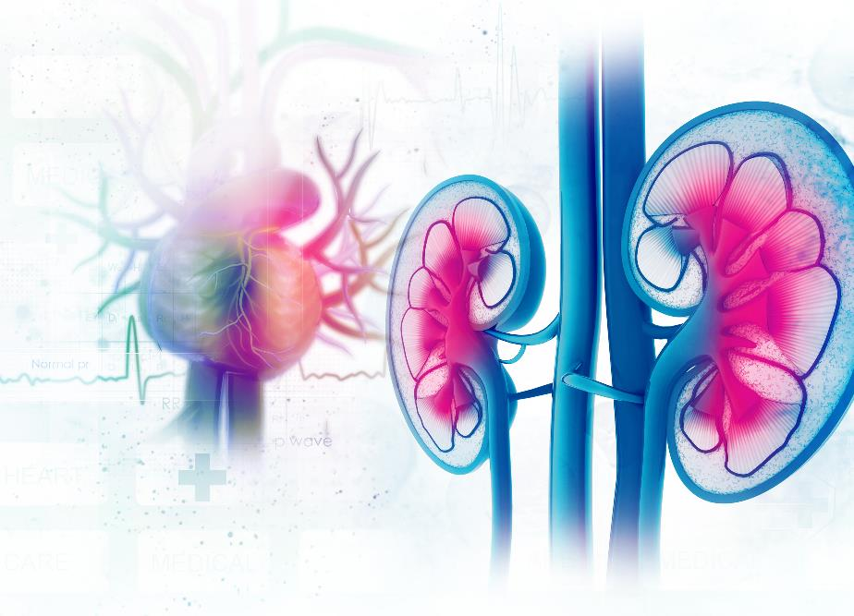
HTN Treatment with CKD
COR | RECOMMENDATIONS
1 | If eGFR <60 ml/min/1.73m² or moderate to severe albuminuria ≥30 mg/g; SBP goal of <130 mmHg to decrease all-cause mortality.
1 | RAASi (either ACEi or ARB but not both) is recommended to decrease CVD and delay progression of kidney disease.
Abbreviations: ACEi indicates Angiotensin Converting Enzyme inhibitors; ARB, Angiotensin Receptor Blocker; CKD, chronic kidney disease;
CVD, cardiovascular disease; eGFR, estimated glomerular filtration rate; HTN, hypertension; and RAASi, renin-angiotensin-aldosterone system inhibitor.

Slide 21
Intracerebral Hemorrhage
Acute Spontaneous Intracerebral Hemorrhage
SBP: 150–220 mmHg
Titration of SBP
SBP: >220 mmHg
Immediately lower SBP to 130 to <140 mmHg for at least 7 days after ICH but stop medications if SBP<130
Smooth, non-labile
Avoid peaks
Avoid peaks and large variability
SBP should not be lowered below 130 mmHg to reduce adverse events
Class 3: Harm
Improved functional outcomes
Class 2a
Abbreviations: ICH indicates intracerebral hemorrhage; and SBP, systolic blood pressure.

Slide 22



Plan of Care for Adults with Uncontrolled HTN
COR | RECOMMENDATIONS
1 | Team-based care approach is recommended.
1 | Evidence-based care plan utilizing HBPM and team-based care that is responsive to addressing adverse SDOH is recommended.
1 | An integrated treatment model that includes accurate BP measurement, prompt treatment, patient engagement, and ongoing review of HBPM is recommended to improve BP control.
Abbreviation: BP indicates blood pressure; HBPM, home blood pressure monitoring; HTN, hypertension; and SDOH, social determinants of health.

Slide 23




Plan of Care for Adults with Uncontrolled HTN
COR | RECOMMENDATIONS
1 | Health information technology is beneficial in improving BP control, access to care, and adherence to standards of care.
1 | Use of electronic health record and patient registries is beneficial for screening and identification of hypertension to focus on those who need additional care.
2a | Telehealth interventions can be useful to reduce BP and improve office BP control.
1 | Adults with uncontrolled hypertension placed on new or intensified medical therapy should have follow-up evaluations for medication adherence and response to treatment at monthly intervals until control is achieved.
Abbreviation: BP indicates blood pressure; and HTN, hypertension.

Slide 24
Hypertension and Pregnancy
Individuals with hypertension who are planning a pregnancy or become pregnant
Pregnant individuals
Labetalol and extended-release nifedipine are preferred
to minimize fetal risk and treat hypertension
Class 1
Should be counseled about the benefits of
low-dose (81mg/day) aspirin to reduce the risk of preeclampsia and its sequelae
Class 1
Should not be treated with atenolol, ACEi, ARBs, direct renin inhibitors, nitroprusside, or MRAs to avoid fetal harm
Class 3: Harm
With SBP ≥160 mmHg or DBP ≥ 110 mm Hg confirmed on repeat measurement within 15 minutes, lower BP to <160/<110 mm Hg within 30-60 minutes to prevent adverse events
Class 1
With Chronic hypertension,
treat to achieve BP <140/90 mm Hg to prevent maternal and perinatal morbidity and mortality
Class 1
Abbreviations: ACEi indicates Angiotensin Converting Enzyme inhibitors; ARB, Angiotensin Receptor Blocker; BP, blood pressure;
DBP, diastolic blood pressure; HTN, hypertension; MRA, mineralocorticoid receptor antagonist; SBP, systolic blood pressure; and TX, treatment.

Slide 25
Diagnostic Criteria for Preeclampsia
Diagnostic Criteria for Preeclampsia
Blood pressure
AND
Proteinuria
OR
Other Criteria
Either of the following:
SBP≥140 mmHg AND/OR DBP≥90 mmHg on 2 occasions 4 hours apart >20 weeks gestation in a woman with previously normal BP
SBP ≥160 mmHg OR DBP ≥110 mmHg (confirmed over 15 min)
Any of the following:
≥300mg per 24 h urine collection
Protein/creatinine ratio ≥0.3
Dipstick reading of 2+ (if other quantitative methods not available)
Any of the following:
Thrombocytopenia (platelet count <100k)
Reduced kidney function (serum creatinine>1.1 mg/dL or 2x baseline creatinine)
Impaired liver function (transaminases >2x ULN)
Pulmonary edema
New-onset headache unresponsive to medication OR visual symptoms
Abbreviations: BP indicates blood pressure; DBP, diastolic blood pressure; SBP, systolic blood pressure; and ULN, upper limit of normal.

Slide 26
Management of Resistant Hypertension
Resistant Hypertension
Office BP ≥ 130/80 on ≥ 3 antihypertensives (ACEi/ARB + CCB + thiazide diuretic)
Office BP < 130/80 but requires ≥ 4 antihypertensives
Workup and Address Potential Causes
Exclude psuedoresistance (ambulatory BPs, medication adherence)
Review and remove interfering medications
Screen for secondary causes (primary aldosteronism, OSA, renal parenchymal disease and renovascular disease, etc.)
Class 1
Add MRA
In adults with uncontrolled resistant hypertension despite optimal treatment with first-line antihypertensive therapy and with an eGFR of ≥45 ml/min/1.73 m²
Class 1
Contraindications
or Intolerant of MRA?
Adding an alternative second line agent is reasonable to control BP
Amiloride
Beta Blocker
Alpha Blocker
Class 2a
No
Yes
Central sympatholytic drug
Dual endothelin receptor antagonist
Direct vasodilator
Abbreviations: ACEi indicates Angiotensin Converting Enzyme inhibitors; ARB, Angiotensin Receptor Blocker; BP, blood pressure; CCB, Calcium Channel Blocker; eGFR, estimated glomerular filtration rate; MRA, mineralocorticoid receptor antagonist; and OSA, obstructive sleep apnea.

Slide 27

Renal Denervation (RDN)
COR | RECOMMENDATIONS
2b | RDN Therapy may be a reasonable adjunct treatment to meds and lifestyle modifications to reduce BP in those with Resistant Hypertension Patients office SBP 140-180 mmHg and DBP ≥ 90 mm Hg AND eGFR ≥40 ml/min/1.73m² despite optimal medical therapy and/or side effects from medications
1 | All Patients who are being considered for RDN should be evaluated by a Multidisciplinary Team with expertise in resistant hypertension and RDN.
1 | For patients who are being considered for RDN, the benefits and risks of the procedure should be discussed as part of the Shared Decision-Making process.
Abbreviations: BP indicates blood pressure; DBP, diastolic blood pressure; eGFR, estimated glomerular filtration rate; RDN, renal denervation; and SBP, systolic blood pressure.

Slide 28

Orthostatic Hypotension
COR | RECOMMENDATIONS
1 | In adults with hypertension, improved BP control is recommended to reduce the risk for orthostatic hypotension (OH).
2a | In adults receiving intensive BP lowering therapy with asymptomatic OH, treatment with a goal of SBP <130 mm Hg is reasonable due to increased CVD and mortality benefit
2a | In adults with hypertension initiating treatment or adding medication with a goal of SBP <130 mm Hg, assessment for symptomatic OH is reasonable to detect other chronic conditions
Abbreviations: BP indicates blood pressure; CVD, cardiovascular disease; OH, orthostatic hypertension; and SBP, systolic blood pressure.

Slide 29
Severe Hypertension and Hypertensive Emergencies
Diagnosis and Treatment
SBP > 180 mmHg or DBP > 120 mmHg
Acute target organ damage?
Yes
No
Hypertensive emergency
Severe hypertension
Admit to ICU (Class 1)
Identified in ED
Identified in OPT setting
Aortic dissection Pheochromocytoma crisis?
Evaluate inpatient vs OPT treatment depending on indications(s) other than BP alone (Class 1)
No need to refer to ED. Reinstitute and intensify or modify medical therapy in the OPT setting (Class 1)
Yes
No
Reduce SBP <140 mmHg in the first hour and to <120 mmHg in aortic dissection (Class 1)
Reduce SBP by 25% in the first hour and to <160/100-110 over the next 6 hours and to normal in the net 24-48 hours (Class 1)
Avoid parenteral BP lowering therapy or intensified oral therapy in the acute setting
(Class 3: HARM)
Close follow-up in the OPT setting in 4 weeks
Abbreviations: DBP indicates diastolic blood pressure; ED, emergency department; ICU, intensive care unit; OPT, outpatient; and SBP, systolic blood pressure.

Slide 30
Patients Scheduled for Surgical Procedures
Patient with Hypertension Planned for Major Surgery
SBP > 180 or DBP > 110
Consider delaying elective surgery to minimize perioperative complications
Class 2b
Yes
No
Continue most antihypertensive medications throughout perioperative period Class 2a
Beta Blockers
Clonidine
ACEi/ARB
In patients on chronic BB, continue BB throughout perioperative period
Class 1
Abrupt Discontinuation of chronic BB therapy is not recommended
Class 3: Harm
BB therapy should not be started on day of surgery in BB naïve patients
Class 3: Harm
Abrupt Discontinuation of chronic clonidine therapy is not recommended
Class 3: Harm
Preoperative discontinuation may reduce risk of perioperative hypotension
Class 2b
Abbreviations: ACEi indicates Angiotensin Converting Enzyme inhibitors; ARB, Angiotensin Receptor Blocker; BB, beta blocker; DBP, diastolic blood pressure; and SBP, systolic blood pressure.

Slide 31







Evidence Gaps and Future Directions
Research to improve screening and implementation strategies for BP control
BP targets and
long-term benefits in younger adults
Studies of patients with white coat HTN and
their long-term risk
Optimal management
of pregnant patients
Understand genetic
and epigenetic risk
factors for hypertension
Understand intersection of BP race/ethnicity
and social determinants of health
Identify alternative and accurate methods to measure BP
Abbreviation: BP indicates blood pressure

Slide 32
Acknowledgments
Many thanks to our Guideline Ambassadors who were guided by Dr. Elliott Antman in developing this translational learning product in support of the
2025 AHA/ACC/AANP/AAPA/ABC/ACCP/ACPM/AMA/ASPC/NMA/PCNA/SGIM Guideline for the Prevention, Detection, Evaluation and Management of High Blood Pressure in Adults.
Olu Akinrimisi, MD MS
Francisco Aguilar Nunez, MD
Jessica Oribabor, MD MS
Chaitanya Rojulpote, MD
Tayyab Shah, MD
The American Heart Association requests this electronic slide deck be cited as follows:
Akinrimisi, O., Aguilar Nunez, F., Oribabor, J., Rojulpote, C., Shah, T., Reyna, G.G., Bezanson, J. L., & Antman, E. M. (2025). AHA Clinical Slides [PowerPoint slides]; Adapted from the 2025 AHA/ACC/AANP/AAPA/ABC/ACCP/ACPM/AMA/ASPC/NMA/PCNA/SGIM Guideline for the Prevention, Detection, Evaluation and Management of High Blood Pressure in Adults. Circulation. Retrieved from:
Guideline Essentials: AHA Clinical Slide Series - Professional Heart Daily | American Heart Association.

Slide 33
Copyright and Permissions Notice
© Copyright 2025. American Heart Association. All rights reserved.
This material is the copyrighted property of the American Heart Association and is provided for reference purposes only. It may not be copied, reproduced, stored in a retrieval system, transmitted, altered in any way or used as a derivative work, or distributed in any form or by any means—electronic, mechanical, photocopying, recording, or otherwise—without prior written permission from the publisher.
This content may be used for limited educational and personal use. Further distribution or dissemination requires a licensing agreement. Unauthorized use or distribution in any media is strictly prohibited.
For permissions inquiries and licensing fee information, please see the information/Request Form at this link:
https://www.heart.org/en/about-us/statements-and-policies/copyright-request-form

