Slide 1

Guideline Essentials: AHA Case Study Slide Series
STEMI Case Studies
ADAPTED FROM:
2025 ACC/AHA/ACEP/NAEMSP/SCAI Guideline for the Management of Patients with Acute Coronary Syndromes.
AHA Clase Study Slides PPTX

Slide 2



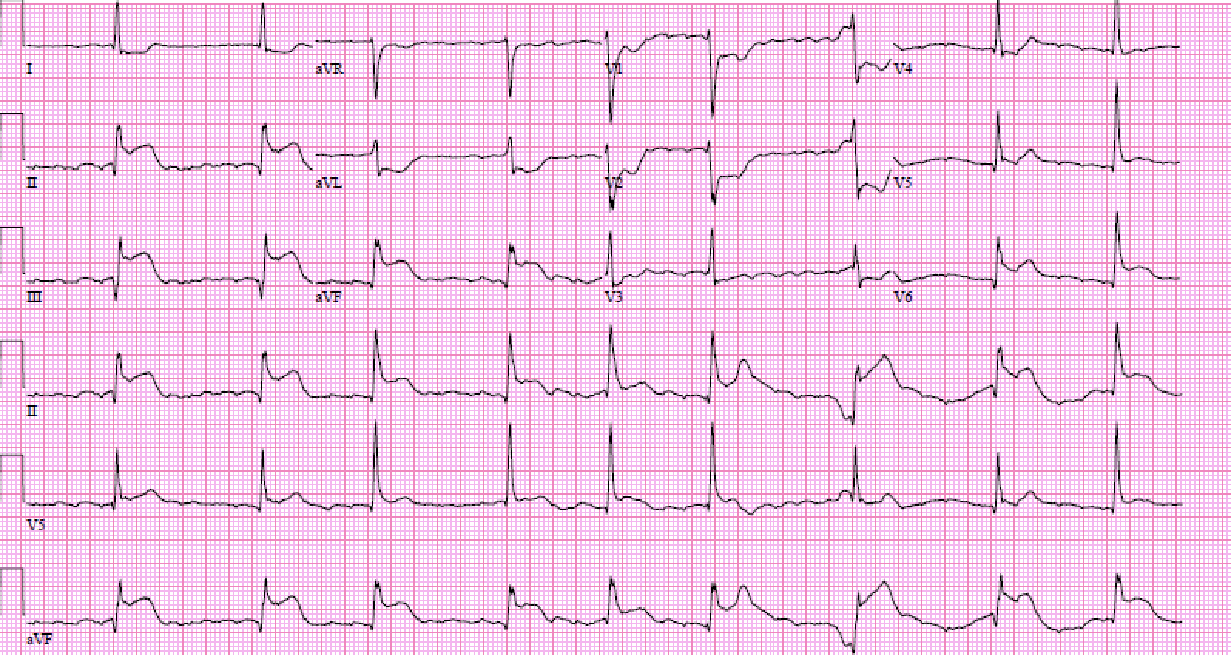


Case Study 1: Patient Presentation
60-year-old woman
History: DM, HTN, HLD, TIA, tobacco use
Exam:
Hemodynamically stable with
​ sinus bradycardia in 50s
Warm and euvolemic
Presentation: Crushing chest pressure began 2 hours ago
On Day One 325 mg ASA
(Class 1, LOE A)
Aspirin
Patient arrives at a PCI capable facility
EKG done within 10 minutes (Class 1, LOE B-NR)
Goal FMC to PCI < 90 minutes (Class 1, LOE B-NR)

Slide 3
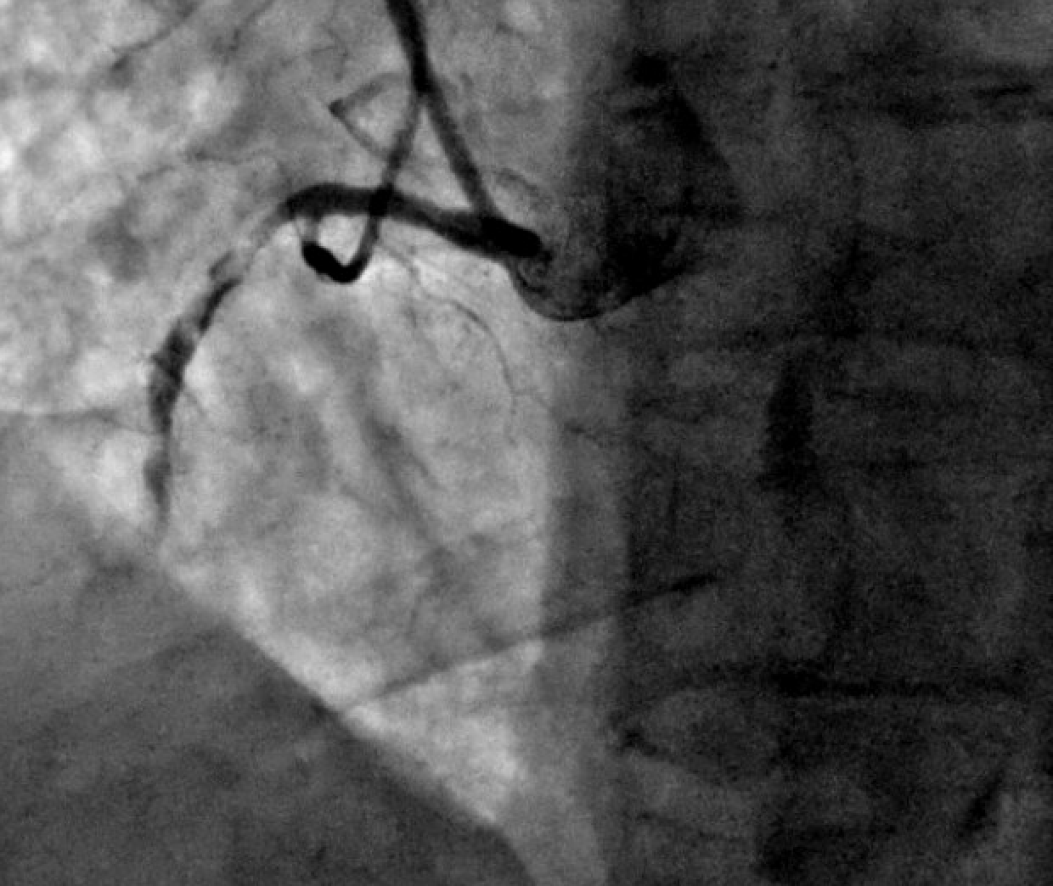


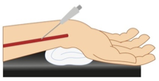
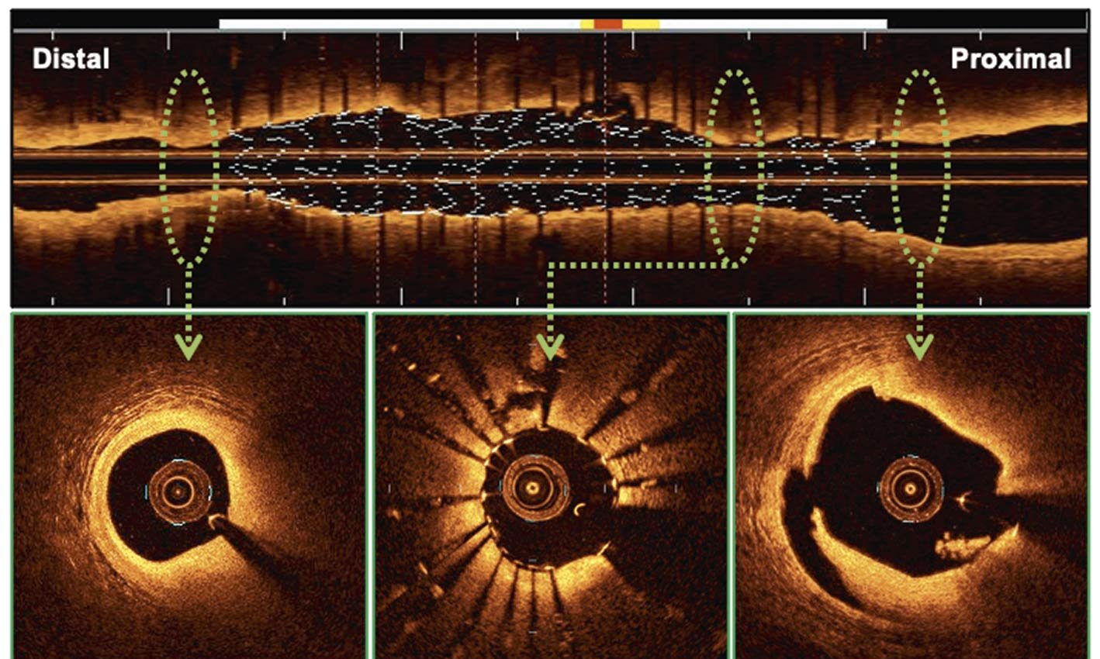
Case Study 1: Cath Lab Course
Mid RCA thrombotic occlusion with TIMI 3 flow
Patient arrives to cath lab
Routine mechanical Thrombectomy not performed (Class 3: No benefit, LOE A)
Radial access is obtained (Class 1, LOE A)
OCT guided-revascularization of complex culprit lesion (Class 1, LOE A)
Ticagrelor administered at time of PCI
(Class 1, LOA A)
Notes:
Right radial access obtained
Coronary angiogram shows mid RCA thrombotic occlusion with TIMI0 flow. Add images for angio
Mechanical thrombectomy not performed
IVUS guided revascularization of the culprit lesion.
Transferred to cardiac ICU with continuous telemetry monitoring. Can also admit to telemetry floorsince its stable STEMI?
High intensity statin therapy initiated
Lipid panel, HbA1c and TTE ordered

Slide 4


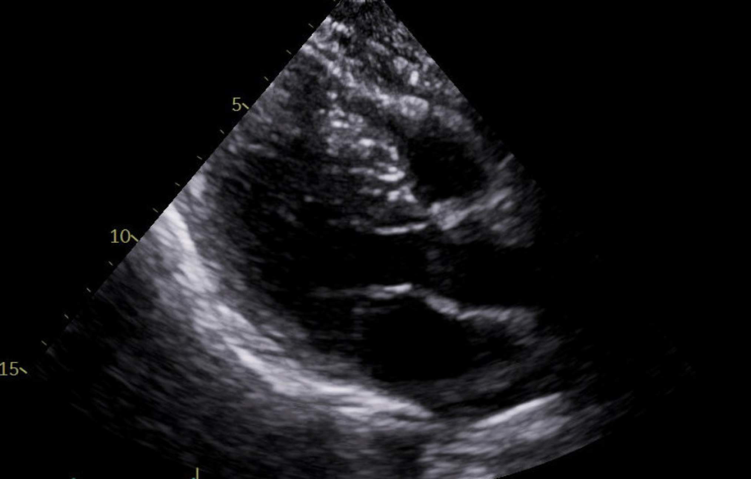

Case Study 1: Hospital Course
Beta blocker initiated on day 1
(Class 1, LOE A)
Home ACEi and SGLT2i were continued
Transferred to telemetry floor
Lipid panel, HbA1c and TTE ordered
Discharged on day 3; LDL-C 125 mg/dL
DAPT on ASA 81 mg+ Ticagrelor for 1 month
Followed by Ticagrelor monotherapy to reduce bleeding risk
High-intensity statin
Beta blocker and ACEi
(Class 1)
Echo (Class 1, LOE C-LD) showed LVEF of 50-55%
High intensity statin therapy initiated
(Class 1, LOE A)
Counseled on smoking cessation​
Cardiac rehab referral on discharge
(Class 1, LOE A)
4
Notes:
Transferred to cardiac ICU with continuous telemetry monitoring. Can also admit to telemetry floorsince its stable STEMI?
High intensity statin therapy initiated
Lipid panel, HbA1c and TTE ordered
Beta blocker therapy initiated on day 1
Transferred out of ICU to telemetry floor after 48 hours
TTE showed LVEF 50-55% ( add images for echo)
Home ACE inhibitor and SGLTi continued
Discharge home on day 3 on DAPT with ASA and ticagrelor for 12 months
Lipid therapy with high intensity statin. Beta blocker and ACE inhibitor.
Counselled on smoking cessation
Cardiac rehab referral on discharge

Slide 5


Case Study 1: Post-Discharge Management
Outpatient follow up in the clinic in 2-4 weeks
Lipid panel re-assessment; LDL target < 70 mg/dL (Class 1, LOE A)
She completed 3 months of center-based Cardiac Rehabilitation program
(Class 1, LOE A)
LDL < 55 mg/dL (class 2a) after 6 weeks
Notes:
Outpatient follow up in the clinic
Completed cardiac rehab
Fu lipid panel in 6 weeks showed LDL <70

Slide 6




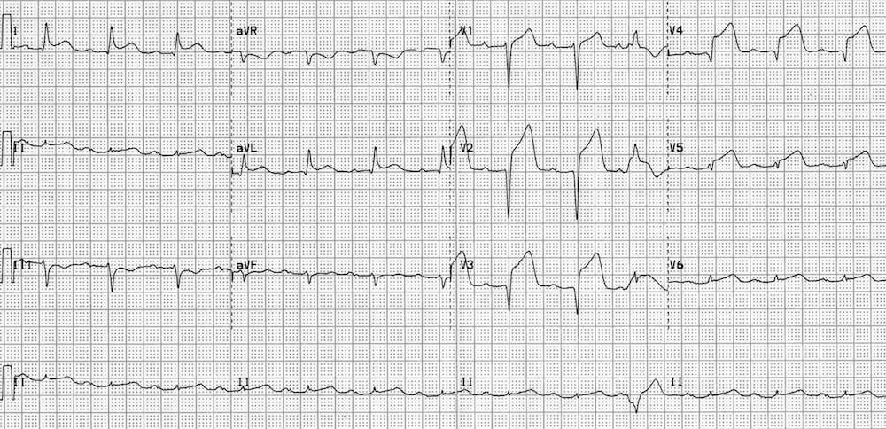

Case Study 2: Patient Presentation
50-year-old male
History: DM, HTN, HLD, Tobacco use, GI bleed
Exam:
Cold & wet
Initial high sensitivity troponin = 15,000 ng/L
ASA (Class 1, LOE A)
UFH or Bivalirudin (Class 1, LOE B-R)
FMC to PCI <120 min if arrive at non-PCI-capable facility (Class 1, LOE B-NR)
Presentation: Crushing substernal chest pain <12 hours
Started on vasopressors in route

Slide 7
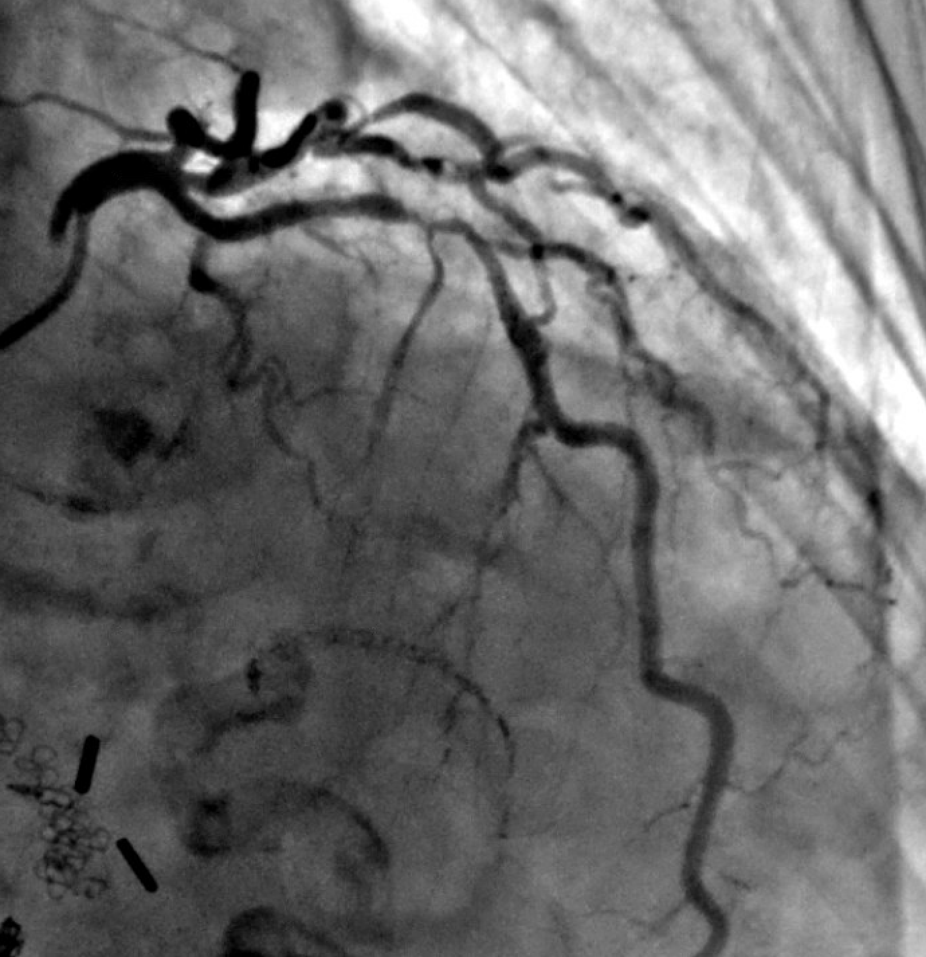
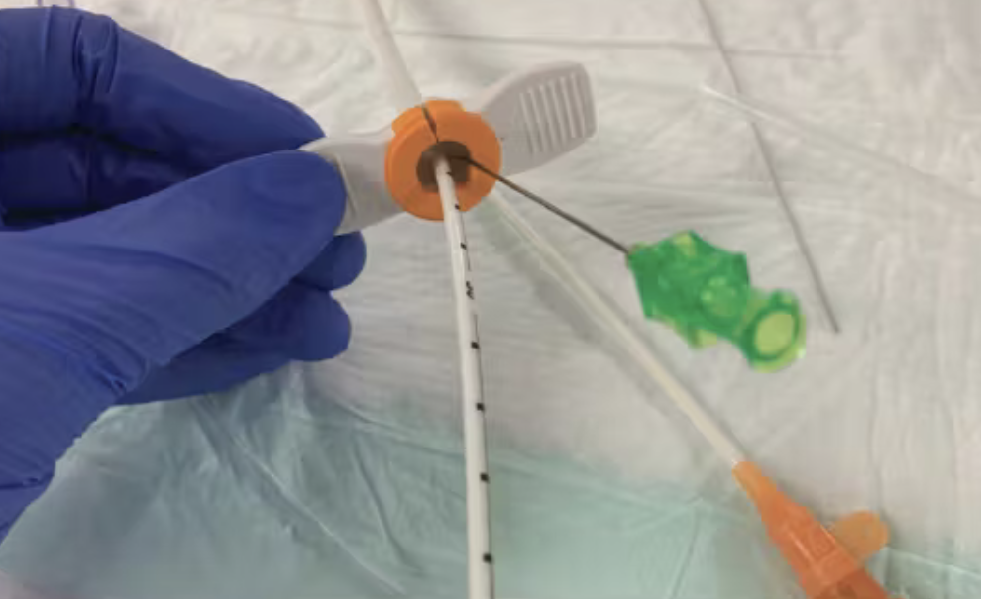
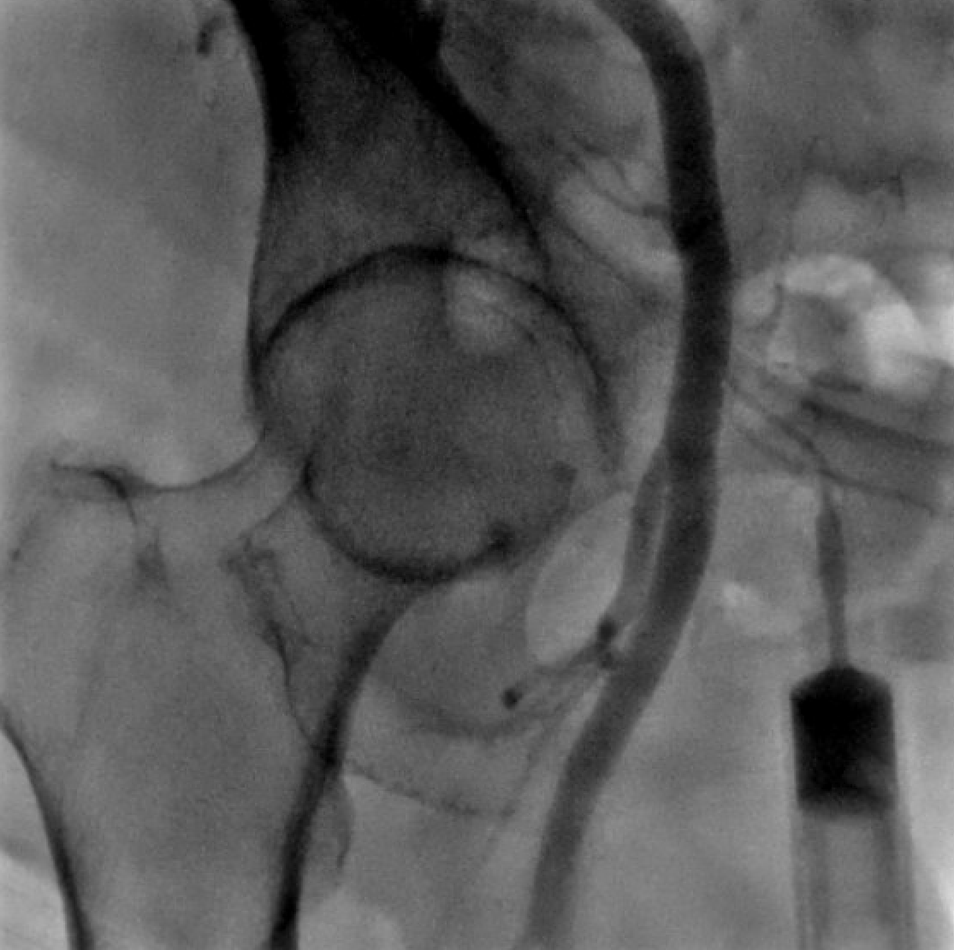
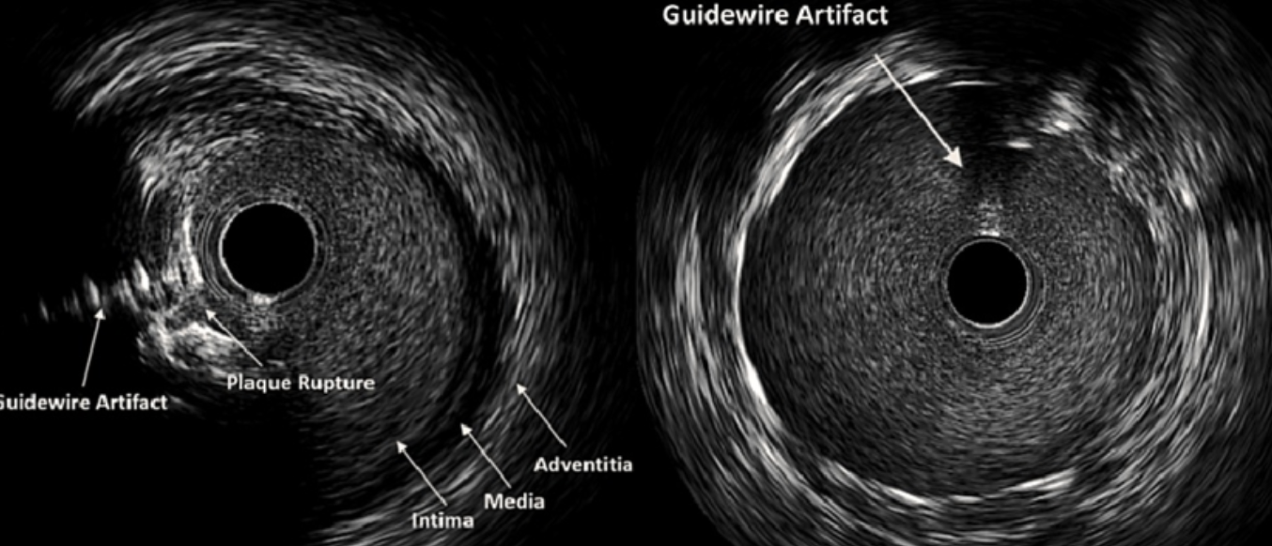
Case Study 2: Cath Lab Course
95% LAD/D1 bifurcation (culprit lesion)
OM2 90% (non-culprit)
Microaxial flow pump placed via right femoral access
Patient arrives to cath lab in cardiogenic shock
RHC: CI <2, PCWP 30 mmHg​
Femoral access obtained in anticipation of MCS
IVUS guided-revascularization of complex culprit lesion.
Intracoronary imaging (Class 1, LOE A)

Slide 8
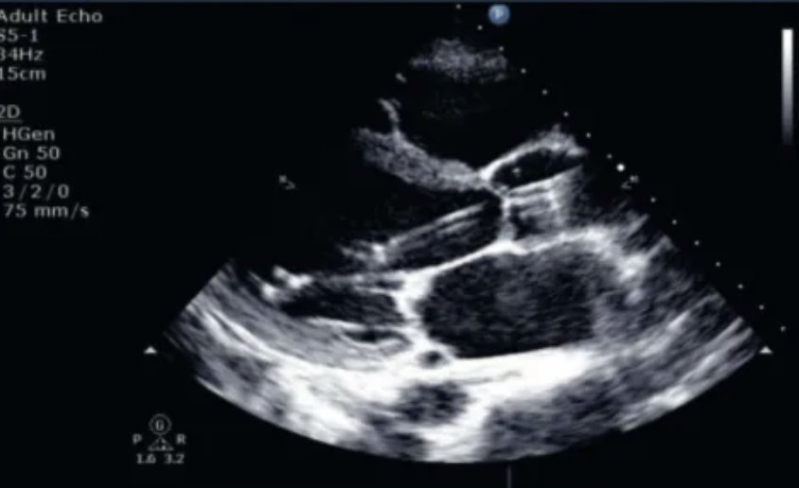

Case Study 2: CCU Course
Transfer to CCU on Micro axial flow pump with continuous monitoring
High intensity statin therapy initiated (Class 1, LOE A)
MCS devices are reasonable for hemodynamic stabilization as a bridge to surgery. (Class 2a, LOE B-NR )
Microaxial flow pump removed on day 2 without complications & stable hemodynamics
Lipid panel, HbA1c and TTE ordered
Transferred out of ICU to telemetry floor after 48 hours
Echo showed
LVEF <30%

Slide 9

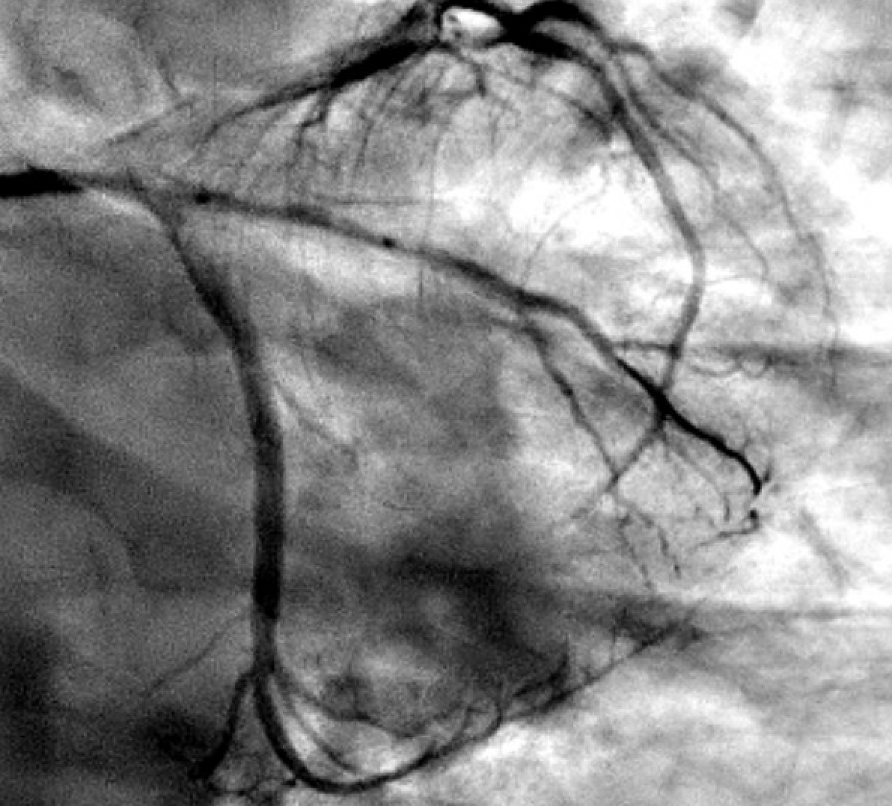
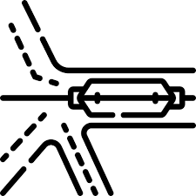
Case Study 2: Floor Management
GDMT initiation
for de novo heart failure with reduced EF
Discharged on Day 5
Addition of SGLT2i, and MRA​ (class I)
DAPT on ASA + ticagrelor
High-intensity atorvastatin
GDMT with beta blocker, SGLT2i, RAASi and MRA
(Class 1)
PPI (history of GIB)
Staged PCI of OM lesion done on day 4 (Class 1, LOE B-R)
PCI of noninfarct-related artery at time of PPCI should not be performed in patients with cardiogenic shock.
(Class 3: Harm, LOE B-R)
Counseled on smoking cessation​
Cardiac rehab referral on discharge (Class 1, LOE A)

Slide 10

Case Study 2: Post-Discharge Management
Outpatient follow up in the clinic in 2-4 weeks
Lipid panel re-assessment (Class 1, LOE A)
LDL 140 mg/dL after 6 weeks
Declined center-based rehab. Undergoing home-based cardiac rehab (Class 2a, LOE B-R)
PCSK9i initiated (Class 1, LOE A)
TTE at 6 weeks showed LVEF 35% with continued HF symptoms
​Primary prevention ICD placed (Class 1, LOE A)

Slide 11
Acknowledgments
Many thanks to our Guideline Ambassadors who were guided by Dr. Elliott Antman in developing this translational learning product in support of the 2025 AHA/ACC/ACEP/NAEMSP/SCAI Guideline for the Management of Patients with Acute Coronary Syndromes.
Waseem Farooq, MD
Ivana Garza, MD
Kathryn Harris, MD
The American Heart Association requests this electronic slide deck be cited as follows:
Farooq, W., Garza, I., Harris, K., Reyna, G. G., Bezanson, J. L., & Antman, E. M. (2025). AHA Case Study Slides [PowerPoint slides]; Adapted from the 2025 AHA/ACC/ACEP/NAEMSP/SCAI Guideline for the Management of Patients with Acute Coronary Syndromes. Retrieved from: Guideline Essentials: AHA Clinical Slide Series - Professional Heart Daily | American Heart Association

Slide 12
Copyright and Permissions Notice
© Copyright 2025. American Heart Association. All rights reserved.
This material is the copyrighted property of the American Heart Association and is provided for reference purposes only. It may not be copied, reproduced, stored in a retrieval system, transmitted, altered in any way or used as a derivative work, or distributed in any form or by any means—electronic, mechanical, photocopying, recording, or otherwise—without prior written permission from the publisher.
This content may be used for limited educational and personal use. Further distribution or dissemination requires a licensing agreement. Unauthorized use or distribution in any media is strictly prohibited.
For permissions inquiries and licensing fee information, please see the information/Request Form at this link:
https://www.heart.org/en/about-us/statements-and-policies/copyright-request-form

