Slide 1

Guideline Essentials: AHA Case Study Slide Series
NSTEMI Case Study
ADAPTED FROM:
2025 ACC/AHA/ACEP/NAEMSP/SCAI Guideline for the Management of Patients with Acute Coronary Syndromes.
AHA Case Study Slides PPTX

Slide 2
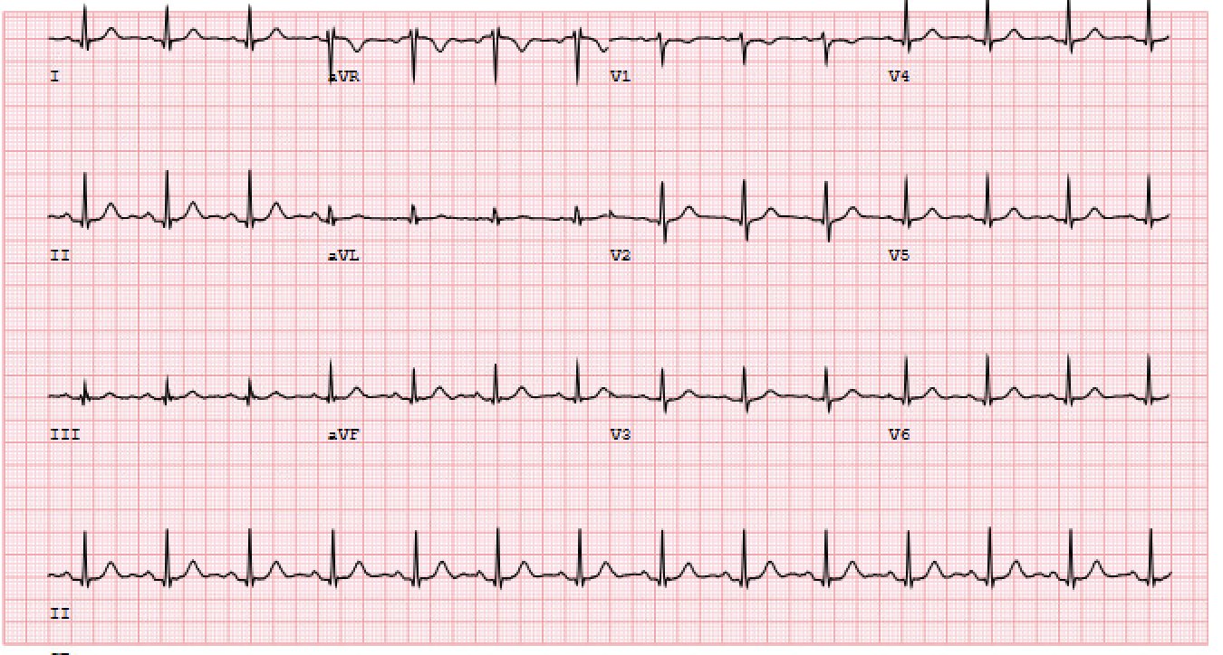
Case Study 2
Patient is a 57-year-old male
Past medical history: Hypertension, type 2 diabetes mellitus, and prior cerebrovascular accident
Presentation: Arrives to ED after an episode of nausea, vomiting, and “crushing” chest pain
ECG was completed within 10 minutes (Class 1, LOE B-NR)
High-sensitivity cTn (hs-cTn) was promptly measured
(Class 1, LOE B-NR)
Presenting ECG
Notes:
Mr. Guy D. Lines is a 57-year-old male with past medical history significant for hypertension, type 2 diabetes mellitus, and prior cerebrovascular accident who presents to the emergency department after an episode of nausea, vomiting, and “crushing” chest pain.
An initial ECG (below) and hs-cTn level were obtained.
In patients with suspected ACS, acquisition and interpretation of an ECG within 10 minutes is recommended to help guide patient management (COR I, LOE B-NR).
cTn should also be measured as soon as possible, preferably using a high-sensitivity cTn (hs-cTn) assay (COR I, LOE B-NR).

Slide 3
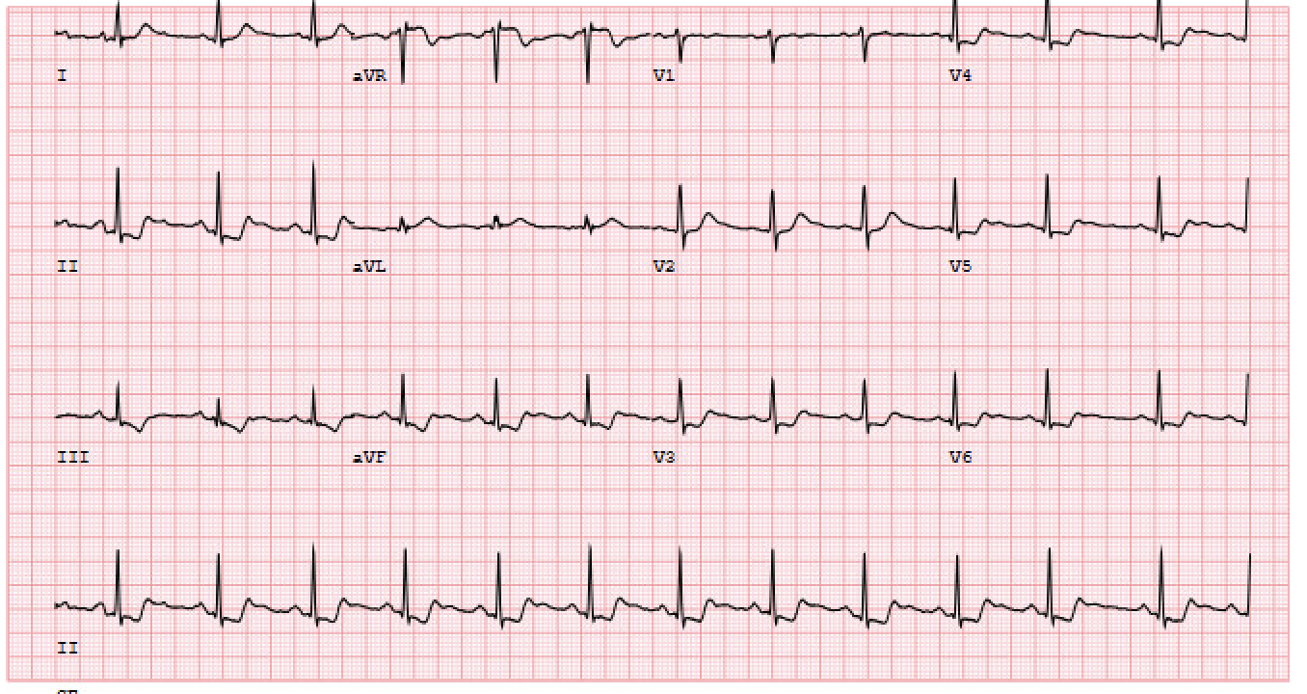
Initial Assessment of Patients with Suspected ACS
Although initial ECG was unremarkable, serial ECGs were obtained due to high clinical suspicion for ACS
(Class 1, LOE B-NR)
Subsequent ECGs were notable for new ST-segment depressions
Serial hs-cTn levels were also measured every 1-2 hours
(Class 1, LOE B-NR)
hs-cTn levels rose to > 99th-percentile upper reference limit
Repeat ECG
Findings are consistent with an evolving NSTE-ACS
Notes:
Initial ECG was unremarkable, and the baseline hs-cTn was within normal limits.
However, subsequent ECGs revealed new ST-segment depressions and repeat hs-cTn levels demonstrated a rising trend above the 99th-percentile upper reference limit, consistent with evolving NSTE-ACS.
In patients with suspected ACS in whom the initial ECG is nondiagnostic, serial 12-lead ECGs should be performed to detect potential ischemic changes, especially when clinical suspicion of ACS is high, symptoms are persistent, or clinical condition deteriorates (COR I, LOE B-NR).
In patients with suspected ACS with an initial hs-cTn or cTn that is nondiagnostic, the recommended time intervals for repeat measurements after the initial sample collection (time zero) are 1 to 2 hours for hs-cTn and 3 to 6 hours for conventional cTn assays. (COR I, LOE B-NR).

Slide 4
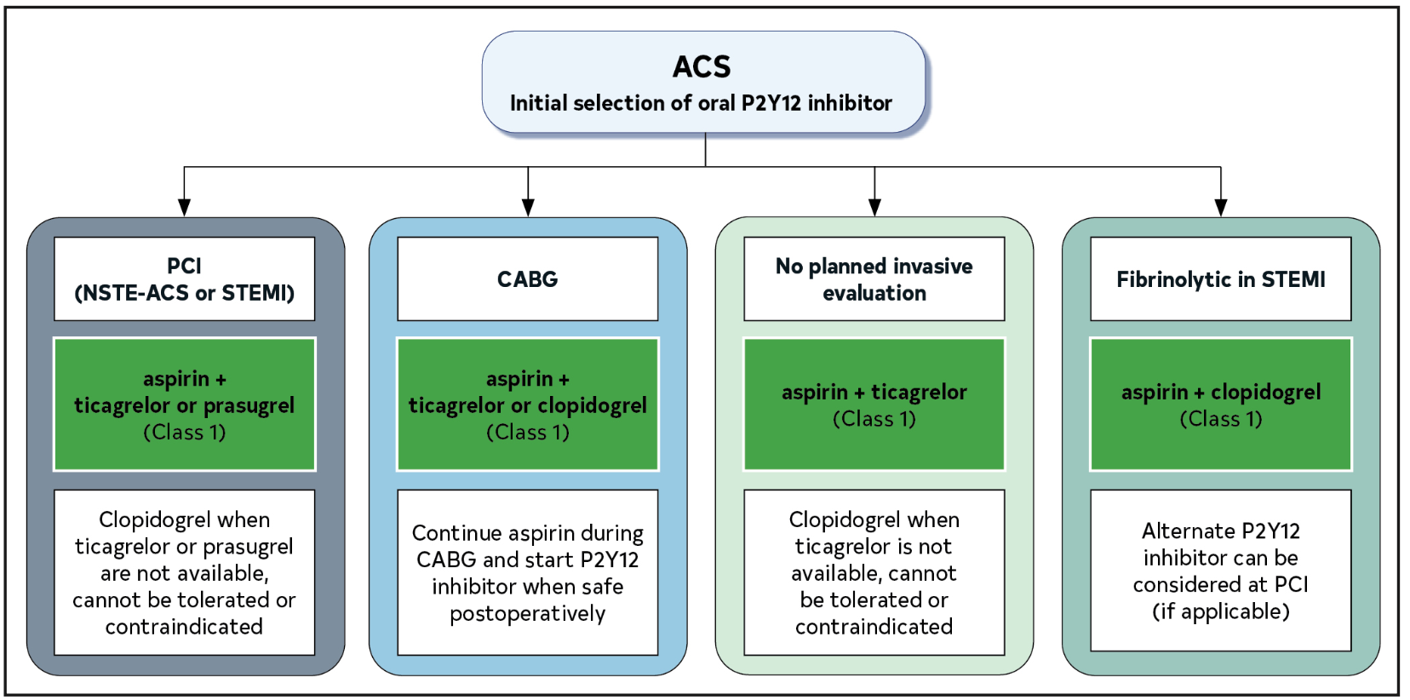

Antiplatelet Therapy for ACS
Patient received an oral loading dose of aspirin (Class 1, LOE A) and was initiated on intravenous unfractionated heparin
(Class 1, LOE B-R)
The selection of oral P2Y12-inhibitor was carefully considered, guided by the anticipated management strategy and bleeding risk (Class 1, LOE A)
Prasugrel was CONTRAINDICATED given patient’s history of stroke (Class 3: Harm, LOE B-R ).
Notes:
Mr. Lines received an oral loading dose of aspirin and was initiated on intravenous unfractionated heparin (UFH). In patients with ACS, an initial oral loading dose of aspirin, followed by daily low-dose aspirin, is recommended to reduce death and MACE (COR I, LOE A).
Patients with ACS should also be treated with a loading dose of an oral P2Y12 inhibitor followed by daily dosing (COR I, LOE A).
The selection of the specific type of oral P2Y12 inhibitor should involve several considerations, including the patient’s anticipated management strategy and their risk of bleeding.
Prasugrel was contraindicated given his history of stroke (COR 3, LOE B-R).

Slide 5


Timing of P2Y12-Inhibitor Administration
The appropriate timing of oral P2Y12-inhibitor loading was considered for the patient
Routine P2Y12 inhibitor pretreatment in NSTE-ACS is NOT supported by current evidence, particularly when an early invasive strategy (<24 h) is planned
However, pre-treatment in NSTE-ACS may be CONSIDERED with clopidogrel or ticagrelor when angiography is delayed (≥24h) and bleeding risk is low (Class 2b, LOE B-NR)
Notes:
Prior to loading of P2Y12 inhibitor, the timing of administration was considered. Current evidence does not support routine pretreatment in NSTE-ACS if an early invasive strategy (<24h) is planned, though it may be considered with clopidogrel or ticagrelor when angiography is delayed (≥24h) and bleeding risk is low (COR 2b, LOE B-NR).
In the CURE substudy, clopidogrel pretreatment before PCI reduced early and 30-day ischemic events.
However, trials using more potent P2Y12 inhibitors, including ACCOAST with prasugrel and DUBIUS with ticagrelor, showed no ischemic benefit of pretreatment and increased bleeding risk with prasugrel.
Because invasive evaluation was not anticipated within 24 hours—given Mr. Lines presented on a Saturday and did not currently meet criteria for urgent catheterization yet—it was reasonable to administer a P2Y12 inhibitor at this time, but will revisit this after the next couple slides.

Slide 6
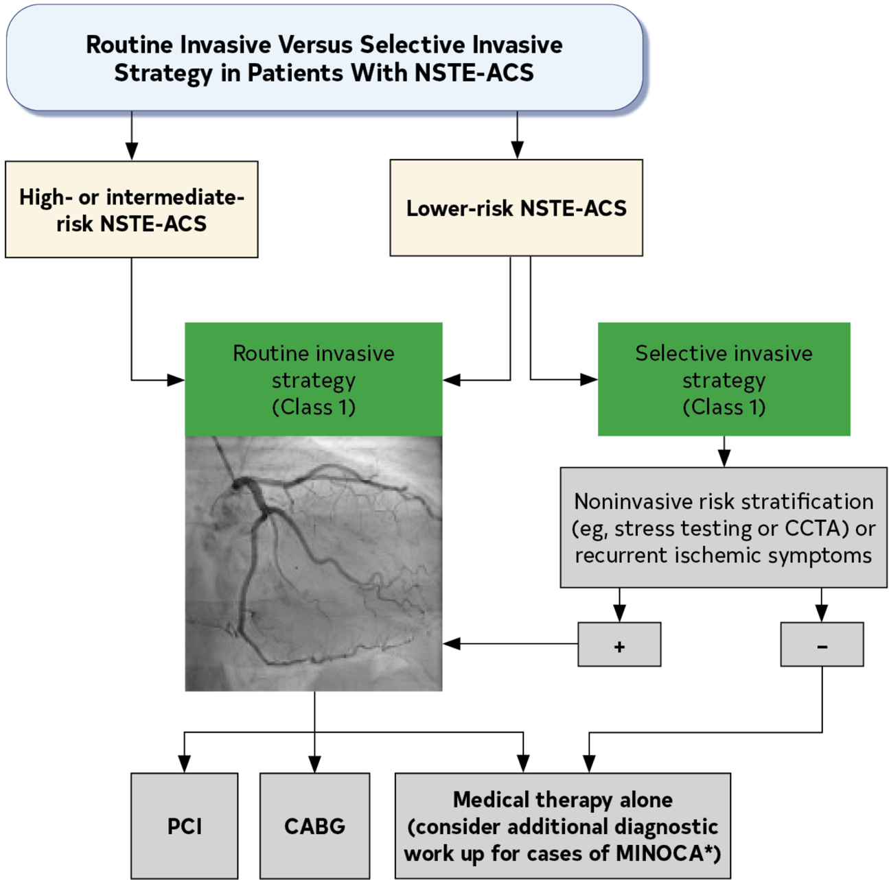
Determination of NSTE-ACS Management Approach
The patient was admitted to the hospital floor for further management of NSTE-ACS.
Based on his clinical history and initial evaluation, he was deemed to be intermediate to high risk for ischemic events.
A routine invasive strategy was recommended with the intent of proceeding with revascularization by PCI or CABG (Class 1, LOE A)

Slide 7
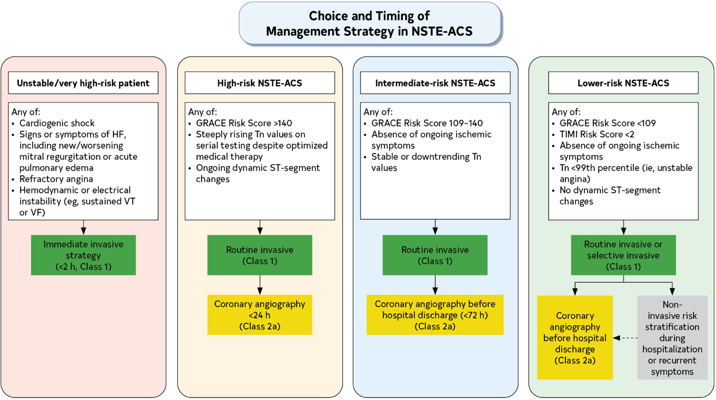
Selecting Timing of Coronary Angiography
The patient had been admitted to the hospital on a Saturday. The cath lab was only available for urgent or emergency cases.
Given dynamic ST-segment changes and steeply rising troponin values, he was referred for coronary angiography within 24 hours of presentation
(Class 2a, LOE B-R)

Slide 8
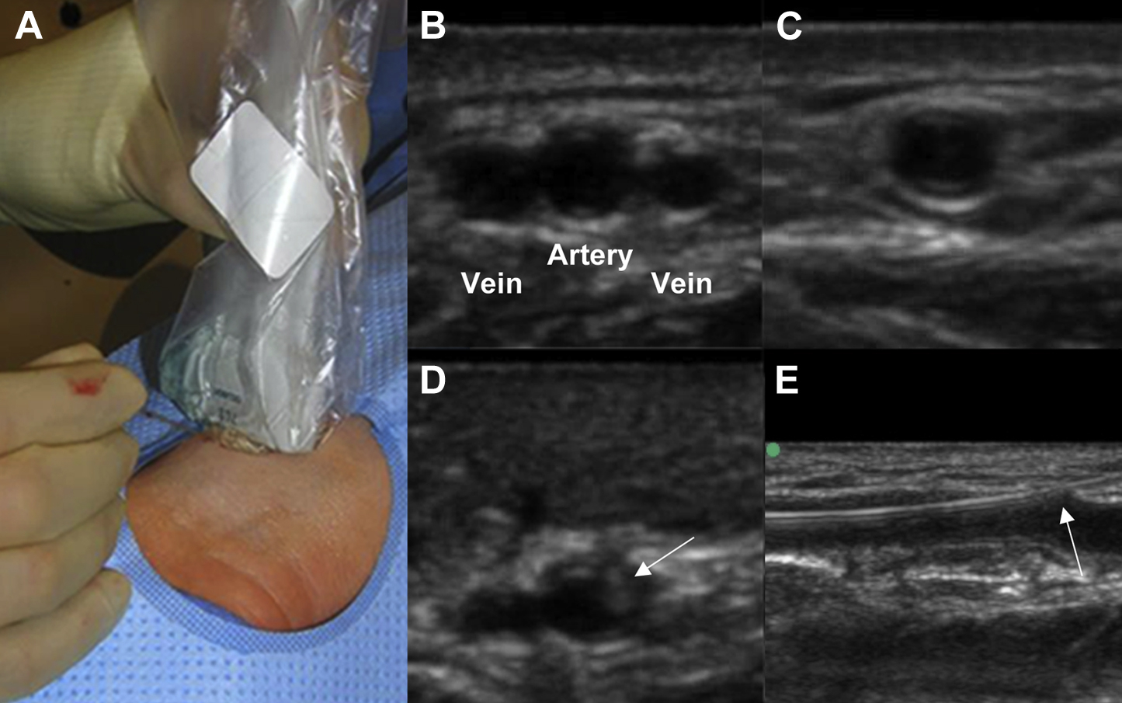
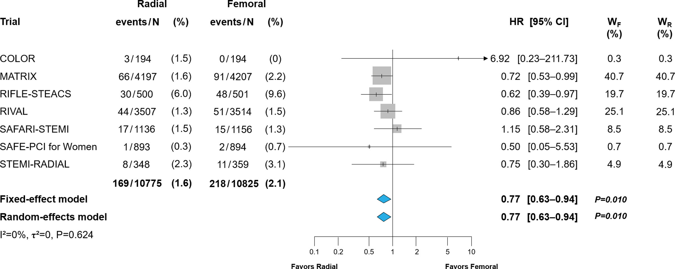
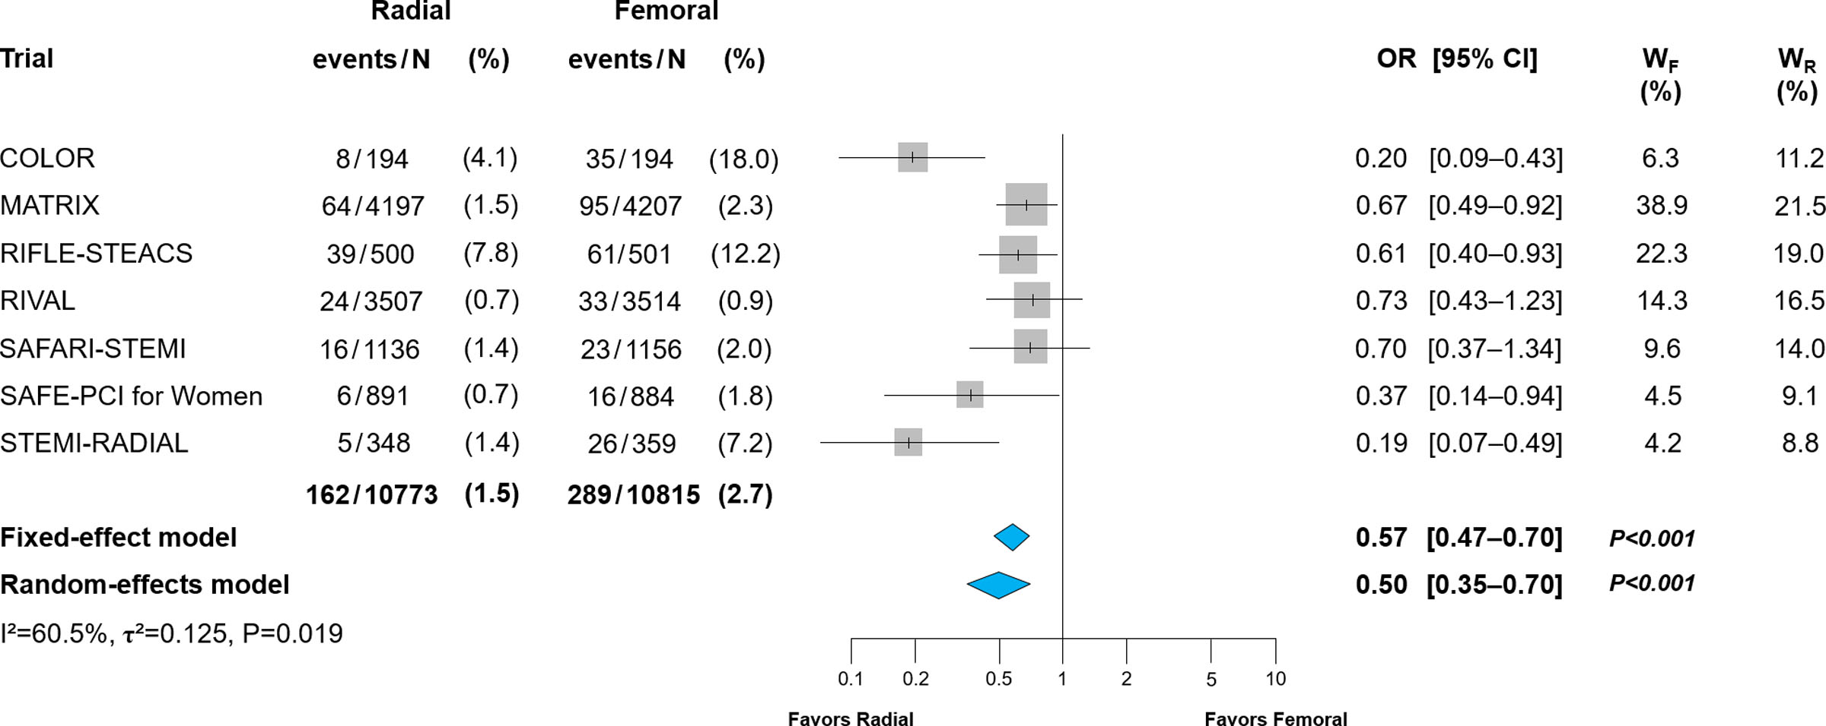
Catheterization Laboratory Considerations in NSTE-ACS
The patient was brought to the cardiac catheterization laboratory within 24 hours of presentation.
A radial approach was chosen for the cardiac catheterization, to reduce the risk of bleeding, vascular complications, and death (Class 1, LOE A)
All-Cause Mortality
Major Bleeding
24% Relative Risk Reduction
51% Relative Risk Reduction
Favors Radial
Favors Femoral
Favors Radial
Favors Femoral
  Szeto et al, JACC Cardiovasc Interv. 2015 Feb;8(2):283-291.
¹Gargiulo G et al, Circulation. 2022 Nov;146(18):1329-1343.

Slide 9
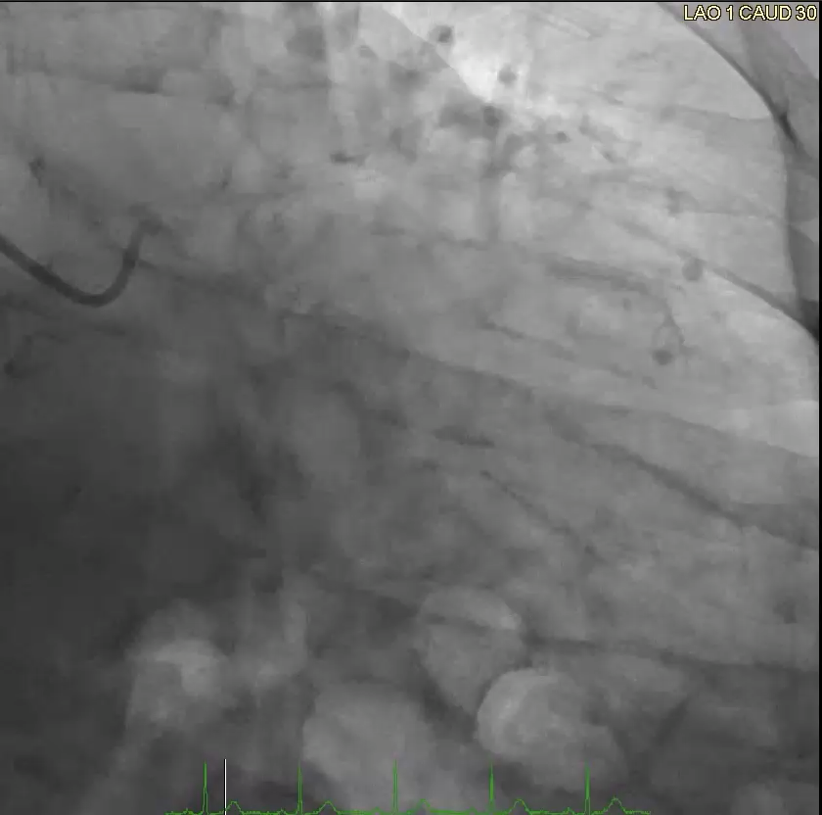
Diagnostic Coronary Angiography
Diagnostic catheterization demonstrated a high-grade stenosis due to a calcific nodule within the proximal LAD. There were no other significant epicardial stenoses.
Given single-vessel disease involving the proximal LAD, a decision was made to proceed with PCI and drug eluting stent implantation.

Slide 10
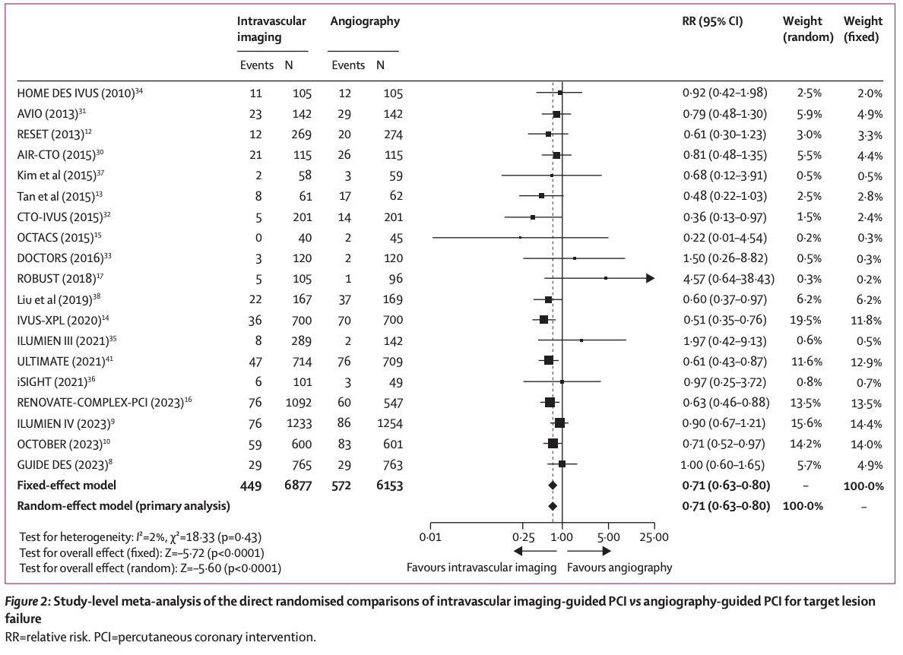
Use of Intracoronary Imaging in Percutaneous Coronary Intervention
RCTs of patients with ACS have shown that use of intravascular imaging is associated with lower rates of target vessel failure.
Intracoronary imaging with IVUS or OCT for procedural guidance is recommended in left main or complex lesions to reduce ischemic events (Class 1, LOE A)
¹Stone GW et al, Lancet. 2024;403:824–837. ²Giacoppo D et al, Circulation. 2024;149:1065–1086.

Slide 11
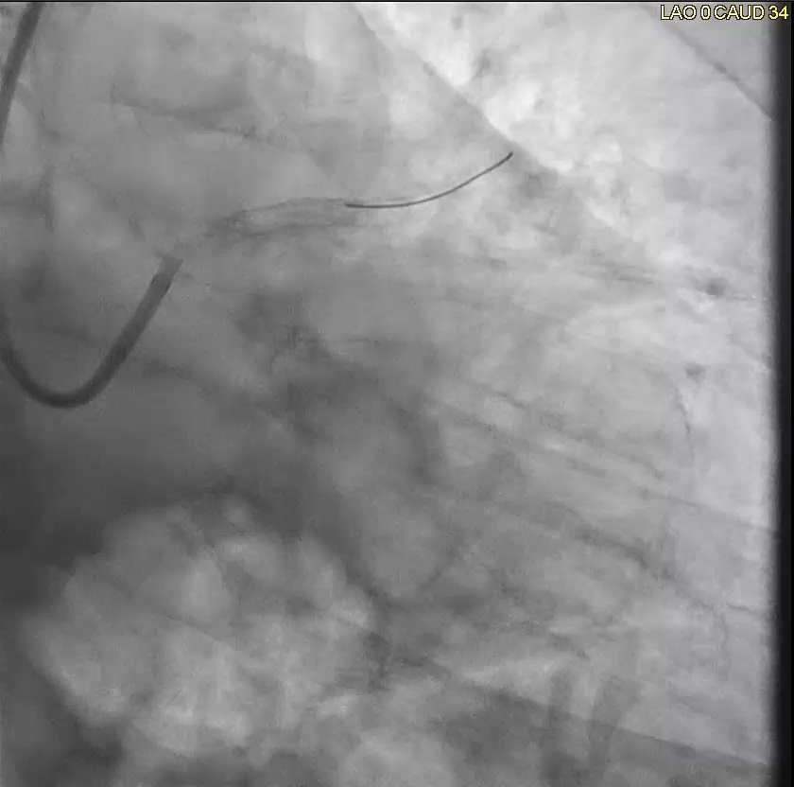
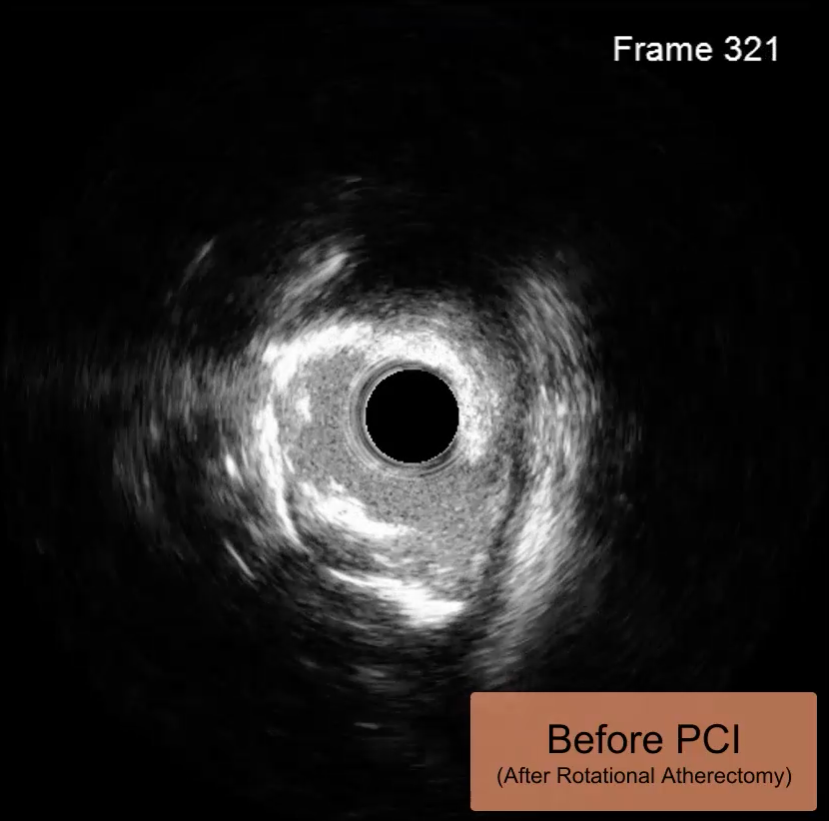
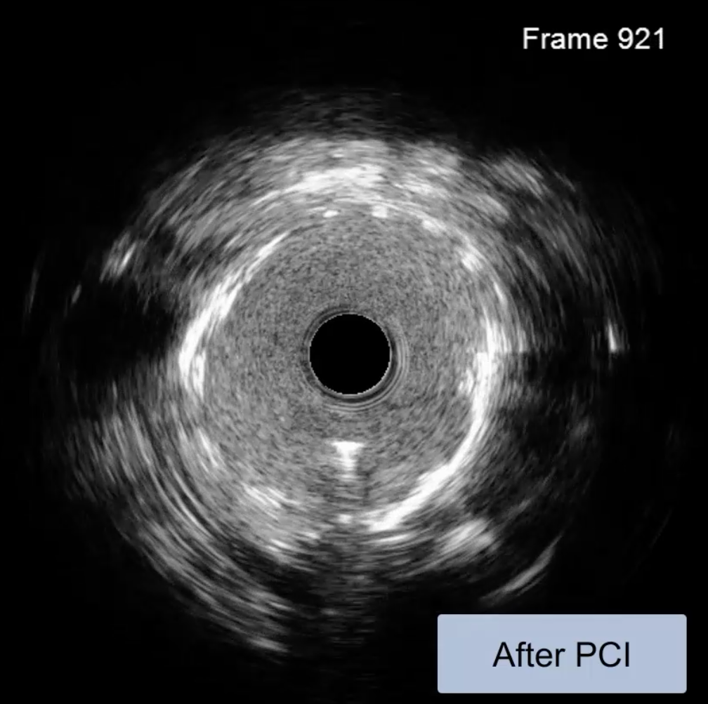
PCI Procedural Summary
High-definition IVUS was used in this case to facilitate rotational atherectomy and single DES placement with a great final result.

Slide 12
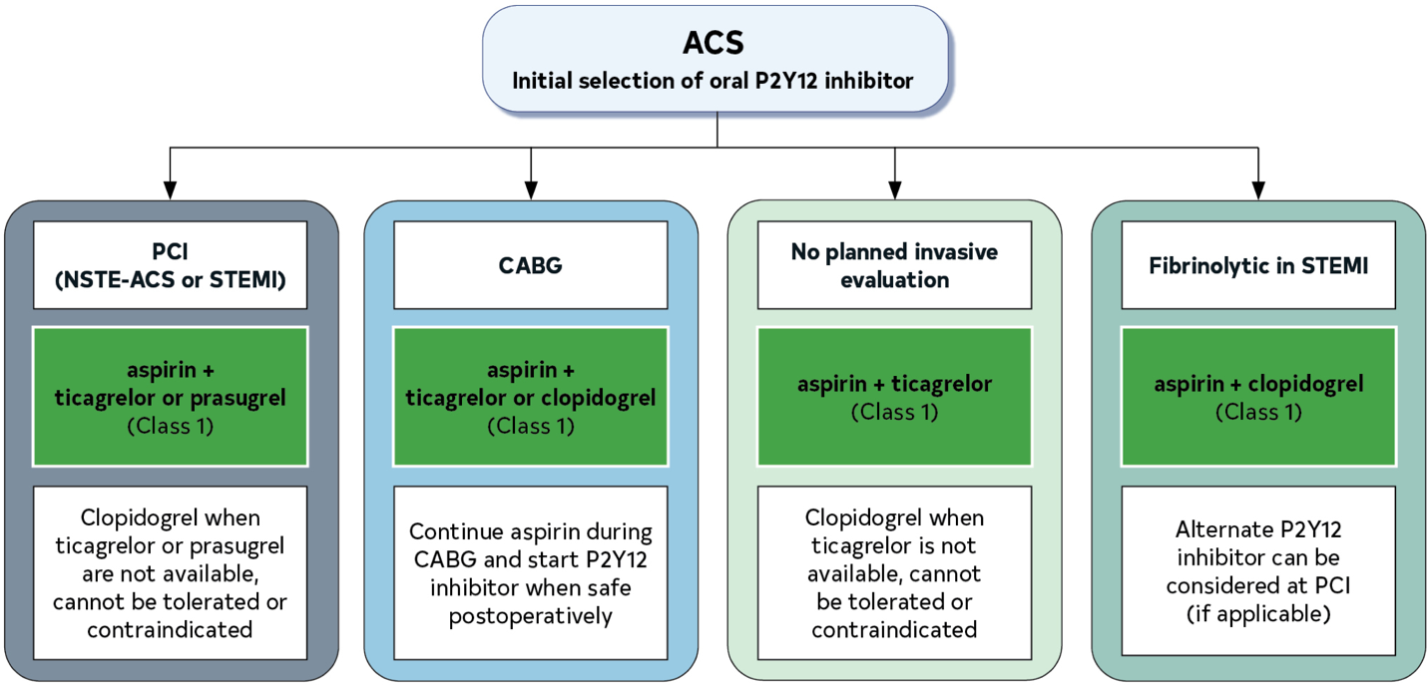
Selection of Antiplatelet Strategy
At the time of PCI, the patient was continued on aspirin and loaded with ticagrelor to reduce the risk of MACE and stent thrombosis (Class 1, LOE A)
As mentioned, prasugrel was contraindicated given patient’s history of stroke (Class 3: Harm, LOE B-R).
¹Wiviott SD et al, N Engl J Med. 2007;357:2001–2015. ²Wallentin L et al, N Engl J Med. 2009;361:1045–1057.

Slide 13


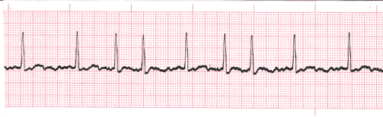
Rhythm Change: Post-PCI Atrial Fibrillation with RVR
Echocardiogram was obtained to assess LVEF, which was preserved. (Class 1, LOE C-LD)
Patient was being monitored on telemetry (Class I, LOE C-LD)
The nurse noticed a change in rhythm on telemetry.
12-lead ECG confirmed new-onset atrial fibrillation (AF) with rapid ventricular response.
The patient was hemodynamically stable. He reported palpitations but no chest pain, dyspnea, or dizziness.
Notes:
atrial fibrillation rhythm strip from an external website:
American Medical Resource Institute. (n.d.). Identifying and Treating Atrial Fibrillation (AFib or AF). ACLSOnline. Retrieved from https://www.aclsonline.us/rhythms/atrial-fibrillation/

Slide 14
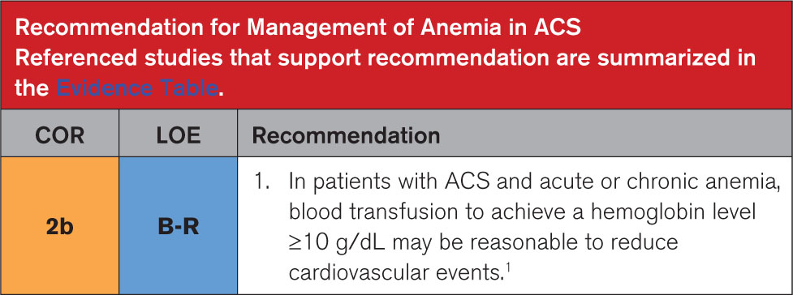
Management of Anemia in ACS
Review of his labs demonstrated a hemoglobin level of 9.5 g/dL, near his chronic baseline anemia.
He received a transfusion to achieve a hemoglobin ≥10 g/dL, a strategy that may reduce CV events (Class 2b, LOE B-R).
Following transfusion and beta blocker therapy, his rhythm stabilized.
Notes:
The AF was not due to acute hemoglobin drop, he is baseline anemic after review of labs

Slide 15
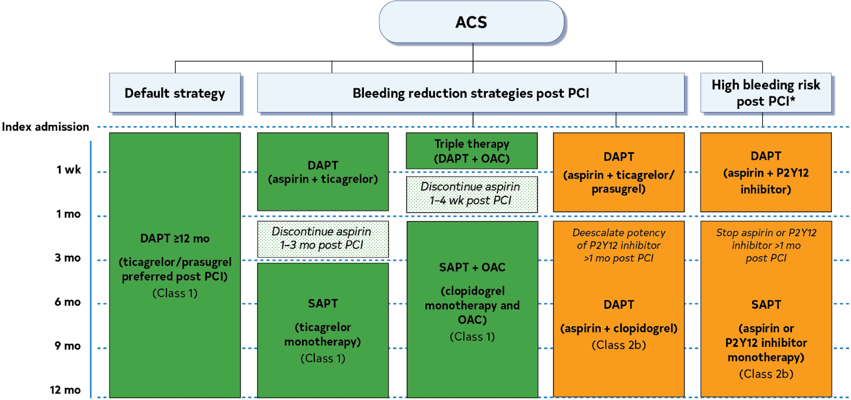
DAPT Strategies in ACS
The team then turned their attention to the various DAPT strategies to balance bleeding and thrombosis risk.
He was switched to triple therapy
(DAPT + Apixaban). Aspirin was stopped after 1 week. (Class 1)

Slide 16

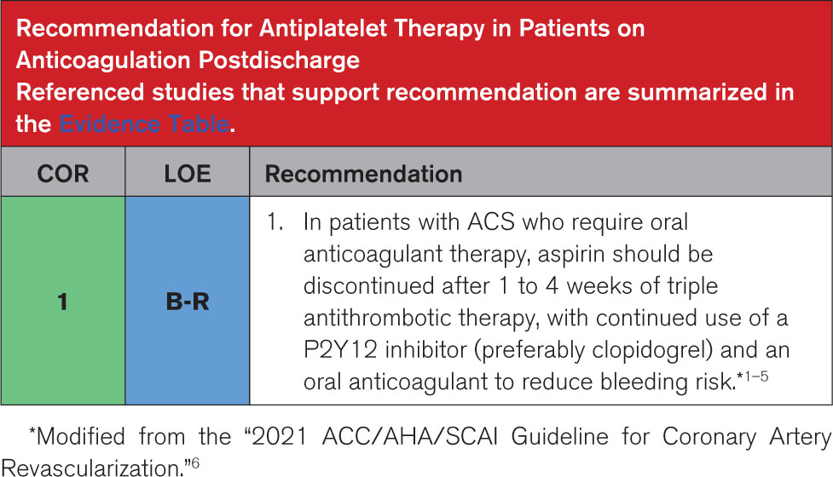
Evidence for Antiplatelet Therapy in Patients on OAC after ACS
Discontinuing aspirin 1-4 weeks after PCI in patients with AF on DAPT and oral anticoagulant (OAC) lowers bleeding risk, without increasing mortality, stroke, and MACE.¹
Most stent thrombosis (80%) occurs within 30 days of PCI, so aspirin may be continued up to 30 days in high-risk patients.²
Ticagrelor was switched to clopidogrel, the guideline-preferred P2Y12 inhibitor when combined with an OAC (Class 1, LOE B-R)
A proton pump inhibitor was also initiated for GI protection.
1] Lopes RD, et al. Optimal Antithrombotic Regimens for Patients With Atrial Fibrillation Undergoing Percutaneous Coronary Intervention: An Updated Network Meta-analysis. JAMA Cardiol. 2020 May 1;5(5):582-589. doi: 10.1001/jamacardio.2019.6175. PMID: 32101251; PMCID: PMC7240352.
2] Alexander JH, et al. Risk/Benefit Tradeoff of Antithrombotic Therapy in Patients With Atrial Fibrillation Early and Late After an ACS or PCI: Insights From AUGUSTUS. Circulation.
Notes:
meta anlyais figure?

Slide 17
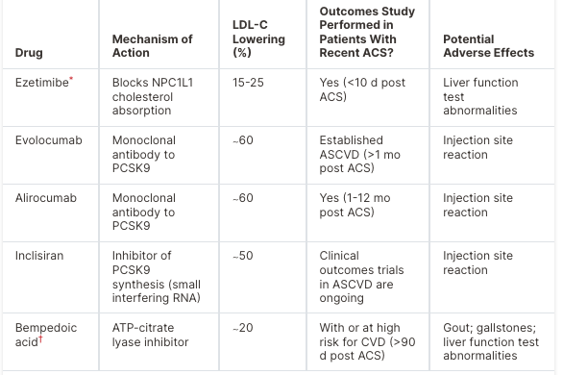
Recommendations for Lipid Management
As discharge approached, the patient’s LDL-C was noted to be 90 mg/dL despite being on high-intensity statin therapy at presentation.
Non-statin Treatment Options for LDL-C Lowering in Patients with ACS:
He was also started on non-statin lipid-lowering therapy to reduce the risk of MACE (Class 1, LOE A)
Recommended to obtain a repeat fasting lipid panel in 4–8 weeks (Class 1, LOE C-LD)
Notes:
For patients who do not reach LDL-C treatment goals on maximally tolerated statin therapy or who are intolerant to statins, several non-statin therapies can lower LDL-C levels and improve ASCVD outcomes across diverse populations.

Slide 18

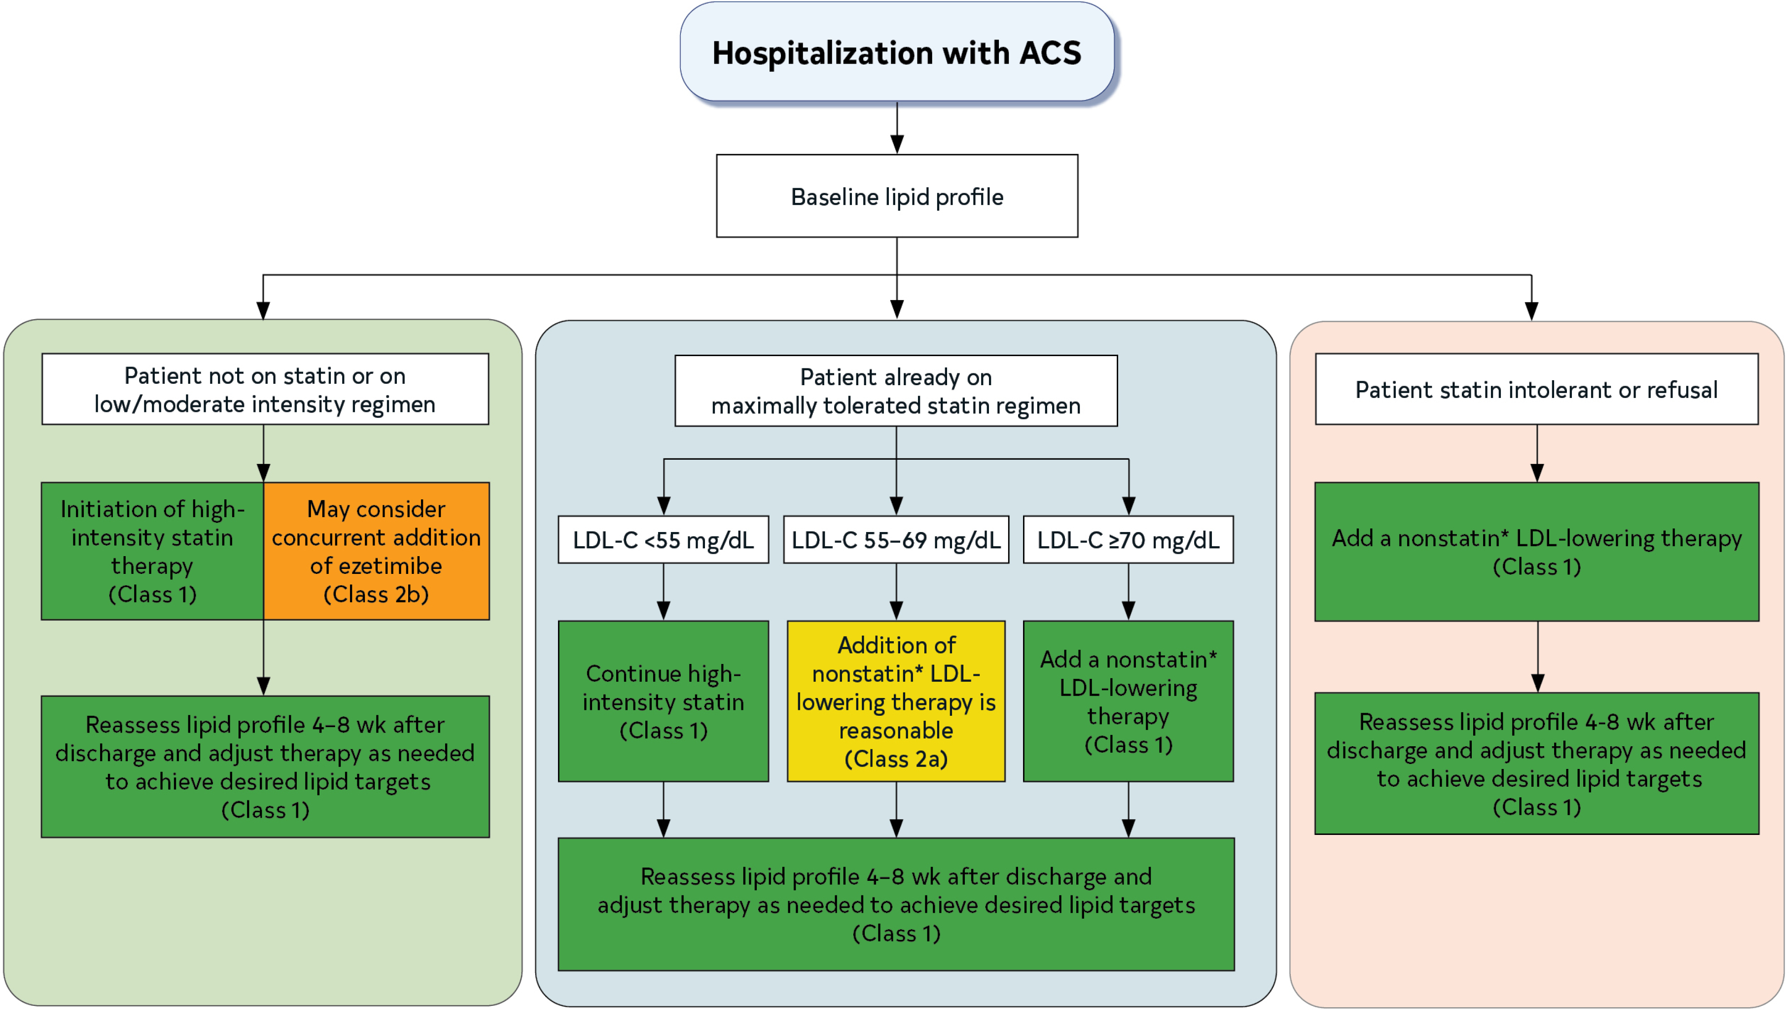
Recommendations for Lipid Management
Target LDL-C goal <70 mg/dL after ACS (Class 1, LOE A)
Reasonable to target LDL-C <55 mg/dL (Class 2a, LOE B-R).
Choice of non-statin LLT may depend on many factors including % LDL-C reduction that is required to achieve LDL-C goal.

Slide 19
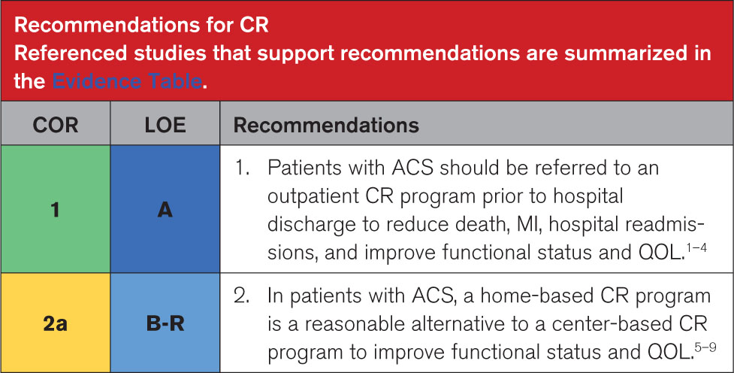
Long-term management
On discharge, the patient was referred to cardiac rehabilitation (Class 1, LOE A).
He was maintained on dual therapy with apixaban and clopidogrel. After one year, clopidogrel was discontinued, and he remained on OAC as monotherapy for atrial fibrillation and coronary artery disease.

Slide 20
Acknowledgments
Many thanks to our Guideline Ambassadors who were guided by Dr. Elliott Antman in developing this translational learning product in support of the 2025 AHA/ACC/ACEP/NAEMSP/SCAI Guideline for the Management of Patients with Acute Coronary Syndromes.
Parth Patel, MD
Warren Tai, MD
Aradhana Verma, MD
The American Heart Association requests this electronic slide deck be cited as follows:
Patel, P., Tai, W., Verma, A., Reyna, G. G., Bezanson, J. L., & Antman, E. M. (2025). AHA Case Study Slides [PowerPoint slides]; Adapted from the 2025 AHA/ACC/ACEP/NAEMSP/SCAI Guideline for the Management of Patients with Acute Coronary Syndromes. Retrieved from: Guideline Essentials: AHA Clinical Slide Series - Professional Heart Daily | American Heart Association

Slide 21
Copyright and Permissions Notice
© Copyright 2025. American Heart Association. All rights reserved.
This material is the copyrighted property of the American Heart Association and is provided for reference purposes only. It may not be copied, reproduced, stored in a retrieval system, transmitted, altered in any way or used as a derivative work, or distributed in any form or by any means—electronic, mechanical, photocopying, recording, or otherwise—without prior written permission from the publisher.
This content may be used for limited educational and personal use. Further distribution or dissemination requires a licensing agreement. Unauthorized use or distribution in any media is strictly prohibited.
For permissions inquiries and licensing fee information, please see the information/Request Form at this link:
https://www.heart.org/en/about-us/statements-and-policies/copyright-request-form

