Slide 1
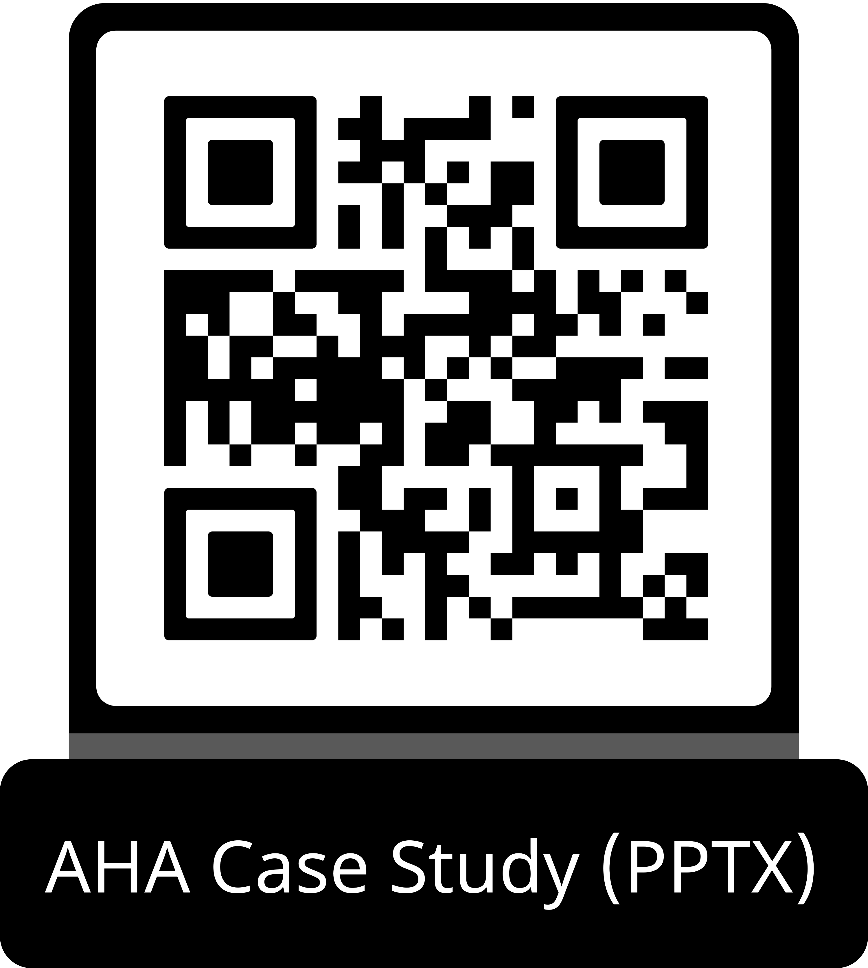
Guideline Essentials: Case Study Slide Series
Acute Ischemic Stroke Case Study
ADAPTED FROM:
Guidelines in Action:
Basilar Artery Occlusion
and Thrombectomy

Slide 2
Case Presentation: Patient Profile
90-year-old woman,
Prestroke mRS = 0; Last known well 45 min prior
RISK FACTORS:
Atrial fibrillation (treated with apixaban)
Hypertension
Hyperlipidemia
Chronic lung disease
PRESENTATION:
GCS 4; extensor posturing
NIHSS score: 32
Emergent intubation + stroke code
IMAGING:
CT head: No hemorrhage
PC-ASPECTS: 10
CTA: Distal basilar artery occlusion
Perfusion: 303 mL mismatch, no core infarct
(Figure 1)
TREATMENT:
Ineligible for thrombolysis (unclear apixaban schedule)
EVT: Successful recanalization (TICI 3)
Time to recanalization: 3h 41min
OUTCOME:
NIHSS ↓ to 2
MRI: bilateral midbrain and cerebellar infarcts (Figure 1)
Discharge day 9 to rehab
3-month mRS: 3 (ambulatory with assist)
Abbreviations: CTA indicates computed tomographic angiography; CT, computed tomography; EVT, emergent endovascular thrombectomy; GCS, Glasgow Coma Scale; MRI, magnetic resonance imaging; mRS, modified Rankin scale; NIHSS, National Institutes of Health Stroke Scale; and TICI, thrombolysis in cerebral infarction.
Rahman, M., et al. Guidelines in Action: Basilar Artery Occlusion and Thrombectomy. Stroke. 2026, doi:10.1161/STROKEAHA.125.054180

Slide 3
Case Presentation: Imaging
Figure 1.
CTA
A and B-Distal basilar artery occlusion
Perfusion: 303 mL mismatch, no core infarct.
C and D-EVT achieved successful recanalization with a Thrombolysis in Cerebral Infarction score of 3, approximately 3 hours and 41 minutes from last known well.
MRI
E and F- Bilateral, acute ischemic infarcts involving the midbrain and cerebellar without hemorrhagic transformation.
Abbreviations: CTA indicates computed tomographic angiography; EVT, endovascular thrombectomy; and MRI, magnetic resonance imaging.

Slide 4
Case Presentation: Treatment and Outcome
ED Arrival
and Imaging
CT/CTA/
Perfusion
TICI 3 Recanalization
TICI 3
Recanalization
Discharge
Day 9
mRS 3
at 3 months
Found Down
LKW 45 min
prior
EVT Performed
3h 41min
from LKW
Etiology
Atrial fibrillation on reduced-dose anticoagulation (apixaban 2.5 mg BID); indication for reduced dosing unclear.
→ Stroke etiology: cardioembolic, secondary to inadequately anticoagulated atrial fibrillation
MRI Findings
Bilateral acute ischemic infarcts
Midbrain + bilateral cerebellum
No hemorrhagic transformation
Secondary Prevention
Apixaban dose adjusted to 5 mg BID and restarted on hospital day 4
Discharged to acute rehabilitation
mRS 3 at 3 months: independent ambulation with cane/walker
Abbreviations: CTA indicates computed tomographic angiography; CT, computed tomography; ED, emergency department; EVT, endovascular thrombectomy; LKW, last known well; mRS, modified Rankin score; and TICI, thrombolysis in cerebral infarction.

Slide 5
2026 AHA/ASA Guidelines:
BAO and Thrombectomy
★ 2026 Guidelines recommend EVT within 24 hours for eligible patients with BAO — a major update from 2019
Class 1
New 2026 Recommendation
In patients with acute ischemic stroke and BAO, a baseline mRS 0–1, NIHSS ≥10, and PC-ASPECTS ≥6, EVT within 24 hours of symptom onset is recommended to achieve better functional outcome and reduce mortality.
2019 Guideline (prior)
Previous Standard
Benefits described as "uncertain...the use of mechanical thrombectomy with stent retrievers may be reasonable for carefully selected patients...within 6 hours of symptom onset."
This Case
Applying the Guidelines
Patient met all new criteria: mRS 0, NIHSS 32, PC-ASPECTS 10, distal BAO.
EVT performed at 3 hours 41 minutes → TICI 3 recanalization, NIHSS 2 at discharge.
Abbreviations: BAO indicates basilar artery occlusion; EVT, emergent endovascular thrombectomy; mRS, modified Rankin scale; NIHSS, National Institutes of Health Stroke Scale; PC-ASPECTS, posterior circulation acute stroke prognosis early computed tomography score; and TICI, thrombolysis in cerebral infarction.

Slide 6
Key Trials Informing BAO Thrombectomy
Trial | Design | Time Window | Primary Outcome | Key Findings
BASICS (2021) | RCT, 300 patients EVT vs. medical | Within 6 h | mRS 0–3 at 90 d | No significant difference; limited by poor recruitment & 29.2% external EVT crossover
BEST (2020) | RCT (China), vertebrobasilar EVT vs. medical | Within 8 h | mRS ≤3 at 90 d | ITT: no difference; per-protocol favored EVT; terminated early due to high crossover
ATTENTION (2022) | RCT (China), 340 patients NIHSS ≥10 | Within 12 h | mRS 0–3 at 90 d | 46% vs. 23% good outcomes; mortality 37% vs. 55%; sICH 5%
BAOCHE (2022) | RCT (China), 217 patients NIHSS ≥10 | 6–24 h | mRS 0–3 at 90 d | 46% vs. 24% good outcomes; mortality 31% vs. 42%; sICH 6% vs. 1%
Abbreviations: ATTENTION indicates endovascular treatment for acute BAO: a multicenter RCT; BAO, basilar artery occlusion; BAOCHE, basilar artery occlusion Chinese endovascular; BASICS, basilar artery international cooperation study; BEST, endovascular treatment versus standard medical treatment for vertebrobasilar artery occlusion; EVT, emergent endovascular thrombectomy; ITT, intention to treat; NIHSS, National Institutes of Health Stroke Scale; mRS, modified Rankin scale; RCT, randomized controlled trial; and sICH, symptomatic intracranial hemorrhage.
Note: ATTENTION and BAOCHE conducted in China — intracranial atherosclerosis accounts for up to 50% of strokes there, limiting generalizability to US populations.

Slide 7
Clinical Caveats and Practical Considerations
1
2
3
  BAO Presentation
  is Nonspecific
Symptoms range from diplopia, dysarthria, ataxia, and vertigo to quadriplegia, ophthalmoplegia, and reduced consciousness. Onset may be acute or stuttering, often preceded by TIAs.
  Imaging Selection Criteria
PC-ASPECTS ≥6 required. Brain perfusion imaging can identify salvageable tissue (303 mL mismatch, no core in this case). Supports intervention even in elderly patients.
  Anticoagulation and Thrombolysis
Unclear anticoagulant status precluded thrombolysis here. Direct oral anticoagulant dosing must be clarified before IVT is considered.
4
5
6
  Applicability to
  US Populations
Both pivotal trials (ATTENTION and BAOCHE) were conducted in China, where intracranial atherosclerosis is more prevalent. Evidence for other stroke etiologies warrants consideration.
  Outcomes in
  Elderly Patients
Advanced age is associated with worse outcomes, but this patient (90s, baseline mRS 0) achieved mRS 3 at 3 months. Baseline function matters more than chronological age.
  Secondary Prevention
BAO attributed to AF on reduced-dose apixaban. Dose adjustment (2.5→5 mg BID) and anticoagulation restart on day 4 are critical to prevent recurrence.
Abbreviations: AF indicates atrial fibrillation; ATTENTION, endovascular treatment for acute BAO: a multicenter RCT; BAO, basilar artery occlusion; BAOCHE, basilar artery occlusion Chinese endovascular; IVT, intravascular thrombolysis; mRS, modified Rankin scale; PC-ASPECTS, posterior circulation acute stroke prognosis early computed tomography score; RCT, randomized controlled trial; TIA, transient ischemic attack; and US, United States.

Slide 8
Take-Home Points
Initiate Treatment
Recognize BAO morbidity and mortality can reach 90% without treatment. The 2026 guidelines now formally recommend EVT within 24 hours for eligible patients, a major shift from the uncertain recommendation in 2019.
Suspect BAO Early
Suspect BAO early despite nonspecific, variable, or stuttering presentations. A high index of suspicion with rapid PC-ASPECTS and perfusion imaging is essential for timely diagnosis.
Utilize EVT
Apply EVT within 24 hours in eligible patients with severe deficits and good baseline function to improve outcomes. Benefit is established for NIHSS ≥10, baseline mRS 0–1, within 24 hours.
Abbreviations: ATTENTION indicates endovascular treatment for acute BAO: a multicenter RCT; BAO, basilar artery occlusion; BAOCHE, basilar artery occlusion Chinese endovascular; EVT, emergent endovascular thrombectomy; mRS, modified Rankin scale; NIHSS, National Institutes of Health Stroke Scale; and PC-ASPECTS, posterior circulation acute stroke prognosis early computed tomography score.

Slide 9
References
Prabhakaran S, et al. 2026 Guideline for AIS: a guideline from the AHA/ASA. Stroke. 2026. In press.
Powers WJ, et al. Guidelines for early management of patients with AIS: 2019 update. Stroke. 2019;50:e344–e418.
Kompanje EJO, et al. Historical sources of basilar artery occlusion. Neurology. 2011;76:1520–1523.
Mattle HP, et al. Basilar artery occlusion. Lancet Neurol. 2011;10:1002–1014.
Lindsberg PJ, Mattle HP. Therapy of basilar artery occlusion. Stroke. 2006;37:922–928.
Ahmed RA, et al. Basilar artery occlusion: clinicoradiologic features, treatment selection, and endovascular techniques. Interv Neuroradiol. 2023;29:748–758.
Langezaal LC, et al. Endovascular therapy for stroke due to basilar-artery occlusion (BASICS). N Engl J Med. 2021;384:1910–1920.
Liu X, et al. Endovascular treatment versus standard medical treatment (BEST). Lancet Neurol. 2020;19:115–122.
Tao C, et al. Trial of endovascular treatment of acute basilar-artery occlusion (ATTENTION). N Engl J Med. 2022;387:1361–1372.
Jovin TG, et al. Trial of thrombectomy 6 to 24 hours after stroke due to basilar-artery occlusion (BAOCHE). N Engl J Med. 2022;387:1373–1384.

Slide 10
Citation
The American Heart Association requests this electronic slide deck be cited as follows:
Reyna, G.G. (2026). Guideline Essentials: Case Study Slide Series [PowerPoint slides]; Adapted from Guidelines in Action: Basilar Artery Occlusion and Thrombectomy. Stroke. Retrieved from:
Guideline Essentials: Case Study Slide Series - Professional Heart Daily | American Heart Association

Slide 11
Copyright and Permissions Notice
© Copyright 2026. American Heart Association. All rights reserved.
This material is the copyrighted property of the American Heart Association and is provided for reference purposes only. It may not be copied, reproduced, stored in a retrieval system, transmitted, altered in any way or used as a derivative work, or distributed in any form or by any means—electronic, mechanical, photocopying, recording, or otherwise—without prior written permission from the publisher.
This content may be used for limited educational and personal use. Further distribution or dissemination requires a licensing agreement. Unauthorized use or distribution in any media is strictly prohibited.
For permissions inquiries and licensing fee information,
please see the information/Request Form at this link:
https://www.heart.org/en/about-us/statements-and-policies/copyright-request-form
11

