Slide 1
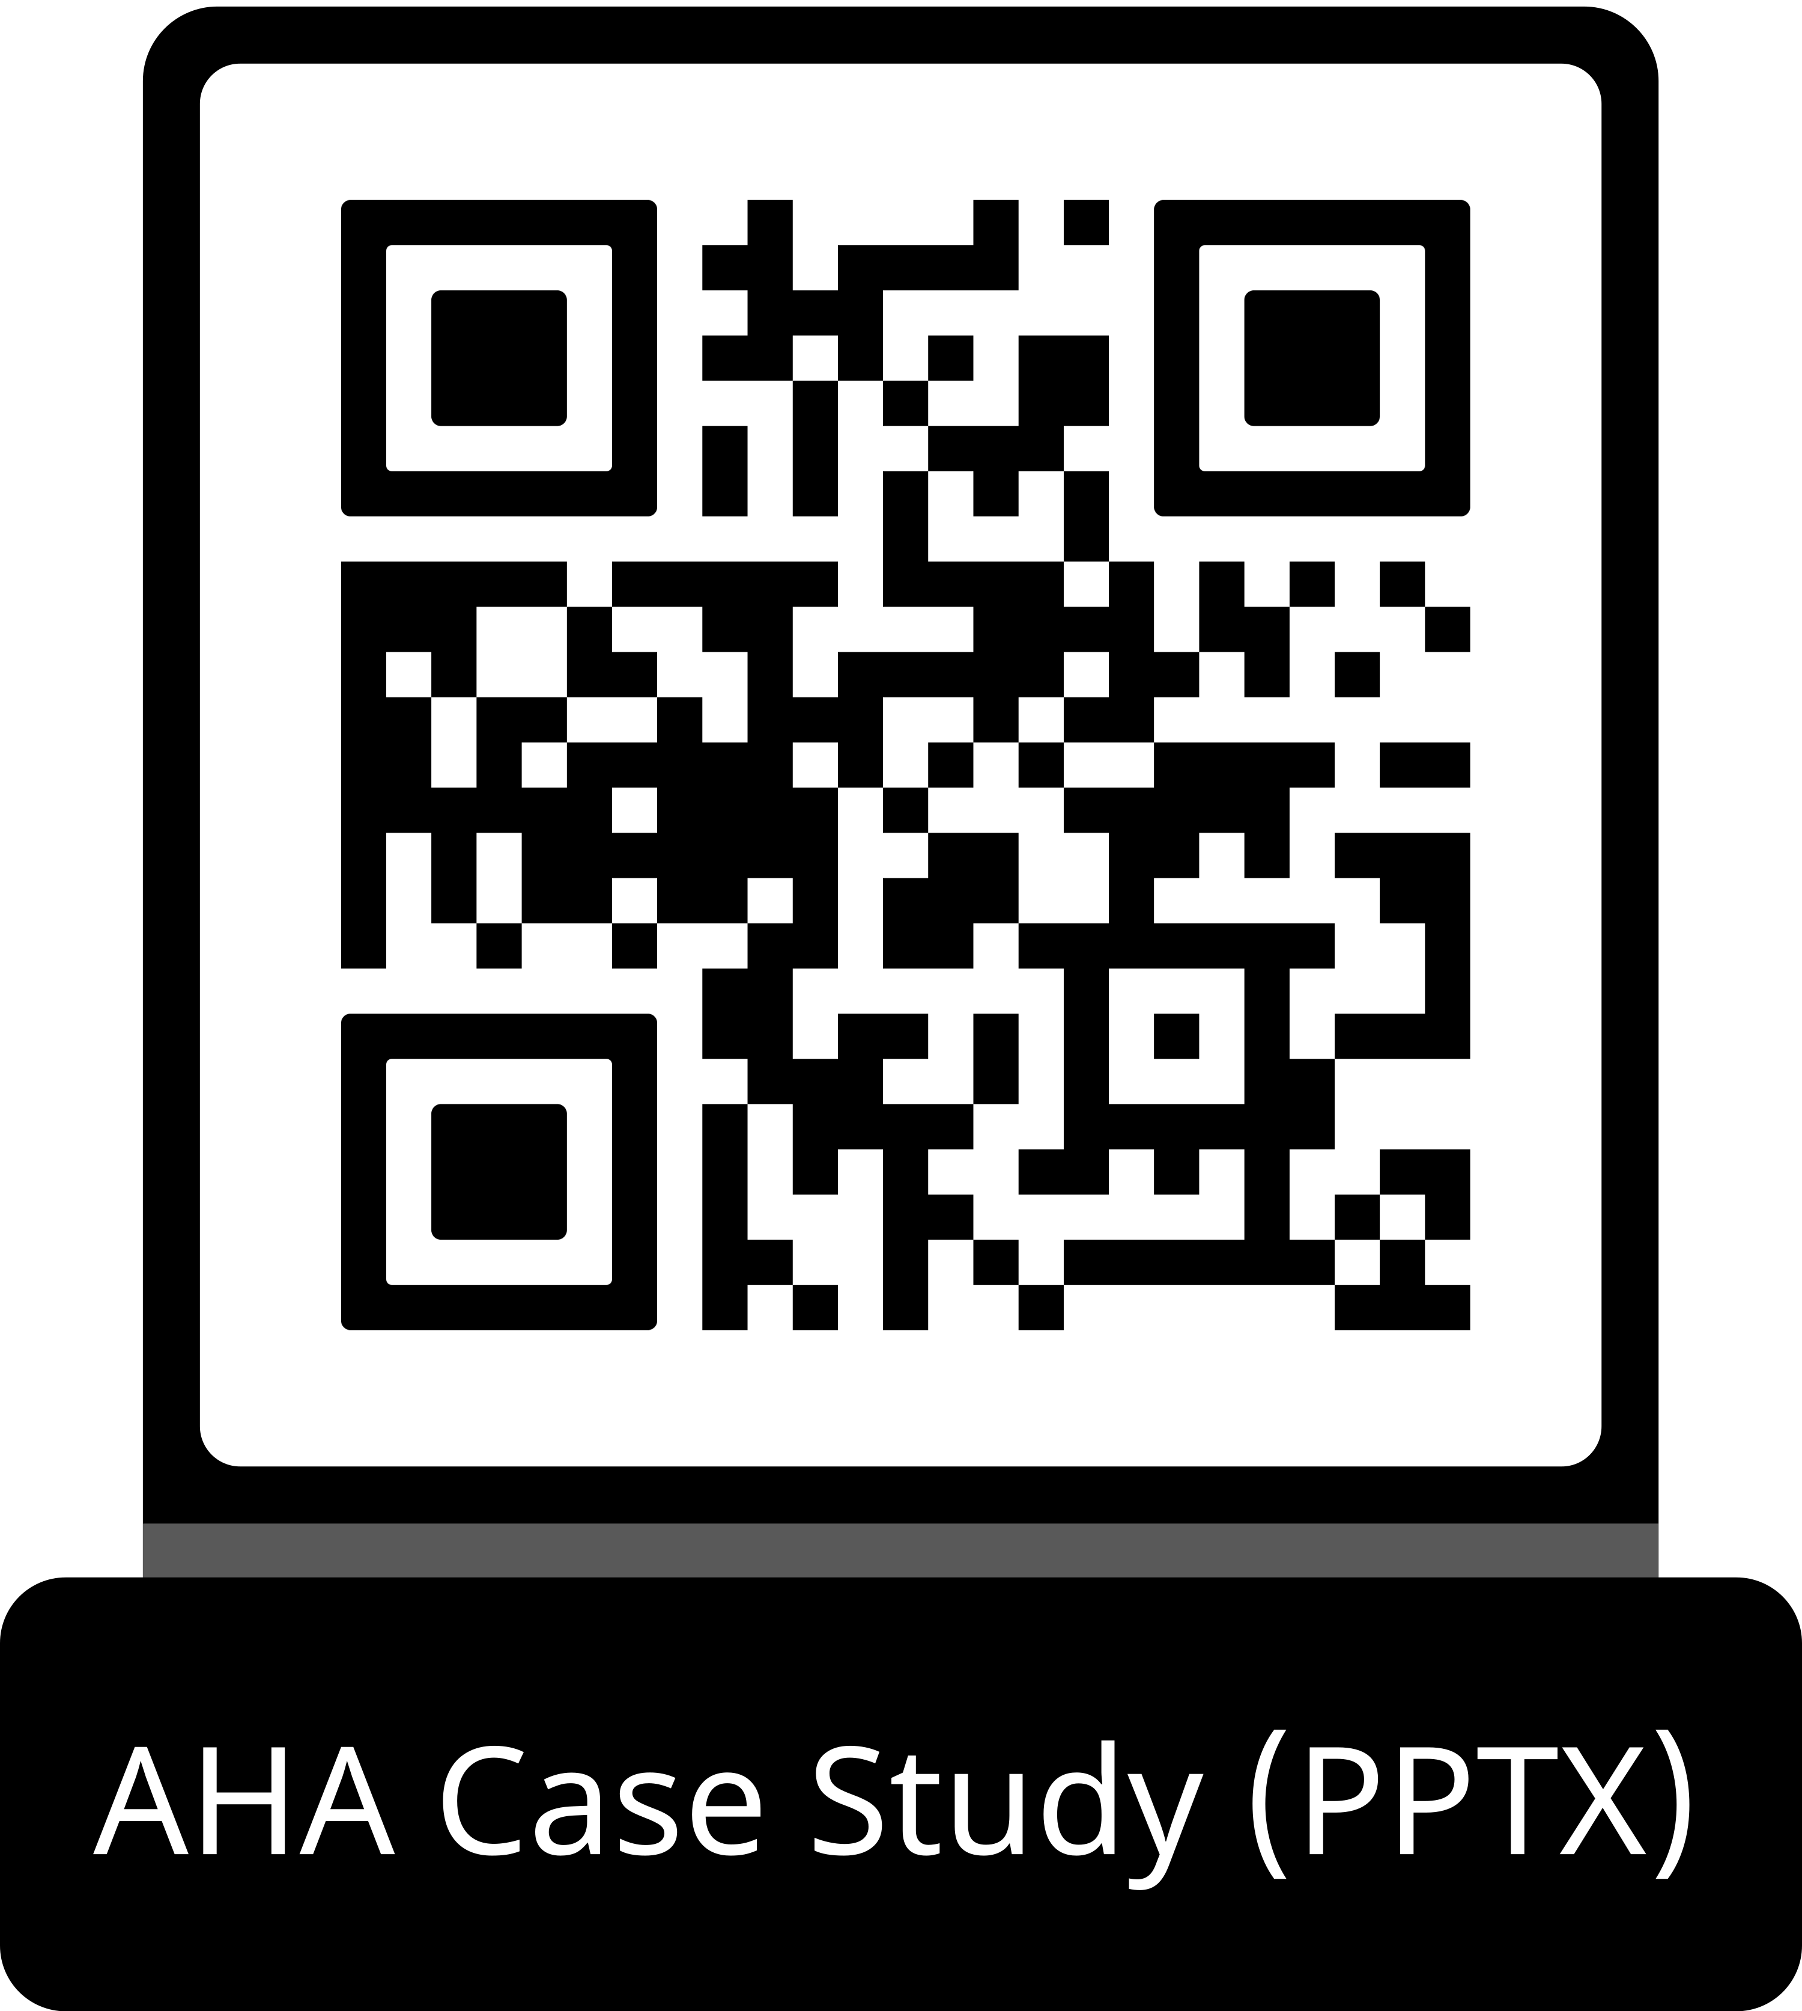
Guideline Essentials: Case Study Slide Series
Acute Ischemic Stroke Case Study
ADAPTED FROM:
Guidelines in Action:
Extending the Treatment Window for Thrombolysis in Acute Ischemic Stroke

Slide 2
Case Presentation: Patient Profile
80-year-old patient,
functionally independent at baseline
RISK FACTORS:
No previously known cerebrovascular risk factors
PRESENTATION:
Awakened with left-sided numbness, inability to control left arm, gait impairment
STROKE CODE:
Called 90 min after symptom recognition
Last known well: 8.5 h prior (bedtime)
NIHSS:
Score 4: dense left sensory loss,
left UE ataxia, left neglect; wide-based unsteady gait
IMAGING MRI:
DWI: diffusion restriction right posterior opercular region; no significant FLAIR signal change (Figure 1)
Abbreviations: DWI indicates diffusion-weighted imaging; FLAIR, fluid-attenuated inversion recovery; MRI, magnetic resonance imaging; NIHSS, National Institutes of Health Stroke Scale; and UE, upper extremity.
Stein, L. K., et al. Guidelines in Action: Extending the Treatment Window for Thrombolysis in Acute Ischemic Stroke. Stroke. 2026, doi:10.1161/STROKEAHA.125.053826

Slide 3
Case Presentation: Imaging
Figure 1. A patient with no known cerebrovascular risk factors presenting to the ED with left-sided numbness, left arm ataxia, left-sided neglect, and gait impairment noted upon awakening.
A through C, Rapid-sequence MRI was performed. A and B, Diffusion restriction in the right posterior opercular region without a significant corresponding FLAIR hyperintense signal in C. D through F, Follow-up MRI was performed 2 days later. Diffusion restriction was improved (D and E), and FLAIR hyperintensity matched the area of diffusion restriction (F).
Abbreviations: ED indicates emergency department; FLAIR, fluid-attenuated inversion recovery; and MRI, magnetic resonance imaging.

Slide 4
Case Presentation: Treatment and Outcome
Repeat MRI
(Day 2)
NIHSS 2 →increased
SBP to 100–110
Discharge
(Day 5)
NIHSS 0 / mRS 0
No residual deficits
Awakening
LKW 8.5 h prior
Symptoms noted
Rapid MRI
DWI-FLAIR mismatch
Right posterior opercular
Tenecteplase
2 h 40 min
post-awakening
9 h 40 min from LKW
Dose & Timing
Tenecteplase 0.25 mg/kg IV
2 h 40 min after symptom recognition upon awakening
≈9 h 40 min from last known well
Follow-up
(3 and 12 months)
Patient remained on aspirin + high-intensity statin
No further neurological symptoms or events
Long-term cardiac rhythm monitoring ongoing
Workup
Inpatient workup:
Embolic stroke of undetermined source
(ESUS)
No large vessel occlusion identified
Abbreviations: DWI indicates diffusion-weighted imaging; FLAIR, fluid-attenuated inversion recovery; LKW, last known well; MRI, magnetic resonance imaging; and NIHSS, National Institutes of Health Stroke Scale.

Slide 5
2026 AHA/ASA Guidelines:
Extended Window Thrombolysis
★ 2026 Guidelines endorse extended window thrombolysis using advanced imaging to demonstrate salvageable brain tissue
Class 2a
Unknown Onset:
DWI-FLAIR Mismatch (within 4.5h of recognition)
In patients with AIS who (1) have an unknown time of onset and are within 4.5 h from symptom recognition and (2) have an MRI DWI lesion smaller than one-third of the MCA territory and no marked signal change on FLAIR, IVT administered within 4.5 h of stroke symptom recognition can be beneficial to improve functional outcomes.
Class 2a
Perfusion Mismatch: Wake-up or 4.5–9h from LKW
In patients with AIS who have salvageable ischemic penumbra detected on automated perfusion imaging and who (1) awake with stroke symptoms within 9 h from the midpoint of sleep or (2) are 4.5–9 h from last known well, IVT may be reasonable to improve functional outcomes.
Class 2b
LVO with Perfusion Mismatch: 4.5–24h
(No EVT available)
In patients with AIS due to LVO with salvageable ischemic penumbra, presenting within 4.5–24 h from symptom onset or last known well, and who cannot receive EVT, treatment with IVT directed by individuals with expertise in thrombolytic stroke care may be beneficial to improve functional outcomes.
Abbreviations: AIS indicates acute ischemic stroke; DWI, diffusion-weighted imaging; EVT, endovascular thrombectomy; FLAIR, fluid-attenuated inversion recovery; IVT, intravenous thrombolysis; LKW, last known well; LVO, large vessel occlusion; MCA, middle cerebral artery; and MRI, magnetic resonance imaging.

Slide 6
Key Trials Informing Extended Window Thrombolysis
Trial | Imaging / Criteria | Window | Agent | Key Findings
WAKE-UP | MRI DWI-FLAIR mismatch; DWI <1/3 MCA | Unknown / wake-up | Alteplase 0.9 mg/kg | Increased functional independence; no increase in mortality or sICH
EXTEND | MR/CT perfusion mismatch >1.2; core <70 mL | 4.5–9 h or wake-up | Alteplase 0.9 mg/kg | Increased excellent outcome (35% vs 29%); Increased sICH noted
TRACE-III | MR/CT perfusion mismatch >1.8; core <70 mL | 4.5–24 h | Tenecteplase 0.25 mg/kg | Increased functional independence at 90 days
TIMELESS | CT perfusion mismatch >1.8; core <70 mL | 4.5–24 h | Tenecteplase 0.25 mg/kg | Did not improve outcomes (77.3% received EVT)
CHABLIS-T II | CT perfusion mismatch >1.2; core <70 mL | 4.5–24 h | Tenecteplase 0.25 mg/kg | Increased recanalization; no difference in sICH or independence (54.9% received EVT)
Abbreviations: CT indicates computed tomography; DWI, diffusion-weighted imaging; EVT, endovascular thrombectomy; FLAIR, fluid-attenuated inversion recovery; MCA, middle cerebral artery; MR, magnetic resonance; MRI, magnetic resonance imaging; and sICH, symptomatic intracranial hemorrhage.
Note: TIMELESS and CHABILIS-T II included patients who received EVT — tenecteplase did not improve outcomes in that setting.

Slide 7
Clinical Caveats and Practical Considerations
1
2
3
  Disabling Symptoms Despite Low NIHSS
An NIHSS score of 4 was considered mild — but the deficits were disabling for this functionally independent patient. Always contextualize deficits against the patient's baseline.
  Core Size and Hemorrhagic Risk
Extended window trials limited infarct core to <70 mL. Median enrolled core volumes were much smaller. Core size is a critical parameter in estimating hemorrhagic conversion risk.
  MRI DWI-FLAIR mismatch vs. CTP
MRI DWI-FLAIR mismatch is preferred for subcortical syndromes. CTP is an alternative when MRI is unavailable and does not add value when mismatch is already demonstrated on CTP.
4
5
6
  Hospital Pathway Modification
Extended window protocols may require changes to existing 4.5-hour pathways. Rapid-sequence MRI or CTP must be available during peak morning utilization hours for wake-up strokes.
  Prioritization and
  EVT Relationship
Extended window thrombolysis benefit is greatest in patients who cannot receive rapid EVT. WAKE-UP excluded planned EVT patients; TIMELESS/CHABLIS-T II showed no benefit in EVT recipients.
  Intracranial
  Hemorrhage Exclusion
Any sign of intracranial hemorrhage on baseline MRI was exclusionary in WAKE-UP. Hemorrhagic conversion risk must be weighed in the extended window risk-benefit discussion.
Abbreviations: CTP indicates computed tomography perfusion; DWI, diffusion-weighted imaging; EVT, endovascular thrombectomy; FLAIR, fluid-attenuated inversion recovery; and MRI, magnetic resonance imaging.

Slide 8
Systems of Care and Implementation
1
2
3
  Wake-Up
  Stroke Protocol
Centers with rapid-sequence MRI capability should ensure availability during peak morning hours for patients presenting upon awakening with disabling symptoms.
  Prioritize Disabling Strokes
Given resource limitations for advanced imaging, extended window protocols should prioritize patients with disabling deficits and no known contraindications to thrombolysis.
  CTP as an Alternative
When rapid-sequence MRI is unavailable, CTP identifies salvageable penumbra in the 4.5–24 h window. Many hospitals already incorporate CTP into their acute stroke workflow.
4
5
6
  Pathway Redesign
Hospital pathways built around the traditional 4.5-hour window need modification to operationalize extended window thrombolysis — including imaging logistics and eligibility criteria.
  Multidisciplinary Coordination
Successful execution requires coordination across neurology, emergency medicine, radiology, and nursing. Automated perfusion software (RAPID or AutoMIStar) enables rapid decision support.
  Equity and Access
Access to rapid-sequence MRI and CTP is not universal. Extended window thrombolysis guidelines must be implemented equitably, with explicit resource-matching strategies.
Abbreviations: CTP indicates computed tomography perfusion; and MRI, magnetic resonance imaging.

Slide 9
Take-Home Points
Tissue Is Brain
Identify patients with unknown onset or beyond the 4.5-hour window who have advanced imaging confirming salvageable brain tissue, as these patients can benefit from thrombolysis with improved 90-day functional outcomes.
Extended Window — Not One Size Fits All
Select treatment candidates based on imaging phenotype: use DWI-FLAIR mismatch for wake-up strokes (within 4.5 h of recognition) and perfusion mismatch to guide treatment up to 9 h or even 24 h from last known well.
EVT vs. IVT in the Extended Window
Prioritize extended window thrombolysis benefit is greatest in patients who cannot undergo rapid EVT, recognizing that Tenecteplase did not improve outcomes in EVT-treated populations in TIMELESS and CHABILIS-T II.
Build Protocols Before the Next Patient Arrives
Implement wake-up and extended window protocols addressing rapid imaging availability (MRI or CTP), eligibility criteria, and peak-hour resource deployment.
Abbreviations: CTP indicates computed tomography perfusion; DWI, diffusion-weighted imaging; EVT, endovascular thrombectomy; FLAIR, fluid-attenuated inversion recovery; IVT, intravenous thrombectomy; and MRI, magnetic resonance imaging.

Slide 10
References
NINDS rt-PA Stroke Study Group. Tissue plasminogen activator for acute ischemic stroke. N Engl J Med. 1995;333:1581–1587.
Hacke W, et al; ECASS Investigators. Thrombolysis with alteplase 3 to 4.5 hours after acute ischemic stroke. N Engl J Med. 2008;359:1317–1329.
Maas MB, Singhal AB. Unwitnessed stroke: impact of different onset times on eligibility into stroke trials. J Stroke Cerebrovasc Dis. 2013;22:241–243.
Davis SM, et al; EPITHET investigators. Effects of alteplase beyond 3 h after stroke (EPITHET). Lancet Neurol. 2008;7:299–309.
Thomalla G, et al; WAKE-UP Investigators. MRI-guided thrombolysis for stroke with unknown time of onset. N Engl J Med. 2018;379:611–622.
Ma H, et al; EXTEND Investigators. Thrombolysis guided by perfusion imaging up to 9 hours after onset of stroke. N Engl J Med. 2019;380:1795–1803.
Xiong Y, et al. Rationale and design of TRACE III: tenecteplase reperfusion therapy in AIS. Stroke Vasc Neurol. 2024;9:82–89.
Albers GW, et al. Tenecteplase for stroke at 4.5 to 24 hours with perfusion-imaging selection (TIMELESS). N Engl J Med. 2024;390:701–711.
Cheng X, et al; CHABILIS-T II Collaborators. Tenecteplase thrombolysis for stroke up to 24 hours after onset. Stroke. 2025;56:344–354.
Guideline for the early management of patients with AIS. AHA/ASA. 2026.

Slide 11
Citation
The American Heart Association requests this electronic slide deck be cited as follows:
Reyna, G.G. (2026). Guideline Essentials: Case Study Slide Series [PowerPoint slides]; Adapted from Guidelines in Action: Extending the Treatment Window for Thrombolysis in Acute Ischemic Stroke. Stroke. Retrieved from:
Guideline Essentials: Case Study Slide Series - Professional Heart Daily | American Heart Association

Slide 12
Copyright and Permissions Notice
© Copyright 2026. American Heart Association. All rights reserved.
This material is the copyrighted property of the American Heart Association and is provided for reference purposes only. It may not be copied, reproduced, stored in a retrieval system, transmitted, altered in any way or used as a derivative work, or distributed in any form or by any means—electronic, mechanical, photocopying, recording, or otherwise—without prior written permission from the publisher.
This content may be used for limited educational and personal use. Further distribution or dissemination requires a licensing agreement. Unauthorized use or distribution in any media is strictly prohibited.
For permissions inquiries and licensing fee information,
please see the information/Request Form at this link:
https://www.heart.org/en/about-us/statements-and-policies/copyright-request-form
12

