Slide 1
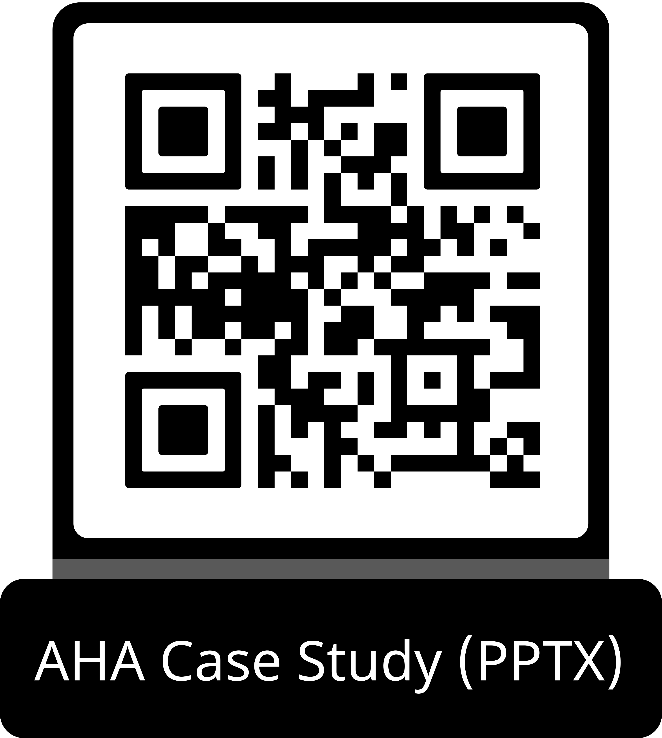
Guideline Essentials: Case Study Slide Series
Acute Ischemic Stroke Case Study
ADAPTED FROM:
Guidelines in Action:
General Supportive Early Management: Blood Pressure and Glucose

Slide 2
Case Presentation: Patient Profile
68-year-old woman
COMORBIDITIES:
Hypertension, hyperlipidemia,
type 2 diabetes (HbA1c 13.8%)
PRESENTATION:
Acute left arm weakness on waking;
last known well prior night
OUTSIDE HOSPITAL:
NIHSS 7 — left hemiparesis, neglect, dysarthria
CT: right parietal hypodensity; CTA: right M2 occlusion
ON TRANSFER:
NIHSS 9 — right gaze deviation, hemianopsia, left facial droop, left hemiparesis and neglect
IMAGING:
CT perfusion: 34 mL penumbra, 6 mL infarct core (rCBF <30%) (Figure 1)
Abbreviations: CT indicates computed tomography; CTA, computed tomography angiography; NIHSS, National Institutes of Health Stroke Scale; and rCBF, relative cerebral blood flow.
Wang & Tahsili-Fahadan. Guideline in Action: General Supportive Early Management: Blood Pressure and Glucose. Stroke. 2026, doi:10.1161/STROKEAHA.125.053824

Slide 3
Case Presentation: Imaging
Figure 1. A woman with perfusion-dependent, recurrent neurological deficits after thrombectomy.
A, Admission noncontrast CT showing early right parietal hypodensity. B, CTA demonstrating right M2 occlusion. C, CT perfusion map (time-to-maximum >6 seconds) showing a parietal penumbra. D, Post-EVT angiogram with TICI 2c reperfusion. E and F, MRI confirming a stable infarct.
Abbreviations: CT indicates computed tomography; CTA, computed tomography angiography; EVT, endovascular therapy; MRI, magnetic resonance imaging; NIHSS, National Institutes of Health Stroke Scale; rCBF, relative cerebral blood flow; and TICI, thrombolysis in cerebral infarction.

Slide 4
Case Presentation: Treatment and Clinical Course
Outside Hospital
NIHSS 7
Right M2 occlusion
Transfer
Arrival
NIHSS 9
34mL penumbra
Post-EVT
Drop
NIHSS 2→worse
SBP to 100–110
Norepinephrine
SBP >150
NIHSS 6→3
Day 6 Discharge
NIHSS 2
mRS 2
EVT
TICI 2c
Sluggish distal flow
Serum Glucose
457 mg/dL
Insulin infusion →
target 140–180 mg/dL
BP Crisis
SBP 150–180 → 100–110 mmHg
Spontaneous drop
~2h post-EVT
EEG Finding
↓ Alpha power right hemisphere
Confirmed hypoperfusion
Outcome
Stable right parietal infarct
No new lesions;
mRS 2 at discharge
Abbreviations: BP indicates blood pressure; EEG, electroencephalogram; EVT, endovascular therapy; mRS, modified Rankin scale; NIHSS, National Institutes of Health Stroke Scale; and TICI, thrombolysis in cerebral infarction.

Slide 5
2026 American Heart Association/American Stroke Association Guidelines:
Blood Pressure Management
★ Updated 2026 guidelines provide specific thresholds for post-EVT blood pressure management.
Class 2a
During and 24h After EVT
Maintain BP ≤180/105 mmHg during and for 24 hours after EVT.
Class 3: Harm
Avoid Intensive BP Lowering
In patients with AIS with LVO of the anterior circulation who have been successfully recanalized by endovascular therapy and without other indication for blood pressure management target, intensive SBP reduction target of <140 mmHg for the first 72 hours is harmful and not recommended.
Abbreviations: AIS indicates acute ischemic stroke; BP, blood pressure; EVT, endovascular therapy; LVO, large vessel occlusion; and SBP, systolic blood pressure.

Slide 6
Perfusion-Dependent Deficits and Induced Hypertension
Pathophysiological Background
Historical evidence: Angiographic and xenon-CT studies show small systemic BP changes can markedly affect cerebral blood flow in regions with impaired autoregulation.
Historical practice: Phenylephrine or dopamine used to improve focal deficits — especially in large-vessel occlusion or poor collaterals.
Evidence gap: Small trials supported physiological plausibility, but no large randomized studies have validated outcome benefit.
This Case — Norepinephrine Protocol
2h post-EVT: SBP dropped spontaneously from 150–180 to 100–110 mmHg
Recurrent left-sided weakness and neglect appeared
EEG: decreased alpha power over right hemisphere → hypoperfusion
Norepinephrine infusion started → SBP target >150 mmHg
Rapid neurological improvement: NIHSS 6→3
Maintained on low-dose NE overnight; weaned over 24h — stable exam
Abbreviations: BP indicates blood pressure; CT, computed tomography; EEG, electroencephalogram; EVT, endovascular therapy; NIHSS, National Institutes of Health Stroke Scale; NE, norepinephrine; and SBP, systolic blood pressure.

Slide 7
Take-Home Points
Promptly correct hypotension:
American Heart Association/American Stroke Association guidelines emphasize correction of hypotension and maintenance of blood pressure ≤180/105 mm Hg after successful reperfusion (Class 2a). Acute blood pressure drops and variability are associated with worse outcomes. After EVT, avoid intensive systolic blood pressure targets (<140 mm Hg in the first 24 h) given associations with poorer functional outcomes, higher mortality, and early neurological deterioration (Class 3: Harm). AIS classic stroke symptoms — maintain high suspicion.
Consider individualized BP augmentation:
In select patients with perfusion-dependent deficits, short-term blood pressure augmentation under close monitoring may improve perfusion, though benefits remain unproven.
Monitor glucose carefully:
Maintain serum glucose in the 140 to 180 mg/dL range (Class 2a); avoid intensive targets (80–130 mg/dL) that increase hypoglycemia risk (Class 3: no benefit).
Implement reliable systems:
ICU-level monitoring, nurse-driven titration protocols, clear stop rules, and standardized order sets should be integrated into stroke pathways to ensure reliability.
Abbreviations: AIS indicates acute ischemic stroke; EVT, endovascular therapy; and ICU, intensive care unit.

Slide 8
References
Prabhakaran S, et al. 2026 guideline for the early management of patients with acute ischemic stroke: AHA/ASA. Stroke. 2026;57:exx.
Mazighi M, et al; BP-TARGET investigators. Safety and efficacy of intensive BP lowering after successful EVT in acute ischaemic stroke. Lancet Neurol. 2021;20:265–274.
Yang P, et al; ENCHANTED2/MT Investigators. Intensive BP control after EVT for acute ischaemic stroke. Lancet. 2022;400:1585–1596.
He J, et al; CATIS Investigators. Effects of immediate BP reduction on death and major disability in acute ischemic stroke. JAMA. 2014;311:479–489.
Sandset EC, et al; SCAST Study Group. Candesartan for treatment of acute stroke: a randomised, placebo-controlled trial. Lancet. 2011;377:741–750.
Lee M, et al. Effect of blood pressure lowering in early ischemic stroke: a meta-analysis. Stroke. 2015;46:1883–1889.
Heiss WD, Rosner G. Functional recovery of cortical neurons as related to degree and duration of ischemia. Stroke. 1983;14:341–345.
Hillis AE, et al. A pilot randomized trial of induced blood pressure elevation in acute and subacute stroke. Cerebrovasc Dis. 2003;16:236–246.
Ntaios G, et al. J-shaped association between serum glucose and functional outcome in acute ischemic stroke. Stroke. 2010;41:2366–2370.
Cerecedo-Lopez CD, et al. Insulin in the management of acute ischemic stroke: a systematic review and meta-analysis. World Neurosurg. 2020;136:e514–e534.

Slide 9
Citation
The American Heart Association requests this electronic slide deck be cited as follows:
Reyna, G.G. (2026). Guideline Essentials: Case Study Slide Series [PowerPoint slides]; Adapted from Guidelines in Action: General Supportive Early Management: Blood Pressure and Glucose. Stroke. Retrieved from:
Guideline Essentials: Case Study Slide Series - Professional Heart Daily | American Heart Association

Slide 10
Copyright and Permissions Notice
© Copyright 2026. American Heart Association. All rights reserved.
This material is the copyrighted property of the American Heart Association and is provided for reference purposes only. It may not be copied, reproduced, stored in a retrieval system, transmitted, altered in any way or used as a derivative work, or distributed in any form or by any means—electronic, mechanical, photocopying, recording, or otherwise—without prior written permission from the publisher.
This content may be used for limited educational and personal use. Further distribution or dissemination requires a licensing agreement. Unauthorized use or distribution in any media is strictly prohibited.
For permissions inquiries and licensing fee information,
please see the information/Request Form at this link:
https://www.heart.org/en/about-us/statements-and-policies/copyright-request-form
10

