Slide 1
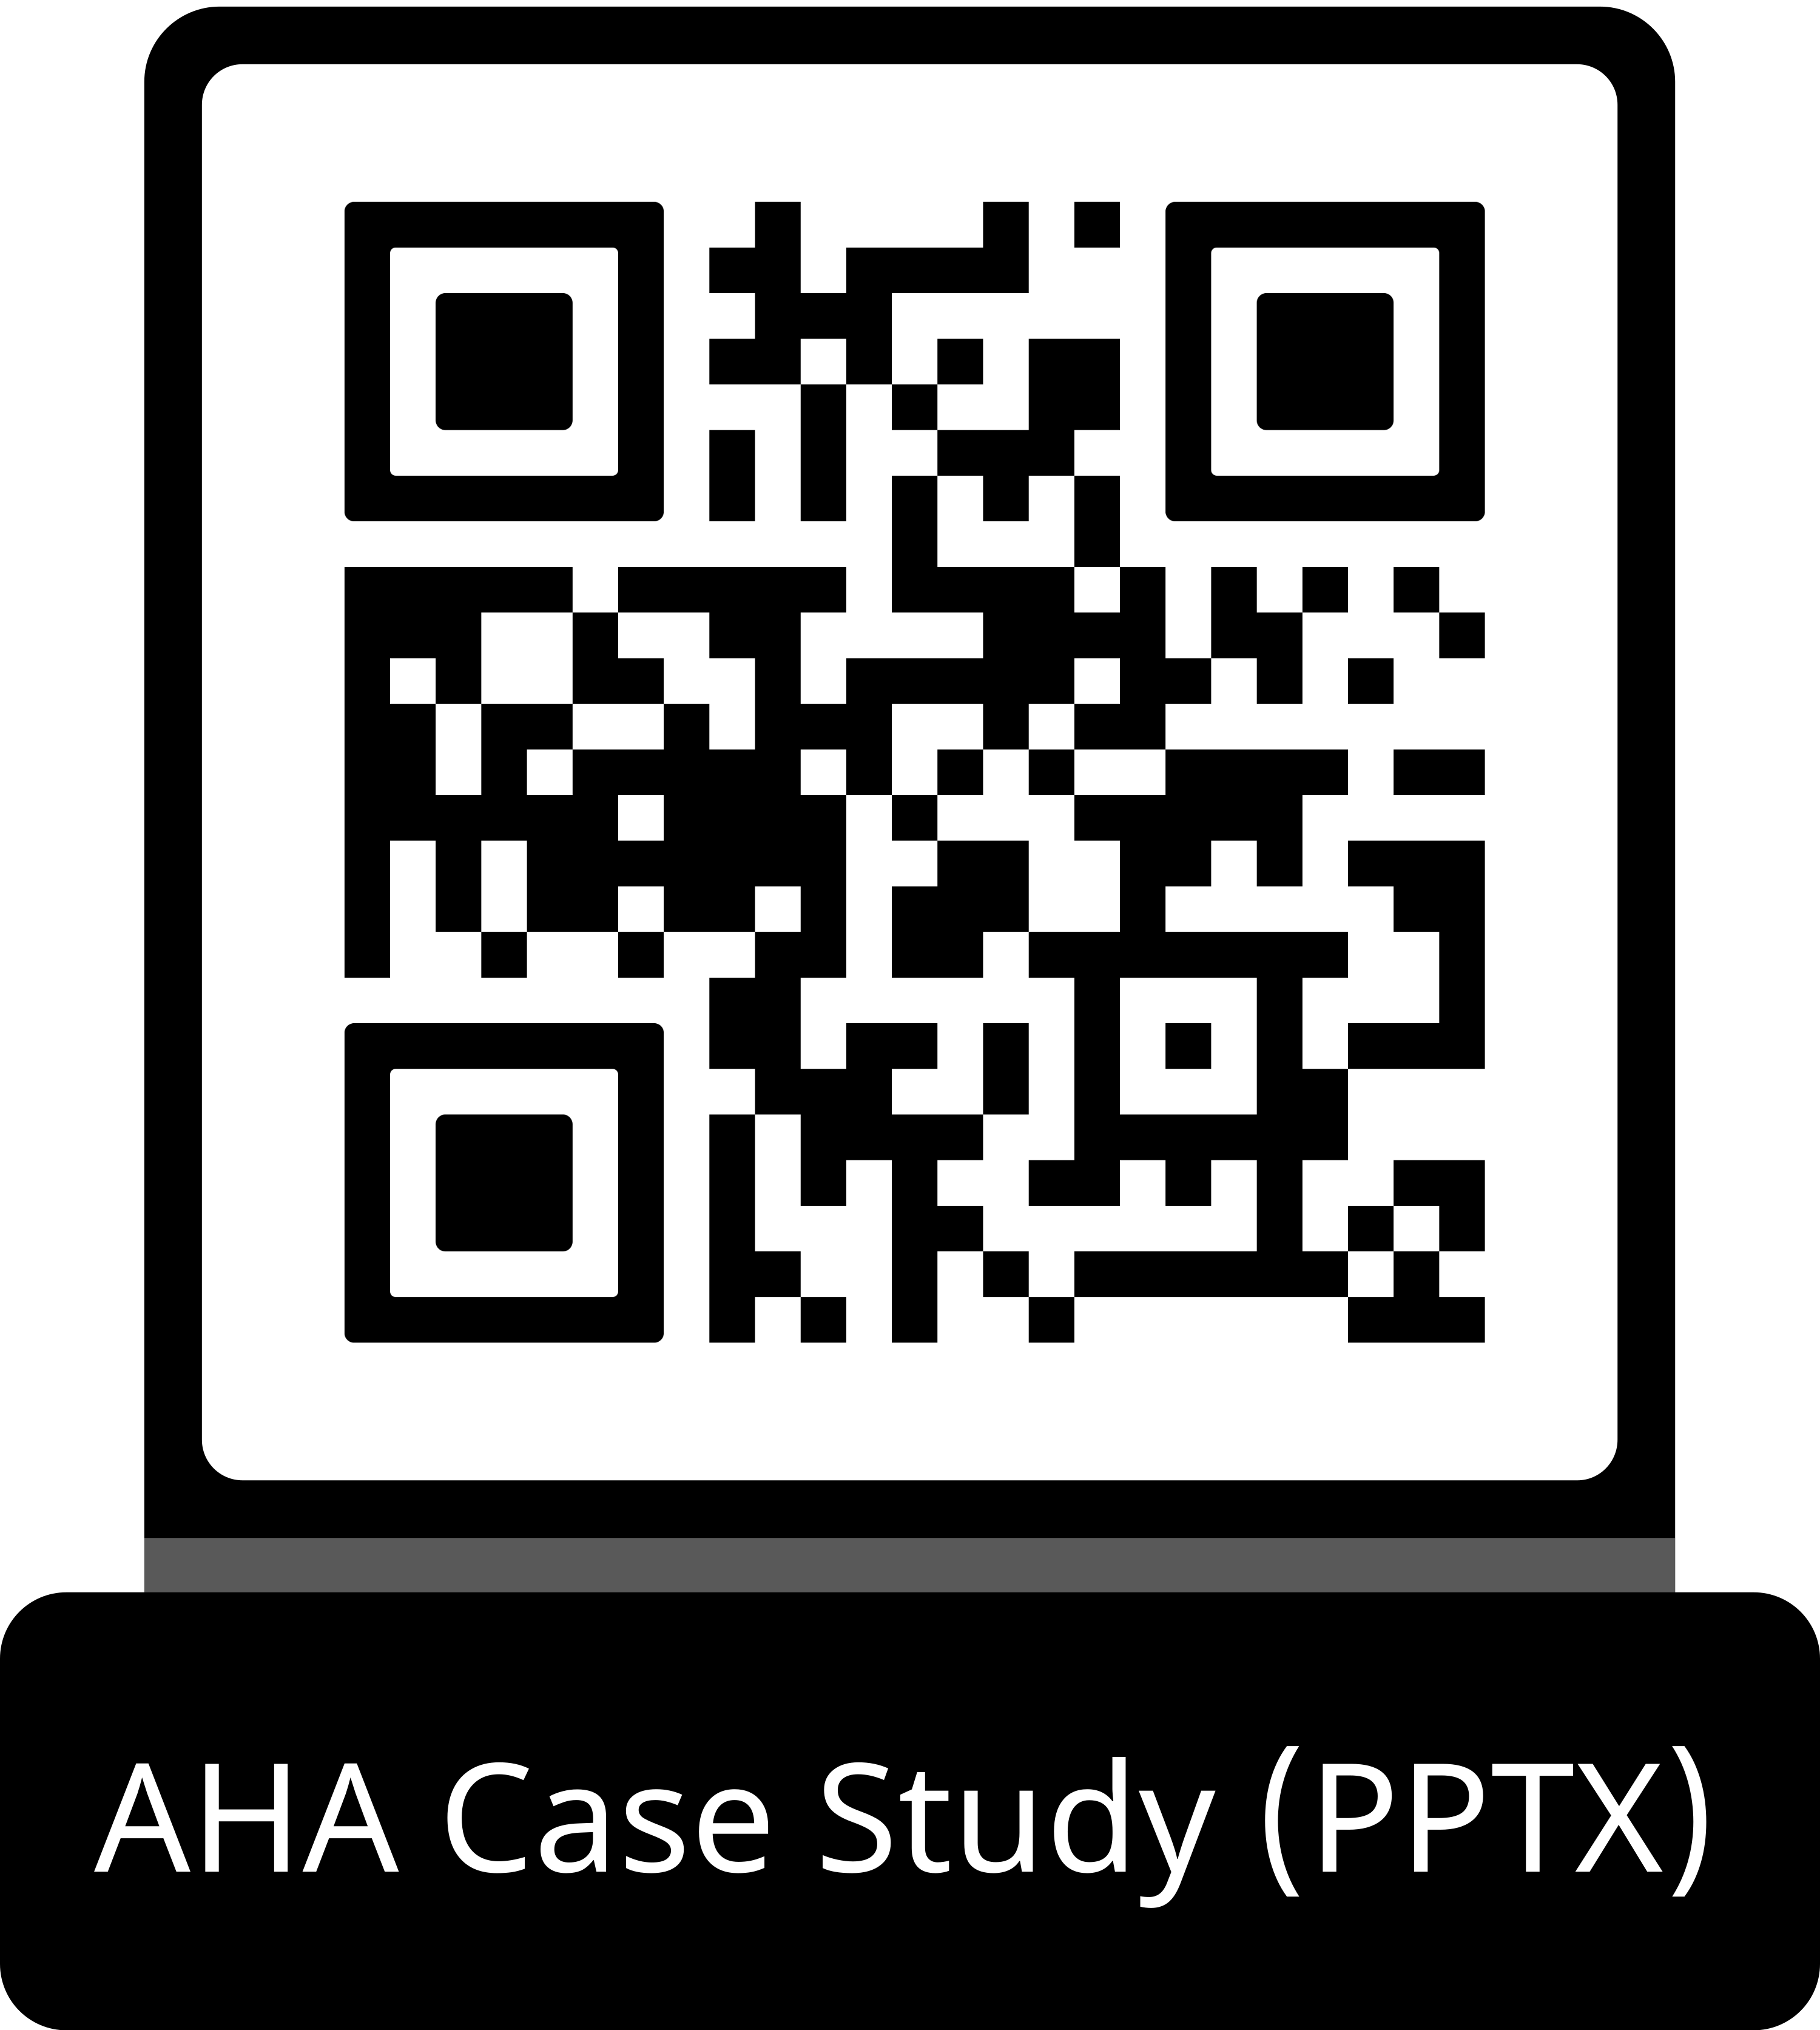
Guideline Essentials: Case Study Slide Series
Acute Ischemic Stroke Case Study
ADAPTED FROM:
Guidelines in Action: Getting to the
(Large) Core of the (T)Issue

Slide 2
Case Presentation: Patient Profile
65-year-old male
PAST MEDICAL HISTORY:
Hypertension, atrial fibrillation
off anticoagulation
TIME FROM LAST KNOWN WELL:
≈12.5 hours on arrival to emergency room
IMAGING:
CT head: early ischemic changes right MCA territory; ASPECTS 5; (Figure 1)
CTA: distal M1 right MCA LVO; CTP: 46 mL core,
119 mL penumbra (Figure 2)
PRESENTATION:
Series of falls at home; slurred speech noted by sister the next morning
NIHSS ON ARRIVAL:
9 — right gaze preference, left facial droop, left arm/leg drift, sensory deficit, extinction/
inattention, dysarthria
Abbreviations: ASPECTS indicates Alberta Stroke Program Early Computed Tomography Score; CT, computed tomography scan; CTA, computed tomography angiography; CTP, computed tomography perfusion; LVO, large vessel occlusion; and MCA, middle cerebral artery.
Stamm & Carrera. Guidelines in Action: Getting to the (Large) Core of the (T)Issue. Stroke. 2026, doi:10.1161/STROKEAHA.125.053822

Slide 3
Case Presentation: Imaging
CT Head
Figure 1. A man with a history of atrial fibrillation off anticoagulation and hypertension presented with an acute right MCA stroke.
A and B, CT of the head demonstrates early ischemic change in the right MCA territory. D and E, CT of the head reveals ASPECTS of 5 with asterisks identifying regions exhibiting early ischemic change. C (axial) and F (coronal), CTA of the head and neck revealed occlusion of the distal M1 segment of the right MCA.
Abbreviations: ASPECTS indicates Alberta Stroke Program Early Computed Tomography Score; CT, computed tomography scan; CTA, computed tomography angiography; and MCA, middle cerebral artery.

Slide 4
Case Presentation: Imaging continued
CTA
Figure 2. A man with a
history of atrial fibrillation
off anticoagulation and hypertension presented with an acute right MCA stroke.
CTP of the brain estimates 46 mL of core infarction as highlighted in pink on the cerebral blood flow map, and 119 mL of penumbra as highlighted in green on the time-to-maximum of the tissue residue function map.
Abbreviations: ASPECTS indicates Alberta Stroke Program Early Computed Tomography Score; CT, computed tomography scan; CTA, computed tomography angiography; CTP, computed tomography perfusion; LVO, large vessel occlusion; and MCA, middle cerebral artery.

Slide 5
Case Presentation: Clinical Timeline
1
Prior Evening
Multiple falls at home; patient neurologically at baseline the night before
2
Morning Call
Called sister to report falls; she noted slurred speech and activated EMS
3
EMS Activation
Prehospital stroke alert activated; NIHSS 9 on
arrival at ≈12.5 hrs from LKW
4
Imaging and EVT
CT/CTA/CTP performed; endovascular thrombectomy → TICI 2b reperfusion
5
Recovery
NIHSS improved to 4 on day 2, to 2 at discharge, to 0 (mRS 0) at 90-day follow-up
Abbreviations: CT indicates computed tomography scan; CTA, computed tomography angiography; CTP, computed tomography perfusion; EMS, emergency medical services; EVT, endovascular thrombectomy; LKW, last known well; mRS, modified Rankin score; NIHSS, National Institutes of Health Stroke scale; and TICI, thrombolysis in cerebral infarction.

Slide 6
Case Presentation: Hospital Course and Outcomes
9
NIHSS on Arrival
Right gaze preference, left neglect, weakness, dysarthria
2
NIHSS on Discharge
Nasolabial fold flattening +
mild dysarthria only
0
NIHSS at 90 Days
mRS = 0;
returned to full baseline
MRI Brain Findings
Acute ischemia corresponding to regions of early ischemic change
seen on initial CT — confirming right MCA territory infarction in areas
of established core.
EVT Result
TICI 2b reperfusion achieved
Distal M1 right MCA occlusion
KEY TAKEAWAY
Despite presenting 12.5 hours from last known well with a large core (ASPECTS 5), this patient achieved full neurological recovery after EVT.
Abbreviations: ASPECTS indicates Alberta Stroke Program Early Computed Tomography Score; CT, computed tomography scan; EVT, endovascular thrombectomy; mRS, modified Rankin score; MCA, middle cerebral artery; MRI, magnetic resonance imaging; NIHSS, National Institutes of Health Stroke scale; and TICI, thrombolysis in cerebral infarction.

Slide 7
What Is Large Core Ischemic Stroke?
> 50-70 mL
Volume-Based Definition
Cerebral infarct volume > 50–70 mL on CT perfusion imaging
≤ 5
Score-Based Definition
ASPECTS score ≤ 5 on CT head (early ischemic changes)
Approximately 8%–25% of patients with large vessel occlusion
present with a large core infarct
Historical Exclusion
Large core patients were excluded or underrepresented in first-generation EVT randomized controlled trials due to perceived risk of postreperfusion hemorrhage and edema.
Clinical Challenge
Association between larger core infarcts and worse functional outcomes raised concern that including such patients may reduce net EVT benefit.
Changing Landscape
Observational data suggested EVT for large core may still improve outcomes vs. best medical treatment alone, prompting new dedicated trials.
Current Significance
Six randomized controlled trials (2022–2024) have now established EVT efficacy in large core populations, reshaping 2026 AHA/ASA guidelines.
Abbreviations: ASPECTS indicates Alberta Stroke Program Early Computed Tomography Score; CT, computed tomography scan; EVT, endovascular thrombectomy; mL, milliliters.

Slide 8
Key Randomized Controlled Trials: (2022–2024)
RESCUE-Japan LIMIT
Apr 2022
SELECT-2
Feb 2023
ANGEL-ASPECT
Feb 2023
Criteria: LVO + ASPECTS 3–5
Finding: EVT → better functional outcomes vs. best medical treatment
Criteria: Large core,
LVO patients
Finding: EVT beneficial in large core population
Criteria: Anterior circulation LVO + large infarct
Finding: Similar evidence
of EVT benefit in large core patients
TESLA
2024
TENSION
2023
LASTE
May 2024
Criteria: LKW ≤ 24 hrs, ASPECTS 2–5
Finding: No significant difference — EVT vs. medical management
Criteria: Extended lesion + extended time window
Finding: Better functional outcomes and lower mortality with EVT
Criteria: ASPECTS ≤ 5 (majority ≤ 2)
Finding: Better functional outcomes and lower mortality with EVT
Abbreviations: ASPECTS indicates Alberta Stroke Program Early Computed Tomography Score; EVT, endovascular thrombectomy; LVO, large vessel occlusion.

Slide 9
2026 AHA/ASA Guidelines: EVT for Large Core
COR 1 | LOE A
EVT is recommended to improve functional clinical outcomes and reduce mortality
PATIENT ELIGIBILITY CRITERIA
Population
Age ≥ 18 years
Vessel Occlusion
Anterior circulation LVO (ICA or M1)
Time from Onset
6 to 24 hours
Age Limit
< 80 years
Stroke Severity
NIHSS ≥ 6
Baseline Function
Prestroke mRS 0–1
Tissue Injury (ASPECTS)
3 to 5
Imaging Exclusion
No significant mass effect
This case (ASPECTS 5, NIHSS 9, anterior LVO, 12.5 hrs from LKW, age < 80, prestroke mRS 0) fulfills all Class 1 eligibility criteria — illustrating the guideline in action.
Abbreviations: ASPECTS indicates Alberta Stroke Program Early Computed Tomography Score; COR, class of recommendation; EVT, endovascular thrombectomy; ICA, internal carotid artery; LOE, level of evidence; LVO, large vessel occlusion; and NIHSS, National Institutes of Health Stroke scale.

Slide 10
EVT Decision Algorithm for Large Core AIS
Population
Vessel Occlusion
Time from Onset
Tissue Injury (ASPECTS)
Baseline Function
Evidence
for EVT
mRS 0–1
EVT (Class 1)
ASPECTS
3–5
mRS ≥ 2
IDD
0–6 hours
mRS 0–1
EVT (Class 2a)
≥ 18 years
LVO
ASPECTS
0–2
mRS ≥ 2
IDD
mRS 0–1
EVT (Class 1)
6–24 hours
ASPECTS
3–5
mRS ≥ 2
IDD
Determine Green = Class 1 (strong) recommendation. Yellow = Class 2a (moderate) recommendation. ASPECTS indicates Alberta Stroke Program
Early Computed Tomography Score; IDD, insufficient data to determine; LVO, large vessel occlusion; and mRS, modified Rankin Scale

Slide 11
Why Not Thrombolysis? The Guideline
ASPECTS vs. CT Perfusion Discordance
This patient had ASPECTS 5 by CT but 46 mL core by CTP — which metric should guide decision-making when they disagree? Guidelines acknowledge this as an important knowledge gap.
Heterogeneous Trial Criteria
The 6 large core trials varied in time window, imaging modality (CT vs. MRI ASPECTS vs. CTP), and core size definition — making direct comparison and broad application challenging.
Lower Functional Independence Rates
Large core EVT patients had functional independence rates of ~19.5% vs. ~50% in prior EVT trials, reflecting greater illness severity. Frank risk/benefit discussions are essential.
Systems of Care Adaptation
Expanding EVT eligibility will significantly increase demand. Acute stroke systems must scale capacity — staffing, infrastructure, and volume — to meet growing needs.
Future research priority: Evaluate predictive value of specific infarct volumes and
CT hypodensity/DWI restriction to refine EVT selection for ASPECTS < 6
Abbreviations: ASPECTS indicates Alberta Stroke Program Early Computed Tomography Score; CT, computed tomography scan; CTP, computed tomography perfusion; DWI, diffusion weighted image; EVT, endovascular thrombectomy; and MRI, magnetic resonance imaging.

Slide 12
Take-Home Points
EVT for Large Core Is Now Guideline-Supported
The 2026 AHA/ASA AIS Guidelines recommend EVT for selected large core patients (Class 1, Level A) — a major shift driven by 6 landmark RCTs published 2022–2024.
Trial Heterogeneity Creates Real-World Complexity
Varied inclusion criteria, imaging modalities, and core definitions across the
6 trials create challenges in clinical application — especially when ASPECTS and CTP volumes disagree.
Outcomes Are Meaningful but Modest
Large core EVT patients more than doubled functional independence rates vs. medical treatment alone — but rates remain lower (~19.5%) than non-large-core populations (~50%).
Systems of Care Must Adapt
Expanding EVT eligibility will substantially increase patient volume. Stroke
systems must scale infrastructure and capacity to meet growing demand for endovascular thrombectomy.
Abbreviations: AIS indicates acute ischemic stroke; ASPECTS, Alberta Stroke Program Early Computed Tomography Score; CTP, computed tomography perfusion; EVT, endovascular thrombectomy; and RCT, randomized controlled trials.

Slide 13
Citation
The American Heart Association requests this electronic slide deck be cited as follows:
Reyna, G.G. (2026). Guideline Essentials: Case Study Slide Series [PowerPoint slides]; Adapted from Guidelines in Action: Getting to the (Large) Core of the (T)issue. Stroke. Retrieved from:
Guideline Essentials: Case Study Slide Series - Professional Heart Daily | American Heart Association

Slide 14
Copyright and Permissions Notice
© Copyright 2026. American Heart Association. All rights reserved.
This material is the copyrighted property of the American Heart Association and is provided for reference purposes only. It may not be copied, reproduced, stored in a retrieval system, transmitted, altered in any way or used as a derivative work, or distributed in any form or by any means—electronic, mechanical, photocopying, recording, or otherwise—without prior written permission from the publisher.
This content may be used for limited educational and personal use. Further distribution or dissemination requires a licensing agreement. Unauthorized use or distribution in any media is strictly prohibited.
For permissions inquiries and licensing fee information,
please see the information/Request Form at this link:
https://www.heart.org/en/about-us/statements-and-policies/copyright-request-form
14

