Slide 1
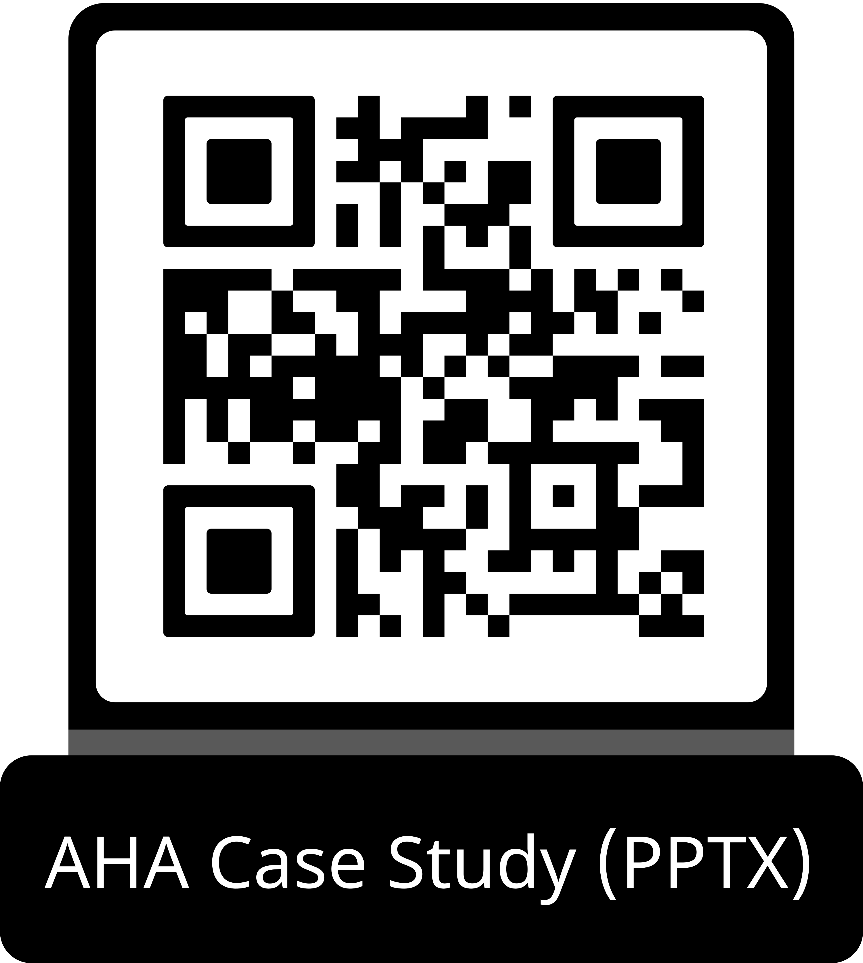
Guideline Essentials: Case Study Slide Series
Acute Ischemic Stroke Case Study
ADAPTED FROM:
Guidelines in Action: Flight of the
Mobile Stroke Unit

Slide 2
Case Presentation: Patient Profile
60-year-old male
CHIEF COMPLAINT:
Acute visual disturbances, right facial droop, right hemiparesis, word-finding difficulty, loss of consciousness
EMS RESPONSE:
EMS + Mobile Stroke Unit dispatched; met patient on the tarmac
CT HEAD (MSU):
No acute hemorrhage
TRANSFER:
Transported to thrombectomy-eligible hospital after MSU care
SETTING:
In-flight emergency on airplane; diverted and landed emergently
NIHSS ON MSU:
20 — hemiplegic, grunting, unable to follow commands
TREATMENT:
IV thrombolysis administered on MSU
Abbreviations: CT indicates computed tomography scan; EMS, emergency medical services; IV, intravenous; MSU, mobile stroke unit; and NIHSS, National Institutes of Health Stroke scale.
Gonzalez & Kaur. Guidelines in Action: Flight of the Mobile Stroke Unit. Stroke. 2026, doi:10.1161/STROKEAHA.125.053830

Slide 3
Case Presentation: In-Flight Timeline
1
In-Flight
Onset
Acute visual disturbances → right facial droop → hemiparesis → word-finding difficulty → loss of consciousness
2
Emergency Diversion
Medical
emergency activated;
flight diverted
and landed emergently
3
MSU on Tarmac
EMS and MSU dispatched;
teams board aircraft and bring patient to
MSU on tarmac
4
Prehospital Work-Up
NIHSS = 20;
CT head → no hemorrhage;
IV thrombolysis administered via virtual vascular neurologist
5
Transfer to Hospital
Positive LVO screening score → transported to thrombectomy-eligible hospital; improving
en route
Abbreviations: CT indicates computed tomography scan; EMS, emergency medical services; LVO, large vessel occlusion; MSU, mobile stroke unit; and NIHSS, National Institutes of Health Stroke scale.

Slide 4
Case Presentation: Hospital Course and Outcomes
20
NIHSS on MSU
Hemiplegic, grunting
5
NIHSS on Arrival ER
Decreased LOC,
dysarthria, ataxia
0
NIHSS at 90 Days
mRS = 0; full recovery
MRI Brain: Acute ischemic infarction of the bilateral medial thalami (Figure 1)
Diagnosis:
Infarct in vascular territory of the Artery of Percheron (AOP) — also consistent with tip-of-the-basilar syndrome. Bilateral medial thalamic infarction on diffusion-weighted MRI.
Key Takeaway:
Timely MSU activation and prehospital thrombolysis facilitated rapid neurological recovery. Discharge NIHSS = 1 (dysarthria only). Complete recovery at
90-day follow-up (NIHSS = 0, mRS = 0).
Abbreviations: AOP, indicates artery of Percheron; ER, emergency room; LOC, loss of consciousness; MRI, magnetic resonance imaging; mRS, modified Rankin scale; MSU, mobile stroke unit; NIHSS, and National Institutes of Health Stroke scale.

Slide 5
Case Presentation: Imaging
MRI Brain
Figure 1. Axial diffusion-weighted magnetic resonance imaging showing infarction of
the medial thalami.
Abbreviations: MRI indicates magnetic resonance imaging.

Slide 6
What Is a Mobile Stroke Unit?
Conceptualized in 2003 • First clinical use in Homburg, Germany (2008) • First US MSU in Houston, TX (2013)
CT
CT Scanner
Noncontrast (and optionally CT angiogram) for rapid hemorrhage exclusion and LVO detection
Lab
Point-of-Care Lab
Rapid blood glucose, coagulation, and other stroke-relevant tests on board
RX
Stroke Medications
IV thrombolytics (alteplase/
tenecteplase) and other acute stroke medications readily available
TX
Telemedicine Link
Virtual vascular neurologist for
real-time NIHSS assessment and treatment decision support
MD
Specialist Team
Registered nurse and/or paramedic with stroke training; some units have on-board neurologist
EMS
EMS Integration
Dispatched alongside or instead of standard EMS for suspected stroke calls
Abbreviations: CT indicates computed tomography scan; EMS, emergency medical services; IV, intravenous; LVO, large vessel occlusion; MD, Doctor of Medicine; MSU, mobile stroke unit; NIHSS, National Institutes of Health Stroke scale; RX, prescription; TX, treatment.

Slide 7
The Stroke Time Problem
<5%
Patients receive
thrombolysis or EVT
<15–40%
Arrive within
treatment window
4.5
NNT within 90 min
for excellent outcome
14
NNT at 181–270 min
for excellent outcome
THREE KEY DELAY POINTS
1
Patient Delay
Onset to emergency call — failure to recognize symptoms
2
Prehospital Delay
Onset to door — transport time, routing decisions
3
Intrahospital Delay
Door to treatment — workup, imaging, approvals
Abbreviations: EVT indicates endovascular thrombectomy; NNT, number needed to treat.

Slide 8
MSU Evidence: Randomized Trials
Key Finding:
MSU reduced onset-to-IVT time from 153 →
72 minutes. Proportion treated within 90 min:
37% → 58%. No safety concerns.
Walter et al. / PHANTOM-S
Berlin, Germany • 2012–2014
B_PROUD
Berlin, Germany • Prospective nonrandomized
Key Finding:
Improved 3-month functional outcomes
with MSU vs. standard EMS care (blinded
outcome assessment).
BEST-MSU
7 US Centers (primarily Houston) • Prospective nonrandomized
Key Finding:
Significant improvement in functional
outcomes at 3 months in patients treated via
MSU vs. standard EMS.
Abbreviations: EMS indicates emergency medical services; IVT, intravenous thrombolysis; and MSU, mobile stroke unit.

Slide 9
MSU Evidence: 2022 Systematic Review
& Meta-Analysis
Turc et al., JAMA Neurology 2022 • MSU vs. Standard EMS for Acute Ischemic Stroke
–30 min
Onset-to-IVT
Time Reduction
+65%
Increased Odds of
Excellent Outcome
Reduced Disability
at 90 Days
Higher Thrombolysis Rate (esp. Golden Hour)
All benefits achieved without significant safety concerns. Evidence on EVT metrics remains mixed pending CT angiogram availability.
Abbreviations: CT indicates computed tomography; EVT, endovascular thrombectomy; IVT, intravenous thrombolysis; and MSU, mobile stroke unit.

Slide 10
MSU & Endovascular Thrombectomy (EVT)
Without CT Angiogram
With CT Angiogram On-Board
B_PROUD and BEST-MSU found no significant association between MSU care and faster dispatch-to-thrombectomy time
No significant increase in thrombectomy rates compared
to standard EMS
Limited prehospital
LVO identification without vascular imaging
Shorter door-to-puncture time (Czap et al., Zhao et al.)
Earlier prehospital LVO
diagnosis and direct triage to EVT-capable centers
Earlier prenotification of receiving stroke teams
Greater estimated disability avoidance due to earlier EVT
Abbreviations: CT indicates computed tomography; EMS, emergency medical services; EVT, endovascular thrombectomy; IVT, intravenous thrombolysis; LVO, large vessel occlusion; and MSU, mobile stroke unit.

Slide 11
MSU in Intracerebral Hemorrhage (ICH)
INTERACT 4 Trial
Current Status
Fourth Intensive Ambulance-Delivered Blood Pressure Reduction in Hyper-Acute Stroke
MSU operational metrics similar to AIS care. Supports MSU utility in ICH management.
Mixed evidence on whether MSU improves ICH outcomes
Larger, dedicated ICH trials are needed
MSU may still benefit by enabling earlier BP management —
a critical intervention in ICH
B_PROUD ICH Subgroup (n=173)
Earlier imaging and lower systolic BP on arrival with MSU vs. conventional care. However, did NOT show improved outcomes. Subgroup was small with limitations — larger studies needed.
Abbreviations: AIS indicates acute ischemic stroke; BP, blood pressure; ICH, intracerebral hemorrhage; and MSU, mobile stroke unit.

Slide 12
MSU Cost-Effectiveness
Rajan et al., Ann Neurol 2025 • Prospective multicenter analysis at 7 US sites
Biggest Cost Drivers
$445,812
Average Annual Capital + Operational Cost per MSU
Personnel costs (team composition, on-board vs. telemedicine specialists, regional salaries)
Hardware costs (CT scanner, medications, diagnostics — can reduce via less expensive alternatives)
MSU IS COST-EFFECTIVE WHEN…
✓
Patients without preexisting disability are included in calculations
✓
Stroke-related downstream costs are accounted for (lifetime horizon)
✓
MSU treats a higher volume of patients annually
✓
Dispatch algorithms optimized through EMS collaboration
Abbreviations: CT indicates computed tomography; EMS, emergency medical services; and MSU, mobile stroke unit.

Slide 13
MSU Programs: Challenges & Limitations
1
Urban Coverage Bias
MSUs typically serve urban areas with limited catchment areas and high population density. Rural deployment remains challenging due to long drive times.
2
Cost & Sustainability
Hardware and personnel are major cost drivers. Programs require sustained funding and high patient volumes to remain cost-effective.
3
Technical Failures
Telemedicine-dependent models face risk of connectivity failures. Remote neurologists offer comparable accuracy, but technical reliability must be assured.
4
CT Angiogram Adoption
Most programs lack on-board CTA due to greater logistical requirements and unproven cost-effectiveness, limiting prehospital LVO triage accuracy.
5
ICH & Other Emergencies
Evidence for MSU in intracerebral hemorrhage remains mixed. Role in TBI, subarachnoid hemorrhage, and status epilepticus needs further research.
6
Rural/Low-Density Settings
Functional and economic impact in low-density or low-incidence settings is poorly studied. More research needed before widespread rural deployment.
Abbreviations: CT indicates computed tomography; CTA, computed tomography angiogram; ICH, intracerebral hemorrhage; LVO, large vessel occlusion; MSU, mobile stroke unit; TBI, traumatic brain injury.

Slide 14
2026 AHA/ASA Guideline: MSU Recommendations
Rajan et al., Ann Neurol 2025 • Prospective multicenter analysis at 7 US sites
COR | LOE | Recommendations
1 | A | In patients with suspected AIS, use of MSUs over conventional EMS where available is recommended for transport and management of thrombolytic-eligible patients — to ensure fastest achievable onset-to-treatment time and improve functional outcomes.
1 | A | In patients with suspected acute stroke, MSUs must be equipped to diagnose and treat patients with IV thrombolysis.
1 | B-R | MSU care, including streamlined protocols and neurological expertise (in-person or telemedicine), is beneficial for emergent evaluation and treatment of patient symptoms — without safety concerns.
2a | B-NR | For endovascular thrombectomy-eligible patients, use of MSUs can be beneficial to identify and triage patients to appropriate thrombectomy-capable facilities with prehospital notification.
Abbreviations: AIS indicates acute ischemic stroke; EMS, emergency medical servuces; and MSU, mobile stroke unit.

Slide 15
Guideline Implementation: MSU Protocol
How this case exemplifies the 2026 AHA/ASA recommendations in action
1
Co-Dispatch with EMS
MSU dispatched in conjunction with EMS for all suspected stroke calls — enabling simultaneous arrival on scene
2
On-Scene CT Imaging
CT scanner aboard MSU enabled immediate hemorrhage exclusion — critical for thrombolysis decision in this airfield case
3
Telemedicine Neurology
Virtual vascular neurologist performed NIHSS assessment and guided thrombolysis administration in real time
4
Point-of-Care Lab
Rapid blood work performed on board to clear patient for thrombolysis without hospital delay
5
IV Thrombolysis on MSU
Thrombolysis administered at the scene — consistent with COR 1, LOE A guideline recommendation
6
LVO Screening & Triage
Positive prehospital LVO screening score directed patient to thrombectomy-capable facility with prenotification
Abbreviations: COR indicates class of recommendation; CT, computed tomography; EMS, emergency medical services; IV, intravenous; LOE, level of evidence; LVO, large vessel occlusion; NIHSS, National Institutes of Health Stroke scale; and MSU, mobile stroke unit.

Slide 16
Take-Home Points
MSUs are specialized ambulances with CT scanners, point-of-care labs, stroke medications, and specialist teams — bringing stroke care to the emergency site.
Prehospital AIS management via MSU reduces onset-to-IVT time, increases thrombolysis rates, and improves 90-day functional outcomes without significant adverse effects.
When equipped with CT angiography, MSUs improve
LVO triage accuracy and reduce door-to-puncture time for endovascular thrombectomy.
MSUs are cost-effective (WHO CHOICE criteria) when serving sufficient patient volumes, accounting for lifetime stroke costs, and optimizing catchment areas.
Abbreviations: AIS indicates acute ischemic stroke; CT, computed tomography; IVT, intravenous thrombolysis; LVO, large vessel occlusion; MSU, mobile stroke unit; and WHO CHOICE, World Health Organization choosing interventions that are cost effective.

Slide 17
Key References
Prabhakaran S et al. 2026 AHA/ASA AIS Guideline. Stroke. 2026.
Walter S et al. Lancet Neurol. 2012;11:397–404.
Ebinger M et al. (STEMO). JAMA. 2014;311:1622–31.
Turc G et al. JAMA Neurol. 2022;79:281–290.
Parker SA et al. Stroke. 2015;46:1384–91.
Czap AL et al. Stroke. 2020;51:1613–15.
Rajan SS et al. Ann Neurol. 2025;97:209–221.
Cooley SR et al. Stroke. 2021;52:3163–66.

Slide 18
Citation
The American Heart Association requests this electronic slide deck be cited as follows:
Reyna, G.G. (2026). Guideline Essentials: Case Study Slide Series [PowerPoint slides]; Adapted from Guidelines in Action: Flight of the Mobile Stroke Unit. Stroke. Retrieved from:
Guideline Essentials: Case Study Slide Series - Professional Heart Daily | American Heart Association

Slide 19
Copyright and Permissions Notice
© Copyright 2026. American Heart Association. All rights reserved.
This material is the copyrighted property of the American Heart Association and is provided for reference purposes only. It may not be copied, reproduced, stored in a retrieval system, transmitted, altered in any way or used as a derivative work, or distributed in any form or by any means—electronic, mechanical, photocopying, recording, or otherwise—without prior written permission from the publisher.
This content may be used for limited educational and personal use. Further distribution or dissemination requires a licensing agreement. Unauthorized use or distribution in any media is strictly prohibited.
For permissions inquiries and licensing fee information,
please see the information/Request Form at this link:
https://www.heart.org/en/about-us/statements-and-policies/copyright-request-form
19

