Slide 1
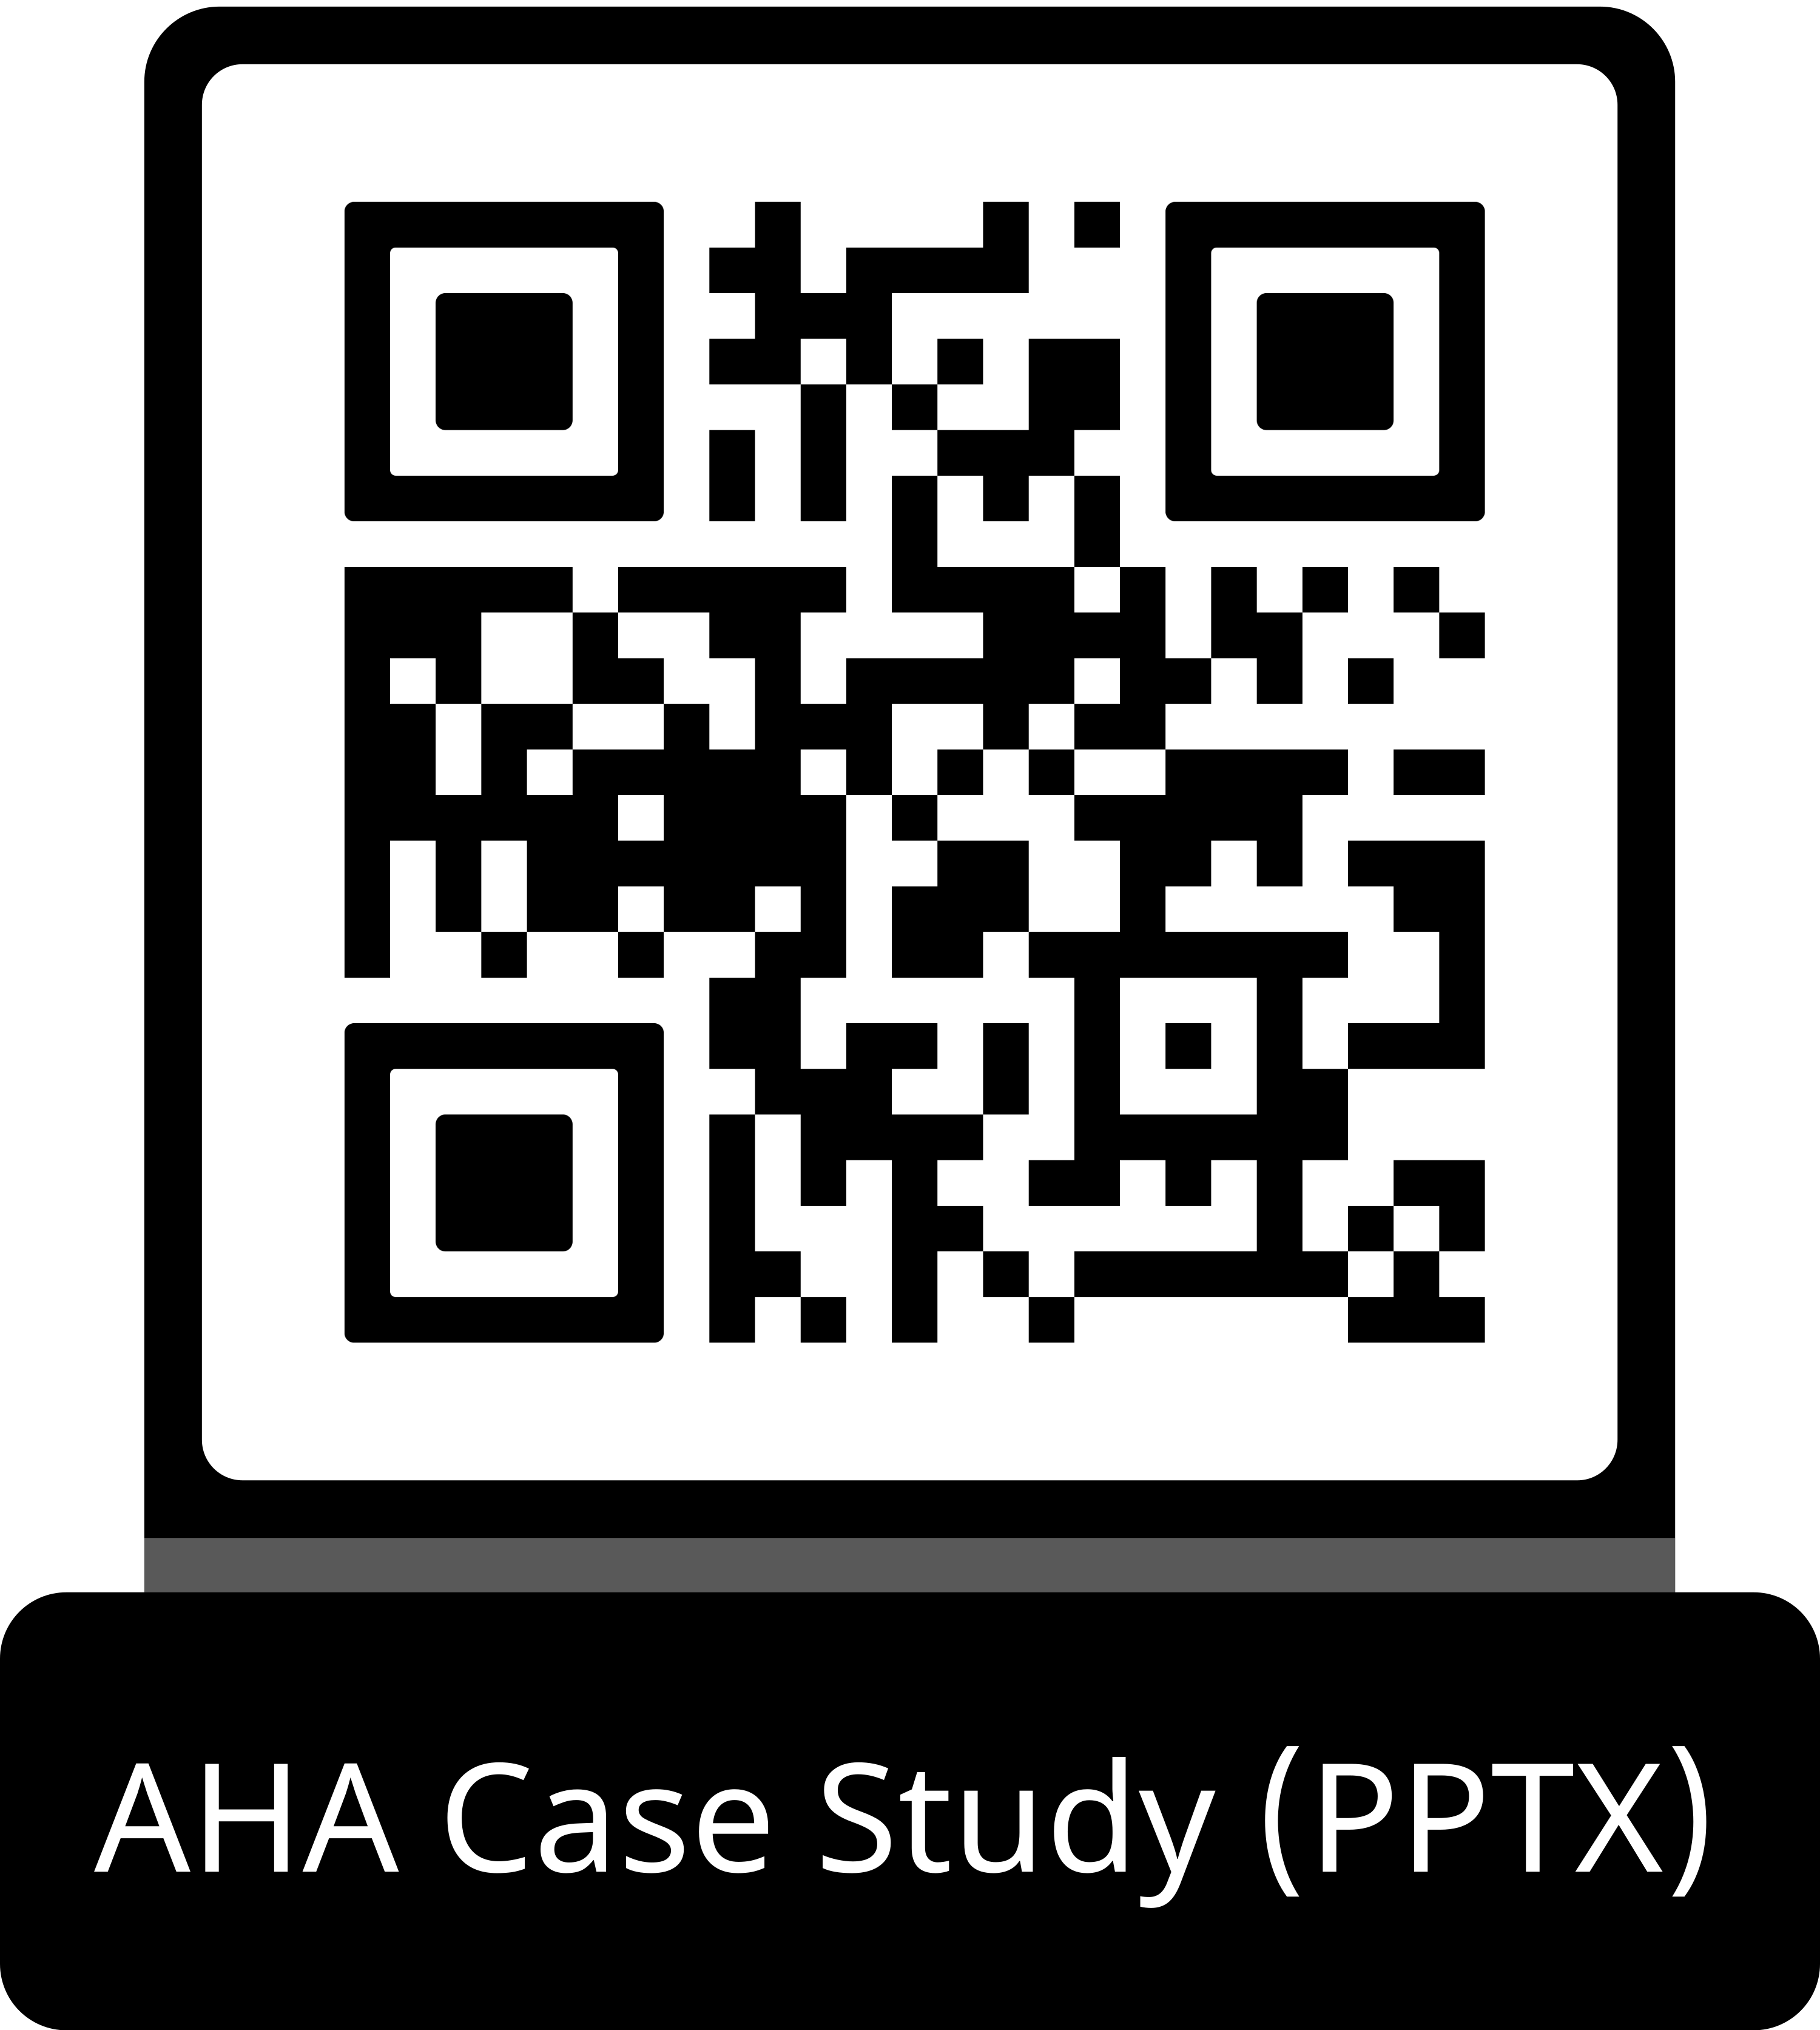
Guideline Essentials: Case Study Slide Series
Acute Ischemic Stroke Case Study
ADAPTED FROM:
Guidelines in Action: Dual Antiplatelet Therapy for Nondisabling Stroke
Within the 4.5-Hour Window

Slide 2
Case Presentation: Patient Profile
60-year-old male
HISTORY:
Hypertension (lisinopril)
SYMPTOM ONSET:
3.5 hours prior to presentation
CHIEF COMPLAINT:
Left facial & arm numbness
BLOOD PRESSURE:
Systolic high 170s on presentation
BLOOD GLUCOSE:
91 mg/dL
DENIED:
Headache, weakness, speech difficulties, vision problems
Osborne, A., et al. Guidelines in Action: Dual Antiplatelet Therapy for Nondisabling Stroke Within the 4.5-Hour Window. Stroke. 2026, doi:10.1161/STROKEAHA.125.053825

Slide 3
Case Presentation: Clinical Scores & Imaging
1
NIHSS Score
Mild sensory loss only
(left face and arm)
4
ABCD2 Score
Indicates high-risk TIA
threshold ≥4
91
Blood Glucose (mg/dL)
Within normal range;
no hypoglycemia
IMAGING FINDINGS:
✓
Initial Brain CT:
Unremarkable — no hemorrhage or obvious infarct (Figure 1)
✓
Intracranial & Cervical Vessels:
Unremarkable — no significant stenosis
12-Hour Brain MRI:
No acute infarction; chronic subcortical small vessel disease and lacunar infarcts confirmed (Figure 2)
✓
Perfusion Imaging (CBF/Tmax):
Unremarkable — no perfusion deficit
!
Abbreviations: ABCD2 indicates age, blood pressure, clinical features, duration of symptoms, and diabetes; CBF, cerebral blood flow; CT, computed tomography scan; MRI, magnetic resonance imaging; NIHSS, National Institutes of Health Stroke scale; and Tmax, time to maximum drug concentration.

Slide 4
Case Presentation: Imaging
✓
Initial Brain CT
Figure 1. A patient presents within 4.5 hours of the onset of left face and arm numbness. Initial imaging of the brain (A), intracranial vessels (B), cervical vessels (C), and perfusion imaging (D) were unremarkable. Cerebral blood flow (CBF), time-to-maximum (Tmax) perfusion.
Abbreviations: CBF indicates cerebral blood flow; CT, computed tomography scan; and Tmax, time to maximum drug concentration.

Slide 5
Case Presentation: Imaging continued
!
12-Hour Brain MRI
Figure 2. Magnetic brain imaging was obtained 12 hours later. A, No brain infarction was present. B, Subcortical chronic microvascular ischemic disease and chronic lacunar infarcts were present.
Abbreviations: MRI indicates magnetic resonance imaging.

Slide 6
Case Presentation: Treatment Decision
Patient arrives within
4.5-hour window
NIHSS = 1
Nondisabling symptoms
Thrombolysis
WITHHELD
DAPT Initiated in ER
Symptoms resolved within hours
TREATMENT ADMINISTERED:
Aspirin (immediate) + Loading dose of clopidogrel — administered in the Emergency Room
12-hour MRI confirmed no acute infarction. Chronic small vessel disease identified as the likely etiology (vs. cortical ischemia).
Abbreviations: DAPT indicates dual antiplatelet therapy; MRI, magnetic resonance imaging; and NIHSS, National Institutes of Health Stroke scale.

Slide 7
Why Not Thrombolysis? The Guideline
COR 3: No Benefit | LOE B-R
In eligible adult patients with AIS presenting with mild non-disabling stroke deficits within 4.5 hours of symptom onset or last known well, intravenous thrombolysis (IVT) is NOT recommended to improve functional outcomes compared with dual antiplatelet therapy.
!
IVT carries a small but clinically significant risk of symptomatic intracerebral hemorrhage (sICH)

DAPT is recommended as an alternative for early secondary stroke prevention in noncardioembolic minor AIS
Abbreviations: COR indicates class of recommendation; DAPT, dual antiplatelet therapy; LOE, level of evidence; IVT, intravenous thrombolysis; and sICH, symptomatic intracerebral hemorrhage.

Slide 8
Why Not Thrombolysis? Bleeding Risk
Symptomatic Intercerebral Hemorrhage (sICH) Rate Comparison
tPA/Alteplase
NINDS Trial-1995
Placebo
NINDS Trial-1995
DAPT (clopidogrel + aspirin)
POINT Trial
6.4%
0.6%
0.1%
DAPT carries approximately 64-fold lower sICH risk than tPA — a key factor in the COR 3 recommendation against thrombolysis in minor nondisabling AIS.
Abbreviations: AIS indicates acute ischemic stroke; COR, class of recommendation; DAPT, dual antiplatelet therapy; NINDS, National Institute of Neurological Disorders and Stroke; POINT, Platelet-oriented inhibition in new TIA and minor ischemic stroke; sICH, symptomatic intracerebral hemorrhage; and tPA, tissue plasminogen activator.

Slide 9
Key Trials: PRISMS
PRISMS Trial
Potential of rtPA for Ischemic Strokes With Mild Symptoms • 2018
Comparison Alteplase vs. Aspirin in minor nondisabling AIS
Primary Endpoint Functional independence (mRS 0–1) at 90 days
Key Finding No significant difference in functional independence at 90 days between alteplase and aspirin
Safety Signal Higher rate of symptomatic ICH in the alteplase group
Limitation Trial ended early; limited power — but findings supported antiplatelet therapy as a viable alternative
Significance Paved the way for further investigation of DAPT as a treatment for minor nondisabling AIS
Abbreviations: AIS indicates acute ischemic stroke; DAPT, dual antiplatelet therapy; ICH, intercerebral hemorrhage; mRS, modified Rankin scale; and PRISMS, Potential of rtPA for Ischemic Strokes With Mild Symptoms.

Slide 10
Key Trials: CHANCE & POINT
CHANCE
2013
POINT
2018
Clopidogrel in high-risk patients with acute non-disabling cerebrovascular events
Lower Stroke Recurrence
Population:
Minor AIS or high-risk TIA
Key Finding:
DAPT (clopidogrel + aspirin) significantly reduced risk of recurrent stroke compared with aspirin alone
LPlatelet-oriented inhibition in new TIA and minor ischemic stroke
Ischemic Events at 21 Days
Population:
High-risk TIA (ABCD2 ≥4) or minor AIS
(NIHSS ≤3) — international cohort
Key Finding:
Clear benefit of DAPT in reducing recurrent ischemic events within first 21 days after the inciting event; modest increase in bleeding risk
➔
➔
Abbreviations: ABCD2 indicates age, blood pressure, clinical features, duration of symptoms, and diabetes; AIS, acute ischemic stroke; CHANCE, clopidogrel in high-risk patients with acute non-disabling cerebrovascular events; DAPT, dual antiplatelet therapy; NIHSS, National Institutes of Health Stroke scale; POINT, Platelet-oriented inhibition in new TIA and minor ischemic stroke; and TIA, transient ischemic attack.

Slide 11
Key Trials: INSPIRES & ARAMIS
INSPIRES
2023
ARAMIS
2023
Lower Intensive statin and antiplatelet therapy for high-risk intracranial or extracranial atherosclerosis
90-Day Stroke Recurrence
Population:
Minor AIS (NIHSS <5); DAPT initiated within 72 hours of symptom onset
Key Finding:
Significantly reduced 90-day stroke recurrence; increased risk of moderate-to-severe bleeding
Antiplatelet Response Against Minor Ischemic Stroke
DAPT Noninferior to Alteplase
Population:
Minor nondisabling AIS presenting within
4.5 hours of symptom onset
Key Finding:
DAPT was noninferior to alteplase for excellent functional outcome (mRS 0–1) at
90 days; more adverse neurological and bleeding events in the alteplase group
➔
Abbreviations: AIS indicates acute ischemic stroke; ARAMIS, Antiplatelet Response Against Minor Ischemic Stroke; DAPT, dual antiplatelet therapy; INSPIRES, Intensive statin and antiplatelet therapy for high-risk intracranial or extracranial atherosclerosis; mRS, modified Rankin scale; and NIHSS, National Institutes of Health Stroke scale.

Slide 12
Key Trials: ATAMIS
ATAMIS
2024
CHANCE + POINT
Meta-Analysis
Antiplatelet Therapy in Acute Mild to Moderate Ischemic Stroke
Population:
Acute mild to moderate ischemic stroke
Comparison:
Clopidogrel + aspirin vs. aspirin alone
Key Finding:
Clopidogrel + aspirin was superior to aspirin alone in reducing early neurological deterioration; bleeding rates were similar between groups
Maximal DAPT benefit occurs within the first 21 days
Ideal initiation: within
24 hours of symptom onset
Benefits outweigh
bleeding risk within this
21-day window
Trial Timeline
CHANCE
2013
POINT
2018
INSPIRES
2023
ARAMIS
2023
ATAMIS
2024

Slide 13
2026 Guideline: Recommendation
COR 1 | LOE A
First-Line DAPT (clopidogrel + aspirin)
In patients with minor (NIHSS ≤3) noncardioembolic AIS or high-risk TIA (ABCD2 ≥4) who did not receive IVT, DAPT (aspirin and clopidogrel with loading dose of clopidogrel) should be initiated early (within 24 hours after symptom onset) and continued for 21 days, followed by single antiplatelet therapy (SAPT) to reduce the 90-day risk of recurrent ischemic stroke.
Timing
Initiate within 24 hours of symptom onset
Duration
Continue DAPT for
21 days, then switch
to SAPT
Target
Reduce 90-day
risk of recurrent ischemic stroke
Abbreviations: ABCD2 indicates age, blood pressure, clinical features, duration of symptoms, and diabetes; AIS, acute ischemic stroke; COR, class of recommendation; DAPT, dual antiplatelet therapy; IVT, intravenous thrombolysis; LOE, level of evidence; NIHSS, National Institutes of Health Stroke scale; and SAPT, single antiplatelet therapy.

Slide 14
2026 Guideline: Recommendations 2a & 2b
COR 2a | LOE B-R
DAPT for Large Artery
Atherosclerosis
Minor AIS (NIHSS ≤5) or high-risk
TIA (ABCD2 ≥4) within 24–72 hours with presumed atherosclerotic cause (≥50% stenosis on imaging): clopidogrel + aspirin for
21 days, then SAPT, to reduce
90-day recurrence.
COR 2b | LOE B-R
Ticagrelor + Aspirin —
CYP2C19 LOF Allele
Minor AIS (NIHSS ≤3) or high-risk TIA (ABCD2 ≥4) within 24 hours who carry the CYP2C19 loss-of-function allele: ticagrelor + aspirin for 21 days (then ticagrelor monotherapy) may be preferred over clopidogrel + aspirin.
Abbreviations: ABCD2 indicates age, blood pressure, clinical features, duration of symptoms, and diabetes; AIS, acute ischemic stroke; COR, class of recommendation;CYP2C19, Cytochrome P450 Family 2 Subfamily C Member 19; DAPT, dual antiplatelet therapy; LOE, level of evidence; LOF, loss of function; NIHSS, National Institutes of Health Stroke scale; SAPT, single antiplatelet therapy; and TIA, transient ischemic attack.

Slide 15
Ticagrelor + Aspirin: Special Considerations
Why Does the CYP2C19 Genotype Matter?
Patients carrying the CYP2C19 loss-of-function allele cannot fully convert clopidogrel into its active metabolite. This means they may not receive the expected reduction in platelet aggregation — potentially leaving them less protected against recurrent stroke.
When to Consider Ticagrelor + Aspirin
CYP2C19 loss-of-function allele confirmed
NIHSS ≤3 noncardioembolic AIS or
high-risk TIA (ABCD2 ≥4)
Within 24 hours of symptom onset
Did not receive IV thrombolysis
Follow with ticagrelor monotherapy at
Day 21 (not aspirin alone)
When to Use Caution
⚠ Higher bleeding risk from any source vs. clopidogrel regimen
⚠ Recent surgery or invasive procedures
⚠ History of gastrointestinal bleeding
⚠ Other recent bleeding events
• Weigh individual patient risk-benefit before choosing ticagrelor
Abbreviations: CYP2C19 indicates Cytochrome P450 Family 2 Subfamily C Member 19; and IV, intravenous.

Slide 16
DAPT Timing: When to Start & How Long
0 hrs
< 24 hrs
≤ 72 hrs
Day 21
90 days
DAPT Window
Symptom Onset
Ideal DAPT Initiation
Extended Window
Switch to SAPT
90-Day Follow-Up
< 24 hrs
Ideal initiation window
Day 21
Duration of dual therapy
90 days
Primary trial endpoint
Abbreviations: DAPT indicates dual antiplatelet therapy; and SAPT, single antiplatelet therapy.

Slide 17
Treatment Regimen: Clopidogrel + Aspirin
COR 1 | LOE A
Standard First-Line Regimen
Supported by CHANCE, POINT, INSPIRES
Loading Dose
Administer loading dose of clopidogrel + aspirin as soon as possible (ideally in the ER)
Initiation Window
Begin within 24 hours of symptom
onset for maximum benefit
Duration
Continue clopidogrel + aspirin for
21 days
Transition
Switch to single antiplatelet therapy (SAPT) at Day 21
Monitoring
Assess for bleeding; consider 90-day follow-up for stroke recurrence
Genetic Consideration
If CYP2C19 loss-of-function allele suspected or confirmed, consider ticagrelor instead
Abbreviations: COR, class of recommendation; CYP2C19, Cytochrome P450 Family 2 Subfamily C Member 19; DAPT, dual antiplatelet therapy; ER, emergency room; LOE, level of evidence; and SAPT, single antiplatelet therapy.

Slide 18
Knowledge Gaps & Future Directions
Imaging Modality
PRISMS, ARAMIS, and ATAMIS used CT or MRI to exclude hemorrhage — not stratified by modality. MRI is more sensitive for early ischemia but less widely available. Whether imaging selection influences treatment effect remains uncertain.
Patient Selection: DAPT vs. Thrombolysis
Pooled patient-level and subgroup analyses are needed to clarify which patients benefit most from DAPT versus IVT — based on clinical, imaging, and demographic characteristics.
Reducing Stroke Mimic Treatment
Better clinical and imaging criteria are needed to ensure patients receiving DAPT have true ischemic stroke rather than mimics, minimizing unnecessary treatment risk.
Optimal Duration & Bleeding Trade-Offs
The 21-day window balances efficacy against bleeding risk. Future research should explore whether shorter or longer durations optimize outcomes in specific subgroups.
Abbreviations: CT indicates computed tomography scan; DAPT, dual antiplatelet therapy; IVT, intravenous thrombolysis; and MRI, magnetic resonance imaging.

Slide 19
Take-Home Points
Disabling vs. Nondisabling Goes Beyond NIHSS
ADL limitations (walking, eating, driving, employment) must factor into the thrombolysis decision.
IVT Not Recommended for Minor Nondisabling AIS
Within 4.5 hours, IVT has shown no superiority over DAPT — COR 3 per 2026 AHA/ASA Guidelines.
Start DAPT Early — Ideally Within 24 Hours
Initiate clopidogrel + aspirin as soon as possible; maximal benefit is within the first 21 days.
Ticagrelor May Be Preferred in CYP2C19 LOF Carriers
When clopidogrel cannot be fully activated, ticagrelor + aspirin is a reasonable alternative, but carries higher bleeding risk.
Abbreviations: ADL indicates activities of daily living; AIS, acute ischemic stroke; COR, class of recommendation;CYP2C19, Cytochrome P450 Family 2 Subfamily C Member 19; DAPT, dual antiplatelet therapy; IVT, intravenous thrombolysis; LOF, loss of function; and NIHSS, National Institutes of Health Stroke scale.

Slide 20
References
Prabhakaran S. 2026 guideline for the early management of patients with AIS: a guideline from the AHA/ASA. Stroke. 2026. doi: 10.1161/STR.0000000000000513
Wang Y, et al; CHANCE Investigators. Clopidogrel with aspirin in acute minor stroke or transient ischemic attack. N Engl J Med. 2013;369:11–19.
Johnston SC, et al; POINT Investigators. Clopidogrel and aspirin in acute ischemic stroke and high-risk TIA. N Engl J Med. 2018;379:215–225.
Gao Y, et al; INSPIRES Investigators. Dual antiplatelet treatment up to 72 hours after ischemic stroke. N Engl J Med. 2023;389:2413–2424.
Pan Y, et al. Outcomes associated with clopidogrel-aspirin use in minor stroke or TIA: a pooled analysis of CHANCE and POINT Trials. JAMA Neurol. 2019;76:
1466–1473.
NINDS rt-PA Stroke Study Group. Tissue plasminogen activator for acute ischemic stroke. N Engl J Med. 1995;333:1581–1588.
Khatri P, et al; PRISMS Investigators. Effect of alteplase vs aspirin on functional outcome for patients with AIS and minor nondisabling deficits. JAMA. 2018;320:156–166.
Chen HS, et al; ARAMIS Investigators. Dual antiplatelet therapy vs alteplase for patients with minor nondisabling AIS. JAMA. 2023;329:2135–2144.
Chen HS, et al; ATAMIS Investigators. Clopidogrel plus aspirin vs aspirin alone in acute mild to moderate stroke. JAMA Neurol. 2024;81:450–460.
Pereira NL, et al; AHA. CYP2C19 genetic testing for oral P2Y12 inhibitor therapy: a scientific statement from the AHA. Circulation. 2024;150:e129–e150.

Slide 21
Citation
The American Heart Association requests this electronic slide deck be cited as follows:
Reyna, G.G. (2026). Guideline Essentials: Case Study Slide Series [PowerPoint slides]; Adapted from Guidelines in Action: Dual Antiplatelet Therapy for Nondisabling Stroke Within the 4.5-Hour Window. Stroke. Retrieved from:
Guideline Essentials: Case Study Slide Series - Professional Heart Daily | American Heart Association

Slide 22
Copyright and Permissions Notice
© Copyright 2026. American Heart Association. All rights reserved.
This material is the copyrighted property of the American Heart Association and is provided for reference purposes only. It may not be copied, reproduced, stored in a retrieval system, transmitted, altered in any way or used as a derivative work, or distributed in any form or by any means—electronic, mechanical, photocopying, recording, or otherwise—without prior written permission from the publisher.
This content may be used for limited educational and personal use. Further distribution or dissemination requires a licensing agreement. Unauthorized use or distribution in any media is strictly prohibited.
For permissions inquiries and licensing fee information,
please see the information/Request Form at this link:
https://www.heart.org/en/about-us/statements-and-policies/copyright-request-form
22

