Slide 1

2026 Guideline for Adult Stroke Rehabilitation and Recovery:
A Guideline from the American
Heart Association and
American Stroke Association
Key Nursing Updates and Review
from the Nursing Perspective
Notes:
This slide presentation highlights key recommendations from the 2026 Guideline for Adult Stroke Rehabilitation and Recovery that are particularly relevant to nursing practice. It is not a comprehensive review of the entirety of the 2026 Guideline for Adult Stroke Rehabilitation and Recovery but should be considered a quick summary of relevant content for nurses.

Slide 2
2026 Guideline for Adult Stroke Rehabilitation and Recovery: A Guideline from the American Heart Association and American Stroke Association
Guideline Writing Group
Lorie G. Richards, PhD, OTR/L, FAHA, Chair; Nneka L. Ifejika, MD, MPH, FAHA, Vice Chair; Joel Stein, MD, FAHA, Vice Chair; Mona N. Bahouth, MD, PhD; Martha Abshire Saylor, PhD, MSN, RN, FAHA; A.M. Barrett, MD; Peii Chen, PhD; Anne F. Deutsch, PhD, RN; Wendy Dusenbury, PhD, DNP, FAHA; Charles Ellis Jr, PhD, CCC-SLP; Janice Eng, PhD; Jamie Fleet, MD; Heather R. Ford, MOT, OTR/L; Emily Grattan, PhD, OTR/L; Richard L. Harvey, MD, FAHA; Corinne Jones, PhD, SLP; Chandramouli Krishnan, PhD, PT; Sara Kutzle; Deven Matthews; Nicole Mazwi, MD; Jamila Minga, PhD, CCC-SLP; Dawn M. Nilsen, EdD, OTR/L; Elizabeth Noser, MD; Heather R. Porter, PhD, CTRS, FDRT; Preeti Raghavan, MBBS; Dorian Rose, MS, PhD, PT; Elizabeth R. Skidmore, PhD, OTR/L; Marie-Pierre St-Onge, PhD, FAHA; Mary Ellen Stoykov, PhD, OTR/L; Amelia Tenberg Schettini, MSN; Alexandra L. Terrill, PhD; David L. Tirschwell, MD, MSc, FAHA; Paul Vilar, MSN, RN, SCRN; Alicen Whitaker-Hilbig, DPT, PhD; Richard Zorowitz, MD, FAHA
See the Guideline for the Writing Group Members’ affiliations and disclosures

Slide 3
2026 Guideline for Adult Stroke Rehabilitation and Recovery: A Guideline from the American Heart Association and American Stroke Association continued
PEER REVIEW COMMITTEE
Warren Lo, MD, Chair; George F. Wittenberg, MD, PhD, Vice Chair; Allison E. Gaffey, PhD, FAHA; Dipika Aggarwal, MD; Maria Cecilia Alpasan, PhD, OTR/L; E. Jackson Amburn, CBIS, MS, CTRS; Sarah Ashcroft, PhD, MCEP; Oluwole Awosika, MD, FAHA; Tamilyn Bakas, PhD, RN, FAAN, FAHA; Mark Bowden, PhD, PT; Robynne Braun, MD, Ph†; Julia Carpenter, MA, CCC‑SLP; John Chae, MD; Paula de la Pena, PhD, RN; Wuwei Feng, MD, MS, FAHA; Margaret A. French, PhD, DPT, Mark P. Goldberg, MD, FAHA; Marlis Gonzalez‑Fernandez, MD, PhD; Jocelyn Harris, PhD; Abhishek Jaywant, PhD; Gert Kwakkel, PhD, PT; Catherine E. Lang, PhD; David J. Lin, MD; Barbara Lutz, PhD, FAHA; Laura M. McPherson, DPT, PhD; Emilia Michou, PhD, PGDip, CertMRCSLT; Vu Nguyen, MD, MBA; DaiWai Olson, PhD, RN; Ela B. Plow, PhD, PT; Robin White (Chism); Lauren Winterbottom, EdD, OTR/L; Stephanie Zawada, PhD, MS; Elizabeth Zink, PhD, MSN, RN
See the Guideline for the Writing Group Members’ affiliations and disclosures

Slide 4
Slide Set Developed By:
Anne Deutsch, PhD, RN, CRRN
Guideline Writing Group Member
Tamilyn Bakas, PhD, RN, FAAN, FAHA
Peer Review Committee Member
Anne Leonard, BSN, MPH, RN, FAHA
AHA – National Senior Director for Science and Medicine
on behalf of the:
2026 Guideline for Adult Stroke Rehabilitation and Recovery:
A Guideline From the
American Heart Association and
American Stroke Association
https://www.ahajournals.org/doi/10.1161/STR.0000000000000536

Slide 5
1. Introduction
2026 GUIDELINE FOR Adult Stroke Rehabilitation and Recovery
KEY NURSING UPDATES AND REVIEW
Notes:
The slide deck focuses on care of adults with stroke. It does not cover the care of pediatric patients with stroke.

Slide 6
Introduction
Facets of the Stroke Survivor’s Journey Through Adult Stroke Rehabilitation and Recovery: Nursing Implications
Poststroke Rehabilitation Levels of Care
Sensory Motor Impairments and Activities
Stroke Survivor and Family
Prevention and Management of Comorbidities
Cognition and Communication
Transitions in Care and Community Rehabilitation, including family caregiver support
Assessment

Slide 7
Purpose Statement
This presentation highlights key recommendations from the 2026 Guideline for Adult Stroke Rehabilitation and Recovery that are particularly relevant to nursing practice and can be used by organizations worldwide to standardize clinical practice for the care of adult patients with stroke. Nurses are integral in developing evidence-based systems of rehabilitation care for patients with stroke. While the entire guideline informs quality care delivery, nurses are uniquely positioned to identify, monitor, and respond to specific clinical situations that directly impact patient outcomes.
The topics presented here reflect the clinical decisions and assessments that nurses routinely encounter in practice—from prevention of complications and management of comorbidities to ensuring continuity through the rehabilitation process and into the community. This slide deck includes nursing clinical practice care specific to the adult stroke population, emphasizing those points of care where nursing knowledge, vigilance, and clinical judgment make a tangible difference in patient recovery and well-being.
By focusing on these specific areas, we aim to strengthen nurses' understanding of evidence-based practices that support organizational efforts to standardize stroke rehabilitation and recovery care and empower nurses to deliver the highest standard of care in their everyday practice.
This slide deck was adapted from the 2026 Guideline for Adult Stroke Rehabilitation and Recovery. The Guideline and its references are available at: https://www.ahajournals.org/doi/10.1161/STR.0000000000000536

Slide 8
Class
(Strength) of Recommendation (COR) and
Level (Quality) of Evidence (LOE)
CLASS (STRENGTH) OF RECOMMENDATION
CLASS 1 (STRONG) Benefit >>> Risk
Suggested phrases for writing recommendations: Is recommended Is indicated/useful/effective/beneficial Should be performed/administered/other Comparative-Effectiveness Phrases†: Treatment/strategy A is recommended/indicated in preference to treatment B Treatment A should be chosen over treatment B
CLASS 2a (MODERATE) Benefit >> Risk
Suggested phrases for writing recommendations: Is reasonable Can be useful/effective/beneficial Comparative-Effectiveness Phrases†: Treatment/strategy A is probably recommended/indicated in preference to treatment B It is reasonable to choose treatment A over treatment B
CLASS 2b (Weak) Benefit ≥ Risk
Suggested phrases for writing recommendations: May/might be reasonable May/might be considered Usefulness/effectiveness is unknown/unclear/uncertain or not well-established
CLASS 3: No Benefit (MODERATE) Benefit = Risk
Suggested phrases for writing recommendations: Is not recommended Is not indicated/useful/effective/beneficial Should not be performed/administered/other
CLASS 3: Harm (STRONG) Risk > Benefit
Suggested phrases for writing recommendations: Potentially harmful Causes harm Associated with excess morbidity/mortality Should not be performed/administered/other
LEVEL (QUALITY) OF EVIDENCE‡
LEVEL A
High-quality evidence‡ from more than 1 RCT Meta-analyses of high-quality RCTs One or more RCTs corroborated by high-quality registry studies
LEVEL B-R (Randomized)
Moderate-quality evidence‡ from 1 or more RCTs Meta-analyses of moderate-quality RCTs
LEVEL B-NR (Nonrandomized)
Moderate-quality evidence‡ from 1 or more well-designed, well-executed nonrandomized studies, observational studies, or registry studies Meta-analyses of such studies
LEVEL C-LD (Limited Data)
Randomized or nonrandomized observational or registry studies with limitations of design or execution Meta-analyses of such studies Physiological or mechanistic studies in human subjects
LEVEL C-EO (Expert Opinion)
Consensus of expert opinion based on clinical experience.
COR: The Class of Recommendation indicates the strength of a recommendation, based on the benefits of a treatment weighed against its risks. It's essentially a grade for what a clinician should do.
LOE: The Level of Evidence explains the quality of the scientific research that supports the recommendation. It tells you how confident the experts are in the data behind the recommendation.
COR and LOE are determined independently (any COR may be paired with any LOE).
A recommendation with LOE C does not imply that the recommendation is weak. Many important clinical questions addressed in guidelines do not lend themselves to clinical trials. Although RCTs are unavailable, there may be a very clear clinical consensus that a particular test or therapy is useful or effective.
* The outcome or result of the intervention should be specified (an improved clinical outcome or increased diagnostic accuracy or incremental prognostic information).
† For comparative-effectiveness recommendation (COR 1 and 2a; LOE A and B only), studies that support the use of comparator verbs should involve direct comparisons of the treatments or strategies being evaluated.
‡ The method of assessing quality is evolving, including the application of standardized, widely-used, and preferably validated evidence grading tools; and for systematic reviews, the incorporation of an Evidence Review Committee.
COR indicates Class of Recommendation; EO, expert opinion; LD, limited
data; LOE, Level of Evidence; NR, nonrandomized; R, randomized;
and RCT, randomized controlled trial.
Notes:
First, let’s review how Guidelines are structured. When the American Heart Association (AHA) and other organizations issue guidelines, they employ a structured rating system to help clinicians and patients understand the strength of the recommendation. This system uses two categories: the Class of Recommendation (COR) and the Level of Evidence (LOE).
The COR indicates the strength of recommendation, encompassing the estimated magnitude and certainty of benefit in proportion to the risk. The LOE rates the quality of scientific evidence supporting the intervention based on the type, quantity, and consistency of data from clinical trials and other sources. Please note, COR and LOE are determined independently (any COR may be paired with any LOE). ¹
Class of Recommendation²:
Class 1 (Strong): The treatment is highly effective and beneficial. It is recommended and should be used for most patients in most circumstances.
Class 2a (Moderate): The treatment is probably beneficial. The weight of evidence or expert opinion is in favor of its use. It is reasonable to consider for most patients.
Class 2b (Weak): The treatment may be beneficial, but its usefulness is not as well-established. It may be considered in some cases, but the decision should be tailored to the individual patient.
Class 3 (Harm/No Benefit): The treatment is not helpful and could be harmful. It is not recommended.
Level of Evidence:
Level A (Highest Quality): Supported by high-quality evidence from multiple, large-scale randomized controlled trials (studies where some patients get the treatment and some get a placebo). The findings are very consistent.
Level B (Moderate Quality): Supported by a single, good-quality randomized trial or several non-randomized studies. The evidence is less certain than Level A.
B-R – Randomized trial(s)
B-NR – Nonrandomized trial(s)
Level C (Limited Quality): Based on the opinion of experts, small studies, or general medical practice. There are not enough high-quality studies to definitively prove a benefit.
C-LD – Limited data
C-EO – Expert Opinion
This slide deck will provide the rating given to each of the new key updates that may impact nursing practice.
Halperin JL, Levine GN, Al-Khatib SM, Birtcher KK, Bozkurt B, Brindis RG, Cigarroa JE, Curtis LH, Fleisher LA, Gentile F, Gidding S, Hlatky MA, Ikonomidis J, Joglar J, Pressler SJ, Wijeysundera DN. Further Evolution of the ACC/AHA Clinical Practice Guideline Recommendation Classification System: A Report of the American College of Cardiology/American Heart Association Task Force on Clinical Practice Guidelines. J Am Coll Cardiol. 2016 Apr 5;67(13):1572-1574. doi: 10.1016/j.jacc.2015.09.001. Epub 2015 Sep 24. PMID: 26409257.

Slide 9
2. Poststroke Rehabilitation
Levels of Care
2026 GUIDELINE FOR Adult Stroke Rehabilitation and Recovery
KEY NURSING UPDATES AND REVIEW

Slide 10
Poststroke Rehabilitation
Levels of Care
Facets of the Stroke Survivor’s Journey Through Adult Stroke Rehabilitation and Recovery: Nursing Implications
Introduction
Sensory Motor Impairments and Activities
Stroke Survivor and Family
Prevention and Management of Comorbidities
Cognition and Communication
Transitions in Care and Community Rehabilitation, including family caregiver support
Assessment

Slide 11
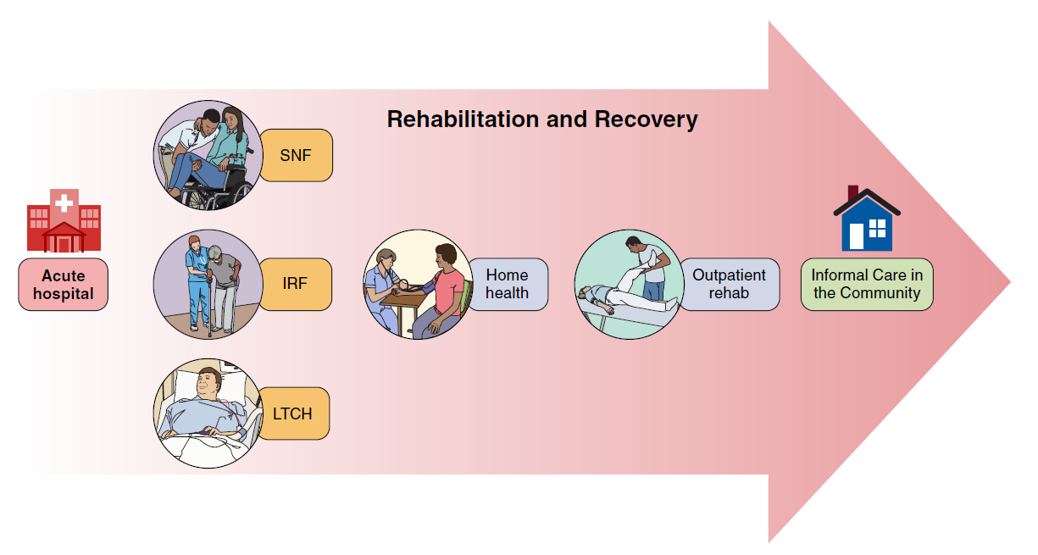
The Rehabilitation Program and Levels of Care
Abbreviations: SNF indicates skilled nursing facility; IRF, inpatient rehabilitation facility; and LTCH, long-term care hospital.
Notes:
After an acute care stay, patients with stroke can receive post-acute care from one or more types of providers, including inpatient rehabilitation facilities, skilled nursing facilities, long-term care hospitals, home health care, outpatient. Informal care in home care settings is also provided to support stroke survivors.

Slide 12


Recommendations 2.1 (Part 1):
Postacute Rehabilitation Care (Levels of Care)
COR | LOE
1 | A | In persons with stroke who are candidates for postacute rehabilitation, organized, coordinated, interprofessional care is recommended to achieve maximal functional independence.
1 | B-NR | In persons with stroke who qualify for inpatient rehabilitation facility (IRF) care, treatment in an IRF in preference to a skilled nursing facility (SNF) is recommended to achieve more functional improvement by discharge and higher rates of community discharge.

Slide 13

Recommendations 2.1 (Part 2):
Postacute Rehabilitation Care (Levels of Care)
COR | LOE
1 | C-LD | In persons with stroke seeking outpatient or home-based rehabilitation, organized community-based and coordinated interprofessional rehabilitation care is recommended to achieve more functional improvement.
2a | C-LD | In persons with stroke who are unable to return directly home after hospitalization and do not qualify for or lack geographic access to inpatient rehabilitation facility (IRF) care, skilled nursing facility (SNF) care can be useful for individuals to achieve additional functional improvement.
2a | C-EO | In persons with stroke who have completed care in an IRF but are unable to return directly home because of ongoing rehabilitation needs, medical requirements, or personal care needs, SNF care can be useful to achieve more functional improvement.

Slide 14
3. Prevention and Management of Comorbidities
2026 GUIDELINE FOR Adult Stroke Rehabilitation and Recovery
KEY NURSING UPDATES AND REVIEW

Slide 15
Prevention and Management of Comorbidities
Facets of the Stroke Survivor’s Journey Through Adult Stroke Rehabilitation and Recovery: Nursing Implications
Introduction
Poststroke Rehabilitation Levels of Care
Sensory Motor Impairments and Activities
Stroke Survivor and Family
Cognition and Communication
Transitions in Care and Community Rehabilitation, including family caregiver support
Assessment

Slide 16
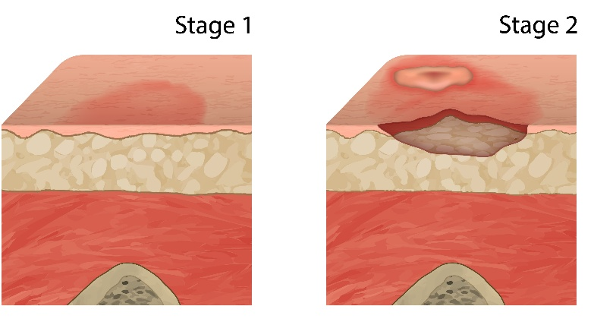
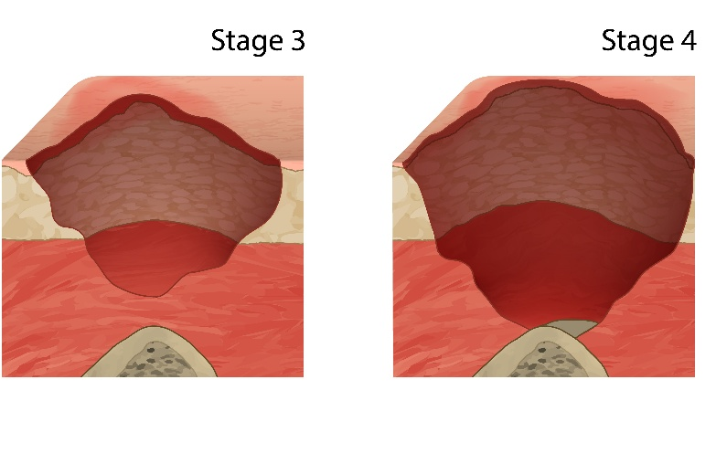
Recommendations 3.1 (Part 1):
Prevention of Skin Breakdown
COR | LOE
1 | A | In persons with acute stroke, regular skin assessments are recommended during acute hospitalization and postacute care using valid measurement instruments (eg, the Braden Scale) to monitor for skin breakdown.
1 | A | In persons with stroke and limited mobility, skin friction should be minimized through the use of foam dressings and durable medical equipment such as pressure-reducing supporting surfaces, reduction of moisture, and maintenance of adequate nutrition and hydration to reduce the occurrence of skin breakdown.
1 | B-R | Persons with stroke, caregivers, and clinical staff should be educated about the prevention of skin breakdown among persons with stroke and limited mobility.

Slide 17
Recommendations 3.1 (Part 2):
Prevention of Contractures
COR | LOE
2a | B-NR | In persons with poststroke spasticity of upper or lower limbs, programs encouraging stretching are reasonable to improve neural, mechanical, and structural changes in involved muscle regions and to prevent contracture.
2b | C-LD | In persons with stroke and hemiplegia, positioning of the hemiplegic shoulder in external rotation, with pain-free shoulder abduction and elbow extension twice daily, while the patient is sitting or in bed for 30 minutes daily, may be reasonable to minimize contracture.
2b | B-NR | In persons with stroke and hemiplegia affecting the lower limb, wearing resting ankle splints when in bed may be considered to prevent contracture.
2b | B-R | In persons with stroke and mild to moderate elbow and wrist contractures, use of serial casting or static adjustable splints may be considered to reduce contractures.
2b | C-LD | In patients with substantial elbow contractures and pain, surgical release of brachialis, brachioradialis, and biceps muscles may be considered to reduce pain and improve mobility.

Slide 18
Recommendations 3.2:
Venous Thromboembolism Prevention
COR | LOE
1 | B-R | In persons with acute stroke who have moderate to severe mobility limitations, intermittent pneumatic compression (IPC) is recommended to reduce the risk of venous thromboembolism (VTE).
3: Harm | B-R | In persons with stroke, use of elastic compression stockings is not effective for the prevention of VTE.
2b | A | In persons with acute ischemic stroke who are hospitalized and have limited mobility, the benefit of prophylactic-dose subcutaneous heparin (unfractionated heparin [UFH] or low-molecular-weight heparin [LMWH]) on reducing pulmonary embolism (PE), mortality, or dependent functioning is unclear given the risk of intracranial hemorrhage (ICH) and extracranial hemorrhage.
2b | B-R | In persons with acute ischemic stroke who are hospitalized and have limited mobility, there is an uncertain benefit of prophylactic-dose LMWH over prophylactic-dose UFH to reduce PE, mortality, or dependent functioning given the risk of ICH and extracranial hemorrhage.
2b | B-R | In persons with acute ICH who are hospitalized and have limited mobility, the benefit of prophylactic-dose subcutaneous heparin (UFH or LMWH) to reduce PE, mortality, or dependent functioning is unclear.

Slide 19
Recommendations 3.3:
Treatment of Bladder Dysfunction
COR | LOE
1 | B-NR | In persons with stroke, assessment of the patient’s premorbid urological issues is recommended to develop a bladder care plan.
1 | B-NR | In persons with poststroke urinary incontinence or retention, assessment of urinary retention through volumetric bladder scanning or postvoid catheterization is recommended to develop a bladder care plan.
1 | B-NR | In persons with stroke admitted to postacute care rehabilitation with an indwelling catheter, removal of any urinary catheter within 24 hours after placement is recommended to improve urinary outcomes.
2a | B-NR | In persons with stroke, assessment of cognitive awareness of the need to void or of having voided is reasonable to develop a bladder care plan.
2b | B-R | In persons with stroke with urinary incontinence, timed prompted voiding might be reasonable to reduce urinary incontinence.
2b | B-R | In persons with chronic stroke with urinary incontinence, pelvic floor muscle training (PFMT) might be reasonable to reduce urinary incontinence.
2b | B-R | In persons with stroke with urinary incontinence, noninvasive electrical stimulation might be reasonable to reduce urinary incontinence.

Slide 20
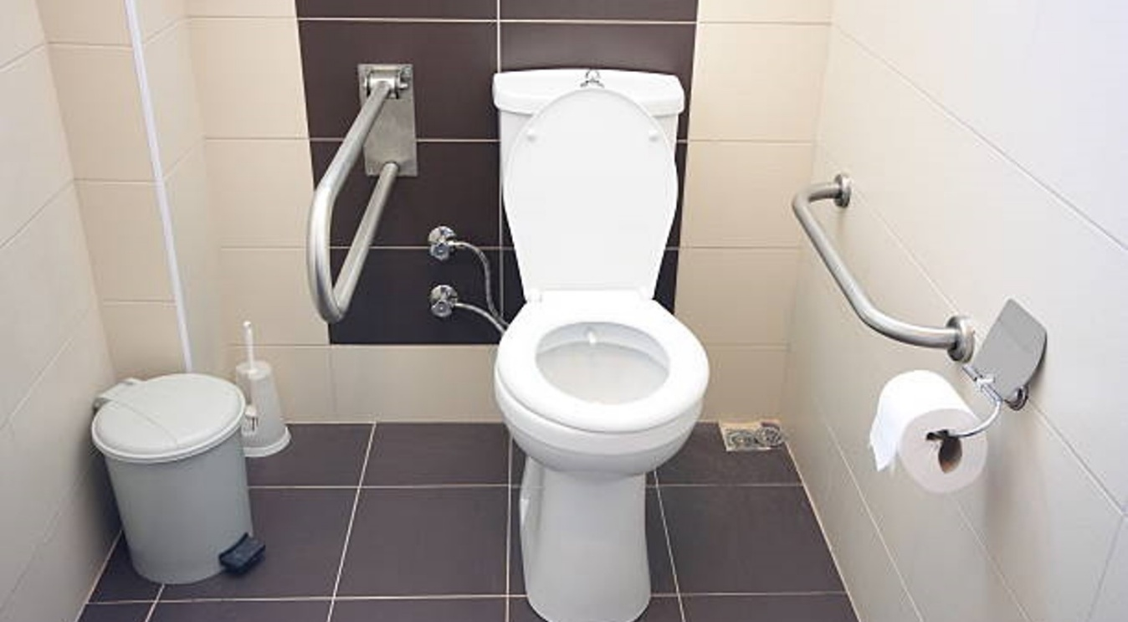
Recommendations 3.3:
Treatment of Bowel Dysfunction
COR | LOE
2b | B-NR | In persons with stroke, assessment of pre-morbid bowel functioning might be reasonable to establish a bowel management care plan.

Slide 21

Recommendations 3.4:
Prevention and Treatment of Hemiplegic Shoulder Pain
COR | LOE
1 | B-NR | In persons with stroke, providing patient and caregiver education (ie, range of motion [ROM], positioning) for hemiplegic shoulder care, particularly before discharge or transitions in care, is recommended to increase confidence with shoulder care and to prevent shoulder injury.
2a | B-R | In persons with shoulder subluxation after stroke, it is reasonable to consider using positioning devices and slings to provide support to the shoulder to prevent worsening of subluxation.
2a | B-R | In persons with spastic shoulder muscles after stroke, botulinum toxin (BT) injection can be useful to decrease hemiplegic shoulder pain (HSP).
2a | B-R | In persons with HSP after stroke who have clinical signs and symptoms of neuropathic pain manifested as sensory changes in the shoulder region, allodynia, or hyperpathia, a trial of neuromodulating treatments, such as peripheral nerve stimulation (PNS), is reasonable to reduce pain.
2a | B-R | In persons with HSP after stroke, corticosteroid injections, suprascapular nerve block (SSNB), high-intensity laser therapy (HILT), extracorporeal shock wave therapy (ESWT), neuromuscular electrical stimulation (NMES), Kinesio taping, and acupuncture can be useful as adjuncts to standard rehabilitation, to reduce shoulder pain and improve upper extremity ROM.
3: Harm | C-EO | In persons with stroke who have glenohumeral joint subluxation, shoulder weakness, or shoulder pain, the use of overhead pulley exercises is not recommended to increase ROM or reduce shoulder pain.

Slide 22
Recommendations 3.5:
Central Poststroke Pain
COR | LOE
1 | C-EO | In persons with pain poststroke, a diagnosis of central poststroke pain (CPSP) should be based on proposed diagnostic criteria to improve validity and consistency and to help plan treatment.
1 | C-EO | In persons with CPSP, a choice of pharmacological treatments individualized to the person’s needs, response, and any adverse effects is recommended to try to reduce pain.
2a | C-LD | In persons with CPSP, established measures (eg, the Numerical Rating Scale, the Visual Analog Scale, or the Faces Pain Scale) are reasonable to monitor pain and response to treatment.
2a | B-R | In persons with CPSP, duloxetine, lamotrigine, or amitriptyline are reasonable first-line treatments to reduce pain.
2a | C-EO | In persons with CPSP, multidisciplinary pain management, in conjunction with pharmacotherapy, is reasonable to improve pain and psychosocial outcomes.
2b | B-NR | In persons with CPSP, pregabalin or gabapentin may be considered as second-line treatments to reduce pain.

Slide 23


Recommendations 3.6 (Part 1):
Prevention of Falls
COR | LOE
1 | B-NR | For persons with stroke, a formal fall prevention program is recommended to decrease fall risk.
2a | B-R | For persons with stroke, balance exercises can be beneficial to decrease falls.
2a | B-NR | For persons with stroke, it is reasonable to perform an annual fall risk evaluation with a valid measurement instrument appropriate to the setting to assess if intervention is indicated.

Slide 24


Recommendations 3.6 (Part 2):
Prevention of Falls
COR | LOE
1 | C-EO | For persons with stroke, it is recommended that they and their caregivers receive information targeted at home and environmental modifications designed to decrease falls.
2a | B-R | For persons with stroke, it is reasonable to provide tai chi training to decrease fall risk.
2a | B-R | For persons with stroke, it is reasonable to provide dual-task training (motor task + cognitive task) to decrease falls.
2b | B-R | For persons with stroke, it may be reasonable to use exergaming as an intervention to decrease fall risk.

Slide 25
Recommendations 3.7 (Part 1):
Mental Health Assessment and Treatment of Poststroke Depression and Anxiety, Including Emotional and Behavioral State
COR | LOE
1 | A | In persons with stroke, early screening using a valid screening instrument for poststroke depression (PSD; from 3 days to 3 months poststroke) is recommended to identify individuals in need of further evaluation and treatment.
1 | B-NR | In persons with stroke, periodic screening of depression, anxiety, and other psychiatric symptoms using valid measurement instruments (at 3 and 6 months, and throughout the lifespan) should be performed to improve detection and access to treatment.
1 | C-LD | In persons with stroke who experience impaired communication, screening for depression, anxiety, and other psychiatric symptoms should be performed using a valid measurement instrument or appropriate supported communication strategies designed for this population to improve detection and access to treatment.
1 | C-EO | In persons with stroke who screen positive for possible depression, a comprehensive evaluation should be conducted by a health care professional with expertise in depression to improve mental health, functional, and quality of life–related outcomes.
1 | A | In persons with chronic stroke and pseudobulbar affect (PBA) causing distress, the use of dextromethorphan/quinidine is recommended to reduce the frequency of episodes.
2a | A | In persons with PSD, use of antidepressants can be beneficial to reduce depressive symptoms.

Slide 26



Recommendations 3.7 (Part 2):
Mental Health Assessment and Treatment of Poststroke Depression and Anxiety, Including Emotional and Behavioral State
COR | LOE
2a | B-R | In persons with poststroke anxiety, selective serotonin reuptake inhibitors (SSRIs) can be useful to reduce anxiety symptoms.
2a | B-R | In persons with PSD or anxiety, cognitive behavioral therapy (CBT) can be beneficial to reduce poststroke depressive and/or anxiety symptoms.
2a | B-R | In persons with poststroke depression (PSD), psychoeducation about the effects of stroke on mental health, dyadic and family-oriented approaches, and peer support can be useful treatment components to reduce PSD.
2a | A | In persons with PSD, an exercise program at least 3 times per week can be beneficial for reducing depressive symptoms.

Slide 27
Recommendations 3.7 (Part 3):
Mental Health Assessment and Treatment of Poststroke Depression and Anxiety, Including Emotional and Behavioral State
COR | LOE
2b | B-R | For persons with poststroke depression (PSD), use of Repetitive Transcranial Magnetic Stimulation (rTMS) may be considered to reduce depressive symptoms.
2b | B-R | In persons with PSD, combining pharmacological and nonpharmacological treatments may be considered to reduce depressive symptoms.
2b | B-R | In persons with PSD or anxiety, acceptance and commitment therapy (ACT) may be considered to reduce depressive and/or anxiety symptoms.
2b | B-R | In persons with PSD or anxiety, the use of music therapy, acupuncture, and mindfulness-based interventions may be considered to reduce depressive and/or anxiety symptoms.
3: No Benefit | A | In persons with stroke, prophylactic use of antidepressants is not recommended for routine prevention of PSD.
3: Harm | B-NR | In persons with poststroke anxiety, regular use of benzodiazepines is potentially harmful due to increased risk of impaired cognition, falls, and mortality.

Slide 28



Recommendations 3.9:
Sleep and Poststroke Fatigue
COR | LOE
2a | B-R | In persons with stroke, cognitive behavioral therapy (CBT) can be beneficial in improving fatigue and sleep quality.
2b | C-LD | In persons with poststroke fatigue, light therapy, compared with conventional lighting, may be considered to reduce fatigue.
3: No Benefit | B-R | In persons with stroke, fluoxetine is not recommended to treat poststroke fatigue.

Slide 29
4. Assessment
2026 GUIDELINE FOR Adult Stroke Rehabilitation and Recovery
KEY NURSING UPDATES AND REVIEW

Slide 30
Assessment
Facets of the Stroke Survivor’s Journey Through Adult Stroke Rehabilitation and Recovery: Nursing Implications
Introduction
Poststroke Rehabilitation Levels of Care
Sensory Motor Impairments and Activities
Stroke Survivor and Family
Prevention and Management of Comorbidities
Cognition and Communication
Transitions in Care and Community Rehabilitation, including family caregiver support

Slide 31
Recommendations 4.1:
Assessment of Disability and Rehabilitation Needs
COR | LOE
1 | B-NR | In persons with stroke, a formal assessment of body structures and functions, activity limitations and participation restrictions, and personal and environmental factors is recommended to inform treatment planning, care transitions, and discharge planning.
1 | B-NR | In persons with stroke, valid measurement instruments should be routinely administered, beginning in the acute phase and continuing through all stages of recovery and rehabilitation, to document stroke severity and disability.
2a | B-NR | In persons with stroke discharged from acute and postacute care, ongoing and repeated follow-up, tailored to the individual’s needs, is reasonable for at least the first year poststroke to monitor functional recovery, identify participation restrictions, and reassess rehabilitation needs.

Slide 32



Assessment of Specific Areas of Functioning
Consult the 2026 Stroke Rehabilitation Guideline for specific recommendations regarding assessment of each of the following areas of functioning:
Hemiplegic shoulder pain (Section 3.4)
Motor impairments and activity and mobility (Section 4.2)
Communication impairments (Section 4.3)
Cognition and perception (Section 4.4)
Sensory impairments, including touch, vision, and hearing (Section 4.5)

Slide 33
5. Sensorimotor Impairments and Activities
2026 GUIDELINE FOR Adult Stroke Rehabilitation and Recovery
KEY NURSING UPDATES AND REVIEW

Slide 34
Sensory Motor Impairments and Activities
Facets of the Stroke Survivor’s Journey Through Adult Stroke Rehabilitation and Recovery: Nursing Implications
Introduction
Poststroke Rehabilitation Levels of Care
Stroke Survivor and Family
Prevention and Management of Comorbidities
Cognition and Communication
Transitions in Care and Community Rehabilitation, including family caregiver support
Assessment

Slide 35
Recommendations 5.1:
Physical Activity
COR | LOE
1 | A | In persons with stroke, an individually tailored exercise program is indicated to optimize physical health, including cardiorespiratory fitness, mobility and to reduce the risk of future vascular events.
1 | A | In persons with stroke, participation in a program of exercise or physical activity commencing in rehabilitation and continuing at home or in the community is recommended to optimize cognitive health.
1 | A | In persons with stroke, exercise guidelines of 150-300 minutes of moderate intensity physical activity per week with 3–5 days/week of aerobic training and 2–3 days/week of strength training and balance training are recommended to achieve health benefits.
1 | C-EO | In patients with stroke, clinicians working collaboratively with persons with stroke while keeping exercise guidelines and the person’s preferences in mind are recommended to determine an appropriate and achievable physical activity program.
2a | B-R | In persons with stroke, exercise programs combined with behavior change techniques can be beneficial to increase daily physical activity.
2a | C-LD | In persons with stroke, physical activity can be measured with valid measurement instruments, devices, and other technology to guide physical activity planning with the patient and caregivers.

Slide 36


Recommendations 5.2:
Limb Apraxia
COR | LOE
2a | B-R | In persons with stroke and limb apraxia, strategy training or gesture training can be considered to improve motor abilities.
2a | C-LD | In persons with limb apraxia, task practice can be considered to reduce apraxia.
Apraxia of limbs: Upper limb apraxia is a brain-based motor disorder causing trouble with skilled, purposeful arm and hand movements, like ideomotor, ideational, and limb-kinetic types. It happens even when muscles are strong and sensations work fine, usually after a stroke or brain injury on the left side of the brain

Slide 37
Recommendations 5.3:
Management of Spasticity
COR | LOE
1 | A | In persons with stroke-related upper extremity spasticity, targeted injection of botulinum toxin into localized upper limb muscles is recommended to reduce spasticity, improve passive range of motion and limb positioning, and improve dressing and hygiene.
1 | A | In persons with stroke-related lower extremity spasticity, targeted injection of botulinum toxin into lower limb muscles is recommended to reduce spasticity that interferes with gait.
2b | A | In persons with stroke with generalized spasticity, oral antispasticity agents may be useful for reducing spasticity but may result in dose-limiting sedation, weakness, or other side effects.
3: No Benefit | B-NR | In persons with stroke, the use of splints and taping are not recommended for prevention of wrist and finger spasticity.

Slide 38
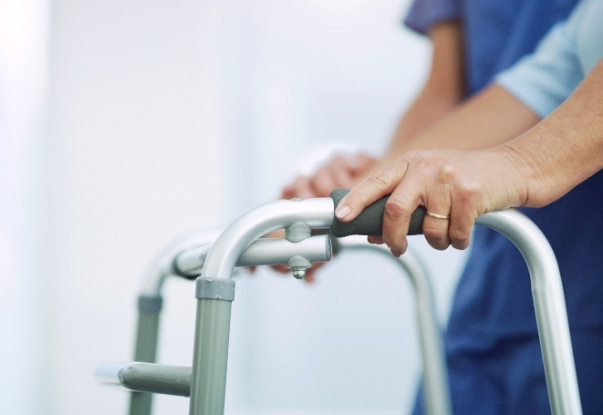
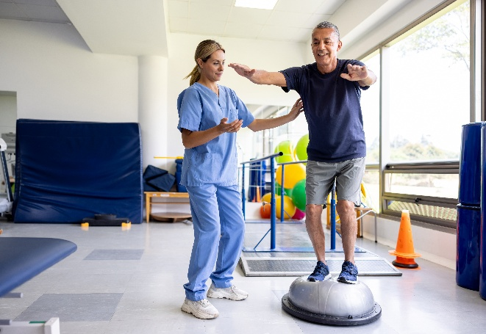

Recommendations 5.4:
Balance and Ataxia
COR | LOE
1 | A | Persons with stroke should be prescribed and fitted with an assistive device or orthosis if appropriate to improve balance and decrease fall risk.
1 | C-EO | Persons with stroke should be evaluated for balance, balance confidence, and fall risk to establish an appropriate treatment plan.
2a | B-NR | In persons with stroke, Tai Chi can be beneficial to improve balance.
Improving balance can decrease fall risk, but if left undetected or untreated, balance impairments can result in a cascade of serious, undesirable, and expensive events, including falls, fractures and hospitalization.
Notes:
Ataxia is a disorder of coordinated muscle activity during voluntary movement associated with injury to the cerebellum, cerebellar peduncles, and brainstem cerebellar tracts and may affect both the upper and lower extremities as well as the trunk. Patients with ataxia have delayed movement initiation, timing errors, abnormal limb trajectories, and dysmetria.

Slide 39
Recommendations 5.5:
Gait and Mobility
COR | LOE
1 | A | For persons with stroke, an evidence-based, goal-oriented, multi-disciplinary physical rehabilitation program is recommended to improve gait and mobility.
1 | A | For persons with stroke, task-specific training focused on overground walking, stepping, and balance is recommended to improve gait and mobility.
2a | B-R | For persons with stroke, interactive gait training with *exergames or virtual reality can be effective to improve walking speed, endurance, mobility, balance, and gait spatiotemporal kinematics.
2a | B-R | For persons with stroke, at least four to eight weeks of high dose therapy (i.e. 1-2 hour sessions, 5 times per week, with moderate to vigorous cardiovascular intensity, and increased stepping repetitions) can be effective at improving walking speed and walking endurance.
2b | A | For persons with stroke, functional electrical stimulation of the affected leg combined with an exercise program may be considered as a restorative therapy for improving gait kinematics, walking endurance, balance, and mobility.
2b | B-R | For persons with chronic stroke, water-based exercises may be considered to improve walking speed, balance, and mobility.

Slide 40
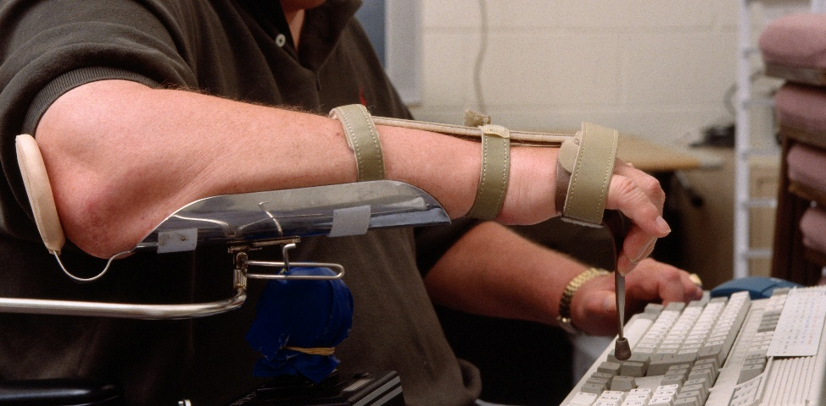

Recommendations 5.6:
Upper Extremity Activity, Including ADLs, IADLs, Touch, and Proprioception
COR | LOE
1 | B-NR | In persons with post-stroke hemiparesis, activities of daily living (ADL) training tailored to individual needs and eventual discharge setting is useful to achieve an optimal level of independence.
1 | B-NR | Persons with stroke should receive instrumental activities of daily living (IADL) training tailored to individual needs and eventual discharge setting for optimal function.
1 | A | In persons with stroke, repetitive, graded functional tasks such as with task-specific training (including constraint-induced movement therapy [CIMT] and its modified versions) should be practiced to improve ADL performance and motor function

Slide 41
Recommendations 5.7:
Adaptive Equipment, Durable Medical Devices, Orthotics, and Wheelchairs
COR | LOE
1 | A | In persons with poststroke hemiplegia, using an ankle foot orthosis (AFO) or functional electrical stimulation (FES) is recommended to improve balance and mobility.
1 | B-NR | In persons with stroke who have activity limitations or participation restrictions, adaptive and assistive devices should be used to improve engagement in activities and participation.
1 | B-NR | In persons with stroke who have gait or balance impairments, ambulatory assistive devices (e.g., cane, walker) should be used to improve mobility efficiency and safety as needed.
1 | C-LD | In persons with stroke who are non-ambulatory or have limited walking ability, wheelchairs should be used to support household and community mobility.
2b | B-NR | In persons with chronic stroke who have moderate to severe limitations in upper limb capacity, the use of static orthotics is not well established to reduce spasticity or improve hand function.

Slide 42
Recommendations 5.8 (Part 1):
Lifestyle Modification and Management: Exercise
COR | LOE
1 | A | In persons with stroke who are physically able, engaging in at least moderate-intensity aerobic activity for a minimum of 10 minutes 4 times a week or vigorous-intensity aerobic activity for a minimum of 20 minutes twice a week is indicated to lower the risk of recurrent stroke and the composite cardiovascular end point of recurrent stroke, myocardial infarction, or vascular death.
2a | A | In persons with stroke who are physically able, engaging in exercise classes that includes counseling to improve physical activity behavior can be beneficial for reducing cardiometabolic risk factors and increasing leisure-time physical activity participation.
2a | B-R | In persons with deficits after stroke that impair their ability to exercise, supervision of an exercise program* by a health care professional, in addition to routine rehabilitation, can be beneficial for secondary stroke prevention.
2b | B-NR | In persons with stroke, breaking up long uninterrupted sedentary periods with short periods of standing or light exercise every 30 minutes may be reasonable to improve cardiovascular health.

Slide 43


Recommendations 5.8 (Part 2):
Lifestyle Modification and Management: Nutrition
COR | LOE
2a | B-R | In persons with stroke, a Mediterranean diet is reasonable to reduce the risk of recurrent stroke.
1 | B-R | In persons with stroke, reducing dietary sodium by ≥1 g/day as part of healthy eating is recommended to decrease the risk of stroke, major cardiovascular events, and mortality.

Slide 44

Recommendations 5.8 (Part 3):
Lifestyle Modification and Management: Smoking Cessation
COR | LOE
1 | A | In persons with stroke who smoke tobacco, counseling with or without drug therapy is recommended to assist in quitting smoking.
1 | B-NR | Persons with stroke should avoid secondhand smoke to reduce post-stroke mortality and recurrent stroke risk.

Slide 45

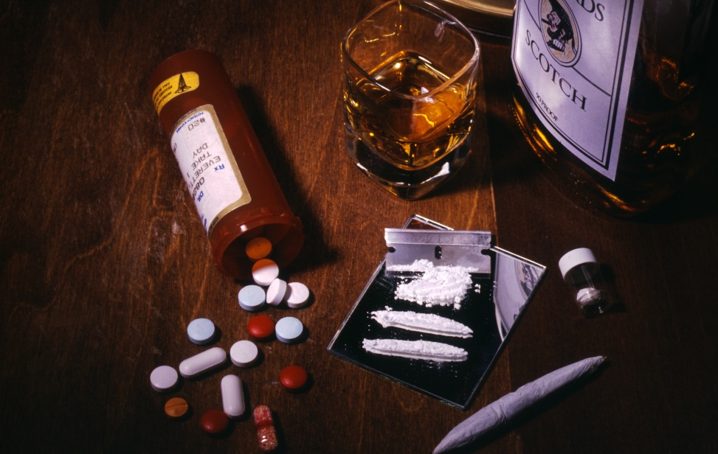
Recommendations 5.8 (Part 4):
Lifestyle Modification and Management: Substance Use and Alcohol
COR | LOE
1 | B-NR | In persons with stroke who have more than 2 drinks of alcohol per day for men and more than 1 drink of alcohol per day for women, counseling, education, and behavioral strategies to abstain from or reduce alcohol consumption should be offered to decrease stroke and major cardiovascular event risk.
1 | B-NR | In persons with stroke who have a substance use disorder (drugs or alcohol), specialized addiction treatment is recommended to manage dependency and reduce risk of recurrent stroke and mortality.

Slide 46

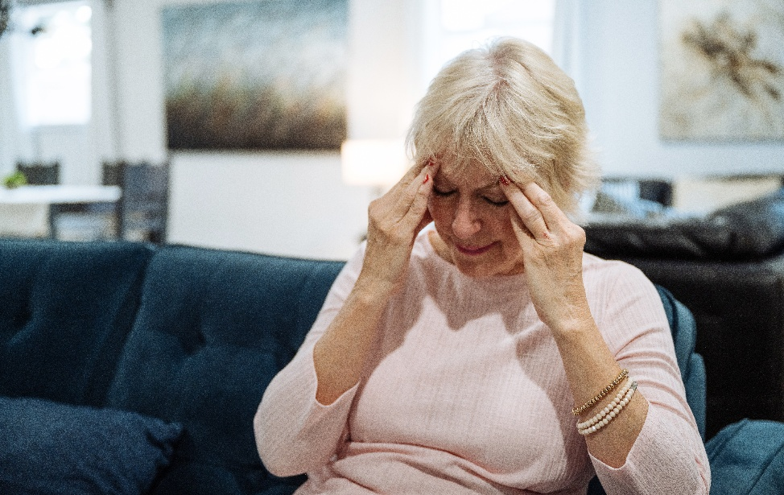
Recommendations 5.9:
Treatment and Interventions for Visual Impairments
COR | LOE
1 | A | In persons with convergence insufficiency post stroke, eye exercises are recommended to improve ocular convergence.
2a | B-R | In persons with eye movement deficits post stroke, compensatory training can be useful for improving performance of ADLs.

Slide 47
Recommendations 5.10 (Part 1):
Dysphagia Screening
COR | LOE
1 | B-R | For persons with acute stroke, dysphagia screening should be performed as soon as possible (within 24 hours of admission) and before the person begins eating, drinking, or receiving oral medications to identify individuals for a full evaluation.
1 | B-NR | For persons with stroke, dysphagia screening should be performed using a formal, validated tool that, at minimum, includes observing attempts to swallow liquids of different volumes to identify those at risk for dysphagia.
1 | B-NR | For persons with stroke and suspected dysphagia, instrumented swallow studies should be chosen over non-instrumented or “bedside” swallow studies to verify the presence/absence of aspiration, to determine the biomechanical reasons for dysphagia, to identify the least restrictive oral diet, and to guide the treatment plan with greater precision.
2a | B-R | For persons with stroke, dysphagia screening is reasonable by a speech-language pathologist, nurse, or other trained healthcare provider to identify those at risk for dysphagia.
2a | B-NR | In persons with stroke receiving instrumented swallow studies, it is reasonable to assess pill swallowing to determine safe and efficient methods of oral medication administration.
2a | B-NR | In persons with dysphagia after stroke, repeated comprehensive swallowing assessment is reasonable within 3 months of discharge from the acute setting to facilitate dysphagia recovery and to identify the least restrictive oral diet.

Slide 48
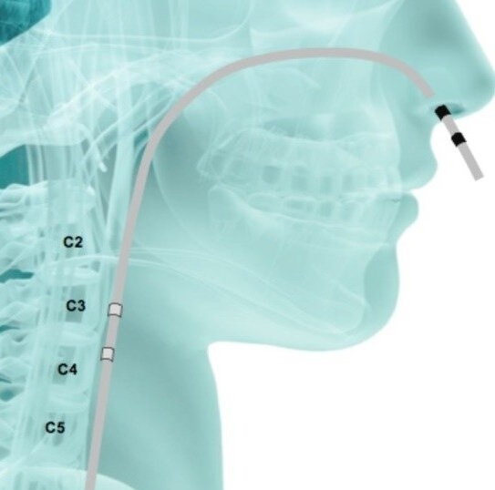
Recommendations 5.10 (Part 2):
Dysphagia Management
COR | LOE
1 | B-NR | For patients with stroke-associated dysphagia, behavioral swallowing treatment is effective for improving swallowing function, increasing tolerance of food textures, reducing the risk of negative health outcomes, and improving quality of life.
2a | B-R | For patients with stroke-associated dysphagia, biofeedback can be a useful addition to behavioral swallowing treatment for improving swallowing function, increasing tolerance of food textures, and improving quality of life.
2b | B-R | For patients with stroke-associated dysphagia, pharyngeal electrical stimulation may be considered to improve swallowing function, increase tolerance of food textures, reduce the risk of negative health outcomes, and improve quality of life.
Restivo, Domenico & Hamdy, Shaheen. (2018). Pharyngeal electrical stimulation device for the treatment of neurogenic dysphagia: technology update. Medical Devices: Evidence and Research. 11. 21-26. 10.2147/MDER.S122287.

Slide 49
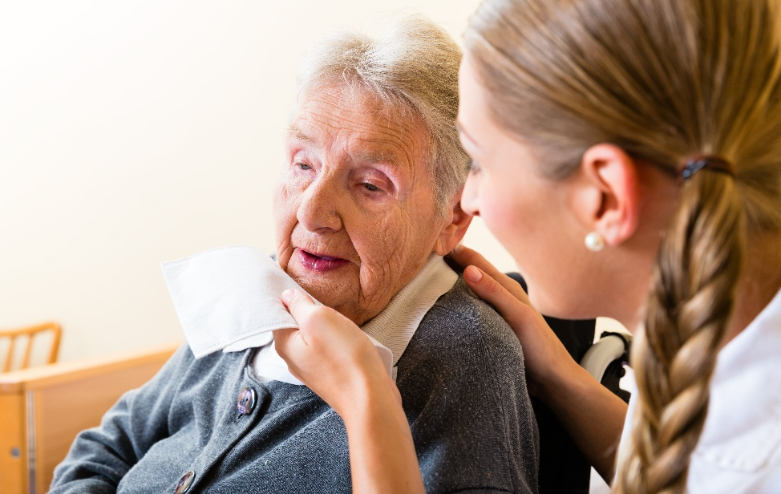
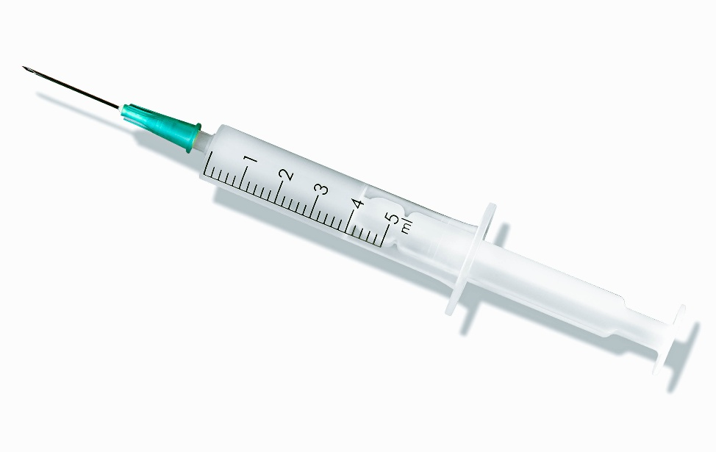
Recommendations 5.10 (Part 3):
Dysphagia Management
COR | LOE
2b | B-R | For patients with stroke-associated dysphagia, effectiveness of neuromuscular electrical stimulation in addition to behavioral swallowing treatment is unknown for improving swallowing function, increasing tolerance of food textures, and improving quality of life.
2b | B-NR | For patients with stroke-associated sialorrhea, medical management with atropine or botulinum toxin injection may be effective at reducing symptoms of drooling.

Slide 50
Recommendations 5.10 (Part 4):
Dysphagia Nutritional Support
COR | LOE
1 | B-R | For patients with stroke-associated dysphagia in the acute phase, early nutrition support is recommended to improve nutritional status, improve functional outcomes, and reduce adverse events.
1 | B-NR | For patients with stroke-associated dysphagia in the subacute and chronic phases, nutritional support can be effective for improving functional outcomes.
1 | B-NR | For patients with stroke-associated dysphagia, percutaneous gastrostomy tubes are recommended in preference to nasogastric tubes for improving nutritional status and reducing adverse events in patients with dysphagia with a chronic inability to swallow safely.
2a | B-R | For patients with stroke-associated dysphagia, it is reasonable to consider nasojejunal tubes or intermittent oroesophageal tube feeding over nasogastric tubes for short term nutritional support for patients who cannot swallow safely.

Slide 51
6. Cognition and Communication
2026 GUIDELINE FOR Adult Stroke Rehabilitation and Recovery
KEY NURSING UPDATES AND REVIEW

Slide 52
Cognition and Communication
Facets of the Stroke Survivor’s Journey Through Adult Stroke Rehabilitation and Recovery: Nursing Implications
Introduction
Poststroke Rehabilitation Levels of Care
Sensory Motor Impairments and Activities
Stroke Survivor and Family
Prevention and Management of Comorbidities
Transitions in Care and Community Rehabilitation, including family caregiver support
Assessment

Slide 53

Recommendations 6.1:
Non-Pharmacological Interventions for Cognitive Impairment, Including Memory
COR | LOE
1 | B-R | In persons with stroke with cognitive impairments, supervised moderate to high intensity technology-supported cognitive training programs that are tailored and adaptive to performance are recommended to improve global cognition, attention and working memory.
2a | B-R | In persons with stroke with cognitive impairments, a combination of cognitive training and physical activity is reasonable to improve global cognition, working memory and delayed recall.
2b | C-LD | In persons with stroke and cognitive impairments, rehabilitation that incorporates cognitively focused and contextually relevant daily life activities is reasonable for improving global cognition, working memory and executive functions.

Slide 54

Recommendations 6.2 (Part 1):
Acquired Communication Disorders: Apragmatism
COR | LOE
2a | B-NR | In persons with stroke and apragmatism, a referral to speech-language pathology is reasonable to facilitate restorative or compensatory communication related to prosody, language understanding and language use.
Apragmatism has been operationally defined as an acquired language disorder that causes difficulty in understanding and conveying the meaning or intent of non-verbal (i.e. gestures, facial expressions, vocal manipulations) and verbal language within a specific context.
Research for the treatment of apragmatism is in its infancy when compared to aphasia treatment.

Slide 55
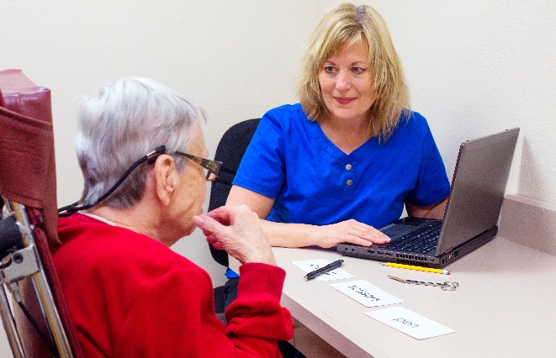


Recommendations 6.2 (Part 2):
Acquired Communication Disorders: Aphasia
COR | LOE
1 | A | In persons with stroke and aphasia, a variety of speech and language treatment approaches should be administered to facilitate restorative or compensatory communication.
2a | A | In persons with stroke and aphasia, use of telerehabilitation is reasonable when face-to-face treatment is not possible or impractical to facilitate access to skilled speech-language pathology treatment.
2b | B-R | In persons with stroke and aphasia, computerized treatment may be considered to supplement traditional aphasia treatments implemented by a speech-language pathologist designed to provide remote restorative or compensatory therapy.
2b | B-NR | In persons with stroke and aphasia, group treatment (e.g. community-based treatment groups) may be considered to facilitate restorative, compensatory, and interpersonal communication.

Slide 56

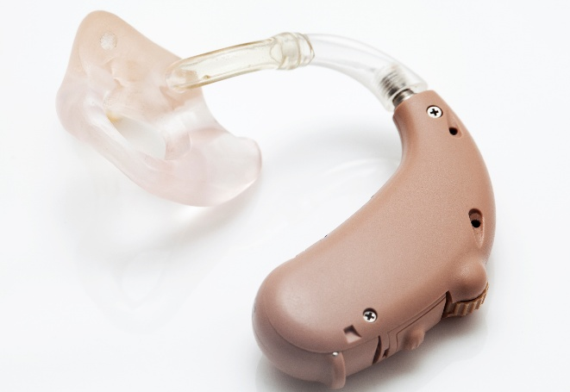

Recommendations 6.2 (Part 3):
Acquired Communication Disorders: Hearing Loss
COR | LOE
1 | B-NR | In persons with stroke and hearing loss, a referral to an audiologist for the assessment of hearing and auditory processing is indicated to evaluate and mitigate the impact of hearing impairment.
2a | B-NR | In persons with stroke and hearing loss, amplification (e.g. hearing aids) and communication facilitating strategies (i.e. reducing background noise, maintaining face-to-face posture) are reasonable to reduce the impact of hearing loss.

Slide 57


Recommendations 6.3:
Motor Speech Disorders: Dysarthria and Apraxia of Speech
COR | LOE
1 | B-NR | In persons with post-stroke motor speech disorders, behavioral speech interventions are recommended to improve communication effectiveness.
1 | C-LD | In persons with post-stroke motor speech disorders or who have a tracheostomy in situ, augmentative and alternative communication devices and modalities should be used to supplement speech to improve communication effectiveness.
2a | B-NR | In persons with post-stroke motor speech disorders, computer or smartphone-based applications can be beneficial as an adjunct to traditional behavioral speech interventions to improve communication effectiveness.
2b | C-LD | In persons with post-stroke motor speech disorders, telerehabilitation may be useful when face-to-face treatment is impossible or impracticable to improve communication effectiveness.

Slide 58

Recommendations 6.4:
Spatial Neglect
COR | LOE
2a | A | In persons with stroke and spatial neglect, it is reasonable to use visual eye movement training approaches such as optokinetic stimulation or saccadic/smooth pursuit eye movement training to improve visual-spatial impairment.
2a | B-R | In persons with spatial neglect after stroke, mirror therapy in combination with conventional therapy is reasonable to improve functional independence.
2b | B-R | In persons with spatial neglect after stroke, prism adaptation therapy (visual shift>10 degrees) in combination with conventional therapy may be reasonable to improve long-term spatial impairment and functional independence, and reduce fall risk.
2b | B-NR | In persons with spatial neglect after stroke, it might be reasonable to use limb activation or virtual reality to reduce spatial impairment.

Slide 59
7. Transitions in Care and
Community Rehabilitation
2026 GUIDELINE FOR Adult Stroke Rehabilitation and Recovery
KEY NURSING UPDATES AND REVIEW

Slide 60
Transitions in Care and
Community Rehabilitation, including family caregiver support
Facets of the Stroke Survivor’s Journey Through Adult Stroke Rehabilitation and Recovery: Nursing Implications
Introduction
Poststroke Rehabilitation Levels of Care
Sensory Motor Impairments and Activities
Stroke Survivor and Family
Prevention and Management of Comorbidities
Cognition and Communication
Assessment

Slide 61
Recommendations 7.1:
Ensuring Medical and Rehabilitation Continuity Through the Rehabilitation Process and Into the Community
COR | LOE
2a | B-R | In persons hospitalized with stroke, individualized discharge planning in the transition from hospital to home can be useful for physical function, self-management, and patient experience.
2b | C-LD | For persons hospitalized with stroke, alternative methods of continuity care using telehealth might be considered to deliver transitional care services from hospital to home.
Abbreviations: SNF indicates skilled nursing facility; IRF, inpatient rehabilitation facility; and LTCH, long-term care hospital.

Slide 62

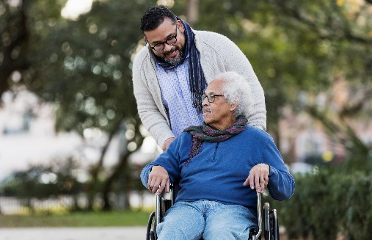

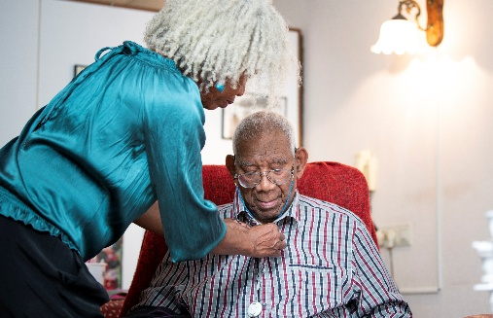
Recommendations 7.2:
Caregiver Engagement and Support
COR | LOE
2a | B-R | Active and intentional engagement of caregivers of persons with stroke as early as possible and throughout rehabilitation can be beneficial to improve knowledge about stroke, mental health and caregiver burden.
2a | B-R | For persons with stroke, involving caregivers in education and training using teach-back about care and rehabilitation activities can be beneficial to improve patient and caregiver outcomes such as experience of care, activities of daily living and mobility.
2a | B-R | For caregivers of persons with stroke, after acute care discharge, longitudinal participation in a tailored caregiver-focused, multi-component psychosocial or psychoeducational intervention, can be beneficial to improve caregiver mental health, burden and/or family functioning.

Slide 63
Recommendations 7.3:
Referral to Community Resources
COR | LOE
1 | C-LD | For persons with stroke and their caregivers, individually tailored information about and referrals to up-to-date community resources should be provided throughout the continuum of care to facilitate access to such services.
2a | B-R | For persons with stroke, interactive education (such as teach-back method or two-way communication) with follow-up can be beneficial to improve stroke survivor knowledge and reduce anxiety and depression.
2a | B-NR | For persons with stroke, administration of the Post-Stroke Checklist (PSC) can be useful to identify stroke-related health problems and inform individualized referrals.
2a | B-NR | For persons with stroke, referral to self-management or lifestyle intervention programs can be useful to improve stroke outcomes.
2b | B-R | For persons with stroke and caregivers, technology-based stroke health education may be considered to improve stroke knowledge.

Slide 64
Examples of Services, Supports, or Referrals
DOMAIN | EXAMPLES
Rehabilitation Services | PT, OT, Speech-language, neuropsychology, community centers
Vocational Support | Job retraining, supported employment, workplace accommodation
Driving and Transportation Services | Driving rehabilitation, adaptive equipment, disability transportation
Social Support | Stroke support groups, caregiver support, counseling, online forums
Leisure and Recreation Programs | Adaptive sports, art/music therapy, community center classes
Home Support and Respite | Respite, adult day care, hospice, Meals on Wheels, State Department of Aging
Financial Aid and Housing | Housing assistance programs, financial planning, Medicaid, Insurance
Assistive Devices and Technology | Medical equipment, mobility aids, communication devices, home modifications
Education and Navigation | Community health workers, social workers, workshops, community centers
Legal and Advocacy | Disability rights organizations, legal aid, patient advocacy groups
Wellness, Nutrition, and Self-Management | Dietician referral, community classes, education materials, coaching, modules, peer mentoring
Local, State, National Resources | American Heart Association/American Stroke Association Website, Centers for Medicare and Medicaid, State Department of Aging, Faith-based organizations

Slide 65
Recommendations 7.4:
Community Rehabilitation and Telerehabilitation
COR | LOE
1 | A | In persons discharging from hospital with recent stroke, ongoing community- or home-based rehabilitation is recommended when feasible to achieve functional goals.
2a | B-R | For persons living at home after stroke, home-based multidisciplinary rehabilitation is a reasonable alternative to clinic-based rehabilitation to achieve functional goals in mobility, self-care and cognitive/communicative function.
2a | B-R | For persons living at home after mild to moderate stroke, telerehabilitation therapies are reasonable alternatives to in-person therapies when access to these in-person therapies is limited or absent.
2a | C-LD | For persons with mild to moderate stroke, participation in community-based exercise programs can be useful to improve strength, mobility, and cardiovascular health.
2b | C-LD | In persons with stroke, coordinated education, therapy and support services during and through the transition from hospital to home may be reasonable to improve stroke survivor self-efficacy, functional ability and quality of life.

Slide 66



Recommendations 7.5:
Sexual Function
COR | LOE
2b | B-NR | In persons with stroke, it may be reasonable for healthcare providers to discuss issues of sexual function.

Slide 67
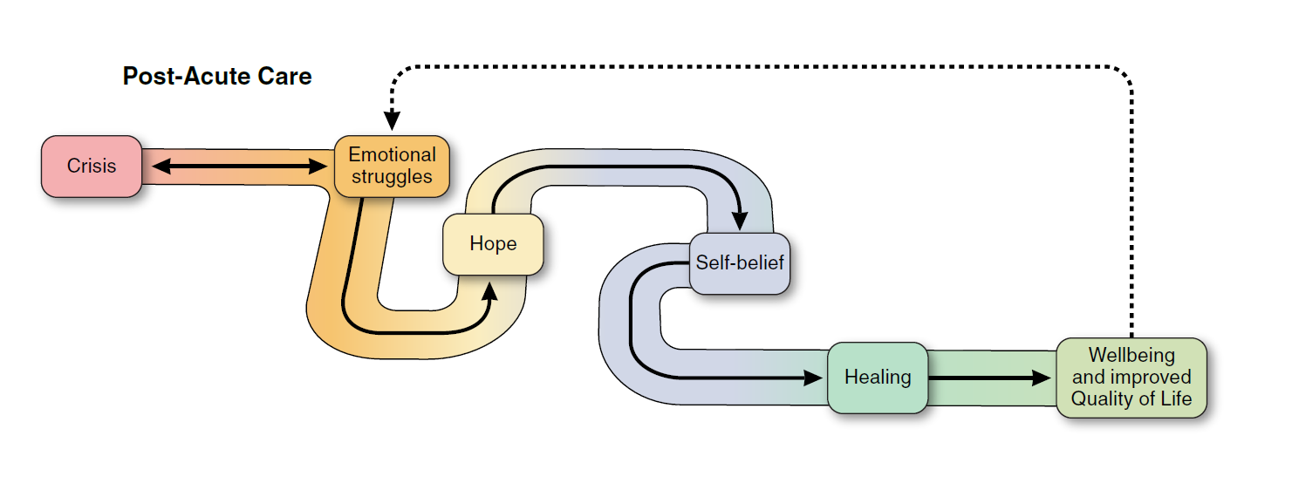
Emotional Responses and Pathway During Stroke Recovery

Slide 68


Recommendations 7.6 (Part 1):
Recreational, Leisure, and Social Activity Participation
COR | LOE
1 | B-NR | In persons with subacute and chronic stroke, an individualized assessment and treatment plan is recommended to address changes in leisure and social participation patterns to improve quality of life, health, and leisure satisfaction.
1 | B-NR | In persons with stroke, it is recommended to screen and discuss social health including social isolation, feelings of loneliness, and limited social supports and networks to decrease stroke mortality and secondary stroke risk and improve quality of life.
2a | B-R | In community-dwelling adults post-stroke, it can be beneficial to provide individually tailored leisure education and counseling related to meaningful and healthy leisure engagement to improve quality of life; psychological functioning; leisure satisfaction, engagement, and competence; and reduce perceived leisure barriers.

Slide 69



Recommendations 7.6 (Part 2):
Recreational, Leisure, and Social Activity Participation
COR | LOE
1 | B-NR | In persons with stroke, it is recommended that regular engagement in personally meaningful leisure time activity is facilitated through individually tailored education, counseling, caregiver-mediated support, and programming to promote holistic health and reduce post-stroke mortality risk.
2a | B-R | In persons with stroke, incorporation of nature-based activities and green space exposure can be beneficial to reduce stroke disability and mortality risk; improve physical, cognitive, social, and psychological functioning; well-being; and quality of life.
2b | B-R | In persons with stroke, it may be reasonable to incorporate evidence-based leisure/recreation activities such as Tai Chi, Qigong, commercial exergames, visual-arts, yoga, adapted sports, music, immersive commercial video games, Pilates, and dance to support health and recovery.

Slide 70
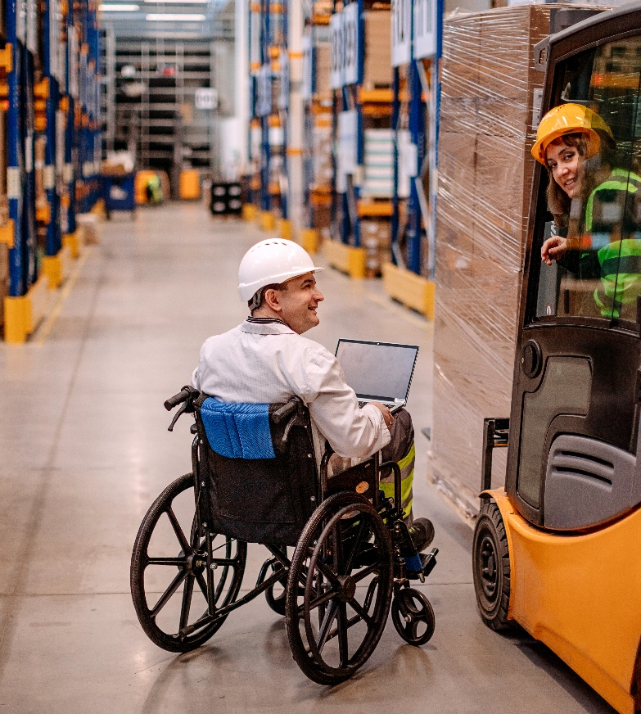
Recommendations 7.7:
Return to Work
COR | LOE
2a | B-R | In persons with stroke, it is reasonable to provide an early, tailored vocational rehabilitation program delivered by occupational therapy and vocational services to promote return to work.
2a | B-R | For persons with stroke, modified job duties and work adaptations are reasonable to support return to work.
2a | B-R | In individuals living with stroke, fatigue management, cognitive and psychosocial support, and early employer engagement into vocational rehabilitation is reasonable for promoting return to work.

Slide 71
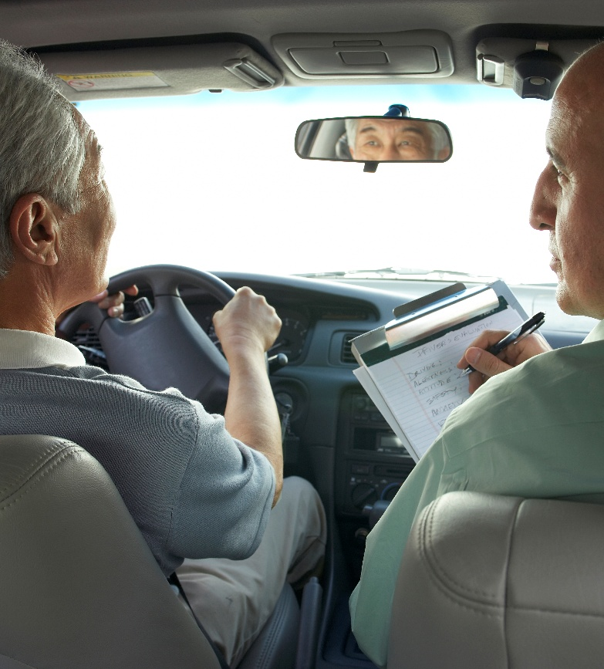
Recommendations 7.8:
Return to Driving
COR | LOE
1 | C-LD | For persons with stroke who have impairments that could impact safe driving (such as cognitive, perceptual, or physical impairments), referral for an on-road test administered by an authorized person is recommended to determine fitness to drive.
2a | C-LD | For persons with stroke who do not pass an on-road driving test or have impairments that could impact safe driving, driving rehabilitation with an authorized person is reasonable to improve driving capability.

Slide 72
Summary and Conclusion
2026 GUIDELINE FOR Adult Stroke Rehabilitation and Recovery
KEY NURSING UPDATES AND REVIEW

Slide 73
Stroke Survivor and Family
Facets of the Stroke Survivor’s Journey Through Adult Stroke Rehabilitation and Recovery: Nursing Implications
Introduction
Poststroke Rehabilitation Levels of Care
Sensory Motor Impairments and Activities
Prevention and Management of Comorbidities
Cognition and Communication
Transitions in Care and Community Rehabilitation, including family caregiver support
Assessment
Notes:
This guideline has provided the latest recommendations for all areas noted in this slide. In the end, it’s all about supporting the stroke survivor and the family throughout the recovery process.

Slide 74
Conclusions
Key recommendations for nurses have been highlighted in this slide deck. There are more recommendations presented in the guideline document that are applicable to other disciplines or that go into further detail into the rehabilitation care for stroke survivors.
We encourage nurses to refer directly to the guideline document for more specifics in the care of stroke survivors across the care continuum.
Nurses are in an ideal position to:
  Ensure proper care
  Provide referral to healthcare providers
  Facilitate community reintegration by recommending community resources for stroke survivors and their family caregivers.
The 2026 Guideline for Adult stroke rehabilitation and recovery is a valuable resource for nurses to support stroke survivors and their family caregivers throughout the recovery process.
https://www.ahajournals.org/doi/10.1161/STR.0000000000000536

