Slide 1
2026 ACC/AHA/ AACVPR/ABC/ACPM/ADA/AGS/APhA/ASPC/NLA/PCNA Guideline on the Management of Dyslipidemia
A Report of the American College of Cardiology/American Heart Association Joint Committee on Clinical Practice Guidelines
Developed in Collaboration With and Endorsed by the American Association of Cardiovascular and Pulmonary Rehabilitation, Association of Black Cardiologists, American College of Preventive Medicine, American Diabetes Association, American Geriatrics Society, American Pharmacists Association, American Society for Preventive Cardiology, National Lipid Association, and Preventive Cardiovascular Nurses Association

Slide 2
Citation
This slide set is adapted from the 2026 ACC/AHA/ AACVPR/ABC/ACPM/ADA/AGS/APhA/ASPC/NLA/PCNA Guideline on the Management of Dyslipidemia. Published ahead of print Friday, March 13, 2026, available at: Circulation. https://www.ahajournals.org/doi/10.1161/CIR.0000000000001423 And Journal of the American College of Cardiology, published online ahead of print Friday, March 13, 2026. J Am Coll Cardiol. https://doi.org/10.1016/j.jacc.2025.11.016
© 2026 the American Heart Association, Inc. and the American College of Cardiology Foundation. All rights reserved. This article has been published in Circulation and the Journal of the American College of Cardiology.

Slide 3
2026 Writing Committee Members*
Roger S. Blumenthal, MD, FACC, FAHA, FASPC, FNLA, Chair
Pamela B. Morris, MD, FACC, FAHA, FASPC, FNLA, Vice-Chair
Mario Gaudino, MD, FAHA, FACC, JC Liaison†
Heather M. Johnson, MD, MS, FAHA, FACC, FASPC, JC Liaison‡
Timothy S. Anderson, MD, MAS§
Vera A. Bittner, MD, MSPH, FACC, FAHA, MNLA, MAACVPR║
Ron Blankstein, MD, FACC
LaPrincess C. Brewer, MD, MPH, FACC, FAHA
Leslie Cho, MD, FACC¶
Sarah D. de Ferranti, MD, MPH, FAHA
Eugenia Gianos, MD, FACC, FAHA, FNLA
Ty J. Gluckman, MD, MHA, FACC, FAHA, FASPC
Kristen F. Gradney, MHA, RDN, LDN#
Ijeoma Isiadinso, MD, MPH, FACC**
Donald M. Lloyd-Jones, MD, ScM, FACC, FAHA, FASPC
Joel C. Marrs, PharmD, MPH, FAHA, FNLA††
Seth S. Martin, MD, MHS, FACC, FAHA, FASPC
Kellie H. McLain, ANP-BC, CLS, FNLA, AACC
Laxmi S. Mehta, MD, FACC, FAHA, FNLA
Samia Mora, MD, MHS, FACC, FAHA
Wudeneh M. Mulugeta, MD, MPH, MS, FACP, FACPM‡‡
Pradeep Natarajan, MD, MMSC, FACC, FAHA
Ann Marie Navar, MD, PhD, FAHA, FACC, FASPC
Carl E. Orringer, MD, FACC, MNLA
Tamar S. Polonsky, MD, MSCI
Harmony R. Reynolds, MD, FACC, FAHA
Joseph J. Saseen, PharmD, MNLA, FACC, FAHA§§
Michael D. Shapiro, DO, MPH, FACC, FAHA, FASPC, FNLA║║
Daniel E. Soffer, MD, MNLA, FACP‡
Sheila A. Tynes, MHA, PMP¶¶
Chloé D. Villavaso, MN, APRN, ACNS-BC, FPCNA, AACC##
Salim S. Virani, MD, PhD, FACC, FASPC***
John T. Wilkins, MD, MSc, FAHA
*Writing committee members are required to recuse themselves from voting on sections to which their specific relationships with industry and other entities may apply; see Appendix 1 for detailed information. †ACC/AHA Joint Committee on Clinical Practice Guidelines liaison. ‡ Former ACC/AHA Joint Committee on Clinical Practice Guidelines member; current member during the writing effort. §American Geriatrics Society representative. ║American Association of Cardiovascular and Pulmonary Rehabilitation representative. ¶ACC/AHA Task Force on Performance Measures liaison. # Patient representative. **Association of Black Cardiologists representative. ††American Pharmacists Association representative. ‡‡American College of Preventive Medicine representative. §§National Lipid Association representative. ║║American Society for Preventive Cardiology representative. ¶¶AHA/ACC Guidelines Staff Consultant. ## Preventive Cardiovascular Nurses Association representative. ***American Diabetes Association representative.

Slide 4
What Is New

Slide 5
Table 1. What Is New
New or Revised | Section Title | 2018 Recommendation | 2026 Recommendation
Revised | 3.2. Measurement of TC, LDL-C, HDL-C, Triglycerides, and Non–HDL-C | COR 2a: For adults with an LDL-C level <70 mg/dL (<1.8 mmol/L), measurement of direct LDL-C or modiﬁed LDL-C estimate is reasonable to improve accuracy over the Friedewald formula. | COR 1: In adults and children who have undergone a standard lipid profile, use of either the Martin/Hopkins equation or the Sampson/NIH equation is preferred over calculation by the Friedewald equation to estimate LDL-C.
New | 3.3. Measurement of Apolipoprotein B | N/A | COR 2a: In adults on LLT, particularly those with ASCVD, CKM syndrome, type 2 diabetes, and/or elevated TG, measurement of apoB is reasonable to guide decisions regarding further therapeutic intensification once LDL-C and/or non–HDL-C goals are achieved.
New | 3.4. Measurement of Lipoprotein(a) | N/A | COR 1: In all adults, measurement of Lp(a) concentration is recommended at least once for ASCVD risk assessment.

Slide 6
Table 1. What Is New (con’t.)
New or Revised | Section Title | 2018 Recommendation | 2026 Recommendation
New | 4.1.5. Dietary Supplements | N/A | COR 3: In individuals with dyslipidemia, the use of dietary supplements is not recommended to lower LDL-C or TG based on limited and inconsistent data and/or limited benefits in lipid-lowering and reduction in ASCVD risk.
New | 4.1.6. When to Refer to a Registered Dietitian Nutritionist | N/A | COR 1: In individuals with fasting TG ≥1000 mg/dL (11.3 mmol/L) referral to an RDN is recommended to create an individualized treatment plan aimed at reducing TG and the risk of pancreatitis.
New | 4.1.6. When to Refer to a Registered Dietitian Nutritionist | N/A | COR 2a: In individuals with fasting TG ≥150 to 999 mg/dL (≥1.7-11.3 mmol/L) and features of the CKM syndrome, referral to an RDN is recommended to provide counseling on evidence-based dietary patterns that can be beneficial to improve lipoprotein levels and reduce the risk of pancreatitis.

Slide 7
Table 1. What Is New (con’t.)
New or Revised | Section Title | 2018 Recommendation | 2026 Recommendation
New | 4.2.3.2. PREVENT-ASCVD Equations | N/A | COR 1: In adults aged 30 to 79 years without ASCVD or subclinical atherosclerosis and with an LDL-C level between 70 and 189 mg/dL (1.8-4.9 mmol/L), the PREVENT-ASCVD equations should be used to estimate 10-year ASCVD risk, with categorization as having low (<3), borderline (3% to <5%), intermediate (5% to <10%), or high (≥10%)risk.
Revised | 4.2.3.3. Risk Enhancers | COR 2b: In patients at borderline risk, in risk discussion, the presence of risk-enhancing factors may justify initiation of moderate-intensity statin therapy. | COR 2a: In adults without ASCVD with a borderline 10-year ASCVD risk estimate (3% to <5%) by the PREVENT-ASCVD equations, consideration of risk enhancers is reasonable to personalize risk assessment and the potential beneﬁt of initiating LLT as an adjunct to lifestyle management to reduce ASCVD risk.
New | 4.2.3.3. Risk Enhancers | N/A | COR 2a: In adults without ASCVD with a borderline 10-year ASCVD risk estimate (3% to <5%) by the PREVENT-ASCVD equations, if hsCRP is measured and is ≥2 mg/L on 2 successive occasions with no identifiable underlying cause of hsCRP elevation, high-intensity statin therapy can be useful to reduce the risk of ASCVD events.

Slide 8
Table 1. What Is New (con’t.)
New or Revised | Section Title | 2018 Recommendation | 2026 Recommendation
New | 4.2.3.4. Reproductive Risk Markers | N/A | COR 2a: In adults without ASCVD, consideration of reproductive risk markers, such as early menopause (<45 years old) and history of adverse pregnancy outcomes (gestational hypertension, preeclampsia, gestational diabetes, preterm delivery) is reasonable to personalize ASCVD risk assessment when considering the potential beneﬁt of initiating LLT as an adjunct to lifestyle management for primary ASCVD prevention.
Revised | 4.2.3.6. Selective Imaging of Subclinical Atherosclerosis | COR 2a: In intermediate-risk or selected borderline-risk adults, if the decision about statin use remains uncertain, it is reasonable to use a CAC score in the decision to withhold, postpone, or initiate statin therapy. | COR 1: In adults at intermediate risk and select adults at borderline risk with no prior ASCVD, if the decision regarding LLT remains uncertain, a CAC score should be used for further risk stratification and to guide the decision to withhold, postpone, or initiate therapy.
New | 4.2.3.6. Selective Imaging of Subclinical Atherosclerosis | N/A | COR 2a: In adults at intermediate risk or select adults at borderline risk who undergo CAC testing, if the CAC score is 0 AU and there is preference to avoid LLT and focus on lifestyle management and no higher risk conditions (FH or severe hypercholesterolemia ≥190 mg/dL, diabetes and age >40 years, current cigarette smoking, strong family history of premature ASCVD) are present, it is reasonable to defer therapy and reassess with repeat CAC testing in 3 to 7 years to personalize management.

Slide 9
Table 1. What Is New (con’t.)
New or Revised | Section Title | 2018 Recommendation | 2026 Recommendation
New | 4.2.3.6. Selective Imaging of Subclinical Atherosclerosis | N/A | COR 1: In adults at intermediate risk and select adults at borderline risk, if the CAC score is >0 AU, it is recommended to initiate LLT, particularly if the CAC score is ≥100 AU or ≥75th standardized percentile to reduce ASCVD risk.
New | 4.2.3.6. Selective Imaging of Subclinical Atherosclerosis | N/A | COR 2a: In adults at intermediate or high risk with no prior ASCVD, if there is uncertainty about the intensity of LLT, a CAC score can be useful to refine treatment goals and decide whether to intensify lipid-lowering therapies.
New | 4.2.3.6. Selective Imaging of Subclinical Atherosclerosis | N/A | COR 1: In adults with no prior ASCVD, if incidental CAC is identified on noncardiac CT scans (eg, by visual estimation or a validated artificial intelligence-based algorithm), the presence of coronary atherosclerosis should be considered during decision-making about initiation or intensification of LLT to reduce ASCVD risk.
New | 4.2.3.7. Management in Primary Prevention in Adults 30 to 79 Years of Age With LDL-C Levels 70 to 189 mg/dL (1.8-4.9 mmol/L) | N/A | COR 1: In adults at low (<3%) 10-year estimated risk for ASCVD who have an LDL-C <160 mg/dL (4.1 mmol/L) and a 30-year risk estimate of <10% (for those aged 30-59 years), counseling on health behaviors is recommended to reduce LDL-C and risk for ASCVD.

Slide 10
Table 1. What Is New (con’t.)
New or Revised | Section Title | 2018 Recommendation | 2026 Recommendation
New | 4.2.3.7. Management in Primary Prevention in Adults 30 to 79 Years of Age With LDL-C Levels 70 to 189 mg/dL (1.8-4.9 mmol/L) | N/A | COR 2a: In adults at low (<3%) 10-year estimated risk for ASCVD but with an LDL-C of 160 to 189 mg/dL (4.1-4.9 mmol/L) or a 30-year ASCVD risk ≥10% (for those aged 30-59 years), a moderate-intensity statin is reasonable to reduce cumulative exposure to atherogenic lipoproteins.
New | 4.2.3.7. Management in Primary Prevention in Adults 30 to 79 Years of Age With LDL-C Levels 70 to 189 mg/dL (1.8-4.9 mmol/L) | N/A | COR 2a: In adults at borderline (3% to <5%) 10-year estimated risk for ASCVD risk in whom a decision is made to initiate statin therapy for primary prevention, a moderate-intensity statin is reasonable to achieve ≥30% to 49% LDL-C reduction and to reduce ASCVD risk.
New | 4.2.3.7. Management in Primary Prevention in Adults 30 to 79 Years of Age With LDL-C Levels 70 to 189 mg/dL (1.8-4.9 mmol/L) | N/A | COR 1: In adults at intermediate (5% to <10%) 10-year estimated risk for ASCVD, at least a moderate-intensity statin is recommended to achieve ≥30% to 49% LDL-C reduction and to reduce ASCVD risk; for those in the higher end of this risk range, a high-intensity statin is beneficial to further reduce LDL-C by ≥50% and reduce ASCVD risk.

Slide 11
Table 1. What Is New (con’t.)
New or Revised | Section Title | 2018 Recommendation | 2026 Recommendation
New | 4.2.3.7. Management in Primary Prevention in Adults 30 to 79 Years of Age With LDL-C Levels 70 to 189 mg/dL (1.8-4.9 mmol/L) | N/A | COR 2a: In adults at borderline (3% to <5%) or intermediate (5% to <10%) 10-year estimated risk for ASCVD in whom statin therapy is initiated, it is reasonable to treat to a goal of LDL-C <100 mg/dL (2.6 mmol/L) and non–HDL-C <130 mg/dL (3.4 mmol/L) to reduce ASCVD risk.
New | 4.2.3.7. Management in Primary Prevention in Adults 30 to 79 Years of Age With LDL-C Levels 70 to 189 mg/dL (1.8-4.9 mmol/L) | N/A | COR 1: In adults at high (≥10%) 10-year risk for ASCVD in whom LLT is initiated for primary prevention, high-intensity statin therapy is recommended to achieve an LDL-C reduction of ≥50% to reduce the risk of ASCVD.
New | 4.2.3.7. Management in Primary Prevention in Adults 30 to 79 Years of Age With LDL-C Levels 70 to 189 mg/dL (1.8-4.9 mmol/L) | N/A | COR 2a: In adults at high (≥10%) 10-year risk for ASCVD in whom a decision to initiate statin therapy is made, it is reasonable to treat to a goal of LDL-C <70 mg/dL (1.8 mmol/L) and non–HDL-C <100 mg/dL (2.6 mmol/L) to reduce ASCVD risk.

Slide 12
Table 1. What Is New (con’t.)
New or Revised | Section Title | 2018 Recommendation | 2026 Recommendation
New | 4.2.3.7. Management in Primary Prevention in Adults 30 to 79 Years of Age With LDL-C Levels 70 to 189 mg/dL (1.8-4.9 mmol/L) | N/A | COR 2a: In adults at high (≥10%) 10-year estimated risk for ASCVD on maximally tolerated statin, it is reasonable to add ezetimibe if a goal LDL-C <70 mg/dL (1.8 mmol/L) and non–HDL-C <100 mg/dL (2.6 mmol/L) is not achieved.
New | 4.2.4.1. Role of Risk Assessment in HeFH | N/A | COR 3: In individuals with HeFH, standard risk assessment tools developed for the general population should not be used to calculate 10- or 30-year ASCVD risk.
New | 4.3.3.2. Genetic Testing for FH | N/A | COR 2a: In adults with severe hypercholesterolemia with an LDL-C ≥190 mg/dL (4.9 mmol/L) without an identified secondary cause, panel-based genetic testing for pathogenic/likely pathogenic rare variants for FH can be useful to identify those with FH who are at higher risk of ASCVD events.

Slide 13
Table 1. What Is New (con’t.)
New or Revised | Section Title | 2018 Recommendation | 2026 Recommendation
Revised | 4.2.4.3. Severe Hypercholesterolemia (LDL-C ≥190 mg/dL) (4.9 mmol/L) | COR 2a: In patients 20 to 75 years of age with an LDL-C level of 190 mg/dL or higher (4.9 mmol/L) who achieve less than a 50% reduction in LDL-C while receiving maximally tolerated statin therapy and/or have an LDL-C level of 100 mg/dL or higher (2.6 mmol/L), ezetimibe therapy is reasonable. | COR 1: In adults with severe hypercholesterolemia with an LDL-C ≥190 mg/dL (4.9 mmol/L) and without clinical ASCVD, additional ASCVD risk factors, HeFH, or subclinical atherosclerosis who are on maximally tolerated statin therapy, the addition of ezetimibe, a PCSK9 mAb and/or bempedoic acid is recommended to achieve a goal of LDL-C <100 mg/dL (2.6 mmol/L) and a non–HDL-C goal of <130 mg/dL (3.4 mmol/L) and to reduce ASCVD risk.
Revised | 4.2.4.3. Severe Hypercholesterolemia (LDL-C ≥190 mg/dL) (4.9 mmol/L) | COR 2b: In patients 30 to 75 years of age with heterozygous FH and with an LDL-C level of 100 mg/dL or higher (2.6 mmol/L) while taking maximally tolerated statin and ezetimibe therapy, the addition of a PCSK9 inhibitor may be considered. | COR 1: In adults with severe hypercholesterolemia with LDL-C ≥190 mg/dL (4.9 mmol/L) without clinical ASCVD but with clinical or genetic confirmation of HeFH, additional ASCVD risk factors, or documented coronary calcification, who are on maximally tolerated statin therapy, the addition of ezetimibe, a PCSK9 mAb and/or bempedoic acid to achieve a goal of LDL-C <70 mg/dL (1.8 mmol/L) and non–HDL-C <100 mg/dL (2.6 mmol/L) is recommended to lower LDL-C and reduce ASCVD risk.

Slide 14
Table 1. What Is New (con’t.)
New or Revised | Section Title | 2018 Recommendation | 2026 Recommendation
New | 4.2.4.3. Severe Hypercholesterolemia (LDL-C ≥190 mg/dL) (4.9 mmol/L) | N/A | COR 1: In adults with severe hypercholesterolemia with LDL-C ≥190 mg/dL (4.9 mmol/L) with clinical ASCVD, who are on maximally tolerated statin therapy, the addition of ezetimibe, a PCSK9 mAb, or bempedoic acid is recommended to achieve a goal of LDL-C <55 mg/dL (1.4 mmol/L) and non–HDL-C <85 mg/dL (2.2 mmol/L) to lower LDL-C and reduce ASCVD risk.
New | 4.2.4.3. Severe Hypercholesterolemia (LDL-C ≥190 mg/dL) (4.9 mmol/L) | N/A | COR 2a: In adults with severe hypercholesterolemia with or without clinical ASCVD and LDL-C ≥100 mg/dL (2.6 mmol/L) despite maximally tolerated statin with or without ezetimibe therapy, treatment with inclisiran is reasonable to lower LDL-C.
New | 4.2.4.4. Severe Hypercholesterolemia with Clinical or Genetic Confirmation of HoFH | N/A | COR 2b: In adults with clinical or genetic confirmation of HoFH currently on maximally tolerated statin therapy, ezetimibe, and PCSK9 mAb with an LDL-C ≥100 mg/dL (2.6 mmol/L), the addition of evinacumab may be reasonable to lower LDL-C.
Revised | 4.2.5. Diabetes in Adults Without Established ASCVD | COR 1: In adults 40 to 75 years of age with diabetes, regardless of estimated 10-year ASCVD risk, moderate-intensity statin therapy is indicated. | COR 1: In adults 40 to 75 years of age with diabetes and without clinical ASCVD, moderate-intensity statin therapy is indicated to achieve ≥30% to 49% reduction in LDL-C and a goal of LDL-C <100 mg/dL (2.6 mmol/L) and non–HDL-C <130 mg/dL (3.4 mmol/L) to reduce ASCVD risk.

Slide 15
Table 1. What Is New (con’t.)
New or Revised | Section Title | 2018 Recommendation | 2026 Recommendation
Revised | 4.2.5. Diabetes in Adults Without Established ASCVD | COR 2a: In adults with diabetes who have multiple ASCVD risk factors, it is reasonable to prescribe high-intensity statin therapy with the aim to reduce LDL-C levels by 50% or more. | COR 2a: In adults 40 to 75 years of age with diabetes who have multiple ASCVD risk factors, it is reasonable to prescribe high-intensity statin therapy to achieve ≥50% reduction in LDL-C and a goal of LDL-C <70 mg/dL (1.8 mmol/L) and non–HDL-C <100 mg/dL (2.6 mmol/L) to reduce ASCVD risk.
Revised | 4.2.6. Secondary ASCVD Prevention | COR 1: In patients who are 75 years of age or younger with clinical ASCVD, high-intensity statin therapy should be initiated or continued with the aim of achieving a 50% or greater reduction in LDL-C levels. | COR 1: In adults with clinical ASCVD who are not at very high risk, high-intensity statin therapy should be initiated to achieve ≥50% reduction in LDL-C and a goal of LDL-C <70 mg/dL (1.8 mmol/L) and non–HDL-C <100 mg/dL to reduce the risk of recurrent ASCVD events.
New | 4.2.6. Secondary ASCVD Prevention | N/A | COR 2a: In adults with clinical ASCVD who are not at very high risk and on maximally tolerated statin therapy, it is reasonable to add ezetimibe, a PCSK9 mAb, or bempedoic acid (selected based on the degree of LDL-C lowering needed and patient preference) to achieve a goal LDL-C <55 mg/dL (1.4 mmol/L) and non–HDL-C <85 mg/dL (2.2 mmol/L) and to reduce the risk of ASCVD events.

Slide 16
Table 1. What Is New (con’t.)
New or Revised | Section Title | 2018 Recommendation | 2026 Recommendation
New | 4.2.6. Secondary ASCVD Prevention | N/A | COR 2a: In adults with clinical ASCVD who are at very high risk and on maximally tolerated statin therapy, ezetimibe and/or a PCSK9 mAb should be added (selected based on the degree of LDL-C lowering needed and patient preference) to achieve a goal of LDL-C <55 mg/dL (1.4 mmol/L) and non–HDL-C <85 mg/dL (2.2 mmol/L) and to reduce risk of ASCVD events.
New | 4.2.6. Secondary ASCVD Prevention | N/A | COR 2a: In adults with clinical ASCVD who are at very high risk on maximally tolerated statin therapy, it is reasonable to add bempedoic acid to a statin, with or without ezetimibe and/or PCSK9 mAb, to reach an LDL-C goal <55 mg/dL (1.4 mmol/L) and non–HDL-C <85 mg/dL (2.2 mmol/L) to reduce the risk of ASCVD events.
New | 4.2.6. Secondary ASCVD Prevention | N/A | COR 2a: In adults with clinical ASCVD who are at very high risk and on maximally tolerated statin therapy with or without ezetimibe, it is reasonable to add inclisiran in those unable to tolerate or obtain evolocumab or alirocumab or have a strong preference for less frequent dosing to achieve an LDL-C goal <55 mg/dL (1.4 mmol/L) and non–HDL-C <85 mg/dL (2.2 mmol/L).

Slide 17
Table 1. What Is New (con’t.)
New or Revised | Section Title | 2018 Recommendation | 2026 Recommendation
New | 4.2.7. Management of Adults With Subclinical Atherosclerosis | N/A | COR 1: In adults with a CAC score of ≥1000 AU, treatment with LDL-C– lowering therapies with consideration of statin therapy as first-line is recommended to achieve a ≥50% reduction in LDL-C and a goal of LDL-C <55 mg/dL (1.4 mmol/L) and non–HDL-C <85 mg/dL (2.2 mmol/L).
New | 4.2.7. Management of Adults With Subclinical Atherosclerosis | N/A | COR 1: In adults with a CAC score of ≥300 to 999 AU, treatment with LDL-C lowering therapies with consideration of statin therapy as first line is recommended to achieve at least a 50% lowering in LDL-C and a goal of LDL-C <70 mg/dL (1.8 mmol/L) and non–HDL-C <100 mg/dL (2.6 mmol/L).
New | 4.2.7. Management of Adults With Subclinical Atherosclerosis | N/A | COR 1: In adults with a CAC score of ≥100 to 299 AU or ≥75th standardized percentile, treatment with LDL-C lowering therapies, with consideration of statins as first-line therapy, is recommended to achieve a goal LDL-C <70 mg/dL (1.8 mmol/L) and non–HDL-C <100 mg/dL (2.6 mmol/L.

Slide 18
Table 1. What Is New (con’t.)
New or Revised | Section Title | 2018 Recommendation | 2026 Recommendation
New | 4.2.7. Management of Adults With Subclinical Atherosclerosis | N/A | COR 2a: In adults with a CAC score of 1 to 99 AU and <75th standardized percentile, or with an incidental finding of mild CAC on noncardiac CT scan, treatment with moderate-intensity statin therapy is reasonable to achieve a ≥30% to 49% reduction in LDL-C and a goal of LDL-C <100 mg/dL (2.6 mmol/L) and non–HDL-C 130 mg/dL< (3.4 mmol/L).
New | 4.2.7. Management of Adults With Subclinical Atherosclerosis | N/A | COR 2a: In adults with a CAC score of ≥300 to 999 AU, it is reasonable to intensify therapy by increasing the intensity of statin therapy or, if needed, adding ezetimibe, a PCSK9 mAb or bempedoic acid to achieve a goal of LDL-C <55 mg/dL (1.4 mmol/L) and non–HDL-C <85 mg/dL (2.2 mmol/L).
New | 4.2.7. Management of Adults With Subclinical Atherosclerosis | N/A | COR 2a: Among adults with no prior ASCVD who have moderate to severe incidental coronary atherosclerosis identified on noncardiac CT scans (eg, by visual estimation or a validated artificial-intelligence based algorithm), it is reasonable to initiate high-intensity statin therapy to achieve at least a ≥50% reduction in LDL-C and a goal of LDL-C <70 mg/dL (1.8 mmol/L) and non–HDL-C <100 mg/dL (2.6 mmol/L); if mild incidental CAC is found, moderate-intensity statin therapy is reasonable to achieve a >30% to 49% reduction in LDL-C and a goal LDL-C <100 mg/dL (2.6 mmol/L) and non–HDL-C goal <130 mg/dL.

Slide 19
Table 1. What Is New (con’t.)
New or Revised | Section Title | 2018 Recommendation | 2026 Recommendation
New | 4.2.8.1. Children and Adolescents | N/A | COR 2a: In children and adolescents with a clinical presentation consistent with FH, panel-based genetic testing for pathogenic/likely pathogenic rare variants for FH can be useful to guide diagnosis, cascade testing, and treatment.
New | 4.2.8.4. Management of Dyslipidemia in Persons Planning Pregnancy, During Pregnancy, and While Lactating | N/A | COR 2a: In pregnant individuals with severe fasting hypertriglyceridemia (TG ≥500 mg/dL [5.7 mmol/L]), the use of fibrates (after the first trimester) or high-dose omega-3 ethyl esters is reasonable as an adjunct to lifestyle management to lower TG levels and reduce the risk of pancreatitis.
New | 4.2.8.8. Adults With Chronic Kidney Disease | N/A | COR 1: In adults with CKD stage 3 or higher and clinical ASCVD, LLT with high-intensity statin therapy with or without ezetimibe and/or a PCSK9 mAb is recommended to achieve a ≥50% reduction in LDL-C levels and a goal of LDL-C <55 mg/dL (1.4 mmol/L) and non–HDL-C <85 mg/dL (2.2 mmol/L) to reduce ASCVD risk.

Slide 20
Table 1. What Is New (con’t.)
New or Revised | Section Title | 2018 Recommendation | 2026 Recommendation
New | 4.2.8.9. Persons Living With HIV | N/A | COR 1: In people living with HIV aged 40 to 75 on stable combination antiretroviral therapy, statin therapy is recommended to reduce risk of a first ASCVD event and reduce the rate of coronary atherosclerosis progression.
New | 4.2.8.10. Adults With Cancer or History of Cancer | N/A | COR 1: Adult cancer survivors with life expectancy of at least 2 years who otherwise qualify for LLT should be treated similarly to people without history of cancer to reduce the risk of ASCVD events.
New | 4.2.9. Management of Hypertriglyceridemia | N/A | COR 1: In adults with clinical ASCVD and LDL-C ≥55 mg/dL (1.4 mmol/L) and non–HDL-C ≥85 mg/dL on maximally tolerated statin with persistently elevated TG levels ≥150 to 999 mg/dL (1.7-11.3 mmol/L), intensification of LDL-C–lowering therapy is recommended to reduce ASCVD risk.
New | 4.2.9. Management of Hypertriglyceridemia | N/A | COR 1: In adults with familial chylomicronemia syndrome and fasting TG ≥1000 mg/dL (11.3 mmol/L), olezarsen (an apoC3 inhibitor) is recommended, as an adjunct to diet, to lower TG levels and reduce the risk of pancreatitis.

Slide 21
Table 1. What Is New (con’t.)
New or Revised | Section Title | 2018 Recommendation | 2026 Recommendation
New | 4.2.9. Management of Hypertriglyceridemia | N/A | COR 1: In adults aged 40 to 75 years without a history of ASCVD or diabetes who have persistently elevated TG levels ≥150 to 499 mg/dL (≥1.7-5.6 mmol/L), it is recommended to estimate 10-year ASCVD risk by the PREVENT equations to guide a benefit-risk discussion regarding further optimization of diet and lifestyle management as well as the potential initiation of statin therapy to reduce ASCVD risk.
New | 4.2.10. Approach to Patients With Elevated Lp(a) | N/A | COR 1: In all individuals with elevated Lp(a) (≥125 nmol/L or ≥50 mg/dL), optimal early control of modifiable cardiovascular risk factors is recommended to reduce ASCVD risk.
New | 4.2.10. Approach to Patients With Elevated Lp(a) | N/A | COR 1: In individuals with clinical ASCVD and elevated Lp(a) who have not achieved LDL-C and non–HDL-C treatment goals on maximally tolerated statin therapy, the addition of a PCSK9 mAb with proven cardiovascular benefit is recommended to achieve treatment goals and reduce ASCVD risk.

Slide 22
Table 1. What Is New (con’t.)
apoB indicates apolipoprotein B; ASCVD, atherosclerotic cardiovascular disease; CAC, coronary artery calcium; CKD, chronic kidney disease; CKM, cardiovascular-kidney-metabolic; CT, computed tomography; FH, familial hypercholesterolemia; HDL-C, high-density lipoprotein-cholesterol; LDL-C, low-density lipoprotein-cholesterol; HeFH, heterozygous familial hypercholesterolemia; HoFH, homozygous familial hypercholesterolemia; hsCRP, high-sensitivity C-reactive protein; Lp(a), lipoprotein (a); mAb, monoclonal antibody; PCSK9i, proprotein convertase subtilisin/kexin type 9 inhibitor; PREVENT, Predicting Risk of Cardiovascular Disease EVENTs; RDN, registered dietitian nutritionist; TC, total cholesterol; and TG, triglycerides.

Slide 23
Top Take-Home Messages

Slide 24
Top Take-Home Messages
Treat dyslipidemia earlier to reduce lifelong risk of prolonged exposure to atherogenic lipoproteins. Health behavior counseling to support lifestyle optimization should start in youth, with early consideration of pharmacotherapy in youth with familial hypercholesterolemia (FH) and in young adulthood in individuals with low-density lipoprotein-cholesterol (LDL-C) ≥160 mg/dL or a strong family history of premature atherosclerotic cardiovascular disease (ASCVD).

Slide 25
Top Take-Home Messages
Use the more contemporary American Heart Association Predicting Risk of cardiovascular disease EVENTs (PREVENT™) equations instead of the older Pooled Cohort Equations (PCE) for 10- and 30-year risk assessment to guide lipid-lowering therapy (LLT) in primary prevention in adults aged 30 to 79 years. Use the “CPR” Model: A) Calculate 10-year ASCVD risk; B) Personalize the estimated risk to the specific patient by considering factors not included in PREVENT-ASCVD equations; and C) possibly Reclassify with selective use of coronary artery calcium (CAC) and Reassess treatment recommendations.

Slide 26
Top Take-Home Messages
LDL-lowering therapy can be considered in adults for primary prevention of ASCVD with a 10-year PREVENT-ASCVD risk estimate of 3% to <5% (borderline risk) and should be considered for those at 5% to <10% (intermediate risk) 10-year risk after a clinician–patient discussion.

Slide 27
Top Take-Home Messages
LDL-C and non–HDL-C treatment goals are back to guide LLT. Percentage reduction in LDL-C remains a priority for all individuals as well, with goal for % reduction depending on the level of ASCVD risk.

Slide 28
Top Take-Home Messages
Apolipoprotein B (ApoB) testing can be useful to improve risk assessment and guide therapy once LDL-C and non–HDL-C goals are met, particularly in those with elevated triglycerides (TG) (>200 mg/dL), diabetes, or low achieved LDL-C (<70 mg/dL). ApoB measurement helps identify adults with residual elevated lipoprotein-related risk that may be underestimated by the standard lipid profile alone and may be useful in the diagnosis of specific lipid and lipoprotein disorders.

Slide 29
Top Take-Home Messages
Lipoprotein(a) [Lp(a)] should be measured at least once to identify those individuals at higher risk of ASCVD. It is considered as a risk-enhancing factor at levels ≥125 nmol/L (50 mg/dL), which is associated with about a 1.4-fold increased ASCVD risk, and values ≥250 nmol/L (100 mg/dL) are associated with ≥2-fold higher estimated risk. The presence of elevated Lp(a) should be an indication for more intensified LDL-C lowering and management of other risk factors.

Slide 30
Top Take-Home Messages
Coronary artery calcium (CAC) scoring in men at least 40 years of age and women at least 45 years of age can improve risk assessment and guide LDL-C and non–HDL-C goals. Both the absolute amount of CAC and the corresponding standardized percentile (currently based on age, sex, and race) have prognostic importance and help to reclassify risk in adults.

Slide 31
Top Take-Home Messages
LDL-lowering therapy is recommended for primary prevention in adults aged 40 to 75 years with diabetes, chronic kidney disease stage 3 or 4, or human immunodeficiency virus, regardless of LDL-C level. After age 75 years, LDL-C–lowering pharmacotherapy can be considered in conjunction with lifestyle interventions to reduce ASCVD risk.

Slide 32
Top Take-Home Messages
In secondary prevention, a goal of LDL-C <55 mg/dL (1.4 mmol/L) and non–HDL-C <85 mg/dL (2.2 mmol/L) is recommended for those at very high risk of ASCVD events. Although a smaller number of patients with ASCVD not at very high risk have an LDL-C goal of at least <70 mg/dL, the majority of those with a history of ASCVD events will likely qualify for an LDL-C goal of <55 mg/dL.

Slide 33
Top Take-Home Messages
In patients with persistently elevated TG, statin therapy remains the foundation of pharmacotherapy as an adjunct to lifestyle intervention to reduce ASCVD risk. Treatment for prevention of pancreatitis may also include TG-lowering therapies, especially in individuals with TG levels ≥1000 mg/dL (11.3 mmol/L).

Slide 34
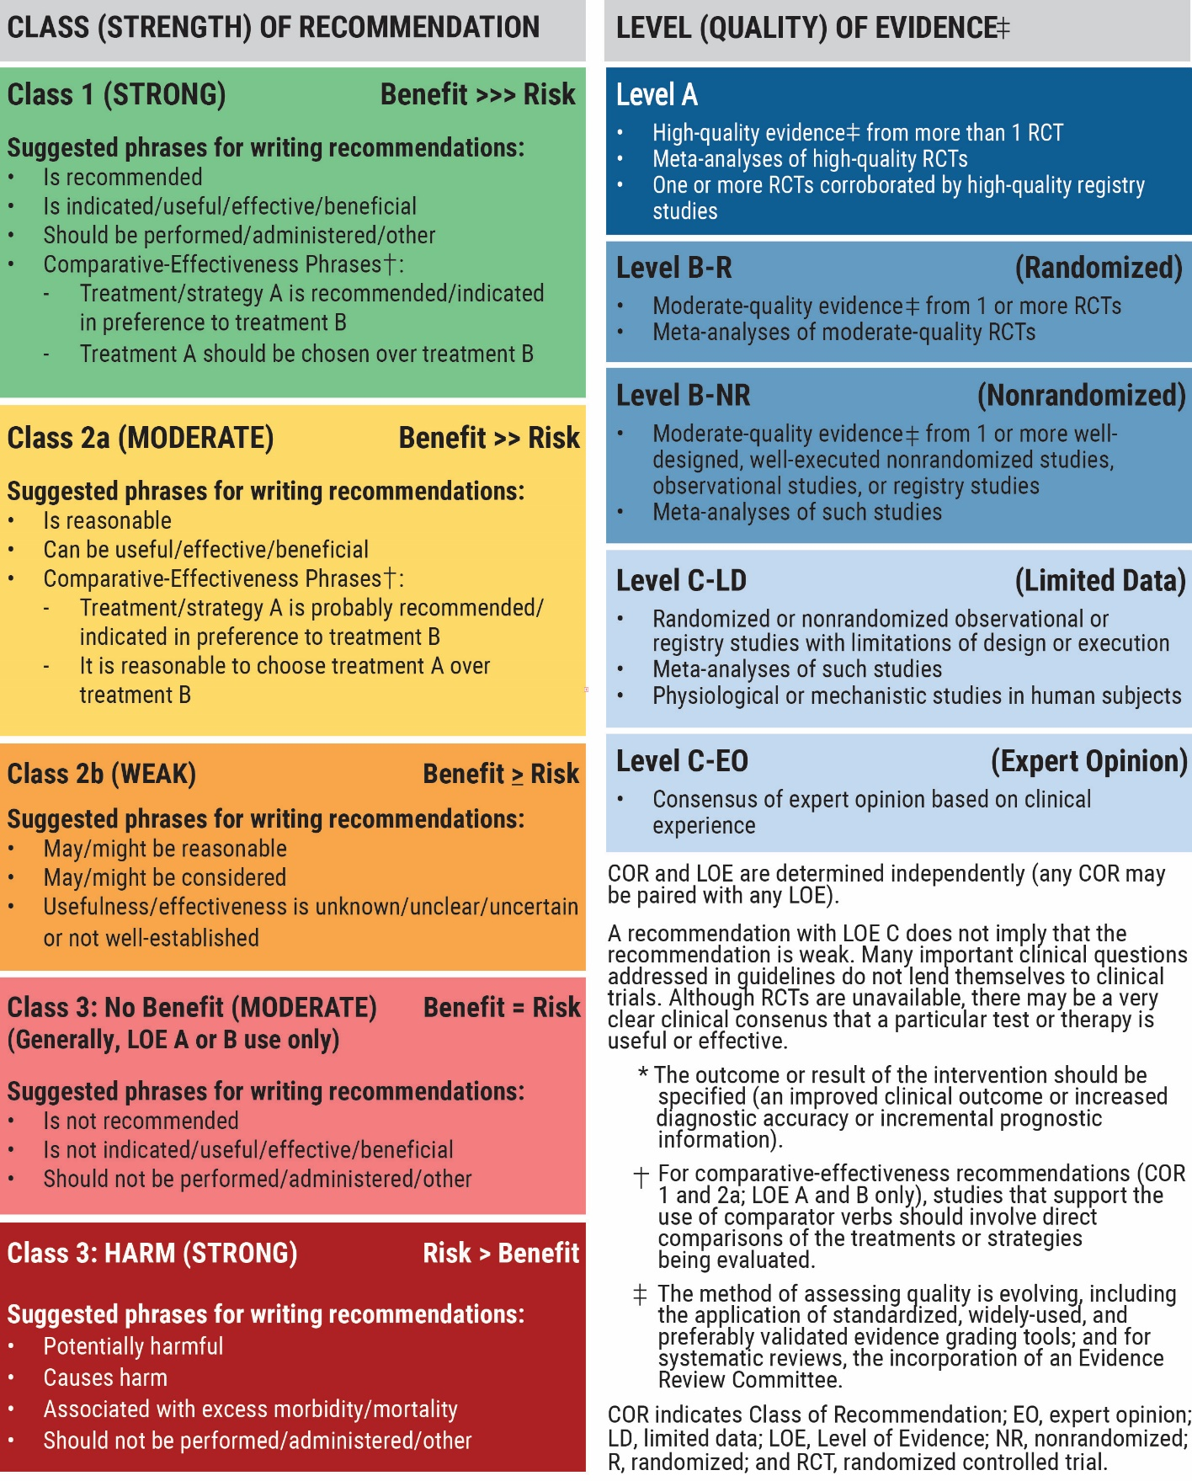
Table 3. Applying the American College of Cardiology/American Heart Association Class of Recommendation and Level of Evidence to Clinical Strategies, Interventions, Treatments, or Diagnostic Testing in Patient Care* (Updated December 2024)

Slide 35
Evaluation and Diagnosis

Slide 36
Screening in Children and Adults
 | Recommendations for Screening in Children and Adults Referenced studies that support recommendations are summarized in the Evidence Table.
COR | LOE | Recommendations
1 | B-NR | In adults, screening with a lipid profile is recommended beginning at age 19 years and at least every 5 years thereafter to identify treatable ASCVD risk, with frequent screening recommended for individuals with additional ASCVD risk factors.
1 | B-NR | In children 9 to 11 years of age not previously tested, it is recommended to screen with a lipid profile to identify familial hypercholesterolemia (FH) and other significant lipid disorders.
2a | B-NR | In individuals with first- or second-degree relatives with premature ASCVD, severe hypercholesterolemia, or FH, it is reasonable to perform screening with a single lipid profile (eg, cascade screening) starting at ≥2 years of age to identify FH.

Slide 37
Measurement of TC, LDL-C, HDL-C, Triglycerides, and Non–HDL-C
 | Recommendations for Measurement of TC, LDL-C, HDL-C, Triglycerides, and Non–HDL-C Referenced studies that support recommendations are summarized in the Evidence Table.
COR | LOE | Recommendations
1 | B-NR | In adults and children, a standard nonfasting or fasting lipid profile is recommended to document baseline lipid levels, estimate ASCVD risk, and guide initiation of LLT.
1 | B-NR | In adults and children with a family history of dyslipidemia or premature ASCVD, a personally known or suspected disorder in TG metabolism, or whose nonfasting lipid profile reveals a TG level ≥400 mg/dL (≥4.5 mmol/L), a fasting lipid profile should be performed to more accurately estimate the LDL-C level.

Slide 38
Measurement of TC, LDL-C, HDL-C, Triglycerides, and Non–HDL-C (con’t.)
1 | B-NR | In adults and children who have undergone a standard lipid profile, use of either the Martin/Hopkins equation or the Sampson/National Institutes of Health (NIH) equation is preferred over calculation by the Friedewald equation to estimate LDL-C.
1 | B-NR | In adults and children who have undergone a standard lipid profile, use of either the Martin/Hopkins equation or Sampson/NIH equation is preferred over direct LDL-C measurement (other than by beta-quantification) to estimate LDL-C.
1 | B-NR | In adults and children who have undergone a standard lipid profile, reporting of non–HDL-C is recommended for ASCVD risk assessment and to guide initiation and monitoring of LLT.
3: No Benefit | B-NR | In adults and children, routine advanced lipoprotein testing (eg, gradient gel electrophoresis, density gradient ultracentrifugation, nuclear magnetic resonance spectroscopy, ion mobility analysis) to assess lipoprotein subclasses and parameters such as LDL particle size is not recommended to estimate ASCVD risk and guide initiation of LLT.

Slide 39
Measurement of Apolipoprotein B
 | Recommendations for Measurement of Apolipoprotein B Referenced studies that support recommendations are summarized in the Evidence Table.
COR | LOE | Recommendations
2a | B-NR | In adults on LLT, particularly those with ASCVD, CKM syndrome, type 2 diabetes, and/or elevated TG, measurement of apoB is reasonable to guide decisions regarding further therapeutic intensification once LDL-C and/or non–HDL-C goals are achieved.
2b | B-NR | In adults not on LLT, measurement of apoB may be reasonable to enhance ASCVD risk assessment, guide decisions about initiation of LLT, and characterize inherited lipid disorders.

Slide 40
Measurement of Lipoprotein (a)
 | Recommendations for Measurement of Lipoprotein (a) Referenced studies that support recommendations are summarized in the Evidence Table.
COR | LOE | Recommendations
1 | B-NR | In all adults, measurement of Lp(a) concentration is recommended at least once for ASCVD risk assessment.
1 | B-NR | In individuals with FH, premature ASCVD, or high Lp(a), cascade testing of first-degree family members for high Lp(a) concentration is recommended to identify those at increased ASCVD risk.
1 | B-NR | For individuals undergoing measurement of Lp(a), use of laboratories employing assays that are insensitive to apo(a) isoforms and traceable to official reference standard materials is recommended to more accurately measure Lp(a) and characterize ASCVD risk.

Slide 41
Table 4. ASCVD Risk Related to Lp(a) Concentrations*
Lp(a) concentration nmol/L (mg/dL) | ASCVD Relative Risk: Increase Compared With Population Median (20 nmol/L, 7 mg/dL)
430 nmol/L (180 mg/dL) | 4-fold
350 nmol/L (150 mg/dL) | 3-fold
250 nmol/L (100 mg/dL) | 2 -fold
125 nmol/L (50 mg/dL) | 1.4-fold
75-124 nmol/L (30-49 mg/dL) | 1.2-fold
<75 nmol/L (<30 mg/dL) | Reference
Data in the table are derived from the UK Biobank Study,14 are intended as a general guide and may differ in other populations. For example, relative risk of 2-fold has been observed for levels of 200 nmol/L in some populations. Equivalence of levels between nmol/L and mg/dL is approximate. An Lp(a) level of 50 mg/dL (125 nmol/L, ~ 80th percentile) is associated with an ~40% relative risk increase in ASCVD compared with 7 mg/dL (20 nmol/L, median in a reference population).1,2 An Lp(a) level of 100 mg/dL (≥250 nmol/L, ~95th percentile) approximately doubles the ASCVD risk. An Lp(a) level of 180 mg/dL (≥430 nmol/L, ~99th percentile) increases the ASCVD risk by ~4-fold, similar to the risk of heterozygous familial hypercholesterolemia.
*Lp(a) concentrations in this threshold range may be considered for repeat testing.
ASCVD indicates atherosclerotic cardiovascular disease; and Lp(a), lipoprotein (a).

Slide 42
Monitoring and Follow-Up
 | Recommendation for Monitoring and Follow-Up Referenced studies that support the recommendation are summarized in the Evidence Table.
COR | LOE | Recommendation
1 | A | In individuals on LLT, clinicians should perform a lipid profile 4 to 12 weeks after initiation or dose adjustment and every 6 to 12 months thereafter to assess efficacy and adherence to LLTs.

Slide 43
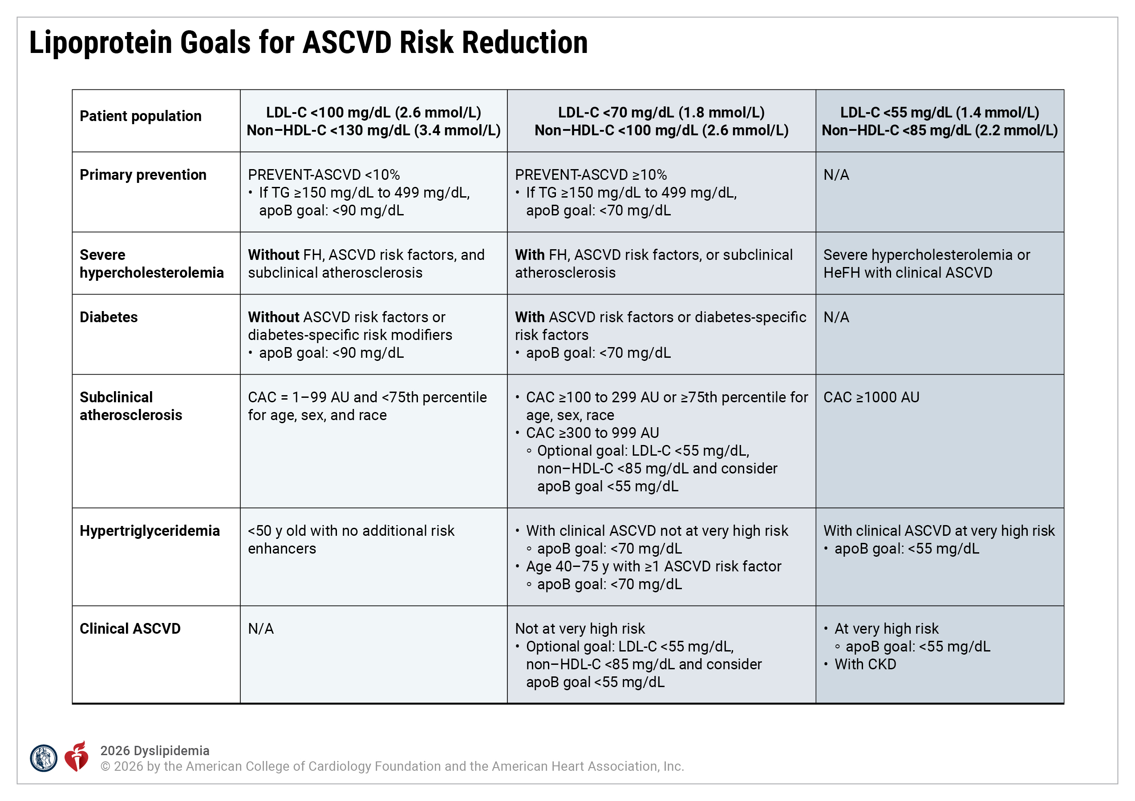
Figure 1. Lipoprotein Goals for ASCVD Risk Reduction
apoB indicates apolipoprotein B; ASCVD, atherosclerotic cardiovascular disease; AU, Agatston units; CAC, coronary artery calcium; CKD, chronic kidney disease; FH, familial hypercholesterolemia; HDL-C, high-density lipoprotein-cholesterol; LDL-C, low-density lipoprotein-cholesterol; and TG, triglycerides.

Slide 44
Management

Slide 45
Primordial Prevention of Dyslipidemia: Childhood Through Adulthood
 | Recommendation for Primordial Prevention of Dyslipidemia: Childhood Through Adulthood Referenced studies that support the recommendation are summarized in the Evidence Table.
COR | LOE | Recommendation
1 | A | In children and healthy adults, healthy dietary patterns, regular physical activity, maintenance of a healthy weight, healthy sleep, stress management, and avoidance of tobacco products should be promoted and reinforced lifelong to reduce the risk for dyslipidemia and ASCVD.

Slide 46
Dietary Management of LDL-C Disorders
 | Recommendation for Dietary Management of LDL-C Disorders Referenced studies that support the recommendation are summarized in the Evidence Table.
COR | LOE | Recommendation
1 | B-R | In adults and children with or without ASCVD, a diet emphasizing intake of fruits, vegetables, nuts, legumes, whole grains, and fiber, while replacing saturated and trans-fat with dietary monounsaturated and polyunsaturated fat, is recommended to decrease LDL-C levels and reduce ASCVD risk.

Slide 47
Lifestyle Management of Hypertriglyceridemia
 | Recommendations for Lifestyle Management of Hypertriglyceridemia Referenced studies that support recommendations are summarized in the Evidence Table.
COR | LOE | Recommendations
1 | A | In adults with fasting TG levels of 150 to 499 mg/dL (1.7-5.6 mmol/L), a diet that is low in added sugar, refined carbohydrates, and saturated fat, and that minimizes alcohol (Figure 2) is beneficial to reduce TG and ASCVD risk.
1 | B-NR | In adults with fasting TG levels of 500 to 999 mg/dL (5.7-11.3 mmol/L), a diet that is low in added sugar, refined carbohydrates, and saturated fat, with no alcohol and individualized limitation of total fat (Figure 2) is beneficial to reduce TG for the reduction of ASCVD risk and risk of pancreatitis.
1 | B-NR | In adults with fasting TG levels of ≥1000 mg/dL (11.3 mmol/L), a diet that is very low in total fat and refined carbohydrates, with elimination of alcohol and added sugars (Figure 2) is beneficial to reduce TG and risk for pancreatitis.
1 | B-NR | In adults with fasting TG levels ≥150 mg/dL (1.7 mmol/L) or nonfasting TG levels ≥175 mg/dL (2 mmol/L), improvement in lifestyle factors related to overweight/obesity and CKM syndrome, weight loss of 5% to 10%, moderate-to-vigorous intensity physical activity of ≥150 minutes a week, and upper and lower body resistance exercise 2 days/week (Figure 2) are beneficial to reduce TG.

Slide 48
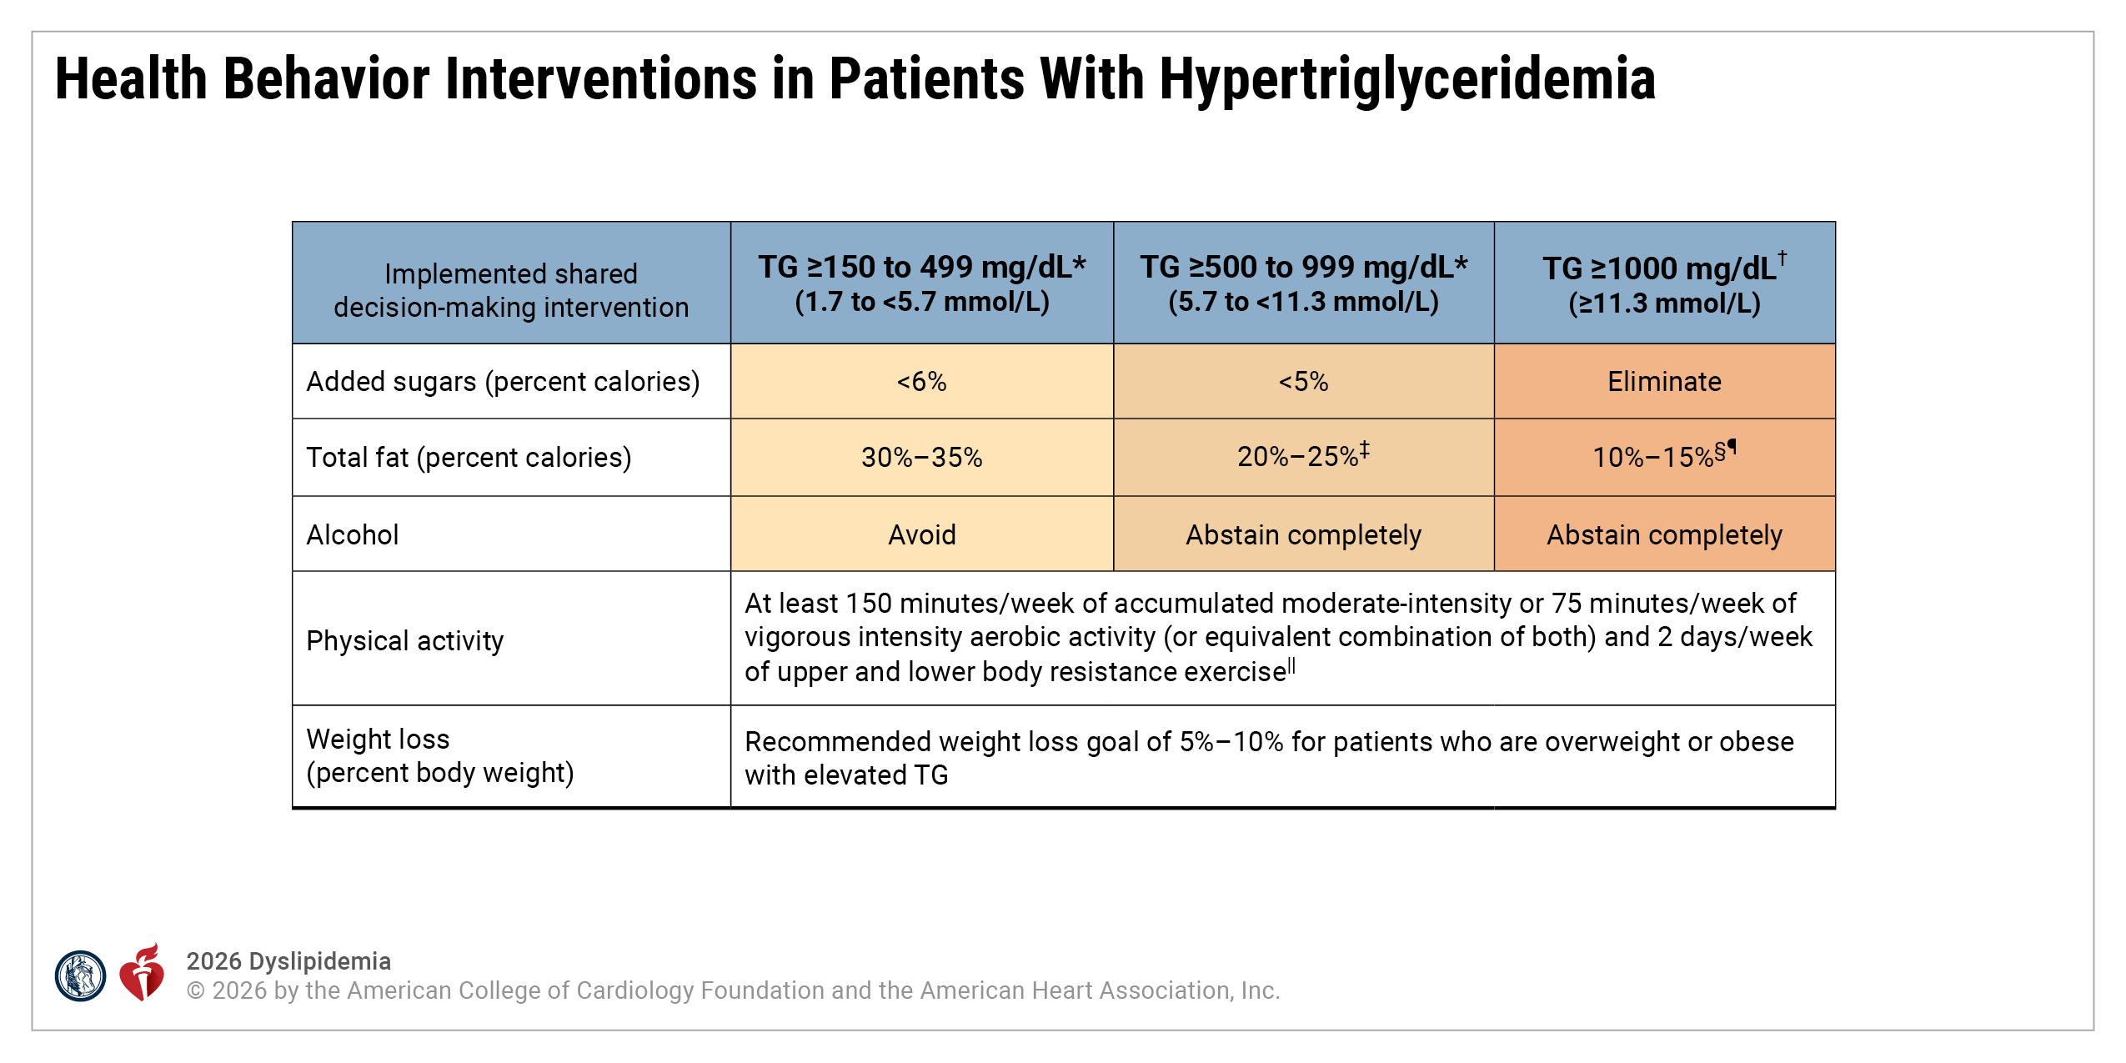
Figure 2. Health Behavior Interventions in Patients With Hypertriglyceridemia.
*Referral to an RDN and lipid specialist advised.
†Referral to an RDN necessary.
‡Clinicians may opt to reduce total fat as a percent of calories in some patients to 10% to 15% (examples include those with a history of pancreatitis or those at the higher end of this range).
§Limitation of total fat to 10% to 15% of total daily intake, with guidance from an RDN is essential for patients with FCS.
¶For those with TG disorders outside of FCS, individually tailored total fat limitation under the guidance of an RDN can be beneficial due to variable response to diet.
||Although clinicians should aim for a patient to achieve the guideline-directed amount of physical activity, any physical activity is likely beneficial in sedentary individuals and should be encouraged to reduce cardiometabolic risk.
FCS indicates familial chylomicronemia syndrome; RDN, registered dietician nutritionist; and TG, triglycerides.
Adapted with permission from Virani et al. with additional information obtained from Arnett et al. Copyright© 2021 American College of Cardiololgy Foundation.

Slide 49
Attainment and Maintenance of Healthy Weight in People With Dyslipidemia
 | Recommendation for Attainment and Maintenance of a Healthy Weight in Dyslipidemia Referenced studies that support the recommendation is summarized in the Evidence Table.
COR | LOE | Recommendation
1 | B-NR | In individuals with overweight or obesity and dyslipidemia, counseling and treatment to achieve weight reduction and maintenance of a healthy weight are recommended to improve dyslipidemia.

Slide 50
Physical Activity
 | Recommendation for Physical Activity Referenced studies that support the recommendation are summarized in the Evidence Table.
COR | LOE | Recommendation
1 | B-R | In individuals with dyslipidemia, regular physical activity that includes moderate-to-vigorous intensity aerobic exercise for ≥150 minutes a week, along with upper and lower body resistance exercise 2 days/week should be recommended as part of a program to improve blood lipids and cardiovascular health.

Slide 51
Dietary Supplements
 | Recommendation for Dietary Supplements Referenced studies that support the recommendation are summarized in the Evidence Table.
COR | LOE | Recommendation
3: No Benefit | B-R | In individuals with dyslipidemia, the use of dietary supplements is not recommended to lower LDL-C or TG based on limited and inconsistent data and/or limited benefits in lipid-lowering and reduction in ASCVD risk.

Slide 52
When to Refer to a Registered Dietitian Nutritionist
 | Recommendations for When to Refer to a Registered Dietitian Nutritionist Referenced studies that support recommendations are summarized in the Evidence Table.
COR | LOE | Recommendations
1 | B-NR | In individuals with fasting TG ≥1000 mg/dL (11.3 mmol/L), referral to an RDN is recommended to create an individualized treatment plan aimed at reducing TG and the risk of pancreatitis.
2a | B-NR | In individuals with fasting TG ≥150 to 999 mg/dL (≥1.7-11.3 mmol/L) and features of the CKM syndrome, referral to an RDN to provide counseling on evidence-based dietary patterns can be beneficial to improve lipoprotein levels and reduce the risk of pancreatitis.

Slide 53
Table 5. Characteristics of Common Lipid-Lowering Medications to Treat Dyslipidemia*
Class | Mechanism of Action | Medications | Typical Dose Range | Dosing Frequency | Comments†
LDL-C–Lowering Medications
HMG-CoA reductase inhibitors (aka statins) | Competitively inhibits HMG-CoA reductase (rate-limiting step of endogenous cholesterol production); increases LDL receptor expression on the surface of hepatocytes | Atorvastatin | 10-80 mg | Once daily | Oral agents First-line therapy for ASCVD risk reduction in nearly all patients Extensive CVOT evidence demonstrates reductions in events over wide range of LDL-C levels in primary and secondary prevention Expected LDL-C reduction: 18%-55%‡ Atorvastatin and rosuvastatin can achieve high-intensity LDL-C reductions and are preferred for patients at high/very high ASCVD risk Atorvastatin, pitavastatin, and rosuvastatin have long half-lives that enable dosing any time of the day
 |  | Fluvastatin | 20-80 mg | Once or twice daily
 |  | Lovastatin | 10-80 mg | Once or twice daily
 |  | Pitavastatin | 1-4 mg | Once daily
 |  | Pravastatin | 10-80 mg | Once daily
 |  | Rosuvastatin | 5-40 mg | Once daily
 |  | Simvastatin | 5-40 mg | Once daily

Slide 54
Table 5. Characteristics of Common Lipid-Lowering Medications to Treat Dyslipidemia* (con’t.)
Class | Mechanism of Action | Medications | Typical Dose Range | Dosing Frequency | Comments†
LDL-C–Lowering Medications
Cholesterol absorption inhibitor | Blocks the sterol transporter protein, NPC1L1, to inhibit intestinal and biliary sterol absorption; increases LDL receptor expression on the surface of hepatocytes secondary to reduced hepatic sterol levels | Ezetimibe | 10 mg | Once daily | Oral agent CVOT evidence demonstrates reductions in cardiovascular events in very high-risk secondary prevention in combination with a moderate-intensity statin therapy Expected LDL-C reduction: monotherapy, 18%; combination with a statin, 25% incremental reduction‡ Drug of choice in sitosterolemia to reduce elevated sitosterol and campesterol

Slide 55
Table 5. Characteristics of Common Lipid-Lowering Medications to Treat Dyslipidemia* (con’t.)
Class | Mechanism of Action | Medications | Typical Dose Range | Dosing Frequency | Comments†
LDL-C–Lowering Medications
PCSK9 inhibitor: monoclonal antibodies | Fully human monoclonal antibodies: binds to PCSK9 in the circulation and decreases degradation of LDL receptors | Alirocumab | 75-150 mg | Every 2 weeks | Subcutaneous agents CVOT evidence demonstrates reductions in cardiovascular events in very high-risk secondary prevention in combination with a maximally tolerated statin therapy Expected LDL-C reduction: 45%-64%‡ Lower mean LDL-C reduction (21%-31%) in homozygous FH due to LDLR gene variants
 |  |  | or
 |  |  | 300 mg | Every 4 weeks
 |  | Evolocumab | 140 mg | Every 2 weeks

Slide 56
Table 5. Characteristics of Common Lipid-Lowering Medications to Treat Dyslipidemia* (con’t.)
Class | Mechanism of Action | Medications | Typical Dose Range | Dosing Frequency | Comments†
LDL-C–Lowering Medications
ATP citrate lyase inhibitor | Inhibits ATP citrate lyase in the liver to decrease cholesterol production upstream of HMG-Co reductase in the cholesterol synthesis pathway; increases LDL receptor expression on the surface of hepatocytes | Bempedoic acid | 180 mg | Once daily | Oral agent CVOT evidence demonstrating reductions in cardiovascular events in individuals treated for high-risk primary and secondary prevention with statin-attributed side effects Prodrug that is activated by very long-chain acyl-CoA synthetase, found primarily in the liver Expected LDL-C reduction: monotherapy in patients with statin-attributed side effects, 21%-24% combination with a statin, 17%-18%‡

Slide 57
Table 5. Characteristics of Common Lipid-Lowering Medications to Treat Dyslipidemia* (con’t.)
Class | Mechanism of Action | Medications | Typical Dose Range | Dosing Frequency | Comments†
LDL-C–Lowering Medications
PCSK9 inhibitor: small interfering RNA | Utilizes endogenous RNA interference mechanism and directs catalytic breakdown of mRNA for PCSK9 and decreases degradation of the LDL receptor | Inclisiran | 284 mg | Initial dose followed by second dose in 3 months, then every 6 months thereafter | Subcutaneous agent administered by a health care professional Expected LDL-C reduction: 48%-52%‡ CVOT in progress

Slide 58
Table 5. Characteristics of Common Lipid-Lowering Medications to Treat Dyslipidemia* (con’t.)
Class | Mechanism of Action | Medications | Typical Dose Range | Dosing Frequency | Comments†
LDL-C–Lowering Medications
Bile acid sequestrants | Bind bile acids in the gut, interrupt enterohepatic recirculation of bile acids and impede their reabsorption, decrease bile acid pooling in the liver, increase conversion of cholesterol to bile acids; increase LDL receptor expression on the surface of hepatocytes | Cholestyr-amine | 8-16 g | Once or twice daily | Oral agents CVOT evidence from 1 trial demonstrating cardiovascular event reduction in primary prevention men as monotherapy Nonsystemic, add-on to statin therapy or in patients with statin-intolerance Expected LDL-C reduction: 10%-27%‡ Gastrointestinal side effects may limit use Both LDL-C lowering and incidence of side effects are dose related May increase serum TG levels; avoid if TG ≥300 mg/dL
 |  | Colesevelam | 3.75 mg | Once or twice daily
 |  | Colestipol | 2-16 g | Once or multiple times daily

Slide 59
Table 5. Characteristics of Common Lipid-Lowering Medications to Treat Dyslipidemia* (con’t.)
Class | Mechanism of Action | Medications | Typical Dose Range | Dosing Frequency | Comments†
LDL-C–Lowering Medications Approved Only in HoFH
Microsomal TG transfer protein inhibitor | Binds and inhibits microsomal TG transfer protein, which is essential for the assembly of apoB-containing lipoproteins, and inhibiting synthesis of chylomicrons and VLDL, which lowers LDL-C | Lomitapide | 5-60 mg | Once daily | Oral agent Expected LDL-C reduction: 40%-50%‡ Only available through a restricted program; several adverse reactions (including hepatotoxicity due to hepatic steatosis exacerbated by concomitant ethanol intake, as well as steatorrhea) and drug-drug interactions Daily vitamin E, linoleic acid, alpha-linolenic acid, EPA, and DHA supplements are needed to mitigate reduced absorption of fat-soluble vitamins/fatty acids Multiple potential drug interactions associated with CYP3A4 metabolism

Slide 60
Table 5. Characteristics of Common Lipid-Lowering Medications to Treat Dyslipidemia* (con’t.)
Class | Mechanism of Action | Medications | Typical Dose Range | Dosing Frequency | Comments†
LDL-C–Lowering Medications Approved Only in HoFH
ANGPTL3 inhibitor | Fully human mAb that binds to and inhibits ANGPTL3; ANGPTL3 inhibition enhances remnant lipoprotein clearance, reducing VLDL remnants and their conversion into LDL particles | Evinacumab-dgnb | 15 mg/kg | Every 4 weeks | Intravenously administered agent Works through an LDL receptor-independent pathway Expected LDL-C reduction: 49%‡

Slide 61
Table 5. Characteristics of Common Lipid-Lowering Medications to Treat Dyslipidemia* (con’t.)
Class | Mechanism of Action | Medications | Typical Dose Range | Dosing Frequency | Comments†
Triglyceride-Lowering Medications
Fibrates | Stimulates PPAR-alpha, which activates lipoprotein lipase and reduces apolipoprotein C-III production; increases lipolysis and elimination of TG-rich particles | Fenofibrate | 40-200 mg | Once daily | Oral agents CVOTs show no reduction in cardiovascular events when fenofibrate is added to statin therapy in primary prevention patients with diabetes; CVOT evidence demonstrating reductions in cardiovascular events in primary and secondary prevention patients with gemfibrozil monotherapy First-line option for severe hypertriglyceridemia (≥500 mg/dL, especially when ≥1000 mg/dL) Expected TG reduction: 30%-50%‡ Many different formulations of fenofibrate and fenofibric acid are available with varied dosages Dose may need to be reduced in decreased kidney function; avoid in severe kidney dysfunction Blunted to no TG reduction in patients with familial chylomicronemia syndrome due to reduced lipoprotein lipase activity Gemfibrozil should not be combined with statin therapy because of serious potential drug interaction
 |  | Fenofibric acid | 35-135 mg | Once daily
 |  | Gemfibrozil | 600 mg | Twice daily

Slide 62
Table 5. Characteristics of Common Lipid-Lowering Medications to Treat Dyslipidemia* (con’t.)
Class | Mechanism of Action | Medications | Typical Dose Range | Dosing Frequency | Comments†
Triglyceride-Lowering Medications
Omega-3 fatty acids | Reduces hepatic VLDL TG synthesis and/or secretion; enhances TG clearance from circulating VLDL; other mechanisms are possible | Icosapent ethyl | 4 g | Twice daily with food | Oral agents First-line option for severe (≥500 mg/dL) hypertriglyceridemia CVOT evidence demonstrating reductions in cardiovascular events with icosapent ethyl in individuals being treated for primary prevention of ASCVD patients with type 2 diabetes or secondary prevention if TG between 150-499 mg/dL and LDL-C is 41-100 mg/dL despite statin therapy Expected TG reduction: 15%-61%‡ Icosapent ethyl contains EPA only Omega-3 acid ethyl esters contain DHA and EPA, which can modestly raise LDL-C (but not apoB) Nonprescription fish oil supplements are not equivalent to, or considered prescription medications, and have variable fatty acid content Give with a fat-containing meal to ensure absorption (pancreatic lipase stimulation breaks ethyl bonds to facilitate absorption)
 |  | Omega-3 acid ethyl esters | 4 g | Once or twice daily with food

Slide 63
Table 5. Characteristics of Common Lipid-Lowering Medications to Treat Dyslipidemia* (con’t.)
Class | Mechanism of Action | Medications | Typical Dose Range | Dosing Frequency | Comments*
Triglyceride-Lowering Medications
Niacin | Reduces esterification of hepatic TG, decreases release of free fatty acids from adipose tissue and increases activity of lipoprotein lipase to enhance removal of TG-rich lipoprotein fatty acids | Extended-release niacin | 500-2000 mg | Once daily | Oral agents CVOTs show no reduction in cardiovascular events when added to statin therapy in individuals being treated for secondary prevention of ASCVD Last-line agent for severe hypertriglyceridemia due to relatively high risk of intolerable side effects; must initiate low dose to minimize side effects and slowly titrate up to an effective dose Expected TG reduction: sustained-release, 10%-30%; immediate-release 20%-50%‡ Increases insulin resistance, high rates of skin flushing, and significant hepatotoxicity
 |  | Immediate-release niacin | 250-6000 mg | Twice to 3 times daily

Slide 64
Table 5. Characteristics of Common Lipid-Lowering Medications to Treat Dyslipidemia* (con’t.)
Class | Mechanism of Action | Medications | Typical Dose Range | Dosing Frequency | Comments†
Triglyceride-Lowering Medications
ApoC-III inhibitor: ASO directed therapy | Binds to and degrades apoC-III mRNA; reduces the apoC-III protein, leading to increased clearance of plasma TG and VLDL | Olezarsen | 80 mg | Once monthly | Subcutaneous agent Only approved for familial chylomicronemia syndrome Expected TG reduction in familial chylomicronemia syndrome: 30% (placebo-corrected is 42.5%)‡

Slide 65
Table 5. Characteristics of Common Lipid-Lowering Medications to Treat Dyslipidemia* (con’t.)
*Dosages and administration from FDA-approved labeling.
†Adverse effects are discussed in Section 5.1, “Medication Safety and Therapy-Associated Side Effects.”
‡Expected lipid-lowering based on estimations from the “2022 ACC Expert Consensus Decision Pathway on the Role of Nonstatin Therapies for LDL-Cholesterol Lowering in the Management of Atherosclerotic Cardiovascular Disease Risk,” the “2019 AHA Science Advisory,” or product labeling.
ANGPTL3 indicates angiopoietin-like protein 3; ApoC-III, apolipoprotein C-III; ASO, antisense oligonucleotide; ATP, adenosine triphosphate; CVOT, cardiovascular outcome trial; DHA, docosahexanoic acid; EPA, eicosapentaenoic acid; FH, familial hypercholesterolemia; HMG-CoA, 3-hydroxy-3-methylglutaryl- coenzyme; mRNA, messenger ribonucleic acid; NPC1L1, Niemann-Pick C1-Like1; PCSK9, proprotein convertase subtilisin/kexin type 9; PPAR-alpha, peroxisome proliferator-activated receptor-alpha; RNA, ribonucleic acid; TG, triglycerides; VLDL, very-low density lipoprotein; and XL, extended release.

Slide 66
Table 6. High-, Moderate-, and Low-Intensity Statin Therapy*
 | High-Intensity | Moderate-Intensity | Low-Intensity
Expected % LDL-C Reduction† | ≥50% | 30%–49% | <30%
Preferred Statins | Atorvastatin (40 mg) 80 mg Rosuvastatin 20 mg (40 mg) | Atorvastatin 10 mg (20 mg) Rosuvastatin (5 mg) 10 mg
Other Statins | --- | Fluvastatin XL 80 mg Fluvastatin 40 mg BID Lovastatin 40 mg (80 mg) Pitavastatin 1, 2, 4 mg Pravastatin 40 mg (80 mg) Simvastatin 20, 40 mg‡ | Fluvastatin 20, 40 mg Lovastatin 20 mg Pravastatin 10, 20 mg Simvastatin 10 mg

Slide 67
Table 6. High-, Moderate-, and Low-Intensity Statin Therapy* (con’t.)
Expected percentage LDL-C reductions with atorvastatin, rosuvastatin, and simvastatin were estimated using the median reduction in LDL-C from the VOYAGER database. Reductions in LDL-C for other statins (fluvastatin, lovastatin, pitavastatin, and pravastatin) were identified according to FDA-approved product labeling in adults with hyperlipidemia, primary hypercholesterolemia, and mixed dyslipidemia.
Boldface type indicates specific statins and doses that were evaluated in placebo-controlled RCTs evaluating ASCVD event lowering, and the Cholesterol Treatment Trialists’ 2010 meta-analysis. These RCTs demonstrated a reduction in major ASCVD events.
Modified with permission from Grundy et al. Copyright© 2018 American Heart Association, Inc. and American College of Cardiology Foundation.
*Expected percentage reductions are estimates from data across large populations. Individual responses to statin therapy varied in the RCTs and should be expected to vary in clinical practice owing to a high degree of heterogeneity seen with LDL-C–lowering medications.
†Expected LDL-C lowering with the dosage listed below each intensity.
‡Although simvastatin 80 mg was evaluated in RCTs, initiation of simvastatin 80 mg or titration to 80 mg is not recommended by the FDA because of the increased risk of myopathy, including rhabdomyolysis.
BID indicates twice daily; FDA, US Food and Drug Administration; LDL-C, low-density lipoprotein-cholesterol; RCT, randomized controlled trial; and XL, extended release.

Slide 68
Table 7. Pharmacokinetic Properties of Statin Medications
 | Absorption |  | Distribution |  | Metabolism |  |  | Elimination
 | Bio-availability (%) | Tmax (h) | Protein Binding (%) | Lipophilicity (log P) | CYP Hepatic Enzyme | Pro- drug | Active Metabolite | Renal Excretion (%) | t1/2 (hr)
Atorvastatin | 14 | 1–2 | ≥98 | Yes, 4.1 | 3A4 | No | Yes | <2 | 14
Fluvastatin | 24 | <1 | 98 | Yes, 3.2 | 2C9 (2C8, 3A4 minor) | No | No | 5 | 3
Lovastatin | <5 | 2–4 | ≥95 | Yes, 4.3 | 3A4 | Yes | Yes | 10 | 2–3
Pitavastatin | 43–51 | 1 | 99 | Yes, 1.5 | 2C9 (2C8 minor) | No | No | 15 | 12
Pravastatin | 17 | 1– 1.5 | 50 | No, -0.2 | None | No | No | 20 | 1.8
Rosuvastatin | 20 | 3–5 | 88 | No, -0.3 | 2C9 | No | Minimal | 10 | 19
Simvastatin | <5 | 4 | 95 | Yes, 4.7 | 3A4 | Yes | Yes | 13 | 2

Slide 69
Table 7. Pharmacokinetic Properties of Statin Medications (con’t.)
Atorvastatin, lovastatin, and simvastatin are P-glycoprotein substrates and may be subject to certain drug-drug interactions.
Modified with permission from Wiggins et al. Copyright© 2016 American Heart Association, Inc.
CYP indicates cytochrome P450; h, hour; Tmax, time until maximum serum concentration achieved; and t1/2, drug half-life.

Slide 70
Table 8. Common Medications That May Interact With Statins
Avoid use with any statin | Can be used with a statin using a risk mitigation strategy*
Gemfibrozil | Amiodarone Amlodipine Atazanavir plus ritonavir Boceprevir Clarithromycin Cobicistat-containing products Colchicine Cyclosporine Danazol Darunavir plus ritonavir Diltiazem Dronedarone Erythromycin Fenofibrate Fenofibric acid Fluconazole Fosamprenavir (with or without ritonavir) Itraconazole | Ketoconazole Lomitapide Lopinavir plus ritonavir Nefazodone Nelfinavir Niacin (≥1 g/d) Nirmatrelvir plus ritonavir Posaconazole Ranolazine Rifampin Saquinavir plus ritonavir Telaprevir Telithromycin Tipranavir plus ritonavir Verapamil Voriconazole Warfarin
*Risk mitigation strategies include a) avoiding use of the coadministered interacting medication, b) using an alternative statin that does not have the drug-drug interaction, and c) limiting the statin dose depending upon the statin and the nature of the drug-drug interaction.
Modified with permission from Wiggins et al. Copyright© 2016 American Heart Association, Inc.

Slide 71
Table 9. Considerations for Referral to a Lipid Specialist*
Patients with diagnosed or suspected FH
Patients with homozygous FH
Patients with heterozygous FH who do not achieve treatment targets on maximally tolerated statin plus nonstatin therapy
Patients with heterozygous FH with statin-attributed side effects on ≥2 statins, including at the lowest dose or with alternate dosing regimens
Patients with ASCVD or at high risk of ASCVD
Patients with premature ASCVD (onset age <40 years)
Patients who do not achieve ≥50% LDL-C reduction and LDL-C (or non–HDL-C) targets on maximally tolerated statin plus nonstatin therapy
Patients with statin-attributed side effects on ≥2 statins, including at the lowest dose or with alternate dosing regimens
Patients who have elevated Lp(a) (≥200 nmol/L or ≥75 mg/dL)
Patients <40 years old with diabetes and dyslipidemia
Patients at high risk for ASCVD or with ASCVD who are on complex medication regimens
Patients receiving treatment for HIV
Patients receiving treatment for cancer
Patients receiving treatments to prevent transplant rejection
Individuals who are considering pregnancy, are pregnant, or are breastfeeding
Patients with heterozygous FH
Patients with hypertriglyceridemia (TG ≥400 mg/dL)
Patients with ASCVD or at high risk of ASCVD requiring LLT
Patients with inherited hyperlipidemias who need genetic testing for diagnosis
Patients with severe/extreme primary hypertriglyceridemia after secondary causes have been ruled out
Patients who may be candidates for treatment with evinacumab, lomitapide, olezarsen, or lipoprotein apheresis

Slide 72
Table 9. Considerations for Referral to a Lipid Specialist* (con’t.)
*Especially if patients are not achieving lipid/lipoprotein goals on recommended therapies.
ASCVD indicates atherosclerotic cardiovascular disease; FH, familial hypercholesterolemia; LDL-C, low-density lipoprotein-cholesterol; LLT, lipid-lowering therapy; LP(a), lipoprotein (a); HDL-C, high-density lipoprotein-cholesterol; HIV, human immunodeficiency virus; and TG; triglycerides.

Slide 73
Role of the Individualized Benefit-Risk Discussion
 | Recommendation for Role of the Individualized Benefit-Risk Discussion Referenced studies that support the recommendation are summarized in the Evidence Table.
COR | LOE | Recommendation
1 | B-NR | In individuals with dyslipidemia, clinicians and their patients should engage in a discussion of the patient’s ASCVD risk, healthy lifestyle as the foundation of risk reduction, expected risk reduction benefits from LLT, possible harms and DDI, costs, and patient preferences to make individualized treatment decisions and/or consider additional options for evaluation to aid in decision-making.

Slide 74
Table 10. Checklist for Individualized Benefit-Risk Discussion
 | Checklist Item | Recommendation
✓ | ASCVD risk assessment | Perform ASCVD risk assessment (Sections 4.2.3.2 through 4.2.3.7). When indicated, use the PREVENT-ASCVD Calculator*. Explain risk in absolute and relative terms. Use decision tools to explain risk (eg, PREVENT-ASCVD Calculator*). Consider CAC scan or the presence and severity of atherosclerosis seen on a non-ECG–gated chest CT or a carotid ultrasound. Consider risk enhancers. Consider reproductive age risk markers.
✓ | Emphasize healthy lifestyle habits as the foundation of treatment | Review lifestyle habits (eg, diet, physical activity, weight or body mass index, and tobacco use). Endorse a healthy lifestyle and provide relevant advice, materials, or referrals (eg, CardioSmart†, AHA Life’s Essential 8‡, NLA Patient Tear Sheets§, PCNA Heart Healthy Toolbox║, cardiac rehabilitation, dietitian, smoking cessation program).

Slide 75
Table 10. Checklist for Individualized Benefit-Risk Discussion (con’t.)
 | Checklist Item | Recommendation
✓ | Potential net clinical benefit of pharmacotherapy | Recommend a statin as first-line therapy. Consider the combination of statin and nonstatin therapy in selected patients. Discuss potential risk reduction from LLT. Discuss the potential for adverse effects or drug-drug interactions.
✓ | Cost and convenience considerations | Discuss potential out-of-pocket cost of therapy to the patient (eg, insurance plan coverage, tier level, copayment). Discuss administration of medicine by daily oral therapy, time of administration, potential drug interactions, subcutaneous injection every 2 weeks versus every 6 months.
✓ | Shared decision-making | Encourage the patient to verbalize what was heard (eg, patient’s personal estimated ASCVD risk, available options, and risks/benefits). Invite the patient to ask questions, express values and preferences, and state ability to adhere to lifestyle changes and medications. Refer patients to trustworthy materials to aid in their understanding of issues regarding risk decisions. Collaborate with the patient to determine therapy and follow-up plan.

Slide 76
Table 10. Checklist for Individualized Benefit-Risk Discussion (con’t.)
*The PREVENT-ASCVD Online Calculator is available at: https://professional.heart.org/en/guidelines-and-statements/prevent-calculator.
†CardioSmart health information is available at: https://www.cardiosmart.org/topics/healthy-living.
‡AHA Life's Essential 8 information is available at: https://www.heart.org/en/healthy-living/healthy-lifestyle/lifes-essential-8.
§NLA Patient Tear Sheets information is available at: https://www.lipid.org/practicetools/tools/tearsheets.
║PCNA Heart Healthy Toolbox information is available at: https://pcna.net/resource/heart-healthy-toolbox/.
Adapted with permission from Martin et al. Copyright© 2015 American College of Cardiology Foundation.
AHA indicates American Heart Association; ASCVD, atherosclerotic cardiovascular disease; CAC, coronary artery calcium; CT, computed tomography; ECG, electrocardiogram; LDL-C, low-density lipoprotein-cholesterol; LLT, lipid-lowering therapy; PCNA, Preventive Cardiology Nurses Association; and NLA, National Lipid Association.

Slide 77
PREVENT-ASCVD Equations
 | Recommendation for PREVENT-ASCVD Equations Referenced studies that support the recommendation are summarized in the Evidence Table.
COR | LOE | Recommendation
1 | B-NR | In adults aged 30 to 79 years without ASCVD or subclinical atherosclerosis and with an LDL-C level between 70 and 189 mg/dL (1.8-4.9 mmol/L), the PREVENT-ASCVD equations should be used to estimate 10-year ASCVD risk, with categorization as having low (<3%), borderline (3% to <5%), intermediate (5% to <10%), or high (≥10%) 10-year estimated ASCVD risk.

Slide 78
Table 11. Salient Features of the American Heart Association PREVENT™* Equations
The PREVENT equations:
Included a large, contemporary, representative sample of U.S. adults for derivation (N ~3.3 million) and external validation (N ~3.3 million).
Lower limit to begin risk prediction to age 30 years (through 79 years).
Provide sex-specific equations; race/ethnicity is not a variable that added predictive value to the equations and provides estimates adjusted for competing risk of non-CVD death.
Provide a base model for risk prediction that includes commonly available risk factor measures: age, sex, blood pressure, total and HDL-C, diabetes status, tobacco use, kidney function (eGFR), statin use, and antihypertensive medication use (and BMI for heart failure prediction).
Provide optional models with additional inputs, if known/measured, of hemoglobin A1c (to capture glycemic status), urinary albumin/creatinine ratio (for proteinuria and CKD), and zip code (to represent social deprivation index and acknowledge social determinants of cardiovascular risk). These factors are not necessary to generate risk estimates, but they may enhance risk prediction if available.
Predict 10-year and 30-year outcomes.
Predict risk for hard ASCVD† (relevant for LLT decisions), HF, and total CVD (ASCVD plus HF; relevant for blood pressure–lowering therapy decisions).
Demonstrate similar risk discrimination (C statistics) as the pooled cohort equations for prediction of ASCVD events.
Provide significantly and substantially more accurate risk estimates (improved calibration) for ASCVD than the pooled cohort equations, overall and in all demographic subgroups. In general, risk estimates from PREVENT-ASCVD equations tend to be 40% to 50% lower than 10-year risk estimates from the pooled cohort equations for the same risk factor profile.

Slide 79
Table 11. Salient Features of the American Heart Association PREVENT™* Equations (con’t.)
*For the purposes of risk assessment in decision-making for LLT, the PREVENT-ASCVD equations version should be used to predict hard ASCVD outcomes and assist the patient-clinician risk/benefit discussion.
†Fatal or nonfatal stroke, nonfatal MI, or CHD death. This does not include revascularizations performed without antecedent clinical events, given wide variation in practice patterns.
Adapted with permission from Khan et al. Copyright© 2023 American Heart Association, Inc.
ASCVD indicates atherosclerotic cardiovascular disease; BMI, body mass index; CVD, cardiovascular disease; CHD, coronary heart disease; CKD, chronic kidney disease; eGFR, estimated glomerular filtration rate; HDL-C, high-density lipoprotein-cholesterol; HF, heart failure; LLT, lipid-lowering therapy; and MI, myocardial infarction.

Slide 80
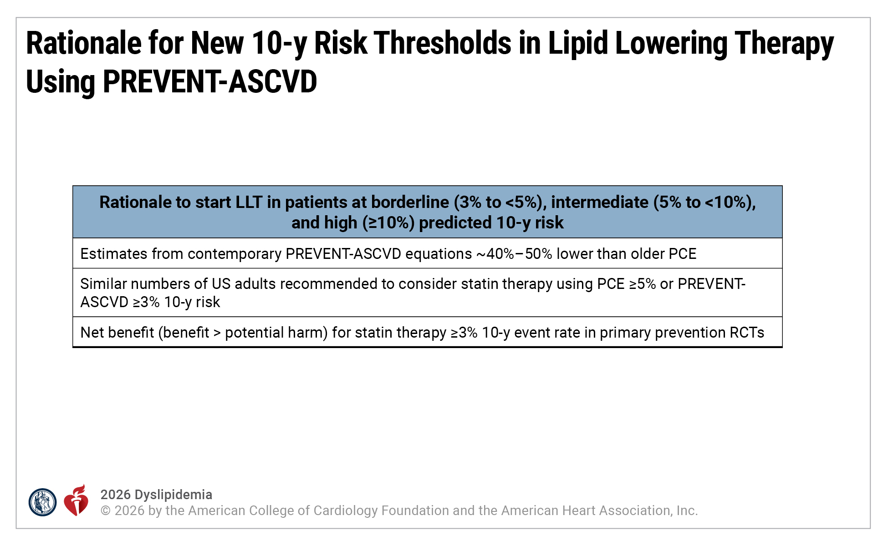
Figure 3. Rationale for New 10-Year Risk Thresholds in Lipid-Lowering Therapy Using PREVENT-ASCVD
ASCVD indicates atherosclerotic cardiovascular disease; LLT, lipid-lowering therapy; PCE, pooled cohort equations; RCTs, randomized controlled trials; and US, United States.
Adapted from Khan et al and Khan et al.

Slide 81
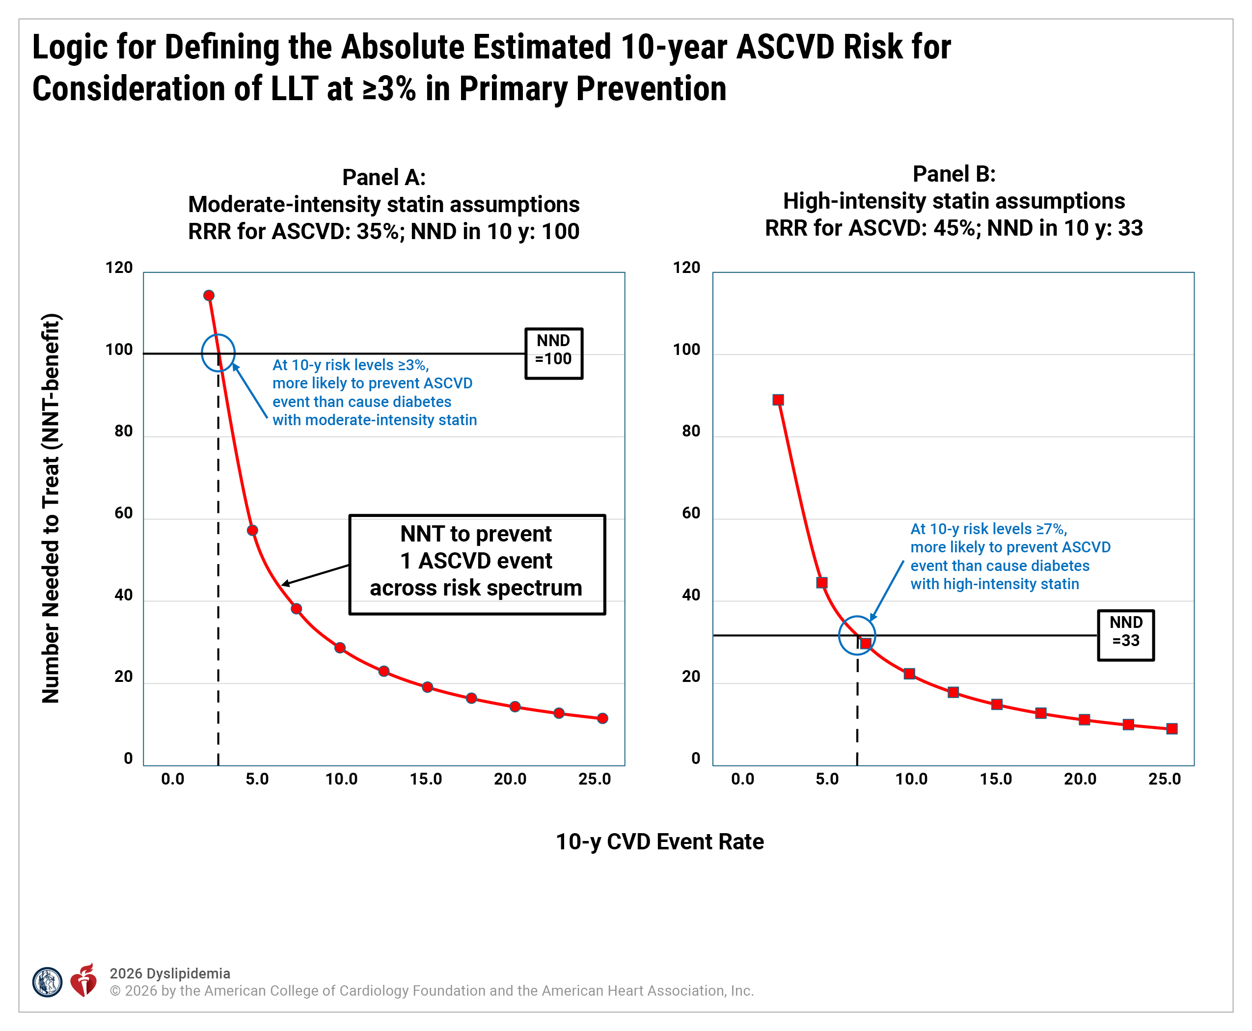
Figure 4. Logic for Defining the Absolute Estimated 10-Year ASCVD Risk for Consideration of LLT at ≥3% in Primary Prevention

Slide 82
Figure 4. Logic for Defining the Absolute Estimated 10-Year ASCVD Risk for Consideration of LLT at ≥3% in Primary Prevention (con’t.)
The graphs plot the number-needed-to-treat to prevent 1 ASCVD event (NNT-benefit; y-axis) as a function of the observed 10-year ASCVD event rate (x-axis) from primary prevention RCTs of statin therapy. The red curves show the number-needed-to-treat to prevent 1 ASCVD event (NNT-benefit) with initiation of (A) moderate-intensity or (B) high-intensity statin, assuming a 35% RRR with moderate-intensity and 45% RRR with high-intensity statin, as has been observed in meta-regression of statin trials. The horizontal black lines represent the number-needed-to-treat to cause 1 case of incident diabetes (NND) over 10 years with (A) moderate-intensity or (B) high-intensity statin. The risk of incident diabetes is higher for high-intensity than lower-intensity statins. Individuals with baseline normoglycemia rarely develop elevations in glucose sufficient to cause a new diagnosis of diabetes. Individuals who develop statin-attributed diabetes almost universally have documented prediabetes and are already near the threshold for diagnosis of diabetes. The points where the red curves and the horizontal black lines cross (blue circle; ~3% 10-year event rates for moderate-intensity and ~7% for high-intensity statin) represent the points at which the NNT-benefit and the NND are equal. Therefore, at risk levels higher than indicated by the dashed lines, there is expected net clinical benefit (potential benefit>potential harm) for initiation of LLT in primary prevention. Given that the PREVENT-ASCVD equations accurately predict ASCVD risk, the threshold for consideration of LLT in primary prevention was set at a PREVENT-ASCVD 10-year risk estimate of ≥3%.
Adapted with permission from Khan et al. Copyright© 2024 American Heart Association, Inc.
ASCVD indicates atherosclerotic cardiovascular disease; CVD, cardiovascular disease; DM, diabetes; LLT, lipid-lowering therapy; NND, number-needed-to-treat to cause 1 case of incident diabetes in 10 years; NNT-benefit, number-needed-to-treat to prevent 1 ASCVD event; RCT, randomized controlled trial; and RRR, relative risk reduction.

Slide 83
Table 12. Crosswalk Between 10-Year Risk ASCVD Estimates From PCE and PREVENT-ASCVD Equations
 | Approximate Equivalent Ranges of 10-Year ASCVD Risk Estimates*
Risk Group | PCE | PREVENT-ASCVD
Low | <5% | <3%
Borderline | 5% - <7.5% | 3% to <5%
Intermediate | 7.5% - <20% | 5% to <10%
High | ≥20% | ≥10%
*The PREVENT-ASCVD equations generally provide 10-year risk estimates that are 40% to 50% lower than the PCE estimates because the PCE calculator often overestimated the risk for adults.
ASCVD denotes atherosclerotic cardiovascular disease; and PCE, pooled cohort equations.
Adapted from Khan et al.

Slide 84
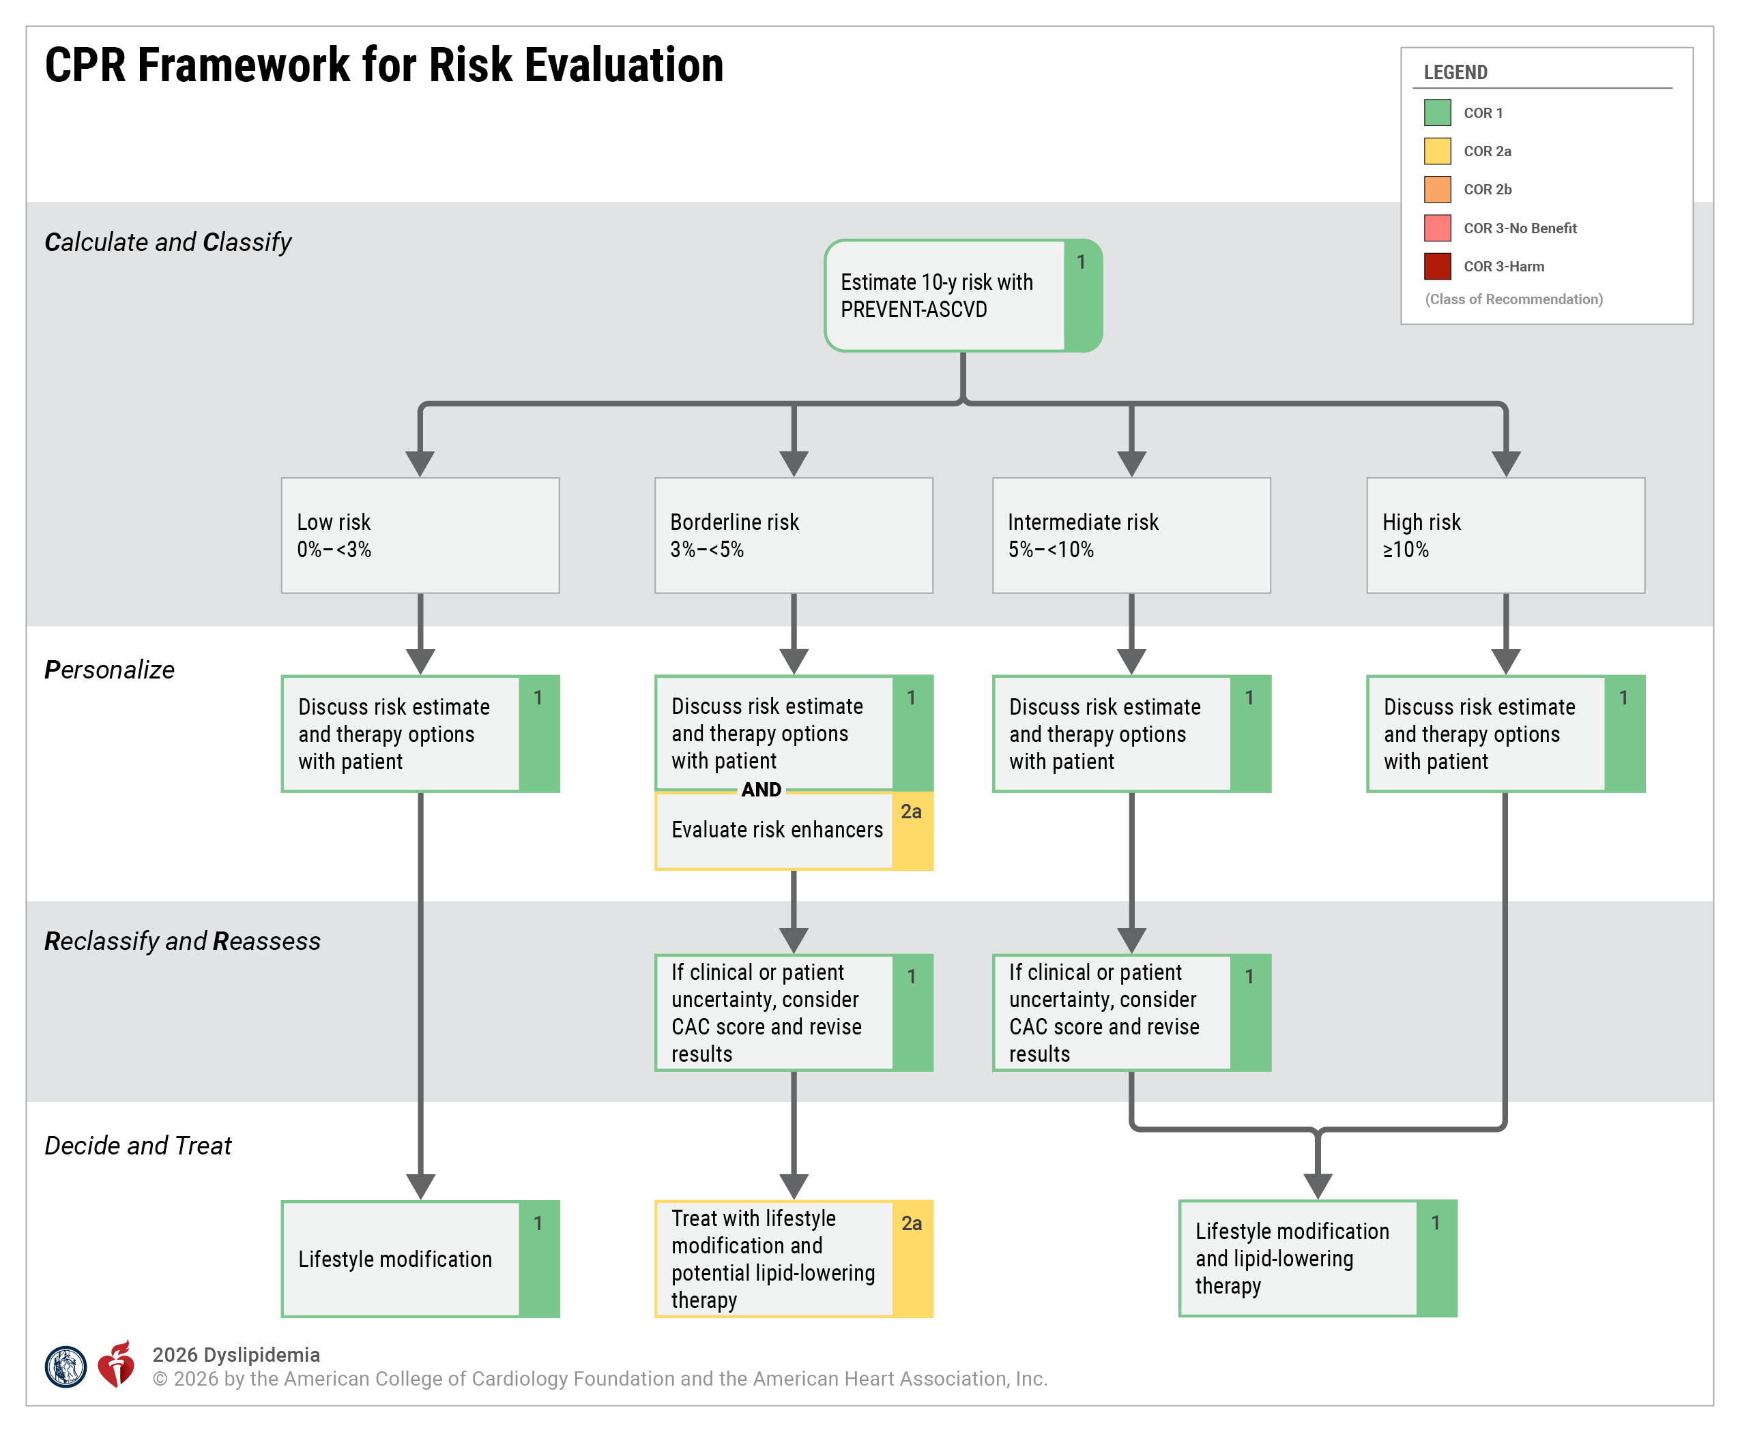
Figure 5. CPR Framework for Risk Evaluation
CAC indicates coronary artery calcium; and CPR, Calculate–Personalize–Reclassify.

Slide 85
Risk Enhancers
 | Recommendations for Risk Enhancers Referenced studies that support recommendations are summarized in the Evidence Table.
COR | LOE | Recommendations
2a | B-NR | In adults without ASCVD with a borderline 10-year ASCVD risk estimate (3% to <5%) by the PREVENT-ASCVD equations, consideration of risk enhancers is reasonable to personalize risk assessment and the potential beneﬁt of initiating LLT as an adjunct to lifestyle management to reduce ASCVD risk (Table 13).
2a | B-R | In adults without ASCVD with a borderline 10-year ASCVD risk estimate (3% to <5%) by the PREVENT-ASCVD equations, if high-sensitivity C-reactive protein (hsCRP) is measured and is ≥2 mg/L on 2 successive occasions with no identifiable underlying cause of hsCRP elevation, high-intensity statin therapy can be useful to reduce the risk of ASCVD events.

Slide 86
Table 13. Risk Enhancers
Risk Enhancers
History of premature ASCVD in a parent or sibling (onset age <55 y for men, <65 y for women)
Higher risk ancestry (eg, South Asian, Filipino)
High polygenic risk (if measured) (Section 4.2.3.5, “Polygenic Risk Scores”)
Chronic inflammatory diseases (eg, systemic lupus, rheumatoid arthritis, advanced psoriasis, inflammatory arthritis
Lp(a) ≥125 nmol/L or ≥50 mg/dL
hsCRP ≥2 mg/L on >1 occasion (if measured)
TG persistently ≥175 mg/dL (2 mmol/L) (if nonfasting) and ≥150 mg/dL (1.7 mmol/L) (if fasting)
CKM syndrome
LDL-C persistently ≥160-189 mg/dL (4.1-4.9 mmol/L), non–HDL-C≥190-219 mg/dL or apoB ≥120 mg/dL*
Reproductive risk markers (premature menopause, preeclampsia, gestational diabetes, gestational hypertension, preterm delivery; Section 4.2.3.4, “Reproductive Risk Marker”)
Note that all available information should be included in risk estimates derived from the PREVENT-ASCVD equations, including albuminuria, HbA1c, and zip code for assessment of neighborhood-level social determinants of health. Given the recent publication of the PREVENT-ASCVD equations, it remains to be demonstrated for most risk enhancers that risk is incremental to the PREVENT-ASCVD equations.
*Although LDL-C is not included in the PREVENT-ASCVD equations (total cholesterol and HDL-C are included), it is included here because persistent elevation of LDL-C may be a useful factor to include in risk-benefit discussions about LDL-C–lowering therapy, given that it is the target of that therapy. See Section 4.2.3.4, “Reproductive Risk Marker,” for more detail regarding reproductive risk factors.
Adapted with permission from Grundy et al. Copyright© 2018 American Heart Association, Inc. and American College of Cardiology Foundation.
ApoB indicates apolipoprotein B; ASCVD, atherosclerotic cardiovascular disease; CKM, cardiovascular-kidney-metabolic; HbA1c, hemoglobin A1c; HDL-C, high-density lipoprotein-cholesterol; hsCRP, high-sensitivity C-reactive protein; LDL-C, low-density lipoprotein-cholesterol; Lp(a), lipoprotein (a); and TG, triglycerides.

Slide 87
Reproductive Risk Markers
 | Recommendation for Reproductive Risk Markers Referenced studies that support the recommendation are summarized in the Evidence Table.
COR | LOE | Recommendation
2a | B-NR | In adults without ASCVD, consideration of reproductive risk markers, such as early menopause (<45 years) and history of adverse pregnancy outcomes (gestational hypertension, preeclampsia, gestational diabetes, preterm delivery) is reasonable to personalize ASCVD risk assessment when considering the potential beneﬁt of initiating LLT as an adjunct to lifestyle management for primary ASCVD prevention.

Slide 88
Table 14. Reproductive Risk Markers Associated With ASCVD Events
Adverse Pregnancy Outcomes* That Have a Stronger Association With ASCVD Events Hypertensive disorders of pregnancy (preeclampsia, gestational hypertension) Gestational diabetes Small-for-gestational age (birthweight below the 10th percentile²⁴) Preterm delivery (before 37 weeks' gestation) Recurrent spontaneous pregnancy loss Other Reproductive Risk Markers Early menarche (<10 y old) Early menopause (<45 y old), especially premature menopause (<40 y old) Polycystic ovarian syndrome and irregular menses
*Reference: Parikh NI, Gonzalez JM, Anderson CAM, et al. Adverse pregnancy outcomes and cardiovascular disease risk: unique opportunities for cardiovascular disease prevention in women: a Scientific Statement from the American Heart Association. Circulation. 2021;143:e902–e916.
ASCVD indicates atherosclerotic cardiovascular disease; and y, years.

Slide 89
Selective Imaging of Subclinical Atherosclerosis (Men ≥40 or Women ≥45 Years)
 | Recommendations for Selective Imaging of Subclinical Atherosclerosis (Men ≥40 or Women ≥45 Years) Referenced studies that the support recommendations are summarized in the Evidence Table.
COR | LOE | Recommendations
1 | B-R | In adults at intermediate risk and select adults at borderline risk with no prior ASCVD, if the decision regarding LLT remains uncertain, a CAC score should be used for further risk stratification and to guide the decision to withhold, postpone, or initiate therapy.
2a | B-NR | In adults at intermediate risk or select adults at borderline risk who undergo CAC testing, if the CAC score is 0 Agatston units (AU), and there is preference to avoid LLT and focus on lifestyle management, and no higher risk conditions (FH or severe hypercholesterolemia >190 mg/dL, diabetes and age >40 years, current cigarette smoking, strong family history of premature ASCVD) are present, it is reasonable to defer therapy and reassess with repeat CAC testing in 3 to 7 years to personalize management.
1 | B-NR | In adults at intermediate risk and select adults at borderline risk, if the CAC score is >0 AU, it is recommended to initiate LLT, particularly if the CAC score is ≥100 AU or ≥75th standardized percentile to reduce ASCVD risk.

Slide 90
Selective Imaging of Subclinical Atherosclerosis (Men ≥40 or Women ≥45 Years) (con’t.)
2a | B-NR | In adults at intermediate or high risk with no prior ASCVD, if there is uncertainty about the intensity of LLT, a CAC score can be useful to refine treatment goals and decide whether to intensify LLT.
1 | B-NR | In adults with no prior ASCVD, if incidental CAC is identified on noncardiac computed tomography (CT) scans (eg, by visual estimation or a validated artificial-intelligence based algorithm), the presence of coronary atherosclerosis should be considered during decision-making about initiation or intensification of LLT to reduce ASCVD risk.
2b | B-NR | In adults with no prior ASCVD who are likely to have a high burden of noncalcified plaque (eg, inflammatory disorders, persons living with HIV, and diabetes), selective use of coronary CT angiography (CCTA) may be useful to inform risk assessment and guide decisions regarding treatment intensity of LLT.

Slide 91
Primary Prevention in Adults 30 to 79 Years With LDL-C Levels 70 to 189 mg/dL (1.8-4.9 mmol/L)
 | Recommendations for Primary Prevention in Adults 30 to 79 Years With LDL-C Levels 70 to 189 mg/dL (1.8-4.9 mmol/L) Referenced studies that support recommendations are summarized in the Evidence Table.
COR | LOE | Recommendations
1 | A | In adults being assessed for primary prevention of ASCVD, health behavior recommendations should be provided in addition to a benefit-risk discussion for consideration of LLT (Section 4.1.2, “Dietary Approaches in Dyslipidemia”).
Low (<3%) Estimated 10-Year ASCVD Risk
1 | A | In adults aged 30 to 59 years, at low (<3%) 10-year estimated risk for ASCVD who have an LDL-C <160 mg/dL (4.1 mmol/L) and a 30-year risk estimate of <10%, counseling on health behaviors is recommended to reduce LDL-C and risk for ASCVD.
2a | C-LD | In adults aged 30 to 59 years, at low (<3%) 10-year estimated risk for ASCVD but with an LDL-C of 160 to 189 mg/dL (4.1-4.9 mmol/L) or a 30-year ASCVD risk ≥10% (for those aged 30-59 years), a moderate-intensity statin is reasonable to reduce cumulative exposure to atherogenic lipoproteins.

Slide 92
Primary Prevention in Adults 30 to 79 Years With LDL-C Levels 70 to 189 mg/dL (1.8-4.9 mmol/L) (con’t.)
Borderline (3% to <5%) and Intermediate (5% to <10%) 10-Year ASCVD Risk
2a | A | In adults at borderline (3% to <5%) 10-year estimated risk for ASCVD in whom a decision is made to initiate statin therapy for primary prevention, a moderate-intensity statin is reasonable to achieve ≥30 to 49% LDL-C reduction and to reduce ASCVD risk.
1 | A | In adults at intermediate (5% to <10%) 10-year estimated risk for ASCVD, at least a moderate-intensity statin is recommended to achieve ≥30 to 49% LDL-C reduction and to reduce ASCVD risk; for those in the higher end of this risk range, a high-intensity statin is beneficial to further reduce LDL-C by ≥50% and reduce ASCVD risk.
2a | B-NR | In adults at borderline (3% to <5%) or intermediate (5% to <10%) 10-year estimated risk for ASCVD in whom statin therapy is initiated, it is reasonable to treat to a goal of LDL-C <100 mg/dL (2.6 mmol/L) and non–HDL-C <130 mg/dL (3.4 mmol/L) to reduce ASCVD risk.

Slide 93
Primary Prevention in Adults 30 to 79 Years With LDL-C Levels 70 to 189 mg/dL (1.8-4.9 mmol/L) (con’t.)
High (≥10%) 10-Year Estimated ASCVD Risk
1 | A | In adults at high (≥10%) 10-year risk for ASCVD in whom LLT is initiated for primary prevention, high-intensity statin therapy is recommended to achieve an LDL-C reduction of ≥50% to reduce the risk of ASCVD.
2a | B-R | In adults at high (≥10%) 10-year risk for ASCVD in whom a decision to initiate statin therapy is made, it is reasonable to treat to a goal of LDL-C <70 mg/dL (1.8 mmol/L) and non–HDL-C <100 mg/dL (2.6 mmol/L) to reduce ASCVD risk.
2a | B-R | In adults at high (≥10%) 10-year estimated risk for ASCVD on maximally tolerated statin, it is reasonable to add ezetimibe if a goal LDL-C <70 mg/dL (1.8 mmol/L) and non–HDL-C <100 mg/dL (2.6 mmol/L) is not achieved.
2b | B-NR | In adults at high (≥10%) 10-year estimated risk for ASCVD on maximally tolerated statin with or without ezetimibe, it may be reasonable to add a PCSK9 mAb or bempedoic acid if a goal LDL-C <70 mg/dL (1.8 mmol/L) and non–HDL-C <100 mg/dL (2.6 mmol/L) is not achieved to lower LDL-C and reduce ASCVD risk.

Slide 94
Primary Prevention in Adults 30 to 79 Years With LDL-C Levels 70 to 189 mg/dL (1.8-4.9 mmol/L) (con’t.)
Special Considerations in Primary Prevention
2b | B-R | In individuals with a life expectancy of <1 year, it may be reasonable to discontinue LLT that was prescribed for primary prevention purposes to avoid unnecessary medication use or adverse medication effects.
3: No Benefit | B-NR | In adults with a baseline untreated LDL-C <70 mg/dL (1.8 mmol/L) and non–HDL-C <100 mg/dL (2.6 mmol/L) and without additional ASCVD risk factors, initiation of LLT for primary prevention is unlikely to reduce ASCVD risk.

Slide 95
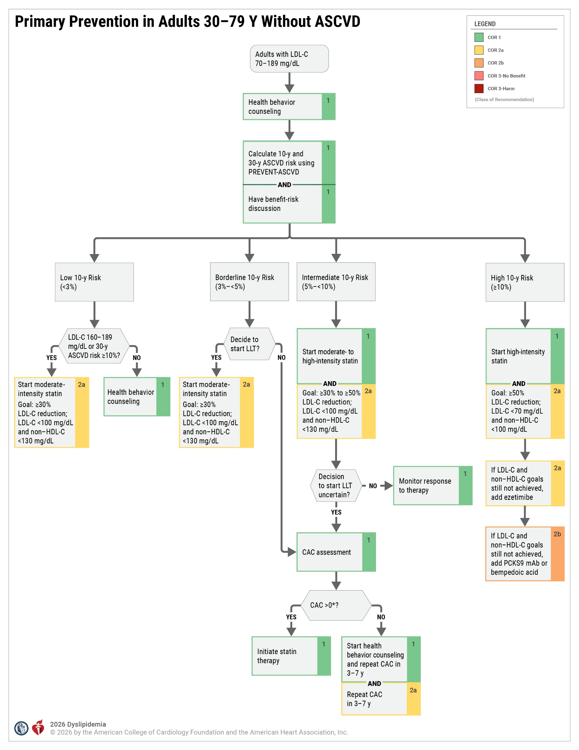
Figure 6. Primary Prevention in Adults 30 to 79 Years Without ASCVD
*For primary prevention recommendations for risk assessment and/or management in the following patient groups, please see the following: Section 4.2.3.7, “Primary Prevention in Adults 30 to 79 Years of Age With LDL-C Levels 70 to 189 mg/dL (1.8-4.9 mmol/L),” Section 4.2.4, “Severe Hypercholesterolemia (LDL-C ≥190 mg/dL [4.9 mmol/L]),” Section 4.2.5, “Diabetes in Adults Without Established ASCVD,” Section 4.2.7, “Management of Adults With Subclinical Coronary Atherosclerosis (Men >40 or Women >45 Years)”, Section 4.2.8.8, “Adults With Chronic Disease – Stage 3 or Higher”), and Section 4.3.8.9, “Persons Living With Human Immunodeficiency Virus (HIV).”
Adapted with permission from Grundy at al. Copyright© 2018 American Heart Association, Inc. and American College of Cardiology Foundation.
ASCVD indicates atherosclerotic cardiovascular disease; CAC, coronary artery calcium; HDL-C, high-density lipoprotein-cholesterol; LDL-C, low-density lipoprotein-cholesterol; and LLT, lipid-lowering therapy.

Slide 96
Role of Risk Assessment in Heterozygous Familial Hypercholesterolemia (HeFH)
 | Recommendations for Role of Risk Assessment in Heterozygous Familial Hypercholesterolemia Referenced studies that support recommendations are summarized in the Evidence Table.
COR | LOE | Recommendations
2b | B-NR | In adults with HeFH, FH-specific risk scores may be useful in predicting short-term ASCVD risk.
3: Harm | C-EO | In individuals with HeFH, standard risk assessment tools developed for the general population should not be used to calculate 10-year or 30-year ASCVD risk.

Slide 97
Genetic Testing for Familial Hypercholesterolemia
 | Recommendations for Genetic Testing for Familial Hypercholesterolemia Referenced studies that support recommendations are summarized in the Evidence Table.
COR | LOE | Recommendations
1 | B-NR | In adults with possible, probable, or definite FH, panel-based genetic testing for pathogenic/likely pathogenic rare variants for FH is beneficial to identify individuals at highest risk of cardiovascular events and to facilitate cascade screening.
2a | B-NR | In adults with severe hypercholesterolemia with an LDL-C ≥190 mg/dL (4.9 mmol/L) without an identified secondary cause, panel-based genetic testing for pathogenic/likely pathogenic rare variants for FH can be useful to identify those with FH who are at higher risk of ASCVD events.
2b | B-NR | In adults with an elevated LDL-C of 160 to 189 mg/dL (4.1-4.9 mmol/L) without an identified secondary cause, panel-based genetic testing for pathogenic/likely pathogenic rare variants for FH may be considered to identify those with FH who are at higher risk of events.

Slide 98
Severe Hypercholesterolemia With LDL-C ≥190 mg/dL (4.9 mmol/L)
 | Recommendations for Severe Hypercholesterolemia With LDL-C ≥190 mg/dL (4.9 mmol/L)* Referenced studies that support recommendations are summarized in the Evidence Table.
COR | LOE | Recommendations
1 | B-NR | In adults with severe hypercholesterolemia with an LDL-C ≥190 mg/dL (4.9 mmol/L)*, secondary causes of dyslipidemia should be excluded and addressed to reduce LDL-C (Table 16).
1 | B-R | In adults with severe hypercholesterolemia with an LDL-C ≥190 mg/dL (4.9 mmol/L)*, treatment with maximally tolerated statin therapy is recommended to lower LDL-C and reduce ASCVD risk.
*Severe hypercholesterolemia with LDL-C >190 mg/dL, non–HDL-C >220 mg/dL, and/or apoB >140 mg/dL.
†Clinical ASCVD includes ACS, a history of MI, stable or unstable angina, coronary or other arterial revascularization, stroke, TIA, lower-extremity PAD or other atherosclerotic forms of PAD, including aortic aneurysm.

Slide 99
Severe Hypercholesterolemia With LDL-C ≥190 mg/dL (4.9 mmol/L) (con’t.)
Severe Hypercholesterolemia in Primary Prevention (Without HeFH, Subclinical Atherosclerosis, and Additional ASCVD Risk Factors)
1 | B-NR | In adults with severe hypercholesterolemia with an LDL-C ≥190 mg/dL (4.9 mmol/L)* and without clinical ASCVD†, additional ASCVD risk factors, HeFH, or subclinical atherosclerosis who are on maximally tolerated statin therapy, the addition of ezetimibe, a PCSK9 mAb, and/or bempedoic acid is recommended to achieve a goal of LDL-C <100 mg/dL (2.6 mmol/L) and a non–HDL-C goal of <130 mg/dL (3.4 mmol/L) and to reduce ASCVD risk.
Severe Hypercholesterolemia With HeFH, Subclinical Atherosclerosis, or With Additional Risk Factors
1 | B-R | In adults with severe hypercholesterolemia with an LDL-C ≥190 mg/dL (4.9 mmol/L)* without clinical ASCVD† but with clinical or genetic confirmation of HeFH, additional ASCVD risk factors, or documented coronary calcification, who are on maximally tolerated statin therapy, the addition of ezetimibe, a PCSK9 mAb, and/or bempedoic acid to achieve a goal of LDL-C <70 mg/dL (1.8 mmol/L) and non–HDL-C <100 mg/dL (2.6 mmol/L) is recommended to lower LDL-C and reduce ASCVD risk.
*Severe hypercholesterolemia with LDL-C >190 mg/dL, non–HDL-C >220 mg/dL, and/or apoB >140 mg/dL.
†Clinical ASCVD includes ACS, a history of MI, stable or unstable angina, coronary or other arterial revascularization, stroke, TIA, lower-extremity PAD or other atherosclerotic forms of PAD, including aortic aneurysm.

Slide 100
Severe Hypercholesterolemia With LDL-C ≥190 mg/dL (4.9 mmol/L) (con’t.)
Severe Hypercholesterolemia With Clinical ASCVD
1 | B-R | In adults with severe hypercholesterolemia with an LDL-C ≥190 mg/dL (4.9 mmol/L)* and clinical ASCVD who are on maximally tolerated statin therapy, the addition of ezetimibe, a PCSK9 mAb, and/or bempedoic acid is recommended to achieve a goal of LDL-C <55 mg/dL (1.4 mmol/L) and non–HDL-C <85 mg/dL (2.2 mmol/L) to lower LDL-C and reduce ASCVD risk.
Inclisiran in Severe Hypercholesterolemia
2a | B-R | In adults with severe hypercholesterolemia, with or without clinical ASCVD, and LDL-C ≥100 mg/dL (2.6 mmol/L) despite maximally tolerated statin with or without ezetimibe therapy, treatment with inclisiran is reasonable to lower LDL-C‡.
*Severe hypercholesterolemia with LDL-C >190 mg/dL, non–HDL-C >220 mg/dL, and/or apoB >140 mg/dL.
‡Cardiovascular outcomes trials are pending for inclisiran. It is indicated only to lower LDL-C and is considered a second-line PCSK9i at this time.

Slide 101
Table 15. Liposorber® (LA-15 System) FDA-Approved Indications for Lipoprotein Apheresis*
Patient Group | Criteria for Treatment
Group A | Clinically diagnosed familial hypercholesterolemic homozygotes with LDL-C >500 mg/dL
Group B | Clinically diagnosed familial hypercholesterolemic heterozygotes with LDL-C ≥300 mg/dL
Group C | Clinically diagnosed familial hypercholesterolemic heterozygotes with LDL-C ≥70 mg/dL and either documented coronary artery disease or documented peripheral artery disease
Group D | Clinically diagnosed familial hypercholesterolemic heterozygotes with Lp(a) ≥60 mg/dL (or 130 nmol/L) and either documented coronary artery disease or documented peripheral artery disease
Disclaimer: The device listed here serves only to illustrate examples of these types of FDA-approved devices. This is not intended to be an endorsement of any commercial product, process, service, or enterprise by the AHA or the ACC.
*As of January 2025: for updated indications for use, please review the website: https://liposorber.com/posts/expanded-indication-for-kanekas-liposorber-la-15-system/
FDA indicates US Food and Drug Administration; LDL-C, low-density lipoprotein-cholesterol; and Lp(a), lipoprotein(a).

Slide 102
Table 16. Physiological and Secondary Causes of Hypercholesterolemia Due to LDL-C
Dietary factors
High saturated fat intake
High trans-fat intake
High cholesterol intake
Weight gain
Rapid weight loss
Ketosis
Metabolic factors
Hypothyroidism
Obstructive liver disease
Chronic kidney disease
Nephrotic syndrome
Diabetes and other insulin-resistant states (excess small LDL particles)
Uncontrolled hyperglycemia
Cushing syndrome
Anorexia nervosa
Obesity
Modified with permission from Virani et al. Copyright© 2021 American College of Cardiology Foundation.
LDL indicates low-density lipoprotein.

Slide 103
Table 16. Physiological and Secondary Causes of Hypercholesterolemia Due to LDL-C (con’t.)
Drugs
High-dose thiazide diuretics
Glucocorticoids
Estrogens
Androgens
Atypical antipsychotic drugs
Cyclosporine
Physiological
Menopausal transition
Pregnancy
Modified with permission from Virani et al. Copyright© 2021 American College of Cardiology Foundation.
LDL indicates low-density lipoprotein.

Slide 104
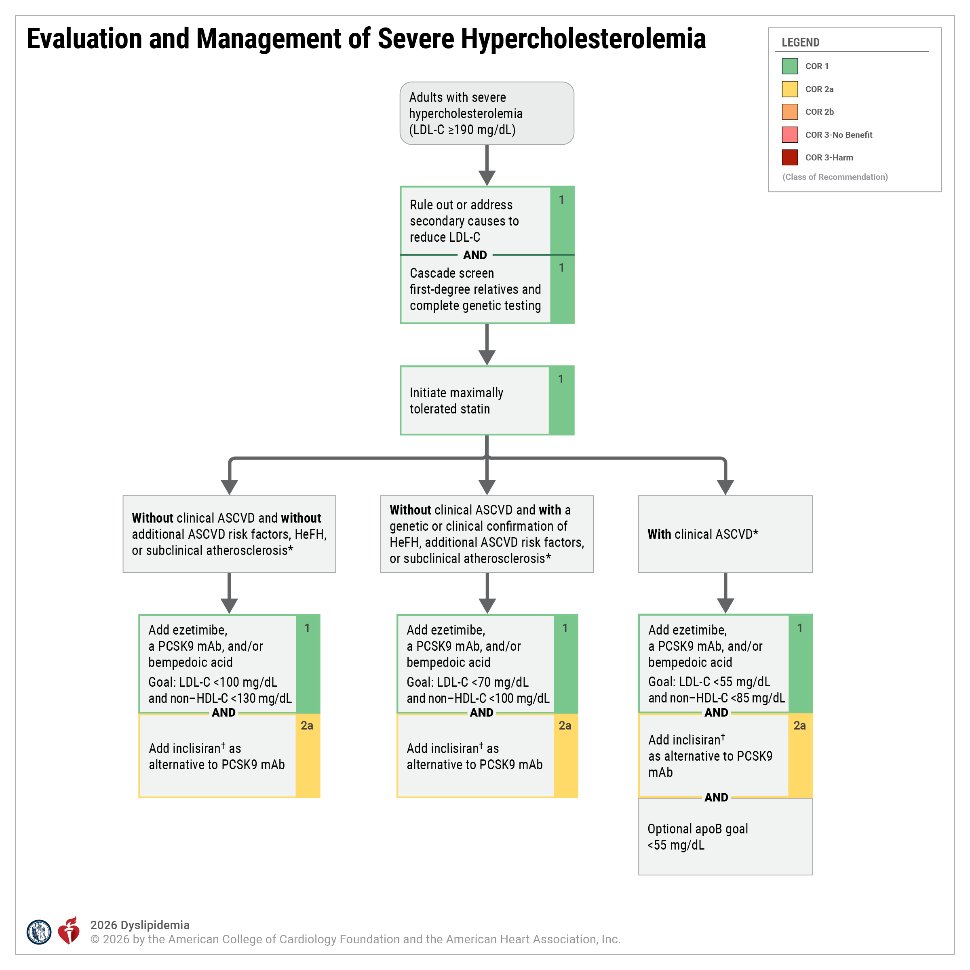
Figure 7. Evaluation and Management of Severe Hypercholest-erolemia
ApoB indicates apolipoprotein B; ASCVD, atherosclerotic cardiovascular disease; CAC, coronary artery calcium; HDL-C, high-density lipoprotein-cholesterol; HeFH, heterozygous familial hypercholesterolemia; LDL-C, low-density lipoprotein-cholesterol; LLT, lipid-lowering therapy; mAb, monoclonal antibody; and PCSK9, proprotein convertase subtilisin/kexin type 9.
*Related to Lipoprotein Goals for ASCVD Risk Reduction table.
†Cardiovascular outcomes trials with inclisiran are pending.

Slide 105
Severe Hypercholesterolemia With Clinical or Genetic Confirmation of Homozygous Familial Hypercholesterolemia (HoFH)
 | Recommendations for Severe Hypercholesterolemia With Clinical or Genetic Confirmation of Homozygous Familial Hypercholesterolemia (HoFH) Referenced studies that support recommendations are summarized in the Evidence Table.
COR | LOE | Recommendations
1 | B-NR | In adults with clinical and/or genetic confirmation of HoFH, consultation with a lipid specialist is recommended for consideration of advanced LDL-C–lowering drug therapies and/or lipoprotein apheresis to lower LDL-C.
1 | B-R | In adults with clinical or genetic confirmation of HoFH, treatment with maximally tolerated statin therapy is recommended to reduce ASCVD risk.

Slide 106
Severe Hypercholesterolemia With Clinical or Genetic Confirmation of Homozygous Familial Hypercholesterolemia (HoFH) (con’t.)
2a | B-R | In adults with clinical or genetic confirmation of HoFH currently on maximally tolerated statin therapy, the addition of ezetimibe, PCSK9 mAb, and/or bempedoic acid is reasonable to lower LDL-C.
2b | B-R | In adults with clinical or genetic confirmation of HoFH currently on maximally tolerated statin therapy, ezetimibe, and PCSK9 mAb with an LDL-C ≥100 mg/dL (2.6 mmol/L), the addition of evinacumab may be reasonable to lower LDL-C.
2b | C-LD | In adults with clinical or genetic confirmation of HoFH currently on maximally tolerated statin therapy, ezetimibe, and PCSK9 mAb with LDL-C ≥100 mg/dL (2.6 mmol/L), the addition of lomitapide with regular monitoring for hepatic safety may be reasonable to lower LDL-C.

Slide 107
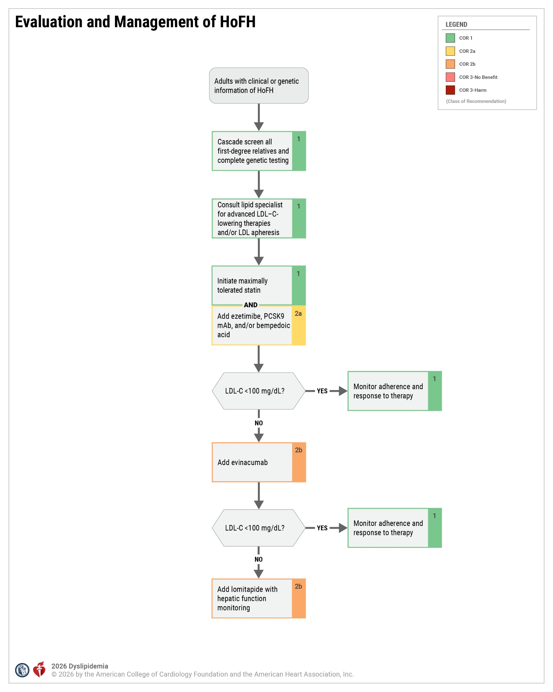
Figure 8. Evaluation and Management of HoFH
HoFH indicates homozygous familial hypercholesterolemia; LDL-C, low-density lipoprotein-cholesterol; and PCSK9, proprotein convertase subtilisin/kexin type 9.

Slide 108
Diabetes in Adults Without Established ASCVD
 | Recommendations for Adults With Diabetes Without Established ASCVD Referenced studies that support recommendations are summarized in the Evidence Table.
COR | LOE | Recommendations
1 | A | In adults 40 to 75 years of age with diabetes and without clinical ASCVD, moderate-intensity statin therapy is indicated to achieve a ≥30% to 49% reduction in LDL-C and a goal of LDL-C <100 mg/dL (2.6 mmol/L) and non–HDL-C <130 mg/dL (3.4 mmol/L) to reduce ASCVD risk.
1 | B-R | In adults with diabetes who have statin-attributed side effects, initiation of ezetimibe and/or bempedoic acid or a PCSK9 mAb is recommended to lower LDL-C and reduce ASCVD risk.
2a | B-R | In adults 40 to 75 years of age with diabetes who have multiple ASCVD risk factors, it is reasonable to prescribe high-intensity statin therapy to achieve a ≥50% reduction in LDL-C and a goal of LDL-C <70 mg/dL (1.8 mmol/L) and non–HDL-C <100 mg/dL (2.6 mmol/L) to reduce ASCVD risk.

Slide 109
Diabetes in Adults Without Established ASCVD (con’t.)
2b | B-R | In adults with diabetes without ASCVD but with additional ASCVD risk factor(s)* on a statin with an LDL-C <100 mg/dL (2.6 mmol/L) and elevated fasting TG (150–499 mg/dL [1.7–5.6 mmol/L]), the addition of IPE may be considered to reduce ASCVD risk.
2b | C-LD | In adults with diabetes and 10-year ASCVD risk of ≥10% by the PREVENT-ASCVD equations, it may be reasonable to add ezetimibe or a PCSK9 mAb to maximally tolerated statin therapy to achieve an LDL-C goal of <70 mg/dL (1.8 mmol/L) and non–HDL-C <100 mg/dL (2.6 mmol/L) to reduce ASCVD risk.
2b | C-LD | In adults >75 years of age with diabetes and an estimated life expectancy of at least 2.5 years, it may be reasonable to initiate moderate-intensity statin therapy after a clinician–patient discussion of potential benefits and risks to reduce ASCVD risk.
2b | C-LD | In adults 20 to 39 years of age with diabetes of long duration (≥10 years of type 2 diabetes, ≥20 years of type 1 diabetes), albuminuria (≥30 µg of albumin/mg creatinine), estimated glomerular filtration rate (eGFR) <60 mL/min/1.73 m², retinopathy, neuropathy, or ankle-brachial index (ABI) <0.9, it may be reasonable to initiate moderate-intensity statin therapy to reduce ASCVD risk.
*As per REDUCE-IT inclusion criteria, high-risk features include men ≥55 years or women ≥65 years, cigarette smoking or stopped smoking within 3 months; hypertension (blood pressure ≥140 mm Hg systolic or ≥90 mm Hg diastolic) or on antihypertensive medication; high-density lipoprotein-cholesterol ≤40 mg/dL for men or ≤50 mg/dL for women; high-sensitivity C-reactive protein >3.0 mg/L (if measured); renal dysfunction: creatinine clearance >30 and <60 mL/min; retinopathy; albuminuria (≥30 µg of albumin/mg creatinine); ankle-brachial index <0.9 without symptoms of intermittent claudication (if measured).

Slide 110
Table 17. Diabetes-Specific Risk Enhancers Independent of Other Diabetes-Related Risk Factors
Risk Enhancers
Long duration (≥10 y for type 2 diabetes or ≥20 y for type 1 diabetes)
Albuminuria ≥30 µg of albumin/mg creatinine
eGFR <60 mL/min/1.73 m²
Retinopathy
Neuropathy
ABI <0.9
Reprinted with permission from Grundy et al. Copyright© 2018 American Heart Association, Inc. and American College of Cardiology Foundation.
ABI indicates ankle-brachial index; eGFR, estimated glomerular filtration rate; and y, years.

Slide 111
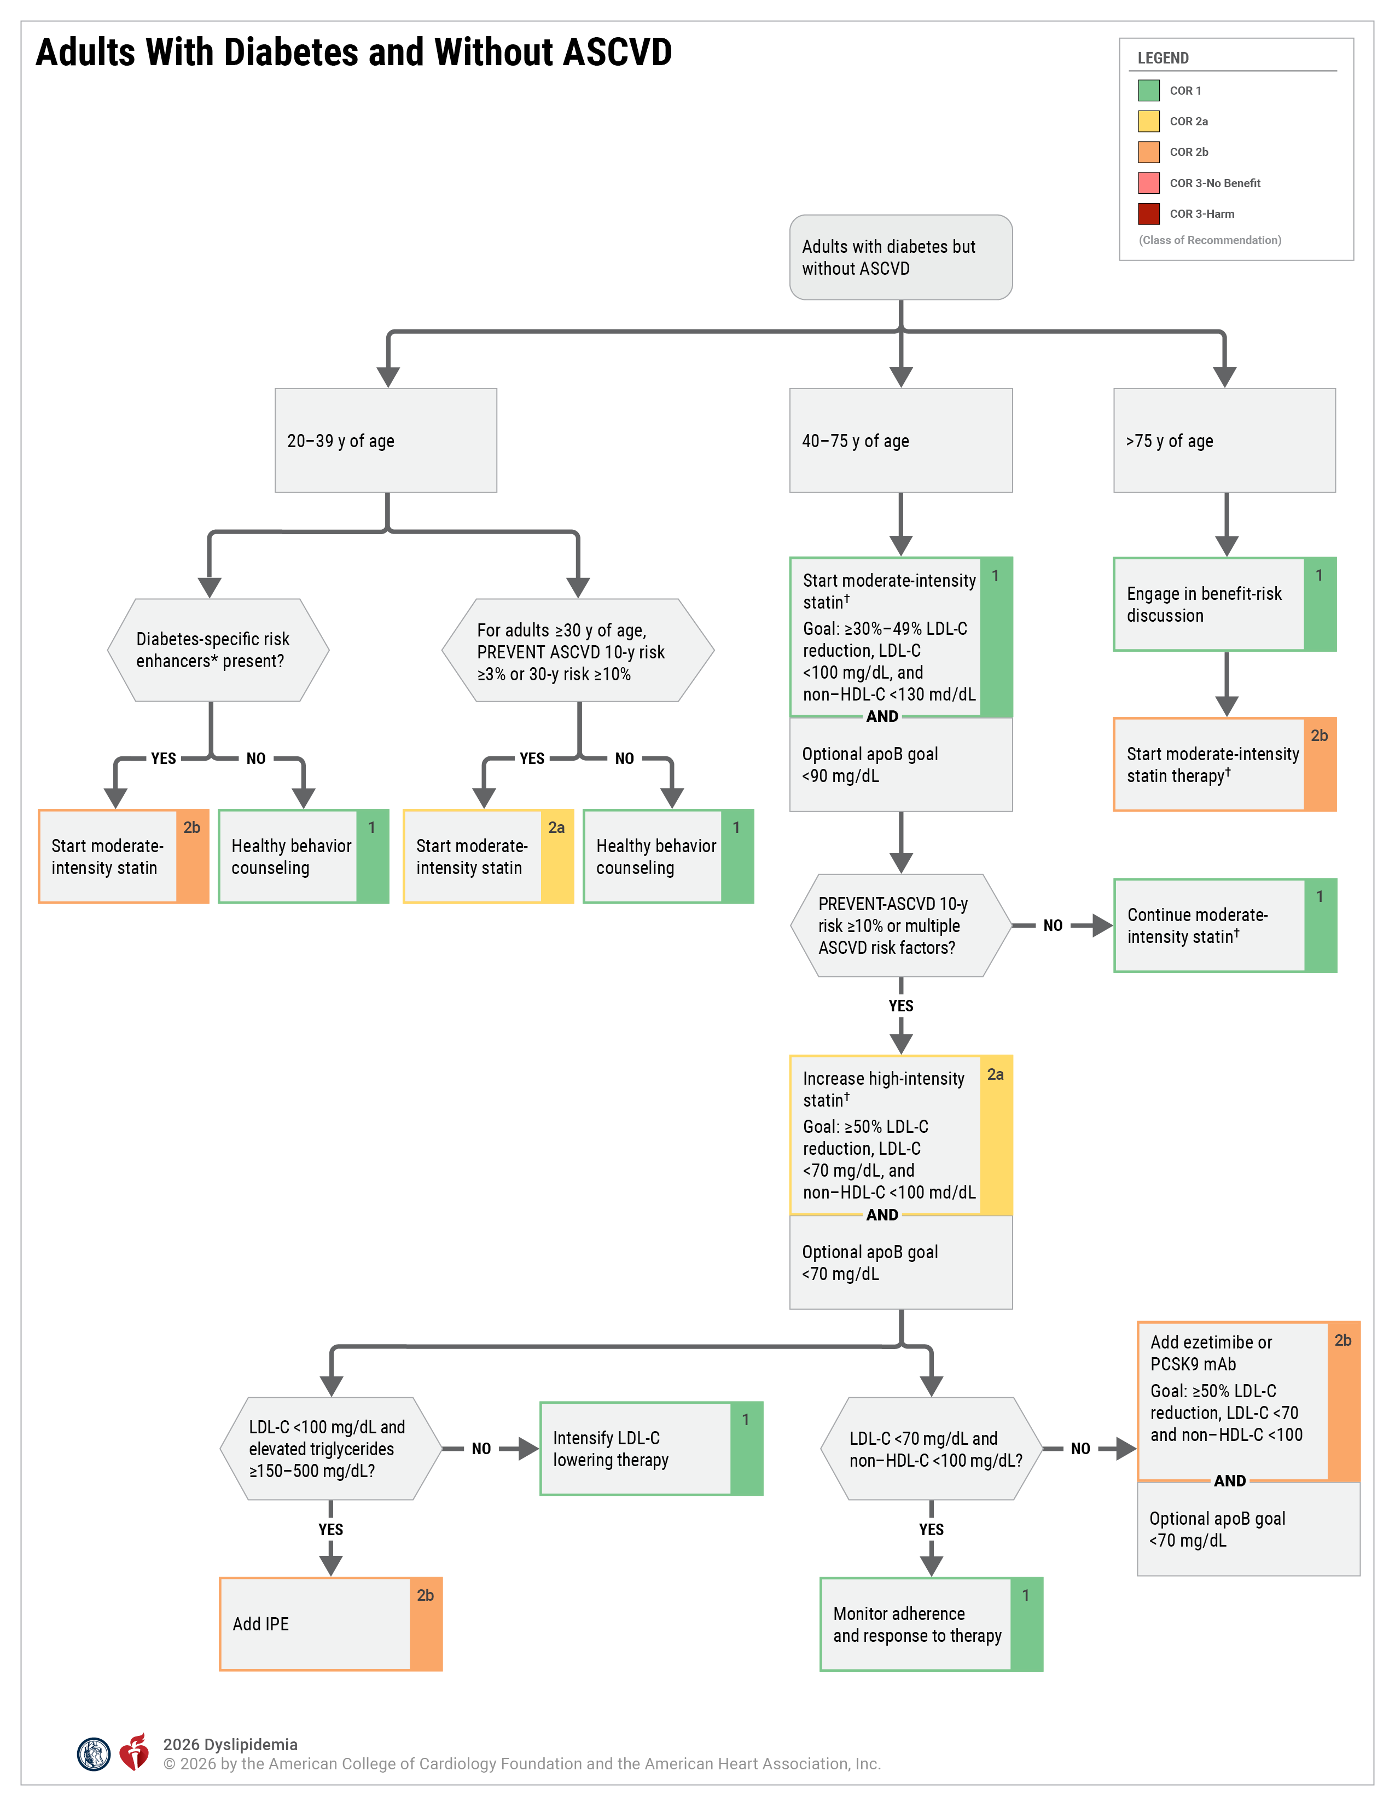
Figure 9. Adults With Diabetes and Without ASCVD
apoB indicates apolipoprotein B; ASCVD, atherosclerotic cardiovascular disease; HDL-C, high-density lipoprotein-cholesterol; IPE, icosapent ethyl; LDL-C, low-density lipoprotein-cholesterol; LLT, lipid-lowering therapy; mAb, monoclonal antibody; and PCSK9, proprotein convertase subtilisin/kexin type 9.
*Refer to Table 17, “Diabetes-Specific Risk Enhancers Independent of Other Diabetes-Related Risk Factors.”
†In adults with diabetes who have statin-attributed side effects, initiation of ezetimibe and/or bempedoic acid and/or a PCSK mAb is recommended to lower LDL-C and reduce ASCVD risk.

Slide 112
Secondary ASCVD Prevention
 | Recommendations for Secondary ASCVD Prevention Referenced studies that support recommendations are summarized in the Evidence Table.
COR | LOE | Recommendations
Clinical ASCVD Not at Very High Risk*
1 | A | In adults with clinical ASCVD who are not at very high risk (Figure 10), high-intensity statin therapy should be initiated to achieve a ≥50% reduction in LDL-C and a goal of LDL-C <70 mg/dL (1.8 mmol/L) and non–HDL-C <100 mg/dL to reduce the risk of recurrent ASCVD events.
2a | B-R | In adults with clinical ASCVD who are not at very high risk and on maximally tolerated statin therapy, it is reasonable to add ezetimibe, a PCSK9 mAb, or bempedoic acid (selection depending on degree of LDL-C lowering needed and patient preference) to achieve a goal of LDL-C <70 mg/dL (1.8 mmol/L) and non–HDL-C <100 mg/dL to reduce the risk of ASCVD events.
2a | B-R | In adults with clinical ASCVD who are not at very high risk and on maximally tolerated statin therapy, it is reasonable to add ezetimibe, a PCSK9 mAb, or bempedoic acid (selection based on the degree of LDL-C lowering needed and patient preference) to achieve a goal LDL-C <55 mg/dL (1.4 mmol/L) and non–HDL-C <85 mg/dL (2.2 mmol/L) and to reduce the risk of ASCVD events.
*The majority of patients with clinical ASCVD are likely to be at very high risk. Very high risk includes a history of multiple major ASCVD events (ACS within past 12 months, history of MI [other than ACS above] history of ischemic stroke, symptomatic PAD) or 1 major ASCVD event and multiple high-risk conditions (age >65 years of age, coronary artery revascularization, current smoker, diabetes, history of heart failure, hypertension, LDL-C >100 mg/dL despite maximally tolerated statin + ezetimibe).

Slide 113
Secondary ASCVD Prevention (con’t.)
Clinical ASCVD at Very High Risk*
1 | A | In adults with clinical ASCVD* who are at very high risk (Figure 10 and Figure 11), high-intensity statin therapy should be initiated to achieve a ≥50% reduction in LDL-C and a goal LDL-C <55 mg/dL (1.4 mmol/L) and non–HDL-C <85 mg/dL (2.2 mmol/L) and to reduce the risk of ASCVD events.
1 | A | In adults with clinical ASCVD who are at very high risk and on maximally tolerated statin therapy, ezetimibe and/or a PCSK9 mAb should be added (selected based on the degree of LDL-C lowering needed and patient preference) to achieve a goal of LDL-C <55 mg/dL (1.4 mmol/L) and non–HDL-C <85 mg/dL (2.2 mmol/L) to reduce risk of ASCVD events.
2a | B-R | In adults with clinical ASCVD who are at very high risk on maximally tolerated statin therapy, it is reasonable to add bempedoic acid, with or without ezetimibe and/or PCSK9 mAb, to reach an LDL-C goal <55 mg/dL (1.4 mmol/L) and non–HDL-C <85 mg/dL (2.2 mmol/L) to reduce the risk of ASCVD events.
2a | B-R | In adults with clinical ASCVD who are at very high risk and on maximally tolerated statin therapy with or without ezetimibe, it is reasonable to add inclisiran† in those unable to tolerate or obtain evolocumab or alirocumab or have a strong preference for less frequent dosing to achieve an LDL-C goal <55 mg/dL (1.4 mmol/L) and non–HDL-C <85 mg/dL (2.2 mmol/L).
*The majority of patients with clinical ASCVD are likely to be at very high risk. Very high risk includes a history of multiple major ASCVD events (ACS within past 12 months, history of MI [other than ACS above] history of ischemic stroke, symptomatic PAD) or 1 major ASCVD event and multiple high-risk conditions (age >65 years of age, coronary artery revascularization, current smoker, diabetes, history of heart failure, hypertension, LDL-C >100 mg/dL despite maximally tolerated statin + ezetimibe).
†Cardiovascular outcomes trials are not completed with inclisiran. It is approved for LDL-C lowering only and is considered a second-line PCSK9i at this time.

Slide 114
Secondary ASCVD Prevention (con’t.)
Heart Failure With Reduced Ejection Fraction (HFrEF) Due to ASCVD
2b | B-R | In adults with HFrEF attributable to ischemic heart disease who have a reasonable life expectancy (3-5 years) and are not already on a statin because of ASCVD, it may be reasonable to consider initiation of moderate-intensity statin therapy to reduce the occurrence of ASCVD events.

Slide 115
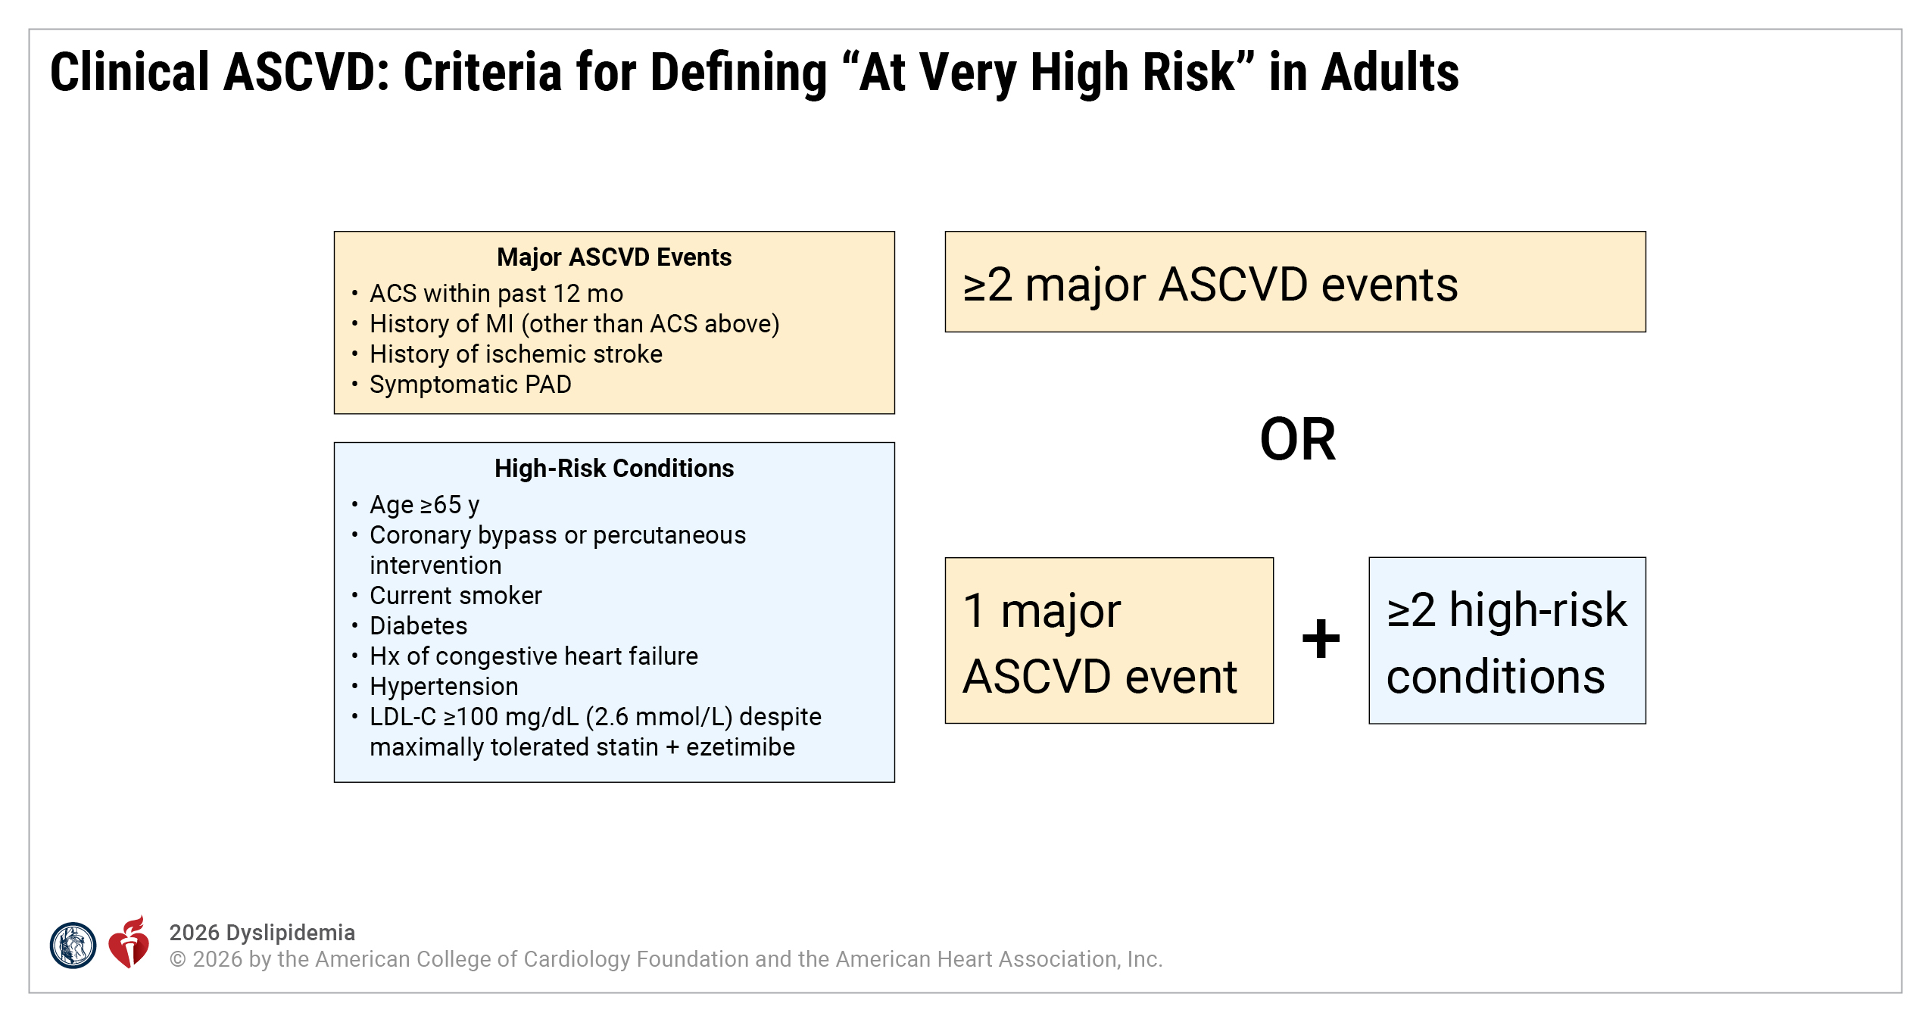
Figure 10. Clinical ASCVD: Criteria for Defining “At Very High Risk” in Adults
Adapted with permission from Grundy et al. Copyright© 2018 American Heart Association, Inc. and American College of Cardiology Foundation.
ACS indicates acute coronary syndrome; ASCVD, atherosclerotic cardiovascular disease; Hx, history; LDL-C, low-density lipoprotein-cholesterol; MI, myocardial infarction; and PAD, peripheral artery disease.

Slide 116
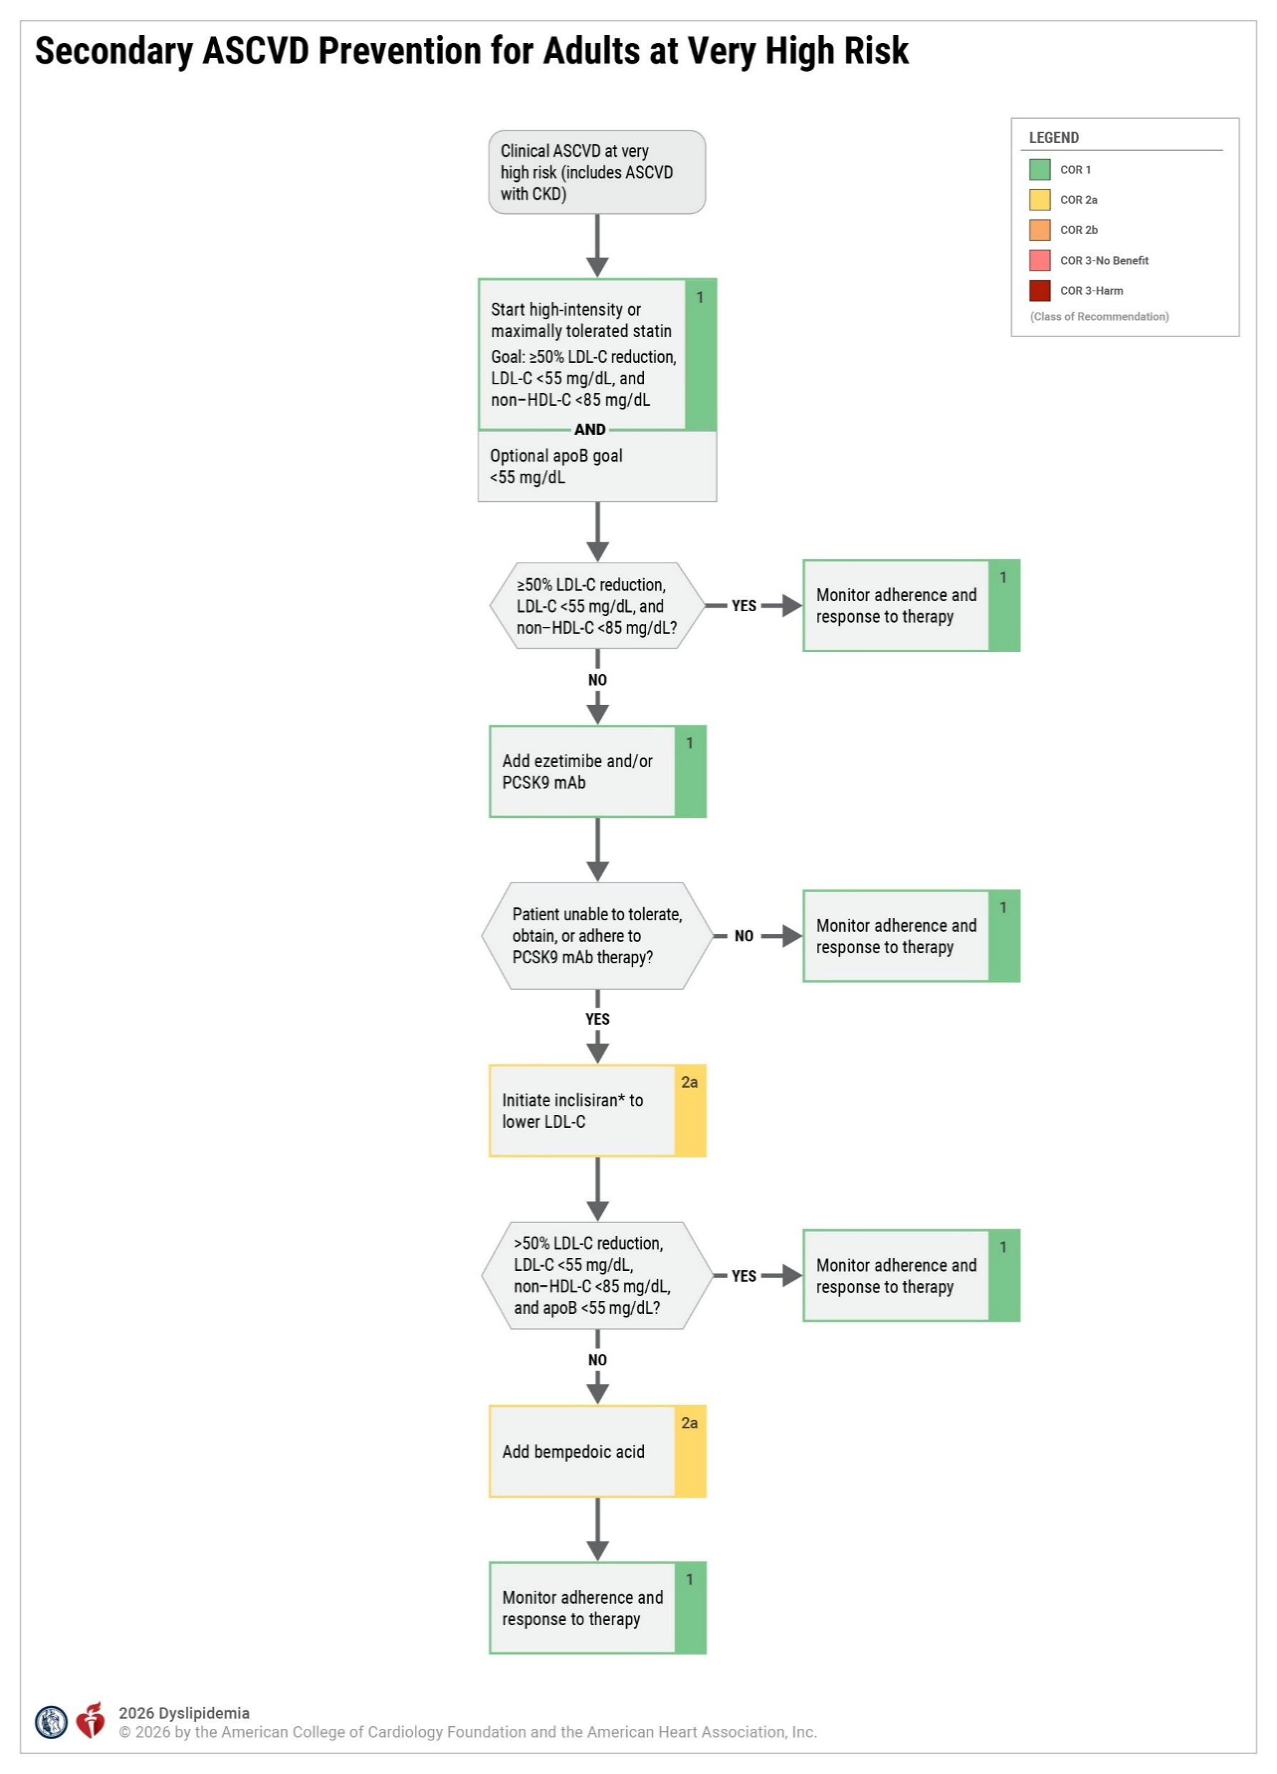
Figure 11. Secondary ASCVD Prevention for Adults at Very High Risk
*Two cardiovascular outcome studies in patients with ASCVD are ongoing with inclisiran.
ASCVD indicates atherosclerotic cardiovascular disease; CKD, chronic kidney disease; HDL-C, high-density lipoprotein-cholesterol; HeFH, heterozygous familial hypercholesterolemia; LDL-C, low-density lipoprotein-cholesterol; mAb, monoclonal antibody; and PCSK9, proprotein convertase subtilisin/kexin type 9.
Adapted with permission from Grundy at al. Copyright© 2018 American Heart Association, Inc. and American College of Cardiology Foundation.

Slide 117
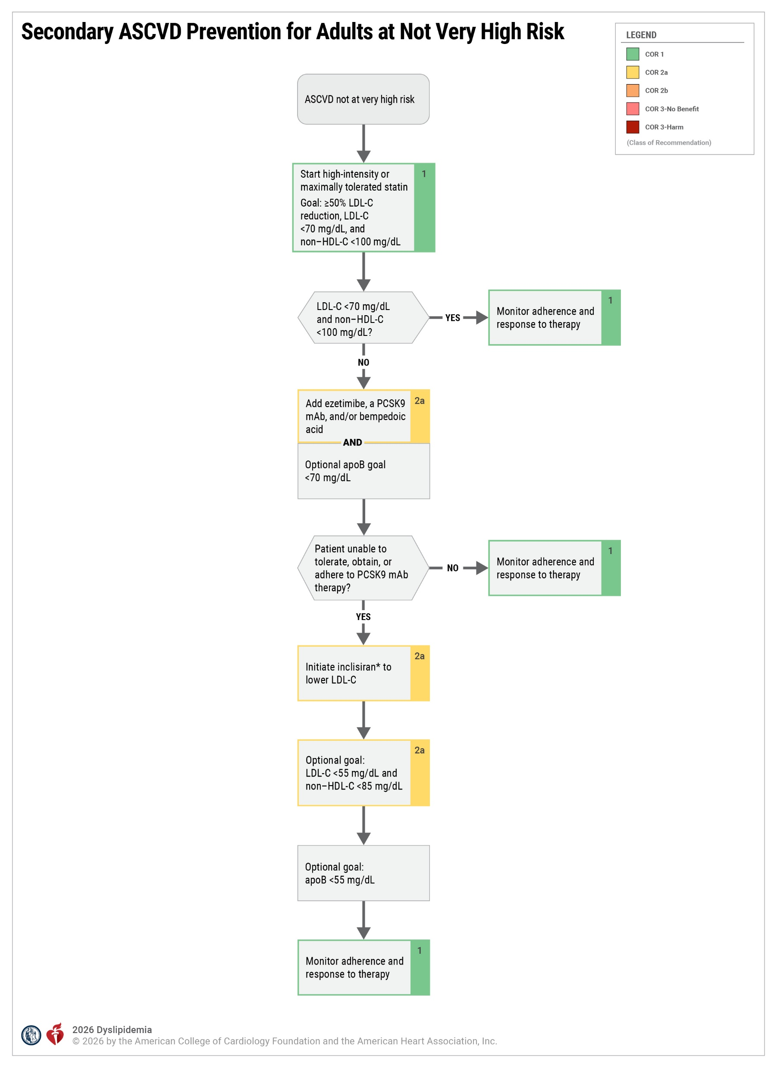
Figure 12. Secondary ASCVD Prevention for Adults at Not Very High Risk
*CVOTS pending; the majority of patients with ASCVD are at very high risk.
ASCVD indicates atherosclerotic cardiovascular disease; HDL-C, high-density lipoprotein-cholesterol; LDL-C, low-density lipoprotein-cholesterol; mAb, monoclonal antibody; and PCSK9, proprotein convertase subtilisin/kexin type 9.
Adapted with permission from Grundy at al. Copyright© 2018 American Heart Association, Inc. and American College of Cardiology Foundation.

Slide 118
Management of Adults With Subclinical Coronary Atherosclerosis (Men ≥40 or Women ≥45 Years)
 | Recommendations for Management of Adults With Subclinical Coronary Atherosclerosis (Men ≥40 or Women ≥45 Years) Referenced studies that support recommendations are summarized in the Evidence Table.
COR | LOE | Recommendations
1 | B-NR | In adults with a CAC score of ≥1000 AU, treatment with LDL-C–lowering therapies with consideration of statin therapy as first line is recommended to achieve a ≥50% reduction in LDL-C and a goal of LDL-C <55 mg/dL (1.4 mmol/L) and non–HDL-C <85 mg/dL (2.2 mmol/L).
1 | B-R | In adults with a CAC score of ≥300 to 999 AU, treatment with LDL-C– lowering therapies, with consideration of statin therapy as first line, is recommended to achieve a ≥50% lowering in LDL-C and a goal LDL-C <70 mg/dL (1.8 mmol/L) and non–HDL-C <100 mg/dL (2.6 mmol/L).
I | B-R | In adults with a CAC score of ≥100 to 299 AU or ≥75th standardized percentile, treatment with LLT, with consideration of statin therapy as first-line therapy, is recommended to achieve a ≥50% reduction in LDL-C and a goal LDL-C <70 mg/dL (1.8 mmol/L) and non–HDL-C <100 mg/dL (2.6 mmol/L).

Slide 119
Management of Adults With Subclinical Coronary Atherosclerosis (Men ≥40 or Women ≥45 Years) (con’t.)
2a | B-R | In adults with a CAC score of 1 to 99 AU and <75th standardized percentile, or with an incidental finding of mild CAC on noncardiac CT scan, treatment with moderate-intensity statin therapy is reasonable to achieve a ≥30% to 49% reduction in LDL-C and a goal of LDL-C <100 mg/dL (2.6 mmol/L) and non–HDL-C <130 mg/dL (3.4 mmol/L).
2a | B-NR | In adults with a CAC score of ≥300 to 999 AU, it is reasonable to intensify therapy by increasing the intensity of statin therapy or, if needed, adding ezetimibe, a PCSK9 mAb, or bempedoic acid to achieve a goal of LDL-C <55 mg/dL (1.4 mmol/L) and non–HDL-C <85 mg/dL (2.2 mmol/L).
2a | B-NR | Among adults with no prior ASCVD who have moderate-to-severe incidental coronary atherosclerosis identified on noncardiac CT scans (eg, by visual estimation or a validated artificial intelligence-based algorithm), it is reasonable to initiate high-intensity statin therapy to achieve at least a ≥50% reduction in LDL-C and a goal of LDL-C <70 mg/dL (1.8 mmol/L) and non–HDL-C <100 mg/dL (2.6 mmol/L); if mild incidental CAC, moderate-intensity statin therapy is reasonable to achieve a ≥30% to 49% reduction in LDL-C and a goal of LDL-C <100 mg/dL (2.6 mmol/L) and non–HDL-C goal <130 mg/dL.

Slide 120
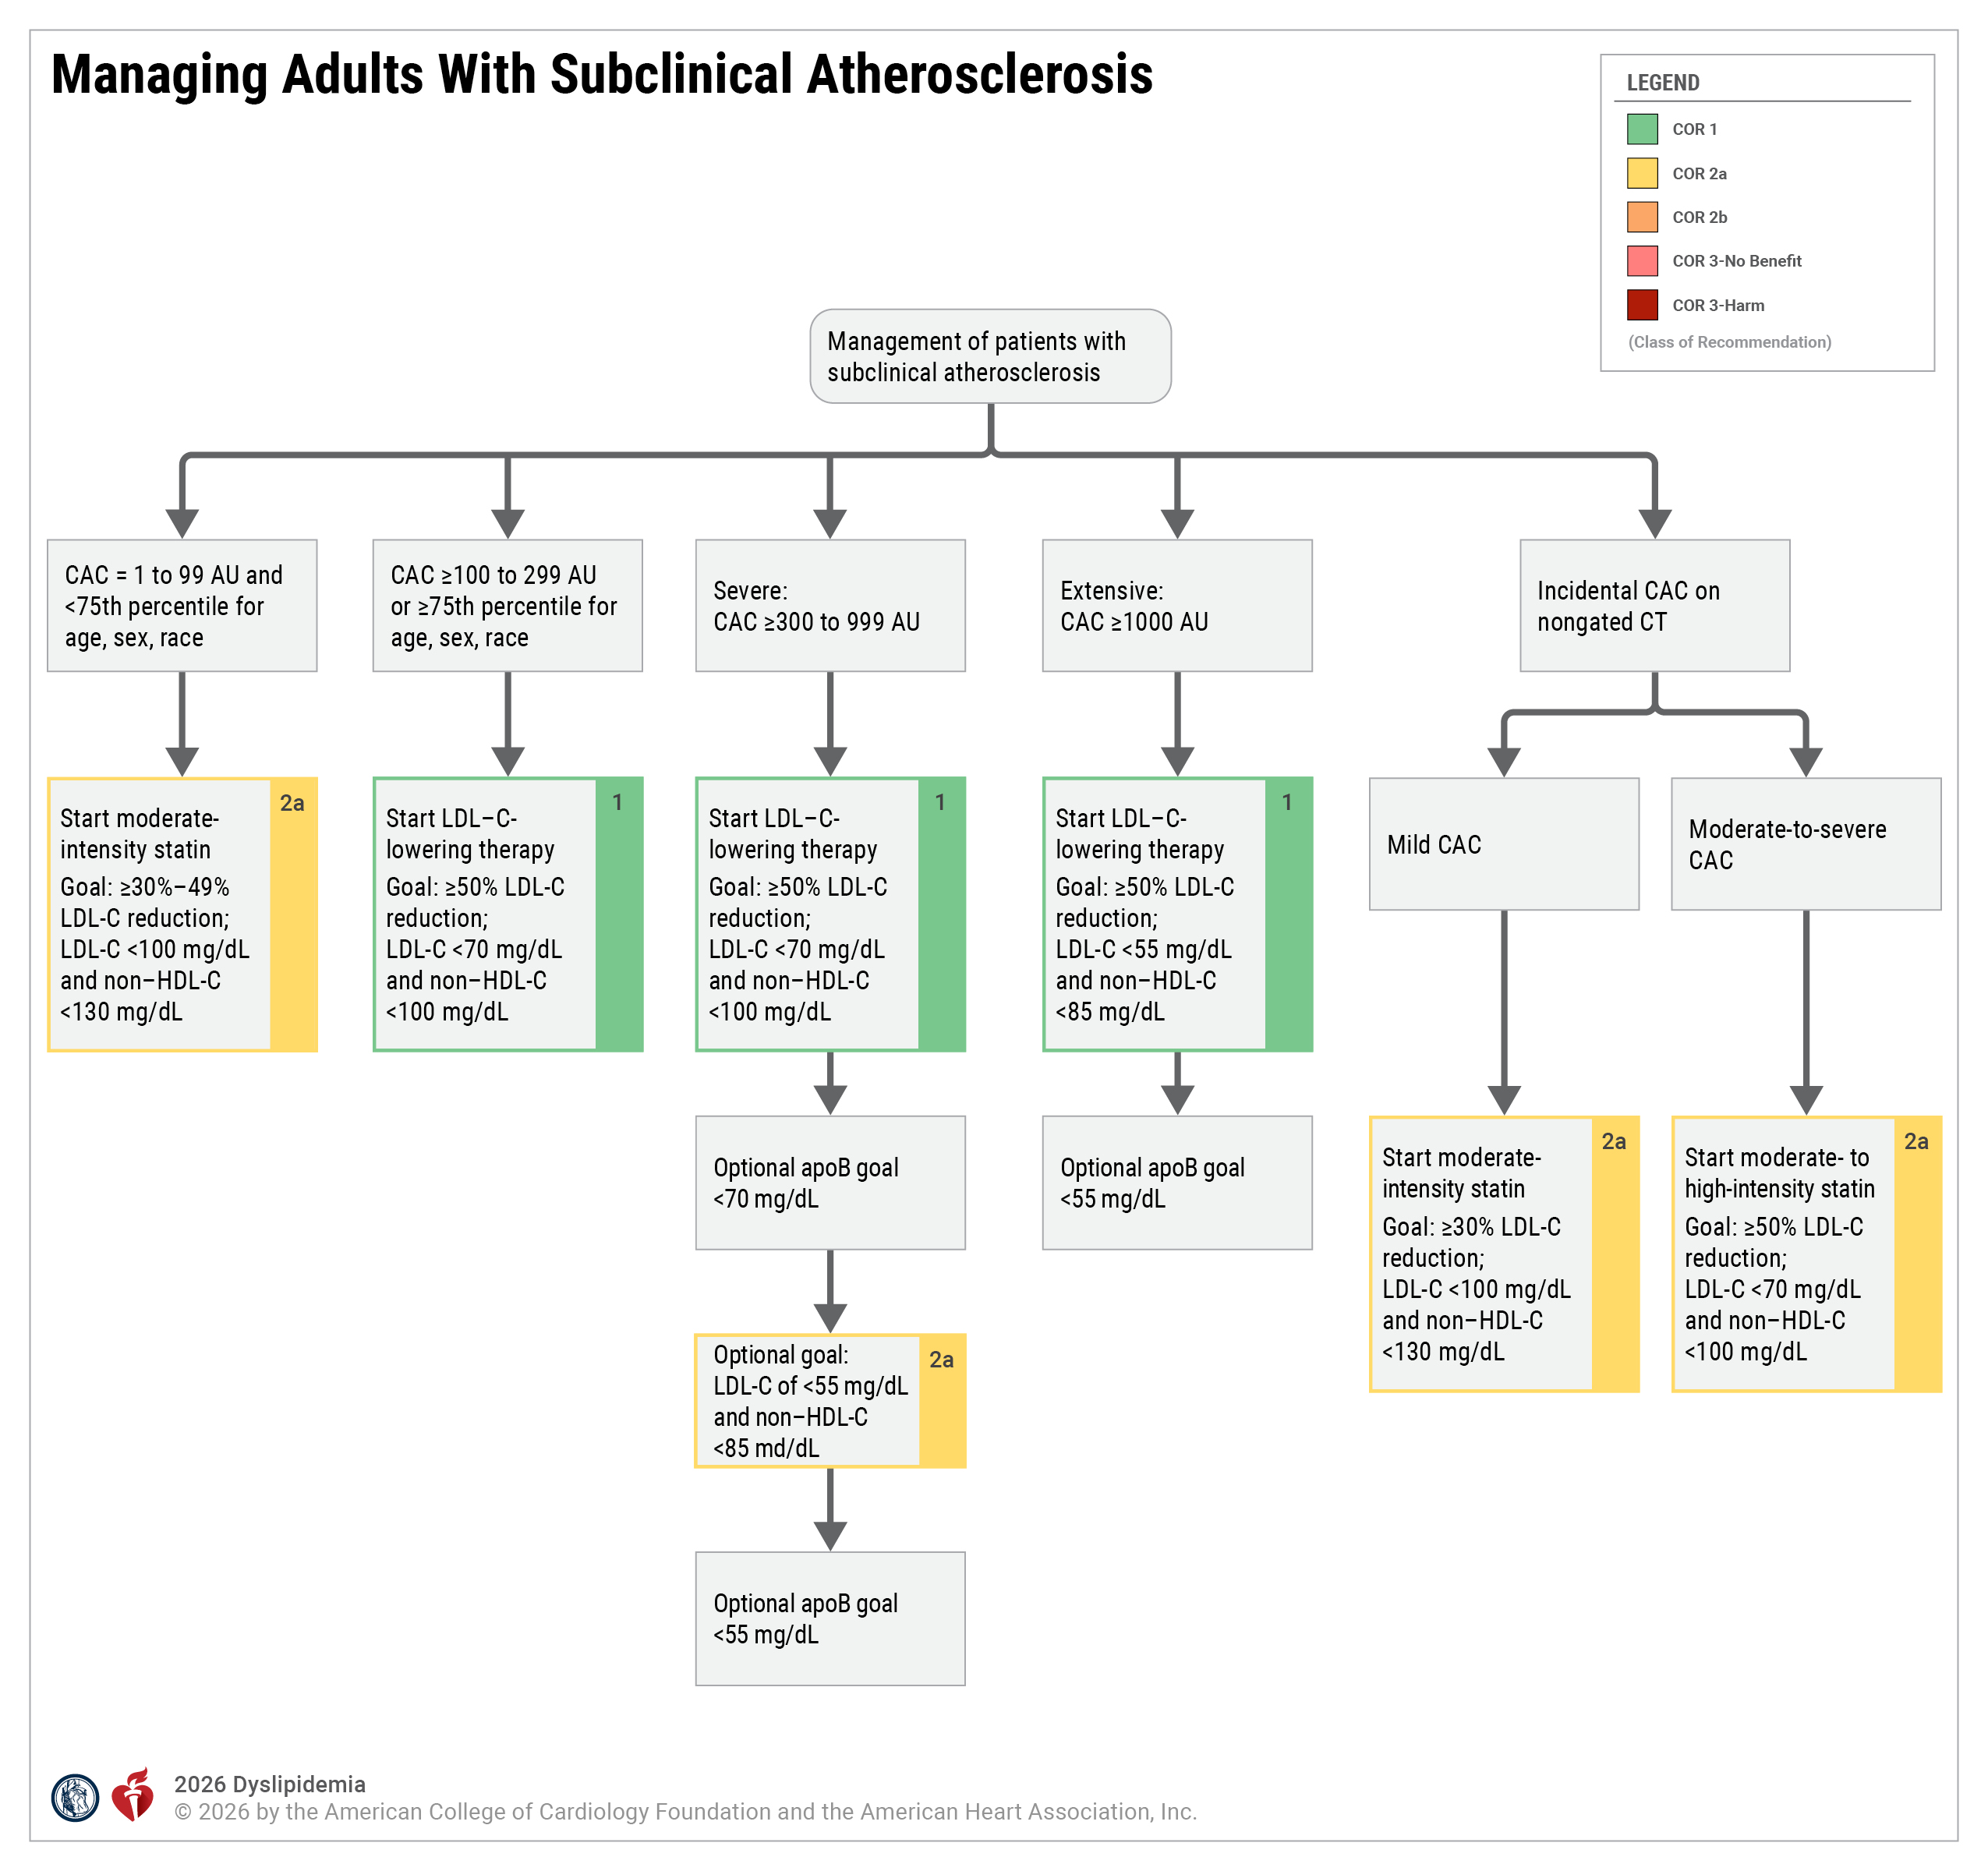
Figure 13. Managing Adults With Subclinical Atherosclerosis
apoB indicates apolipoprotein B; AU, Agatston Units; CAC, coronary artery calcium; CT, computed tomography; HDL-C, high-density lipoprotein-cholesterol; and LDL-C, low-density lipoprotein-cholesterol.

Slide 121
Children and Adolescents
 | Recommendations for Children and Adolescents Referenced studies that support recommendations are summarized in the Evidence Table.
COR | LOE | Recommendations
1 | B-R | In children and adolescents with lipid abnormalities, lifestyle management is recommended to improve LDL-C, TG, and non–HDL-C.
1 | B-R | In children and adolescents ≥8 years of age with an LDL-C level persistently ≥160 mg/dL (4.1 mmol/L) and a presentation consistent with FH who do not respond sufficiently after 3 to 6 months of lifestyle management, initiation of statin and other LLT as necessary is recommended to lower LDL-C.*
2a | B-NR | In children and adolescents with a clinical presentation consistent with FH, panel-based genetic testing for pathogenic/likely pathogenic rare variants for FH can be useful to guide diagnosis, cascade testing, and treatment.
*Children with HoFH require specialized consideration, including aggressive LLT at the time of diagnosis, including in infancy (Section 4.2.4.4, “Severe Hypercholesterolemia with Clinical or Genetic Confirmation of Homozygous Familial Hypercholesterolemia [HoFH]”).

Slide 122
Table 18. Normal and Elevated Lipid Values in Childhood*
 | Acceptable, mg/dL | Borderline, mg/dL | Abnormal, mg/dL
TC | <170 mg/dL | 170-199 mg/dL | ≥200 mg/dL
TG: 0-9 y | <75 mg/dL | 75-99 mg/dL | ≥100 mg/dL
TG: 10-19 y | <90 mg/dL | 90-129 mg/dL | ≥130 mg/dL
HDL-C | >45 mg/dL | 40-45 mg/dL | <40 mg/dL
LDL-C | <110 mg/dL | 110-129 mg/dL | ≥130 mg/dL
Non–HDL-C | <120 mg/dL | 120-144 mg/dL | ≥145 mg/dL
Values given are in mg/dL. To convert to SI units, divide the results for TC, LDL-C, HDL-C, and non–HDL-C by 38.6; for TG, divide by 88.6.
*Values for plasma lipid and lipoprotein levels are from the National Cholesterol Education Program Expert Panel on Cholesterol Levels in Children; non–HDL-C values equivalent to LDL-C are taken from the Bogalusa Heart Study.³⁸ The cutpoints for high and borderline high represent approximately the 95th and 75th percentiles, respectively. Low cutpoints for HDL-C represent approximately the 10th percentile.
Modified with permission from Grundy et al. Copyright© 2018 American Heart Association, Inc. and American College of Cardiology Foundation.
HDL-C indicates high-density lipoprotein-cholesterol; LDL-C, low-density lipoprotein-cholesterol; SI, Système international d’unités (International System of Units); TC, total cholesterol; and TG, triglyceride.

Slide 123
Table 19. Lipid-Lowering Agents in Childhood and Adolescents (eg, <Age 18 Years)
Medication | FDA approved dosing for use in childhood | FDA indicated age | Expected LDL-C reduction at maximum pediatric dose | Potential adverse effects
Statins |  |  |  | Myalgias (rare), abdominal pain (rare), accelerated risk of diabetes type 2 (unknown, reported in adults), hepatotoxicity (very rare), HMG-CoA antibody myopathy (very rare) rhabdomyolysis (extremely rare)
Atorvastatin | 5 mg, 10 mg, 20 mg, 40 mg, 8 mg PO/d | ≥10 y | ≥50%
Pitavastatin | 1 mg, 2 mg, 4 mg PO/d | ≥8 y | 30-49%
Pravastatin | 10 mg, 20 mg, 40 mg PO/d | ≥8 y | 30-49%
Simvastatin | 5 mg, 10 mg, 20 mg, 40 mg* PO/d | ≥10 y | 30-49%
Rosuvastatin | 5 mg, 10 mg, 20 mg PO/d | ≥8 y for 5 and 10 mg doses and >10 y for 20 mg dose | ≥50%
Dosing information and contraindications from FDA-approved labeling available at: http://dailymed.nlm.nih.gov/dailymed/index.cfm
*The 80 mg dose of simvastatin should not be used due to myopathy risk.
HeFH indicates heterozygous familial hypercholesterolemia; HoFH, homozygous familial hypercholesterolemia; IV, intravenous; PO, per os; and SQ, subcutaneous.

Slide 124
Table 19. Lipid-Lowering Agents in Childhood and Adolescents (eg, <Age 18 Years) (con’t.)
Cholesterol absorption inhibitors
Ezetimibe | 10 mg PO/d | ≥10 y | 13-20% | Myalgias, muscle weakness, fatigue, diarrhea (all very rare)
Bile acid binding resin | Colesevelam: 3.75 g PO/d as 1 packet or six 625 mg tablets divided twice daily | ≥10 y | 15% | Significant drug interactions exist. Contraindicated if TG are elevated (will raise TG). Abdominal pain, constipation (rare), pancreatitis (very rare)
PCSK9 monoclonal antibodies
Evolocumab | 140 mg SQ every 2 wk or 420 mg SQ every 2 wk† | ≥10 y | 38% (HeFH) 14% (HoFH) | Hypersensitivity (rare), nasopharyngitis (common), headache, sore throat (common)
Alirocumab | Pediatric dosing by weight in 2- or 4-wk intervals SQ | ≥8 y | 34-44% (HeFH) 13% (HoFH) | Nasopharyngitis (common), tonsilitis (common), headache (common), injection site reaction (common). Attention and memory problems, syncope were rarely reported
Dosing information and contraindications from FDA-approved labeling available at: http://dailymed.nlm.nih.gov/dailymed/index.cfm
†The 420 mg dose of evolocumab is no longer manufactured for administration.
HeFH indicates heterozygous familial hypercholesterolemia; HoFH, homozygous familial hypercholesterolemia; IV, intravenous; PO, per os; and SQ, subcutaneous.

Slide 125
Table 19. Lipid-Lowering Agents in Childhood and Adolescents (eg, <Age 18 Years) (con’t.)
Other cholesterol-lowering medications
Evinacumab | 15 mg/kg IV q 4 wk | ≥5 y old HoFH only | 48% (HoFH) | Fatigue, pyrexia, headache, oropharyngeal pain, nasopharyngitis, abdominal pain
Supplements
Psyllium fiber | 10 g PO/d |  | 6-24% | GI effects, although these tend to resolve with regular use
Plant Stanol/Sterol | 2 g PO/d (available as capsules or as food additives) |  | 6-12% | Diarrhea, steatorrhea
Dosing information and contraindications from FDA-approved labeling available at: http://dailymed.nlm.nih.gov/dailymed/index.cfm
*The 80 mg dose of simvastatin should not be used due to myopathy risk.
†The 420 mg dose of evolocumab is no longer manufactured for administration.
HeFH indicates heterozygous familial hypercholesterolemia; HoFH, homozygous familial hypercholesterolemia; IV, intravenous; PO, per os; and SQ, subcutaneous.

Slide 126
Young Adults >18 to 39 Years of Age
 | Recommendation for Young Adults Ages 18 to 39 Years of Age Referenced studies that support the recommendation are summarized in the Evidence Table.
COR | LOE | Recommendation
1 | B-NR | In young adults (>18-39 years of age), dietary, physical activity, and weight optimization recommendations should be provided to reduce cumulative atherogenic lipid exposure and lifetime ASCVD risk.

Slide 127
Older Adults
 | Recommendations for Older Adults Referenced studies that support recommendations are summarized in the Evidence Table.
COR | LOE | Recommendations
1 | C-EO | In older adults, the benefit-risk discussion should include patient priorities, functional status, multimorbidity, frailty, polypharmacy, and life expectancy, and should not be based solely on chronological age when considering the decision to discontinue LLT.
2b | B-NR | In adults aged >75 years with an estimated life expectancy of at least 2.5 years, it may be reasonable to initiate moderate-intensity statin therapy after a clinician–patient discussion of potential benefits and risks to reduce ASCVD risk.
2b | B-R | In patients with a life expectancy of <1 year, it may be reasonable to discontinue LDL-lowering therapy to avoid unnecessary medication use or adverse medication effects.
2b | B-NR | In adults aged >75 years with an estimated life expectancy of at least 2.5 years, and for whom the decision regarding LLT is uncertain, it may be reasonable to measure CAC to reclassify those with minimal (1-10) or no CAC to avoid LLT.

Slide 128
Management of Dyslipidemia in Persons Planning Pregnancy, During Pregnancy, or While Lactating
 | Recommendations for Management of Dyslipidemia in Persons Planning Pregnancy, During Pregnancy, or While Lactating Referenced studies that support recommendations are summarized in the Evidence Table.
COR | LOE | Recommendations
1 | C-LD | Persons of childbearing age with hypercholesterolemia who are not at high risk for ASCVD and plan to become pregnant should stop statin therapy 1 to 2 months before attempting to become pregnant or as soon as pregnancy is discovered to avoid uncertain risks to the fetus.
2a | B-NR | In pregnant or lactating individuals with HoFH, it is reasonable to undergo lipoprotein apheresis to lower LDL-C and reduce ASCVD risk.

Slide 129
Management of Dyslipidemia in Persons Planning Pregnancy, During Pregnancy, or While Lactating (con’t.)
2a | B-NR | In pregnant individuals with severe fasting hypertriglyceridemia (TG ≥500 mg/dL [5.7 mmol/L]), the use of fibrates (after the first trimester) or high-dose omega-3 ethyl esters is reasonable as an adjunct to lifestyle management to lower TG levels and reduce the risk of pancreatitis.
2a | C-EO | In pregnant or lactating individuals with hypercholesterolemia but without hypertriglyceridemia, the use of bile acid sequestrants is reasonable to lower LDL-C.
2b | C-LD | In pregnant individuals with FH or a history of clinical ASCVD, it may be reasonable to continue statin therapy to lower LDL-C and ASCVD risk following an individualized benefit-risk discussion.*

Slide 130
Table 20. Lipid-Lowering Therapies During Pregnancy and Lactation
 | Pregnancy | Lactation
Statins | Should be discontinued in most pregnancies Can be considered in high-risk individuals (ASCVD or FH) | Avoid use
Ezetimibe | Avoid use due to insufficient data regarding risk to fetus | Avoid use
Bile acid sequestrants | Safe to use. No evidence of risk in humans due to lack of systemic absorption Known to interfere with absorption of fat-soluble vitamins High rate of gastrointestinal side effects | Not excreted in human milk Caution if used—associated with malabsorption of fat-soluble vitamins (A, D, E, and K). Prenatal vitamins may not be sufficient
Niacin | Avoid use due to insufficient data regarding risk to fetus or clinical utility for the mother | Avoid use
Fibric acid derivatives | Can be considered (after the first trimester) for severe hypertriglyceridemia only if the potential benefit justifies the potential risk to the fetus | Avoid use during lactation. If taken during pregnancy, lactation can be resumed 5 days after last dose of fibric acid derivatives
ASCVD indicates atherosclerotic cardiovascular disease; FH, familial hypercholesterolemia; mAb, monoclonal antibodies; and PCSK9 proprotein convertase subtilisin/kexin type 9.
Adapted with permission from Agarwala et al. Copyright© 2024 Elsevier. Adapted with permission from Jacobson et al. Copyright© 2015 Elsevier

Slide 131
Table 20. Lipid-Lowering Therapies During Pregnancy and Lactation (con’t.)
 | Pregnancy | Lactation
Omega-3 fatty acids | Can be considered for severe hypertriglyceridemia¹² | Known to be excreted in human milk. Effects on infants are unknown Caution if used during lactation
Bempedoic acid | Avoid use due to insufficient data regarding risk to fetus | Avoid use
PCSK9 mAb | Avoid use due to insufficient data regarding risk to fetus | Avoid use
Inclisiran | Avoid use due to insufficient data regarding risk to fetus | Avoid use
Evinacumab | Avoid use due to insufficient data regarding risk to fetus | Avoid use
Lomitapide | Avoid use due to risk of embryo-fetal toxicity | Avoid use
Adapted with permission from Agarwala et al. Copyright© 2024 Elsevier. Adapted with permission from Jacobson et al. Copyright© 2015 Elsevier
ASCVD indicates atherosclerotic cardiovascular disease; FH, familial hypercholesterolemia; mAb, monoclonal antibodies; and PCSK9 proprotein convertase subtilisin/kexin type 9.

Slide 132
Table 21. Considerations According to Ancestry Groups
Observed Higher Risk in Demographic Groups South Asian ancestry is a high-risk demographic group and considered a risk enhancer. Increased prevalence of diabetes at lower BMI and waist circumferences across Asian populations. Increased CKM syndrome risk factors among Filipino American individuals, including hypertension, hyperlipidemia, and obesity.
Variation in Lipid Measures Higher levels of Lp(a) are found in non-Hispanic Black individuals, but associated increase in CVD relative risk is similar to other groups. Elevated Lp(a) is associated with a higher population-attributed risk for MI among South Asian and Latin American people. Baseline CK levels are higher in non-Hispanic Black individuals but may not portend greater risk for statin-associated adverse events.
Statin Sensitivity Some individuals of Chinese, Japanese, or Korean ancestry have been observed to have higher plasma concentrations of rosuvastatin, resulting in heightened sensitivity, and may benefit from starting rosuvastatin therapy at a lower dose.
BMI indicates body mass index; CK, creatine kinase; CVD, cardiovascular disease; Lp(a), lipoprotein (a); and MI, myocardial infarction.

Slide 133
Adults With Heart Failure
 | Recommendation for Adults With Heart Failure Referenced studies that support recommendation are summarized in the Evidence Table.
COR | LOE | Recommendation
3: No Benefit | A | 1. In adults with HFrEF who do not have clinical ASCVD or another indication for LLT, initiation of LLT is not recommended to reduce clinical events or mortality.

Slide 134
Adults With Chronic Kidney Disease – Stage 3 or Higher
 | Recommendations for Adults With Chronic Kidney Disease – Stage 3 or Higher Referenced studies that support recommendations are summarized in the Evidence Table.
COR | LOE | Recommendations
1 | B-R | In adults 40 to 75 years of age with CKD stage 3 or higher and an LDL-C of 70 to 189 mg/dL (1.8-4.9 mmol/L), moderate-intensity statin therapy or moderate-intensity statin combined with ezetimibe is recommended to reduce ASCVD risk.
1 | B-R | In adults with CKD stage 3 or higher and clinical ASCVD, LLT with high-intensity statin therapy, with or without ezetimibe and/or a PCSK9 mAb, is recommended to achieve a ≥50% reduction in LDL-C levels and a goal of LDL-C <55 mg/dL (1.4 mmol/L) and non–HDL-C <85 mg/dL (2.2 mmol/L) to reduce ASCVD risk.
2b | C-LD | In adults with CKD who require maintenance hemodialysis, it may be reasonable to continue statin therapy to reduce the risk of ASCVD events. Treatment decisions should be individualized with consideration of expected survival, other comorbidities, and severity of ASCVD.

Slide 135
Persons Living With Human Immunodeficiency Virus (HIV)
 | Recommendation for Persons Living With HIV Referenced studies that support the recommendation are summarized in the Evidence Table.
COR | LOE | Recommendation
1 | B-R | In people living with HIV aged 40 to 75 on stable combination antiretroviral therapy, statin therapy is recommended to reduce risk of a first ASCVD event and reduce the rate of coronary atherosclerosis progression.

Slide 136
Table 22. Antiretroviral Therapy and Statin Drug Interactions
Statin | Antiretroviral Drug | Recommendations
Protease Inhibitors
Atorvastatin | Atazanavir Atazanavir/ritonavir | Titrate atorvastatin dose carefully and administer the lowest effective dose while monitoring for toxicities.
 | Atazanavir/cobicistat | Do not coadminister.
 | Darunavir/cobicistat Darunavir/ritonavir | Titrate atorvastatin dose carefully and administer the lowest effective dose while monitoring for toxicities. Do not exceed atorvastatin 20 mg daily.
 | Lopinavir/ritonavir | Titrate atorvastatin dose carefully and administer the lowest effective dose while monitoring for toxicities. Do not exceed atorvastatin 20 mg daily.
 | Tipranavir/ritonavir | Do not co-administer.
Lovastatin | All protease inhibitors | Contraindicated.
Pitavastatin | All protease inhibitors | No dose adjustment needed.
Adapted from and modified with permissions from Sarkar et al. Copyright© 2000-2025 MDText.com, Inc.

Slide 137
Table 22. Antiretroviral Therapy and Statin Drug Interactions (con’t.)
Statin | Antiretroviral Drug | Recommendations
Protease Inhibitors
Pravastatin | Atazanavir/ritonavir Atazanavir/cobicistat | Titrate pravastatin dose carefully while monitoring for pravastatin-related adverse events.
 | Darunavir/cobicistat Darunavir/ritonavir | Titrate pravastatin dose carefully while monitoring for pravastatin-related adverse events.
 | Lopinavir/ritonavir | No dose adjustment needed.
Rosuvastatin | Atazanavir/ritonavir | Titrate rosuvastatin dose carefully and administer lowest effective dose while monitoring for rosuvastatin-related adverse events.
 | Atazanavir/cobicistat | Do not exceed rosuvastatin 10 mg daily.
 | Darunavir/cobicistat | Titrate rosuvastatin dose carefully and administer lowest effective dose while monitoring for rosuvastatin-related adverse events. Do not exceed rosuvastatin 20 mg daily.
 | Darunavir/ritonavir | Titrate rosuvastatin dose carefully and administer the lowest effective dose while monitoring for rosuvastatin-related adverse events.
 | Lopinavir/ritonavir | Titrate rosuvastatin dose carefully and administer the lowest effective dose. Do not exceed rosuvastatin 10 mg daily.
 | Tipranavir/ritonavir | No dose adjustment needed.
Adapted from and modified with permissions from Sarkar et al. Copyright© 2000-2025 MDText.com, Inc.

Slide 138
Table 22. Antiretroviral Therapy and Statin Drug Interactions (con’t.)
Statin | Antiretroviral Drug | Recommendations
Protease Inhibitors
Simvastatin | All protease inhibitors | Contraindicated.
NNRTIs
Atorvastatin | Doravirine Rilpivirine | No dose adjustment needed.
 | Efavirenz Etravirine | Adjust atorvastatin dose according to lipid response, but do not exceed the maximum recommended dose.
 | Nevirapine | Adjust atorvastatin dose according to lipid response, but do not exceed the maximum recommended dose.
Fluvastatin | Doravirine Rilpivirine Nevirapine | No dose adjustment needed.
 | Efavirenz Etravirine | Dose adjustments for fluvastatin may be necessary. Monitor for fluvastatin toxicity.
Adapted from and modified with permissions from Sarkar et al. Copyright© 2000-2025 MDText.com, Inc.
NNRTI indicates non-nucleoside reverse transcriptase inhibitor; and NRTI, nucleoside reverse transcriptase inhibitor.

Slide 139
Table 22. Antiretroviral Therapy and Statin Drug Interactions (con’t.)
Statin | Antiretroviral Drug | Recommendations
NNRTIs
Lovastatin Simvastatin | Doravirine Rilpivirine | No dose adjustment needed.
 | Efavirenz | Adjust simvastatin dose according to lipid response, but do not exceed the maximum recommended dose.
 | Etravirine Nevirapine | Adjust lovastatin or simvastatin dose according to lipid response, but do not exceed the maximum recommended dose.
Pitavastatin | All NNRTIs | No dose adjustment needed.
Pravastatin | Doravirine Rilpivirine Nevirapine | No dose adjustment needed.
 | Efavirenz Etravirine | Adjust statin dose according to lipid responses, but do not exceed the maximum recommended dose.
Rosuvastatin | All NNRTIs | No dose adjustment needed.
Adapted from and modified with permissions from Sarkar et al. Copyright© 2000-2025 MDText.com, Inc.
NNRTI indicates non-nucleoside reverse transcriptase inhibitor; and NRTI, nucleoside reverse transcriptase inhibitor.

Slide 140
Table 22. Antiretroviral Therapy and Statin Drug Interactions (con’t.)
Statin | Antiretroviral Drug | Recommendations
NRTIs
All statins | All NRTIs | No dose adjustment needed.
Integrase Strand Transfer Inhibitors
Atorvastatin | Bictegravir Dolutegravir Raltegravir | No dose adjustment needed.
 | Elvitegravir/cobicistat | Titrate statin dose carefully and administer the lowest effective dose while monitoring adverse events. Do not exceed atorvastatin 20 mg daily.
Lovastatin | Bictegravir Dolutegravir Raltegravir | No dose adjustment needed.
 | Elvitegravir/cobicistat | Contraindicated.
Pitavastatin Pravastatin | Bictegravir Dolutegravir Raltegravir | No dose adjustment needed.
Adapted from and modified with permissions from Sarkar et al. Copyright© 2000-2025 MDText.com, Inc.
NNRTI indicates non-nucleoside reverse transcriptase inhibitor; and NRTI, nucleoside reverse transcriptase inhibitor.

Slide 141
Table 22. Antiretroviral Therapy and Statin Drug Interactions (con’t.)
Statin | Antiretroviral Drug | Recommendations
NRTIs
Rosuvastatin | Bictegravir Dolutegravir Raltegravir | No dose adjustment needed.
 | Elvitegravir/cobicistat | Titrate statin dose carefully and use the lowest effective dose while monitoring for adverse events.
Simvastatin | Bictegravir Dolutegravir Raltegravir | No dose adjustment needed.
 | Elvitegravir/cobicistat | Contraindicated.
Adapted from and modified with permissions from Sarkar et al. Copyright© 2000-2025 MDText.com, Inc.
NNRTI indicates non-nucleoside reverse transcriptase inhibitor; and NRTI, nucleoside reverse transcriptase inhibitor.

Slide 142
Adults With Cancer or History of Cancer
 | Recommendations for Adults With Cancer or History of Cancer Referenced studies that support recommendations are summarized in the Evidence Table.
COR | LOE | Recommendations
1 | B-NR | Adult cancer survivors with life expectancy of at least 2 years who otherwise qualify for LLT should be treated similarly to people without history of cancer to reduce the risk of ASCVD events.
1 | B-NR | In adults with active cancer currently on statin therapy, treatment should be continued to reduce ASCVD risk unless there is concern for a specific drug interaction or life expectancy is <1 year.
2b | B-R | In adults with active cancer, initiation of statin therapy may be considered to prevent anthracycline-induced cardiotoxicity.

Slide 143
Management of Hypertriglyceridemia
 | Recommendations for Management of Hypertriglyceridemia Referenced studies that support recommendations are summarized in the Evidence Table.
COR | LOE | Recommendations
1 | B-NR | In adults with persistently elevated TG levels ≥150 mg/dL (1.7 mmol/L), after evaluation and management of secondary causes,¹ lifestyle management (consuming a diet that consists of low added sugars, as well as reduced alcohol and saturated fat intake, routine exercise, and weight loss of 5%-10% of body weight if overweight or obese) is recommended as a first-line approach to reduce TG levels (Figure 2).
1 | B-R | In adults with clinical ASCVD and LDL-C ≥55 mg/dL (1.4 mmol/L) and non–HDL-C ≥85 mg/dL on maximally tolerated statin with persistently elevated TG levels ≥150 to 999 mg/dL (1.7-11.3 mmol/L), intensification of LDL-C–lowering therapy is recommended to reduce ASCVD risk.
1 | B-R | In adults with FCS and fasting TG ≥1000 mg/dL (11.3 mmol/L), olezarsen is recommended as an adjunct to diet to lower TG levels and reduce the risk of pancreatitis.

Slide 144
Management of Hypertriglyceridemia (con’t.)
2b | B-R | In adults ≥50 years of age with clinical ASCVD or with diabetes and ≥1 ASCVD risk factors, with persistently elevated TG levels ≥150 to 499 mg/dL (1.7-5.6 mmol/L), and LDL-C <100 mg/dL (2.6 mmol/L) on maximally tolerated statin, the addition of IPE may be reasonable to lower ASCVD risk. (See Figure 9 in Section 4.2.5, “ Diabetes in Adults Without Established ASCVD.”)
1 | A | In adults aged 40 to 75 years without a history of ASCVD or diabetes who have persistently elevated TG levels ≥150 to 499 mg/dL (≥1.7- 5.6 mmol/L), it is recommended to estimate 10-year ASCVD risk by the PREVENT-ASCVD equations to guide the benefit-risk discussion regarding further optimization of diet and lifestyle management as well as the potential initiation of statin therapy to reduce ASCVD risk. ( Figure 12.)
2a | B-NR | In adults with severe hypertriglyceridemia (persistently elevated TG levels ≥500-999 mg/dL [5.7 mmol/L] and especially with TG levels ≥1000 mg/dL (11.3 mmol/L) despite dietary intervention, the use of fibric acid derivatives or prescription omega-3 fatty acids is reasonable to lower TG levels and reduce the risk of pancreatitis. (Figure 12.)
2a | B-NR | In adults with hypertriglyceridemia (TG ≥150 mg/dL), measurement of non–HDL-C or apoB is preferred over LDL-C to guide clinical decision-making.

Slide 145
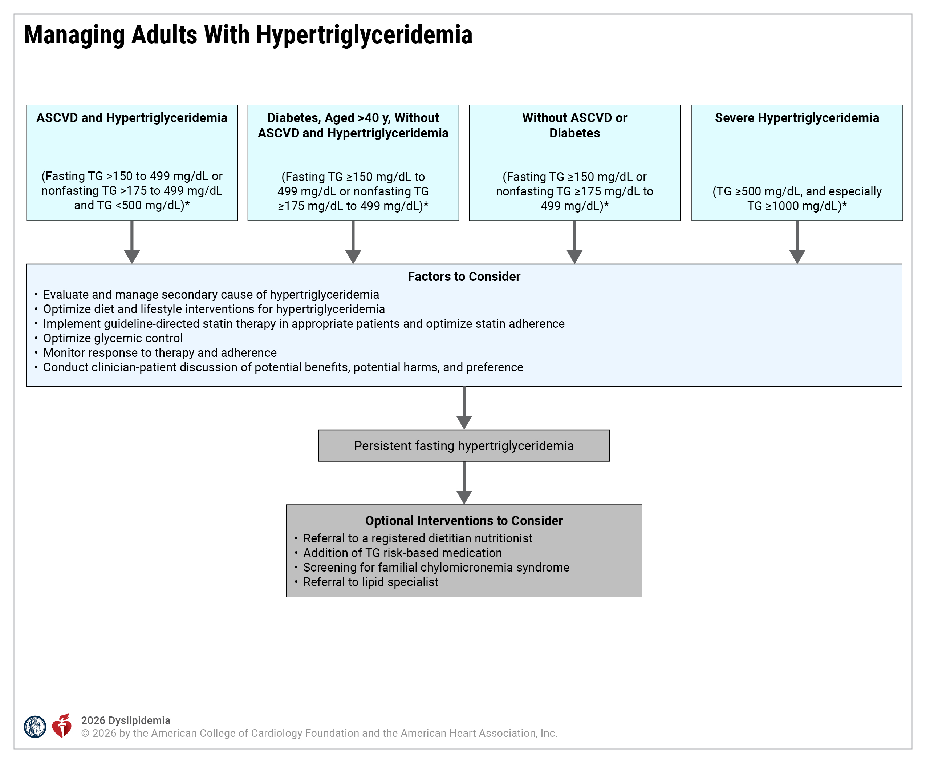
Figure 14. Managing Adults With Hypertrigly-ceridemia
*Conversion of TG from mg/dL to mmol/L: 150 mg/dL=1.7 mmol/L, 175 mg/dL=2 mmol/L, 500 mg/dL to 5.7 mmol/L, 1000 mg/dL=11.3 mmol/L.
ASCVD indicates atherosclerotic cardiovascular disease; and TG, triglycerides.
Adapted with permission from Virani et al. Copyright© 2021 American College of Cardiology Foundation.

Slide 146
Table 23. Physiological and Secondary Causes of Hypertriglyceridemia
Categories | Conditions and Medications Contributing to Hypertriglyceridemia
Diseases | Poorly controlled diabetes Chronic kidney disease, nephrotic syndrome Lipodystrophy Uncontrolled hypothyroidism Cushing syndrome Glycogen storage disease, acute hepatitis Rheumatoid arthritis Psoriasis Systemic lupus erythematosus Multiple myeloma Sepsis (repeat measurement is recommended if lipids were measured during an episode of sepsis)
Diet/Lifestyle | History of alcohol abuse or alcohol excess Diets high in saturated fat, sugar, or high-glycemic-index foods Sedentary lifestyle Total parenteral nutrition with lipid emulsions
Adapted from Virani et al.

Slide 147
Table 23. Physiological and Secondary Causes of Hypertriglyceridemia (con’t.)
Categories | Conditions and Medications Contributing to Hypertriglyceridemia
Drugs* (Medications) | Anesthesia: Propofol Cardiology: Beta-adrenergic–blocking agents Thiazide and loop diuretic agents Bile acid sequestrants (cholestyramine, colestipol, colesevelam) Endocrine: Glucocorticosteroids Anabolic steroids Oral estrogens Raloxifene Clomiphene citrate Estradiol Ethinyl estradiol Conjugated estrogens Tamoxifen
*Caveats: TG-raising medications require careful monitoring; minimizing other conditions that raise TG; and, when clinically appropriate, using alternatives.
Adapted from Virani et al.

Slide 148
Table 23. Physiological and Secondary Causes of Hypertriglyceridemia (con’t.)
Categories | Conditions and Medications Contributing to Hypertriglyceridemia
Drugs* (Medications) | Dermatology: Isotretinoin Infectious Disease: HIV protease inhibitors Oncology: Tamoxifen L-asparaginase Bexarotene Cyclophosphamide Psychiatry: Atypical antipsychotic agents (eg, olanzapine, mirtazapine, clozapine) Immunosuppressive agents: Tacrolimus ﻿﻿Sirolimus Cyclosporine ﻿﻿Interferons
*Caveats: TG-raising medications require careful monitoring; minimizing other conditions that raise TG; and, when clinically appropriate, using alternatives.
Adapted from Virani et al.

Slide 149
Table 23. Physiological and Secondary Causes of Hypertriglyceridemia (con’t.)
Categories | Conditions and Medications Contributing to Hypertriglyceridemia
Disorders of metabolism | Overweight and obesity Metabolic syndrome/insulin resistance Weight gain after weight loss
Physiological | Pregnancy (especially during the third trimester, when pregnancy-associated TG elevation is peaking)
*Caveats: TG-raising medications require careful monitoring; minimizing other conditions that raise TG; and, when clinically appropriate, using alternatives.
Adapted from Virani et al.
TG indicates triglycerides.

Slide 150
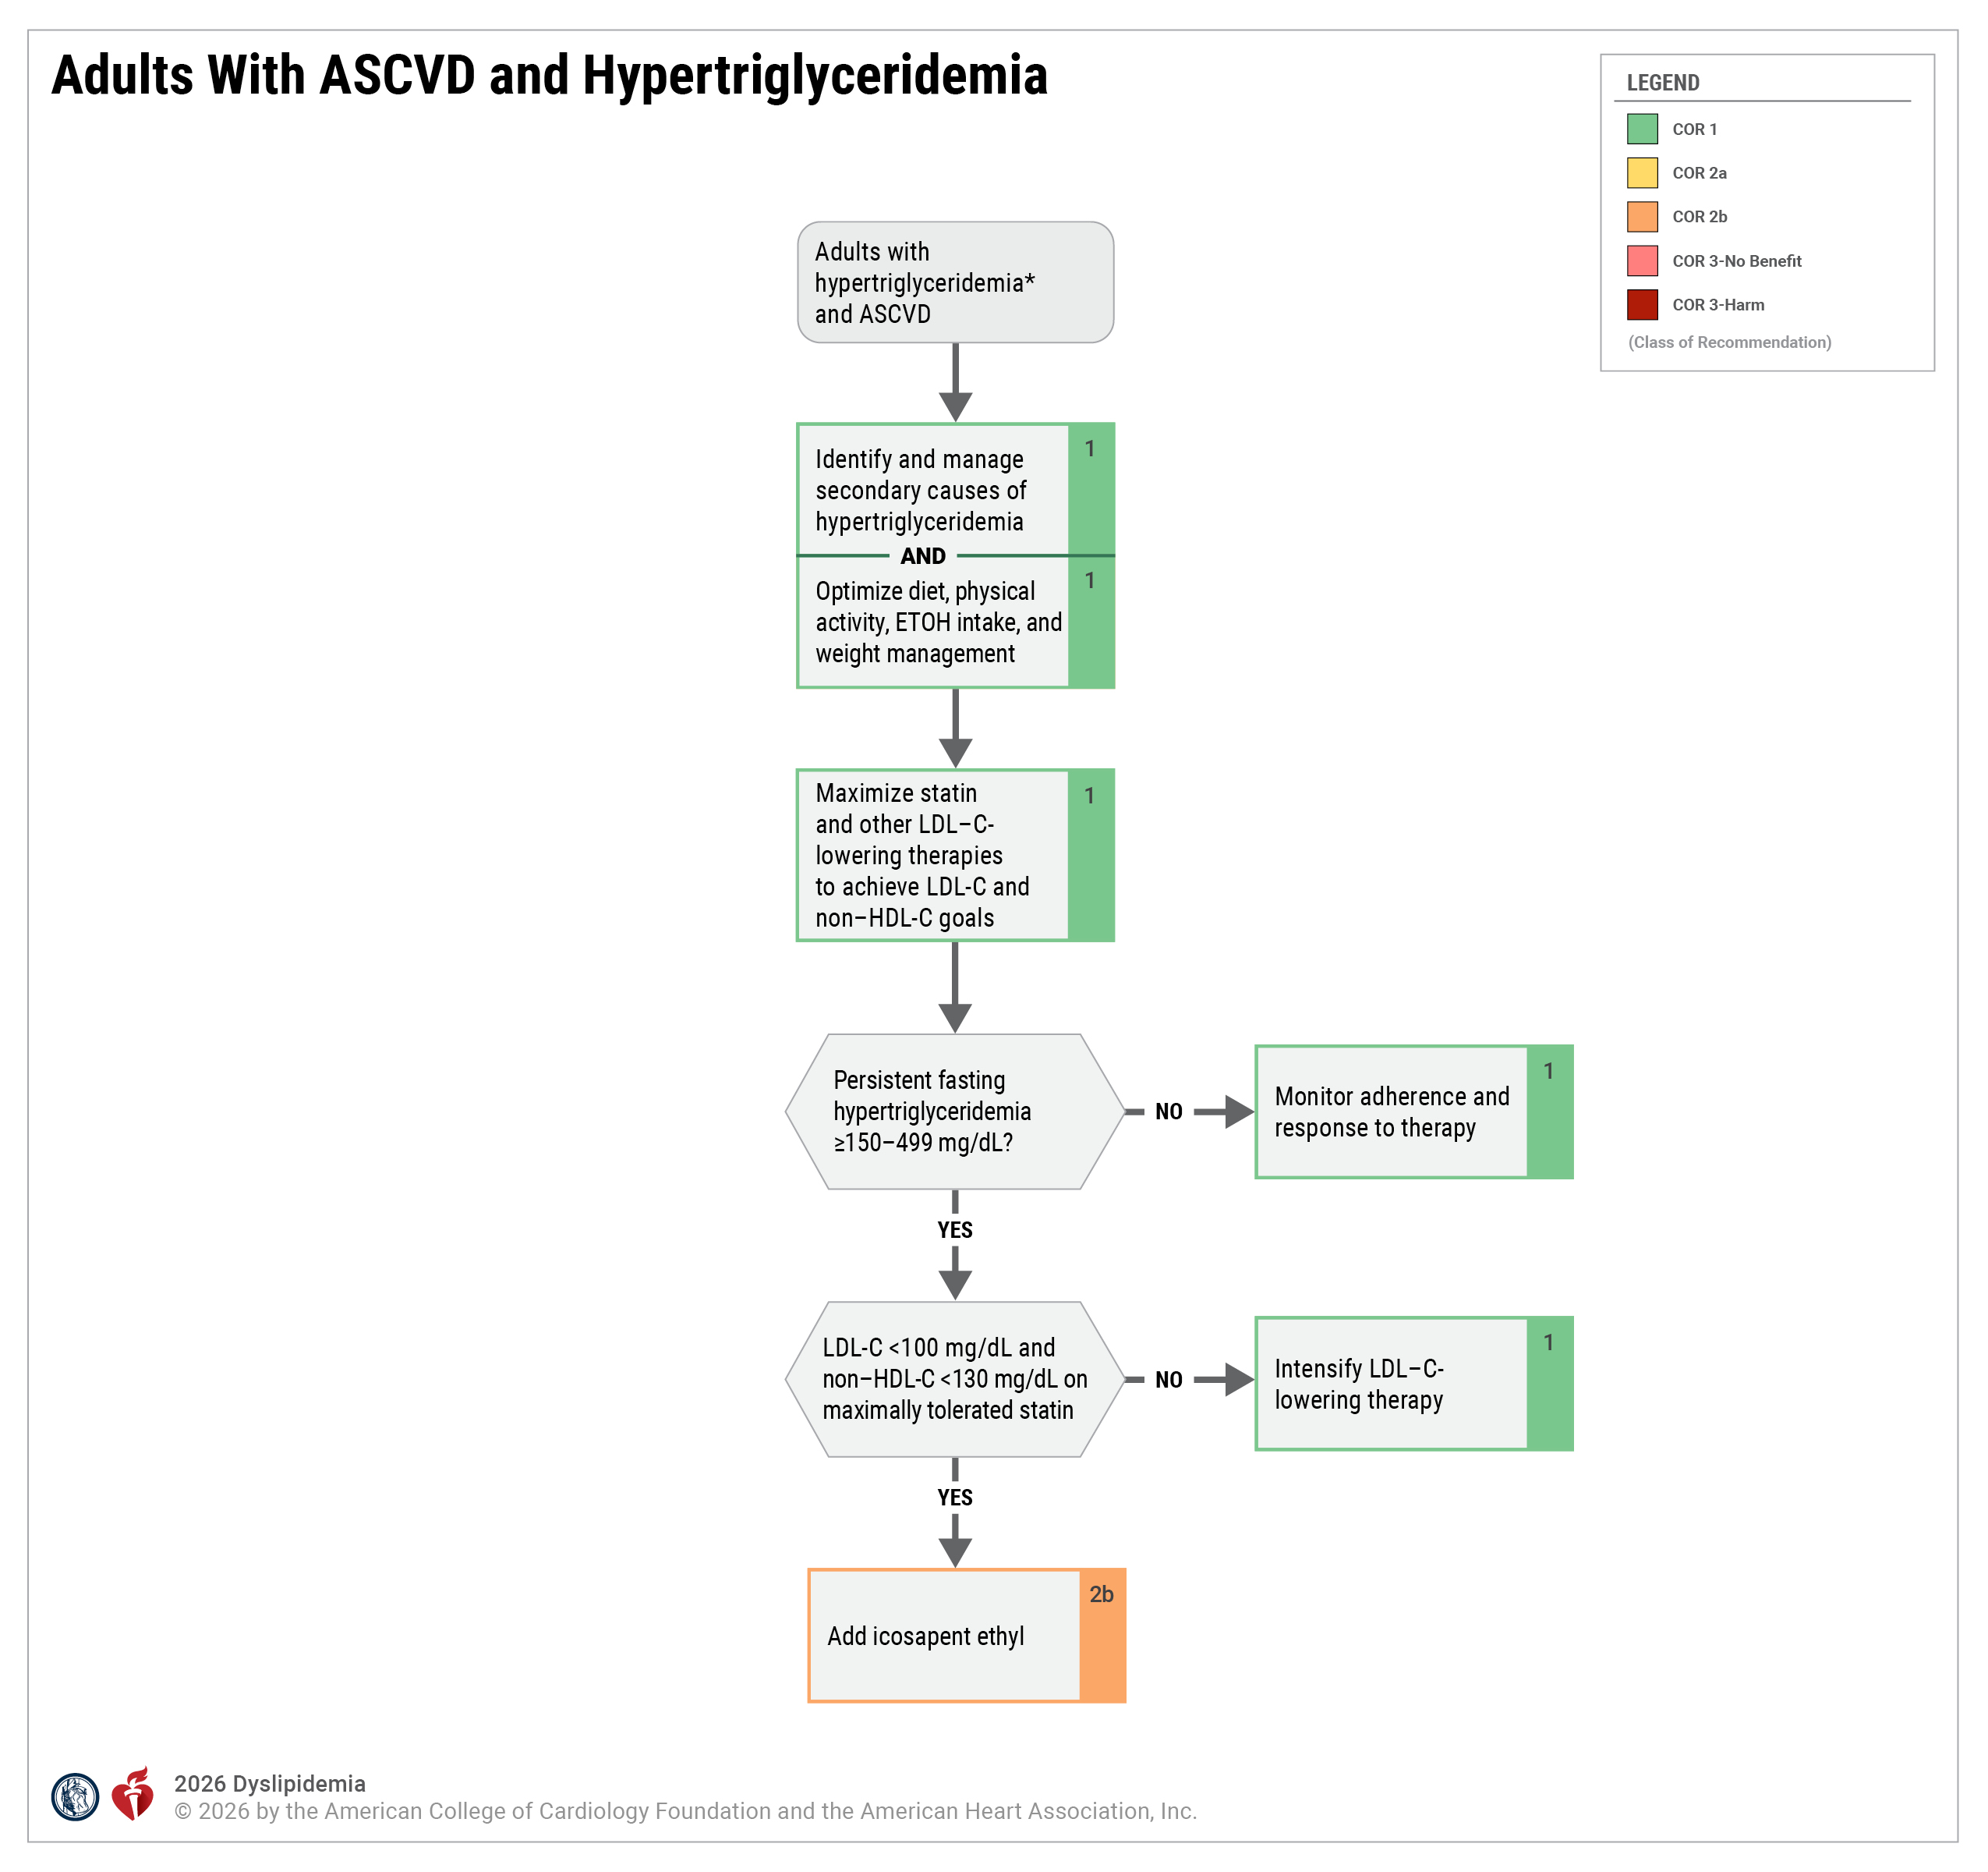
Figure 15. Adults With ASCVD and Hypertrigly-ceridemia
*Conversion of triglyceride from mg/dL to mmol/L: 150 mg/dL=1.7 mmol/L, 175 mg/dL=2 mmol/L, 500 mg/dL to 5.7 mmol/L, 1000 mg/dL=11.3 mmol/L.
ASCVD indicates atherosclerotic cardiovascular disease; ETOH, ethyl alcohol; HDL-C, high-density lipoprotein-cholesterol; and LDL-C, low-density lipoprotein-cholesterol.
Adapted from Virani et al.

Slide 151
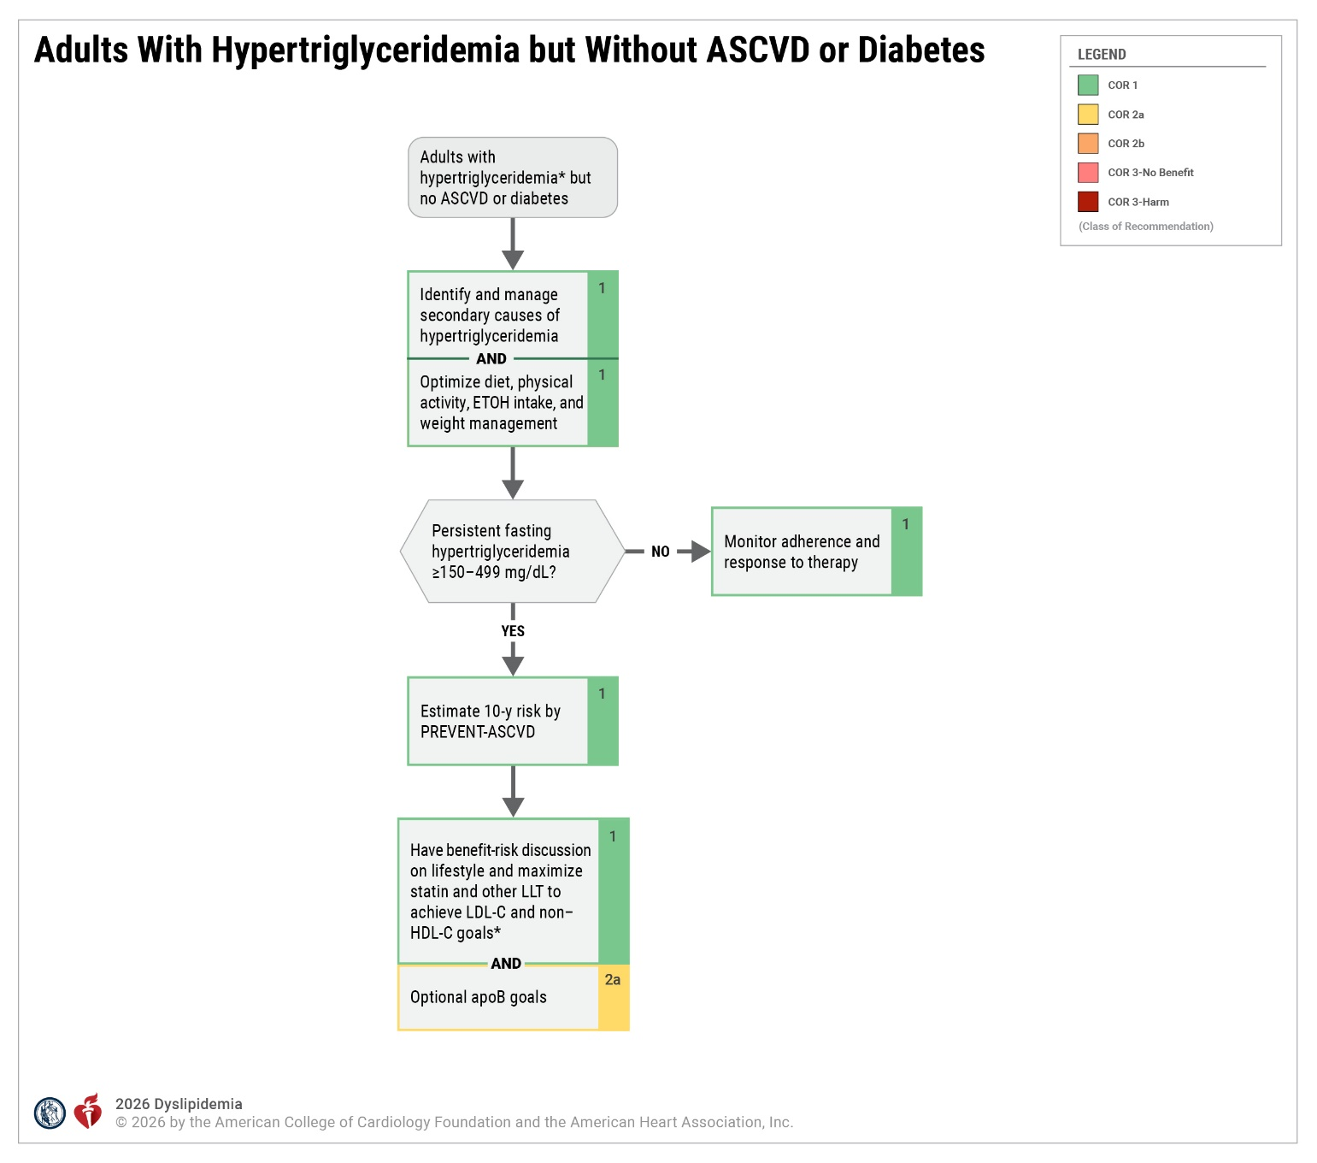
Figure 16. Adults With Hypertriglyceridemia but Without ASCVD or Diabetes
*Conversion of triglyceride from mg/dL to mmol/L: 150 mg/dL=1.7 mmol/L, 175 mg/dL=2 mmol/L, 500 mg/dL to 5.7 mmol/L, 1000 mg/dL=11.3 mmol/L.
apoB indicates apolipoprotein B; ASCVD, atherosclerotic cardiovascular disease; ETOH, ethyl alcohol; HDL-C, high-density lipoprotein-cholesterol; LDL-C, low-density lipoprotein-cholesterol; and LLT, lipid-lowering therapy.
Adapted with permission from Virani et al. Copyright© 2021 American College of Cardiology Foundation.

Slide 152
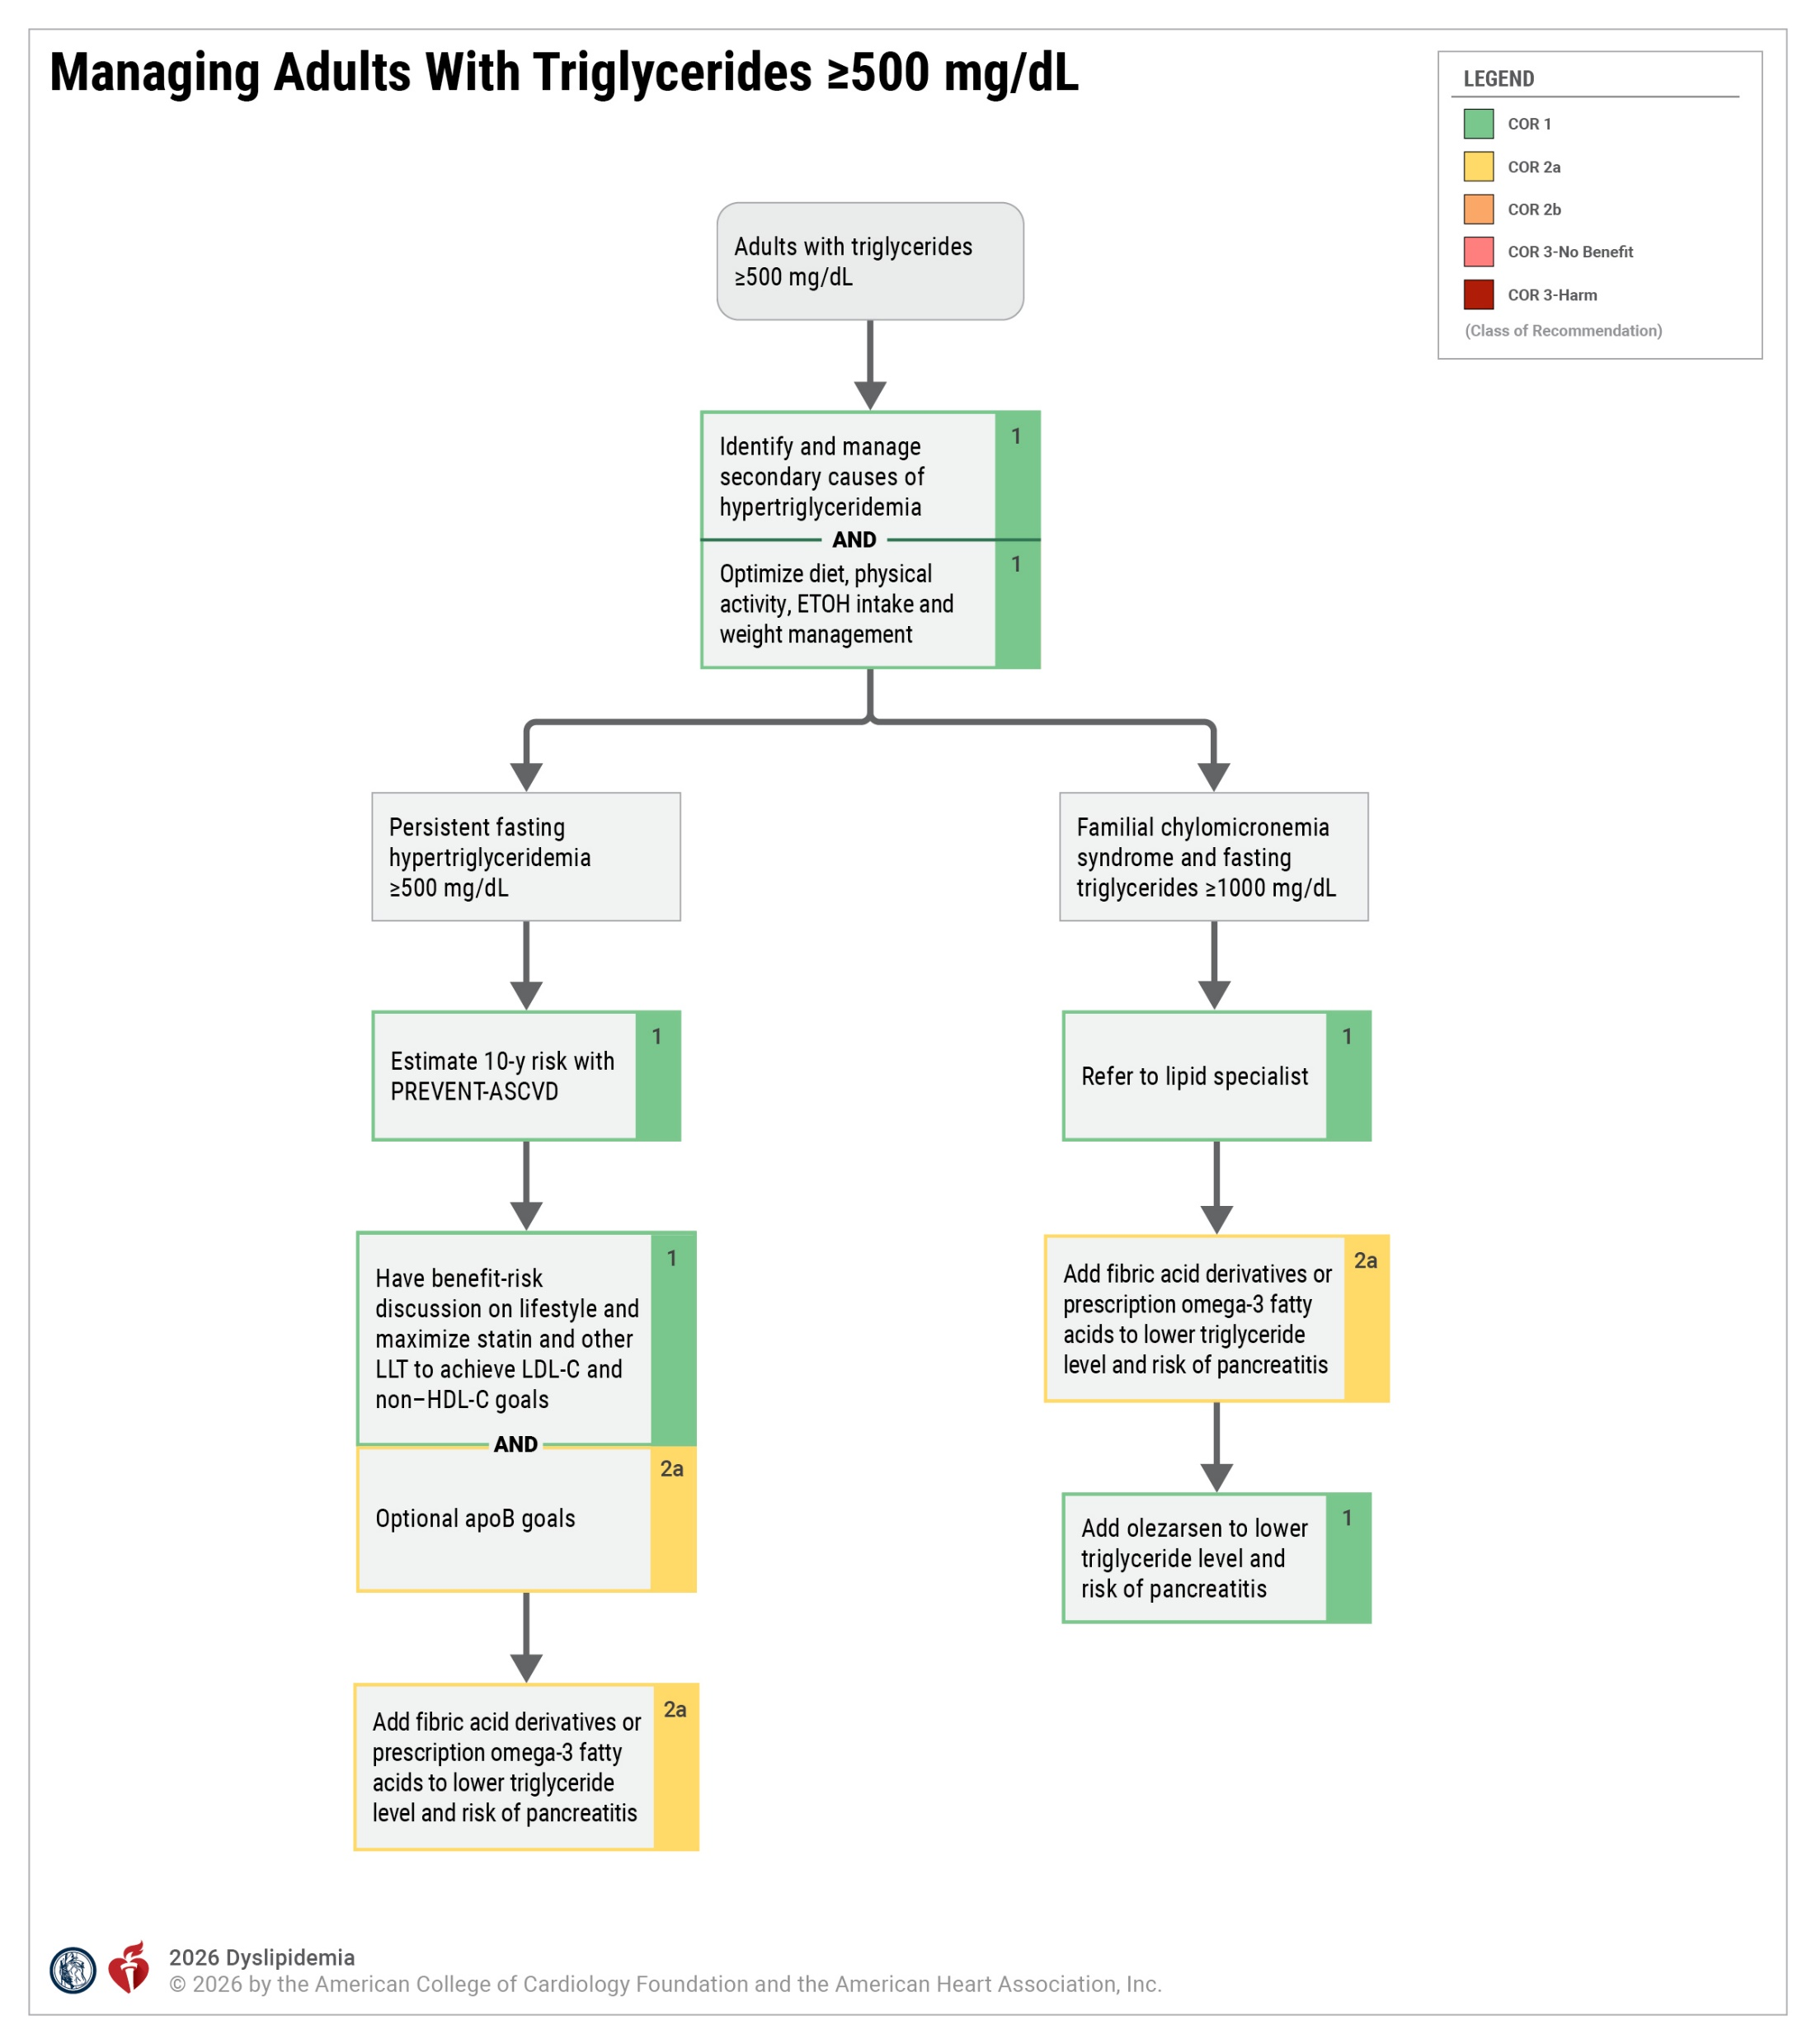
Figure 17. Managing Adults With Triglycerides ≥500 mg/dL
apoB indicates apolipoprotein B; ASCVD, atherosclerotic cardiovascular disease; ETOH, ethyl alcohol; HDL-C, high-density lipoprotein-cholesterol; LDL-C, low-density lipoprotein-cholesterol; and LLT, lipid-lowering therapy.
Adapted with permission from Virani et al. Copyright© 2021 American College of Cardiology Foundation.

Slide 153
Approach to Patients With Elevated Lp(a)
 | Recommendations for the Approach to Patients With Elevated Lp(a) Referenced studies that support recommendations are summarized in the Evidence Table.
COR | LOE | Recommendations
1 | B-NR | In all individuals with elevated Lp(a) (≥125 nmol/L or ≥50 mg/dL), optimal early control of modifiable cardiovascular risk factors is recommended to reduce ASCVD risk.
1 | B-R | In individuals with clinical ASCVD and elevated Lp(a) who have not achieved LDL-C and non–HDL-C treatment goals on maximally tolerated statin therapy, the addition of a PCSK9 mAb with proven cardiovascular benefit is recommended to achieve treatment goals and reduce ASCVD risk.

Slide 154
Management of Statin-Attributed Muscle Symptoms
 | Recommendations for Management of Statin-Attributed Muscle Symptoms Referenced studies that support recommendations are summarized in the Evidence Table.
COR | LOE | Recommendations
1 | C-LD | In adults with statin-attributed muscle symptoms, assessment should include evaluation for secondary causes (Table 24), and in those with severe myalgias or weakness, objective clinical measures of muscle strength and measurement of CK are recommended to assess severity of the condition.
1 | B-R | In adults with statin-attributed muscle symptoms, the clinician–patient discussion should acknowledge patient side effect concerns, inform the patient of the heightened ASCVD risk associated with statin discontinuation, and provide alternative treatment options to reduce ASCVD risk.

Slide 155
Management of Statin-Attributed Muscle Symptoms (con’t.)
1 | B-R | In adults with clinical ASCVD who experience statin-attributed muscle symptoms on the recommended intensity of statin therapy (secondary causes excluded) and are unable to achieve recommended treatment goals, use of a reduced statin dose (if tolerable) and the addition of bempedoic acid, ezetimibe, or a PCSK9 mAb, alone or in combination, are recommended to lower LDL-C and reduce ASCVD risk.
1 | B-R | In adults without a history of clinical ASCVD who experience statin-attributed muscle symptoms on the recommended intensity of statin therapy (secondary causes excluded) and are at high ASCVD risk based on a PREVENT-ASCVD equation of ≥10% or a CAC score ≥300 AU, or women >65 years of age or men >60 years of age with diabetes, the addition of bempedoic acid and/or ezetimibe is/are indicated to lower LDL-C to <70 mg/dL (1.8 mmol/L) and non–HDL-C <100 mg/dL (2.6 mmol/L) and to reduce ASCVD risk.
1 | B-R | In adults without a history of clinical ASCVD who experience statin-attributed muscle symptoms on the recommended intensity of statin therapy (secondary causes excluded) and are at high ASCVD risk based on a PREVENT-ASCVD equation of ≥10% or a CAC score ≥300 AU or diabetes and are unable to achieve recommended treatment goals, the addition of a PCSK9 mAb is recommended to lower LDL-C.

Slide 156
Management of Statin-Attributed Muscle Symptoms (con’t.)
2a | B-NR | In adults with clinical ASCVD who experience statin-attributed muscles symptoms (secondary causes excluded) and are unable to achieve recommended treatment goals on bempedoic acid³ with or without ezetimibe, it is reasonable to add inclisiran in those unable to tolerate or obtain evolocumab or alirocumab or who have a strong preference for less frequent dosing to achieve an LDL-C goal <55 mg/dL (1.4 mmol/L) and non–HDL-C <85 mg/dL (2.2 mmol/L).
2b | B-R | In adults without a history of clinical ASCVD who experience statin-attributed muscle symptoms on the recommended intensity of statin therapy (secondary causes excluded) and are at borderline to intermediate ASCVD risk based on a PREVENT-ASCVD equation of 3% to <10%, and in whom the decision to treat with ezetimibe and/or bempedoic acid is uncertain, coronary calcium scoring may be reasonable to aid in ASCVD risk stratification to inform decision- making about add-on therapy to reduce ASCVD risk.
2b | B-NR | In adults without a history of clinical ASCVD who experience statin-attributed muscle symptoms on the recommended intensity of statin therapy (secondary causes excluded) and are at borderline or intermediate ASCVD risk based on a PREVENT-ASCVD equation of 3% to <10%, the addition of ezetimibe and/or bempedoic acid⁷ may be reasonable to lower LDL-C to <100 mg/dL (2.6 mmol/L) and non–HDL-C to <130 mg/dL (3.4 mmol/L) and reduce ASCVD risk.

Slide 157
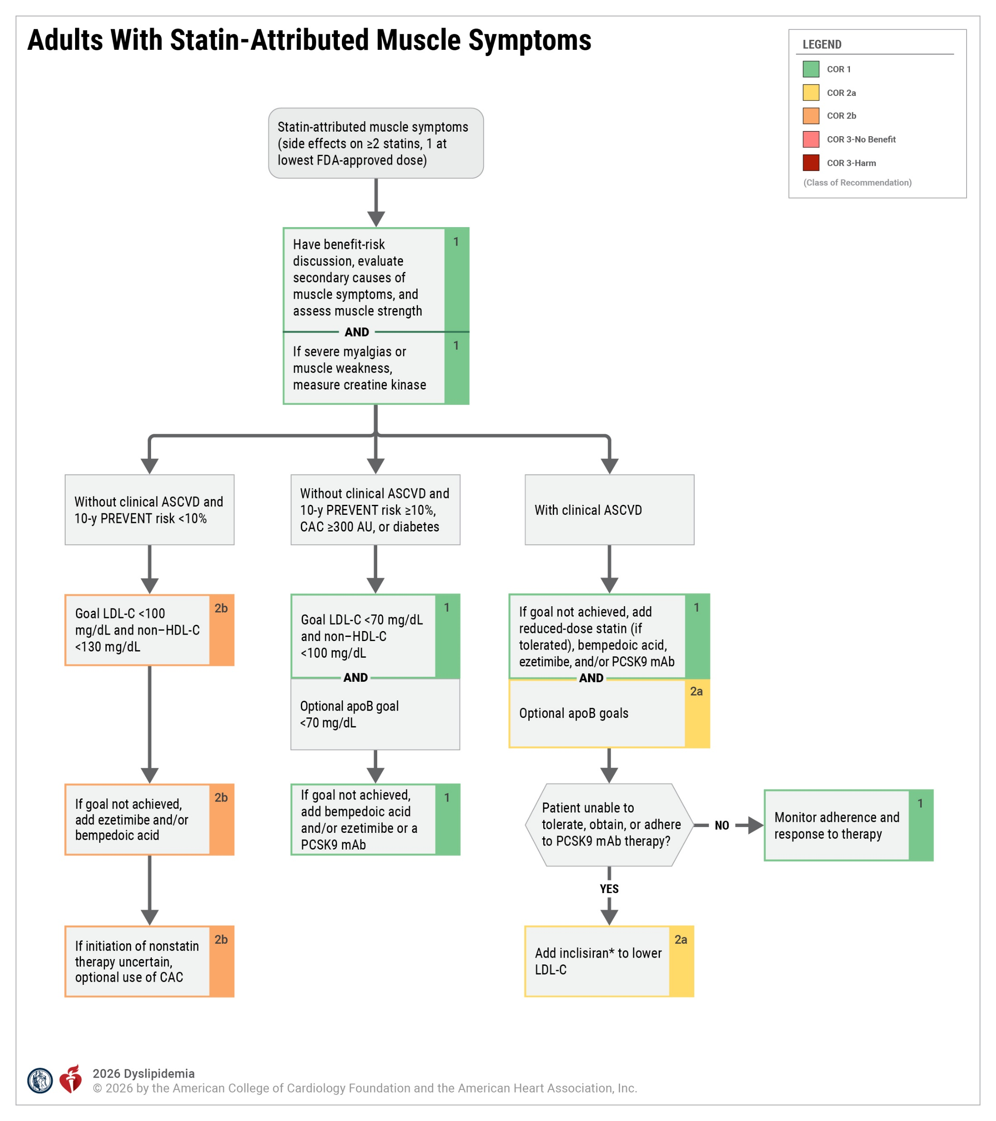
Figure 18. Adults With Statin-Attributed Muscle Symptoms
*Cardiovascular outcomes for inclisiran pending results of ongoing RCTs.
ASCVD indicates atherosclerotic cardiovascular disease; CAC, coronary artery calcium; FDA, US Food and Drug Administration; HDL-C, high-density lipoprotein-cholesterol; LDL-C, low-density lipoprotein-cholesterol; LLT, lipid-lowering therapy; mAb, monoclonal antibody; and PCSK9, proprotein convertase subtilisin/kexin type 9.

Slide 158
Table 24. Patients or Characteristics Associated With Increased Risk for Statin-Attributed Muscle Symptoms
Age ≥65 y
Low body mass index
Female sex
Obesity
Hypothyroidism
Diabetes
Chronic liver disease
Chronic kidney disease
Alcohol consumption
Vigorous exercise
High-dose statin therapy
Diseases associated with myalgia or muscle weakness (eg, fibromyalgia, polymyalgia rheumatica, polymyositis, primary myopathies)
Pharmacotherapy affecting statin metabolism (Section 5.2, “Statin-Cardiovascular Drug Interactions”)
Gene variants affecting statin metabolism (eg, SLCO1B1)
Adapted from Wiggins et al. Modified with permission from Stroes et al. Copyright© 2015 Oxford University Press. Modified with permission via Creative Commons CC BY license from Bytyci et al. Copyright© 2022 Oxford University Press.
An increased risk of statin-attributed muscle symptoms is associated with the use of higher doses of a statin within the approved dosage range. The increase in risk is not attributed to the statin potency (higher potency statins do not have higher risk; high doses do have higher risk).

Slide 159
Complications of Management

Slide 160
Medication Safety and Therapy-Associated Side Effects
 | Recommendations for Medication Safety and Therapy-Associated Side Effects Referenced studies that support recommendations are summarized in the Evidence Table.
COR | LOE | Recommendations
1 | A | In adults with dyslipidemia, an individualized clinician–patient discussion prior to initiating lipid-lowering medication is recommended to review the benefits and risks of pharmacotherapy to promote patient engagement and medication adherence.
1 | A | In adults with elevated diabetes risk or new-onset diabetes, it is recommended to continue statin therapy, with added emphasis on adherence, net clinical beneﬁt, and lifestyle management.

Slide 161
Medication Safety and Therapy-Associated Side Effects (con’t.)
2a | B-R | In adults at elevated ASCVD risk with chronic, stable liver disease (including metabolic dysfunction-associated steatotic liver disease), it is reasonable to treat with statin therapy to reduce ASCVD risk.
3: No Benefit | B-R | In adults on statin therapy, routine use of coenzyme Q10 is not recommended to treat or prevent statin-attributed muscle symptoms.
3: No Benefit | A | In adults on statin therapy who do not have severe statin-attributed muscle symptoms, routine measurement of CK is not useful to assess safety.
3: No Benefit | B-NR | In adults treated with statin therapy who do not have severe symptoms suggestive of hepatotoxicity (ie, jaundice, pruritus, fatigue, nausea and vomiting, abdominal pain), routine measurement of hepatic function is not useful to assess safety.

Slide 162
Table 25. Safety Considerations for LDL-C–Lowering Medications
Medication Class | Common Side Effects | Contraindications* | Comments
HMG-CoA reductase inhibitors (statins) | Myalgia (normal CK level) is common and dose-related | Acute liver failure; decompensated cirrhosis; lactation; severe underlying neuromuscular diseases (eg, dermatomyositis, muscular dystrophy) | See Section 4.2.11, “Management of Statin-Attributed Muscle Symptoms” Myositis/myopathy (CK >ULN) with concerning symptoms or objective weakness is rare; rhabdomyolysis (CK >10 times ULN with renal injury) is rare; immune-mediated necrotizing myopathy (with HMGCR antibodies) is very rare Transaminase elevations (>3 times ULN) are rare Postmarketing reports of cognitive impairment (eg, memory loss, forgetfulness) are rare, generally nonserious, reversible upon statin discontinuation, and not observed in prospective clinical trials See Section 4.2.8.4, “Management of Dyslipidemia in Persons Planning Pregnancy, During Pregnancy, or While Lactating”, pregnancy is not a contraindication, but statins should be avoided while lactating†

Slide 163
Table 25. Safety Considerations for LDL-C–Lowering Medications (con’t.)
Medication Class | Common Side Effects | Contraindications* | Comments
Cholesterol absorption inhibitor (ezetimibe) | Typically well tolerated | Prior hypersensitivity to ezetimibe | Not recommended in patients with moderate or severe hepatic impairment Persistent elevations in hepatic transaminase (>3 times ULN) can occur when added to a statin; monitor hepatic transaminase levels before and after initiating statin with ezetimibe combination therapy
PCSK9 inhibitor: monoclonal antibodies (alirocumab, evolocumab) | Injection site reactions | Prior hypersensitivity to the PCSK9 monoclonal antibody | Hypersensitivity reactions (including angioedema) are rare Latex is in some evolocumab single-dose prefilled syringe covers; alirocumab products do not contain latex
ATP citrate lyase inhibitor (bempedoic acid) | Typically well tolerated | Prior serious hypersensitivity reaction to bempedoic acid or any of the excipients | Elevated BUN, creatinine, and uric acid have been reported (monitoring serum urate level necessary in patients with preexisting and untreated hyperuricemia)
PCSK9 inhibitor: small-interfering RNA (inclisiran) | Injection site reactions | Prior serious hypersensitivity to inclisiran or any of the excipients | Hypersensitivity reactions (including angioedema) are rare

Slide 164
Table 25. Safety Considerations for LDL-C–Lowering Medications (con’t.)
Medication Class | Common Side Effects | Contraindications* | Comments
Bile acid sequestrants | Abdominal pain, bloating, dyspepsia, nausea, and constipation are common | TG >500 mg/dL (colesevelam); history of hypertriglyceridemia-induced pancreatitis; bowel obstruction | Poor tolerability due to side effects and potential drug-drug interactions limits use; may decrease absorption of fat-soluble vitamins and folic acid; generally considered the safest medication in pregnancy
Microsomal triglyceride transfer protein inhibitor (lomitapide) | Gastrointestinal effects (ie, diarrhea, nausea, vomiting, dyspepsia, abdominal pain) are common; elevated hepatic transaminases; increased hepatic fat; embryo-fetal toxicity | Pregnancy, concomitant use with a CPY3A4 inhibitor, moderate or severe hepatic impairment or active liver disease including unexplained persistent abnormal liver function tests | Use is restricted to patients with HoFH Available only through a restricted REMS program that ensures safe use requiring regular monitoring of liver function and other health parameters
ANGPTL3 inhibitor (evinacumab) | Serious hypersensitivity reactions; embryo-fetal toxicity | History of serious hypersensitivity reactions to evinacumab-dgnb or to any of its excipients | Use is restricted to patients with HoFH Infusion rate can be slowed, interrupted, or discontinued if signs of adverse reactions, including infusion or hypersensitivity reactions are present during administration

Slide 165
Table 25. Safety Considerations for LDL-C–Lowering Medications (con’t.)
*Contraindications from FDA-approved labeling (available at:
http://dailymed.nlm.nih.gov/dailymed/index.cfm)
†The Food and Drug Administration has removed pregnancy as a contraindication to statin therapy.
ANGPTL3 indicates angiopoietin-like protein 3; ATP, adenosine triphosphate; CK, creatine kinase; HMG-CoA, 3-hydroxy-3-methylglutaryl- coenzyme; HoFH, homozygous familial hyperlipidemia; mRNA, messenger ribonucleic acid; PCSK9, proprotein convertase subtilisin/kexin type 9; REMS, Risk Evaluation and Mitigation Strategy; RNA, ribonucleic acid; and ULN, upper limit of normal.

Slide 166
Table 26. Safety Considerations for Triglyceride-Lowering Medications
Medication Class | Common Side Effects | Contraindications* | Comments
Fibrates (fenofibrate, fenofibric acid, gemfibrozil) | Myalgia; persistently elevated hepatic transaminases | Severe renal dysfunction; active liver disease; gallbladder disease; during lactation; history of hypersensitivity to the fibrate product | Fenofibrate and fenofibric acid can reversibly elevate serum creatinine When given in combination with statin therapy can increase risk of muscle toxicity; gemfibrozil should not be used in combination with a statin; fenofibrate or fenofibric acid can be used in combination with statin with monitoring
Omega-3 fatty acids (icosapent ethyl, omega-3-acid ethyl esters) | Eructation, dyspepsia, and taste perversion | History of hypersensitivity to the omega-3 fatty acid product | Side effects less with prescription omega-3 fatty acids compared to nonprescription fish oil supplements New onset atrial fibrillation/flutter reported Must monitor hepatic transaminases in patients with hepatic impairment DHA-containing products (omega-3 acid ethyl esters) can raise LDL-C, but not apoB Derived from fish and purified; use with caution in patients with known hypersensitivity to fish and/or shellfish Possible increased bleeding when used in combination with an antithrombotic agent

Slide 167
Table 26. Safety Considerations for Triglyceride-Lowering Medications (con’t.)
Medication Class | Common Side Effects | Contraindications* | Comments
Niacin | Facial flushing, gastrointestinal symptoms (diarrhea, nausea, vomiting) are common; persistent hepatic transaminase and glucose elevations | Active liver disease (including unexplained persistent elevated hepatic transaminases), active peptic ulcer disease, arterial bleeding, known hypersensitivity to product components | Monitoring liver enzymes before and during treatment is necessary May cause and/or exacerbate insulin resistance Infrequently used owing to poor tolerability and lack of proven cardiovascular benefits; tolerability improved with long-acting products and by optimizing administration (slow titration, administering with food, predosing with aspirin or an NSAID) Serious muscle toxicity possible with statin use
ApoC-III inhibitor: ASO-directed therapy (olezarsen) | Injection site reactions | Prior serious hypersensitivity to olezarsen or any of the excipients | Use is restricted to patients with FCS Decreased platelet count is possible but not common

Slide 168
Table 26. Safety Considerations for Triglyceride-Lowering Medications (con’t.)
*Contraindications from FDA-approved labeling (available at:
http://dailymed.nlm.nih.gov/dailymed/index.cfm).
ApoC-III indicates apolipoprotein C-III; ASO, antisense oligonucleotide; DHA, docosahexanoic acid; FCS, familial chylomicronemia syndrome; and NSAID, nonsteroidal anti-inflammatory drug.

Slide 169
Statin-Cardiovascular Drug Interactions
 | Recommendation for Managing Statin-Cardiovascular Drug Interactions Referenced studies that support the recommendation are summarized in the Evidence Table.
COR | LOE | Recommendation
1 | B-NR | In adults for whom the decision is made to initiate statin therapy, a review of concomitant medications and assessment for potential DDI with other cardiovascular medications is recommended to minimize the risk of statin-associated adverse events.

Slide 170
Table 27. Clinical Recommendations on Management of DDI With Statins and Cardiovascular Medications
Interacting Drug | Statin | Clinical Recommendation for Management
Amiodarone | Lovastatin | Limit dose of lovastatin to 40 mg daily
 | Simvastatin | Limit dose of simvastatin to 20 mg daily
Amlodipine | Lovastatin | Limit dose of lovastatin to 20 mg daily
 | Simvastatin | Limit dose of simvastatin to 20 mg daily
Bempedoic acid | Pravastatin | Limit dose of pravastatin to 40 mg daily
 | Simvastatin | Limit dose of simvastatin to 20 mg daily
Modified with permission from Kellick et al. Copyright© 2014 Elsevier. Modified with permission from Wiggins et al. Copyright© 2016 American Heart Association, Inc. See additional references for prescribing information for each statin.
DDI indicates drug-drug interaction.

Slide 171
Table 27. Clinical Recommendations on Management of DDI With Statins and Cardiovascular Medications (con’t.)
Interacting Drug | Statin | Clinical Recommendation for Management
Colchicine | Atorvastatin | Closer monitoring for muscle-related toxicity is recommended when used in combination
 | Fluvastatin
 | Lovastatin
 | Pitavastatin
 | Pravastatin
 | Rosuvastatin
 | Simvastatin
Conivaptan | Lovastatin | Avoid combination
 | Simvastatin | Avoid combination
Diltiazem | Lovastatin | Limit dose of lovastatin to 20 mg daily
 | Simvastatin | Limit dose of simvastatin to 10 mg daily
Dronedarone | Lovastatin | Limit dose of lovastatin to 10 mg daily
 | Simvastatin | Limit dose of simvastatin to 10 mg daily
Modified with permission from Kellick et al. Copyright© 2014 Elsevier. Modified with permission from Wiggins et al. Copyright© 2016 American Heart Association, Inc. See additional references for prescribing information for each statin.
DDI indicates drug-drug interaction.

Slide 172
Table 27. Clinical Recommendations on Management of DDI With Statins and Cardiovascular Medications (con’t.)
Interacting Drug | Statin | Clinical Recommendation for Management
Gemfibrozil | Atorvastatin | Avoid combination
 | Lovastatin | Avoid combination
 | Pitavastatin | Avoid combination
 | Pravastatin | Avoid combination
 | Rosuvastatin | Avoid combination
 | Simvastatin | Avoid combination
Lomitapide | Lovastatin | Reduce dose of lovastatin by 50%
 | Simvastatin | Reduce dose of simvastatin by 50% and limit dose to 20 mg daily
Ranolazine | Lovastatin | Combination is acceptable to use if clinically indicated and an alternative non-CYP3A4 statin cannot be used. However, doses of lovastatin or simvastatin should not exceed 20 mg daily
 | Simvastatin
Modified with permission from Kellick et al. Copyright© 2014 Elsevier. Modified with permission from Wiggins et al. Copyright© 2016 American Heart Association, Inc. See additional references for prescribing information for each statin.
DDI indicates drug-drug interaction.

Slide 173
Table 27. Clinical Recommendations on Management of DDI With Statins and Cardiovascular Medications (con’t.)
Interacting Drug | Statin | Clinical Recommendation for Management
Ticagrelor | Atorvastatin | Combination is acceptable without dose limitations
 | Lovastatin | Limit dose of lovastatin to 40 mg daily
 | Simvastatin | Limit dose of simvastatin to 40 mg daily
Verapamil | Lovastatin | Limit dose of lovastatin to 20 mg daily
 | Simvastatin | Limit dose of simvastatin to 10 mg daily
Modified with permission from Kellick et al. Copyright© 2014 Elsevier. Modified with permission from Wiggins et al. Copyright© 2016 American Heart Association, Inc. See additional references for prescribing information for each statin.
DDI indicates drug-drug interaction.

Slide 174
Abbreviations
Abbreviation | Meaning/Phrase
ABI | ankle-brachial index
ACS | acute coronary syndrome
aHR | adjusted hazard ratio
AOR | adjusted odds ratio
ApoB | apolipoprotein B
ARR | absolute risk reduction
ASCVD | atherosclerotic cardiovascular disease
ATP | adenosine triphosphate
AU | Agatston units
AUC | area under the curve
BMI | body mass index
CAC | coronary artery calcium
CAD | coronary artery disease
CHD | coronary heart disease
CI | confidence interval
CID | chronic inflammatory diseases
CK | creatine kinase
CKD | chronic kidney disease
CKM | cardiovascular-kidney-metabolic
CT | computed tomography

Slide 175
Abbreviations (con’t.)
Abbreviation | Meaning/Phrase
CTA | computed tomography angiography
CCTA | coronary computed tomography angiography
CVD | cardiovascular disease
CVOT | cardiovascular outcome trial
CYP3A4 | cytochrome P450 3A4
DASH | Dietary Approach to Stop Hypertension
DDI | drug-drug interactions
DHA | docosahexanoic acid
eGFR | estimated glomerular filtration rate
EPA | eicosapentanoic acid
FCS | familial chylomicronemia syndrome
FDA | US Food and Drug Administration
FH | familial hypercholesterolemia
HDL-C | high-density lipoprotein-cholesterol
HeFH | heterozygous familial hypercholesterolemia
HF | heart failure
HFrEF | heart failure with reduced ejection fraction
HIV | human immunodeficiency virus
HMG-CoA | 3-hydroxy-3-methylglutaryl- coenzyme
HoFH | homozygous familial hypercholesterolemia

Slide 176
Abbreviations (con’t.)
Abbreviation | Meaning/Phrase
HR | hazard ratio
HsCRP | high-sensitivity C-reactive protein
IPE | icosapent ethyl
LDL | low-density lipoprotein
LDL-C | low-density lipoprotein-cholesterol
LLT | lipid-lowering therapy
Lp(a) | lipoprotein (a)
LPL | lipoprotein lipase
mAbs | monoclonal antibodies
MACE | major adverse cardiovascular events
MASLD | metabolic dysfunction-associated steatotic liver disease
MCS | multifactorial chylomicronemia syndrome
MI | myocardial infarction
NIH | National Institutes of Health
PAD | peripheral artery disease

Slide 177
Abbreviations (con’t.)
Abbreviation | Meaning/Phrase
PCSK9i | proprotein convertase subtilisin/kexin type 9 inhibitor
PLHIV | persons living with HIV
PREVENT | Predicting Risk of cardiovascular disease EVENTs
PRS | polygenic risk scoring
QOL | quality of life
RCT | randomized controlled trial
RDN | registered dietitian nutritionist
RNA | ribonucleic acid
RRR | relative risk reduction
SAMS | statin-attributed muscle symptoms
TC | total cholesterol
TG | triglycerides
VLDL | very-low-density lipoprotein

