Slide 1
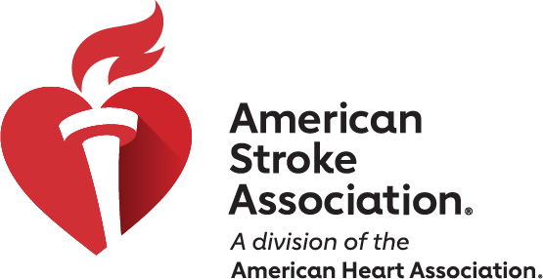
2026 Guideline for the Early Management of Patients with Acute Ischemic Stroke
Key Nursing Updates and Review
from the Nursing Perspective
Notes:
This slide presentation is designed to highlight the key changes that may impact nursing practice, and in some cases provide a review of the topic discussed in the Guideline. It is not a comprehensive review of the entirety of the 2026 Guideline for Early Management of Patients with AIS but should be considered a quick summary of important updates.

Slide 2
Slide set developed by
Karen Rapp, BSN, RN
Mary Rodgers, DHA, MS, RN
Anne Leonard, MPH, bsn, RN on behalf of the
STROKE SCILL/Professional Education Committee
This document includes select AI-assisted imagery created by our designers.

Slide 3
Class (strength) of Recommendation (COR) and Level (quality) of Evidence (LOE)
CLASS (STRENGTH) OF RECOMMENDATION
CLASS 1 (STRONG) Benefit >>> Risk
Suggested phrases for writing recommendations: Is recommended Is indicated/useful/effective/beneficial Should be performed/administered/other Comparative-Effectiveness Phrases†: Treatment/strategy A is recommended/indicated in preference to treatment B Treatment A should be chosen over treatment B
CLASS 2a (MODERATE) Benefit >> Risk
Suggested phrases for writing recommendations: Is reasonable Can be useful/effective/beneficial Comparative-Effectiveness Phrases†: Treatment/strategy A is probably recommended/indicated in preference to treatment B It is reasonable to choose treatment A over treatment B
CLASS 2b (Weak) Benefit ≥ Risk
Suggested phrases for writing recommendations: May/might be reasonable May/might be considered Usefulness/effectiveness is unknown/unclear/uncertain or not well-established
CLASS 3: No Benefit (MODERATE) Benefit = Risk
Suggested phrases for writing recommendations: Is not recommended Is not indicated/useful/effective/beneficial Should not be performed/administered/other
CLASS 3: Harm (STRONG) Risk > Benefit
Suggested phrases for writing recommendations: Potentially harmful Causes harm Associated with excess morbidity/mortality Should not be performed/administered/other
LEVEL (QUALITY) OF EVIDENCE‡
LEVEL A
High-quality evidence‡ from more than 1 RCT Meta-analyses of high-quality RCTs One or more RCTs corroborated by high-quality registry studies
LEVEL B-R (Randomized)
Moderate-quality evidence‡ from 1 or more RCTs Meta-analyses of moderate-quality RCTs
LEVEL B-NR (Nonrandomized)
Moderate-quality evidence‡ from 1 or more well-designed, well-executed nonrandomized studies, observational studies, or registry studies Meta-analyses of such studies
LEVEL C-LD (Limited Data)
Randomized or nonrandomized observational or registry studies with limitations of design or execution Meta-analyses of such studies Physiological or mechanistic studies in human subjects
LEVEL C-EO (Expert Opinion)
Consensus of expert opinion based on clinical experience.
COR: The Class of Recommendation indicates the strength of a recommendation, based on the benefits of a treatment weighed against its risks. It's essentially a grade for what a clinician should do.
LOE: The Level of Evidence explains the quality of the scientific research that supports the recommendation. It tells you how confident the experts are in the data behind the recommendation.
COR and LOE are determined independently (any COR may be paired with any LOE).
A recommendation with LOE C does not imply that the recommendation is weak. Many important clinical questions addressed in guidelines do not lend themselves to clinical trials. Although RCTs are unavailable, there may be a very clear clinical consensus that a particular test or therapy is useful or effective.
* The outcome or result of the intervention should be specified (an improved clinical outcome or increased diagnostic accuracy or incremental prognostic information).
† For comparative-effectiveness recommendation (COR 1 and 2a; LOE A and B only), studies that support the use of comparator verbs should involve direct comparisons of the treatments or strategies being evaluated.
‡ The method of assessing quality is evolving, including the application of standardized, widely-used, and preferably validated evidence grading tools; and for systematic reviews, the incorporation of an Evidence Review Committee.
COR indicates Class of Recommendation; EO, expert opinion; LD, limited data; LOE, Level of Evidence; NR, nonrandomized; R, randomized; and RCT, randomized controlled trial.
Prabhakaran, S., et al. 2026 AHA/ASA Guideline for the Early Management of Patients with AIS. Stroke.
Notes:
First, let’s review how Guidelines are structured. When the American Heart Association (AHA) and other organizations issue guidelines, they employ a structured rating system to help clinicians and patients understand the strength of the recommendation. This system uses two categories: the Class of Recommendation (COR) and the Level of Evidence (LOE).
The COR indicates the strength of recommendation, encompassing the estimated magnitude and certainty of benefit in proportion to the risk. The LOE rates the quality of scientific evidence supporting the intervention based on the type, quantity, and consistency of data from clinical trials and other sources. Please note, COR and LOE are determined independently (any COR may be paired with any LOE). ¹
Class of Recommendation²:
Class 1 (Strong): The treatment is highly effective and beneficial. It is recommended and should be used for most patients in most circumstances.
Class 2a (Moderate): The treatment is probably beneficial. The weight of evidence or expert opinion is in favor of its use. It is reasonable to consider for most patients.
Class 2b (Weak): The treatment may be beneficial, but its usefulness is not as well-established. It may be considered in some cases, but the decision should be tailored to the individual patient.
Class 3 (Harm/No Benefit): The treatment is not helpful and could be harmful. It is not recommended.
Level of Evidence:
Level A (Highest Quality): Supported by high-quality evidence from multiple, large-scale randomized controlled trials (studies where some patients get the treatment and some get a placebo). The findings are very consistent.
Level B (Moderate Quality): Supported by a single, good-quality randomized trial or several non-randomized studies. The evidence is less certain than Level A.
B-R – Randomized trial(s)
B-NR – Nonrandomized trial(s)
Level C (Limited Quality): Based on the opinion of experts, small studies, or general medical practice. There are not enough high-quality studies to definitively prove a benefit.
C-LD – Limited data
C-EO – Expert Opinion
This slide deck will provide the rating given to each of the new key updates that may impact nursing practice.
¹ Prabhakaran, S., et al. 2026 AHA/ASA Guideline for the Early Management of Patients with AIS. Stroke.
²Halperin JL, Levine GN, Al-Khatib SM, Birtcher KK, Bozkurt B, Brindis RG, Cigarroa JE, Curtis LH, Fleisher LA, Gentile F, Gidding S, Hlatky MA, Ikonomidis J, Joglar J, Pressler SJ, Wijeysundera DN. Further Evolution of the ACC/AHA Clinical Practice Guideline Recommendation Classification System: A Report of the American College of Cardiology/American Heart Association Task Force on Clinical Practice Guidelines. J Am Coll Cardiol. 2016 Apr 5;67(13):1572-1574. doi: 10.1016/j.jacc.2015.09.001. Epub 2015 Sep 24. PMID: 26409257.

Slide 4
Purpose Statement
This presentation highlights key recommendations from the 2026 Guideline for the Early Management of Patients with Acute Ischemic Stroke that are particularly relevant to nursing practice and can be used by individual organizations to standardize clinical practice for the care of acute ischemic stroke. Nurses are integral in developing congruent, evidence-based systems of care for stroke patients across care settings. While the entire guideline informs quality care delivery, nurses are uniquely positioned to identify, monitor, and respond to specific clinical situations that directly impact patient outcomes on a daily basis.
The topics presented here reflect the clinical decisions and assessments that nurses routinely encounter during their shifts—from recognizing early warning signs and implementing preventive measures to collaborating with the interdisciplinary team and advocating for patient safety. This slide deck includes neuroscience nursing clinical practice care assessments specific to the acute stroke population, emphasizing those points of care where nursing knowledge, vigilance, and clinical judgment make a tangible difference in patient recovery and well-being.
By focusing on these specific areas, we aim to strengthen nurses' understanding of evidence-based practices that support organizational efforts to standardize stroke care and empower nurses to deliver the highest standard of care in their everyday practice.
This slide deck was adapted from the 2026 AHA/ASA for the Early Management of Patients with
Acute Ischemic Stroke.

Slide 5
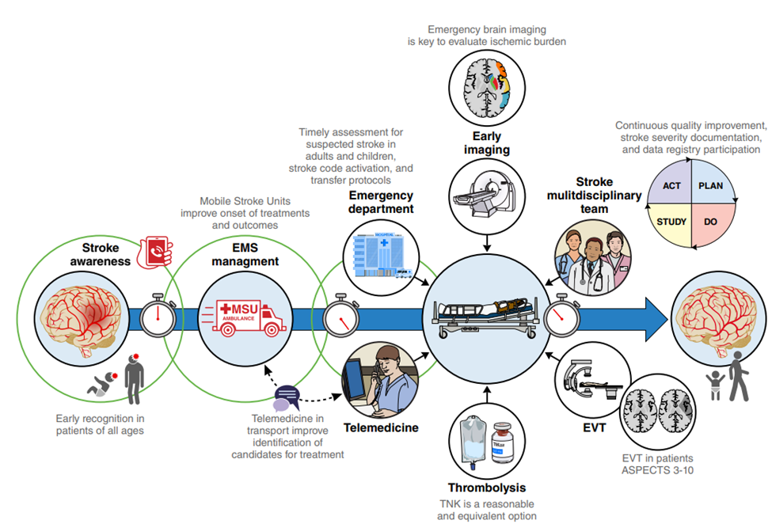
JOURNEY OF A PATIENT WITH AIS
Notes:
The 2026 Guideline for Acute Management of AIS, spans from stroke awareness, through prehospital care, telemedicine facilitation and care, acute diagnostic imaging and treatment upon arrival to the hospital, to post acute treatments, nutrition, dysphagia, palliative care and more, and address both pediatric and adult care.

Slide 6
KEY NURSING TOPICS FOR REVIEW
From the 2026 Guideline for the Early Management of Patients with Acute Ischemic Stroke
Recommendation Categories | Topics for Review
Pediatric | General Summary of Updates
Prehospital | EMS Destination Management , Mobile Stroke Units, Interhospital Transfers
Acute Treatment | Thrombolysis and Management Review, Wake Up and 4.5 – 9 hour strokes, Telestroke and Thrombolysis, BP Management after Acute Treatments, Basilar EVT
Post Acute | Dual Antiplatelets for Minor AIS and High-Risk TIA, Early Anticoagulation and AF, Head Positioning, Brain Swelling,
General Supportive Care | Blood Glucose Monitoring, Depression, Nutrition, Dysphagia, Early Mobilization, Palliative Care, Multidisciplinary Management

Slide 7
2026 GUIDELINE FOR THE EARLY MANAGEMENT OF PATIENTS WITH AIS
KEY NURSING UPDATES AND REVIEW
Pediatric Recommendations
Notes:
While new in the clinical practice guidelines the focus of this educational slide deck, does not focus on the care of the pediatric patient. A summary of the new recommendations is provided.

Slide 8
Pediatrics – General Summary
More research is needed on tools to identify pediatric stroke in the EMS setting. (COR: 2b; LOE: B-NR)
Nursing should facilitate rapid imaging on all suspected pediatric AIS patients utilizing an MRI/MRA of the brain if it can be performed in 25 minutes, or a CT/CTA, in order to diagnose LVO, hemorrhagic stroke, or other stroke mimics. (COR: 2a; LOE: C-LD)
Alteplase (tPA) may be considered by the provider to treat pediatric ischemic stroke within 4.5 hours of onset, but efficacy is unknown. (COR: 2b; LOE: C-LD)
If experienced pediatric neurointerventionalists are available:
  for patients ≥ 6 years of age, and an LVO confirmed within 6 hours of symptom onset, EVT is reasonable to consider and can be effective to improve functional outcomes. (COR: 2a; LOE: B-NR)
  for patients ≥ 6 years of age, and an LVO confirmed between 6 – 24 hours of symptom onset, with imaging that suggests potentially salvageable brain, EVT is reasonable to consider and can be effective to improve functional outcomes. (COR: 2a; LOE: B-NR)
  for patients aged 28 days to 6 years, and an LVO confirmed within 24 hours, with imaging that suggests potentially salvageable brain, EVT may be reasonable to consider to improve functional outcomes. (COR: 2b; LOE: B-NR)
Notes:
Although the general approach to the identification, triage and treatment of the pediatric population is similar to adults, the strength of the recommendations of the guidelines remain moderate to weak and is based on limited data or non-randomized data in this population.

Slide 9
2026 GUIDELINE FOR THE EARLY MANAGEMENT OF PATIENTS WITH AIS
KEY NURSING UPDATES AND REVIEW
Prehospital Recommendations

Slide 10

EMS Destination Management
Section | COR | LOE | RECOMMENDATIONS
2.4 | 1 | B-NR | In patients with suspected acute stroke, EMS professionals should prioritize transport to the closest appropriate facility (acute stroke-ready hospital [ASRH], primary stroke center [PSC], thrombectomy-capable stroke center [TSC], or comprehensive stroke center [CSC]) to reduce time to treatment compared with transport to a nonstroke capable hospital.
Section | COR | LOE | RECOMMENDATIONS
2.4 | 3 No Benefit | B-R | In areas with well-coordinated SSOC and local hospital(s) proficient in thrombolysis delivery and secondary interhospital transfer, direct transport of patients with suspected LVO to a distant (eg, 45-60 min) TSC compared with transport to a local stroke center does not improve 3-month clinical outcomes.
Notes:
The first recommendation is listed as a reminder that suspected acute stroke patients should be transported to the closest most appropriate facility that has been recognized as a stroke ready level hospital or higher to reduce time to acute treatments.
The second recommendation is new. In areas with well coordinated stroke systems of care and local hospitals proficient in thrombolysis delivery and secondary interhospital transfer, direct transport of patients with suspected LVO to a distant (eg. 45-60 min) TSC does not improve 3-month outcome and has been assigned the Class of Recommendation of NO BENEFIT, with Level of Evidence B – from moderate quality, randomized data.

Slide 11
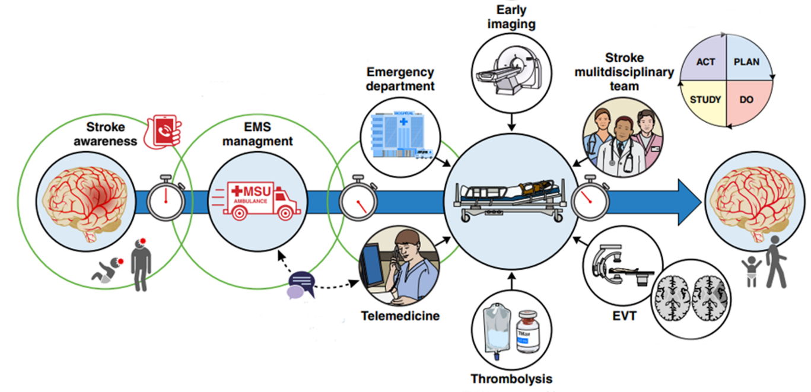
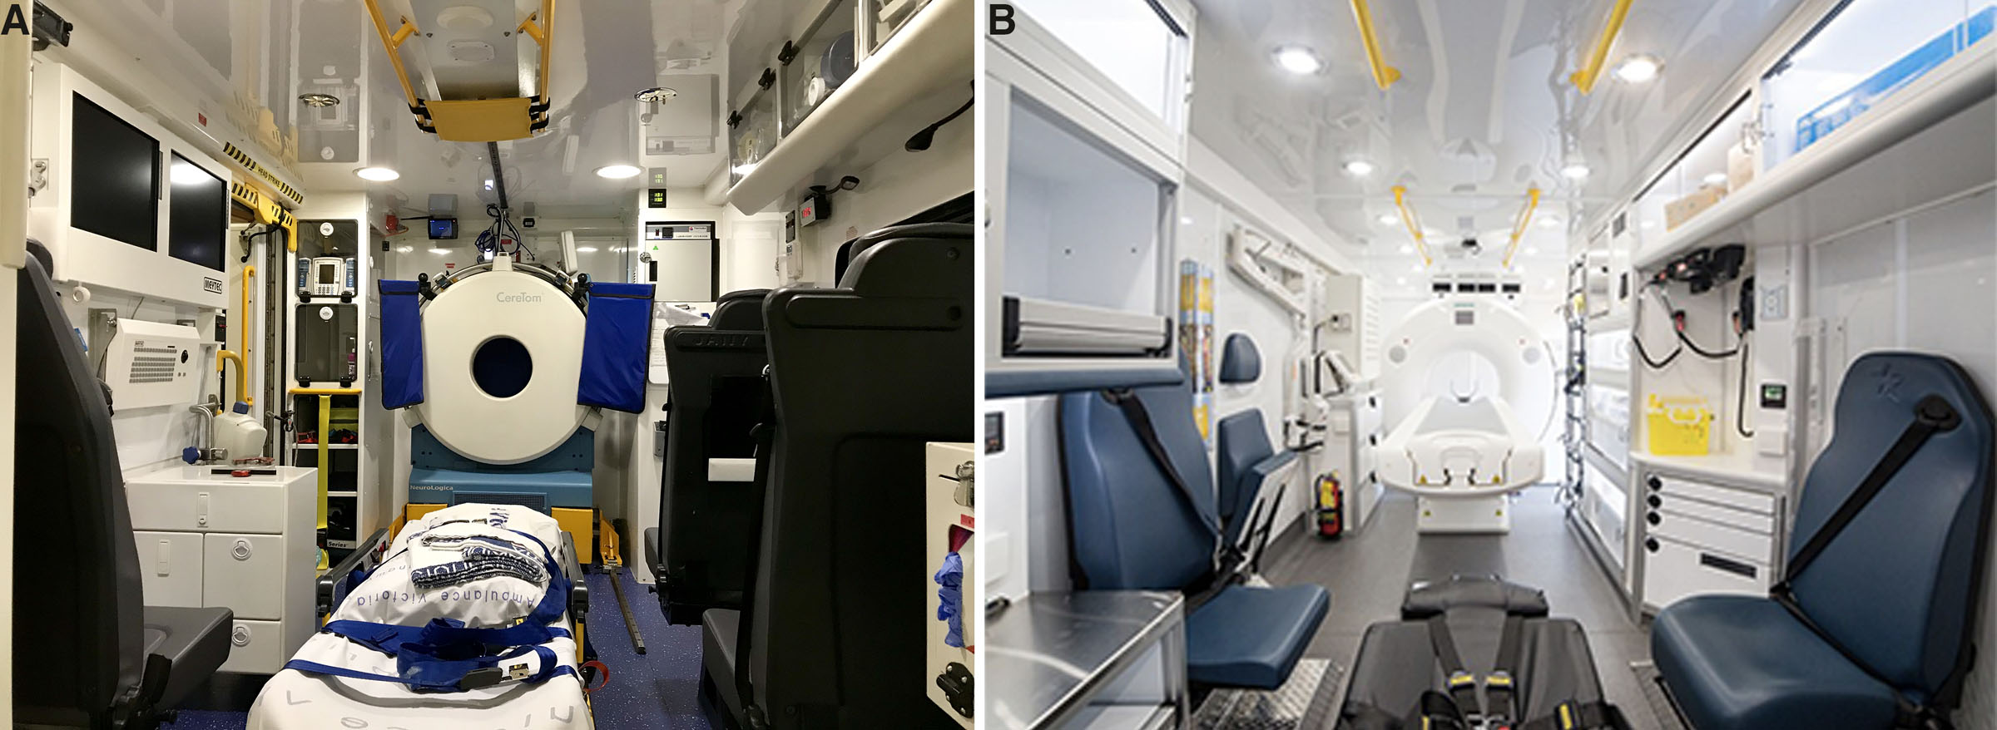
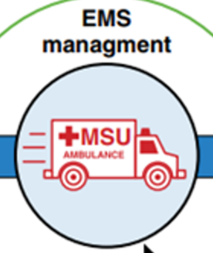
EMS – Areas with Mobile Stroke Units (MSU)
Interior pictures of regular-sized and large mobile stroke units displaying their essential components. Navi, B. B, et al. (2022). Mobile Stroke Units: Evidence, Gaps, and Next Steps. Stroke, 53(6). https://doi.org/10.1161/strokeaha.121.037376
Section | COR | LOE | RECOMMENDATIONS
2.4 | 1 | A | In patients with suspected AIS, the use of MSUs over conventional EMS where available is recommended for the transport and management of thrombolytic-eligible patients to ensure the fastest achievable onset-to-treatment time and improve functional outcomes.
Notes:
New to the guidelines is a COR1, LOE A recommendation to transport patients using mobile stroke units, if available, to ensure the fastest onset to treatment times and ultimately improve functional outcomes. Mobile Stroke Units (MSUs) are specialized ambulances equipped to diagnose and begin treatment for stroke patients in the field. Key features of a MSU include an onboard CT scanner, telemedicine capability, stroke trained personnel, a neurologist (on rig or remote), advanced practice providers, nurse, paramedic, and a radiology technician, point of care testing, and the ability to administer thrombolytics on scene if appropriate.

Slide 12

Interhospital transfers
Section | COR | LOE | RECOMMENDATIONS
2.4 | 1 | B-NR | Hospitals and EMS professionals should establish agreements and protocols to prioritize interhospital transfer of patients with acute stroke needing a higher level of care to reduce door-in-door-out (DIDO) times.
Notes:
Emergency nurses play a critical, hands-on role in inter-hospital stroke transfers, especially when a patient requires escalation to a comprehensive stroke center or thrombectomy capable facility. Their role ensures continuity of care, patient stabilization, and rapid coordination with EMS or other transport providers, which are all essential in time-sensitive stroke cases which facilitates the reduction in door-in-door-out (DIDO) times.

Slide 13
2026 GUIDELINE FOR THE EARLY MANAGEMENT OF PATIENTS WITH AIS
KEY NURSING UPDATES AND REVIEW
Acute Treatment Recommendations

Slide 14

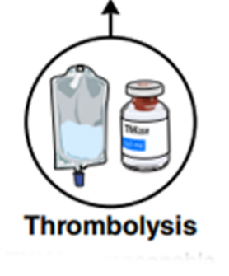
Adult Thrombolysis
Tenecteplase (TNK)
versus Alteplase (tPA)
In adult patients with AIS presenting within 4.5 hours of symptom onset or LKW and eligible for IVT either of the following is recommended to improve functional outcomes:
TNK at a dose of 0.25 mg/kg body weight (max 25 mg) as a single
5-10 second IV bolus.
- or -
tPA at a dose of 0.9 mg/kg body weight (max 90 mg) 10% given as an initial IV bolus and the remaining dose infused IV over 60 minutes
Section | COR | LOE | RECOMMENDATIONS
4.6.2 | 1 | A | In adult patients with AIS presenting within 4.5 hours of symptom onset or last known well and eligible for IVT, tenecteplase at a dose of 0.25 mg/kg body weight (max 25 mg) or alteplase at a dose of 0.9 mg/kg body weight is recommended to improve functional outcomes.
Notes:
Two major updates to thrombolytic administration guidelines significantly impact nursing practice. First, the treatment window has been standardized to 4.5 hours for all eligible AIS patients, eliminating the previous 3-hour distinction. Second, Tenecteplase or TNK is now a Class 1A recommendation, offering some workflow advantages. TNK is administered as a single 5-second bolus, compared to tPA's 1-minute bolus followed by a 60-minute infusion. From a nursing perspective, TNK offers simplification: the entire dose is given as a single 5-10 second push, eliminating the pump setup, line management, and monitoring required during tPA's hour-long infusion that follows the initial bolus. This change reduces medication administration time and allows nurses to focus on other critical aspects of stroke care.

Slide 15
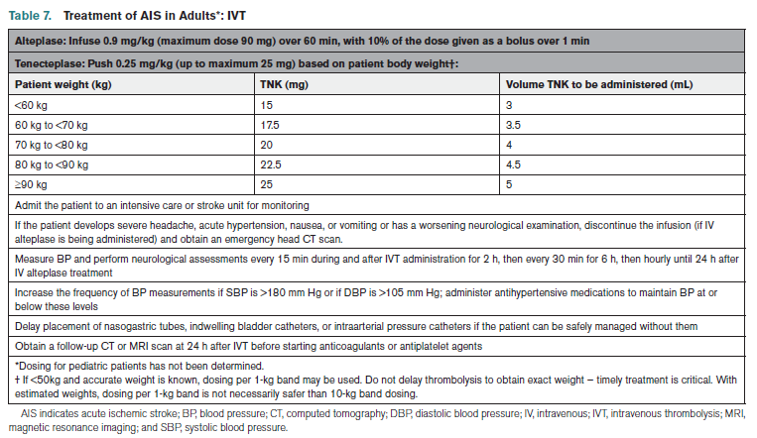
ADULT Thrombolysis – Nursing Review
Thrombolysis Dosing and Care
tPA/Alteplase Dosing:
TNK/Tenecteplase dosing based on a sliding scale weight-based dosing table
Anticipated nursing orders post thrombolytics
Notes:
Table 7 of the Guidelines provides a variety of nursing reminders:
Dosing of tPA or TNK
What to do if the patient experiences signs and symptoms of ICH.
The BP and neuro check assessment schedule – q 15m x 2h, q 30m x 6h, then q1h x 16h for a total of 24 hours of monitoring.
Try to delay placement of invasive catheters and tubes if it can be done so safely.
Repeat a CT or MRI at 24h prior to starting anticoagulants or antiplatelets.

Slide 16
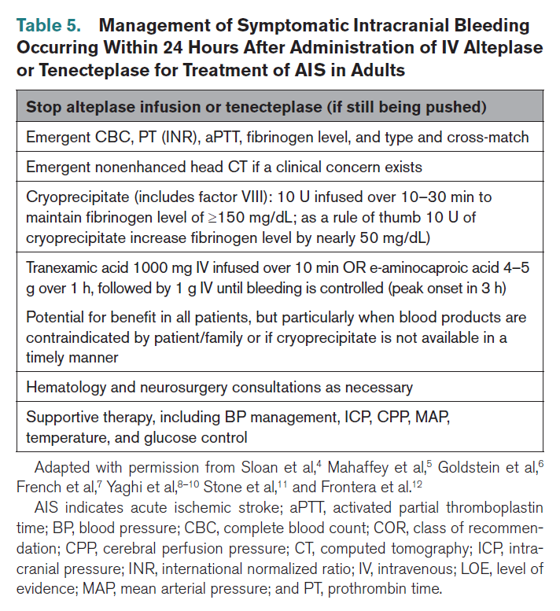
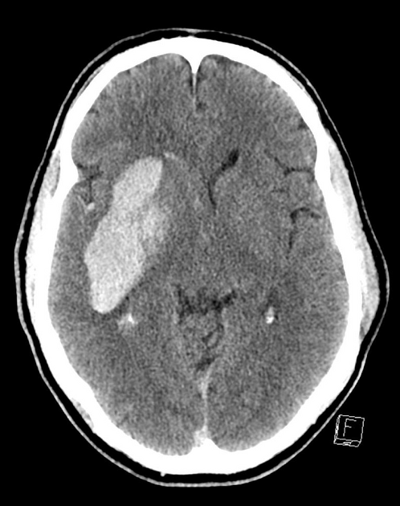
Adult thrombolysis - Nursing Review
Symptomatic intracranial hemorrhage (SICH)
Post thrombolysis symptomatic intracerebral hemorrhage.
Gaillard F, Hemorrhagic transformation of MCA infarct. Case study, Radiopaedia.org; https://doi.org/10.53347/rID-23522
Notes:
Table 5 serves as an essential quick-reference guide for nurses administering thrombolytics, specifically addressing the critical complication of intracranial hemorrhage (ICH). This table provides a systematic approach to post-treatment ICH management, detailing the immediate interventions nurses should initiate and the orders they can anticipate from providers. Use this as a bedside resource to ensure rapid, protocol-driven response in this time-sensitive emergency.

Slide 17
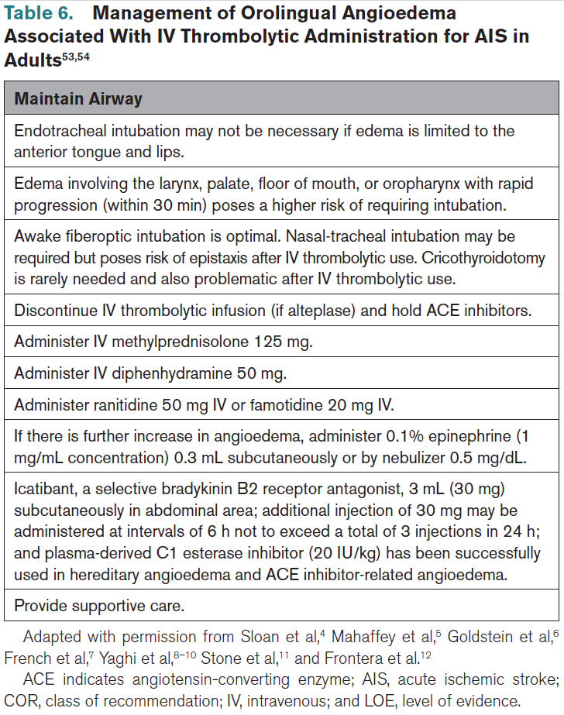
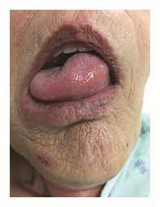
Thrombolysis – Nursing Review
Orolingual Angioedema Management
Chaucer B, Whelan D, Veys C, Upadhyaya M. Angioedema secondary to IV tissue plasminogen activator administration for treatment of acute ischemic stroke. Case Rep Crit Care. 2018;2018:3257215. doi: 10.1155/2018/3257215
Notes:
Table 6 provides essential guidance for managing orolingual angioedema, a rare but serious complication of thrombolytic therapy. Reference this table to identify the treatments and interventions you should anticipate providers ordering if signs of angioedema develop during or after administration.

Slide 18

Adult Thrombolysis
Section | COR | LOE | RECOMMENDATIONS
4.6.3 | 2a | B-R | In patients with AIS who have salvageable ischemic penumbra detected on automated perfusion imaging and who (a) awake with stroke symptoms within 9 hours from the midpoint of sleep or (b) are 4.5-9 hours from last known well, IV thrombolysis may be reasonable to improve functional outcomes.

Slide 19

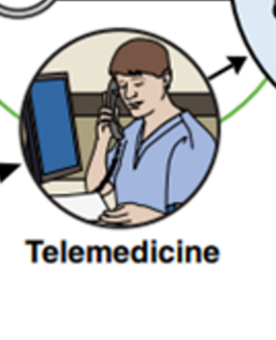
Adult Thrombolysis – TELESTROKE
Section | COR | LOE | RECOMMENDATIONS
2.4 | 1 | B-R | For patients with suspected stroke in the prehospital setting, telemedicine in the ambulance should be considered, when feasible, to complement paramedic assessment to identify candidates for reperfusion interventions.

Slide 20
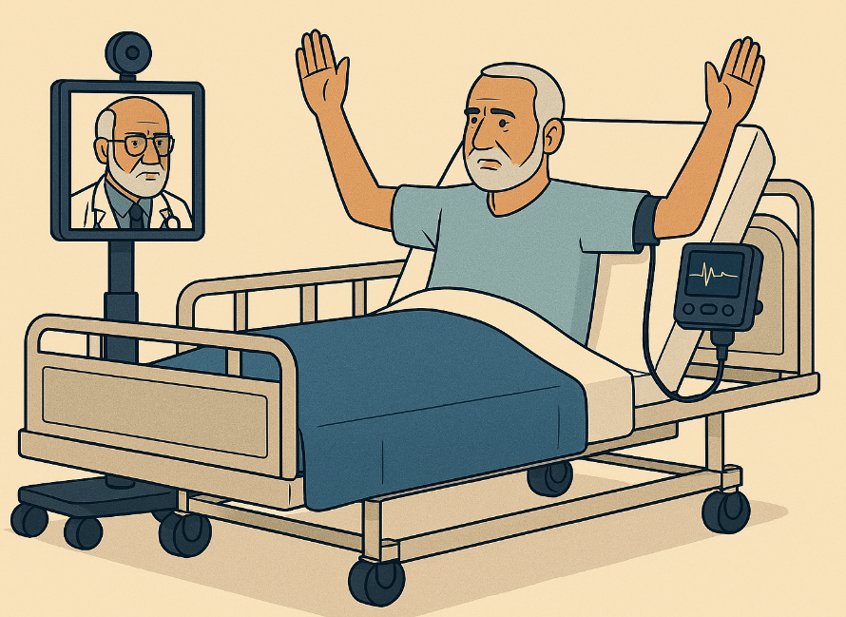
Adult Thrombolysis – TELESTROKE continued
Section | COR | LOE | RECOMMENDATIONS
2.8 | 1 | B-R | For patients with AIS presenting to EDs without acute neurological expertise, telestroke systems are effective over usual care by the ED team for IVT decision-making and optimal thrombolytic delivery including increased thrombolytic administration and shorter time to delivery.
2.8 | 2a | B-NR | For patients with AIS treated at hospitals without local stroke expertise, telestroke is reasonable to reduce short-term mortality.
2.8 | 2a | C-LD | For patients with AIS treated at hospitals without in-house stroke expertise or telestroke capabilities, decision-making support by telephone consultation with a stroke specialist can be beneficial for IVT decision-making and consideration of EVT eligibility.
Notes:
Telestroke has proven effective in expanding access to acute neurologic expertise and increasing thrombolytic administration rates in hospitals without on-site stroke specialists. For facilities lacking both telestroke infrastructure and in-house expertise, telephone consultation with a stroke specialist can provide valuable decision-making support for intravenous thrombolysis (IVT) and endovascular thrombectomy (EVT) consideration and treatment.

Slide 21
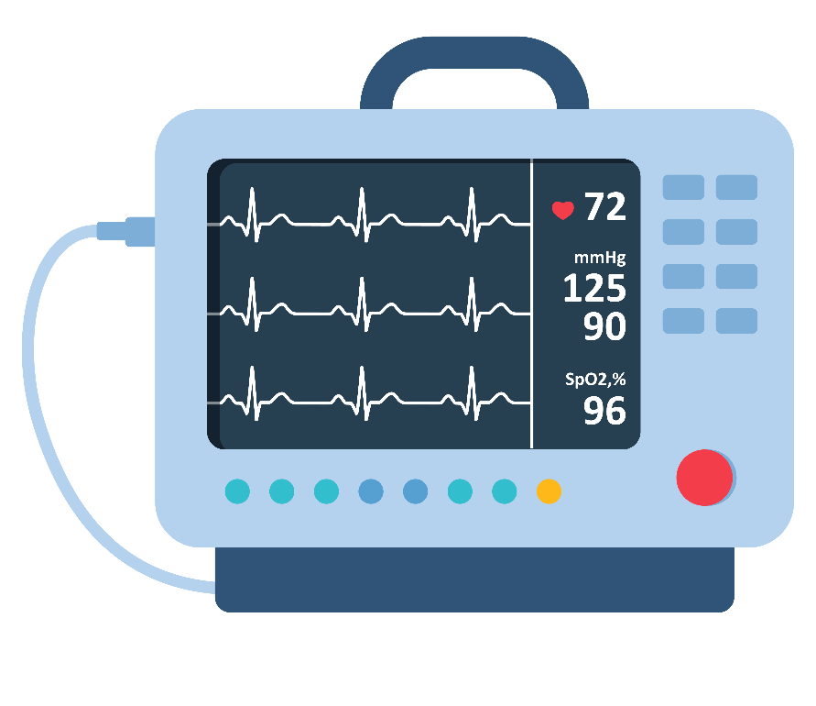
Adult – Blood pressure management after acute treatments
Section | COR | LOE | RECOMMENDATIONS
4.3 | 1 | B-R | BP should be maintained at <180/105 mm Hg for at least the first 24 hours after IVT treatment.
4.3 | 3 No Benefit | B-R | In patients with mild to moderate severity AIS who have been treated with IVT, intensive SBP reduction (target of <140 mm Hg compared with <180 mm Hg) is not recommended because it is not associated with an improvement in functional outcome.
Notes:
Blood pressure management following thrombolytic administration remains critical, with the established target of maintaining BP below 180/105 mm Hg for 24 hours post-treatment. The new guidance specifically addresses aggressive BP lowering: intensive reduction to systolic BP <140 mm Hg is now explicitly not recommended, as randomized trial data show no improvement in functional outcomes. This is a Class 3 recommendation (No Benefit) with Level B-R evidence (moderate-quality randomized data), meaning aggressive BP lowering may expose patients to unnecessary risk without clinical benefit.

Slide 22

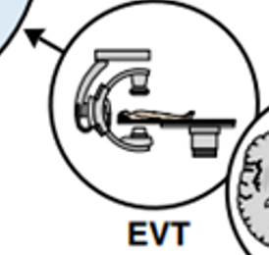
Adult – Blood pressure management after acute treatments continued
Section | COR | LOE | RECOMMENDATIONS
4.3 | 3 Harm | A | In patients with AIS with LVO of the anterior circulation who have been successfully recanalized by endovascular therapy (mTICI 2b, 2c, or 3) and without other indication for blood pressure management target, intensive SBP reduction target of <140 mm Hg for the first 72 hours is harmful and not recommended.
Notes:
This guideline is particularly noteworthy because it explicitly warns against potential harm from overly aggressive intervention—something rarely stated so directly in clinical guidelines. For patients who achieve successful recanalization following large vessel occlusion (LVO) stroke with excellent reperfusion (mTICI score 2b, 2c, or 3), intensive systolic blood pressure reduction to <140 mm Hg during the first 72 hours is harmful and contraindicated. Nurses play a critical role in post-procedural BP management and must recognize that aggressive BP lowering in this specific population can worsen outcomes, likely by compromising perfusion to newly recanalized tissue.

Slide 23
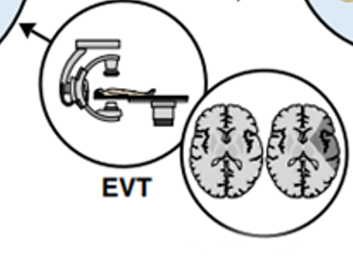
Adult EVT - Basilar Criteria
Section | COR | LOE | RECOMMENDATIONS
4.7.3 | 1 | A | In patients with AIS, with basilar artery occlusion, a baseline mRS score of 0 to 1, NIHSS score ≥10 at presentation, and PC-ASPECTS ≥6 (mild ischemic damage), EVT within 24 hours from onset of symptoms is recommended to achieve better functional outcome and reduce mortality.
Notes:
Basilar artery occlusions are among the most devastating types of ischemic stroke, often resulting in severe disability or death. New guidelines extend the endovascular thrombectomy treatment window to 24 hours for carefully selected patients meeting specific baseline criteria. These include the prestroke modified Rankin Scale (mRS) score, the presenting stroke severity (NIHSS), the imaging ASPECTS score. Nurses can play a vital role by collecting accurate baseline functional status which can directly impact treatment eligibility for these critically ill patients.

Slide 24
2026 GUIDELINE FOR THE EARLY MANAGEMENT OF PATIENTS WITH AIS
KEY NURSING UPDATES AND REVIEW
Post Acute Recommendations

Slide 25

DUAL Antiplatelet treatment for Minor AIS and High-Risk TIA
Section | COR | LOE | RECOMMENDATIONS
4.8 | 2a | B-R | In patients with minor (NIHSS score ≤5) noncardioembolic AIS or high-risk TIA (ABCD2 score >4) within 24 to 72 hours from stroke onset, or NIHSS score of 4 to 5 within 24 hours from onset, who did not receive IVT, with presumed atherosclerotic cause (>50% stenosis of intracranial or extracranial stenosis that was likely to have accounted for clinical presentation or acute new infarctions on imaging of presumed large artery atherosclerosis origin), DAPT (clopidogrel and aspirin) for 21 days followed by SAPT is reasonable to reduce the 90-day risk of recurrent stroke.
Notes:
Nurses should be aware that early DAPT may be ordered for eligible patients and recognize that, when used, prompt administration is as time-sensitive as any other acute stroke treatment—early secondary prevention can begin in the emergency department.

Slide 26
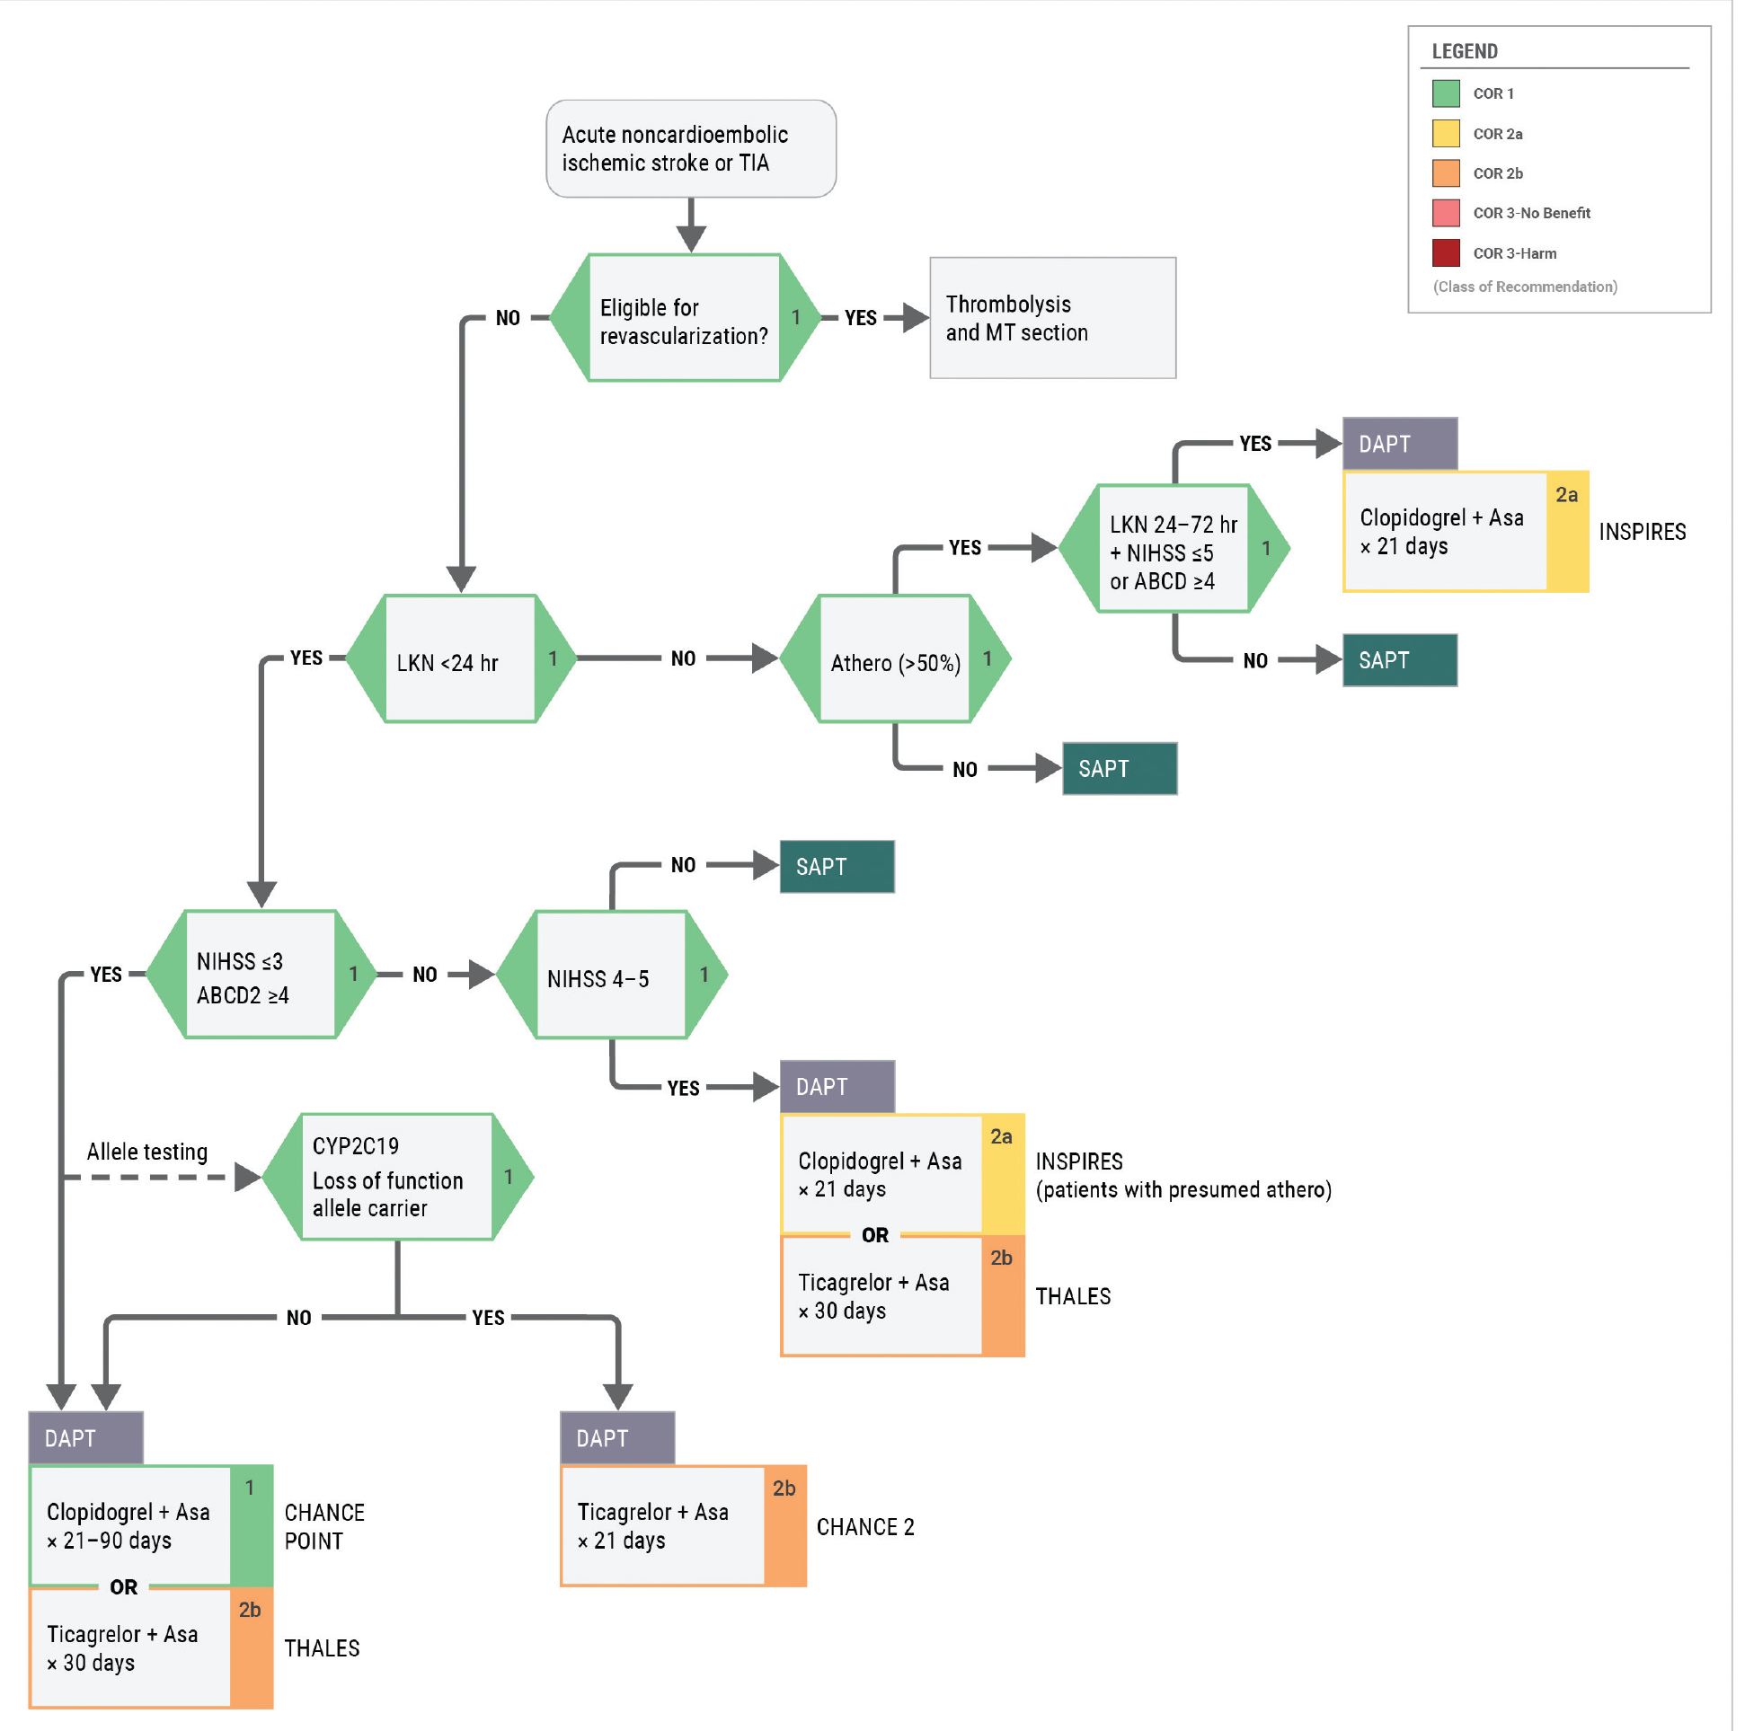
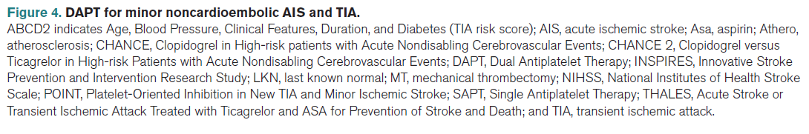
dual antiplatelet therapy for minor noncardioembolic ais and high-risk tia
Notes:
DUAL ANTIPLATELET THERAPY FOR MINOR AIS AND HIGH-RISK TIA
Figure 4 presents a clinical decision pathway illustrating how prescribing providers determine the most appropriate antiplatelet therapy for patients with minor noncardioembolic stroke or high-risk TIA. This evidence-based algorithm demonstrates the clinical reasoning behind choosing between single antiplatelet therapy (SAPT) and dual antiplatelet therapy (DAPT), drawing on results from multiple randomized trials. Nurses are encouraged to reference this flowchart to build clinical understanding of antiplatelet selection, recognize how patient-specific factors—such as time from symptom onset, and stroke

Slide 27
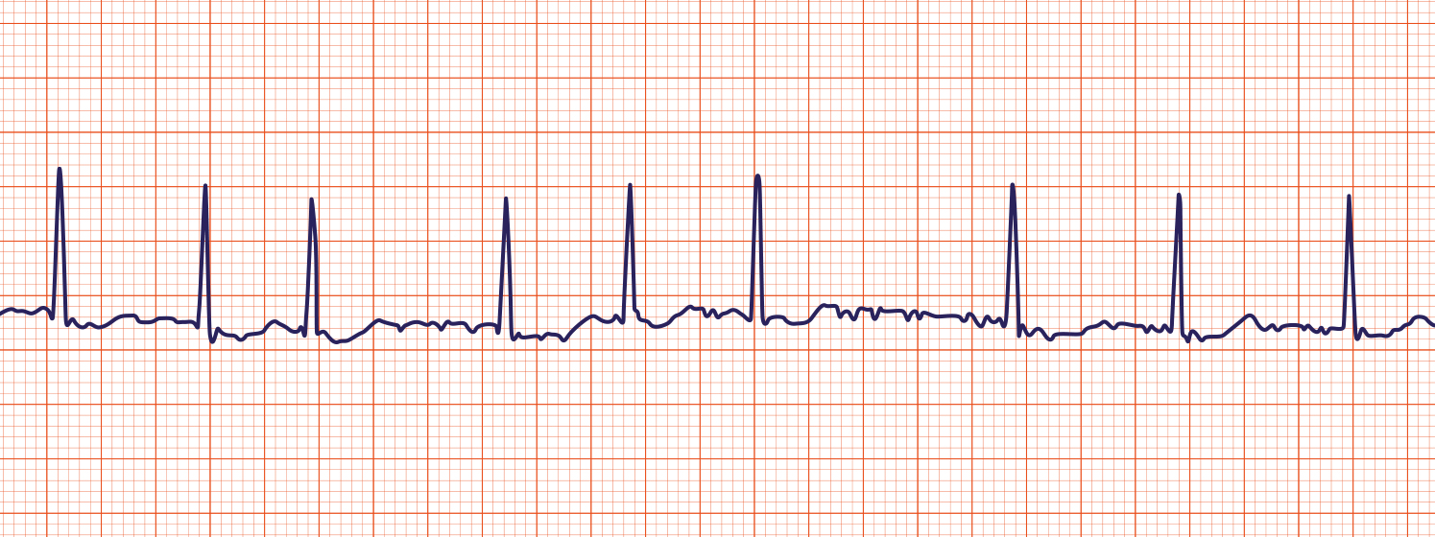
Early Anticoagulation and Atrial Fibrillation
Section | COR | LOE | RECOMMENDATIONS
4.9 | 2a | A | In carefully selected (eg, milder severity) patients with AIS with atrial fibrillation, a strategy of early oral anticoagulation poststroke is low risk and is reasonable compared with a strategy of delayed anticoagulation, although the efficacy of early anticoagulation for prevention of early recurrent stroke is not established.
Source: ACLS Medical Training
Notes:
Anticoagulation for atrial fibrillation-related stroke has long presented a clinical dilemma: when is it safe to start? Clinicians have historically delayed initiation due to concern about precipitating hemorrhagic transformation in injured brain tissue. New guidelines provide evidence-based clarity: for patients with AF and milder stroke severity, early oral anticoagulation (within days rather than weeks) carries low bleeding risk and is reasonable compared to delayed strategies. This is a Class 2a recommendation with Level A evidence, meaning high-quality data support this approach. Important caveat: while early initiation appears safe, its effectiveness in preventing early recurrent stroke remains unproven—the recommendation is based on safety data, not demonstrated superior efficacy.
Nursing practice implications: Expect to see anticoagulation orders initiated sooner than in the past—often within 4-14 days post-stroke depending on severity. Nurses should anticipate patient and family questions about why blood thinners are being started "so soon" after a stroke and be prepared to explain that recent evidence supports earlier initiation as safe. Continue vigilant neurological monitoring for signs of hemorrhagic conversion, particularly in the first 24-48 hours after anticoagulation begins. Patient education about medication adherence, bleeding precautions, and fall prevention becomes critical earlier in the hospital course.

Slide 28

Head Positioning
Section | COR | LOE | RECOMMENDATIONS
4.2 | 3 No Benefit | B-R | In patients with AIS, there is no benefit of 0-degree head positioning compared with 30 degrees for 24 hours, to improve functional outcome.
4.2 | 3 No Benefit | B-R | In patients with AIS with probable large artery atherosclerosis etiology for whom no reperfusion intervention is available, there is no benefit of routine Trendelenburg positioning (-20 degrees) compared with 0- to-30 degree head positioning to improve functional outcome.
Notes:
Head-of-bed positioning is a fundamental nursing intervention you perform multiple times per shift for stroke patients. Previous guidelines left this decision uncertain, leading to varied practice patterns and questions about optimal positioning. The updated guidelines now provide clear, evidence-based direction that should simplify your practice.
What the evidence shows: For acute ischemic stroke patients, flat (0-degree) positioning offers no functional outcome benefit compared to the standard 30-degree elevation over 24 hours. Similarly, for patients with large artery atherosclerosis who aren't candidates for reperfusion therapy, Trendelenburg positioning (-20 degrees) provides no benefit over the typical 0-30 degree range. This is a Class 3 recommendation with Level B-R evidence—meaning moderate-quality randomized data definitively shows no benefit from these alternative positioning strategies.
What this means for your practice:
You can position acute stroke patients at 30 degrees—the standard comfortable position—without concern you're compromising cerebral perfusion.
There's no need for labor-intensive frequent repositioning or maintaining uncomfortable flat positioning.
Trendelenburg positioning is not indicated and should not be routinely used.
You can prioritize patient comfort, aspiration prevention, and ease of care without sacrificing neurological outcomes.

Slide 29
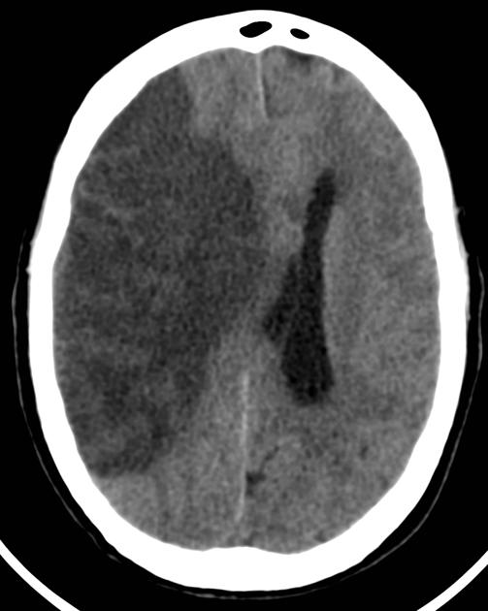
Brain Swelling
Section | COR | LOE | RECOMMENDATIONS
6.1 | 1 | C-EO | In patients with large cerebral or cerebellar infarctions, close monitoring of the patient for signs of neurological worsening during the first days after stroke is recommended to rapidly evaluate the need for potential interventions.
6.1 | 1 | C-EO | In patients with large cerebral or cerebellar infarctions who are at increased risk for malignant brain swelling, early transfer to an institution with appropriate neurosurgical and critical care expertise is recommended to ensure timely treatment.
6.2 | 3 Harm | C-LD | In patients with large cerebral or cerebellar infarctions and brain swelling, hypothermia, barbiturates, or corticosteroids should not be administered to treat brain swelling due to the lack of evidence of efficacy and potential of increased adverse effects.
6.2 | 3 No Benefit | B-R | In patients with large hemispheric infarction aged 18 to 70 years, the use of IV glibenclamide does not result in improved functional outcome and is not recommended.
Right MCA stroke with cerebral edema and midline shift.
Hsu C, Subfalcine herniation from complete MCA infarct, complicated by ACA infarct. Case study, Radiopaedia.org https://doi.org/10.53347/rID-19973
Notes:
When caring for patients with large cerebral or cerebellar infarctions, your nursing vigilance can be life-saving. These patients are at high risk for malignant brain swelling, which typically develops 24-72 hours post-stroke and can rapidly become fatal without intervention.
Your critical role in monitoring: Close, frequent neurological assessments during the first days after large strokes are essential—you are often the first to detect subtle changes indicating deterioration. Watch for:
Declining level of consciousness or increasing lethargy
New or worsening headache
Pupillary changes or loss of previously intact reflexes
Worsening motor deficits or new focal signs
Vital sign changes suggesting increased intracranial pressure (Cushing's triad)
Early recognition allows for timely neurosurgical evaluation and potential life-saving interventions like decompressive hemicraniectomy.
Transfer considerations: If your facility lacks neurosurgical capabilities or neuro-ICU expertise, advocate for early transfer of high-risk patients before they deteriorate. Don't wait for obvious signs of herniation—proactive transfer to a comprehensive stroke center ensures access to neurosurgical intervention when the therapeutic window is still open.
What NOT to do: Although based on limited data, the guidelines explicitly state that certain interventions are NOT recommended for treating brain swelling in stroke patients:
Hypothermia protocols – no proven benefit, potential complications
Barbiturate coma – ineffective and increases adverse effects
Corticosteroids (steroids) – do not help vasogenic edema from stroke and worsen outcomes
IV glibenclamide – does not improve functional outcomes in large hemispheric infarctions
If you see orders for these interventions specifically for stroke-related edema management, this represents outdated practice.
Your advocacy matters: Know your facility's capabilities and transfer protocols. For large strokes, early escalation of care—whether through transfer or neurosurgery consultation—can mean the difference between survival and death. Your assessment skills and timely communication with providers directly impact patient outcomes in this high-risk population.

Slide 30
2026 GUIDELINE FOR THE EARLY MANAGEMENT OF PATIENTS WITH AIS
KEY NURSING UPDATES AND REVIEW
General Supportive Care Recommendations

Slide 31
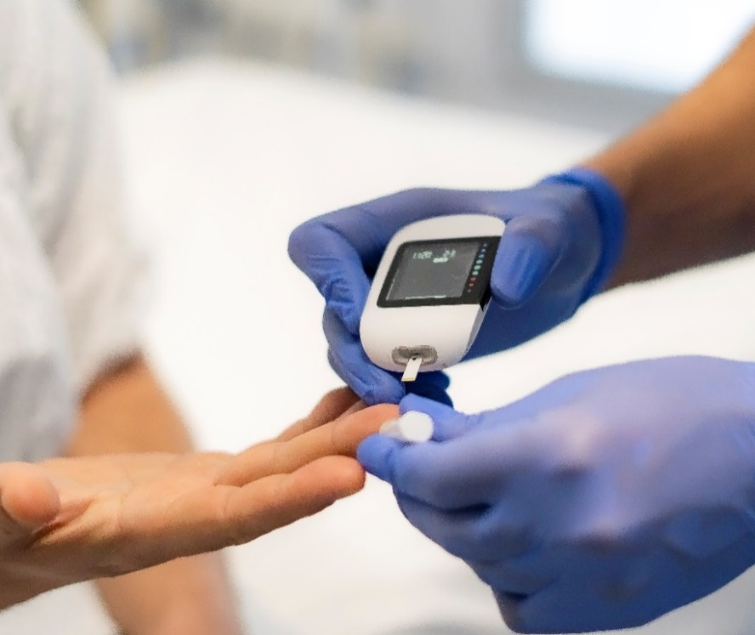
Blood Glucose Monitoring
Section | COR | LOE | RECOMMENDATIONS
4.5 | 1 | C-LD | In patients with AIS, hypoglycemia (blood glucose <60 mg/dL) should be treated to avoid complications.
4.5 | 2a | C-LD | In patients with AIS, it is reasonable to treat persistent hyperglycemia to achieve blood glucose levels in a range of 140 to 180 mg/dL with close monitoring to prevent worse functional outcomes.
4.5 | 3 No Benefit | A | In hospitalized patients with AIS with hyperglycemia, treatment with IV insulin to achieve blood glucose levels in the range of 80 to 130 mg/dL is not recommended to improve 3-month functional outcomes.
Notes:
Blood glucose management is a core nursing responsibility in acute stroke care, and you perform this intervention multiple times per shift. The guidelines provide clear, evidence-based targets that should shape your assessment and treatment protocols.
Established recommendations:
Hypoglycemia (<60 mg/dL) requires treatment. Low blood glucose worsens brain injury and must be corrected promptly. This is standard practice—treat with your facility's hypoglycemia protocol. (COR 1; LOE C-LD)
Persistent hyperglycemia should be treated to maintain glucose between 140-180 mg/dL. This range balances the harm of hyperglycemia against the risks of aggressive lowering. Elevated glucose increases infarct size, hemorrhagic transformation risk, and worsens outcomes—but tight control has its own dangers. (COR 2a; LOE C-LD)
NEW GUIDELINE UPDATE – Critical change to practice:
Aggressive IV insulin protocols targeting 80-130 mg/dL are NOT recommended and do not improve 3-month functional outcomes. This represents a significant shift from previous intensive glucose management strategies you may have used in the past. (COR 3; LOE A)

Slide 32
Depression
Section | COR | LOE | RECOMMENDATIONS
5.5 | 1 | B-NR | In patients with AIS, administration of a structured depression inventory is recommended to routinely screen for poststroke depression (PSD), although the optimal timing of screening is uncertain.¹⁻⁴
5.5 | 1 | B-NR | In patients diagnosed with PSD, treatment with antidepressants and/or nonpharmacological interventions (ie, psychotherapy, noninvasive brain stimulation, acupuncture) is recommended to improve depressive symptoms.⁵⁻¹⁷
Notes:
In 2024, a meta-analysis of studies evaluating 10 depression screening tools (32 studies, N=3865) found that each scale had different degrees of benefit in diagnosing PSD based on depression type and time of screening. The Patient Health Questionnaire-9 (PHQ-9) demonstrated higher diagnostic accuracy when evaluating any PSD type and during the first 2 months after stroke. Higher diagnostic accuracy was noted with the Hamilton Depression Scale (HDS) in the chronic phase (>2 months) after stroke and in the major depression classification. Due to the heterogeneity of studies included, data were insufficient to assess PSD in patients with combined aphasia and cognitive impairments.
Post-stroke depression affects 30-50% of stroke survivors and significantly impacts rehabilitation outcomes, yet it often goes unrecognized. As bedside nurses, you spend the most time with patients and are uniquely positioned to identify early signs of depression—withdrawal, tearfulness, poor engagement in therapy, appetite changes, or expressions of hopelessness.
Depression screening shouldn't be a one-time checkbox at admission. Integrate brief depression assessment throughout the hospital stay and communicate concerns to the interdisciplinary team. Early identification and treatment of post-stroke depression improves not just mood, but also functional recovery, rehabilitation participation, and long-term outcomes. Your observations and screening efforts are essential first steps in addressing this common but under-treated complication.

Slide 33
Nutrition
Section | COR | LOE | RECOMMENDATIONS
5.3 | 1 | B-R | In patients with AIS, enteral diet should be started within 7 days of admission after an AIS.
5.3 | 1 | B-NR | In patients with AIS, nutritional screening is recommended to direct nutritional management early into hospitalization, preferably within 48 hours of admission, with a nutritional screening or assessment tool that has been validated in patients with acute stroke.
5.3 | 2a | B-NR | In patients with AIS with dysphagia, it is reasonable to use nasogastric tubes initially for feeding within the first 7 days and to place percutaneous gastrostomy tubes in patients with longer anticipated persistent inability to swallow safely (>2–3 weeks).
Notes:
While not new to the guidelines, nutrition management in acute stroke remains a critical nursing responsibility that directly impacts patient outcomes. These evidence-based recommendations should guide your daily practice and advocacy for appropriate nutritional support.
Early nutrition is essential—start enteral feeding within 7 days of admission. Malnutrition develops quickly after stroke and worsens recovery, increases infection risk, and prolongs hospital stays. Don't let patients go days without adequate nutrition while "waiting to see" if swallowing improves.
Formal nutritional screening should occur within 48 hours of admission using a validated stroke-specific tool.
Feeding tube decisions—timing matters:
For patients with dysphagia, the type of feeding tube depends on anticipated duration:
Nasogastric (NG) tubes are appropriate initially and for the first 7 days. These are your go-to for short-term feeding needs. Don’t delay nutrition awaiting "something more permanent.” COR: 2a; LOE: B-NR
Percutaneous gastrostomy (PEG) tubes are indicated when dysphagia is expected to persist beyond 2-3 weeks. If speech therapy assessment suggests prolonged swallowing impairment, initiate early discussion about PEG placement rather than leaving an NG tube in for weeks. Long-term NG tubes are uncomfortable, increase aspiration risk from oral secretions, and delay rehabilitation progress. COR: 2a; LOE: B-NR

Slide 34
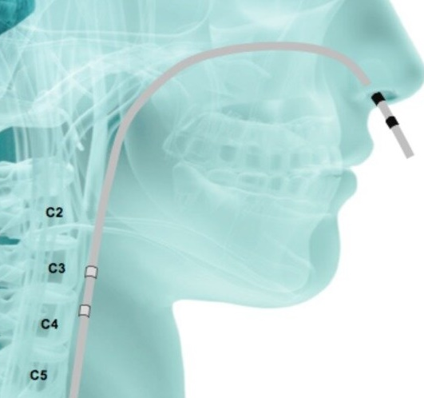
Dysphagia
Section | COR | LOE | RECOMMENDATIONS
5.2 | 2a | B-R | In patients with stroke with dysphagia, treatment with pharyngeal electrical stimulation (PES), can be beneficial to reduce dysphagia severity and decrease the risk of aspiration.
Restivo, Domenico & Hamdy, Shaheen. (2018). Pharyngeal electrical stimulation device for the treatment of neurogenic dysphagia: technology update. Medical Devices: Evidence and Research. 11. 21-26. 10.2147/MDER.S122287.
Notes:
Pharyngeal electrical stimulation (PES) represents a new opportunity in dysphagia management that has direct implications for your bedside care. The PHADER trial (2020) demonstrated that this therapy significantly reduces dysphagia severity, aspiration risk, and hospital length of stay, with more patients able to safely return to oral diet compared to standard care.
PES is delivered through a specialized nasogastric catheter that provides targeted electrical stimulation to the pharyngeal muscles while simultaneously functioning as a standard feeding tube. The treatment protocol involves 3 consecutive days of once-daily stimulation sessions—a short, focused intervention during the critical early recovery window. The catheter functions like a regular NG tube between stimulation sessions—you can administer medications and tube feedings through it as usual. Treatments are typically delivered by trained personnel (RT, SLP, or specially trained RNs depending on facility protocol). Nurses should continue to monitor patients for tolerance during and after stimulation sessions, as well as continuing standard aspiration precautions and oral care.

Slide 35
Early Mobilization
Section | COR | LOE | RECOMMENDATIONS
5.7 | 3 Harm | B-R | In patients with AIS, high-dose, very early mobilization within 24 hours of stroke onset is not recommended to improve the odds of a favorable outcome at 3 months and may be harmful.
Notes:
AVERT (A Very Early Rehabilitation Trial) High-dose mobilization protocol interventions included the following: mobilization was initiated within 24 hours of stroke onset, whereas usual care typically was 24 hours after the onset of stroke; there was a focus on sitting, standing, and walking activity in the intervention arm; and there were at least 3 additional out-of-bed sessions compared with usual care. 8% versus 7% (p 0.004) of patients died in the very early mobilization group, and 19% versus 20% had a nonfatal serious adverse event with high-dose, very early mobilization.
While early mobilization is generally beneficial in hospitalized patients, aggressive very early mobilization in acute stroke patients can actually cause harm.

Slide 36
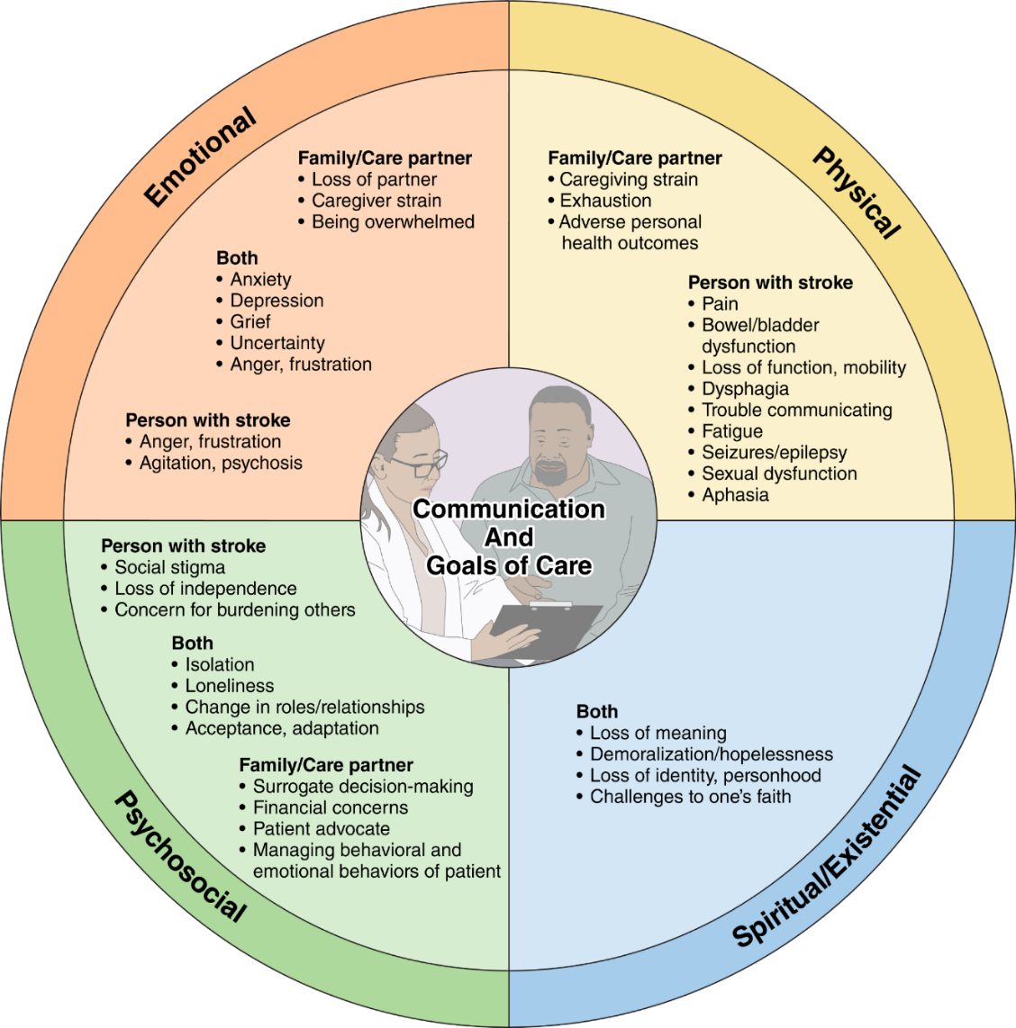
Palliative Care
Section | COR | LOE | RECOMMENDATIONS
5.6 | 2a | C-EO | For select patients with AIS and their families, referral to palliative care resources is reasonable as appropriate.
Notes:
It is reasonable for health care professionals to ascertain and include patient-centered preferences in decision-making, especially during prognosis formation and considering interventions or limitations in care.
Reference for infographic: Creutzfeldt CJ, et.al. Palliative and End-of-Life Care in Stroke: A Scientific Statement From the American Heart Association. Stroke. 2024 Dec 16. doi: 10.1161/STR.0000000000000479.

Slide 37
Multidisciplinary Management
Assessment & Monitoring
Clinical
Management
(First 5 days)
Discharge
Planning
Rehabilitation
Assessment of stroke diagnosis/mechanism by specialized stroke provider
Assessment and monitoring by nurses with continuous specialized training in stroke
Stroke mechanism treatment planning
Standardized acute stroke care order sets utilization
Physical and medical complications management guided by clinical practice guidelines/protocols
Early rehabilitation assessment and mobilization by the
stroke team
Multidisciplinary team care to include nursing and caregivers with weekly meetings
Early goal setting and onset of rehabilitation by physical, occupational, and speech therapy
Integration with specialized rehabilitation nursing care and caregivers
Collaborative planning with interdisciplinary clinical team
Early assessment of discharge needs
Integration of patient and caregivers with a focus on continued education support
Coordination of follow-up care
Notes:
Coordination of high-quality clinical care requires a well-organized, multidisciplinary care team. To ensure that optimal care is provided to every patient, care protocols or pathways with detailed instructions, is logical.

