Slide 1
2026 AHA/ACC/ADA/ASN Guideline for the Prevention, Detection, Evaluation, and Management of Cardiovascular-Kidney-Metabolic Syndrome
A Report of the American College of Cardiology/American Heart Association Joint Committee on Clinical Practice Guidelines
Developed in Collaboration With and Endorsed by the American Diabetes Association, the Obesity Association, a division of the American Diabetes Association, and the American Society of Nephrology

Slide 2
Citation
This slide set is adapted from the 2026 AHA/ACC/ADA/ASN Guideline for the Prevention, Detection, Evaluation, and Management of Cardiovascular-Kidney-Metabolic Syndrome. Published ahead of print, June 9, 2026, available at: Circulation. www.ahajournals.org/doi/10.1161/CIR.0000000000001453 And Journal of the American College of Cardiology, published online ahead of print, June 9, 2026. J Am Coll Cardiol. https://www.jacc.org/doi/10.1016/j.jacc.2026.03.056
© 2026 the American Heart Association, Inc. and the American College of Cardiology Foundation. All rights reserved. This article has been published in Circulation and the Journal of the American College of Cardiology.

Slide 3
2026 Writing Committee Members*
Chiadi E. Ndumele, MD, PhD, MHS, FAHA, Chair
Fatima Rodriguez, MD, MPH, FAHA, FACC, Vice Chair
Dave L. Dixon, PharmD, FAHA, FACC, BCACP, CLS, JC Liaison†
Sadiya S. Khan, MD, MSc, FAHA, FACC, JC Liaison†
Debabrata Mukherjee, MD, MS, FAHA, FACC, JC Liaison‡
Mandeep Bajaj, MBBS, FAHA§
Sripal Bangalore, MD, MHA, FAHA, FACC
Biykem Bozkurt, MD, PhD, FAHA, FACC
Khadijah Breathett, MD, MS, FAHA, FACC
Shoa L. Clarke, MD, PhD, FAHA
Ian H. de Boer, MD, MS, FAHA║
David H. Ellison, MD, FASN, FAHA
Lorraine S. Evangelista, PhD, RN, FAHA
Sean P. Heffron, MD, MS, MSc, FAHA
Dhruv S. Kazi, MD, MSc, MS, FAHA, FACC
Ambar Kulshreshtha, MD, PhD, FAHA
Ildiko Lingvay, MD, MPH, MSCS, FAHA¶
Cecilia C. Low Wang, MD, FAHA
Claudia A. Mercado#
John Magaña Morton, MD, MPH, MHA, FAHA
Ian J. Neeland, MD, FAHA
Neha Pagidipati, MD, MPH, FAHA, FACC
Tiffany M. Powell-Wiley, MD, MPH, FAHA
Janani Rangaswami, MD, FAHA
Goutham Rao, MD, FAHA
Nosheen Reza, MD, FAHA, FACC**
Anum Saeed, MD, FAHA
Wendy St. Peter, PharmD, FAHA
J. Bradley Starks#
Madeline Sterling, MD, MPH, FAHA
Amy W. Talbot, MPH††
Andrew H. Tran, MD, MPH, MS, FAHA
Katherine R. Tuttle, MD, FASN, FAHA
Lisa B. VanWagner, MD, MSc, FAHA
Amanda R. Vest, MBBS, MPH, FAHA, FACC
Salim S. Virani, MD, PhD, FAHA, FACC
*Writing committee members are required to recuse themselves from voting on sections to which their specific relationships with industry may apply; see Appendix 1 for detailed information. †ACC/AHA Joint Committee on Clinical Practice Guidelines liaison. ‡Former ACC/AHA Joint Committee on Clinical Practice Guidelines member; current member during the writing effort. §ADA representative. ║ASN representative. ¶ADA Obesity Alliance representative. #Patient advocate representative. **JCPM representative. ††Former AHA/ACC joint staff; current staff member during the writing effort.

Slide 4
Top Take-Home Messages

Slide 5
Top Take-Home Messages
1. Cardiovascular-Kidney-Metabolic Syndrome Staging: Cardiovascular-kidney-metabolic (CKM) syndrome staging is recommended for youths and adults to prevent CKM stage progression, to tailor therapy to absolute risk, to reduce cardiovascular events and loss of kidney function across the life course, and to promote CKM stage regression through lifestyle changes and weight loss.

Slide 6
Top Take-Home Messages
2. Quantify Risk Using the PREVENT Equations: Individuals at risk for cardiovascular disease (CVD) (CKM syndrome stage 0-3) should have their risk quantified with the PREVENT (Predicting Risk of Cardiovascular Disease EVENTS) equations to estimate 10- and 30-year risk for atherosclerotic cardiovascular disease (ASCVD), heart failure (HF), and total CVD. PREVENT estimates inform CKM syndrome staging, with ≥20% predicted 10-year CVD risk serving as 1 criterion for CKM syndrome Stage 3. A ≥7.5% predicted 10-year CVD risk further informs the prioritization of pharmacotherapies for the treatment of CKM syndrome.

Slide 7
Top Take-Home Messages
3. Routinely Assess for CKM Risk Factors: Routine assessments for metabolic risk factors and kidney function are recommended among all adults, as well as selected assessments for pre-HF, metabolic dysfunction–associated steatotic liver disease (MASLD), and obstructive sleep apnea (OSA) in subsets of individuals.

Slide 8
Top Take-Home Messages
4. Evaluate and Address Social Determinants of Health: Routine assessments for social determinants of health (SDOH) that are closely linked with the development of CKM syndrome and its complications are recommended. Addressing adverse SDOH when identified is a key component of holistic care for CKM syndrome.

Slide 9
Top Take-Home Messages
5. Emphasize Interdisciplinary Care With a CKM Coordination Point Person: Use of interdisciplinary care models for those with overlap among the CKM conditions of type 2 diabetes (T2D), chronic kidney disease (CKD), and CVD is recommended to facilitate patient-centered care. The need for a point person is emphasized, to coordinate efforts of the CKM interdisciplinary team, to facilitate implementation of evidence-based care and guideline-directed medical therapy (GDMT), and to support patients and clinicians.

Slide 10
Top Take-Home Messages
6. Assess and Treat Overweight and Obesity: Assessments for overweight/obesity and abdominal adiposity with both body mass index (BMI) and waist circumference are recommended to characterize risk related to excess adiposity. Overweight and obesity should be addressed to prevent CKM syndrome progression and to promote CKM syndrome regression. Support for lifestyle modification is emphasized, with adjunctive use of obesity pharmacotherapies and metabolic and bariatric surgery as needed to facilitate weight loss.

Slide 11
Top Take-Home Messages
7. Utilize Cardioprotective Antihyperglycemic Therapies in Diabetes: Among patients with T2D with CVD or at increased risk for CVD, in addition to lifestyle modification, weight management, and risk factor control, utilization of cardioprotective antihyperglycemic GDMT is recommended, including sodium–glucose cotransporter-2 inhibitors (SGLT2i), glucagon-like peptide-1 (GLP-1)–based therapy, or both, to improve cardiovascular and kidney outcomes. The choice of agent should be guided by clinical comorbidities such as CKD, ASCVD, HF, obesity, severe hyperglycemia, and MASLD.

Slide 12
Top Take-Home Messages
8. Assess for CKD and Utilize Kidney Protective Agents: Use of both estimated glomerular filtration rate (eGFR) and urine albumin-to-creatinine ratio (UACR) is recommended to characterize CKD and guide the use of kidney-protective agents to confer both cardiovascular and kidney benefits. For patients with CKD and T2D or CKD and albuminuria, renin-angiotensin system inhibitors (RASi) and SGLT2i should be used as first-line therapy. If albuminuria persists among patients with CKD and T2D, nonsteroidal mineralocorticoid receptor antagonist (MRA) or a GLP-1–based therapy should be added for further kidney and cardiovascular protection.

Slide 13
Top Take-Home Messages
9. Address CKM Risk Factors in Patients With ASCVD: Management of ASCVD should emphasize CKM syndrome comorbidities, including obesity treatment through lifestyle modification, pharmacotherapy, and, when appropriate, metabolic and bariatric surgery; the use of cardioprotective antihyperglycemic agents for T2D; and the use of kidney-protective agents for CKD to reduce the risk for adverse cardiovascular events and loss of kidney function.

Slide 14
Top Take-Home Messages
10. Address CKM Risk Factors in Patients with HF: CKM factors should be incorporated into HF management. For HF with reduced ejection fraction (HFrEF), emphasize the cardiovascular and kidney benefits of RASi (angiotensin receptor-neprilysin inhibitors [ARNI], angiotensin-converting enzyme inhibitors [ACEi], angiotensin II receptor blockers [ARB]) and SGLT2i as part of quadruple therapy with beta blockers and steroidal mineralocorticoid receptor antagonists (MRAs). For HF with mildly reduced ejection fraction/preserved ejection fraction (HFmrEF/HFpEF), use SGLT2i as first-line GDMT, add GLP-1–based therapies in patients with obesity or other CKM risk factors, and consider nonsteroidal MRAs in those with T2D and CKD to reduce adverse cardiovascular events and loss of kidney function.

Slide 15
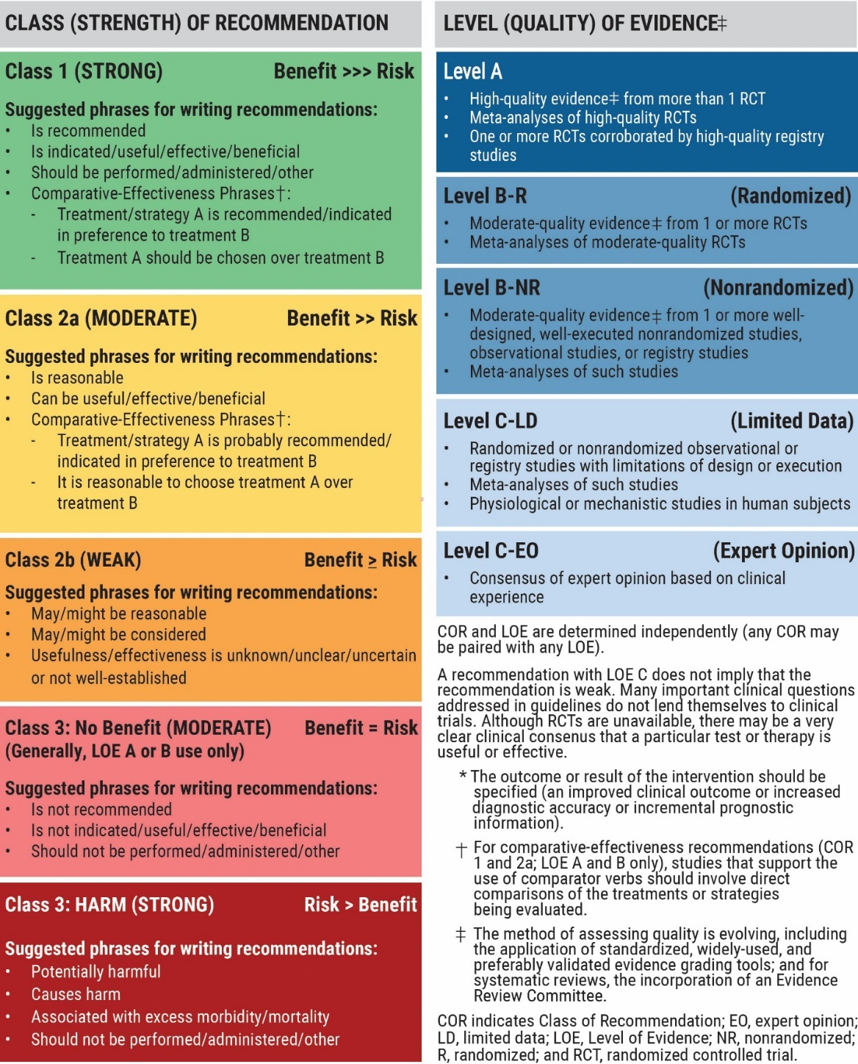
Table 2. Applying Class of Recommendation and Level of Evidence to Clinical Strategies, Interventions, Treatments, or Diagnostic Testing in Patient Care (Updated December 2024)

Slide 16
Table 3. CKM Syndrome Definition
Definition | CKM syndrome is a systemic disorder characterized by pathophysiological interactions among metabolic risk factors, CKD, and the cardiovascular system, leading to multiorgan dysfunction and a high rate of adverse cardiovascular outcomes. CKM syndrome includes both individuals at risk for CVD due to the presence of metabolic risk factors, CKD, or both, and individuals with existing CKD or CVD that is potentially related to or complicates metabolic risk factors. The increased likelihood of CKM syndrome and its adverse outcomes is further influenced by unfavorable conditions for lifestyle and self-care resulting from policies, economics, and the environment.
Simplified Definition | CKM syndrome is a health disorder due to connections among heart disease, kidney disease, diabetes, and obesity, leading to poor health outcomes.
CKD indicates chronic kidney disease; CKM, cardiovascular-kidney-metabolic; and CVD, cardiovascular disease.

Slide 17
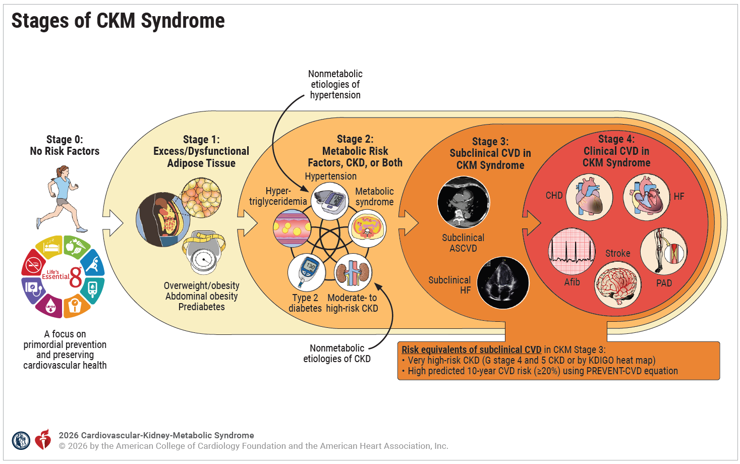
Figure 1. Stages of CKM Syndrome

Slide 18
Figure 1. Stages of CKM Syndrome (con’t.).
Adapted with permission from Ndumele et al. Copyright 2023 American Heart Association, Inc.
The CKM staging construct reflects the progressive pathophysiology and increasing absolute CVD risk along the spectrum of CKM syndrome. Stage 0 includes individuals without CKM syndrome with normal weight, normal glucose, normal blood pressure, normal lipids, normal kidney function, and no evidence of subclinical or clinical CVD; the focus in stage 0 CKM is primordial prevention and preserving cardiovascular health. CKM syndrome stage 1 includes individuals with excess adipose tissue, dysfunctional adipose tissue, or both. Excess adiposity is identified by either weight or abdominal obesity, and dysfunctional adipose tissue is reflected by prediabetes (elevated glucose or impaired glucose tolerance). CKM syndrome stage 2 includes individuals with metabolic risk factors (hypertriglyceridemia, hypertension, metabolic syndrome, or type 2 diabetes), moderate- to high-risk CKD, or both. Although hypertension and CKD are usually downstream of metabolic risk factors, the curved arrows represent individuals with nonmetabolic causes of these conditions; the risk implications and treatment approaches are similar. CKM syndrome stage 3 includes individuals with subclinical CVD with overlapping CKM risk factors (excess/dysfunctional adipose tissue, metabolic risk factors, or CKD) or those with the risk equivalents of very high-risk CKD or high 10-year predicted risk (≥20%) using the PREVENT risk equations. CKM syndrome stage 4 includes individuals with clinical CVD (coronary heart disease, HF, stroke, PAD, or atrial fibrillation) overlapping with CKM risk factors.
Afib indicates atrial fibrillation; ASCVD, atherosclerotic cardiovascular disease; CHD, coronary heart disease; CKD, chronic kidney disease; CKM, cardiovascular-kidney-metabolic; CVD, cardiovascular disease; HF, heart failure; KDIGO, Kidney Disease: Improving Global Outcomes; PAD, peripheral artery disease; and PREVENT, Predicting Risk of Cardiovascular Disease Events.

Slide 19
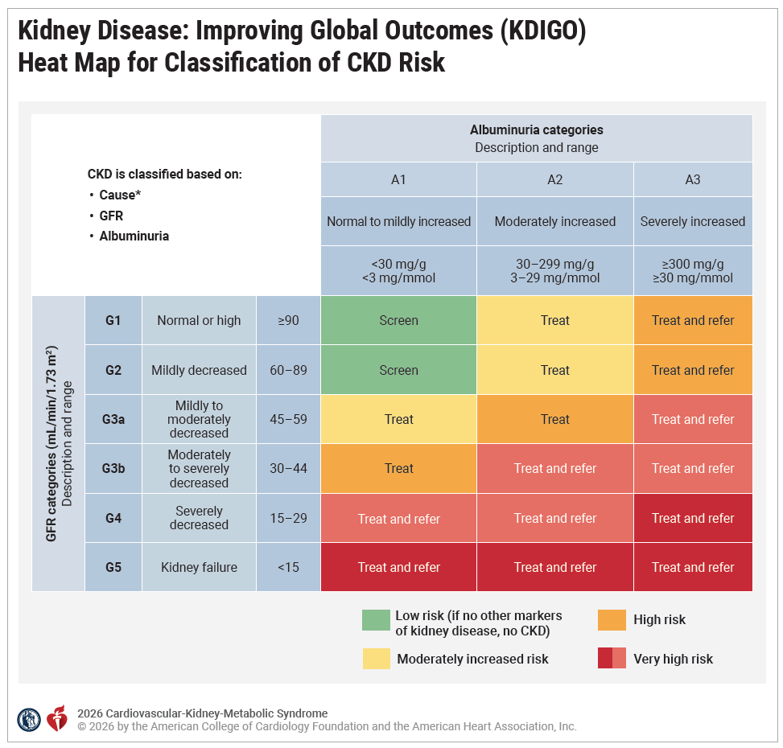
Figure 2. Kidney Disease: Improving Global Outcomes (KDIGO) Heat Map for Classification of CKD Risk.
The colors depicted in this figure are not reflective of the American Heart Association/American College of Cardiology Class of Recommendation/Level of Evidence Table 2.
Modified with permission from KDIGO. Copyright 2022, KDIGO: Kidney Disease Improving Global Outcomes. Published by Elsevier Inc. on behalf of the International Society of Nephrology.

Slide 20
Figure 2. Kidney Disease: Improving Global Outcomes (KDIGO) Heat Map for Classification of CKD Risk (con’t.).
“Treat” means that clinicians should initiate appropriate management for patients at risk for CKD progression or for cardiovascular disease as a consequence of CKD. “Refer” means consultation with the nephrology service should take place as needed depending on local arrangements regarding frequency of monitoring and timing of referral.
*Cause reflects the etiology of CKD as diagnosed by the clinician. The majority of CKD cases in CKM syndrome are attributable to diabetes, hypertension, and other metabolic risk factors. However, kidney-protective therapies such as angiotensin-converting enzyme inhibitors/angiotensin II receptor blockers and sodium glucose cotransporter 2 inhibitors have demonstrated kidney and cardiovascular benefits for patients with CKD from metabolic etiologies as well as from some other causes. Therefore, the CKM staging construct is relevant for almost all patients with CKD.
CKD indicates chronic kidney disease; CKM, cardiovascular-kidney-metabolic; and GFR, estimated glomerular filtration rate.

Slide 21
Table 4. CKM Staging Definitions and Diagnostic Criteria for Adults
Stages of CKM Syndrome | Staging Criteria and Definition
Stage 0: No CKM risk factors | Individuals with normal BMI and waist circumference, normoglycemia, normotension, normal lipid profile, and no evidence of CKD or subclinical or clinical CVD
Stage 1: Excess or dysfunctional adiposity | Individuals with overweight/obesity, abdominal obesity, or dysfunctional adipose tissue, without the presence of other metabolic risk factors or CKD: BMI ≥25 kg/m² (or ≥23 kg/m² if Asian ancestry), waist circumference ≥88/102 cm in women/men (or if Asian ancestry ≥80/90 cm in women/men), or Fasting blood glucose ≥100 to 125 mg/dL or HbA1c between 5.7% and 6.4%*

Slide 22
Table 4. CKM Staging Definitions and Diagnostic Criteria for Adults (con’t.)
Stages of CKM Syndrome | Staging Criteria and Definition
Stage 2: Metabolic risk factors, CKD, or both | Individuals with metabolic risk factors, moderate-high–risk CKD, or both: hypertension (SBP ≥130 mm Hg, DBP ≥80 mm Hg or use of antihypertensive medications) hypertriglyceridemia (≥150 mg/dL) MetS (per AHA/NHLBI criteria)† T2D (fasting blood glucose ≥126 mg/dL or HbA1c ≥6.5%) and/or moderate-to-high risk CKD per the KDIGO risk categorization

Slide 23
Table 4. CKM Staging Definitions and Diagnostic Criteria for Adults (con’t.)
Stages of CKM Syndrome | Staging Criteria and Definition
Stage 3: Subclinical CVD in CKM | Subclinical CVD (subclinical coronary atherosclerosis or pre-HF) among individuals with excess/dysfunctional adiposity, or other metabolic risk factors, or CKD; or a risk equivalent of subclinical CVD: Subclinical coronary atherosclerosis principally diagnosed as CAC with Agatston score ≥100 (moderate to severe incidental CAC, subclinical coronary atherosclerosis by coronary catheterization/CT angiography, or low ankle-brachial index without claudication symptoms also meet criteria) Pre-HF diagnosed by elevated cardiac biomarkers (NT-proBNP ≥125 pg/mL, hs-cTnT ≥14 ng/L for women and ≥22 ng/L for men, hs-cTnI ≥10 ng/L for women and ≥12 ng/L for men) or by echocardiographic parameters‡, with a combination of the 2 indicating highest HF risk. Risk equivalents of subclinical CVD: Very high-risk CKD (stages G4-G5 CKD or very high-risk per the KDIGO risk classification§) Predicted 10-year CVD risk ≥ 20% using PREVENT-CVD

Slide 24
Table 4. CKM Staging Definitions and Diagnostic Criteria for Adults (con’t.)
Stages of CKM Syndrome | Staging Criteria and Definition
Stage 4: Clinical CVD in CKM | Clinical CVD (coronary heart disease, HF, stroke, PAD, AF) among individuals with excess/dysfunctional adiposity, other CKM risk factors, or CKD Stage 4a: no kidney failure Stage 4b: kidney failure present (eGFR <15 mL/min/1.73m² or need for chronic kidney replacement therapy)

Slide 25
Table 4. CKM Staging Definitions and Diagnostic Criteria for Adults (con’t.)
*Individuals with gestational diabetes should receive intensified screening for prediabetes after pregnancy.
†MetS is defined by the presence of 3 or more of the following: (1) waist circumference ≥88 cm for women and ≥102 cm for men (≥80 cm for women and ≥90 cm for men if Asian ancestry); (2) high-density lipoprotein cholesterol <40 mg/dL for men and <50 mg/dL for women; (3) triglycerides ≥150 mg/dL; (4) elevated blood pressure (SBP ≥130 mm Hg or DBP≥80 mm Hg and/or use of antihypertensive medications); and (5) fasting blood glucose ≥100 mg/dL.
‡CAC>100 threshold based on high absolute CVD risk with an impact on therapeutic decision-making.
§KDIGO risk classification for moderate-high–risk CKD: stages G1-G2 with A2-A3, stage G3a with A1-A2, or stage G3b with A1; for very high-risk CKD: stages G3a with A3, stage G3b with A2-A3, or stages G4-G5 CKD. A1 albuminuria is UACR <30 mg/g; A2 albuminuria is UACR 30 to <300 mg/g; A3 albuminuria is UACR ≥300 mg/g.
AF indicates atrial fibrillation; AHA/NHLBI, American Heart Association/National Heart, Lung, and Blood Institute; BMI, body mass index; CAC, coronary artery calcium; CKD, chronic kidney disease; CKM, cardiovascular-kidney-metabolic; CT, computed tomography; CVD, cardiovascular disease; DBP, diastolic blood pressure; HbA1c, hemoglobin A1c; HF, heart failure; hs-cTnI, high sensitivity-cardiac troponin I; hs-cTnT, high sensitivity-cardiac troponin T; KDIGO, Kidney Disease: Improving Global Outcomes; MetS, metabolic syndrome; NT-proBNP, N-terminal prohormone of B-type natriuretic peptide; PAD, peripheral artery disease; SBP, systolic blood pressure; T2D, type 2 diabetes; and UACR, urine albumin-to-creatinine ratio.

Slide 26
Table 5. Diagnostic Criteria for Obesity, Hypertension, Dyslipidemia, and Diabetes in Youth (<18 years)
Health Factor | Criteria
Overweight and Obesity | Overweight: BMI ≥85th to <95th percentile Obesity: BMI ≥95th percentile Severe Obesity: BMI ≥120% of the 95th percentile Class 2 Obesity: BMI ≥120% to <140% of the 95th percentile or a BMI ≥35 kg/m² to < 40 kg/m², whichever is lower based on age and sex Class 3 Obesity: ≥140% of the 95th percentile or BMI ≥40 kg/m², whichever is lower based on age and sex
BMI indicates body mass index; h, hour; HbA1c, hemoglobin A1c; HDL-C, high-density lipoprotein cholesterol; and LDL-C, low-density lipoprotein cholesterol.

Slide 27
Table 5. Diagnostic Criteria for Obesity, Hypertension, Dyslipidemia, and Diabetes in Youth (<18 years) (con’t.)
Health Factor | Criteria
Blood Pressure | Age <13 years Normal: <90th percentile Elevated: ≥90th percentile to <95th percentile or 120/80 mmHg to <95th percentile (whichever is lower) Stage 1 Hypertension: ≥95th percentile to <95th percentile + 12 mm Hg, or 130/80 to 139/89 mm Hg (whichever is lower) Stage 2 Hypertension: ≥95th percentile + 12 mm Hg, or ≥140/90 mm Hg (whichever is lower) Age ≥13 years Normal: <120/<80 mm Hg Elevated: 120/<80 to 129/<80 mm Hg Stage 1 Hypertension: 130/80 to 139/89 mm Hg Stage 2 Hypertension: ≥140/90 mm Hg
BMI indicates body mass index; h, hour; HbA1c, hemoglobin A1c; HDL, high-density lipoprotein; and LDL, low-density lipoprotein.

Slide 28
Table 5. Diagnostic Criteria for Obesity, Hypertension, Dyslipidemia, and Diabetes in Youth (<18 years) (con’t.)
Health Factor | Criteria
Dyslipidemia | Fasting Lipid Panel Total cholesterol ≥200 mg/dL HDL-C <40 mg/dL LDL-C ≥130 mg/dL Triglycerides 0-9 years: ≥100 mg/dL 10-19 years: ≥130 mg/dL Non-HDL-C ≥145 mg/dL Nonfasting Lipid Panel Non–HDL-C ≥145 mg/dL HDL-C <40 mg/dL
BMI indicates body mass index; h, hour; HbA1c, hemoglobin A1c; HDL, high-density lipoprotein; and LDL, low-density lipoprotein.

Slide 29
Table 5. Diagnostic Criteria for Obesity, Hypertension, Dyslipidemia, and Diabetes in Youth (<18 years) (con’t.)
Health Factor | Criteria
Abnormal Glucose | Prediabetes Fasting plasma glucose 100-125 mg/dL OR HbA1c 5.7-6.4% OR 2-h plasma glucose during 75-g oral glucose tolerance test 140-199 mg/dL Diabetes Fasting plasma glucose ≥126 mg/dL OR HbA1c ≥6.5% OR 2-h plasma glucose during 75-g oral glucose tolerance ≥200 mg/dL OR Random plasma glucose ≥200 mg/dL in individual with classic symptoms of hyperglycemia or hyperglycemic crisis
BMI indicates body mass index; h, hour; HbA1c, hemoglobin A1c; HDL, high-density lipoprotein; and LDL, low-density lipoprotein cholesterol.

Slide 30
Evaluation and Diagnosis

Slide 31
Diagnostic Approach to CKM Staging
 | Recommendations for Diagnostic Approach to CKM Staging Referenced studies that support recommendations are summarized in the evidence table.
COR | LOE | Recommendations
1 | B-NR | Among both youth (<18 years) and adults (≥18 years), CKM syndrome staging should be performed by assessing metabolic risk factors, kidney function (calculating eGFR, with additional UACR assessments in CKM stage ≥2), and cardiovascular disease status to support prevention of CKM syndrome stage progression, promote regression of CKM syndrome, and personalize treatment of individuals according to their absolute CVD risk and expected net benefit of therapies.
2a | B-NR | Among adults at intermediate 10-year risk for ASCVD (PREVENT-ASCVD 5% to <10%) or select adults at borderline risk for ASCVD (PREVENT-ASCVD 3% to <5%) for whom decisions about preventive therapies remains uncertain, the presence of subclinical coronary atherosclerosis identified via coronary artery calcium (CAC) can be beneficial for informing optimal CVD prevention.
2a | B-NR | Among adults with increased predicted 10-year risk of HF (PREVENT-HF ≥5%), evaluation for pre-HF using cardiac biomarkers (natriuretic peptides [B-type natriuretic peptide {BNP} and N-terminal prohormone of B-type natriuretic peptide {NT-proBNP}], high-sensitivity cardiac troponin [hs-cTn]) can be beneficial to guide additional diagnostic testing (eg, cardiac imaging) and coordinated care for optimal HF prevention.

Slide 32
Longitudinal Diagnostic Assessment for all CKM Stages
 | Recommendation for Longitudinal Diagnostic Assessment for all CKM Stages Referenced studies that support recommendations are summarized in the evidence table.
COR | LOE | Recommendations
1 | B-NR | Among all adults with or at risk for CKM syndrome, it is recommended to measure BMI and waist circumference at least annually to identify the risk for CKM stage progression.
1 | B-NR | Among all adults without CKM syndrome (CKM stage 0), it is recommended to assess lipids, glycemia, and kidney function (to calculate eGFR) at least every 5 years and BP at least annually to ensure timely identification of CKM risk factors for optimal CVD prevention.

Slide 33
Longitudinal Diagnostic Assessment for all CKM Stages (con’t.)
1 | B-NR | Among adults with CKM stage 1, it is recommended to assess lipids, glycemia and kidney function (to calculate eGFR) at least every 2 to 3 years and BP at least annually to ensure timely identification of CKM risk factors and to facilitate timely risk factor modification for optimal CVD prevention.
1 | B-NR | Among adults in CKM stages 2 and above, it is recommended to assess lipids, glycemia, and BP at least annually to inform the optimal prevention and management of CVD.
1 | B-NR | Among adults in CKM stages 2 and above, assessments of both eGFR and UACR are recommended at least annually to characterize risk related to CKD and to guide the prevention and management of CVD and kidney disease.

Slide 34
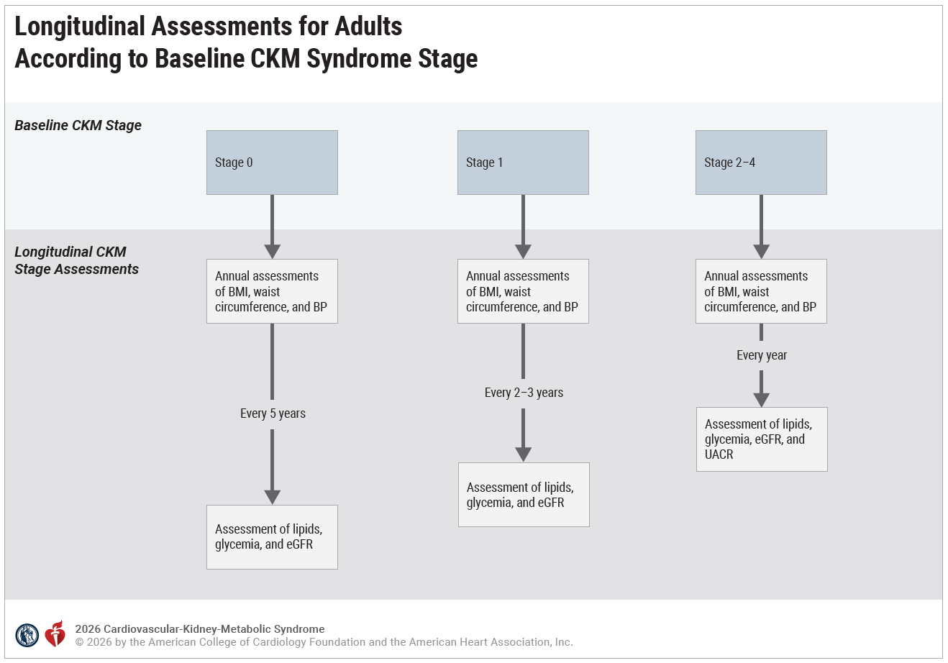
Figure 3. Longitudinal Assessments for Adults According to Baseline CKM Syndrome Stage.
BMI indicates body mass index; BP, blood pressure; CKM, cardiovascular-kidney-metabolic; eGFR, estimated glomerular filtration rate; and UACR, urine albumin-to-creatinine ratio.

Slide 35
Figure 3. Longitudinal Assessments for Adults According to Baseline CKM Syndrome Stage (con’t.).
Systematic assessments for CKM risk factors allow for the timely detection of risk factors and the quantification of cardiovascular risk using the PREVENT equations. The frequency and intensity of assessments for CKM syndrome risk factors increase with higher CKM stages. Annual assessments for anthropometrics and blood pressure should be performed for all patients. Additional assessments for lipids, glycemia, and eGFR should occur at least every 5 years in CKM stage 0 and more frequently every 2 to 3 years in CKM stage 1. In CKM stage 2, with the presence of metabolic risk factors, CKD, or both, these assessments should occur yearly. Furthermore, the higher prevalence of albuminuria in CKM stage 2 supports yearly assessments for UACR to fully assess for CKD and related cardiovascular risk.

Slide 36
Social Determinants of Health Assessments
 | Recommendations for Social Determinants of Health Assessment Referenced studies that support recommendations are summarized in the evidence table.
COR | LOE | Recommendations
1 | B-NR | In adults with or at risk for CKM syndrome (≥18 years), routine screening with a tool (Table 6) validated for assessing SDOH is recommended to inform the implementation of patient-centered care.
1 | B-NR | In youth with or at risk for CKM syndrome (<18 years of age), routine screening of their caregivers with a tool (Table 7) validated for assessing caregiver SDOH is recommended to inform the implementation of patient-centered care.

Slide 37
Table 6. SDOH Screening Tools for Adult Populations With or at Risk for CKM Syndrome
Social Determinants of Health Screening Tool | Essential or Core Domains Assessed by the Screening Tool
SDOH Screening Tools for Adults
Health Leads | Exposure to violence Financial strain Food insecurity Housing instability Sociodemographic information Transportation challenges Utility needs
Centers for Medicare & Medicaid Innovation: Accountable Health Communities (AHC) HRSN Screening Tool | Food insecurity Housing instability Interpersonal safety Transportation problems Utility help needs

Slide 38
Table 6. SDOH Screening Tools for Adult Populations With or at Risk for CKM Syndrome (con’t.)
Social Determinants of Health Screening Tool | Essential or Core Domains Assessed by the Screening Tool
SDOH Screening Tools for Adults
AAFP: The EveryONE Project | Childcare Employment Education Finances Food Housing Interpersonal safety Transportation Utilities
PRAPARE Implementation and Action Toolkit | Family and home Money and resources Social and emotional health Sociodemographics

Slide 39
Table 6. SDOH Screening Tools for Adult Populations With or at Risk for CKM Syndrome (con’t.)
Social Determinants of Health Screening Tool | Essential or Core Domains Assessed by the Screening Tool
SDOH Screening Tools for Adults
OCHIN: Social Determinants of Health Electronic Health Record Tools in Community Health Centers | Education Exposure to violence Financial resource strain Food insecurity Health behaviors (alcohol use, race, ethnicity, tobacco use and exposure, physical inactivity) Housing insecurity Mental health (depression, social isolation, stress)
HealthBegins Upstream Risks Screening Tool* | Economic stability Education Food insecurity Housing insecurity Social and community context Neighborhood and physical environment Health behaviors (physical activity, dietary pattern)

Slide 40
Table 6. SDOH Screening Tools for Adult Populations With or at Risk for CKM Syndrome (con’t.)
Modified with permission from Ndumele et al. Copyright 2023 American Heart Association, Inc.
International Classification of Diseases, Tenth Revision (ICD-10) Z codes are for supplemental reporting purposes and are not primary diagnosis codes. Z55 indicates problems related to education and literacy; Z57, occupational exposure to risk factors; Z58, problems related to physical environment; Z59, problems related to housing and economic circumstances; and Z60.9, problems related to social environment, unspecified.
*Not yet validated or validity not specified.
AAFP indicates American Academy of Family Physicians; CKM, cardiovascular-kidney-metabolic; HRSN, Health-Related Social Needs; OCHIN, Oregon Community Health Information Network; PRAPARE, Protocol for Responding to and Assessing Patients’ Assets, Risks, and Experiences; SDOH, social determinants of health.

Slide 41
Table 7. SDOH Screening Tools for Caregivers of Youth Populations With or at Risk for CKM Syndrome
Social Determinants of Health Screening Tool | Essential or Core Domains Assessed by the Screening Tool
Screening Tools for Caregivers of Youth
HealthBegins Upstream Risks Screening Tool* | Economic stability Education Food insecurity Housing insecurity Social and community context Neighborhood and physical environment Health behaviors (physical activity, dietary pattern)
Child ACE Tool* | Education: parental education Family context: suspected child maltreatment, intimate partner violence in the household, mental illness in the household, substance abuse in the household, household member is incarcerated, parental marital status

Slide 42
Table 7. SDOH Screening Tools for Caregivers of Youth Populations With or at Risk for CKM Syndrome (con’t.)
Social Determinants of Health Screening Tool | Essential or Core Domains Assessed by the Screening Tool
Screening Tools for Caregivers of Youth
SEEK PSQ | Economic stability: food insufficiency Family context: parental intimate partner violence, parental depression, parental stress, parental substance or alcohol use disorder, tobacco use within home, gun in home, help with childcare when needed Health and health care: smoke alarm needed, contact information for poison control needed
IHELLP Screening Tool | Economic stability: food insufficiency, housing instability Education: concerns about child’s education needs Family context: violence in the household Health and health care: concerns about child’s health insurance Neighborhood environment: concerns about physical conditions of housing

Slide 43
Table 7. SDOH Screening Tools for Caregivers of Youth Populations With or at Risk for CKM Syndrome (con’t.)
Social Determinants of Health Screening Tool | Essential or Core Domains Assessed by the Screening Tool
Screening Tools for Caregivers of Youth
WE CARE Screening Tool | Economic stability: food insufficiency, housing instability, difficulty paying bills, parental employment Education: parental education, lack of childcare Family context: intimate partner violence in household, parental depression symptoms, alcohol or substance use disorder in household

Slide 44
Table 7. SDOH Screening Tools for Caregivers of Youth Populations With or at Risk for CKM Syndrome (con’t.)
Modified with permission from Ndumele et al. Copyright 2023 American Heart Association, Inc.
ICD-10 Z codes are for supplemental reporting purposes and are not primary diagnosis codes. Z55 indicates problems related to education and literacy; Z57, occupational exposure to risk factors; Z58, problems related to physical environment; Z59, problems related to housing and economic circumstances; and Z60.9, problems related to social environment, unspecified.
*Not yet validated or validity not specified.
ACE indicates Adverse Childhood Experiences; CKM, cardiovascular-kidney-metabolic; IHELLP, Income, Housing, Education, Legal Status, Literacy, and Personal Safety; SDOH, social determinants of health; SEEK PSQ, Safe Environment for Every Kid Parent Screening Questionnaire; and WE CARE, Well Child Care, Evaluation, Community Resources, Advocacy, Referral, Education.

Slide 45
Risk Assessment

Slide 46
Quantitative Assessment of CVD Risk
Recommendations for Quantitative Assessment of CVD Risk Referenced studies that support recommendations are summarized in the evidence table.
COR | LOE | Recommendations
1 | B-NR | In adults 30 to 79 years of age without CVD (coronary heart disease, stroke, or HF), calculation of 10-year risk of CVD (and its components of ASCVD and HF) with the PREVENT equations is recommended to quantify risk related to CKM syndrome and to inform prevention strategies.
2a | B-NR | In adults 30 to 59 years of age without CVD (coronary heart disease, stroke, or HF), calculation of 30-year risk of CVD (and its components of ASCVD and HF) with the PREVENT equations can be useful to quantify risk related to CKM syndrome and to inform prevention strategies.

Slide 47
Table 8. Summary of Guideline-Based Recommendations for the Use of Outcome-Specific PREVENT Equations in the Primary Prevention of CVD-Based Risk Thresholds
PREVENT Equations | Outcome of Interest | Goal of Risk Assessment |  | Guideline Referenced
PREVENT-CVD | Total CVD: a composite of ASCVD and HF | CKM syndrome staging | To define CKM stage 3 syndrome when 10-year risk PREVENT-CVD ≥20% (risk equivalent with subclinical CVD) | 2026 AHA/ACC/ADA/ASN CKM Guideline
 |  | Treatment | To recommend initiation of GLP-1 based therapy or SGLT2i or both, with 10-year risk PREVENT-CVD ≥7.5% when indicated | 2026 AHA/ACC/ADA/ASN CKM Guideline
 |  |  | To recommend initiation of drug therapy for intensive BP-lowering in stage 1 hypertension, with 10-year risk of PREVENT-CVD ≥7.5% | 2025 AHA/ACC High BP Guideline⁹

Slide 48
Table 8. Summary of Guideline-Based Recommendations for the Use of Outcome-Specific PREVENT Equations in the Primary Prevention of CVD-Based Risk Thresholds (con’t.)
PREVENT-ASCVD | ASCVD: Fatal CHD, nonfatal MI, fatal and nonfatal stroke | CKM syndrome staging/ detection of subclinical CVD | To recommend evaluation of subclinical atherosclerosis, with 10-year risk PREVENT-ASCVD 3% to <10% when there is uncertainty about the initiation or intensification of therapy | 2026 ACC/AHA Dyslipidemia Guideline
 |  | Treatment | To recommend initiation of lipid-lowering treatment, with 10-year risk PREVENT-ASCVD ≥5% To consider initiation of lipid-lowering treatment, with 10-year risk PREVENT-ASCVD 3% to <5% after evaluation of risk enhancers, 30-year ASCVD risk, or CAC when there is uncertainty To consider initiation of lipid-lowering treatment, with 30-year risk PREVENT-ASCVD ≥10% | 2026 ACC/AHA Dyslipidemia Guideline

Slide 49
Table 8. Summary of Guideline-Based Recommendations for the Use of Outcome-Specific PREVENT Equations in the Primary Prevention of CVD-Based Risk Thresholds (con’t.)
PREVENT-HF | HF, which includes HF with reduced, mildly reduced, and preserved ejection fraction | CKM syndrome staging/ detection of subclinical CVD | To recommend evaluation of subclinical HF and care coordination, with 10-year risk PREVENT-HF ≥5% | 2026 AHA/ACC/ADA/ASN CKM Guideline
See complementary AHA/ACC scientific statement on risk assessment in CKM syndrome.
ASCVD indicates atherosclerotic cardiovascular disease ; AHA, American Heart Association; ACC, American College of Cardiology; ADA, American Diabetes Association; ASN, American Society of Nephrology; CAC, coronary artery calcium; CHD, coronary heart disease; CKM, cardiovascular-kidney-metabolic; CVD, cardiovascular disease; GLP-1, glucagon-like peptide; HF, heart failure; MI, myocardial infarction; PREVENT, Predicting Risk of Cardiovascular Disease Events; and SGLT2i, sodium–glucose cotransporter-2 inhibitors.

Slide 50
Risk Enhancers for CKM Syndrome
 | Recommendation for Risk Enhancers for CKM Syndrome Referenced studies that support the recommendation are summarized in the evidence table.
COR | LOE | Recommendation
2a | B-NR | In adults 30 to 79 years of age without CVD (coronary heart disease, stroke, or HF), it is reasonable to use risk enhancers for CKM syndrome progression to guide decisions about intensification of prevention strategies.

Slide 51
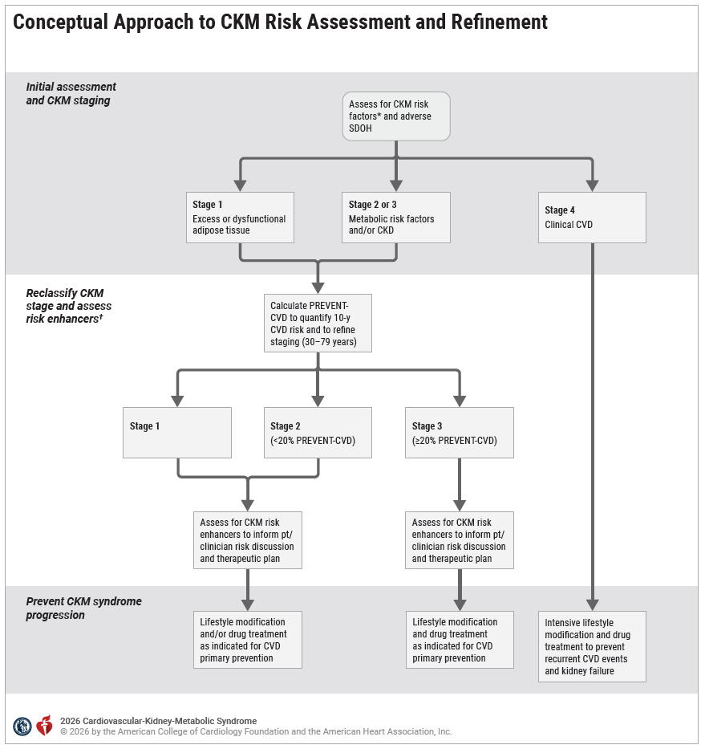
Figure 4. Conceptual Approach to CKM Risk Assessment and Refinement.

Slide 52
Figure 4. Conceptual Approach to CKM Risk Assessment and Refinement (con’t.).
The systematic approach to evaluating risk in the patient with CKM syndrome starts with assessments for CKM risk factors and CKM syndrome staging. Subsequent PREVENT calculation helps to quantify CVD risk and can also help to differentiate between stage 2 (10-year score <20%) and stage 3 (10-year score ≥20%) for those with metabolic risk factors or CKD. The presence of subclinical CVD or very-high risk CKD also identifies those individuals with CKM stage 3. PREVENT is not indicated for those in CKM stage 4 with existing CVD. For patients in CKM stage 1 to 3, risk-enhancing factors that influence CKM stage progression can further inform patient-clinician risk discussions about the benefits versus risks of preventive therapies.
*CKM risk factors include adiposity measures, blood pressure, lipids, glycemia, and kidney function. Conceptual overview of the approach to staging that integrates baseline CKM assessments, risk estimation with the PREVENT-CVD equations, and personalization with risk-enhancing factors.
†Refers to Table 9 “Risk Enhancers for CKM Syndrome.”
CKM indicates cardiovascular-kidney-metabolic; CKD, chronic kidney disease; CV, cardiovascular; CVD, cardiovascular disease; pt, patient; and SDOH, social determinants of health.

Slide 53
Table 9. Risk Enhancers for CKM Syndrome
Risk Enhancers for CKM Syndrome
Personal medical history | Chronic inflammatory or autoimmune conditions (eg, rheumatoid arthritis, SLE, HIV/AIDS)^{4,11}
 | Sleep disorders (eg, obstructive sleep apnea)¹⁶
 | Poor psychological health (eg, depression, anxiety)¹⁷
 | Sex-specific risk factors (eg, premature menopause age<40 years, adverse pregnancy outcomes, polycystic ovarian syndrome, erectile dysfunction)²
SDOH | Lower socioeconomic status
 | Higher burden of adverse individual- and place-based SDOH (Section 3.2)
Inflammation | Elevated high-sensitivity C-reactive protein (≥2.0 mg/L if measured)
Family history | Diabetes
 | Kidney failure
Demographic | Increased risk groups (eg, self-identified race or ethnicity of South Asian, American Indian, Pacific Islander)*
*Mechanisms for increased risk may include social and/or genetic factors that disproportionately impact individuals from a certain ancestry.
CKM indicates cardiovascular-kidney-metabolic; HIV/AIDS, human immunodeficiency virus/acquired immunodeficiency syndrome; SDOH, social determinants of health; and SLE, systemic lupus erythematosus.
Adapted with permission from Ndumele et al. Copyright 2023 American Heart Association Inc.

Slide 54
General Principles of Care in CKM Syndrome

Slide 55
Table 10. Summary of Therapeutic Considerations Related to Overlapping CKM Conditions
Overlapping Condition | Major CKM Risk Factors
 | Obesity | T2D | CKD
 | Core Management: Lifestyle modification; adjunctive obesity pharmacotherapy; or metabolic and bariatric surgery as needed (Section 5.4) | Core Management: Lifestyle modification; risk factor control; use of SGLT2i, GLP-1–based therapy, or both in those at increased risk for CVD events (Section 5.5.1) | Core Management: RASi and SGLT2i as first-line therapies in patients with albuminuric CKD to reduce CVD risk and prevent loss of kidney function (Section 5.5.4)
Obesity | n/a | With ≥ class II obesity, prioritize GLP-1–based therapy for managing T2D and reducing CVD risk | Intentional weight loss reduces albuminuria
T2D | With ≥ class II obesity, prioritize GLP-1–based therapy for managing T2D and reducing CVD risk | n/a | RASi and SGLT2i as first-line therapies to reduce CVD and kidney risk; addition of GLP-1 RA and/or finerenone for DKD with persistent albuminuria on first-line therapies

Slide 56
Table 10. Summary of Therapeutic Considerations Related to Overlapping CKM Conditions (con’t.).
Albuminuric CKD | Intentional weight loss reduces albuminuria | RASi and SGLT2i as first-line therapies to reduce CVD and kidney risk; addition of GLP-1 RA and/or finerenone for DKD with persistent albuminuria on first-line therapies | n/a
MASLD (Section 7.2.) | Weight reduction advised; GLP-1 RA advised if fibrotic MASLD present | Weight reduction if appropriate; GLP-1 RA advised in MASLD given high risk of fibrosis | n/a
Subclinical Coronary Atherosclerosis (Section 6.2.) | Potential for greater absolute risk reduction with indicated preventive therapies | Potential for greater absolute risk reduction with indicated preventive therapies | Potential for greater absolute risk reduction with indicated preventive therapies
Pre-HF (Section 5.6.2.) | Marked weight loss may reduce risk for HF development | Prioritize SGLT2i as primary cardioprotective antihyperglycemic agent for HF prevention | Use SGLT2i for HF prevention; if DKD is present, pre-HF favors consideration of adding GLP-1 RA or finerenone

Slide 57
Table 10. Summary of Therapeutic Considerations Related to Overlapping CKM Conditions (con’t.).
ASCVD (Section 6.2.) | Integrated weight management team to reduce weight and CKM risk; GLP-1-based therapy to decrease MACE/CV death | Lifestyle modification, risk factor control, and use of SGLT2i, GLP-1-based therapy, or both in those with ASCVD to reduce MACE/CV death | Use SGLT2i to reduce MACE, CV death, and loss of kidney function
HFpEF (Section 6.3.) | GLP-1–based therapy recommended to reduce HF events; consider exercise training and a caloric deficit diet | SGLT2i should be the first-line cardioprotective glucose lowering therapy to reduce HF events; additionally consider GLP-1–based therapy if diabetes and obesity present | SGLT2i (as part of standard HF GDMT) reduces HF events and loss of kidney function; additionally consider finerenone if DKD is present
HFrEF (Section 6.3.) | Unclear risk/benefit of GLP-1–based therapy in HFrEF (particularly in the absence of ASCVD) | SGLT2i should be the first-line cardioprotective glucose lowering therapy to reduce HF events and CV death | SGLT2i and ARNI/RASi (as part of standard HF GDMT) reduce HF events, CV death, and loss of kidney function

Slide 58
Table 10. Summary of Therapeutic Considerations Related to Overlapping CKM Conditions (con’t.).
This table describes management considerations related to the overlap of the major CKM risk factors of obesity, diabetes, and CKD, with additional comorbid conditions in CKM syndrome. The top row describes core management for the CKM risk factors. Lower rows describe how the overlap of that CKM risk factor with another condition should impact clinical management. Recommendations regarding the management approach for obesity, T2D, and CKD, in those with and without CVD, are detailed in subsequent sections.
ARNI indicates angiotensin receptor/neprilysin inhibitor; ASCVD, atherosclerotic cardiovascular disease; CV, cardiovascular; CVD, cardiovascular disease; CKD, chronic kidney disease; CKM, cardiovascular-kidney-metabolic; DKD, diabetic kidney disease; GDMT, guideline-directed medical therapy; GLP-1, glucagon-like peptide-1; GLP-1 RA, GLP-1 receptor agonist; HF, heart failure; HFrEF, heart failure with reduced ejection fraction; MACE, major adverse cardiovascular events; MASLD, metabolic dysfunction–associated steatotic liver disease; n/a, not applicable; RASi, renin-angiotensin system inhibitors; SGLT2i, sodium–glucose cotransporter-2 inhibitors; and T2D, type 2 diabetes.

Slide 59
Interdisciplinary Care
 | Recommendations for Interdisciplinary Care Referenced studies that support recommendations are summarized in the evidence table.
COR | LOE | Recommendations
1 | B-R | For adults with stage 2 to 4 CKM syndrome with ≥2 CKM conditions of diabetes, CKD, and/or CVD, the use of interdisciplinary care teams with a CKM coordination point person is recommended to facilitate multisystem CKM syndrome care, including lifestyle interventions and optimization of GDMT.
1 | C-EO | In adults with CKM syndrome, mitigating the clinical impact of adverse SDOH should be prioritized to optimize holistic CKM syndrome care.

Slide 60
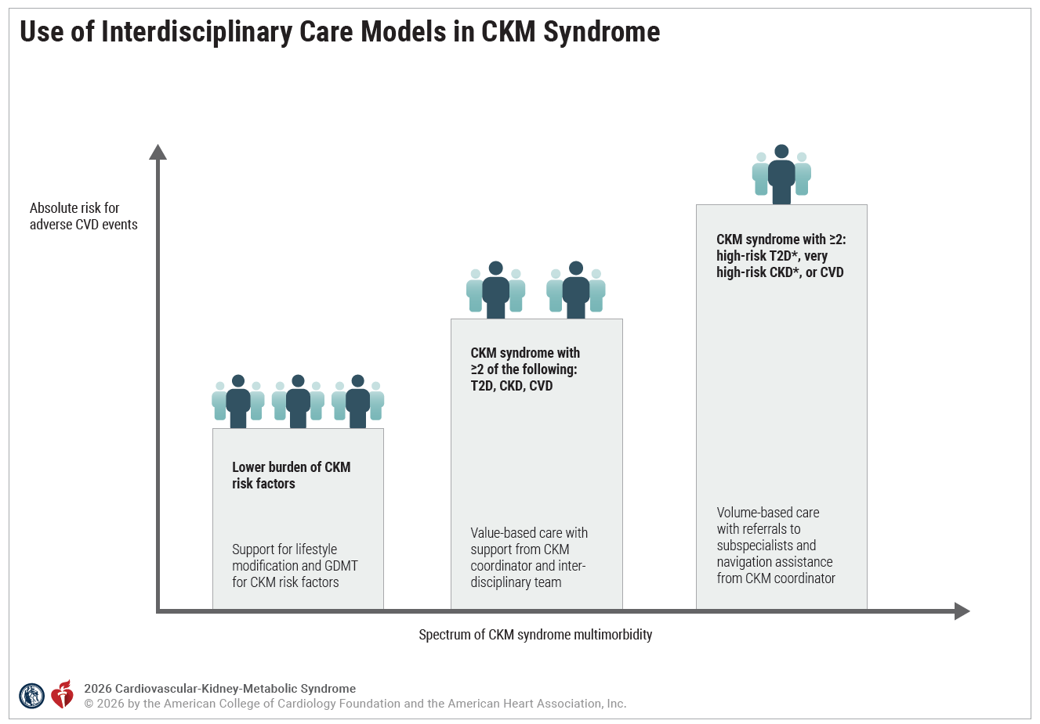
Figure 5. Use of Interdiscipl-inary Care Models in CKM Syndrome.

Slide 61
Table 11. CKM Interdisciplinary Team
Care Category | Team Members
General Medical Care | Primary care clinician*
 | CKM coordination point person†
 | Clinical pharmacist
 | Nurse
 | Dietician
Subspeciality Care | Cardiology clinician*
 | Endocrinology clinician*
 | Nephrology clinician*
 | Hepatology clinician*
 | Diabetes educator
Social Support | Social worker
 | Community health worker
*Could include MD, DO, or advanced practice professional.
†Individuals in subspecialty roles such as diabetes educators or heart failure care coordinators can also play the role of the CKM coordination point person.
CKM indicates cardiovascular-kidney-metabolic.

Slide 62
Table 12. Coordinated Services for Optimal CKM Management
Task | Details
*Comprehensive medication management | Patient education on CKM conditions and related medications to encourage patient empowerment Medication reconciliation Initiation, titration, monitoring of evidence-based CKM therapies Address side effects or inappropriate medication discontinuation Use of shared decision-making when deprescribing medications that are not indicated Assessment of and coaching to increase adherence Facilitate access to therapies, including patient assistance programs
Facilitation of lifestyle management | Education and coaching for dietary and exercise modification and tobacco cessation
*Comprehensive medication management is a standard of practice that assures that patients’ medications (ie, prescription, nonprescription, medication alternatives, vitamins, or nutritional supplements) are individually assessed to make sure each medication is indicated (appropriate), effective for their medical conditions, safe given comorbidities and other medications being taken, and able to be taken by the patient as intended as per an individualized care plan.
CKM indicates cardiovascular-kidney-metabolic.

Slide 63
Table 12. Coordinated Services for Optimal CKM Management (con’t.)
Task | Details
Care coordination | Facilitate communication between patient’s clinicians Ensure that the patient’s entire team is aware of challenges of initiating or adherence to evidence-based therapies Ensure patient’s understanding of complex care plans
Patient navigation | Ensure patient understands the role of care team members and their entire care plan Facilitate communication between patient and clinicians Ensure patient is aware of follow-up testing and appointments Facilitate access to social assistance programs
CKM indicates cardiovascular-kidney-metabolic.

Slide 64
Figure 5. Use of Interdisciplinary Care Models in CKM Syndrome (con’t.).
Conceptual framework for use of interdisciplinary care models in CKM syndrome, tailored to multimorbidity profiles and reflecting the corresponding absolute risk of CVD events. For most patients with CKM syndrome who have a lower burden of CKM risk factors, clinicians should facilitate and encourage lifestyle modification and initiation of guideline-directed therapies based on CKM risk profiles and estimated CVD risk. The smaller number of individuals with CKM syndrome and a confluence of ≥2 conditions of T2D, CKD, and CVD have higher absolute CVD risk, and a value-based care approach with support from a CKM coordinator and virtual interdisciplinary team is recommended. A yet smaller number of individuals with a confluence of ≥2 of high-risk T2D, very high-risk CKD, or clinical CVD are at the highest absolute CVD risk. For this group, a volume-based interdisciplinary strategy, with referrals for subspecialty care and navigation support from a CKM coordinator, is recommended.
CKD indicates chronic kidney disease; CKM, cardiovascular-kidney-metabolic; CVD, cardiovascular disease; GDMT, guideline-directed medical therapy; and T2D, type 2 diabetes.
* High-risk T2D is defined as a HbA1c ≥9% or microvascular complications of T2D, and very high-risk CKD is defined as per the KDIGO heat map (Figure 2).

Slide 65
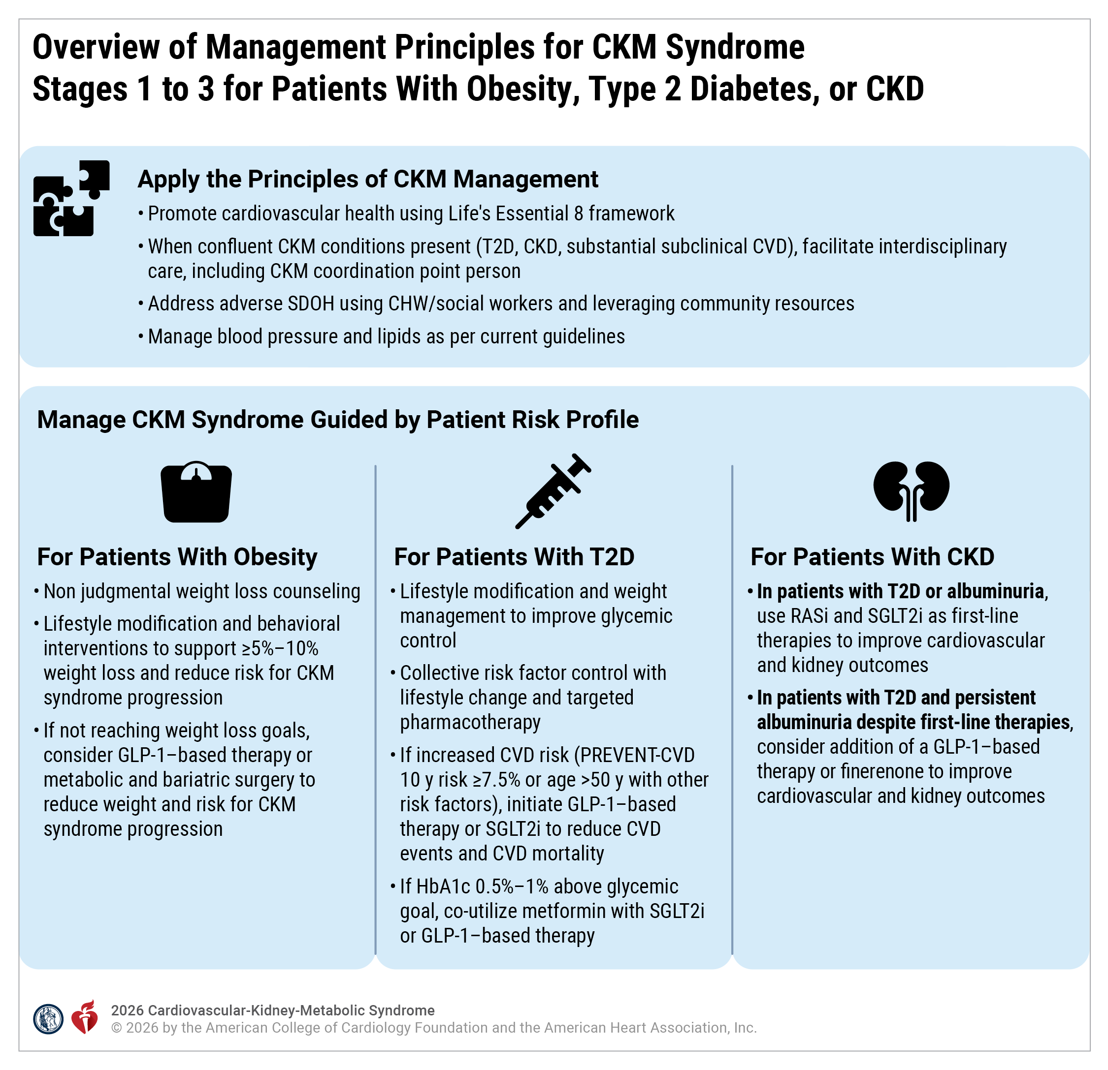
The approach to CKM syndrome management in patients with obesity, diabetes, and/or CKD in CKM syndrome stages 1 to 3 should involve applying general principles of CKM syndrome management, as well as additional therapeutic approaches for the individual CKM risk factors, as depicted. If HbA1c is sufficiently above glycemic goal (≥0.5% to 1% above), metformin can be co-initiated with a SGLT2i (most necessary, given the limited glycemic effects of these agents) or a GLP-1–based agent; alternatively, metformin can be added later depending on patient preferences.
CHW indicates community health worker; CKD, chronic kidney disease; CKM, cardiovascular-kidney-metabolic; CV, cardiovascular; CVD, cardiovascular disease; DM, diabetes; GLP-1, glucagon-like peptide-1; RASi; renin-angiotensin system inhibitors; SDOH, social determinants of health; SGLT2i, sodium–glucose cotransporter-2 inhibitors; and T2D, type 2 diabetes.
Figure 6. Overview of Management Principles for CKM Syndrome Stages 1 to 3 for Patients With Obesity, Type 2 Diabetes, or CKD

Slide 66
Overarching Approach to Obesity Management
 | Recommendations for Overarching Approach to Obesity Management Referenced studies that support recommendations are summarized in the evidence table.
COR | LOE | Recommendations
1 | A | Among adults with overweight or obesity, lifestyle modification is recommended as the first-line strategy to facilitate weight loss of at least 5% to 10% of baseline weight.
1 | B-NR | Among adults with overweight or obesity receiving weight loss counseling, a nonjudgmental approach to initiating weight loss discussions is recommended in order to increase the effectiveness of weight loss.
2a | B-NR | Among adults with obesity, integrated interdisciplinary weight management teams can be effective to enhance patient-centered approaches to weight loss.

Slide 67
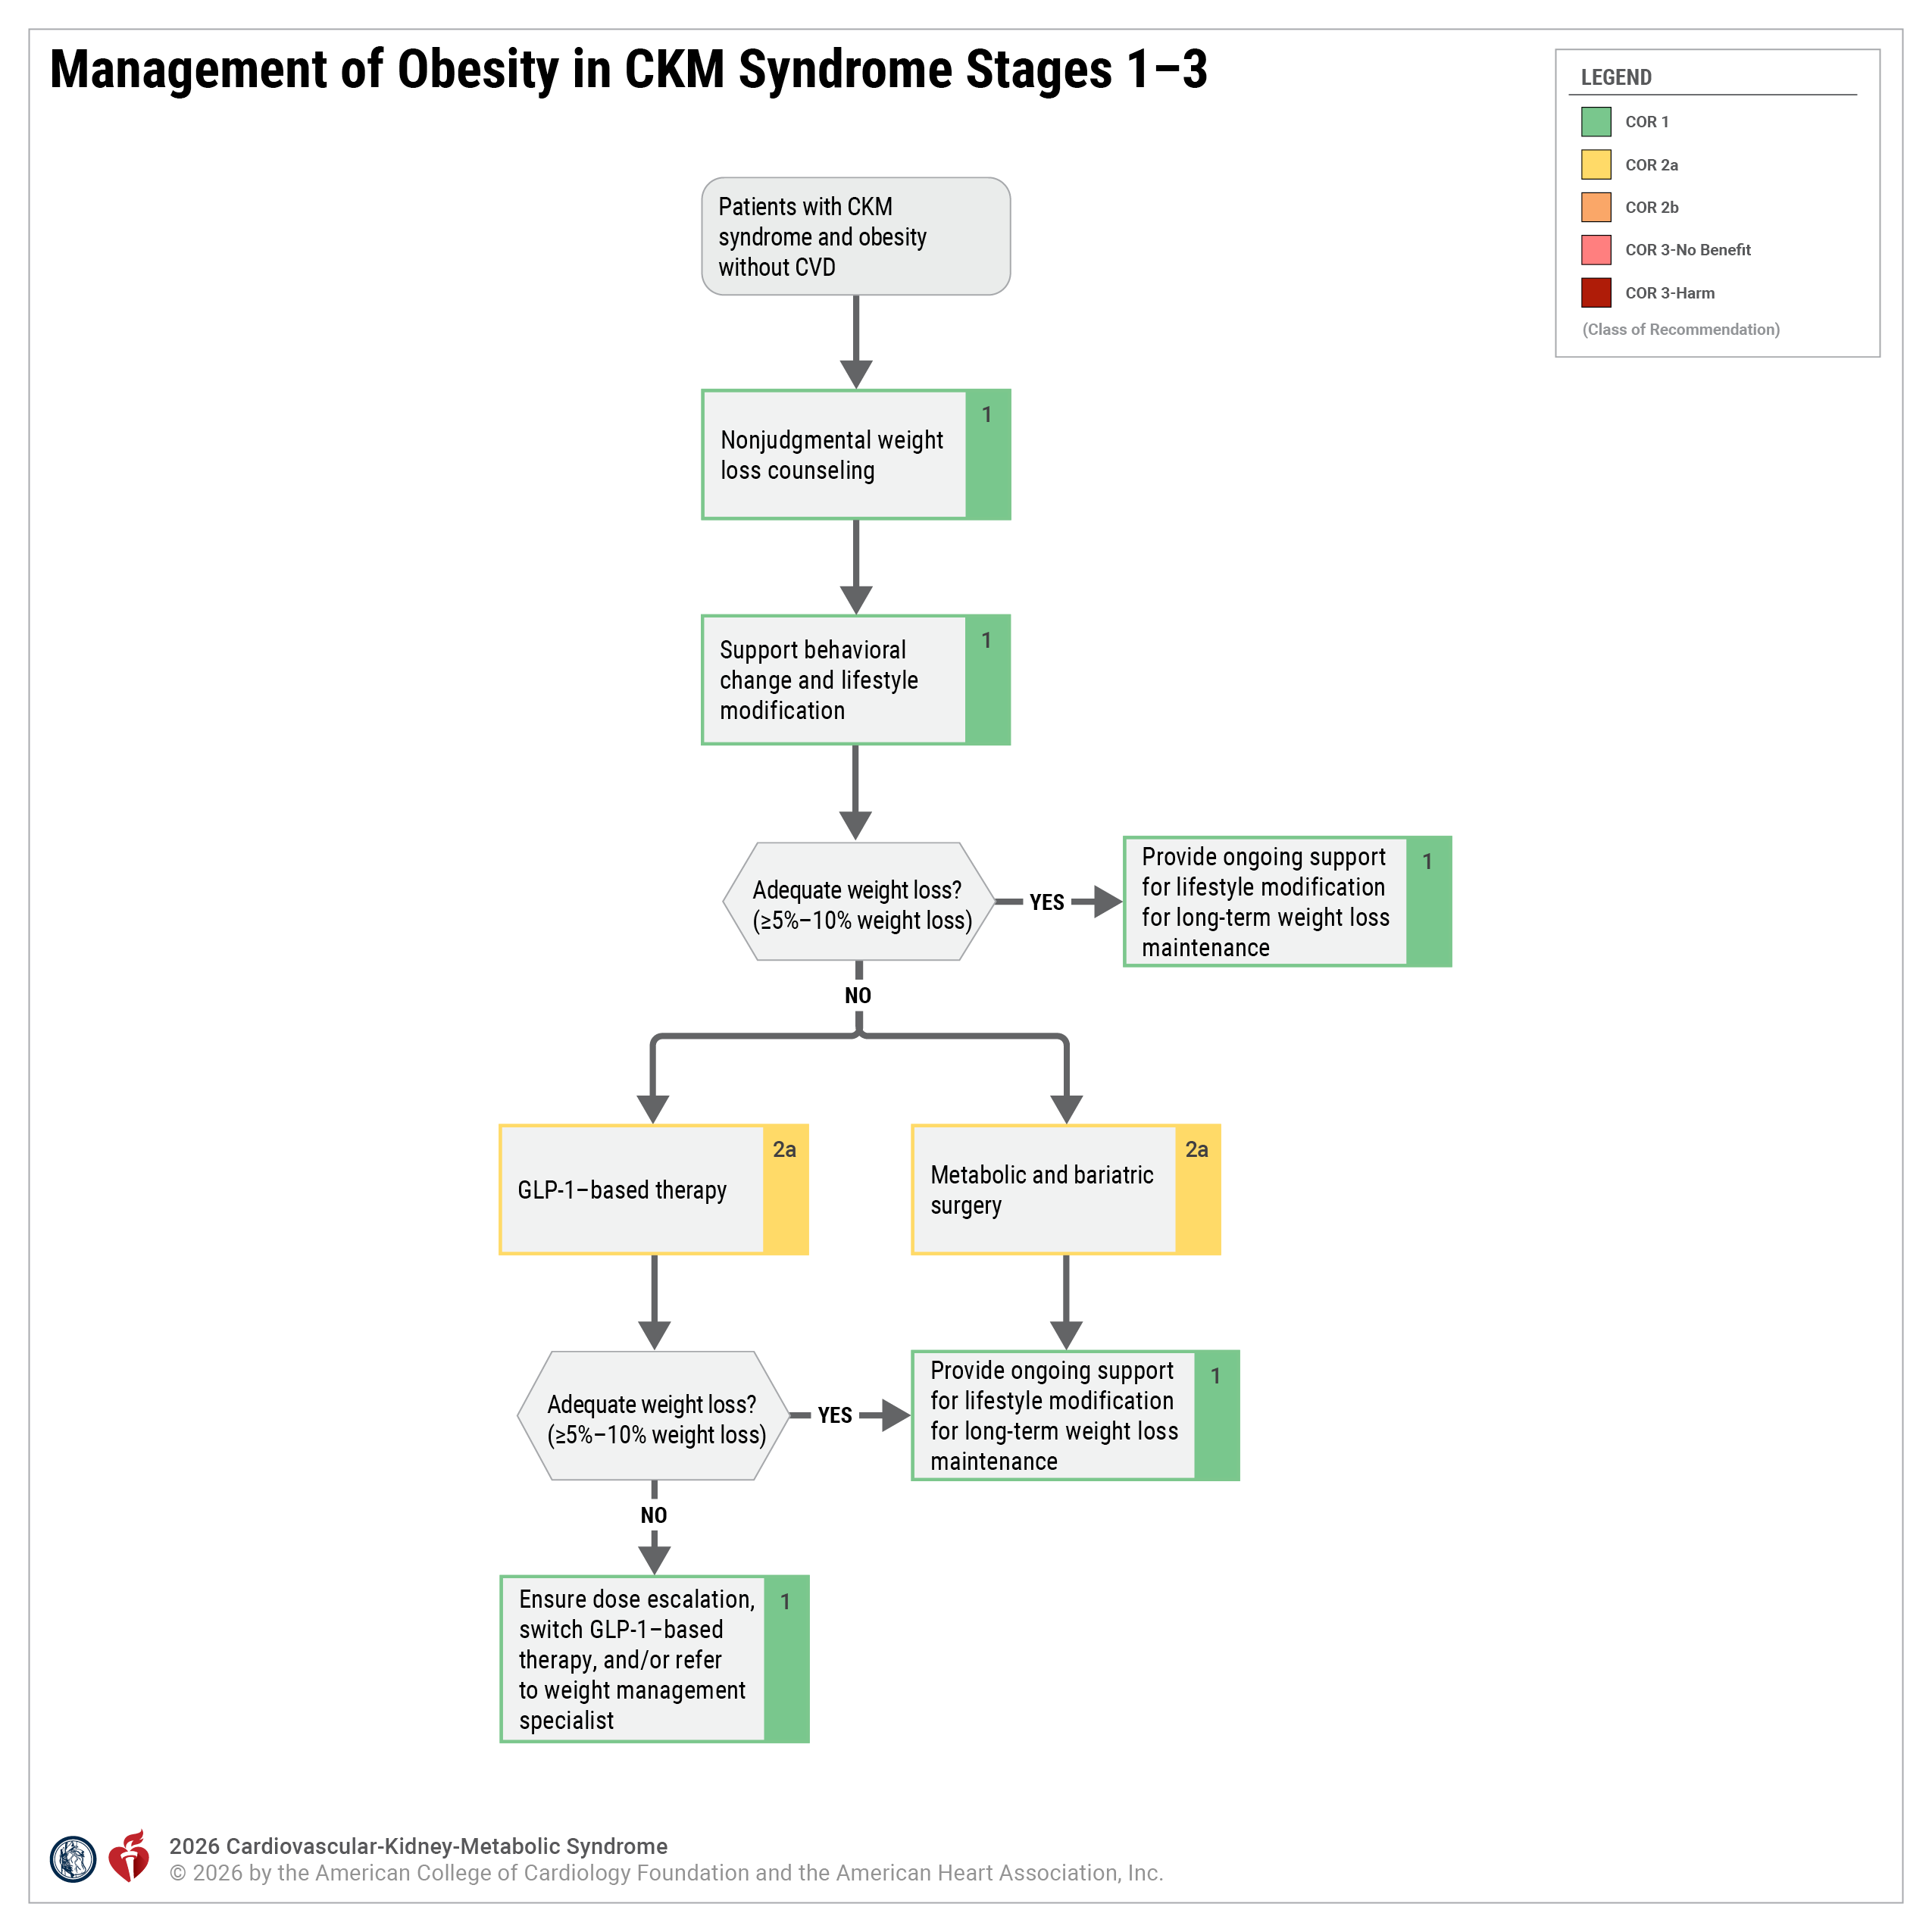
Figure 7. Management of Obesity in CKM Syndrome Stages 1 to 3.
CKM indicates cardiovascular-kidney-metabolic; and GLP-1, glucagon-like peptide-1.

Slide 68
Intensive Lifestyle Modification for Weight Loss
 | Recommendations for Intensive Lifestyle Modification for Weight Loss Referenced studies that support recommendations are summarized in the evidence table.
COR | LOE | Recommendations
1 | A | Among adults with overweight or obesity, clinicians should provide counseling at least annually regarding the benefits of achieving at least 5% to 10% weight loss for CKM syndrome risk reduction.
1 | A | Among adults with overweight or obesity, clinician referral to in-person or virtual multicomponent behavioral interventions is beneficial for promoting weight loss for CKM syndrome risk reduction.

Slide 69
Intensive Lifestyle Modification for Weight Loss (con’t.)
2a | B-R | For adults with overweight or obesity who have significant barriers to participating in multicomponent behavioral weight loss interventions, self-directed digital health solutions can be beneficial to promote weight loss for CKM syndrome risk reduction.
1 | A | Among adults with overweight or obesity, lifestyle modification that incorporates moderate caloric restriction and regular physical activity should be recommended to promote weight loss and reduce cardiovascular risk.
1 | B-NR | Among adults who have successfully lost weight, long-term weight management programs that, in part, emphasize increased physical activity should be recommended to maintain lost weight.

Slide 70
Obesity Pharmacotherapy for Weight Management in CKM Syndrome Stage 1
 | Recommendations for Obesity Pharmacotherapy for Weight Management in CKM Stage 1 Referenced studies that support recommendations are summarized in the evidence table.
COR | LOE | Recommendations
2a | A | In adults with CKM stage 1 (ie, overweight/obesity [BMI ≥ 27 kg/m²] without other metabolic risk factors, CKD or subclinical/clinical CVD), the addition of GLP-1–based therapy with proven benefit to structured lifestyle intervention can be beneficial in promoting weight loss and improving glycemia and CKM risk profiles.
Economic Value:* Not Cost-Effective (High Level of Certainty) |  | In adults with CKM stage 1, addition of a GLP-1–based therapy with proven benefit to a structured lifestyle intervention is projected to not be cost effective at 2025 U.S. prices.
2b | A | In adults with CKM stage 1, non-GLP-1–based obesity pharmacotherapy may be reasonable to use for promotion of weight loss.
* Economic value statements inform population- and health system–level decisions and are not meant to directly influence clinical decision-making for individual patients.

Slide 71
Table 13. Average Changes in Weight and Metabolic Risk Profiles, as well as Common Side Effects of Approved Obesity Pharmacotherapies
Agent | Average Maximal Placebo-Corrected Weight Loss* | Maximal Weight Loss* | Duration of Trial (weeks) | Placebo-Corrected Impact on Metabolic Risk Factor Reduction at RCT Completion | Most Common Side Effects | Cautions
Tirzepatide 15 mg† | 15% | 21% | 72 | SBP: 6.5 mm Hg; DBP: 3 mm Hg: A1c: 0.4%; TG: 19% | Nausea, diarrhea, constipation | Avoid in type II multiple endocrine neoplasia, history of pancreatitis
Semaglutide 2.4 mg | 12% | 15% | 68 | SBP: 4.5 mm Hg; DBP: 2 mm Hg; A1c: 0.3%; TG: 16% | Nausea, diarrhea, vomiting, constipation | Avoid in type II multiple endocrine neoplasia, history of pancreatitis

Slide 72
Table 13. Average Changes in Weight and Metabolic Risk Profiles, as well as Common Side Effects of Approved Obesity Pharmacotherapies (con’t.)
Liraglutide 3 mg | 5% | 8% | 56 | SBP: 3 mm Hg; A1c: 0.3%; TG: 8 mg/dL | Increased heart rate, nausea, diarrhea, constipation | Avoid in type II multiple endocrine neoplasia, history of pancreatitis
Phentermine/topiramate 15 mg/92 mg | 8% | 13% | 56 | SBP: 3 mm Hg; DBP: 1 mm Hg; TG: 20 mg/dL | Increased heart rate, dizziness, dry mouth, constipation | Limit dose with GFR <50, avoid in CAD, abrupt withdrawal is seizure risk
Naltrexone/bupropion 32 mg/360 mg | 4% | 8% | 56 | TG: 9 mg/dL; A1c: 1% in T2D | SBP +2 mm Hg, headache, nausea, constipation | Limit dose with GFR <50, monitor BP, avoid in HTN and CAD, contraindicated in individuals at risk for seizures

Slide 73
Table 13. Average Changes in Weight and Metabolic Risk Profiles, as well as Common Side Effects of Approved Obesity Pharmacotherapies (con’t.)
Orlistat 120 mg | 3% | 10% | 52‡ | SBP: 2.5 mm Hg; may help prevent progression to DM | Fecal spotting, steatorrhea, fecal urgency | Fat-soluble vitamin supplementation is recommended
Phentermine15-37.5 mg | 3%-5% | 10% | 28 | SBP: 1.3 mm Hg; heart rate: 5 bpm; 10% in TG | Dry mouth, insomnia, headache, anxiety, agitation, hypertension (rare) | Avoid in uncontrolled HTN and CVD, history of substance abuse disorder, glaucoma

Slide 74
Table 13. Average Changes in Weight and Metabolic Risk Profiles, as well as Common Side Effects of Approved Obesity Pharmacotherapies (con’t.)
*Assuming maximum approved or tolerated dose during RCT.
†Includes outcomes in patients without diabetes.
‡Peak weight loss occurred at the end of year 1, during which participants adhered to a "weight loss diet." The trial continued for an additional year with a "weight maintenance diet" during which weight was regained.
A1c indicates hemoglobin A1c; BP, blood pressure; CAD, coronary artery disease; CVD, cardiovascular disease; DBP, diastolic blood pressure; DM, diabetes mellitus; GFR, glomerular filtration rate; HTN, hypertension; RCT, randomized controlled trial; SBP, systolic blood pressure; T2D, type 2 diabetes; and TG, triglycerides.

Slide 75
Surgical Interventions for Weight Loss in CKM Syndrome Stage 1 to 3
 | Recommendations for Surgical Interventions for Weight Loss in CKM Syndrome Stage 1 to 3 Referenced studies that support recommendations are summarized in the evidence table.
COR | LOE | Recommendations
2a | A | Among patients with CKM stage 1 to 3 and obesity without an adequate weight loss response to lifestyle modification, with or without the use of adjunctive obesity pharmacotherapies, MBS can be beneficial to facilitate weight loss and to mitigate CKM syndrome progression.
Economic Value:* Cost-Effective (High Level of Certainty) |  | Among patients with severe obesity, bariatric surgery is cost-effective compared with medical treatment regardless of baseline diabetes status.
2a | B-NR | Among patients who have undergone MBS and have regained a significant amount of weight (≥25% or more of total lost weight), GLP-1–based therapies can be useful in promoting weight loss and management of comorbidities.
*Economic value statements inform population- and health system–level decisions and are not meant to directly influence clinical decision-making for individual patients.

Slide 76
Management after Gestational Diabetes
 | Recommendations for Management After Gestational Diabetes Referenced studies that support recommendations are summarized in the evidence table.
COR | LOE | Recommendations
1 | B-R | In women diagnosed with GDM, an oral glucose tolerance test 4 to 12 weeks postpartum is recommended for prediabetes and diabetes screening and to identify increased risk for development of T2D and for CKM stage progression.
1 | C-LD | In women diagnosed with GDM, counseling by a health care clinician is recommended to provide education regarding the increased risk for developing T2D and for CKM stage progression.
1 | B-R | Among postpartum women with a history of GDM and prediabetes, optimizing glucose and metabolic risk factors through lifestyle interventions or metformin use is recommended to reduce the risk for incident T2D and CKM stage progression.

Slide 77
Management of T2D in CKM Syndrome Stage 2 to 3
 | Recommendations for T2D in CKM Syndrome Stage 2-3 Referenced studies that support recommendations are summarized in the evidence table.
COR | LOE | Recommendations
1 | A | In adults with CKM syndrome stage 2 to 3 with T2D, lifestyle modification that includes behavior modification, healthy diet, and recommended physical activity levels, with adjunctive pharmacological and/or surgical approaches as needed, is recommended to achieve and maintain a healthy weight and to improve glycemia control.
1 | B-R | In adults with CKM syndrome stage 2 to 3 with T2D, intensified multifactorial interventions including both lifestyle change and targeted pharmacotherapy to address hyperglycemia, hypertension, dyslipidemia, and albuminuria is recommended to reduce the risk of CVD, mortality, and kidney complications.
1 | A | In adults with CKM syndrome stage 2 to 3 with T2D and increased risk for CVD (10-year PREVENT-CVD ≥7.5%),the treatment plan should include a sodium–glucose cotransporter-2 inhibitors (SGLT2i) or a GLP-1–based therapy with demonstrated benefit to reduce cardiovascular events and mortality.

Slide 78
Management of T2D in CKM Syndrome Stage 2 to 3 (con’t.)
Economic Value Statement:* Cost Effective (Moderate Level of Certainty) |  | In adults with CKM syndrome stage 2 to 3 with T2D and increased risk for CVD , treatment with SGLT2i at 2025 U.S. prices is projected to be cost effective compared with usual care.
Economic Value:* Not Cost Effective (Moderate Level of Certainty) |  | In adults with CKM syndrome stage 2 to 3 with T2D at increased risk for CVD, treatment with a GLP-1–based therapy at 2025 U.S. prices is projected to be not cost effective compared with usual care.
2a | A | In adults with CKM syndrome stage 2 to 3 with T2D and increased risk of CVD with A1C levels 0.5% to 1% above their individualized glycemic goal, metformin therapy can be effective when combined with cardioprotective antihyperglycemic therapies (GLP-1–based therapy or SGLT2i) to achieve glycemic targets.
2b | B-NR | In adults with CKM syndrome stage 2 to 3 with T2D and increased risk for CVD or multiple CKM risk factors, or both, combination therapy with a GLP-1–based therapy with proven benefit and an SGLT2i may be considered for reducing the risk of cardiovascular events beyond that conferred by a single cardioprotective antihyperglycemic agent.
* Economic value statements inform population- and health system–level decisions and are not meant to directly influence clinical decision-making for individual patients.

Slide 79
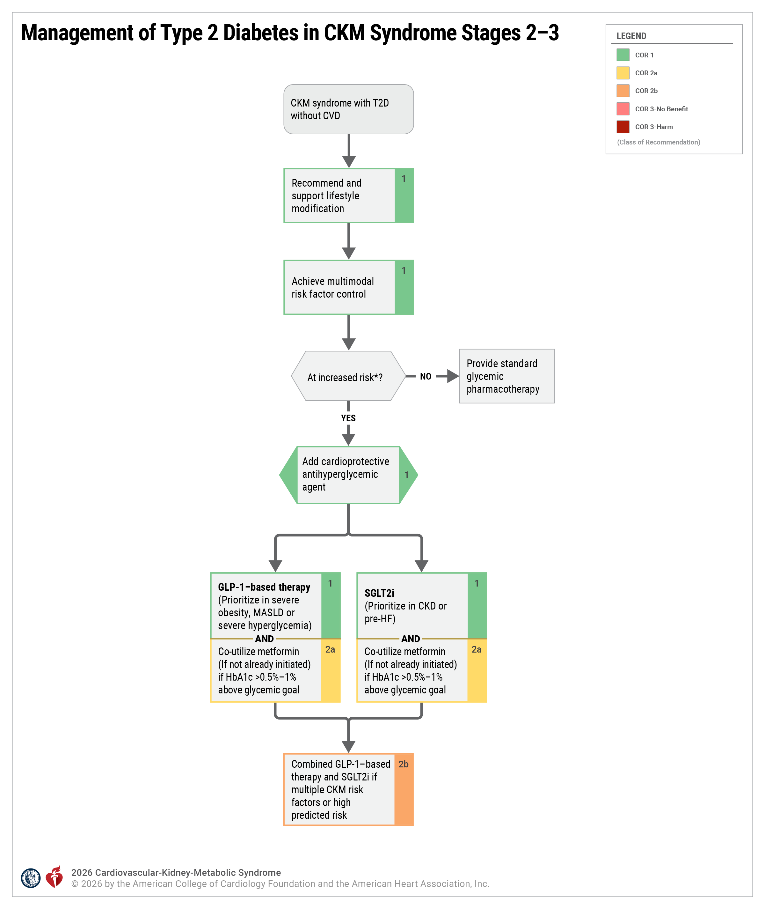
Figure 8. Management of Type 2 Diabetes in CKM Syndrome Stages 2-3.
*Increased risk is defined as a 10-year PREVENT-CVD of ≥7.5% or age ≥50 years with T2D and additional CKM risk factors.
CKM indicates cardiovascular-kidney-metabolic; CVD, cardiovascular disease; GLP-1, glucagon-like peptide-1; HbA1c, glycated hemoglobin A1C; HF, heart failure; MASLD, metabolic dysfunction–associated steatotic liver disease; SGLT2i ; sodium–glucose cotransporter-2 inhibitors; and T2D, type 2 diabetes.

Slide 80
Table 14. Adverse Effects of SGLT2i in T2D
Adverse Effect | Preventive and Therapeutic Considerations
DKA risk in individuals with insulin deficiency | Much less common in those with T2D. Discontinue, evaluate, and treat promptly if suspected; be aware of predisposing risk factors (ketogenic diet) and clinical presentations (including euglycemic DKA); mitigate risk with sick-day planning; discontinue before scheduled surgery (eg, 3-4 days), during critical illness, or during prolonged fasting
Genital mycotic infections | Mitigate risk with genital hygiene and avoid use in high-risk individuals. Use with caution or avoid in the setting of severe hyperglycemia to reduce infectious risk.
Adapted and reprinted with permission from American Diabetes Association Professional Practice Committee for Diabetes. Copyright 2026 American Diabetes Association.
DKA indicates diabetic ketoacidosis; SGLT2i, sodium–glucose cotransporter-2 inhibitors; and T2D, type 2 diabetes.

Slide 81
Table 14. Adverse Effects of SGLT2i in T2D (con’t.)
Adverse Effect | Preventive and Therapeutic Considerations
Necrotizing fasciitis of the perineum (Fournier gangrene) | Rare; prompt treatment if suspected.
Intravascular volume depletion | Attention to volume status and blood pressure, particularly when ill or fasting; consider dose reduction of other volume contracting agents as applicable; monitor kidney function after initiation.
Adapted and reprinted with permission from American Diabetes Association Professional Practice Committee for Diabetes. Copyright 2026 American Diabetes Association.
DKA indicates diabetic ketoacidosis; SGLT2i, sodium–glucose cotransporter-2 inhibitors; and T2D, type 2 diabetes.

Slide 82
Table 15. Adverse Effects of GLP-1–Based Therapy in T2D
Adverse Effect | Preventive and Therapeutic Considerations
Gastrointestinal adverse effects | Counsel on potential for GI side effects; provide guidance on dietary modifications to mitigate GI side effects; consider slower dose titration for those experiencing GI challenges. Not recommended for individuals with gastroparesis.
Thyroid C-cell tumors | Thyroid C-cell tumors identified in rodents; human relevance not determined. Contraindicated in patients with personal or family history of medullary thyroid carcinoma or in patients with multiple endocrine neoplasia syndrome type 2
Pancreatitis | Acute pancreatitis has been reported, but causality has not been established. Do not initiate if at high risk for pancreatitis, and discontinue if pancreatitis is suspected.
Adapted with permission from the American Diabetes Association Professional Practice Committee for Diabetes.
GI, gastrointestinal; GLP-1, glucagon-like peptide-1; T2D, type 2 diabetes.

Slide 83
Table 15. Adverse Effects of GLP-1–Based Therapy in T2D (con’t.)
Adverse Effect | Preventive and Therapeutic Considerations
Acute gallbladder disease | Evaluate for gallbladder disease if cholelithiasis or cholecystitis is suspected; avoid use in at-risk individuals
Ileus | Reported; risk level is not well-established.
Potential to impact concomitantly administered oral medications due to delayed gastric emptying | Orally administered drug absorption may be impaired during dose titration including oral contraceptives. Advise female patients using oral contraceptives to switch to a nonoral contraceptive method or add a barrier method of contraception for 4 weeks after initiation and for 4 weeks after each dose escalation.
Diabetic retinopathy complications in patients with a history of diabetic retinopathy | Close monitoring of retinopathy in those at high risk (older individuals and those with longer duration of T2D [≥10 years]).
Adapted and reprinted with permission from the American Diabetes Association Professional Practice Committee for Diabetes. Copyright 2026 American Diabetes Association.
GI, gastrointestinal; GLP-1, glucagon-like peptide-1; T2D, type 2 diabetes.

Slide 84
Table 15. Adverse Effects of GLP-1–Based Therapy in T2D (con’t.)
Adverse Effect | Preventive and Therapeutic Considerations
Nonarteritic anterior ischemic optic neuropathy (NAION) | Rare; monitor for NAION during eye examinations
Acute kidney injury | Monitor kidney function in patients with CKD reporting severe adverse GI reactions.
Risk of pulmonary aspiration | Provide guidance on discontinuation prior to surgical procedures to mitigate potential for pulmonary aspiration with general anesthesia or deep sedation.
Adapted and reprinted with permission from the American Diabetes Association Professional Practice Committee for Diabetes. Copyright 2026 American Diabetes Association.
GI, gastrointestinal; GLP-1, glucagon-like peptide-1; T2D, type 2 diabetes.

Slide 85
Management of CKD in CKM Syndrome Stage 2 to 3
 | Recommendations for Management of CKD in CKM Syndrome Stage 2-3 Referenced studies that support recommendations are summarized in the evidence table.
COR | LOE | Recommendations
1 | B-R | In adults with CKM syndrome stage 2 to 3 who have CKD and T2D, or CKD without T2D but with UACR ≥30 mg/g, and with eGFR ≥30 mL/min/1.73m², use of a RASi (eg, ACEi or ARB) at the maximum tolerated dose is recommended to reduce the loss of kidney function and to lower the risk of CVD.
1 | A | In adults with CKM syndrome stage 2 to 3 who have CKD and T2D, or CKD without T2D but with UACR ≥200 mg/g, and with eGFR ≥20 mL/min/1.73m², use of an SGLT2i is recommended to reduce the loss of kidney function and to lower the risks of HF hospitalization and CVD mortality.
2a | B-R | In adults with CKM syndrome stage 2 to 3 who have CKD without T2D but with UACR ≥30-199 mg/g, SGLT2i can be considered to reduce the loss of kidney function and to lower the risks of HF hospitalization and CVD mortality.
Economic Value:* Cost-Effective (High Level of Certainty) |  | In adults with CKM syndrome stage 2 to 3 who have CKD with or without T2D, treatment with SGLT2i at 2025 U.S. prices is projected to be cost-effective compared with not using an SGLT2i.
* Economic value statements inform population- and health system–level decisions and are not meant to directly influence clinical decision-making for individual patients.

Slide 86
Management of CKD in CKM Syndrome Stage 2 to 3 (con’t.)
1 | A | In adults with CKM syndrome stage 2 to 3 who have CKD, T2D, and UACR ≥30 mg/g despite ACEi/ARB and SGLT2i as tolerated, with eGFR ≥25 mL/min/1.73m², the addition of a nonsteroidal MRA (nsMRA) with proven kidney and cardiovascular benefit is recommended to reduce the risks of losing kidney function and kidney failure, and to lower the risk of CVD.
Economic Value:* Not Cost-Effective (Moderate Level of Certainty) |  | In adults with CKM syndrome stage 2 to 3 who have CKD, T2D and UACR ≥30 mg/g, treatment with finerenone at U.S. 2025 prices is projected to not be cost-effective compared with usual care.
1 | B-R | In adults with CKM syndrome stage 2 to 3 who have CKD, T2D and UACR ≥100 mg/g despite ACEi/ARB and SGLT2i as tolerated, treatment with GLP-1–based therapy with proven kidney and cardiovascular benefit is recommended to reduce the risks of losing kidney function and kidney failure, and to lower the risk of CVD.
Economic Value:* Indeterminate (Insufficient Evidence) |  | In adults with CKM syndrome stage 2 to 3, CKD, T2D, and UACR ≥100 mg/g despite ACEi/ARB and SGLT2i as tolerated, the cost effectiveness of adding GLP-1–based therapy is indeterminate.
* Economic value statements inform population- and health system–level decisions and are not meant to directly influence clinical decision-making for individual patients.

Slide 87
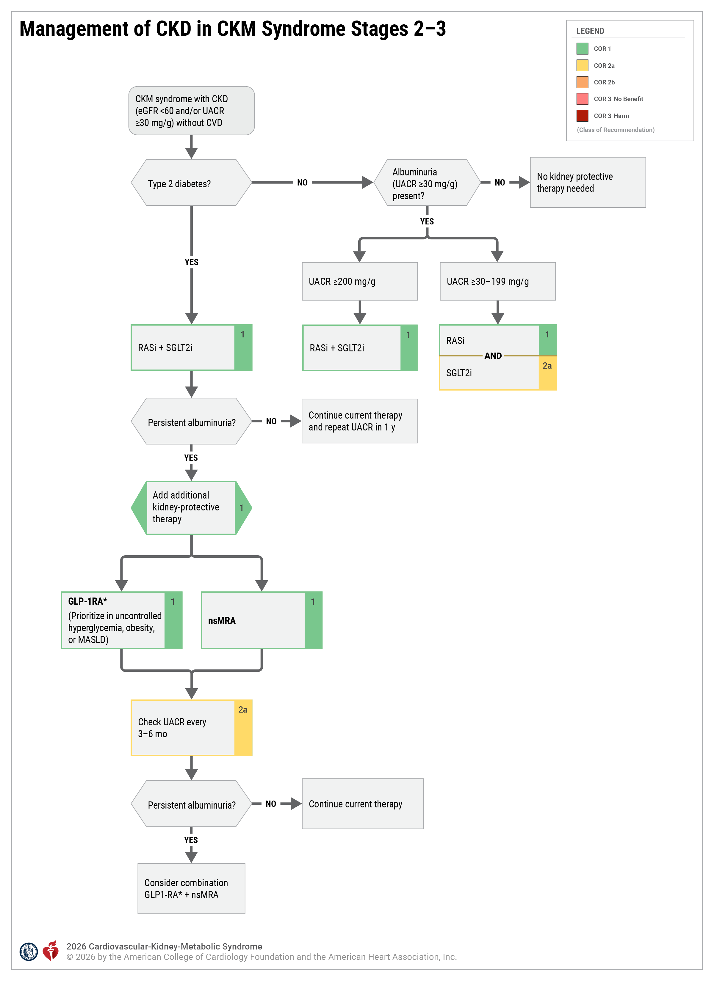
Figure 9. Management of CKD in CKM Syndrome Stages 2 to 3.
*Semaglutide is currently the only GLP-1 RA demonstrated to improve kidney and CVD outcomes among patients with T2D and CKD with albuminuria.
CKD indicates chronic kidney disease; CVD, cardiovascular disease; eGFR, estimated glomerular filtration rate; GLP-1, glucagon-like peptide-1; nsMRA, nonsteroidal mineralocorticoid receptor antagonist; RASi, renin-angiotensin system inhibitors; SGLT2i; sodium–glucose cotransporter-2 inhibitors; and UACR,. urine albumin-to-creatinine ratio

Slide 88
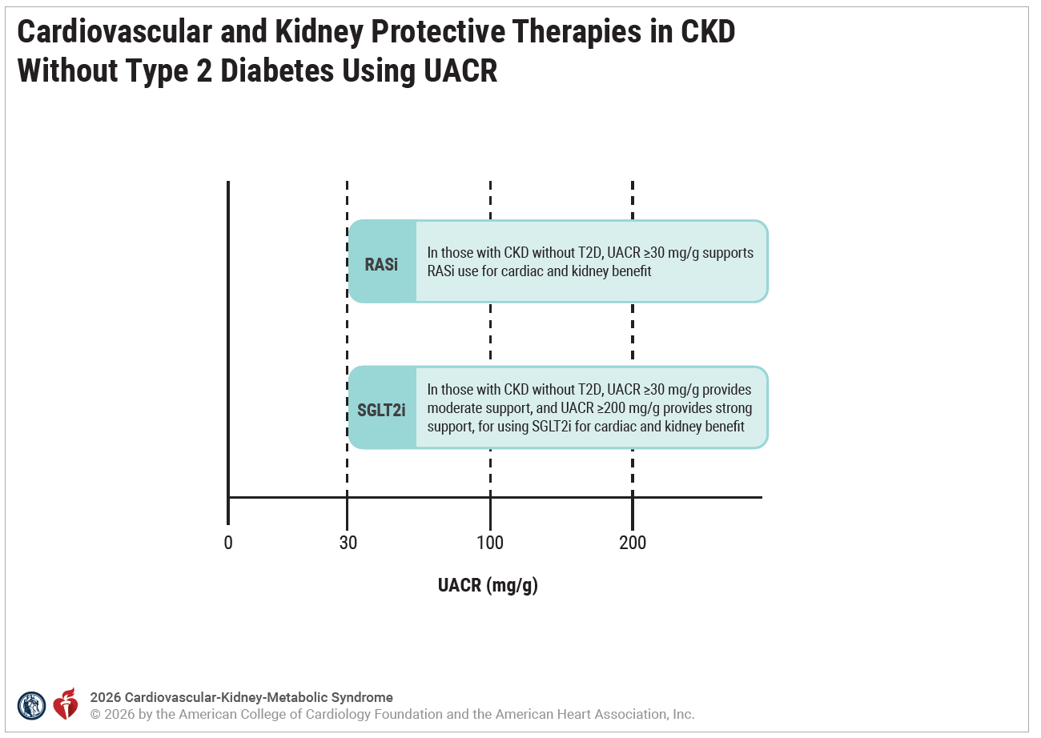
Figure 10. Cardiovascular and Kidney Protective Therapies in CKD Without Type 2 Diabetes Using UACR.
In patients without T2D, a UACR ≥30 mg/g is an indication for kidney-protective therapy. RASi is recommended for all patients with UACR ≥30 mg/g. SGLT2i have strong evidence for cardiac and kidney benefit for those with UACR ≥200 mg/g and more moderate evidence for benefit in those with UACR 30 to 199 mg/g.
CKD indicates chronic kidney disease; T2D, type 2 diabetes; RASi; renin-angiotensin system inhibitors; SGLT2i, sodium–glucose cotransporter-2 inhibitors; and UACR, urine albumin-creatinine ratio.

Slide 89
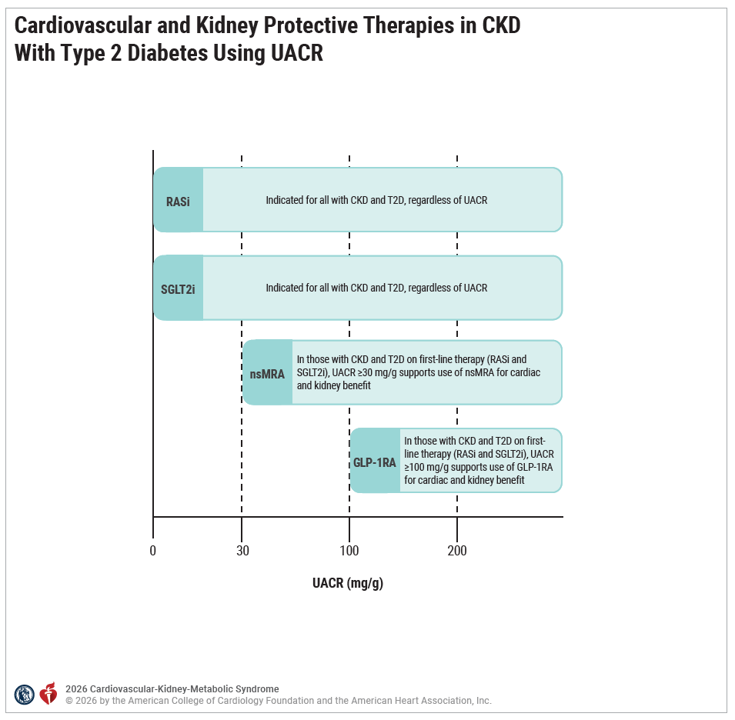
Figure 11. Cardiovascular and Kidney Protective Therapies in CKD With Type 2 Diabetes Using UACR.
CKD indicates chronic kidney disease; GLP-1, glucagon-like peptide 1; nsMRA, nonsteroidal mineralocorticoid receptor antagonist; RASi; renin-angiotensin system inhibitors; SGLT2i, sodium–glucose cotransporter-2 inhibitors; T2D, type 2 diabetes; and UACR, urine albumin-creatinine ratio.
In patients with T2D, RASI and SGLT2i are recommended as first line therapy for all patients with CKD. For those with persistent albuminuria on first line therapy, UACR ≥30 mg/g is an indication for adding nsMRA and UACR ≥100 mg/g is an indication for adding GLP-1 RA therapy.

Slide 90
Use of Markers of Subclinical Atherosclerosis
 | Recommendation for Use of Markers of Subclinical Atherosclerosis Referenced studies that support the recommendation are summarized in the evidence table.
COR | LOE | Recommendation
2a | B-NR | In adults with CKM syndrome stage 3 due to the presence of clinically significant CAC (CAC score >100 or moderate to severe CAC on qualitative assessment), initiation or intensification of preventive therapies indicated for CKM syndrome can be beneficial to reduce cardiovascular events.

Slide 91
Pre–Heart Failure
 | Recommendations for Pre–Heart Failure Referenced studies that support the recommendations are summarized in the evidence table.
COR | LOE | Recommendations
1 | B-R | In adults with CKM stage 3 due to pre-HF, intensive lifestyle interventions and intensive risk factor control are recommended to improve CKM health and prevent progression to clinical HF.
1 | B-NR | In adults with CKM stage 3 due to pre-HF with T2D or CKD, the use of SGLT2i is recommended as first-line therapy for the prevention of HF.
2a | B-NR | In adults with CKM stage 3 due to pre-HF with diabetes, CKD, and UACR ≥100 mg/g, the addition of GLP-1–based therapy with proven benefit to SGLT2i therapy is reasonable for the prevention of HF.
2a | B-NR | In adults with CKM stage 3 due to pre-HF with diabetes, CKD, and UACR ≥30 mg/g, the addition of nsMRA to SGLT2i therapy is reasonable for the prevention of HF.

Slide 92
Table 16. Definition of Pre–Heart Failure
Pre–HF* Echocardiographic and Biomarker-Based Thresholds
Structural Heart Disease | • LAVI ≥29 mL/m² • LVMI >116 g/m² in men; >95 g/m² in women • RWT >0.42 • LV wall thickness ≥12 mm
 | • LVEF <50% • GLS <16%
 | • Septal eʹ <7 cm/s • Lateral eʹ <10 cm/s • TR velocity >2.8 m/s
Noninvasive Imaging to Estimate Filling Pressures | • Estimated PA systolic pressure >35 mm Hg
 | • Average E/eʹ ≥15
Cardiac Biomarkers† | • BNP ≥35 pg/mL‡• NT-proBNP ≥125 pg/mL†

Slide 93
Table 16. Definition of Pre–Heart Failure (con’t.)
Adapted with permission from Heidenreich et al. Copyright 2022 American Heart Association, Inc. and American College of Cardiology Foundation.
*Pre-HF, also referred to as stage B HF in the 2022 HF Guidelines, is defined as no symptoms or signs of HF, and evidence of 1 of the following: [1] structural heart disease, [2] noninvasive evidence for increased filling pressure, or [3] risk factors with elevated levels of cardiac biomarkers (in the absence of a competing diagnosis resulting in such biomarker elevations such as acute coronary syndrome, CKD†, pulmonary embolus, or myopericarditis)
†BNP/NTproBNP only cited in the 2022 ACC/AHA HF guidelines; in contrast, the universal definition of HF includes persistently elevated troponin (>99th percentile in a normal reference population).
‡Cutoffs provided for natriuretic peptide levels may have lower specificity, especially in older patients or in patients with AF or CKD.
BNP indicates B-type natriuretic peptide; GLS, global longitudinal strain; LAVI, left atrial volume index; LV, left ventricular; LVEF, left ventricular ejection fraction; LVMI, left ventricular mass index; and RWT, relative wall thickness.

Slide 94
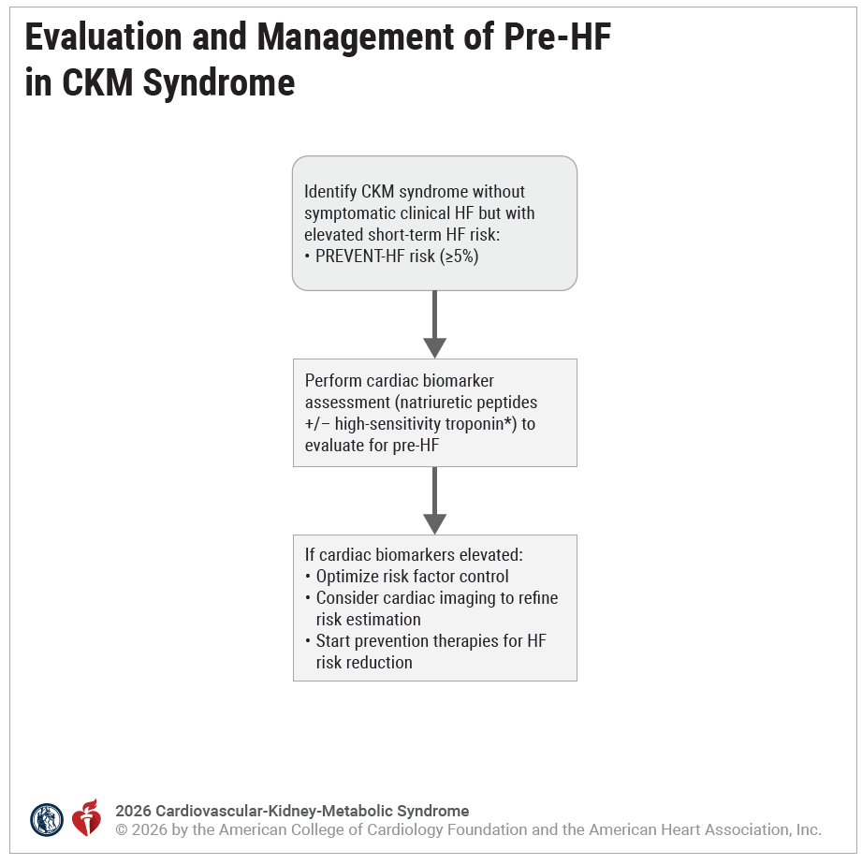
Figure 12. Evaluation and Management of Pre-HF in CKM Syndrome.
*High-sensitivity troponin can be considered for those with obesity, where natriuretic peptides may be low even in the setting of cardiac dysfunction and increased risk for developing HF. Assessments for pre-HF in patients with CKM syndrome are indicated for those with increased predicted HF risk (PREVENT-HF risk ≥5%).
CKM indicates cardiovascular-kidney-metabolic; HF, heart failure; and PREVENT, Predicting Risk of Cardiovascular Disease Events.

Slide 95
Management of CVD in CKM Syndrome

Slide 96
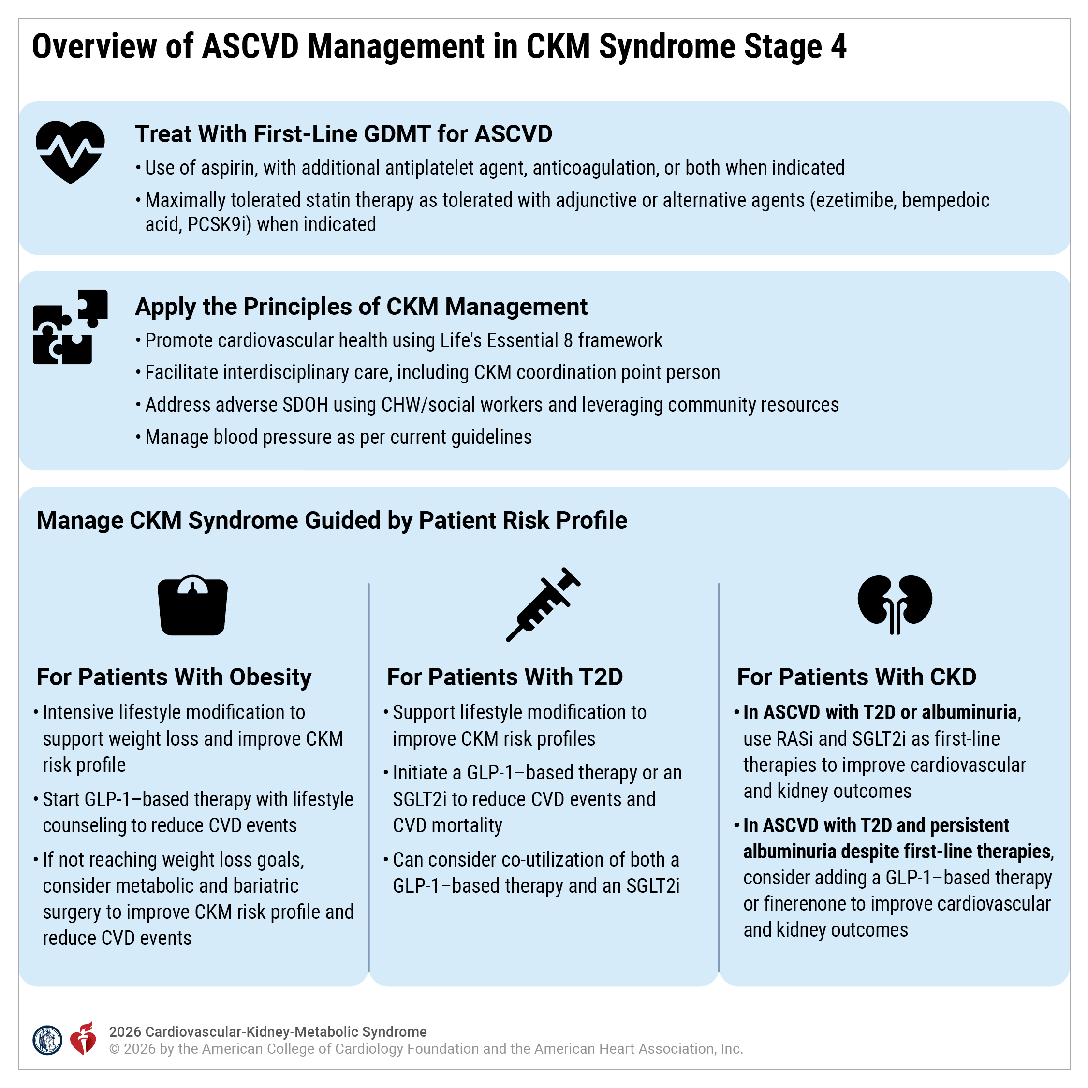
Figure 13. Overview of ASCVD Management in CKM Syndrome Stage 4.
CHW indicates community health worker; CKM, cardiovascular-kidney-metabolic; CVD, cardiovascular disease; GDMT, guideline-directed medical therapy; GLP-1, glucagon-like peptide-1; RASi; renin-angiotensin system inhibitors; SDOH, social determinants of health; SGLT2i, sodium–glucose cotransporter-2 inhibitors; and T2D, type 2 diabetes.
The approach to CKM syndrome management in patients with ASCVD in CKM syndrome stage 4 should involve the use of first-line GDMT for ASCVD, applying general principles of CKM syndrome management and additional therapeutic approaches for the individual CKM risk factors, as depicted.

Slide 97
CKM Syndrome Stage 4 With Obesity and ASCVD
 | Recommendations for CKM Syndrome Stage 4 With Obesity and ASCVD Referenced studies that support recommendations are summarized in the evidence table.
COR | LOE | Recommendations
1 | A | In adults with CKM syndrome stage 4 with overweight or obesity and ASCVD, treatment with an intensive, multicomponent, behavioral lifestyle intervention is recommended to promote weight loss and improvement in CKM risk factors.
1 | B-R | In adults with CKM syndrome stage 4 with overweight or obesity (BMI ≥27 kg/m²) and ASCVD, treatment with a GLP-1–based therapy with proven cardiovascular benefit in addition to counseling to promote healthy dietary intake and regular physical activity is recommended to reduce the risk of cardiovascular events.

Slide 98
CKM Syndrome Stage 4 With Obesity and ASCVD (con’t.)
Economic Value:* Cost-Effective (Moderate Level of Certainty) |  | In adults with CKM syndrome stage 4 with overweight or obesity (BMI ≥27 kg/m²) and ASCVD, treatment with a GLP-1–based therapy with proven cardiovascular benefit at 2025 U.S. prices is projected to be cost-effective compared with usual care.
2a | B-NR | In adults with CKM syndrome stage 4 with obesity (BMI ≥30 kg/m²) and ASCVD who have not reached weight loss goals with lifestyle interventions, with or without maximally tolerated pharmacotherapy, MBS can be beneficial to facilitate a minimum weight loss of 5% to 10% to improve CKM health and to reduce the risk of cardiovascular events.
3: Harm | B-R | In adults with CKM syndrome stage 4 with overweight or obesity (BMI ≥27 kg/m²) and ASCVD, treatment with naltrexone/bupropion or phentermine-containing agents is potentially harmful as they can increase BP and heart rate.
* Economic value statements inform population- and health system–level decisions and are not meant to directly influence clinical decision-making for individual patients.

Slide 99
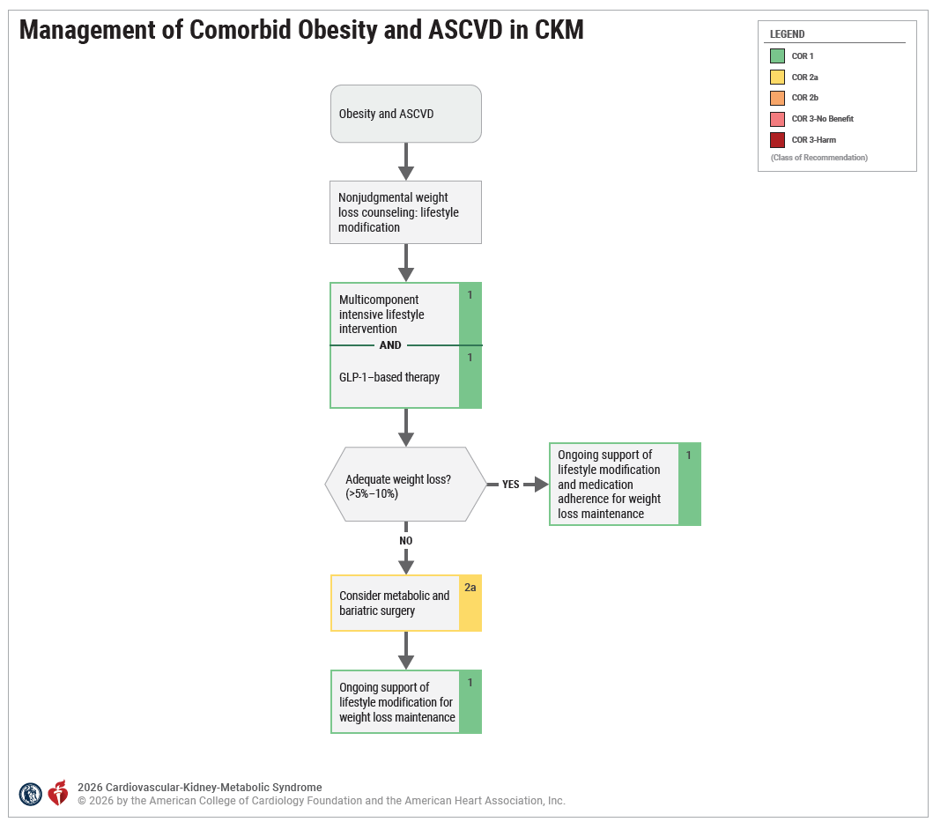
Figure 14. Management of Comorbid Obesity and ASCVD in CKM.
Note that the cardiovascular benefits associated with semaglutide in the setting of obesity and ASCVD appear to be largely independent of the extent of weight loss achieved, which may support ongoing treatment with GLP-1–based therapy, even in the absence of adequate weight loss.
ASCVD indicates atherosclerotic cardiovascular disease; CKM, cardiovascular-kidney-metabolic; COR, Class of Recommendation; and GLP-1, glucagon-like peptide 1.

Slide 100
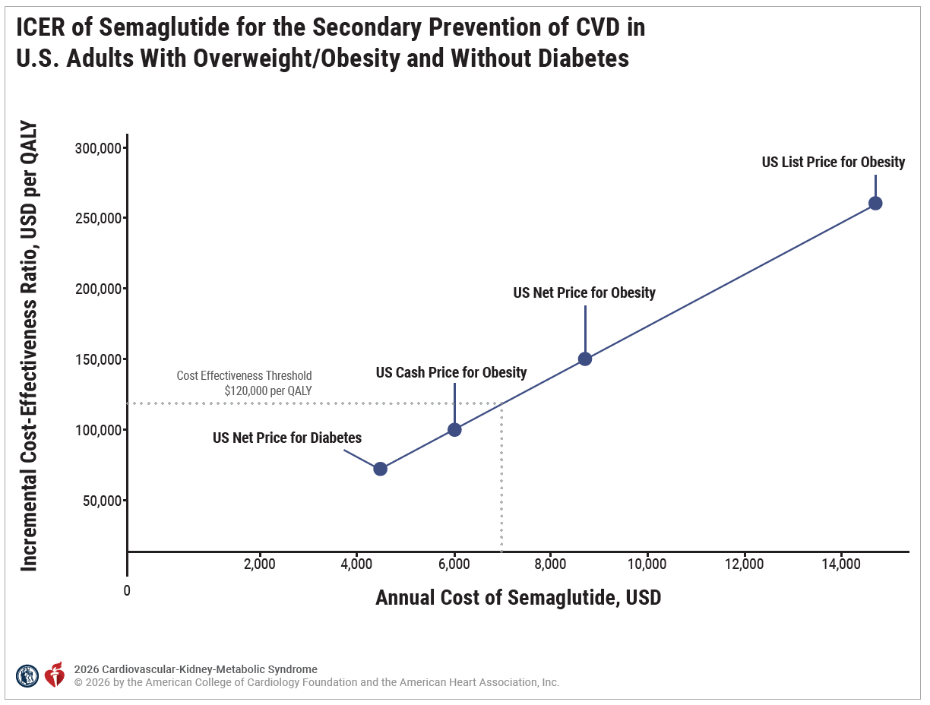
Figure 15. ICER of Semaglutide for the Secondary Prevention of CVD in U.S. Adults With Overweight/Obesity and Without Diabetes.

Slide 101
Figure 15. ICER of Semaglutide for the Secondary Prevention of CVD in U.S. Adults With Overweight/Obesity and Without Diabetes (con’t.).
Adapted with permission from Hennessy et al. Copyright 2026 American Medical Association. All rights reserved, including those for text and data mining, AI training, and similar technologies.
The ICER for injectable semaglutide therapy increases with the annual cost of the drug; at the 2023 U.S. price net of rebates and discounts ($8604), the ICER relative to usual care is $148 100 per QALY gained. The vertical lines indicate the cost at which semaglutide would become cost-effective in the United States at cost-effectiveness thresholds of $50 000 per QALY gained ($3295), $100 000 per QALY gained ($5940), $120 000 per QALY gained ($7055), and $150 000 per QALY gained ($8710). Note that if the current U.S. cash price (ie, the price for patients who pay for the therapy themselves instead of through insurance, $5988 per year) were available to all patients, semaglutide therapy would be cost-effective for the secondary prevention of cardiovascular disease, with an ICER of $99 610 per QALY gained.
CVD indicates cardiovascular disease; ICER, incremental cost-effectiveness ratio; QALY, quality-adjusted life-year; and USD, U.S. dollars.

Slide 102
CKM Syndrome Stage 4 With T2D and ASCVD
 | Recommendations for CKM Syndrome Stage 4 With T2D and ASCVD Referenced studies that support recommendations are summarized in the evidence table.
COR | LOE | Recommendations
1 | A | For adults with CKM syndrome stage 4 with T2D and ASCVD, a tailored lifestyle modification plan focusing on a heart-healthy dietary pattern and physical activity is recommended to improve glycemic control, to achieve and maintain a healthy weight, and improve other ASCVD risk factors.
1 | A | For adults with CKM syndrome stage 4 with T2D and ASCVD, the use of either an SGLT2i or a GLP-1–based therapy with proven cardiovascular benefit is recommended to reduce the risk of cardiovascular events and cardiovascular mortality.

Slide 103
CKM Syndrome Stage 4 With T2D and ASCVD (con’t.)
Economic Value:* Cost-Effective (Moderate Level of Certainty) |  | In adults with CKM syndrome stage 4 with T2D and ASCVD, treatment with SGLT2i at 2025 U.S. prices is projected to be cost-effective compared with usual care.
Economic Value:* Indeterminate (Insufficient Evidence) |  | In adults with CKM syndrome stage 4 with T2D and ASCVD, treatment with GLP-1–based therapy at 2025 U.S. prices is indeterminate.
2a | C-LD | For adults with CKM syndrome stage 4 with T2D and ASCVD, the use of a combination of SGLT2i and a GLP-1–based therapy can be beneficial to improve cardiovascular outcomes.
* Economic value statements inform population- and health system–level decisions and are not meant to directly influence clinical decision-making for individual patients.

Slide 104
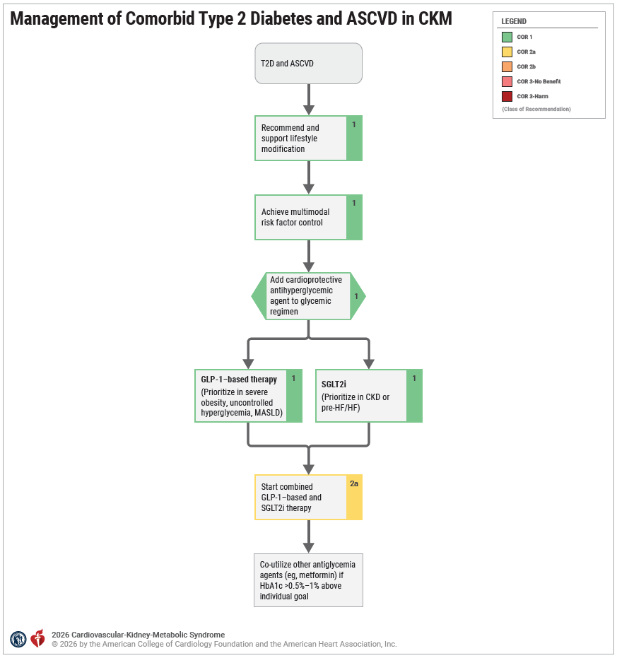
Figure 16. Management of Comorbid Type 2 Diabetes and ASCVD in CKM.
ASCVD indicates atherosclerotic cardiovascular disease; CKM, cardiovascular-kidney-metabolic; COR, ; Class of Recommendation; GLP-1, glucagon-like peptide-1; HbA1c, glycated hemoglobin A1C; HF, heart failure; MASLD, metabolic dysfunction–associated steatotic liver disease; SGLT2i, sodium–glucose cotransporter-2 inhibitors; and T2D, type 2 diabetes.

Slide 105
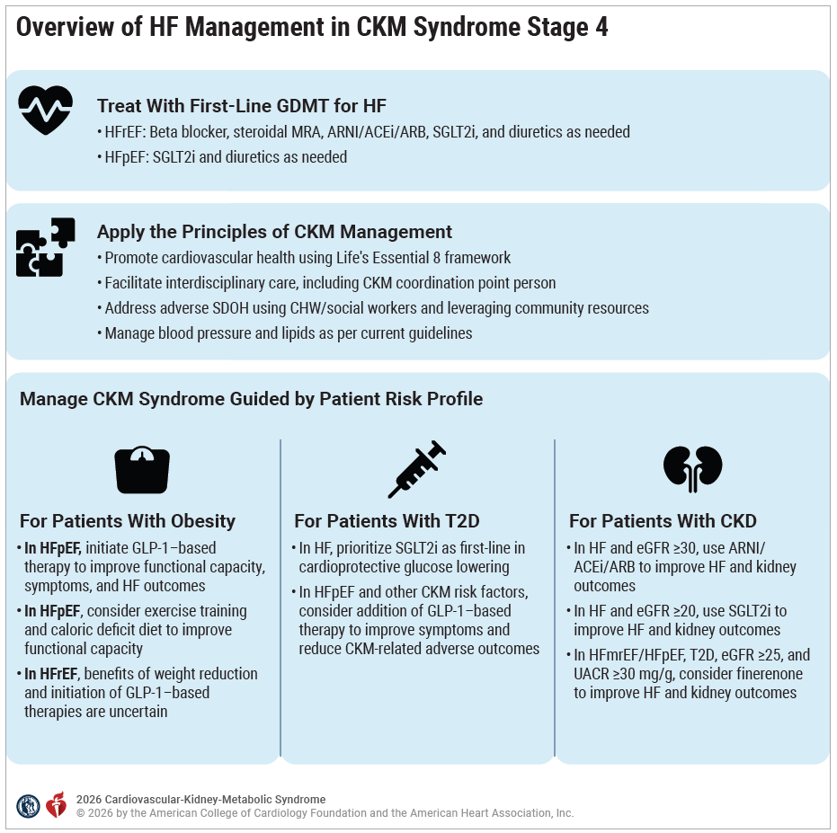
Figure 17. Overview of HF Management in CKM Syndrome Stage 4.
ACEi indicates angiotensin-converting enzyme inhibitors; ARNI, angiotensin receptor/neprilysin inhibitors; CHW indicates community health worker; CKM, cardiovascular-kidney-metabolic; CVD, cardiovascular disease; eGFR, estimated glomerular filtration rate; GDMT, guideline-directed medical therapy; GLP-1, glucagon-like peptide-1; HF, heart failure; HFpEF, heart failure with preserved ejection fraction; HFrEF, heart failure with reduced ejection fraction; MRA, mineralocorticoid receptor antagonist; SDOH, social determinants of health; SGLT2i, sodium–glucose cotransporter-2 inhibitors; and T2D, type 2 diabetes.
The approach to CKM syndrome management in patients with HF in CKM syndrome stage 4 should involve use of first-line GDMT for HF, applying general principles of CKM syndrome management and additional therapeutic approaches for the individual CKM risk factors, as depicted.

Slide 106
CKM Syndrome Stage 4 With Obesity and HF
 | Recommendations for CKM Syndrome Stage 4 With Obesity and HF Referenced studies that support recommendations are summarized in the evidence table.
COR | LOE | Recommendations
1 | A | Among adults with CKM syndrome stage 4, obesity, and symptomatic HFpEF, a GLP-1–based therapy with proven cardiovascular benefit is indicated to improve CKM risk profile, functional capacity, and HF symptoms, and prevent worsening HF events.
Economic Value:* Indeterminate (Insufficient Evidence) |  | Among adults with CKM syndrome stage 4, obesity, and symptomatic HFpEF, the cost effectiveness of adding a GLP-1–based therapy with proven cardiovascular benefit to GDMT is indeterminate.
2a | B-R | Among adults with CKM syndrome stage 4, obesity, and HFpEF, a combination of exercise training and a caloric deficit diet can be beneficial for improving functional capacity.
2b | B-NR | In select adults with CKM syndrome stage 4, obesity, and symptomatic HFrEF, treatment of obesity may be considered to improve functional capacity and facilitate heart transplantation in otherwise eligible patients.
* Economic value statements inform population- and health system–level decisions and are not meant to directly influence clinical decision-making for individual patients.

Slide 107
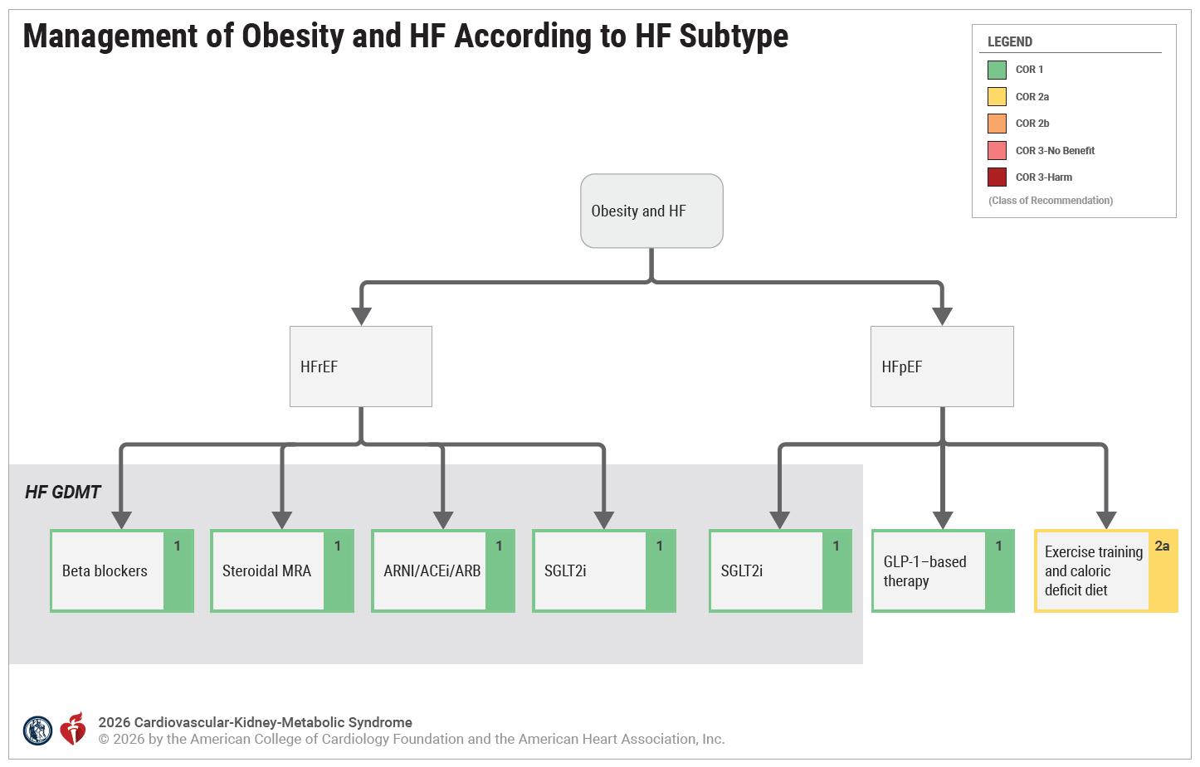
Figure 18. Management of Obesity and HF According to HF Subtype
With the exception of the SGLT2i COR for HFpEF, which is anticipated to be updated in the next 2022 HF guideline iteration, GDMT is concordant with the 2022 HF guideline per HF subtype, which is highlighted in gray.
Adapted with permission from Heidenreich et al.
Copyright 2022 American Heart Association, Inc. and American College of Cardiology Foundation.
COR indicates Class of Recommendation; GDMT, guideline-directed medical therapy; GLP-1, glucagon-like peptide-1; HF, heart failure; HFpEF, heart failure with preserved ejection fraction; HFrEF, heart failure with reduced ejection fraction; and SGLT2i, sodium–glucose cotransporter-2 inhibitors.

Slide 108
CKM Syndrome Stage 4 With T2D and HF
 | Recommendations for CKM Syndrome Stage 4 With T2D and HF Referenced studies that support recommendations are summarized in the evidence table.
COR | LOE | Recommendations
1 | A | In patients with CKM syndrome stage 4 with T2D and HF, SGLT2i should be prioritized as the first-line cardioprotective glucose-lowering medications to reduce cardiovascular death and HF hospitalizations.
Economic Value:* Cost-Effective (High Level of Certainty) |  | In patients with CKM syndrome stage 4 with T2D and symptomatic HF with LVEF ≤40%, addition of an SGLT2i to prior GDMT at 2025 U.S. prices is projected to be cost-effective compared with prior GDMT (incremental cost-effectiveness ratio <$120 000 per QALY gained).
* Economic value statements inform population- and health system–level decisions and are not meant to directly influence clinical decision-making for individual patients.

Slide 109
CKM Syndrome Stage 4 With T2D and HF (con’t.)
Economic Value:* Indeterminate (Conflicting Evidence) |  | In patients with CKM syndrome stage 4 with T2D and symptomatic HFpEF, cost-effectiveness of adding an SGLT2i at 2025 U.S. prices is indeterminate.
2a | B-R | In patients with CKM syndrome stage 4 with T2D, HFpEF, and other CKM risk factors, the addition of GLP-1–based therapy with proven cardiovascular benefit to foundational SGLT2i therapy can be beneficial to improve HF symptomology and reduce CKM-related adverse outcomes.
2a | B-NR | In patients with CKM syndrome stage 4 with T2D, stable HF, eGFR ≥30 mL/min/1.73m², and A1c levels above their individualized glycemic goal, the addition of metformin therapy to SGLT2i can be beneficial to help achieve glycemic targets.
* Economic value statements inform population- and health system–level decisions and are not meant to directly influence clinical decision-making for individual patients.

Slide 110
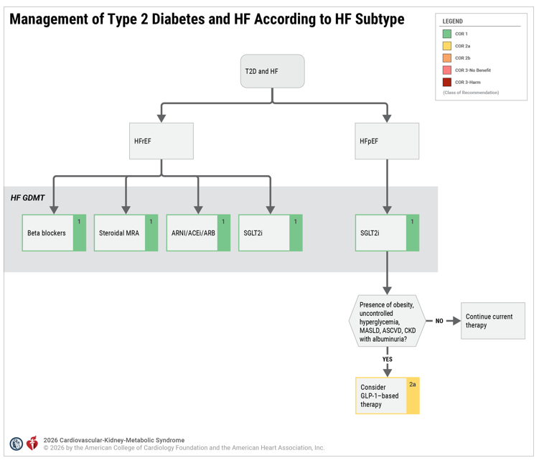
Figure 19. Management of Type 2 Diabetes and HF According to HF Subtype.
ACEi indicates angiotensin-converting enzyme inhibitors; ARB, angiotensin II receptor blockers; ARNI, angiotensin receptor/neprilysin inhibitors; ASCVD, atherosclerotic cardiovascular disease; CKD, chronic kidney disease; COR, Class of Recommendation; GDMT indicates guideline directed medical therapy; GLP-1, glucagon-like peptide-1; HF, heart failure; HFpEF, heart failure with preserved ejection fraction; HFrEF, heart failure with reduced ejection fraction; MASLD, metabolic dysfunction–associated steatotic liver disease; MRA, mineralocorticoid receptor antagonist; SGLT2i, sodium–glucose cotransporter-2 inhibitors; and T2D, type 2 diabetes.
Adapted with permission from Heidenreich et al. Copyright 2022 American Heart Association, Inc. and American College of Cardiology Foundation.
Management of patients with comorbid T2D and HF according to HF subtype, with HF GDMT as recommended by the 2022 HF guidelines highlighted in gray.

Slide 111
CKM Syndrome Stage 4 With CKD and HF
 | Recommendations for CKM Syndrome Stage 4 with CKD and HF Referenced studies that support recommendations are summarized in the evidence table.
COR | LOE | Recommendations
1 | A | In adults with CKM syndrome stage 4 with CKD, eGFR ≥30 mL/min/1.73 m², and HFrEF, the initiation of an angiotensin receptor-neprilysin inhibitor (ARNI), or other RASi if an ARNI cannot be initiated, is recommended to reduce the risk of cardiovascular death or HF hospitalization and loss of kidney function.
Economic Value:* Cost-Effective (Moderate Level of Certainty) |  | In adults with CKM syndrome stage 4 with CKD, eGFR ≥30 mL/min/1.73 m², and HFrEF, treatment with an ARNI is projected to be cost-effective compared with RASi therapy.
1 | A | In adults with CKM syndrome stage 4 with CKD and HF with any ejection fraction, who have eGFR ≥20 mL/min/1.73 m², initiation of a SGLT2i is recommended to reduce cardiovascular mortality, HF hospitalization, and possibly, loss of kidney function.
* Economic value statements inform population- and health system–level decisions and are not meant to directly influence clinical decision-making for individual patients.

Slide 112
CKM Syndrome Stage 4 With CKD and HF (con’t.)
Economic Value:* Cost-Effective (Moderate Level of Certainty) |  | In adults with CKM syndrome stage 4 syndrome with CKD and symptomatic HF with LVEF ≤40%, addition of an SGLT2i prior to GDMT at 2025 U.S. prices is projected to be cost effective compared with prior GDMT.
Economic Value:* Indeterminate (Conflicting Evidence) |  | In adults with CKM syndrome stage 4 syndrome with CKD and symptomatic HFpEF, the cost effectiveness of adding a SGLT2i prior to GDMT at 2025 U.S. prices is indeterminate.
2a | B-R | In adults with CKM syndrome stage 4 with CKD, T2D, UACR ≥30 mg/g and HF with LVEF >40% (HFmrEF and HFpEF), who have eGFR ≥25 ml/min/1.73m², initiation of a nonsteroidal MRA is reasonable to reduce risk of HF hospitalization and loss of kidney function.
* Economic value statements inform population- and health system–level decisions and are not meant to directly influence clinical decision-making for individual patients.

Slide 113
CKM Syndrome Stage 4 With CKD and HF (con’t.)
Economic Value:* Indeterminate (Insufficient Evidence) |  | In adults with CKM syndrome stage 4 with CKD and eGFR ≥25 mL/min/1.73 m², T2D, and HF with LVEF >40% (HFmrEF and HFpEF), the cost effectiveness of adding nsMRA to other GDMT is indeterminate.
2b | B-R | In adults with CKM syndrome stage 4 with CKD and HFrEF, who have eGFR >30 mL/min/1.73 m², use of novel oral potassium-binding agents may be reasonable to reduce risk of hyperkalemia and allow use of RAAS inhibition.
Economic Value:* Indeterminate (Insufficient Evidence) |  | In adults with CKM syndrome stage 4 with CKD, and HFrEF who have eGFR >30 mL/min/1.73 m², the cost effectiveness of adding newer oral potassium-binding agents to GDMT is uncertain.
* Economic value statements inform population- and health system–level decisions and are not meant to directly influence clinical decision-making for individual patients.

Slide 114
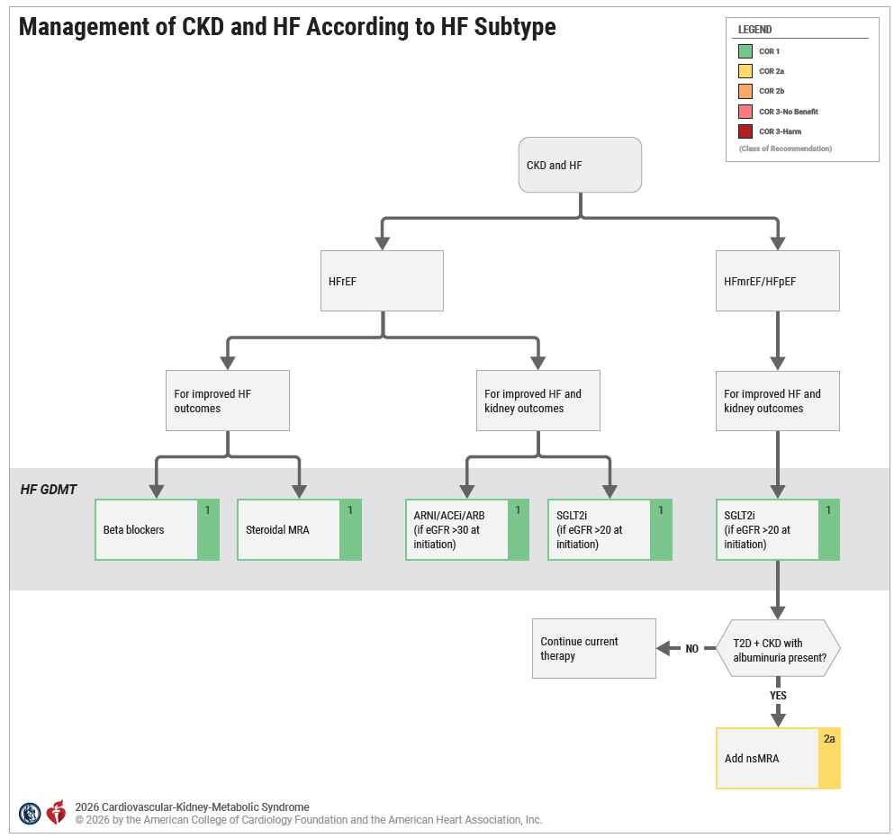
Figure 20. Management of CKD and HF According to HF Subtype.
CKD indicates chronic kidney disease; GDMT, guideline-directed medical therapy; eGFR, estimated glomerular filtration rate; HF, heart failure; HFpEF, heart failure with preserved ejection fraction; HFrEF, heart failure with reduced ejection fraction; HFmrEF, heart failure with mildly reduced ejection fraction; nsMRA, nonsteroidal mineralocorticoid receptor antagonist; SGLT2i, sodium–glucose cotransporter-2 inhibitors; and T2D, type 2 diabetes.
Adapted with permission from Heidenreich et al. Copyright 2022 American Heart Association, Inc. and American College of Cardiology Foundation.
Management of patients with comorbid CKD and HF according to HF subtype with HF GDMT as recommended by the 2022 Heart Failure Guidelines highlighted in gray.

Slide 115
Treating CKM Syndrome in Patients With Advanced CKD
 | Recommendation for Treating CKM Syndrome in Patients With Advanced CKD Referenced studies that support the recommendation are summarized in the evidence table.
COR | LOE | Recommendation
2a | B-R | Among adults with CKD who are being treated with kidney-protective therapies for both kidney and cardiovascular benefit and whose eGFR falls below drug-specific initiation thresholds, it is reasonable to continue those treatments as safely tolerated.

Slide 116
Important Considerations

Slide 117
Metabolic Dysfunction–Associated Steatotic Liver Disease
 | Recommendations for Metabolic Dysfunction–Associated Steatotic Liver Disease Referenced studies that support recommendations are summarized in the evidence table.
COR | LOE | Recommendations
1 | B-NR | Among adults with CKM syndrome and diabetes or ≥ 2 cardiometabolic risk factors, calculation of the Fibrosis-4 (FIB-4) index is recommended every 1 to 2 years to assess risk for liver fibrosis related to MASLD.
2a | C-LD | Among adults with CKM stage 1 due to prediabetes, it is reasonable to calculate the fibrosis-4 (FIB-4) index every 2-3 years to assess risk for liver fibrosis related to MASLD.
1 | B-R | For adults with CKM syndrome and MASLD, lifestyle modification through physical activity and dietary approaches for weight loss, with adjunctive use of obesity pharmacotherapy and/or MBS as needed, is recommended to reduce MASLD severity, reduce risk of MASLD progression, and improve CKM risk profiles.
1 | B-R | In adults with CKM syndrome and MASLD with T2D or MASH with evidence of clinically significant liver fibrosis, treatment with a GLP-1–based therapy with proven benefit is indicated to facilitate histologic improvements in MASLD.

Slide 118
Table 17. Increased Risk of MASLD*
Age (Years) | FIB-4 | Follow-Up
<35 | Not applicable
35-64 | <1.3 | Routine monitoring
 | 1.3-2.67 | Refer for VCTE or ELF
 | >2.67 | Refer to hepatology
65+ | <2.0 | Routine monitoring
 | 2.0-2.67 | Refer for VCTE or ELF
 | >2.67 | Refer to hepatology
*FIB-4 indicates liver fibrosis calculation (age×AST)/(platelet count×√ALT); FIB-4 should not be used in acutely ill patients; see Table 18.
ALT indicates alanine aminotransferase; AST, aspartate aminotransferase; ELF indicates enhanced liver fibrosis score; and VCTE, vibration-controlled transient elastography.

Slide 119
Table 18. Secondary Risk Assessment Tools for Clinically Significant Fibrosis Among Patients at Risk for MASLD
Test | Score | Risk Level | Action
Vibration-controlled transient elastography (VCTE)* | <8 | Low | Standard risk surveillance for MASLD every 1 to 3 years† with FIB-4 calculation.
 | 8-12 | Intermediate | Referral to GI/hepatology
 | >12 | High
Enhanced Liver Fibrosis‡ (ELF) Score⁵⁵ | <7.7 | Low | Standard risk surveillance for MASLD every 1 to 3 years† with FIB-4 calculation.
 | 7.7-9.8 | Intermediate | Referral to GI/hepatology
 | >9.8 | High
*Point-of-care ultrasound-based test performed in clinic. The individual must fast for ≥3 hours. Body habitus affects accuracy and is not recommended if BMI ≥ 40 kg/m2.
†FIB-4 indicates liver fibrosis calculation (age × AST)/(platelet count × √ALT); FIB-4 is recommended every 1 to 2 years if T2D or ≥2 CKM risk factors; FIB-4 is reasonable every 2 to 3 years if at CKM stage 1 due to prediabetes.
‡Blood-based biomarker score sent to reference laboratory.
ALT indicates alanine aminotransferase; AST, aspartate aminotransferase; CKM, cardiovascular-kidney-metabolic; GI, gastroenterology; and MASLD, metabolic dysfunction–associated steatotic liver disease.

Slide 120
Obstructive Sleep Apnea
 | Recommendations for Obstructive Sleep Apnea Referenced studies that support recommendations are summarized in the evidence table.
COR | LOE | Recommendations
2a | C-LD | For adults with CKM syndrome and obesity, annual assessments for symptoms of sleep apnea, including utilization of validated screening tools, are reasonable to facilitate the detection of OSA.
1 | B-R | For adults with CKM syndrome and OSA, the treatment strategy should include weight management interventions where indicated, in addition to continuous positive airway pressure (CPAP) and other therapies, to improve OSA-related symptoms and to reduce the risk for CKM stage progression.

Slide 121
Pregnancy and CKM Health
 | Recommendations for Pregnancy and CKM Health Referenced studies that support recommendations are summarized in the evidence table.
COR | LOE | Recommendations for Pre-Partum CKM Management
1 | B-NR | Among persons with CKM syndrome planning pregnancy, optimizing weight, kidney function, glycemia, and BP control, through lifestyle modification and appropriate medication, is recommended to reduce the risk of APOs and optimize postpartum CKM health.
1 | B-R | Among persons with diabetes planning pregnancy, optimizing glucose control (with a target HbA1c <6.5%) through lifestyle modification and medication as needed is recommended to reduce the risk of APOs and optimize postpartum CKM health.

Slide 122
Pregnancy and CKM Health (con’t.)
1 | C-LD | Persons planning pregnancy who have CKM syndrome stages 2 to 4 should receive care from an interdisciplinary care team to reduce the risk of APOs and optimize postpartum CKM health.
Recommendations for Post-Partum CKM Management
1 | B-NR | Among persons who have experienced an APO, screening for CKM risk factors (BP, lipids, glycemia, CKD, BMI, and waist circumference), at least once within the first postpartum year, and lifestyle counseling are recommended to guide optimization of CKM health.
1 | B-NR | Persons who have experienced an APO are recommended to transition from postpartum to longitudinal primary care to facilitate monitoring for CKM risk factors and optimization of CKM health.

Slide 123
Monitoring and Follow-Up After Initiation of Therapies

Slide 124
Monitoring and Follow-Up After Initiation of Therapies
 | Recommendations for Monitoring and Follow-Up After Initiation of Therapies Referenced studies that support recommendations are summarized in the evidence table.
COR | LOE | Recommendations
1 | B-NR | For patients with CKM syndrome who start treatment with GLP-1–based therapy for weight loss, hyporesponsiveness for weight loss should be reassessed periodically (within 3 to 6 months), and insufficient weight loss (<5%) should be addressed with dose escalations, switching to another agent with similar CKM syndrome benefits, and/or referral to a weight management specialist to consider additional therapeutic approaches to optimize weight loss.

Slide 125
Monitoring and Follow-Up After Initiation of Therapies (con’t.)
1 | A | In patients with stage 2 to 4 CKM syndrome and T2D who have initiated a cardioprotective glucose-lowering agent (SGLT2i or GLP-1–based therapy), glycemic status should be assessed by A1C, blood glucose monitoring, and/or continuous glucose monitoring metrics every 3 to 6 months and more frequently in individuals not meeting glycemic goals to guide further glycemic management.
2a | B-R | For patients with CKM stage 2 to 4 and albuminuria (UACR ≥ 30 mg/g) who initiate kidney-protective therapies, it is reasonable to remeasure albuminuria after 3 to 6 months to assess residual CKM risk and indications for additional kidney-protective therapies to prevent CVD events and loss of kidney function.
2a | B-R | For patients with CKM stage 2 to 4 who initiate a drug that acts on the RAAS system (RASi or MRA), it is reasonable to recalculate eGFR and measure potassium after 2 to 4 weeks to assess tolerance and safety of the medication regimen.

Slide 126
Table 19. Management of Gastrointestinal Adverse Effects of GLP-1–Based Therapies
Lifestyle changes | Eating habits: Eat smaller meals more frequently, eat slowly, and stop when full; avoid high-fat and spicy foods, and limit or avoid alcohol. Hydration: Drink plenty of water and sugar-free beverages throughout the day. Activity: Avoid vigorous activity after meals, and opt for light activities such as walking. Sleep: Wait ≥2 to 3 hours after eating a meal before lying down. Relaxation: Techniques such as guided imagery can help to control nausea.
Medication supplementation | Consider temporary use of antiemetic and/or prokinetic medications, or probiotic and/or antidiarrheal supplements.
GLP-1 indicates glucagon-like peptide-1; GLP-1 RA, GLP-1 receptor agonist.

Slide 127
Table 19. Management of Gastrointestinal Adverse Effects of GLP-1–Based Therapies (con’t.)
Dose escalation | Slowing dose escalation and waiting longer to escalate can help reduce gastrointestinal adverse effects* (usually occurring with dose changes). Extend current phase for 2 to 4 more weeks before moving forward to next dose. Go back to prior dose for a few days and then increase dose gradually.
Switching to alternative therapies | Consider switching to a different GLP-1–based therapy. For example, dulaglutide may be better tolerated than semaglutide or tirzepatide, though the efficacy for weight loss may be less.
*Many gastrointestinal adverse effects will improve over time with consistent dosing, but patient tolerance is highly variable.
GLP-1 indicates glucagon-like peptide-1; GLP-1 RA, GLP-1 receptor agonist.

Slide 128
Table 20. Recommendations for Achieving Glycemic Goals in Patients With T2D With CVD or High Risk for CVD After Initiation of Cardioprotective Therapy
HbA1c 7% to 8.5% (mild-moderate hyperglycemia) | Metformin can be added to SGLT2i or GLP-1–based therapy to achieve glycemic goals.
HbA1c > 8.5% (severe hyperglycemia) | Add semaglutide or tirzepatide if patients are already on SGLT2i therapy. If symptoms of hyperglycemia are present or when HbA1c or blood glucose levels are very high (ie, HbA1C >10.0% or blood glucose ≥300 mg/dL), referral to an endocrinologist is recommended for further management of hyperglycemia as per ADA guidelines.
CVD indicates cardiovascular disease; GLP, glucagon-like peptide-1; HbA1c, hemoglobin A1c; SGLT2i, sodium–glucose cotransporter-2 inhibitors; and T2D, type 2 diabetes.

Slide 129
Evidence Gaps and Future Directions

Slide 130
Table 21. Future Directions in CKM Syndrome: Research Summary Table
Domain | Evidence Gaps | Key Research Questions | Clinical/Policy Relevance
Risk Prediction and Stratification | Refinement needed in PREVENT calculator; unclear use of 30-year risk estimates; limited risk communication tools. | How do biomarkers, genetics, and artificial intelligence improve CKM risk prediction? What is the role of 30-year risk estimates? | Improves prediction accuracy, supports tailored prevention, informs patient engagement strategies.
Early Identification of CKD and MASLD | Delayed recognition of CKD/MASLD; unclear role of systematic assessments; underutilization of fibrosis screening. | Can systematic CKD/MASLD screening improve detection and outcomes? | Promotes earlier treatment, reduces progression, informs testing policy and population health planning.
CKD indicates chronic kidney disease; CKM, cardiovascular-kidney-metabolic; GFR, glomerular filtration rate; GLP-1, glucagon-like peptide; HF, heart failure; HFmrEF, heart failure with mildly reduced ejection fraction; HFpEF, heart failure with preserved ejection fraction; HFrEF, heart failure with reduced ejection fraction; MASLD, metabolic dysfunction–associated steatotic liver disease; MRA, mineralocorticoid receptor antagonist; PREVENT, Predicting Risk of Cardiovascular Disease Events; SDOH, social determinants of health; T2D, type 2 diabetes.

Slide 131
Table 21. Future Directions in CKM Syndrome: Research Summary Table (con’t.)
Domain | Evidence Gaps | Key Research Questions | Clinical/Policy Relevance
Heart Failure Prevention | Rising HF prevalence; undefined multidisciplinary care; unclear prognostic echocardiographic markers; limited preventive therapy data. | Which imaging abnormalities best predict HF risk in those with elevated biomarkers? What are essential components of HF-preventive care? | Enables early HF intervention, reduces morbidity/mortality, defines preventive care frameworks.
Interdisciplinary and Coordinated Care | Fragmented subspecialty care; undefined team roles; untested CKM coordinator impact; impact of addressing SDOH unclear. | What outcomes result from interdisciplinary CKM teams? How can CKM coordinators improve patient navigation/education and CKM syndrome care? | Enhances care coordination, reduces fragmentation, supports reimbursement for team-based care.
CKD indicates chronic kidney disease; CKM, cardiovascular-kidney-metabolic; GFR, glomerular filtration rate; GLP-1, glucagon-like peptide; HF, heart failure; HFmrEF, heart failure with mildly reduced ejection fraction; HFpEF, heart failure with preserved ejection fraction; HFrEF, heart failure with reduced ejection fraction; MASLD, metabolic dysfunction–associated steatotic liver disease; MRA, mineralocorticoid receptor antagonist; PREVENT, Predicting Risk of Cardiovascular Disease Events; SDOH, social determinants of health; T2D, type 2 diabetes.

Slide 132
Table 21. Future Directions in CKM Syndrome: Research Summary Table (con’t.)
Domain | Evidence Gaps | Key Research Questions | Clinical/Policy Relevance
Weight Management Strategies | Unclear design of integrated programs; reimbursement barriers; high GLP-1 discontinuation and weight regain. | What are the most effective integrated weight programs? What supports long-term GLP-1 weight loss maintenance? | Improves long-term outcomes, informs reimbursement policy, addresses sustainability of weight loss.
Therapeutic Combinations in T2D and CKD | Limited interventional data on additive benefits; underexplored polypharmacy effects; lacking cost-effectiveness studies. | What are outcomes of CKM-targeted therapy combinations? How does polypharmacy affect adherence/outcomes? | Optimizes therapy strategies, improves adherence, informs cost-effectiveness and coverage policy.
CKD indicates chronic kidney disease; CKM, cardiovascular-kidney-metabolic; GFR, glomerular filtration rate; GLP-1, glucagon-like peptide; HF, heart failure; HFmrEF, heart failure with mildly reduced ejection fraction; HFpEF, heart failure with preserved ejection fraction; HFrEF, heart failure with reduced ejection fraction; MASLD, metabolic dysfunction–associated steatotic liver disease; MRA, mineralocorticoid receptor antagonist; PREVENT, Predicting Risk of Cardiovascular Disease Events; SDOH, social determinants of health; T2D, type 2 diabetes.

Slide 133
Table 21. Future Directions in CKM Syndrome: Research Summary Table (con’t.)
Domain | Evidence Gaps | Key Research Questions | Clinical/Policy Relevance
CKM Syndrome and Heart Failure Subtypes | HFpEF/HFmrEF obesity treatment benefits established; HFrEF obesity management unclear; some uncertainty with MRAs. | How should obesity be managed in HFrEF? Can steroidal MRAs replicate finerenone benefits? Does finerenone improve CKD outcomes in HF? | Guides safe obesity management in HFrEF, informs optimal MRA use, improves HF+CKD outcomes.
Advanced CKD and Dialysis | Exclusion from major trials; lack of evidence for therapies in advanced CKD/dialysis. | Which therapies are safe/effective in advanced CKD and dialysis? Does continuation of therapies at low eGFRs sustain benefit? | Addresses high-risk population needs, informs trial design and therapy use in dialysis patients.
CKD indicates chronic kidney disease; CKM, cardiovascular-kidney-metabolic; GFR, glomerular filtration rate; GLP-1, glucagon-like peptide; HF, heart failure; HFmrEF, heart failure with mildly reduced ejection fraction; HFpEF, heart failure with preserved ejection fraction; HFrEF, heart failure with reduced ejection fraction; MASLD, metabolic dysfunction–associated steatotic liver disease; MRA, mineralocorticoid receptor antagonist; PREVENT, Predicting Risk of Cardiovascular Disease Events; SDOH, social determinants of health; T2D, type 2 diabetes.

Slide 134
Table 21. Future Directions in CKM Syndrome: Research Summary Table (con’t.)
Domain | Evidence Gaps | Key Research Questions | Clinical/Policy Relevance
Education, Training, and Infrastructure | Training models remain siloed; insufficient structural supports (automation, telemedicine, reimbursement). | How should curricula evolve for CKM syndrome? Which infrastructure models best support integrated care? | Prepares workforce for integrated CKM care, supports investment in infrastructure and policy reform.
Cross-Cutting Themes | Equity gaps; limited implementation science; underemphasis on patient-centered outcomes; global relevance underdeveloped. | How can equity, implementation science, patient-centered outcomes, and global health be embedded across CKM care? | Reduces disparities, scales interventions globally, improves patient-centered outcomes, informs health equity policy.
CKD indicates chronic kidney disease; CKM, cardiovascular-kidney-metabolic; GFR, glomerular filtration rate; GLP-1, glucagon-like peptide; HF, heart failure; HFmrEF, heart failure with mildly reduced ejection fraction; HFpEF, heart failure with preserved ejection fraction; HFrEF, heart failure with reduced ejection fraction; MASLD, metabolic dysfunction–associated steatotic liver disease; MRA, mineralocorticoid receptor antagonist; PREVENT, Predicting Risk of Cardiovascular Disease Events; SDOH, social determinants of health; T2D, type 2 diabetes.

Slide 135
Abbreviations
Abbreviations | Meaning
ACEi | angiotensin-converting enzyme inhibitors
APO | adverse pregnancy outcome
ARB | angiotensin II receptor blockers
ASCVD | atherosclerotic cardiovascular disease
BNP | B-type natriuretic peptide
BP | blood pressure
CAC | coronary artery calcium
CCD | chronic coronary disease
CI | confidence interval
CKD | chronic kidney disease
CKM | cardiovascular-kidney-metabolic
CVD | cardiovascular disease

Slide 136
Abbreviations (con’t.)
Abbreviations | Meaning
DOAC | direct oral anticoagulants
eGFR | estimated glomerular filtration rate
GDM | gestational diabetes mellitus
GDMT | guideline-directed medical therapy
HDL-C | high-density lipoprotein cholesterol
HF | heart failure
HFmrEF | heart failure with mildly reduced ejection fraction
HFpEF | heart failure with preserved ejection fraction
HFrEF | heart failure with reduced ejection fraction
HR | hazard ratio
HS | high-sensitivity
ICER | incremental cost-effectiveness ratio

Slide 137
Abbreviations (con’t.)
Abbreviations | Meaning
LDL-C | low-density lipoprotein cholesterol
LSG | laparoscopic sleeve gastrectomy
LVEF | left ventricular ejection fraction
MACE | major adverse cardiovascular event
MASLD | metabolic dysfunction–associated steatotic liver disease
MBS | metabolic and bariatric surgery
MI | myocardial infarction
MRA | mineralocorticoid receptor antagonist
nsMRA | nonsteroidal mineralocorticoid receptor antagonist
NT-proBNP | N-terminal prohormone of B-type natriuretic peptide
OR | odds ratio
OSA | obstructive sleep apnea

Slide 138
Abbreviations (con’t.)
Abbreviations | Meaning
PAD | peripheral artery disease
QALY | quality-adjusted life-year
RAASi | renin-angiotensin-aldosterone system inhibitors
RASi | renin-angiotensin system inhibitors
RCT | randomized controlled trial
RR | relative risk
RYGB | Roux-en-Y gastric bypass
SGLT2i | Sodium–glucose cotransporter-2 inhibitors
T2D | type 2 diabetes
UACR | urine albumin-to-creatinine ratio
VKA | vitamin K antagonist
VTE | venous thromboembolism

